Slide 1
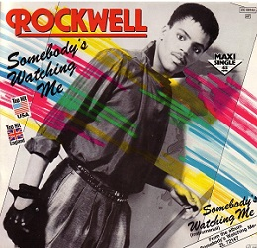
Class 7 Privacy and Government
Keith A. Pray
SocialImps.com
Notes:
After this class we will be half done with the course… very sad I know.
Somebody’s Watching Me (1984) – Rockwell (3:36)
https://www.youtube.com/watch?v=7YvAYIJSSZY
Be the envy of all your classmates if you know the band and/or year:
Rockwell (1984) Michael Jackson sings chorus and Jermaine Jackson on backing vocals.

Slide 2
Logistics
Turn presentations and papers in on Canvas, drafts too
You can submit multiple times to the same assignment
Review Presentation and Paper Guidelines on course site
Sign up for Individual Presentation, it’s not too late
Notes:
Not needed this time:
Address email to entire course staff for quickest response time
Do not change the format, footers, etc. in the template slides.
Paper writing process: Sources → Notes → Conclusion → Argument → Counter Point → Response
Turn extra credit paper in on myWPI/Canvas and hard copy in class like regular papers
Use Presentation Guidelines on course web site
Use paper and presentation templates
Keep topics inside the course scope: Computing + Society
Presentations are due 24 hours before class
Sign up for Individual Presentation, it’s not too late
Providing comments on drafts is a limit, first come first served
We would like to help everyone asking but sometimes we run out of time
Try asking a peer to give notes on your work

Slide 3
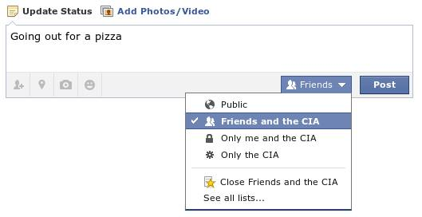
Overview
Review
Assignment
Students Present
Notes:
Review before debate in case anyone unsure of something in reading.
TODO: Image source?
Look at ACM TechNews if time

Slide 4
My Reading Notes
p. 269 Used to start with “A system that fails to respect its citizens’ right to privacy fails to respect the citizens themselves.” – Richard Nixon, 1974-02-23
p. 271 Genetic Information Nondiscrimination Act (2008): Gattaca (1997)
p. 273 Any NCIC success since 1995?
p. 274 Arrests, altering and deleting records are violations of privacy?
p. 275 Figure does not show # cameras increasing.
p. 276 300 times = frames, locations, …?
p. 277 Public drone opinion change since 2012? Any more states pass drone laws since 2013?
p. 281 “Carnivore…” what’s in a name?
p. 284 Stored Comms Act, any news since 2010?
p. 285 CALEA update since 2005?
p. 288 Google’s Eric Schmidt quote seems naïve
p. 293 Shouldn’t credit card issuers take “reasonable steps” to verify identity all the time?
p. 294 Target example, see Ch. 5 p. 248
p. 295 How many names on no fly lists now compared to 2014?
p. 297 Confusing false positive and negative explanations. 2001 source old for claims. See ‘What “Orwellian” Really Means’ video
p. 301 Other states using E-ZPass since 2007?
p. 303 Papa Smurfs…
Questions I liked: 1, 24
From previous edition interview at end of Chapter: “Since I have done nothing wrong, why should the government be investigating me?” – Jerry Berman
Notes:
Let’s debate!

Slide 5
Debate Ground Rules
National ban on facial recognition surveillance for law enforcement
Before Debate
10 minutes to converse with your team
Share argument points, counter points, and responses
Share experiences, especially in different countries, cultures, situations
Decide who will:
Go first
Respond to which points from opposing side
During Debate
1 turn per person until everyone on your team has spoken
Try to keep remarks to 30 seconds
Notes:
“National ban on facial recognition surveillance for law enforcement” Debate
If in class:
Stand up when speaking
30 second limit (elect a timekeeper)
If Remote:
Add “(YES)” or “(NO)” to the end of your name in Zoom to show your side
Previous:
Should law require you to use an official ID for Internet access
National ID or Not Debate

Slide 6
Group Quiz
Give a problem with using biometrics for identification.
Give an advantage of using biometrics for identification.
Describe a tool people can use to protect their privacy on the Web.
For each of the 4 categories of Daniel Solove’s privacy taxonomy give an example not listed in the book.
Notes:
Only if we have time.
Information Collection
Information Processing
Information Dissemination
Invasion

Slide 7
Overview
Review
Assignment
Students Present

Slide 8
Assignment – Group Project
Catch up on reading
Group Project
Finish analysis of computing technology portrayed to web site
Analyze Movie for all topics covered to date
Keep in course scope: Computing + Society
See group project slide deck for more
Frequent interaction with your group members is key to success!
-----
Canvas → Quizzes → Mid Term Survey on Canvas
Notes:
Movie group project: List of computing technologies portrayed in movie on website Categorize computing technologies as existing, future, emerging, impossible or plausible with rationale Analyze movie for all topics covered to date

Slide 9
Overview
Review
Assignment
Students Present

Slide 10
Biometrics in U.S. Customs
Reid Dugas
Notes:
My presentation is about biometric technology usage in Customs and Border Protection and by extension the Department of Homeland Security
We’ll cover
What biometric information U.S. Customs, Border Protection, and by extension Department of Homeland Security collect
How they go about collecting this data and keeping it secure
How they manage privacy
If these privacy and data protection regulations are sufficient

Slide 11
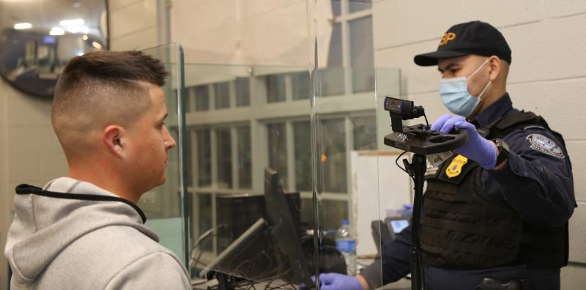
When does customs use biometrics?
Reid Dugas
Facial Biometric Comparison Technology (~10 years old)
“Compares your live facial features with the photo in your travel documents to verify your identity” ^{[1]}
Used when entering/exiting country in
Airports
Land Borders (Canada & Mexico) [1]
Source: CBP
Notes:
U.S. Customs and Border Protection use Facial Biometric comparison technology for people entering and exiting the country
This technology has only been made available around 10 years ago.
It is used to compare you to your ID photos on file and verify who you are
Technology is used at
Entering and exiting the U.S. at Airports
Entering and exiting at Land Borders such as Canada and Mexico
Specifically for land borders, people traveling as Pedestrians or in Vehicles
Image: A U.S. customs officer taking a photo of someone entering or exiting the country to be uploaded to the biometric identification system.
All non-obvious information provided by [1]

Slide 12
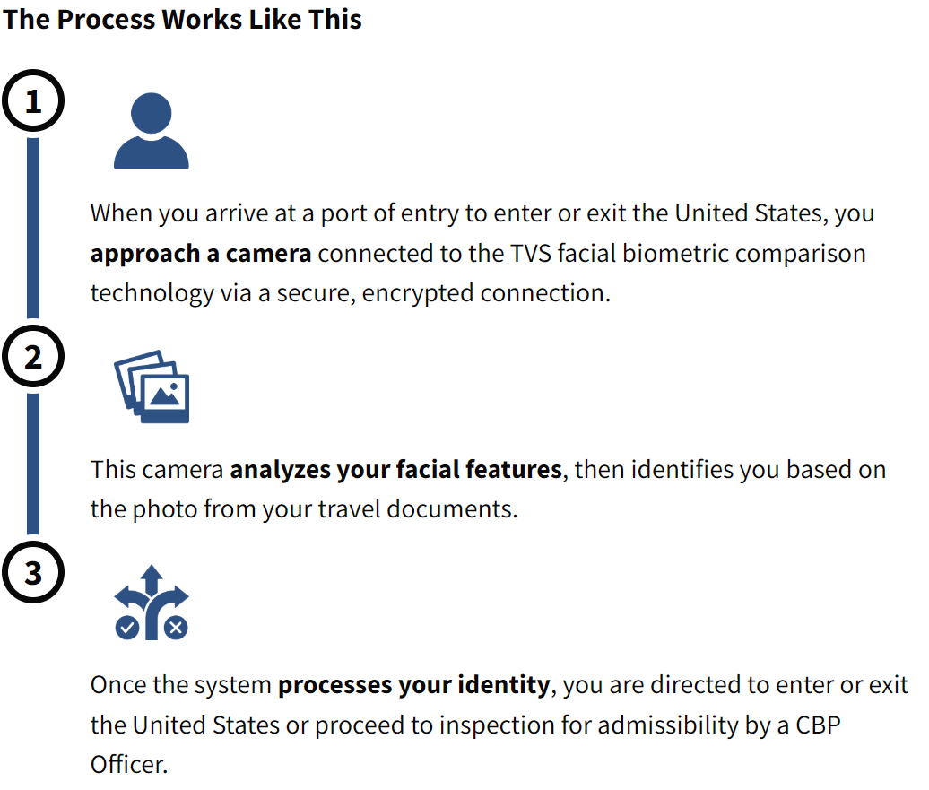
How does the system work?
Reid Dugas
Data transmitted through encrypted, “secure” connection to Traveler Verification Service (TVS) ^{[1]}
Office of Biometric Identity Management
Part of Department of Homeland Security (DHS) ^{[2]}
Collects, compares, and saves biometric data. ^{[2]}
Provides “biometric and identity capabilities” to the U.S. Government ^{[2]}
Runs the TVS Service ^{[1]}
Source: CBP
Notes:
All biometric data is sent to and processed by the Office of Biometric Identity Management – a subset of the DHS (Department of Homeland Security) [2]
They are responsible for the collection, usage, and storage of the data [2]
Provides all biometric and identity capabilities to the government. [2]
Customs and Border Protection provide this graphic depicting the experience of someone entering or exiting the country. [1]
Those of you who have entered or exited the country recently may have been asked to stand in front of a camera
This camera takes a picture which is sent to the Office of Biometric Identity Management’s Traveler Verification Service [2]
Once processed, the system informs the officer what steps should be taken next, such as allowing/disallowing entry, or requiring additional screening [2]
Image: Process when approaching customs using biometrics

Slide 13
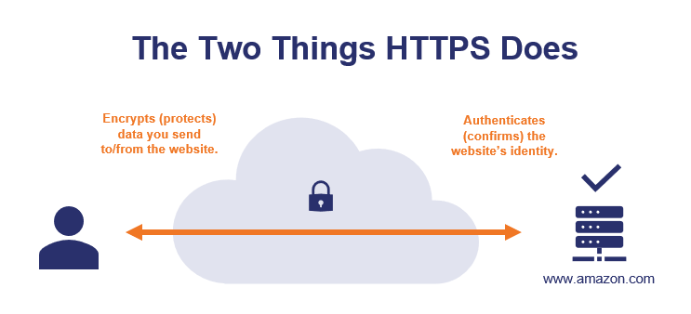
Is it secure?
Reid Dugas
“Currently holds more than 320 million unique identities and processes more than 400,000 biometric transactions per day.” ^{[2]}
Uses HTTPS/SSL encryption in transit. ^{[3]}
Industry standard for Commerce, Financial Communications, etc. [4]
Data is encrypted in storage. ^{[5]}
Yes, it is secure.
Source: TheSSLStore
Notes:
The Automated Biometric Identification System contains over 320 million people’s biometric identities, and processes almost a half million requests a day. [3]
The communications between OBIM (Office of Biometric Identity Management) and the different customs cameras is encrypted with HTTPS/SSL.
Ensures data is being sent to correct server and server is who they claim to be. [4]
Data sent is encrypted. [4]
HTTPS/SSL is the industry standard for many applications which require secure data transmission, such as Commerce, Financial Communications, etc. [4]
On the OBIM side, the data is stored in an encrypted format, and the deletion of data and encryption keys is documented to make sure data is securely destroyed. [5]
Image: Demonstrates both main security features of HTTPS/SSL between the client (camera) and server (TVS)

Slide 14
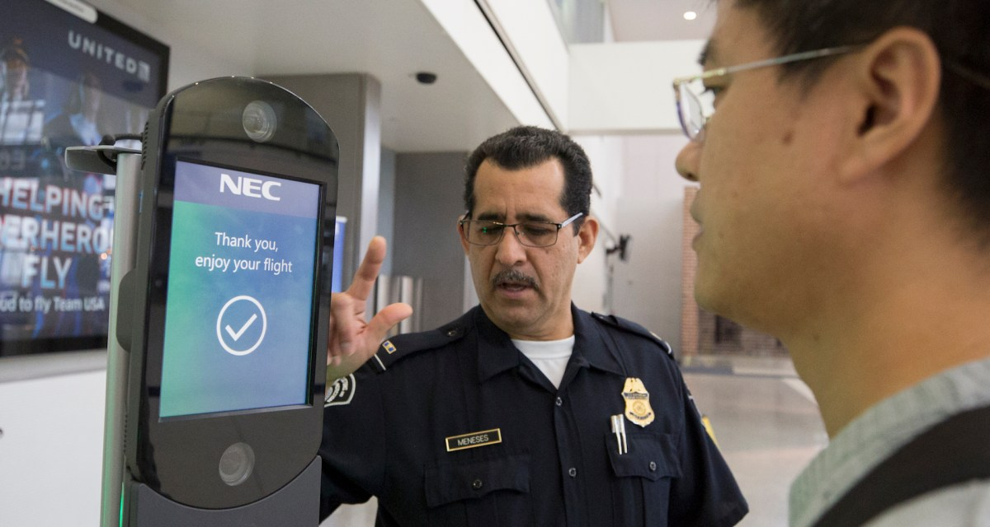
Privacy measures 1/2
Reid Dugas
Actual photos not permanently stored on TVS servers – instead, biometric templates. ^{[5]}
Photos are retained for no more than 12hrs for citizens. ^{[5]}
Template is a mathematical representation of facial features ^{[5]}
Airlines can opt to own and operate their own camera system connected to TVS. ^{[5]}
Infrastructure supporting backend process is the same ^{[5]}
“Commercial Partnership” between CBP and the company ^{[5]}
No biometric data is processed or accessible by airline company ^{[5]}
A privately-owned camera system connected to TVS
Source: FedScoop
Notes:
TVS (Traveler Verification Service) deletes images within 12 hours of collection and processing, as a measure for disaster prevention.
The images are then destroyed, but a mathematical representation of the person’s facial features, called a biometric template, is preserved.
Airlines and travel companies can have their own camera system connected to TVS. This system is still secure and protects the customer’s privacy because
All the backend infrastructure is the same as the CBP owned and operated cameras
No data is sent to or processed by the airline company
CBP has a partnership with all companies who use the TVS system, and they ensure the standard procedures are being followed.
Image: A privately owned camera system connected to TVS (this one for United Airlines)

Slide 15
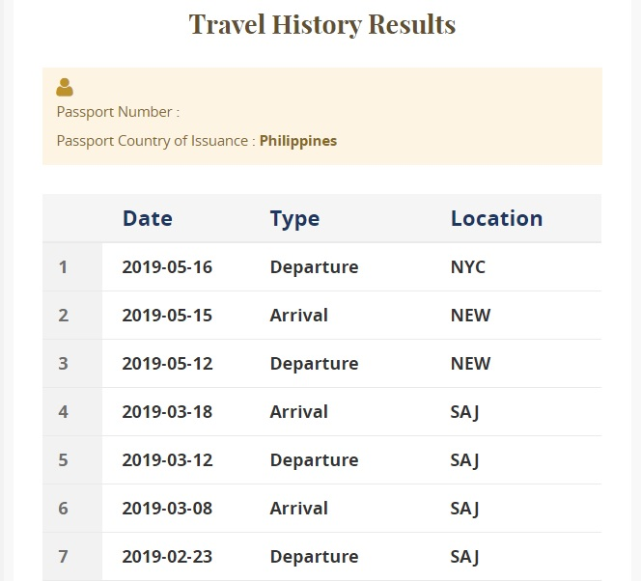
Privacy measures 2/2
Reid Dugas
U.S. Citizens can Opt-out of biometric identification and request alternative screening ^{[5]}
Entrance/exit records stored no matter what (unrelated to biometrics) ^{[5]}
Non-citizen traveler photos are collected and retained on entry or exit and used to build a DHS profile on the person. ^{[5]}
In some cases, photos are stored indefinitely, others are deleted after 14 days. ^{[5]}
A sample travel history search result, minus the specific information about the traveler
Source: TMTG
Notes:
Even with all of these features, if citizens are not comfortable with the biometric system, they can opt-out and request alternative screening
You are not able to opt-out of the collection and storage of entrance/exit records, which are not biometric related
Opting out does make the screening process longer and more involved, and there may be privacy concerns with those screening processes, which is outside the scope of this presentation
This system isn’t perfect, and those who are not U.S. Citizens have much less privacy protection than Citizens
Non-citizen traveler photos are kept for either 14 days, or indefinitely at the discretion of the Department of Homeland Security
Image: an example entry/exit record search result excluding the personal information of the traveler

Slide 16
In summary…
Reid Dugas
Citizens
Photos aren’t retained
Can opt-out of biometrics entirely
Non-Citizens
Photos are retained either 14 days or indefinitely
Cannot opt out of biometrics
Both
Data is handled securely using industry standards
Biometric face templates are stored indefinitely
U.S. Customs protects the privacy of citizens when using biometrics,
but foreigners do not get the same privacy protections.
Notes:
Overall, the use of biometrics in U.S. Customs and Border Protection protects the privacy very well for Citizens of the United States.
Photos aren’t retained, data is securely collected, transmitted, processed, stored, and destroyed
Citizens are able to completely opt-out of biometric identification if they wish
Non-citizens do not get as many privacy protections as citizens
Photos are retained for either 14 days or indefinitely at the discretion of the Department of Defense
The person is not informed if their data is being kept or not
They cannot opt out of biometric identification
Everyone has their biometric face templates stored indefinitely, regardless of citizenship status
Overall, the biometrics identification system used by CBP and DHS implement many standard security and privacy features for citizens and do a good job of protecting their privacy
The system doesn’t protect the privacy of non-citizens as much as citizens for the sake of homeland security, but their data is still securely protected

Slide 17
References
Reid Dugas
[1] Anon, “Biometrics: Overview”, (CPB, Apr 9, 2025), https://www.cbp.gov/travel/biometrics/overview
[2] Anon, “Biometrics | Homeland Security”, (DHS, Jan 24, 2025), https://www.dhs.gov/biometrics
[3] Kim A. Mills, “Privacy Impact Assessment Update for the Traveler Verification Service”, (DHS, May 15, 2017),
https://www.dhs.gov/sites/default/files/publications/privacy-pia-cbp030- tvs-may2017.pdf
[4] Adam Thompson, “How Does HTTPS Work?”, (hashedout, October 26, 2020), https://www.thesslstore.com/blog/how-does-https-work/
[5] Colleen Manaher, “Privacy Impact Assessment for the Traveler Verification Service”, (DHS, November 14, 2018), https://www.dhs.gov/sites/default/files/publications/privacy-pia- cbp056tvs-february2021.pdf
All accessed 4/9/2025

Slide 18
FBI vs apple
John Perveiler

Slide 19
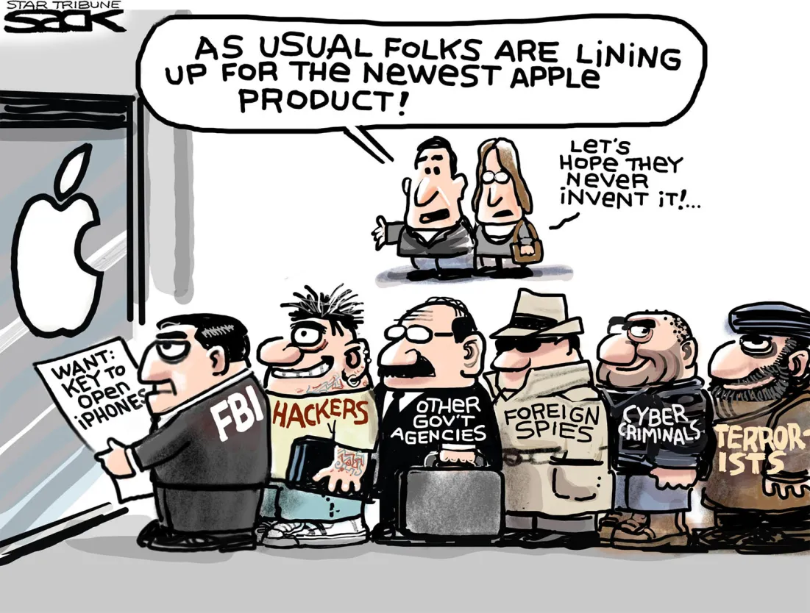
Context
John Perveiler
December 2015 San Bernardino attacks
One of the attackers was using an encrypted Apple device
The FBI gave Apple a court order to install a “backdoor” into their devices [1]
[7]
Cartoon by Steve Sack [4]
Notes:
For a bit of background, this case arose out of the December San Bernardino attack in 2015. During the investigation, the FBI wanted access to one of the attacker’s iPhone to help them prevent similar situations in the future. The FBI provided Apple with a court order for Apple to help them crack into the phone. Apple sent some engineers alongside all the data they had, but they refused to bypass the 4-digit pin. The court order was grounded in the All Writs Act, an act that allowed the court to make a judgement call on it’s authority when laws aren’t specific enough. Because a case of this nature hadn’t been seen or dealt with, the court claimed it was necessary for the investigation. The graphic here is dated and was probably intended as fearmongering and propaganda, but each of these caricatures represent a very possible outcome of this case.

Slide 20
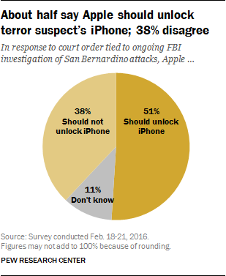
Government access
John Perveiler
The government should not have this power.
The FBI claimed it would only be for that one phone
[1]
Tim Cook said it would be a master key the FBI could use to access millions of private devices [6]
From Pew Research Center [3]
Notes:
The government should not have this kind of power. The FBI accused Apple of being more concerned with its business model then national security. While the FBI claimed that it would only be for the one iPhone, there’s no stopping them from using it elsewhere. The government would be able to access any iPhone with this backdoor. The CEO of Apple, Tim Cook, described the scenario as giving the FBI a master kay to all iPhones. In addition to the fact that this gives the government more power, the FBI using the U.S. court as leverage is also an overstep of boundaries. Considering U.S. court resolutions can modify the context and meaning of a rule or law, this could set a precedent for the court that the FBI could exploit in the future. The graphic on the right is a study from the Pew Research Center about support for the court order. The graphic on the right is another part of the Pew Research Center’s study where we can see that 51% of people supported the FBI, whereas only 38% supported Apple. The remaining 11% didn’t answer or didn’t know. This is surprising at first, but considering fear was running high at the time (similar to the 9/11 attacks) it makes sense that most people wanted the FBI to prevent such an event from occurring again.

Slide 21
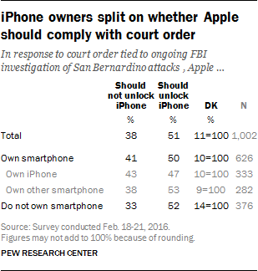
User security
John Perveiler
Thankfully, the FBI recalled the court order
Surprisingly, 51% of users wanted the backdoor [3]
Even though the FBI had good intentions, their request could have had catastrophic side effects [2]
From Pew Research Center [3]
Notes:
The FBI ended up not going through with this, claiming they “no longer needed it.” It was later revealed that the FBI received help from another tech company that discovered a vulnerability in iPhones, but that isn’t important to this conversation. The graphic on the right is from the same study as before with a more detailed breakdown of the pie chart from the previous slide. We can see that people without smartphones or with a non-iPhone smartphone preferred the FBI’s side more than the iPhone users based on the difference in the two sides, but iPhone users still had a greater percentage on the FBI’s side. This tells us that one of the factors that makes up these numbers is the type of smartphone because people without iPhones were less concerned with their privacy when it didn’t directly affect them. While the FBI’s intentions were good (at least, what they told us) the side effects could have been very bad.

Slide 22
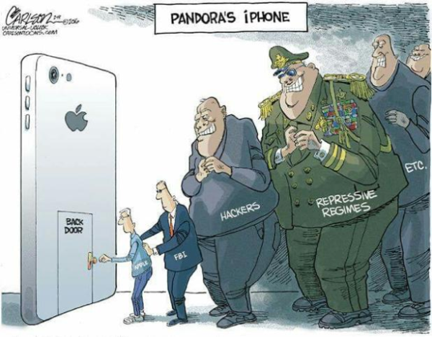
Foreign security
John Perveiler
Foreign governments would be able to monitor citizens’ phones [7]
Cybercriminals would be able to crack iPhones easier
The FBI would be able to request access to any device
This case would also establish the notion that companies can be conscripted by the government [2]
Political Cartoon by Stuart Carlson [5]
Notes:
To start, the presence of a backdoor would allow foreign governments to monitor the phones of citizens as well as issue warrants to specific people’s phones. An example of this would be a surveillance state like China. If the Chinese government had a backdoor into iPhones they would have even more control over their citizens. And what if it wasn’t just a 4-digit pin bypass? What if the government could turn on your camera or microphone to listen in on conversations? And because of the way the FBI handled this issue it’s not unreasonable to say that they would be able to conscript companies to work for the government. The backdoor itself could become a major vulnerability if it were ever discovered by hackers or cybercriminals. The cartoon used by Stuart Carlson on the right describes it perfectly, as this scenario would have opened a Pandora’s Box onto the world. To conclude,

Slide 23
References
John Perveiler
[1] Kumar Mukul et al., Individual Freedom Vis-à-Vis Integrity of the State: A Study with Reference to Apple iPhone,
(Sage Publishing, Jul 21, 2021) https://journals.sagepub.com/doi/pdf/10.1177/25166042211027425, (4/10/25)
[2] Noa Yachot, 7 Reasons a Government Backdoor to the iPhone Would Be Catastrophic (ACLU, Feb 25, 2016) https://www.aclu.org/news/privacy-technology/7-reasons-government-backdoor-iphone-would-be-catastrophic, (4/9/25)
[3] Pew Research Center, More Support for Justice Department Than for Apple in Dispute Over Unlocking iPhone (Pew Research Center, Feb 22, 2016), https://www.pewresearch.org/politics/2016/02/22/more-support-for-justice-department-than-for-apple-in-dispute-over-unlocking-iphone/, (4/9/25)
[4] Steve Sack, Apple Lock (Cagle Cartoons, Feb 19, 2016), https://cagle.com/cartoonist/sack/2016/02/19/175741/apple-lock, (4/10/25)
[5]Patty Seybold, Why Apple vs. FBI Matters, (Outside Innovation, Nov 2, 2016), https://outsideinnovation.blogs.com/pseybold/2016/11/why_apple_vs_fbi_matters.html, (4/9/25)
[6] Tim Cook, A Message to Our Customers, (Apple Inc., Feb 16, 2016), https://www.apple.com/customer-letter/, (4/10/25)
[7] Rafita Alham, APPLE, THE GOVERNMENT, AND YOU:
SECURITY AND PRIVACY IMPLICATIONS OF THE
GLOBAL ENCRYPTION DEBATE (Fordham University School of Law, 2021 https://ir.lawnet.fordham.edu/cgi/viewcontent.cgi?article=2818&context=ilj, (4/10/25)

Slide 24
The Laws Around Internet Privacy
Quincy Laflin

Slide 25
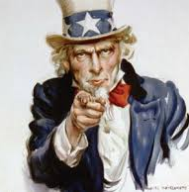
Your privacy is respected… until there’s a reason to access it.
Quincy Laflin
The Electronic Communications Privacy Act (ECPA) is designed to protect your digital from the government [1][2]
The ECPA has exceptionds to void your protection under certain circumstances [1]
Notes:
Privacy laws restrict government access to personal data (devices, cloud, third-party).
Exceptions allow access under specific circumstances.
Be cautious with:
What you post publicly.
What you share in private messages.
Data permissions granted to apps/devices.
Electronic Communications Privacy Act (ECPA) 1986
Title I (Wiretapping Act): Protects communications in transit
Title II (Stored Communications Act): Governs access to stored data (e.g., emails, cloud).
Title III (Pen/Trap Act): Regulates devices collecting non-content data (e.g., call logs, IP addresses).
ECPA Allows 12 Exceptions:
Consent given.
Warrant/subpoena obtained.
Data is publicly accessible.
Title 2 protects communication data stored on devices and third parties.
Makes it illegal to:
Intentionally access electronic communication without authorization.
Exceed authorized access to storage facilities.
Law enforcement requires a warrant or subpoena to access stored data.
Service providers cannot voluntarily disclose data unless:
There is an emergency involving death or serious harm.
Disclosure is to intended recipients.
Disclosure is made under a legal process.

Slide 26
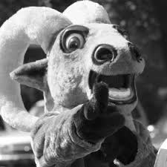
Is Gompei Guilty???
Quincy Laflin
Gompei Goats has been charged with possession of illegal drugs with intent to distribute
Gompei’s Digital Data was analyzed by state DOJ to build a case
Among the evidence was:
Drugs
Communications with seller/buyers
Location data
Notes:
Gompei Goats has been charged with possession of illegal drugs with intent to distribute
April, 1, 2024, Gompei Goats was arrested following a search warrant issued for the seizure of drugs and personal devices
Law Enforcement seized his: smartphone, laptop, tablet, money stash, and drugs
Gompei’s Digital Data was analyzed by state DOJ . These include: Text messages, emails , social media, call logs and notes.
Key Physical/Drug Evidence:
$10,000 cash seized.
0.4 kg cocaine recovered.
Key Digital Evidence:
Supplier cooperation: Text messages/emails shared by a supplier.
Buyer list: Found in Gompei’s notes.
Third-party data: Deleted social media, supplier emails, and search history provided by providers.
Snapchat: Location data matching known transaction sites.
Texts: Explicit intent to distribute to buyers.
Prosecution: Digital/third-party data (texts, Snapchat, deleted social media) prove intent
Defense: 4th Amendment violation—warrant scope exceeded (e.g., deleted data, search history).
Conflict: Privacy rights vs. warrant authority for digital searches.

Slide 27
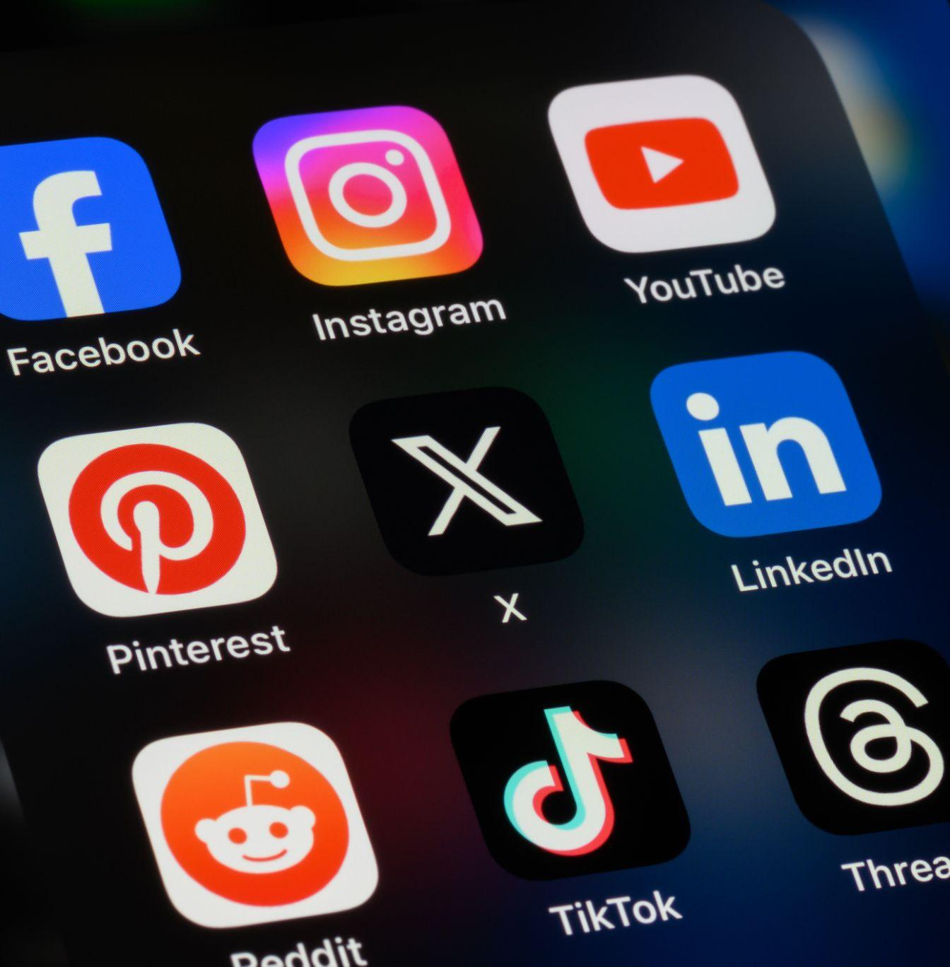
There is no 4th Amendment protection for data voluntarily shared with third parties
Quincy Laflin
People v. Harris(2012) it establishes [3]
Public post are not private posts
Deleted post are not truly deleted
Third party doctrine: No 4th Amendment protection for data voluntarily shared with third parties
Notes:
People v. Harris(2012) it establishes
Public Posts: Not protected under privacy laws if publicly shared.
Deleted Posts are owned by service providers
Third-Party Doctrine: No 4th Amendment protection for data voluntarily shared with third parties (e.g., social media companies).
Gompei’s Case:
Deleted social media/data can be accessed via warrant (no user "ownership").
Providers (e.g., Snapchat) can disclose stored/deleted data under legal process.

Slide 28
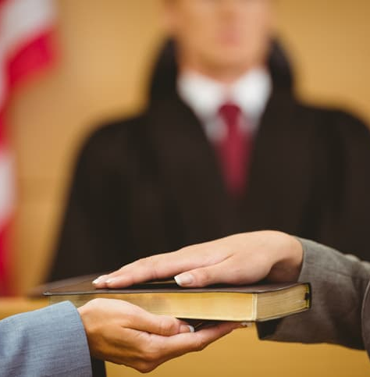
The law allows disclosure of private communications by cooperating witnesses
Quincy Laflin
United States v. Meregildo (2012) [4]
Friends or platforms can legally share your messages with law enforcement if they choose to.[4]
Privacy settings don’t guarantee protection—anything shared can be used as evidence.[5]
Text messages can be admissible evidence if it can be tied to defendant [5]
Notes:
United States v. Meregildo (2012)
Law Allows Disclosure
Friends or platforms can legally share your messages with law enforcement if they choose to.
Privacy settings don’t guarantee protection—anything shared can be used as evidence.
Gompei’s supplier can legally disclose their text messages
Texts Can Be Evidence: If there’s enough contextual evidence, texts can be linked to a defendant.
Rule 901 = Reasonable Certainty: The law doesn't require perfect proof— reasonably identify the sender.

Slide 29
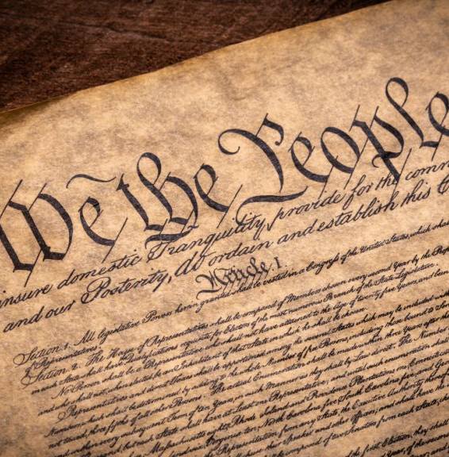
Warrants must specify the search & seizure of digital information
Quincy Laflin
Warrants have scopes for what can be searched or seized[6]
Carpenter v. United States (2018): Upholds warrant specificity pertaining to GPS data[6]
United States v. Warshak (2010) upholds warrant specificity pertaining to communication data stored by you and third parties [7]
Notes:
Warrants must have:
Probable cause
Particularity for:
Location
Items
For things to be searched in seize the Warrant must specify it
The warrant called for the seizure of drugs, money, and personal devices not the data on those devices
Example of this being up held:
Carpenter v. United States (2018)
The Supreme Court ruled accessing historic GPS data without a warrant violates 4A
The court never issued a warrant for Gompei's GPS data; therefore, it cannot be used as evidence since it was acquired unlawfully.
United States v. Warshak (2010)
4A protects email content under the Fourth Amendment: Courts cannot grant access to digital communication contents without warrants.

Slide 30
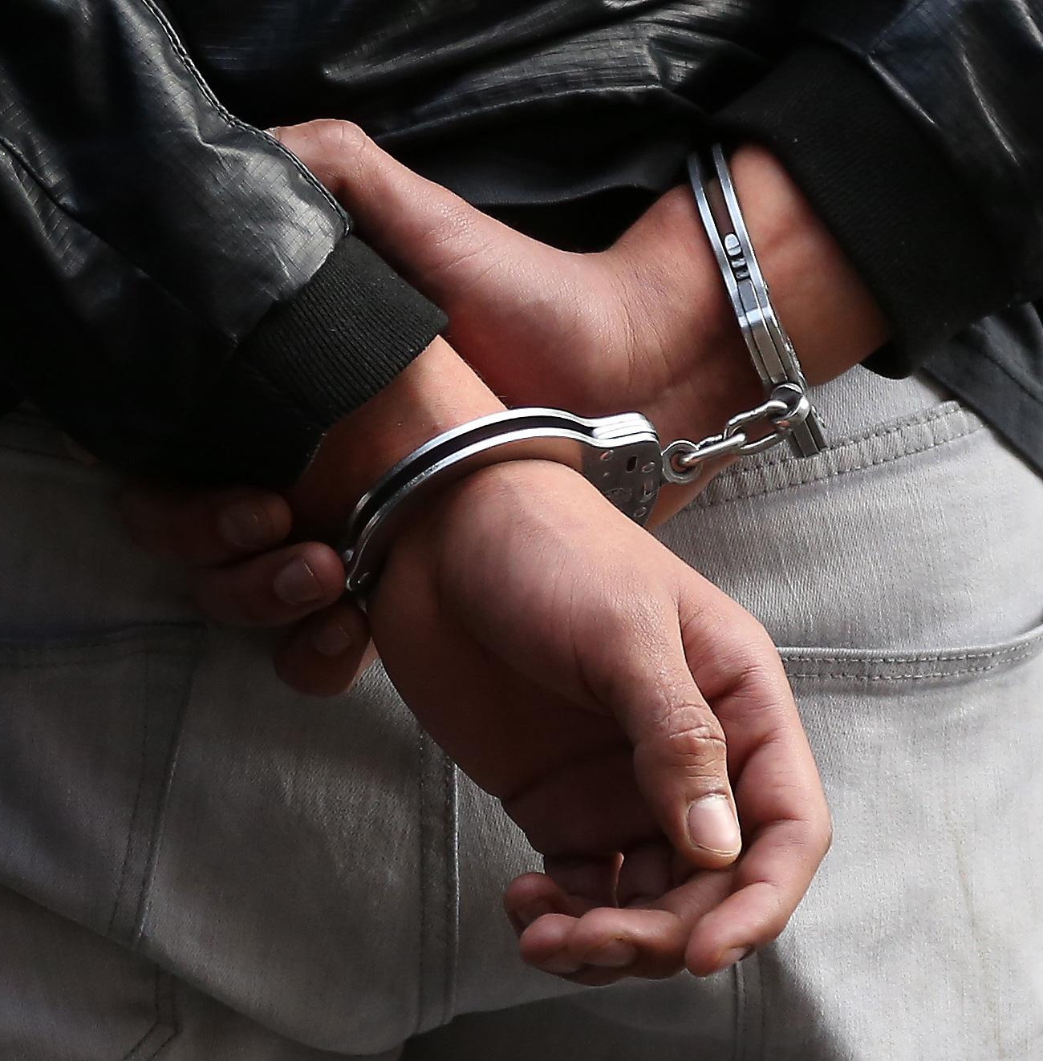
Gompei is guilty of possession but not intent to distribute
Quincy Laflin
The drugs are enough for conviction of possession
The digital evidence proving intent was obtained unlawfully
Gompei’s 4A rights were violated
Notes:
The drugs found at Gompei’s apartment are sufficient evidence to convict him of drug possession but are not enough to prove intent to distribute.
Digital Data proves intent
Digital information was not part of the original warrant
Gompei 4A was violated and the digital evidence is inadmissible, it cannot be used to convict Gompei.

Slide 31
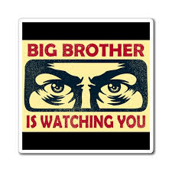
Your digital privacy from the government is a illusion
Quincy Laflin
4A protects you from searches & seizure without a warrant
Warrant and subpoena are used to justify & compel searches/seizures
The government respects your privacy—until they have a compelling reason to access it
Notes:
The Fourth Amendment, along with additional laws, protects your digital information from unlawful access by the government
Given probable cause, the government can use warrants and subpoenas to compel you, your friends, and third parties to hand over your digital information
The government respects your privacy—until they have a compelling reason to access it

Slide 32
REFERENCES
<Your Name>
Electronic Communications Privacy Act (ECPA). 18 U.S.C. § 2510, 1986.
Stored Communications Act. 18 U.S.C. § 2701, 1986.
People v. Harris. 949 N.Y.S.2d 590, Crim. Ct. 2012.
United States v. Meregildo. 883 F. Supp. 2d 523, S.D.N.Y. 2012.
United States v. Turner. 839 F.3d 429, 5th Cir. 2016.
Carpenter v. United States, 585 U.S. 207 (2018)
United States v. Warshak. 631 F.3d 266, 6th Cir. 2010.

Slide 33
Class 7 The End
Keith A. Pray
SocialImps.com
Notes:
Look at ACM TechNews if time
This is the end. Any slides beyond this point are for answering questions that may arise but not needed in the main talk. Some slides may also be unfinished and are not needed but kept just in case.

Slide 34
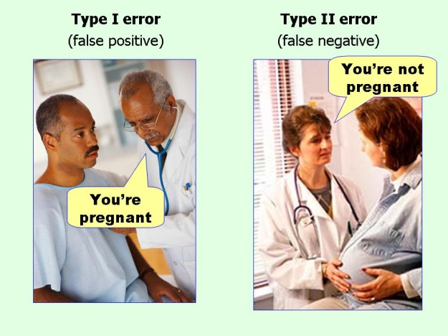
marginalrevolution.com/marginalrevolution/2014/05/type-i-and-type-ii-errors-simplified.html (2016-04-11)

Slide 35
what works well Online With Zoom
Turn your camera on
Sign in with First and Last Name
Stay muted unless you are going to speak
To speak use the raise your hand feature

