Slide 1
Eighth grade
June Whittall, Sean Arackal, Hasan Gandor, Ashley Jacob, Jacob Curtis

Slide 2
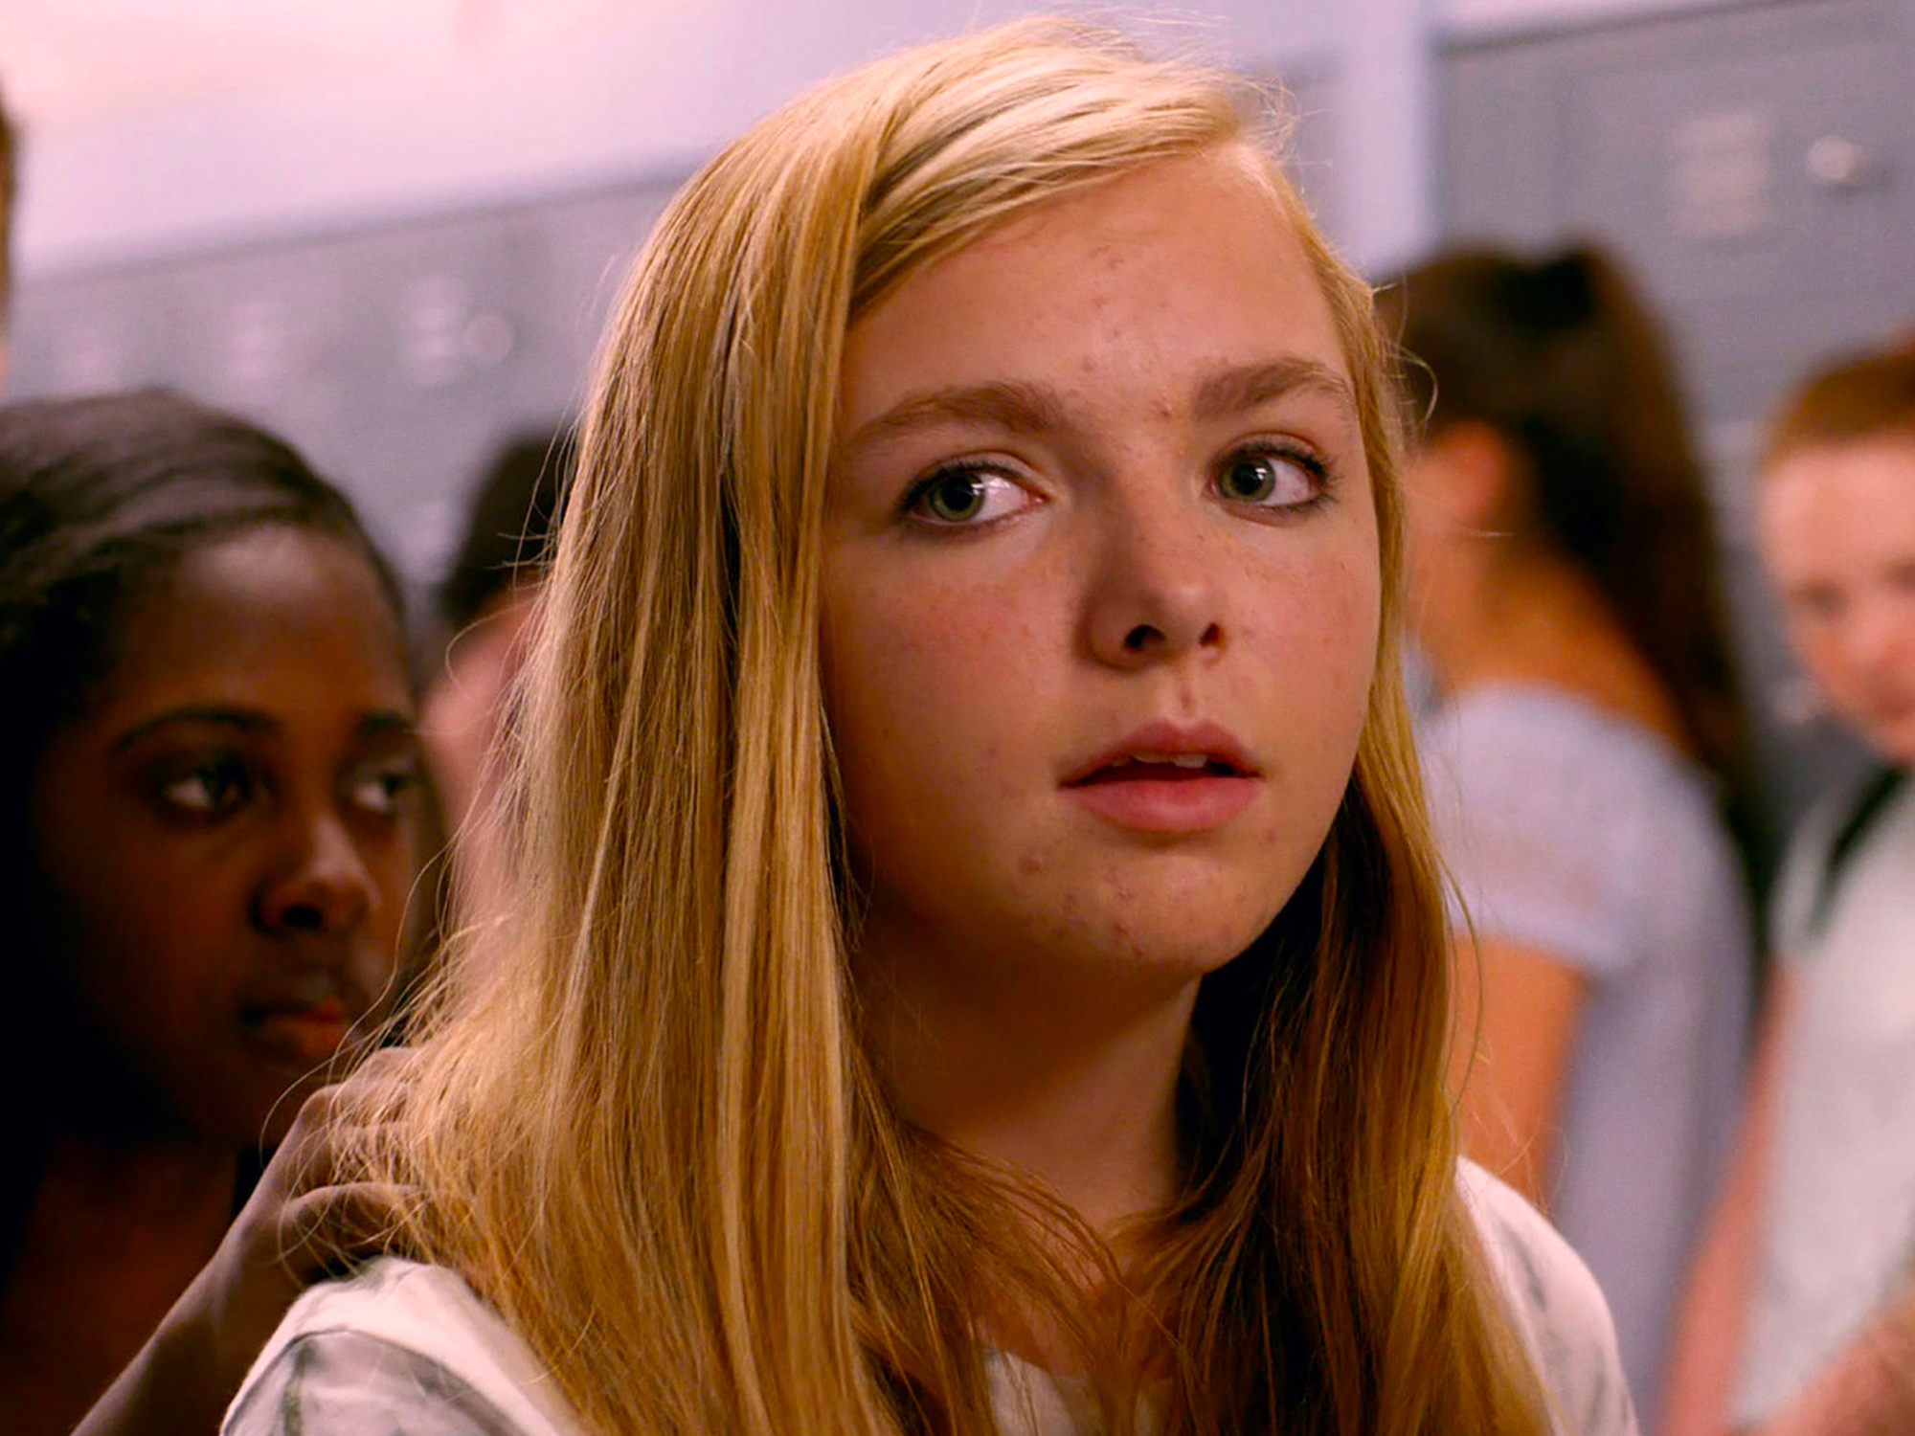
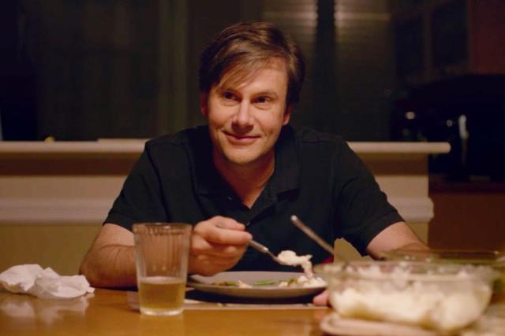
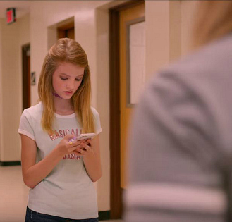


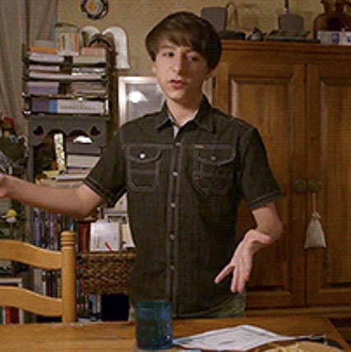
Characters
Kayla Day
Mark Day
Kennedy
Olivia
Aiden
Gabe
Notes:
There are six primary characters in Eighth Grade. First we have our protagonist, Kayla Day. She’s in her last week of eighth grade, and she’s trying to navigate the realities of growing up in a technology-filled world. She’s rather shy, but she is putting in effort to come out of her shell and reach out. She likes to make videos for YouTube, reflecting and giving advice on the subjects of self-actualization and growing up, but she doesn’t live up to her own expectations. To Kayla’s right we have her father, Mark. He tries really hard to relate to Kayla, but he has trouble understanding her relationship to technology. Next we have Kennedy, one of Kayla’s classmates. Kennedy is one of the first people we see Kayla try to talk to, but Kennedy is too busy on her phone to acknowledge her. Later, when Kennedy is hosting a pool party, she doesn’t want to invite Kayla, but her mom invites Kayla before Kennedy has a chance to stop her. Moving to the bottom left there’s Olivia. As part of graduating eighth grade, Kayla got to spend a day “shadowing” a high schooler, and Olivia was Kayla’s mentor for that day. They hit it off quite well, and Olivia started to try to integrate Kayla into her friend group. Next is Aiden, the boy Kayla has a crush on, seemingly just because of his appearance. When Kayla speaks to Aiden, he brushes her off. That is, until she pretends to have a folder of “dirty pictures of herself” on her phone, which immediately grabs his attention. Finally there’s Gabe, who is Kennedy’s cousin. He’s one of the few people who actually watches Kayla’s videos. He meets Kayla at the pool party, where at first Kayla dismisses him as being strange, but after he reaches out to her later over Instagram they meet up and become friends.

Slide 3




Technologies Used
Notes:
The focal technology of Eighth Grade is social media, specifically these four. Kayla spends a lot of her time making videos for YouTube, but they don’t get very much traction.
The others, being Snapchat, Twitter, and Instagram, are used primarily for communication between characters, but Kayla is often seen passively scrolling through Instagram.

Slide 4
Conclusions
Social Media
- Hurts the Physical and Mental Health of Teens
- Hinders Formation of Face-To-Face Connections
- Can be an Avenue for Self-Expression, Identity Exploration, and Socialization
Notes:
Eighth Grade is an exploration of the impact of technology on the coming-of-age of modern teens, and these are the effects we’ve found it to have.

Slide 5
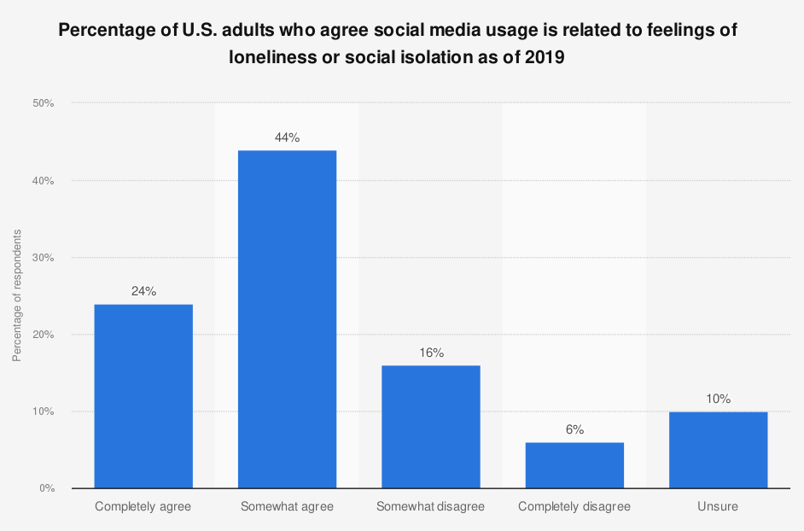
LACK OF real life CONNECTIONS
“Humans require interaction to maintain a healthy psychological state” [8]
"Loneliness remains pervasive in societies where social media usage is highest." [9]
Lonely turn to social media [10]
Social Comparision [10]
NA coefficients [10]
Facebook: 0.06
Twitter: 0.09
Instagram: 0.08
Offline interactions predicted PA [10]
U.S. Adults agree social media usage is linked with loneliness [11]
Notes:
Human beings need interaction
"Humans require interaction to maintain a healthy psychological state" [8]
(Define Loneliness) Loneliness still prevails where social media does
Loneliness definition:
"Loneliness refers to the subjective, distressing experience of having a lack or deficiency in one’s social connection to others, indicating that relationships with others are missing or inadequate" [https://www.ncbi.nlm.nih.gov/pmc/articles/PMC9817115/]
"Loneliness remains pervasive in societies where social media usage is highest." [9]
"Interconnectedness offered by social media usage should attenuate loneliness." [9]
Lonely people turn to social media
"Social network sites, rather than serving as facilitators of face-to-face contact, tend to promote the asynchronous posting and passive consumption of information about others—an environment that encourages upward social comparison" [10]
"Researchers found that people turn to social media more when they’re feeling lonely. But, surprisingly, people felt worse after spending time on social media. It didn’t help them feel less isolated. It actually made them feel lonelier. This was due to social comparison — or the act of comparing yourself to others. The more study participants compared themselves to others while using social media, the less happy they felt."
Refers to [10, Journal of Happiness Studies] https://healthy.kaiserpermanente.org/health-wellness/healtharticle.have-healthier-relationship-with-social-media
Study conducted and published in the Journal of Happiness Studies
3 Hypotheses of the study:
Use of Multiple Social Network Sites Predicts Declines in Subjective Well-Being
Social Comparison on Social Media Undermines Subjective Well-Being
Direct Interaction with Others Increases Subjective Well-Being
NA = Negative affect
PA = Positive affect
When people used Facebook, Twitter, or Instagram individually, they all were associated with an increase in negative feelings (NA). For Facebook, the coefficient was 0.06; for Twitter, it was 0.09, and for Instagram, it was 0.08. These coefficients represent the increase in negative feelings over time after using each of these social networking sites.
Contrast this with offline interactions, which predict positive affects and decreased negative affects
The study "predicted that direct (offline) interactions with others—defined as those occurring face-to-face or by voice—would predict greater positive affect, while inversely predicting negative affect" [10]
Discuss the bar graph
In 2019, Majority of U.S. adults either completely or somewhat agree (68%) that social media usage is related to feelings of loneliness

Slide 6
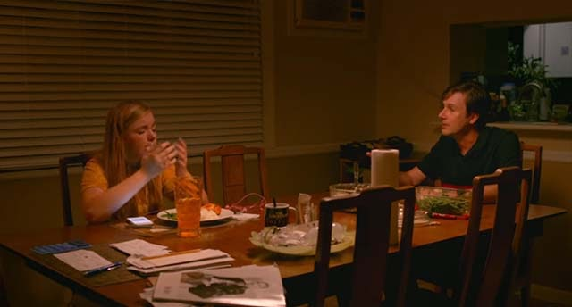
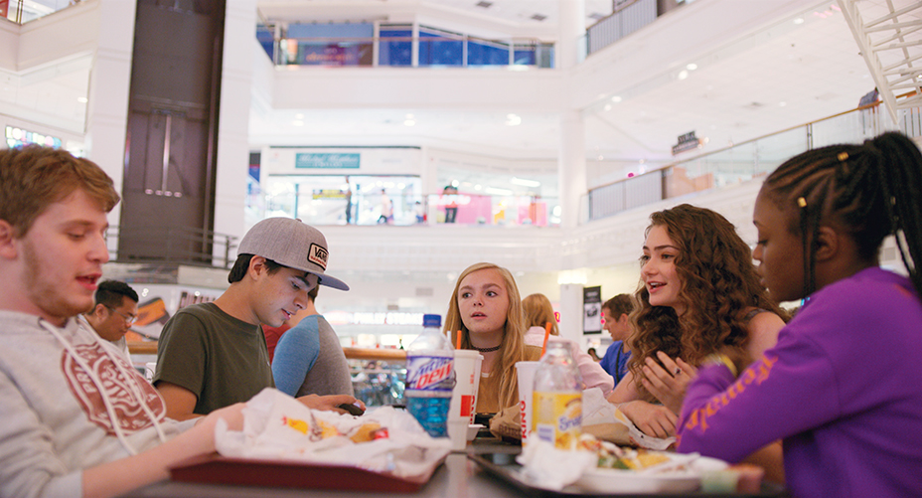
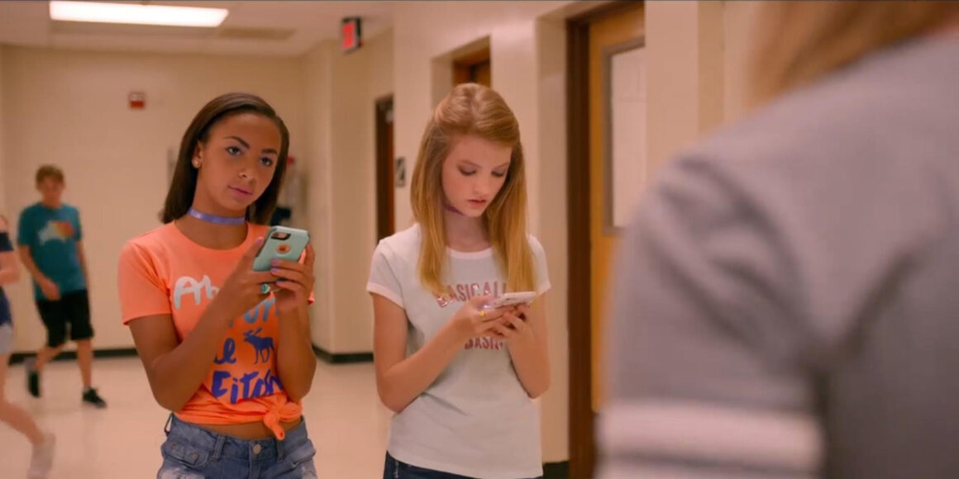
IN THE MOVIE
Kayla ignoring her dad [5]
Kennedy ignoring Kayla [5]
Kayla meeting with Olivia at the mall [5]
Notes:
Kayla ignoring her dad (top right) and Kennedy ignoring Kayla (bottom right) are both instances where social media was a distraction from the face-to-face conversations. This resulted in inadequate social interactions because one side was focused on social media instead of the other party.
When Kayla met with Olivia and her friends at the mall (bottom left), everyone spoke to each other without the impediment of social media, leading to open and natural conversation. Kayla seemed to be the most happy at this part in the movie because she found a place where she belonged. And consequently, social media and phones were largely absent as the group was talking with one another.

Slide 7
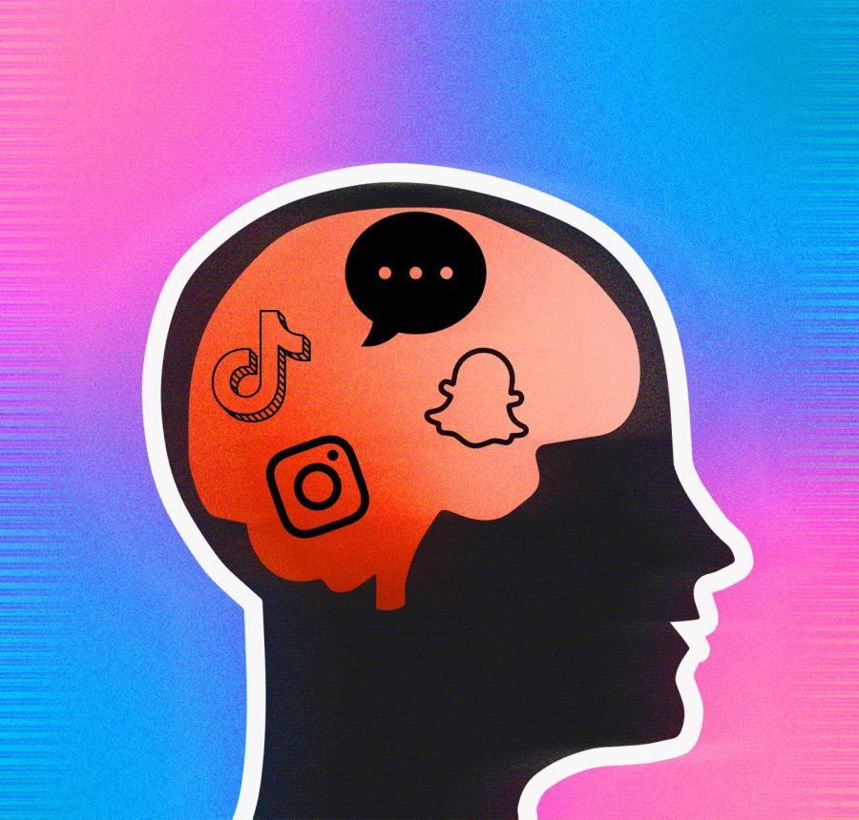
Negative physical/physiological effects of social media
Social media is addictive[6]
What does Face-to-Face offer?[7]
Type 2 diabetes correlation[7]
<Graphic as big as will fit>
Notes:
Using social media activates a rewards system in the brain. It releases quickly fading feelings of happy chemicals such as dopamine when someone receives positive comments or likes on social media.
Social media is unpredictive therefore it pulls users back repeatedly until it makes them sick. It's like a slot machine in which players continue to play because there is a slight chance they could make money. Engagement on social media is like that possible desired outcome.
Researchers know that the mind and gut have a strong connection. Social media can also affect a persons mental health causing anxiety and depression, this can turn into nausea, headaches, muscle tension, and tremors (parts of the body having uncontrollable trembling or shaking movements most commonly the hands)
Social media's ability to cause isolation and loneliness can cause people to miss out on the benefits of In person interactions. Having an active social life with face to face interactions can also produce healthier responses in the nervous system. It releases a the happy chemicals of dopamine and oxytocin while also regulating stress and anxiety. It helps to lower cortisol which is the main stress hormone. It has been also researched that having an active social life can reduce the risk of type 2 diabetes as well.
A study conducted in Maastricht University found participants who didn’t join in with club activities or associate with any social groups were 60% more likely to have prediabetes.
These findings support the idea that resolving social isolation may prevent the development of type 2 diabetes. It is extremely important to be able to use social media in moderation in order to avoid any of these health risks.
.

Slide 8
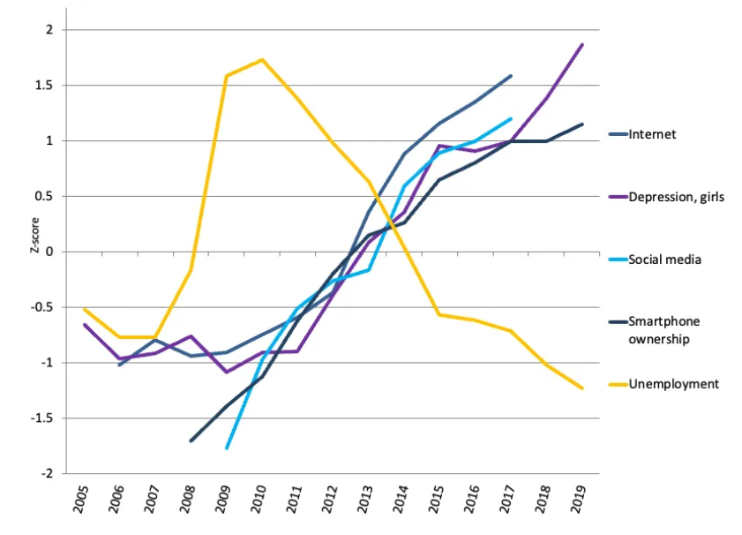
Stress, Depression and Anxiety
Over three hours per day leads to doubled risk of experiencing mental health issues
Comparative aspect of social media
Body Image Issues
“U.S. teen girls; depression rates
and possible causes” [16]
Notes:
We see that social media directly has an impact on the physiological state of people but let's talk a little bit more about how that intersects with social media use in adolescents.
Children and adolescents who dedicate over three hours per day to social media usage are exposed to a doubled risk of experiencing mental health issues such as depression and anxiety. [12]
Additionally, in a study done by JAMA Psychiatry it was found that, spending more than 30 minutes on social media, compared with no use, was associated with increased risk of internalizing problems alone [13]
And mobile social media-related fear of missing out can significantly and positively predict depressive symptoms among college students [14]
A cause for these symptoms can be the comparative aspect of social media specifically in terms of body image issues that can arise from it's use
People care about crafting an image and reputation on social media and present an idealized version of themselves online. This leads to other people viewing those posts and having a skewed view on what is normal.
High levels of social media interaction in early adolescence have implications for well-being in later adolescence, particularly for teen girls . [15]
This graph shows the correlation between the increase in depression rates among teen girls in the US and the increase of internet, smartphone and social media use.

Slide 9

Kayla's Struggles
Anxiety
Panic Attacks
Snapchat Filters
Kayla looking out at the pool party,
anxious to join
Notes:
Adolescents’ online lives can contrast and at the same time greatly impact their offline lives. The movie provides further evidence of this.
We see that in the movie, Kayla faces problems like anxiety that seem to stem from her use of social media however this is would not be apparent to someone who simply views her YouTube videos or see her Instagram page,
She's timid and struggling to form friendships at school. . At the start of the movie she is voted "Most Quiet" by her classmates which is a reflection of her isolation from them.
Mark, her single father, struggles to establish a meaningful connection with Kayla and tries to reduce her reliance and use of social media as seen in the dinner table scene.
This dynamic between Mark and Kayla is an instance of how adolescents’ online lives and use of social media and negatively impact their connections with people in the real world.
There is a scene in the movie where Kayla is at a party, she has a panic attack in the bathroom. This is partly caused by her anxiety about being in her swimsuit. This is an instance where the comparative aspect of social media negatively affects the body image that especially young girls tend to feel. Another instance of these kinds of issues crop up with Kayla when she is seen getting out of bed, doing her makeup and then using snapchat filters in bed to make it seem as though that's how she woke up. It's a very clear depiction of depiction of the idealized versions of people being posted online and how that could contrast with their real lives.

Slide 10
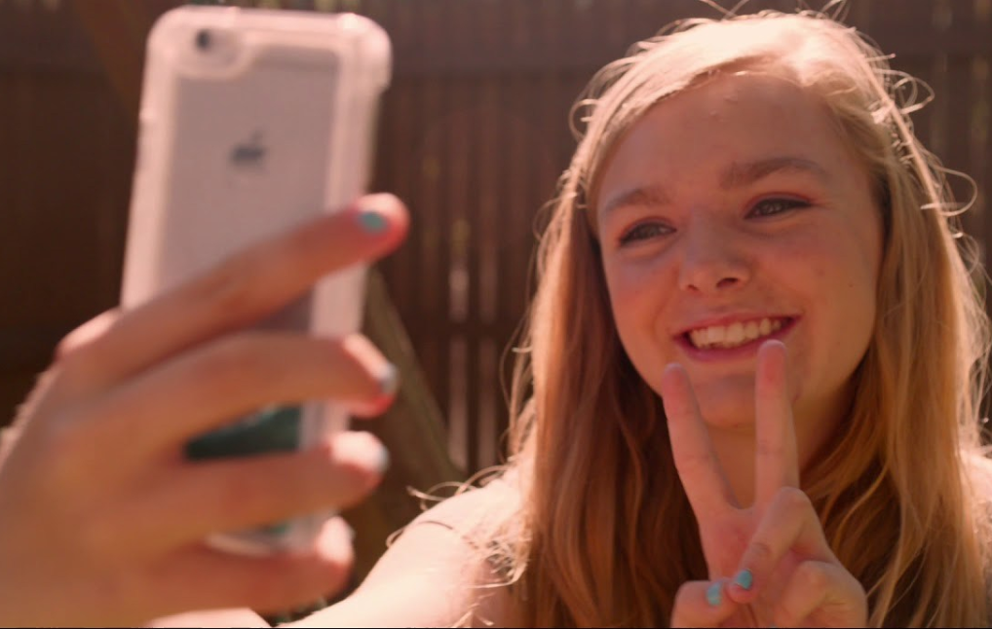
positive impacts: self-expression
Kayla’s YouTube videos as a coping mechanism
Queer youth can benefit from online self- expression [1]
Mental health benefits from developing one’s identity
lower levels of paranoia, anxiety, and hostility [2]
Benefits not the same among heterosexual youth [2]
Screenshot of the film, showing Kayla taking a selfie [5]
Notes:
In the film, Kayla’s YouTube videos show her giving advice to other people her age, about the things that she is going through. Topics include “being yourself” and “confidence,” and she discusses ways to achieve such things, almost as if she is advising herself. The videos seem to serve as a coping mechanism for her own anxiety.
Studies looking at queer youth have found benefits of self-expression in this way, with the ability of being able to disclose one’s identity resulting in mental health benefits. Social media was used to develop and find confidence in one’s identity, which was fully or partially associated with lower levels of paranoia, anxiety, and hostility.
Benefits of exploring one’s identity were not found the same way in heterosexual youth, suggesting that these effects are more exclusive to those whose identities are marginalized or who do not have the ability to express themselves freely outside of an online space.

Slide 11
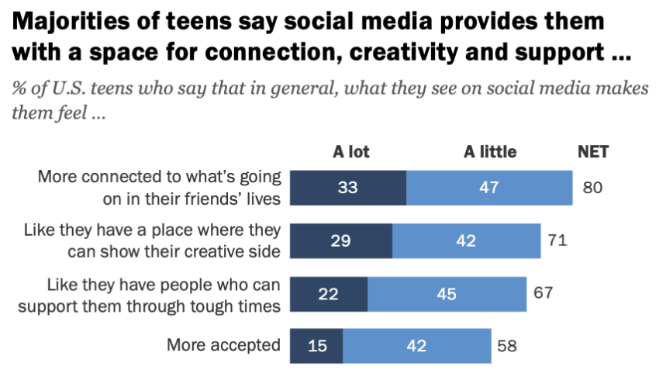
mental health destigmatization
Discussion of one’s mental health online can help lead to destigmatization and finding community [3]
These online spaces offer advice, solidarity, education, and connection [3]
Graph showing teens use of social media for
support and acceptance [4]
Notes:
With this, discussion of mental health issues online was seen to foster benefits as well, such as destigmatization and finding community.
One study analyzed the comments under YouTube vlogs discussing personal experiences with Borderline PD, finding that there were dominant positive themes such as offering advice, support, solidarity, education, and connection.
The graph on thee right shows that teens do feel importance in social media’s ability to grant them a place to be creative, to seek support, and to find acceptance.

Slide 12
References
[1] Yao, X., Zhao, Y. C., Song, S., & Wang, X. (2022). Beyond disclosure: The role of self-identity and context collapse in privacy management on identified social media for LGBTQ+ people. Journal of Documentation, 79(3), 718–742. https://doi.org/10.1108/jd-04-2022-0080
[2] Ceglarek, Peter J.D., and L. Monique Ward. “A tool for help or harm? how associations between social networking use, social support, and mental health differ for sexual minority and heterosexual youth.” Computers in Human Behavior, vol. 65, 2016, pp. 201–209, https://doi.org/10.1016/j.chb.2016.07.051.
[3] King, Clare M., and Darragh McCashin. “Commenting and connecting: A thematic analysis of responses to YouTube vlogs about borderline personality disorder.” Internet Interventions, vol. 28, 2022, https://doi.org/10.1016/j.invent.2022.100540.
[4] Anderson, Monica. “Connection, Creativity and Drama: Teen Life on Social Media in 2022.” Pew Research Center, Pew Research Center, 16 Nov. 2022, www.pewresearch.org/internet/2022/11/16/connection-creativity-and-drama-teen-life-on-social-media-in-2022/. Accessed 10 October, 2023.
[5] Castro, Thalia. “‘eighth Grade’ (2018): The Emotional Depth of Kayla.” Flip Screen, Wordpress.com, 22 Mar. 2020, flipscreened.com/2019/03/24/eight-grade-the-emotional-depth-of-kayla/. Accessed 10 October, 2023.
[6] “The Social Dilemma: Social Media and Your Mental Health.” Here’s How Social Media Affects Your Mental Health | McLean Hospital, McLean Hospital, 18 Jan. 2023, www.mcleanhospital.org/essential/it-or-not-social-medias-affecting-your-mental-health#:~:text=Social%20media%20use%20can%20affect,%2C%20muscle%20tension%2C%20and%20tremors.
[7] “Is Social Media Causing Social Isolation?” Social Media and Social Isolation | Relationships Australia QLD, Relationships Australia, 20 Apr. 2022, www.raq.org.au/blog/social-media-causing-social-isolation.
[8] Halston, Abby, et al. "Social media and loneliness." International journal of psychological studies 11.3 (2019): 27-38.
[9] Matthew Pittman, Brandon Reich, Social media and loneliness: Why an Instagram picture may be worth more than a thousand Twitter words, Computers in Human Behavior, Volume 62, 2016, Pages 155-167, ISSN 0747-5632, https://doi.org/10.1016/j.chb.2016.03.084.
[10] Wirtz, D., Tucker, A., Briggs, C. et al. How and Why Social Media Affect Subjective Well-Being: Multi-Site Use and Social Comparison as Predictors of Change Across Time. J Happiness Stud 22, 1673–1691 (2021). https://doi.org/10.1007/s10902-020-00291-z
[11] "Percentage of U.S. Adults Who Agree Social Media Usage Is Related to Feelings of Loneliness or Social Isolation as of 2019." Statista, Statista Inc., 1 May 2019, https://www.statista.com/statistics/1104187/us-adults-social-media-loneliness/

Slide 13
References
[12] Dr. Vivek Murthy, Surgeon General Issues New Advisory About Effects Social Media Use Has on Youth Mental Health, (source, May 23, 2023) https://www.hhs.gov/about/news/2023/05/23/surgeon-general-issues-new-advisory-about-effects-social-media-use-has-youth-mental-health.html#:~:text=Recent%20research%20shows%20that%20adolescents,a%20day%20on%20social%20media. (10/10/2023)
[13]https://jamanetwork.com/journals/jamapsychiatry/fullarticle/2749480 (10/10/2023)
[14] https://bmcpsychology.biomedcentral.com/articles/10.1186/s40359-023-01231-1#:~:text=The%20results%20showed%20that%20(1,of%20MSM%2Drelated%20FoMO%20on (10/10/2023)
[15] https://bmcpublichealth.biomedcentral.com/articles/10.1186/s12889-018-5220-4 (10/10/2023)
[16] U.S. teen girls; depression rates and possible causes, 2005-2019. Sources: Monitoring the Future, National Study of Drug Use and Health, Pew Research Center, U.S. Bureau of Labor Statistics, https://www.samhsa.gov/data/sites/default/files/reports/rpt29393/2019NSDUHFFRPDFWHTML/2019NSDUHFFR090120.htm (10/10/2023)

