Slide 1
Class 12-14
Last Days
Keith A. Pray
SocialImps.com

Slide 2
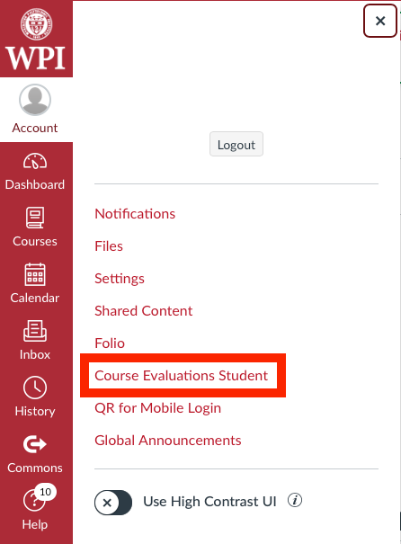
Overview
Class 12: Assistant Evaluation - Group Presentations
Class 13: Course Evaluations - Group Presentations
Class 14:
  Group Evaluations version 2
  Automation Paper Results
  Points to date
  Students Present
  Students’ Choice

Slide 3
Notes:
Automation Paper results. This term’s additions in RED

Slide 4
Papers
Consistent performance!
Many students highest grade yet!
Notes:
Save for next time:
More Clear Conclusions
Significant Counter Points
Clearly state conclusion
First statement preferred
Absolute statements are difficult to prove
Avoid: all, always, any, every, everyone, never, none… unless you can show it
Be sure to put quotes around entire quote
Hyperbole is the best thing ever!
but not in these papers
Print 2 sided and save a tree
Use template, saves time (and -1 point)
Include Counter Point and Response
Include Author, Title, Publish Date, Publisher for references
Read paper aloud to proof

Slide 5
Grades
To Date
58 Max Possible
- Discussion 1-13
- Papers 1-4
Does not include points:
- 2 Discussion
- 10 Individual Presentation
- 35 Group Project
- Extra Credit

Slide 6
Depending on i.t.
By: Chloë Polit
Notes:
Hello everyone! If you don’t know me yet by the last day of classes this term, my name is Chloe Polit, and I will be covering the societal dependence on information technology and the implications of outages as it relates to recent global events. Getting into it… (next slide)

Slide 7
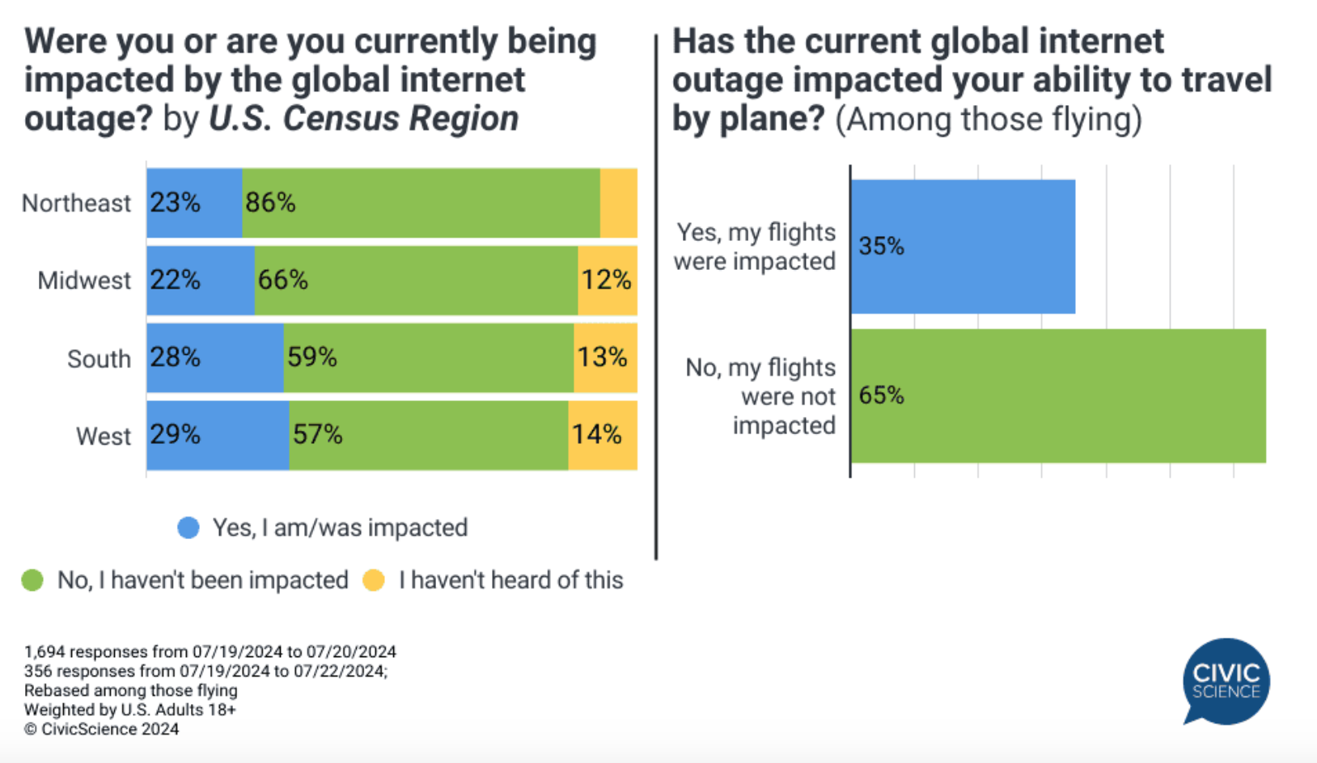
Currently, information technology dependence for infrastructure leaves us vulnerable
Chloë Polit
Disruptions ripple across industries, nations, and sectors [1]
Stock markets, banks, airlines, emergency services, tech companies, etc. are all affected by these outages
Small scale effects: halt operations
Large scale effects: economic loss, public safety risks, potential political instability
Survey taken during CrowdStrike Outage [8]
Notes:
<Conclusion and Argument>
The world’s increasing reliance on technological infrastructure has created a fragile foundation for modern society, making the risks of large-scale outages and cyber incidents more dangerous than ever. As systems become more interconnected, disruptions, whether from hardware failures, software bugs, or cyberattacks, can ripple across industries and nations.
On the right you can see a survey taken
The 2024 CrowdStrike outage, for example, exposed vulnerabilities in cybersecurity, affecting many organizations that depend on these services to prevent breaches or leaks. Outages of this scale can cripple entire sectors, halt operations, and undermine trust in digital systems, leading to economic loss, public safety risks, and potential political instability. As digital infrastructure becomes more critical, ensuring its security and resilience must be a global priority to avoid catastrophic failures.

Slide 8
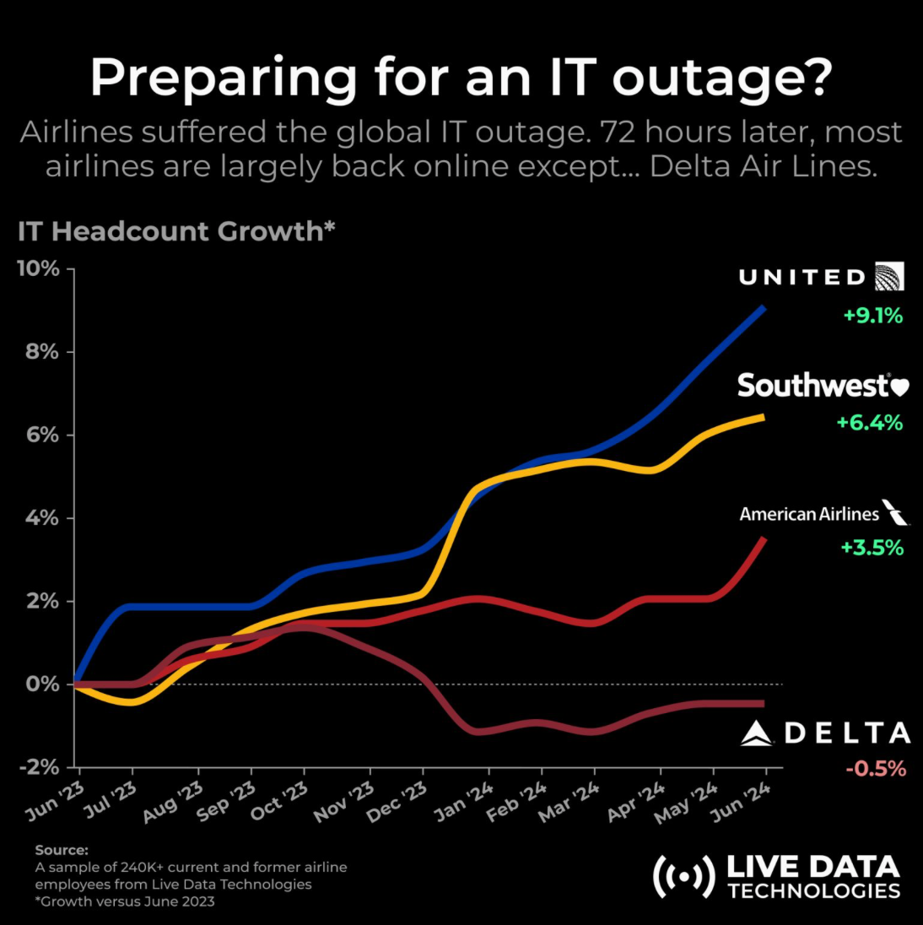
Crowdstrike timeline [4]
Chloë Polit
<Graphic as big as will fit>
July 19th, 2024, 4:09 UTC: Sensor Configuration Update released to Windows
July 19th, 2024, 5:27 UTC: Changes were reverted and original issue was resolved
July 19-22, 2024: CrowdStrike and Microsoft work together to remediate affected technology worldwide
[9]
Notes:
<Timeline and Impacts>
Most of you have probably either heard about or been affected by the CrowdStrike outage that occurred in July over summer break. This was one of the most substantial outages in current history. To give a quick timeline on the events that occurred…
Coordinated Universal Time
July 19, 2024, 04:09 UTC: CrowdStrike released a sensor configuration update to Windows systems as part of their ongoing operations. This update triggered a logic error that caused system crashes on impacted machines​.
July 19, 2024, 05:27 UTC: CrowdStrike identified the issue and reverted the changes, but by then, many systems had already been affected. The update impacted Windows 10 and later versions, but did not affect Mac and Linux systems.
July 19-22, 2024: CrowdStrike and Microsoft worked together to provide remediation steps. Affected machines required manual intervention to delete the faulty .sys file from the CrowdStrike directory. This process involved booting into Safe Mode or the Windows Recovery Environment, making recovery a time-consuming task for large organizations​. There are reports that cloud remediation is possible, but users must opt-in by submitting a request via the support portal and requesting to be included in cloud remediation and then rebooting.
As seen on the right, the airlines took about 72 hours to recover to a normal amount, however certain airlines such as Delta suffered the lasting effects for longer.

Slide 9
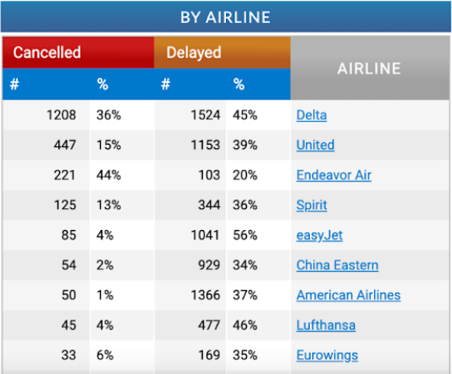
Crowdstrike impacts in airline sector [6]
Chloë Polit
8.5 million devices affected [4]
Projected between $4-6 billion losses [1]
Total delays Saturday: 35,204
Total delays within, into, or out of United States Saturday: 9,149
Total cancellations Saturday: 2,881
Total cancellations within, into, or out of the United States Saturday: 2,145
<Graphic as big as will fit>
[6]
Notes:
<Timeline and Impacts>
Immediate Impact: The faulty update caused significant disruptions globally. Approximately 8.5 million devices were affected, leading to outages in various sectors, including airlines, healthcare, and financial institutions.
Analyze statistics on slide
Delta Airlines was still struggling to return to normal operation as of July 23.

Slide 10
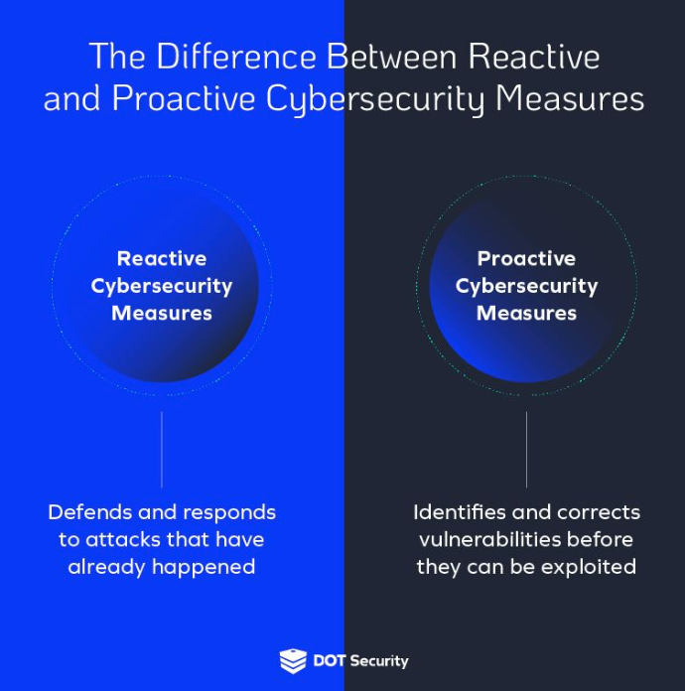
Fixed short-term, unsure long-term?
Chloë Polit
Short term vs Long Term fixes
Complexity and interdependency raises the likelihood of issues [7]
National Security, Critical Infrastructure, Public Safety
Reactive → Proactive [10]
Implement Safeguard
<Graphic as big as will fit>
[10]
Notes:
<Rebuttal>
Short term vs Long Term fixes
Significant disruptions
Complexity raises the likelihood of issues
National Security, Critical Infrastructure, Public Safety
Severe, lasting consequences
Reactive → Proactive
Safegaurd
While disaster recovery mechanisms and redundancy systems can mitigate short-term damage, they do not fully address the long-term vulnerabilities created by overreliance on technology.
As evidenced by the 2024 CrowdStrike outage, even industries with sophisticated contingency plans experienced significant disruption. Additionally, the complexity of modern technological infrastructure increases the likelihood of cascading failures, where the breakdown of one system triggers failures across others. The high stakes tied to technology dependence, including national security, critical infrastructure, and public safety, mean that even temporary outages can have severe, lasting consequences.
Thus, while technology brings immense benefits, society’s approach to digital infrastructure must shift from reactive measures to proactive, systemic solutions to safeguard against increasingly sophisticated and far-reaching threats.

Slide 11
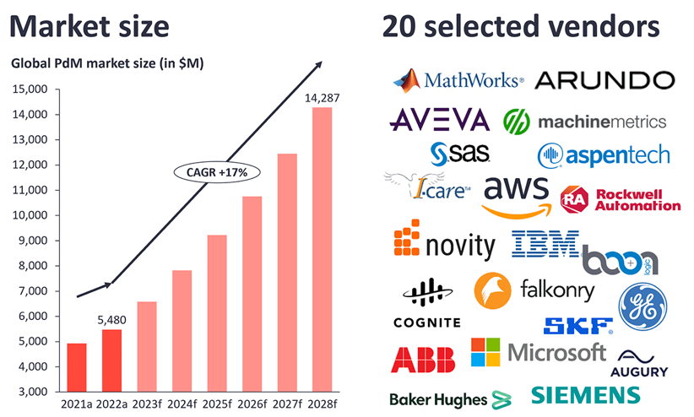
solutions
Chloë Polit
Decentralization and Diversification of infrastructure [2]
Enhance Cybersecurity Measures [10]
Investment in AI-Powered Predictive Maintenance [11]
Disaster Recovery and Response Planning
Sustainable Infrastructure Development
Market snapshot: Predictive maintenance 2024[11]
Notes:
<Solutions>
1. Decentralization and Diversification of Infrastructure:
Solution: Encourage the decentralization of critical infrastructure, distributing data and services across multiple geographic locations and cloud providers. This reduces the risk of widespread failure if one system goes down. Using blockchain or other decentralized networks can also increase resilience by eliminating dependence on a single point of failure. Having some locally and main centers spread out reduces the reach of a data leak or error.
2. Enhanced Cybersecurity Measures:
Solution: Strengthen cybersecurity frameworks through multi-layered defense strategies, continuous monitoring, and rapid threat detection systems. This includes integrating artificial intelligence (AI) and machine learning to identify and respond to threats in real-time. Organizations should regularly update and patch systems, enforce strict authentication processes, and conduct routine penetration testing.
3. Investment in AI-Powered Predictive Maintenance:
Solution: Use AI and machine learning for predictive maintenance, which can foresee potential breakdowns before they occur. By analyzing data from sensors and system logs, AI can predict equipment failure, cyber-attacks, or performance bottlenecks, allowing for preventative action.
4. Disaster Recovery and Response Planning:
Solution: Mandate disaster recovery plans that include regular drills and testing. These plans should outline steps for maintaining operations during outages and quickly recovering lost data or functionality. Business continuity plans should be updated regularly and stress-tested against worst-case scenarios.
5. Sustainable Infrastructure Development:
Solution: Invest in sustainable, scalable infrastructure designed to withstand increasing demands and environmental stresses, such as climate change. Governments and industries should prioritize smart grids, renewable energy sources, and energy-efficient technologies that are less vulnerable to fluctuations and outages.
Looking at the market snapshot, the global predictive maintenance market grew to $5.5 billion in 2022 and is predicted to grow to $14,287 billion in 2028

Slide 12
References
Chloë Polit
[1] Dr. A. Shaji George, "When Trust Fails: Examining Systemic Risk in the Digital Economy from the 2024 CrowdStrike Outage," Partners Universal Multidisciplinary Research Journal, Vol. 1, No. 2, pp. 134–152, 2024, https://doi.org/10.5281/zenodo.12828222 (accessed October 10, 2024).
[2] Yassin Abdalla Abdelkarim, Exploring the Preventive Contribution of Data Localization Against IT Outages: The CrowdStrike Case (Egyptian Ministry of Justice; Leeds Beckett University, August 6, 2024), SSRN, https://papers.ssrn.com/sol3/papers.cfm?abstract_id=4929163 (accessed October 10, 2024).
[3] Sayonara De Zoysa, Microsoft Global Outages Caused by CrowdStrike Software Glitch (2024), https://www.researchgate.net/profile/Sayonara-De-Zoysa/publication/382625564_Microsoft-global-outages_caused_by_CrowdStrike_software_glitch/links/66a61b9c4433ad480e80d589/Microsoft-global-outages-caused-by-CrowdStrike-software-glitch.pdf (accessed October 10, 2024).
[4] Pedro Umbelino, "CrowdStrike Outage Timeline and Analysis," BitSight, (2024), https://www.bitsight.com/blog/crowdstrike-outage-timeline-and-analysis (accessed October 10, 2024).
[5] Olugbenro Ogundipe, The Shaky Foundation of Global Technology: A Case Study of the 2024 CrowdStrike Outage(2024), https://www.researchgate.net/profile/Olugbenro-Ogundipe/publication/384191414_The_shaky_foundation_of_global_technology_A_case_study_of_the_2024_crowdstrike_outage/links/66ed971119c9496b1faf0cec/The-shaky-foundation-of-global-technology-A-case-study-of-the-2024-crowdstrike-outage.pdf (accessed October 10, 2024).
[6] FlightAware, "Live Airline Flight Cancellations Info & Statistics," (July 2024), https://www.flightaware.com/live/cancelled (Accessed: October 11, 2024).
[7] Korkali, M., Veneman, J., Tivnan, B., et al. "Reducing Cascading Failure Risk Increasing Infrastructure Network Interdependence," Scientific Reports 7, 44499 (2017). https://doi.org/10.1038/srep44499 (Accessed: October 11, 2024).
[8] CivicScience, "Global Internet Outage: Are Americans Concerned Over Internet Infrastructure?" (2023), https://civicscience.com/global-internet-outage-are-americans-concerned-over-internet-infrastructure/ (Accessed: October 11, 2024).
[9] Live Data Technologies, "Preparing for an IT Outage?" (June 2023), https://www.livedatatechnologies.com (Accessed: October 11, 2024).
[10] DOT Security, "The Difference Between Reactive and Proactive Cybersecurity Measures," (2023), https://dotsecurity.com/insights/blog-reactive-proactive-cybersecurity-measures (Accessed: October 11, 2024).
[11] IoT Analytics, "Predictive Maintenance Market: Insights and Trends," (2024), https://iot-analytics.com/predictive-maintenance-market/ (Accessed: October 11, 2024).

Slide 13
Trusting deep-fake
Tien Nguyen

Slide 14
Conclusion
Tien Nguyen
Know how to use Deep-Fake is the best way to avoid Deep-Fake.
Misusing deep-fake could cause unreversible consequences.

Slide 15
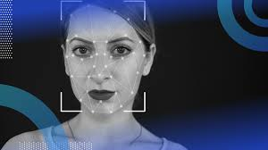
What is deep-fake?
Tien Nguyen
The term was coined in 2017 by a Reddit moderator [3].
Audio, images or videos are generated using AI tool, to create the likeliness of real or non-existent people. [1]
Deep-Fake is derived from combination of deep learning concept with something fake. [2]
https://builtin.com/machine-learning/deepfake
Notes:
Talk a bit about history of deep fake.
Lots of sources say deepfake was coined by a Reddit moderator in 2017. That one created a site -> exchange pornographic pictures of celebrities -> created by using open-source swapping-face technology.
With the explosion of AI recently, deepfake become more popular.
Then say definitions.

Slide 16

Spread of misinformation
Tien Nguyen
Deep-fake is used to spread wrong information during war/ elections or political events.
  A fake video of Volodymyr Zelensky, the president of Ukraine, announcing a surrender [4].
  Thousands of New Hamshire residents received a call from deep-fake President Biden saying "Your vote makes a difference in November, not this Tuesday [5].
  DeSanti's campaign against Donald Trump who was running for president in 2023 [7]
[7] “Video from Republican presidential candidate and Florida Gov. Ron DeSantis includes an image with three fake photos of former President Donald Trump and Dr. Anthony Fauci hugging. These three images appear to be AI-generated. “
Notes:
Used to distort information.
Deep-fake is used to spead wrong information during elections or political events.
You can easily find a manipulated video that falsely showed Volodymyr Zelensky, the president of Ukraine, announcing a surrender.
At the beginning of 2024, thousands of residents in NH received a robocall imitate President Joe Biden's voice -> with fake content "Your vote makes a difference in November, not this Tuesday" -> suppress NH voters.
In 2023, DeSantis's campaign released a negative ad that used fake AI-made pictures of Donald Trump who is also running for president at that time, hugging Anthony Fauci. And Fauci, he is the former top medical advisor in the White House, and he is disliked by many of Trump's supporters.

Slide 17
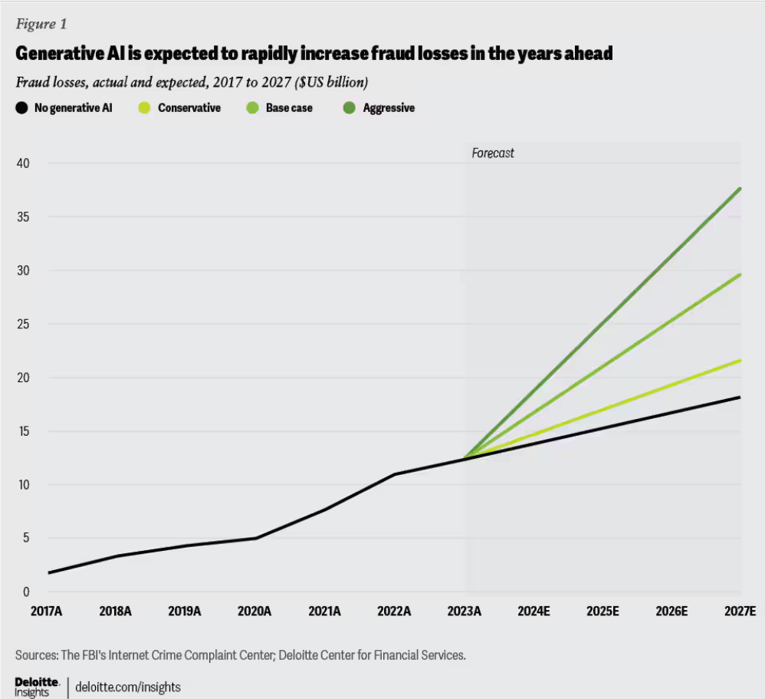
As a method of fraud
<Your Name>
Everyone can be the target of deep-fake. Especially, big cooporations.
  87% professionals would make a payment if instructed by their CEO or CFO, and 57% can do so without needing extra approval. [9]
  Deepfake fraud increased by 1,740% in North America and by 1,530% in the Asia-Pacific region in 2022. [8]
  Crypto sector is the main target sector of fraud attack (88%) [8]
Notes:
In 2019, The CEO of a UK energy company thought he was talking to his boss from the parent company in Germany and was told to transfer €220,000 ($243,000) to a Hungarian supplier. However, it was actually a scammer using AI to fake the boss’s voice.
In January 2024, an employee at a Hong Kong-based firm sent $25 million to fraudsters after being instructed to do so by her chief financial officer (CFO) on a video call that also included other colleagues. And it turns out this fake call was created by deep-fake.
Deloitte’s Center for Financial Services predicts that gen AI could enable fraud losses to reach US$40 billion in the United States by 2027, from US$12.3 billion in 2023, a compound annual growth rate of 32%.
-> raise question to transfer to next slide

Slide 18
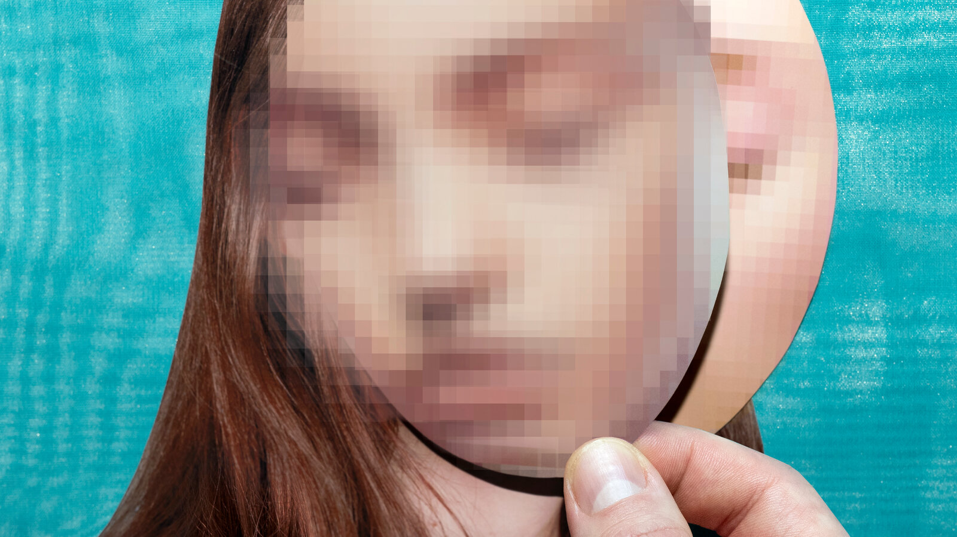
blackmail
Tien Nguyen
Extort money by harmful or embarrassing content
  According to FBI, in 2022, 7000 reports related to online sextortion of minors. [13]
  More than a dozen sextortion victims were reported to have died by suicide [13]
Almost impossible to track those criminals.
Notes:
Question for the class about how much are people aware of deepfake consequences?
law enforcement agencies have received over 7,000 reports related to the online sextortion of minors and more than a dozen committed to succide

Slide 19
REgulations
Tien Nguyen
We should have regulations on deep-fake products
  EU working on to finalize its landmark AI Act
  China has strict rules on DeepFake
  The US propose fedaral legislation related to DeepFake.
Notes:
Deepfakes are currently receiving a lot of policy attention. The European Union (EU) is working to finalize its landmark AI Act which would require disclosures regarding AI-generated content.
China has rules restricting deepfakes. -> more detail
In the US, the White House secured a commitment from leading AI companies to watermark AI content, and several members of Congress have also proposed federal legislation related to deepfakes [a]

Slide 20
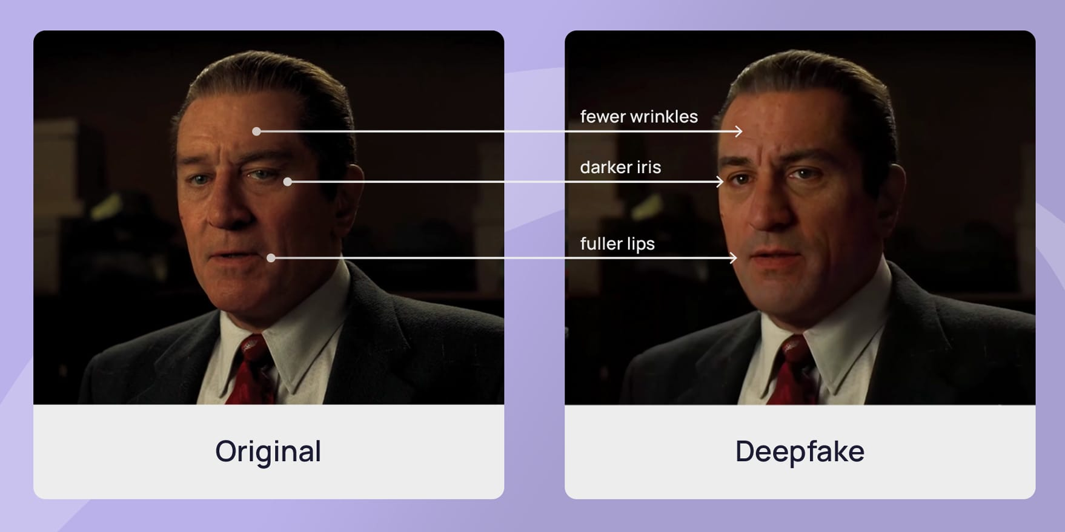
How to detect deep-fake?
Tien Nguyen
By raising the knowledge in recognition of deep-fake
  It's usually complicated
  3 seconds of audio to produce a voice clone matching up to 85% [10].
  Illogic elements in deep-fake videos.
  Learn how to use deep-fake. Open sources such as DeepFaceLab, Wav2Lip...
    Knowledge check
https://sosafe-awareness.com/blog/how-to-spot-a-deepfake/
Notes:
While regulations around deepfakes are still catching up, it's important to take proactive steps to protect ourselves from the potential harms.
By recognition: The first and most import
- Audio: it's hard because AI almost can copy perfectly one's voice. Emotion and sentiment are especially difficult to get right in AI-generated audio. Slurred speech or mispronounced words. I think the best way is to always raise suspicion for anything related to financial.
- Video: unusual movements such as too much blinking or lack of blinking, the facial expression doesn't match the speech...
- Pictures: spot out illogic elements from the pictures
- Encourage people experience and learn how to use deep fake. There are few open sources such as DeepFaceLab, Wav2Lip ...
By tech:
- Lots of web app is built up to detect deepfake

Slide 21
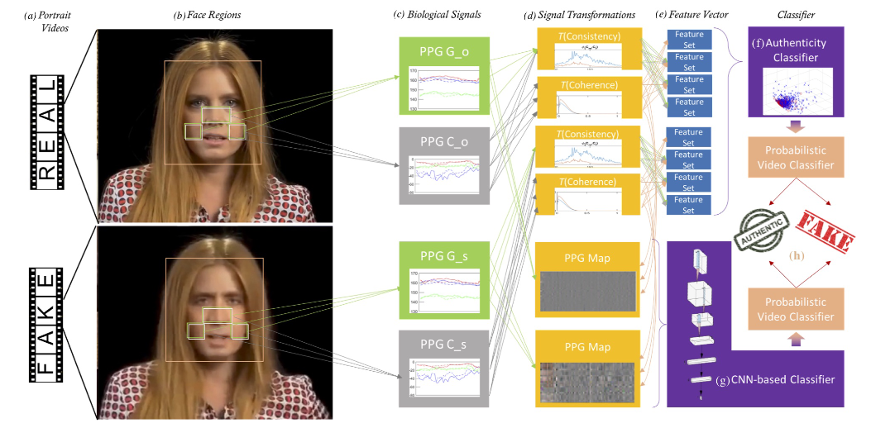
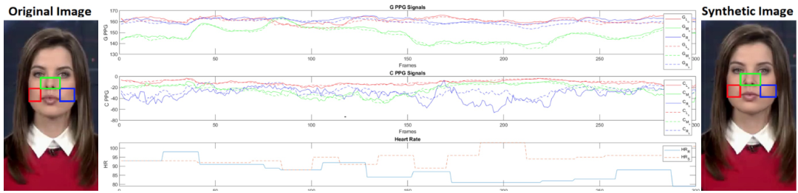
How to detect deep-fake?
Tien Nguyen
By technology tools:
  Sentinal, Attestive, FakeCatcher (by Intel)…
  Detect Deep-Fake tech by using blood flow – FakeCatcher [11]
    Photoflexmography (PPG)
    Real-time
    96% accuracy rate [12]
Both images coming from http://arxiv.org/pdf/1901.02212
Notes:
By tech:
- Lots of web app is built up to detect deepfake. List all web app out -> using data set to train the AI to detect it.
- Other apps using pure machine learning technique to detect Deep-Fake -> FakeCatcher using biological features of human like blood flow to recognize whether that video is a fake -> when our heart pump blood, our vein changing colors – photoflexmography (PPG) -> collect all PPG signals all over the face and convert that into PPG map and then using machine learning on it -> it can detect fake videos with 96% correct rate.

Slide 22
References
Tien Nguyen
[1] Deepfake - Wikipedia
[2] What Is Deepfake: AI Endangering Your Cybersecurity? | Fortinet
[3] https://mitsloan.mit.edu/ideas-made-to-matter/deepfakes-explained
[4] https://www.npr.org/2022/03/16/1087062648/deepfake-video-zelenskyy-experts-war-manipulation-ukraine-russia
[5] https://www.npr.org/2024/02/08/1229641751/ai-deepfakes-election-risks-lawmakers-tech-companies-artificial-intelligence
[6] https://casmi.northwestern.edu/news/articles/2024/tracking-political-deepfakes-new-database-aims-to-inform-inspire-policy-solutions.html
[7]https://www.npr.org/2023/06/08/1181097435/desantis-campaign-shares-apparent-ai-generated-fake-images-of-trump-and-fauci
[8] https://sumsub.com/blog/top-kyc-trends/
[9] https://www.medius.com/news/cid-AE4E2284A2CBFDAE/half-of-us-and-uk-finance-professionals-hit-by-deepfake-fraud-scams/
[10] https://www.mcafee.com/blogs/privacy-identity-protection/artificial-imposters-cybercriminals-turn-to-ai-voice-cloning-for-a-new-breed-of-scam/
[11] https://www.youtube.com/watch?v=aPTnq_1hWDE
[12] https://www.intel.com/content/www/us/en/newsroom/news/intel-introduces-real-time-deepfake-detector.html
[13] https://www.justice.gov/usao-sdin/pr/fbi-and-partners-issue-national-public-safety-alert-sextortion-schemes
[14] https://www.reuters.com/legal/legalindustry/manipulating-reality-intersection-deepfakes-law-2024-02-01/#:~:text=Deepfakes%20can%20depict%20individuals%20in%20compromising%20or%20harmful,embarrassing%2C%20or%20violates%20their%20personal%20or%20professional%20ethics.
[15] https://www.essex.ac.uk/research-projects/human-rights-big-data-and-technology/misinformation-and-disinformation-and-deep-fakes
[16] https://www2.deloitte.com/us/en/insights/industry/financial-services/financial-services-industry-predictions/2024/deepfake-banking-fraud-risk-on-the-rise.html
[17] https://mitsloan.mit.edu/ideas-made-to-matter/deepfakes-explained
[a] https://casmi.northwestern.edu/news/articles/2024/tracking-political-deepfakes-new-database-aims-to-inform-inspire-policy-solutions.html
...

Slide 23



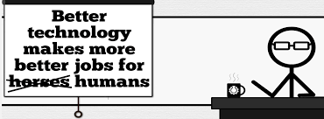


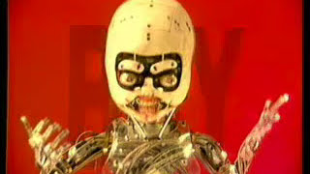
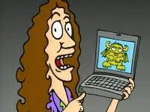
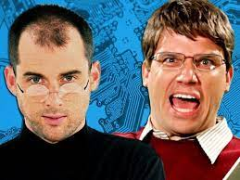

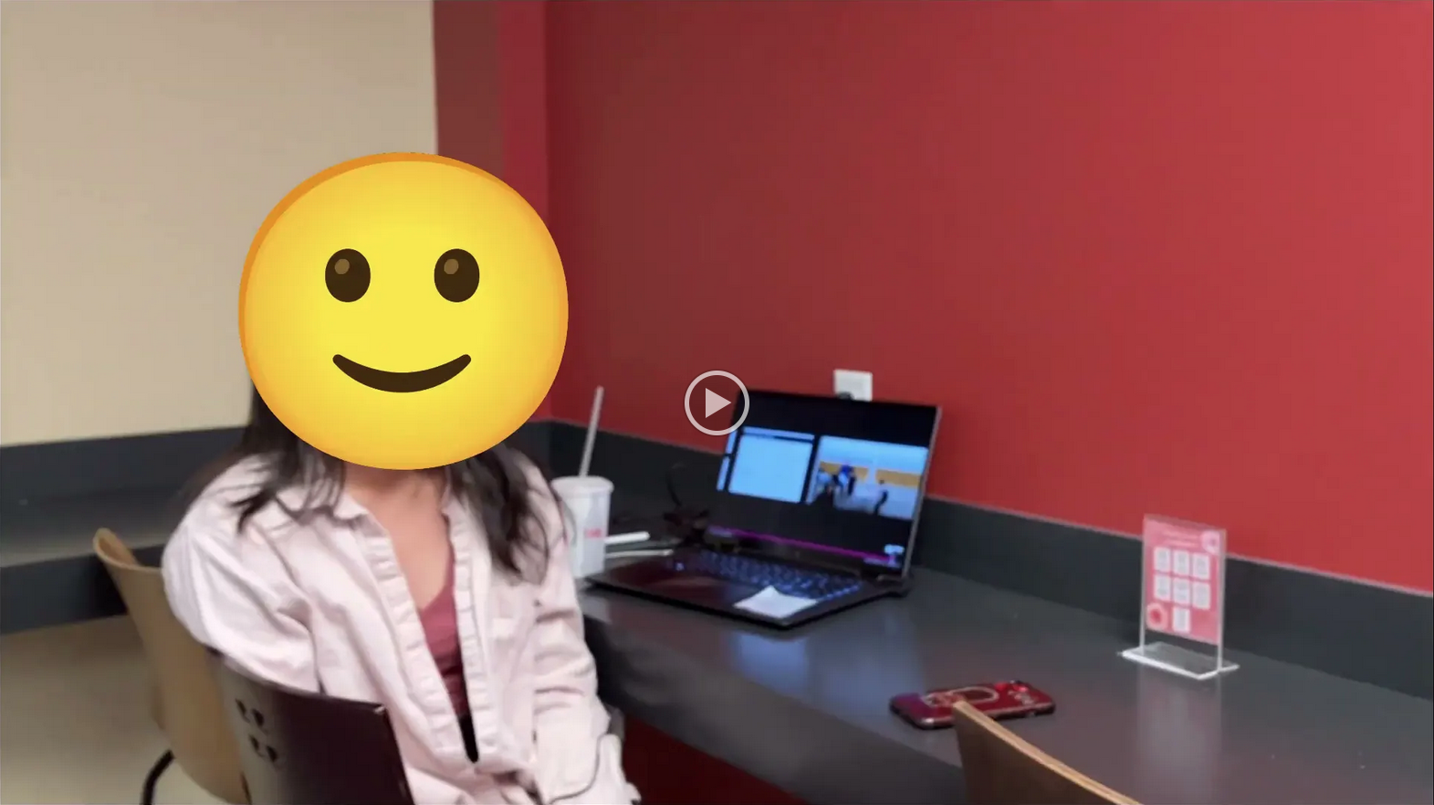
Student Choice – Interesting Videos (1/2)
  Don’t Download This Song (2006)
  - Weird Al (3:53)
  It’s All About The Pentiums (1999)
  - Weird Al (3:34)
  White and Nerdy (2006)
  - Weird Al (2:50)
  Virus Alert (2006)
  - Weird Al (3:43)
  Word Crimes (2014)
  - Weird Al (3:45)
  Copyright: Forever Less One Day (2011)
  - CGP Grey (6:27)
  Humans Need Not Apply (2014)
  - CGP Grey (15:00)
  This Video Will Make You Angry (2015)
  - CGP Grey (7:25)
  Technologic (2005). ← Which topic?
  - Daft Punk (2:55)
  Epic Rap Battles of History: Steve Jobs vs. Bill Gates (2013) (2:47)
  Passwords (2024) ← Compare
  - Elizabeth Levin, Silas Joy (WPI CS3043) (5:37)
© 2023 Keith A. Pray
Notes:
Technologic: Critical Thinking, Ethics, Networked Communications, Information Privacy, Reliability, Professional Ethics?
David Autor
Will automation take away all our jobs? (18:27) (2016)
https://www.ted.com/talks/david_autor_will_automation_take_away_all_our_jobs/transcript?language=en
TEDxXambridge, 2016-12-19
All Last Accessed 2018-10-04
CGP Grey
Copyright: Forever Less One Day (6:27)
https://www.youtube.com/watch?v=tk862BbjWx4
CGP Grey
Humans Need Not Apply (15:00) – 2014-08-13
http://www.youtube.com/watch?v=7Pq-S557XQU
Last access 2016-04-22
CPG Grey
This Video Will Make You Angry [Thought Germs] (7:25) – 2015-03-10
https://www.youtube.com/watch?v=rE3j_RHkqJc
Weird Al – It’s All About The Pentiums (3:34)
https://www.youtube.com/watch?v=qpMvS1Q1sos
TODO: Tie into Ray Kurzweil Singularity
Epic Rap Battles of History: Steve Jobs vs. Bill Gates (If class ok with obscene lyrics) (2:47)
https://www.youtube.com/watch?v=njos57IJf-0
Also Work links on web site http://socialimps.keithpray.net/documents/
-----
Passphrases (2:08 need to give context for video)
https://firstlook.org/theintercept/2015/03/26/passphrases-can-memorize-attackers-cant-guess/
If not shown during first class
What "Orwellian" really means - Noah Tavlin (5:31)
http://ed.ted.com/lessons/what-orwellian-really-means-noah-tavlin
Weird Al – White and Nerdy (2:50) and look at lyrics
https://www.youtube.com/watch?v=N9qYF9DZPdw
Weird Al Yankovic “Don’t Download This Song” (3:53)
2006-08-21 released exclusively as digital download
https://www.youtube.com/watch?v=zGM8PT1eAvY
Styx - Mr. Roboto (1983) (5:34)
https://www.youtube.com/watch?v=uc6f_2nPSX8
Epic Rap Battles of History: Steve Jobs vs. Bill Gates (If class ok with crude lyrics) (2:47)
https://www.youtube.com/watch?v=njos57IJf-0
Daft Punk - Technologic (2005) (2:55)
https://www.youtube.com/watch?v=D8K90hX4PrE

Slide 24



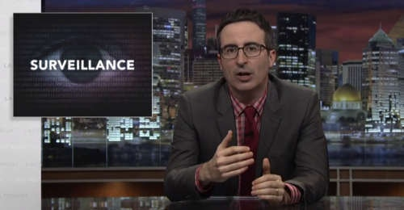


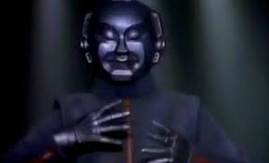

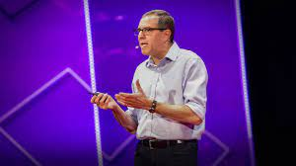


Student Choice – Interesting Videos (2/2)
  MSNBC on Denver's Automated Baggage System (2010) (2:27)
  Last Week tonight with John Oliver (2015) - Snowden (33:14)
  3D Printed Homes (2018)
  - News Story (1:28)
  The Game Of Trust (2017)
  - Nicky Case
  Adobe Firefly (2023)
  - Adobe (1:16)
  What "Orwellian" really means (2015)
  - Noah Tavlin (5:31)
  Why Electronic Voting is Still a Bad Idea (2019) - Tom Scott (12:00)
  Welcome To Life (2012)
  - Tom Scott (2:44)
  Mr. Roboto (1983)
  - Styx (5:34)
  Will automation take away all our jobs? (2016) – David Autor (18:27)
  What is your password? (2015)
  - Jimmy Kimmel Live (2:49)
© 2023 Keith A. Pray
Notes:
All Last Accessed 2018-10-04 unless publish date later
Last Week tonight with John Oliver – Patriot Act, Edward Snowden (33:14)
http://www.upworthy.com/john-oliver-flew-10-hours-to-russia-to-interview-edward-snowden-and-get-him-on-record?c=ufb1
TODO: Tie into Ray Kurzweil Singularity
Epic Rap Battles of History: Steve Jobs vs. Bill Gates (If class ok with obscene lyrics) (2:47)
https://www.youtube.com/watch?v=njos57IJf-0
Also Work links on web site http://socialimps.keithpray.net/documents/
-----
Passphrases (2:08 need to give context for video)
https://firstlook.org/theintercept/2015/03/26/passphrases-can-memorize-attackers-cant-guess/
If not shown during first class
What "Orwellian" really means - Noah Tavlin (5:31)
http://ed.ted.com/lessons/what-orwellian-really-means-noah-tavlin
MSNBC on Denver's Automated Baggage System 2010-08-23 (2:27)
https://www.youtube.com/watch?v=xx8f4x6C_KY
Accessed 2019-04-09
These 3D printed homes can be constructed for $4,000 (3:00 – 2018-04-02)
http://www.businessinsider.com/3d-printed-homes-constructed-icon-new-story-tech-charity-4000-dollars-2018-3
https://www.youtube.com/watch?v=SvM7jFZGAec (1:28)
Last access 2018-04-22
Why Electronic Voting is a BAD Idea – Computerphile (Tom Scott) (8:20)
https://www.youtube.com/watch?v=w3_0x6oaDmI
Tom Scott
http://tomscott.com
Welcome To Life (2:44)
https://www.youtube.com/watch?v=IFe9wiDfb0E&feature=youtu.be
Jimmy Kimmel Live – What is your password? (2:49)
https://www.youtube.com/watch?v=opRMrEfAIiI

Slide 25
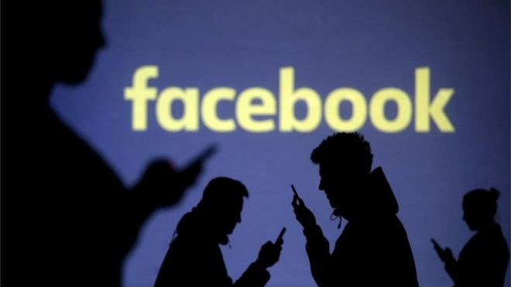
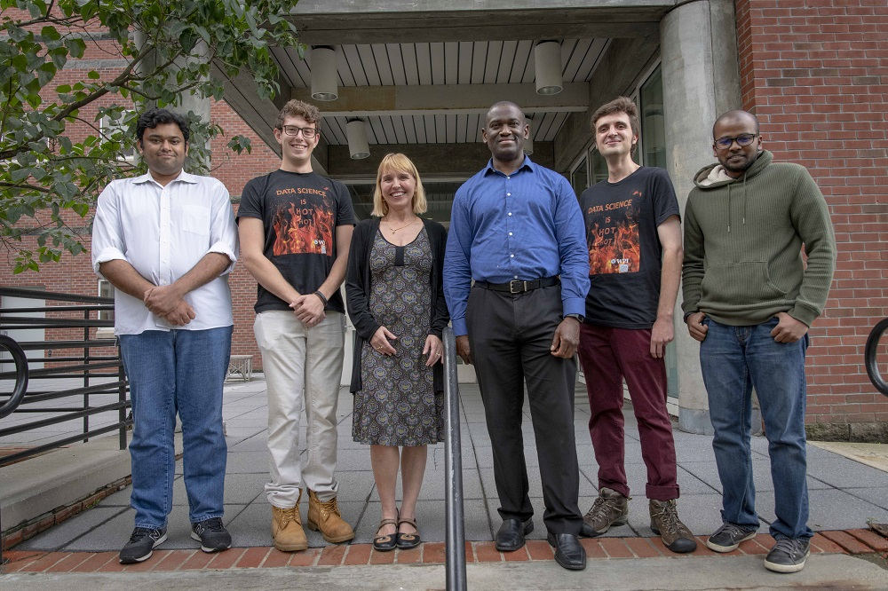

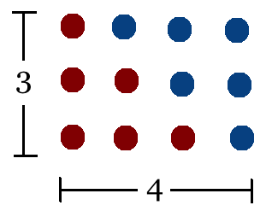
Student Choice – Interesting Articles 1/2
Communications of The ACM – Latest edition (through library)
Facebook security breach: Up to 50m accounts attacked - Dave Lee, North America technology reporter, 2018-09-29
WPI Secures $2.8 Million to Develop a Smartphone App to Help Assess the Health of Soldiers, 2018-09-24
Quantified Toilets, 2014, Quantified Toilets LLC (empty)
What a Toilet Hoax Can Tell Us About the Future of Surveillance – Jennifer Golbeck, The Atlantic, 2014-04-29
What Did Ada Lovelace's Program Actually Do? - Sinclair Target, 2018-08-18 (First Programming Bug 1843?)
Notes:
All Last Accessed 2021-04-03

Slide 26
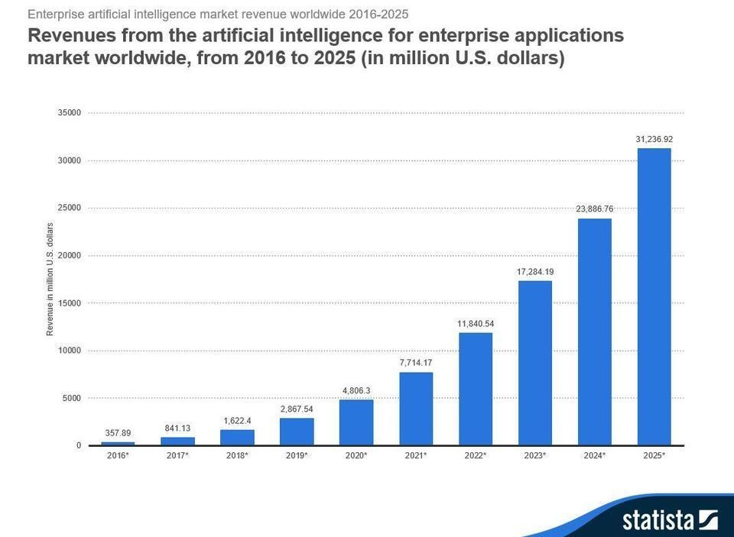
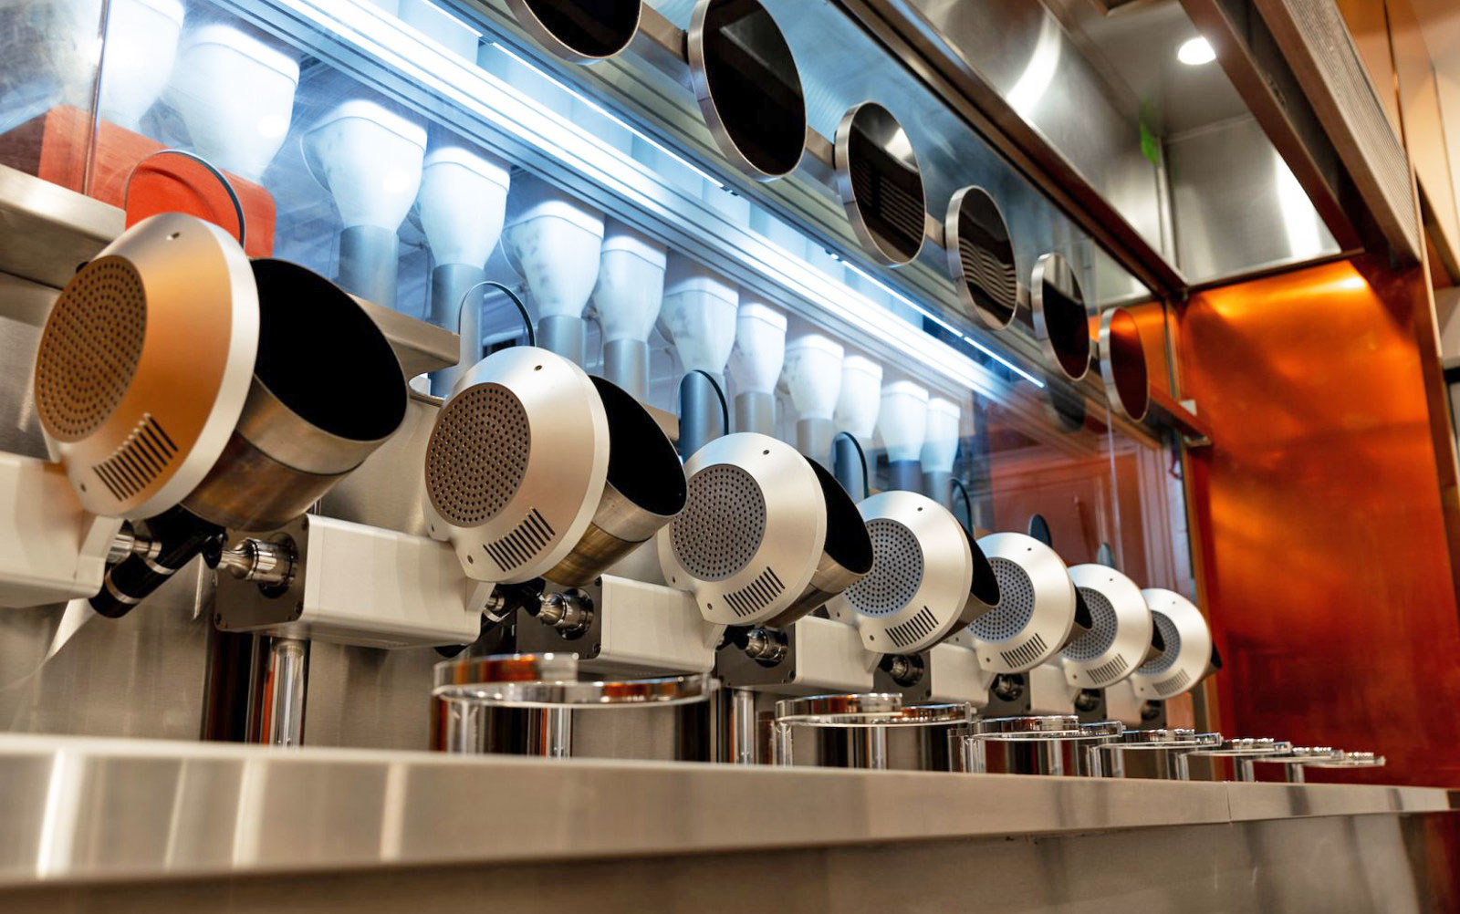
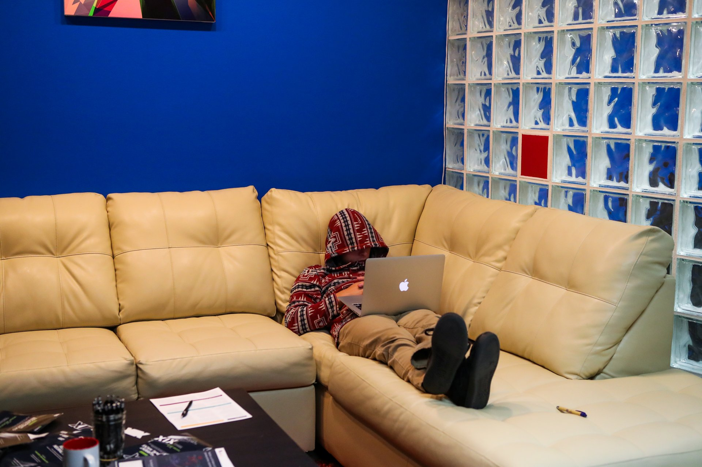
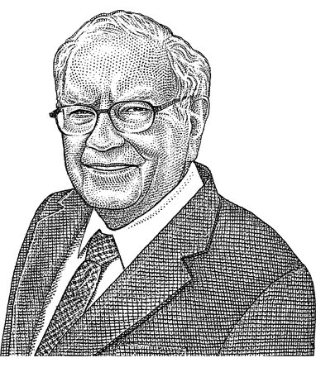
Student Choice – Interesting Articles 2/2
We know ethics should inform AI. But which ethics? - Mauro Guillen, World Economic Forum, 2018-07-26
MIT-born Spyce raises $21M to open new robotic restaurants - Lucia Maffei, BostInno, 2018-09-07
The Coders Programming Themselves Out of a Job - Brian Merchant, The Atlantic, 2018-10-02
Berkshire Hathaway’s Stock Price Is Too Much for Computers - Alexander Osipovich, The Wall Street Journal, 2021-05-05 (approaching $429,496.7295 32 bit limit) (access limited)
Notes:
All Last Accessed 2021-04-03
Spyce image: https://www.engadget.com/2018/05/04/boston-robotic-kitchen-spyce/ , 2018-05-04
Coders Programming Themselves Out of a Job image: Gabrielle Lurie, Reuters (date unknown)

Slide 27
Class 12-14
The End
Keith A. Pray
SocialImps.com

