Slide 1

Class 11
Livelihood
Keith A. Pray
socialimps.keithpray.net
Notes:
Styx - Mr. Roboto (1983) (5:34)
https://www.youtube.com/watch?v=uc6f_2nPSX8
Ask about Automation paper:
What did people choose to automate
Share 1 main reason

Slide 2
Papers
Excellent improvement!
Better quantification, some improvement left to be had
Use high quality sources
https://socialimps.com/assignments/references/
https://socialimps.com/assignments/paper-guidelines/
Notes:
Save for next time:
Clearly state conclusion
First statement preferred
Absolute statements are difficult to prove
Avoid: all, always, any, every, everyone, never, none… unless you can show it
Be sure to put quotes around entire quote
Hyperbole is the best thing ever!
but not in these papers
Print 2 sided and save a tree
Use template, saves time (and -1 point)
Include Counter Point and Response
Include Author, Title, Publish Date, Publisher for references
Read paper aloud to proof
Changing a couple words does not constitute paraphrasing.
Include tests/results in Appendix
Ask for help if you have trouble with backing data
Define test strategy clearly

Slide 3
Grades
To Date
44 Max Possible
- Discussion 1-10
- Papers 1-3

Slide 4
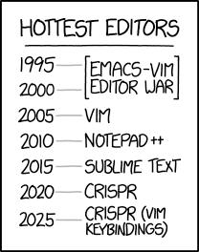
Overview
Review
Assignment
Students Present
https://www.xkcd.com/1823/
Notes:
Used to be full circle. Might have to retire this if no one know what emacs and vi are.
CRISPR: Clustered Regularly Interspaced Short Palindromic Repeats
Allows permanent modification of genes within organisms.
Published 2017-04-12 according to https://www.explainxkcd.com/wiki/index.php/List_of_all_comics_(1501-2000)
Kickstarter Charter
https://www.kickstarter.com/charter?ref=about_subnav

Slide 5
Overview
Review
Assignment
Students Present
C lustered
R egularly
I nterspaced
S hort
P alindromic
R epeats
Permanent gene modification
https://www.xkcd.com/1823/
Notes:
Full circle (not quite since the Emacs/VIM comic no longer used… may have to retire this as students seem to not be aware of different text editors).
CRISPR: Clustered Regularly Interspaced Short Palindromic Repeats
Allows permanent modification of genes within organisms.
Published 2017-04-12 according to https://www.explainxkcd.com/wiki/index.php/List_of_all_comics_(1501-2000)
Kickstarter Charter
https://www.kickstarter.com/charter?ref=about_subnav

Slide 6
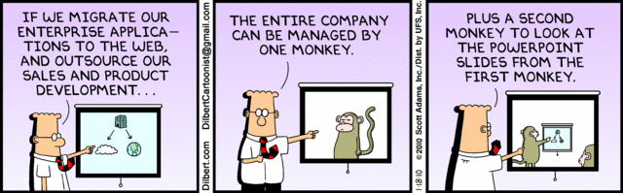
Let’s Look At One way to handle a Decrease In Jobs
Notes:
Poll class:
Expected salary range upon graduation? Min, Max? Put in spreadsheet.
Assume 40 hour work week.
How many people would work:
32 hours for 0.8 * Max?
24 hours for 0.6 * Max?
…continue until Min is reached.

Slide 7
My Reading Notes
p. 457 “Mr.” → “Ms.”
p. 458 Asimov “Three Laws of Robotics” not guarantee as his stories show… absolutes “never” difficult to prove.
p. 459 Tesla and other newer car manufacturers similar to 15 person hours per car? 2003, 2008 sources update?
p. 460 “all time… work time” 1998 source, newer corroborate?
p. 461 securities industry employment rise source 2005.
p. 462 “Working less, making more” 2001 source, now? “stone-age” source 1991, now?
p. 463 Cost of AC, screens, etc. much lower. 2022 home size source 2001? Cancelled vacation not computing, sounds likely, just in computing fields? Kantian, Stuart treated himself as a means to an end, see Virtue p. 464
p. 465 Multiple citing Wikipedia ☹
p. 468 ChatGPT Plus (et al) → more Digital Divide?
p. 473 Hawking, appeal to authority fallacy? AI needs us like we need plants, we’ve done great keeping those safe.
p. 475 Generative AI transparency difficult with text. Brake efficiently, rear end collision most common accident p. 379, 2017, diff. now?
p. 476 Trolly, most, many, quantify.
p. 479 Amazon, Slack, source title Intel.
p. 481 Uber/Lygt lawsuit sources 2015, outcome? Monitoring data needs update, 2008 newest. Security and IP seem more likely primary purpose, 2002 source. Many people only regular Internet access was at work. More schools using cameras source 2003, need newer for claim.
p. 482 Multinational Team Patents need sources. India salary info from 2003. Jobs moving out of US 2008 source.
p. 483 3. Arg statement, 1999, still holding?
p. 484 WTO seems implementation complaint, not globalization. Corn, wheat example from 2012. Are the subsidies more the problem than globalization?
p. 485 Gates quote, what about new grads without experience?
p. 486 90% computers made in China 2014 source. 2015 example of Chinese university accomplishment.
p. 489 No other reasons for North Korea? No newspaper, radio, TV claim from 2001. Secondary school 2003. DVD player may be more relevant example than VCR.
p. 491 Online courses synchronous or asynchronous?
p. 492 DSL still relevant?
p. 493 More Wikipedia citing ☹
p. 494 2022 CEO salary source 2003? Still true more people know Windows than Mac? Is US still dominant economic power?
p. Rec Center gives students advantage, but who really pays?
p. 496 Blue laws limiting store hours computing?
p. 498 “bus” → “bust”
p. 501 21. I think Blaise doesn’t watch movies.
p. 502 29. Ignores cost of living differences.
Questions I liked: 15, 16, 17, 22, 23, 24, 25, 26, 27, 32, 33

Slide 8
Group Quiz
List 2 ways IT can lead to organizational change.
List 4 ways a Video Game Producer may protect its IP and what specific IP each protects.
List a computing technology that can be used to protect an individual’s privacy.
List a computing technology that can be used to intrude upon an individual’s privacy.
Notes:
Could split into groups of 4-5 for this.
Fill time with Work Discussion on Course Web Site

Slide 9
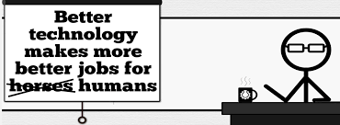
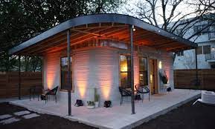
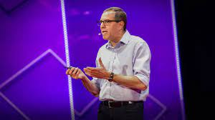
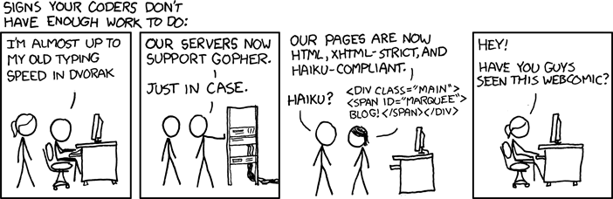
Overview
Review
Assignment
Students Present
http://xkcd.com/554/
Notes:
CGP Grey
Humans Need Not Apply (15:00) – 2014-08-13
http://www.youtube.com/watch?v=7Pq-S557XQU
Last access 2016-04-22
These 3D printed homes can be constructed for $4,000 (3:00 – 2018-04-02)
http://www.businessinsider.com/3d-printed-homes-constructed-icon-new-story-tech-charity-4000-dollars-2018-3
https://www.youtube.com/watch?v=SvM7jFZGAec (1:28)
Last access 2018-04-22
David Autor
Will automation take away all our jobs? (18:27) (2016)
https://www.ted.com/talks/david_autor_will_automation_take_away_all_our_jobs/transcript?language=en
TEDxXambridge, 2016-12-19
Review Group Assignment Details.
Or first watch video: depends on student presentations, no thunder stealing.
Look at:
BBC Intelligent Machines
http://www.bbc.com/news/technology-33978561
BBC Likelihood of robot taking your job
http://www.bbc.com/news/technology-34066941

Slide 10
Assignment Reminders
Finish all reading
Finish Automation Paper
Optional Game Paper due last day of class
Group Web Sites and Presentations
If your group is not presenting next class prepare 3 questions for each group that is presenting by visiting their web sites.
  See Group Project Details

Slide 11
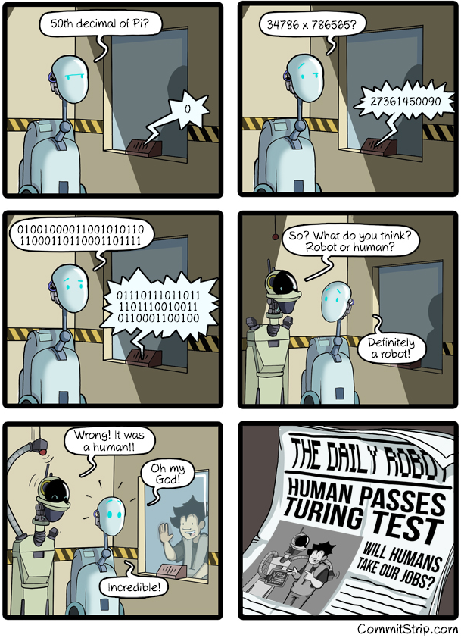
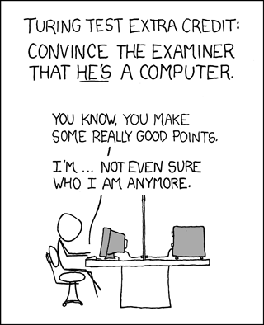
Overview
Review
Assignment
Students Present
https://xkcd.com/329/
Notes:
http://www.commitstrip.com/en/2016/04/14/meanwhile-in-a-parallel-universe-3/ (2016-04-14)
https://xkcd.com/329/ (2007-10-15)

Slide 12
Gig economy: Dark side
Joseph Thesmar
Notes:
Greetings + opening sentence

Slide 13
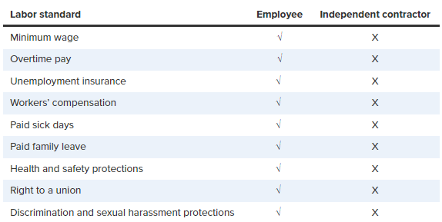
The gig economy exploits workers
Joseph Thesmar
About “14% of gig workers earned less than the federal minimum wage” [1]
Lack of job security and benefits [3]
Platforms profit at workers’ expense
Fig 1: Comparison of employee vs. independent contractor job protections [1]
Notes:
Survey of gig workers in the spring of 2020: [3]
Workers treated as contractors, not employees [3]
62% of gig workers lost earnings due to technical difficulties (compared to 19% with FTE) [1]
30% of workers used the Supplemental Nutrition Assistance Program, twice the rate of W-2 service sector workers [1]
Examples of gigs: baby-sitter, musicians, truck drivers, artist, food delivery person, freelancer programmers
Negative aspects of the gig economy (poor benefits):
Full-time employees get company-sponsored benefits [2]
Part-time employees don’t get benefits but rather just job flexibility [2]
employer-sponsored benefits gained from long term work [2]
Gig work values flexibility, difficult to apply those same benefits to someone who comes and leaves [2]

Slide 14
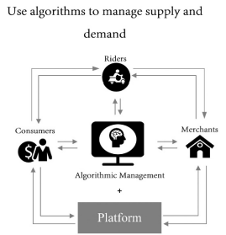
Gig Platforms leverage technology to control workers
Joseph Thesmar
Algorithm control over wages and tasks [4]
Workers often receive incomplete information about tasks [4]
Workers controlled through behavioral nudges like notifications [4]
Fig. 2. The evolution of Meituan Takeaway [4]
Notes:
Uber and Lyft use algorithm to dictate when and where workers get gigs
pay rate and performance evaluations are calculated behind the scenes
Control of workers (Uber example): [4]
Drivers monitored and reviewed by algorithms once they log into app
Tracks their GPS location and speed
Algorithm generated route planning
Pay-rate and customer satisfaction rate generation by algorithms
Meituan Takeaway: [4]
Fast food delivery service, popular in China
Algorithmic pressure on riders (tight deadlines, prioritize efficiency)
Low pay and instability (delivery demand)
No guaranteed minimum wage, health insurance or benefits
Riders are powerless

Slide 15
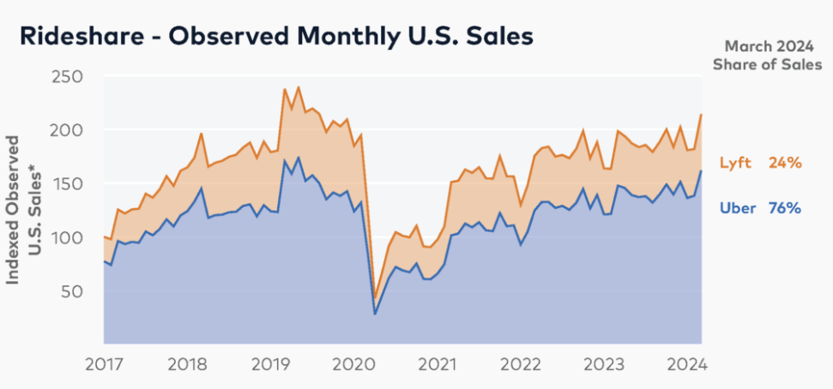
Workers face financial instability
Joseph Thesmar
Fluctuating earnings and inconsistent work
High dependence on summer and post pandemic demand surges [6]
No safety nets for slow periods [6]
Fig 3. Uber monthly sales over time [6]
Notes:
Graph:
Increased sales due to shelter in place orders [6]
Uber 76% of US rideshare spending (Lyft 24%) [6]
Little curve during 2021 is inflation’s result on consumer spending [6]
Seasonal trends [6]
Uber new offering of Uber one membership and Lyft with food delivery [6]
Consensus:
unstable incomes
fluctuating demand
Competition
platform policies (e.g., surge pricing)
without a steady paycheck, planning for long-term financial stability is hard

Slide 16
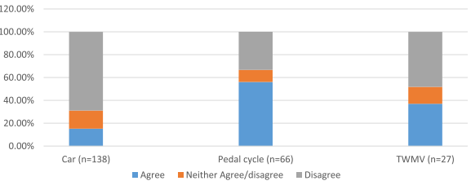
Health and Safety Risks are overlooked
Joseph Thesmar
Higher risks in physically demanding jobs (delivering, driving) [5]
75% admitted to take action to avoid a collision [5]
Only 26% felt their company cared about their safety [5]
Fig 4. % Agreement with 'Driven Through a Red Light Under Pressure' by Vehicle Type [5]
Notes:
Gig economy promotes flexibility
TWMV (motorcycles)
working unsocial and irregular hours (Schor and Atwood-Charles 2017), overwork, sleep deprivation, and exhaustion
Factors that can impact and increase health risks:
Night riding, weather conditions, fatigue from long working hours, aggressive riding, time pressure, physical strain from two-wheel vehicles [5]
42% experienced vehicle damage from a collision [5]
10% reported injuries from collisions [5]
40% said their app-based work caused driving distractions[5]
16% struggled to stay awake due to fatigue while driving [5]
47% felt time pressure led them to exceed speed limits [5]
30% drove through red lights [5]
67% said the company didn’t suggest taking rest breaks [5]

Slide 17
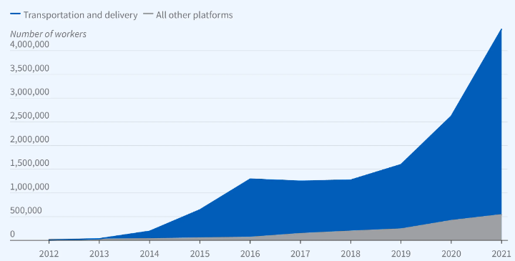
Unreported income and Growth of platform-based gig work
Joseph Thesmar
Gig workers grew by 3.1 million [7]
Over 90% of gig jobs in 2019 involved transportation platforms [7]
1099-K gap led to $323.4 million in unreported income [7]
Fig 5. Surge in Gig Workers with Platform Payments (2012-2021) [7]
Notes:
Between 2011 and 2017, the 1099-K tax form required gig companies to report payments only if [7]
More than 200 transactions and $20000 annually
In 2018, 770 000 gig workers did not receive a 1099 because they didn’t meet the standards [7]
Since 2014, 90% of gig workers have been in transportation [7]
Most people avoid taxes by earning less than $20000 annually
Pandemic marks a surge in new gig workers (2.1 million), additional 3.1 in 2021 [7]
Pandemic Unemployment Assistance on Gig workers: [7]
Gig workers did not qualify for unemployment insurance, except if combined with traditional employment
During covid this changed
Gig workers received 6 times increased pay as a result from 2020 to 2021
Workers exited to benefit from generous UI benefits

Slide 18
References
Joseph Thesmar
[1] Economic Policy Institute. "National Survey of Gig Workers Paints a Picture of Poor Working Conditions, Low Pay." EPI, 1 June 2021
[2] Brookings Institution. "How Should We Provide Benefits to Gig Workers?" Brookings, 23 June 2022
[3] Prassl, Jeremias. "Humans as a Service: The Promise and Perils of Work in the Gig Economy." Oxford University Press, 2018.
[4] Wood, Alex J., et al. "Good Gig, Bad Gig: Autonomy and Algorithmic Control in the Global Gig Economy." Work, Employment and Society, vol. 33, no. 1, 2019, pp. 56-75.
[5] Christie, Nicola, and Heather Ward. "The Health and Safety Risks for People Who Drive for Work in the Gig Economy." Journal of Transport & Health, vol. 12, 2019, pp. 115-127. Elsevier, https://doi.org/10.1016/j.jth.2019.02.007.
[6] Kaczmarski, Michael. Title: The U.S. Rideshare Industry: Uber vs. Lyft (Bloomberg Second Measure, 2023), Page: 1.
[7] Laurent Belsie, Title: The Evolving Role of Gig Work during the COVID-19 Pandemic (National Bureau of Economic Research, 2023), Page: 1.

Slide 19
i-CyBORG
Kimberly Cummings
Notes:
Presentation topic: iCyborg
For purpose of this presentation iCyborg will be referring to invasive interfaces, which is technology that is integrated into the mind or body
Should technology be integrated with our brains and bodies?

Slide 20
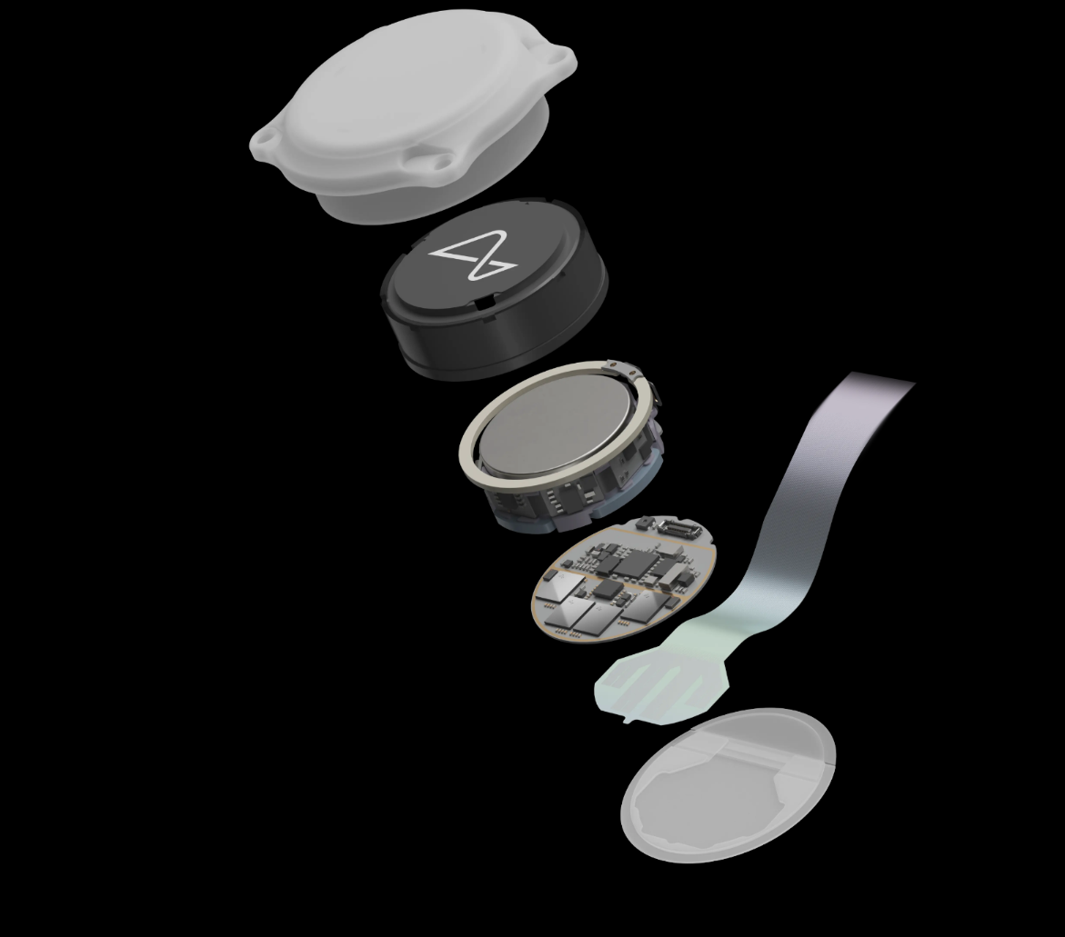
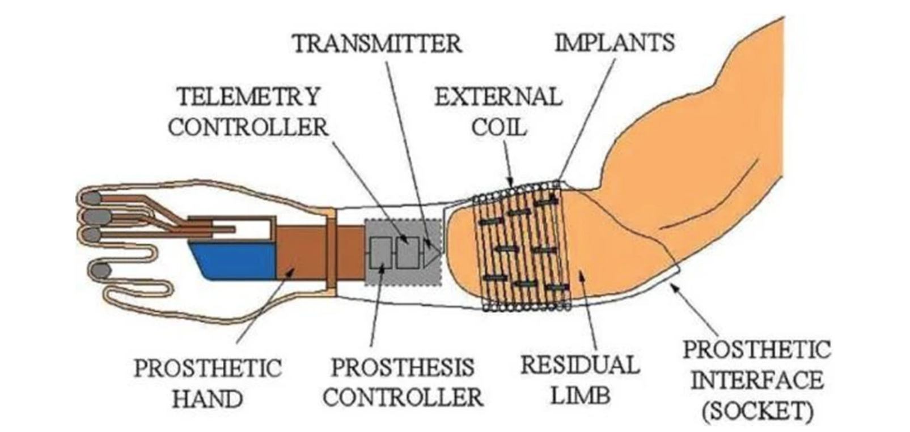
Kimberly Cummings
Technology should only be integrated for Health Reasons
Implantable Myoelectric Sensor [2]
Neuralink [7]
Notes:
Technology should only be integrated for health reasons
Invasive interfaces are a type of technology that works directly with neurons and the brain.
On this slide there are two examples of this type of technology.
On the left is an example of this technology to create prosthetics and the right is a neuralink
Invsaive interfaces should only be used to help people for health reasons

Slide 21
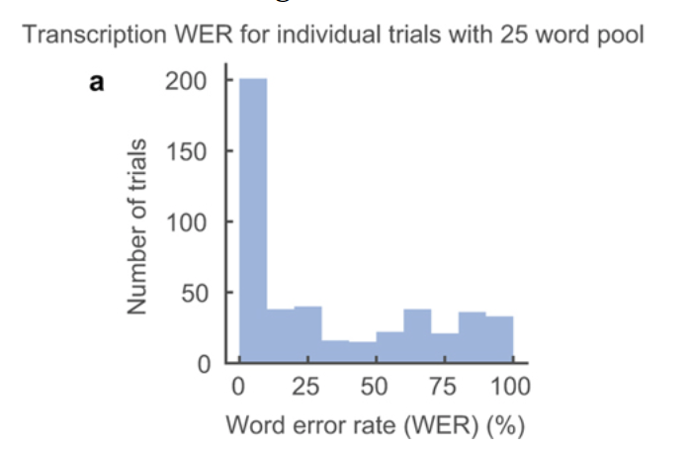
Invasive Interfaces can help disabled people
Kimberly Cummings
Majority of trials had a WER less than 25% [1]
Has been successfully implemented and used for prosthetics
failure rate was less than 2% [2]
Allows people to communicate who lack the ability to speak
There is only a 35% average Word Error Rate (WER) percent [1]
Notes:
Reason invasive interfaces should be used to help:
- Electrodes can be successfully integrated and used for prosthetics
- Evidence: a study following patients for 16 years only had a 2% failure rate
- People who cannot speak can use these systems to communicate
-Evidence: average Word Error Rate Percent is only 35%, which means the majority of the time it is accurate
-Graph: The data is skewed to the right, which means that most people had 0-25 percent error rate

Slide 22
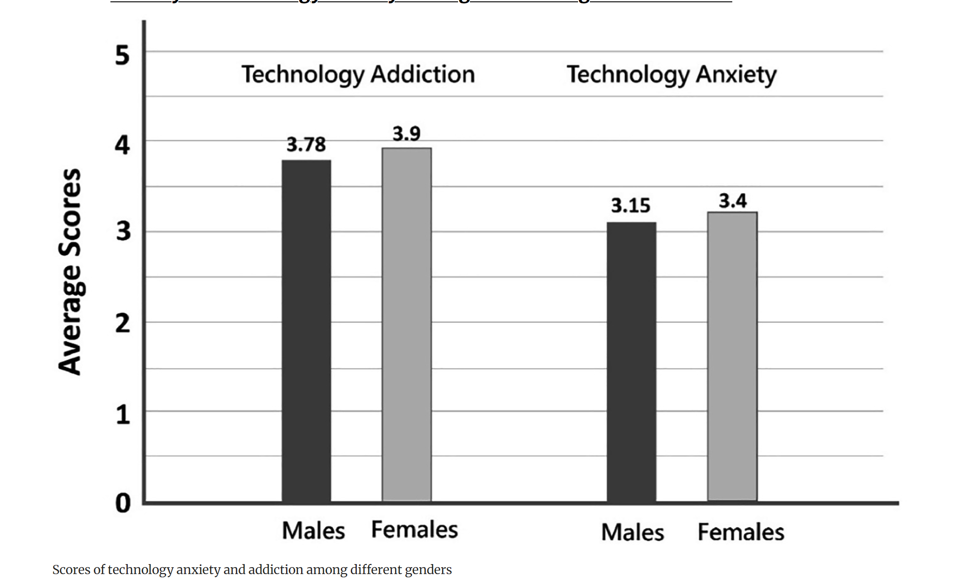
Easy-access technology leads to anxiety
Kimberly Cummings
Too much internet leads to anxiety
60% of US students are addicted to phones [4]
54.3% of people have high levels of stress [5]
Positive correlation of r = 0.2 and p < 0.002 between smartphone addiction and anxiety [5]
Accessibility of Twitter has a positive correlation with internet addiction [11].
People are already concerned they are too contactable
43% of people have concerns about always being contactable [4]
Average American spends 11 hours a day looking at screens [4]
Invasive technology will increase accessibility of technology
High amounts of technology addiction and technology anxiety [6]
Notes:
Reason invasive interfaces should not be used for people who do not need it
- Internet addiction leads to anxiety
-Evidence: 60% students are addicted to phones and 54.3% of people have high levels stress already, this can be seen on the graph
-Evidence: positive correlation of r = 0.2 between smartphone addiction and anxiety.
-Evidence: accessibility of twitter helped contribure to internet addiction for both women and men with p-scores of 0.045 and 0.02 respectively
-Point to make: having technology inside your brain will make it even more accessible and addictive, leading to more anxiety
-People are concerned about always being contactable and amount of screen time already
-Evidence: 43% of people have concerns about being contactable at any given moment
-Evidence: average American spend 11 hours a day looking at screens
-Point to make: if technology is implanted into your nervous system, it will make people even more contactable and spend more time on screens

Slide 23
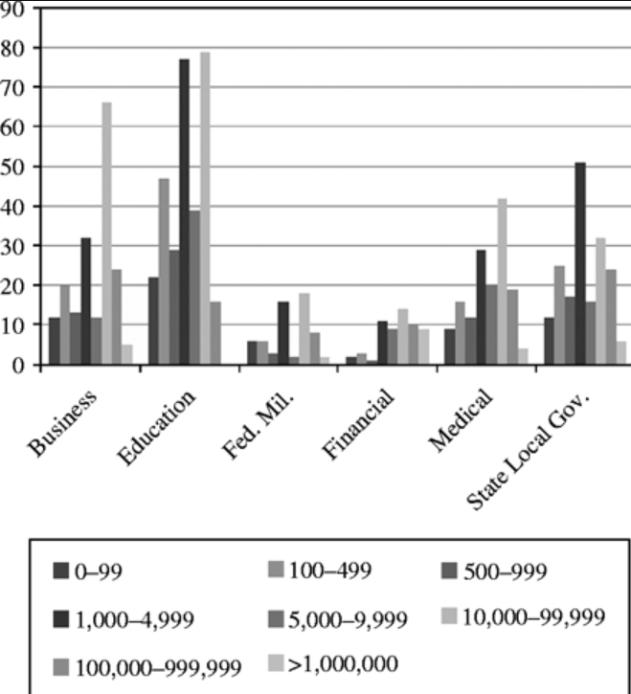
Businesses will have access to private data
Kimberly Cummings
Invasive interfaces will allow more private and personal data to be spread
Neuralink has 1024 electrodes in the cerebral cortex [7]
82% of people are either somewhat concerned or very concerned about privacy concerns [8]
Businesses should not be trusted with your brain data
Businesses account for 36.12% of data leaks [3]
945 billion dollars lost due to cybersecurity attacks in 2020 [9]
Businesses leak the second most amount of information [3]
Notes:
Reason invasive interfaces should not be used for people who do not need it
-Integration, like the neuralink, will allow for highly private info to be collected
-Evidence: Devices like the neuralink connect to the cerebral cortex, which is where emotion regulation is
-Evidence: 82% of people are already concerned about private data
-Point to make: having a device inside the cerebral cortex will allow businesses to collect data on people’s exact emotions and invade more privacy
-Businesses should not be trusted with more private information
-Evidence: As can be seen in the graph, businesses leak the second most information per institute
-Evidence: In 2020, America lost 945 billion dollars in cybersecurity attacks, taking data or destroying data
-Point to make: giving businesses more data, will allow more private information to be leaked

Slide 24
References
Kimberly Cummings
[1] Anumanchipalli G. et al., Speech Synthesis from Neural Decoding of Spoken Sentences, (National Library of Medicine, 2019 Apr 24, https://www.ncbi.nlm.nih.gov/pmc/articles/PMC9714519/ (09/27/2024)
[2] Yildiz K. et al., Interfaces with the Peripheral Nervous System for the Control of a Neuroprosthetic limb: a review, (Springer Link, 2020 Mar 10), https://link.springer.com/article/10.1186/s12984-020-00667-5#Sec22 (09/27/2024)
[3] Garrison C. and Ncube M., A longitudinal Analysis of Data Breaches, (Emerald Insight, 2011 Oct), https://www.emerald.com/insight/content/doi/10.1108/09685221111173049/full/html?casa_token=9kIEDlaQCd4AAAAA:ZPeyWvEFbyh6YD2kTxFeENJ4MS80I32jms61ZZMsCua5WaGm9RFX1hE3KTa9H0fA1KFs-YBn5LjwgAfARPXu3oTnsnMzM6ZQakedM3q0w3Fgvq4lBPPo (09/27/2024)
[4] Oraison H. et al., Smartphone Distraction-Addiction: Examining the Relationship Between Psychosocial Variables and Patterns of Use, (Taylor & Francis, 2019 Apr 29), https://www.tandfonline.com/doi/full/10.1111/ajpy.12281#abstract (09/27/2024)
[5] Samaha M. and Hawi N., Relationships among Smartphone Addiction, Stress, Academic Performance, and Satisfaction with Life, (ScienceDirect, 2016 Apr), https://www.sciencedirect.com/science/article/pii/S0747563215303162?via%3Dihub (09/27/2024)
[6] Hsieh Y. et al., A Study on Technology Anxiety Among Different Ages and Genders, (Springer Link, 2020 July 10), https://link.springer.com/chapter/10.1007/978-3-030-50232-4_17 (09/27/2024)
[7] Neuralink 2024, Redefining the Boundaries of Human Capabilities Requires Pioneers, (2024), https://neuralink.com/ (09/27/2024)
[8] Kozyreva A., et al., Public Attitudes Towards Algorithmic Personalization and Use of Personal Data Online: Evidence from Germany, Great Britain, and the United States, (Humanities & Social Sciences Communications, 2021 May 14), https://www.nature.com/articles/s41599-021-00787-w (09/27/2024)
[9] Cremer F., et al., Cyber Risk and Cybersecurity: a Systematic Review of Data Availability, (National Library of Medicine, 2022 Feb 17), https://www.ncbi.nlm.nih.gov/pmc/articles/PMC8853293/ (09/27/2024)
[10] Lotti F. et al., Invasive Intraneural Interfaces: Foreign Body Reaction Issues, (Frontiers, 2017 Sept 05), https://www.frontiersin.org/journals/neuroscience/articles/10.3389/fnins.2017.00497/full (09/27/2024)
[11] Kawabe K. et al., Association between Internet Addiction and Application Usage among Junior High School Students: A Field Survey, (National Library of Medicine, May 1st 2021), https://www.ncbi.nlm.nih.gov/pmc/articles/PMC8124386/ (09/22/2024)
Notes:
Counter point/Additional Info:
There Is little long-term testing when it comes to invasive interfaces [10]
Animal testing with invasive interfaces have mostly been unsuccessful [10]

Slide 25
Automated vehicles are the future of TRANSPORTATION
Benson Lin
Notes:
Hey everyone, my name’s Benson Lin, and I’ll be talking about automated vehicles and why they’re the future of transportation.

Slide 26
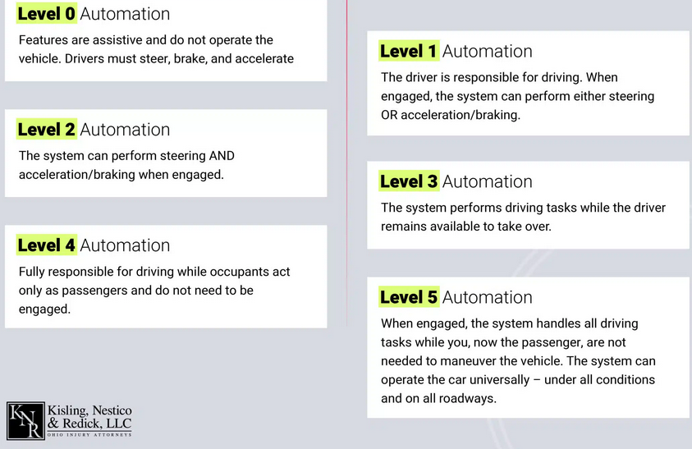
What are autonomous vehicles?
Benson Lin
  CURRENT STATUS
  Level 2 & 3 currently being tested and deployed in various regions:
  U.S (Silicon Valley)
  Europe (Germany, UK)
  Asia (China, Japan)
  GOAL
  Achieve level 5!
  (Full Automation)
[2]
Notes:
Alright, before diving in, let’s run through the levels of autonomous driving real quick. It’s broken down into six levels, from 0 to 5—basically going from you doing all the work, to the car driving itself
Level 0 – No automation at all. You’re the one doing everything. Hands on the wheel, foot on the pedal. The car’s just along for the ride.
Level 1 – Here you get a bit of backup. You’ve got things like adaptive cruise control helping out, but you’re still handling the steering and braking. The car’s not in charge yet.
Level 2 – Now it gets interesting. The car can handle steering and acceleration by itself, but you still gotta stay alert with your hands on the wheel. Think Tesla Autopilot—it does a lot, but you’re not off the hook yet.
Level 3 – Conditional automation. In certain situations, the car can fully take over driving, but you need to be ready to step in if something goes down.
Level 4 – Full self-driving, but only in specific zones, like city streets or highways. The car does its thing without any input from you, but it’s not perfect everywhere.
Level 5 – The holy grail of automation. Full autonomy, no steering wheel, no pedals, no driver needed at all. The car handles everything in every condition, so you can kick back and relax
Right now, we’re seeing Level 2 and 3 systems actively being tested and deployed in places like Silicon Valley, Germany, and Japan. These systems still need driver oversight, but the car handles most of the heavy lifting—things like steering, braking, and accelerating.
But the real game-changer is where we’re headed: Level 4 and Level 5 autonomy. This is where companies like Waymo, Tesla are pushing the limits. We’re talking about fully autonomous vehicles that don’t need human intervention at all. These will be safer, more efficient, and available on a much larger scale

Slide 27
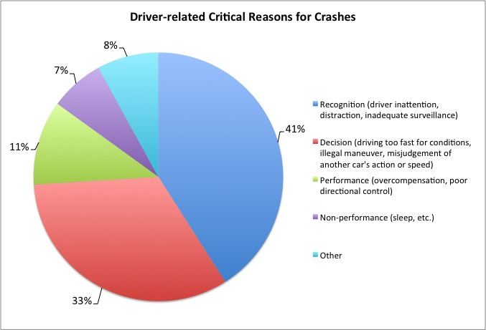
The Leading Cause of Accidents
Benson Lin
MOST CAR ACCIDENTS ARE FROM HUMAN ERRORS
  94% of Accidents are caused by driver-related mistakes [1].
  Traffic Crashes: Up by 16% (2020-2021) to 6.1M. [1]
  21% of Crashes: Weather-related (slick or icy roads). [11]
  13,000 Deaths in 2021 from drunk driving. [1]
  $44 Billion in annual damages due to alcohol-related crashes. [12]
[14] Show THE REASONS BEHIND CAR CRASHES
Notes:
Alright, first of all, human error is the biggest reason for car crashes. According to the NHTSA, 94% of crashes happen because of mistakes we make behind the wheel. That’s stuff like getting distracted, driving too fast, or just making bad decisions.
For example, between 2020 and 2021, crashes shot up by 16%, bringing the total to 6.1 million in the U.S. alone.
But it’s not always just us messing up. 21% of crashes happen because of bad weather, including slick roads, ice, heavy rain, and whatever else there is.
And of course, we have drunk driving. In 2021, over 13,000 people died because someone couldn’t stay off the booze before getting behind the wheel. That’s like 30% of all road deaths. And it doesn’t just end with lives lost since they also take a huge hit on the economy, around $44 billion annually.
REFERENCE TO THE CHART
As you can see on the chart, a lot of these crashes come down to two types of mistakes: recognition errors, where drivers fail to notice hazards, and decision errors, like speeding or misjudging distances. A lot of these could be avoided with better automation and this is where self-driving cars could really cut down on these numbers.

Slide 28
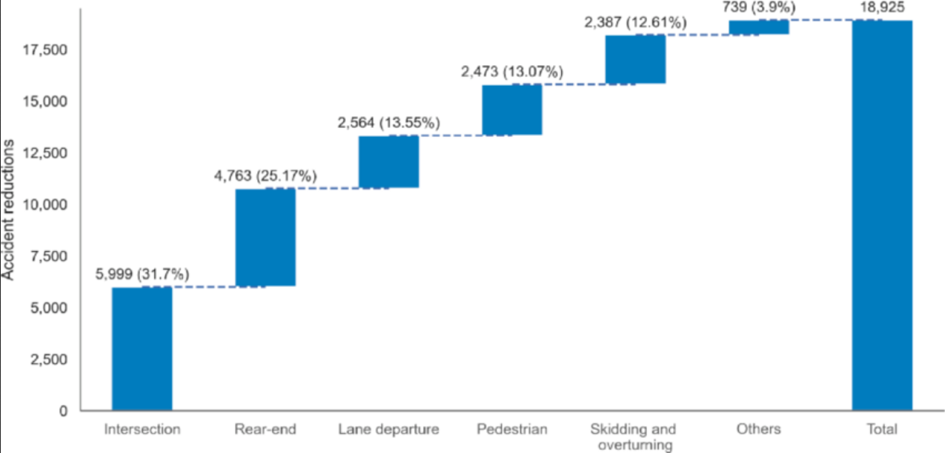
REDUCES ACCIDENTS
Benson Lin
AV IMPROVES ROAD SAFETY
  Fewer pedestrian accidents: 0% for AVs vs. 16.3% for human drivers
  Drastic reduction in T-bone collisions: 5.7% for AVs vs. 25.8% for humans
  Majority of AV accidents are rear-end collisions (64%)
SIGNIFICANT REDUCTIONS
  Rear-End Collisions: Reduced by 25.17% (4,763 accidents) [16]
  Intersection Accidents: Reduced by 31.7% (5999) accidents [16]
  Total Reduction: 18,925 accidents. [16]
[16] HUGE POTENTIAL FOR REDUCING ACCIDENTS
Notes:
So how are autonomous vehicles changing the game when it comes to road safety.
First, in real-world applications, AVs have already made some noticeable differences. For example, T-bone crashes—also known as broadside accidents—are significantly lower with AVs. They account for only 5.7% of AV accidents, compared to 25.8% for human-driven vehicles. Pedestrian accidents are another area where AVs excel. In certain studies, 0% of AV-related accidents involve pedestrians, compared to 16.3% for human-driven cars. These numbers show that while the technology is still evolving, it’s already reducing some of the most dangerous types of crashes.
Now let’s talk about the future potential. According to studies using Advanced Driver Assistance Systems (ADAS), once AVs are fully rolled out, we’re looking at about 18,925 fewer accidents. That includes a 31.7% drop in intersection crashes and 25.17% fewer rear-end collisions. They could also cut down on lane departures and pedestrian crashes. Basically, as the tech levels up and more AVs hit the streets, the impact could be huge.
REFERENCE TO THE CHART
Here are the statistics displayed visually for each sector. They’re not gonna eliminate everything, but they’ll knock out a lot of the most common and dangerous ones, making our roads way safer

Slide 29
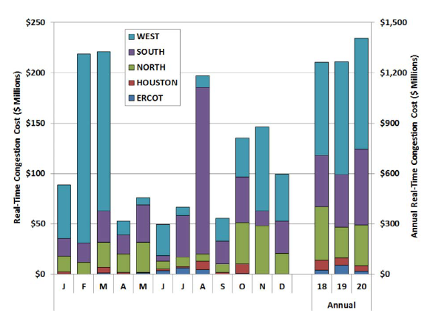
[8] CONGESTIONS wastes significant time and resources
Benson Lin
Traffic congestions = COST + fuel + TIME WASTED
SIGNIFICANT ECONOMIC CONCERNS
  In 2017, congestion cost the economy $166 billion [4]
  Average drivers paid $134 more for fuel in 2022 than 2021. [5]
TIME AND FUEL WASTED FOR AVG DRIVER
  Spent 54 hours per year stuck in traffic [4]
  Wasted 21 gallons of fuel [4]
Notes:
Next up is traffic congestion. First, traffic congestions wrecks both the economy and the environment. To give you an idea, back in 2017, traffic jams cost the U.S. economy a massive $166 billion [4]. That’s lost productivity, higher fuel costs, and a huge hit on infrastructure. Fast forward to 2022, and the average driver shelled out an extra $134 on fuel compared to 2021, just because they were stuck in traffic longer [5]. More time in traffic means more cash burned at the pump.
Now, let’s break down the time side of it. On average, drivers are losing about 54 hours a year sitting in traffic—which is about equivalent to over a week of workdays. That’s more than two full days wasted—just sitting there, staring at the bumper in front of you. And while you’re stuck, you’re burning through an extra 21 gallons of fuel a year [4]. So yeah, all of this? It’s just money straight down the drain, and it’s trashing the environment in the process
REFERENCE TO THE CHART
As you can see from the graph, it shows how congestion costs hit different regions across the U.S. Places like the west, south, and specific spots like Houston. While this graph highlights regional costs, it’s clear how congestion adds up over time, and when you add it all together across the country, it contributes to the $166 billion total in economic loss we talked about earlier.

Slide 30
REDUCING TRAFFIC CONGESTION
Benson Lin
REDUCING TRAFFIC WAVES & INCREASING LANE CAPACITY
  According to a study by the UIUC, if just 10% of cars on the road are autonomous, traffic congestion caused by human errors could be reduced by 40% [10]
  AVs can increase lane capacity by 1.78 times [6]
SAVING FUEL
  AVs traveling in close platoons lead to 10-15% fuel savings and minimizing stop-and-go traffic patterns [6]
  5-7% decrease in fuel use with adaptive cruise control vs. human driving [17]
Notes:
So, this is where autonomous vehicles can really step in and cut down on traffic congestion by fixing the inefficiencies we deal with from human drivers.
First off, a study from the University of Illinois shows that if just 10% of cars were AVs, we could drop congestion caused by human errors by up to 40% [10]. That’s because AVs get rid of those annoying traffic waves , that stop-and-go patterns we all hate from people reacting too slow.
Second, AVs can increase lane capacity. We’re talking about 1.78 times more cars fitting on the same road compared to regular human-driven vehicles.
Then there's platooning—where AVs drive close together in sync. This cuts down aerodynamic drag, saving 10-15% on fuel. Plus, platooning means less of that constant stopping and starting, which keeps traffic flowing.
And lastly, with adaptive cruise control, AVs can cut fuel consumption by about 5-7% compared to human drivers [17]. So not only are AVs helping kill congestion, but they’re also making your ride more fuel-efficient and better for the environment.

Slide 31
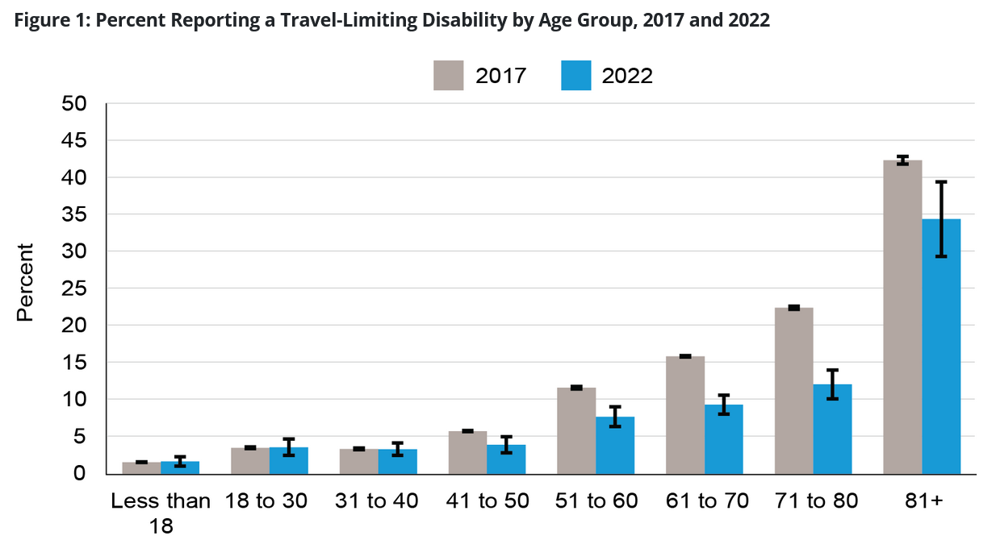
Driving issues with elders & disabilities & MORE
Benson Lin
MANY PEOPLE HAVE ISSUES WITH DRIVING
  25.5 million working-age Americans have disabilities [9]
  Seniors (65-69) face a fatal crash of 12.6%, increasing after age 70 [7]
  Teens (16-19) have a crash rate of 14%
  By 2030, 20% of the U.S. population will be over 65 [13]
IMPACT ON HEALTHCARE ACCESS
  5.8 million Americans (1.8%) delayed medical care due to lack of transportation [15]
[15] LIMITED MOBILITY HINDERS ACCESS TO ESSENTIAL SERVICES
Notes:
And lastly, we have driving issues especially for seniors and people with disabilities
Right now, 25.5 million working-age Americans live with disabilities that can make driving difficult or impossible [9]. That’s a huge chunk of the population that would seriously benefit from better transportation options
Then, you got seniors For those aged 65-69, the fatal crash rate is sitting at around 12.6 deaths per 100,000, but the second they hit 70, that number starts climbing. As they age, they’re becoming more vulnerable on the road [7]
When you compare that to teens, the crash rate for them is sitting at about 14 deaths per 100,000. So the risk between teens and seniors is pretty close
.
But this is also beyond driving, since transportation issues also mess with healthcare access. 5.8 million Americans—about 1.8% of the population—have delayed medical care because they didn’t have reliable transportation [15]. This problem hits the elderly and disabled even harder.
REFERENCE TO THE CHART
Take a look at this graph. It shows the percentage of people reporting travel-limiting disabilities across different age groups in 2017 and 2022. As you can see, mobility limitations really jump as people get older, especially for those over 65. Autonomous vehicles could be a total game-changer here, offering reliable, accessible transport that makes it easier to get to healthcare appointments and overall improves quality of life

Slide 32
IMPROVES INDEPENDENCE AND MOBILITY
Benson Lin
ENHANCED MOBILITY & INDEPENDENCE
  AVs provide reliable transport for older adults who no longer drive [18]
  Promotes independence and reduces feelings of isolation [18]
  14.3% of adults aged 18-64 with disabilities live in zero-vehicle households, limiting their mobility. AVs would offer equitable access to mobility and improve quality of life [19].
IMPACT ON HEALTHCARE ACCESS
  AVs enable door-to-door transport, allowing older adults to stay in their homes longer [18]
  Increases access to healthcare and essential services [18]
Notes:
First, AVs provide a reliable transportation option for older adults who no longer drive. In a way, AVs give them their freedom back—they’re no longer stuck at home relying on others to get them around.
In addition, 14.3% of adults aged 18 to 64 with disabilities are living in zero-vehicle households [18]. That’s a huge chunk of the population that’s very limited when it comes to mobility. AVs can level the playing field, giving them the same equitable access to transportation and improving their quality of life [19]
And finally, AVs helps solve major healthcare challenges. For older adults, AVs can offer door-to-door transport, so the elderly can stay in their homes longer, and people with disabilities can get the care they need without worrying about how they’re going to get there.

Slide 33
References
Benson Lin
[1] LawInfo Staff, "How Many Car Accidents Are Caused by Human Error?" (LawInfo, 2024-06-04), https://www.lawinfo.com/resources/car-accident/how-many-car-accidents-are-caused-by-human-er.html (Accessed 2024-09-01)
[2] Kisling, Nestico & Redick, "Self-Driving Car Accident Statistics," (Kisling, Nestico & Redick, 2023), https://www.knrlegal.com/car-accident-lawyer/self-driving-car-accident-statistics/ (Accessed 2024-09-01)
[3] Rescu Staff, "How Safe Are Self-Driving Cars?" (Rescu, 2024-07-15), https://www.rescu.com/how-safe-are-self-driving-cars/ (Accessed 2024-09-30).
[4] 2019 Urban Mobility Report, (Texas A&M Transportation Institute, August 2019), https://static.tti.tamu.edu/tti.tamu.edu/documents/umr/archive/mobility-report-2019.pdf (Accessed 2024-09-01)
[5] Traffic Congestion Costs Commuters Valuable Time And Has A Heavy Economic Cost, Costing $120 Billion A Year - Is This Company's A.I. The Solution?, (Yahoo Finance, May 26, 2023), https://finance.yahoo.com/news/traffic-congestion-costs-commuters-valuable-122500799.html (Accessed 2024-09-01)
[6] Othman, K. (2022). Exploring the implications of autonomous vehicles: a comprehensive review, Innovative Infrastructure Solutions, 7(2), 165. doi: 10.1007/s41062-022-00763-6 (Accessed 2024-09-29)
[7]Insurance Institute for Highway Safety (IIHS). (2024). Fatality Facts: Older people. https://www.iihs.org/topics/fatality-statistics/detail/older-people (Accessed 2024-09-30)
[8] Sherman, A. (2023). Transmission Congestion Costs in the U.S. RTOs, Grid Strategies LLC, March. https://gridstrategiesllc.com/wp-content/uploads/transmission-congestion-costs-in-the-us-2021-update.pdf (Accessed 2024-09-01)
[9] Brumbaugh, S. (2018). Travel Patterns of American Adults with Disabilities. U.S. Department of Transportation, Office of the Secretary of Transportation, Bureau of Transportation Statistics. https://www.bts.gov/sites/bts.dot.gov/files/2022-01/travel-patterns-american-adults-disabilities-updated-01-03-22.pdf (Accessed September 1, 2024)
[10] Work, D. B., Piccoli, B., Seibold, B., Sprinkle, J., & Work, D. (2017). Experiments show that a few self-driving cars can dramatically improve traffic flow. University of Illinois Urbana-Champaign. https://cee.illinois.edu/news/experiments-show-few-self-driving-cars-can-dramatically-improve-traffic-flow (Accessed 2024-09-02).
[11] Federal Highway Administration. (2024). How do weather events impact roads? Road Weather Management Program, U.S. Department of Transportation. https://ops.fhwa.dot.gov/weather/q1_roadimpact.htm (Accessed September 2, 2024).
[12] Okey, B. & Draskovic, M. (2024). What is the economic impact of alcohol consumption in the US? Ardu Recovery Center. https://www.ardurecoverycenter.com/economic-costs-of-excessive-alcohol-use/ (Accessed 2024-09-02)
[13] McKenzie, B. (2024). U.S. Population Will Grow Bigger and Get Older. University of Virginia. https://news.virginia.edu/content/us-population-will-grow-bigger-and-get-older (Accessed 2024-09-02)
[14] Schaff, S. (2018). The War on Error? Rethinking What Matters in Automated Vehicle Safety. Frontier Group. https://frontiergroup.org/articles/war-error-rethinking-what-matters-automated-vehicle-safety/ (Accessed 2024-09-02)
[15] Wolfe, M. K., McDonald, N. C., & Holmes, G. M. (2020). Transportation Barriers to Health Care in the United States: Findings From the National Health Interview Survey, 1997–2017. American Journal of Public Health, 110(6), 815-822. https://doi.org/10.2105/AJPH.2020.305579 (Accessed 2024-09-02)
[16] Masello, L., Castignani, G., Sheehan, B., & McDonnell, K. (2022). On the road safety benefits of advanced driver assistance systems in different driving contexts. Transportation Research Interdisciplinary Perspectives, 15, 100670. doi: 10.1016/j.trip.2022.100670 (Accessed 2024-09-09)
[17] Muller, J. (2019-08-07). Self-driving cars could be more fuel-efficient than human drivers. Axios. https://www.axios.com/2019/08/07/volvo-study-self-driving-cars-fuel-efficiency (Accessed 2024-09-29)
[18] Fitt, H., Curl, A., Dionisio-McHugh, R., Fletcher, A., Frame, B., & Ahuriri-Driscoll, A. (2018). Think Piece: Autonomous vehicles and future urban environments: Exploring implications for wellbeing in an ageing society (Second ed.). Christchurch, NZ: National Science Challenge 11: Building Better Homes, Towns and Cities. https://ir.canterbury.ac.nz/server/api/core/bitstreams/d428eb7c-af81-481e-9361-1f97912dff86/content (Accessed 2024-09-29)
[19] Bureau of Transportation Statistics. (2024-04-18). Travel Patterns of American Adults with Disabilities. U.S. Department of Transportation. https://www.bts.gov/travel-patterns-with-disabilities (Accessed 2024-09-29)

Slide 34
Class 11
The End
Keith A. Pray
socialimps.keithpray.net
Notes:
If there’s time and we didn’t get to it:
Kickstarter Charter
https://www.kickstarter.com/charter?ref=about_subnav
CGP Grey
Humans Need Not Apply (15:00) – 2014-08-13
http://www.youtube.com/watch?v=7Pq-S557XQU
Last access 2016-04-22
These 3D printed homes can be constructed for $4,000 (3:00 – 2018-04-02)
http://www.businessinsider.com/3d-printed-homes-constructed-icon-new-story-tech-charity-4000-dollars-2018-3
https://www.youtube.com/watch?v=SvM7jFZGAec (1:28)
Last access 2018-04-22
Look at:
BBC Intelligent Machines
http://www.bbc.com/news/technology-33978561
BBC Likelihood of robot taking your job
http://www.bbc.com/news/technology-34066941

Slide 35
Remote With Zoom
Turn your camera on
Sign in with First and Last Name
Stay muted unless you are going to speak
Use the raise your hand feature to ensure a turn
Wait until the end of student presentations to ask questions
  Write them down so you don’t forget

