Slide 1


Class 4
Communication
Keith A. Pray
socialimps.keithpray.net
Notes:
Monty Python – Spam (3:19) (1970)
https://www.youtube.com/watch?v=anwy2MPT5RE
TSLAMP – MGMT (4:30) (2018)
https://www.youtube.com/watch?v=T8EL51jlrJA
TODO: get lyrics: https://genius.com/Mgmt-tslamp-lyrics
If forgot to show the ethical analysis guide, do so now.
Possible song:
TODO: Find clean version to use
Welcome to the Internet - Bo Burnham (from "Inside" -- ALBUM OUT NOW) (4:40)
Very Explicit Lyrics
https://www.youtube.com/watch?v=k1BneeJTDcU

Slide 2
Overview
Review
Assignment
Students Present
Notes:
Show syllabus updates if any

Slide 3
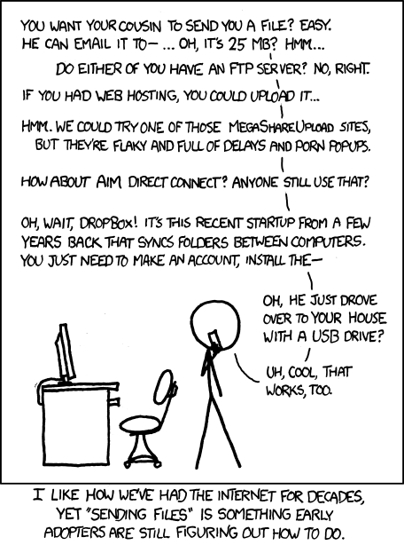
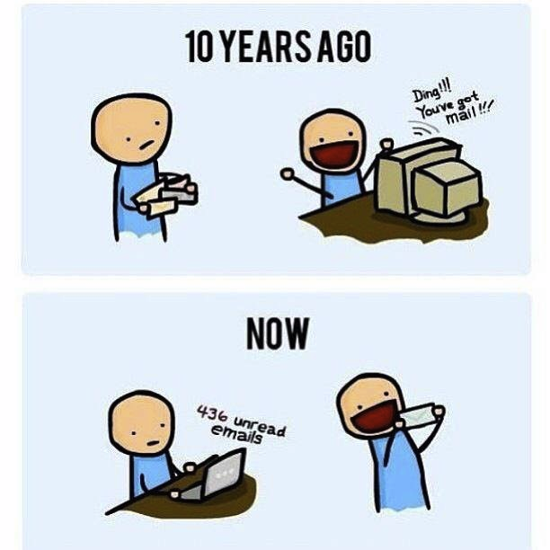
http://poofytoo.com/
30
http://xkcd.com/949/
Notes:
What is more exciting now for you, email or snail mail?
http://xkcd.com/949/
2011

Slide 4
My Reading Notes
p. 124 Search engines link deeper than home page
p. 125 Any US agencies employing this many people?
p. 128 Adult bookstores lowering property values source?
p. 132 “texted… images”
p. 133 Stating people searching did not consent to material being blocked makes more sense.
p. 134 Example with decision could be more helpful. Sexting examples all from 2009?
p. 136 “Identify fraud”. College students still as likely, 2013 source?
p. 137 Do mobile plans still charge extra for text messages? “Kit Messenger” → “Kik Messenger”
p. 139 punished vs. stopped?
p. 141 Cyberbullying since 2009?
p. 143 Hunter Moore convictions seem unrelated to “Anyone Up?” site.
p. 144 Have South Korean gaming related deaths declined?
p. 150 Q 30 See: https://en.wikipedia.org/wiki/Wikipedia:Citing_Wikipedia
p. 152 Q 49 How likely is a business to not set up a web site? Q 51 “attachments” → plugins?
Questions I liked: 17, 18, 24, 26, 30, 34, 36, 44, 51, 53
p. 105 Example cell phone use nice addition
p. 106 First e-games 1972 at Stanford [1]. How does 5 mil. Viewers compare to traditional sport viewer counts?
p. 108 Spam downward trend still? 2012 source. ½ 350 billion (p. 25)?
p. 109 Are rules against email personal use most common now? Anh did not force people to complain.
p. 112 15% # transactions or $$?
p. 113 Wikipedia critics source from 2005, is quality still in question?
p. 114 IoT interaction security nightmare?
p. 116 ”…no way Bitcoin will ever replace credit cards for everyday transactions.” absolutes difficult to prove.
p. 117 M-PESA redundant with p. 105 Are scratch codes for meds still used, 2012 source? Twitter → X
p. 118 Twitter only marketing tool source 2009, still?
p. 121 “may have” = weak conclusion. Who funded studies?
p. 122 Easier consolidation of newspapers. Advertisers switching away from newspaper source from 2014.
Notes:
[1] Owen Good (19 October 2012). "Today is the 40th Anniversary of the World's First Known Video Gaming Tournament". Kotaku. Retrieved 1 August 2013

Slide 5
Group Quiz
Name methods some governments use to control access to information. There are at least 5.
A large company has a policy prohibiting employees from blogging about company products.
  Does it violate the First Amendment? Why?
  Name two possible reasons for the policy.
  Is it reasonable? Why?
What does “URL” stand for and what is it?
Notes:
Censorship (religious, governmental, private). Adult authentication. Firewalls. Government owned media outlets (TV and radio stations, newspapers), private photocopier ownership illegal
First Amendment prohibits Congress from making laws limiting free speech, not private companies.
Uniform Resource Locator

Slide 6

Overview
Review
Assignment
Students Present
Notes:
But before that:
CPG Grey - This Video Will Make You Angry [Thought Germs] (7:25) – 2015-03-10
https://www.youtube.com/watch?v=rE3j_RHkqJc

Slide 7
Assignment
Reading
Individual Presentations
Extra Credit – One page paper
  Is WPI’s IT Acceptable Use Policy morally acceptable?
Work on your group project
  1.27 Group Happiness!
    1-3 scale with 1 = everyone getting their first pick
  See full group project description on course website
  Send Web Site URL – We start looking at them next class
Notes:
- Or review group project and individual presentation guidelines right now.
Possible One page paper:
Global intellectual property laws, friends or foes?

Slide 8
Overview
Review
Assignment
Students Present

Slide 9
Social Media psychosis
Damian Jadczak
Notes:
State the original question: “is social media is psychologically harmful for younger audiences?” I argue yes.
Psychosis is a disconnect from reality: social media causes people to disconnect from the world. Includes confused thinking, delusions, agitations, et cetera.

Slide 10
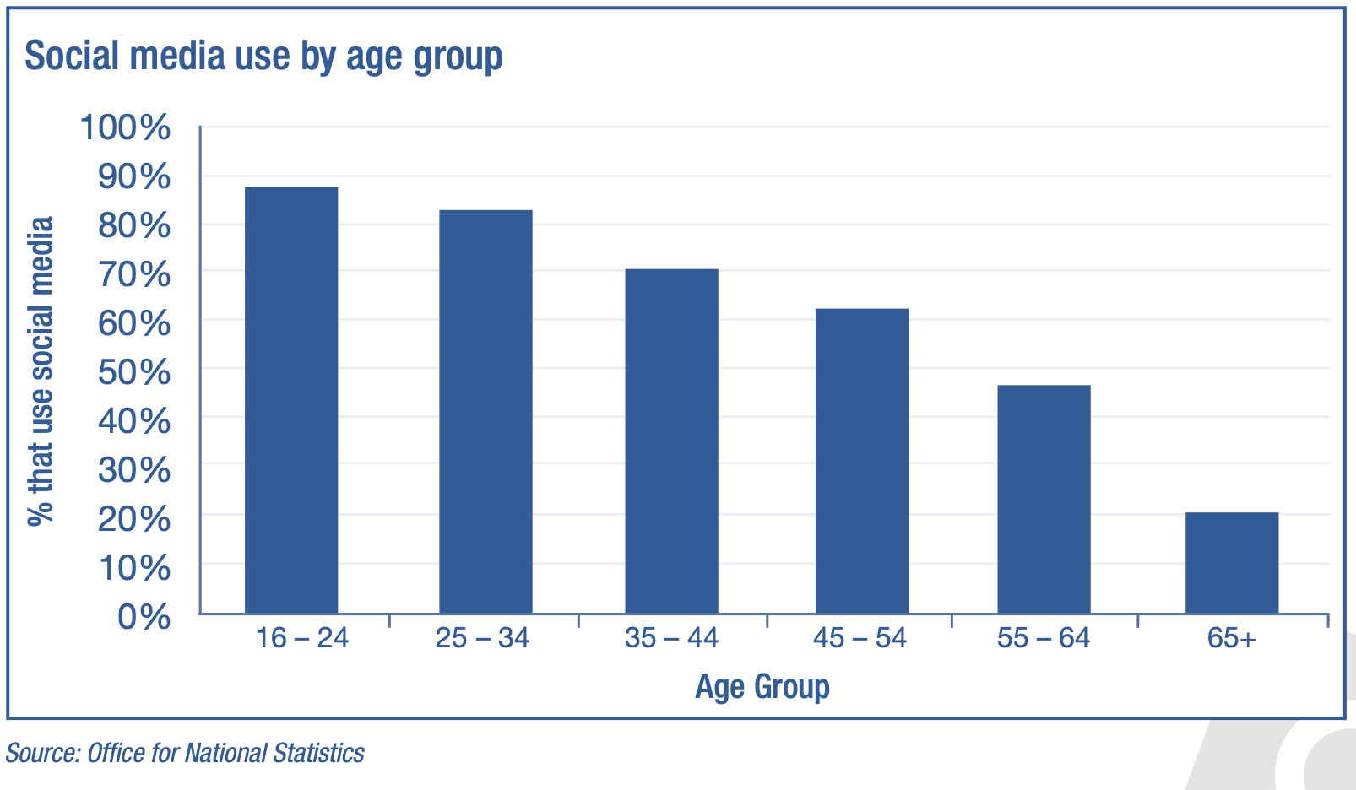
Social media harms young people mentally
Damian Jadczak
91% of young people use social media.
Social media linked to detrimental effects. [1]
  Anxiety.
  Body image concerns.
Social media is filled with short-form video content, which relates to some issues. [5]
  Poor vision and decreased depth perception.
  Emotion regulation problems.
Figure from [1]
Notes:
91% percent of young people (ages 16-24) use social media. [1] The graph says differently, likely because its data is sourced from Office for National Statistics
Anxiety caused by not having access to endless streams of content on social media.
Mention depression and attention disorders like attention-deficit/hyperactivity disorder (ADHD).
Short-form video content examples are Vine (outdated but definitely known), TikTok, Instagram/Facebook reels, and YouTube shorts.
Vision problems caused by excessive use of screens.
Excessive use of social media can distract people from physical fitness.
Lack of well-being and suicidal thoughts. [5]

Slide 11
Social media disturbs productivity
Damian Jadczak
Fear of Missing Out
Social media is linked to poor sleep outcomes for adolescents [3] [5].
  Poor sleep contributes to academic burnout. [5]
Short-form video addiction leaves students prone to academic procrastination. [5]
  Short-term oriented mindset.
  “Doomscrolling” and “brainrot.”
⬇
Nighttime Social Media Use
⬇
Reduced Sleep Quality
Inspired by figures in [3].
Notes:
The figures from [3] were omitted because they would be challenging for the audience to digest.
FOMO is important for attention economy.
Poor sleep outcomes based on what time adolescents went to bed, long it took them to fall asleep, and how many hours of actual sleep they got. [3]
Academic burnout results in stress and anxiety.
Academic procrastination can be caused by detrimental mental health problems caused by depression, anxiety, and stress.
Short-term oriented mindset leaves students with a disrupted rewards system in their brain which seeks immediate pleasure and satisfaction. [5]
Students not able to finish their homework because they spent too much time on Instagram reels “doomscrolling.”
The term “brainrot” describes how the brain behaves because of social media addiction.

Slide 12
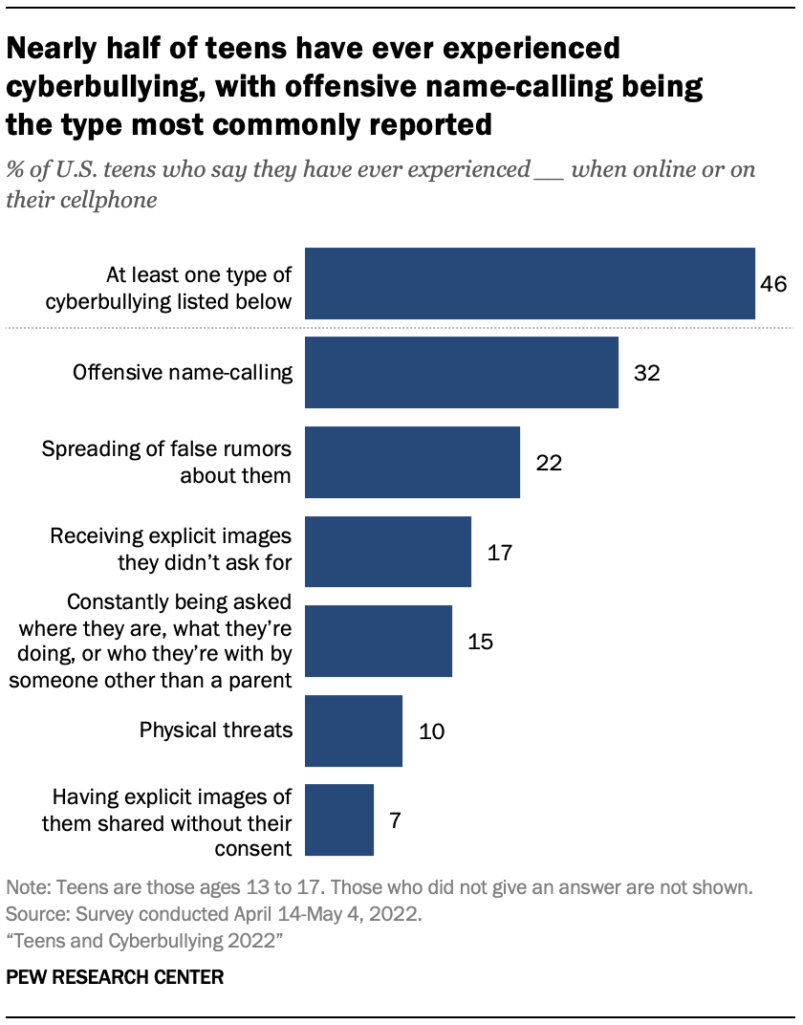
Social media is a haven for cyberbullies
Damian Jadczak
Approximately 46% of teens have experienced some form of cyberbullying. [6]
Beware sexting and revenge porn. [7]
  Social anxiety and isolation.
  Depression, suicidality, and self-harm.
Women are often criticized when their intimate pictures are shared without consent.
  Men are not criticized as much.
Figure from [6]
Notes:
The mentioned cyberbullies state their reasoning as revenge or “they deserved it.”
Cyberbullying does not have a simple solution like “turning the computer off.”
Mention Megan Meier case to give an example of the harsh effects of cyberbullying. (In the textbook somewhere in Chapter 3)
Revenge porn is sexual abuse!
Revenge porn makes it difficult for victims to trust people, making new relationships difficult to form.
When women are criticized, it is an addition to the stress already caused by the sharing of their images.

Slide 13
Social media is addictive
Damian Jadczak
Social media is designed to be addictive. [8]
  Less time to devote to other activities that make you feel like a human.
  In Kantian terms, social media users are treated as a means to an end.
Decline in reasoning and thinking caused by social media addiction. [8]
  Social media addicts are more likely to use harmful substances and have a poor diet.
  Association with social isolation and loneliness.
  Creation of subcultures like the “incel” movement. [9]
Notes:
Mention attention economy for the first bullet.
From the textbook: three types of addiction: gaming, sexual, and messaging. [Chapter 3 153] p. 144
From the textbook: same relief as drugs, food, or gambling. [Chapter 3 161] p. 145
We are the product sold to advertising companies. [8]
Psychological manipulation is wrong.
A comparison can be made here: Britain getting China addicted to opium.
Harmful substances include tobacco and alcohol. [8] Can reason that other substances like Marijuana are included in this.
Why put in the work to make a meal when you can easily purchase heavily processed food or order food from a delivery service like DoorDash?
The term “incel” is short for “involuntary celibate” which describes people (typically men) that are unable to find romantic or sexual partners. [9]
In the context of male incels, the movement typically becomes an ”anti-women” movement. [9]
“While incels view themselves at the bottom of their hierarchy, they consider all men, including themselves, as superior to women.” [9]
This is a very strange product of the internet and social media.

Slide 14
Damian Jadczak
P.S., here is an interesting song: TSLAMP by MGMT. “TSLAMP” stands for ‘Time Spent Looking At My Phone.” I was listening to this song when I thought about the topic for this presentation. The lyrics are helpful.

Slide 15
Social media is harmful for younger audiences
Damian Jadczak
Social media is shown to disrupt mental wellbeing.
Social media disturbs productivity.
Social media is a haven for cyberbullies.
Social media is addictive.
Notes:
91% percent of young people (ages 16-24) use social media. [1]
Anxiety caused by not having access to endless streams of content on social media.
Mention depression and attention disorders like attention-deficit/hyperactivity disorder (ADHD).
Short-form video content examples are Vine (outdated but definitely known), TikTok, Instagram/Facebook reels, and YouTube shorts.
Vision problems caused by excessive use of screens.
Excessive use of social media can distract people from physical fitness.
Lack of well-being and suicidal thoughts. [5]

Slide 16
References
Damian Jadczak
[1] “#StatusOfMind: Social Media and Young People’s Mental Health and Wellbeing.” (Royal Society for Public Health, London, 2017). https://www.issup.net/knowledge-share/resources/2018-05/statusofmind-social-media-and-young-peoples-mental-health-and, (Accessed September 1, 2024)
[2] “Teen Online & Wireless Safety Survey: Cyberbullying, Sexting, and Parental Controls.” (Cox Communications, May 2009).
[3] Scott H, Woods HC. Fear of missing out and sleep: Cognitive behavioural factors in adolescents' nighttime social media use. (J Adolesc., 2018).
[4] Riehm KE, Feder KA, Tormohlen KN, et al. Associations Between Time Spent Using Social Media and Internalizing and Externalizing Problems Among US Youth. JAMA Psychiatry. 2019;76(12):1266–1273. doi:10.1001/jamapsychiatry.2019.2325. (Accessed September 1, 2024)
[5] Xie J, Xu X, Zhang Y, Tan Y, Wu D, Shi M, Huang H. The effect of short-form video addiction on undergraduates' academic procrastination: a moderated mediation model. (Front Psychol., 2023 Dec 15);14:1298361. doi: 10.3389/fpsyg.2023.1298361. PMID: 38162977; PMCID: PMC10756502. (Accessed September 1, 2024)
[6] Vogels, A., Emily, Teens and Cyberbullying 2022, (Pew Research Center, December 15, 2022), https://www.pewresearch.org/internet/2022/12/15/teens-and-cyberbullying-2022/, (Accessed September 2, 2024)
[7] Sciacca, B., Mazzone, A., Loftsson, M., O'Higgins Norman, J., & Foody, M. (2023). Nonconsensual Dissemination of Sexual Images Among Adolescents: Associations With Depression and Self-Esteem. Journal of interpersonal violence, 38(15-16), 9438–9464. https://doi.org/10.1177/08862605231165777 (Accessed September 1, 2024)
[8] Bhargava, V. R., & Velasquez, M. (2021). Ethics of the Attention Economy: The Problem of Social Media Addiction. Business Ethics Quarterly, 31(3), 321–359. doi:10.1017/beq.2020.32. (Accessed September 2, 2024)
[9] Brace, L. A short introduction to the involuntary celibate Sub-Culture. CREST Research. (2021, August 26). https://crestresearch.ac.uk/resources/a-short-introduction-to-the-involuntary-celibate-sub-culture/. (Accessed September 2, 2024)

Slide 17
Children Should be Limited in their Use of Computing Devices
Matt Nickerson
Notes:
In this presentation, I discuss the question of: “Should children's use of computing devices be limited?
YES, it should be limited, but limited to the extent of what the child needs in terms of education, accessibility, and without breaching the bounds of studied health risks.
During my research on the topic, anecdotal evidence was reported from elementary teachers who teach in Massachusetts: Keli Smith, a 4th grade math teacher at clinton elementary school for over 8 years, Liz Thibeault, a Kindergarten teacher at Houghton Elementary School for over 22 years, and her husband, Professor Dan Thibeault of the UMASS Lowell and Middlesex community college who presents lectures on media history and studies.

Slide 18
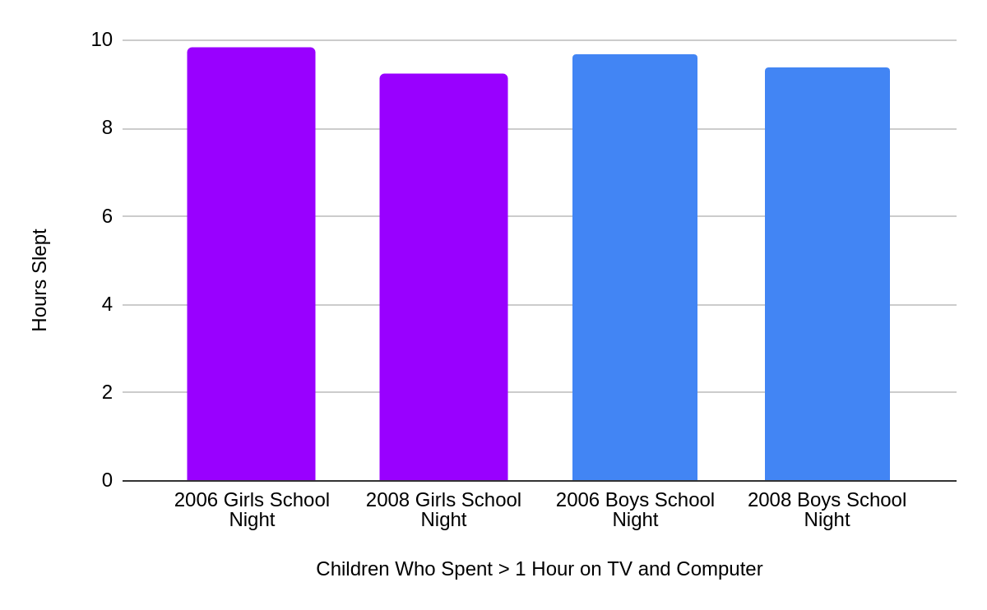
Irregular Sleep Habits
Matt Nickerson
Difference in sleep between 2006 and 2008 [1]:
  Boys: (Δ -.3 hours)
  Girls: (Δ -.6 hours)
Exposure to blue light
affects melatonin levels and causes sleep disturbances [2].
<Graphic as big as will fit>
Notes:
Increased use of computing devices can cause irregular and disrupted sleep habits. In a study on 353 different 4th and 5th graders with 51% being female, hours slept at night were surveyed once in 2006 and again in 2008 to research how exposure to technological media like TV and computers affected the sleep of these students. This was done by randomly choosing students and asking them how much sleep they got at night on average on a school night, and then how long their exposure to television and other medias was each night on average. The results recorded showed that on average, girls in 2006 were getting on 9.8 hours of sleep, and in 2008 were getting less sleep at an average of 9.2 hours. The boys surveyed said they were getting on average 9.7 hours of sleep in 2006, and in 2008 were getting around 9.4 hours of sleep. From these numbers, it was concluded that there was a connection between the effects of technological exposure and sleep durations. Researchers explained in their conclusions how this lack of sleep caused by technology can cause attention and behavioral issues as well [1]. Along with this, the American Academy of Pediatrics published an article detailing how blue light from screens of many media devices can have an effect on melatonin levels in children, which also leads to sleep problems and the health risks that follow those [2]. This holds true with accounts of the teachers I had interviewed. Keli explained how she would have students come in and explain how they would stay up most of the night playing video games or watching videos online, which those same students would have a harder time staying focused in class.
353 different 4th and 5th graders - how much sleep they got and how much TV and media they watched
Girls: 9.8 - 9.2
Boys: 9.7 - 9.4
From results, there was a clear connection between the two, behavioral and attention issues
Blue light
Blue light affects melatonin levels - sleep problems and health risks
Keli explained the video games being up all night

Slide 19
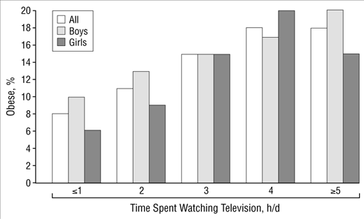
Increased Risk of Obesity
Matt Nickerson
Excessive device use causes:
  Increased energy-dense food ingestion
  Increased exposure to food marketing ($1.8 Billion dollars)
  Lack of physical activity [5].
60% of cases of obesity in 10 - 15 year olds were linked to over exposure of media devices [5].
Graphic of the 4-year study of 8 - 16 y.o time spent watching TV when compared to obesity rates [6].
Notes:
The link between obesity rates in children and screen time exposure have been researched and heavily solidified. There are multiple ways that the use of devices through screen time affect diets and eating habits, which includes lack of physical activity, energy dense food ingestion while not feeling less hungry, and food marketing on these mediums. A four year long study was conducted on an age range of 10 - 15 year old children, monitoring the amount of screen time they had per day and how overweight they became. When looking further into the cases of overweight children over the time of this experiment, they concluded that 60 percent of the cases were attributed to over exposure of media devices, particularly television [5]. The bar chart above shows another study in the same fashion, where 4069 children ages 8 - 16 were interviewed and questioned in surveys about their physical activity habits, television exposure, and weight. There is an observable positive linear relation between the amount of TV that was watched and the percent of obese children [6]. A New Zealand study also concluded that the around 17 percent of people who were overweight by age 26 had causations rooted back to over 2 hours of exposure to TV per day during childhood. Epidemiologic studies had also researched and discovered a direct link between increased screen time and the types of food children were eating. On average, the more screen time, the less fruits were consumed and more energy filled foods were consumed in their absence. Along with these other connections, the Federal Trade Commission reported “food and beverage companies spent $1.8 billion on marketing to children and adolescents in the United States in 2009 [5].” 2 - 11 year olds were being exposed to an average of 12.8 food and beverage commercials, and 12 - 17 year olds were being exposed to 15.2 per day. Many children cannot see their persuasive intent and many children were automatically eating more foods during viewing as a result.
Heavily solidified information
Lack of physical activity, energy-dense food, food marketing
4 year long study on 5-10 y.o. monitored how much screen time and their weight
For the overweight children, 60 percent were attributed to overexposure of media (television)
4069 8 - 16 yo: observable positive linear relation between tv and obesity
Direct link between screen time and types of food eaten and media
Federal Trade commission about amt spent on food marketing
2 - 11 yo exposed to 12.8 food coms on average, 12- 17 is 15.2

Slide 20
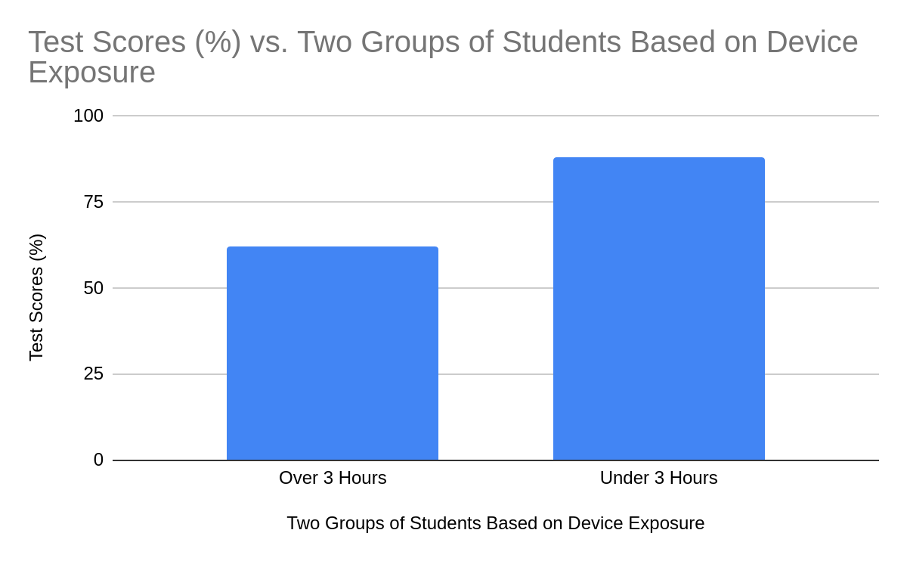
Academic Performance
Matt Nickerson
Young children age 3 - 5 have increase chances of literacy skill issues if exposure increases to computing devices [8].
  > 3 hours on computing devices: 62% average test score [7]
  < 3 hours on computing devices: 88% average test score [7]
Notes:
Academic performances as a result of increased computing device usage has a negative relationship. A study used 301 adolescents between the ages of 10 -18 to determine the effects of computing devices and media exposure on their overall academic performances. Each of the students were picked by a process of an initial questioning and demographic control to limit any outside sources or possible causations for differing test scores, leaving the question of how long each student uses media and computing devices as the variable. The two groups were split into students who had over 3 hours of exposure and those who did not. As shown on the figure, the students with over 3 hours a day of screen time a day had an average score of 62% and those with under had an average score of 88%. They follow up these claims but discussing sleep habits as discussed prior and how sleep deprivation caused by excessive screen time can have effects on these scores, along with mentioning the distraction and attention problems that can root from excessive use [7]. Another study on children aged 3 - 5 showed a clear connection between increased screen usage and lower “brain white matter tracts supporting language and emergent literacy skills in prekindergarten children [8].” Parents would fill out a survey on how long their child would have access to computing devices, and the children would complete cognitive testing and then receive diffusion tensor imaging, which is a type of MRI scan that detects the white matter organization in the brain. They used this data to conclude that there is a negative connection between the usage of the computing technology in prekindergarten children and literacy skills [8].
301 10 - 18 yo studied for connection to academic performance
initial questioning for most control and then categorized into two groups
> 3 = 62%
< 3 = 88%
study of 3 - 5 yo and how screen usage lowers brain white matter tracts (fiber pathways that connect neural system)
fill out survey, go through cognitive testing, and then diffusion tensor imaging (MRI that detects white matter in brain)
Connection that causes literacy skills to decrease in PreK

Slide 21
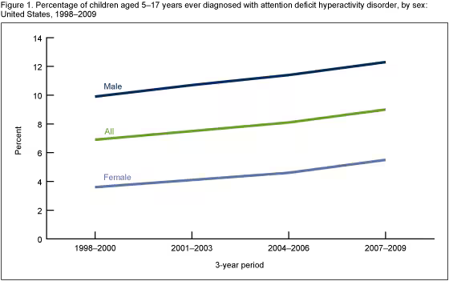
Stress, Anxiety, and Violence
Matt Nickerson
Increased use of computing devices during Covid-19 (15%) [3].
Children exposed to acts of violence on media: ~12,000 acts/yr
Sexual themes in media (+270% between 1976 - 1996) [4].
Figure shows the percent of children age 5 - 17 that have been diagnosed with ADHD from 1998 - 2009 [9].
Notes:
Increased usage of media devices and technology in children have a direct link to stress and anxiety. In one study, children ages 1-17 years of age were interviewed and studied, results showing they were affected by the increased use of technology that was demanded by the lockdown of Covid-19. Along with the isolation that was faced during this time, there was a 15 percent increase in technology use, with a reported 61.7 percent of that being smartphone use. It was concluded that because of this increase, there was a noticeable disturbance in brain functionality and that can cause risks of mental health conditions in children such as stress, anxiety, and ADHD [3]. Along with that, current day violent and sexual media and its exposure towards children is also a notable factor in these behavioral issues and mental health conditions. It is reported that children are exposed annually to over 12,000 different acts of violence between online media and television, with studies confirming a direct connection between violent behavior in children and their exposure to violent media. “Between 1976 and 1996, there has been a 270% increase in sexual interactions on TV…exposes children to adult sexual behaviours in ways that portray these actions as normal and risk-free [4]”. Children should not need to be exposed to sexual themes at such a young age. Both of the teachers when questioned about exposure to material that may cause stress, anxiety, or violence explained how students would come in sharing information with other students or with the teacher about topics that were not appropriate for their age range. Liz Thibeault discussed a student she had taught a few years prior who showed intense signs of behavioral issues related to violent actions. She explained how he had a strong affixation with guns, weaponry in general, and violent actions he had learned from movies and the internet. Keli explained how when she first began teaching, hearing questionable and inappropriate material from students meant questioning home life and possibly further involvement, but today with such exposure being so accessible on the internet and TV, she cannot make the same assumptions she once did towards unhealthy quality of life at home.
1 - 17 year olds affected by covid lockdown: 15% increase in tech use, 61.7% being smartphone use
noticeable disturbances in brain functionality that can cause risks of mental health conditions like stress, anxiety, and ADHD
Violent and Sexual media and exposure
connection between exposure and violent behavior
12,000 acts of violence annually
270% increase in sexual interactions on TV
talk about keli and liz

Slide 22
REFERENCES
Matt Nickerson
[1] Nuutinen, Teija, et al. “DO Computer Use, TV Viewing, and the Presence of the Media in the Bedroom Predict School-Aged Children’s Sleep Habits in a Longitudinal Study? - BMC Public Health.” BioMed Central, BioMed Central, 26 July 2013, bmcpublichealth.biomedcentral.com/articles/10.1186/1471-2458-13-684#Sec8.
[2] “Media Use in School-Aged Children and Adolescents | Pediatrics | American Academy of Pediatrics.” AAP.Org, 1 Nov. 2016, publications.aap.org/pediatrics/article/138/5/e20162592/60321/Media-Use-in-School-Aged-Children-and-Adolescents.
[3] Limone P, Toto GA. Psychological and Emotional Effects of Digital Technology on Children in COVID-19 Pandemic. Brain Sci. 2021 Aug 25;11(9):1126. doi: 10.3390/brainsci11091126. PMID: 34573148; PMCID: PMC8465704.
[4] Impact of media use on children and youth. Paediatr Child Health. 2003 May;8(5):301-17. doi: 10.1093/pch/8.5.301. PMID: 20020034; PMCID: PMC2792691.
[5] Robinson, Thomas N, et al. “Screen Media Exposure and Obesity in Children and Adolescents.” Pediatrics, U.S. National Library of Medicine, Nov. 2017, www.ncbi.nlm.nih.gov/pmc/articles/PMC5769928/.
[6] Carlos J. Crespo, DrPH. “Television Watching, Energy Intake, and Obesity in US Children.” Archives of Pediatrics & Adolescent Medicine, JAMA Network, 1 Mar. 2001, jamanetwork.com/journals/jamapediatrics/fullarticle/190446.
[7] Patel M, Patel SK, Suresh S, et al. Relationship between Screen Time and Academic Performance in Adolescents. Caspian J Pediatrs September 2022; 8(2): 739-47.
[8] Hutton JS, Dudley J, Horowitz-Kraus T, DeWitt T, Holland SK. Associations Between Screen-Based Media Use and Brain White Matter Integrity in Preschool-Aged Children. JAMA Pediatr. 2020;174(1):e193869. doi:10.1001/jamapediatrics.2019.3869
[9] “Products - Data Briefs - Number 70 - August 2011.” Centers for Disease Control and Prevention, Centers for Disease Control and Prevention, 6 Nov. 2015, www.cdc.gov/nchs/products/databriefs/db70.htm.

Slide 23
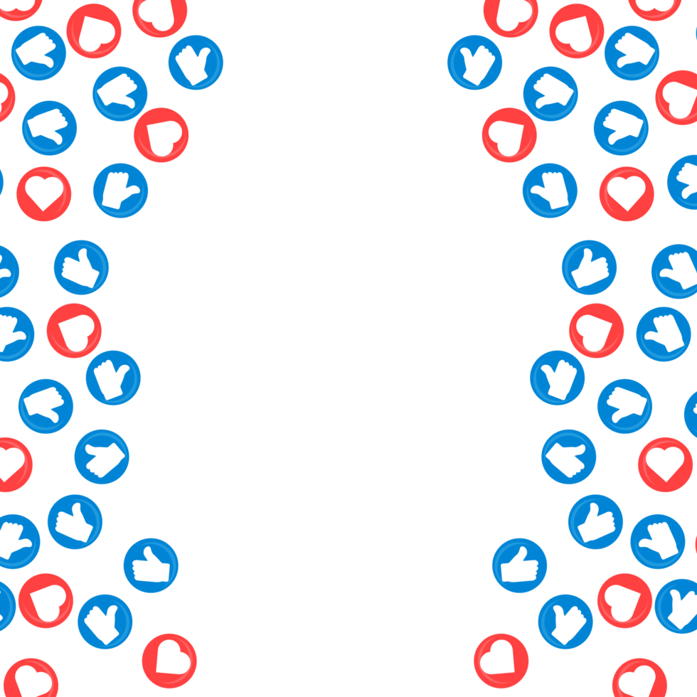
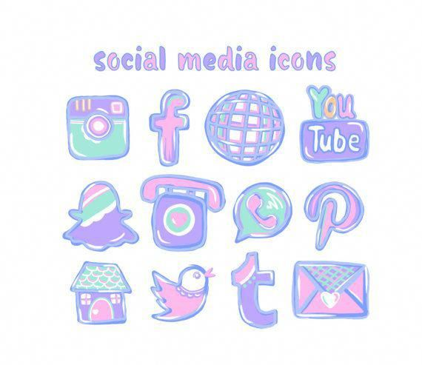
What You should do about Social Media
Eleanor Foley
© 2024 Keith A. Pray
23

Slide 24
Background information on Social Media

Slide 25
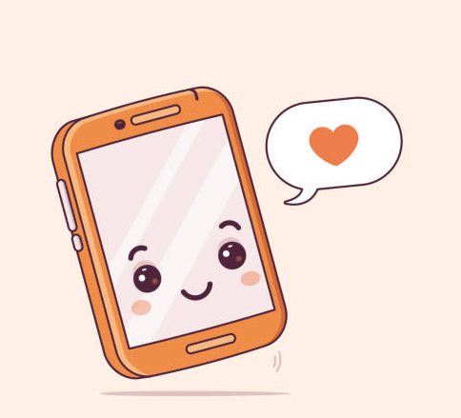
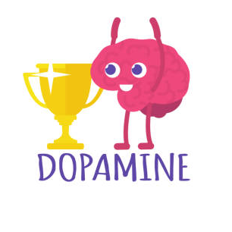
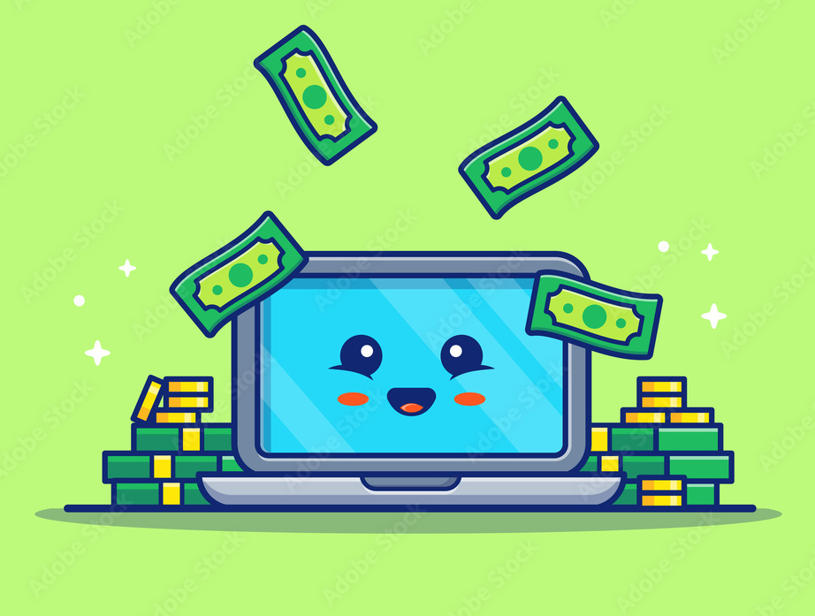
Social Media is addicting
Eleanor Foley
They make money from having users watch ads
They collect users’ data to build models that predict the user’s actions -> recommending what users want to see next to keep them online
Built to trigger dopamine releases in the brain
Aim is to have users spend long time on their site
Notes:
Social Media is addicting
They want users to spend the most amount of time on their site. Because social media’s make money from users watching ads.
And the more users they have watching ads the more money they make.
They collect users’ data to build models that predict the user’s actions which leads them to recommend what users want to see next
Their sites are built to trigger dopamine releases in the brain keeping their users feeling satisfied
All of this is in order to keep users on their site longer
A good source for learning more about this is by watching the “Social Dilemma” movie. Which also happens to be one of out movie groups.
EXTRA
(off topic but initially I didn’t watch this movie cause once I got 15-20 minutes in I felt called out because I, myself use my phone way too much to be healthy)
Social Medias work on making their site as addictive as possible.

Slide 26
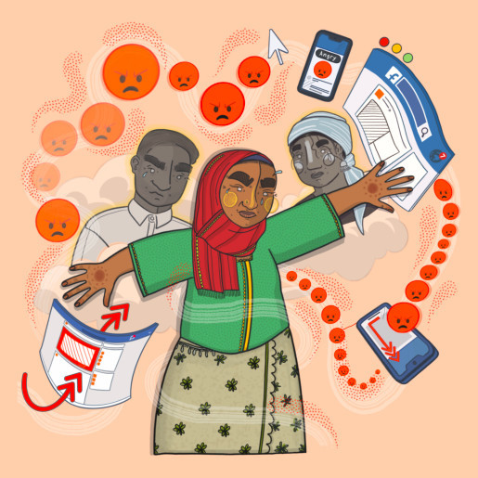
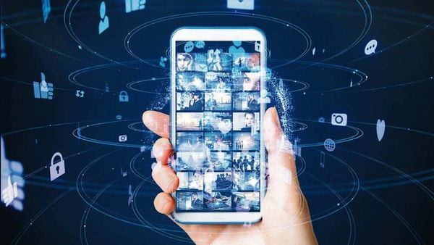
Social Media largely unregulated
Eleanor Foley
Easily can spread fake news, organize violence
Image from Amnesty International
Notes:
Social Media is largely unregulated which means fake news spreads easily
In MIT study, published in 2018, found fake news travels 6 times faster than real news
For example, in the textbook for class, it mentions how fake news about the 2016 election candidates was about to spread easily
A seperate example I looked into myself
is about how Facebook Algorithms Promoted Violence Against the Rohingya, an ethnic minority group,
In Myanmar, mobile phones are sold with Facebook already installed meaning most Myanmar citizens use Facebook.
In 2017, Myanmar’s armed forces called Tatmadaw used Facebook to boost propaganda to amass support for the persecution of the minority
In the end, many Rohingya’s were forced to take refuge
A U.N. fact-finding mission in 2018 determined that Facebook had been a “useful instrument” for vilifying the Rohingya in Myanmar “where, for most users, Facebook is the internet.
It concludes that Facebook’s parent company—then known as Facebook Inc.—was made aware of its role in contributing to the atrocities against the Rohingya ethnic group years before 2017, and it both failed to heed such warnings at the time and took “wholly inadequate” measures to address issues after the fact.
Extra
- A TIME article came out in 2022 talking about Rohingya killings
- There is also a minority ethnic group called Rohingya that have been persecuted by the Myanmar’s Buddhist majority.
In the aftermath, more than 730,000 Rohingya in the western Rakhine state were forced to take refuge in camps in neighboring Bangladesh.
Today, more than a million Rohingya are living in exile, and Myanmar’s military leaders are facing charges of genocide at the International Court of Justice.

Slide 27

Scams are easily operated on social media
Eleanor Foley
Money scams
  Facebook
Catfishing (term originated 2010)
  Catfish: The TV Show
Phishing
pharmaceutical scam
  Snap Chat
Notes:
Scams are Easily operated on social media
We can find money scams rather easily on social medias
For example, on Facebook cyber criminals can send messages of
Lottery scams, inheritance scams, loan scams
Example: My mom received a Facebook message from someone pretending to be a higher up in her company asking for money. She then asked my sister on what she should do.
It may seem easy for us to identify scams but it can be much for challenging for the elderly
Catfishing
when a person takes information and images, from other people, and uses them to create a new identity for themselves
Many people can be tricked online by others.
In the Catfish tv show, there are many examples of people in relationships with someone who doesn’t exist
Phishing
Online scam where attackers trick people into giving away sensitive information or installing malware
pharmaceutical scams (this is a lesser popular scam
Which I was looking for social media scams, I read about a case where someone used snapchat features in the mall to get potential victims.
Specifically, they used (snap score, quick add feature, and geotagging feature) to advertise a quick video and then walk up to snapchat users who saw the ad. A user bought what they thought was a Percocet pill for working out but ended up being laced with a hard drug instead
Extra
(https://www.youtube.com/watch?v=2w_ZXzbU-Pk&t=1577s&pp=ygUUZmVudGFueWwga2lsbHMgc3Rvcnk%3D)

Slide 28
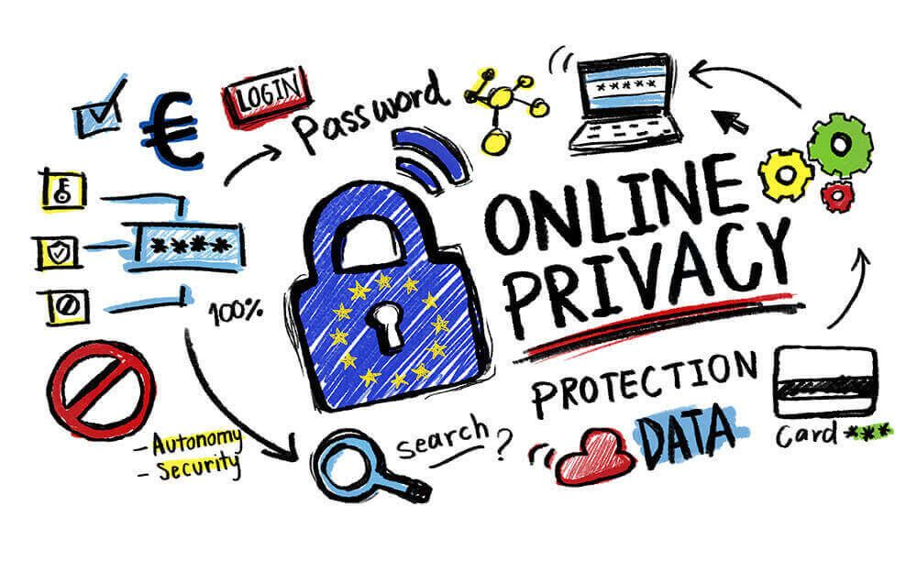
Social Media has privacy issues
Eleanor Foley
Personal data can be misused or exposed
Some applications track your location
  Snap Chat (others users can misuse this information)
Stalkers
  Many popular Twitch users have gotten FBI raids called on them
Notes:
Social Media has Privacy Issues
A Forbes article in 2018 mentioned
Facebook confirmed that an outside company has been harvesting and misusing user data without its knowledge.
Another article in 2018
Talked about how Twitter and Facebook found that a company had broke the social networks' rules on user surveillance and data privacy on their sites
https://www.washingtonpost.com/technology/2018/11/27/facebook-twitter-crack-down-ai-babysitter-rating-service/
These are just 2 examples of user’s data being misused without their knowledge from a social media
Another issues is that popular people on social media can get stalkers
Many popular twitch streams (mainly for video gaming website) have gotten FBI raids on them from users giving fake reports

Slide 29
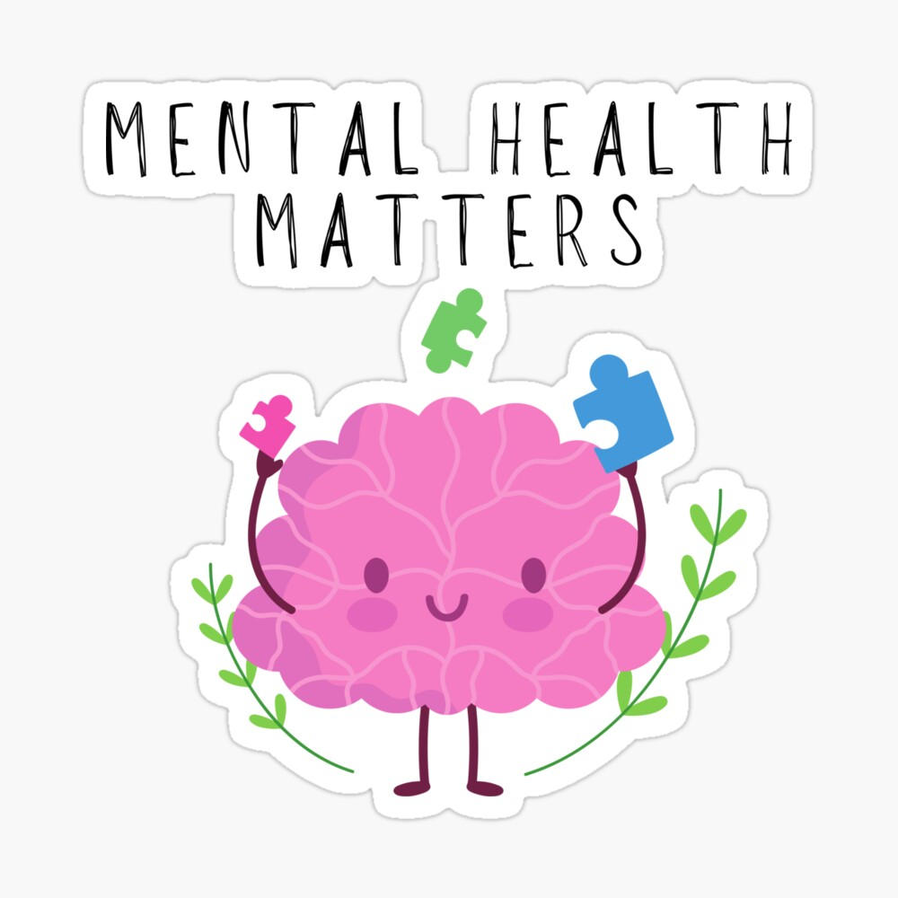
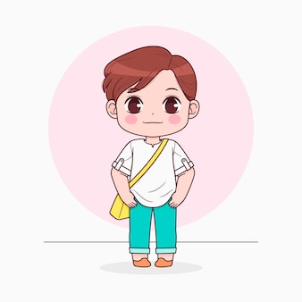
There are mental health concerns about Social Media
Eleanor Foley
Filters
  Self-conscious
  Body dysmorphia
FOMO (fear of missing out)
Cyberbullying
Reduced Face-to-Face Communication Skills
  Decline in the quality of in-person interactions.
Notes:
There are Mental Health Concerns about Social Media
Many sites have filters which means
- People are constant exposure to altered images can also lead them to feel self-conscious and dislike the way they look.
FOMO (fear of missing out)
Social Medis is only showing the “highlights” of someone’s life, other people can see these images and feel dissatisfied about their own day-to-day. Which can impact self-esteem and trigger anxiety
FOMO can also compel users to constantly check social media so that they don’t miss out on what’s happening.
Cyberbullying
It exists on all social media and negatively impacts users
Anyone noticed in the elevators on campus everyone is always on their phones. We don’t do normal pleasantries with strangers on campus too much.
Extra
- In person Example: My friend and I noticed during the summer the custodian would start conversations in the elevator. But I myself wasn’t used to that and was a little nervous

Slide 30
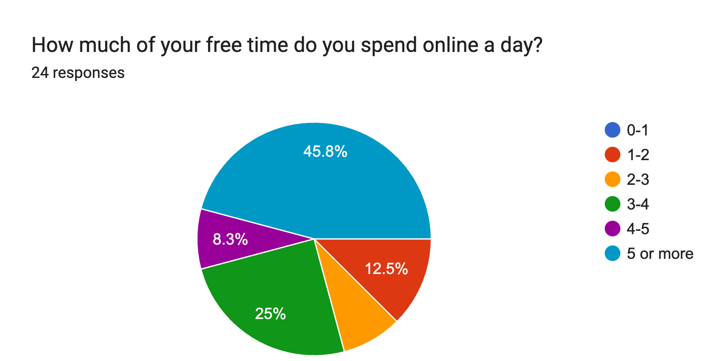
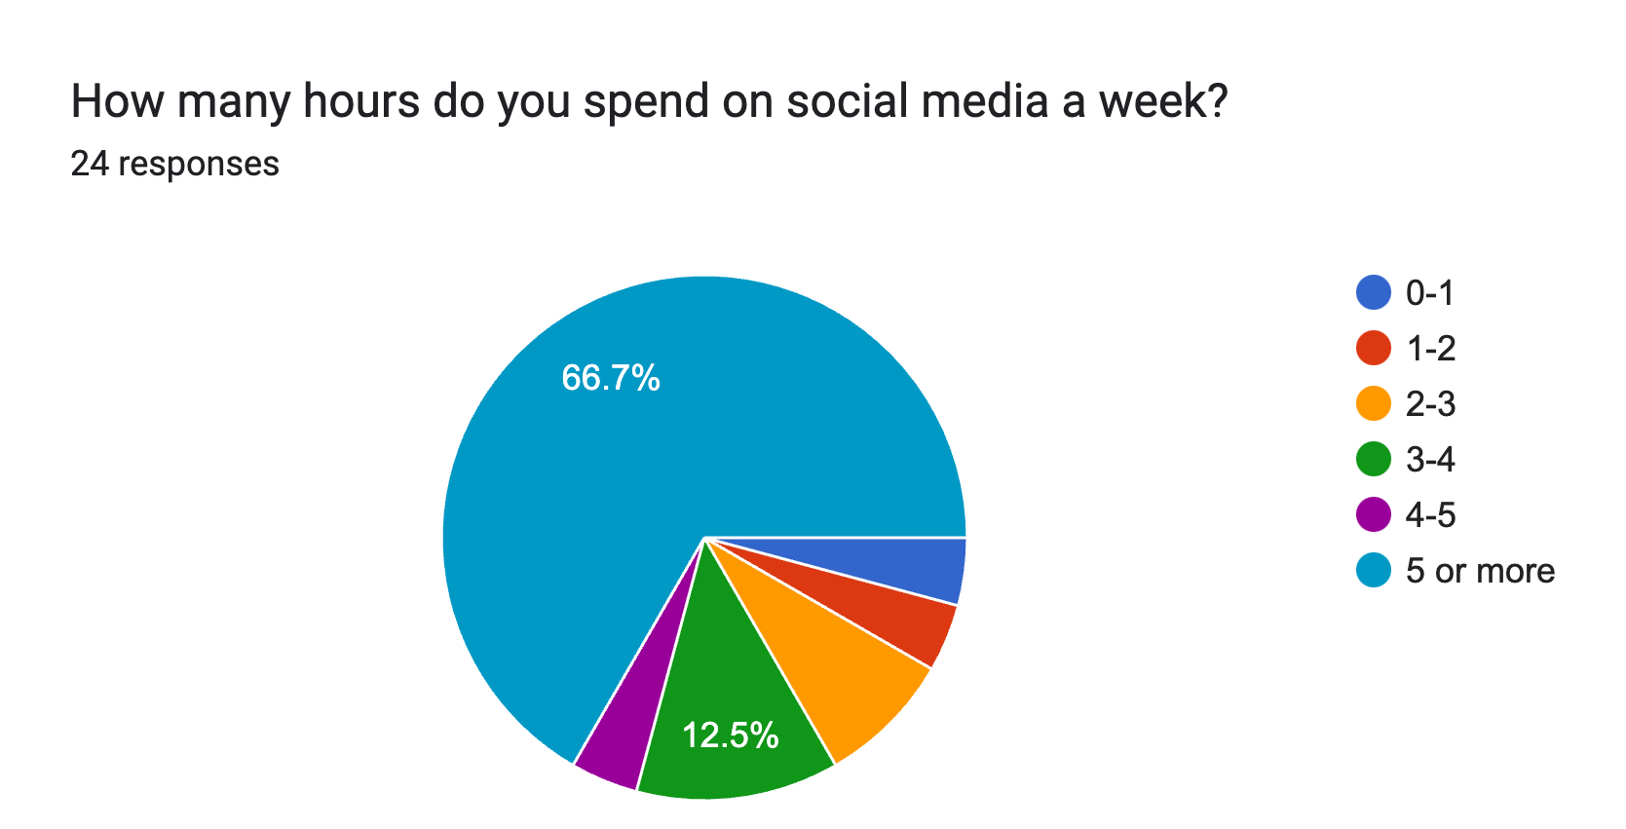
Survey (part 1)
Eleanor Foley
N=24
Average amount of time 18-24 aged people spend on social media is around 2 hours a day
11
16
Notes:
I conducted a quick survey on campus to see how WPI students feel about social media
I got 24 responses in total (small sample size I know) and found
16 people said they spend more than 5 hours a week on social media
And 11 people said they spend more than 5 hour a day online in their free time
experts generally recommend keeping usage between 30 minutes and two hours per day (link on page 13)
So that is 3 hours more than recommended. We are a STEM school so there is a higher expectation students will be online so that is not uncommon

Slide 31
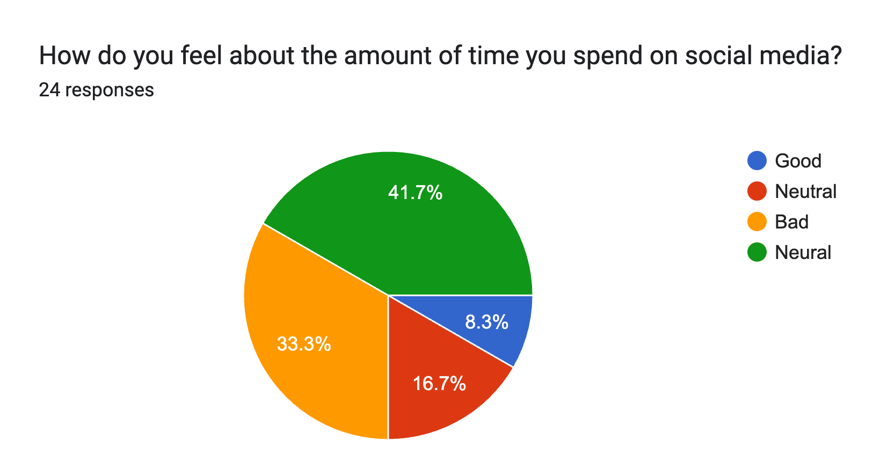
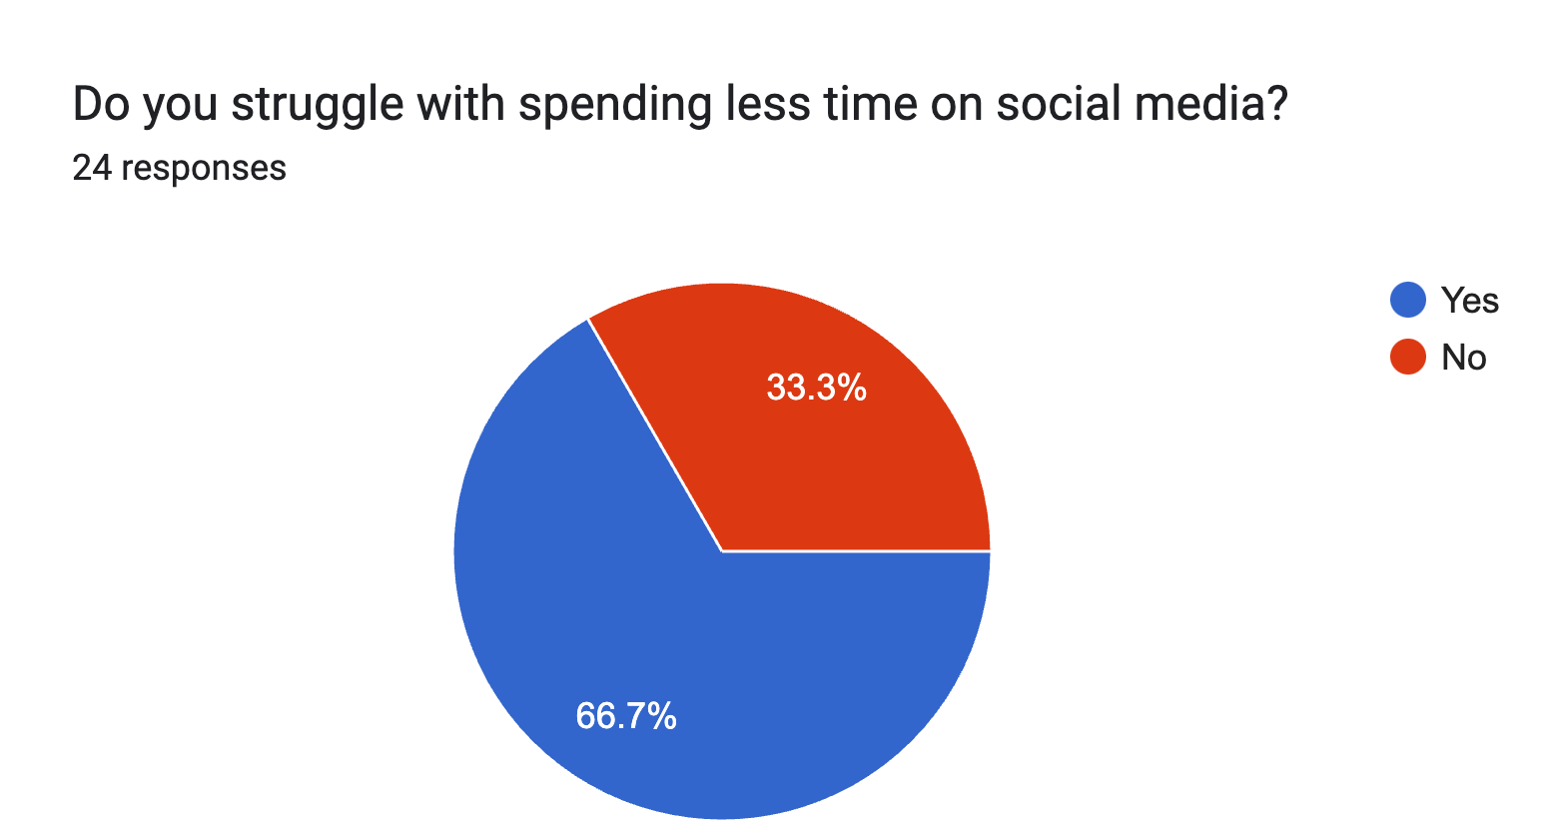
Survey (part 2)
Eleanor Foley
8
2
Neutral =14
8
16
Notes:
Surprising that a majority said they felt neutral about the amount of time they spend on social media, when a lot said they spend 5+ daily in their free time online and
5 or more a week on social media.
This is surprising because they are spending more time then recommended and is considered healthy on social media
2 said they felt good about their social media use.
Yet 8 said they didn’t struggle with spending less time on social media that indicates some people feel neutral with their social media use YET they struggle with spending less time online
This seemed quite odd to me.
I myself struggle with spending less time on social media and feel bad about that

Slide 32
Result
Eleanor Foley

Slide 33
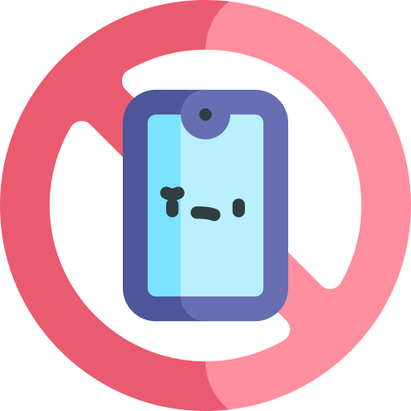

WHAT YOU SHOULD DO
Eleanor Foley
Take breaks
Limit screentime (depending on how much you use social media)
  Social media overuse is linked to increased levels of stress and anxiety and diminished concentration.
For iPhone users in Settings, one can set time limits for apps
After certain apps rate your mood
  I did this myself
Disable notifications
Monitor social media use
Notes:
(very well health) said people should keeping usage between 30 minutes and two hours per day
- find an accountability partner
I, myself turn do not disturb on in the evenings from 10pm-6am and have a time limit on Youtube (expect I often break that limit which isn’t great)
I have SnapChat and Instagram but no not enable notifications. Because I feel I only should be looking at those apps when I want to. Not when it’s telling me to look.
After certain apps rate your mood
I did this with Reddit. And saw I mostly felt mad in the end because I would only read AITA posts. Which were largely negative but got my dopamine running. Therefore I made the decision to delete the app.
https://www.verywellhealth.com/social-media-timing-8573175#:~:text=Although%20there%20is%20no%20set,and%20find%20an%20accountability%20partner.
s

Slide 34

Thank you!
Eleanor Foley

Slide 35
References
Eleanor Foley
[3] The Social Dilemma, Jeff Orlowski
[3] Hansen, Kelsey. “Our Social Media Addiction.” Harvard Business Review, 1 Nov. 2022, https://hbr.org/2022/11/our-social-media-addiction.
[4] Zaveri, Jui. “TikTok and the Death of the Attention Span.” The Oxford Blue, 23 May 2023, https://theoxfordblue.co.uk/tiktok-and-the-death-of-the-attention-span/.
[4] Guzman, Chad de. “Report: Facebook Algorithms Promoted Anti-Rohingya Violence.” TIME, 29 Sept. 2022, https://time.com/6217730/myanmar-meta-rohingya-facebook/.
[4] “Study: On Twitter, False News Travels Faster than True Stories.” MIT News | Massachusetts Institute of Technology, 8 Mar. 2018, https://news.mit.edu/2018/study-twitter-false-news-travels-faster-true-stories-0308.
[4] Navaroli, Anika Collier, and Ellen K. Pao. “Opinion: There’s a Clear Way to Regulate Facebook, TikTok and Other Social Media.” Los Angeles Times, 20 Mar. 2024, https://www.latimes.com/opinion/story/2024-03-20/social-media-facebook-tiktok-government-regulation.
[5] “Scammers Are Swiping Billions from Americans Every Year. Worse, Most Crooks Are Getting Away with It.” AP News, 7 July 2024, https://apnews.com/article/scammers-billions-elder-fraud-aarp-ai-f9530303e10b998720414e88430bcf6b.
[6] Leetaru, Kalev. “Social Media Platforms Are Still Powerless To Stop Data Misuse.” Forbes, https://www.forbes.com/sites/kalevleetaru/2018/12/05/social-media-platforms-are-still-powerless-to-stop-data-misuse/. Accessed 2 Sept. 2024.
[13] Tucker, Emma. “TikTok’s Search Engine Repeatedly Delivers Misinformation to Its Majority-Young User Base, Report Says | CNN Business.” CNN, 18 Sept. 2022, https://www.cnn.com/2022/09/18/business/tiktok-search-engine-misinformation/index.html.
[13] Zaveri, Jui. “TikTok and the Death of the Attention Span.” The Oxford Blue, 23 May 2023, https://theoxfordblue.co.uk/tiktok-and-the-death-of-the-attention-span/.
[9] “Social Media’s Impact on Our Mental Health and Tips to Use It Safely.” Cultivating-Health, https://health.ucdavis.edu/blog/cultivating-health/social-medias-impact-our-mental-health-and-tips-to-use-it-safely/2024/05. Accessed 2 Sept. 2024.
[10] “Time Spent Daily on Social Media U.S. by Age 2024.” Statista, https://www.statista.com/statistics/1484565/time-spent-social-media-us-by-age/. Accessed 1 Sept. 2024.
[14] “Addicted to Social Media? There’s a Healthier Way to Scroll.” Verywell Health, https://www.verywellhealth.com/social-media-timing-8573175. Accessed 2 Sept. 2024.

Slide 36

Tik tok
Eleanor Foley
Short videos
Shortens Attention Span
  In 2023, nearly 50% of users surveyed by TikTok said that videos longer than a minute long were “stressful” (WIRED)
  a third of users watched videos online at double speed (WIRED)
Easily Spread fake news
  In 2022, a research report said nearly 20% of videos presented by TikTok's search engine contain misinformation (NewsGuard)
Notes:
CUT THIS SLIDE OUT
In this slide, I am going to talk TIKTOK.
Tik Tok is known for their short vides which also shortens attention spans
A study published on ScienceDirect focusing on young adults who use the Chinese equivalent of TikTok – Douyin – found mild to significant “addiction-like symptoms” in more than half of the participants (total was 30 so 15).
In 2023, nearly 50% of users surveyed by TikTok said that videos longer than a minute long were “stressful” (WIRED)
And a third of users watched videos online at double speed (WIRED)
And in 2022 a research report said nearly 20% of videos presented by TikTok's search engine contain misinformation
extra
There was a count case in the supreme court about the fear of propaganda about the CCP spreading on the site (https://www.npr.org/2023/03/23/1165579717/tiktok-congress-hearing-shou-zi-chew-project-texas)

Slide 37
Class 4
The End
Keith A. Pray
socialimps.keithpray.net
Notes:
Use remaining time for group project questions and/or review group assignment slides.
This is the end. Any slides beyond this point are for answering questions that may arise but not needed in the main talk. Some slides may also be unfinished and are not needed but kept just in case.

Slide 38
what works well REmotely With Zoom
Turn your camera on
Sign in with First and Last Name
Stay muted unless you are going to speak
To speak use the raise your hand feature
Wait until the end of student presentations to ask questions
  Write them down so you don’t forget

