Slide 1
Class 3
Ethics
Keith A. Pray
socialimps.keithpray.net
Notes:
How is the first paper going?
What are your topics?
Conclusions?

Slide 2
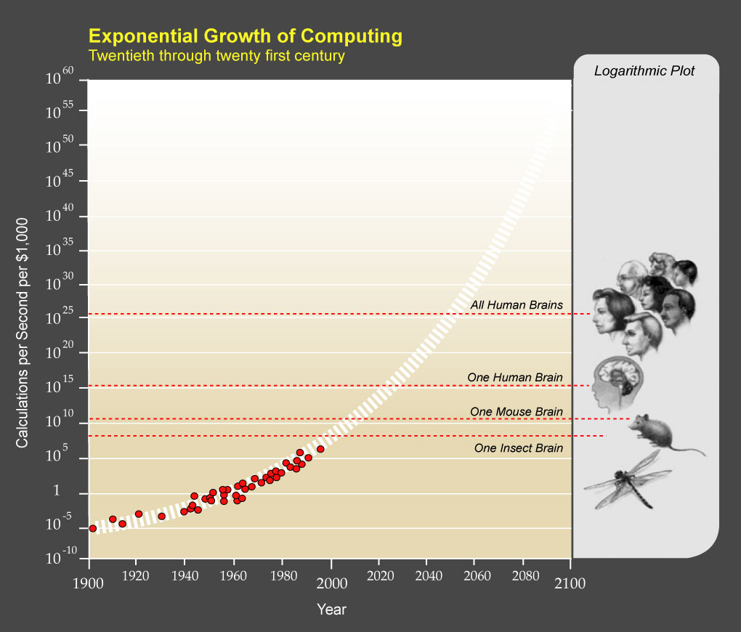
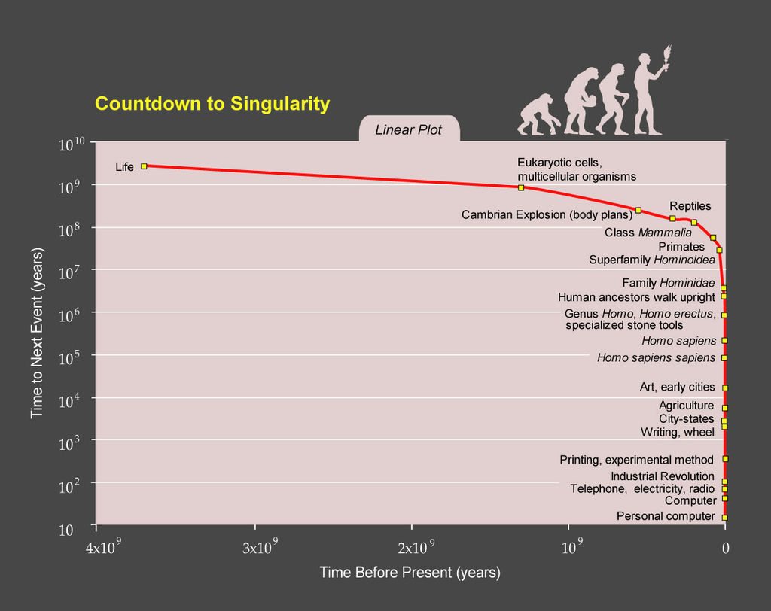
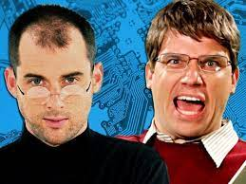
Ray Kurzweil: The Singularity Is Near: When Humans Transcend Biology, 2005
Notes:
On the left we see an exponential growth of the computations per second available for $1K, adjusted for inflation. Given the lower bound of an estimate (see relevant chapter in the Kurzweil’s book” for the calculations per second of organic brains, we see the inevitable eclipse of all human brain power within your lifetimes. Given the exponential growth, note it is a logarithmic scale to boot, even if the estimates are off by a good margin the claim still holds. Not sure if this accounts for the human population growth since this was published but given a 1/7 billion increase the linear growth does not make a dent in the exponential growth.
On the right we see the same growth from the perspective of planet Earth as a calculation power producer machine. The number of significant computing advancing events increasing exponentially is good evidence that the computations/second growth on the left is likely to continue. A look at our class time line wiki also shows this, with many more events being found relevant for this course in more recent years.
Show book if you have it.
This puts it a different way:
Show Epic Rap Battles of History: Steve Jobs vs. Bill Gates (2013) (If class ok with crude lyrics) (2:47)
https://www.youtube.com/watch?v=njos57IJf-0
Things of note from general knowledge and https://epicrapbattlesofhistory.fandom.com/wiki/Steve_Jobs_vs_Bill_Gates/Rap_Meanings
Numerous references to Steve Jobs’ personality, often a hinderance to business
Notes transformative effect of Apple products on every day life
Gates would have been 27 by the time Apple hit Fortune 500 list
Apple IIe – Apple too easy
Melinda developed MS Bob GUI overlay for Windows 3.1
Jobs need to run some BASIC programs
Microsoft - portmanteau of “Microprocessor Software”
SBBoD – Spinning Beach Ball Of Death – just as dreaded as the Windows hourglass
TODO: How much was Gates donating at time of battle?
Apple and Microsoft roughly equivalent worth at time of battle (TODO: how much?)
“pwn” common mistyping of “own” with “o” and “p” being adjacent on QWERTY keyboards
Does the stereotypical creative, recreational, individual empowering use of Apple products and business use of Windows machine still hold?
Jobs/Apple build off of Xerox PARC and Wozniak often in background with Jobs out front (Woz was on Dancing with the Stars for a bit…)
1988 and subsequent lawsuits of GUI copyright infringement and Apple logo
Open system vs. closed and economic advantage
Claim Apple less malware vulnerable largely due to being a smaller target, as market share grew so did targeted malware
Apple products still more expensive until you compare higher end capabilities/capacities
PC – Pancreatic Cancer
2001: A Space Odyssey, in which it originally said, "I'm sorry, Dave. I'm afraid I can't do that," HAL 9000
In context of this class, see history in Kurzweil’s graphs
IMB Deep Blue (chess), IBM Watson (Jeopardy), HAL beats a crew member at chess
When being shutdown HAL began singing "Daisy Bell" (aka "A Bicycle Built for Two"), as it was the first song that he learned. HAL never understood the concept of sleeping, so thought he was dying, so he possibly plans to actually kill Bill. The song was also the first song "sung" by a computer in real life—an IBM 7094 in 1961. Arthur C. Clarke, author of 2001: A Space Odyssey, was at the demo event and drew HAL from that.
Socket I see as a move into robotics in addition to moving out of human control
Ubiquitous computing and accidental emergent behaviors could result in sentient machines even if we don’t try to build one
Cortex, see left graph again
TODO: systems currently passing the Turing Test?
See Linux/GNU in IP chapter of test book
17 lines SCO claimed stolen from SCO UNIX in Linux kernel, HAL delivered 17 lines of rap so far
Apple :Think Different” slogan, Babbage’s Difference machine
Windows Vista (2007), Terminator 2 movie
The Singularity Is Near: When Humans Transcend Biology, Ray Kurzweil, Viking, 2005
[1] "PPTExponentialGrowthof Computing" by Coutesy of Ray Kurzweil and Kurzweil Technologies, Inc. - en:PPTExponentialGrowthof_Computing.jpg. Licensed under CC BY 1.0 via Wikimedia Commons, 2005 - http://commons.wikimedia.org/wiki/File:PPTExponentialGrowthof_Computing.jpg#/media/File:PPTExponentialGrowthof_Computing.jpg
[2] "PPTCountdowntoSingularityLinear" by Coutesy of Ray Kurzweil and Kurzweil Technologies, Inc. - en:PPTCountdowntoSingularityLinear.jpg. Licensed under CC BY 1.0 via Wikimedia Commons, 2005 - http://commons.wikimedia.org/wiki/File:PPTCountdowntoSingularityLinear.jpg#/media/File:PPTCountdowntoSingularityLinear.jpg

Slide 3
Logistics Reminder
Sign up for individual presentations
  Great ideas so far!
  3 slots still open, 1 disappears September 6th
  Worth 10 points
Send me your top 3 movie choices so we can form groups
Email all the course staff, you’ll get a quicker response
Notes:
Hide if N/A
Common Reminders:
Email Etiquette – thoughts?
Extra credit for identifying extra credit opportunities requires you complete the extra credit assignment
Email all the course staff, you’ll get a quicker response
Read Assignment Slides
Sign up for individual presentations
Send course staff email

Slide 4
Overview
Group Project
Review
Ethics
Assignment

Slide 5
Movie Group Project Overview
Explore computing technology portrayed, analyze course topics
Project Web Site
  Will review progress in class
  Analyze subject from the prospective of each topic covered in class
  Critical Thinking, Ethics, and Professional Ethics are analysis tools, not topics
Presentation
  Give arguments for most salient conclusions drawn
We will review group project details at end of class time permitting

Slide 6
Overview
Group Project
Review
Ethics
Assignment

Slide 7
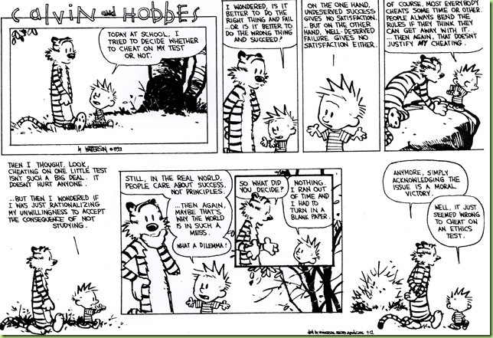
Notes:
TODO – Find comic directly related to computing

Slide 8
My Reading Notes
A number of sources without publish dates
p. 47 Used to start with nice quote:
  “No man is an island, entire of itself; every man is a piece of the continent, a part of the main. If a clod be washed away by the sea, Europe is the less, as well as if a promontory were, as well as if a manor of thy friend’s or of thine own were. Any man’s death diminishes me, because I am involved in mankind; and therefor never send to know for whom the bell tolls; it tolls for thee. – John Donne, Meditation XVII , 1624
p. 49 isn’t thinking you are better than others indicative of the opposite?
p. 53 Self driving car would change example scenario a lot
p. 55 Does mention of Hitler invalidate the argument? - Mike Godwin
p. 56 “Instincts were learned…”?
p. 58 many/any fallacy not mentioned in Appendix B
p. 60 Low value image
p. 64 There’s no expectation the doctor’s practice would suffer?
p. 68 Is it easier for CS types to use 2nd Categorical Imperative formulation? Am I generalizing or biased for asking?
p. $133K for house?
p. 78 Insurance companies do it, should they?
p. 84 Convenience stores rent DVDs? Example does not have clear conclusion.
p. 92 Case 3 against: minors vs adults, help and education vs. punishment
p. 94 Low value image
p. 96 How about lending the CD? Virtue ethics?
p. 100 Q 37 NA, interview not in 9th edition.
Questions I Liked: 7, 8

Slide 9
Overview
Group Project
Review
Ethics
Assignment

Slide 10
Clarifying Points
Ethical Actions
Based on belief that people are
  Rational
  Free to choose
Can be
  Mandatory
  Prohibited
  Acceptable
Rights
Negative
  Liberties
  Often Absolute
Positive
  Claim-rights
  Often Limited
  Usually requires someone else to provide

Slide 11
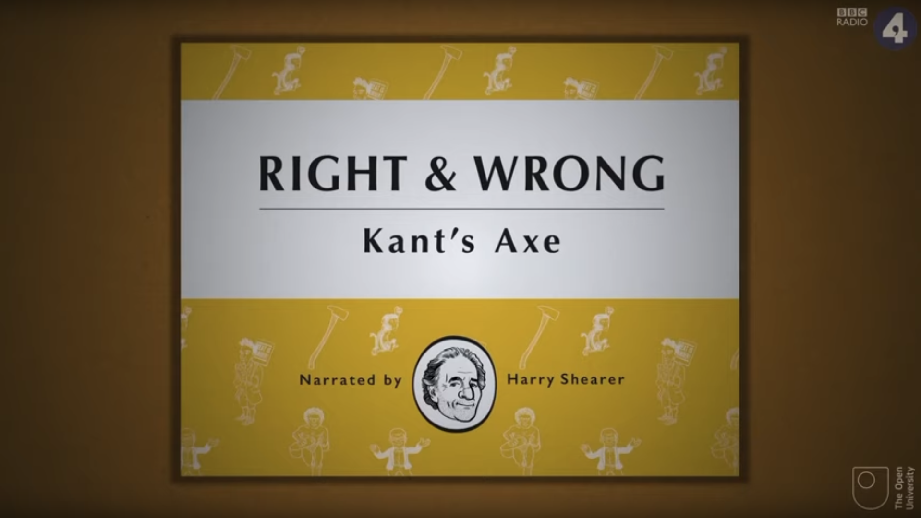
Ethics Vocabulary
Deontological Theories
  A.K.A. nonconsequentialist
  Theory/study of moral obligation
Consequentialist Theories
Social Contract Theory
  A.K.A. Contractarianism
Virtue Ethics
  A.K.A. Character Based Theory
Information Ethics
Greek deon = duty
Emphasizes duty and absolute rules to be followed whether they lead to good or bad consequences.
Kant often primary example.
Rules should apply to everyone.
Good rules intrinsically follow logic. Follow reason not emotion to make decisions.
Treat people as an ends, not solely as a means. Respect for persons.
Notes:
Which formulation of the categorical imperative do you prefer?
Kant’s Axe (1:33)
Published on Nov 18, 2014 – BBC Radio 4
Accessed 2016-09-02
www.youtube.com/watch?v=x_uUEaeqFog

Slide 12
Ethics Vocabulary
Deontological Theories
  A.K.A. nonconsequentialist
  Theory/study of moral obligation
Consequentialist Theories
Social Contract Theory
  A.K.A. Contractarianism
Virtue Ethics
  A.K.A. Character Based Theory
Information Ethics
Main example is Utilitarianism.
Increase aggregate utility, value, or happiness. How to measure?
The Happiness Unit: util
  “just perceivable increment of subjective wellbeing (or happiness) over a just perceivable interval of time” –Ng (1996) [1]
Watch out for theories going to far; violating rights of a few for the “good” of the many.
Notes:
[1] Ng, Y.-K. (1996). Happiness surveys: some comparability issues and an exploratory survey based on just perceivable increments. Social Indicators Research, 38: 1-29.

Slide 13
Ethics Vocabulary
Deontological Theories
  A.K.A. nonconsequentialist
  Theory/study of moral obligation
Consequentialist Theories
Social Contract Theory
  A.K.A. Contractarianism
Virtue Ethics
  A.K.A. Character Based Theory
Information Ethics
Uses rights as basis
Explains people’s selfishness in absence of common agreement
Analysis of moral issues regarding people and government.
Characterization of actions can change outcome of analysis, does not solve conflicting rights.
Are laws based on ethics?
Are all laws ethical?
Civil Disobedience
Notes:
Civil Disobedience: acceptance of consequences of breaking the law is a main tool in effecting change.
From Wikipedia (TODO: get primary source):
“Consent of the governed" is a political theory stating that a government's legitimacy and moral right to use state power is, or ought to be, derived from the people or society over which that power is exercised.
This theory of "consent" is historically contrasted to the divine right of kings and has often been invoked against the legitimacy of colonialism.
Following John Locke's notion of a nation of "free and equal" citizens, the Founders of the United States believed that consent of the governed was the only legitimate basis upon which one "free and equal" citizen could exercise legal authority over another -- otherwise neither equal could overcome the other.

Slide 14
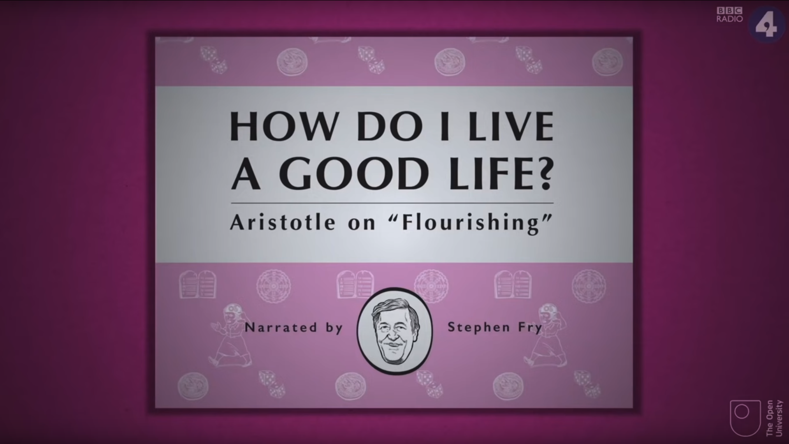
Ethics Vocabulary
Deontological Theories
  A.K.A. nonconsequentialist
  Theory/study of moral obligation
Consequentialist Theories
Social Contract Theory
  A.K.A. Contractarianism
Virtue Ethics
  A.K.A. Character Based Theory
Information Ethics
Stresses character development and moral education, not formalized rules.
What kind of person should I be?
Does this feel right or wrong?
Depends on homogeneous community standards for morality.
Confucianism, Plato and Aristotle, more recently Alasdair MacIntyre.
Notes:
Aristotle on 'Flourishing’ (2:00)
https://www.youtube.com/watch?v=j_7deR0idvs
BBC Radio 4
Published 2015-03-30

Slide 15
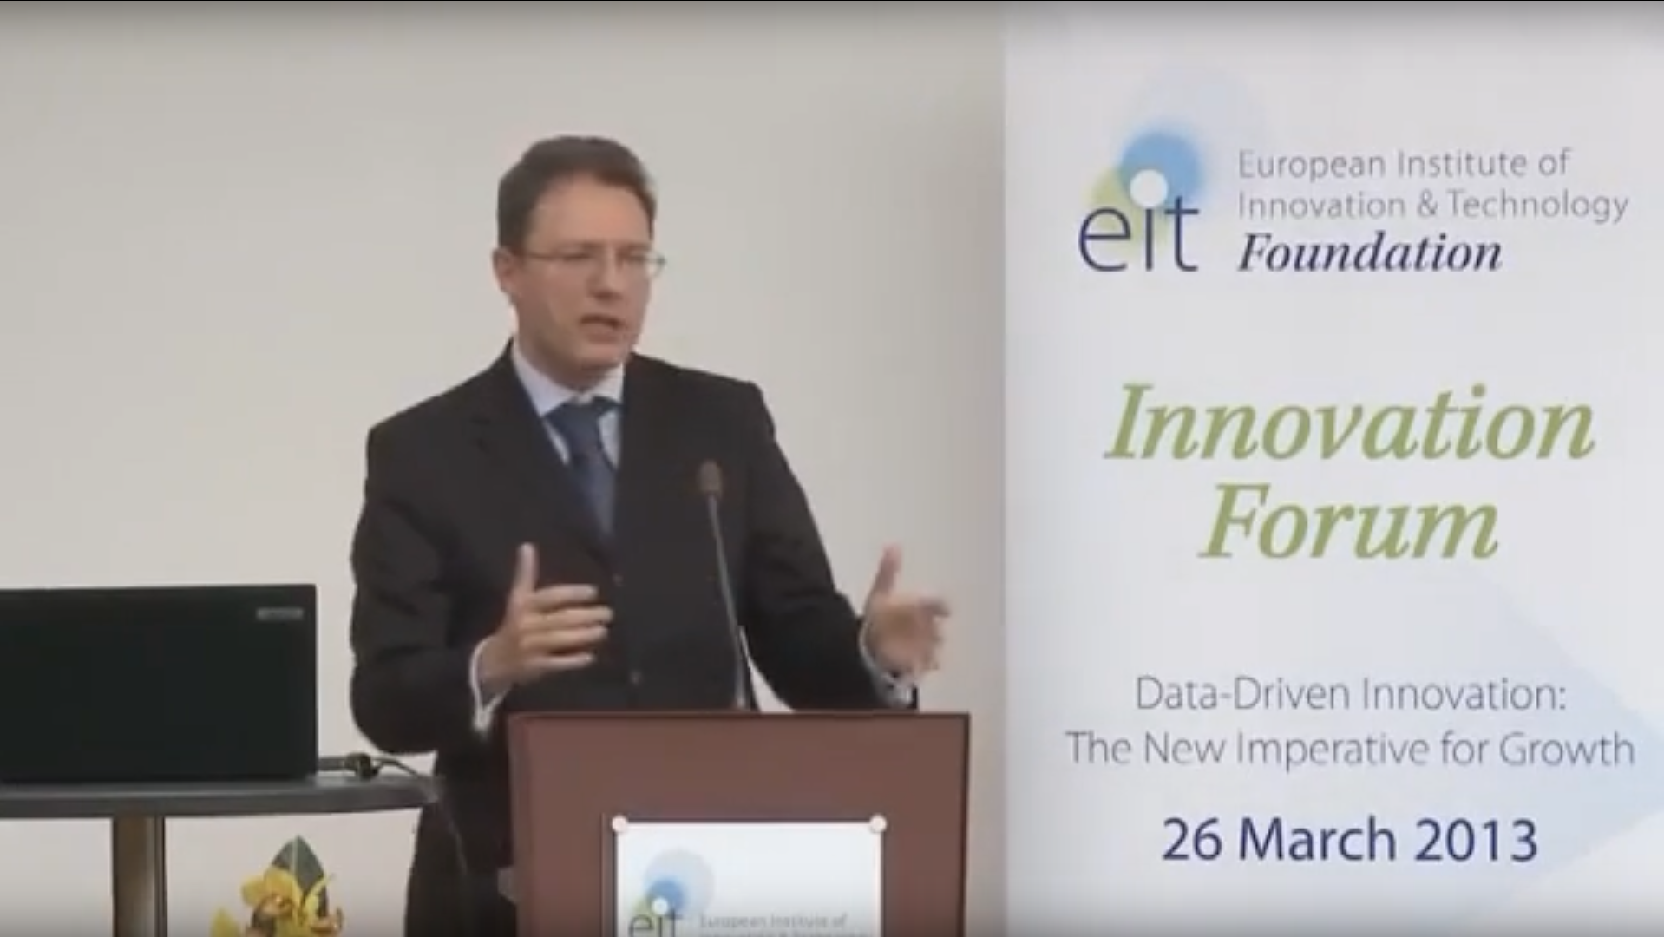
Ethics Vocabulary
Deontological Theories
  A.K.A. nonconsequentialist
  Theory/study of moral obligation
Consequentialist Theories
Social Contract Theory
  A.K.A. Contractarianism
Virtue Ethics
  A.K.A. Character Based Theory
Information Ethics
Macroethics – Luciano Floridi [1]
All entities informational → moral value → right to persist
Information = Good
Entropy = Evil
Moral agents: interactive, autonomous, adaptable transition systems that can cause good or evil
Accountability != Responsibility
Notes:
Moral accountability is different from responsibility. Responsibility is current focus of much ethics and certainly law but moving to accountability and managing ethical decisions from this perspective may enable a more inclusive framework.
[1] Luciano Floridi, “Information Ethics,” in The Cambridge Handbook of Information and Computer Ethics, ed. Luciano Floridi (Cambridge, UK: Cambridge University Press, 2010)
“The philosophy of information and information ethics – Lecture” (15:35)
https://www.youtube.com/watch?v=s2QLL8WawoQ
Luciano Floridi
Published 2016-12-19
“TEDxMaastricht - Luciano Floridi - "The fourth technological revolution” (8:50)
https://www.youtube.com/watch?v=c-kJsyU8tgI
Published 2011-04-06

Slide 16
Group Quiz
Scenario 4 in Section 2.1.3
Split into teams of 3
Pick one:
  Kantian
  Act Utilitarian
  Rule Utilitarian
  Social Contract Theory
  Virtue Ethics
Does your team recommend release next week?
Provide justification (argument)
Ethical Analysis Guide
https://socialimps.keithpray.net/documents

Slide 17
Overview
Group Project
Review
Ethics
Assignment

Slide 18
Assignment
Finish Paper 1
Complete all assigned reading
Work on your individual presentations
Start Group Project work
  Review assignment slides
Notes:
Common Reminders:
Send email with your top 3 movie choices after I send out the list to choose from

Slide 19
Class 3
The End
Keith A. Pray
socialimps.keithpray.net

Slide 20
what works well Online With Zoom
Sign in with First and Last Name
Stay muted unless you are going to speak
To speak use the raise your hand feature
To answer yes/no questions use the “yes” ”no” buttons
Turn your camera on
Wait until the end of student presentations to ask questions
  Write them down so you don’t forget

