Slide 1

Class 1
Introduction
Keith A. Pray
socialimps.keithpray.net
Notes:
Show https://zombo.com/ (1999)
If applicable: Zoom guidance.
Retire “anything wrong with this slide” opener, students are unlikely to have encountered older 3:4 display formats.
- Practice critical thinking: Is there anything wrong with this slide?

Slide 2
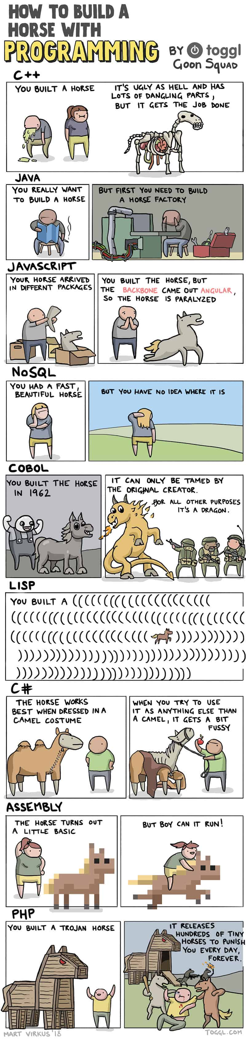
Notes:
How many people in the world get these jokes?
https://toggl.com/blog/build-horse-programming
Accessed: 2022-10-14

Slide 3
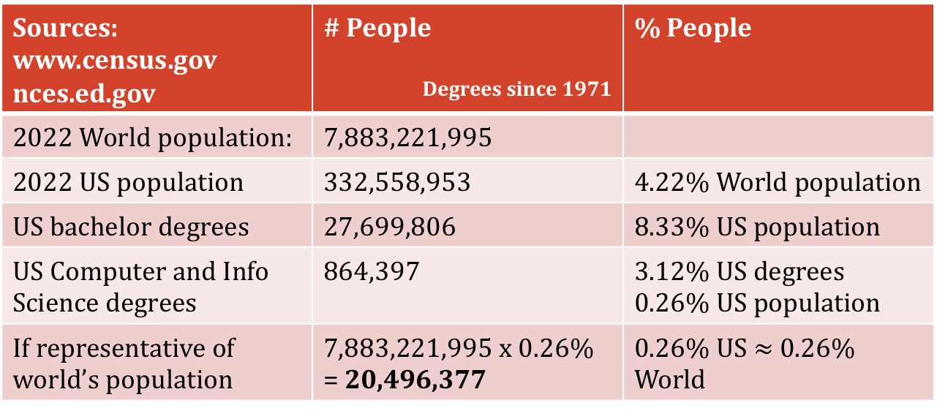
How many people might get those jokes?
Sources: www.census.gov nces.ed.gov | # People Degrees since 1971 | % People
2022 World population: | 7,883,221,995
2022 US population | 332,558,953 | 4.22% World population
US bachelor degrees | 27,699,806 | 8.33% US population
US Computer and Info Science degrees | 864,397 | 3.12% US degrees 0.26% US population
If representative of world’s population | 7,883,221,995 x 0.26% = 20,496,377 | 0.26% US $≈$ 0.26% World
Notes:
So about 1/385 people you meet might know what you’re talking about…
https://www.census.gov
2022 World population: 7,883,221,995
2022 US population: 332,558,953 (4.22% World)
https://nces.ed.gov
Since 1971 US bachelor degrees: 27,699,806 (8.33% US)
Since 1971 US Computer and information sciences and support services: 864,397 (3.12% US degrees, 0.26 US population)
If US representative of world, ~ # CS related degrees: 20,496,377
OLD INFO
https://www.census.gov
2017 World population: 7,377,435,000
2017 US population: 324,674,608 (4.4% World population)
https://nces.ed.gov
Since 1971 US bachelor degrees: 25,568,606 (7.9% US population)
Since 1971 US Computer and Info Science degrees: 675,412 (2.6% US degrees, 0.2% US population)
If representative of whole world’s population:
0.2% US == 0.2% World: 7,377,435,000 x 0.2% = 14,754,870
2014-2015 US bachelor degrees: 1,894,934
2014-2015 US Computer and Info Science degrees: 59,581
OLDER INFO
According to wolframalpha.com (2012-08-23):
2.34% (of 6.79 billion people) attend secondary school
50 million secondary school grads in United States (of 309 million people) 16.18%
3.3 million computer specialists in United States (of 309 million people) 1.06% (or 6.6% of college grads)

Slide 4
Rise of PC era?
Internet/.com bubble?
Notes:
Source: https://nces.ed.gov
Total = all Degrees Majors
27.6 million degrees from previous slide from summing total from each period shown here
Nice to point out things you want people to notice:
Interesting peaks during 1980s (rise of the PC era?) and late 1990/early 2000s (rise of the Internet/.com bubble?)
Best to avoid animation though.

Slide 5
/(BB|[^B]{2})/
2022 LinkedIn People Claiming:
Software Development: 5,530,000
Regular Expressions : 27,000 (0.49%)
Using Key Word Search, skill filter not available w/out subscription
See Notes for 2018 and earlier data
Notes:
/
bb # two b's
| # or
[^ # not
b]{2} # two b's
/
2022:
Need subscription to filter by skill now.
LinkedIn key word search “software development” yields: 5,530,000
LinkedIn key word search “Regular Expressions” yields: 27,000 (0.49%)
2018:
People on LinkedIn claiming to have the skill “Software Development”: 5,594,241
People on LinkedIn claiming to have the skill “Regular Expressions”: 33,007 (0.59%)
2017:
People on LinkedIn claiming to have the skill “Software Development”: 896,137
People on LinkedIn claiming to have the skill “Regular Expressions”: 34,528 (3.9%)

Slide 6
Overview
Introduction
  Course Staff
  Logistics
  Outcomes
Assignment

Slide 7
Course Staff
Instructor
Assistant
Keith A. Pray
kap@wpi.edu
Office Hours
  Room: FL 140
  30 minutes before class
  the hour following class
  By Appointment
SA
  Laura Pellowski
  lmpellowski@wpi.edu
Who are you?
  Youngest? Oldest?
  Majors? Years?
  Why take this course?
Notes:
Here’s our contact info.
Introduce yourself.
Get to know class:
Youngest? Oldest? Country of origin?
Majors? Years?
Reasons for taking class
Maybe go around the room and have student introduce themselves noting something interesting computing related about themselves.

Slide 8
Logistics
Course Web Site
Interactive Activities
http://socialimps.keithpray.net
Syllabus
Grading Policy
Due Dates
Guides
Slides with Assignment Descriptions
Canvas
  Discussion Boards
  Assignment Turn In
  Announcements made on Canvas
  Canvas → Account → Notifications
https://wiki.wpi.edu/cs3043
Notes:
Let’s go to the course website for this stuff.
Always check course web site for grading rubrics.
Individual presentations are due 24 hours before class so that they can be incorporated into class slides.
Mention use of Zoom for Office Hours/meetings, and in case I cannot come to campus.

Slide 9
Grades
To Date
0 Max Possible
Notes:
Grading philosophy
No mastery of material has been demonstrated yet, everyone has zero points
The course staff create opportunities to show mastery of the material for which points are awarded
Points are not taken away, only earned
Papers take a bit of practice and the grading policy takes this into account
Typical progression shown
Consistent standard throughout term to see actual improvement
Two optional papers
Final letter grade takes entire class performance into account

Slide 10
Outcomes – You will
Demonstrate understanding of links between computing technology, society, and computing professional responsibilities
Discover and use primary sources relevant to course topics in support of arguments
Present personal verbal and written opinions based on well reasoned arguments
Be familiar with social, moral, and ethical issues faced by computer professionals
Be able to recognize computing related ethical issues
Understand professional codes and ideals and apply them in decision making
Analyze popular portrayal of computing and its effects
Practice critical thinking, written, and oral presentations skills
Be responsible for your own learning
Practice dealing with ambiguity
Notes:
Focus on Decision Making
Try Using web site instead this time
Paraphrased from Outcomes on web site
Stress students are responsible for their own learning
Stress dealing with ambiguity as useful skill
BLUF: Bottom Line Up Front – mostly practicing this style of delivery

Slide 11
Group Quiz!
What is computing?
What is the oldest computing device you can think of?
Is there a computing technology you wish society had not adopted?
How do you make decisions regarding computing?
Notes:
The counters in an abacus is where the term “counter” meaning place in a shop where transactions take place.
What is the oldest computing device you can think of?
manual calculating aids –
clay or wax tablet (5500 BC or older)
slate tablet (1300s BC)
paper tablet
abacus (2700 BC)
mathematical tables (190 BC) (logarithms is an important one 1500s)
Antikythera Mechanism analog computer (0 BC)
Is there a computing technology you wish society had not adopted?
What good will you do with your degree?
What is the biggest impact computing has had on your life?
What is computing?
What computing technologies have been invented during your lifetime?
How do you make decisions regarding computing?

Slide 12


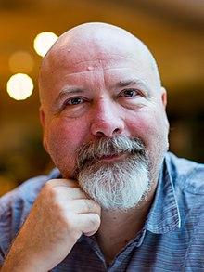
What is Technology?
Merriam-Webster: The use of science in industry, engineering, etc., to invent useful things or to solve problems [1]
Alan Kay: Technology is anything invented after you were born
  Pioneer in object oriented programming
Hillis Danny: Technology is anything that doesn't work yet
  Of Thinking Machines Corporation
Notes:
Segue: What technologies have been invented during your lifetime?
[1] http://www.merriam-webster.com/dictionary/technology (Accessed 2016-08-26)
Allan Kay: Pioneer in object oriented programming
Photo from https://amturing.acm.org/award_winners/kay_3972189.cfm
Hillis Danny: Of Thinking Machines Corporation
Phot0 from https://en.wikipedia.org/wiki/Danny_Hillis

Slide 13
Manufacturer | Compaq Computer Corporation, United States
Type | Portable computer
Release date | January 1983
Introductory price | US $3,590
Operating system | MS-DOS
Storage capacity | Two 5.25" floppy drives or, 1 floppy drive + 10 MB HD
Memory | 128 kilobytes (expandable to 640)
Display | Built-in 9" green screen monitor + CGA-compatible video card
Weight | 28 lbs (12.5 kg)
Processor | Intel 8088
Speed | 4.77 MHz
Notes:
Color Graphics Adapter (CGA)
Show old portable computer.
Info in slide from http://en.wikipedia.org/wiki/Compaq_portable
Links on web site.
http://socialimps.keithpray.net/documents/index.jsp?content=Show_and_Tell.html

Slide 14

Utopias and Dystopias
Types:
  Economic
  Political
  Technological
What makes it a utopia or dystopia?
Why do we create them?
Examples, real or fictional?
Notes:
What "Orwellian" really means - Noah Tavlin (5:31)
http://ed.ted.com/lessons/what-orwellian-really-means-noah-tavlin
Canvas Discussion Board

Slide 15
Overview
Introduction
  Course Staff
  Logistics
  Outcomes
Assignment

Slide 16
Assignment 1/2
Read “Organization of The Book” (xiv - xvi) in Preface
Movie Discussion Board on Canvas
  List 2 movies you believe relevant to computing AND society
  State why in a paragraph
  Create a new thread for each movie
  Do not summarize the movie, you can reference a synopsis
  Avoid repeating entries, they won’t count and are confusing
  Comment on a minimum of 2 movies you did not add
    Add your own rationale, avoid repeating previous comments
  Cite reference material –use at least 1 per post
Notes:
Encourage students to send email right away if they have any problems with Canvas.

Slide 17
Assignment 2/2
Sign up for individual presentation
Current schedule at:
  http://socialimps.keithpray.net
Sign up by sending course staff email
State what decision you’ll be making
  For example:
    “AI” is too general
    “Does AI research need to be regulated?” is better
  It may take time to refine your topic
  I’m happy to discuss your ideas
10 Minutes, reserve 2 for Q/A
6 points material quality
2 points presenting in class
2 points showing depth during Q/A
See Presentations on course web site for details
  http://socialimps.keithpray.net/assignments/presentation-guidelines/
Notes:
Show Syllabus again and stress email.

Slide 18
Class 1
The End
Keith A. Pray
socialimps.keithpray.net
Notes:
This is the end. Any slides beyond this point are for answering questions that may arise but not needed in the main talk. Some slides may also be unfinished and are not needed but kept just in case.
Interesting career:
Bob Supnik: A pioneer in the computer industry who (almost) eschews high tech
by Mary-Lynne Bohn
Carlisle Mosquito, print: 2021-05-14, online 2021-05-12
https://www.carlislemosquito.org/index.php/search/?id=37781
Last accessed 2021-05-31

Slide 19
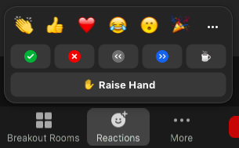
Online With Zoom
Turn your camera on
Sign in with First and Last Name
Stay muted unless you are going to speak
To speak use the raise your hand feature
To answer yes/no questions use the “yes” ”no” buttons
Wait until the end of student presentations to ask questions
  Write them down so you don’t forget
Notes:
If at all possible turn your camera on. It makes conversations much easier and you’ll find yourself much more likely to participate.

Slide 20
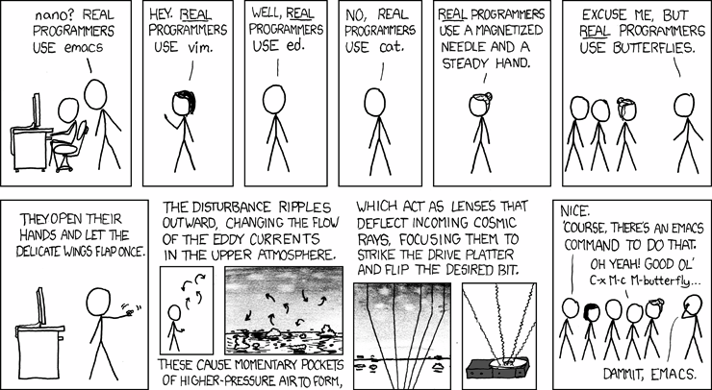
2008-02-01 http://xkcd.com/378/
Notes:
How many people in the world get this joke?
nano’s defining traits? – pico like editor from pine email system
emacs? - extensibility
vim? – Amiga programmers, modal
ed? – first parts of UNIX from 1969, very basic
cat? –concatenates files (displays by concatenating to screen file)
What about Solid State Drives?
Emacs – psychoanalyze-pinhead
doctor (implementation of ELIZA)
yow (quotes from Zippy the Pinhead zippythepinhead.com)

