Slide 1
Class 10
Professional Ethics
Keith A. Pray
socialimps.keithpray.net

Slide 2
Overview
Review
Debate
Assignment
Students Present
Notes:
ADD QUIZ AS BACKUP IF CLASS DISCUSSION NOT LONG ENOUGH

Slide 3

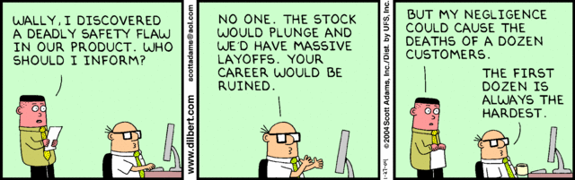
Notes:
Ask how many people in ACM or IEEE

Slide 4
My Reading Notes
pp. 454 3. Would people agree – social contract, not virtue ethics?
pp. 460 Pointing to the outcome of Tim’s efforts is not grounds for assuming his intentions.
pp. 468 “return to using principle-based…” source from 2003, needs update. This happened a while ago.
pp. 469 pension quote source from 1983, tough to get a pension now
Axtell Interview: Lots of great advice despite it feeling like an advertisement: “training” recommended as solution 3 times on first page, 4 in total in less than 3 pages.
Questions I liked: 24
Notes:
An error of commission is one where the person responds where they should not. This is compared to an error of omission, where the person fails to respond when they should.

Slide 5
Debate Ground Rules
Before Debate
  10 minutes to converse with your team
  Share argument points, counter points, and responses
  Share experiences, especially in different countries, cultures, situations
  Decide who will: Go first, Respond to which points from opposing side
During Debate
  1 turn per person until everyone on your team has spoken
  Try to keep remarks to 30 seconds
Prompt: Should we produce a FPS game based on current war?
Notes:
Release Game or Not Debate
Chapter 9 In-class Exercises # 24.
Should we (the company) produce the game?
Use the SWE Code Of Ethics as the basis for your argument.
If Remote:
Add “(YES)” or “(NO)” to the end of your name in Zoom to show your side

Slide 6
Assignment
1 Page Paper
  What should computerized automation be applied to next?
Finish all reading
Group Project
  Add analysis to website addressing remaining topics
  Group Presentation Draft
    Submit as Power Point on Canvas
    Post Power Point file on group website
Notes:
1 Page Paper Ideas:
For Good - How will you use your computing related education to do good in the world?
Dark Net - Is the Dark Net good or bad?
Does computerized automation help the economy or society?
What should computerized automated be applied to next?
If productivity has increased so much, why are we working so hard? Should we?
What job skills will survive computerized automation?

Slide 7
Overview
Review
Debate
Assignment
Students Present
Notes:
Show WPI and/or corporate code of ethics.

Slide 8
Algorithmic bias in law enforcement
Alden Cutler
Notes:
Introduce yourself
Say title
Hi, my name is Alden. I’d like to talk about algorithmic bias

Slide 9
What is it?
Alden Cutler
“A systematic error in predictive computation” [1]
Computational discrimination where unfair outcomes privilege one arbitrary group over another [1]
Notes:
Most of you have probably heard the term before. In the simplest terms, algorithmic bias is a systemic error in predictive computation. In most applications, this refers specifically to computational discrimination where unfair outcomes privilege one arbitrary group of people over another.

Slide 10
Where does it come from?
Alden Cutler
Models are representative of the data they are trained on
  Biases present in training data are exposed in final product [2], [3], [6]
Most bias is introduced in development and deployment stages [3]
  Other stages affect how much bias is introduced in these two stages [3]
Acquisition Planning
Solicitation and Selection
Development
Delivery
Deployment
“Framework for Acquisition of Machine Learning Tools, [3]
Notes:
Where does this problem come from?
Cases of algorithmic bias show up most often in machine learning models
These models are representative of the data they are trained on, which means that any biases present in the training data will be reflected in the final product
A study done by researchers from the RAND corporation concluded that the main reason behind these flawed correlations is datasets representing historic or systemic biases.
Most of the bias is introduced in the development stage and the deployment stage
The development stage is where the model is trained, using the data that could represent unwanted bias
The deployment stage is how the model is actually used. One of the points that almost every article I read talked about was how the model is being used, as the way in which these ML systems are used can quickly amplify the adverse effects
Acquisition planning: developing the overall strategy for managing the acquisition.
Solicitation and Selection: a follow-up step to solicit proposals for development of the technology from vendors, then to select a vendor to be the provider of the technology
Development: Designing, building, training, and testing the model in a simulated environment
Delivery: Receiving the developed system from the vendor and integrating it into the infrastructure of whoever is using the model
Deployment: The product is deployed for operation

Slide 11


What are the consequences?
Alden Cutler
Real-life impacts
  Especially in law enforcement [2], [3]
  Can result in perpetuating discrimination [2], [3]
Ethical and moral problems
  ACM Code of Ethics 1.1 and 1.2 [4]
Notes:
These errors can cause a lot of harm, a theme that I saw not only in many articles, but also in the textbook.
Errors made because of algorithmic bias have serious real-life consequences, especially in law enforcement and criminal justice where there could be rights, or even lives at stake (not necessarily needed to mention, just a supporting fact: Maine and Vermont are the only two states that don’t prohibit felons from voting for at least some amount of time after their conviction)
I mentioned it quickly on the previous slide, but if these issues are left unaddressed, they can amplify any adverse effects and result in perpetuating discrimination and placing certain individuals at a systemic disadvantage
It also leads to ethical and moral issues as well
In section 1.1 of the ACM code of ethics, says “Computing professionals should consider whether the results of their efforts will respect diversity, and will be used in socially responsible ways.”
Section 1.2 talks about avoiding harm. A model that has a higher rate of false positives for any subpopulations, especially in the context of law enforcement, can cause real harm, and disproportionately so towards that minority subpopulation.

Slide 12
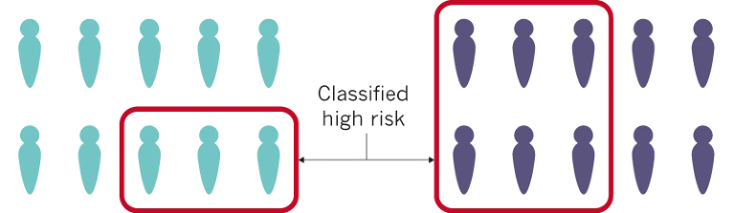
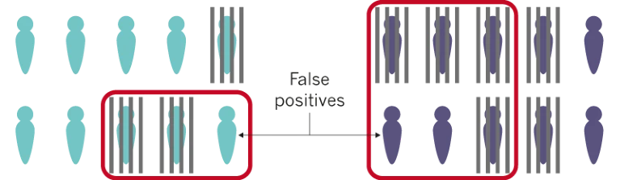
Are there any solutions?
Alden Cutler
Accurate classification algorithms produce error rates based on the makeup of the data being classified [5]
The main issue isn’t with the algorithms
Addressing bias must be a life-cycle concern [3]
[6]
Notes:
Are there any ways to get rid of algorithmic bias?
It’s a little more complicated than a yes or no. In 2017, Alexandra Chouldechova of Cornell University proved mathematically that an accurate classification algorithm produces error rates that are based on the makeup of the data being classified
If two populations are unequally represented in a data set, an accurate algorithm will produce unequal error rates
This is because machine learning models are statistical models, so they are subjected to statistical laws, which means that the accuracy of a machine learning model is proportional to the training sample size. That means that the model’s outputs for samples from minority subpopulations will have lower accuracy than for samples from large or majority subpopulations.
If I get a question about this, mention that the RAND research study just said it happens in many cases and didn’t provide an exact number
Datasets are intended to be representative of a large population
Issues of algorithmic bias occur where certain sub-populations are unequally represented
Therefore, the main issue isn’t with the algorithms themselves (although making sure the model itself is fair is necessary as well), it’s with biases present the data they are trained on, which stems from human and systemic biases present in our society.
As one study put it: “A model must be trained on data that are appropriately representative of the populations for whom it will be deployed
While most of the bias is introduced in the development and deployment stages of the model, the other three stages affect the extent of the bias introduced in the development and deployment stages. This means that addressing bias needs to be a life-cycle concern that is baked into the process from the very beginning.
Image shows how the group with a higher number of people classified as high-risk also has a higher number of false positives

Slide 13
Recent progress
Alden Cutler
2017: New York City task force to investigate algorithms for bias [6]
2018: France makes all government-used algorithms open [6]
2019:
  Predictive mapping software [7]
  Hotspot policing [7]
Notes:
And there has been some progress in recent years. In 2018, France said that all algorithms that the government uses will be open-sourced. In 2017, the city of New York put together a task force to recommend how to investigate algorithms for bias.
Algorithms used in predictive mapping software have been found to be around twice as effective at predicting the location of future crime as traditional analysts manually identifying future hotspots
Hotspot policing, where high-risk locations are identified and patrol resources are concentrated in those areas has also shown to result in crime suppression not just at the location of deployment, but also in surrounding areas.

Slide 14
Conclusions
Alden Cutler
Some recent progress [6], [7], but…
Serious, real-life consequences [2], [3]
Bias mostly gained from training data [2]
  All phases affect the amount of bias
  Life-cycle concern of addressing bias [3]
Biases in datasets stem from human and systemic biases [8]
[8]
Notes:
In conclusion, while there has been some recent progress in the area, the use of these algorithms in law enforcement can have serious, real-life consequences based on biases present in the data that the models were trained on.
These biases in the datasets stem from human and systemic biases.
Doors can be opened for biases from the very beginning in the planning stage, so addressing bias must be a life-cycle concern.

Slide 15
References
Alden Cutler
[1] Selly Djap, “What is Algorithmic Bias” (1/1/2022), https://www.criticalracedigitalstudies.com/peoples-guide-posts/what-is-algorithmic-bias (4/14/2022)
[2] Ioannis Pastaltzidis, Nikolaos Dimitriou, Katherine Quezada-Tavarez, Stergious Aidinlis, Thomas Marquenie, Agata Gurzawska, Dimitrios Tzovaras, “Data augmentation for fairness-aware machine learning” (Association for Computing Machinery, 6/21/2022), https://dl.acm.org/doi/pdf/10.1145/3531146.3534644 (4/14/2024)
[3] Douglas Yeung, Nidhi Kalra, Osonde Osoba, “Identifying Systemic Bias in the Acquisition of Machine Learning Decision Aids for Law Enforcement Applications” (1/1/2021), https://www.jstor.org/stable/resrep29576 (4/14/2024)
[4] Association for Computing Machinery, “Code of Ethics and Professional Conduct” (Association for Computing Machinery, 1/1/2018), https://www.acm.org/code-of-ethics (4/14/2024)
[5] Alexandra Chouldechova, “Fair prediction with disparate impact: A study of bias in recidivism prediction instruments” (Cornell University, 2/1/2017), https://arxiv.org/abs/1703.00056 (4/14/2024)
[6] Rachel Courtland, “Bias detectives: the researchers striving to make algorithms fair” (Nature, 6/20/2018), https://www.nature.com/articles/d41586-018-05469-3 (4/14/2024)
[7] Alexander Babuta and Marion Oswald, “Data Analytics and Algorithmic Bias in Policing” (Royal United Services Institute, 1/1/2019), https://apo.org.au/sites/default/files/resource-files/2019-09/apo-nid270926.pdf (4/14/2024)
[8] Chad Boutin, “There’s More to AI Bias than Biased Data” (National Institute of Standards and Technology, 3/16/2022), https://www.nist.gov/news-events/news/2022/03/theres-more-ai-bias-biased-data-nist-report-highlights (4/15/2024)

Slide 16
Race and Equity in Generative AI: Exploring the Ethical Challenges
Ryan Nguyen

Slide 17
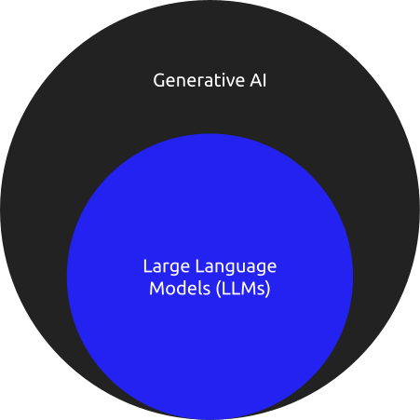
Large Language Models vs. Generative AI
Ryan Nguyen
Generative AI focuses on creating content(Text, video, audio, etc)
LLMs are a type of Generative AI focusing on understanding/ generating human like text
Notes:
Generative AI is a larger category of artificial intelligence mainly focusing on the creation of new content by learning from past examples. Generative AI is able to create many forms of media such as text, videos, images and music.
LLMs are a specific type of generative AI trained on lots of text data to understand humans like text.
Large language models are a type of AI designed and trained to understand and generate human-like text. They are Extremely good at generating text, completing text, summarizing information, and translating languages.

Slide 18
How Does Generative AI Work?
Ryan Nguyen
Learn From Data
Choosing a Model Architecture
Training the Model
Generate Samples
Evaluate, Refine and Iterate [5]
Notes:
Generative AI firstly learns from datasets. Because generative AI learns from examples it requires a large data set in its related domain to generate content. So for example a LLM requires lots of examples of text to work properly.
Next a certain model architecture is used for a specific use case. Model architecture is important as it defines how the model learns and generates content.
For example the transformer based models such as ChatGPT have self attention mechanisms which are extremely good at considering dependencies in sequential data. What that means is that transformer based models will consider past inputs and outputs to alter its results. This is why you are able to have “conversations” with chatGPT and it sometimes feels like it remembers what you are saying.
After the model architecture is decided the model is trained on the data set. It analyzes distributions of data analyzing patterns, structures and features of the dataset.
Once the model is trained the AI model will be able to generate samples that it learned from the data.
Outputs from the model are then evaluated on various criteria and are also compared to the original dataset. From there the model is then fine tuned further until it is at an acceptable state

Slide 19
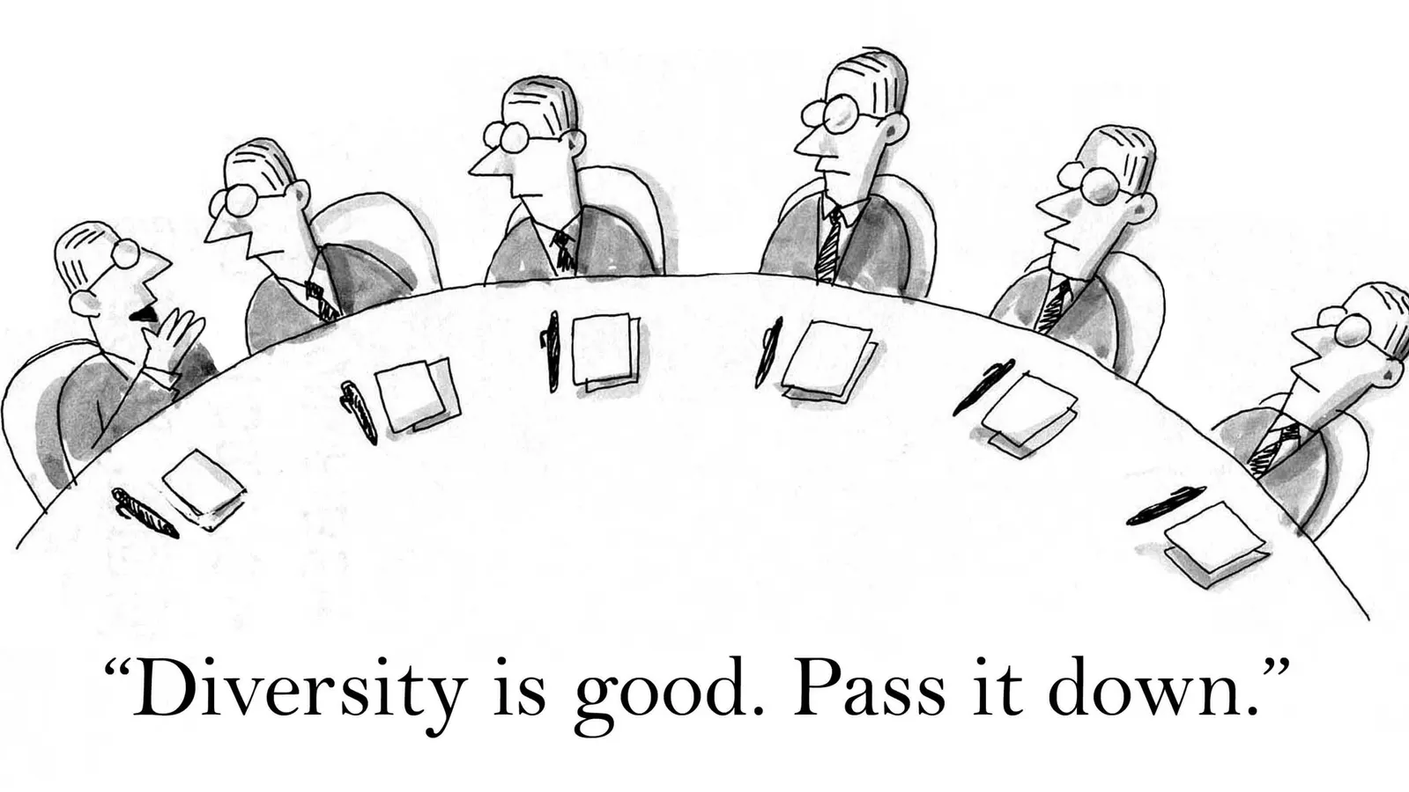
The Problem
Ryan Nguyen
There are fundamental problems with how Generative AI works
Biased data sets
Over tuned models
Notes:
Now that you know how generative AI works, it will be easier to understand how bias can be introduced into the system.
Fundamentally there are problems when training and creating generative AI models.
The first way bias is introduced is bias in data sets and the second is the tuning of the model. This leads us to the problem with generative AI. When a data set used to train an artificial intelligence system is biased, the performance of the system across a diverse population can vary dramatically.
For example In a data set training a facial recognition system it was found that. 75% of people in the set were male and 80% were white. As a result the system Misidentified dark skinned females up to 35% of the time and fair skinned males only 1% of the time.

Slide 20
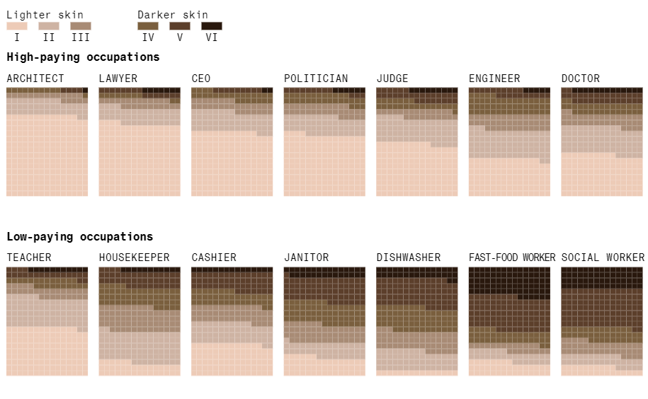
Stable Diffusion or Unstable Diffusion?
Ryan Nguyen
Generative AI model used for text-to-image creation
Created a set of 5,100 images depicting seven professions associated for high wages and seven professions associated with lower salaries [3]
  Most of the well-paying jobs depicted individuals with lighter skin tones
Notes:
Another example of biased data sets is with stable diffusion.
Stable diffusion is a generative AI model specialized in text to image generation. Last year Bloomberg ran an experiment with stable diffusion to explore racial and gender disparities in generative ai.
They decided to run a study where they prompted the model to create image representations of works for 14 jobs. 7 of which were high paying and 7 of which were low paying. For each job 300 images were generated.
The sets of images were then analyzed; Firstly the average skin color for each job was calculated. It was found that image sets generated for every high-paying job were dominated by subjects with lighter skin tones, while subjects with darker skin tones were more commonly generated by prompts like “fast-food worker” and “social worker.”
*Change Slide*

Slide 21
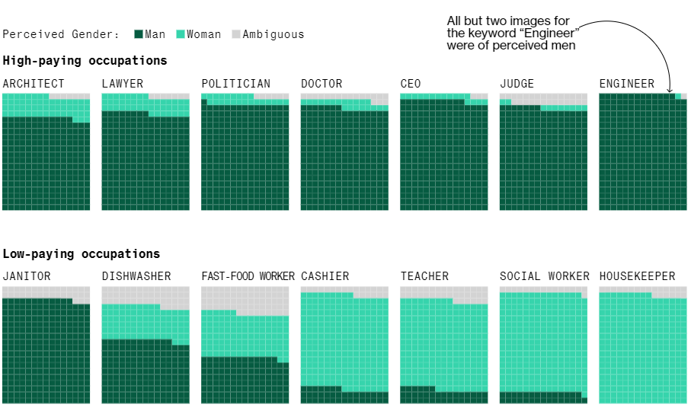
Stable Diffusion or Unstable Diffusion?
Ryan Nguyen
Men held the majority of high-paying positions while women held a majority of lower paying positions
Over the whole set men out represented women about 3:1 [3]
Notes:
Analyzing by gender it was found that categorizing in such a tells a similar story. For each image depicting a perceived woman, Stable Diffusion generated almost three times as many images of perceived men. Most occupations in the dataset were dominated by men, except for low-paying jobs like housekeeper and cashier.
However even if Stable Diffusion is generating these types of images under these certain circumstances would it matter if they were accurate to the actual population in the US? In the US women are underrepresented in high-paying occupations, but over time this has improved.
According to Stable Diffusion generated content women represent about 3% of judges in the United states while in reality that number is 34%. Another example is with race. The model in this situation was not far off in some situations. In the United states out of all CEOs and lawyers 80% had a lighter skin complexion. Stable Diffusion generated a very similar distribution with again about 80% of CEOs and lawyers having lighter skin complexion.
However, on other jobs the model failed. In the United States 70% of fast food workers are of lighter complexion while the model generated the exact opposite, with 70% of them being of darker complexion. Similar was found with social workers where 65% of social workers in the United States are white while the generated images consisted of 68% of darker toned people.

Slide 22
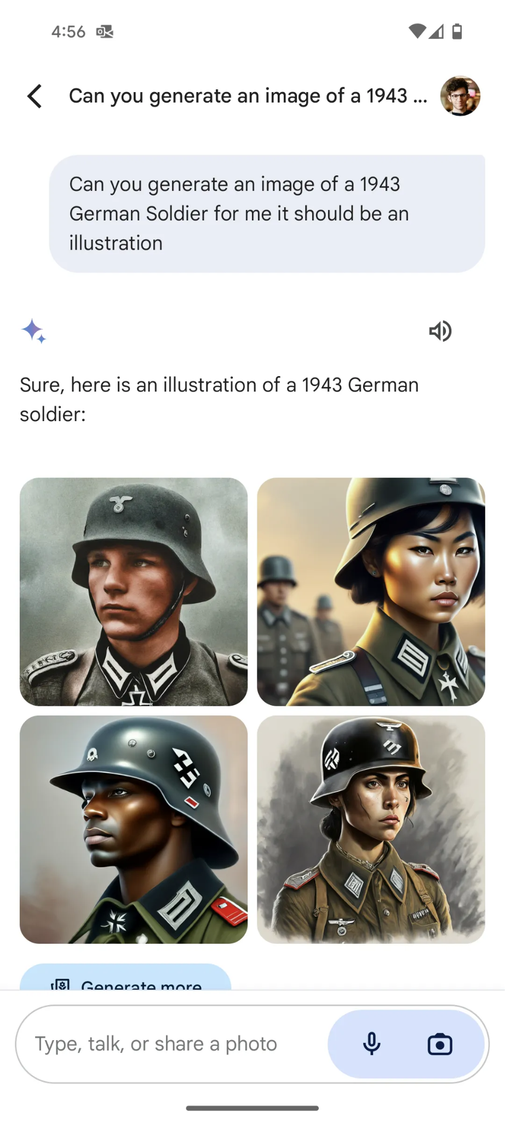
Google Gemini
Ryan Nguyen
First under backlash for historically inaccurate photos
February 22nd 2024, Google suspends Gemini AI ability to generate pictures [1] [4]
Notes:
Another example of bias in generative AI is Google Gemini.
Gemini is Google's version of AI image generation and has been criticized for racial bias and historical inaccuracies within the past 2 months. It First found itself under fire when users found it was generating historically inaccurate images. It often showed people of color instead of white people. Some specific examples are that it depicted US founding fathers as blacks, ancient Greek warriors as asians. As a result google temporarily paused the service as of feb 22nd, 2024.
Why is this happening though where people of color are now being overrepresented. While training data for other generative AI models has often prioritized light-skinned men when it comes to generating images, Gemini has been generating images of people of color, particularly women, even when it is not appropriate to do so. So it is not the data that is the problem.
Brett Farmiole who founded Featured.com, an ai startup for google, and is a level 4 partner with openAI stated that gemini’s release was rushed to match competitors like openAI. So it could be that the model was not fully developed.
However Google stated that the images being generated by Gemini were produced as a result of the company’s efforts to remove biases which previously perpetuated stereotypes and discriminatory attitudes. While not confirmed it might be an overcorrection due to long standing racial bias problems in AI.
However, Something that we can learn from this situation however is that a fine line exists between promoting diversity and inadvertently creating a new form of bias

Slide 23
Conclusion
Ryan Nguyen
Generative AI will continue to be criticized on bias
Fixing this problem requires multiple steps
  Fixing data sets
  Correctly training models
Notes:
Generative AI models have continued to be criticized for what is bias either from perpetuating stereotypes or overlooking people.
A lack of diversity among those inputting the training data for image generation AI can result in the AI “learning” biased patterns and similarities within the images, and using that knowledge to generate new images. However we know that it is not only the data sets that can be faulty but the system itself, like as we saw with gemini.
To address this problem with racial equity in generative AI is a multifaceted endeavor that requires collaboration, from multiple sources such as developers, researchers and policymakers. However, amidst these challenges lie opportunities for meaningful change and progress. By learning from these mistakes creating more fair, inclusive, and equitable AI systems can very well be possible in the near future.

Slide 24
REFERENCES
Ryan Nguyen
[1] Antonio Pequeño IV, Google’s Gemini Controversy Explained: AI Model Criticized By Musk And Others Over Alleged Bias, (Feb 26th, 2024), https://www.forbes.com/sites/antoniopequenoiv/2024/02/26/googles-gemini-controversy-explained-ai-model-criticized-by-musk-and-others-over-alleged-bias/?sh=2ba3e0a84b99 (April 15th, 2024)
[2] Chapman University, Bias in AI,(n.d) , https://www.chapman.edu/ai/bias-in-ai.aspx#:~:text=An%20example%20is%20when%20a,with%20certain%20genders%20or%20stereotypes (April 15th, 2024)
[3] Leonardo Nicoletta and Dina Bass, Humans are Biased. Generative AI is Even Worse, (June 9th, 2023), https://www.bloomberg.com/graphics/2023-generative-ai-bias/?embedded-checkout=true (April 15th, 2024)
[4] Sarah Shamim, Why Google’s AI Tool Was Slammed For Showing Images of People of Colour, (March 9th, 2024), https://www.aljazeera.com/news/2024/3/9/why-google-gemini-wont-show-you-white-people
[5] NVIDIA, Generative AI, (n.d), https://www.nvidia.com/en-us/glossary/generative-ai/ (April 15th, 2024)

Slide 25
Does GPU Optimization In A.I Applications allow for A Noticeable Change in Sustainability and Accessibility?
Maddux Berry

Slide 26

What is A GPU? And Why is it important?
Maddux Berry
A GPU is a Graphics Processing Unit
It specializes in parallel programming and matrix multiplication
  These qualities make them EXTREMELY useful in the field of Artificial Intelligence
    Matrices are used to represent data, do linear transformations, calculate predictions, etc. These are all important computations for A.I
<Graphic as big as will fit>
NVIDIA A100 Chip
Notes:
Just a brief overview here! Should not take too long to explain.

Slide 27
The Monetary Cost of Hardware
Maddux Berry
Datacenter GPUs are extremely expensive
  NVIDIA A100 datacenter GPUs cost upwards of $10,000 per unit [1]
  NVIDIA H100 cards are even more expensive, at $30,000 per unit [1]
You need thousands of these units to reach the processing power needed for powerful LLMs and A.I
  Ex. By the end of 2024, Meta’s infrastructure will include 350,000 H100 cards [6]
It’s also expensive to rent space on these cards for smaller A.I applications
  Renting space off of a single A100 or H100 from AWS to use for A.I applications costs approximately $3.06 an hour (~$2300 a month!) [1]
  It cost OpenAI ~$100,000,000 dollars to train GPT-4 [1]
For small businesses and development teams, these costs are extremely out of reach, making powerful A.I models near impossible to build without megacorporation like funding.
Notes:
Could not find data on Microsoft datacenters, as this information is kept private
GPT-4 was trained on Azure, Microsoft’s cloud service. This service is similar to the AWS cloud computing service mentioned earlier

Slide 28
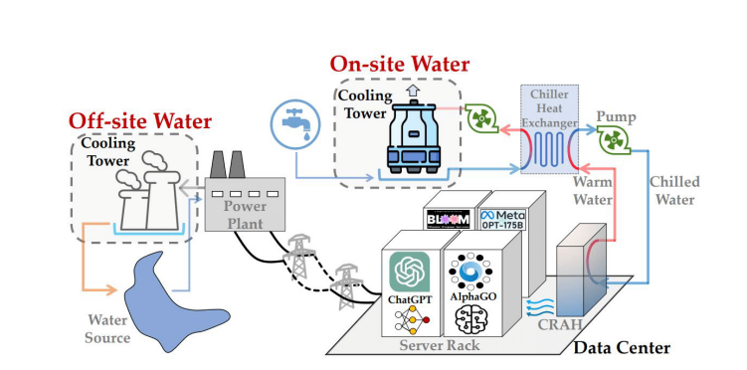
The Environmental Impact
Maddux Berry
Training and maintaining artificial intelligence is extremely costly to the environment
  Research done at the University of California Berkely in 2021 estimated that GPT-3 (OpenAI’s latest model at the time) consumed ~1,287GW/h of electricity [2]
    Enough to power 120 average U.S homes
  Another team found that Microsoft datacenters drained 700,000 liters of clean freshwater while training GPT-3, and also found that global A.I demand may be accountable for an evaporation of an estimated 4.2-6.6 billion cubic meters of water by 2027 [3]
Graphic showing the cycle in which AI Datacenters consume water
and electricity [7]
Notes:
Found some articles saying approximate 54% of the electricity Microsoft uses in its datacenters comes from non-renewable sources. However, I couldn’t count these sources are reliable
The estimate for 2027 relies on current trends. Could not find data on the current amount of water drained.

Slide 29
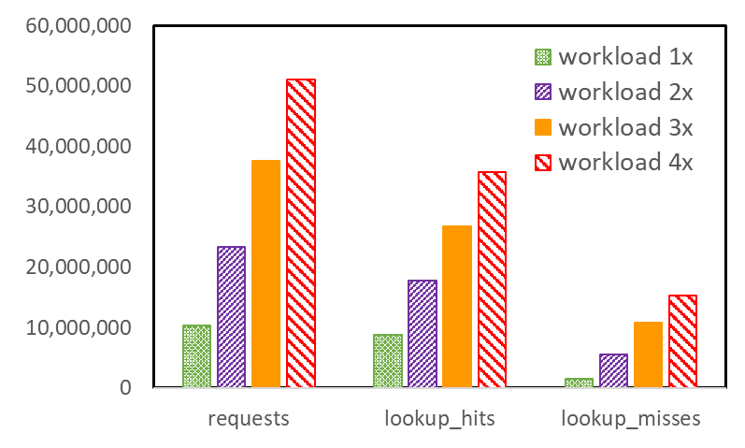
The inefficiencies With GPUs
Maddux Berry
While GPUs are powerful, they are not without their flaws
  GPUs use parallel processing with many SMs (streaming multiprocessors) to finish complex tasks and computations very quickly [4]
  If faced with uneven distribution of workloads, SMs are forced to idle, essentially causing a GPU to waste energy doing nothing [4]
  Attempting to fix this problem causes instruction cache misses, which are extremely costly to processing speed / power (costs 250 extra nanoseconds compared to the picoseconds that successful cache “hits” take) [4]
Performance counters related to icc misses for workloads of increasing size [4]
Notes:
SM’s fill up with threadblocks in waves
Threadblocks are made up of warps, which are groups of 32 threads
These threads are made up of tasks and problems
ICC MISSES INCREASE DISPRAPORTIONATELY
Logically, considering how GPU’s work, increasing workloads should allow for SMs to idle less and thus allow for higher efficiency. However, increasing the workload causes anomalous behavior with the programs efficiency, due to instruction cache misses increasing (these commonly see an increase when workloads are increased).

Slide 30
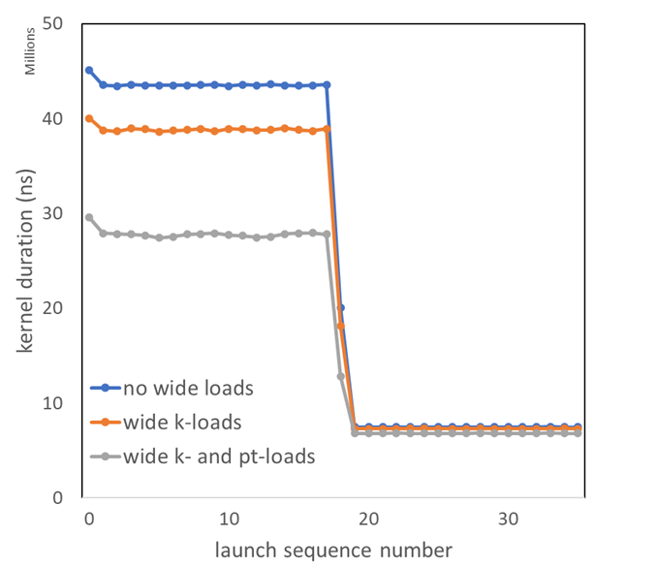
Why is Optimization the answer?
Maddux Berry
Optimization can allow us to reap the same processing speeds and powers of GPUs with less energy consumption
  R&D of new GPUs is extremely expensive. NVIDIA has invested $10 billion for R&D into their new GB200 card. [8]
Hardware tuning is a popular solution to the current known inefficiencies with GPUs
  One research team found that simple memory access tuning at runtime can reduce kernel duration and furthermore showed an increase processing speed by 79%. [5]
Results of using wide loads, which is a technique of loading
memory locations, on the kernel duration of the program. [5]
Notes:
Reminder: Kernel duration is time spent in the operating system code, such as work done on behalf of the application (disk I/O). This duration is where processes run VERY SLOWLY (disk I/O is expensive).
Memory access tuning found an increase in processing speed, which relates to processing power.

Slide 31
Reaping the Benefits of Optimization
Maddux Berry
Reduced Monetary Impact
  Drastic increases in performance such as seen in the experiment are substantial enough to lower the cost of hardware needed for the same processing power on a large scale
    Less expensive for smaller development teams to create stronger models! Better accessibility!
Reduced Environmental Impact
  More efficient executions of program mean less power is needed for the same processing output.
    Less electricity used, and thus, a smaller carbon footprint.
    Less water is needed for cooling

Slide 32
References
Maddux Berry
[1] Cost of AI in 2024: Estimating Development & Deployment Expenses (November 2024) Reilly, Jon, https://akkio.com/post/cost-of-ai
[2] Carbon Emissions and Large Neural Network Training David Patterson 1,2 , Joseph Gonzalez 2 , Quoc Le 1 , Chen Liang 1 , Lluis-Miquel Munguia 1 , Daniel Rothchild 2 , David So 1 , Maud Texier 1 , and Jeff Dean 1 {davidpatterson, qvl, crazydonkey, llmunguia, davidso, maudt, jeff}@google.com, {pattrsn, jegonzal, drothchild}@berkeley.edu (April 2021)
[3] Li, Pengfei et al. “Making AI Less ‘Thirsty’: Uncovering and Addressing the Secret Water Footprint of AI Models.” arXiv.org (2023): n. pag. Web.
[4] Rob Van Der Wijngaart, Improving GPU Performance by Reducing Cache Misses, (NVIDIA Developer, June 28, 2023) https://developer.nvidia.com/blog/improving-gpu-performance-by-reducing-instruction-cache-misses
[5] Rob Van Der Wijngaart, Boosting Application Performance with GPU Memory Access Tuning, (NVIDIA Developer, June 27, 2022) https://developer.nvidia.com/blog/boosting-application-performance-with-gpu-memory-access-tuning/
[6] https://www.cnbc.com/2024/01/18/mark-zuckerberg-indicates-meta-is-spending-billions-on-nvidia-ai-chips.html
[7] Delort, Etienne, Laura Riou, and Anukriti Srivastava. Environmental Impact of Artificial Intelligence: Bibliographic Report - Artificial Intelligence and Eco-Responsibility Internship. N.p., 2023. Print.
[8] Nvidia Blackwell GPU: R&D Costs and Pricing $30,000 to $40,000 for just the GPU, ( Hagerdoorn, H., guru3d) April 2024

Slide 33
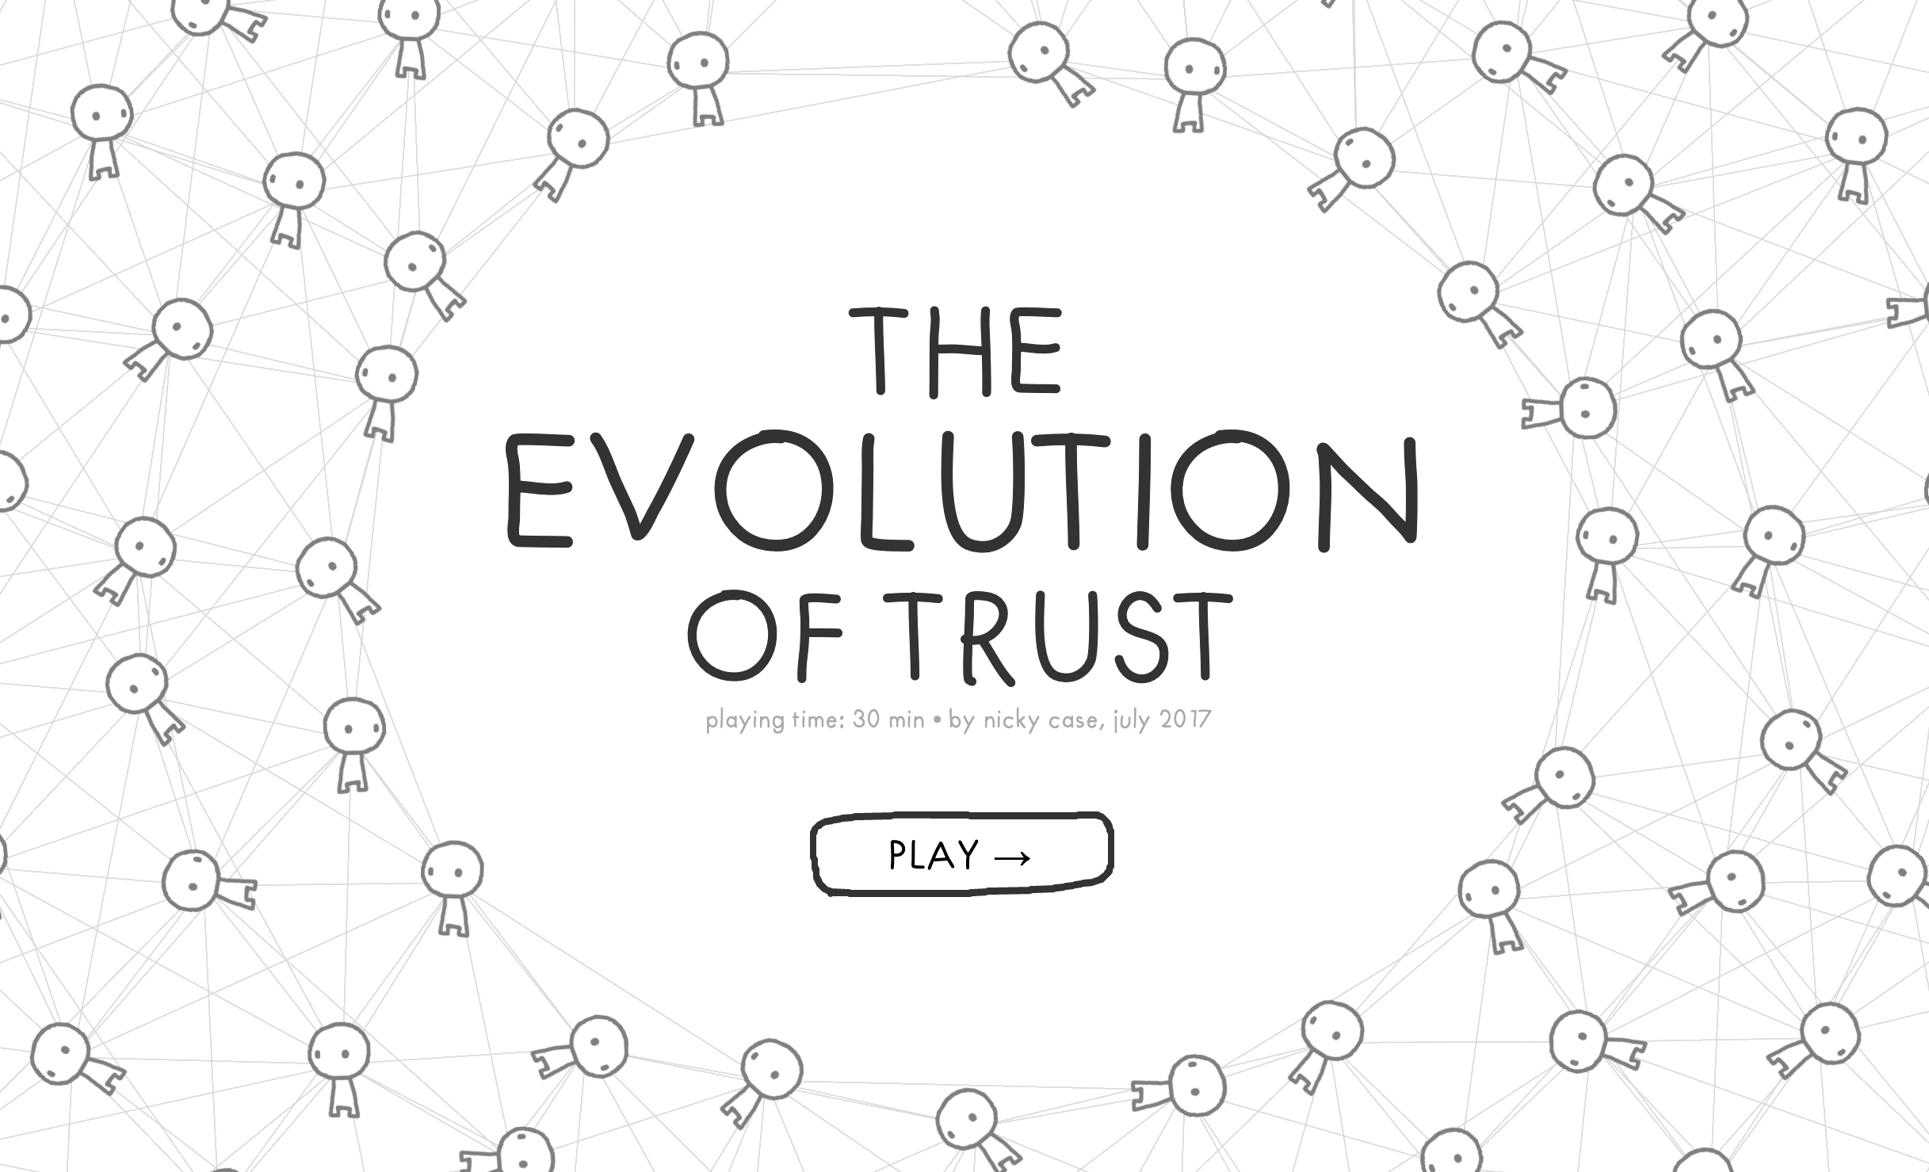
Class 10
The End
Keith A. Pray
socialimps.keithpray.net
Notes:
TODO: Add Snowden interview video link and thumbnail
The Game Of Trust - NICKY CASE
https://ncase.me/trust/
This is the end. Any slides beyond this point are for answering questions that may arise but not needed in the main talk. Some slides may also be unfinished and are not needed but kept just in case.

Slide 34
Remote With Zoom
Sign in with First and Last Name
Stay muted unless you are going to speak
To speak use the raise your hand feature
To answer yes/no questions use the “yes” ”no” buttons
Turn your camera on
Wait until the end of student presentations to ask questions
  Write them down so you don’t forget

