Slide 1

Class 9
Errors Failures Risks
Keith A. Pray
socialimps.keithpray.net
Notes:
Did SW Teams from the reading pick good test strategies? Will you be able to support your choices if something goes wrong?
What errors? – Use spreadsheet to record defects.
Who looked for directions on how to test currency?
MSNBC on Denver's Automated Baggage System 2010-08-23 (2:27)
https://www.youtube.com/watch?v=xx8f4x6C_KY
Accessed 2019-04-09
No Discussion Board

Slide 2
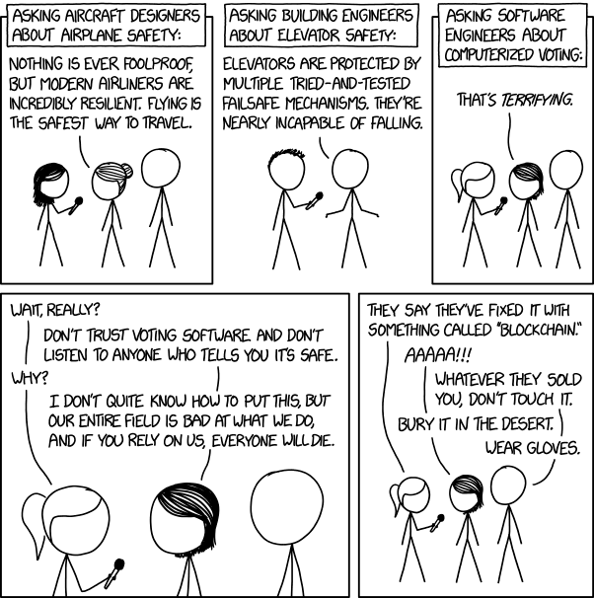

Overview
Review
Assignment
Students Present
https://xkcd.com/2030/ (2018-09-21)
Notes:
Why Electronic Voting Is Still A Bad Idea (2019)(12:00)
Tom Scott
https://www.youtube.com/watch?v=LkH2r-sNjQs
Old Version
Why Electronic Voting is a BAD Idea – Computerphile (2014)(8:20)
https://www.youtube.com/watch?v=w3_0x6oaDmI
Might be better in Security
Other videos:
9News - Looking back at the massive failure that was DIA's automated baggage system 2020-02-28 (2:32)
https://www.youtube.com/watch?v=xmas0-SthUQ
9News - Watch DIA's old luggage system toss baggage into the air 1995 (1:42)
https://www.youtube.com/watch?v=OtLHVGtFmKU
abcNews - Major Luggage Debacle at Denver Airport
https://abcnews.go.com/Travel/video/major-luggage-debacle-denver-airport-28054918
We can also discuss articles listed on Security Discussions under documents of course web site.
TODO: add quiz as backup if class discussion or guest speaker fail

Slide 3

http://pbfcomics.com/197 (2014-09-26)
Notes:
10 – Errors, Failures, Risks

Slide 4
Overview
Review
Assignment
Students Present

Slide 5
My Reading Notes
pp. 383 Check Priv Gov Chapter for not requiring FBI to ensure accuracy of data entered into NCIC, before March 2003?
pp. 383 Any false arrests since 1989?
pp. 384 Implementation cost not considered. Argument assumes DB cannot exist w/out existing inaccuracies.
pp. 387 Real-time system explanation misses known execution time
pp. 388 PATRIOT needs track to shoot, not prevent false alarm.
pp. 389 Asset assumptions in code and/or tests.
pp. 390 Robot Mission to Mars: Always encapsulate units!
pp. 391 Any SW diffs between Mars Missions?
pp. 392 BAE Automated Systems != BAE Systems
pp. 393 Why did the Tokyo Stock Exchange refuse?
pp. 396 “steer voting off a cliff” = Strawman Fallacy
pp. 397. Do the second thoughts on DRE machines make the interview at end Chapter’s end less relevant?
pp. 407 typo “not do so” → “not to do so”
pp. 408 video of self-driving Uber running red light, tech vs. tech
pp. 412 Did The Limits to Growth predictions motivate people to change? No simulation examples since 2002?
pp. 413 What happened to Verification?
pp. 415 Race conditions still likely with OO since most implementations use direct method/function class instead of message passing.
pp. 416 “satisfies the specification” = verification. “needs of the user” = validation.
pp. 417 “As recently as 1994…”, “Another… in 2009…” – need update. Industry activity not mentioned: Waterfall, Agile, AS1900D, CMMI, AS9145 (TODO: slide)
pp. 418, 435 reference [105] has no publication date
pp. 425 Redundancy like system of AI Experts? Assert assumptions in automated SW tests.
pp. 429 21 like game release question in next chapter.
pp. 433 [50] no release date
pp.437 Very expensive pencil
Questions I liked: 1, 8, 22

Slide 6
Overview
Students Present
Review
Assignment
Notes:
We can also discuss articles listed on Security Discussions under documents of course web site.
ADD QUIZ AS BACKUP IF CLASS DISCUSSION OR GUEST SPEAKER FAIL

Slide 7
Assignment
Prepare for Debate
  You are a software engineer in the employee-owned company from Chapter 9 In-class Exercises # 24.
  Should the company produce the game based on a current war?
  Use the SWE Code Of Ethics as the basis for your argument
  Use high quality sources and supporting data
Optional 1 page paper, lowest paper grade will be dropped
Add to Group Project Web Site

Slide 8
AI Flying war machines
Claire Desrosiers
Notes:
Script:
Good Afternoon. Today I will be talking about AI flying war machines in the US military and why this trajectory will benefit the country and its allies. For context, the US military successfully tested its first flight with an AI co-pilot in 2020 and that is the scope of the warfighting capabilities I will be speaking about today [3].

Slide 9
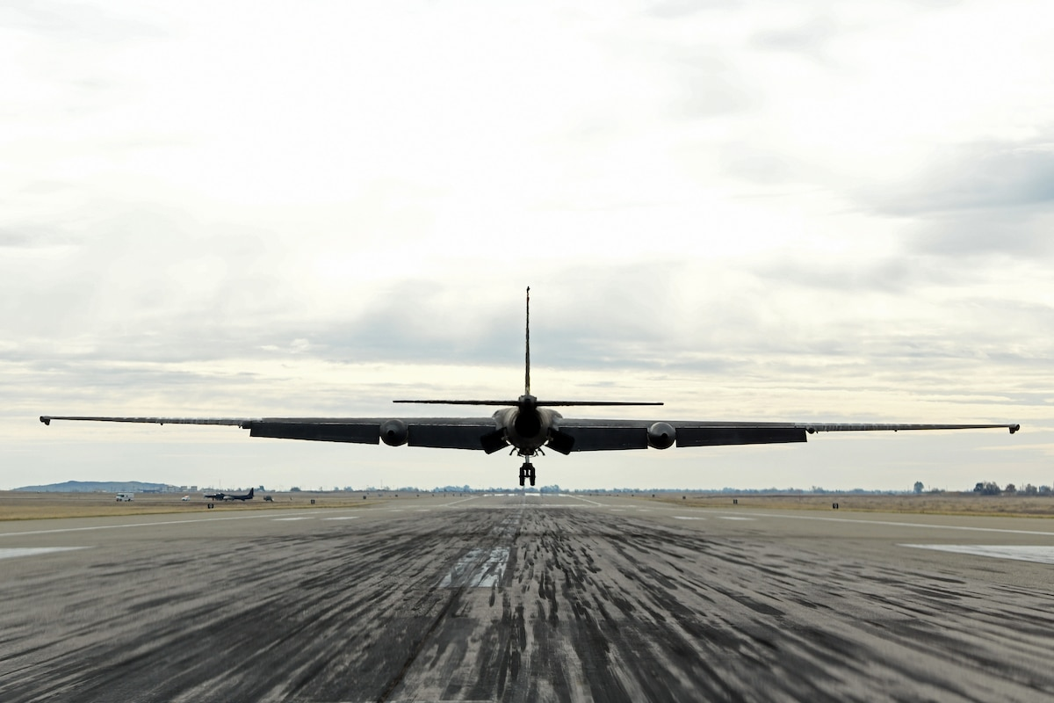
Protects our most valuable asset: people
Claire Desrosiers
Lessens the strain on weakened manning numbers [1]
  Improves training for pilots [2]
Offers increased situational awareness to human counterpart [3]
U-2 Dragon Lady [3]
Notes:
First, the integration of AI into our warfighting capabilities helps protect our most valuable asset: people.
1. AI co-pilots will lessen the strain on weakened manning numbers. In 2023, the military missed its manning goals by 41,000 recruits. Furthermore, the AF has advocated for a “pilot training transformation” in Congress that will effectively address the pilot shortage. The AF has been routinely short more than 1500 pilots per year for the past 7 years. In his testimony to Congress, now AF Chief of Staff General David W. Allvin expressed the need to “modernize pilot training” by “implementing advanced technology”; AI co-pilots are being tested in response to these issues in the force.
2. These systems can also offer increased situation awareness for their human counterparts. I’ll elaborate on what I said earlier with first successfully tested AI co-pilot. The ARTUµ, an AI algorithm, flew onboard with callsign Major “Vudu” during a simulated reconnaissance mission. The AI capability was on the lookout for enemy launch positions while the pilot searched for threatening aircraft; the two utilized the aircraft’s radar simultaneously. This mission gathered data to better understand how AI can be used to supplement the skills of the human pilot.

Slide 10
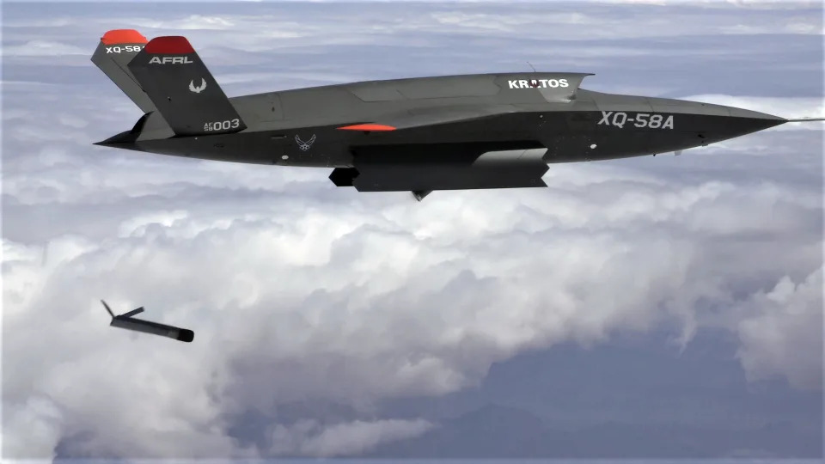
Gives powerful edge for future conflict
Claire Desrosiers
Generates first mover advantage [4]
  Key in National Security Strategy [5]
Cheaper to make than solely-manned aircraft [6]
  XQ-58A Valkyrie vs. fighter aircraft [7]
<Graphic as big as will fit>
XQ-58A Valkyrie [7]
Notes:
AI in our aerial combat arsenal is also essential for getting an edge on other world superpowers, should tensions continue to rise.
1. It generates a first mover advantage in favor of the US. For those of you who don’t know, a first mover advantage in this context is good for whichever country implements and masters a new warfighting capability first. In 2017, President Putin said the first country to master AI “will become the ruler of the world”. In our own National Security Strategy, it mentions investing in “trusted artificial intelligence” 3 times as a means to remain ready for global conflicts. Incrementally implementing this technology safely onto aircraft is important to maintain a mission-ready force ready to take on new challenges.
2. AI-piloted aircraft are nothing new and are widely available commercially online. In August of 2023, the Pentagon released a statement that it is looking to buy multiple thousands of “autonomous systems in all domains, which are less expensive…” to combat China’s growing miliary size. The new initiative is called Replicator. They have not disclosed further details on the systems they are buying in order to not tip off Beijing. For reference, a XQ-58A Valkyrie (a likely large part of the new fleet) is expected to cost less than $3 million while an F-22 and F-35 cost $143 million and $75 million respectively.

Slide 11
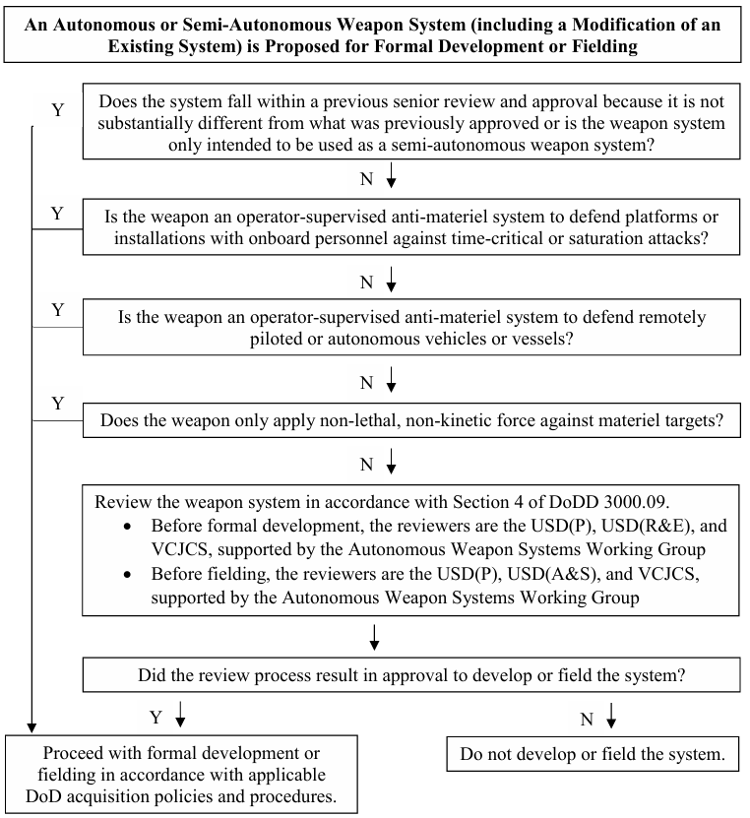
Ethics of ai weaponry
Claire Desrosiers
Questions remain to be answered:
  To what extent will AI be integrated into our warfighting capabilities?
DoD Directive on Autonomy in Weapon Systems [8]
DoD Directive Flow Chart [8]
Notes:
It would not be appropriate to talk about AI in advanced weaponry without countering it with thoughts on the ethics behind it.
1. Counter: There are still many questions that need to be answered such as to what extent will AI be integrated into our warfighting capabilities? Will we ever take it a step too far? If and when an AI-piloted makes a mistake, who takes on the moral responsibility? These are all reasonable questions and concerns, especially after we read an entire chapter on how software can fail.
2. Rebuttal: The Department of Defense issued a directive effective January of last year outlining their policy on autonomy in weapon systems. This directive has evolved for at least the past 12 years, on pace with how quickly the autonomous weaponry landscape has been changing. In the directive, it states, “Autonomous and semi-autonomous weapon systems will be designed to allow commanders and operators to exercise appropriate levels of human judgment over the use of force.” It lists an extensive number of standards and procedures that must be followed in order to make and operate the specified weaponry.
Conclusion: No piece of software is going to be perfect. There will be training mistakes that may be costly. However, the US cannot afford to cede these decisions to the adversary. We have sufficient and evolvable directives in place to guide us as our weaponry systems advance, directives that once again, our adversaries do not abide by. AI flying war machines are necessary in the United States’ aircraft arsenal.

Slide 12
References
Claire Desrosiers
[1] Vergun, D., DOD Addresses Recruiting Shortfall Challenges (U.S. Department of Defense, December 2023) https://www.defense.gov/News/News-Stories/Article/Article/%203616786/dod-addresses-recruiting-shortfall-challenges/ Accessed 11 April 2024
[2] Lucas, N. and Parrish, P, U.S. Air Force Pilot Training Transformation (PPT), (Congressional Research Service, January 2023)
[3] “AI Copilot: Air Force Achieves First Military Flight with Artificial Intelligence.” Air Force, www.af.mil/News/Article-Display/Article/2448376/ai-copilot-air-force-achieves-first-military-flight-with-artificial-intelligence/. Accessed 11 Apr. 2024.
[4] Petrella, S. et al., Russia’s Artificial Intelligence Strategy: The Role of State-Owned Firms (Foreign Policy Research Institute, Winter 2021)
[5] National Security Strategy (The White House Washington, October 2022)
[6] Clark, J., Hicks Underscores U.S. Innovation in Unveiling Strategy to Counter China’s Military Buildup, (U.S. Department of Defense, August 2023) https://www.defense.gov/News/News-Stories/Article/Article/3507514/hicks-underscores-us-innovation-in-unveiling-strategy-to-counter-chinas-militar/ Accessed 11 April 2024
[7] Tarantola, A., The Air Force wants $6 billion to build a fleet of AI-controlled drones, (Engadget, August 2023) https://www.engadget.com/the-air-force-wants-6-billion-to-build-a-fleet-of-ai-controlled-drones-204548974.html Accessed 11 April 2024
[8] DoD Directive 3000.09: Autonomy in Weapon Systems, (U.S. Department of Defense, effective 25 January 2023)
Notes:
Here are my references.

Slide 13
Passengers or Pedestrians?
Eric K. Li
Notes:
Brief class on how I’m going to be conducting a poll later on in the presentation before starting.
Who should be prioritized in terms of safety in autonomous cars? Passengers or Pedestrians?
Answer: Both groups should be equally considered optimally, However, as we will see, this is likely not to be the case.
https://www.cnn.com/2016/06/23/health/driverless-cars-safety-public-opinion/index.html
https://www.nhtsa.gov/vehicle-safety/automated-vehicles-safety

Slide 14
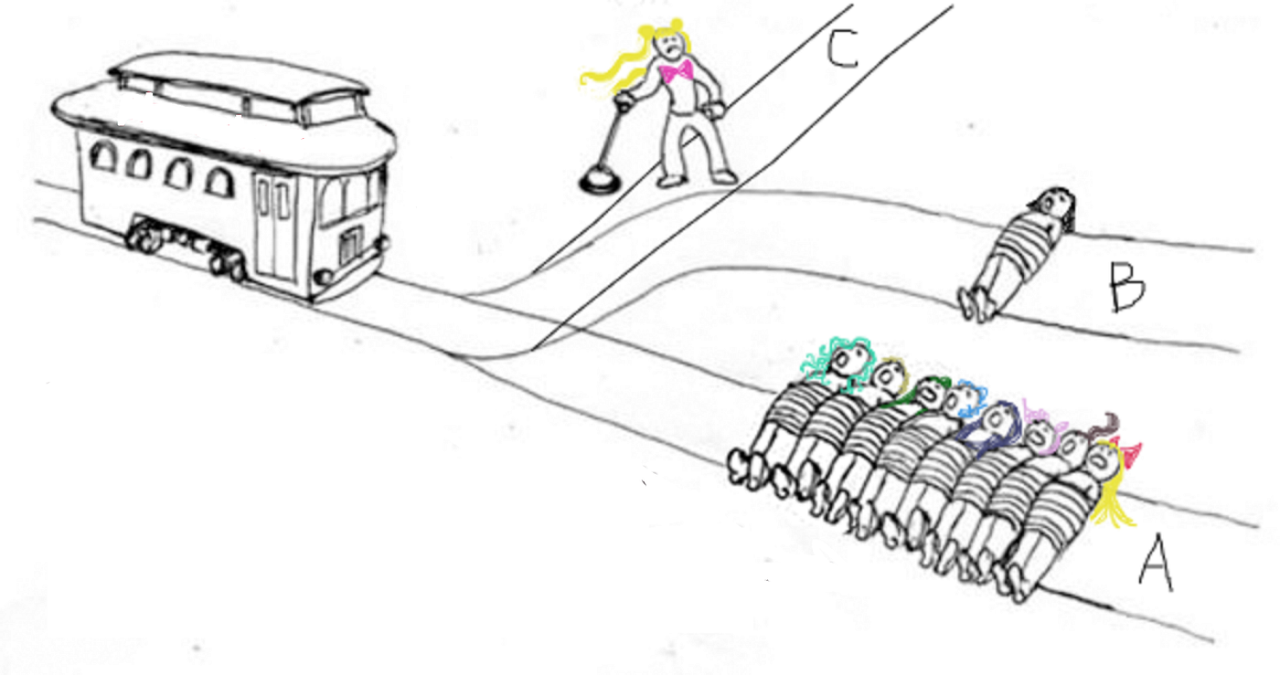
THE MORAL ANSWER VS. THE PRACTICAL ANSWER
Eric K. Li
The trolley problem, 1 person, 8 people, or yourself.
According to an MIT study, people will take a utilitarian approach, with 76% saying that they believe it is moral for an autonomous vehicle to sacrifice 1 passenger over 10 pedestrians. [2]
<Graphic as big as will fit>
What would you do?
[4]
Notes:
If you are utilitarian, looking for the best outcome for the most people, killing one to save five is clearly the right choice. Now you are one of the options. Talk about the trolley problem, compare to killing 5 people or 1 from a third person view in comparison to a first-person view. Animate it out. What about the age, gender, profession? All factors.
Identify how there is a DILEMMA HERE.
Reference MIT study
WE NEED TO TEACH THE CAR ETHICS? TOO DIFFICULT

Slide 15
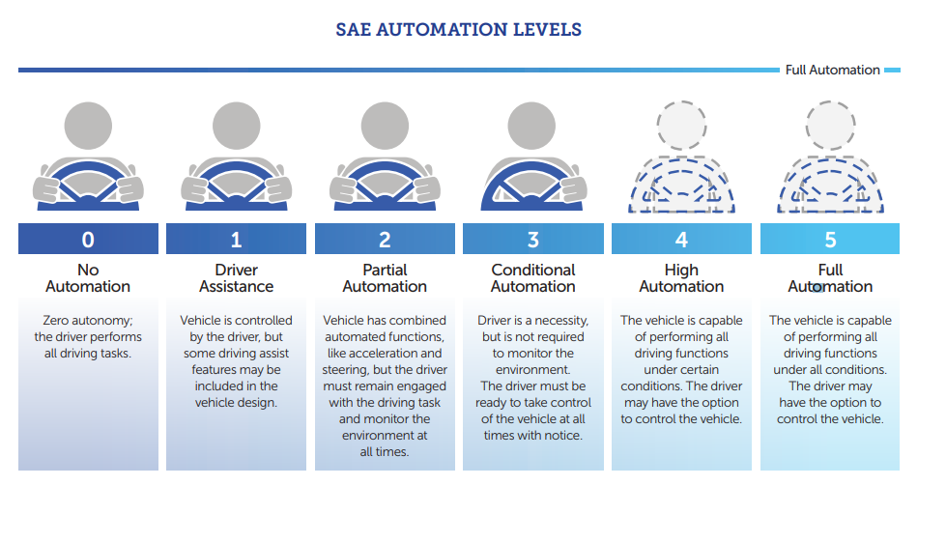
Levels of self driving
Eric K. Li
[7]
Notes:
An image taken from source 7 explaining the different levels of self-driving According to the NHTSA. We are currently at LEVEL 3.
2024 Mercedes-Benz EQS sedan first Level 3
Tesla is level 2

Slide 16

What would you want?
Eric K. Li
Consumer intention also must be considered [1]
According to the National Highway Traffic Safety Administration (NHTSA), “These technologies will help protect drivers and passengers, as well as bicyclists and pedestrians.” [7]
[6]
Notes:
Talk about what the consumers will want. Something that keeps them safe. Maybe have a show of hands as to who would purchase a car that will kill them to save someone/something else. Similarly, few pedestrians would feel comfortable with driverless cars sharing the streets if they thought autonomous cars would choose to run them over to prevent an on-road collision.

Slide 17
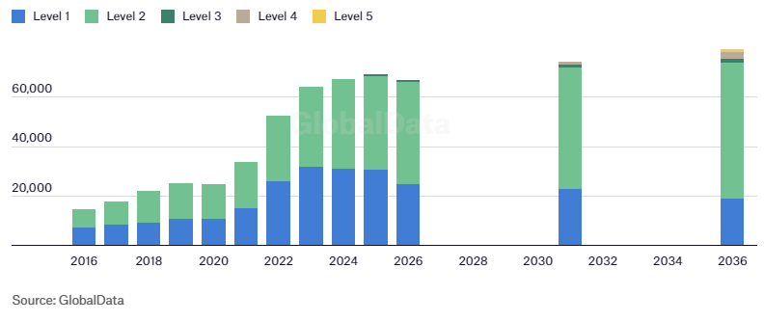
Who is responsible?
Eric K. Li
Since fully self-driving vehicles still have not come to market, policymakers plan to address questions on liability. [3]
Ultimately, the self-driving industry has a long way to go. Policymakers need to pass guidelines, and the entities involved should work together to establish the proper safety standards. [7]
[5]
[5]
Notes:
FULL SELF DRIVING CARS ARE DECADES AWAY! NOT going to happen until technology can mimic human common sense.
2035
Long way to go to be accepted into society. AS A CONCLUSION
Follow with the legal issues of what happens if a self-driving vehicle crashes. Maybe tie in Current assistance level 2 (Partial Automation) as found in Tesla's for instance. Driver is still liable. Later on, There will be guidance on this.
Industry sharing of information on vehicle cybersecurity facilitates collaborative learning and helps prevent industry members from experiencing the same cyber vulnerabilities
“Entities are further encouraged to establish robust cyber incident response plans and employ a systems engineering approach that considers vehicle cybersecurity in the design process.” [7]

Slide 18
References
Eric K. Li
[1] XAVIER HARDING, Should driverless cars prioritize passenger or pedestrian safety? A study reveals how millions feel., (IMPACT, OCT. 26, 2018) https://www.mic.com/articles/192103/driverless-cars-prioritize-passenger-or-pedestrian-safety-study-shows-how-millions-feel (March 13, 2024)
[2] Peter Dizikes, Driverless cars; Who gets protected? (MIT News, June 23, 2016), https://news.mit.edu/2016/driverless-cars-safety-issues-0623 (March 13, 2024)
[3] NHTSA Automated Vehicles for Safety, (NHTSA), https://www.nhtsa.gov/vehicle-safety/automated-vehicles-safety (March 13, 2024)
[4] Sara Bizarro, The Trolly Problem Now (March 19, 2020) https://sarabizarro.medium.com/the-trolley-problem-now-903adaa295e9 (March 13, 2024)
[5] Kurt Robson, Fully self-driving cars unlikely before 2035, experts predict (2023) https://www.verdict.co.uk/fully-self-driving-cars-unlikely-before-2035-experts-predict/?cf-view (March 26, 2024)
[6] Mathew Maniyamkott, Top 5 Ways to Influence Consumer Behavior and Boost Sales(October 9, 2023) https://surveysparrow.com/blog/five-ways-influence-consumer-behavior/ (March 26, 2024)
[7] NHTSA, Automated Driving Systems, (NHTSA) https://www.nhtsa.gov/sites/nhtsa.gov/files/documents/13069a-ads2.0_090617_v9a_tag.pdf (March 26, 2024)
Notes:
- Why given risks:
1) Reduce traffic fatalities,
2) mobility for elderly people
- Link healthcare as a thing with risks as well but accepted by society.

Slide 19
Driving Bias
Connor Bouffard

Slide 20
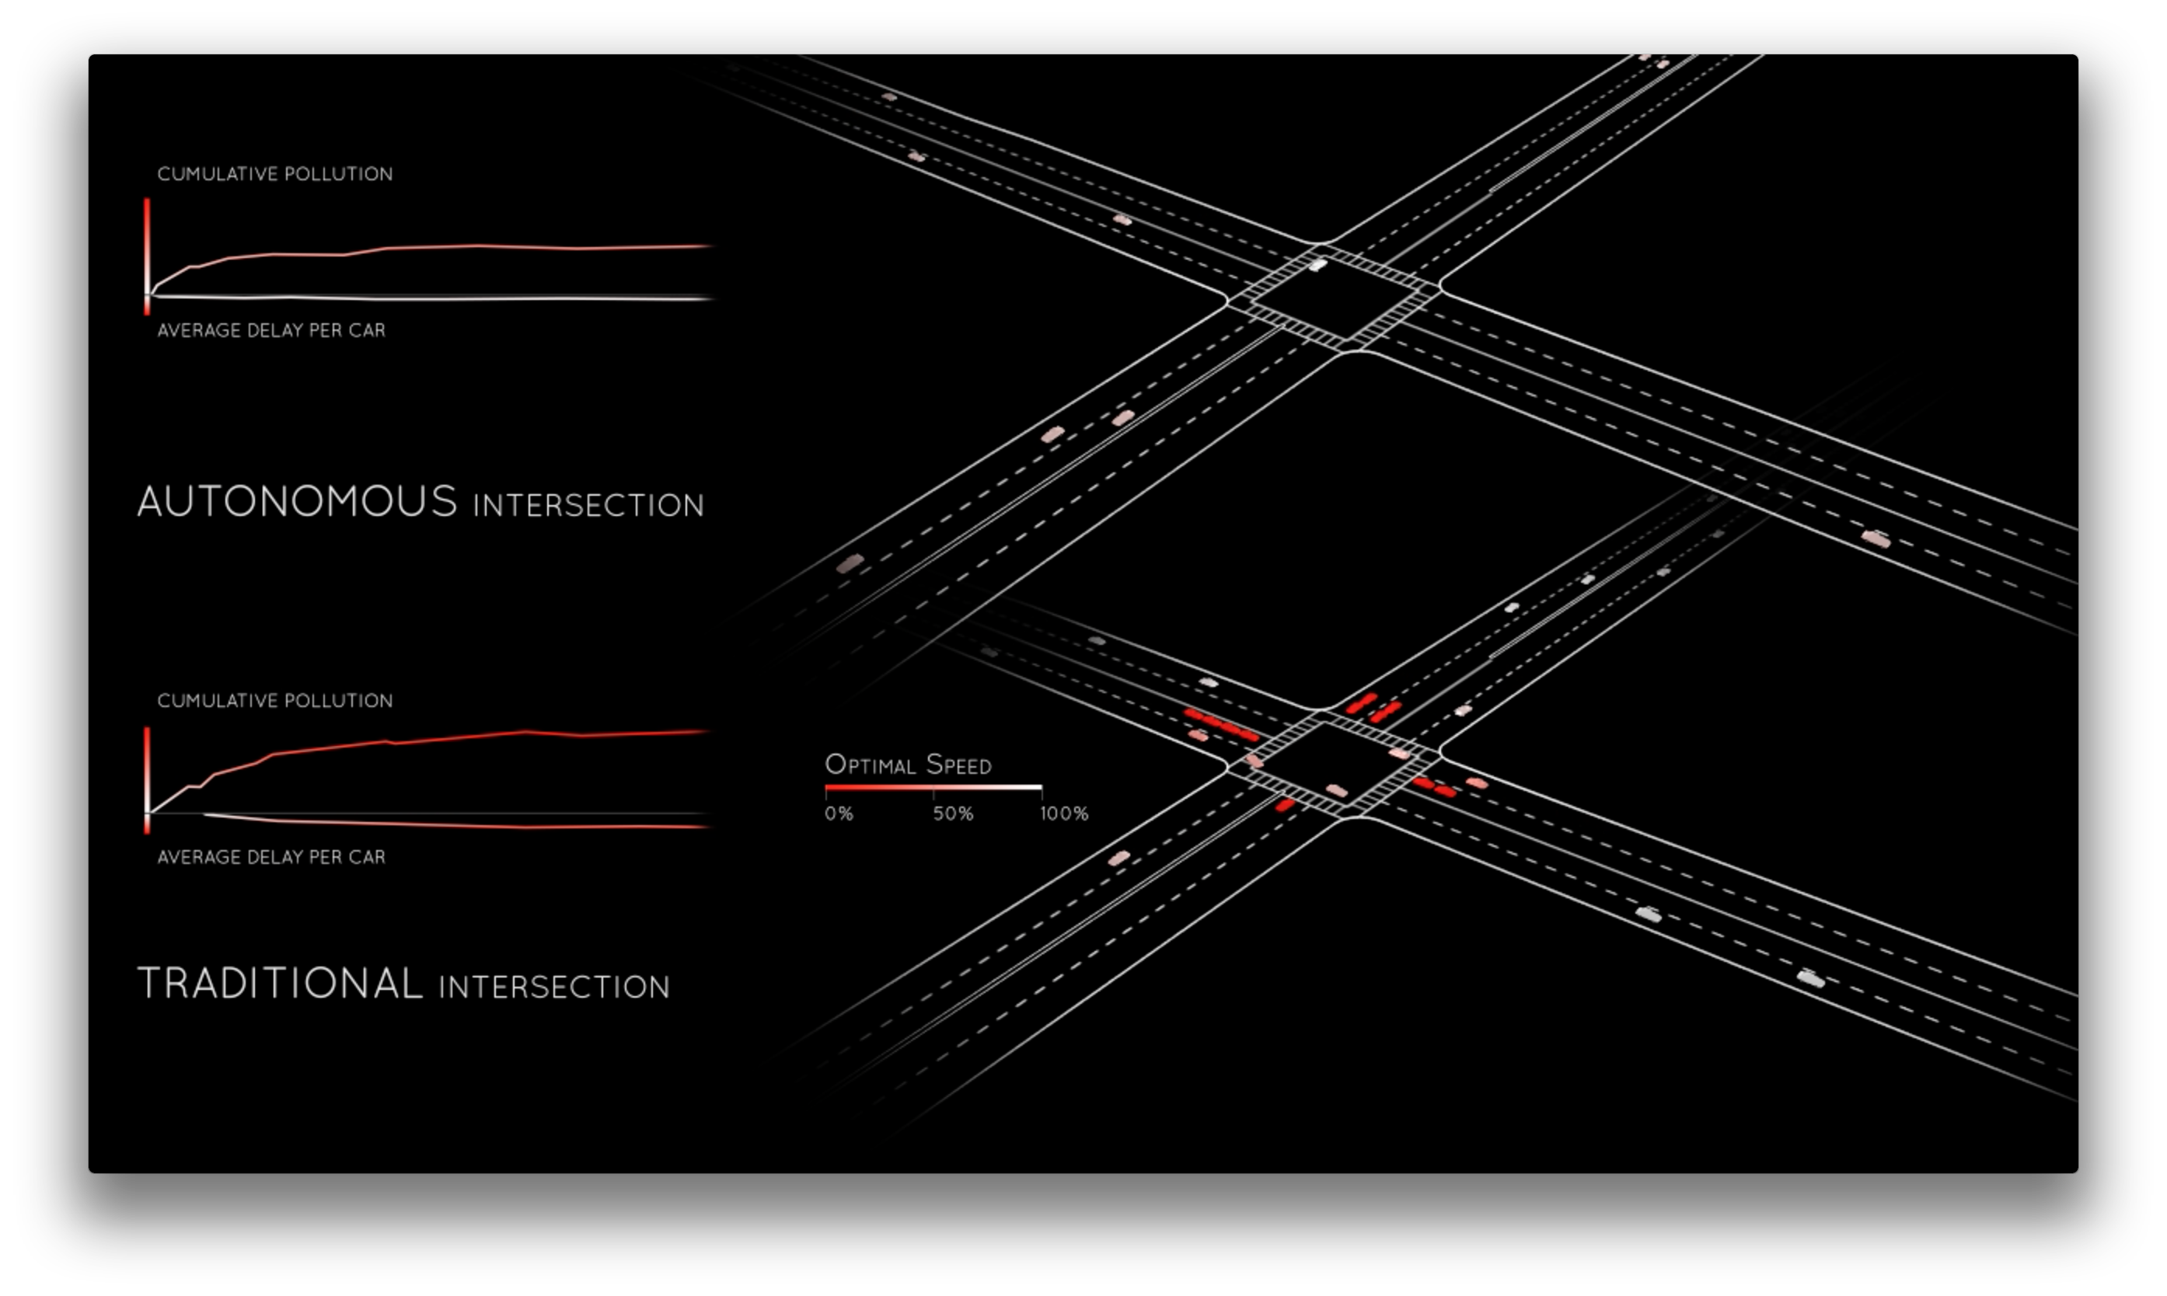
Accidental Biases
Connor Bouffard
Detection accuracy is 20% lower for children, 7.5% lower for darker skinned individuals [5]
“Car’s sensors will only register people if they move in an expected way, such as walking” [4]
Drivewave did not account for pedestrians [1]
Notes:
Training data dictates the effectiveness of the AI, current data contains more white people than other groups [5]
AI is trained to detect pedestrians through their movement, location, and image, if any of these are interfered with (wheelchair, guide dog, etc.) AI messes up [4]
Drivewave simulates an autonomous intersection without a traffic light, was accused for not incorporating pedestrians or regular drivers [1]
AI models are not transparent with training data [5]

Slide 21
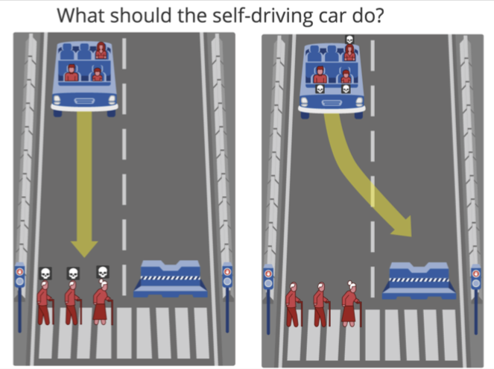
Purposeful Biases
Connor Bouffard
Moral Machine used to poll 2 million people in 233 countries [3]
People chose to save the most people, and younger people [3]
No one ruleset will work everywhere [3]
Notes:
AI should try to prevent accidents at all costs, but sometimes they are unavoidable [2]
Attempting to solve the trolley problem
Example, cows sacred in Hinduism, many Asian countries would never allow cows to be harmed by the AI [3]
Different cultures treat individuals differently, leading to mixed results in different scenarios (Jaywalkers, elderly) [3]

Slide 22
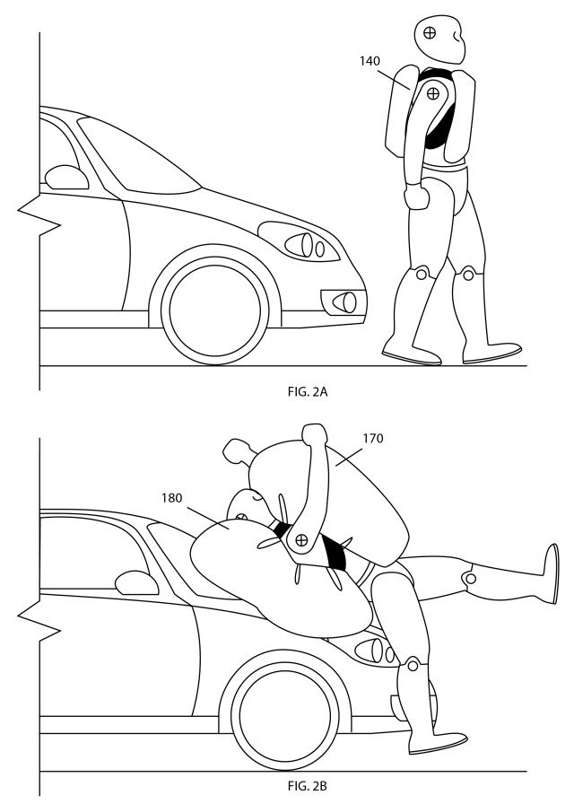
Solutions
Connor Bouffard
Pedestrian safety should not revolve around cars [1]
Patents: Adhesive car, shock watch, airbag suit, rocket belt [1]
“In the event of unavoidable accident situations, any distinction based on personal features (age, gender, physical or mental constitution) is strictly prohibited.” [2]
Notes:
Patents have been created in ridiculous ways that only affect the pedestrian without penalizing the car [1]
German Ministry of Transportation created regulations that autonomous cars must follow [2]
AI must prioritize human life over animals and structures [2]
Accountability placed on manufacturers [2]

Slide 23
References
Connor Bouffard
[1] Cortright, Joe, Pedestrian Safety: There’s No Technical Fix, (2023, June 5), https://www.strongtowns.org/journal/2023/6/5/pedestrian-safety-theres-no-technical-fix, Accessed 2024, April 6
[2] Federal Ministry of Transport and Digital Infrastructure, Ethics Commission Automated and Connected Driving, (2017, June), https://bmdv.bund.de/SharedDocs/EN/publications/report-ethics-commission.pdf?__blob=publicationFile#:~:text=The%20objective%20is%20to%20reduce,a%20positive%20balance%20of%20risks., Accessed 2024, April 5
[3] Leventhal, Jamie, In a crash, should self-driving cars save passengers or pedestrians? 2 million people weigh in, (2018, October 24), https://www.pbs.org/newshour/science/in-a-crash-should-self-driving-cars-save-passengers-or-pedestrians-2-million-people-weigh-in, Accessed 2024, April 5
[4] Stine, Alison, The Promise and Problems of Self-Driving Cars for the Disabled Community, (2023, September 25), https://nonprofitquarterly.org/the-promise-and-problems-of-self-driving-cars-for-the-disabled-community/, Accessed 2024, April 7
[5] Zhang, Jie, Driverless cars worse at detecting children and darker-skinned pedestrians say scientists, (2023, August 23), https://www.kcl.ac.uk/news/driverless-cars-worse-at-detecting-children-and-darker-skinned-pedestrians-say-scientists, Accessed 2024, April 6

Slide 24
Class 9
The End
Keith A. Pray
socialimps.keithpray.net
Notes:
This is the end. Any slides beyond this point are for answering questions that may arise but not needed in the main talk. Some slides may also be unfinished and are not needed but kept just in case.

Slide 25
Reliability Of Statistics
Are other factors controlled?
Is enough time covered?
Is all data reported?
Use Intuition
  Are results reasonable?
Notes:
Power line dangers. Electromagnetic fields? PCBs in transformers?

Slide 26
Some Measures
Mean Time To Failure (MTTF)
Mean Time Between Failures (MTBF)
Mean Time To Repair (MTTR)
Notes:
Is it repairable?
What does it mean to repair? Running again? Data fixed? Caught up?
Restoring the GBC Web site.

Slide 27
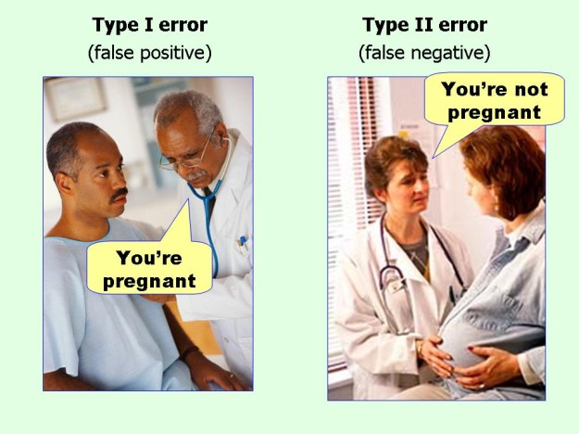
marginalrevolution.com/marginalrevolution/2014/05/type-i-and-type-ii-errors-simplified.html (2016-04-11)

Slide 28
what works well Online With Zoom
Sign in with First and Last Name
Stay muted unless you are going to speak
To speak use the raise your hand feature
To answer yes/no questions use the “yes” ”no” buttons
Turn your camera on
Wait until the end of student presentations to ask questions
  Write them down so you don’t forget

Slide 29
Survey Results (1/3) -22 Responses
Notes:
Common items for next time:
I am in FL 140 about an hour before and after each class
Estimated breakdown of course time per week:
4 hours class time
4 hours reading (2 chapters ~90 pages @ 2 minutes per page)
8 hours practicing mastery of material (papers, group project, class activity prep)
If you are spending much more than this let me know and we can figure out a more efficient way to spend your time

Slide 30
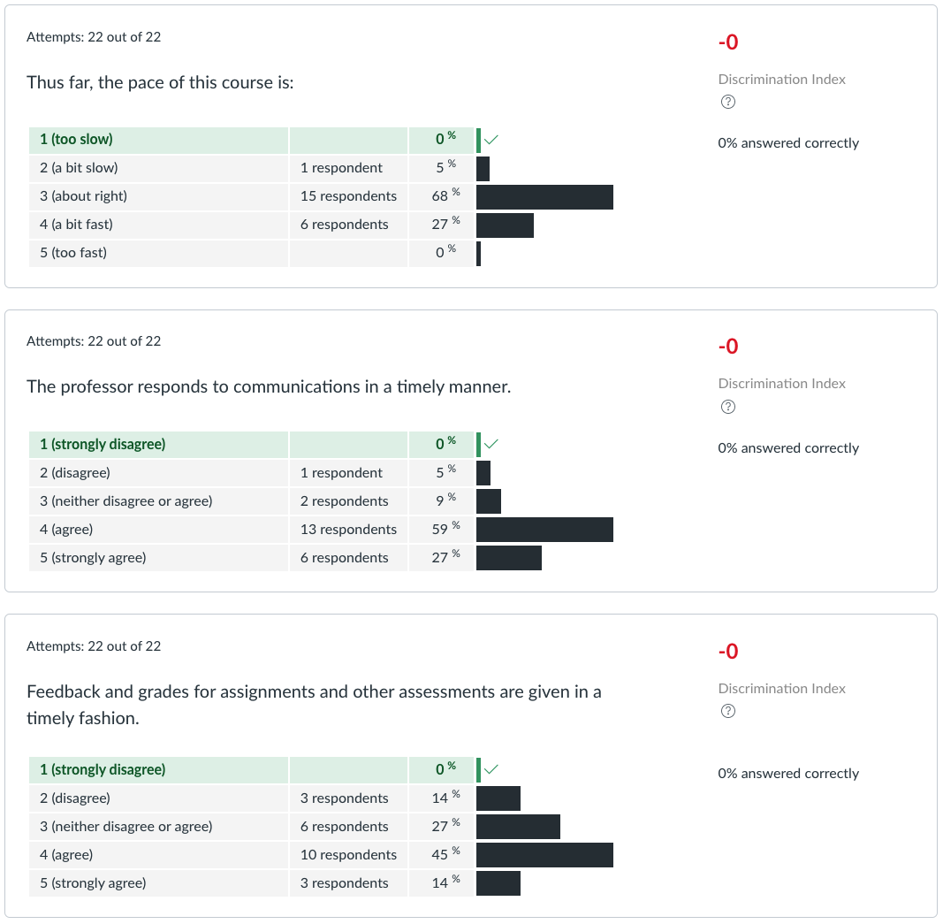
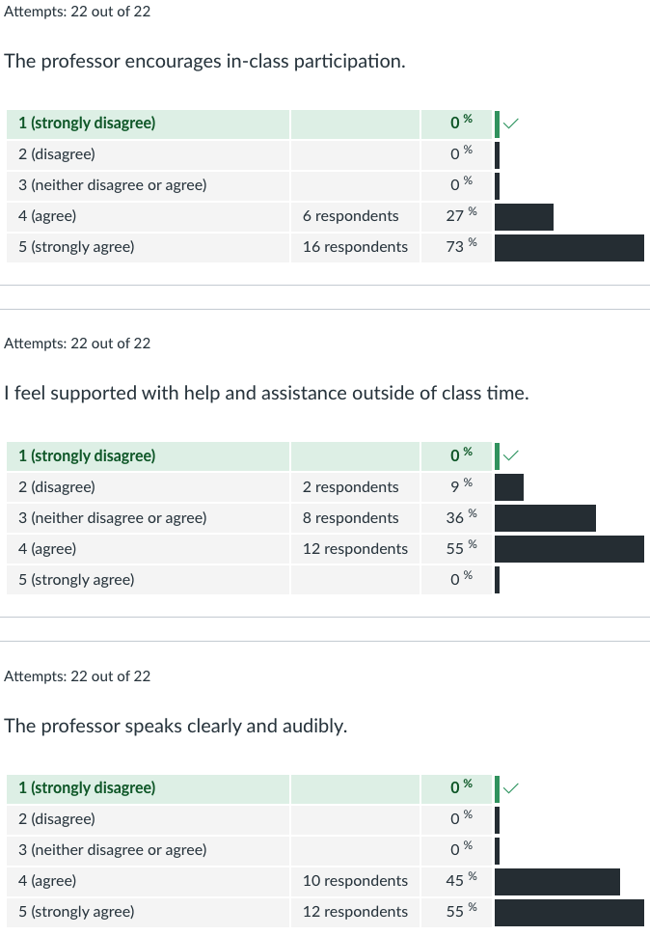
Survey Results (2/3) -22 Responses

Slide 31
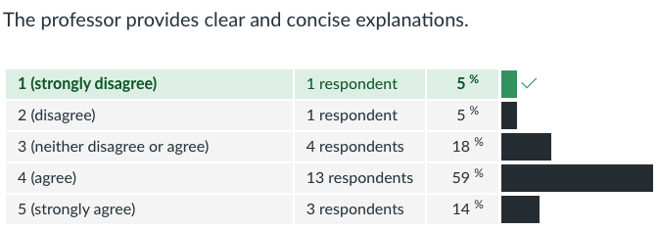
Survey Results (3/3) -22 Responses

