Slide 1
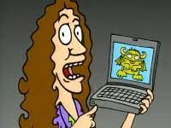
Class 8
Crime
Keith A. Pray
socialimps.keithpray.net
Notes:
“Weird” Al Yankovic – Virus Alert (2006) (3:43)
https://www.youtube.com/watch?v=zvfD5rnkTws
Internet of Things (IoT) first coined in 1999
Take 5 minutes to fill out survey on Canvas → Quizzes → SGA’s Midterm Course Feedback Questionnaire

Slide 2
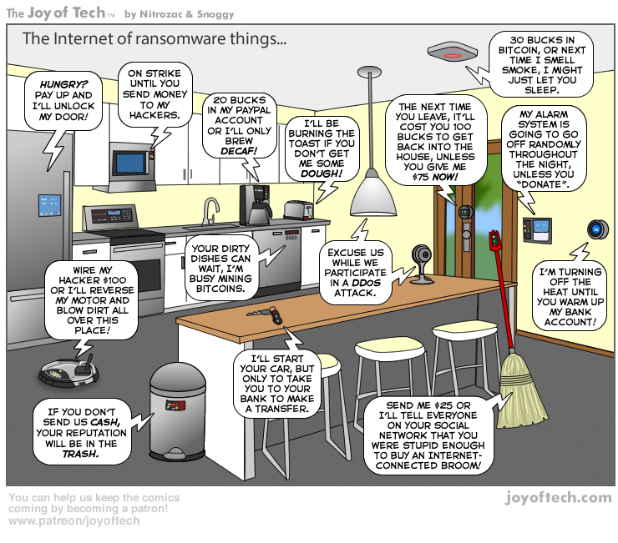
https://cointelegraph.com/storage/uploads/view/5e8f6e0d3a029807dfe181dc3d160cf0.png
Notes:
Find publish date
Note which really exist
Extra credit

Slide 3
Papers – Nice
Improvement!
Use backing data, including counter point and rebuttal
Quantify
  Instead of terms like: less, more, a lot, huge, great, big, tiny, growing, etc.
Review feedback from previous papers, located in Word doc attachment in Canvas
Be concise with language, avoid filler words
Please name files “FirstnameLastname-Topic.docx”
http://socialimps.keithpray.net/assignments/paper-guidelines/
Notes:
0s not included.
Save for next time:
Search results provide a single data point, motivation, and anecdotal context. Still need to back claims with high quality source and data.
Use sources that back claims with data
Read assignment
many profiles missing
space used to describe search findings instead of providing argument
Make decisive conclusions
may, could, etc. = trivial
Absolute statements are difficult to prove
Avoid: all, always, any, every, everyone, never, none… unless you can show it
Be sure to put quotes around entire quote
Hyperbole is the best thing ever!
but not in these papers
Print 2 sided and save a tree
Use template, saves time
Use and cite supporting data from at least 5 high quality sources
Argument should directly support conclusion
Response should directly address counter point
Arguments should have at least 3 statements
Review fallacies in Appendix B and Class 2 Slides
Avoid Strawman Fallacy
Counter Point and Rebuttal should relate to each other and conclusion
Use supporting data in counter point and rebuttal
Clear, strong conclusion, easy to find
Quantify
Instead of terms like: less, more, a lot, huge, great, big, tiny, growing, etc.
Make clear what claim evidence is supporting, explain how it’s relevant
Avoid fallacies, e.g. begging the question
Try reading paper out loud to yourself to catch typos, grammatical errors, contradictions

Slide 4
Grades
To Date
30 Max Possible

Slide 5
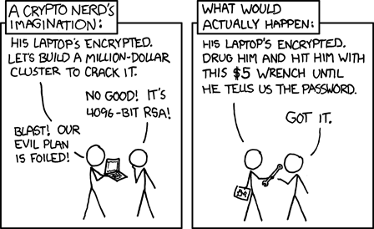
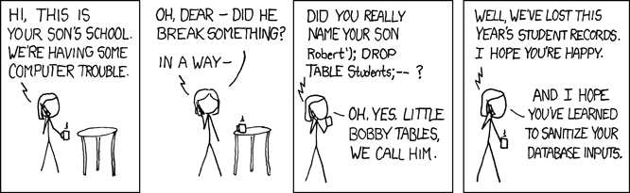
Overview
Review
Assignment
Students Present
https://xkcd.com/538/ (2010-11-14)
https://xkcd.com/327/ (2007-10-10)
Notes:
Are there any questions on the assigned reading?
Use the backup slides to explain Buffer Overflow or TCP attack methods from the text.
XKCD Links last accessed 2020-09-25

Slide 6
My Reading Notes
pp. 334 Interesting more movies referenced
pp. 335 Interesting to compare password guidance over the years. Anything sources newer than 2013? Writing down pw not option for classified systems. Giving silly answers good for info privacy too.
pp. 338 plenty not sent with HTTP
pp. 340 privacy policies AND implementations need to change
pp. 341 Getting on TV much more difficult than releasing software
pp. 343 Virus could be new
pp. 345 Goals include infect 3 machine per LAN and as many computers as possible? Never make last minute changes before release. Were they related to the defects?
pp. 346 Testing w/out DEBUG often neglected
pp. 348 Do people use the Internet as an experimental laboratory these days? Shutdown right after booting, “benign” doesn’t seem like the right word.
pp. 349 1.3% Google results malicious URL 2009, now?
pp. 350 “send reports back to a host computer”?
pp. 352 Does company have right to read data in addition to erase?
pp. 353 Annual ecommerce > $1 trillion 2013, now?
pp. 363 How is online voting a moral issue? How is making it easier for other, but NOT more difficult for everyone else, unfair?
pp. 368 13 study from 2003, now?
End of Chapter questions: 1, 15, 32
Notes:
- If time ask class about online voting in light of COVID-19 challenges.

Slide 7
Buffer Overrun
Run time stack
Local Variables
Return Address
Parameters
Variable Attack
buffer
Target Variable
Stack Attack
buffer
Return Address
code
Return Address
Notes:
Retired slide. Most students have this in depth from new class now.
When a function call is made, local variables, return address, parameters stored on run time stack. Local variables occupy lower memory addresses.
Variable attack – change variable value. Program expects user to input character and allocates a buffer for them. Attacker supplies too many characters and ends up over writing a variable.
Run example of this if there’s interest – next slide
Stack Attack – goal is to change value of return address so execution control goes to code which the attacker has provided in the input buffer.
Prevention – add checks against array bounds being exceeded. modify operating system to not execute instructions stored on run time stack.

Slide 8
TCP Three-way Handshake
SYN
SYN-ACK
ACK
Notes:
Retired slide. Most students have this in depth from new class now.
SYNchronize
SYNchronize ACKnowledgement (socket reserved awaiting ACK)
ACKnowledgement
TCP socket connection established

Slide 9
SYN Flood Attack
SYN
SYN-ACK
Notes:
Retired slide. Most students have this in depth from new class now.
Attacker spoofs the IP address so the SYN-ACK is sent to a different machine that cannot respond to the SYN-ACK.
This leaves the connection half open on the server machine decreasing the resources (sockets, memory, threads/processes) available to respond to legitimate clients.
The attacker send many such spoofed SYN messages.

Slide 10
Group Quiz
Ethical Analysis Guide
https://socialimps.keithpray.net/documents
A denial-of-service attack shuts down a bunch of retailer, stock brokerage, large corporate entertainment, and information web sites.
Guilty parties:
  Terrorist who aimed to cause billions of damage to U.S. economy
  Protestor opposing corporate manipulation of consumers
  A minor just having fun with tools found on the web
  Show off hacker in search of bragging rights
Choose one ethical theory to use:
  Kantian, Rule Utilitarian, Act Utilitarian, Social Contract Theory, Virtue Ethics
State what penalties are appropriate for each
Explain your decisions using your ethical theory
Name the laws/acts under which these parties could be prosecuted
Notes:
Works well as small group exercise.
Note: short answer format expected.
Note: 2. only one argument needed, should include logic for all parties
Note: 3. same law(s) should be applicable to all parties

Slide 11
Assignment
Code Testing 1 Page Paper 1/2
Research testing, decide on test strategy, test the given code
There are major and minor defects to find
Once testing is done write paper with conclusion: Testing strategy was adequate
  Include tests and results in an Appendix to save paper space for argument
Things that might be useful in your argument:
  Rationale for testing strategy used (use data, high quality sources)
  Explanations of defects found (use data, high quality sources)
  How to fix them (use data, high quality sources)
  Consequences of leaving defects in production code (use data, high quality sources)
Weakness in testing strategy as counter point (use data, high quality source)
Working example: http://socialimps.keithpray.net/assignments/Test_Sales_Fun
Notes:
If guest presenter coming next class remind students to prepare questions for him.
Remember to work on groups projects.
Each group should have material on their sites for the topics we’ve covered so far.
OLD Prompt:
Design tests for the code on the following slide.
Contains at least one major defect and several minor ones.
Write a paper (1 page not counting any source code) including :
Did you choose a good test strategy? (This is your conclusion.)
The inputs and expected outputs
What defects you found
How you would fix the defects (you may include fixed source)
Why would that fix the problems?
What could happen if the defects are not found before the code is put into production?

Slide 12
Assignment
Code Testing 2/2
import java.text.NumberFormat;
public class SalesFun {
public static double calculateSalesTotal ( double amount, double discountRate, double taxRate ) {
double discount = amount * discountRate;
double total = amount - discount;
double tax = total * taxRate;
double taxedTotal = tax + total;
NumberFormat numberFormat = NumberFormat.getCurrencyInstance();
System.out.println ( "Subtotal : " + numberFormat.format ( amount ) );
System.out.println ( "Discount : " + numberFormat.format ( discount ) );
System.out.println ( "Total : " + numberFormat.format ( total ) );
System.out.println ( "Tax : " + numberFormat.format ( tax ) );
System.out.println ( "Tax+Total: " + numberFormat.format ( taxedTotal ) );
return taxedTotal;
}
}
} Lines of interest
Notes:
Bold lines are real focus.
Example input:
amount = 100.05;
discountRate = 0.10;
taxRate = 0.05;
OR
0.70, 0.0, 0.05
95.67, 0.20, 0.7

Slide 13
Overview
Review
Assignment
Students Present

Slide 14
Forensics AI
Pranav Jain
Notes:
Should AI be used in Forensics?

Slide 15
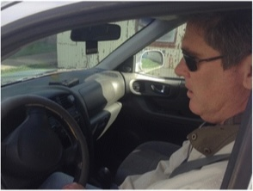
Public safety video and image analysis
Pranav Jain
“Very labor-intensive”, prone to human error due to huge amounts of information [1]
AI: identify faces, weapons, license plates, etc. [1]
Helpful for analyzing people’s behavior [1][6]
Notes:
One of the first places where AI could be used is for analyzing images and video footage. This could be done manually; however, this would take a long time to go through the evidence and there is a possibility that humans might miss information. [1]
In this picture, even though the gun is kept in plain sight, most people focus more on the driver himself, making them miss the gun. In this study, done in 2017, 58% of the police trainees and 33% of the police officers failed to notice the gun. [4]
AI could be helpful in identifying faces, weapons and other objects like license plates. It could also be implemented with a criminal database search which could give crucial information about any criminals within the media. [1]
AI could be further trained to analyze the behavior of people, among other things. The behavior of people could be useful to determine if a crime might take place or detect crime and help identify suspects, especially in security cameras. [1][6]

Slide 16
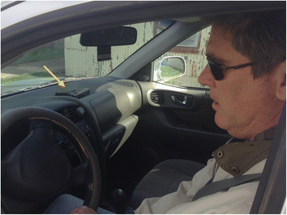
Public safety video and image analysis
Pranav Jain
“Very labor-intensive”, prone to human error due to huge amounts of information [1]
AI: identify faces, weapons, license plates, etc. [1]
Helpful for analyzing people’s behavior [1][6]
Did you notice the gun? [4]
Notes:
One of the first places where AI could be used is for analyzing images and video footage. This could be done manually; however, this would take a long time to go through the evidence and there is a possibility that humans might miss information. [1]
In this picture, even though the gun is kept in plain sight, most people focus more on the driver himself, making them miss the gun. In this study, done in 2017, 58% of the police trainees and 33% of the police officers failed to notice the gun. [4]
AI could be helpful in identifying faces, weapons and other objects like license plates. It could also be implemented with a criminal database search which could give crucial information about any criminals within the media. [1]
AI could be further trained to analyze the behavior of people, among other things. The behavior of people could be useful to determine if a crime might take place or detect crime and help identify suspects, especially in security cameras. [1][6]

Slide 17
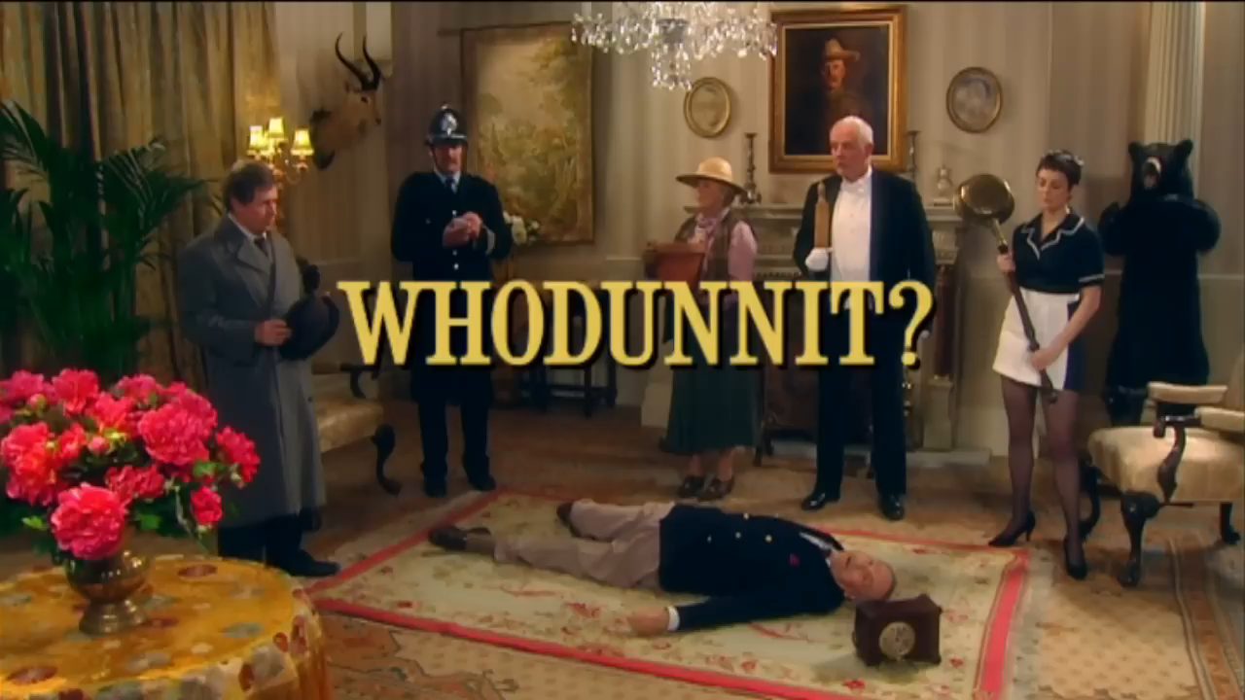
Public safety video and image analysis
Pranav Jain
Very labor-intensive, prone to human error due to huge amounts of information. [1]
AI could help to identify faces, weapons and other objects like license plates. [1]
Helpful for analyzing people’s behavior, doing disaster assessment, etc.
[4] https://www.youtube.com/watch?v=ubNF9QNEQLA
Notes:
The first use of AI in crime is something that we all know about and is the first thing that we suggest. The use of AI to analyze images and video footage. This could be done manually; however, this would take a long time to go through the evidence and there is a possibility that humans might miss information. (This could be seen in the experiment.) [1]
AI could be helpful in identifying faces, weapons and other objects like license plates. It could also be implemented with a criminal database search which could give crucial information about any criminals within the media. [1]
This could be helpful for analyzing the behavior of people, do assessment of a disaster situation, etc. The behavior of people could be useful to determine if a crime might take place or detect crime and help identify suspects, especially in security cameras. [1][6]

Slide 18
DNA analysis
Pranav Jain
Small amounts of “blood, saliva, semen, and skin cells, can be transferred” when contact is made [1]
Advances in DNA technology makes it possible to detect small traces of DNA [1]
DNA mixture interpretation [1]
Combining “human analysts with data mining and AI algorithms” [1]
Notes:
Another place where AI could be used is DNA analysis. When you touch another person or object, blood, saliva, semen and skin cells can be transferred. With the advances in DNA technology, it is possible to detect the small amount of DNA present on the sample, making it possible to find DNA from multiple people, even if they are small quantities. This causes the issue of DNA mixture interpretation where it becomes difficult to determine who were involved in the crime. [1]
The DNA analysis produces lots of complex data digitally. Hence, AI could be used to find patterns in the data, especially those which might not noticed by humans. [1]
This DNA analysis could be further improved by using a hybrid method by combining human analysts with data mining and AI algorithms. This would combine the strengths of all the approaches and hence, give a better output. [1]

Slide 19
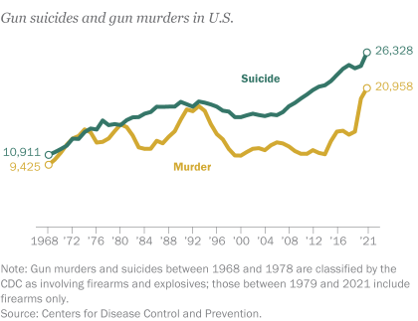
Gunshot Analysis
Pranav Jain
In 2014, more than 30,000 people were shot: 2/3 suicide and 1/3 murder. [2]
Lacks background information: “weapon type, bullet type, gunshot trajectory, and shooting distance” [2]
AI: give estimations about the background information [2]
<Graphic as big as will fit>
Rising number of gunshot cases increases the need for accuracy in classification [5]
Notes:
Another place where AI could be used is Gunshot analysis. In 2014, more than 30,000 people were with 2/3 being suicides and 1/3 being murder. These number are seeming increasing [5]. This requires the need for higher accuracy to classify the gunshots as suicide or murder. However, in many cases, there is a lack of background information, especially relating to the weapon used, the type of bullet, the trajectory of the gunshot and the shooting distance. These need to be inferred based on the wound on the victim’s body. [2]
AI could give estimations about the various information by inferring these by using patterns from previous data. [2]
An experiment took place in 2016 where they shot a few pig carcasses, giving the pigs one of 3 types of wounds: distant wound, close-range wound and contact wound. A picture was taken, and AI was asked to determine the type of wound. It was able to predict with 98% accuracy. This could allow forensics to use AI as a tool to double check their predictions and help them make more informed decisions. [2]

Slide 20
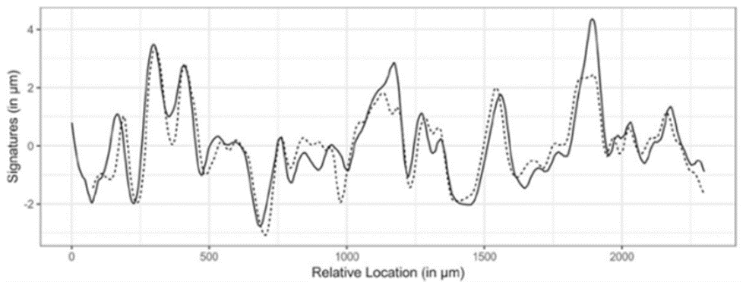
Gunshot Analysis
Pranav Jain
<Graphic as big as will fit>
Overlapped signatures of two bullets fired by the same firearm [3] can be detected using AI
Notes:
AI could also be used to determine whether the bullets were shot from the same gun. When a bullet shot from the gun, the bullet gets engraved at a microscopic level based on how it interacts with the gun. This is the signature of the bullet. When two bullets are shot using the same gun, they have very similar signatures as seen in the graph. [3]
AI could be trained to read these patterns. AI was implemented in the crime laboratories around the US to classify the performance of the bullets in a database. The results showed no false positives or negatives. [3]

Slide 21
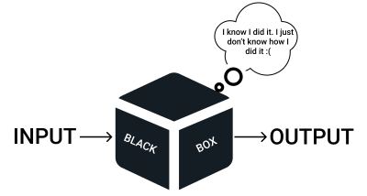
AI Black box Problem
Pranav Jain
<Graphic as big as will fit>
“In forensics, where findings may be used in court to determine fault, transparent and auditable decision-making” is a must [7] [8]
Notes:
However, with the use of AI, it causes the black box problem where the input and output can be seen; however, the process to reach the specific output isn’t clear. “In forensics, where findings may be used in court to determine fault, transparent and auditable decision-making” is a must. [7]
Hence, a hybrid solution of humans and AI would give the best outcome in Forensic Analysis. [7]

Slide 22
References
Pranav Jain
[1] Christopher Rigano, Using Artificial Intelligence to Address Criminal Justice Needs, (National Institute of Justice, October 8, 2018), https://nij.ojp.gov/topics/articles/using-artificial-intelligence-address-criminal-justice-needs (April 6, 2024)
[2] P. Oura, A. Junno, JA. Junno, Deep learning in forensic gunshot wound interpretation—a proof-of-concept study, (National Library of Medicine, April 6, 2021), https://www.ncbi.nlm.nih.gov/pmc/articles/PMC8354947/ (April 6, 2024)
[3] M. Kudonu, M. A. AlShamsi, S. Philip, G. Khokhar, P. B. Hari and N. Singh, Artificial Intelligence: Future of Firearm Examination, (IEEE, February 21-24, 2022), https://ieeexplore.ieee.org/stamp/stamp.jsp?tp=&arnumber=9735105 (April 7, 2024)
[4] D. J. Simons, M. D. Schlosser, Inattentional blindness for a gun during a simulated police vehicle stop, (Springer, September 20, 2017), https://doi.org/10.1186/s41235-017-0074-3 (April 8, 2024)
[5] John Gramlich, What the data says about gun deaths in the U.S., (April 26, 2023), https://www.pewresearch.org/short-reads/2023/04/26/what-the-data-says-about-gun-deaths-in-the-u-s/ (April 6, 2024)
[6] T. Yoshinaga, Y. Fukuda, Y. Watanabe, A. Hiroike, Video Analytics AI for Public Safety and Security, (Hitachi Review, 2022), https://www.hitachi.com/rev/archive/2022/r2022_02/pdf/02a04.pdf (April 7, 2024)
[7] Matt Zbrog, Forensic AI: The Increasing Automation of Digital Forensics, (Forensics Colleges, January 8, 2024), https://www.forensicscolleges.com/blog/automation-in-digital-forensics#:~:text=That%20makes%20AI%20and%20automation,relevant%20information%20for%20follow%2Dup. (April 8, 2024)
[8] Justin S., The AI Black Box Problem: An Unseen Challenge for Emergency Management and Public Health, (June 7, 2023), https://www.linkedin.com/pulse/ai-black-box-problem-unseen-challenge-emergency-public-justin-snair- (April 8, 2024)

Slide 23
AI Cyberattacks: how should we proceed?
April Bollinger

Slide 24
Increase in Research
April Bollinger
Cyber attacks are increasing and becoming more powerful [1].
The global economy loses $400 billion annually as a result of cyber crimes [1][3].
The main reason for cyber security failure is humans [1].
The most dangerous part of AI-controlled weapons may not be the weapons by themselves but those controlled by both AI and humans [2].
Artificial intelligence is primarily being developed by private companies with little regulation from countries [2].
Notes:
Most people are probably aware of the increase in research into Artificial Intelligence, but AI effects many other fields including cybersecurity.
The annual loss was 400 billion dollars a year when source [1] was written in 2021. The costs are only going to increase as they start using more AI-driven attacks.
Humans introduce a higher chance of failure [2].
AI cyberattacks can be almost completely untraceable and do not have the risk of human error [3].

Slide 25
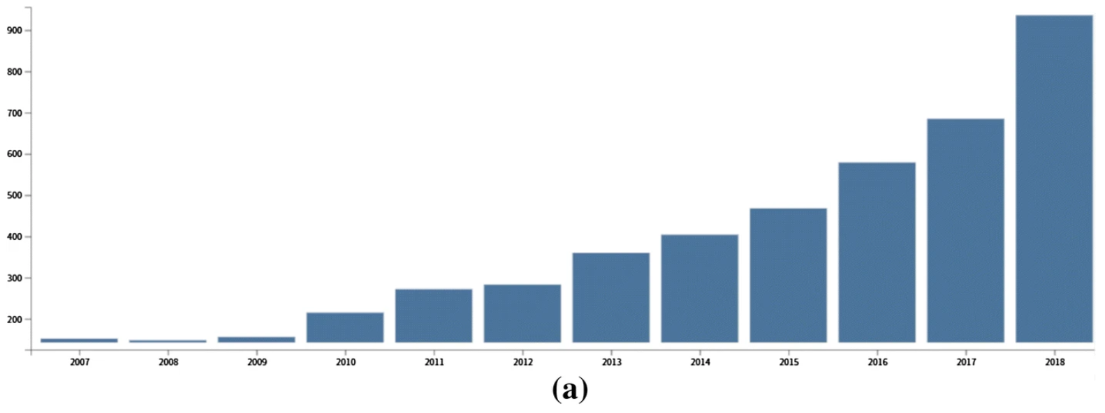
April Bollinger
(a) Published articles each year [1]
Notes:
Graphic: More than 900 articles were published in 2018 that related to AI application in cyber security.

Slide 26
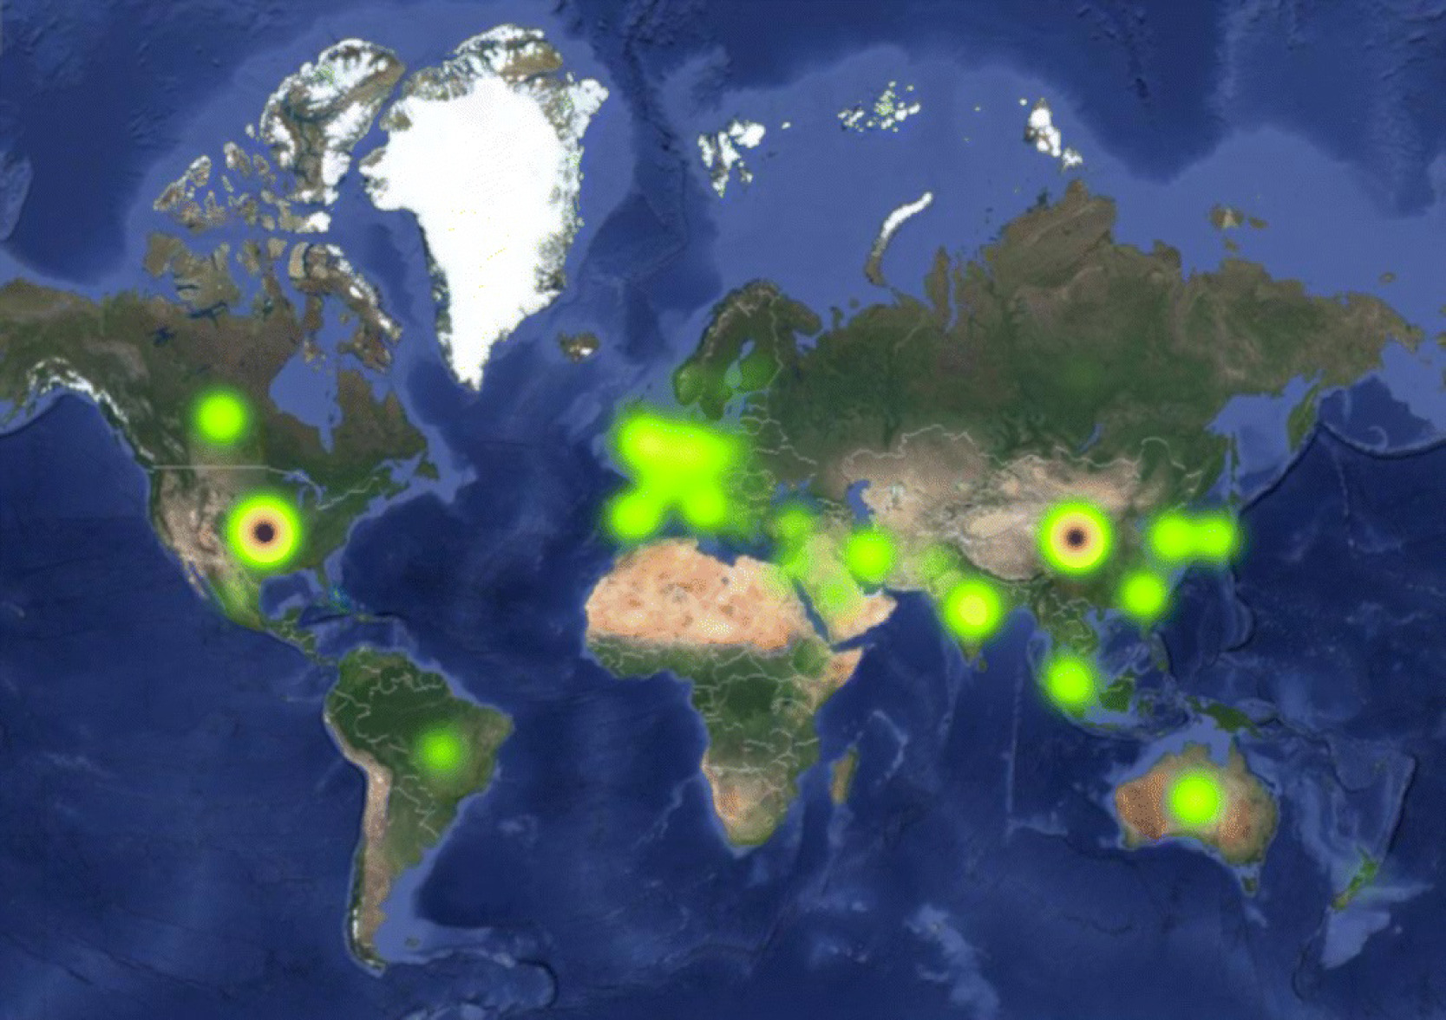
Intense Competition
April Bollinger
Research in AI applications for cyber security has been especially active in the United States, China, Germany, Japan, India, Australia, and several other European countries.
In countries such as the US, China, and Russia, the AI arms races has begun [2].
Hotspots of AI research for cyber security [1][2]
Notes:
We are not the only ones researching Artificial intelligence and its uses in cybersecurity.
“The New Zealand Navy is using it for logistics purposes. The NSA is using AI in its PRISM program to utilize big data for counterterrorism. Israel is using Al with the Harpy drone in dismantling enemy ops remotely, and China has developed a drone swarm technology that can be used to bypass enemy defenses.” [2].
Graphic: Green spots indicate active research areas and red spots indicate highly active areas.

Slide 27
Consequences
April Bollinger
It is believed that the winner of the AI arms race will secure global dominance [4].
Stephen Hawking, Bill Gates, and Elon Musk have acknowledged the risk of AI evolving to a point where it can no longer be controlled by humans [5].
“The development of full artificial intelligence could spell the end of the human race.” – Stephan Hawking [6].
Notes:
There are also consequences to pursuing such intense research. When the frontiers of a technology are pushed rabidly and understanding is not sufficient, there are risks.
“Whoever is “ahead” in the AI race, however, is not the most important question. The mere perception of an “arms race” may well push companies and governments to cut corners and eschew safety research and regulation. For AI — a technology whose safety relies upon slow, steady, regulated, and collaborative development — an arms race may be catastrophically dangerous.” [4].
“The logic goes: “AGI is inevitable, so the United States should be first.” The problem is that, in the words of Paul Scharre, “AI technology poses risks not just to those who lose the race but also to those who win it.” [4]”

Slide 28
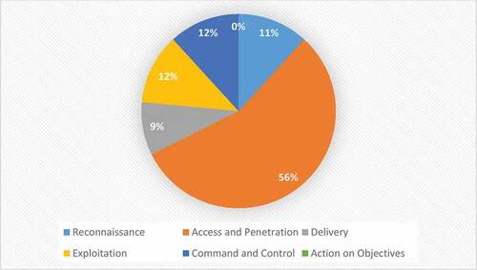
April Bollinger
Identified AI-Driven Cyberattack Techniques [3]
Notes:
Graphic: 56% of the AI-Driven cyberattack technique were identified in the access and penetration phase of the cybersecurity kill chain, 12% AI techniques were identified in the exploitation and command and control phase, respectively, 11% AI techniques were identified in the reconnaissance phase, 9% AI technique were identified in the delivery phase, and no AI technique was demonstrated in action on the objective stage of the cybersecurity kill chain to execute offensive AI attacks

Slide 29
Conclusion
April Bollinger
The advancement of AI is inevitable, but we must proceed carefully. Balance must be attained between the urgency of developing a new technology and comprehensive understanding of AI and the need to keep up with developments made in other countries.
Notes:
“Missile gap logic is rearing its ugly head again today, this time with regard to artificial intelligence, which could be more dangerous than nuclear weapons.” [4].
“More global cooperation over AI’s deployment will reduce the risk that a misaligned AI is integrated into military — and even nuclear — applications that would give it a greater capacity to create a catastrophe for humanity.“ [4].
“In order to control the advancement in AI’s weaponization, a few compromises must be made amongst superpowers, which include checks and balances that put national and international stability and well-being first and politics and power dynamics second.” [2].

Slide 30
References
April Bollinger
[1] Abbas, N.N., Ahmed, T., Shah, S.H.U. et al. Investigating the applications of artificial intelligence in cyber security. Scientometrics 121, 1189–1211 (2019). https://doi.org/10.1007/s11192-019-03222-9, (4/7/2024)
[2] Yamin, Muhammad Mudassar, et al. “Weaponized AI for Cyber Attacks.” Journal of Information Security and Applications, vol. 57, 2021, pp. 102722-, https://doi.org/10.1016/j.jisa.2020.102722, (4/7/2024)
[3] Guembe, B. et al. (2022) ‘The Emerging Threat of Ai-driven Cyber Attacks: A Review’, Applied Artificial Intelligence, 36(1). https://www.tandfonline.com/doi/full/10.1080/08839514.2022.2037254, (4/7/2024)
[4] Meacham, Sam. (2023), “A Race to Extinction: How Great Power Competition Is Making Artificial Intelligence Existentially Dangerous”, Harvard International Review, https://hir.harvard.edu/a-race-to-extinction-how-great-power-competition-is-making-artificial-intelligence-existentially-dangerous/, (4/8/2024)
[5] Yampolskiy, Roman V. (2017), “AI Is the Future of Cybersecurity, for Better and for Worse”, Harvard Business Review, https://hbr.org/2017/05/ai-is-the-future-of-cybersecurity-for-better-and-for-worse, (4/8/2024)
[6] Cellan-Jones, Rory (2014), “Stephen Hawking warns artificial intelligence could end mankind”, BBC, https://www.bbc.com/news/technology-30290540, (4/8/2024)
Notes:
Other thoughts:
Arms race is like the nuclear arms race which due to pressure was tested in the US even with the risk of a chain reaction that would ignite the atmosphere.
From [2], radiologists were given normal CT and AI changed CT scans. AI could not determine whether they were changed or not and the radiologists thought they were all real.

Slide 31
Quantum Security
Matt Hagger

Slide 32
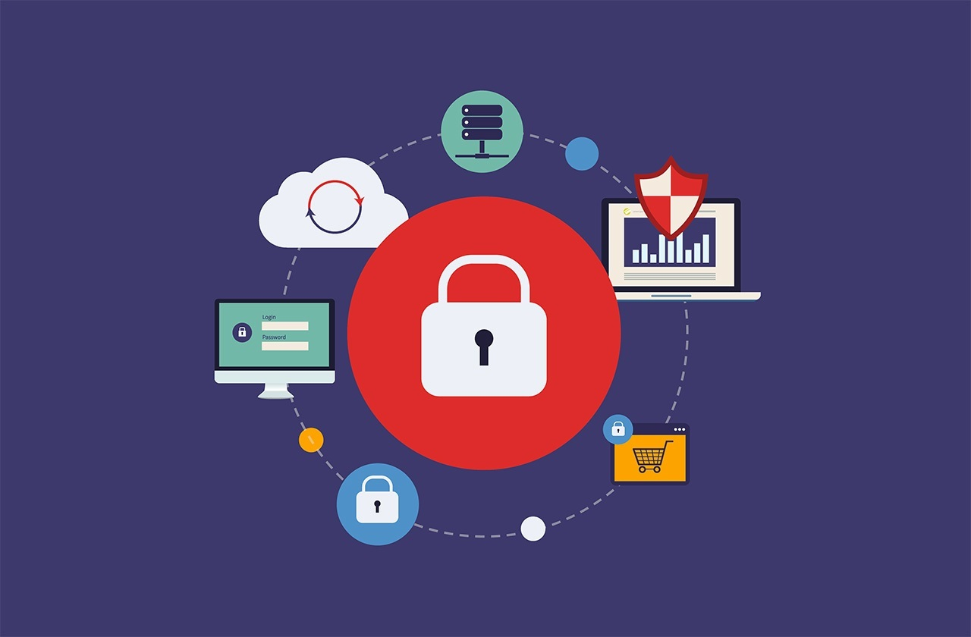
Online security
Matt Hagger
We rely on digital devices for our day-to-day lives
  Communication
  Banking
  Information
What happens when it goes wrong?
It does! $172b & 53% pop / y [1]
Notes:
We all know of someone or have been victims of cybercrime
It’s a serious issue, our security is fragile

Slide 33
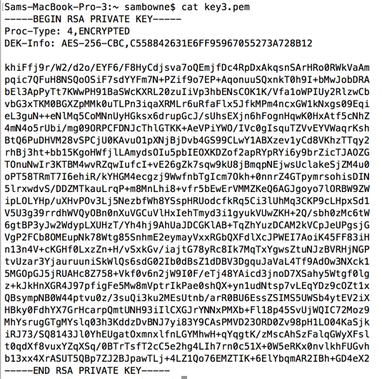
How do we stay safe?
Matt Hagger
The main way we stay safe is encryption.
  RSA asymmetric
Messages on the internet are scrambled by a 1024–4096-bit number
Public key made from multiplying 2 512-2048-bit primes. Easy to multiply, hard to find prime factors
Encrypt with public key, can only decrypt with both private keys
[2]
Notes:
The image is a private RSA key in base 64
RSA = Rivest Shamir Adleman
P*Q, key= public
Private = Extended Euclidean algorithm of P and Q
cip = (msg^key)%P*Q
Send…
Message =(cip^private) % P*Q

Slide 34
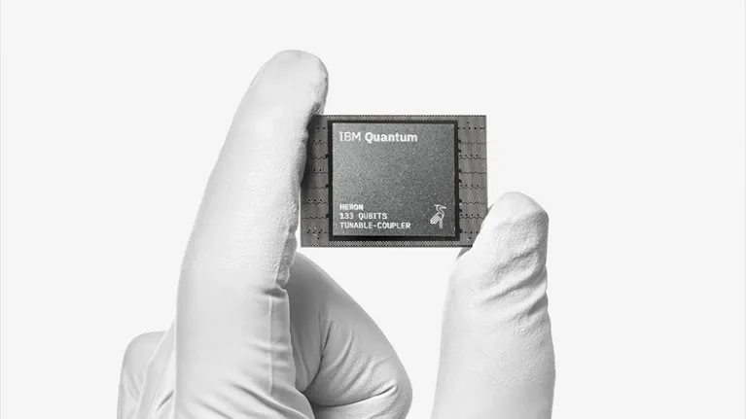
Quantum Computers
Matt Hagger
Use qubits which can be 0 & 1 at the same time. Superposition
By entangling the bits, computation can happen. Every possible answer calculated simultaneously
Measuring the state of the QC gives 1 possible answer.
Not replacements for PCs, only good for certain cases such as:
  AI training
  Complex exponential equations
  Cryptography
[3]
Notes:
Qubits are like normal bits in a computer, but instead of being 0 or 1 they are ‘entangled’ with other qubits based on the algorithm to give a probability of it being either a 1 or a 0 when measured
This isn’t a traditional computer, you wont be buying one anytime soon
Can run as many threads in a traditional computer all in parallel. Very slow at operations, but can execute many all at once
Image is the 133 qubit IBM Heron processor released December 2023.

Slide 35
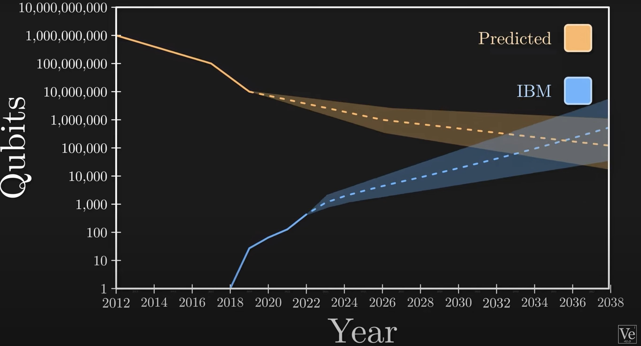
The end of RSA
Matt Hagger
Unfortunately, one of those cases is what the digital world is built on for 40 years
RSA would take the best supercomputer 16 million years to crack. QC takes minutes.
There are not enough physical qubits currently. When, not if, it will break.
Many criminals use SNDL
[4]
Notes:
RSA2048 likely not broken this decade, but its on the horizon
Picture that shows the potential future intersection of qubits needed to break RSA and how many exist over time
(SNDL) store now decrypt later – criminals harvest massive amount of encrypted info and store it away since storage is cheap. When QC is available in the future they can decrypt old data

Slide 36
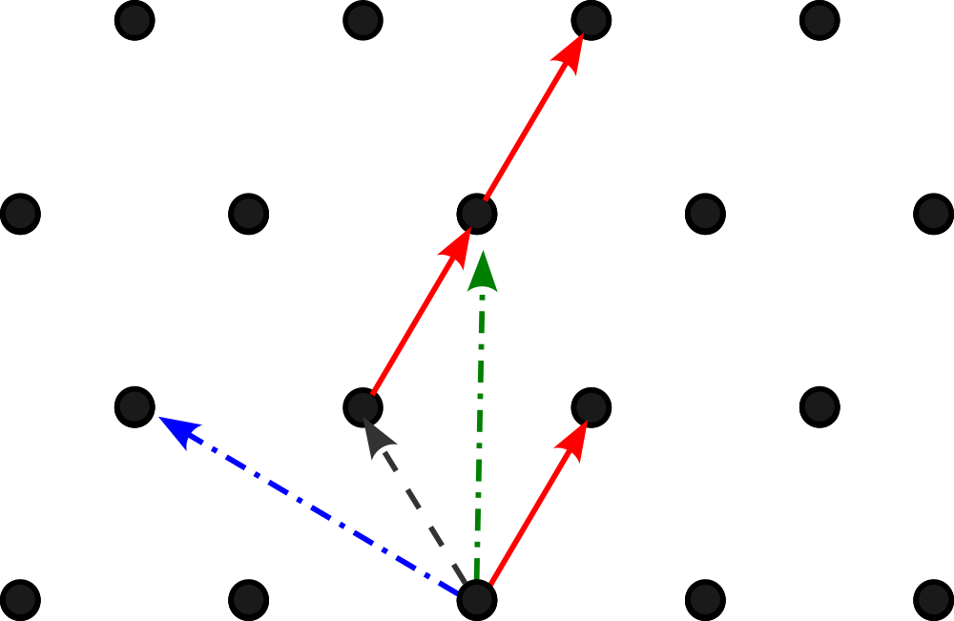
What’s next?
Matt Hagger
NIST issues a challenge to make a QC-proof algorithm
Winners used lattice encryption
n easy private vectors, n hard (public) vectors that make same lattice
Encrypt message with hard vectors + noise
Decrypt by finding sequence with easy vectors
[5]
Notes:
There is hope
1234 dimensions proposed
Find a linear combination of vectors and add a small offset. Use point that to encode messages, send message + point w/ noise
Need to find the closest lattice point to decrypt. Really hard to do with bad vectors. Can't be done by QC
US govt required to start using lattice algo

Slide 37
References
Matt Hagger
[1] Farahbod, Shayo and Varzavdeh, CYBERSECURITY INDICES AND CYBERCRIME ANNUAL LOSS AND ECONOMIC IMPACTS (Journal of Business and Behavioral Sciences, Spring 2020)
[2] R. L. Rivest, A. Shamir, L. Adleman, A method for obtaining digital signatures and public-key cryptosystems (ACM, 01 February 1978)
[3] Committee on Technical Assessment of the Feasibility and Implications of Quantum Computing, Quantum Computing: Progress and Prospects (National Academies Press, 4/27/19)
[4] Vaishali Bhatia; K.R. Ramkumar, An Efficient Quantum Computing technique for cracking RSA using Shor’s Algorithm (IEEE, 2019)
[5] Johannes Buchmann, Florian Göpfert, Tim Güneysu, Tobias Oder, Thomas Pöppelmannt, High-Performance and Lightweight Lattice-Based Public-Key Encryption (ACM, 05/30/2016)

Slide 38
Class 8
The End
Keith A. Pray
socialimps.keithpray.net
Notes:
Any slides beyond this point are for answering questions that may arise but not needed in the main talk.
Some slides may also be unfinished and are not needed but kept just in case.

Slide 39
Buffer Overrun
Run time stack
Local Variables
Return Address
Parameters
Variable Attack
buffer
Target Variable
Stack Attack
buffer
Return Address
code
Return Address
Notes:
Retired slide. Most students have this in depth from new class now.
When a function call is made, local variables, return address, parameters stored on run time stack. Local variables occupy lower memory addresses.
Variable attack – change variable value. Program expects user to input character and allocates a buffer for them. Attacker supplies too many characters and ends up over writing a variable.
Run example of this if there’s interest – next slide
Stack Attack – goal is to change value of return address so execution control goes to code which the attacker has provided in the input buffer.
Prevention – add checks against array bounds being exceeded. modify operating system to not execute instructions stored on run time stack.

Slide 40
Run Example Code
Notes:
Retired demonstration. Most students have this in depth from new class now.
Also, compilers getting more difficult to disable protections, need older HW/OS/compiler for demo to work.
> imps
> assembly
> 123456789qwerty1

Slide 41
Buffer Overrun Code
#include <stdio.h>
#include <string.h>
int main ( void ) {
char buff [ 15 ]; int ace = 0;
printf ( "\n Enter best class ever : \n" );
gets ( buff );
if ( strcmp ( buff, "imps" ) ) {
printf ( "\n %s is wrong! You should FAIL! \n ace=%i\n", buff, ace ); }
else { printf ( "Correct! \n") ; ace = 1; }
if ( ace ) { printf ( "You get an A! \n" ); }
return 0; }
} The Naughty Line
Notes:
Retired slide. Most students have this in depth from new class now.

Slide 42
TCP Three-way Handshake
SYN
SYN-ACK
ACK
Notes:
Retired slide. Most students have this in depth from new class now.
SYNchronize
SYNchronize ACKnowledgement (socket reserved awaiting ACK)
ACKnowledgement
TCP socket connection established

Slide 43
SYN Flood Attack
SYN
SYN-ACK
Notes:
Retired slide. Most students have this in depth from new class now.
Attacker spoofs the IP address so the SYN-ACK is sent to a different machine that cannot respond to the SYN-ACK.
This leaves the connection half open on the server machine decreasing the resources (sockets, memory, threads/processes) available to respond to legitimate clients.
The attacker send many such spoofed SYN messages.

Slide 44
Ping Attack
Target
Attacker
ping
ping
Notes:
Retired slide. Most students have this in depth from new class now.
Attacker finds routers that support broadcasting messages to all computers on their local area networks.
The attacker sends a spoofed ping message, which the routers echo to the spoofed address.

Slide 45
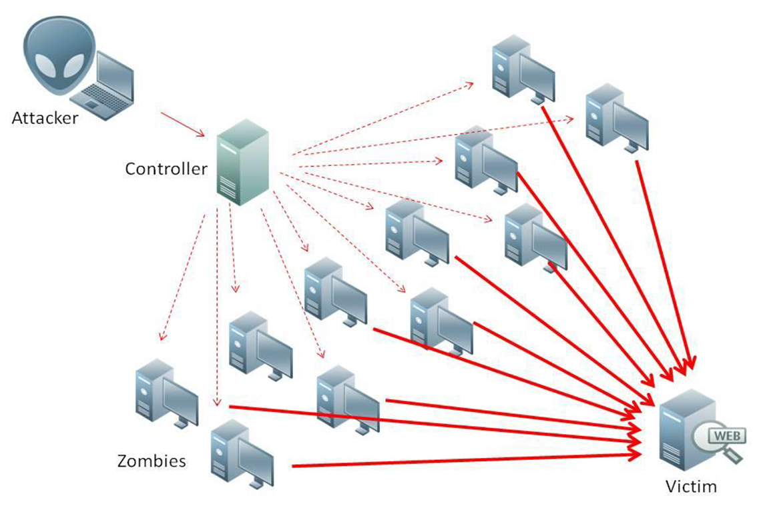
What is Denial of Service (DoS)
Attempts to make target unavailable by flooding with traffic
If victim has to filter attack, it’s too late
Internet Providers have no incentive to help
  Businesses get affected, but would not pay provider enough to make worthwhile
  This is why Cloudflare, e.g., exists
Many ways to perform this attack
Notes:
Contributed by Brett Ammeson.
https://www.cloudflare.com/ddos/reflection-attack-1.png
https://i.imgur.com/lxYv8cF.png

Slide 46
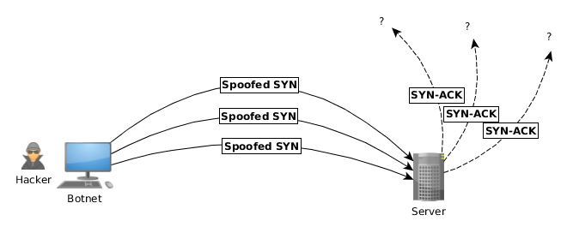
Distributed DoS Vectors
TCP SYN attack
  SYN packets are small, low difficulty for attacker
  Leaves half-open connections on server
  SYN cookies mitigate this
DNS amplification attack
  DNS requests are small
  Can request all records on server
  Crippled by proper configuration
Ingress/egress filtering will reduce effect
Notes:
Contributed by Brett Ammeson.
TCP SYN: https://www.cert.org/historical/advisories/CA-1996-21.cfm
DNS amplification: https://www.cert.org/historical/incident_notes/IN-2000-04.cfm
Ingress/egress: www.giac.org/paper/gsec/705/egress-filtering-keeping-internet-safe-systems/101588

Slide 47
Crime How
Technical and Non-Technical
  Break into computer.
  Prevent access to computer.
What things make computer related crime easy?
Notes:
Exploit security holes, Break encryption, Spoofing
Social Engineering: Guess passwords, Find out passwords and procedures
Poor passwords, Insecure protocols, Program limitations (buffer overruns), Eavesdropping (Email, Interactive), Insecure files

Slide 48
Crime Bane
Trojan Horse
Virus
Worm
Bot Network
Buffer Overrun
(Distributed) Denial Of Service Attack
How do they work?
How harmful are they?

Slide 49
Crime Why
Why?
Notes:
Money: stolen credit cards, change records, stolen property.
Political, military, economic.
Challenge, Revenge, Mean
Why do at all? Have motivation, think about it, think it will help, think it’s acceptable.
Feel forced. Don’t agree. Don’t care.

Slide 50
Crime Time
What is different now compared to:
  10 years ago?
  20 years ago?
  30 years ago?
  40 years ago?
Notes:
More computers. Unsophisticated owners. More complex software. Greater connectivity. Easy access to cracking tools. Incentives. File-sharing
In ’60s and ’70s, access was mostly localized.
Modems. Wardialing.
Some Arpanet and Usenet.

Slide 51
Crime Doers
Hacker or Cracker
  Pre-1980 - Golden Age ☺ ?
  Eighties
  Nineties
  Naughts
Criminal Hacking == Cracking?
Notes:
Script kiddies
Phreakers
Security analysts
Packet monkey

Slide 52
Crime Gain
Justifications for Computing Crimes?
What can be done after access is gained?
  What resources are available?
  How valuable are they?
Notes:
Machines are unused. No harm done. Education. Exposes security holes. Exposes abuses.
Use computer and/or resources. Take data. Destroy data. Alter data. Lock out others. Attack other computers.
Equipment, Processor Time, Disk space, Printer time / paper, Bandwidth

Slide 53
Crime Pay
Computer Fraud and Abuse Act (1986)
  Bans :
    unauthorized access or use of computers, copying, modifying, or destroying data, disclosing of passwords.
    disrupting government and utilities.
  Covers government, financial, medical, and interstate systems.
USA Patriot Act (2001)
  Raised penalties.
  Permits freer surveillance and monitoring to detect illegal activity.
Electronic Communications Privacy Act
  Illegal to intercept telephone, email, other data transmissions, access stored email messages without authorization
Assign Cybercrime Treaty (2006), Wire Fraud Act, National Stolen Property Act, Identity Theft and Assumption Deterrence Act
Notes:
Are either of these laws still in effect? Have they been changed?
For additional legislation ask for presenting volunteers to brief recent incidents/cases.
Also ask for volunteers to find out laws from their home country/state.

Slide 54
Crime Stop
Technical
  Protect Data
  Protect Machine
  Protect Access
Non-technical?
  Social?
  Legal?
Notes:
Encryption, Authentication, Biometrics, Anti-virus, File integrity checking (E.g. Tripwire), Virtual private networks, Point-to-point networking (Twisted-pair Ethernet vs. Coax vs. wireless)
Security through obscurity, physical access required, not on network, behind locked doors.
Remove desire, remove incentives
Legalize, increase penalties, increase chance of getting caught.

Slide 55
what works well Online With Zoom
Turn your camera on
Sign in with First and Last Name
Stay muted unless you are going to speak
Use the raise your hand feature to ensure your turn
Wait until the end of student presentations to ask questions
  Write them down so you don’t forget

