Slide 1
Class 4
Freedom Of Speech
Keith A. Pray
socialimps.keithpray.net
Notes:
If forgot to show the ethical analysis guide, do so now.

Slide 2
what works well REmotely With Zoom
Turn your camera on
Sign in with First and Last Name
Stay muted unless you are going to speak
To speak use the raise your hand feature
Wait until the end of student presentations to ask questions
  Write them down so you don’t forget

Slide 3
Overview
Review
Assignment
Students Present
Notes:
Show syllabus updates if any

Slide 4
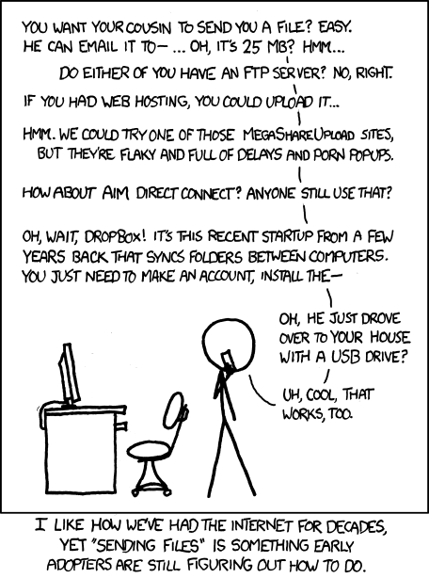
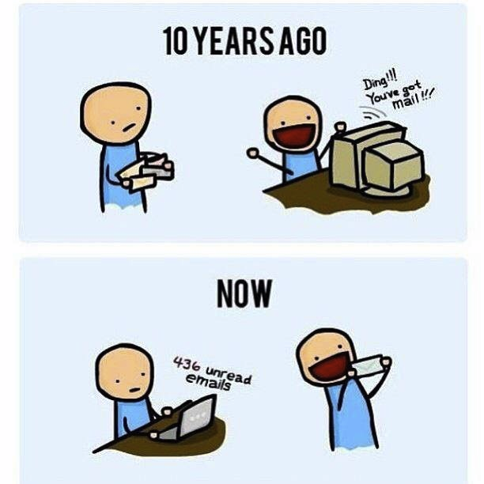
http://poofytoo.com/
25
http://xkcd.com/949/
Notes:
What is more exciting now for you, email or snail mail?
http://xkcd.com/949/
2011

Slide 5
My Reading Notes
pp. 110 First e-games 1972 at Stanford [1]. Has Twitch viewership gone up since the start of the COVID pandemic?
pp. 111 What powers the cell phones and towers? “everyday tasks” not apparent from image.
pp. 113 Ann did not force people to complain.
pp. 114 Does Kantian analysis agree?
pp. 117 9% # transactions or $$? Wikipedia critics source from 2005, is quality still in question?
pp. 118 MOOC source from 2012, now?
pp. 122 Macedonian is nice addition to new edition
pp. 123 “may have” = weak conclusion. Who funded studies?
pp. 124 Easier consolidation of newspapers. Advertisers switching away from newspaper source from 2014.
pp. 126 Search engines link deeper than home page
pp. 127 Any US agencies employing this many people?
pp. 131 Adult bookstores lowering property values source?
pp. 135 “texted… images”
pp. 136 Stating people searching did not consent to material being blocked makes more sense.
pp. 138 sexting examples all from 2009?
pp. 140 College students still as likely? 2013 source
pp. 141 Do mobile plans still charge for text messages?
pp. 146 Hunter Moore convictions seem unrelated to “Anyone Up?” site.
pp. 153 See: http://en.wikipedia.org/wiki/Wikipedia:Citing_Wikipedia
pp. 154 Question 40 same as 46
Questions I liked: 17, 43
Interview nice update
Notes:
[1] Owen Good (19 October 2012). "Today is the 40th Anniversary of the World's First Known Video Gaming Tournament". Kotaku. Retrieved 1 August 2013

Slide 6
Group Quiz
Name two methods some governments use to control access to information.
A large company has a policy prohibiting employees from blogging about company products.
  Does it violate the First Amendment? Why?
  Name two possible reasons for the policy.
  Is it reasonable? Why?
What does “URL” stand for and what is it?
Notes:
Censorship (religious, governmental, private). Adult authentication. Firewalls. Government owned media outlets (TV and radio stations, newspapers), private photocopier ownership illegal
First Amendment prohibits Congress from making laws limiting free speech, not private companies.
Uniform Resource Locator

Slide 7

Overview
Review
Assignment
Students Present
Notes:
But before that:
CPG Grey - This Video Will Make You Angry [Thought Germs] (7:25) – 2015-03-10
https://www.youtube.com/watch?v=rE3j_RHkqJc
Find better examples:
Cedric Gervais - Hashtag (Original Mix) (3:58)
https://www.youtube.com/watch?v=6OmBKd7X7EE
Dave Audé vs Luciana - You Only Talk In #HASHTAG (3:36)
http://www.youtube.com/watch?v=53wIN87lJn0

Slide 8
Assignment
Reading
Individual Presentations
Extra Credit – One page paper
  Is WPI’s IT Acceptable Use Policy morally acceptable?
Work on your group project
  1.16 Happiness!
    1-3 scale with 1 = everyone getting their first pick
  See full group project description on course website
  Send Web Site URL before next class
Notes:
- Or review group project and individual presentation guidelines right now.
Possible One page paper:
Global intellectual property laws, friends or foes?

Slide 9
Overview
Review
Assignment
Students Present

Slide 10
Virtual Reality’s
Personal Social Impact
Torin GD Danielski

Slide 11
What is the impact of using virtual reality to supplement physical social interactions?
Torin GD Danielski
Notes:
Not a replacement
Mention stigma

Slide 12
The impact is positive as a backup to physical socialization
Torin GD Danielski
Notes:
Not a replacement

Slide 13
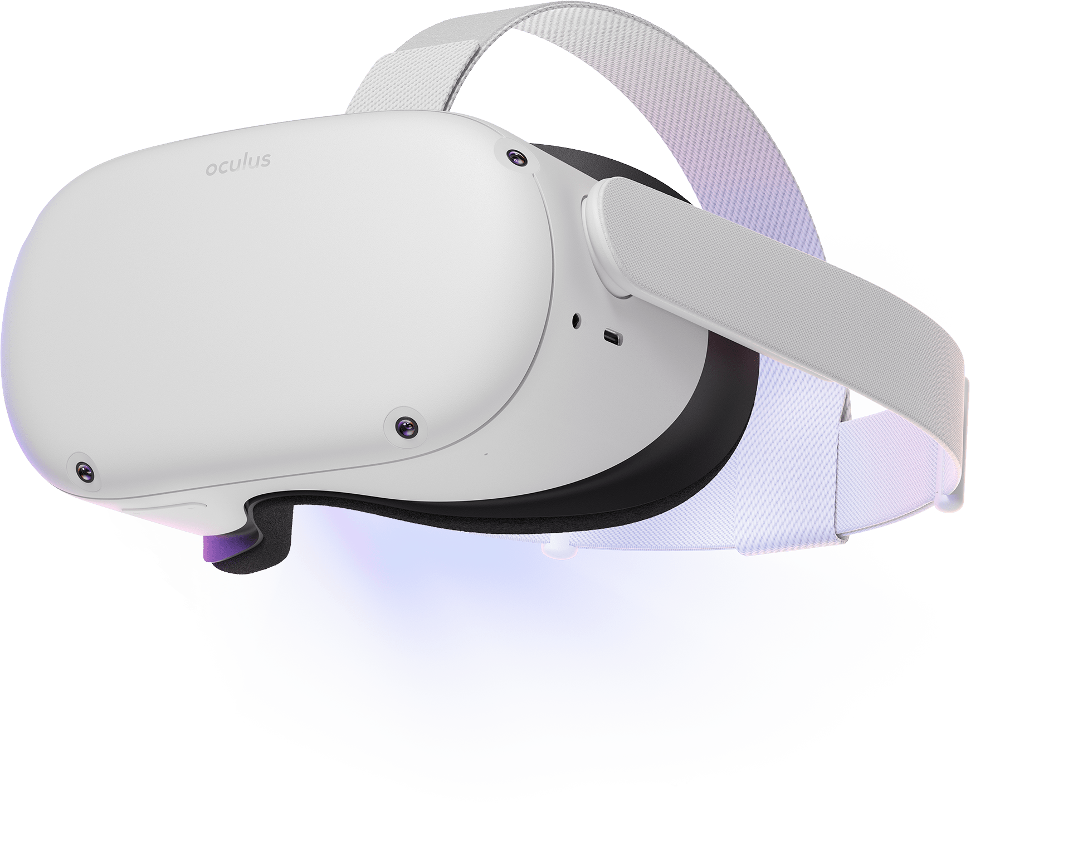

Step-up
Torin GD Danielski
"In the internet club it's better and it's much more interesting when we go into virtual reality together, it gives us the opportunity to discuss things” [1]
Next best thing, after reality
Supplement for online-only relationships
Clip Art Source: いらすとや
Notes:
Machine Translated from Russian, Vanya Serafimova
“Step up” referring to a step-up from the alternative- playing games on a PC or chatting over discord/call.
Recall back to “backup to physical socialization” on title
Internet club seems to be referring to the concept of meeting online
Close to reality- has a physical component. You can see a person’s movement. Maybe not their facial expressions, but their posture and ****hand movements****
Supplement online-only relationships
Emphasize not a replacement for physical, just a chance where it otherwise wouldn’t be possible (as elaborated later)

Slide 14
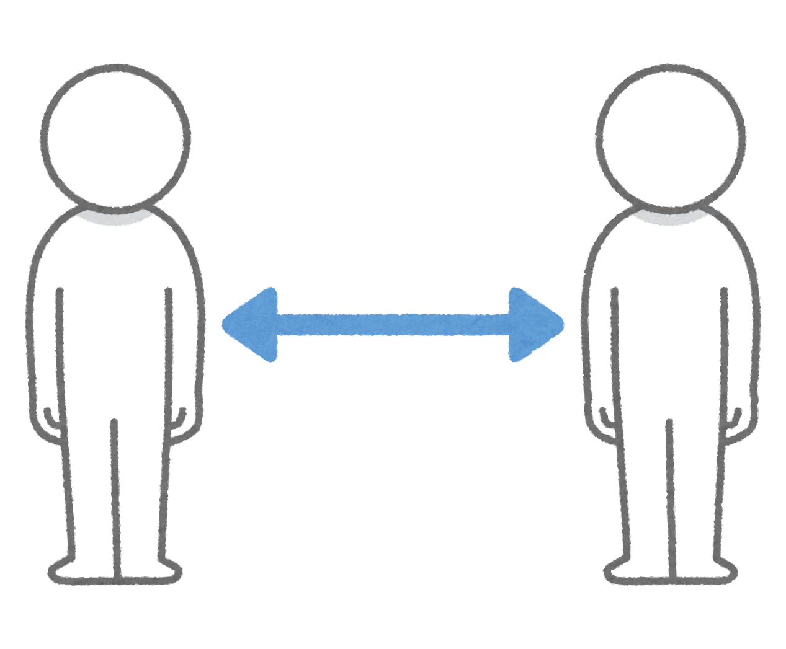
Opportunity
Torin GD Danielski
Problem of distance
Supports pre-formed relationships in nuanced ways
“such as through building a sense of physically being together, facilitating physical contacts to recall familiar moments, and simulating offline activities to create new shared memories” [5]
Clip Art Source: いらすとや
Notes:
Over distance you can’t meet up- say different state, different country.
You may not be able to fly to them every day to hang out, but this can be a good alternative.
I predict this slide will be full of re-iteration

Slide 15
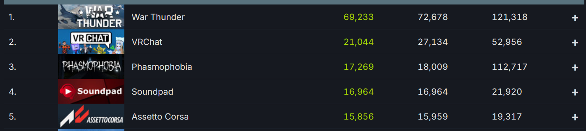
Statistics
Torin GD Danielski
SteamDB most played VR games on Steam [3]
Notes:
Statistics as in this is what people are proven to be doing- socializing.
MENTION THAT THIS IS TOP **VR**, I KEPT FORGETTING THAT IN PRACTICE
Point out that War Thunder is not exclusively VR, the main player base is flat-screen.
Among people in VR, large portion are in VRChat, an app only really meant to socialize.

Slide 16
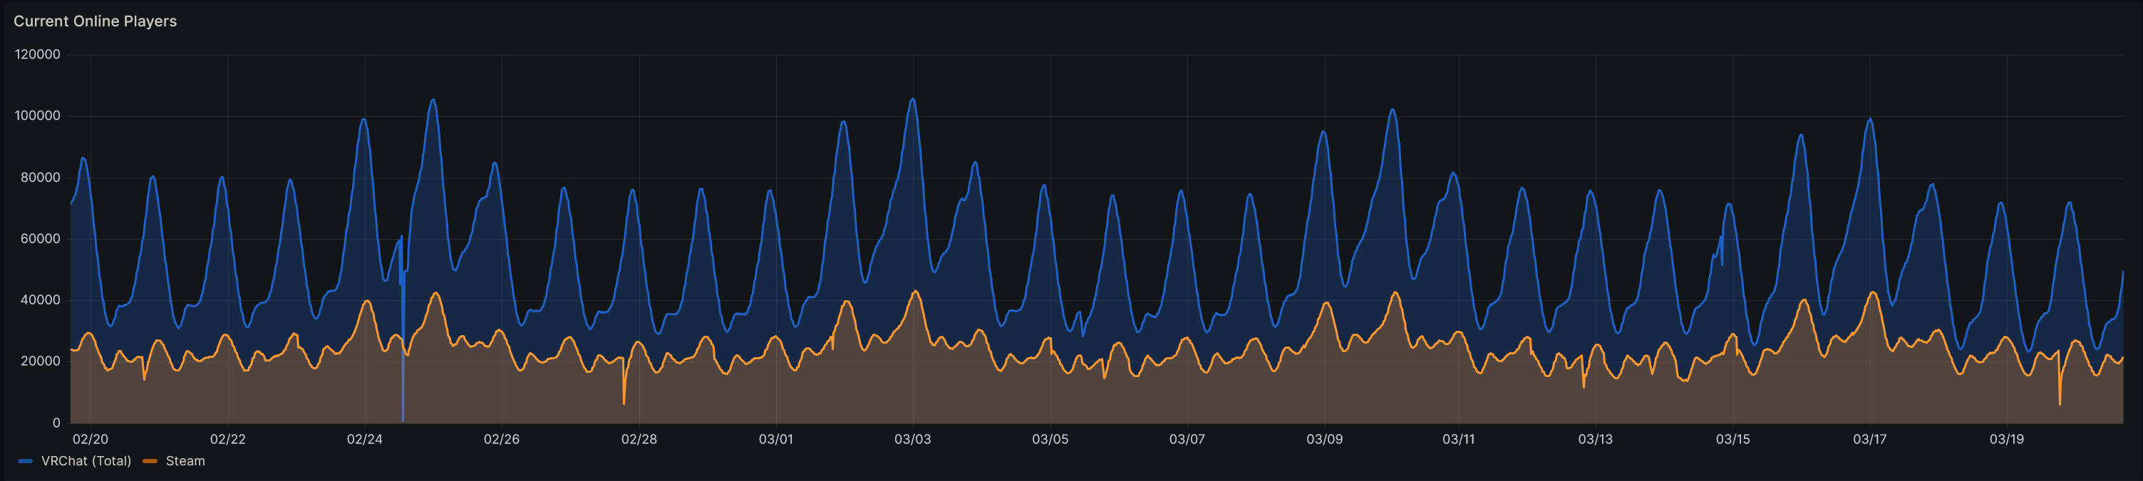
Statistics
Torin GD Danielski
VRChat API online player count [2]
Notes:
Peaks above 100k concurrent players including Meta
Mention how AltspaceVR and RecRoom do the same things as VRChat with massive playerbases
Large percent of active VR users are just chatting

Slide 17
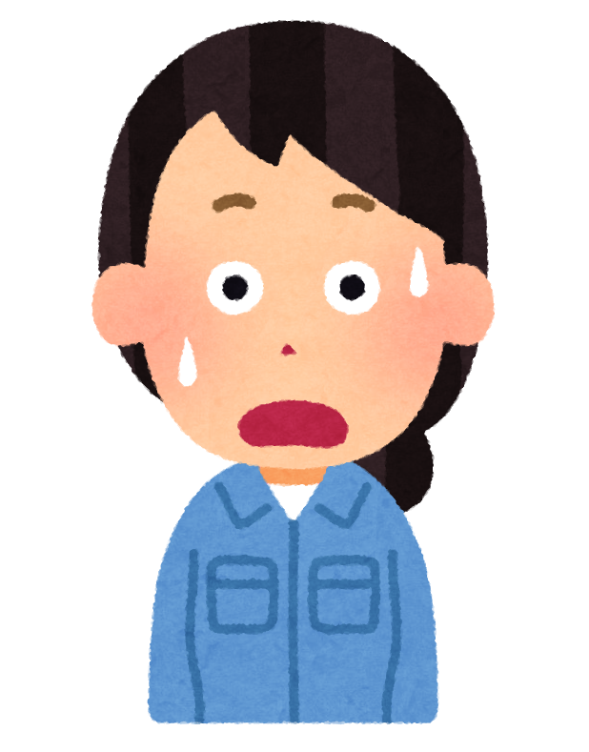
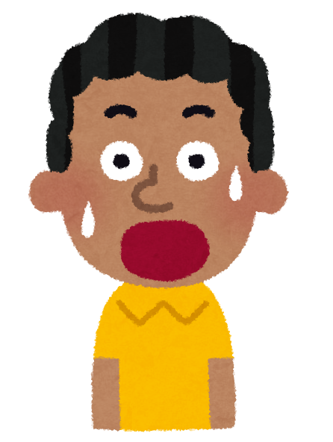
Diversity as a side note [6,4]
Torin GD Danielski
Races are hidden behind avatars
May help overcome internalized racism and other irrational prejudices
Clip Art Source: いらすとや
Notes:
Social diversity
Not just internalized- explicit racism as well, though that may not work as well
Source 4 mentioning people are more easily moldable in VR vs
Source 6, 4.2.2 <- internalized racism, unable to see they’re being racist

Slide 18
References
Torin GD Danielski
Vanya Serafimova, THE PLACE OF VIRTUAL REALITY AND THE SCHOOL IN THE SOCIALIZATION PROCESS TODAY, pg 19-25, https://mgu.bg/wp-content/uploads/2022/02/ANNUAL-IV-Vol.-49.pdf#page=17
VRChat API, https://metrics.vrchat.community/?orgId=1&refresh=30s
SteamDB, https://steamdb.info/charts/?tagid=21978
Baglan Zhaparova et. Al, Influence of virtual reality on the process of personality socialization:Adistance model of socialization, http://www.ijirss.com/index.php/ijirss/article/view/1243/334
Samaneh Zamanifard and Guo Freeman, A Surprise Birthday Party in VR: Leveraging Social Virtual Reality to Maintain Existing Close Ties over Distance, https://guof.people.clemson.edu/papers/iconf23.pdf
Danielle Marie Olson, 2019, Exploring the role of racial and ethnic socialization in virtual reality (VR) narratives, https://dspace.mit.edu/handle/1721.1/121658
Clip art provided by: いらすとや Irasutoya

Slide 19
Social Media Divides
Nia Junod

Slide 20
Social Media was developed to connect people it hasn’t worked out, and its ended up keeping people apart…
Nia Junod

Slide 21
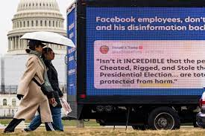
Misinformation and polarization
Nia Junod
False information spreads rapidly online, eroding trust in factual reporting [10]
Algorithms reinforce existing beliefs, limiting diversity[1]
Platforms amplify harmful content, spreading misinformation[1]
Influencers propagate falsehoods, shaping public opinion[11]
[2]
Notes:
1. Misinformation and information, in general, spreads like wildfire on social media, often spreading faster than factual information and beating out any efforts to take it down. This phenomenon undermines the credibility of reliable sources, making it very difficult to differentiate fact and fiction; who knows what is real and what's not?
These algorithms are coded to cater to users, which creates echo chambers where users are exposed to content that aligns with their beliefs and likes. This contributes to polarization by limiting exposure to alternative perspectives and content.
The algorithms employed by social media platforms prioritize engagement, which amplifies misleading content. This unintentional promotion of misinformation causes societal tensions and ruins all trust in the internet.
Social Media influencers, with their large fan bases and persuasive capabilities, are a host of problems; they have way too much power and sometimes exploit their platforms to spread false information
The image represents how fast information can spread, ex-President Trump’s tweet was put on the side of a truck, he was tweeting about how the election was rigged because he lost.

Slide 22
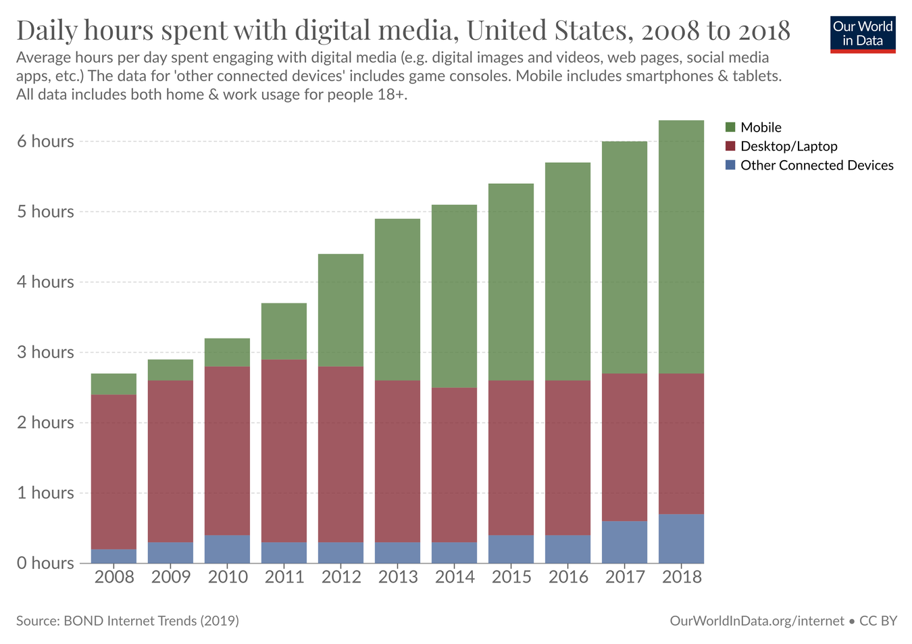
Rise of Social Media platforms
Nia Junod
Social media usage is widespread, with billions of users [3]
Platforms are integral to global communication
Since the early 2000s, social media has grown rapidly since [3]
Preferences and features reshape the landscape [3]
Reflects broader trends in technological diffusion [2]
The time spent has increased by more than double [3]
<Graphic as big as will fit>
[3]
Notes:
Social Media is widespread, with billions of users on each platform. This shows the sheer magnitude of social media usage, with billions of individuals worldwide actively engaging with each other on various platforms.
Here, we see the critical role that social media platforms play in facilitating communication on a global scale, from connecting friends and family members to enabling businesses to reach their target audience. These platforms are tools for communication amongst a diverse group of people.
Since the early 2000s social media has snowballed since its inception in the early 2000s. The first ever social media platforms started with MySpace, which paved the way for a rapid expansion of more platforms such as Facebook, Instagram, Twitter, TikTok, Snapchat, and VSCO.
Shifts in preferences and features have reshaped the landscape. By that, I mean that social media is a dynamic ecosystem constantly evolving and changing based on user preferences and platform features that have allowed trends to grow fast and fall hard.
Reflects broader trends in technological diffusion means that the rise of social media has reflected the broader trends in technological adoption and diffusion across society. As technology becomes an integral part of our lives, social media has also found a way to be integral to how we communicate, share information, and ultimately connect to the world.
The last point/picture showcases that the time spent has increased by more than double; not only has social media usage become widespread, but individuals are also spending increasingly more time on these platforms. Social media is shaping modern communication behaviors and even societal norms.

Slide 23
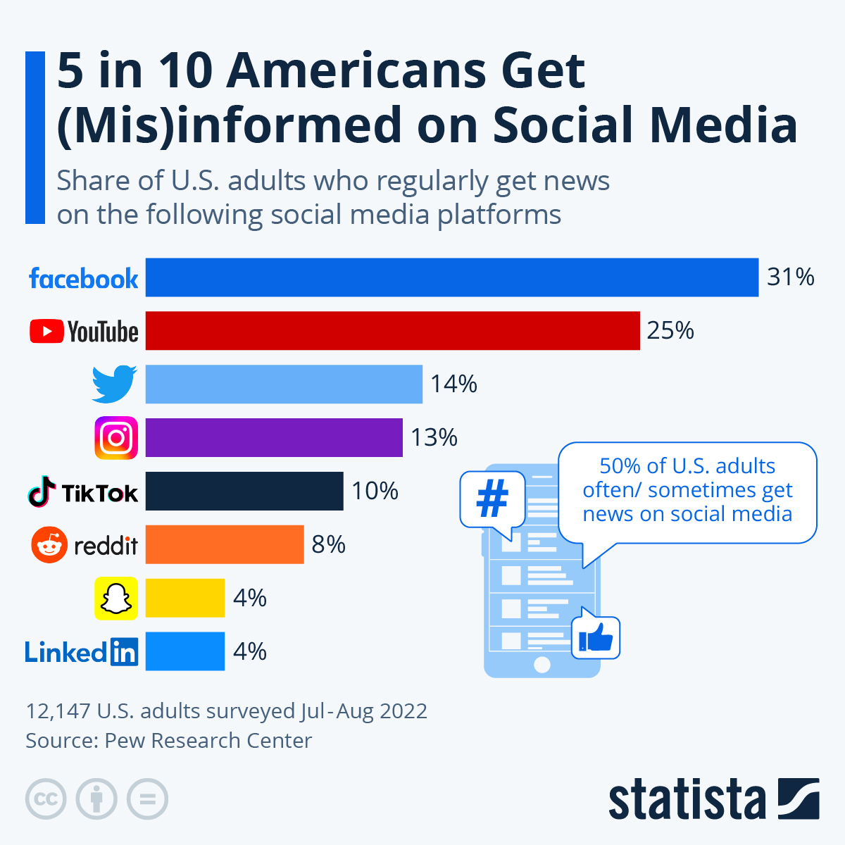
Spread of misinformation
Nia Junod
Social Media enables misinformation to spread [10]
Easy sharing features drive virality [1]
Algorithms predict engagement, boost misinformation [1]
People can retweet in a matter of seconds [10]
Influencers wield significant influence to sway followers beliefs [11]
[9]
Notes:
Social Media platforms serve as a method for the rapid dissemination of misinformation and undermining the reliability of the internet
Features like retweets on Twitter and the quick and easy sharing options on Tiktok facilitate and enable the spread of false information, ultimately amplifying its reach.
Algorithms are designed to predict user engagement, which promotes misinformation to a larger audience
Facebook’s reel feature and Watch are based on algorithmic recommendations
Misinformation amplification tends to peak during critical events like elections
Since social media influencers have large communities, they can use leverage over their followers and spread their beliefs; they are also viewed as credible sources to die hard fans
This picture represents that 5 in 10 Americans are quickly misinformed on social media, which shows how fast information can spread.

Slide 24
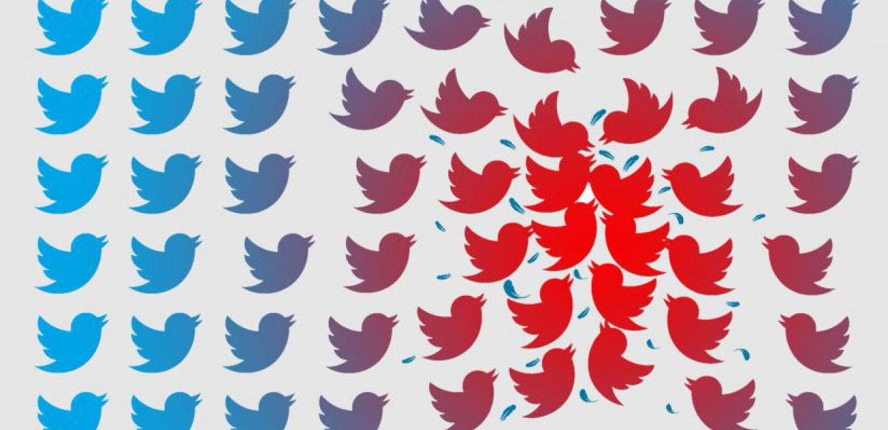
polarization and social fragmentation
Nia Junod
Algorithms guide users to partisan content [2]
Changes have minimal effect on beliefs or behaviors [2]
University-Meta partnership reveals social media’s ideological division [2]
Lawsuit alleges social media role in shooter radicalization [5]
Judge allows lawsuit against Youtube, Facebook, Reddit [5]
[7]
Notes:
Facebook and Instagram algorithms are created to cater to users preferences, often leading them towards partisan content that aligns with their existing beliefs and continues circulating the same content
Research conducted in collaboration between university researchers and Meta analysts highlights the significant role algorithms play in shaping users' on-platform experiences, leading to the polarization of online discourse
Despite efforts to alter feed algorithms to reduce polarization, these articles show that these changes have no effect on the user's political beliefs, which highlights the real issue at hand
The social media landscape is characterized by ideological segregation, with users consuming news from sources that align with their political affiliations, thus deepening societal divisions
The lawsuit says that social media platforms played a role in radicalizing a mass shooter responsible for a tragic event in Buffalo, New York. It was noted that platforms like Meta, Alphabet, Reddit, and 4chan profited from hosting a racist and ultimately catered to his violent tendencies by providing violent content. These platforms made the shooter feel at peace and reasoned with his decision.
The platform was responsible for this; the court documents revealed that plaintiffs argue the defendant's platforms are more than just chat rooms; they were addictive schemes that lured him in.
The legal action plan: Meta and Reddit are appealing the decision.

Slide 25
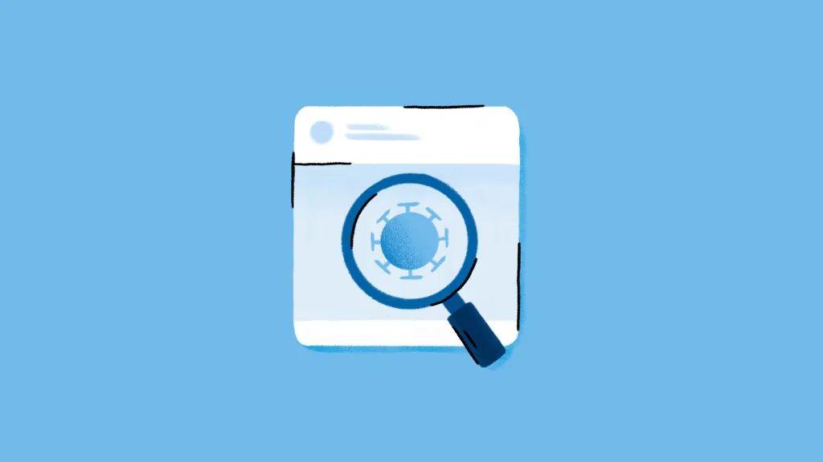
how to stay informed within society
Nia Junod
1. Verify Sources ( Check credibility before investing)[4]
2. Pause before spreading/sharing (Verify authenticity)[4]
3. Follow trusted outlets (Rely on established news sites) [4]
4. Seek context (Look beyond individual tweets) [4]
5. Utilize fact-checking tools (Extra/Last Resort) [4]
[8]
Notes:
Verify Sources: It's crucial to verify the credibility of sources before accepting information as accurate. At the same time, it's hard to determine if something is false at first glance; try to avoid being gullible and falling into believing what you see at first glance. [4]
Pause before sharing: Avoid sharing immediately. Take the time to verify
Follow trusted outlets: For actual news and factual news, stick to globally accepted and trusted outlets that are known to provide accurate information. Verified journalists and established news organizations often have credible and factual coverage
Seek context: In a rapidly evolving story that has just come out and is continuing to come out, look at many different news providers to seek out what the information
Utilize fact-checking tools: If you are genuinely looking for factual information, use fact-checking sites; if you are looking for fun, then this is not necessary.
For the picture, I used it because it represents that you have to analyze what you are looking at with a magnifying glass to be sure you are not reading fake news

Slide 26
References
Nia Junod
[1] Steven Lee Myers, How Social Media Amplifies Misinformation more than information, (New York Times, 10/13/2022), https://www.nytimes.com/2022/10/13/technology/misinformation-integrity-institute-report.html (3/15/2024)
[2] The Washington Post, Changing Facebooks Algorithm won’t fix polarization new study finds, (The Washington Post,(7/27/2023), https://www.washingtonpost.com/technology/2023/07/27/social-media-research-meta-political-views/ (3/15/2024)
[3] Esteban Ortiz-Ospina, The rise of social media, (Our World in Data, (9/18/2019), https://ourworldindata.org/rise-of-social-media (3/16/2024)
[4] Heather Kelly, How to Avoid falling for misinformation AI images on social media, (The Washington Post, 5/22/2023) https://www.washingtonpost.com/technology/2023/05/22/misinformation-ai-twitter-facebook-guide/ (3/19/2024)
[5] Melissa Alonso, Judge rules Youtube, Facebook and Reddit must face lawsuits claiming they helped radicalize a mass shooter, (CNN Business 3/19/2024), https://www.cnn.com/2024/03/19/tech/buffalo-mass-shooting-lawsuit-social-media/index.html(3/20/2024)
[6] Hewlett Foundation, Social Media, Political Polarization, and Political Disinformation: A Review of the Scientific Literature, (Hewlett Foundation, 3/19/2018), https://hewlett.org/library/social-media-political-polarization-political-disinformation-review-scientific-literature/(3/20/2024)
[7] USC Annenberg, USC Polarization Index reveals America’s political divide remains wide, (USC Annenberg, 11/3/2021), https://annenberg.usc.edu/news/research-and-impact/usc-polarization-index-reveals-americas-political-divide-remains-wide (3/20/2024)
[8] Meta, How We’re Taking Action Against Vaccine Misinformation Superspreaders, (Meta, 8/21/2021), https://about.fb.com/news/2021/08/taking-action-against-vaccine-misinformation-superspreaders/(3/20/2024)
[9] Felix Richter, 5 in 10 Americans Get (Mis) informed on Social Media, (Statista, (10/18/2022), https://www.statista.com/chart/28490/news-consumption-on-social-media/(3/21/2024)
[10] Peter Dizkes, Study: On Twitter, false news travels faster than true stories, (MIT News, 3/8/2018), https://news.mit.edu/2018/study-twitter-false-news-travels-faster-true-stories-0308(3/21/2024)
[11] Francisco Tutella, Social media influencers may affect more than voter opinions, (PennState, 12/1/2023), https://www.psu.edu/news/research/story/social-media-influencers-may-affect-more-voter-opinions/(3/21/2024)

Slide 27
Can we trust what we see?:
Deep fakes and media credibility
Jan Pilja

Slide 28
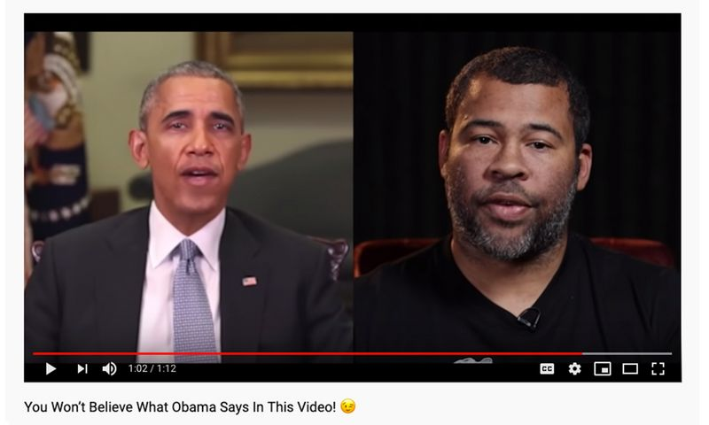
deep Fakes
Jan Pilja
What are deep fakes?
Examples of misuse
  Spreading of disinformation
  Impersonation of public figures
  Manipulation of audio/video evidence
https://www.youtube.com/watch?v=cQ54GDm1eL0
[2]
Notes:
- Deep fakes are synthetic media created using deep learning AI technologies that manipulate or generate visual and audio content.
-They can swap faces, alter spoken words, or create entirely fictional scenes/events that seem realistic.
- For example here's a video Jordan Peele using deep fake technology to impersonate former president Barack Obama

Slide 29
WHAT DOES THIS MEAN FOR NEWS/MEDIA OUTLETS?
Jan Pilja
Deeptrace, 2019 report on the state of deep fakes [5]
  “More than 14,000 deepfake videos online”
  “100% increase over their 2018 count”
Implications
  Verification of information
  Erosion of public trust
  Malicious actors
Notes:
Deeptrace is a company founded in late 2018, provides capabilities(software-as-a-service) for detecting deepfake images and videos.
Monitors deepfake activity online and assists with taking down malicious deepfake videos targeting clients
As deep fake technology advances at this rate it poses an issue for media and news outlets
Difficulty verifying and authenticating sources and information, which is far from the traditional journalistic approach to the fact-checking process
Erosion of public trust, which only adds to the ‘fake news’ crisis and disinformation landscape
Potential for malicious actors to spread disinformation and propaganda, which can amplify societal rifts, fuel conspiracy theories, and shake the publics faith in the integrity of elections and democratic decision making

Slide 30
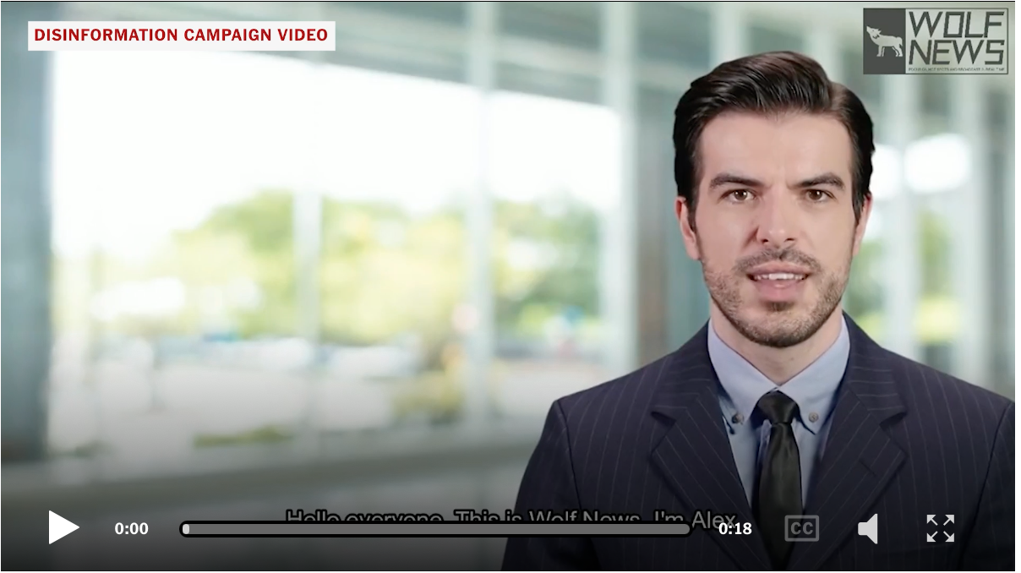
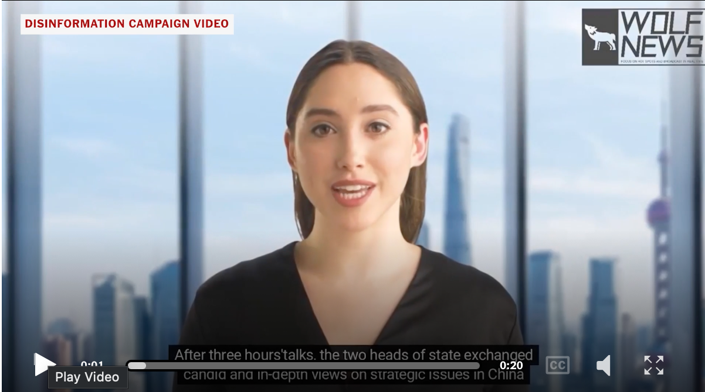
Threat from other Nations
Jan Pilja
Deep fake videos created by “pro-China bot accounts” Feb, 2023 [1]
Low quality
Easily detectable for some
Notes:
This was the first real instance of deep fake technology being used as a part of a coordinated effort by China
- These examples are deep fake videos that were created by pro-China bot accounts and distributed through twitter and Facebook
In this video the “news anchors” promote interests of China by criticizing the lack of action against gun violence in a dramatic video and praising China’s role in geopolitical relations at an international summit meeting

Slide 31
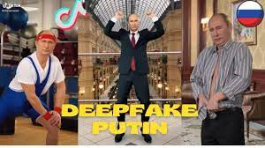
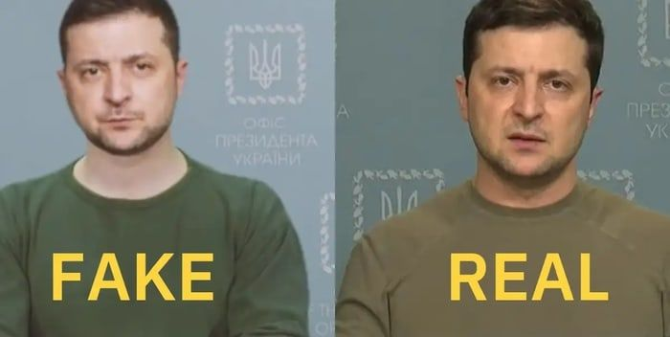
Can we trust what we see?
Jan Pilja
In short…….. No
[3]
[4]
Notes:
In this day and age, I believe that the sensible thing to do is to be skeptical of everything you see online
If it’s a less severe examples like funny satire videos of Putin dancing weird
Or a very severe examples like Ukraine’s President Zelensky surrendering the war in his country
The risks and potential consequences are too high to believe everything you see especially as this technology continues to develop and become more undetectable
The important thing to do is to keep a critical eye when viewing social media posts and news reports from an unfamiliar source and to fact check things you see online

Slide 32
References
Jan Pilja
[1]Adam Satariano, Paul Mozur, The People onscreen Are Fake. The Disinformation Is Real, (The New York Times, February 7, 2023), https://www.nytimes.com/2023/02/07/technology/artificial-intelligence-training-deepfake.html
[2] You Won’t Believe What Obama Says In This Video!, (BuzzFeedVideo, April 17, 2018), https://www.youtube.com/watch?v=cQ54GDm1eL0
[3] deepfake putin tiktok ~ wide putin tiktok filter ~ Путин Тикток, (Ironic Tok, April 18, 2021), https://www.youtube.com/watch?v=nSn6Io3KCZo
[4] Graham Cluley Deepfake President Zelensky calls on Ukraine to surrender, as TV station hacked, (Bitdefender, March 17, 2022), https://www.bitdefender.com/blog/hotforsecurity/deepfake-president-zelensky-calls-on-ukraine-to-surrender-as-tv-station-hacked/
[5] Meredith Somers, Deepfakes, explained, (MIT Management Sloan School, July 21, 2020), https://mitsloan.mit.edu/ideas-made-to-matter/deepfakes-explained
…

Slide 33
Class 4
The End
Keith A. Pray
socialimps.keithpray.net
Notes:
Use remaining time for group project questions and/or review group assignment slides.
This is the end. Any slides beyond this point are for answering questions that may arise but not needed in the main talk. Some slides may also be unfinished and are not needed but kept just in case.

