Slide 1

Class 11
Work
Keith A. Pray
socialimps.keithpray.net
Notes:
Styx - Mr. Roboto (1983) (5:34)
https://www.youtube.com/watch?v=uc6f_2nPSX8
Ask about Automation paper:
What did people choose to automate
Share 1 main reason

Slide 2
Remote With Zoom
Turn your camera on
Sign in with First and Last Name
Stay muted unless you are going to speak
Use the raise your hand feature to ensure a turn
Wait until the end of student presentations to ask questions
  Write them down so you don’t forget

Slide 3
Papers
While average was lower the standard deviation was 2.4 resulting from many being the highest paper grade yet
Include tests/results in Appendix
Define test strategy clearly
Ask for help if you have trouble with backing data
Notes:
Save for next time:
Clearly state conclusion
First statement preferred
Absolute statements are difficult to prove
Avoid: all, always, any, every, everyone, never, none… unless you can show it
Be sure to put quotes around entire quote
Hyperbole is the best thing ever!
but not in these papers
Print 2 sided and save a tree
Use template, saves time (and -1 point)
Include Counter Point and Response
Include Author, Title, Publish Date, Publisher for references
Read paper aloud to proof

Slide 4
Grades
To Date
44 Max Possible
- Discussion 1-10
- Papers 1-3

Slide 5
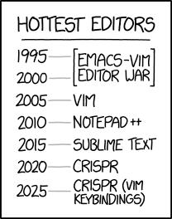
Overview
Review
Assignment
Students Present
https://www.xkcd.com/1823/
Notes:
Full circle.
CRISPR: Clustered Regularly Interspaced Short Palindromic Repeats
Allows permanent modification of genes within organisms.
Published 2017-04-12 according to https://www.explainxkcd.com/wiki/index.php/List_of_all_comics_(1501-2000)
Kickstarter Charter
https://www.kickstarter.com/charter?ref=about_subnav

Slide 6
Overview
Review
Assignment
Students Present
C lustered
R egularly
I nterspaced
S hort
P alindromic
R epeats
Permanent gene modification
https://www.xkcd.com/1823/
Notes:
Full circle.
CRISPR: Clustered Regularly Interspaced Short Palindromic Repeats
Allows permanent modification of genes within organisms.
Published 2017-04-12 according to https://www.explainxkcd.com/wiki/index.php/List_of_all_comics_(1501-2000)
Kickstarter Charter
https://www.kickstarter.com/charter?ref=about_subnav

Slide 7
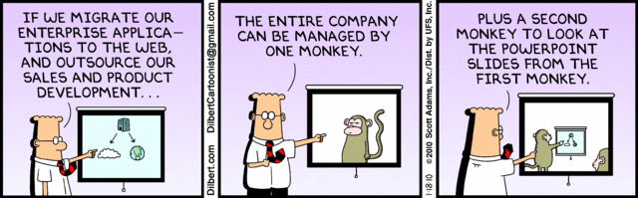
Let’s Look At One way to handle a Decrease In Jobs
Notes:
Poll class:
Expected salary range upon graduation? Min, Max? Put on board.
Assume 40 hour work week.
How many people would work:
32 hours for 0.8 * Max? Put on board.
24 hours for 0.6 * Max? Put on board.
…continue until Min is reached.

Slide 8
Group Quiz
List 2 ways IT can lead to organizational change.
List 4 ways a Video Game Producer may protect its IP and what specific IP each protects.
List a computing technology that can be used to protect an individual’s privacy.
List a computing technology that can be used to intrude upon an individual’s privacy.
Notes:
Could split into groups of 4-5 for this.
Fill time with Work Discussion on Course Web Site

Slide 9
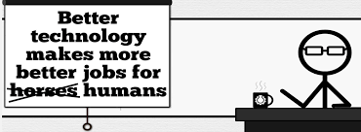
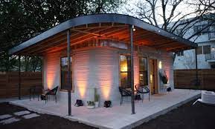
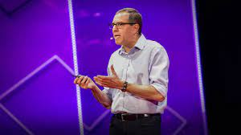
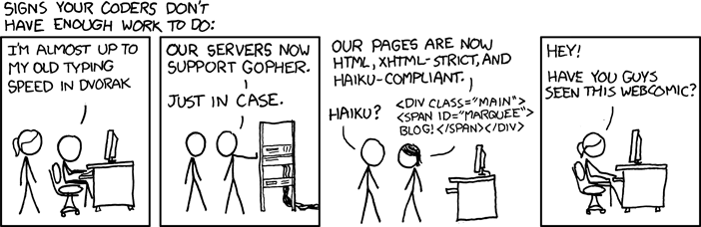
Overview
Review
Assignment
Students Present
http://xkcd.com/554/
Notes:
CGP Grey
Humans Need Not Apply (15:00) – 2014-08-13
http://www.youtube.com/watch?v=7Pq-S557XQU
Last access 2016-04-22
These 3D printed homes can be constructed for $4,000 (3:00 – 2018-04-02)
http://www.businessinsider.com/3d-printed-homes-constructed-icon-new-story-tech-charity-4000-dollars-2018-3
https://www.youtube.com/watch?v=SvM7jFZGAec (1:28)
Last access 2018-04-22
David Autor
Will automation take away all our jobs? (18:27) (2016)
https://www.ted.com/talks/david_autor_will_automation_take_away_all_our_jobs/transcript?language=en
TEDxXambridge, 2016-12-19
Review Group Assignment Details.
Or first watch video: depends on student presentations, no thunder stealing.
Look at:
BBC Intelligent Machines
http://www.bbc.com/news/technology-33978561
BBC Likelihood of robot taking your job
http://www.bbc.com/news/technology-34066941

Slide 10
Assignment Reminders
Finish all reading
Finish Automation Paper
Group Web Sites and Presentations
If your group is not presenting next class prepare 3 questions for each group that is presenting by visiting their web sites.
  See Group Project Details

Slide 11
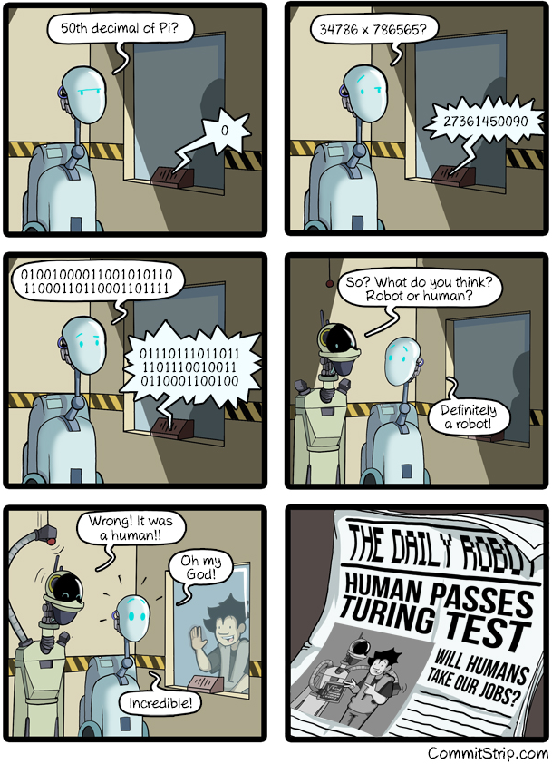
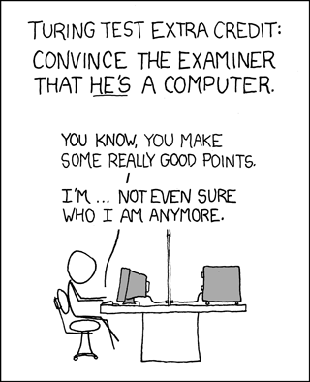
Overview
Review
Assignment
Students Present
https://xkcd.com/329/
Notes:
http://www.commitstrip.com/en/2016/04/14/meanwhile-in-a-parallel-universe-3/ (2016-04-14)
https://xkcd.com/329/ (2007-10-15)

Slide 12
AI’s Impact on Social Globalization
Robbie Eskridge

Slide 13
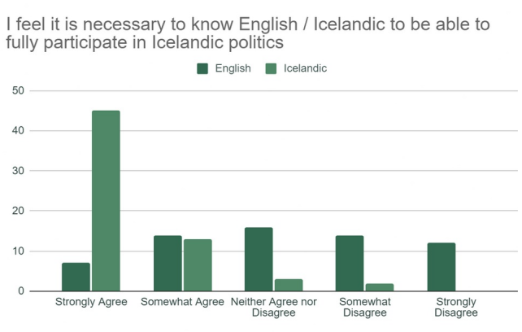
How Social Disconnect Works
Robbie Eskridge
Immigrant Language Barrier
  Language barriers prevent societal participation [11]
What is participating in society?
  Political Involvement
  Participation in Workforce
  Community Engagement
Notes:
Immigrants arriving in countries have a few barriers to being able to participate in society.
These are - language barriers, insider/outsider mentality, and cultural differences, the biggest of which is language barrier. [11]
Most immigrants surveyed in Iceland felt that they needed to speak perfect Icelandic to integrate fully with the culture and participate in three buckets.
Among immigrants ages 5 and older in 2018, only 53% are proficient English speakers [1] [2].

Slide 14
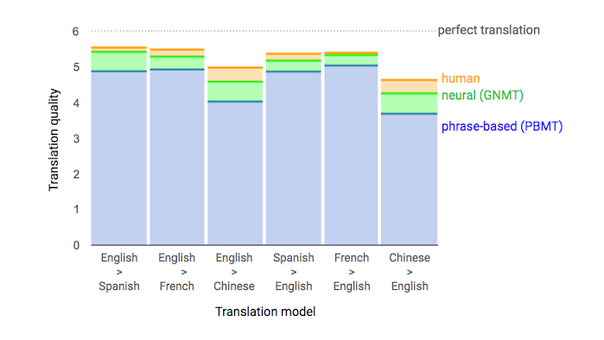
How AI is Changing the Game
Robbie Eskridge
Google Translate
  2005: Grab a Spanish -> English dictionary
  2010: Run into your house, translate on computer
  2015: Use smartphone to provide semi-accurate broken translation
  2020: Use smartphone to engage in full conversation [8]
Figure 2: data from side by side evaluations, where humans rate the quality of translations for a given source set. [9]
Notes:
Personal anecdote about Portuguese guy at back door [0].
This slide is about how you might deal with a similar situation going year by year. Google translate is improving people’s abilities to interact with each other at an increasing rate.
As of today, there are 133 languages fully supported on Google Translate. [8]

Slide 15
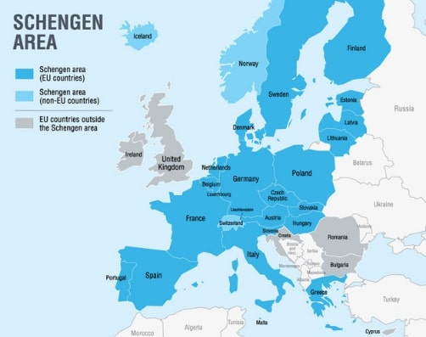
Concerns at Border
Robbie Eskridge
Inaccuracy of current technology
  Legality is being explored of moderately-accurate algorithms [6]
Potential for Spread
  Complacency could lead to widespread adoption
  Could lead to government invasion of privacy
Figure 3: Current Signatories of the Schengen Area
Notes:
AI is being used at immigration services in several locations in Europe. This is cause for some concern, as several companies have revealed their general algorithms to be only partially effective. [6]. Some of these algorithms use facial micro-expressions among other strategies which are inconsistent in some cases. Several technologies are being developed in tandem to increase accuracy, and being tested immigration-heavy places like Greece. [7] The service or denial of an immigrant based on an AI algorithm is something being explored legally by the EU right now. [next slide]

Slide 16
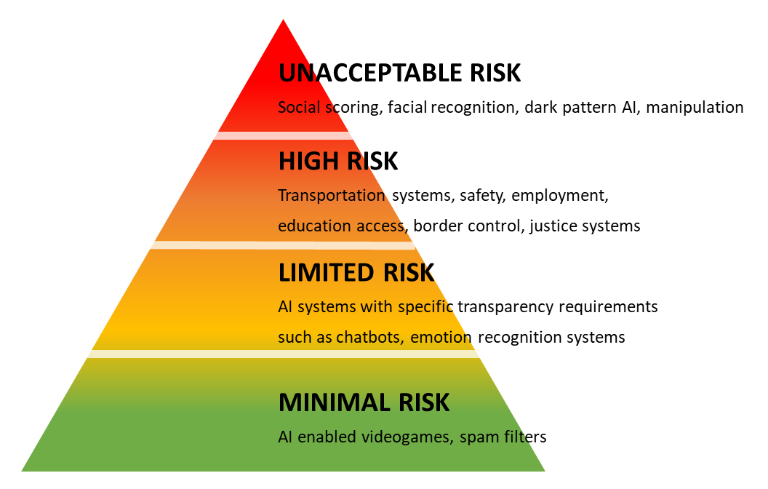
Technology Outpacing Regulation
Robbie Eskridge
EU AI Act
  Entities are allowed to use AI for certain tasks [5]
  Heated debate, and cause for a lot of contention. [4]
  “Risky” tasks and exemptions defined.
Penalties for AI misuse
  Entities that don’t adhere to the rules laid out by the European Commision will face large fines [3]
Figure 4: A diagram showing the classifications of risk
Notes:
AI technologies are advancing faster than governments can put regulations on them. The first groundbreaking government regulations are entering their final stages this month October. Major concessions are being made in order to reach a consensus [4]. The concessions are on the definition of “risky” AI, and what categories different programs fall into. Exemptions are made for programs doing menial jobs, or programs assisting a human assessment. [5]. The probable outcome is that AI will be permitted for menial, automation-level tasks in high-stakes jobs. Additionally, many programs using AI will need to be in conjunction with a human, to ensure fairness and accuracy. Violation of fairness, or non-adherence to the ruling, is likely to result in a large fine. [3].

Slide 17
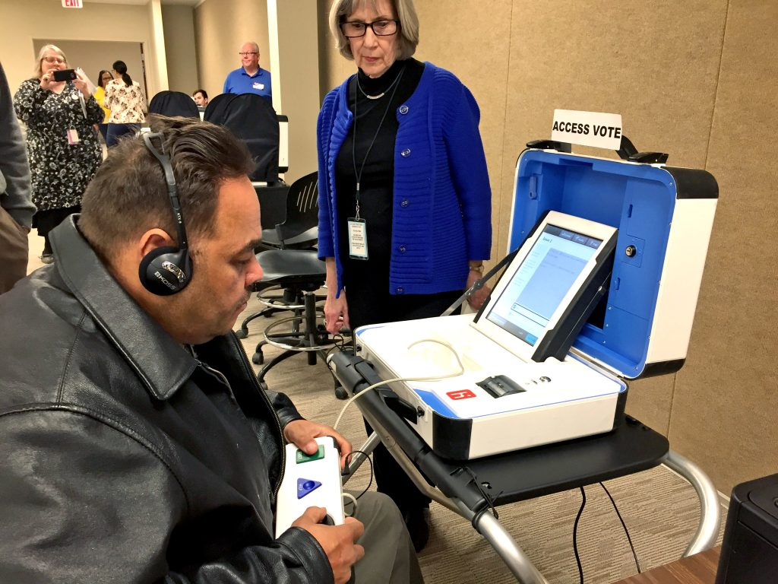
Other Technology’s Role in Acclimation
Robbie Eskridge
Language models
  Previously discussed
Inclusive voting / civil opportunities
  Simple polling interfaces, accessible locations, audio-based polling [12]
Inclusive education
  Text to Speech, Zoom, Remote Campuses, and more innovations [10]
Figure 5: A voter uses an accessible voting machine in 2022.
Notes:
Other technologies are proving useful in acclimating foreign citizens to their current environment. We’ve already talked about google translate and associated antiquated language models. Schools are starting to use technology to increase accessibility, in a linguistic sense and in a disability sense. [10]. Entrepreneurs and innovators are coming up with solutions to accessible voting services. [12]. Overall, things are trending in a positive direction.

Slide 18
REFERENCES
Robbie Eskridge
[1] Hill, 2011. English Proficiency of Immigrants https://www.ppic.org/publication/english-proficiency-of-immigrants/ Accessed 9/18/2023
[2] Budiman, 2020. Key Findings about U.S. Immigrants https://www.pewresearch.org/short-reads/2020/08/20/key-findings-about-u-s-immigrants/ Accessed 9/18/2023
[3] Lomas, 2021. EU plan foir risk-based AI rules to set fines as high as 4%. https://techcrunch.com/2021/04/14/eu-plan-for-risk-based-ai-rules-to-set-fines-as-high-as-4-of-global-turnover-per-leaked-draft/ Accessed 9/20/2023
[4] McGowan, Scherer, 2023. EU’s AI Act: CDT Europe responds to European Commission’s Procosal on High-Risk Classification https://cdt.org/insights/eus-ai-act-cdt-europe-responds-to-the-european-commissions-proposal-on-high-risk-classification/ Accessed 10/2/2023
[5] European Parliament, 2023. EU AI Act: first regulation on artificial intelligence https://www.europarl.europa.eu/news/en/headlines/society/20230601STO93804/eu-ai-act-first-regulation-on-artificial-intelligence Accessed 9/21/2023
[6] Tyler, 2022. The Increasing Use of Artificial Intelligence in Border Zones Prompts Privacy Questions https://www.migrationpolicy.org/article/artificial-intelligence-border-zones-privacy Accessed 10/1/2023
[7] European Commision, 2020. Intelligent Border Control System. https://cordis.europa.eu/project/id/700626 Accessed 10/1/2023
[8] Southern, 2023. Google Launches AI-Powered Contextual Translations. https://www.searchenginejournal.com/google-launches-ai-powered-contextual-translations/478863/ Accessed 10/2/2023
[9] Le, Schuster, 2016. A Neural Network for Machine Translation, at Production Scale. https://blog.research.google/2016/09/a-neural-network-for-machine.html Accessed 10/2/2023
[10] Baker, 2019. How Technology is making education more accessible. https://penntoday.upenn.edu/news/how-technology-making-education-more-accessible Accessed 10/1/2023
[11] Eskridge, Kresge, Meza, Yakavenko, Effects of Language Acquisition on Immigrant Societal Participation. https://digital.wpi.edu/concern/student_works/ht24wn744 Accessed 10/2/2023
[12] Center for Civic Design, Innovation in Accessible Elections. https://civicdesign.org/avti/innovations-in-accessible-elections/ Accessed 10/2/2023

Slide 19
The effect of Video Games in Education
Owen Lacey

Slide 20
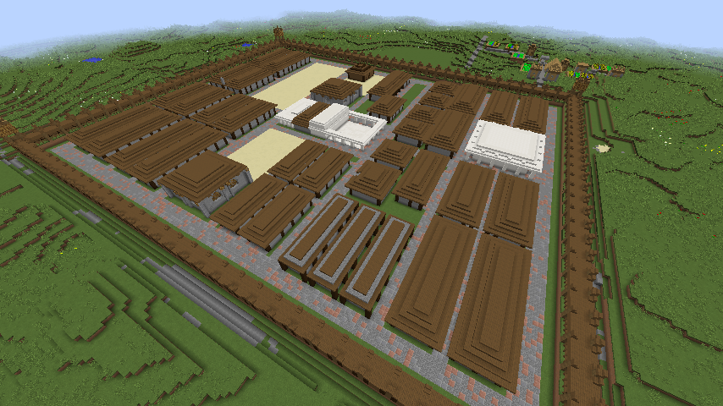
Visual interaction
Owen Lacey
Unlike textbooks and lectures, video games provide direct interaction with material
Students can engage in their own way as needed instead of being forced to only read a book.
Minecraft in particular has been used to help students engage with the material [1]
Notes:
<speaker notes>

Slide 21
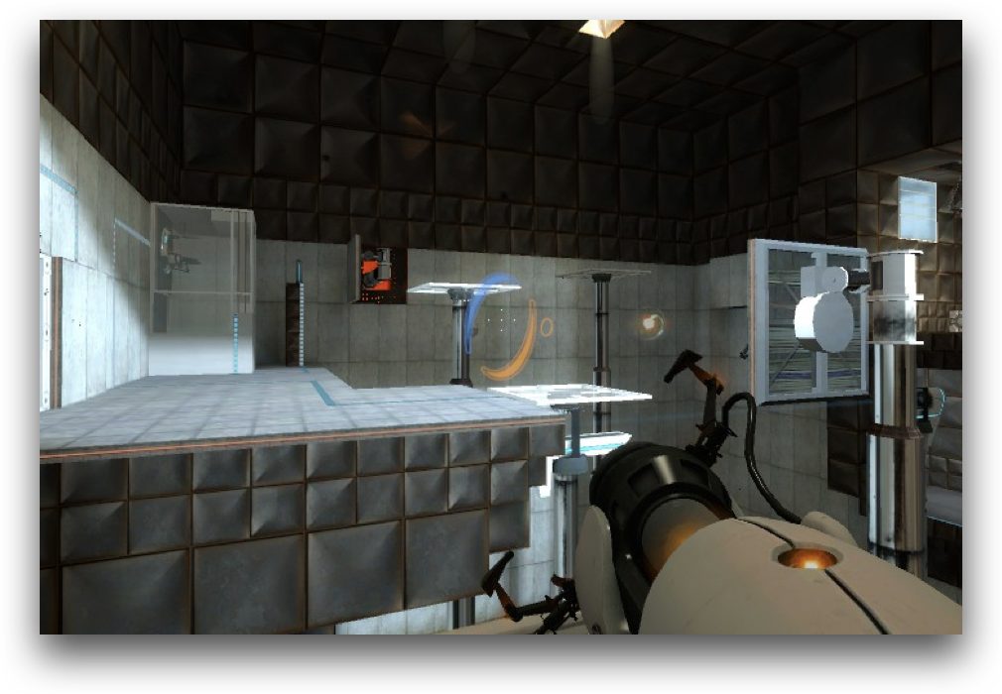
Problem solving skills
Owen Lacey
Some video games can train people in problem solving skills
Game like Myst and Portal have been shown to improve problem solving skills more than the standard “brain-training” games [2][3].
Notes:
<speaker notes>

Slide 22
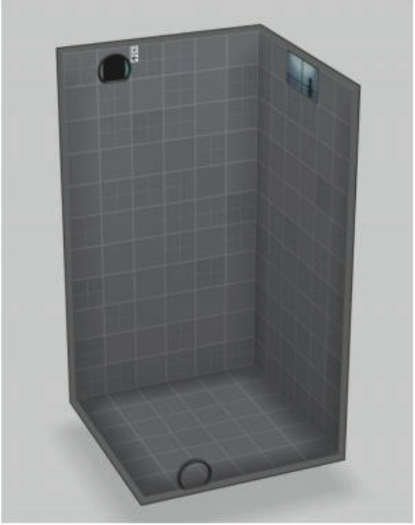
Enjoyable learning
Owen Lacey
Portal 2 has also been used to teach reasoning skills in a math class in place of normal algebra problems [4]
It was a more enjoyable experience for the students to play a game than to work on algebra.
Notes:
<speaker notes>

Slide 23
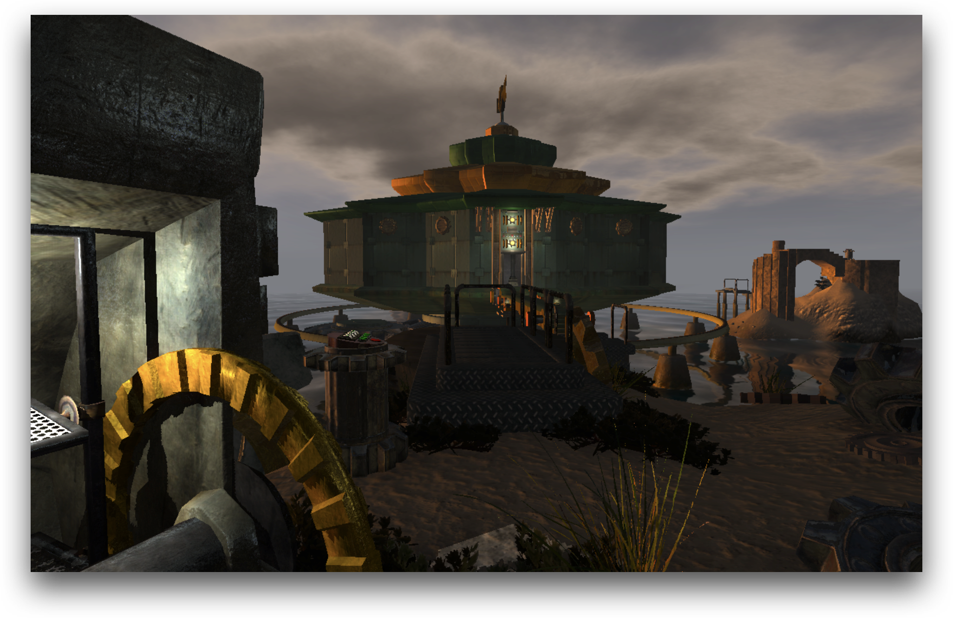
conclusion
Owen Lacey
Video game can help students learn problem solving skills in a more enjoyable manner
They can let students engage with material directly rather than through reading or lectures.
Notes:
<speaker notes>

Slide 24
References
Owen Lacey
[1] www.jstor.org/stable/jeductechsoci.18.3.114.
[2] https://doi.org/10.1016/j.compedu.2014.08.013
[3] http://news.bbc.co.uk/2/hi/technology/4160466.stm
[4] https://drive.google.com/file/d/11_QvUUYogZw2fQmi3YB_3z8tdsaDJbOi/view
[5] https://www.jstor.org/stable/24145444
[6] https://www.wired.co.uk/article/minecrafted

Slide 25
Class 11
The End
Keith A. Pray
socialimps.keithpray.net
Notes:
If there’s time and we didn’t get to it:
Kickstarter Charter
https://www.kickstarter.com/charter?ref=about_subnav
CGP Grey
Humans Need Not Apply (15:00) – 2014-08-13
http://www.youtube.com/watch?v=7Pq-S557XQU
Last access 2016-04-22
These 3D printed homes can be constructed for $4,000 (3:00 – 2018-04-02)
http://www.businessinsider.com/3d-printed-homes-constructed-icon-new-story-tech-charity-4000-dollars-2018-3
https://www.youtube.com/watch?v=SvM7jFZGAec (1:28)
Last access 2018-04-22
Look at:
BBC Intelligent Machines
http://www.bbc.com/news/technology-33978561
BBC Likelihood of robot taking your job
http://www.bbc.com/news/technology-34066941

