Slide 1
Class 10
Professional Ethics
Keith A. Pray
socialimps.keithpray.net

Slide 2
Overview
Review
Debate
Assignment
Students Present
Notes:
ADD QUIZ AS BACKUP IF CLASS DISCUSSION NOT LONG ENOUGH

Slide 3
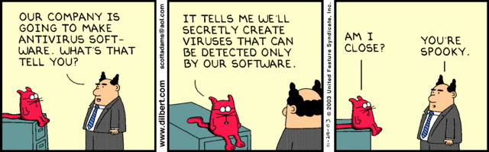
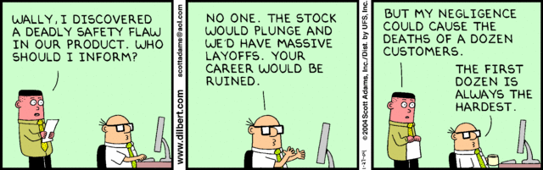
Notes:
Ask how many people in ACM or IEEE

Slide 4
Debate Ground Rules
Before Debate
  10 minutes to converse with your team
  Share argument points, counter points, and responses
  Share experiences, especially in different countries, cultures, situations
  Decide who will: Go first, Respond to which points from opposing side
During Debate
  1 turn per person until everyone on your team has spoken
  Try to keep remarks to 30 seconds
Notes:
Release Game or Not Debate
Chapter 9 In-class Exercises # 24.
Should the company produce the game?
Use the SWE Code Of Ethics as the basis for your argument.
If Remote:
Add “(YES)” or “(NO)” to the end of your name in Zoom to show your side

Slide 5
Assignment
1 Page Paper
  What should computerized automation be applied to next?
Finish all reading
Group Project
  Add analysis to website addressing remaining topics
  Group Presentation Draft
    Submit as Power Point on Canvas
    Post Power Point file on group website
Notes:
1 Page Paper Ideas:
For Good - How will you use your computing related education to do good in the world?
Dark Net - Is the Dark Net good or bad?
Does computerized automation help the economy or society?
What should computerized automated be applied to next?
If productivity has increased so much, why are we working so hard? Should we?
What job skills will survive computerized automation?

Slide 6
Overview
Review
Debate
Assignment
Students Present
Notes:
Show WPI and/or corporate code of ethics.

Slide 7
SENSATIONALISM PLATFORMS
June Whittall
Notes:
In this presentation I will be discussing the issue of sensationalism in journalism and how it manifests on different platforms, primarily social media, and will discuss how computing professionals should respond to this issue

Slide 8

what is sensationalism?
June Whittall
Shock/excitement, often at the expense of accuracy
  boosts engagement
Some news agencies exaggerate 60% of articles [1]
Rewarded by social media [2]
Image of a sensationalist news headline [12]
Notes:
Sensationalism, in journalism is defined as the use of exaggerating the shock or excitement to better get the attention of an audience, often at the expense of accuracy. This can encompass clickbait news, things that are extremist, or downright fake.
This issue is and has been pervasive in journalism; one study found that certain news agencies exaggerated 60% of their articles.
However, this problem is made worse by social media, which is built to further reward sensationalism. I’ll elaborate more on that later in this presentation.

Slide 9
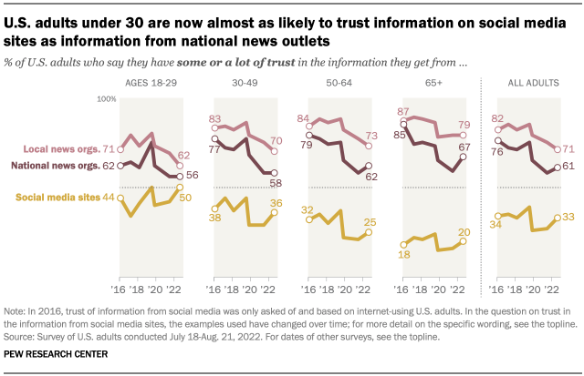
media consumption
June Whittall
Trust in mainstream media is declining[5]
  65% of adults trusting in 2019, 58% in 2021
  differs based on political party [5]
53% of US adults get news from social media [4]
  36%, regularly, from Facebook
U.S adults’ trust in various media sources, over time [3]
Notes:
One survey found that, in 2019, 65% of US adults said they trusted mainstream media, but that in 2021, that number decreased to 58%. It’s interesting to note that the decline in trust also differs greatly based on political party, with republicans’ trust in mainstream media decreasing far more than democrats.
With this, 53% of US adult get news from social media; it’s a very popular way for people to find their news. One study found that 36% of people regularly get their news from Facebook, alone. Facebook was the leading platform for news consumption, out of all the other social media platforms in the study. Behind it was YouTube, and then Twitter, but Facebook was the clear winner.
The graph shows the decreasing amount of trust that US adults have in the mainstream media, over time. It also shows that younger people have the highest amount of trust in social media for obtaining news.

Slide 10
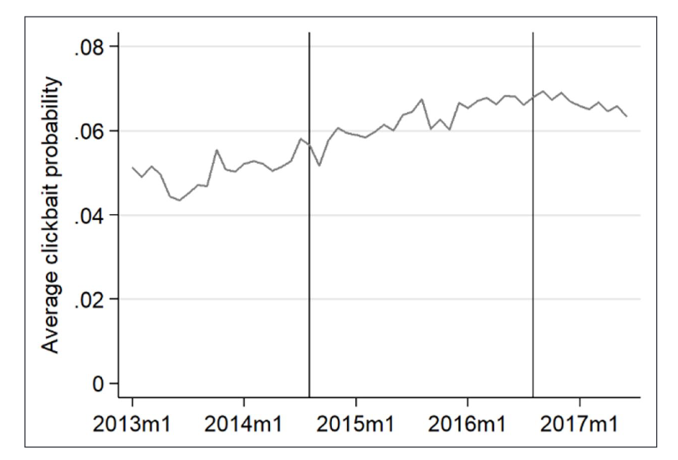
how social media promotes sensationalism
June Whittall
Algorithms personalize feeds
  News curated by algorithms, not journalists
  News outlets must adapt [9]
Platforms seek user attention [10]
Users rewarded for attention-seeking behavior [2]
Probability of a post being clickbait, over time,
on Facebook [8]
Notes:
As I said earlier, the way that social media is structured promotes sensationalist news, or content in general. This can be attributed to their algorithms, which personalize a user’s feed to them. This means that a news isn’t being curated by journalists, but the algorithm, which favors reaction and engagement. News outlets are needing to account for this to retain an audience on social media
With this, social media companies will make more money the time users spend on their apps, which means they have a motive to capture users’ attention as effectively as possible. Thus, attention-seeking posts, which get a lot of engagement, are rewarded.
Also, with social media giving everybody an equal platform, it creates a place where regular users, along with large companies, are rewarded for attention-seeking behavior. Instead of news outlets only competing amongst themselves, they also compete with everyday users, for attention and engagement

Slide 11
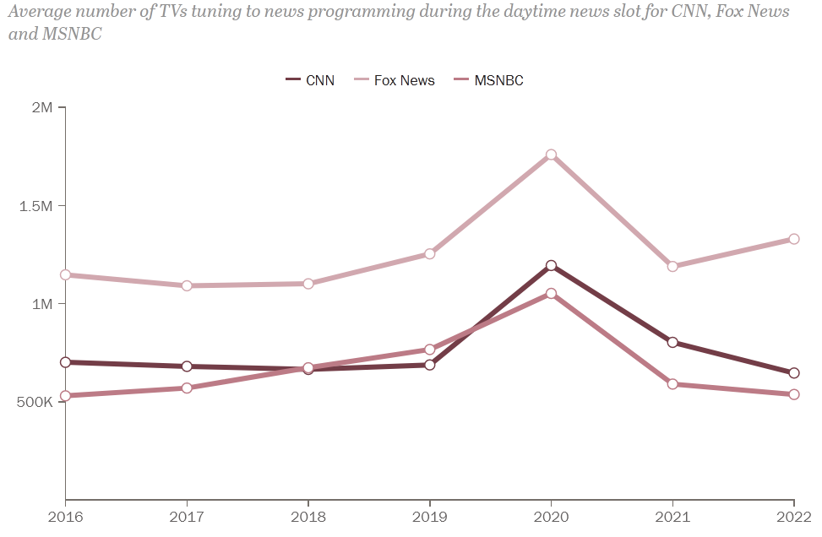
case study: covid-19
June Whittall
Mass misinformation spread over social media [11]
  direct harms to public health
WHO fought an “infodemic” along with pandemic [11]
Sensationalism/misinformation in mainstream media [11]
Size of audience of CNN, Fox News, and MSNBC from
2016-2022, with a spike in 2020 [12]
Notes:
I’m sure we all saw these issues pan out during the pandemic a few years ago. Misinformation was widely spread, resulting in direct harms to public health.
The World Health Organization had to put resources towards halting the “infodemic,” along with the pandemic.
This issue was not only seen in the realm of social media, but also in mass media.
The graph shows the spike in audience size for CNN, Fox News, and MSNBC, during the year 2020, showing how much more of our attention they had during the pandemic, and how wide reaching any misinformation could have been during that time

Slide 12
should computing professionals be held accountable?
June Whittall
Consulting the ACM Code of Ethics, yes:
1.1 Contribute to society and human well-being
3.1 Ensure that public good is central to work
3.7 Recognize and take special care of systems that become integrated into the infrastructure of society [7]
Notes:
Looking at the ACM Code of Ethics, it’s clear that computing professionals should be held accountable for this.
There are many points which could be interpreted to be relevant, but I chose these three, since they seemed to be the most obvious, to me.
Taking into account how sensationalism impacted us during the pandemic, it’s clear that the promotion of sensationalist media on social media platforms does have the potential to harm human well-being and public good.
Social media has also become deeply ingrained into our society and the way we see and process information

Slide 13
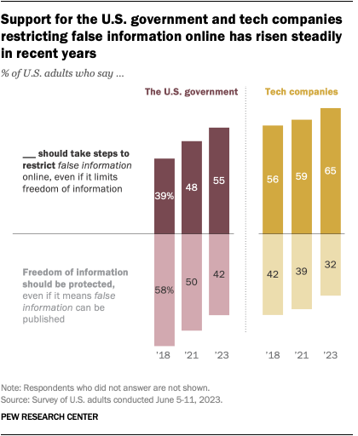
what should be done?
June Whittall
Two primary mitigation strategies:
“5-strike system”
  regulates users
“Disseminating balanced options”
  regulates algorithm [2]
Graph showing approval for social media restriction [6]
Notes:
There were two mitigation strategies that I found through my research:
The 5-strike system regulates users by removing them from the social media platform after five violations of the platforms’ guidelines for misinformation.
The second option is disseminating balanced options, which regulates the algorithm by ensuring that all social media users have a more similar feed of news media, and that no person finds themselves in an echo chamber of misinformation or sensationalized news.
This graph shows the growing support for the government and tech companies restricting false information online, from 2018 to 2023, with, this year, 65% of US adults saying that tech companies should do so

Slide 14
References
June Whittall
[1] Patro, Jasabanta, et al. “Characterizing the spread of exaggerated health news content over social media.” Proceedings of the 30th ACM Conference on Hypertext and Social Media, 2019, https://doi.org/10.1145/3342220.3344927.
[2] Lim, Soo Ling, and Peter J. Bentley. “Opinion amplification causes extreme polarization in social networks.” Scientific Reports, vol. 12, no. 1, 2022, https://doi.org/10.1038/s41598-022-22856-z.
[3] Liedke, Jacob. “U.S. Adults under 30 Now Trust Information from Social Media Almost as Much as from National News Outlets.” Pew Research Center, Pew Research Center, 27 Oct. 2022, www.pewresearch.org/short-reads/2022/10/27/u-s-adults-under-30-now-trust-information-from-social-media-almost-as-much-as-from-national-news-outlets/. Accessed 28 September 2023.
[4] Shearer, Elisa. “News Use across Social Media Platforms in 2020.” Pew Research Center’s Journalism Project, Pew Research Center, 12 Jan. 2021, www.pewresearch.org/journalism/2021/01/12/news-use-across-social-media-platforms-in-2020/. Accessed 28 September 2023.
[5] Gottfried, Jeffrey, and Jacob Liedke. “Partisan Divides in Media Trust Widen, Driven by a Decline among Republicans.” Pew Research Center, Pew Research Center, 30 Aug. 2021, www.pewresearch.org/short-reads/2021/08/30/partisan-divides-in-media-trust-widen-driven-by-a-decline-among-republicans/. Accessed 28 September 2023.
[6] St. Aubin, Christopher, and Jacob Liedke. “Most Americans Favor Restrictions on False Information, Violent Content Online.” Pew Research Center, Pew Research Center, 20 July 2023, www.pewresearch.org/short-reads/2023/07/20/most-americans-favor-restrictions-on-false-information-violent-content-online/. Accessed 28 September 2023.

Slide 15
References
June Whittall
[7] ACM. “ACM Code of Ethics and Professional Conduct.” Code of Ethics, Association for Computing Technology, 2018, www.acm.org/code-of-ethics. Accessed 28 September 2023.
[8] Lischka, Juliane A, and Marcel Garz. “Clickbait News and algorithmic curation: A game theory framework of the relation between journalism, users, and platforms.” New Media &amp; Society, vol. 25, no. 8, 2021, pp. 2073–2094, https://doi.org/10.1177/14614448211027174.
[9] Scheffauer, Rebecca, et al. “Social Media Algorithmic Versus Professional Journalists’ news selection: Effects of gate keeping on traditional and Social Media News Trust.” Journalism, 2023, https://doi.org/10.1177/14648849231179804.
[10] Zarocostas, John. “How to fight an infodemic.” The Lancet, vol. 395, no. 10225, 2020, p. 676, https://doi.org/10.1016/s0140-6736(20)30461-x.
[11] “Cable News Fact Sheet.” Pew Research Center’s Journalism Project, Pew Research Center, 14 Sept. 2023, www.pewresearch.org/journalism/fact-sheet/cable-news/?tabId=tab-60742c6e-7b0f-41e7-9e8a-ed1e9b3ada0e. Accessed 28 September 2023.
[12] JRN. “Article: Sensationalism Does Indeed Boost Viewing Time of News Videos.” Journalism Research News, 16 Nov. 2017, journalismresearchnews.org/article-sensationalism-indeed-boost-viewing-time/. Accessed 28 September 2023.

Slide 16
Food apps don’t serve you
Sean Arackal
Notes:
With my presentation I hope to convince you that online food delivery is :
not good for the users,
the restaurants making your food,
the people delivering your food
or the apps themselves.
And yet they don’t seem to be going anywhere.

Slide 17
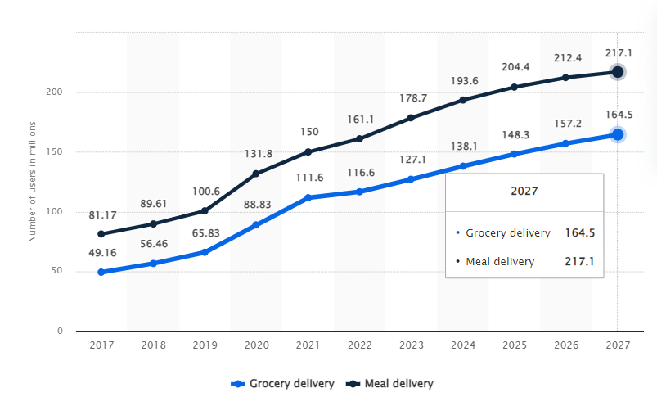
online food delivery
Sean Arackal
“More than 112 million Americans say they’ve used a food delivery service.” [1]
“60% of American consumers order takeout or delivery at least once a week. “[1]
“31% of American consumers use third-party food delivery services at least twice a week.” [1]
[2]
Notes:
Food delivery is a ubiquitous service that most people have used before. Read statistical point 1.
It is also not uncommon for people to regularly use food delivery services. Read statistical point 2 and 3.
Here is a projection by Statista for the Number for the projected number of users of the online food delivery market in the United States from 2017 to 2027. 2022 had a record high of 161.1 million users for meal delivery and this number is projected to only keep increasing. By 2027, it is estimated to reach a whopping 217.1 million users.

Slide 18
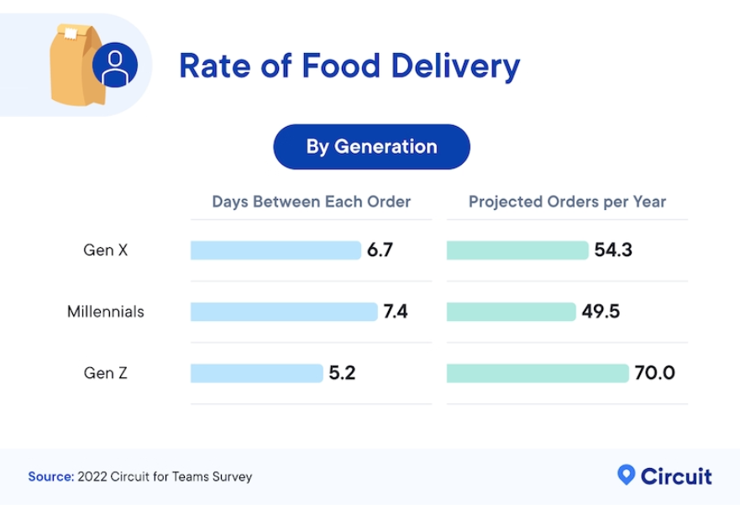
Bad for Consumers
Sean Arackal
“Average American makes nearly 55 food delivery orders annually
spending almost $1,850” [3]
“Delivery fees, service fees, and tips make up roughly 36% of food delivery costs
an average of $654 each year per customer” [3]
[3]
Notes:
Despite the seemingly high support and usage of online food delivery. It doesn’t seem to be good for consumers. Read statistical point 1.
The costs for using food delivery apps are fairly high. And can be argued to be too high Read statistical point 2. And over a third of these costs come from “hidden fees”.
Read statistical point 3 and 4.
Gen Z on average report even higher numbers than these. Talk about graph
You might say: At least the food that arrives is of good quality right? Well…

Slide 19
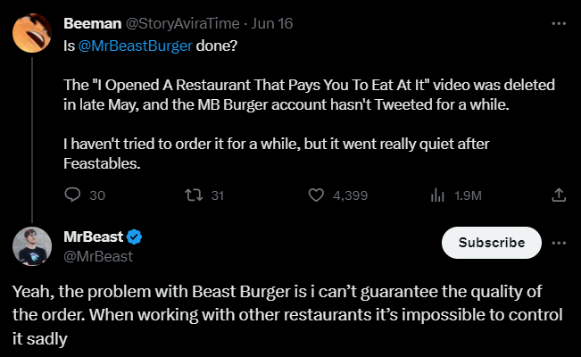
Bad for Consumers
Sean Arackal
Virtual or Ghost Kitchens
more than 1 in 5 appear to be virtual [4]
Lack of a physical dining space
Can be misleading to consumers
Notes:
A problem that tends to specifically come up the rising popularity of delivery apps are ghost kitchens. You might have heard of some companies like CloudKitchens and Virtual Dining Concepts.
One of the most famous ghost kitches are Beast Burgers. The bad quality of these kitchens has led to Mr. Beast filing a lawsuit against his food delivery service partner, Virtual Dining Concepts. [5]
Why care? Since 2021, the number of virtual restaurants listed on Uber Eats has quadrupled in the U.S. and Canada. [4]
In New York City, a sample of 1,656 Uber Eats listings showed that more than 1 in 5 appear to be virtual, a trend repeated across each of the 12 cities. [4] (Even one in Worcester called the Burger Den!)
While it can seem like virtual kitchens are harmless the anonymity makes it hard to hold bad restaurants accountable especially when it comes to kitchen, health and quality ratings.
“If you kill a [virtual] restaurant and start a new one with a new name, what do identity and reputation mean?” Nagaraj said. [4]

Slide 20
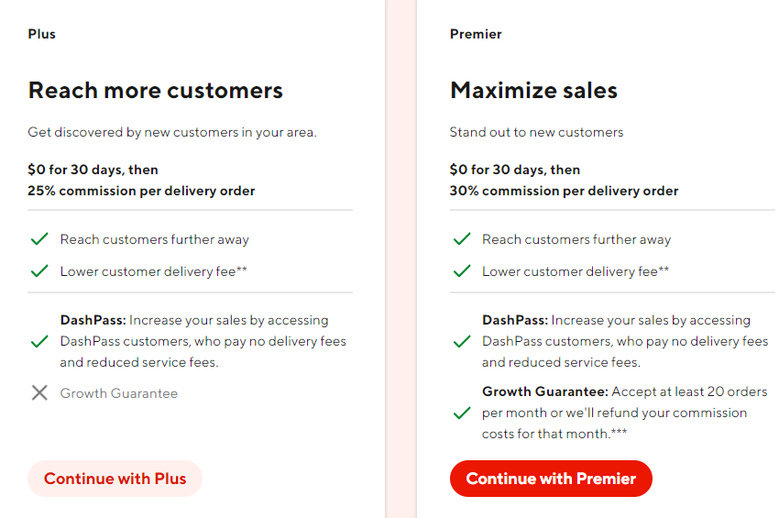
Bad for restaurants
Sean Arackal
Average Profit Margins for restaurants are generally 3-5% [6]
15, 25 or 30% commissions [8]
6% commission on pickup orders for UE [9]
Markups leads to pricier menus [11]
So even why stay on these apps?
[8]
Notes:
Some may argue that fees are worth it if it goes towards supporting local restaurants. In fact a recent study conducted by Square, two-thirds of customers say they would prefer to order food via a restaurant’s own mobile ordering platform, rather than using a third-party. Out of that group, 61% said their preference for direct ordering was because they wanted to support the restaurant. [7]
However these apps seem to only hurt what little money a restaurants is able to make. Read lines 2 and 3 which are already high amounts considering 1.
I encourage you to go to https://get.doordash.com/en-us to see how egregiously exploitative some of their pricing models are as shown in the fig.
And this is after an improvement. In early 2020 there were cases of DD listing restaurants without their permission [10]
And these commissions only cause the restaurants to increase the prices on their menu
Ok but if its so bad for the restaurants then why don’t they just not list themselves on the delivery apps?

Slide 21
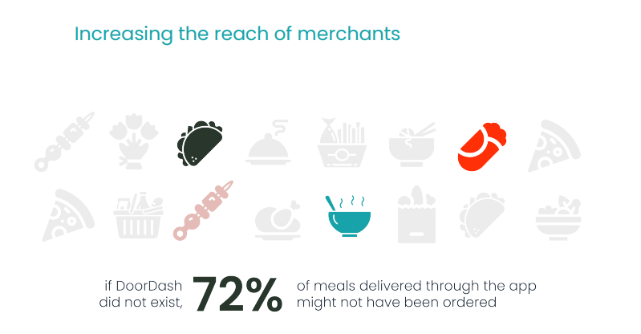
Bad for restaurants
Sean Arackal
Provides Reach: 52% said customer growth would have been lower without DoorDash[11]
No delivery fleet: 61% of restaurants that use DoorDash said they preferred DoorDash to operating their own delivery fleet. [11]
[12]
Notes:
Because most cannot afford to hire their own fleet of delivery drivers and not being on the delivery apps would hurt the visitors, orders and customers that they see.
Point to figure, 72% of consumer on DoorDash said they used DoorDash to try restaurants that they would not have otherwise tried
Restaurants pay DoorDash as much as 30% in commissions per order, and they do not get access to customer data that could allow them to market directly to guests. [11]
Even Dominos, which infamously stayed out of using third party apps is signing a deal with UberEats. [13]
You may say well okay I’m getting ripped off and the restaurants aren’t even getting a lot of money but what about the drivers? At least I’m helping them out right? Well kind of…

Slide 22
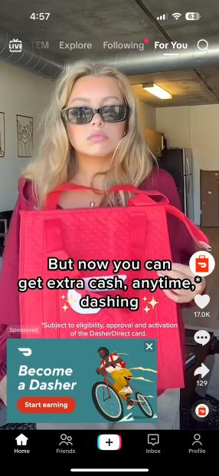
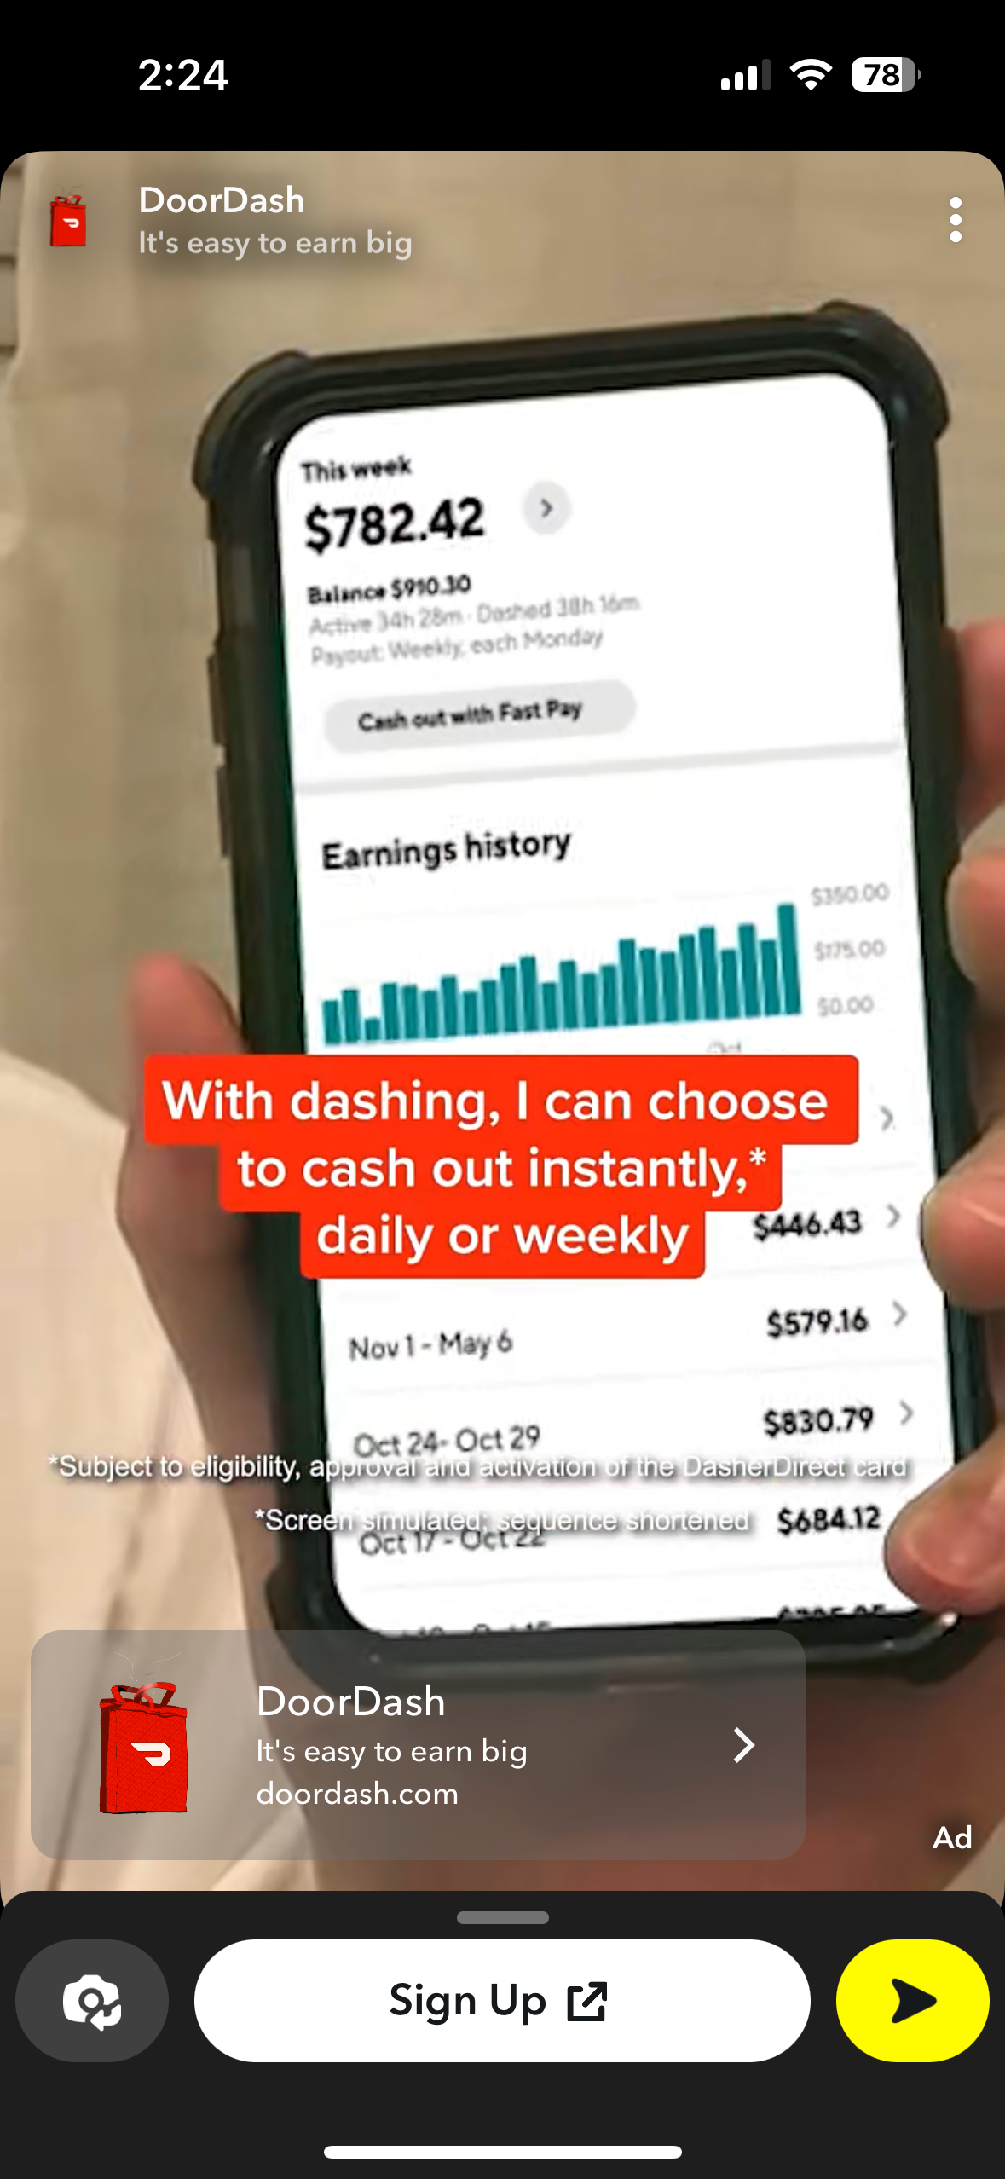
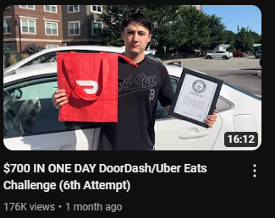
Bad for drivers
Sean Arackal
Over glamourized online
Lucrative part time as college students
Not as viable full time [14]
Lack of support as not being considered a full time employee
Notes:
When I started researching this topic I started getting a lot of ads for becoming a DoorDasher. These screenshots are only a few of what I could fit in.
Being a delivery driver for Food apps is not a bad idea. Especially if you are looking for part time work as a college student.
The advertisements make it seem better than it is, especially if you are not living in a major city.
If you do decide to do it full time it ends up being a bigger burden than you might think. Especially with things like self employed tax and the lack of things like insurance.
Generally being a delivery driver for these apps has gotten better. Especially after DoorDash was forced to pay their drivers complete tips and not subsidize those amounts from their wages [15]

Slide 23
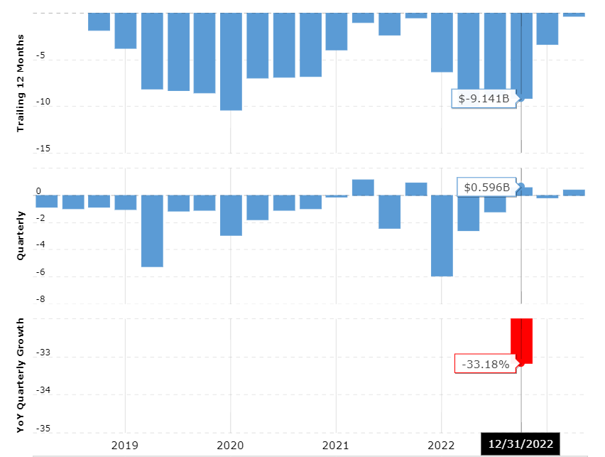
Bad for the apps themselves
Sean Arackal
DoorDash annual net income for 2022 was $-1.365B [16]
Uber Technologies annual net income for 2022 was $-9.141B [17]
Difficult process to streamline.
<Graphic as big as will fit>
[17]
Notes:
Ok so surely the fact that restaurants and consumers losing all this money would benefit the apps right? Turns out not really.
Delivery apps tend to report high losses. Read statistical point 1.
Some apps post record losses. Like Uber which. Read statistical point 2.
The caveat here is that this includes to loses from Uber’s ride-hailing services too.
Delivery is a complex service for which costs can add up quick. Drivers tend to have to go to different restaurants for each delivery over a large radius as opposed to smaller local delivery fleets.
Which leads to the losses. Maybe this can improve in the future? Losses seem to be going down but the costs don’t. We’ll have to wait and see.

Slide 24
References
Sean Arackal
[1] Fundera, 20 Food Delivery and Online Ordering Statistics,(Nerdwallet, Jan. 23, 2023) https://www.fundera.com/resources/food-delivery-statistics (09/28/2023)
[2] Statista Digital Market Insights, Number of users of the online food delivery market in the United States from 2017 to 2027, (Statista, April 2023) https://www.statista.com/forecasts/891084/online-food-delivery-users-by-segment-in-united-states (09/28/2023)
[3] Heather Reinblatt, How Much Do Americans Spend on Excessive Delivery Fees?, (Circuit, Sept. 6, 2022) https://getcircuit.com/teams/blog/hidden-cost-of-delivery (09/28/2023)
[4] Jasmine Cui, ‘I got catfished by a sandwich’: Virtual kitchens boom on delivery apps, (NBC News, April 8, 2023) https://www.nbcnews.com/data-graphics/virtual-restaurant-boom-uber-eats-data-rcna76532?utm_source=NBC&utm_medium=iframely (09/28/2023)
[5] Kalhan Rosenblatt, MrBeast sues his food delivery partner over ‘low quality’ food, (NBC News, July 31, 2023) https://www.nbcnews.com/business/mrbeast-lawsuit-mrbeast-burger-virtual-dining-concepts-rcna97396 (09/28/2023)
[6] Restaurant365, Average Profit Margins for a Restaurant, (Restaurant365, Feb 25, 2020), https://www.restaurant365.com/blog/what-is-the-average-profit-margin-for-a-restaurant/, (09/28/2023)
[7] Grace Dean, Digital Ordering Could Lead to Customers Placing Bigger Orders, (The Bottom Line by Square, Aug. 9, 2021), https://squareup.com/us/en/the-bottom-line/selling-anywhere/digital-ordering-ticket-size, (09/28/2023)
[8] DoorDash, Products & Pricing, (DoorDash for Merchants), https://get.doordash.com/en-us/products, (09/28/2023)
[9] UberEats, Pricing tailored to your business, (UberEats for Merchants), https://merchants.ubereats.com/us/en/pricing/, (09/28/2023)
[10] Gloria Dawson, What to do if your restaurant is listed on a third-party marketplace without your permission, (Nation’s Restaurant News, Feb. 06, 2020), https://www.nrn.com/technology/what-do-if-your-restaurant-listed-third-party-marketplace-without-your-permission, (09/28/2023)
Notes:
Cool videos to watch that I took inspiration from: Drew Gooden: [Delivery Apps are Bad for Everyone](https://youtu.be/hsMujJYPagQ?si=nzwsxkOzMmd2bPRH) and Eddy Burback: [The Deceptive World of Ghost Kitchens](https://youtu.be/KkIkymh5Ayg?si=MBp6_KOcIpUIKARq)

Slide 25
References
Sean Arackal
[11] Heather Haddon, Restaurants Are Arm-Twisting Delivery Companies to Lower Fees, (The Wall Street Journal, June 23, 2019), https://www.wsj.com/articles/restaurants-are-arm-twisting-delivery-companies-to-lower-fees-11561282202?mod=article_inline, (09/28/2023)
[12] DoorDash, Measuring Our Impact, (DoorDash, Aug. 29, 2022), https://about.doordash.com/en-us/impact/measuring-our-impact, (09/28/2023)
[13] Spencer Jakab, Domino’s Investors Overpay for a Pizza the Action, (The Wall Street Journal, July 12, 2023), https://www.wsj.com/articles/dominos-investors-overpay-for-a-pizza-the-action-951d51d6, (09/28/2023)
[14] Tina Orem, Self-Employment Tax: What It Is, How To Calculate It, (Nerdwallet, May 23, 2023), https://www.nerdwallet.com/article/taxes/self-employment-tax, (09/28/2023)
[15] Andy Newman, DoorDash Changes Tipping Model After Uproar From Customers, (The New York Times, July 24, 2019), https://www.nytimes.com/2019/07/24/nyregion/doordash-tip-policy.html, (09/28/2023)
[16] MacroTrends, Uber Technologies Net Income 2017-2023 | UBER, https://www.macrotrends.net/stocks/charts/DASH/doordash/net-income, (09/28/2023)
[17] MacroTrends, DoorDash Net Income 2019-2023 | DASH, https://www.macrotrends.net/stocks/charts/DASH/doordash/net-income, (09/28/2023)
Notes:
Cool videos to watch that I took inspiration from: Drew Gooden: [Delivery Apps are Bad for Everyone](https://youtu.be/hsMujJYPagQ?si=nzwsxkOzMmd2bPRH) and Eddy Burback: [The Deceptive World of Ghost Kitchens](https://youtu.be/KkIkymh5Ayg?si=MBp6_KOcIpUIKARq)

Slide 26
STARTING With the Little Things
Connor Thompson

Slide 27
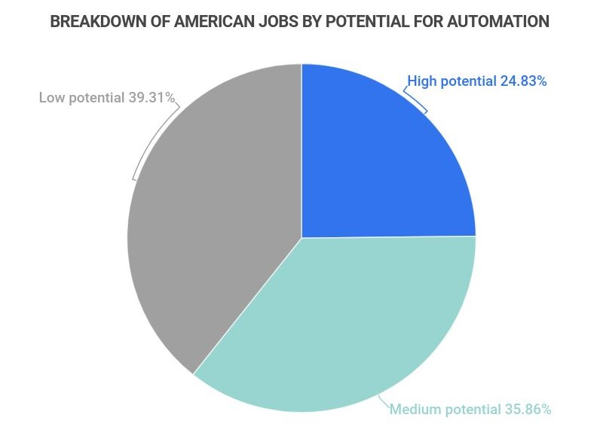
Automation in the workplace is increasing
Connor Thompson
Robots expected to replace 2 million factory jobs by 2023 (2)
Automation has the potential to replace 73 million jobs total, 46% of total jobs currently (3)
14% of jobs have been previously replaced by some form of robot (6)
Percentage of jobs susceptible to automation (3)
Notes:
<speaker notes>

Slide 28
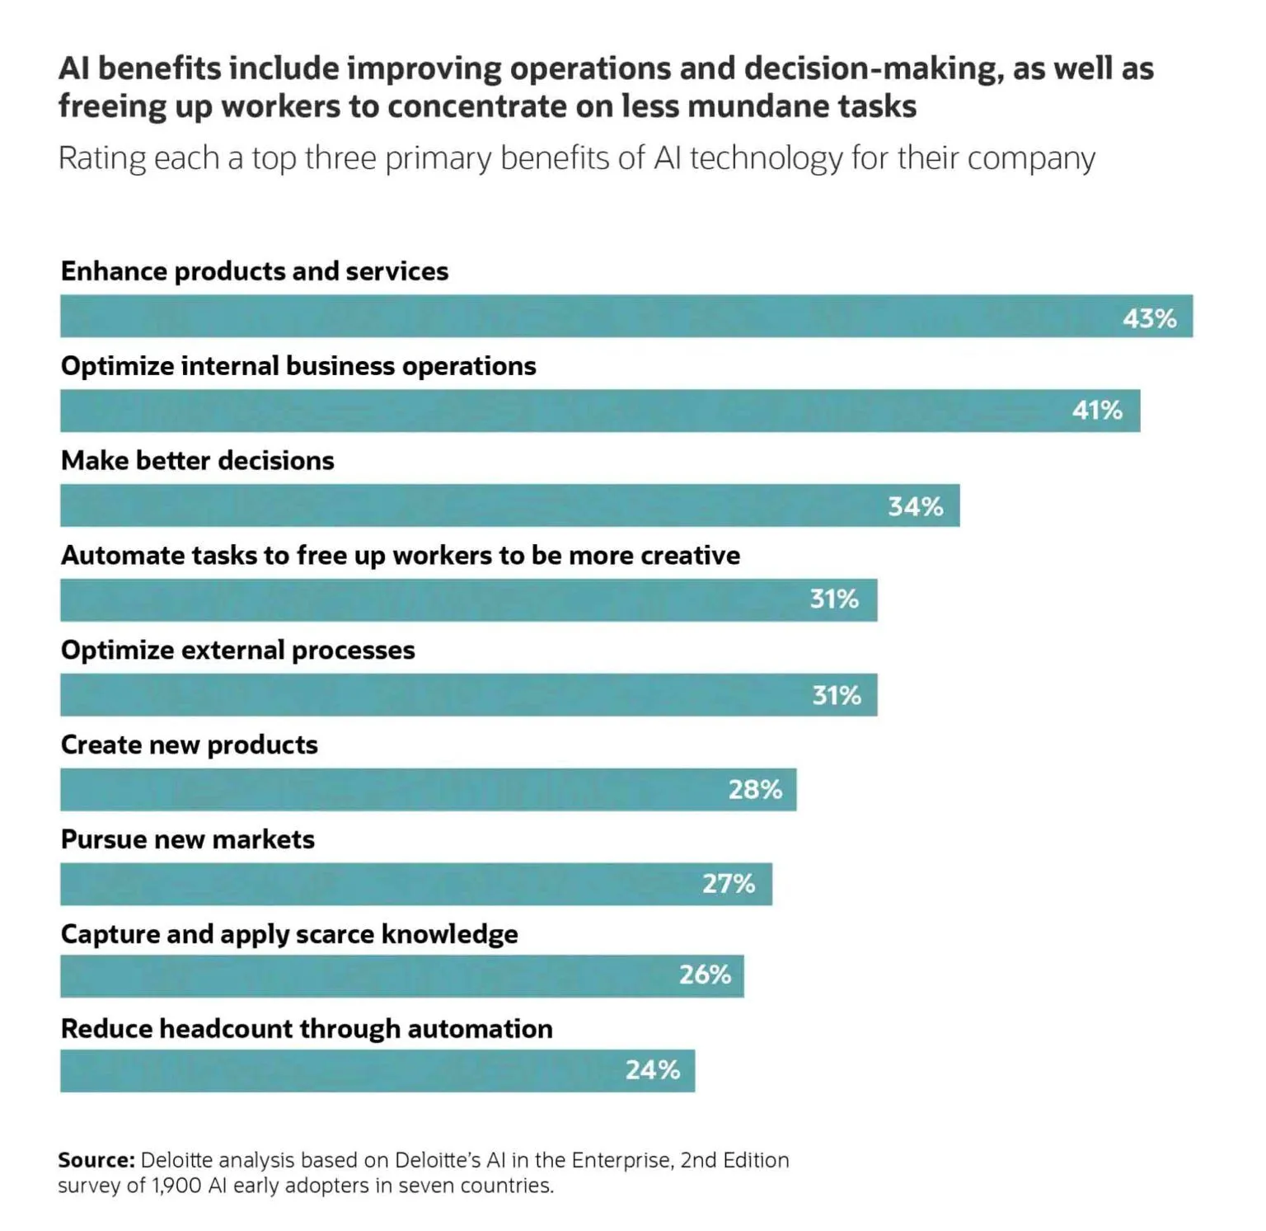
Automation in White Collar work
Connor Thompson
AI allows to automate previously jobs previously unavailable (1)
Labor accounts for 30% of revenue cost in small business (5)
Automation increases productivity in sales by 14.5% while reducing cost 12.2% (4)
AI benefits to various workplaces (1)
Notes:
<speaker notes>

Slide 29
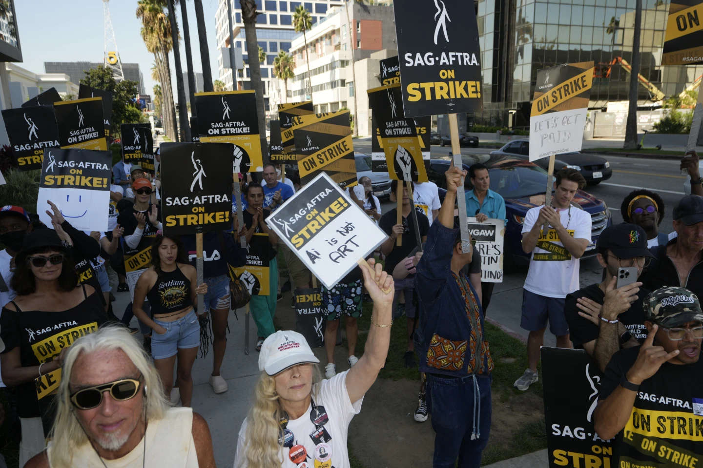
Direct Impact of ai and Automation
Connor Thompson
Hollywood strike was directly against AI automation (7)
AI banned for rewriting scripts and cannot be used as a source material (8)
French metro implementing automated drivers amidst strike (12)
Protesters against AI during 2023 Hollywood Strike (7)
Notes:
<speaker notes>

Slide 30
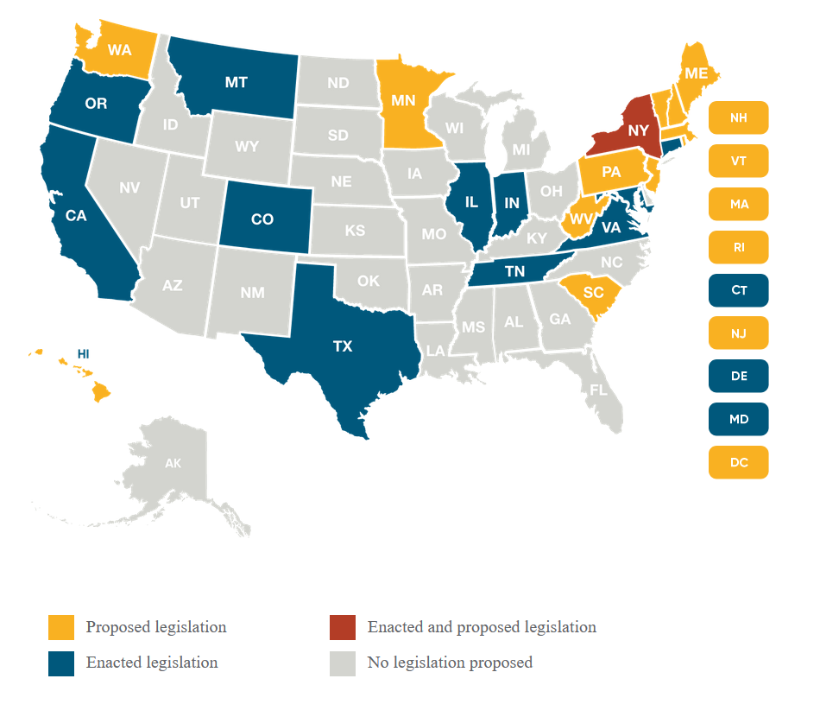
Moving into the Future
Connor Thompson
AI is too beneficial to fully ban, therefore other limits are necessary (1)
AI laws to protect consumers from overreaching data retention (9) (10)
Severance Packages for displaced workers (11)
States with AI Legislation (13)
Notes:
<speaker notes>

Slide 31
References
Connor Thompson
[1] Ghetau, C. (2023, April 17). Automation in the workforce: Everything you need to know. Buchanan Technologies. https://www.buchanan.com/automation-workforce
[2] Lemay PatrickTulip Interfaces. (2023, July 25). The growth of manufacturing process automation. Tulip. https://tulip.co/blog/manufacturing-process-automation
[3] Flynn, Jack (2023). 35+ Alarming Automation & Job Loss Statistics [2023]: Are Robots, Machines, And AI Coming For Your Job? Zippia. https://www.zippia.com/advice/automation-and-job-loss-statistics/
[4] <Automation Statistics You Need To Know—The Mega-List. (n.d.). https://www.windwardstudios.com/blog/automation-statistics-mega-list>
[5] Adkins, WIlliam How to calculate the employee labor percentage. (2019, January 31). Small Business - Chron.com. https://smallbusiness.chron.com/calculate-employee-labor-percentage-15980.html
[6] Stahle, Tyler (2022). Robots are taking over jobs, but not at the rate you might think says BYU research. News. https://news.byu.edu/intellect/robots-are-taking-over-jobs-but-not-at-the-rate-you-might-think-says-byu-research

Slide 32
References
Connor Thompson
[7] Coyle, Jake (2023, September 27). In Hollywood writers’ battle against AI, humans win (for now) | AP News. AP News. https://apnews.com/article/hollywood-ai-strike-wga-artificial-intelligence-39ab72582c3a15f77510c9c30a45ffc8
[8] Silbering, Amanda The Writers Strike Is Over, heres how it plaed you. (2023b, September 26). https://techcrunch.com/2023/09/26/writers-strike-over-ai/
[9] The White House. (2023, March 16). Blueprint for an AI Bill of Rights | OSTP | The White House. https://www.whitehouse.gov/ostp/ai-bill-of-rights/[10] https://epic.org/the-state-of-state-ai-laws-2023/
[11] Semuels, Alana (2020, August 6). Millions of Americans have lost jobs in the Pandemic—And robots and AI are replacing them faster than ever. Time. https://time.com/5876604/machines-jobs-coronavirus/
[12] Cokelaere, Hanne (2020, January 18). Robot scab! How automation is threatening striking French workers. POLITICO. https://www.politico.eu/article/robot-scab-automation-threatening-striking-french-workers/
[13] Bryan Cave Leighton Paisner. (n.d.). US state-by-state AI legislation snapshot. Bryan Cave Leighton Paisner - US State-by-state AI Legislation Snapshot. https://www.bclplaw.com/en-US/events-insights-news/2023-state-by-state-artificial-intelligence-legislation-snapshot.html

Slide 33
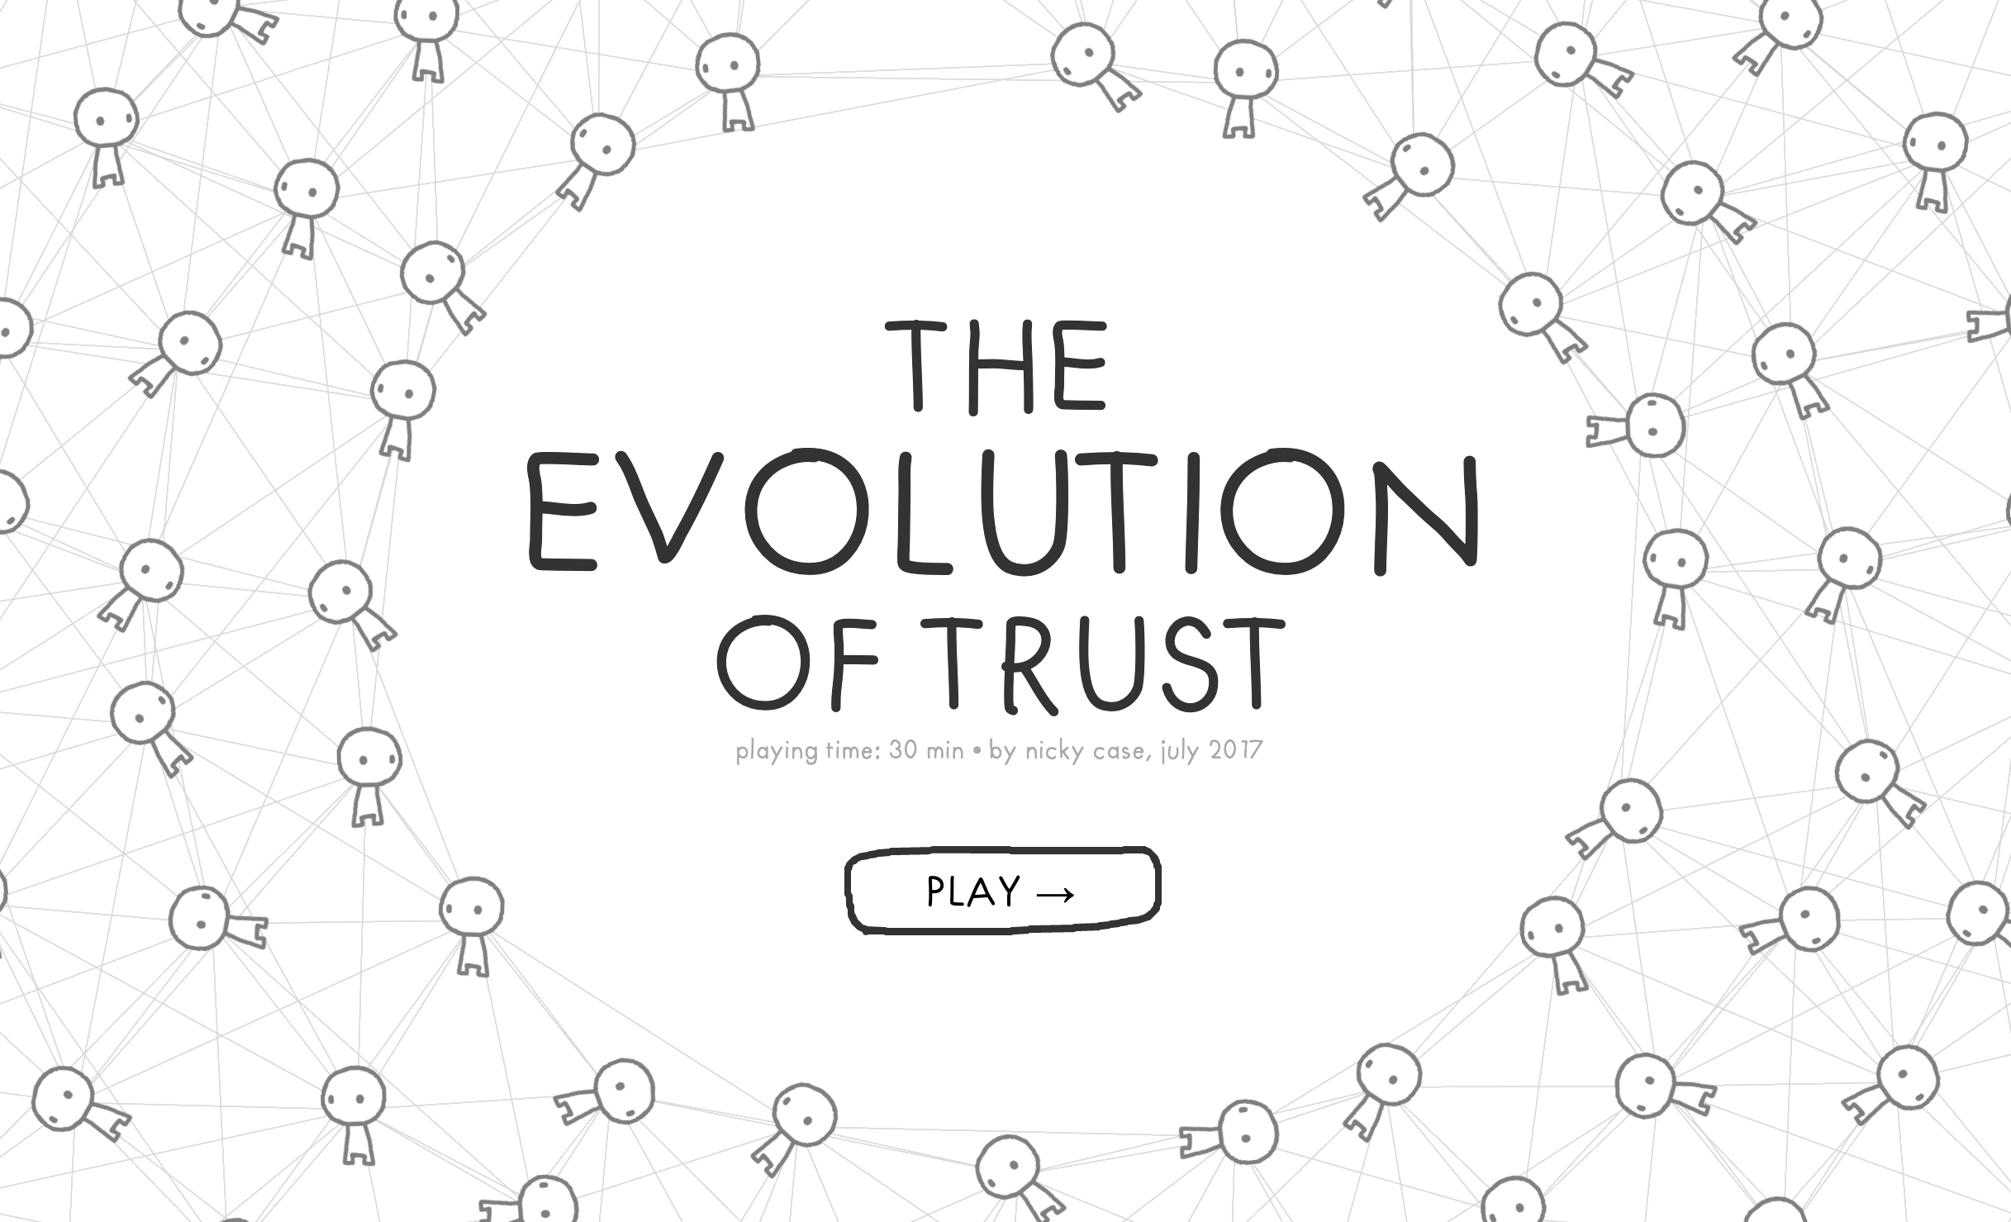
Class 10
The End
Keith A. Pray
socialimps.keithpray.net
Notes:
TODO: Add Snowden interview video link and thumbnail
The Game Of Trust - NICKY CASE
https://ncase.me/trust/
This is the end. Any slides beyond this point are for answering questions that may arise but not needed in the main talk. Some slides may also be unfinished and are not needed but kept just in case.

Slide 34
Remote With Zoom
Sign in with First and Last Name
Stay muted unless you are going to speak
To speak use the raise your hand feature
To answer yes/no questions use the “yes” ”no” buttons
Turn your camera on
Wait until the end of student presentations to ask questions
  Write them down so you don’t forget

Slide 35
My Reading Notes
pp. 409 Can one perform services for one’s self?
pp. 412 1993-1999 Does this seem like a long time?
pp. 413 “errors of omission or commission”?
UPDATE
pp. 422 3. Would people agree – social contract?
pp. 438 So the baby can be left outside and no one is responsible?
Notes:
An error of commission is one where the person responds where they should not. This is compared to an error of omission, where the person fails to respond when they should.

