Slide 1

Class 9
Errors Failures Risks
Keith A. Pray
socialimps.keithpray.net
Notes:
Did SW Teams from the reading pick good test strategies? Will you be able to support your choices if something goes wrong?
What errors? – Have student record list on board
Who looked for directions on how to test currency?
MSNBC on Denver's Automated Baggage System 2010-08-23 (2:27)
https://www.youtube.com/watch?v=xx8f4x6C_KY
Accessed 2019-04-09
No Discussion Board

Slide 2
Overview
Review
Assignment
Students Present

Slide 3
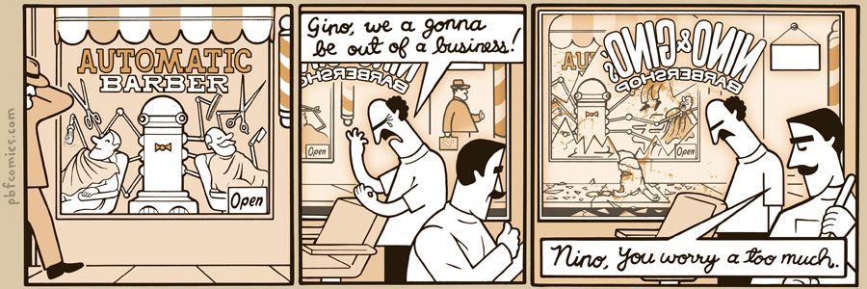
http://pbfcomics.com/197 (2014-09-26)
Notes:
10 – Errors, Failures, Risks

Slide 4
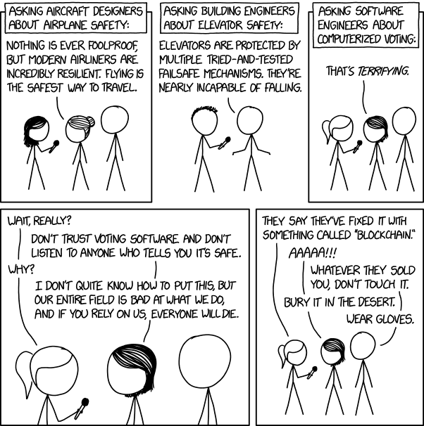

Overview
Students Present
Review
Assignment
https://xkcd.com/2030/ (2018-09-21)
Notes:
Why Electronic Voting Is Still A Bad Idea (2019)(12:00)
Tom Scott
https://www.youtube.com/watch?v=LkH2r-sNjQs
Old Version
Why Electronic Voting is a BAD Idea – Computerphile (2014)(8:20)
https://www.youtube.com/watch?v=w3_0x6oaDmI
Might be better in Security
Other videos:
9News - Looking back at the massive failure that was DIA's automated baggage system 2020-02-28 (2:32)
https://www.youtube.com/watch?v=xmas0-SthUQ
9News - Watch DIA's old luggage system toss baggage into the air 1995 (1:42)
https://www.youtube.com/watch?v=OtLHVGtFmKU
abcNews - Major Luggage Debacle at Denver Airport
https://abcnews.go.com/Travel/video/major-luggage-debacle-denver-airport-28054918
We can also discuss articles listed on Security Discussions under documents of course web site.
TODO: add quiz as backup if class discussion or guest speaker fail

Slide 5
Overview
Students Present
Review
Assignment
Notes:
We can also discuss articles listed on Security Discussions under documents of course web site.
ADD QUIZ AS BACKUP IF CLASS DISCUSSION OR GUEST SPEAKER FAIL

Slide 6
Assignment
Prepare for Debate
  You are a software engineer in the employee-owned company from Chapter 9 In-class Exercises # 24.
  Should the company produce the game based on a current war?
  Use the SWE Code Of Ethics as the basis for your argument
  Use high quality sources and supporting data
Optional 1 page paper, lowest paper grade will be dropped
Add to Group Project Web Site

Slide 7
Who is responsible for early screen time harms?
Nora Cleary
Notes:
Who Is Responsible for Early Screen Time Harms?
Government responsibility? Tech companies? Children who choose to use them? Their parents?
I have come to the conclusion that each guardian is ultimately responsible for exposing their children to screens, and the harms that may occur as a result.
However, clear warnings on devices, applications and media should be nationally enforced to ensure guardians are capable of making informed decisions about screens.

Slide 8
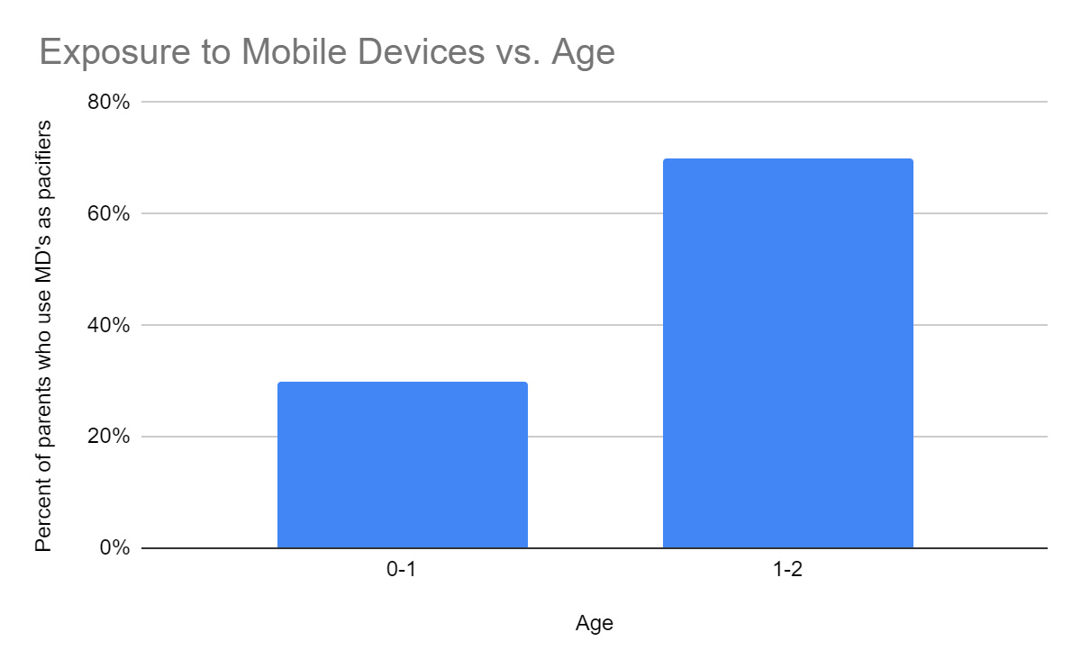
Harms of early introduction to the digital world
Nora Cleary
Emotional Development:
Media Emotion Regulation – “dependency on screens to manage emotions” [1]
Negative Emotionality – Tantrums, isolation, impulsivity
  Media emotion regulation is positively associated with negative emotionality
  β = 0.22, p = .001 [1]
Parents give screens to upset children in order to pacify them [1]
Notes:
What are these harms specifically?
First, we look at dangers to emotional development. Learning the skills to cope with emotions happens during infancy – however, as screens begin to replace pacifiers, this crucial development is interrupted.
The graph to the right shows the percent of parents who give their child a mobile device to calm children during tantrums, signs of restlessness and boredom, and as a distraction from their negative emotions.
This practice of using screens to regulate difficult emotions is called media emotion regulation and it has some long-term consequences.
A study from 2021 analyzed the emotional regulation efficiency of toddlers who were pacified by screens in infancy.
The results highlighted the strong relationship between media emotional regulation and negative emotionality.
Negative Emotionality being behaviors associated with a child’s poor handling of distress. Tantrums, shutting down, low self control…
Translating those statistics…
The beta coefficient measures the strength and direction of the relationship between the two variables. In this case, a beta coefficient of 0.22 suggests a positive relationship of moderate strength, so as "Media Emotion Regulation" increases, “negative emotionality" is expected to increase as well.
The p-value is a measure of the statistical significance of the relationship. A p-value of 0.001 is very low, typically indicating strong statistical significance. In other words, the relationship between "Media Emotion Regulation" and “negative emotionality" is highly likely to be real and not just due to random chance.

Slide 9
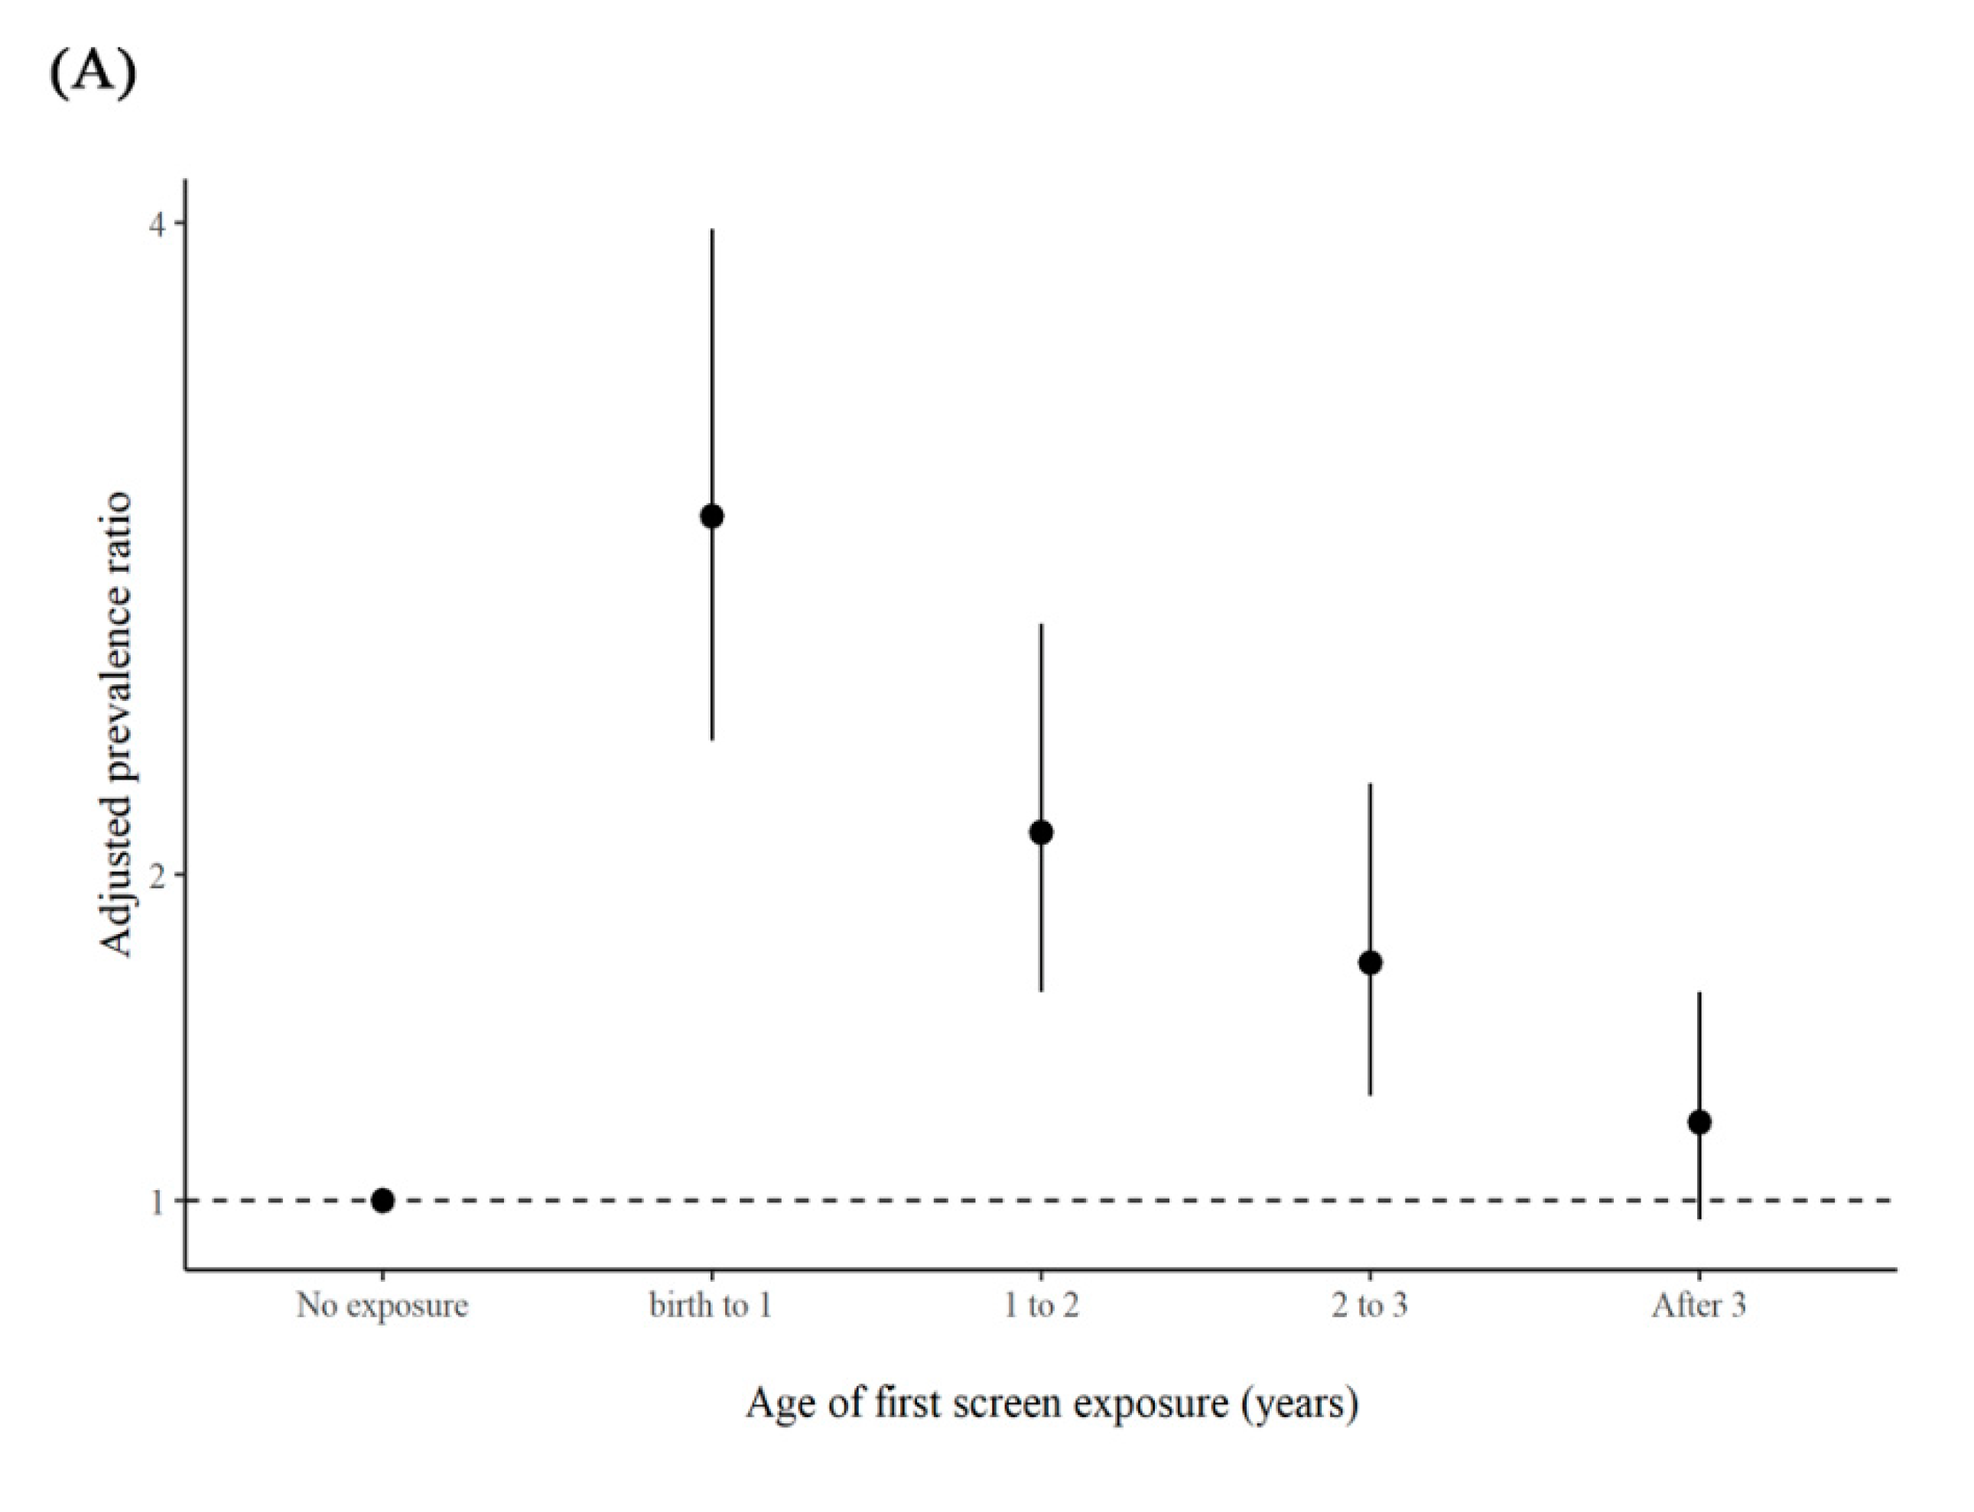
Harms of early introduction to the digital world
Nora Cleary
Physical Development:
Early exposure to screens damages eye-sight
  Astigmatism – “imperfection in the curvature of the eye that causes blurred vision” [2]
“Associations between the age of first screen exposure and preschool astigmatism” [2]
Notes:
Astigmatism is an eye condition that causes distorted sight – light rays cannot meet at one single point in the eye. Astigmatism can lead to further eye-sight problems like myopia.
A 2020 study of preschool children ages 2-7 found a relation between screen exposure and astigmatisms. Taking genetic factors into account, the results found that children exposed to screens before the age of 1 typically are more likely to develop an astigmatism as a toddler. Typically, the longer a parent waits until exposing their child to a screen, the less likely it will be that the child will later develop an astigmatism.

Slide 10
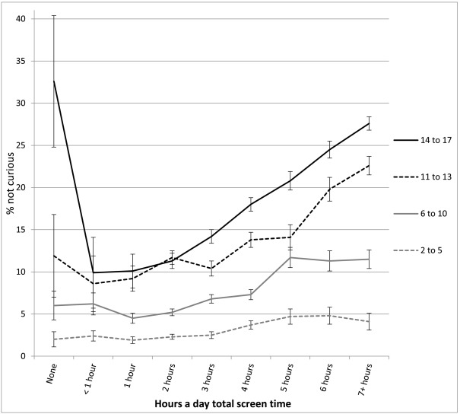
Harms of early introduction to the digital world
Nora Cleary
Intellectual Development:
Apathetic attitudes towards learning
66% more likely to not finish tasks they started [3]
65% used technology to watch non-educational content
“Percentage not curious or interested in learning new things. Error bars are ±1 SE” [3]
Notes:
An early introduction to constant entertainment via mobile devices, television, and other technology has increased apathy in the learning.
Parents of preschool age children were questioned about their child's screentime use. All of the children in the study began using technology (TV, MDs, watching with adult…) within their first year of life. Compared to a study of children who were introduced to technology later in life (after first year), those who used technology before age 1 were 66% more likely to not finish a task.
These same children also demonstrated less curiosity when they consumed more media. 65.1% of the children used technology to watch non-educational content on YouTube and television programs.
As a result, these children were reported to be overall less curious. With curiosity being the desire to try new things, asking questions, exploring how their toys work…
As observed, typically, the more exposure a child has, the less curious they become.

Slide 11
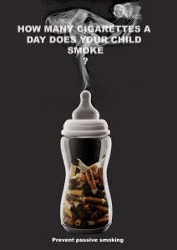
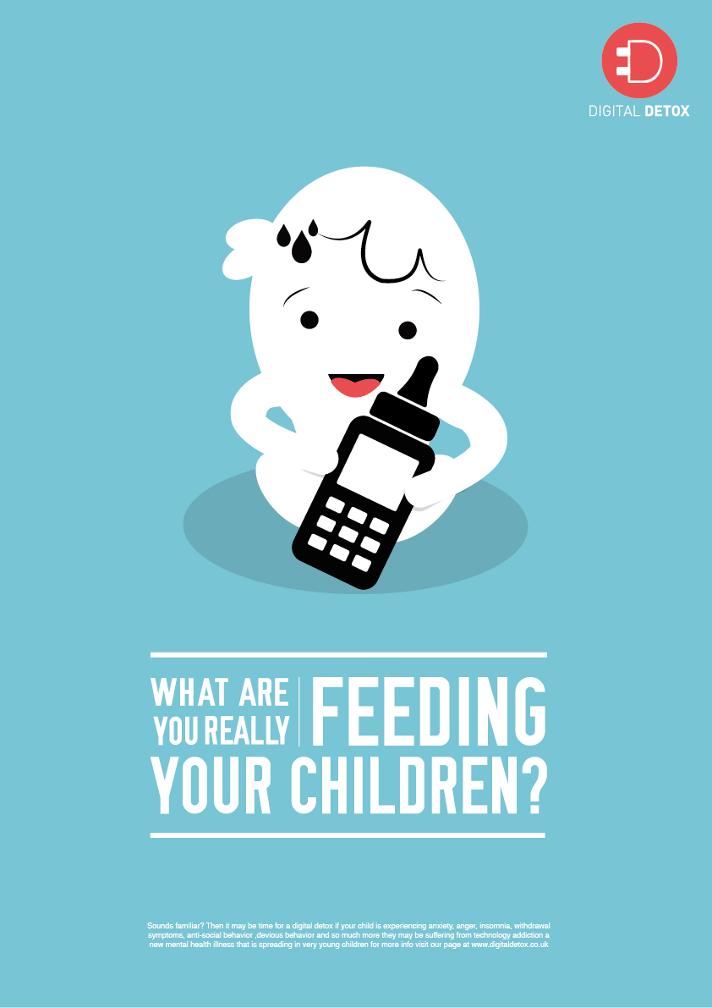
Should the government ban screens for children?
Nora Cleary
Screens are the new cigarettes
  Secondhand screen time [4]
  Addiction [4]
  Long term health harms
1991 Synar Laws
  Restrict youth access to tobacco products [5]
Campaigns cautioning screens for children resemble anti-smoking ads [6, 7]
Notes:
Parent blogs and media outlets are claiming screen time to be the new smoking. Comparing the warnings of screens to those of cigarettes – dangers including addiction, the long term health affects (many of which were previously mentioned) and even second-hand screen time – indirect impact of screens – TV playing in the background while playing, children watching their parents use mobile devices – which a 2020 study showed a positive relationship between a mother’s screen time and the screen time of their child.
Obviously, smoking is dangerous - these undeniable dangers led Congress to enact the Synar law, which prohibits the sale of tobacco products to minors.
If cigarettes and screens have such similar warnings, should the government enact laws prohibiting screens for young children?
As studies begin to expose the true dangers of childhood technology use, many argue that the government should be responsible for protecting the youth from its harm, enacting a national ban on childhood screen use.

Slide 12
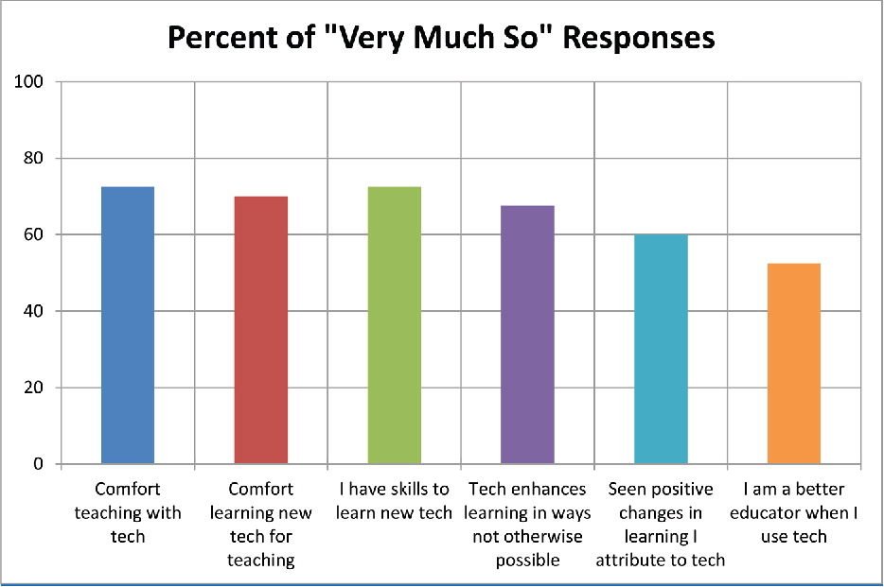
Not all screens are evil
Nora Cleary
Screens in the classroom
  Facilitate engagement and participation
  51% of ESL students use social media platforms to advance language skills [9]
Percent of 40 K-6 teachers who responded in agreement to displayed questions [8]
Notes:
Unlike cigarettes, which are all harm no benefits, screen time has some positive affects on children.
Directing your attention to the right hand of the graph, teachers have seen improvements in learning when they incorporate tech – over 60% of teachers claiming tech enhances learning in ways not otherwise possible
Technology also presents new opportunity. 51% of English as a Second Language students use social media platforms to improve their informal vocabulary and practice cinversations. ESL children who watched television programs in English were more successful in developing conversational skills.
Because of the benefits, like using screens as a teaching tool, a government enforced ban on youth technology use would inhibit learning. Consequently, the government is not entirely responsible for the restriction of technology use.

Slide 13

conclusion
Nora Cleary
Government enforcement of technology transparency
  Clearly state all potential harms
Guardians are ultimately responsible
  Aware of harms before exposing their child to screens
“WARNING:
This device is designed to be addictive” [10]
Notes:
A government ban would not solve issue.
The responsibility of safe screen practices should therefore be placed upon the guardian of the child.
While the guardian is overall accountable for the harms caused by exposure to screens, they should not be entirely responsible for a general understanding of these harms.
Tech companies should provide clear warning that caution adults about the potential dangers of childhood exposure to screens. An unavoidable caution outlining the general mental, emotional, and physical harms. Parents can do further research about screen safety as needed.
Guardians are responsible for using this information to make an informed decision on how their child will use technology.
The image demonstrates how technology – mobile devices, televisions, applications, software downloads… should be cautioned. A direct warning that cannot be ignored.

Slide 14
References
Nora Cleary
[1] Covolo L, Zaniboni D, Roncali J, Mapelli V, Ceretti E, Gelatti U, “Parents and Mobile Devices, from Theory to Practice: Comparison between Perception and Attitudes to 0-5 Year Old Children's Use” (Int J Environ Res Public Health, 2021 Mar 26) https://www.ncbi.nlm.nih.gov/pmc/articles/PMC8037713/#:~:text=Parents%20often%20use%20media%20as,70%25 (23 September 2021).
[2] Huang, L.; Yang, G.-Y.; Schmid, K.L.; Chen, J.-Y.; Li, C.-G.; He, G.-H.; Ruan, Z.-L.; Chen, W.-Q, “Screen Exposure during Early Life and the Increased Risk of Astigmatism among Preschool Children: Findings from Longhua Child Cohort Study.” (Int. J. Environ. Res. Public Health 2020) https://doi.org/10.3390/ijerph17072216 (22 September 2021).
[3] Jean M. Twenge, “Associations between screen time and lower psychological well-being among children and adolescents: Evidence from a population-based study” (University of Georgia, 18 October 2018), https://www.sciencedirect.com/science/article/pii/S2211335518301827 (22 September 2023).
[4] Joelle Renstorm, “Secondhand screen time may be just as dangerous as secondhand smoking” (The Conversation, 25 January 2020) https://www.fastcompany.com/90454545/copycatting-parents-screentime-may-be-just-as-dangerous-as-secondhand-smoke (22 September 2023).
[5] Gottlieb NH, Loukas A, Corrao M, “Minors’ tobacco possession law violations and intentions to smoke: implications for tobacco control” (University of Texas, 2004) https://tobaccocontrol.bmj.com/content/13/3/237 (22 September 2023).
[6] Campaign for Change, https://oakescc.org/crimready/ (23 September 2023).
[7 ] Michelle Gore, https://michellegore.co.uk/self-initiated-project-technology-addiction (23 September 2023).
[8] Katherine McKnight, Kimberly O'Malley, Roxanne Ruzic, Maria Kelly Horsley, John J. Franey, Katherine Bassett “Teaching in a Digital Age: How Educators Use Technology to Improve Student Learning” (Journal of Research on Technology in Education, 2016) https://www.tandfonline.com/doi/full/10.1080/15391523.2016.1175856 (22 September 2023).
[9] Mohd Shakir Azfar Abdul Halim, “Integrating web 2.0 technology in ESL classroom: A review on the benefits and barriers” (Redwhitepress, 2019) http://journal.redwhitepress.com/index.php/jcet/article/view/38 (22 September 2023).
[10] John Kuczala, (LifeTime, 2018) https://experiencelife.lifetime.life/wp-content/uploads/2021/02/Tech-Fix.jpg (23 September 2023).
Notes:
Helpful for possible questions:
Slide 1 -> Data presented is just the use of tech to pacify - Similar studies found that 92.2% of children started using mobile devices before 1 year of age
(https://ncbi.nlm.nih.gov/pmc/articles/PMC8709520/)
Slide 6 -> Synar law prohibited distribution of tobacco, but the law pushed state governments to enforce Minor in Possession laws, which a majority did.
Conclusion -> The current laws surrounding youth and technology use are largely to restrict WHAT child has access to on the internet, not restricting their overall access to screens themselves
The Children's Internet Protection Act (CIPA) was enacted by Congress in 2000 to address concerns about children's access to obscene or harmful content over the Internet.
- Harms of tech -> why not look at the obvious mental health challenges
- wanted to focus on the harms of an early introduction to technology. Although there are significant dangers of social media on mental health, it is difficult to attribute this to early use of screens – no studies looking into correlation between early use and later mental health challenges.

Slide 15
Ai Crime detection
Ella Dunne
Notes:
A question that must be asked when implementing any new technology should be what are the risks associated with this?
Today I am going to answering the question of what are is the largest risk-error-or potential failure associated with AI crime detection.

Slide 16
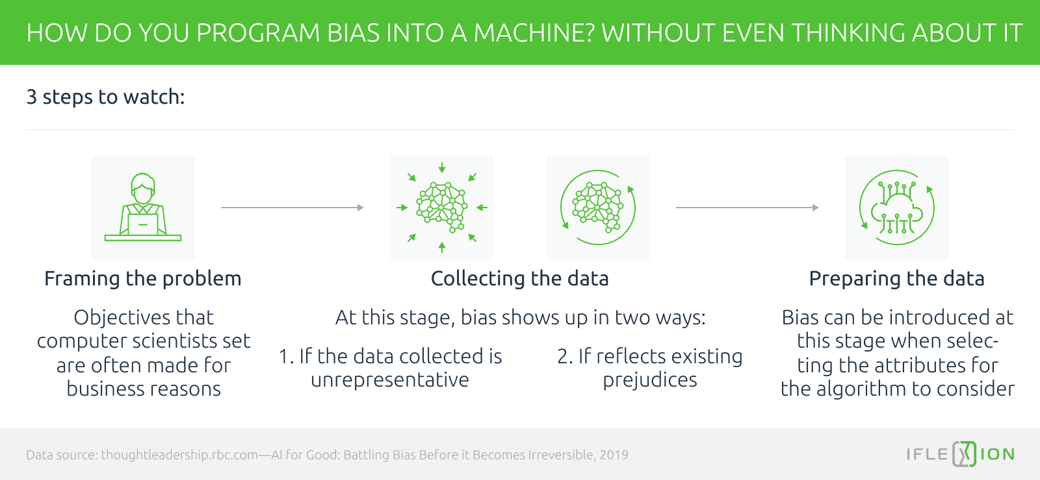
Conclusion – The risk of bias
Ella Dunne
Explicit and implicit bias in policing [1]
How we train, design, use, and hold accountable our learning models [2]
James Hendler: "AI can be used for social good. But it can also be used for other types of social impact in which one man's good is another man's evil. We must remain aware of that.”[3]
[4]
Notes:
The simple answer is bias.
This is because bias can influence crime detection AI at every point in its creation and use.
This can be seen in the graphic to the right, which lays out how bias can enter our machines at any point in time without us even realizing.
Crime detection AI is a law enforcement tool. Therefore, to fully understand its implications, we have to look at the environment its being used in, and the bias present there.
This represents the first step in the graphic to the right, framing the problem,.
After all, the environment influences how we train and use our models.
[1] Expands a bit on how explicit and implicit bias has become a core part of policing through history of discrimination, and modern implicit biases has been left unchecked
It was published by the US Department of Justice with intent on helping people recognize and challenge/overcome bias
It also details, however, that bias is a typical human trait/tendency. It stems from "our tendency and need to classify individuals into categories as we strive to quickly process information and make sense of the world".
So through this we can infer that bias is a point of risk in framing and collecting the data needed for crime detection AI.
Biases in our data, how we collect that data, and how we use that data all effect the end product.
In relation to law enforcement in this country, that means it is impacting peoples lives. Therefore, when we are preparing and further down the line using this data, we still need to be aware of how our biases may be influencing it.
This is the last step in the graphic
A paper by LinkedIn talking about the ethics of AI and their importance
"AI has the potential to revolutionize many industries and solve some of our biggest problems, but it can also create new problems and exacerbate existing ones if not developed with ethical considerations in mind."
Bias, privacy, accountability and responsibility were all risks associated with AI and ethics
When we don't hold these algorithms and our methods accountable, and we do not look for our biases, the data's biases, the algorithm's biases, we allow this risk to become a point of error, and subsequently failure.
As such, this is the primary risk associated with AI crime detection
A great quote from James Hendler, who is the director of the institute for data exploration and applications at Rensselaer is at the bottom here, and I believe that it really represents this conclusion. It is, after all, him talking about bias in artificial intelligence.

Slide 17
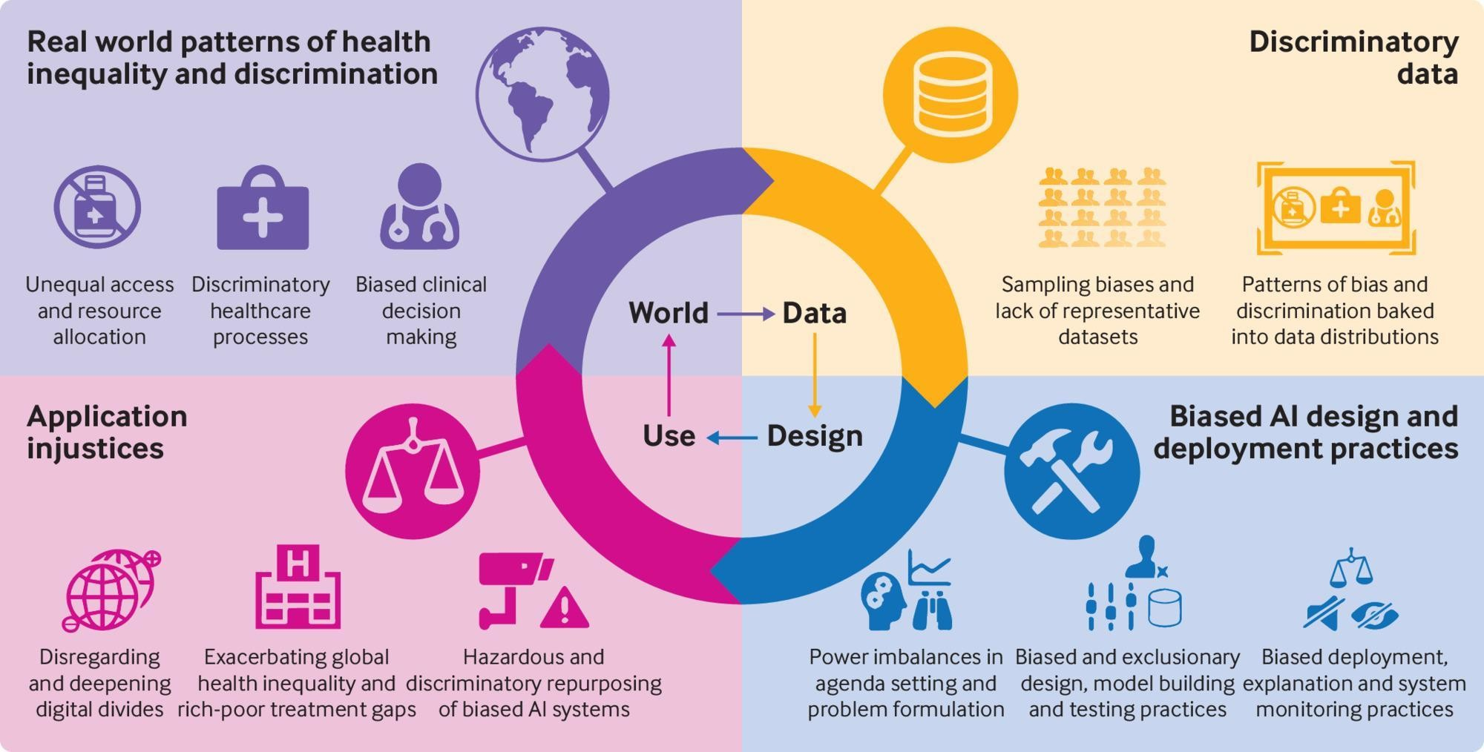
How BIAS influences algorithms
Ella Dunne
ACM Study: 19 Recognized Biases in Machine Learning [5]
Gender Shades:
  IBM: 34.4% error difference
  Microsoft: 93.6% of errors were darker-skinned
  Face++ 95.3% of errors were female
Correlations are not always causations [7]
[8]
Notes:
Machine learning and artificial intelligence must be trained from data.
As such, when we knowingly or unknowingly train algorithms with biased data, it then creates biased results, which then get used to make biased decisions
This process of leaving bias unchecked creates a feedback loop, causing the system to become discriminatory.
While not law enforcement related, the graphic on the right actually demonstrates this loop with medical information and medical AI use.
There are 19 types of bias in machine learning listed under this study, and they follow:
Data to algorithm: Measurement bias, omitted variable bias, representation bias, aggregation bias, sampling bias, longitudinal data fallacy, linking bias
Algorithm to user: algorithmic bias, user interaction bias, popularity bias, emergent bias, evaluation bias,
User to data: historical bias, population bias, self-selection bias, behavioral bias, temporal bias, content production bias
Of these: Historical bias, sampling bias, omitted variable/representation bias, evaluation bias, and social bias all relate to AI crime detection through this surveys descriptions
In addition, however, when training models we commonly have to refine and reaffirm what they're doing. In this sense, unintentional bias can even be directly built into algorithms via algorithmic bias.
With these bias in mind, we can see how bias in law enforcement reflects onto our algorithms
One example of this is the issue with sampling bias and evaluation bias in facial recognition software.
The Gender Shades study found the IBM, Amazon, and Face++ gender classifiers all performed significantly worse on dark-skinned females in comparison lighter-skinned males.
IBM had the largest gap in accuracy: "difference of 34.4% in error rate between lighter males and darker females"
Error analysis found 93.6% of subjects misgendered by Microsoft were darker-skinned individuals
95.3% of faces misgendered by Face++ were female
The book actually mentions that some individuals believed some of these models were trained on around 75% male, and 80% white faces
When looking at a technology that is used in crime detection and law enforcement, this bias in how we actually train our models, on top of data issues, disproportionately impacts certain groups of people.
Finally, when we are training our algorithms on historical data, we have to be aware that correlation is not causation. An algorithm could find that red cars are correlated to speeding, but that would not mean the color of the car determines if it will speed. Similarly, an algorithm can find "that low income was correlated with high recidivism," but "it would leave you none the wiser about whether low income actually caused crime."
Recidivism is the likelihood of an individual to reoffend, and will be expanded upon more on the next slide.

Slide 18
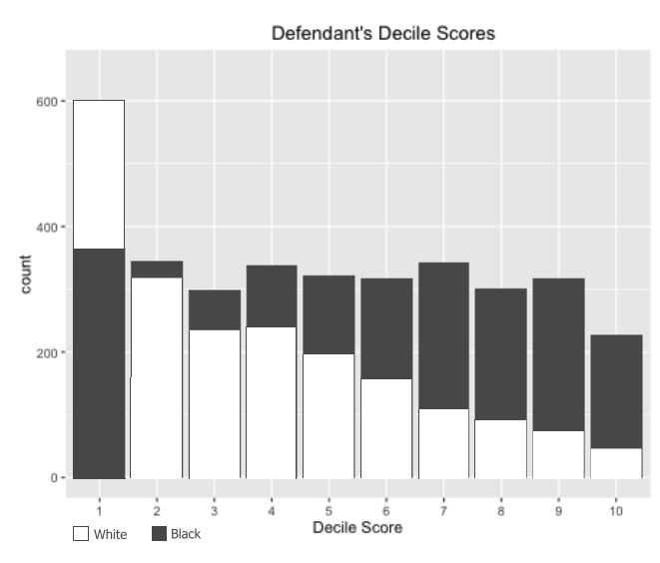
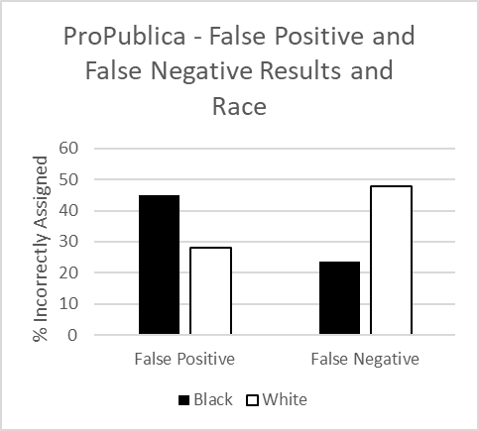
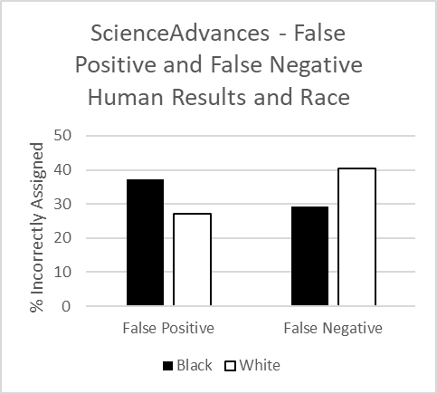
CASE Study: COMPAS – Crime prevention
Ella Dunne
[9]
[10]
"black defendants recidivate at a rate of 51% as compared with 39% for white defendants" [10]
Notes:
And we need to watch these biases, because if we don't, the role of bias as a risk can develop to being an error/failure.
COMPAS is one of the most commonly used algorithms in the US for accessing a defendants likelihood of reoffending, something that it judges through a recidivism scale. (Recidivism meaning the likelihood of someone to reoffend) It has fallen under study several times since it started being used, however a 2016 ProPublica study found interesting results.
On the left are the plotted scores for 6,172 defendants for their scores of recidivism of nonviolent crimes. Data on either not committing crimes or reoffending in 2 years.
There is a significant difference in the distribution of scores between white and black defendants. Black defendants have a nearly linear distribution while white defendants have a left skewed distribution. This same trend was repeated in the violent scores.
For black defendants that never reoffended, COMPAS was twice as likely to classify them at a higher risk than their white counterparts.
The opposite applied to white defendants, with COMPAS under-classifying "white reoffenders as low risk 70.5 percent more often than black reoffenders"
When looking at only high risk scores, black defendants were 3 times as likely to be falsely rated at this score.
A similar study was run to see the accuracy of COMPA compared to non-Criminal Justice trained humans. The comparisons between humans and COMPAS aren't shown here, but they were usually within a close range of each other (37.1% of humans versus 40% of COMPAS). Rather, these are human calculations shown in this second large bullet point.
This study eloquently opened addressing the racial discrepancies that ProPublica found, where they argue that it is impossible for COMPAS to be fair, since (quote). In this regard, it is argued that because recidivism is different between races, you can't have scoring absent of races.
It should be highlighted that the second study questions if COMPAS is worthwhile, because untrained humans seem to reach almost identical conclusions.
COMPAS does not use race in its calculations. The humans in the second study also did not have racial information when asked 'yes' or 'no' to recidivism.
Incredibly when they did, their accuracy became worse because the false positives of black defendants and false negatives of white defendants both went up.
This brings us to our final point of why bias is the primary risk associated with AI in crime detection and crime prevention.

Slide 19
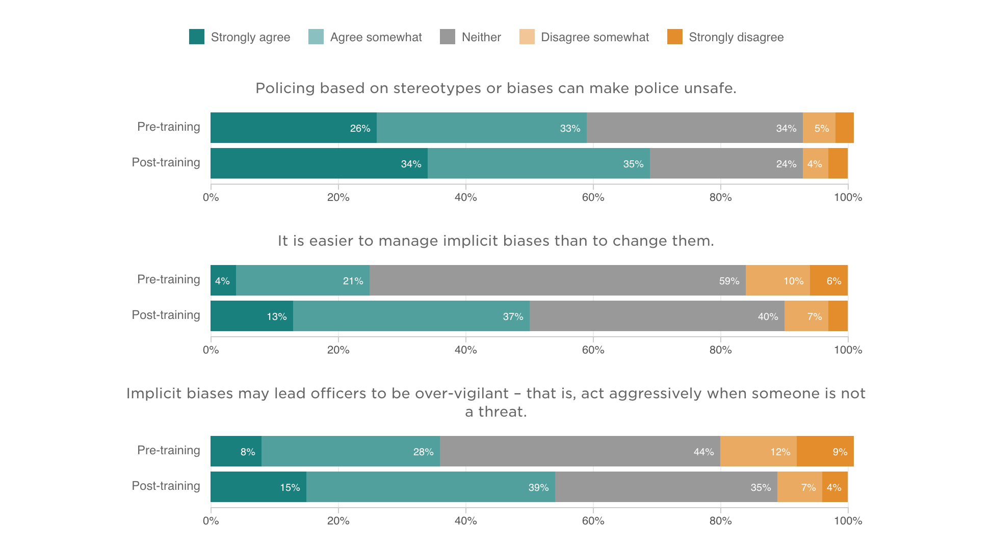
Accountability IN ai crime detection
Ella Dunne
The implications of "race neutral" [11] [16]
  2016 Survey: "not a proxy for race"
  2013: Systemic bias rather than algorithms
Correcting and understanding the data [12]
  “It’s not the algorithm that’s to blame, it’s the data"[13]
"recognize that the application of these tools and their subsequent decisions affect peoples’ lives" [5] [14]
[15]
Notes:
A simple assumption to make when talking about bias, in this case racial bias, is to simply ignore it.
A 2016 COMPAS study discredited the idea of racial bias in the algorithm because criminal history is "not a proxy for race". A 2013 study opted to blame the disparities on the systemic bias rather than the algorithms. However, these arguments do not take away from bias, rather it simply shifts the responsibility to the law enforcement structure and institutional practices.
When we opt to ignore race, or shift blame, "Potential conduits of racial bias are thus ignored". And this paper goes on at length about this interaction.
These arguments for the shortcomings of race neutral approaches also highlight other potential sources of bias, such as economic.
However, it should be highlighted that this paper was not written with the intent of discrediting AI technology, rather, the "focus has been on unravelling the adverse structural conditions enabling the creation of such tools, alongside the liberal ideology and standardization logics obscuring these structural conditions, legitimizing the technologies, and consequently fomenting the digital racialization of risk"
And this is why bias is such a prominent risk: It isn't a one and done. There is no simple fix for it, because there is no simple fix for bias. Going back to the first slide, having bias is natural to humans. But as seen by COMPAS and Gender Shades, if we want to use artificial intelligence in crime detection, prevention and prediction, it cannot be ignored. Shifting blame, or assuming non-proxy relationships allows it to go from a risk to a failure.
So how do we minimize it? Upon seeing the results of the Gender Shades study, IBM moved to using "different training data and different recognition capabilities" to increase their accuracy, reducing the error rate for darker skinned women to 3.46%, and the average error rate to 1.23%.
Taking accountability, and responsibility for bias is a crucial step to addressing the risk
The graphic on the right shows 3 comparisons, top versus bottom for each of these three concepts, of how bias training changed opinions and feelings of police officers on bias. It highlights that while we cannot erase the impact of bias, we can address it. The three things they were studied on were how training helps them recognize that
Policing based on stereotypes or biases can make police unsafe,
It is easier to manage implicit biases than to change them
And that implicit biases may lead officers to be over-vigilant
All three of these are great examples of how bias impacts law enforcement, and by extension law tools such as crime detection AI. Trainings, and assuming accountability for this bias helps improve it.
Quote [13]
And it also cannot be overstated how this risk has the ability to impact peoples lives
"You can’t have ethical A.I. that’s not inclusive"
Quote: Crime detection AI has the capability of changing peoples lives. For good and bad. Accountability does not negate bias. Accountability is simply the thing that allows us to recognize and improve it.
With such a large number of types of biases, and the capability of bias to enter crime detection AI at any stage of its lifecycle, and the constant need to hold our biases accountable, bias is the most prominent risk AI crime detection technology faces, and highlights what can go wrong if we don't hold ourselves and our technology accountable.

Slide 20
References
Ella Dunne
[1] "Understanding Bias: A Resource Guide" (U.S. Department of Justice Community Relations Service) https://www.justice.gov/file/1437326/download Accessed September 22, 2023
[2] "Why can't we ignore ethics in the making of AI?" (LinkedIn, April 24, 2023) https://www.linkedin.com/pulse/why-cant-we-ignore-ethics-making-ai-dubdub-ai Accessed September 22, 2023
[3] "Why avoiding bias is critical to AI success"(IBM) https://www.ibm.com/resources/guides/predict/trustworthy-ai/avoid-bias/ Accessed September 22, 2023
[4] https://www.iflexion.com/files/content/research/2_how_do_you_program_bias_into_a_machine_without_even_thinking_about_it.png Accessed September 23, 2023
[5] Mehrabi, Ninareh and Morstatter, Fred and Saxena, Nripsuta and Lerman, Kristina and Galstyan, Aram. "A Survey on Bias and Fairness in Machine Learning" (Association for Computing Machinery, July 2021) https://dl.acm.org/doi/pdf/10.1145/3457607 Accessed September 22, 2023
[6] "Gender Shades" (MIT Media Lab and Civic Media, 2018) http://gendershades.org/overview.html Accessed September 22, 2023
[7] Hao, Karen. "AI is sending people to jail—and getting it wrong" (MIT Technology Review, January 21, 2019) https://www.technologyreview.com/2019/01/21/137783/algorithms-criminal-justice-ai/ Accessed September 22, 2023
[8] Omowole, Agbolade. "Research shows AI is often biased. Here's how to make algorithms work for all of us" (World Economic Forum, July 19, 2021) https://www.weforum.org/agenda/2021/07/ai-machine-learning-bias-discrimination/ Accessed September 23, 2023

Slide 21
References
Ella Dunne
[9] Jeff Larson, Surya Mattu, Lauren Kirchner and Julia Angwin. "How We Analyzed the COMPAS Recidivism Algorithm" (ProPublica, May 23, 2016) https://www.propublica.org/article/how-we-analyzed-the-compas-recidivism-algorithm Accessed September 22, 2023
[10] Dressel, Julia and Farid, Henry. "The accuracy, fairness, and limits of predicting recidivism" (ScienceAdvances, January 17, 2018) https://www.science.org/doi/full/10.1126/sciadv.aao5580 Accessed September 22, 2023
[11] Ugwudike, Pamela. "Digital prediction technologies in the justice system: The implications of a ‘race-neutral’ agenda" (SageJournals, January 22, 2020) https://journals.sagepub.com/doi/abs/10.1177/1362480619896006?journalCode=tcra Accessed September 22, 2023
[12]"IBM Response to “Gender Shades: Intersectional Accuracy Disparities in Commercial Gender Classification”"(MIT Media Lab and Civic Media, 2018, January 2018) http://gendershades.org/docs/ibm.pdf Accessed September 22, 2023
[13] Martineau, Kim. "Debugging foundation models for bias" (IBM, November 28, 2022) https://research.ibm.com/blog/debugging-AI-bias Accessed September 22, 2023
[14] Lohr, Steve. "Facial Recognition Is Accurate, if You’re a White Guy" (The New York Times, February 9, 2018) https://www.nytimes.com/2018/02/09/technology/facial-recognition-race-artificial-intelligence.html Accessed September 22, 2023
[15] Robert E. Worden, Sarah J. McLean, Robin S. Engel, Hannah Cochran, Nicholas Corsaro, Danielle Reynolds, Cynthia J. Najdowski and Gabrielle T. Isaza. "The Impacts of Implicit Bias Awareness Training in the NYPD." (IACP/UC Center for Police Research and Policy & John F. Finn Institute for Public Safety, 2020) https://www.npr.org/2020/09/10/909380525/nypd-study-implicit-bias-training-changes-minds-not-necessarily-behavior Accessed September 23, 2023
[16] Skeem, Jennifer L and Lowenkamp, Christopher. "Risk, Race, & Recidivism: Predictive Bias and Disparate Impact" (SSRN, June 14, 2016) https://papers.ssrn.com/sol3/papers.cfm?abstract_id=2687339 Accessed September 24, 2023

Slide 22
Unfinished, But Monetized
Alexander Zhang
Notes:
Hello, my name is Alex.
Today I want to talk about unfinished games
Specifically, I want to spotlight the rising practice of releasing games that are incomplete at full price
This happens because, companies only care about their bottom line and have learned that they can succeed with these unfinished games.
Consumers are unhappy with this practice; but they still buy the games and trend isn’t changing.

Slide 23
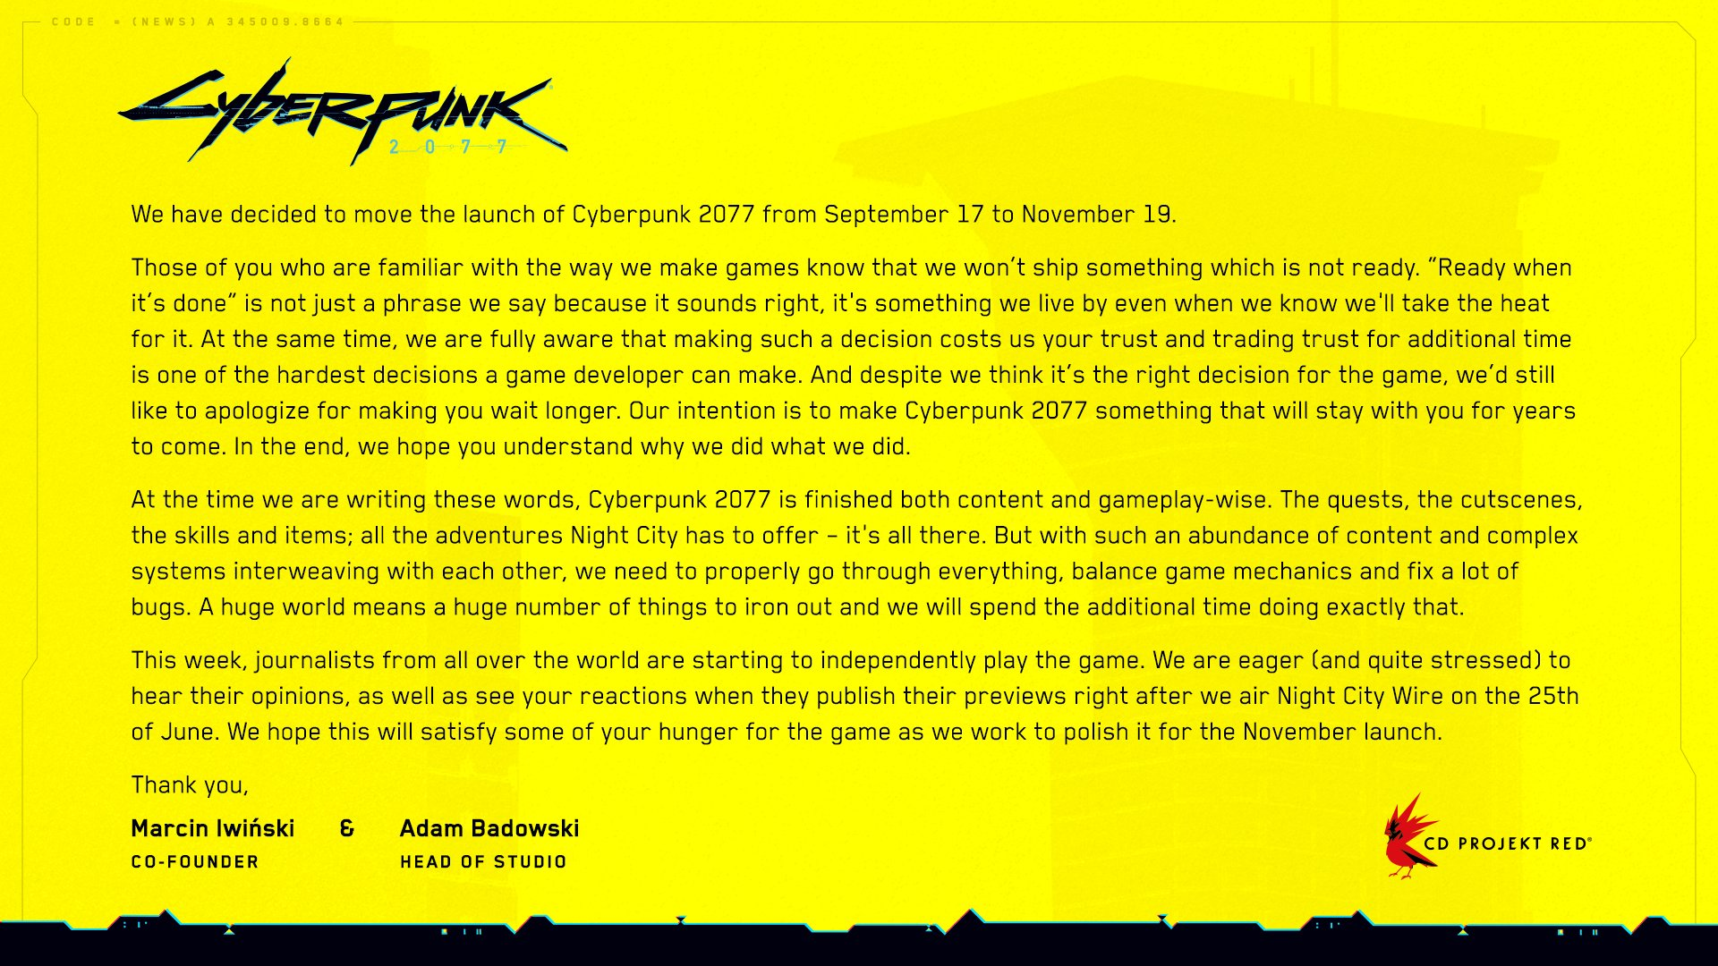
Released Unfinished
Alexander Zhang
Cyberpunk Apology [2]
No Man’s Sky (2016)
Mass Effect Andromeda (2017)
Fallout 76 (2018)
Anthem (2019)
Cyberpunk 2077 (2020)
FNAF: Security Breach (2021)
Battlefield 2042 (2021)
STAR WARS Jedi: Survivor (2023)
PAYDAY 3 (2023)
Notes:
To begin with I want to give a few examples and talk about a few specific games.
The first game that ignited the era of unfinished games is No Man’s Sky. This game touted itself as an amazing new experience with a procedurally generated world with millions of different planets.
It also made many promises like, multiplayer, space battles, interesting crafting/unique periodic table, and no skyboxes (you can leave a planet manually) [4][5].
Unfortunately, it failed to deliver. There was a ridiculous number of bugs and the features I just mentioned + many more were missing [4][5]. In the month it was released, less than 50% of the review were positive [6].
To give context, in my experience a decent/average game has 70% positive reviews, and great games can achieve 90% to 98%
Fallout 76 may be the worst example of this general issue in all of gaming history. It had some of the greatest hype following Bethesda’s previous titles in addition to their new promises.
Then it proceeded to fail all the promises and fall into some of the worst practices in the industry, including false banning players and online only (2 things which aren’t even related to this talk).
I will go further in depth on Fallout 76 in each of following slides because each issue applies to the game.
Cyberpunk 2077 is special because their developers, CD Projekt Red, had a particularly good reputation after huge successes such as the well renowned, The Witcher 3 in 2016.
Furthermore, work on the game began in 2012, so the game was in development for 8 years [28].
As a result, there was a lot of trust place in the company. When the game released in 2020, people were very unpleasantly surprised.
It had major problems with performance, and like many of the previous games, lacked the functionality promised.
Other than that, I want to mention PAYDAY 3 because it came out 5 days ago. I know a lot of people including my friends were really hyped for this game.
Unfortunately, the reviews are already only 33% positive, with 20 thousand plus reviews [7].
Now that we have the context… let’s look at some of the specific problems.

Slide 24
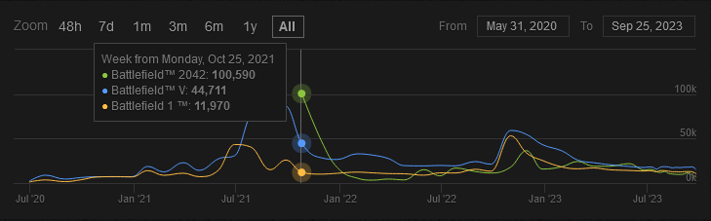
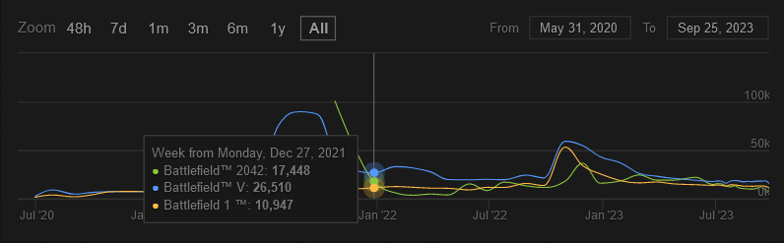
Hard Release dates
Alexander Zhang
Hard deadline for Nov 12, 2021 [29]
May have cost $2 billion [30]
Initially 100k concurrent players [26]
Fallout 76 deadline for Nov 14, 2018 [34]
Battlefield 2042 vs Battlefield V vs Battlefield 1
Concurrent Players [26]
Notes:
So why are there so many games being released unfinished?
Because the projects become too massive and bloated, and the deadlines are set in stone.
Battlefield 2042 had a beta, where they learned the game wasn’t ready. Instead of setting the release date back. The company forged ahead with their early access release date of Nov 12th [29].
So, when the game released, the issues that were waved off as problems exclusive to the beta made the game not fun and unplayable for some.
If you look at the graph, the latest Battlefield starts out at having the highest concurrent players. But as the day one rush ends, the previous game Battlefield V, and even the game before that Battlefield 1 beat it out.
But the damage was done, and people had already spent their money on the games.
Fallout 76 was no different when it released. The date was hard set for Nov 14 and the beta “stress test” changed nothing [34]. Instead, the company just overworked their staff until very last minute expecting the developers to magically finish the game in time [35].
So, the inflexibility of their release dates led to games that were unfinished, but they still made money.

Slide 25

Microtransactions
Alexander Zhang
Overwatch Battle/Season Pass [24]
Blizzard announced Overwatch PvE in 2019 [8]
PvE cancelled in 2023 [9]
Smaller paid PvE announced [10]
6 Battlepass Seasons in just 1 year [11]
10% positive on Steam with 190k people [12]
Fallout 76 charges $14 for a giant sign [13]
Notes:
With these unfinished games, deadlines are not the only issue holding them back. Sometime the focus is just on making money, instead of completing a product.
Overwatch 2 is a perfect example of this.
In 2019, Blizzard announced Overwatch 2, which would include a player vs environment game mode [8]. Specifically, there would be Story Missions which would be a co-op experience focused on a narrative and Hero Missions which would focus on replayability [8].
Unfortunately, Blizzard did not have the resources to complete these projects and canceled them in 2023 with a ‘heartfelt apology’ from the director [9].
Now why couldn’t they finish this? Because they had other priorities. One of the main ones being microtransactions – where they charge for in-game content.
In the year that Overwatch 2 had been released, there has been a total of 6 seasons.
These seasons are a way to break up the competition in the game into smaller segments. But more importantly for their bottom line, create a bi-monthly scheme to extract money from players as there are rewards exclusive to spending $10 for each season [11].
Furthermore, they reintroduced a smaller part of the PvE and made it a paid addition rather than a part of Overwatch 2 itself.
As before, I want to mention Fallout 76. Right after their terrible launch, before fixing any of the issues, they started offering cosmetic microtransactions like a Santa clause set for $20.
All of this is important because companies are learning what they can get away with.
Instead of making a good game that people will come to because it’s reputation, just milk the users who will come either way.
If there is time:
Recently, Overwatch 2 has decided to become available on Steam, where users could easily voice their opinions. As result, Overwatch 2 currently has 10% positive reviews on steam with 190k reviewers.

Slide 26


Preordering
Alexander Zhang
Nylon Bag [22]
Canvas Bag [23]
Cyberpunk 2077 had 8 million pre-orders [18]
Worth over $500 million [18]
Microsoft offered full refunds [19]
Fallout 76 canvas bag controversy [20]
Notes:
One could say that the root of these issues is preordering.
Cyberpunk 2077, as I discussed earlier, had a lot of trust going for it. As a result, the game had more than 8 million pre-order worldwide, the equivalent of $500 million in revenue [18].
To put that in perspective, the highest ever day one sales is GTAV with $800 million. And that also included the non-preorder sales during the first day [18].
Unfortunately, Cyberpunk 2077 did not live up to hype. People were so upset, that in a PR move, Microsoft offered full refunds on their digital stores [19].
But for most games and on other platforms, those pre-orders are committed.
The $60+ that people spent on a game is gone, added to the wallets of companies that learn:
“We can do this again.”
Fallout 76 scammed people out of $200 for their “Power Armor Edition.” [20] The people who purchased this extremely expensive edition were supposed to receive a canvas bag as part of the package. Instead, they received a cheap and crappy nylon bag [20]. After 7 months, the complaints about the bag finally got the company to actually make and send canvas bags [20]. Though even these did not send until the year after [20].

Slide 27
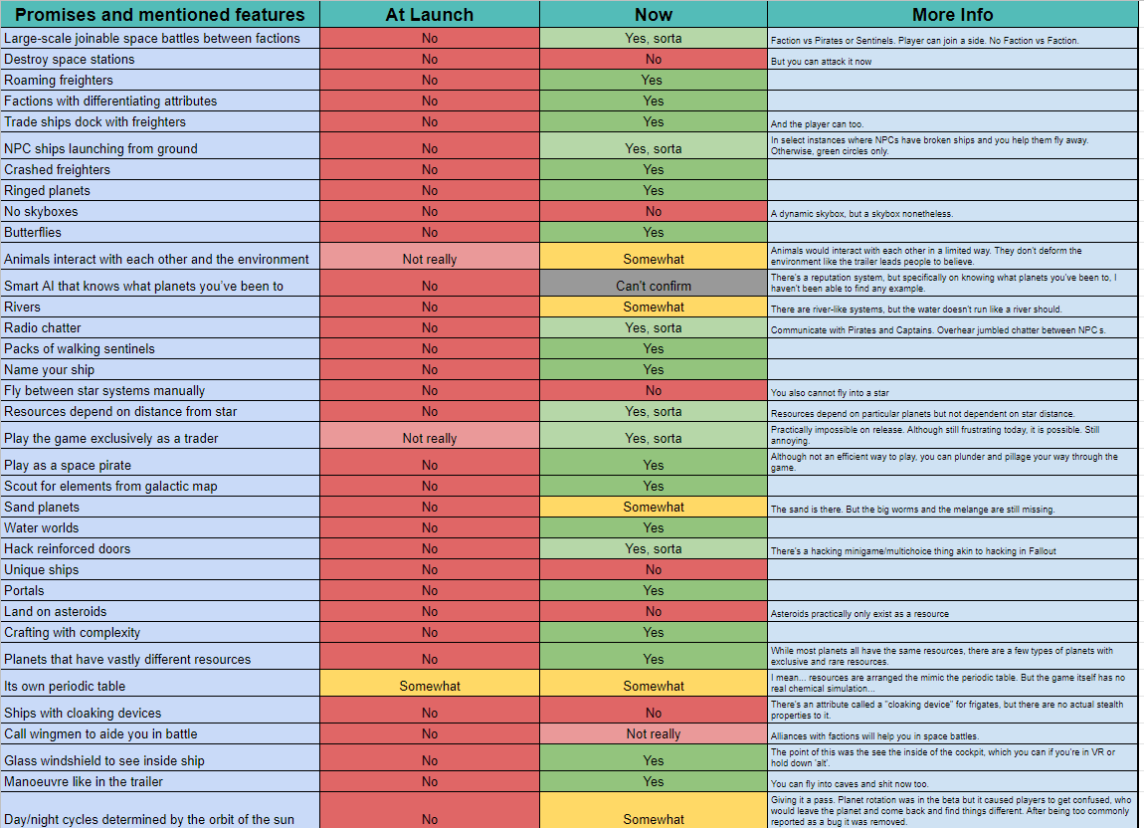
The Good
Alexander Zhang
Hollow Knight / Silksong
Cuphead
Elden Ring
Baldur’s Gate 3
No Man’s Sky?
Notes:
Now let’s briefly talk about some good examples of games.
Hollow Knight is one of my favorite games and has developed a sort of cult following. As a result, the sequel Silksong is highly anticipated. The game began development in 2019, and there have been a few events that point to potential release dates [31]. For example, an Xbox trailer that said all games shown would be available within 12 months [32]. But that date has come and passed. And while there is some disappointment among fans, to my understanding people generally feel that the quality will be worth the wait.
To give a more concrete example, take Cuphead. Cuphead took 5 years to complete [25].
Initially they planned to release in 2014 [25]. Then it turned into 2015, and 2016 [25]. Finally, it was released in 2017 [21].
Delayed 3 years from total, with 3 separate year-long delays. A reasonable intuition would be that with such delays, people would be pretty upset the game and not buy it.
On the contrary, the game currently 96% positive on steam [25] and even won 2 steam awards for 2017 [33].
People are willing to wait for high quality games.
One last modern example, Baldur’s Gate was initially announced in 2019 [16]. They planned to release the game in 2022, but when they realized it wasn’t ready, they moved their expected time a year later [15].
As a result, Baldur’s Gate released as a finished game, and now has a 95% positive rating on Steam [14]. Even the deluxe DLC has a 96% positive rating [17].
Because people are happy to spend money on games that are worth it.
Finally, it’s worth talking about the change in No Man’s Sky. We started with it as the game that began this epidemic of unfinished games, and we should end with it as the game can find redemption.
The developers for No Man’s Sky did not run off with the money they earned from the hype of the game. Instead, they off all the hate mail from the outside world and got to work [5]. In 4 years, they tolled away to implement everything they promised, as shown in the chart, as well as much more that’s been omitted for space/visibility reasons [5]. During that time almost no one supported them, but they also showed that games can be finished with time and effort.

Slide 28
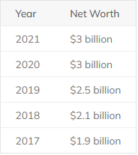
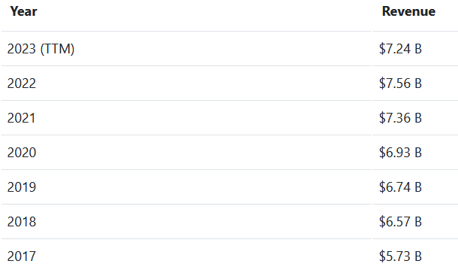
Conclusion
Alexander Zhang
Bad behavior does NOT lead to negative financial impact
Bethesda (Fallout 76)
Net Worth [36]
Bandai Namco (Elden Ring)
Revenue [37]
Elden Ring
Fallout 76
Notes:
In an ideal world, one would expect that a company that makes good games will have more financial success.
Unfortunately, that is not necessarily the case:
Take Bethesda, the company that made Fallout 76. Their net worth trend hasn’t changed a bit after they made Fallout 76 [36].
Bandai Namco’s revenue, the company that made Elden Ring, has also stayed on the same trend [37].
Unfortunately, it doesn’t matter to companies if they make good or bad games, because they make money regardless.
Might be worth mentioning, if there is time:
There are only 2 ways to change bad behavior:
By market force
Regulation
Market force hasn’t worked out, but regulation may have its own issues.
Appeal to consumers
Even games whose trailer looks incredibly promising, do not need to be pre-ordered. That game will still be there* in a few months or years.
And when the dust has settled, and the game is either good or has been fixed, that’s when it should be bought. There are many great games out there whose polish has been finished.
Our wallets speaks volumes, and we should be telling companies that a rushed product won’t succeed while a truly polished game will thrive.
*There are a few very rare exceptions to this like games who do so badly that they shut off their game servers.

Slide 29
References
Alexander Zhang
[1] Jason Schreier, How BioWare’s Anthem Went Wrong (04/02/2019), https://kotaku.com/how-biowares-anthem-went-wrong-1833731964 (09/23/2023)
[2] Cyberpunk 2077 Twitter, An important development update (06/18/2020) https://twitter.com/CyberpunkGame/status/1273647385294626816 (09/23/2023)
[3] Brendan Cladwell, The Broken Promise Of No Man’s Sky And Why It Matters (08/17/2016), https://www.rockpapershotgun.com/broken-promises-of-no-mans-sky (09/23/2023)
[4] Crowbcat, New disappointment discovered : No Man’s Sky (2016) (08/16/2016), https://www.youtube.com/watch?v=A8P2CZg3sJQ (09/23/2023)
[5] Internet Historian, The Engoodening of No Man’s Sky (01/08/2020), https://www.youtube.com/watch?v=O5BJVO3PDeQ (09/23/2023)
[6] Steam Store, No Man’s Sky (08/12/2016), https://store.steampowered.com/app/275850/No_Mans_Sky/ (09/23/2023)
[7] Steam Store, PAYDAY 3 (09/21/2023), https://store.steampowered.com/app/1272080/PAYDAY_3/ (09/25/2023)
[8] Aaron Keller, Director’s Take – Reflecting on the Future of Overwatch 2 (05/19/2023), https://overwatch.blizzard.com/en-us/news/23952480/ (09/23/2023)
[9] Blizzard Entertainment, Introducing Our Most Exciting Season Yet… Overwatch 2: Invasion (06/12/2023), https://overwatch.blizzard.com/en-us/news/23964186/ (09/23/2023)
[10] Bryn Gelbart, Overwatch 2: Everything Revealed at BlizzCon 2019 (11/02/2019), https://gamerant.com/overwatch-2-pve-pvp-hero-maps-sojourn/ (09/23/2023)
[11] Jerome Heath et al., The start and end dates for all Overwatch 2 seasons (07/26/2023), https://dotesports.com/overwatch/news/start-end-dates-all-overwatch-2-seasons (09/25/2023)
[12] Steam Store, Overwatch 2 (08/10/2023), https://store.steampowered.com/app/2357570/Overwatch_2/ (09/25/2023)
[13] Wesley yin-Poole, Fallout 76 players say the Atom shop prices are getting out of hand (12/17/2018), https://www.eurogamer.net/fallout-76-players-say-the-atom-shop-prices-are-getting-out-of-hand (09/23/2023)

Slide 30
References
Alexander Zhang
[14] Steam Store, Baldur’s Gate 3 (08/03/2023), https://store.steampowered.com/app/2357570/Overwatch_2/ (09/25/2023)
[15] Jody Macgregor, Bladur’s Gate 3: release date, classes, and everything else we know (08/18/2023), https://www.pcgamer.com/baldurs-gate-3-everything-we-know/ (09/23/2023)
[16] Jordan Ramee, Balduer’s Gate 3 Announced, Coming From Divinity: Original Sin Studio (06/10/2019), https://www.gamespot.com/articles/baldurs-gate-3-announced-coming-from-divinity-orig/1100-6467362/ (09/23/2023)
[17] Steam Store, Baldur’s Gate 3 – Digital Deluxe Edition DLC (08/03/2023), https://store.steampowered.com/app/2378500/Baldurs_Gate_3__Digital_Deluxe_Edition_DLC/ (09/23/2023)
[18] Hirun Cryer, Cyberpunk 2077 pre-order went over 8 million worldwide (12/10/2020), https://www.gamesradar.com/cyberpunk-2077-pre-orders-went-over-8-million-worldwide-cd-projekt-reveals/ (09/23/2023)
[19] Tom Warren, Microsoft offers Cyberpunk 2077 refunds for all digital sales, but it’s not pulling the game (10/18/2020), https://www.theverge.com/2020/12/18/22189059/microsoft-cyberpunk-2077-refunds-xbox-microsoft-store (09/23/2023)
[20] Dustin Bailey, Seven months later, Fallout 76’s canvas bags are finally in players’ hands (06/14/2019), https://www.pcgamesn.com/fallout-76/canvas-bag-replacement (09/23/2023)
[21] Sandeep Bhandari, How Long Did It Take to Make Cuphead (And Why) (10/02/2022), https://exactlyhowlong.com/how-long-did-it-take-to-make-cuphead-and-why (09/23/2023)
[22] Cynical Designer on Twitter, (11/15/2018), https://twitter.com/cynicdesignco/status/1063247880054435841 (09/23/2023)
[23] Jordan Stapleton on Twitter, (06/14/2019), https://twitter.com/GTAJJ_/status/1139534228532736001 (09/23/2023)
[24] Echo Apsey, Overwatch 2 battle pass – how it works, tiers, rewards (10/2022), https://www.theloadout.com/overwatch-2/battle-pass (09/23/2023)
[25] Steam Store, Cuphead (09/29/2017), https://store.steampowered.com/app/268910/Cuphead/ (09/23/2023)

Slide 31
References
Alexander Zhang
[26] Steam Charts, Comparison (09/25/2023), https://steamcharts.com/cmp/1517290,1238840#All (09/25/2023)
[27] Zarmena Khan, Baldur’s Gate 3 Causing Some Devs to Worry About Fan Expectations, Larian Responds (08/11/2023), https://www.playstationlifestyle.net/2023/08/11/baldurs-gate-3-worrying-other-devs-high-bar/ (09/23/2023)
[28] Matt Cook, How long was Cyberpunk 2077 in development (11/14/2023), https://www.destructoid.com/how-long-was-cyberpunk-2077-in-development/ (09/23/2023)
[29] Christian Vaz, Battlefield 2042 release date, early access, and everything we know (10/22/2021), https://www.pcgamesn.com/battlefield-2042/release-date (09/23/2023)
[30] Chris Barnewall, A Reporter’s Leak About ‘Battlefield 2042’ May Have Cost EA $2 Billion And Gamers Are Stunned (09/16/2021), https://uproxx.com/edge/battlefield-2042-delay-ea-stock-crash-leak-reaction/ (09/23/2023)
[31] Marloes Valentina Stella, Hollow Knight Silksong release date speculation, gameplay and trailers (09/12/2023), https://www.pcgamesn.com/hollow-knight-silksong/release-date (09/23/2023)
[32] Xbox, Hollow knight: Silksong – Xbox Game Pass Reveal Trailer – Xbox & Bethesda Games Showcase 2022 (06/12/2022), https://youtu.be/JSfuFlhsxZY?si=g2_tD3MQhkrY9Ck0 (09/23/2023)
[33] Steam Awards 2017, The Winners (01/04/2018), https://store.steampowered.com/steamawards/2017 (09/23/2023)
[34] Jordan Forward, Fallout 76 release date and multiplayer news – all the latest details (11/12/2018), https://www.pcgamesn.com/fallout-76/fallout-76-release-date (09/23/2023)
[35] Dustin bailey, Report calls Fallout 76 a crunch “nightmare” that drained staff and pulled devs from Starfield and Redfall (10/10/2022), https://www.gamesradar.com/report-calls-fallout-76-a-crunch-nightmare-that-drained-staff-and-pulled-devs-from-starfield-and-redfall/ (09/23/2023)
[36] Jasmine, Bethesda Net Worth (05/31/2021), https://whatstheirnetworth.com/richest-businessmen/companies/bethesda-net-worth/ (09/23/2023)
[37] Companies Market Cap, Bandai Namco (09/26/2023), https://companiesmarketcap.com/bandai-namco/revenue/ (09/26/2023)

Slide 32
Class 9
The End
Keith A. Pray
socialimps.keithpray.net
Notes:
This is the end. Any slides beyond this point are for answering questions that may arise but not needed in the main talk. Some slides may also be unfinished and are not needed but kept just in case.

Slide 33
Reliability Of Statistics
Are other factors controlled?
Is enough time covered?
Is all data reported?
Use Intuition
  Are results reasonable?
Notes:
Power line dangers. Electromagnetic fields? PCBs in transformers?

Slide 34
Some Measures
Mean Time To Failure (MTTF)
Mean Time Between Failures (MTBF)
Mean Time To Repair (MTTR)
Notes:
Is it repairable?
What does it mean to repair? Running again? Data fixed? Caught up?
Restoring the GBC Web site.

Slide 35
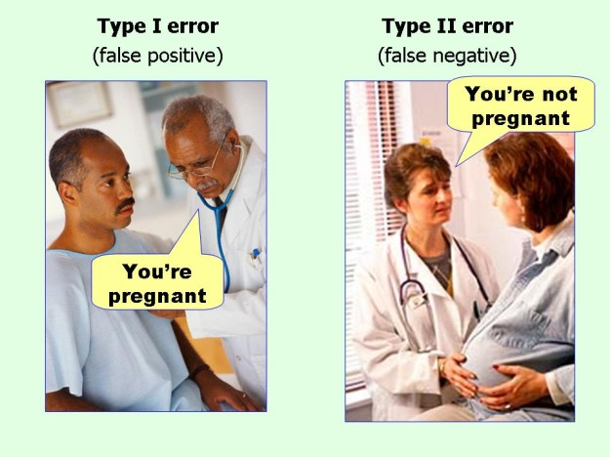
marginalrevolution.com/marginalrevolution/2014/05/type-i-and-type-ii-errors-simplified.html (2016-04-11)

Slide 36
My Reading Notes
pp. 383 Check Priv Gov Chapter for not requiring FBI to ensure accuracy of data entered into NCIC, before March 2003?
pp. 384 Implementation cost not considered. Argument assumes DB cannot exist w/out existing inaccuracies.
pp. 387 Real-time system explanation misses known execution time
pp. 388 PATRIOT needs track to shoot, not prevent false alarm.
pp. 389 Asset assumptions in code and/or tests.
UPDATE
pp. 366 Any false arrests since 1989?
pp. 375 Always encapsulate units! Not clear if SW involved.
pp. 376 Any SW diffs between Mars Missions?
pp. 378 Why did the Tokyo Stock Exchange refuse?
pp. 380 Republicans and Florida?
pp. 381. Do the second thoughts on DRE machines make the interview at end Chapter’s end less relevant?
pp. 389 No simulation examples since 2002?
pp. 390 Did The Limits to Growth predictions motivate people to change?
pp. 392 What happened to Verification?
pp. 394 “satisfies the specification” = verification. “needs of the user” = validation.
pp. 395 SW quality since 2009?
pp. 396 Gender bias nice addition!
pp. 406 21, source from 2004, is it implemented yet? 23 like game release question in next chapter.
Questions I liked: 10, 12, 16, 17, 18, 20, 21
Notes:
TODO: Update for 8th edition

Slide 37
what works well Online With Zoom
Sign in with First and Last Name
Stay muted unless you are going to speak
To speak use the raise your hand feature
To answer yes/no questions use the “yes” ”no” buttons
Turn your camera on
Wait until the end of student presentations to ask questions
  Write them down so you don’t forget

