Slide 1
Class 6
Information Privacy
Keith A. Pray
socialimps.keithpray.net
Notes:
How is the self search paper going? Offer small group discussion instead of class wide.
Who: found a lot, very little, surprised, not surprised, creepy, share conclusions

Slide 2
Papers
Read assignment
  time lines missing
  space used describing history instead of providing argument
  conclusions did not answer prompt
Use template, saves time
Quantify
  Not terms like: less, more, a lot, huge, great, big, tiny, drastic, quicker, faster, easier, etc.
Avoid absolutes
  Terms like: all, none, always, never
  Difficult to prove, easy to show false
Cite as specified [1]
Read paper aloud to proof
http://socialimps.keithpray.net/assignments/paper-guidelines/
Notes:
Not needed this time:
Note ChatGPT Use not permitted.
Any logistic questions?
Save for next time:
Define terms
Quantify
Not terms like: less, more, a lot, huge, great, big, tiny, drastic, etc.
Avoid absolutes
Terms like: all, none, always, never
Difficult to prove, easy to show false
Read paper aloud to proof
Read directions, many time lines missing
Be sure to put quotes around entire quote
State a strong, clear conclusion
First statement preferred
Provide Counter Point and Rebuttal
Counter Point and Rebuttal should directly relate
Print 2 sided and save a tree
Hyperbole is the best thing ever!
but not in these papers
Be wary of counter point strawman fallacy
Text book is not a primary source
Use template, saves time
Beware of fallacies
Avoid blogs, encyclopedias, and text book. These are generally not primary and high quality sources.

Slide 3
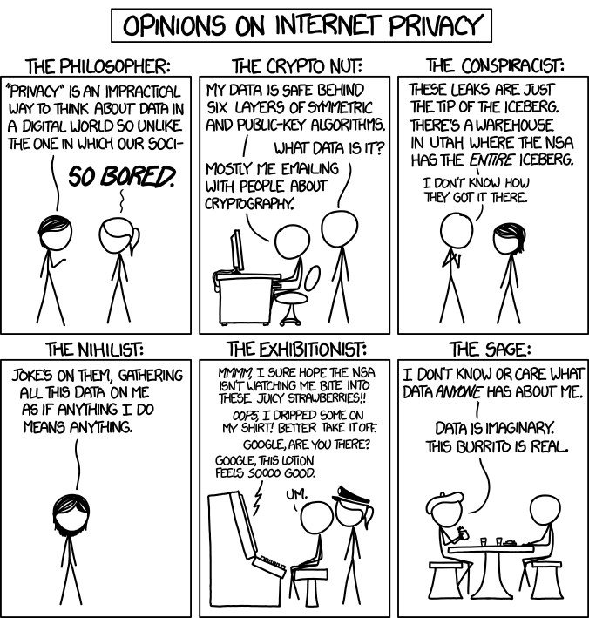

Overview
Review
Assignment
Students Present
http://xkcd.com/1269/
Notes:
1 – Accessed 2014-04-14
Everyone pick the category they identify most with.
Share reasons why.
Jimmy Kimmel Live – What is your password? (2:49)
https://www.youtube.com/watch?v=opRMrEfAIiI
Find out what your DNA says about you and your family.
https://www.23andme.com/
https://motherboard.vice.com/en_us/article/xwkaz3/23andme-sold-access-to-your-dna-library-to-big-pharma-but-you-can-opt-out?utm_source=vicefbus

Slide 4
My Reading Notes
pp. 234 Alexa calling unbeknown scary
pp. 235 How much do you use computer labs now?
pp. 236 Park example, videotape unlikely, Panopticon, businesswoman nice change
pp. 237 “moral capital” Book 1984 relationship == subversive act, ex-spouses just above enemies?
pp. 239 tech price down privacy invasion up?
pp. 240 Hilton consent to pic being in book?
pp. 242 How common are internet connected home surveillance systems?
pp. Do you expect privacy in others’ homes?
pp. 244 Many daycares monitor, any studies yet?
pp. 245 junk mailers not using info well
pp. 246 Anything come of EPIC Facebook Tag Suggestions complaint?
pp. 247 Loyalty programs changed in 20 years?
pp. 248 Clothing body scans common 20 years later?
pp. 249 How common implanted chips now, sources from 2002, 2004, 2007, 2010?
pp. 251 Any OnStar listening in events since? How much do auto black boxes record now?
pp. 252 Does Tivo’s ad skip weaken time shifting fair use? Browsers put cookies on hard drive, not Servers.
pp. 256 Target execs were not savvy before see pp. 308. 2012 source same year Target outed pregnant teen to parents.
pp. 257 500 mil more than US population
pp. 262 How many times has Zuckerberg been quoted saying “I know we can do better”?
pp. 263 Why did Apple not enforce policy of asking permission in the API?
pp. 265 10 hours > 1 page paper
Questions I liked: 30, 39
Notes:
Notes updated: 2023-04-04
OLD not incorporated yet:
pp. 229 means to end?
pp. 245 “…by 2015” did it happen?
pp. 250 why is bills – responsibility assumption flawed?

Slide 5
Assignment
Prepare for class debate:
National ban on facial recognition surveillance for law enforcement?
  Do background reading and decide “Yes” or “No”
  Come prepared with notes, facts, dates, high quality sources
  Optional One Page Paper on the topic, lowest paper grade will be dropped
Notes:
Morgan Lee write up 2021-09-13:
“Facial recognition technology has begun to see widespread adoption in modern law enforcement, with applications in physical & digital security, as well as identifying potential suspects. Critics of the technology argue that passive facial recognition technology violates privacy rights of individuals, while its proponents emphasize its positive uses in preventing and detecting crime. There are currently 12 state-level bills which propose limits or bans on the use of facial recognition technologies by government agencies, with several local bans (including ones in Boston, Brookline, and Cambridge) already in place. Should the United States implement a national ban on the use of facial recognition technology by law enforcement?”
Previous Debates:
Should law require you to use an official ID for Internet access?
Is a National ID System a good thing?

Slide 6
Overview
Review
Assignment
Students Present

Slide 7
Payment Card Industry and You
Myles Ku
Notes:
Goals:
By the end of the talk, I hope to
-give you a brief overview of PCI compliance
-explain its relevance to you as a developer
-talk about ways to make PCI compliance as painless as possible

Slide 8
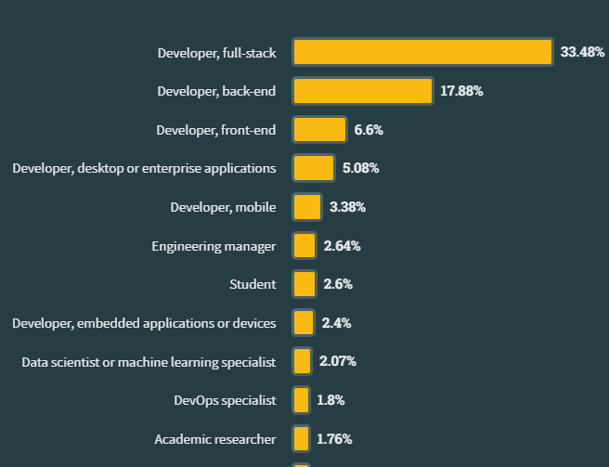
Why should you care?
Myles Ku
Ecommerce is on the rise!
  Grew from 8% of total sales in 2016 to 15.4% in 2023 . [1]
So is web/mobile development
Encompasses the entire stack
  Frontend: PAN masking
  Backend: Encryption
<Graphic as big as will fit>
[2]
Notes:
So why should you care?
- A greater percentage of our payments are becoming digital.
-COVID could account for this – all time high 16.5% market share in 2020 and has grown from 8% to 15.4% from 2016.
-Incredibly convenient for the consumer making it a great way to monetize a website
-Web/ mobile development is on the rise
-Figure from stack overflow developer survey – roughly 60-65% of developers are building websites or mobile applications.
-A decent percentage of you (cs majors) will end up in roles that will have to deal with payment systems
-With that being said, payment systems requires consideration on all layers of the stack, for example:
-On one end of the spectrum, UX has to worry about masking PAN (primary account number) when being typed
-On the other, backend has to encrypt cardholder data

Slide 9
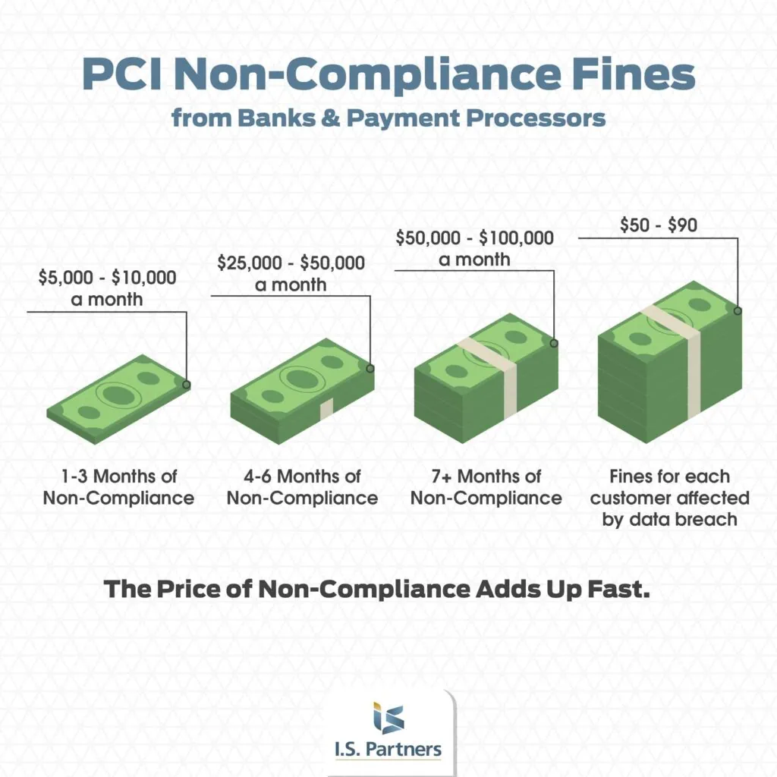
PCI non-compliance is costly
Myles Ku
A security standard [3]
Non-compliance has consequences:
  Depends on which company you are contracted with
  Monthly fines ($5k - $100k)
  Per-incident penalty (up to $500k)
  Other fees (you are held liable for breaches) [14]
  The average data breach in 2023 cost around 4.45 million [12]
[4]
Notes:
In addition to this, being non compliant is very costly!
-Pci compliance is a security standard CREATED BY CREDIT CARD COMPANIES (not government) for building payment systems
-This is important because it is not required by law,
-HOWEVER you are entering a contractual relationship with these companies by building a payment system, and are subject to terms of this contract. The contract can vary between vendors, but generally there are:
-Monthly fees can be up to ($5k-$100k) depending on size and severity
-Flat fees per data breach or incident
-Every time an incident occurs, you will pay for the cleanup
-Legal fees
-Reissuing fees
-Even postage costs to notify customers
All in all, the average data breach cost an average of 4.45 million in 2023. This will obviously depend on your size of business, but even for larger businesses this can be a lot.

Slide 10
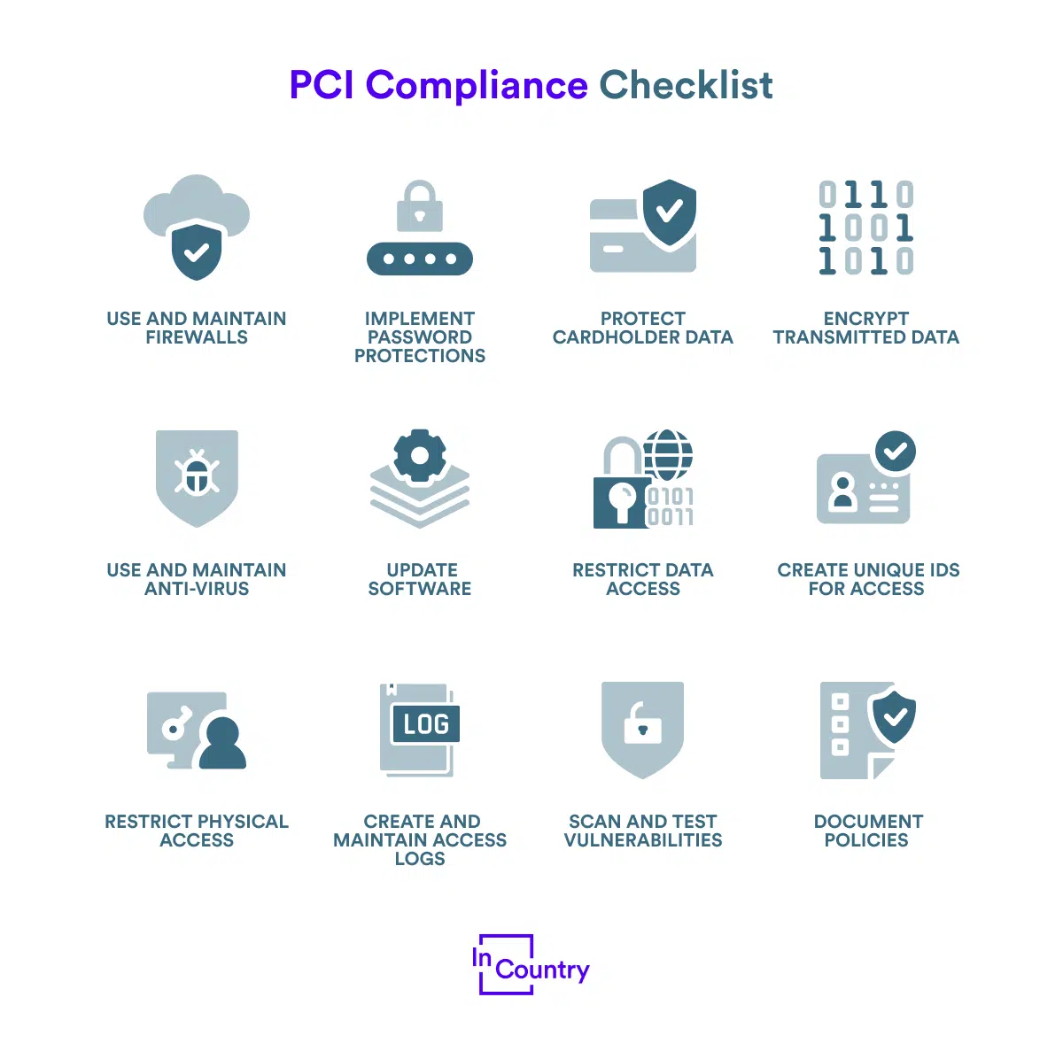
PCI COMPLIANCE IS COSTLY
Myles Ku
ASV scans ($100-200) per IP
SAQ costs ($50-200)
Training employees ($70/ per) [5]
TIME
  Hard to see profit incentive
  Can take an average of a month to become compliant [13]
<Graphic as big as will fit>
[6]
Notes:
On the flipside, being compliant can be very costly.
-ASV (Approved Scanning Vendor) start at around $100-200 per IP
-SAQ (Self Assessment Questionnaire) has fees associated with validation and there are NINE different questionnaires – you need to figure out which one applies to you
-Employee training
-The biggest cost, however, is time.
-PCI compliance requires massive infrastructure changes on all parts of the stack.
-This means a lot of refactoring in most cases
-In general being more secure means spending more – otherwise every company would be compliant.

Slide 11
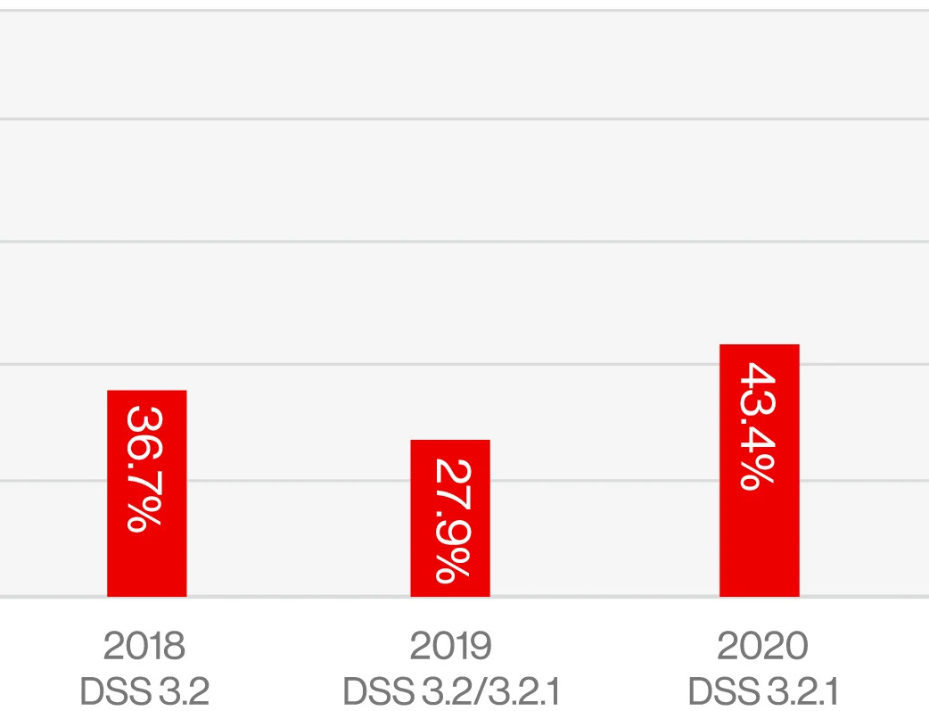
The Dilemma
Myles Ku
% of companies compliant
On one hand...
  Moral/ethical obligation to consumer
  Social contract obligation to company
  Protection in the event of breaches
On the other
  Being fully compliant is very difficult
  It can be easier to just ride fees.
  Roughly 2/3 companies are non-compliant.
<Graphic as big as will fit>
[7]
Notes:
This tension between the costs of being compliant and being non-compliant creates a situation where it feels impossible to win.
-On one hand
-You have a responsibility to your customers to protect their personal data. This is not just credit card data, but information which could easily be used to commit identity theft.
-You also have a responsibility to the company since you entered a contract with them by using their services. You have an obligation to respect that contract.
-You are "insured" against breaches in that you won't be subject to massive fines and fees in the event of one. (Generally if you are PCI compliant breaches won't occur anyways).
-On the other
-Pragmatically speaking, PCI compliance can feel ridiculous sometimes.
-Imagine being in a start up and you haven't even started making money yet, but you have to implement complex security solutions.
-In this case, it may be easier to just pay a monthly fee which has led to roughly 2/3 companies being non compliant.

Slide 12

The Solution
Myles Ku
Stripe (DPaaS)
  Highly specialized
  Highly compliant (level 1)
  Handles a lot of the backend
    All 5 most common vulnerabilities are encryption related [13]
  Acts as intermediary between you and bank
  Can even handle frontend! (Checkout)
  Reduces paperwork [9]
[8]
Notes:
What’s the solution? It depends a lot on how much control you want to have and how much money you can spend, but in general:
-For most companies, the best option is to outsource payment processing to a service, AKA data protection as a service
-These services are highly specialized in this field and usually have the highest level of PCI compliance (this allows for high volume of processing)
-The most common vulnerabilities when it comes to compliance are encryption related. Stripe will take care of that, and handle all of the backend.
-In the case of stripe, it can also handle a lot of the frontend. Stripe has service called checkout which will even host the payment page for you so all you have to do is link it.
-Stripe will tell you exactly which paperwork you need to fill out and can even fill it out for you in most cases.

Slide 13
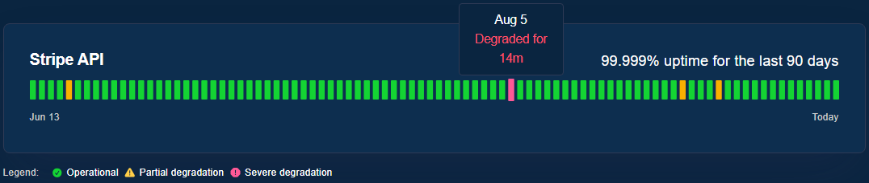
Stripe isn't perfect
Myles Ku
You are outsourcing a solution.
  Downtime
    Generally not a problem if you are a smaller business
    Unlikely you can build a better solution
  Lack of Control
    "Black box"
  Fees
[10]
Notes:
There are a few downsides to using services like Stripe, which is the same as any time you are outsourcing a solution.
-For one, you have to deal stripe's downtime.
-This is generally not a problem if you are a hobbyist or smaller business since these services generally have near 100% uptime
-It is also unlikely you will be able to build a better solution anyways (these services specialize in this, have teams of site reliability engineers, etc)
-You also lose a lot of control since you are essentially outsourcing the entire backend
-If you need a custom solution, you probably aren't looking to Stripe anyways
-The more control you want, the more compliance you have to own (E.G if you don't like Stripes checkout UI you have to build your own gateway)
-Fees

Slide 14

The Alternative
Myles Ku
Custom Solutions
  Usually reserved for very large companies
  Implemented by specialists
    GRC analysts
    FinTech developers
    Site reliability engineers
  Usually don't abandon Stripe completely (Amazon Pay)
[11]
Notes:
Some companies have decided that they can do some things Stripe does better.
-If you've reached this point you can probably afford to hire specialists that will take care of these problems for you (GRC analysts, FinTech developers, Site reliability engineers)
Even still, companies usually still outsource payment processing to some degree.
-Amazon Pay used to do its own payment processing, but encountered difficulties when dealing with global payments
-Made a deal with Stripe to create a solution

Slide 15
In summary
Myles Ku
Being non-compliant is risky and irresponsible.
Know how much of PCI compliance you are prepared to be responsible for.
Outsource whatever you don't
Notes:
In summary, if there are three things I want you to take away from this it is:
1. Being non compliant, while it may be practical for the short term, is not sustainable nor ethical.
2. You should now the scope of what you want to handle in terms of pci compliance
3. Whatever you don't/can't handle, outsource

Slide 16
References
Myles Ku
[1] Quarterly Retail E-Commerce Sales, (US Department of Commerce, August 17, 2023), https://www.census.gov/retail/mrts/www/data/pdf/ec_current.pdf (September 10, 2023)
[2] Stack Overflow Developer Survey 2023, (Stack Overflow, May 2023), https://survey.stackoverflow.co/2023/#developer-profile-developer-roles (September 10, 2023)
[3] Kurt Woock, What Is PCI Compliance? A Guide for Small-Business Owners, (NerdWallet, Oct 18, 2022), https://www.nerdwallet.com/article/small-business/pci-compliance (September 10, 2023)
[4] Mike Mariano, PCI Non Compliance Fines from Banks & Payment Processors, (I.S. Partners, August 11, 2022), https://www.ispartnersllc.com/blog/pci-non-compliance-fines-consequences/ (September 10, 2023)
[5] Gary Glover, How Much Does PCI Compliance Cost?, (Security Metrics), https://www.securitymetrics.com/blog/how-much-does-pci-compliance-cost (September 10, 2023)
[6] PCI Compliance Checklist – Are You Compliant?, (InCountry, October 13, 2021), https://incountry.com/blog/2021-pci-compliance-checklist-are-you-compliant/ (September 10, 2023)
[7] The state of compliance, (Verizon, 2022), https://www.verizon.com/business/reports/payment-security-report/2022/the-state-of-pci-dss-compliance/ (September 10, 2023)
[8] We built checkout so you don't have to, (Stripe), https://stripe.com/en-ca/payments/checkout (September 10, 2023)
[9] Mike Dahn, A guide to PCI compliance, (Stripe), https://stripe.com/guides/pci-compliance (September 10, 2023)
[10] Stripe system status, (Stripe), https://status.stripe.com/ (September 10, 2023)
[11] Alex Clere, Amazon and Stripe double down on their payments partnership, (FinTech, January 24, 2023) https://fintechmagazine.com/articles/amazon-and-stripe-double-down-on-their-payments-partnership (September 10, 2023)
[12] Cost of Data Breach Report 2023, (IBM, 2023), https://www.ibm.com/reports/data-breach (September 11, 2023)
[13] 2022 PCI Compliance Trends, (SecurityMetrics, 2022), https://www.securitymetrics.com/learn/pci-compliance-trends (September 11, 2023)
[14] PCI-DSS: Security – Penalties, (UC Santa Cruz) https://financial.ucsc.edu/pages/security_penalties.aspx (September 11, 2023)

Slide 17
IS AR Watching You?
By: Ryan Offstein
Notes:
The privacy concerns around AR
(Question I am answering):
- Is AR a technology that is to be trusted when it comes to privacy?
- Do we have enough privacy regulations on ar
- is the public ready.

Slide 18

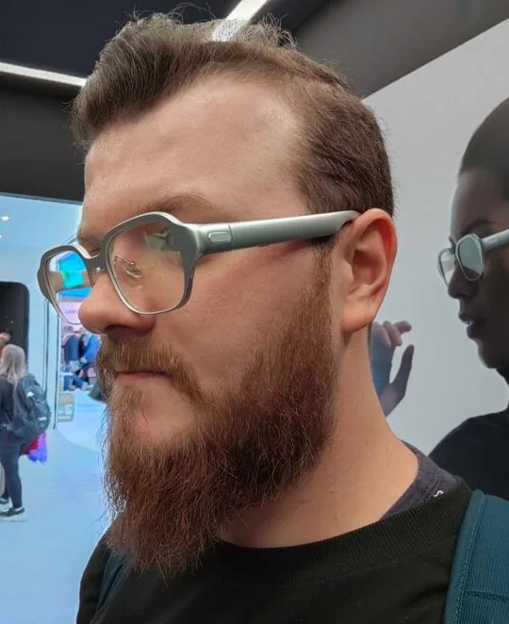
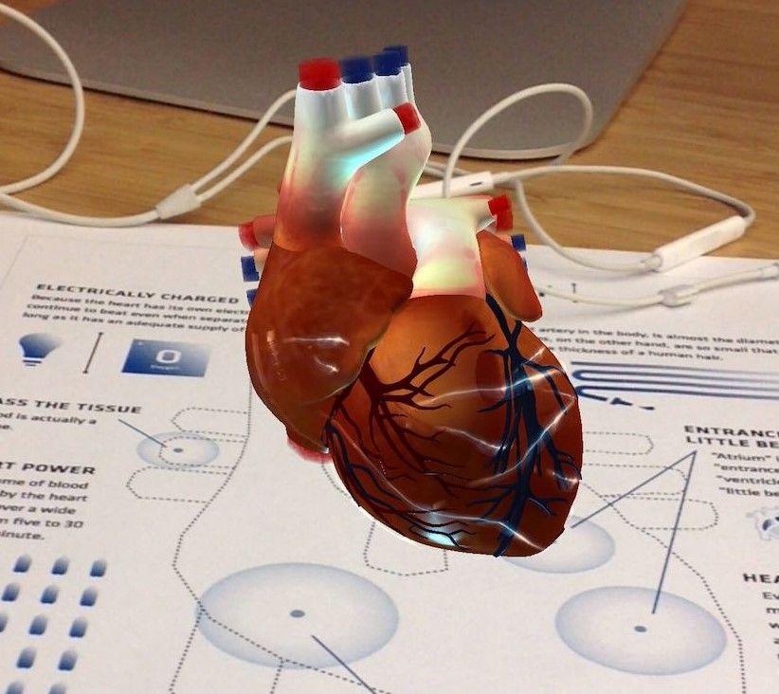
What is AR
Ryan Offstein
AR uses a “headset” similar to VR
Uses in
Education [1]
Personal/Homes
Medical/Surgery [2]
Industrial/Construction [3]
Cars/Driving [4]
And more!
Notes:
Just a quick note.
Presenting notes for Me
- VR and AR similarities and differences
- Uses for AR
- Limitless, transhumanism
AR is Like VR where you are wearing a headset and a picture is displayed for you, the only difference is that with VR you are only seeing a screen while AR Projects your world on top of what you see.
As big as clunky headset, to as small as weightless glasses
Used in Education for teaching, Home Planning like picturing furniture in a house, driving like heads up displays, medical uses such as surgeries, industrial work, the possibilities are limitless because you have the power to overlay information on top of someone vision, almost as an extension of one's own vision senses.
Image Sources:
- https://www.trustedreviews.com/opinion/the-oppo-air-glass-2-are-the-first-ar-glasses-i-could-see-myself-using-4305360
- https://www.pxfuel.com/en/search?q=reality
- https://www.healthysimulation.com/augmented-reality-in-medicine/
https://onlinelibrary.wiley.com/doi/full/10.1002/cae.22593 [1]
https://dl.acm.org/doi/abs/10.1145/1324892.1324915 [2]
https://dl.acm.org/doi/abs/10.1145/2994310.2994321 [3]

Slide 19
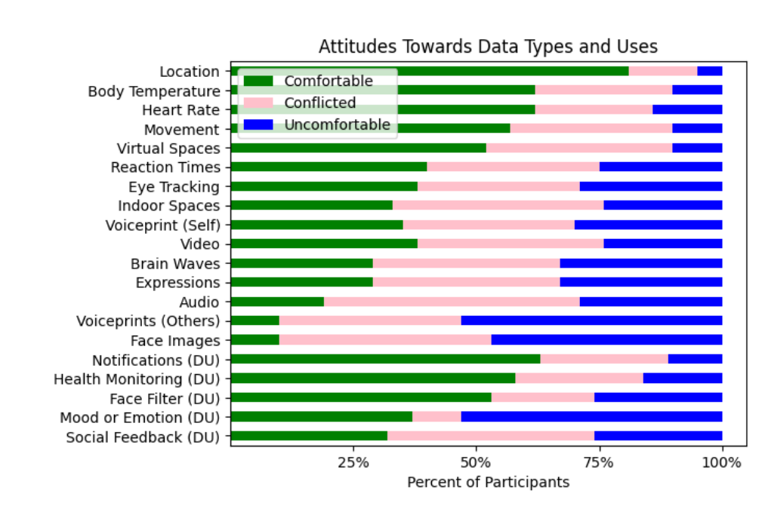
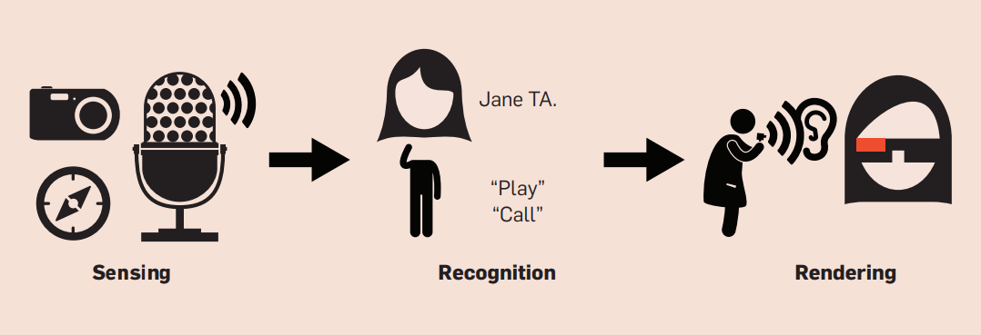
Potential Privacy and Security Risks
Ryan Offstein
Spying On Others [5][6]
Getting your data collected/stolen
Getting Hacked into [4]
Notes:
Trust, me. I’m a big fan of the technology. But doesn’t mean that we shouldn’t evaluate the privacy and security risks objectively
Presenting notes for Me
- Lots of data collected
- People uncomfortable with that collection
- Stigma around being recorded
- Easier to record
- Can record yourself as well
- Face
- Provide data to AI and the botnet/target adds
- Hacked. Even if safeguarded, it can be worked around.
- Or malicious attacks on working indiviudals
Spying On Others
One of the bigger concerns is that AR technology is being used to spy on others. That the cameras that allow the user to see the outside world are being used to. As shown by in many research studies (In my sources) conducting interviews on individuals this hardware has the potential to track many different types of data about the user, and the people around the user.
Phone in pocket
- This technology has the power to scan and take pictures inwards as well. The microphone can be used to record your conversations, and your face. This is a major privacy concern for you as that data could be personal, and not wanted to be released.
Data like location, video feeds, audio recordings, facial maps, info about your house and environment, all can be monitored, tracked and stored by anyone with this technology.
What makes a problem is the ease of data acquisition
This can potentially be done with or without the consent of the user. Just like many of our other devices.
Getting hacked into
- As the technology gets more and more integrated into our person, the hacking risks become more and more severe. If used and trusted in an educational, or medical, or driving, the information must be accurate. If it is not, it poses a risk to the user. [4]
The hacking into can also lead to more of personal data getting stolen and the technology being used for those negatives, even if we do our best to prevent them.
https://dl.acm.org/doi/pdf/10.1145/2580723.2580730 [4]
https://dl.acm.org/doi/abs/10.1145/2556288.2557352 [5]
Photo source
- [4] [6]

Slide 20
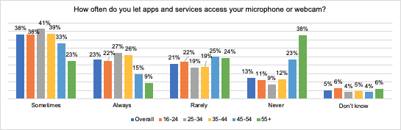
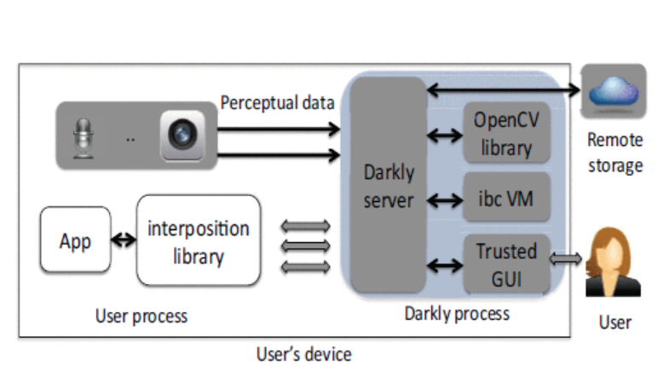
Counter Arguments
Ryan Offstein
Similar to other technologies [6]
Middle processing/censorship [7]
Hide/Disclose Camera
Mimic Technology Safeguards
Notes:
Presenting notes for Me
- Not as bad as it is because other tech already tracks us.
- One big statistic, is that around a quarter of people always let software access their webcam
- Privacy just a sacrifice as tech gets better and closer
- Sensors get in the middle to protect.
- Mimic things other tech does like ask for permission or have a recording light
- And more are still being developed
- Many people noted that it is similar to other forms of tracking that current devices use on us anyways. In similar veins, our phones, smartwatches and computers all have the ability to track our information, faces conversations, it just comes down to when public use is comfortable with it [6]
- There are also technologies that have the potential to get into the middle of the raw sensor data to allow for security and censorship of the private data not only for us but for the people around us. One paper proposed a created software that handles the raw input data before anything else and is able to provide levels and customizable privacy and censorship in the retrieval and storage of all the data collected by the hardware [7]. I think that once more technologies like this are available then this technology will become as privacy centered as any other on the market. [7]
- Other things can be done to mimic other technologies, such as having a light to indicate when recording is happening, or setting recording to off by default. Needless to day many similar have the potential to be adapted and expanded into the realm of AR as well.
If we can get more ideas and technologies for the protection of privacies, then then we don't need to worry about the development of this potentially revolutionary hardware.
https://petsymposium.org/2023/files/papers/issue4/popets-2023-0117.pdf [6]
https://ieeexplore.ieee.org/abstract/document/6547120 [7]

Slide 21
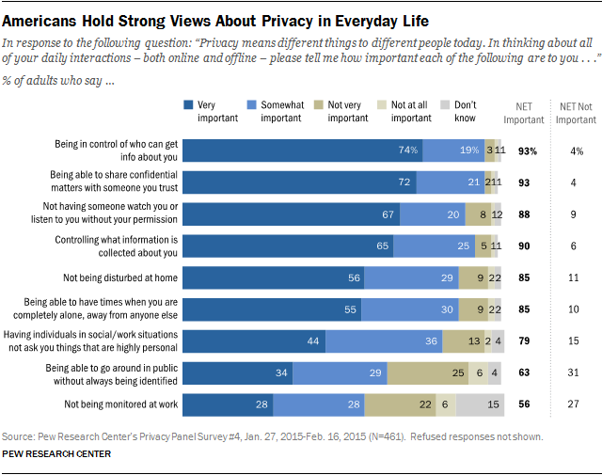
Conclusion
Ryan Offstein
Public appearance/lack of perceived privacy
Don’t want to halt the development
Time for public use not now but in the future [8]
Notes:
Presenting notes for Me
- Public stigma, not quite at the level
- We still care a lot about our privacy.
- With future innovations in the works that can definitely change.
- Development shouldn’t stop
- Tech becomes smaller and less “scary”
- Potential for so much good.
Because of the publics want for privacy and the stigma around anything like AR that appears to be a video recording. I don’t think we are at the level where we are ready to accept the privacy limitations of a hardware like this.
As with any piece of new technology in this era, a bounds of privacy is expected to be lost, but most of the privacy concerns can be mitigated.
That doesn’t mean that development needs to stop. If public tests are run, and opinions start to switch over, and greater security measures are put into place and made more knowledgeable to the common person. The public perception can turn positive.
This technology has the potential to be great and dangerous. As anything. And I think that soon it will be ready for the public.

Slide 22
References
Ryan Offstein
[1] Magdalena Garlinska, Magdalena Osial, Klaudia Proniewska, Agnieszka Pregowska, The Influence of Emerging Technologies on Distance Education, December 2022, https://onlinelibrary.wiley.com/doi/full/10.1002/cae.22593
[2] Susanna Nilsson, Björn Johansson, Authors Info & ClaimsFun and usable: augmented reality instructions in a hospital setting, November 2007, https://dl.acm.org/doi/abs/10.1145/1324892.1324915
[3] Susanna Aromaa, Iina Aaltonen, Eija Kaasinen, Joona Elo, Ilari Parkkinen, Use of wearable and augmented reality technologies in industrial maintenance work, October 2016, https://dl.acm.org/doi/abs/10.1145/2994310.2994321
[4] Franziska Roesner, Tadayoshi Kohno, David Molna, AR systems pose potential security concerns that should be addressed before the systems become widespread, April 2014, https://dl.acm.org/doi/pdf/10.1145/2580723.2580730
[5] Tamara Denning, Zakariya Dehlawi, Tadayoshi Kohno, In situ with bystanders of augmented reality glasses: perspectives on recording and privacy-mediating technologies, April 2014, https://dl.acm.org/doi/abs/10.1145/2556288.2557352
[6] Andrea Gallardo, Chris Choy, Jaideep Juneja, Efe Bozkir, Camille Cobb, Lujo Bauer, Lorrie Cranor, Speculative Privacy Concerns About AR Glasses Data Collection, 2023, https://petsymposium.org/2023/files/papers/issue4/popets-2023-0117.pdf
[7] Suman Jana, Arvind Narayanan, Vitaly Shmatikov, A Scanner Darkly: Protecting User Privacy from Perceptual Applications, May 2013, https://ieeexplore.ieee.org/abstract/document/6547120
[8] Yunus Gumbo, Liang Zhao, Xin Tian, Zhigang Li, Yuan Long, Literature Review on Privacy and Security in Virtual Reality and Augmented Reality, March 2023, https://aisel.aisnet.org/cgi/viewcontent.cgi?article=1005&context=sais2023

Slide 23
Today's Big Brother:
Surveillance in A Technologically
Reliant Country like China
Enoch Zhao

Slide 24
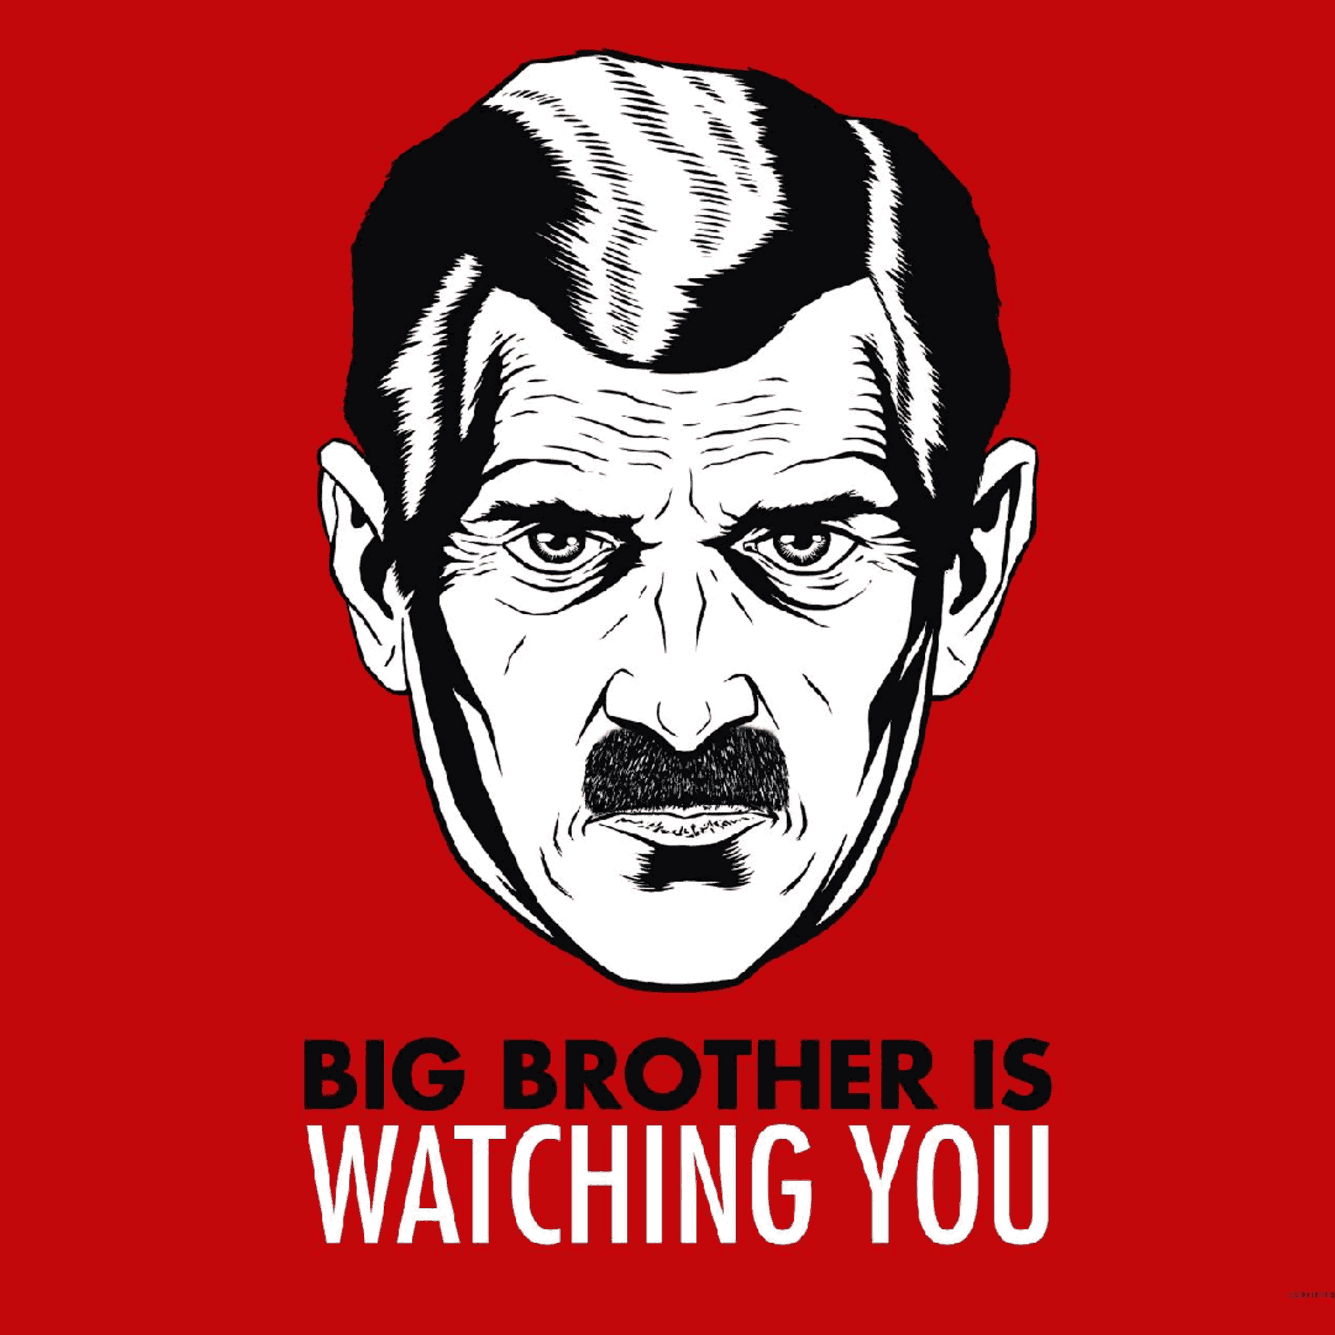
Defining Today's Big Brother
Enoch Zhao
"Big Brother" as coined by George Orwell in "1984" [1]
Government surveillance in modern society
Technological advancements - enhancing scope and depth
[2]
Notes:
Definition: Define "Big Brother" as a term coined by George Orwell in his novel 1984, where it referred to the government's surveillance of individuals' lives [1].
Modern Interpretation: Discuss how the term has come to represent government surveillance in the modern world, facilitated by advanced technology.
Technological advancements and role: Highlight the role of technology in enhancing the scope and depth of surveillance, setting the stage for a detailed discussion in the following slides.

Slide 25
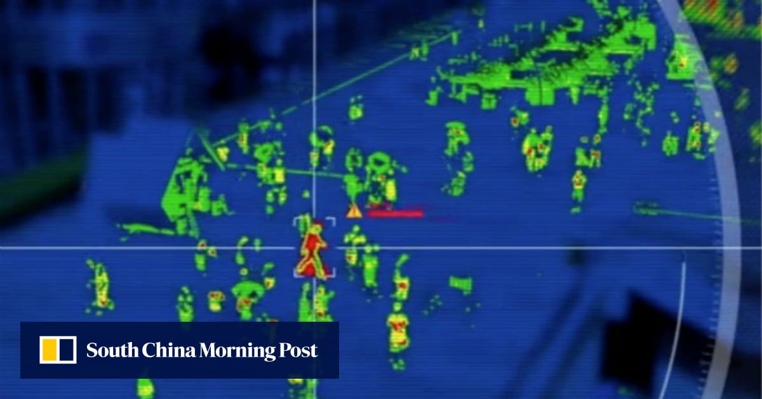
China's Technological Surveillance
Enoch Zhao
Surveillance technology in China
  AI, Big Data, & Predictive Algorithms
Skynet and Sharp Eyes projects
  Nationwide surveillance network [3][6]
Use of Facial Recognition
  Not just for security, extends to various aspects of daily life [4]
[18]
Notes:
China's Surveillance Technology: Talk about China's comprehensive surveillance technology infrastructure. Mention the network of over 200 million CCTV cameras, AI technology to process data, and predictive policing algorithms that use data to predict and prevent potential criminal activities before they occur.
Skynet and Sharp Eyes Projects: Dive into the specifics of the Skynet Project, initiated in 2005, which aims to cover all urban and rural areas with surveillance cameras. This project was further extended through the Sharp Eyes project, aiming to achieve a 100% coverage rate in key public areas. The goal is to connect the surveillance networks to a centralized database, accessible by authorized personnel through mobile devices. [3][6]
Facial Recognition: Discuss the pervasive use of facial recognition technology in China, which is not limited to security purposes but extends to various aspects of daily life. Mention the use in public transport systems for fare collection, in residential areas for access control, and in schools for monitoring students' attentiveness [4]. Highlight the efficiency brought in administrative and security procedures through this technology, but also hint at the concerns it raises regarding privacy, setting the stage for the counterpoint in slide 5.

Slide 26
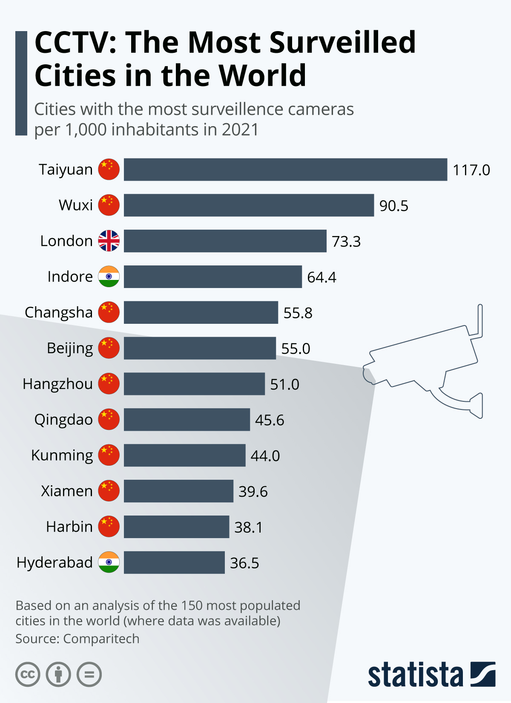
The Implications of Surveillance
Enoch Zhao
How many CCTV cameras?
Pandemic Control
  Monitoring and implementing strict quarantine measures ([7][9]).
Xiqiao (2015 –2019)
  Installation of 1400 cameras, 300 with full facial recognition capability [8]
[10]
Notes:
CCTV Cameras: Guide attention to figure that shows the extent in the number of CCTV cameras installed across China. Talk about how you could probably imagine this massive network of cameras facilitating a high level of surveillance, aiding in maintaining security and order. 200 million cameras [5]
SCRAPPED >> Criminal Case Resolutions: Transition into how surveillance has aided in resolving criminal cases, providing statistics or case studies to support the point. Mention that new surveillance methods are seen as solutions that can resolve cases in a fraction of the time previously required [11].
Pandemic Control: Briefly present a case study on how this surveillance network aided in controlling the pandemic in China. Highlight the use of technology in contact tracing, monitoring quarantine compliance, and even using drones to enforce lockdowns [7][9]. This not only showcases the efficiency of the system but also its versatility in addressing unprecedented challenges [7][9].
Case Study - Xiqiao: Highlight the meticulous planning in Xiqiao to cover the entire town with cameras, emphasizing the local government's initiative to control people through surveillance technology [8]. Population of over 140,000, but designated land area of 176sqkm.

Slide 27
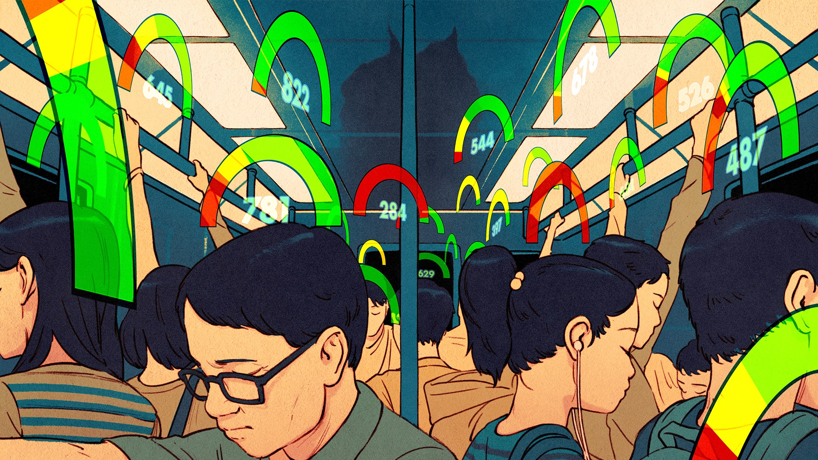
Concerns over Surveillance
Enoch Zhao
Personal Privacy
  Risks to privacy and liberties [12]
Digital Privacy Code
  Legal system fragility and nascent digital privacy code [13]
Systemic Bias and Inaccuracy
  May not always be reliable [13]
[19]
Notes:
Point 1: The surveillance system in China has minimal accountability, which poses a serious threat to personal privacy and civil liberties. It is important to note that these technologies can potentially limit the freedom of expression and the ability to raise concerns or dissent, as mentioned in a report by The Diplomat.
Point 2: Despite having a digital privacy code, it is still in its nascent stage, and the weak legal system in China does not offer much protection against privacy invasion. Tech giants and the security apparatus have the ability to track phones, monitor online purchases, and even decrypt messages, creating a significant concern for digital privacy, as highlighted in a report by NPR.
Point 3: The surveillance system is not just invasive but also has a level of systemic bias and inaccuracy. This means that the system might not always be reliable and can potentially lead to unjust situations, as discussed in the same NPR report.

Slide 28
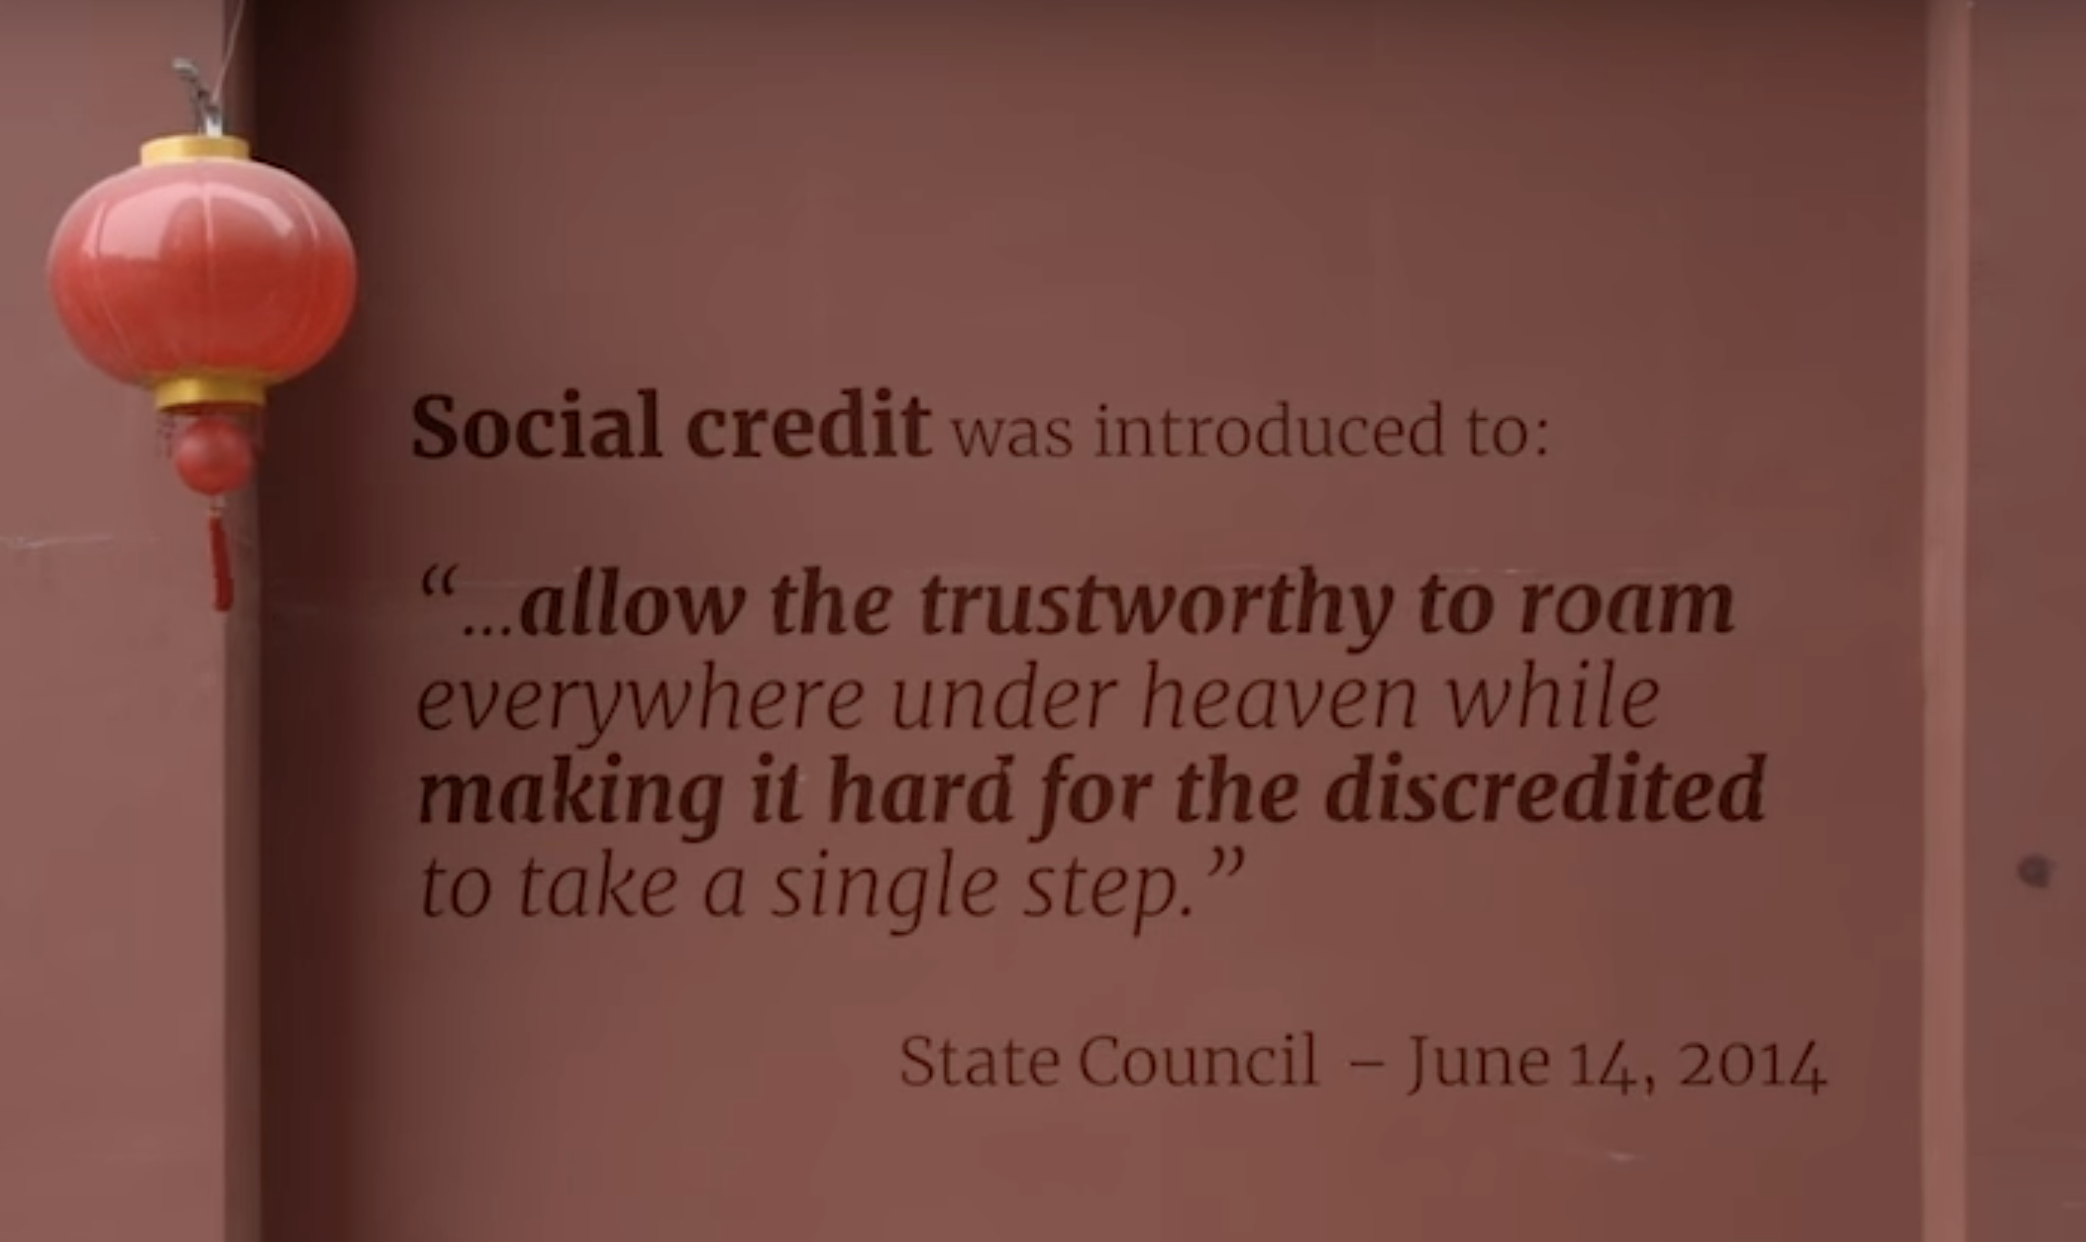
Why Such Surveillance is necessary
Enoch Zhao
[18]
Notes:
Point 1: The surveillance system in China has minimal accountability, which poses a serious threat to personal privacy and civil liberties. It is important to note that these technologies can potentially limit the freedom of expression and the ability to raise concerns or dissent, as mentioned in a report by The Diplomat.
Point 2: Despite having a digital privacy code, it is still in its nascent stage, and the weak legal system in China does not offer much protection against privacy invasion. Tech giants and the security apparatus have the ability to track phones, monitor online purchases, and even decrypt messages, creating a significant concern for digital privacy, as highlighted in a report by NPR.
Point 3: The surveillance system is not just invasive but also has a level of systemic bias and inaccuracy. This means that the system might not always be reliable and can potentially lead to unjust situations, as discussed in the same NPR report.

Slide 29
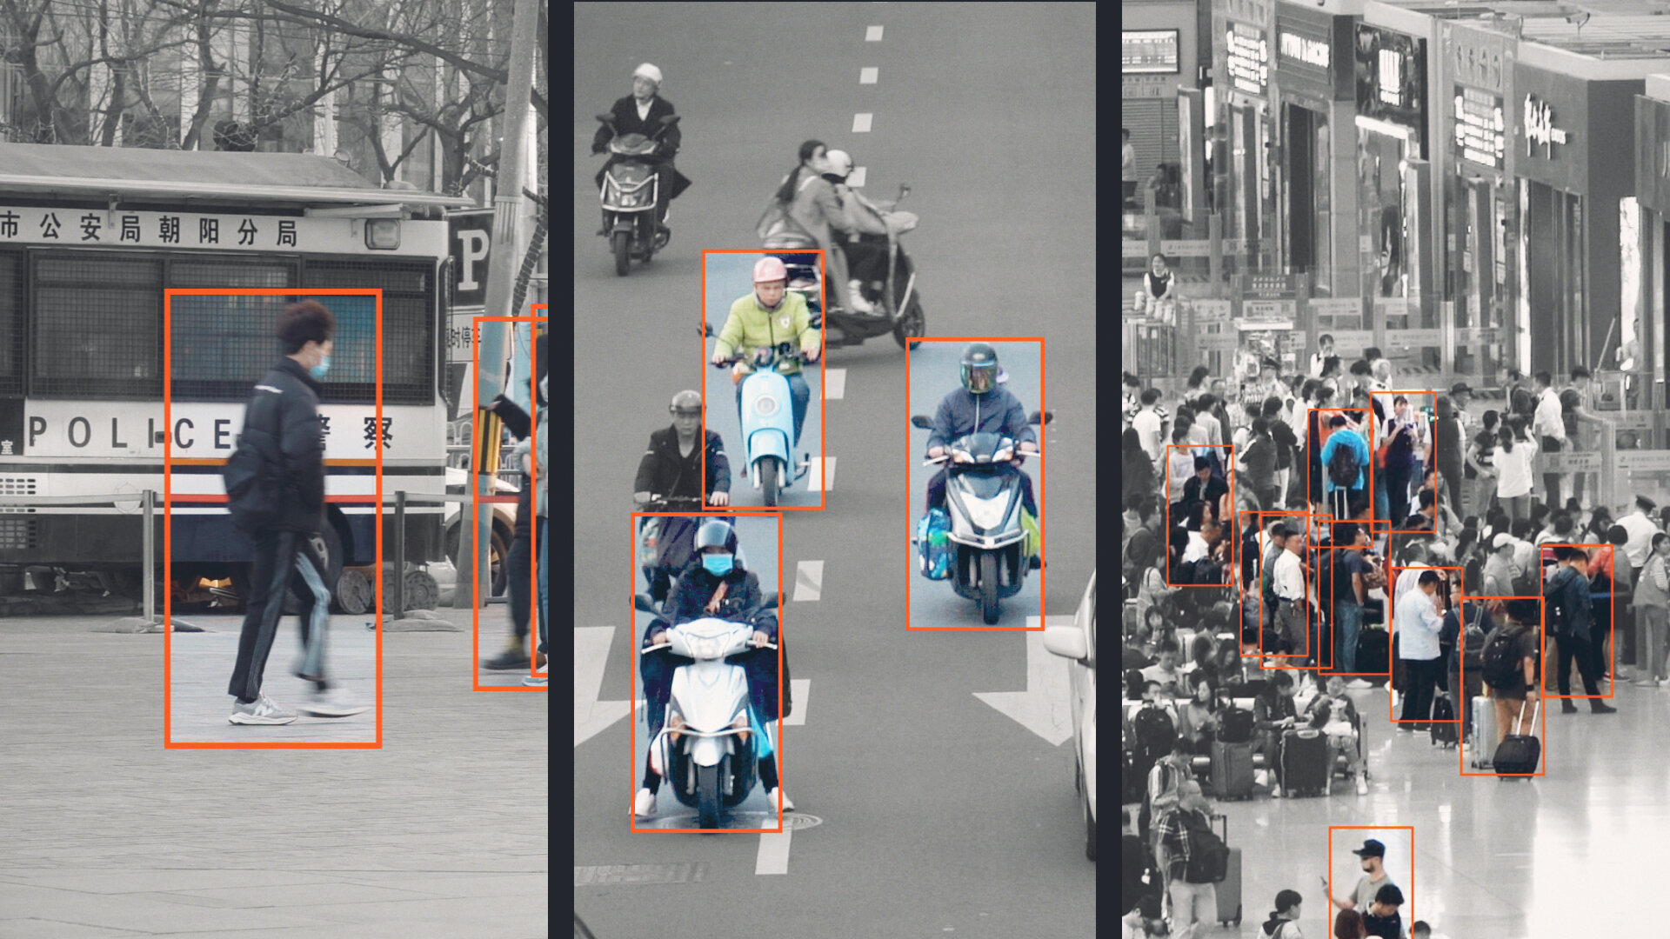
Why such Surveillance is Necessary
Enoch Zhao
Population Density
  Crowd management and security is a significant challenge
Crime Prevention
  Maintaining law and order in densely populated regions [15]
Outbreak Control
  COVID-19 contact tracing and virus tracking [16]
[20]
Notes:
Point 1: China, being one of the most densely populated countries globally, faces unique challenges in managing crowds and ensuring security. The surveillance system aids in this by providing the necessary infrastructure to monitor and manage large populations efficiently.
Point 2: The surveillance system has been instrumental in crime prevention and resolution. It has helped maintain law and order in densely populated regions by aiding the authorities in resolving criminal cases swiftly, as reported by the South China Morning Post.
Point 3: Didn't want to put pandemic control down again, but realistically no other real world examples - The surveillance system proved to be a vital tool during the COVID-19 pandemic. It played a significant role in contact tracing and controlling the spread of the virus effectively, a strategy that has been acknowledged in a report by Nature.

Slide 30
Technology for a "safer" tomorrow
Enoch Zhao
Balanced Approach
  Despite valid concerns, balanced approach can lead to a safer more secure society
Technological Advancements
  Advancements viewed as step forward
Future Prospects
  Promising potential in public safety and national security
Notes:
Point 1: In conclusion, it is evident that a balanced approach to surveillance, which respects individual privacy while ensuring public safety, can foster a safer and more secure society.
Point 2: It is important to view the integration of advanced surveillance systems as a progressive step towards leveraging technology for the greater good, rather than a regression into a state of constant monitoring.
Point 3: Looking ahead, with the right balance of regulations and transparency, the future of surveillance technology holds a promising potential in safeguarding public safety and bolstering national security.

Slide 31
References
Enoch Zhao
[1] George Orwell, "1984" (Secker & Warburg, 1949), various pages.
[2] Unknown Author, "Big Brother 1984 Image," Villains Wiki, no date, https://static.wikia.nocookie.net/villains/images/8/80/Big-Brother-1984.jpg/revision/latest?cb=20190323152040 (accessed September 4, 2023).
[3] Josh Chin, Liza Lin, "China’s All-Seeing Surveillance State Is Reading Its Citizens’ Faces" (The Wall Street Journal, June 26, 2017), https://www.wsj.com/articles/the-all-seeing-surveillance-state-feared-in-the-west-is-a-reality-in-china-1498493020 (Accessed September 5, 2023).
[4] Paul Mozur, "One Month, 500,000 Face Scans: How China Is Using A.I. to Profile a Minority" (The New York Times, April 14, 2019), https://www.nytimes.com/2019/04/14/technology/china-surveillance-artificial-intelligence-racial-profiling.html (Accessed September 5, 2023).
[5] Steve White, "CCTV Cameras by Countries & Cities (2023 Guide)," Upcoming Security, last updated June 10, 2023, [Link](https://upcomingsecurity.co.uk/security-guides/cctv-camera-guides/cctv-by-country/).
[6] Xinmei Shen, "Skynet: China’s massive video surveillance network," South China Morning Post, no date, https://www.scmp.com/abacus/who-what/what/article/3028246/skynet-chinas-massive-video-surveillance-network (accessed September 4, 2023).
[7] Wen Dong, Liam Scott, "COVID Controls Offer Insight into China's Surveillance Network," VOA News, no date, https://www.voanews.com/a/covid-controls-offer-insight-into-china-s-surveillance-network/6888440.html (accessed September 4, 2023).
[8] Jessica Batke, "State Surveillance in China," ChinaFile, no date, https://www.chinafile.com/state-surveillance-china (accessed September 4, 2023).
[9] Alex Plavevski, "China’s surveillance creep: How big data, COVID monitoring could be used to control people post-pandemic," The Conversation, no date, https://theconversation.com/chinas-surveillance-creep-how-big-data-covid-monitoring-could-be-used-to-control-people-post-pandemic-164788 (accessed September 4, 2023).
[10] Unknown Author, "Infographic Image," Statista, no date, https://cdn.statcdn.com/Infographic/images/normal/19256.jpeg (accessed September 4, 2023).
Notes:
[1] George Orwell, "1984" (Secker & Warburg, 1949), various pages.
[2] Unknown Author, "Big Brother 1984 Image," Villains Wiki, no date, https://static.wikia.nocookie.net/villains/images/8/80/Big-Brother-1984.jpg/revision/latest?cb=20190323152040 (accessed September 4, 2023).
[3] Josh Chin, Liza Lin, "China’s All-Seeing Surveillance State Is Reading Its Citizens’ Faces" (The Wall Street Journal, June 26, 2017), https://www.wsj.com/articles/the-all-seeing-surveillance-state-feared-in-the-west-is-a-reality-in-china-1498493020 (Accessed September 5, 2023).
[4] Paul Mozur, "One Month, 500,000 Face Scans: How China Is Using A.I. to Profile a Minority" (The New York Times, April 14, 2019), https://www.nytimes.com/2019/04/14/technology/china-surveillance-artificial-intelligence-racial-profiling.html (Accessed September 5, 2023).
[5] Steve White, "CCTV Cameras by Countries & Cities (2023 Guide)," Upcoming Security, last updated June 10, 2023, [Link](https://upcomingsecurity.co.uk/security-guides/cctv-camera-guides/cctv-by-country/).
[6] Xinmei Shen, "Skynet: China’s massive video surveillance network," South China Morning Post, no date, https://www.scmp.com/abacus/who-what/what/article/3028246/skynet-chinas-massive-video-surveillance-network (accessed September 4, 2023).
[7] Wen Dong, Liam Scott, "COVID Controls Offer Insight into China's Surveillance Network," VOA News, no date, https://www.voanews.com/a/covid-controls-offer-insight-into-china-s-surveillance-network/6888440.html (accessed September 4, 2023).
[8] Jessica Batke, "State Surveillance in China," ChinaFile, no date, https://www.chinafile.com/state-surveillance-china (accessed September 4, 2023).
[9] Alex Plavevski, "China’s surveillance creep: How big data, COVID monitoring could be used to control people post-pandemic," The Conversation, no date, https://theconversation.com/chinas-surveillance-creep-how-big-data-covid-monitoring-could-be-used-to-control-people-post-pandemic-164788 (accessed September 4, 2023).
[10] Unknown Author, "Infographic Image," Statista, no date, https://cdn.statcdn.com/Infographic/images/normal/19256.jpeg (accessed September 4, 2023).
[11] Josh Chin, Liza Lin, "Article Abstract on British Journal of Criminology," Oxford Academic, no date, https://academic.oup.com/bjc/article-abstract/63/2/534/6827557 (accessed September 4, 2023).
[12] Chauncey Jung, "China’s Political Surveillance System Keeps Growing," The Diplomat, June 2022, https://thediplomat.com/2022/06/chinas-political-surveillance-system-keeps-growing/ (accessed September 4, 2023).
[13] Emily Feng, "‘Surveillance State’ Explores China’s Tech and Social Media Control Systems," NPR, September 7, 2022, https://www.npr.org/2022/09/07/1118105165/surveillance-state-explores-chinas-tech-and-social-media-control-systems (accessed September 4, 2023).
[14] Unknown Author, "China Population," Worldometers, no date, https://www.worldometers.info/world-population/china-population/ (accessed September 4, 2023).
[15] Mimi Lau, "How China’s high-tech surveillance technology is making it impossible to escape the watchful eyes of the state," South China Morning Post, no specific date available, https://www.scmp.com/news/china/society/article/2187450/how-chinas-high-tech-surveillance-technology-is-making-it (accessed September 4, 2023).
[16] David Cyranoski, "China set to introduce gene-editing regulation following CRISPR-baby furore," Nature, January 27, 2020, https://www.nature.com/articles/d41586-020-00154-w (accessed September 4, 2023).
[17] Unknown Author, "Image on South China Morning Post website," South China Morning Post, April 12, 2019, https://cdn.i-scmp.com/sites/default/files/styles/1200x800/public/d8/images/methode/2019/04/12/7fa641b6-5c36-11e9-bbcc-84176f6dd1e7_image_hires_083216.JPG?itok=xpyAkq0W&v=1555029141 (accessed September 4, 2023).
[18] Li Tao, "What you need to know about SenseNets, the facial recognition firm tracking China’s Muslims," South China Morning Post, no specific date available, https://www.scmp.com/tech/science-research/article/3005733/what-you-need-know-about-sensenets-facial-recognition-firm (accessed September 4, 2023).
[19] Nicole Kobie, "The complicated truth about China's social credit system," WIRED UK, no specific date available, https://www.wired.co.uk/article/chinese-government-social-credit-score-privacy-invasion (accessed September 4, 2023).
[20] Unknown Author, "Image on The New York Times website," The New York Times, June 21, 2022, https://static01.nyt.com/images/2022/06/21/world/asia/Chinafilesurveillance-CoverArt-01/Chinafilesurveillance-CoverArt-01-superJumbo.jpg (accessed September 4, 2023).

Slide 32
References
Enoch Zhao
[11] Josh Chin, Liza Lin, "Article Abstract on British Journal of Criminology," Oxford Academic, no date, https://academic.oup.com/bjc/article-abstract/63/2/534/6827557 (accessed September 4, 2023).
[12] Chauncey Jung, "China’s Political Surveillance System Keeps Growing," The Diplomat, June 2022, https://thediplomat.com/2022/06/chinas-political-surveillance-system-keeps-growing/ (accessed September 4, 2023).
[13] Emily Feng, "‘Surveillance State’ Explores China’s Tech and Social Media Control Systems," NPR, September 7, 2022, https://www.npr.org/2022/09/07/1118105165/surveillance-state-explores-chinas-tech-and-social-media-control-systems (accessed September 4, 2023).
[14] Unknown Author, "China Population," Worldometers, no date, https://www.worldometers.info/world-population/china-population/ (accessed September 4, 2023).
[15] Mimi Lau, "How China’s high-tech surveillance technology is making it impossible to escape the watchful eyes of the state," South China Morning Post, no specific date available, https://www.scmp.com/news/china/society/article/2187450/how-chinas-high-tech-surveillance-technology-is-making-it (accessed September 4, 2023).
[16] David Cyranoski, "China set to introduce gene-editing regulation following CRISPR-baby furore," Nature, January 27, 2020, https://www.nature.com/articles/d41586-020-00154-w (accessed September 4, 2023).
[17] Unknown Author, "Image on South China Morning Post website," South China Morning Post, April 12, 2019, https://cdn.i-scmp.com/sites/default/files/styles/1200x800/public/d8/images/methode/2019/04/12/7fa641b6-5c36-11e9-bbcc-84176f6dd1e7_image_hires_083216.JPG?itok=xpyAkq0W&v=1555029141 (accessed September 4, 2023).
[18] Li Tao, "What you need to know about SenseNets, the facial recognition firm tracking China’s Muslims," South China Morning Post, no specific date available, https://www.scmp.com/tech/science-research/article/3005733/what-you-need-know-about-sensenets-facial-recognition-firm (accessed September 4, 2023).
[19] Nicole Kobie, "The complicated truth about China's social credit system," WIRED UK, no specific date available, https://www.wired.co.uk/article/chinese-government-social-credit-score-privacy-invasion (accessed September 4, 2023).
[20] Unknown Author, "Image on The New York Times website," The New York Times, June 21, 2022, https://static01.nyt.com/images/2022/06/21/world/asia/Chinafilesurveillance-CoverArt-01/Chinafilesurveillance-CoverArt-01-superJumbo.jpg (accessed September 4, 2023).
Notes:
[1] George Orwell, "1984" (Secker & Warburg, 1949), various pages.
[2] Unknown Author, "Big Brother 1984 Image," Villains Wiki, no date, https://static.wikia.nocookie.net/villains/images/8/80/Big-Brother-1984.jpg/revision/latest?cb=20190323152040 (accessed September 4, 2023).
[3] Josh Chin, Liza Lin, "China’s All-Seeing Surveillance State Is Reading Its Citizens’ Faces" (The Wall Street Journal, June 26, 2017), https://www.wsj.com/articles/the-all-seeing-surveillance-state-feared-in-the-west-is-a-reality-in-china-1498493020 (Accessed September 5, 2023).
[4] Paul Mozur, "One Month, 500,000 Face Scans: How China Is Using A.I. to Profile a Minority" (The New York Times, April 14, 2019), https://www.nytimes.com/2019/04/14/technology/china-surveillance-artificial-intelligence-racial-profiling.html (Accessed September 5, 2023).
[5] Steve White, "CCTV Cameras by Countries & Cities (2023 Guide)," Upcoming Security, last updated June 10, 2023, [Link](https://upcomingsecurity.co.uk/security-guides/cctv-camera-guides/cctv-by-country/).
[6] Xinmei Shen, "Skynet: China’s massive video surveillance network," South China Morning Post, no date, https://www.scmp.com/abacus/who-what/what/article/3028246/skynet-chinas-massive-video-surveillance-network (accessed September 4, 2023).
[7] Wen Dong, Liam Scott, "COVID Controls Offer Insight into China's Surveillance Network," VOA News, no date, https://www.voanews.com/a/covid-controls-offer-insight-into-china-s-surveillance-network/6888440.html (accessed September 4, 2023).
[8] Jessica Batke, "State Surveillance in China," ChinaFile, no date, https://www.chinafile.com/state-surveillance-china (accessed September 4, 2023).
[9] Alex Plavevski, "China’s surveillance creep: How big data, COVID monitoring could be used to control people post-pandemic," The Conversation, no date, https://theconversation.com/chinas-surveillance-creep-how-big-data-covid-monitoring-could-be-used-to-control-people-post-pandemic-164788 (accessed September 4, 2023).
[10] Unknown Author, "Infographic Image," Statista, no date, https://cdn.statcdn.com/Infographic/images/normal/19256.jpeg (accessed September 4, 2023).
[11] Josh Chin, Liza Lin, "Article Abstract on British Journal of Criminology," Oxford Academic, no date, https://academic.oup.com/bjc/article-abstract/63/2/534/6827557 (accessed September 4, 2023).
[12] Chauncey Jung, "China’s Political Surveillance System Keeps Growing," The Diplomat, June 2022, https://thediplomat.com/2022/06/chinas-political-surveillance-system-keeps-growing/ (accessed September 4, 2023).
[13] Emily Feng, "‘Surveillance State’ Explores China’s Tech and Social Media Control Systems," NPR, September 7, 2022, https://www.npr.org/2022/09/07/1118105165/surveillance-state-explores-chinas-tech-and-social-media-control-systems (accessed September 4, 2023).
[14] Unknown Author, "China Population," Worldometers, no date, https://www.worldometers.info/world-population/china-population/ (accessed September 4, 2023).
[15] Mimi Lau, "How China’s high-tech surveillance technology is making it impossible to escape the watchful eyes of the state," South China Morning Post, no specific date available, https://www.scmp.com/news/china/society/article/2187450/how-chinas-high-tech-surveillance-technology-is-making-it (accessed September 4, 2023).
[16] David Cyranoski, "China set to introduce gene-editing regulation following CRISPR-baby furore," Nature, January 27, 2020, https://www.nature.com/articles/d41586-020-00154-w (accessed September 4, 2023).
[17] Unknown Author, "Image on South China Morning Post website," South China Morning Post, April 12, 2019, https://cdn.i-scmp.com/sites/default/files/styles/1200x800/public/d8/images/methode/2019/04/12/7fa641b6-5c36-11e9-bbcc-84176f6dd1e7_image_hires_083216.JPG?itok=xpyAkq0W&v=1555029141 (accessed September 4, 2023).
[18] Li Tao, "What you need to know about SenseNets, the facial recognition firm tracking China’s Muslims," South China Morning Post, no specific date available, https://www.scmp.com/tech/science-research/article/3005733/what-you-need-know-about-sensenets-facial-recognition-firm (accessed September 4, 2023).
[19] Nicole Kobie, "The complicated truth about China's social credit system," WIRED UK, no specific date available, https://www.wired.co.uk/article/chinese-government-social-credit-score-privacy-invasion (accessed September 4, 2023).
[20] Unknown Author, "Image on The New York Times website," The New York Times, June 21, 2022, https://static01.nyt.com/images/2022/06/21/world/asia/Chinafilesurveillance-CoverArt-01/Chinafilesurveillance-CoverArt-01-superJumbo.jpg (accessed September 4, 2023).

Slide 33
Class 6
The End
Keith A. Pray
socialimps.keithpray.net
Notes:
This is the end. Any slides beyond this point are for answering questions that may arise but not needed in the main talk. Some slides may also be unfinished and are not needed but kept just in case.
If there’s time and we didn’t already look at:
Find out what your DNA says about you and your family.
https://www.23andme.com/
Jimmy Kimmel Live – What is your password? (2:49)
https://www.youtube.com/watch?v=opRMrEfAIiI

Slide 34
what works well Online With Zoom
Sign in with First and Last Name
Stay muted unless you are going to speak
To speak use the raise your hand feature
To answer yes/no questions use the “yes” ”no” buttons
Turn your camera on
Wait until the end of student presentations to ask questions
  Write them down so you don’t forget

Slide 35
Logistics
Address email to entire course staff for quickest response
Review Presentation and Paper Guidelines on course site
Notes:
Not needed this time:
Address email to entire course staff for quickest response time
Do not change the format, footers, etc. in the template slides.
Paper writing process: Sources → Notes → Conclusion → Argument → Counter Point → Response
Turn extra credit paper in on myWPI/Canvas and hard copy in class like regular papers
Use Presentation Guidelines on course web site
Use paper and presentation templates
Keep topics inside the course scope: Computing + Society
Presentations are due 24 hours before class
Sign up for Individual Presentation, it’s not too late

