Slide 1
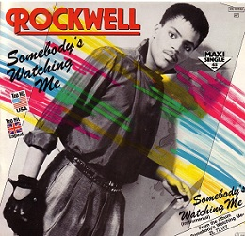
Class 7
Privacy and Government
Keith A. Pray
socialimps.keithpray.net
Notes:
After this class we will be half done with the course… very sad I know.
Somebody’s Watching Me (1984) – Rockwell (3:36)
https://www.youtube.com/watch?v=7YvAYIJSSZY
Be the envy of all your classmates if you know the band and/or year:
Rockwell (1984) Michael Jackson sings chorus and Jermaine Jackson on backing vocals.

Slide 2
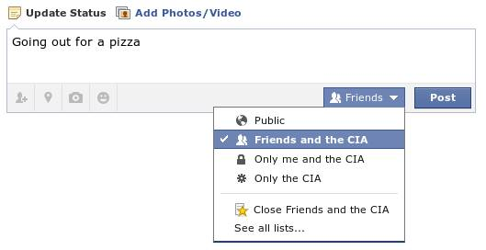
Overview
Review
Assignment
Students Present
Notes:
Review before debate in case anyone unsure of something in reading.
TODO: Image source?
Look at ACM TechNews if time

Slide 3
Debate Ground Rules
Before Debate
  10 minutes to converse with your team
  Share argument points, counter points, and responses
  Share experiences, especially in different countries, cultures, situations
  Decide who will: Go first, Respond to which points from opposing side
During Debate
  1 turn per person until everyone on your team has spoken
  Stand up when speaking
  Try to keep remarks to 30 seconds (each side elect a timekeeper)
Notes:
“National ban on facial recognition surveillance for law enforcement” Debate
If in class:
Stand up when speaking
30 second limit (elect a timekeeper)
If Remote:
Add “(YES)” or “(NO)” to the end of your name in Zoom to show your side
Previous:
Should law require you to use an official ID for Internet access
National ID or Not Debate

Slide 4
Group Quiz
List two problems with using biometrics for identification.
List two advantages of using biometrics for identification.
Describe two tools people can use to protect their privacy on the Web.
For each of the 4 categories of Daniel Solove’s privacy taxonomy give an example not listed in the book.
Notes:
Only if need to fill time.
Information Collection
Information Processing
Information Dissemination
Invasion

Slide 5
Overview
Review
Assignment
Students Present

Slide 6
Assignment – Group Project
Catch up on reading
Group Project
  Analyze Movie for all topics covered to date
  Add analysis of computing technology portrayed to web site
  See group project slide deck for more
  Frequent interaction with your group members is key to success!
-----
Mid Term Survey on Canvas → Quizzes
Notes:
Movie group project:
List of computing technologies portrayed in movie on website
Categorize computing technologies as existing, future, emerging, impossible or plausible with rationale
Analyze movie for all topics covered to date

Slide 7
Overview
Review
Assignment
Students Present

Slide 8
Internet search privacy
Samson Hodges
Notes:
Start by introducing myself and mention my topic
And in this presentation, we’ll be talking about why there is no way to keep your internet searches private

Slide 9

Who can see your online searches?
Samson Hodges
Internet Service Provider (ISP) [1]
Websites that use Cookies [1]
The government [6]
Hackers
Notes:
ISPs can see your searches because all your internet traffic has to go through their monitored servers
Nearly all websites use cookies, which are data packets designed to remember what you do on a website
The government requires ISPs to save all Internet searches, so the government can request your search history at any time if they suspect you of a crime
The government also has many encryption backdoors built into internet communications, which can be used to see your searches
Hackers lure you to download spyware which can be used to see your search history and more
Picture shows someone who can see your search history, in this case it’s a hacker.

Slide 10


Problems with common protections
Samson Hodges
Incognito mode – still need ISP servers to function [2]
Deleting search history – ISP still has record of what you searched
VPN – Hacker spyware [4]
Notes:
Incognito mode may seem like a safe way to protect your searches, but it is still connected to the Internet, which uses your ISP servers which are monitored
Deleting your search history doesn’t negate the fact you visited the website. Your ISP still saves that search regardless as the law requires them to
While VPN encryption makes it extremely difficult for someone to see your searches, hacker spyware can compromise your VPN, allowing the hacker to see your search history
Pictures serve as visuals of the mentioned Incognito mode and VPN

Slide 11
Internet privacy statistics
Samson Hodges
86% US internet users tried delete their digital footprint [5]
40,000 requests for user data from law enforcement [3]
60% malware attacks sent using encrypted traffic [2]
Notes:
The 1st statistic shows how common reducing digital footprint is as a way to protect their searches on the internet
2nd statistic shows how often the government requests user data, which includes search history
3rd statistic shows the most common ways malware is sent, which includes spyware as spyware is a type of malware

Slide 12
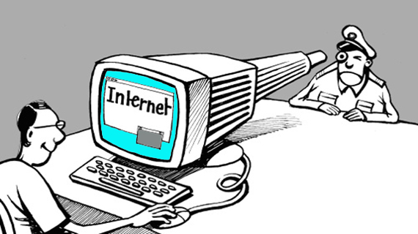
conclusion
Samson Hodges
Your “private” searches are not private!
Private searches are always vulnerable
Big brother is always watching
There is a way around common protections
Notes:
To conclude, there your internet searches are not private, even if you use protections like incognito mode
There’s always someone who can see your searches like your ISP, or gain access to them like the government or hackers
There’s always a way around common protections with monitored servers or spyware
Visual is a funny representation of someone actively watching your internet search activity

Slide 13
References
Samson Hodges
[1] Cook, P. (2004, July 1). What are your web data good for - time for a rethink on web analytics standards - journal of direct, data and digital marketing practice. SpringerLink. Retrieved April 2, 2023, from https://link.springer.com/article/10.1057/palgrave.im.4340268
[2] Cook, S. (2023, March 21). Malware statistics in 2023: Frequency, impact, cost & more. Comparitech. Retrieved April 4, 2023, from https://www.comparitech.com/antivirus/malware-statistics- facts/
[3] Cooke, T. (2023, March 21). Internet privacy statistics 2023: Is your online data safe? EarthWeb. Retrieved April 4, 2023, from https://earthweb.com/internet-privacy-statistics/
[4] Jonasson, D., & Sigholm, J. (n.d.). What is Spyware? project.div. Retrieved April 2, 2023, from https://citeseerx.ist.psu.edu/document?repid=rep1&type=pdf&doi=
[5] Rainie, L. (2020, August 17). Anonymity, privacy, and security online. Pew Research Center: Internet, Science & Tech. Retrieved April 2, 2023, from
  https://www.pewresearch.org/internet/2013/09/05/anonymity-privacy-and-security-online/
[6] Surveillance Techniques: How Your Data Becomes Our Data. Domestic Surveillance Techniques - Our Data Collection Program. (n.d.). Retrieved April 2, 2023, from https://nsa.gov1.info/surveillance/

Slide 14
References
Samson Hodges
[7] Averous, J. (2018). Internet Privacy Cartoon. In The Fourth Revolution.
  https://thefourthrevolution.org/wordpress/archives/5933?doing_wp_cron=1680886018.0463650226593017578125
[8] Can WiFi Provider See Your Browsing History. (2020). In SwitchVPN.
  https://switchvpn.net/blog/can-wifi-provider-see-your-browsing-history/
[9] Google. (2016). Incognito Mode Symbol. In Thrillist.
  https://www.thrillist.com/tech/nation/what-is-incognito-mode-private-browsing
[10] VPN Symbol. (2020). In CyberTechAccord.
  https://cybertechaccord.org/basic-cyber-hygiene-the-benefits-of-using-a-virtual-private-network-vpn/

Slide 15
Appropriate Digital Surveillance
Julie Vieira
Notes:
Does anyone lean towards the idea that the government should be able to utilize digital surveillance freely?
Does anyone believe there should be more restrictions placed on the government’s surveillance tactics?

Slide 16
Is digital surveillance appropriate?
Julie Vieira
Each situation is unique
  Consider the severity of the situation
  How invasive is the technology?
  Who is involved?
Legislative action
  Invasive methods can be outlawed
  Laws should protect the liberties of individuals first
  Methods should be equitable
Notes:
So is digital surveillance appropriate?
Dependent on the situation
Severity
Stealing a candy bar vs murder suspect
Invasive
Just as law enforcement cannot enter a home without a warrant, they can’t use surveillance technology in the home
Involvement
Is law enforcement surveilling coworkers and family
Cannot infringe upon others rights related to suspect
More laws should be created to address the boundaries between protecting the liberties of individuals (like peaceful protests) while maximizing the potential for devices (if there are so many street cameras that they can’t all be monitored, it isn’t very helpful until after the crime has been committed; even in this case will take time and resources to search through all this footage)
No solution will appease everyone but as long as steps are being taken towards a better system, like with the acts outlined above, then this will create a healthy balance of privacy and security

Slide 17
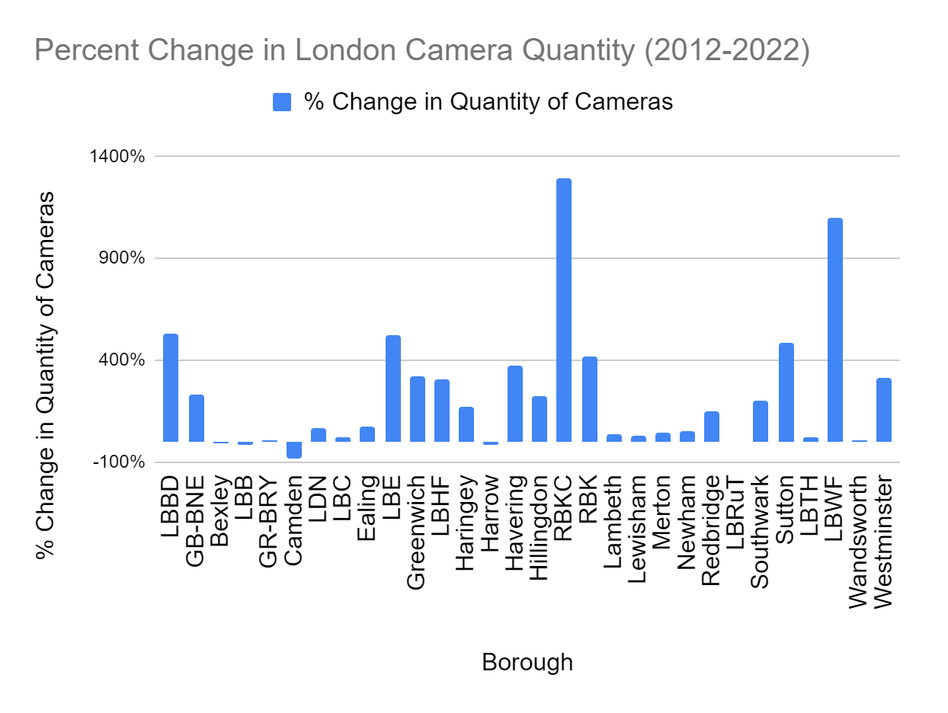
quantity of digital surveillance technology
Julie Vieira
Street Cameras [1]
  London has 942,562 street cameras
  Proportion increase by 238.16% in the past decade
Body Cameras [6]
  Used by 47% of general purpose law enforcement
  Used in 80% large scale departments
Drones [2]
  Used by 1,578 public safety agencies
  70% involve law enforcement
Figure 1: Percent change in the quantity of street surveillance cameras in London boroughs from 2012 to 2022
Notes:
Updated statistics from 2022
1 camera for every 10 citizens
942,562 street surveillance cameras in London
Average person walking down the street will be captured on video 70 times
238.16% increase in the total number of street surveillance cameras in London over the past decade
The graph on the right depicts the percentage difference in the cameras for each borough. While the borough of Camden has the greatest percentage decrease at 78.33%, the borough of Kensington Chelsea represents the largest percentage increase in cameras at 1294.83%.
47% of general purpose law enforcement have purchased body cameras
80% of large scale departments also possess this technology
1105 drones populate law enforcement offices across the country (70% of drones used for public safety are owned by law enforcement.)

Slide 18
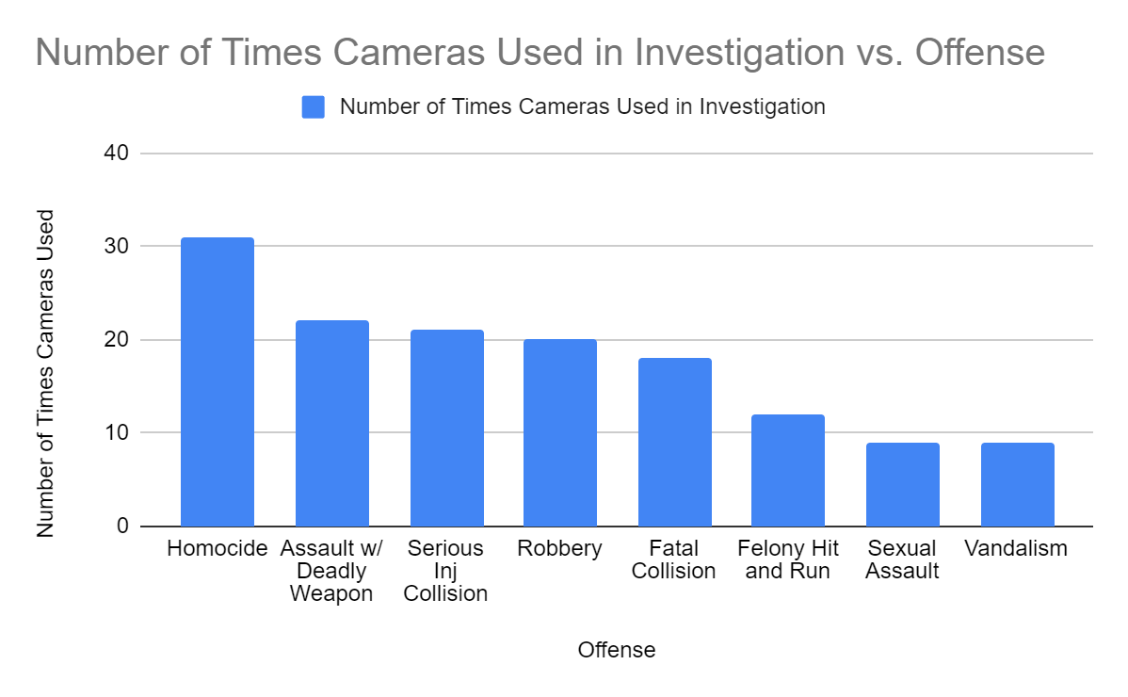
Benefits of digital surveillance
Julie Vieira
Reduces Misconduct [6]
  Increases accountability if officers do not perform their duties properly
  Multiple perspectives
  Multiple failsafes
Aids in Search & Rescue and Disaster Recovery [2]
  Bird’s eye view
  Cost efficient
  Time efficient
Figure 2: Number of cameras used in criminal investigations in San Diego (2018-2019)
Notes:
Officers will be more aware that their behavior is constantly being recorded
If duties are not fulfilled, the body cam footage can be used against them so there is a checks and balance system established
Digital surveillance offers a unique perspective that can be vital in the courtroom to come to a decision
If one technology fails or is manipulated, there are other technologies around to capture the events
In 2014, there was an incident in which police officers claimed that the suspect, Derrick Price, was resisting arrest
The body camera footage was manipulated to show select footage in favor of the officers
Nearby street cameras recorded the incident which revealed the officer’s misconduct and this evidence was used against them
Search and rescue
Rescuers will be able to cover more ground in a smaller amount of time as drones can navigate all types of terrain
Uses fewer resources as the victim can be located sooner and a direct path is made
The graph on the right shows what types of criminal investigations street cameras were utilized in San Diego over the course of a year
There were 157 instances where footage was pulled

Slide 19
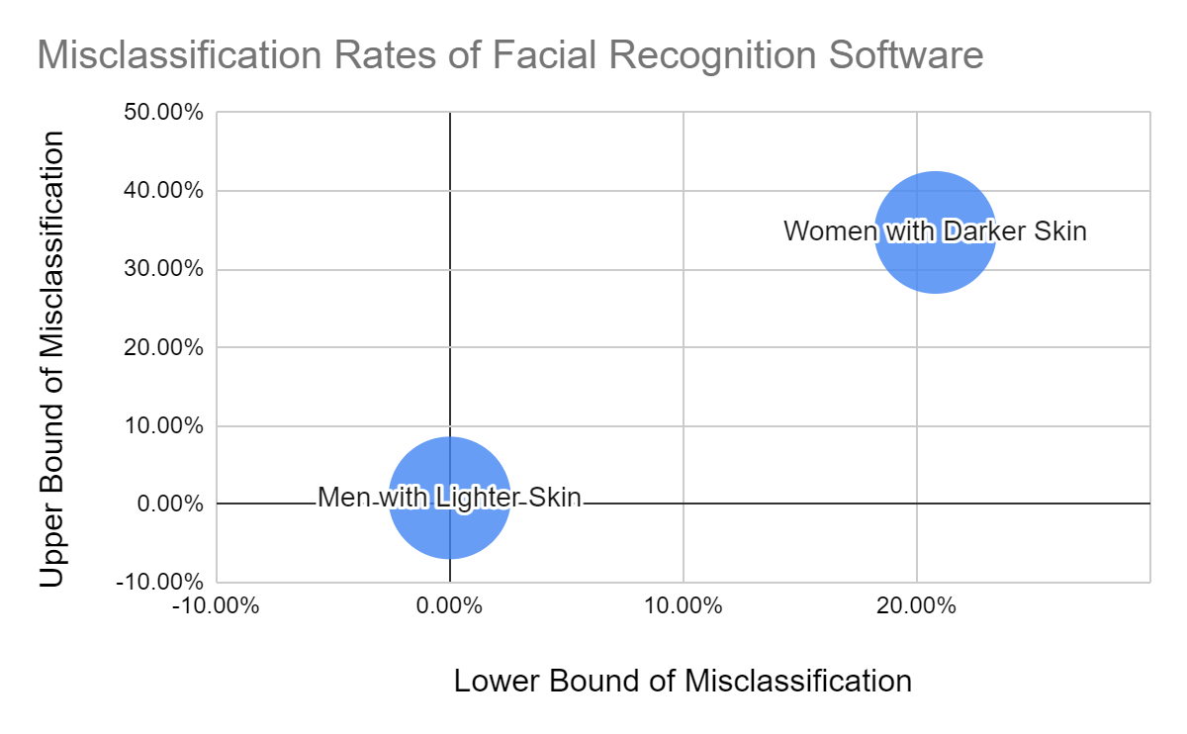
Disadvantages of digital surveillance
Julie Vieira
Inaccuracies in Training Data [2]
  Disparity between skintones
  Monopolies over training
Marginalized Groups Targeted [2]
  Geolocation used to target illegal immigration
  Used to monitor peaceful protests
Media Distortion [5]
  Footage may be manipulated when released to press
  Different media outlets highlight single perspective
Figure 3: Misclassification rates of facial recognition software for Microsoft, Face++, and IBM
Notes:
Training data is not representative of the general population
After analyzing facial recognition software from Microsoft, Face++, and IBM, there was a distinct inconsistency in the misclassified data
Whereas women with darker skin tones were misclassified 20.8% to 34.7% of the time, men with lighter skin tones were misclassified 0% to 0.8% of the time
Additionally, a select few companies like Clearview AI control the largest amount of data so there is little diversity across software using this training data
Putting into perspective how much larger Clearview is, the FBI has a database with 640 million photos while Clearview has 1 billion
Wrongful convictions
Nijeer Parks spent 10 days in jail and paid a $5000 fine after being misidentified using facial recognition software
Marginalized groups targeted
Geolocation apps are used to target illegal immigration which can lead to greater disparities if technology is focused on a specific population
Baltimore police used facial recognition software to identify individuals who were peacefully protesting for Freddie Gray and drones were released to observe protesters in the wake of George Floyd’s murder
Media distortion
When given to the press, news outlets can take specific clips to make their position seem more sound than it is
Reporters can ignore the other side of the story and therefore not educate their audience properly
This creates division
Police drones also have in the past prevented from media drones from capturing footage of the incident as it can be considered an ongoing investigation when police drones look over an area

Slide 20
Actions influencing the future of law enforcement
Julie Vieira
20 V.S.A. § 4622
  Vermont has banned drone use for surveillance purposes on citizens exercising their right to freedom of speech and assembly [7]
Long Lake Township v. Todd Maxon (2021)
  Drone surveillance of citizen’s propery requires a warrant [2]
George Floyd Justice in Policing Act (2021)
  Prohibits federal law enforcement from using facial recognition software in body cameras or patrol vehicle cameras [2]
The Fourth Amendment Is Not For Sale Act (2021)
  Limits federal law enforcement access to remote computing services [2]
Notes:
Actions are being taken to address the concerns of the public and lay the groundwork for future generations
Many of these rules have been established in the past couple years which coincides with the increased use in surveillance technology and pushed boundaries
Vermont implemented a statute so that protesters do not have to be intimidated by drone surveillance while exercising their rights
Long Lake Township v. Maxon established a rule that prevented law enforcement to record their property using a drone without a warrant
Facial recognition cannot be used in the cameras police officers use during their shifts
The final act prohibits activity such as using geolocation which could become discriminatory

Slide 21
References
Julie Vieira
[1] Barker, Richard. “How Many CCTV Cameras in London? UK CCTV Numbers (Updated 2022).” Clarion UK, https://clarionuk.com/resources/how-many-cctv-cameras-are-in-london/. Accessed 6 Apr. 2023.
[2] Chin, Nicol Turner Lee and Caitlin. “Police Surveillance and Facial Recognition: Why Data Privacy Is Imperative for Communities of Color.” Brookings, 7 Apr. 2022, https://www.brookings.edu/research/police-surveillance-and-facial-recognition-why-data-privacy-is-an-imperative-for-communities-of-color/.
[3] Greenwood, Faine. “How to Regulate Police Use of Drones.” Brookings, 24 Sept. 2020, https://www.brookings.edu/techstream/how-to-regulate-police-use-of-drones/.
[4] Hill, Kashmir. “Another Arrest, and Jail Time, Due to a Bad Facial Recognition Match.” The New York Times, 29 Dec. 2020. NYTimes.com, https://www.nytimes.com/2020/12/29/technology/facial-recognition-misidentify-jail.html.
[5] Lee, Jennifer. “Will Body Cameras Help End Police Violence?” ACLU of Washington, 7 June 2021, https://www.aclu-wa.org/story/%C2%A0will-body-cameras-help-end-police-violence%C2%A0.
[6] “Research on Body-Worn Cameras and Law Enforcement.” National Institute of Justice, 7 Jan. 2022, https://nij.ojp.gov/topics/articles/research-body-worn-cameras-and-law-enforcement.
[7] “Vermont Laws.” Vermont General Assembly, https://legislature.vermont.gov/statutes/section/20/205/04622. Accessed 6 Apr. 2023.

Slide 22
Class 7
The End
Keith A. Pray
socialimps.keithpray.net
Notes:
Look at ACM TechNews if time
This is the end. Any slides beyond this point are for answering questions that may arise but not needed in the main talk. Some slides may also be unfinished and are not needed but kept just in case.

Slide 23
what works well Online With Zoom
Sign in with First and Last Name
Stay muted unless you are going to speak
To speak use the raise your hand feature
To answer yes/no questions use the “yes” ”no” buttons
Turn your camera on
Wait until the end of student presentations to ask questions
  Write them down so you don’t forget

