Slide 1
Class 2
Critical Thinking
Keith A. Pray
socialimps.keithpray.net
Notes:
Have wiki open to show time line. https://wiki.wpi.edu/cs3043/Timeline

Slide 2
Overview
Review
Assignment
Critical Thinking
Notes:
How did Movie Discussion Board go?
How are Individual Presentation ideas coming along?

Slide 3
Logistics Reminder
Sign up for individual presentations
  Great ideas so far!
  20 slots still open, 2 disappear March 24th
  Worth up to 10 points
  Inspiration: WPI Research March 2023 https://view.discover.wpi.edu/?qs=d33145d72746715fb28ffbc86e3076ac3f31f33298a55205cbb8d0842928d0e0ae8fd242ca50af6c422d928d533134da43a39c4e6cde0a3bf3bf52d0749e2736152b208c0098cbe7bac977815a8df5a2
Email all the course staff, you’ll get a quicker response
Notes:
Hide if N/A
Common Reminders:
Time expectations on Syllabus
Email Etiquette – thoughts?
Extra credit for identifying extra credit opportunities requires you complete the extra credit assignment
Email all the course staff, you’ll get a quicker response
Read Assignment Slides

Slide 4
My Reading Notes
pp. 30 Lots of buzz on campus for the 1995 switch of backbone providers. 1973 saw the introduction of *handheld* mobile phone, larger versions available dating back to 1946 [1] and earlier.
pp. 31 Compare cloud to client/server, mainframe
pp. 34 Email demonstrated in 1968, pp. 29 claims 1972 but maybe just for ARPANET.
pp. 34 the “mother of all demos” is worth watching if you haven’t. Watch it and write a 1 page paper for extra credit (2 points).
pp. 34 Does Windows still have a near monopoly?
pp. 35 HyperCard was my first.
pp. 37 75% MS in China source from 2015, now? Compare free Windows upgrade with pp. 18 open letter to hobbyists.
pp. 38 Outsourcing source from 2003, now?
pp. 42 Q 23, Source for 90%?
End of Chapter questions I liked: 1, 7, 15, 22
pp. 3 Is it now more common to be unconnected? Are there more modern examples now used by Amish?
pp. 4 Three Mile Island source published 2001, 1979 + 25 = 2004. How about now?
pp. 6 No slide rule?
pp. 19 Metric for most popular? Are there are more popular PCs today?
pp. 20 Quantify ”most popular application”, “increased significantly”
pp. 22-25 6 years since proposal, 24 years eclipsing prior tech, 30 years after until not sole solution. 23 years after patent for reliable typewriter. 20 years for radio concept to reality. Compare to timelines today.
pp. 27 How did computerized prediction of election results get worse from 1952 pp 12?
pp. 29 “…transfer programs and data only.” Isn’t everything data? “250 million email messages” 90% of which are spam (pp. 112)
Notes:
[1] Motorola, “A Legacy of Innovation: Timeline of Motorola history since 1928”, Accessed 2021-03-30
[2] http://www.wolframalpha.com accessed 2014-09-01
[3] http://www.radicati.com/wp/wp-content/uploads/2013/04/Email-Statistics-Report-2013-2017-Executive-Summary.pdf accessed 2014-09-01
Didn’t notice in 2016 edition but keeping around just in case:
~pp. 38 “just about everyone” implies a large majority, 7.22 billion people ^{[2]} , ~4 billion email accounts^{[3]} , with many people having multiple accounts.

Slide 5
Group Quiz!
List 4 ways of committing plagiarism.
Name earliest wireless network mentioned in Chapter 1.
  List 2 practical reasons it was more rapidly adopted on the continent of Europe than the British Isles.
When was the term “hypertext” introduced? The concept?
Who invented the computer mouse?
Notes:
Possible Answers[1]:
copying another’s words without putting the words in quotation marks and citing the source
paraphrasing another’s words without citing the source
incorporating someone else’s figures or drawings without citing the source
referencing facts that are not common knowledge without citing the source
using another person’s ideas without giving that person credit
Semaphore Telegraph
Poor visibility due to weather, distance between islands
When was the term “hypertext” introduced? The concept?
1965 (Ted Nelson) – 1945 (Vannevar Bush)
Douglas Engelbart – Mother of all demos. Announce extra credit for watching the demo and writing a paper.
-----
Difference between plagiarism and misuse of sources?
Deliberate attempt to conceal source versus failure to use quotes and citations correctly.
Principal innovation of IBM System/360?
Compatible software
What different meanings of “codex” can you list?
Earliest books, audio/video encoding schemes,…
When was the term “hypertext” introduced? The concept?
1965 (Ted Nelson) – 1945 (Vannevar Bush)
[1] Council of Writing Program Administrators, “Defining and Avoiding Plagiarism: The WPA Statement on Best Practices.” January 2003. www.wpacouncil.org (last accessed 2021-08-31)
[1] Michael J. Quinn, Ethics for the Information Age (Eigth Edition, Addison-Wesley, 2020), Appendix A

Slide 6
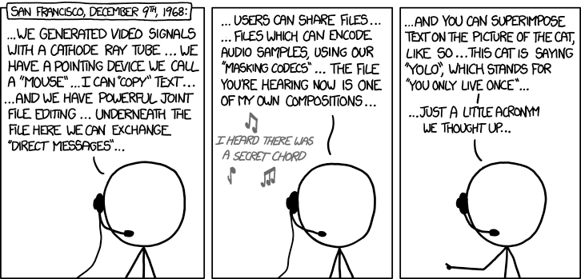
Douglas Engelbart (1925-2013) http://xkcd.com/1234/
Notes:
Highlighted are parts I am unable to find evidence of Engelbart inventing
Video Windowed Display
Mouse Cursor Text Operations including Drag and Drop
Collaborative File Authoring
Email
Video and Audio Teleconferencing with Picture-In-Picture
Personal Computer
Inter Networking
Desktop and Application Sharing
Hierarchical File System and Files
Pattern Search
Interactive Line Drawing
Hyperlinks in and across documents
Graphics tagging and Hyperlinking
Mixed-Object Documents – to provide for an arbitrary mix of text, diagrams, equations, tables, raster-scan images (single frame or live video), spread sheets, recorded sound, etc. – all bundled within a common "envelope" to be stored, transmitted, read (played) and printed as a coherent entity called a "document". Source: http://www.dougengelbart.org/content/view/266/102/

Slide 7
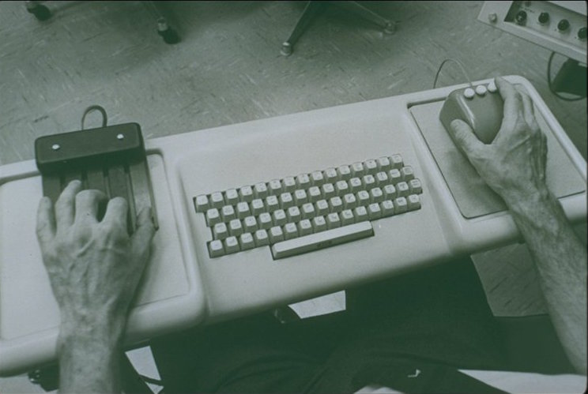
http://dougengelbart.org/images/pix/img0030.jpg
Notes:
Accessed 2019-03-15

Slide 8
Overview
Review
Assignment
Critical Thinking

Slide 9
Assignment – Computing Timeline
Choose a computing technology that you are interested in
Construct a time line of events about this computing technology
  You can choose any scope (time periods, domains, etc.) and format you like
Decide if you would recommend starting/working for a company to further it’s development
Write a 1 page paper arguing for your conclusion using the timeline as a basis
  Use Template - http://socialimps.keithpray.net/assignments/Paper_Template.docx
  Use Guidelines - http://socialimps.keithpray.net/assignments/paper-guidelines/
  Use References - https://socialimps.keithpray.net/assignments/references/
  Include your timeline as an appendix
After you have turned in your paper → Class Timeline Wiki
  Add items from your timeline to Class Site → Wiki Timeline
  Please insert according to date.
  Add your references
  If you encounter any trouble please contact me and our TA/SA to assist
Notes:
Review paper guidelines
Sign up to present in class
Send TA (and me) email
Specify your topic. By that I mean be specific.
I’ll be happy to discuss your ideas.

Slide 10
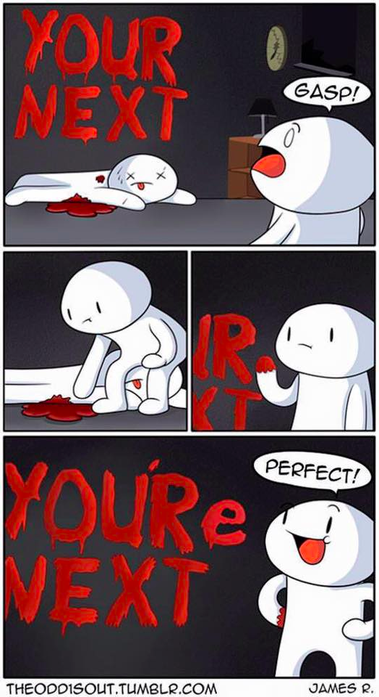
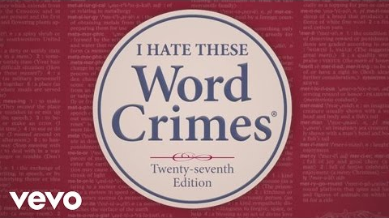

Overview
Review
Assignment
Critical Thinking
  Review Paper Guidelines
Notes:
Review Paper Guidelines
“Weird” Al Yankovic – Word Crimes (2014) (3:45)
https://www.youtube.com/watch?v=8Gv0H-vPoDc
If not shown last class:
What "Orwellian" really means (2015) - Noah Tavlin (5:31)
http://ed.ted.com/lessons/what-orwellian-really-means-noah-tavlin

Slide 11
Logical Arguments
2 or more Claims
Premise
.
.
.
Conclusion
For our 1 page papers it is easiest to start with conclusion:
Bottom Line Up Front (BLUF)
Every A is a B
C is an A
Conclusion: C is a B
Every dog is a canine
Rupert is a dog
Conclusion: Rupert is a canine
Notes:
A basic argument contains 2 or more claims, one of which is the conclusion.
The others are the premises.
The premises should logically lead to the conclusion being true if each in turn is true.
For 1 page papers it is more clear to start with your conclusion. Bottom Line Up Front (BLUF)

Slide 12
Weak Or Strong Arguments
Valid | Invalid
Valid: conclusion logically true
Inductive: conclusion likely true
Fallacious: error in logic
Sound: facts true
All bats are animals
Some wooden objects are bats
Some wooden objects are animals
Inductive | Fallacious
Sound | Unsound
Strong
Weak
Notes:
Valid: Assuming the premises are true, does it logically follow that the conclusion must be true. One way of doing this is to find a counter example where the premises are true but the conclusion is not.
Inductive: If an argument is invalid it could still be inductive, that is it could increase the likelihood that the conclusion is true. Otherwise it might include a fallacy. A fallacy is an error in logic.
Sound: If an argument is valid or inductive the premises should be verified as facts. If they are true the argument is sound, and the argument strong. Otherwise the argument is weak.

Slide 13
IP Protection Is Important To Our Economy
2019 Intangible Assets Financial Statement Impact Comparison Report [1]
Notes:
An example of using data to back a statement:
From the transition of tangible assets to intangible, ie. intellectual property assets we can see today’s global economy is highly dependent on IP and the laws governing its protection.
Note how the 5 largest companies also changed to those who’s main product or business model relies heavily on IP.
TODO: Look into Apple’s split between tangible and IP assets since they do have a very successful manufacturing and physical product base.
TODO: In the 1995 section there is a company labeled "Attria," no company of this size, at that time. I believe it is a misspelled reference to the Altria Group, a tobacco conglomerate formerly known as Phillip Morris. Although this is anachronistic as Altria as a brand name did not begin public rollout until 2001. (contributed by Nathan Smith, 2023)
[1] AON report: 2019 Intangible Assets Financial Statement Impact Comparison Report
Sponsored by AonIndependently conducted by Ponemon Institute LLCPublication Date: April 2019
https://www.aon.com/getmedia/60fbb49a-c7a5-4027-ba98-0553b29dc89f/Ponemon-Report-V24.aspx
Last accessed 2021-09-10

Slide 14
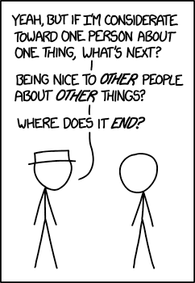
Common Fallacies 1/7
Slippery Slope
  “A baddie might use computers to steal. Therefore we should outlaw computers.”
http://xkcd.com/1332/
Notes:
Another interesting source:
http://www.informationisbeautiful.net/visualizations/rhetological-fallacies/

Slide 15
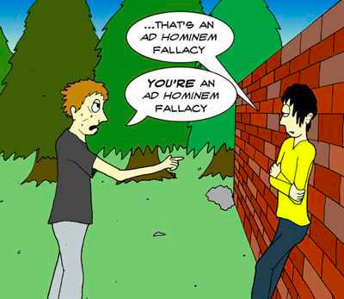
Common Fallacies 2/7
Attack Person, Not Argument
  Ad Hominem
  “He’s a messy eater, obviously his software design will be sloppy and never work.”
http://listverse.com/2012/11/08/15-bad-arguments-we-all-abuse/
Notes:
http://listverse.com/2012/11/08/15-bad-arguments-we-all-abuse/
Accessed 2015-03-19

Slide 16
Common Fallacies 3/7
Begging The Question
  Petitio Principii, Circulus in Probando
  “OO languages are superior to non-OO languages because they have objects as their basic constructs.”
Appeal To Authority
  Ad Vericundiam
  “Ernie, an expert on internet protocols, said MySpace is far superior than Facebook, so it must be so.”
Many / Any
  Faulty/Hasty Generalization
  “Many programming languages such as C, C++, and Java are statically typed. Scheme is a programming language so it is statically typed too.”
Notes:
Static vs. Dynamic Typed: Dynamically-typed languages perform type checking at runtime. Statically typed languages perform type checking at compile time. Statically-typed languages require you to declare the data types of your variables before you use them, while dynamically-typed languages do not.
Strong vs. Weak Typing: is about how strictly types are distinguished. Strongly typed languages do not allow for implicit casts. [2]
Explicit vs. Implicit Typing: is about declaring a variable’s type. Explicit languages force a programmer to clearly ("explicitly") define a variable type during the declaration, while implicit typing languages may infer the type of a variable during compile or interpretation time. [3]
[2] Yedhu Krishnan, Static/Dynamic vs Strong/Weak, http://stackoverflow.com/questions/2351190/static-dynamic-vs-strong-weak (last retrieved August 31, 2016)
[3] Wiz E. Wig, C: Implicit vs. Explicit Typed Variables, https://bitwizards.com/Thought-Leadership/Blog/2014/November-2014/C-Implicit-vs-Explicit-Typed-Variables (last retrieved August 31, 2016)
[4] https://docs.oracle.com/cd/E57471_01/bigData.100/extensions_bdd/src/cext_transform_typing.html (TODO get author and publish date)

Slide 17
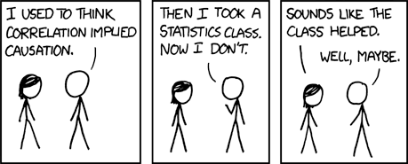
Common Fallacies 4/7
False Cause
  Non Sequitur – post hoc ergo propter hoc
http://xkcd.com/552

Slide 18
Common Fallacies 5/7
Composition / Division
  “All the actors in this movie are highly skilled, the movie must be great.”
  “WPI was founded in 1865 so all the faculty must be over 150 years old.”
Appeal To The People
  Argumentum ad Populum
  Bandwagon Fallacy
  “Windows is installed on more desktop computers than any other OS. Windows is the best OS.”

Slide 19
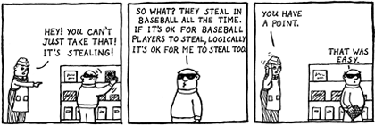
Common Fallacies 6/7
Ambiguity
  Fallacy of Equivocation
  Often a form of conflation.
  Respect – “recognize a right” vs. “hold in high regard”
Notes:
http://www.christianlogic.com/images/uploads/christianlogic_nunaandtoodles_2003_equivocation.png
Accessed 2015-03-19
TODO: get primary source for conflation below
From Wikipedia: (accessed 2012-08-27)
In logic, conflation is the error of treating two distinct concepts as if they were one. The result of conflating concepts may give rise to fallacies of ambiguity, including the fallacy of four terms in a categorical syllogism. For example, the word "bat" has at least two meanings: a flying animal, and a piece of sporting equipment (such as a baseball bat or a cricket bat). If these two meanings are not distinguished, the result may be the following categorical syllogism, which is clearly intended as a joke (pun):
1. All bats are animals.
2. Some wooden objects are bats.
3. Therefore, some wooden objects are animals.
Conflating words with different meanings can cause real confusion. For example, respect is used both in the sense of “recognize a right" and "have high regard for". We can recognize someone's right to the opinion that humanity is controlled by alien lizards in human form, without holding this idea in high regard. But conflation of these two different concepts leads to the notion that all religious ideas, for example, should be treated with respect, rather than just the right to hold these ideas.

Slide 20
Common Fallacies 7/7
Straw Man
  “He says taking Social Imps is a waste of time. He wants you to think computing and society are useless.”
  ”She says OO is not superior. She wants you to put everything in one big main function.”
There are many more…
A nice source:
http://www.informationisbeautiful.net/visualizations/rhetological-fallacies/

Slide 21
Class 2
The End
Keith A. Pray
socialimps.keithpray.net
Notes:
Ask if Appendix B should be moved to the next class.
This is the end. Any slides beyond this point are for answering questions that may arise but not needed in the main talk. Some slides may also be unfinished and are not needed but kept just in case.

Slide 22
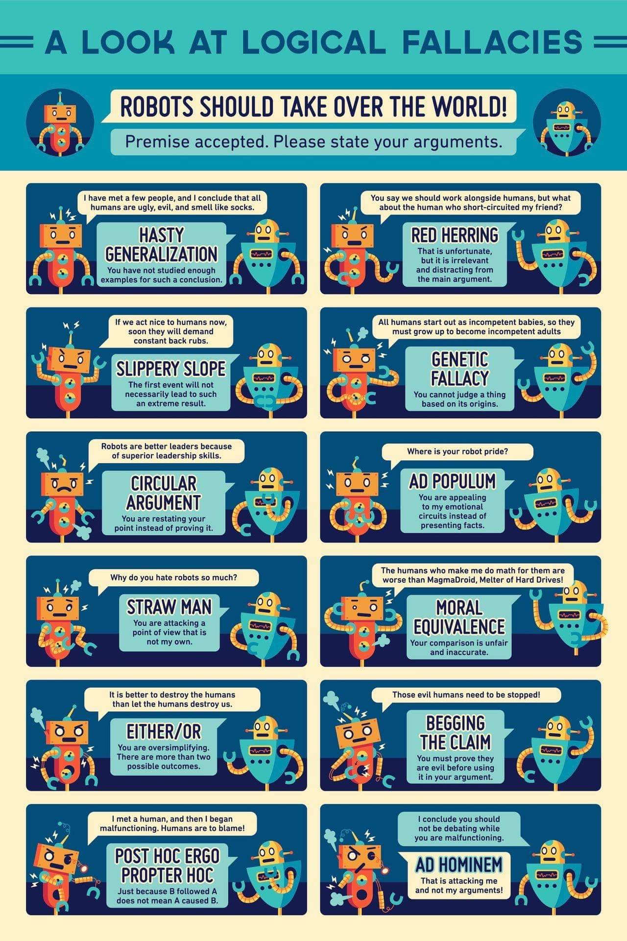
Notes:
TODO: need source

Slide 23
Notes:
TODO: need source.

Slide 24
what works well Online With Zoom
Sign in with First and Last Name
Stay muted unless you are going to speak
To speak use the raise your hand feature
To answer yes/no questions use the “yes” ”no” buttons
Turn your camera on
Wait until the end of student presentations to ask questions
  Write them down so you don’t forget

