Slide 1
Class 12-14
Last Days
Keith A. Pray
socialimps.keithpray.net

Slide 2
Notes:
Automation Paper results. This term’s additions in RED

Slide 3
Papers
Great improvement!
Many students highest grade yet!
More Clear Conclusions
Significant Counter Points
Notes:
Save for next time:
Clearly state conclusion
First statement preferred
Absolute statements are difficult to prove
Avoid: all, always, any, every, everyone, never, none… unless you can show it
Be sure to put quotes around entire quote
Hyperbole is the best thing ever!
but not in these papers
Print 2 sided and save a tree
Use template, saves time (and -1 point)
Include Counter Point and Response
Include Author, Title, Publish Date, Publisher for references
Read paper aloud to proof

Slide 4
Grades
To Date
58 Max Possible
- Discussion 1-12
- Papers 1-4

Slide 5
Overview
Reminder: Course and Group Evaluations
Class 14:
  Students Present
  Students’ Choice

Slide 6
GAMING Crunch Time
Michael Gatti
Notes:
Hello everyone, My name is Michael Gatti and today I will be discussing the ethics surrounding gaming crunch time and how it is damaging the gaming industry.

Slide 7

What is crunch and Crunch Culture?
Michael Gatti
Crunch: "Highly Recommended" Overtime
Crunch Culture
  Abused Passion
  Threat of Unemployment
  Peer Pressure
  Developers are used to it
Up to 100 hours a week [1]
40% of developers have experienced crunch [2]
<Graphic as big as will fit>
Notes:
So the first question that has to be answered is, What is Crunch... Simply put it's something that college students (specifically CS majors) and professors are all too aware of. Let me know if this sounds familiar: late night, pressure building until all you can think about is what font size you are using, with the whole experience coming down to you submitting the project seconds before the due date. In an institute environment, it typically is a result of procrastination, but in the gaming industry, it stems from so many aspects of the job where at this point highly recommended(often unpaid) overtime is expected when coming on as an employee of the company. Now hold on a minute, it may be considered weird that I said highly recommended rather than just saying mandatory. A later slide will provide more detail but to avoid legal prosecution many companies develop something commonly referred to as crunch culture. Your favorite companies such as Epic Games and Activision Blizzard take the passion behind the project, the looming threat of unemployment, and peer pressure to fuel an unhealthy working environment. Beyond creating a negative culture, even the developers have accepted it as part of the work and do not see a problem with working up to 100 hours a week[1]. It is seen as dedication but this common situation has developers damaging their health for hours that are even more than the 80-90 hours seen in many sweatshops[2]. This resulted in a 2019 survey reporting that "around 40% of developers dealt with crunch at least once in the past year." [3]

Slide 8

The effect of crunch On Developers
Michael Gatti
Mental Health Issues
  Stress
  Anxiety
  Depression
Physical Health Issues
  Lack of sleep
  Not eating
"After a few weeks, I wasn't able to sleep, eat, or function" [5]
  Byron Atkinson-Jones, Game Designer
<Graphic as big as will fit>
Notes:
Now lets address the biggest issue, how is this affecting the employees? Working in a stressful environment hours on end for months can damage anyone's mental health severely, and this is exactly what we are seeing in the gaming industry. High levels of stress, anxiety, and depression are all common visitors during the last few months before a game's release date and this has lead to severe health issues. Lack of sleep and not eating enough or even at all take a toll on the developers of your favorite titles. In a technical report done by 10 students and researchers across the US, they cited that not only are lack of job security and heavy work hours stressors[4] from the company onto its employees but also the public perception of their work forces developers to increase the already detrimental stress that they are experiencing. As we all know, social media has enveloped our world for better or in the case of developers, for the worse. CD Projekt RED whose logo is pictured here, is a game developer located in Warsaw Poland. They are famous for their titles such as The Witcher franchise, and Cyberpunk 2077 with the latter being one of the most controversial game releases in the past 5 years. They had a disastrous development and countless delays that lead to death threats from their supposed fans. Even the Senior Game Designer, Andrezej Zawdazki citing that "I understand you're feeling angry, however sending death threats to developers is absolutely unacceptable and just wrong. We are people, just like you." [5] This happens too frequently in the game industry due to social media's perceived shroud of anonymity and leads to developers such as Byron Atikinson-Jones saying that "After a few weeks, I wasn't able to sleep, eat or function". [6]

Slide 9
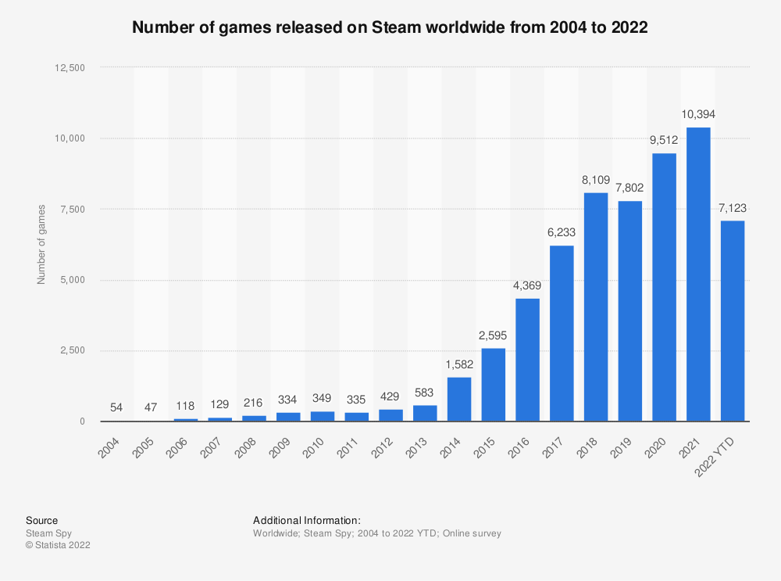
Why is it "needed"?
Michael Gatti
More Games = More Competition
Difference between development and publisher
Overall pressure to keep up
<Graphic as big as will fit>
Notes:
With all of this pain and suffering in this creative field why is it even needed? There are a few answers to this, but as we have seen in class technology is constantly improving and this has led the demand and production of games to both increase. Fortunately, this has lead to the game industry gaining more revenue than the cable industry with the former being valued at a whopping 256 Billion by 2025[7]. As displayed on the graph, on purely steam alone (which is the premier online game distributing website) there have been a total of 10,394 games released on their website alone in the last year.[8] But it leads developers into a cold war-esc arms race to make the best game the fastest. To ensure that the game sells well, there is the game publisher which handles the marketing, and sales of the game. With such a demand and competition they are understandably doing their jobs to make sure they get the biggest slice of the pie possible. This however leads to games being pushed out earlier before full bug testing is completed. The examples that we saw in class with releasing a product too early to meet the early demand are a reality for our developers. It was even stated in a Forbes article that "Releasing a game before it is fully debugged and ready is just a recipe for disaster". [9] This is due to the publisher usually targeting a holiday release date due and this adds to the stress of the developers where they are caught at a crossroad. If they release too early then the product is worse and they are the ones that get the backlash from fans, but if they fully test it then they damage their reputation with the publisher and gain less revenue from their project.

Slide 10
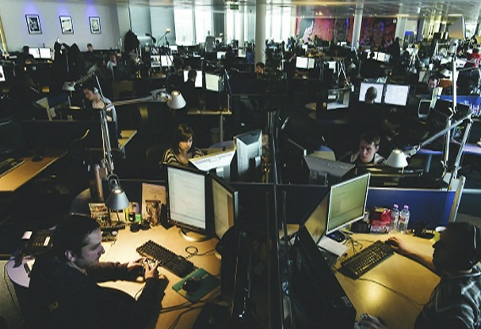
Is it legal? what is being done?
Michael Gatti
Not holding a gun to their head
Use a sense of "family" to force unhealthy habits
Microsoft Purchasing Activision Blizzard
<Graphic as big as will fit>
Notes:
Now you might be wondering how is this even legal, trust me I am too. But the bottom line is that they are not technically forcing the developers to do anything. Many developers use the common defense of having a "gun to the head" but as I stated before there is an expectation to be working as a team or as pittnews describes it "the mindset of working as a "family" means that someone choosing not to crunch while others do can feel selfish or even hold up parts of production"[10]. This is the primary defense from employers about how working an extraordinary amount of hours is legal and how images like this appear. This is an image of Rockstar Games (developers for titles such as Grand Theft Auto) whose spouses wrote a collective letter describing what it was like "living with" a developer who is experiencing a crunch. After a list of complaints including poor work conditions, salary rises that haven't accounted for inflation, and 12-hour workdays including Saturdays. They threatened to proceed with legal action if the work conditions were not improved and work was compensated,[11] but this along with other cases was settled out of court in 2009. [12] Besides community and employee backlash, another way that companies themselves have been addressing the issue is through potential buyouts. One in particular that has been in the news over the last few years has been Microsoft attempting to buy Activision Blizzard which will hopefully reform their notorious poor working environment for the better. However, until there is enough public outcry and crack down on the companies associated with this horrible trend it will continue plaguing the industry.

Slide 11
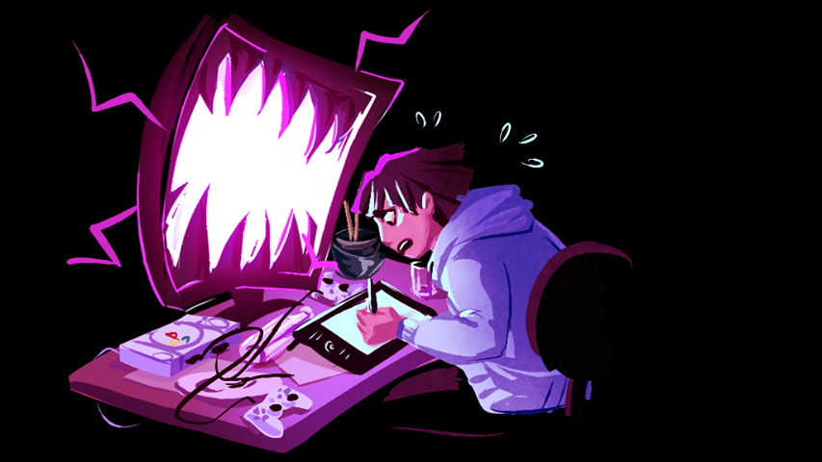
Conclusion
Michael Gatti
Is it legal... yeah, but is it ethical...
Stems from technology generating more demand for games
<Graphic as big as will fit>
Notes:
To wrap this all up I just wanted to review some of the key points and really analyze if it is ethical. The whole situation puts the directors and producers in a tough spot that is torn between being ethically sound according to Act and Rule utilitarianism due to meeting deadlines and generating revenue for the company but damaging the lives of the people in the company. Crunch culture hurts employees and gives them severe health issues both mentally and physically. It even tears apart families due to overworking. It also forces the employees into a mental agreement that is reminiscent of a Social Contract Theory which forces them to develop unhealthy habits just to get the job done. It all stems from the advancing technology making the gaming industry have to adapt. All that has to be said is that the next few years will determine the new standard of working for game developers.

Slide 12
References
Michael Gatti
[1] Taylor, R. (n.d.). Crunch Time in Video Games. ToughNickel. Retrieved October 9, 2022, from https://toughnickel.com/industries/Crunch-Time-in-Video-Games
[2]What Are Common Sweatshop Conditions? (with picture). (n.d.). Smart Capital Mind. Retrieved October 9, 2022, from http://www.smartcapitalmind.com/what-are-common-sweatshop-conditions.htm
[3] Thomsen, M. (n.d.). Why is the games industry so burdened with crunch? It starts with labor laws. Washington Post. Retrieved October 9, 2022, from https://www.washingtonpost.com/video-games/2021/03/24/crunch-laws/
[3]Crevoshay, E., Sawyer, S., Kowert, R., Boccamazzo, R., Dunlap, K., Cocks, J., Skimmons, R., Kocurek, C., VanDenBogaard, J., & Rogers, L. (2019). State of the Industry 2019: Mental Health in The Game Industry. Retrieved October 9,2022, from https://www.researchgate.net/publication/336208930_State_of_the_Industry_2019_Mental_Health_in_the_Game_Industry
[5]CD Projekt RED Death Threats Received Following Cyberpunk 2077 Delay. (2020, October 29). PlayStation LifeStyle. Retrieved October 10,2022, from https://www.playstationlifestyle.net/2020/10/29/cd-projekt-red-death-threats-cyberpunk-2077/
[6] Arguello, D. (2018, October 21). How Crunch Affects the Lives of Game Developers. Digital Trends.Retrieved October 10,2022, from https://www.digitaltrends.com/gaming/how-crunch-affects-game-developers/

Slide 13
References cont.
Michael Gatti
[7]How Much Is the Gaming Industry Worth in 2022? [+25 Powerful Stats]. (n.d.). Techjury. Retrieved October 12, 2022, from https://techjury.net/blog/gaming-industry-worth/
[8] Steam Spy. (September 5, 2022). Number of games released on Steam worldwide from 2004 to 2022 [Graph]. In Statista. Retrieved October 10, 2022, from https://www.statista.com/statistics/552623/number-games-released-steam/
[9] Barder, O. (n.d.). When Games Are Rushed To Release Who Is To Blame? Hint: It’s Not The Testers. Forbes. Retrieved October 13, 2022, from https://www.forbes.com/sites/olliebarder/2014/11/17/when-games-are-rushed-to-release-who-is-to-blame-hint-its-not-the-testers/
[10] Manager, T. D., & McDevitt, S. (2022, February 28). Level Up! | Crunch culture in the gaming industry. The Pitt News. Retrieved October 13,2022, from https://pittnews.com/article/171814/blogs/level-up-crunch-culture-in-the-gaming-industry/
[11]Brice, K. (2010, January 11). Rockstar Spouse" accuses dev of pushing its employees "to the brink. GamesIndustry.Biz.Retrieved October 12, 2022, from https://www.gamesindustry.biz/rockstar-spouse-accuses-dev-of-pushing-its-employees-to-the-brink
[12]Rockstar quietly settled class-action lawsuit with “over 100” ex-Rockstar San Diego employees. (n.d.). Engadget. Retrieved October 13, 2022, from https://www.engadget.com/2010-01-15-rockstar-quietly-settled-class-action-lawsuit-with-over-100-ex.html

Slide 14
The ethics of digital sports betting
Krish Shah-Nathwani
Notes:
Hello everyone, my name is Krish Shah-Nathwani and today I will be telling you all about the ethics of digital sports betting.

Slide 15
Conclusions
Krish Shah-Nathwani
Increased accessibility of sports betting is not beneficial to society
Sports betting should be better regulated in order to decrease addiction
Notes:
After careful consideration and research, I believe that [say conclusions].

Slide 16
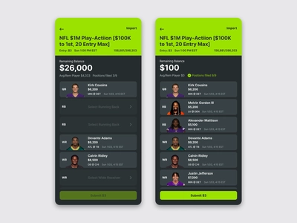
What is digital sports betting?
Krish Shah-Nathwani
Gambling on sports, but online
Draft Kings is biggest platform
<Graphic as big as will fit>
[7] https://dribbble.com/shots/14859900-DraftKings-Quick-Design-Concept
Notes:
First of all, for the sake of this presentation, we are going to examine Draft Kings, the leading platform for digital sports betting. To place a bet, you simply find an outcome you would like to bet on, and add it to yourbet slip [1]. You can add up to 12 picks to your bet slip. It is as simple as this.. Over the last 3 or so years, Draft Kings have gained immense popularity. From 2020 to 2021 alone, their users went up by 110% [2]. Additionally, as digital sports betting becomes legal in more and more states, revenue increases. Draft Kings made $1.3 billion in 2021 [2].

Slide 17
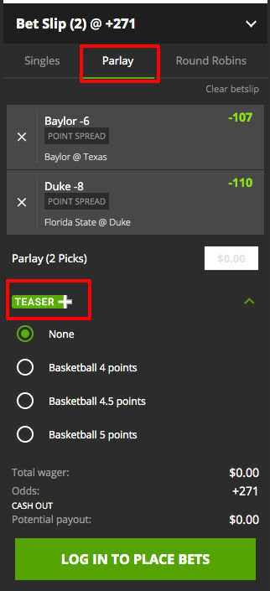
How does it work?
Very simple
Up to 12 bets per slip
$2,000 daily maximum for most accounts
[8] https://images.actionnetwork.com/blog/2020/02/Screen-Shot-2020-02-10-at-4.jpg
Notes:
This is what a standard Draft Kings bet looks like, you can make 12 of these per bet slip.

Slide 18
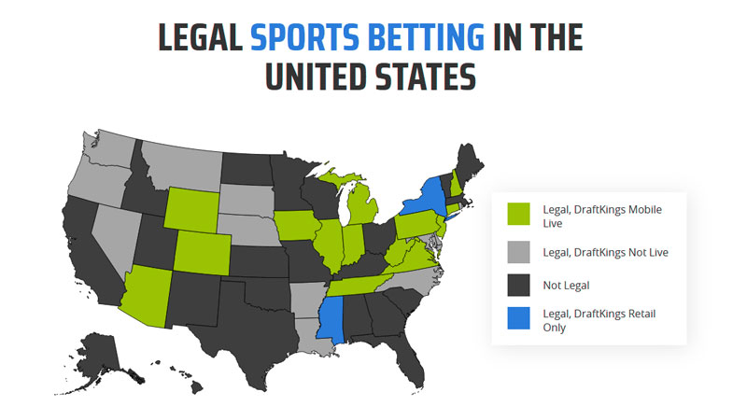
legality
Krish Shah-Nathwani
DraftKings sportsbook legal in 17 states
Legal Sports-Betting in 30 states in some form
[9] https://www.esports.net/fantasy/is-draftkings-legal/
Notes:
DraftKings is slowly becoming legal in more and more states. Sports betting is legal in some form in 30 states and Draft Kings is legal in 17 [3]. Draft Kings also has a sportsbook outpost set up in Ontario, Canada, meaning that they are hoping to further expand as more states legalize sports betting.

Slide 19
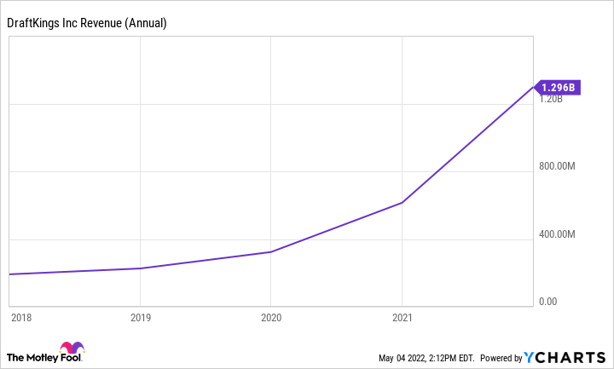
Digital vs. in person sports betting
Krish Shah-Nathwani
“I had to get in a car, I had to have gas money, I had to have three, four hours to go gamble,” Hatch said. “If I’m on my phone, I don’t need that time. I can do it anytime” (Marketplace)
More accessible = more addictive
[10] https://www.fool.com/investing/2022/05/05/can-draftkings-sustain-blistering-revenue-growth/
Notes:
The increased accessibility and convenience of sports betting have led to a drastic increase in users. Looking at this figure we can see that Draft Kings users have grown exponentially over the last 3 years. According to Casino.org, approximately 80% of all sports betting is done online [4]. These two factors combined, will lead to continued increase in online sports betting, thus allowing the problem cycle to repeat.

Slide 20
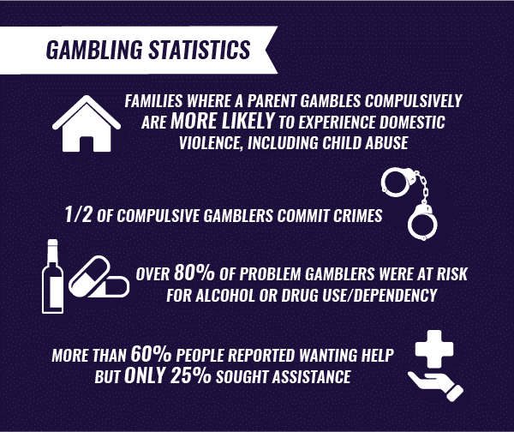
Gambling Addictions
Krish Shah-Nathwani
Young adults have a problem
1% of adults have a severe gambling problem
<Graphic as big as will fit>
[11] https://www.therecoveryvillage.com/process-addiction/compulsive-gambling/gambling-statistics/
Notes:
With the increase in accessibility of gambling, it is plausible that there will be an increase in gambling addictions. 6 to 9 percent of young adults have some sort of gambling problem [5]. Because online gambling is barely regulated, those 21 or over are at risk of forming gambling addictions. Without regulation this problem will only continue to grow. It is estimated at 23 million americans are suffering from financial hardship due to gambling [6]. It is important that we take measures to prevent more people from being added to this number.

Slide 21

Solution
Krish Shah-Nathwani
Add in limits to amounts of bets placed per day
Regulate spending limits
[12] https://emojipedia.org/thumbs-up/
Notes:
While digital sports betting is a growing business, it's important to keep in mind that we must consider the well being of the consumers. Because of the easy access and lack of regulation, gambling addictions will grow if these sites aren’t kept in check. [Say solutions]. Hopefully if these solutions are implemented, this problem can be contained, and the severity of addictions can be lessened.

Slide 22
References
Krish Shah-Nathwani
[1] https://sportsbook.draftkings.com/help/quick-start-guide/2?wpsrc=Organic%20Search&wpaffn=Google&wpkw=https%3A%2F%2Fsportsbook.draftkings.com%2Fhelp%2Fquick-start-guide%2F2&wpcn=help&wpscn=quick-start-guide%2F2
[2] https://www.fool.com/investing/2022/05/05/can-draftkings-sustain-blistering-revenue-growth/
[3] https://www.forbes.com/betting/sports-betting/where-is-sports-betting-legal/#:~:text=DraftKings%20Sportsbook%20States,-The%20company%20that&text=DraftKings%20operates%20in%2017%20states,mobile%20and%2For%20retail%20outlets.
[4] https://www.casino.org/news/most-sports-betting-is-online-as-more-states-plan-to-go-mobile/
[5] https://www.icrg.org/sites/default/files/oec/pdfs/ncrg_fact_sheet_gambling_disorders.pdf
[6] https://www.karinalucidlaw.com/online-gambling-and-bankruptcy/
[7] https://dribbble.com/shots/14859900-DraftKings-Quick-Design-Concept
[8] https://images.actionnetwork.com/blog/2020/02/Screen-Shot-2020-02-10-at-4.jpg
[9] https://www.esports.net/fantasy/is-draftkings-legal/
[10] https://www.fool.com/investing/2022/05/05/can-draftkings-sustain-blistering-revenue-growth/
[11] https://www.therecoveryvillage.com/process-addiction/compulsive-gambling/gambling-statistics/
[12] https://emojipedia.org/thumbs-up/

Slide 23
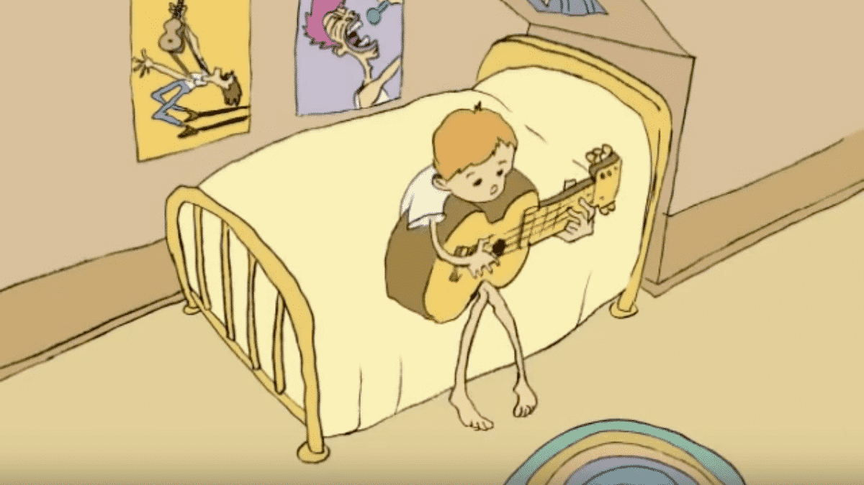

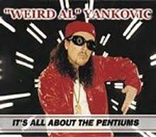
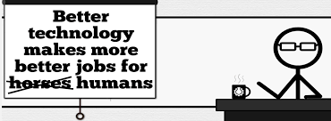





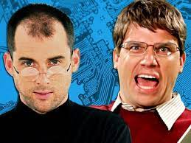
Student Choice – Interesting Videos (1/2)
  Don’t Download This Song (2006)
  - Weird Al (3:53)
  It’s All About The Pentiums (1999)
  - Weird Al (3:34)
  White and Nerdy (2006)
  - Weird Al (2:50)
  Virus Alert (2006)
  - Weird Al (3:43)
  Word Crimes (2014)
  - Weird Al (3:45)
  Copyright: Forever Less One Day (2011)
  - CGP Grey (6:27)
  Humans Need Not Apply (2014)
  - CGP Grey (15:00)
  This Video Will Make You Angry (2015)
  - CGP Grey (7:25)
  Will automation take away all our jobs? (2016) – David Autor (18:27)
  Epic Rap Battles of History: Steve Jobs vs. Bill Gates (2013) (2:47)
Notes:
David Autor
Will automation take away all our jobs? (18:27) (2016)
https://www.ted.com/talks/david_autor_will_automation_take_away_all_our_jobs/transcript?language=en
TEDxXambridge, 2016-12-19
All Last Accessed 2018-10-04
CGP Grey
Copyright: Forever Less One Day (6:27)
https://www.youtube.com/watch?v=tk862BbjWx4
CGP Grey
Humans Need Not Apply (15:00) – 2014-08-13
http://www.youtube.com/watch?v=7Pq-S557XQU
Last access 2016-04-22
CPG Grey
This Video Will Make You Angry [Thought Germs] (7:25) – 2015-03-10
https://www.youtube.com/watch?v=rE3j_RHkqJc
Weird Al – It’s All About The Pentiums (3:34)
https://www.youtube.com/watch?v=qpMvS1Q1sos
TODO: Tie into Ray Kurzweil Singularity
Epic Rap Battles of History: Steve Jobs vs. Bill Gates (If class ok with obscene lyrics) (2:47)
https://www.youtube.com/watch?v=njos57IJf-0
Also Work links on web site http://socialimps.keithpray.net/documents/
-----
Passphrases (2:08 need to give context for video)
https://firstlook.org/theintercept/2015/03/26/passphrases-can-memorize-attackers-cant-guess/
If not shown during first class
What "Orwellian" really means - Noah Tavlin (5:31)
http://ed.ted.com/lessons/what-orwellian-really-means-noah-tavlin
Weird Al – White and Nerdy (2:50) and look at lyrics
https://www.youtube.com/watch?v=N9qYF9DZPdw
Weird Al Yankovic “Don’t Download This Song” (3:53)
2006-08-21 released exclusively as digital download
https://www.youtube.com/watch?v=zGM8PT1eAvY
Styx - Mr. Roboto (1983) (5:34)
https://www.youtube.com/watch?v=uc6f_2nPSX8
Epic Rap Battles of History: Steve Jobs vs. Bill Gates (If class ok with crude lyrics) (2:47)
https://www.youtube.com/watch?v=njos57IJf-0

Slide 24








Student Choice – Interesting Videos (2/2)
  MSNBC on Denver's Automated Baggage System (2010) (2:27)
  Last Week tonight with John Oliver (2015) Snowden (33:14)
  3D Printed Homes (2018)
  - News Story (1:28)
  The Game Of Trust (2017) - Nicky Case
  What "Orwellian" really means (2015)
  - Noah Tavlin (5:31)
  Why Electronic Voting is Still a Bad Idea (2019)
  - Tom Scott (12:00)
  Welcome To Life (2012)
  - Tom Scott (2:44)
  Mr. Roboto (1983)
  - Styx (5:34)
Notes:
All Last Accessed 2018-10-04
Last Week tonight with John Oliver – Patriot Act, Edward Snowden (33:14)
http://www.upworthy.com/john-oliver-flew-10-hours-to-russia-to-interview-edward-snowden-and-get-him-on-record?c=ufb1
TODO: Tie into Ray Kurzweil Singularity
Epic Rap Battles of History: Steve Jobs vs. Bill Gates (If class ok with obscene lyrics) (2:47)
https://www.youtube.com/watch?v=njos57IJf-0
Also Work links on web site http://socialimps.keithpray.net/documents/
-----
Passphrases (2:08 need to give context for video)
https://firstlook.org/theintercept/2015/03/26/passphrases-can-memorize-attackers-cant-guess/
If not shown during first class
What "Orwellian" really means - Noah Tavlin (5:31)
http://ed.ted.com/lessons/what-orwellian-really-means-noah-tavlin
MSNBC on Denver's Automated Baggage System 2010-08-23 (2:27)
https://www.youtube.com/watch?v=xx8f4x6C_KY
Accessed 2019-04-09
These 3D printed homes can be constructed for $4,000 (3:00 – 2018-04-02)
http://www.businessinsider.com/3d-printed-homes-constructed-icon-new-story-tech-charity-4000-dollars-2018-3
https://www.youtube.com/watch?v=SvM7jFZGAec (1:28)
Last access 2018-04-22
Why Electronic Voting is a BAD Idea – Computerphile (Tom Scott) (8:20)
https://www.youtube.com/watch?v=w3_0x6oaDmI
Tom Scott
http://tomscott.com
Welcome To Life (2:44)
https://www.youtube.com/watch?v=IFe9wiDfb0E&feature=youtu.be

Slide 25
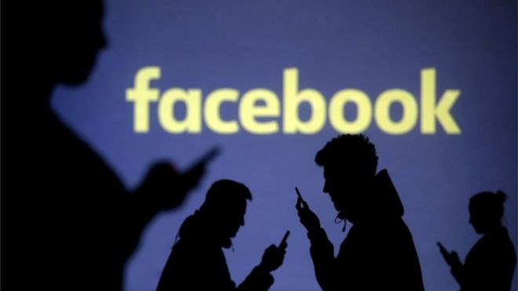
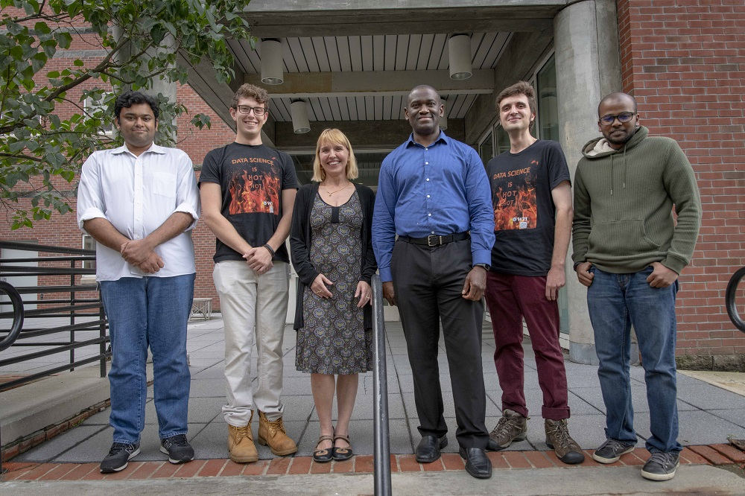

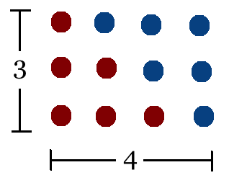
Student Choice – Interesting Articles 1/2
Communications of The ACM – Latest edition (through library)
Facebook security breach: Up to 50m accounts attacked - Dave Lee, North America technology reporter, 2018-09-29
WPI Secures $2.8 Million to Develop a Smartphone App to Help Assess the Health of Soldiers, 2018-09-24
Quantified Toilets, 2014, Quantified Toilets LLC
What a Toilet Hoax Can Tell Us About the Future of Surveillance – Jennifer Golbeck, The Atlantic, 2014-04-29
What Did Ada Lovelace's Program Actually Do? - Sinclair Target, 2018-08-18 (First Programming Bug 1843?)
Notes:
All Last Accessed 2021-04-03

Slide 26
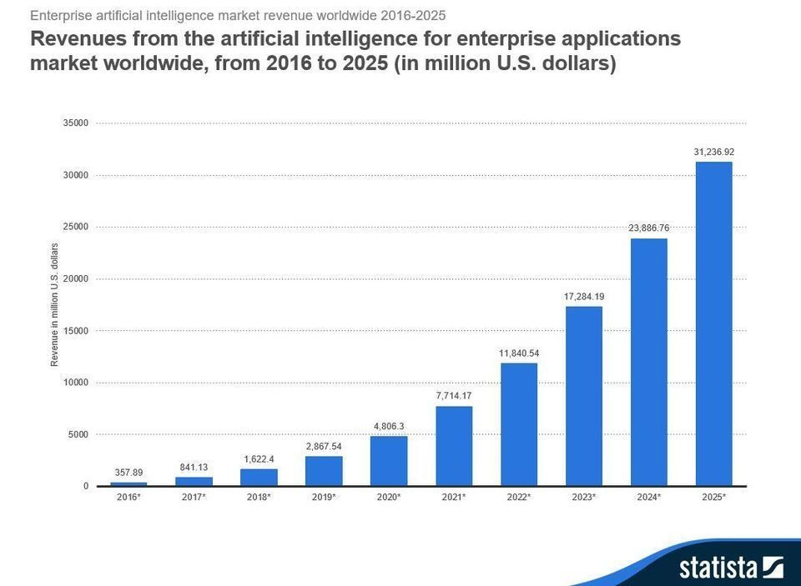



Student Choice – Interesting Articles 2/2
We know ethics should inform AI. But which ethics? - Mauro Guillen, World Economic Forum, 2018-07-26
MIT-born Spyce raises $21M to open new robotic restaurants - Lucia Maffei, BostInno, 2018-09-07
The Coders Programming Themselves Out of a Job - Brian Merchant, The Atlantic, 2018-10-02
Berkshire Hathaway’s Stock Price Is Too Much for Computers - Alexander Osipovich, The Wall Street Journal, 2021-05-05 (approaching $429,496.7295 32 bit limit) (access limited)
Notes:
All Last Accessed 2021-04-03
Spyce image: https://www.engadget.com/2018/05/04/boston-robotic-kitchen-spyce/ , 2018-05-04
Coders Programming Themselves Out of a Job image: Gabrielle Lurie, Reuters (date unknown)

Slide 27
Class 12-14
The End
Keith A. Pray
socialimps.keithpray.net

