Slide 1
Class 10
Professional Ethics
Keith A. Pray
socialimps.keithpray.net

Slide 2
Remote With Zoom
Sign in with First and Last Name
Stay muted unless you are going to speak
To speak use the raise your hand feature
To answer yes/no questions use the “yes” ”no” buttons
Turn your camera on
Wait until the end of student presentations to ask questions
  Write them down so you don’t forget

Slide 3
Overview
Review
Debate
Assignment
Students Present
Notes:
ADD QUIZ AS BACKUP IF CLASS DISCUSSION NOT LONG ENOUGH

Slide 4
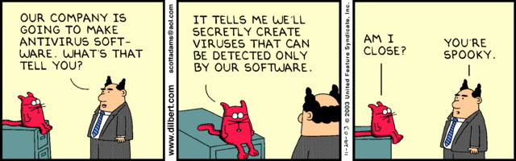
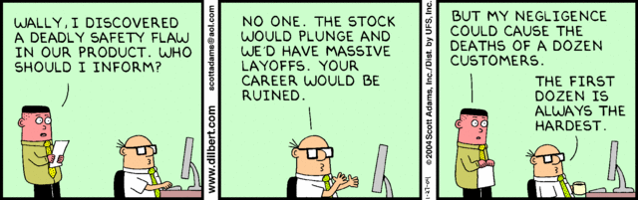
Notes:
Ask how many people in ACM or IEEE

Slide 5
Debate Ground Rules
Before Debate
  Add “(YES)” or “(NO)” to the end of your name in Zoom to show your side
  10 minutes to converse with your team
  Share argument points, counter points, and responses
  Share experiences, especially in different countries, cultures, situations
  Decide who will: Go first, Respond to which points from opposing side
During Debate
  1 turn per person until everyone on your team has spoken
  Try to keep remarks to 30 seconds
  Switch sides at any time if you change your mind
Notes:
Release Game or Not Debate
Chapter 9 In-class Exercises # 24.
Should the company produce the game?
Use the SWE Code Of Ethics as the basis for your argument.
If Remote:
Add “(YES)” or “(NO)” to the end of your name in Zoom to show your side

Slide 6
Assignment
1 Page Paper
  What should computerized automation be applied to next?
Finish all reading
Group Project
  Add analysis to website addressing remaining topics
  Group Presentation Draft
    Submit as Power Point on Canvas
    Post Power Point file on group website
Notes:
1 Page Paper Ideas:
For Good - How will you use your computing related education to do good in the world?
Dark Net - Is the Dark Net good or bad?
Does computerized automation help the economy or society?
What should computerized automated be applied to next?
If productivity has increased so much, why are we working so hard? Should we?
What job skills will survive computerized automation?

Slide 7
Overview
Review
Debate
Assignment
Students Present
Notes:
Show WPI and/or corporate code of ethics.

Slide 8
Do Artificially Intelligent Entities Deserve Rights?
Jonathan Hsu

Slide 9

Rapid Advance of AI Models
Jonathan Hsu
Pace of development increases exponentially with technological advancement
  Consumer-grade computers now capable of producing complex AI models using only 8 GB of VRAM [1]
  Complex heuristic functions can be modified with additional training
Perovskite nickelate chips can imitate neuronal development [6]
Notes:
Arguing for the eventual adoption of rights for artificially intelligent beings, we approach this argument from two perspectives:
AI advances towards becoming more human-like
Humanity advances in the same direction, and augments itself to a transhuman and eventual posthuman state
I believe that artificially intelligent entities deserve rights, as the differences between these non-human minds those of us humans will eventually diminish.
We have already seen massive generational increases in Stable Diffusion AI Models in just a single month
- My own consumer-grade RTX 3060TI is capable of further refining a Stable Diffusion model that is readily available
- Perform reinforcement training to modify the heuristic functions that govern how Stable Diffusion generates images
- Able to “learn” from the styles of artists if their work is fed into training data
The image on the right-hand side is an example of just how quickly these AI models have progressed. In just a single month, we have seen Dall-E 2 and Stable Diffusion models increase rapidly, and they are now able to mimic the styles of prominent artists, as well as generate accurate human faces which is something that they struggled with before.
Researchers at the School of Materials Engineering at Purdue developing hardware
- Most of the discussion focuses on whether the software implementation of an Artificial Intelligence can mimic human thought
- If these perovskite nickelate chips can imitate how the neurons behave in a human brain, this brings them one step closer to being able to develop into an entity physically similar to the function of a human brain

Slide 10
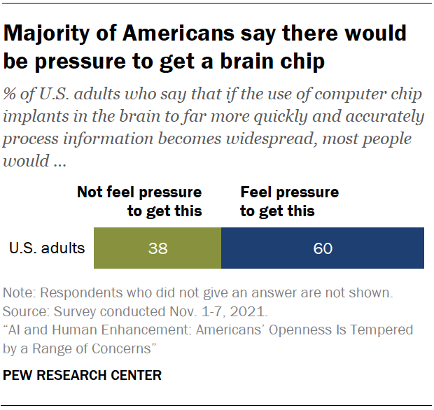
Transhuman and Posthuman Existence
Jonathan Hsu
As humanity progresses, people will adopt brain/mind-altering technology
  Implantable communication device research began in 1970s, has allowed disabled patients to communicate [3]
Companies such as Neuralink and Synchron starting trials
  Neuralink equipping itself for human trials lacking FDA approval [4]
  Synchron capable of implanting device without skull or tissue damage [5]
Notes:
Humans tend to adopt technologies as they become readily available in order to augment their own lives
- Research began in 1970 with J. J. Vidal reading electrical impulses off of the scalps of human patients
- Evidenced by fast-paced adoption of cellular communication devices, which augment personal computing ability by providing internet connectivity to greatly enhance the knowledge-base people can draw upon
- Implantable technology could approach this same function, giving humanity access to a wide database of information
The image on the right shows that recent studies from the Pew Research Center (Nov, 2021) show that more than half of US adults would feel pressure to receive a computer chip in their brain. This demonstrates how people believe that eventually society will trend towards the mass adoption of these devices, and that they would feel the need to utilize these implanted chips themselves in order to stay relevant and keep up with the cognitive advances of their peers.
Research in this field began just 50 years ago in 1970, with the first efforts being focused on allowing humans to regain function after paralysis
- Firms such as Neuralink and Synchron are already beginning trials, with Synchron having secured FDA approval for human trials in July of 2021
-Synchron implanted its first Stentrode system into a human patient in July 2022 in NYC
- Clinical and bioanalytical studies began just one month afterwards

Slide 11
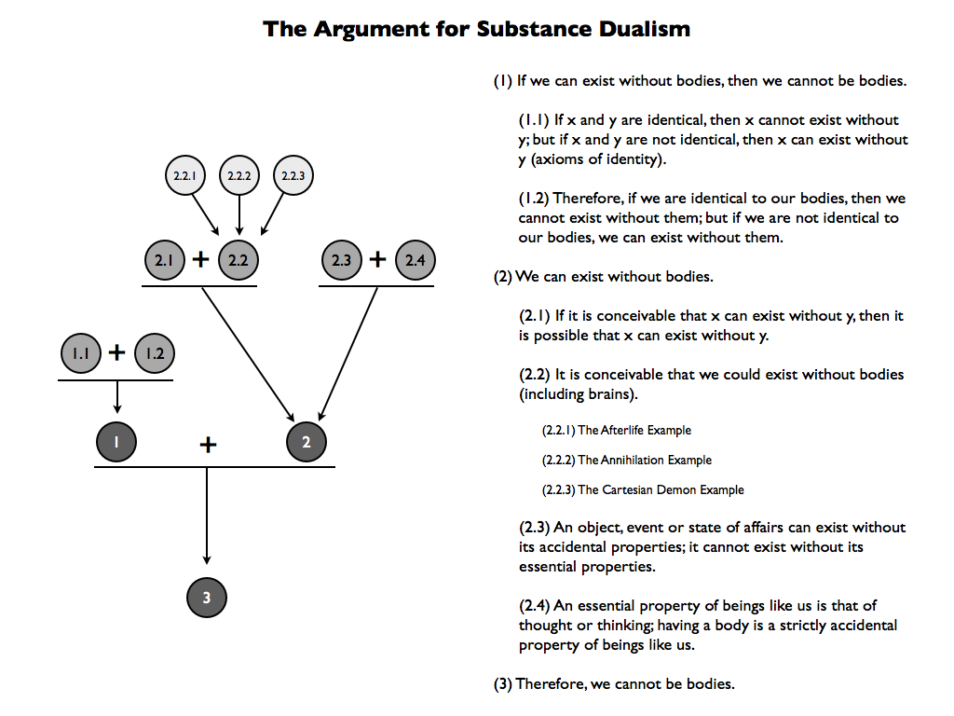
Mental Illness Indicating Humanity
Jonathan Hsu
Mental illness is attributed to humans and complex minds [8]
  David Chalmers’ theory of consciousness refutes physicalism
  AI consciousness can be considered separately from physical/software representation
Mental illness in AI could point to a conscious entity
  Ashrafian’s hypothetical case of mental illness in AI[7]
Notes:
Many philosophers and psychiatrists alike attribute mental illness to human consciousness, or consciousness of the mind in general
- David Chalmers posits that mental illness is a component of the human mind’s consciousness and that consciousness and sentience cannot be fully explained by physical properties.
- If we invest in this school of thought, then the ability for an artificial intelligence to gain consciousness should not be completely rooted in their physical or software representation, but their ability to “feel” aware
- Ashrafian poses a hypothetical: if a combat robot equipped with an AI exhibits mental illness, has it gained consciousness
The figure on the right demonstrates an example of an argument for substance dualism, laying out how the human consciousness can be perceived as separate from the mechanical component of our existence. Another example of an argument for substance dualism would be the idea of a philosophical zombie, also know as a p-zombie. If a human is able to be duplicated, and made physically identical but does not have conscious experience, then it can be said that the human consciousness is separate from the physical body. There are arguments for and against the logical possibility of p-zombies existing (however that is outside the scope of the class).
If an AI could exhibit mental illness, then should it be considered conscious?
- If we base our definition of what constitutes consciousness (human) on substance dualism, then there is a logical argument to be found in Ashrafian’s and Chalmer’s materials

Slide 12
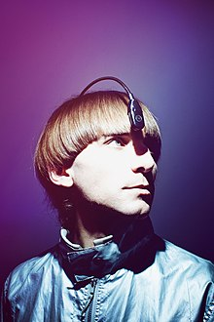
Towards Cyborgs
Jonathan Hsu
There are real-world examples of cyborgs [9]
  Neil Harbisson has an internet-connected node attached
  Moon Ribas is able to detect seismic activity over a threshold
Theseus’ Ship
  At what point do we consider these people to no longer be human?
  They should still have the same rights as us
Notes:
The advancement of humanity itself as it attaches technology to its body could see humans reach towards what we now call an artificially intelligent existence
- Neil Harbisson has an antenna implanted in his skull that allows him to have phone calls, music, videos, and images translated into vibrations. His antenna has been able to receive signals and data from satellites.
- Moon Ribas can detect earthquakes above a 1.0 on the Richter Scale, which she says gives her a greater connection with nature
The image on the right shows Neil Harbisson wearing the connected device on the end of his implanted antenna. I believe that most casual observers would see him and still classify him as a human. How far would an individual such as Neil have to augment their mind and body to no longer be consider human? Are humans considered humans because they started their lives as one?
We face a Theseus’ ship-type problem, where we will have to decide at what point a human is no longer considered to be one and is instead a transhuman or posthuman existence.
- I believe that since these entities were once considered human, that the humans of that time will still elect to grant them rights just like any other human
- Conversely, as an AI begins to exhibit more and more traits that are associated with humans, such as mental illness or emotions, we encounter the inverse of this problem

Slide 13
Closing Remarks
Jonathan Hsu
Decision needs to made about when to begin treating AI entities similarly to humans
  All self-evolving artificial intelligences should be granted basic rights
  Should the same question be asked about cyborgs/posthumans
The legislation created regarding this field will impact public perceptions [10]
  The general public’s sentiments will reflect the wording of legislation
  AIonAI law has already been proposed, recognizing rights of AI
Notes:
As we can see from the examples listed before, humanity has already begun a transformation (evolution?) into existences with distinctly non-human traits
- Prosthetics, neural implants, can all be classified as augmentations that have been made to the human body
- Brain-in-a-jar existence is something that people have looked towards as an answer for human mortality
If legislation is drafted to help define the dignity and rights of artificial intelligences, then they could very easily become belittled and cruelly mistreated, despite them potentially possessing consciousness and emotions
- The process has already been started by the proposal of AIonAI, a law of rights that “recognize inherent dignity and the inalienable rights of artificial intelligences”
- This legislation was proposed in 2014, and there has been no formal progress made since then. Most legislation focuses on the implications of utilizing AI, which presupposes that AI will never progress beyond mere tools for humanity to use

Slide 14
References
Jonathan Hsu
[1] "Compvis/Stable-Diffusion · Hugging Face". Huggingface.Co, 2022, https://huggingface.co/CompVis/stable-diffusion.
[2] Ho, Jonathan, and Tim Salimans. "Classifier-Free Diffusion Guidance". Arxiv.Org, 2022, https://arxiv.org/abs/2207.12598.
[3] Hochberg, Leigh R et al. “Neuronal ensemble control of prosthetic devices by a human with tetraplegia.” Nature vol. 442,7099 (2006): 164-71. doi:10.1038/nature04970
[4] Musk, Elon. "An Integrated Brain-Machine Interface Platform With Thousands Of Channels". Journal Of Medical Internet Research, vol 21, no. 10, 2019, p. e16194. JMIR Publications Inc., doi:10.2196/16194.
[5] Oxley, Thomas J et al. "Motor Neuroprosthesis Implanted With Neurointerventional Surgery Improves Capacity For Activities Of Daily Living Tasks In Severe Paralysis: First In-Human Experience". Journal Of Neurointerventional Surgery, vol 13, no. 2, 2020, pp. 102-108. BMJ, doi:10.1136/neurintsurg-2020-016862.

Slide 15
References
Jonathan Hsu
[6] Hai-Tian Zhang. “Reconfigurable perovskite nickelate electronics for artificial intelligence”. Science.org, 2022, https://www.science.org/doi/10.1126/science.abj7943
[7] Ashrafian H. Can Artificial Intelligences Suffer from Mental Illness? A Philosophical Matter to Consider. Sci Eng Ethics. 2017 Apr;23(2):403-412. doi: 10.1007/s11948-016-9783-0. Epub 2016 Jun 28. PMID: 27351772; PMCID: PMC5364237.
[8] " Mental Disorder (Illness) (Stanford Encyclopedia Of Philosophy) ". Plato.Stanford.Edu, 2022, https://plato.stanford.edu/entries/mental-disorder/#Bib.
[9] Alcaraz, Aleksandra Łukaszewicz. "Cyborgs’ Perception, Cognition, Society, Environment, And Ethics: Interview With Neil Harbisson And Moon Ribas, 14 October 2016, Ace Hotel, New York City". Journal Of Posthuman Studies, vol 3, no. 1, 2019, pp. 60-73. The Pennsylvania State University Press, doi:10.5325/jpoststud.3.1.0060.
[10] Ashrafian, Hutan. "Aionai: A Humanitarian Law Of Artificial Intelligence And Robotics". Science And Engineering Ethics, vol 21, no. 1, 2014, pp. 29-40. Springer Science And Business Media LLC, doi:10.1007/s11948-013-9513-9.

Slide 16
Image Citations
Jonathan Hsu
[1] Andres Guadamuz, Dall-E 2 generated image mimicking style of Simon Stalenhag, https://www.wired.com/story/artists-rage-against-machines-that-mimic-their-work/
[2] "Majority Of Americans Say There Would Be Pressure To Get A Brain Chip". Pew Research Center: Internet, Science & Tech, 2022, https://www.pewresearch.org/internet/2022/03/17/ai-and-human-enhancement-americans-openness-is-tempered-by-a-range-of-concerns/ps_2022-03-17_ai-he_06-03/.
[3] Danaher, John. "Substance Dualism (Part Three): The Problem Of Other Minds". Philosophicaldisquisitions.Blogspot.Com, 2011, https://philosophicaldisquisitions.blogspot.com/2011/05/substance-dualism-part-three-problem-of.html.
[4]

Slide 17
DARPA: Do the ends justify the means?
Jacob Reiss

Slide 18

What is Darpa?
Jacob Reiss
Defense Advanced Research Projects Agency
Founded in 1958 [1]
Notes:
DARPA started in response to Sputnik launch
Fueled by cold war fear
Originally called ARPA
Part of DoD

Slide 19
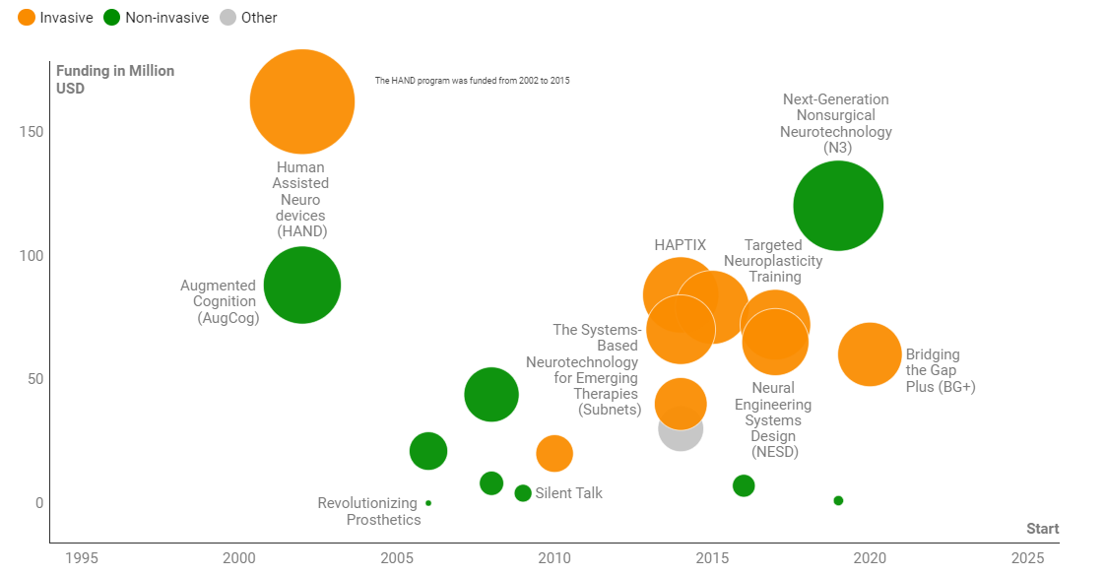
The Wonderful Contributions of Darpa
Jacob Reiss
Siri [2]
Global Positioning System (GPS) [3]
Internet [4]
Neural Implants [5] [7]
Advancements in insect research [6]
DARPA Funding for BCI Over Decades [8]
Notes:
Siri is a spinoff of CALO, an AI made by DARPA for organizational purposes
Internet started out as ARPANET, used for sharing information over large distances
While DARPA did not invent neural implants, they have heavily invested in improving the technology -> advances in medicine
While DARPA did not invent these technologies, they helped fund/kick start them
BCI: Brain-Computer Interface
DARPA has basically funded all the technology in the BCI field, and continues to do so

Slide 20
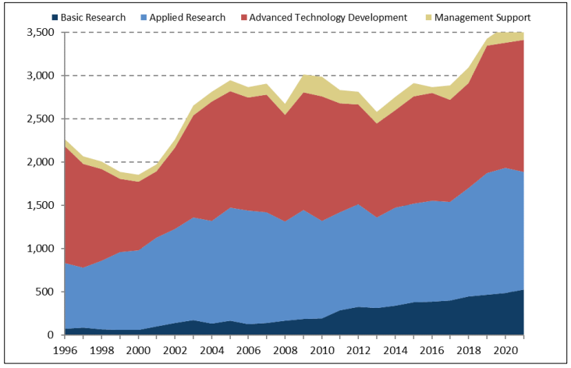
Motivations behind Them
Jacob Reiss
DARPA Funding [9]
(in millions of dollars)
Improve office efficiency
Locating soldiers
Military communications
Long distance close combat
Collection and manipulation of environmental data
Notes:
CALO: Improve efficiency in office tasks
GPS: tracking enemy persons of interest and our home soldiers
ARPANET: decentralize intel sharing so information can be shared anywhere without being taken out by an attack
Neural Implants: making “super soldiers” [4]
Insect research: gathering of environmental data; identifying problems is a byproduct- intention is to weaponize environment
also used in surveillance

Slide 21
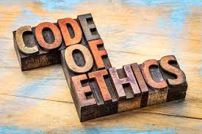
What needs to be done
Jacob Reiss
Reform code of ethics
Change motivation
Subject itself to scrutiny
Notes:
Currently, DARPA’s code of ethics is lacking, and concerns many [6].
DARPA was founded for the sake of defense, however in practice it works to promote violence rather than just protect us [7]

Slide 22

What ethical theory should we use?
Jacob Reiss
Ethics of Care! [10]
Often overlooked
Caring for those we are responsible for
Addresses problem with “logical reasoning”
<Graphic as big as will fit>
Notes:
Concept from feminist theory
Highlights the importance of emotions and feelings where “rationality” fails to
Focuses on those we affect without the constraints of loyalty
Be kind instead of cold and calculating

Slide 23
References
Jacob Reiss
[1] DARPA. https://www.darpa.mil/about-us/about-darpa. Accessed: 9/27/22.
[2] SRI International. “Artificial Intelligence: CALO.” https://www.sri.com/hoi/artificial-intelligence-calo/. Accessed: 9/27/22
[3] DARPA. https://www.darpa.mil/about-us/timeline/transit-satellite. Accessed: 9/28/22
[4] Featherly, Kevin. Britanica. “ARPANET.” https://www.britannica.com/topic/ARPANET. Accessed: 9/27/22
[5] DARPA. “Bridging the Bio-Electronic Divide.” https://www.darpa.mil/news-events/2015-01-19. Accessed 9/27/22
[6] Congressional Research Service. “Defense Advanced Research Projects Agency: Overview and Issues for Congress.” pp. 20 https://sgp.fas.org/crs/natsec/R45088.pdf#page=23. Accessed 9/28/22
[7] Turse, Nick. “The Wild and Strange World of DARPA.” https://historynewsnetwork.org/article/3894. Accessed 9/28/22
[8] Rao, Pooja. “How DARPA Drives Brain Machine Interface Research.” Figure 1.
https://www.from-the-interface.com/DARPA-funding-BCI-research/. Accessed 9/29/22
[9] Congressional Research Service. “Defense Advanced Research Projects Agency: Overview and Issues for Congress.” Figure 2. https://sgp.fas.org/crs/natsec/R45088.pdf#page=23. Accessed 9/29/22
[10] Held, Virginia. “The Ethics of Care: Personal, Political, and Global.” pp. 9-11. https://www.darpa.mil/work-with-us/covid-19.
Accessed 9/29/22

Slide 24
Is the way that we teach security ethical?
Jared Lasselle
Notes:
I’m going to go out on a limb and assume that I do not need speaker notes for this slide.

Slide 25
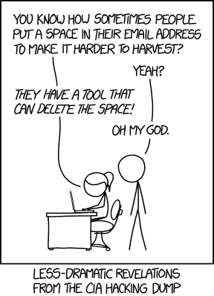
How do we teach security
Jared Lasselle
CS 2011 Introduction to machine organization and assembly language. This course is taught at many university in the united States.
Attack Lab: five phases of a program with major security flaws. Figure out how to hack the program to get a better grade on the assignment.
Notes:
I included a comic because the professor likes to put comics in his presentations.
Main point of this slide are that this way of teaching security is widely used, machine org is taught pretty much everywhere that has a comp sci program.

Slide 26

The Morris Worm. November 1988
Jared Lasselle
The original internet worm
Created by Robert Tappan Morris Jr who was a graduate student in Computer Science at Cornell university.
Infected roughly 6000 computers within 24 hours (about 10% of the internet at the time)
Was sentenced with 3 years probation, 400 hours of community service, and fines totaling $10,050
Damage estimates range from $100,000 to millions of dollars.
Notes:
Attempt to convince people that this is really bad. The most important point on this slide is that Robert Morris Jr was a comp sci student.

Slide 27

Love Bug virus. May 2000
Jared Lasselle
Written by Onel de Guzman, a Computer Science student at a local AMA computer college in the Philippines.
Reportedly it affected 45 million machines. [4]
Estimates of damage are tens of billions of dollars. [4]
Notes:
Most important point on this slide is that Onel de Guzman was a comp sci student.

Slide 28
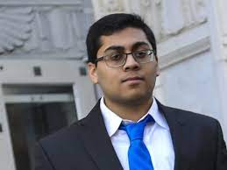
Mirai Botnet. October 2016
Jared Lasselle
Written primarily by Paras Jha, who was a Computer Science Student at Rutgers University [5]
Infected over 100,000 devices. [2]
DDos attacks were able to peak at 1.2 Terabyte per second. [2]
The authors admitted to being hired to administer DDos attacks [5]
Jha also admitted to using the Mirai botnet to DDos his University during the time that he was enrolled. [5]
Notes:
Most important point on this slide is that Paras Jha was a comp sci student, over the three slides about different people and different viruses/hacks note the years and locations. Make a point that they are not isolated incidents in time or in location.

Slide 29
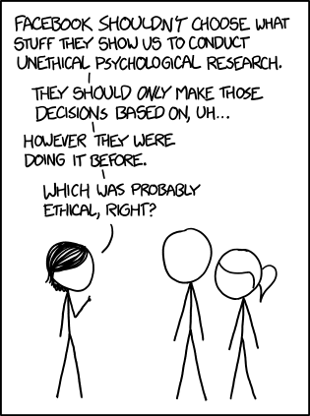
What is the solution
Jared Lasselle
Rutgers University does not have a class in ethics.
Cornell university has CS 1340. A class which appears to have ethical components. But it is only offered once a year, and is not required to graduate.
WPI requires all CS majors to take an ethics course. In 2019 a WPI research group found vulnerabilities with computer chips. This flaw was reported to manufacturers. [1]
Notes:
There’s another comic here because the professor likes comics. Main purpose of this slide is to use it as an opportunity to talk about how the previous slides relate to the second slide. If there is time you can mention that there is are no ethics courses are other colleges are that we are the solution to the given problem because of how we are in an ethics class.

Slide 30
References
Jared Lasselle
[1] Sharon Gaudin, WPI researchers discover vulnerabilities affecting billions of computer chips (EurekAlert Nov 12, 2019), https://www.eurekalert.org/news-releases/461488 (Sep 29, 2022)
[2] Nicky Woolf, Ddos attack that disrupted internet was largest of its kind in history (The Guardian Oct 26, 2016), https://www.theguardian.com/technology/2016/oct/26/ddos-attack-dyn-mirai-botnet (Sep 29, 2022)
[3] The Morris Worm (FBI November 2, 2018), https://www.fbi.gov/news/stories/morris-worm-30-years-since-first-major-attack-on-internet-110218 (Sep 29, 2022)
[4] Geoff White, The 20-Year hunt for the Man Behind the Love Bug Virus (Wired Sep 12, 2020), https://www.wired.com/story/the-20-year-hunt-for-the-man-behind-the-love-bug-virus/ (Sep 29, 2022)
[5] Mirai Botnet Authors Avoid Jail Time (KrebsOnSecurity Sep 19, 2018), https://krebsonsecurity.com/2018/09/mirai-botnet-authors-avoid-jail-time/ (Sep 29, 2022)

Slide 31
Class 10
The End
Keith A. Pray
socialimps.keithpray.net
Notes:
TODO: Add Snowden interview video link
TODO: Add thumbnail of videos
The Game Of Trust - NICKY CASE
https://ncase.me/trust/
This is the end. Any slides beyond this point are for answering questions that may arise but not needed in the main talk. Some slides may also be unfinished and are not needed but kept just in case.

Slide 32
My Reading Notes
pp. 409 Can one perform services for one’s self?
pp. 412 1993-1999 Does this seem like a long time?
pp. 413 “errors of omission or commission”?
UPDATE
pp. 422 3. Would people agree – social contract?
pp. 438 So the baby can be left outside and no one is responsible?
Notes:
An error of commission is one where the person responds where they should not. This is compared to an error of omission, where the person fails to respond when they should.

