Slide 1
Class 7
Privacy and Government
Keith A. Pray
socialimps.keithpray.net
Notes:
After this class we will be half done with the course… very sad I know.
Somebody’s Watching Me (1984) – Rockwell (3:36)
https://www.youtube.com/watch?v=7YvAYIJSSZY
Be the envy of all your classmates if you know the band and/or year:
Rockwell (1984) Michael Jackson sings chorus and Jermaine Jackson on backing vocals.

Slide 2
what works well Online With Zoom
Sign in with First and Last Name
Stay muted unless you are going to speak
To speak use the raise your hand feature
To answer yes/no questions use the “yes” ”no” buttons
Turn your camera on
Wait until the end of student presentations to ask questions
  Write them down so you don’t forget

Slide 3
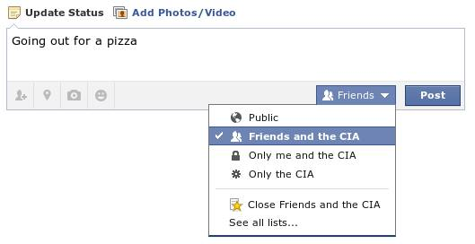
Overview
Review
Assignment
Students Present
Notes:
Review before debate in case anyone unsure of something in reading.
TODO: Image source?
Look at ACM TechNews if time

Slide 4
My Reading Notes
pp. 276 Any examples from the last 25 years? Arrests, altering and deleting records are violations of privacy?
pp. 277 Why not try to verify and correct records?
pp. 278 Figure does not show # cameras increasing.
pp. 279 300 times = frames, locations, …? More police drones since 2013?
pp. 296 Shouldn’t credit card issuers take “reasonable steps” to verify identity all the time?
pp. 297 Any syndromic system successes in the last 15 years?
pp. 301 Confusing false positive and negative explanations. Not correct use of “Orwellian”
pp. 305 E-ZPass now mandatory on Mass Pike…
pp. 310 # 17 Interesting but not computing related
End of Chapter questions: 1, 18
pp. 319 “Since I have done nothing wrong, why should the government be investigating me?”
Notes:
Let’s debate!

Slide 5
Debate Ground Rules
Before Debate
  Add “(YES)” or “(NO)” to the end of your name in Zoom to show your side
  10 minutes to converse with your team
  Share argument points, counter points, and responses
  Share experiences, especially in different countries, cultures, situations
  Decide who will: Go first, Respond to which points from opposing side
During Debate
  1 turn per person until everyone on your team has spoken
  Try to keep remarks to 30 seconds
  Switch sides at any time if you change your mind
Notes:
“National ban on facial recognition surveillance for law enforcement” Debate
If in class:
Stand up when speaking
30 second limit (elect a timekeeper)
Previous:
Should law require you to use an official ID for Internet access
National ID or Not Debate

Slide 6
Group Quiz
List two problems with using biometrics for identification.
List two advantages of using biometrics for identification.
Describe two tools people can use to protect their privacy on the Web.
For each of the 4 categories of Daniel Solove’s privacy taxonomy give an example not listed in the book.
Notes:
Only if need to fill time.
Information Collection
Information Processing
Information Dissemination
Invasion

Slide 7
Overview
Review
Assignment
Students Present

Slide 8
Assignment – Group Project
Catch up on reading
Group Project
  Analyze Movie for all topics covered to date
  Add analysis of computing technology portrayed
  See group project slide deck for more
  Frequent interaction with your group members is key to success!
-----
Mid Term Survey on Canvas → Quizzes
Notes:
Movie group project:
List of computing technologies portrayed in movie on website
Categorize computing technologies as existing, future, emerging, impossible or plausible with rationale
Analyze movie for all topics covered to date

Slide 9
Overview
Review
Assignment
Students Present

Slide 10
Ai shouldn't be used in the criminal justice system
Cambria Pomeranz
Notes:
In this presentation, I will argue that no, AI shouldn't be used in the criminal justice system, at least right now, but it should be used in the future.

Slide 11
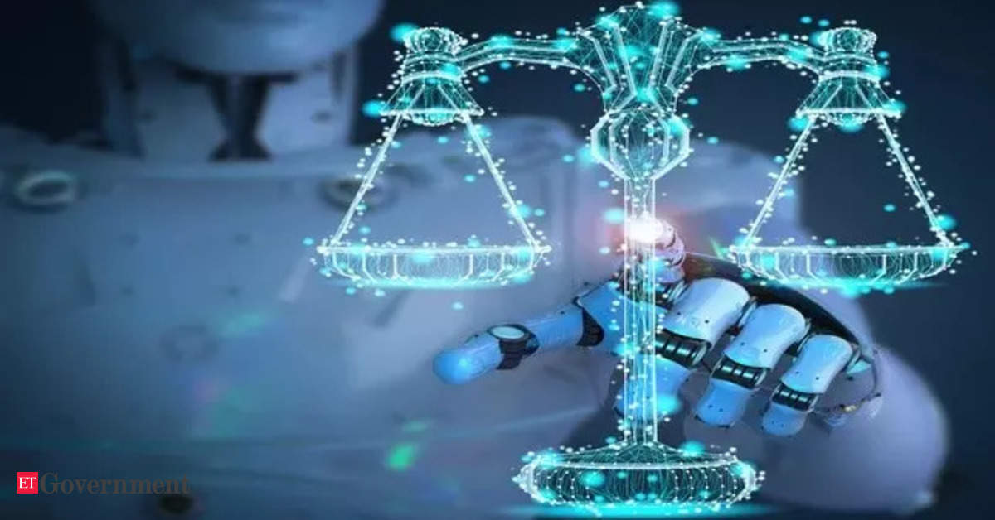
How Ai is used in the criminal justice system
Cambria Pomeranz
Two popular AI tools used to help judges make unbiased decisions
1. COMPAS – static and dynamic factors
2. PSA – only static factors
Predicts the risk of recidivism, or to offend again [5]
Difference in transparency
Notes:
Today, AI is already being used in the criminal justice system in 46 states [3] .I'm going to give some background on the AI tools that are being used in the court room. COMPAS stands for Correctional Offender Management Profiling for Alternative Sanctions. PSA stands for Public Safety Assessment. Both are risk/needs assessment tools used to predict the risk of recidivism, or the risk to offend again [5]. They help judges make unbiased and accurate decisions "regarding bail, sentencing, and parole, rating a person’s likelihood of re-offending based on a collection of data about them" [4]. The difference between COMPAS and PSA is that COMPAS calculates its score using static and dynamic factors while PSA only uses static factors. Static factors include variables like prior arrests, "whereas dynamic factors include substance abuse, employment history, and pessimism" [5]. The tool then analyzes this data and compiles a risk score of offending again.
There is also a difference in transparency between the two. PSA is open to the public and judges know the algorithm it uses. On the other hand, COMPAS is not transparent and only the developers of the tool, Northpointe, know how it works [4]. We're going to take a closer look into the COMPAS algorithm.

Slide 12
Bias in the COMPAS algorithm
Cambria Pomeranz
Judges are not perfectly unbiased
Bias is built into COMPAS by being fed past cases [4]
Study found COMPAS was discriminatory [4]
Northpointe denied the accusation [3]
Notes:
Judges are not perfectly unbiased so that's why they use these algorithms to help make things more fair. The algorithms are meant to be unbiased. But for an AI tool like COMPAS, it must be fed information on past cases in order to work. These previous cases were decided by human judges, who are not perfectly unbiased. Therefore, COMPAS cannot be completely unbiased, the bias it built into the tool. "Discrimination [is] hard-wired into the algorithm [4]. To prove this, a study by ProPublica found COMPAS "was more likely to falsely rate black defendants as higher risk than it was with white defendants, and more likely to falsely rate white defendants as lower risk” [4]. Northpointe denied this accusation, saying the algorithm was working correctly [3]. The higher rate of false positive for blacks is due to the fact that blacks on average have a higher rate of recidivism [4]. Would it be fair to the community to alter the algorithm so that whites and blacks have the same false positive rate?

Slide 13
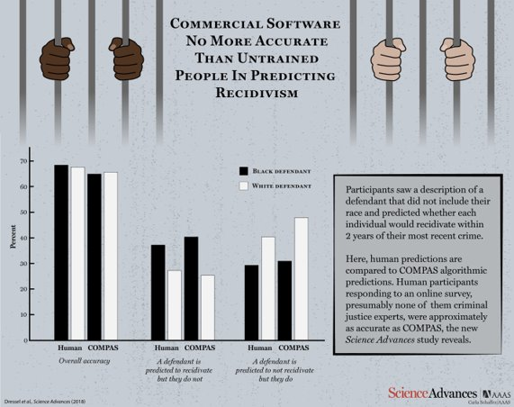
Cambria Pomeranz

Slide 14
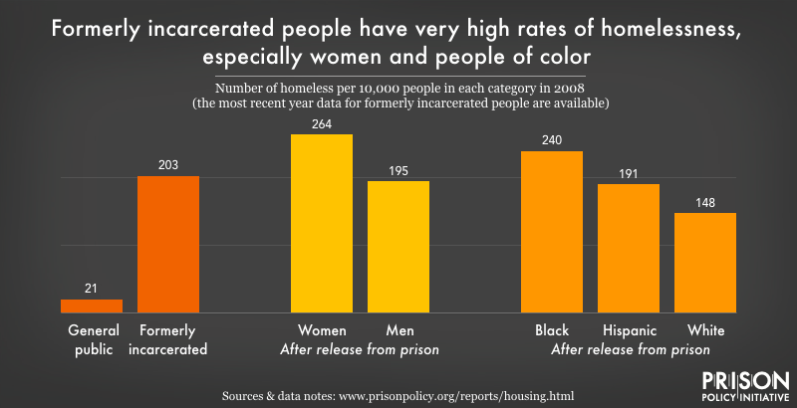
What is fair?
Cambria Pomeranz
Two definitions of fair
  Being more accurate
  Having equal errors between races
Accuracy reinforces the discrimination
Equal errors between races decreases accuracy
There are unavoidable trade offs
Who gets to decide?
Notes:
What is fair? There are two definitions of fair in this scenario. One focuses on the accuracy of the tool. If COMPAS is more accurate than humans, that makes it fair, right? A tool that uses this approach only reinforces the discrimination and oppression that black people face [3]. This discrimination is directly related to the higher incarceration levels. Since black people were more subject to live in poverty due to white people, there is more violence which leads to incarceration. Incarceration then leads to poverty and violence which leads again to incarceration. If we follow this definition of fair, it continues the cycle. However, if we make the amount of errors the same for all races, it leads the algorithm to produce less accurate results which could hurt communities. There is no solution to this problem because there are will always be unavoidable trade-offs [3]. If this is the case, why does the creator of COMPAS get to make the final decision?

Slide 15
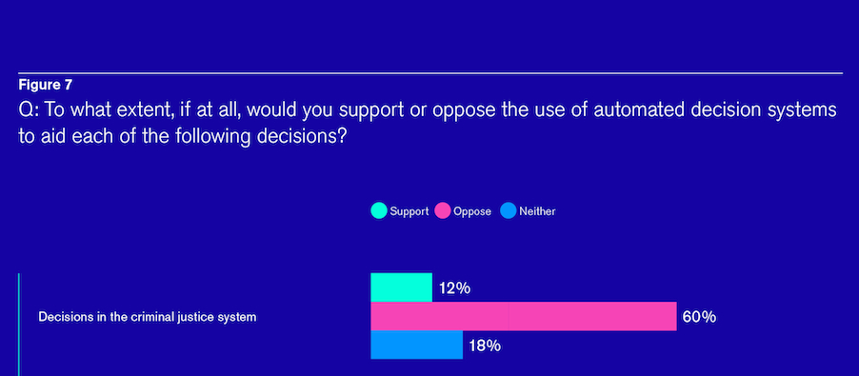
Why we shouldn't use Ai in the present day
Cambria Pomeranz
Dissertation conducted study and found COMPAS to be reliable [1]
Another study found COMPAS to be no more accurate than humans [2]
AI shouldn’t be used in the criminal justice system as of yet
Wait until accuracy is closer to 100%
COMPAS needs to be transparent
Consistency matters
Notes:
I found a scholarly dissertation that conducted a study on the accuracy of COMPAS and it states, “Results from this study indicate that the COMPAS is a reliable risk/needs instrument with" the sample used [1]. However, there is also evidence of the tool being no more accurate than humans [2]. With that being said, I don't think AI should be used in the criminal justice system, at least right now.
Now is not the right time to use this technology, considering the proof of the machine's bias and the fact that it is no more accurate than humans. If you were in a defendant's shoes, would you think a harsh sentence given with the help of technology is humane? I, personally, would not.
We should wait until the accuracy is closer to 100%, provided it will achieve that in the future. That way, if the sentence ends up being wrong, the blame isn’t put on a machine like some futuristic dystopian movie. COMPAS also needs to be transparent. That way, judges are aware of how the algorithm works which is better for the public overall.
There will always be bias in humans, but we are learning to develop AI without bias. Therefore, once it is more developed, we should then lean towards using AI because it will be more accurate, more consistent, and supposedly less biased than humans.

Slide 16
References
Cambria Pomeranz
[1] Herrschaft, Bryn A.. Evaluating the reliability and validity of the Correctional Offender Management Profiling for Alternative Sanctions (COMPAS) tool. Retrieved from https://doi.org/doi:10.7282/T38C9XX2
[2] Matacic, Catherine. “In the United States, Computers Help Decide Who Goes to Jail. but Their Judgment May Be No Better than Ours.” Science, AAAS, 17 Jan. 2018, https://www.science.org/content/article/united-states-computers-help-decide-who-goes-jail-their-judgment-may-be-no-better-ours.
[3] Mesa, Natalia. “Can the Criminal Justice System's Artificial Intelligence Ever Be Truly Fair?” Massive Science, Massive Science Inc., 13 May 2021, https://massivesci.com/articles/machine-learning-compas-racism-policing-fairness/.
[4] Spivack, Jameson. “Ethical Issues: Predictive Algorithms in Criminal Justice.” Jameson Spivack, http://jamesonspivack.squarespace.com/ethical-issues-predictive-algorithms-in-criminal-justice.
[5] Team, PixelPlex. “Artificial Intelligence (AI) & Criminal Justice System: How Do They Work Together?” PixelPlex, PixelPlex, 15 Jan. 2021, https://pixelplex.io/blog/artificial-intelligence-criminal-justice-system/.

Slide 17
References
Cambria Pomeranz
Images
“Bar Graph about Support of AI in the Criminal Justice System.” Thersa.org, https://www.thersa.org/globalassets/images/arc/forum-on-ethical-ai/interim-report-graphics/rsa_ai_ethics_graphics7-1000.jpg. Accessed 15 Sept. 2022.
“Commercial Software No More Accurate Than Untrained People in Predicting Recidivism.” Acsh.org, AAAS, https://www.acsh.org/sites/default/files/images/dressel1HR.jpg. Accessed 15 Sept. 2022.
“Formerly Incarcerated People Have Very High Rates of Homelessness, Especially Women and People of Color.” Prisonpolicy.org, Prison Policy Initiative, https://static.prisonpolicy.org/images/homelessnessbyracesex.png. Accessed 15 Sept. 2022.
“Technology and the Law.” etb2bimg.Com, https://etimg.etb2bimg.com/thumb/msid-89502089,imgsize-25114,width-1200,height-628,overlay-etgovernment/how-ai-can-play-a-catalytic-role-in-managing-criminal-justice-system-for-more-equitable-outcomes.jpg. Accessed 15 Sept. 2022. -1000.jpg

Slide 18
The practicality of anonymity online
Justin Healey

Slide 19
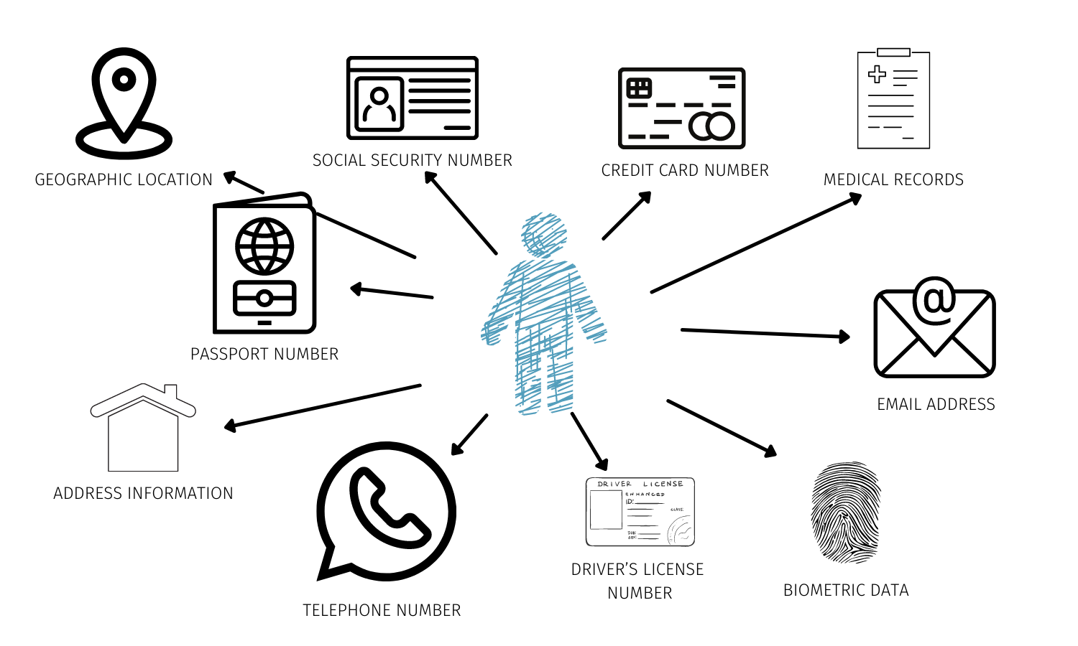
Personally Identifiable Information (PII)
Justin Healey
Age
Gender
Ethnicity & Race
Interests
Employment Status
Religious & Political Beliefs
Lifestyle
IP & MAC addresses
Graphic from Data Privacy Manager.
Notes:
<speaker notes>
[*] Some examples but not all forms of PII
[*] The graphic is a visual representation to make it easier to understand and see the connections
[*] Age, gender, ethnicity and race are easiest to find
- Usually just a google search
[*] Interests, employment status, beliefs and lifestyle can typically be found with slight effort
- Maybe an hour of searching
- Piece together some information
[*] Companies like Amazon, Google, Facebook etc. can get your interests, employment status, beliefs and lifestyle in seconds
[*] Any website you visit can see your IP address
[*] Some apps you consent to can get your MAC address
- Linked directly to that device
- Can give them device information, like the manufacturer
- TikTok was accused of doing this and they were, but it was in their Terms of Service so it was legal

Slide 20




Targeted media
Justin Healey
Advertisements
Job Recommendations
Search Results
Media Selection
TikTok
Facebook
Twitter
Swaying Political Opinions
Notes:
<speaker notes>
> Images are for visual engagement, adds some value to the slide and almost everyone knows the companies by logo
> Helps connect the dots to the listeners
[*] Companies want your data
- Different companies have different motives
[*] Not just companies
- Hackers
- Spammers/Scammers
> Spear phishing
- Nation states (Russia 2016 election)

Slide 21
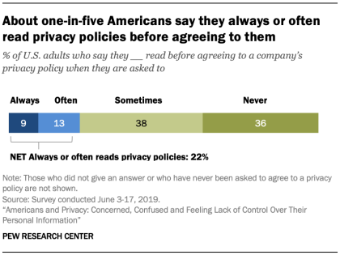
How targeted media works
Justin Healey
Linking devices that use the same IP address [2,4]
  A downfall of network address translation
Linking profiles that use the same credentials [1]
  Email
  Username
  Phone number
Sometimes you do it to yourself [2]
  “Sign in with Google”
  “Would you like to link this to your Facebook account?”
Pew Research Center
Notes:
<speaker notes>
[*] More ways than just this
[*] Some are unavoidable if you want to use the service
- Terms of Service
[*] Who actually reads the terms of service?
- Pew Research center found that more than one third of adults say they “never” read the terms of service
> You agree to things and data collection that you don’t even know what it is

Slide 22
what can you do?
Justin Healey
Temporary emails
Encrypted storage & smartphones
Avoid social media
Don’t use smart speakers
Use cryptocurrency
VPNs & Proxies
Secure browsers
Secure/Anonymous search engines
Ad blockers
Disable cookies
Secure email services
* All concepts from reference [1] *
Notes:
<speaker notes>
BRIEF OVERVIEWS:
- VPNs hide IP address
- Secure browsers & search engine mask IP and identity (accounts etc)
- Ad blockers make sure you don’t accidently click on something
- Cookies can track you and your sessions across sites and gather information on your device
- Gmail or any service is storing your emails somewhere and has information that links them and the content to you
- Temp emails to prevent spear phishing and mask identity across accounts
- Encrypted smart phones provide similar features as VPNs and secure browsers
- Smart speakers are helpful but not private at all
- Crypto helps provide anonymity in payments
[*] You’d have to do most if not all of these things all the time
[*] Is this really practical?
- In theory t’s possible, but is it realistic?

Slide 23
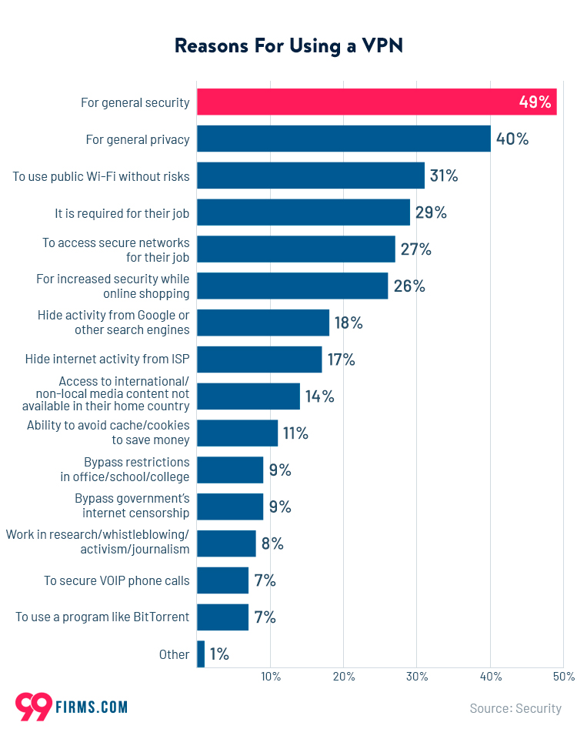
The fatal flaw in VPNs
Justin Healey
Doesn’t prevent your email from being linked to different accounts
Doesn’t account for any other PII
  Just IP address
  That’s not nearly enough
Doesn’t stop cookies
Chart from Firms Media.
Notes:
<speaker notes>
[*] VPNs are great but not bulletproof
[*] VPNs in conjunction with other measures is necessary
[*] Using just a VPN provides a decent amount of anonymity, but not complete anonymity
[*] Law enforcement can usually* trace a VPN connection back to you

Slide 24
Secure browsers vs. search engines
Justin Healey
Secure Browsers
Secure Search Engines
Prevent unwanted actions [3]
  Block cookie tracking
  Browser fingerprinting
  Unwanted downloads
Examples:
  Tor
  Brave
Hide your identity [6]
  IP address
  User agent
  Unique identifier (in cookies)
    Used for targeted media
Prevent content filtering [6]
Examples:
  DuckDuckGo
  StartPage
  Searx
Notes:
[*] Secure browsers are the first layer
[*] Secure search engines are the second layer
[*] They go hand in hand
[*] Used with a VPN can provide almost complete anonymity, but you still have to be careful
Usernames
Emails and phone numbers linked to accounts

Slide 25
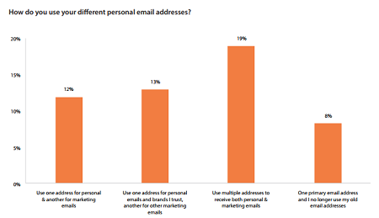
Email Protection measures
Justin Healey
Secure email services
  ProtonMail
  Startmail
Burner emails
  Untraceable back to you (in theory)
  Prevent spam to your primary inbox
VPNs when sending emails
  Email headers contain IP addresses
Chart from Zetta Sphere.
Notes:
[*] Google is not anonymous or secure at all
- They’re greedy
- Law enforcement can easily access google servers with the right permission
[*] You can also host your own email server
- As long as you can keep it secure, you know its secure
[*] Use a domain you own
- But that domain can’t be registered under your name
[*] Email headers contain the sending IP address

Slide 26
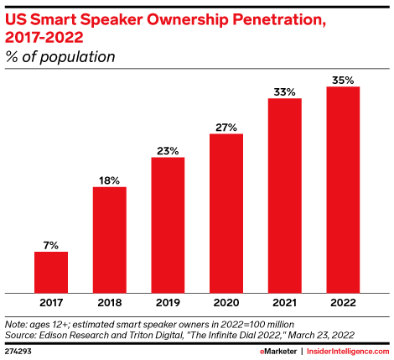
Dangers of smart speakers
Justin Healey
They’re always “actively” listening [8]
  They have to
  Listening for the wake word
  Claimed nothing is recorded until the wake word
They’re vulnerable [9]
  2021 study – third parties
    Many applications use third parties
  Unintentionally sharing data
They’re not perfect [8]
  Sometimes listen with an incorrect wake word
Chart from Insider Intelligence.
Notes:
[*] They’re not “spying on you”
- But they are collecting data
[*] You could share data with a third party without knowing it
- If you use their application or service
- The smart speaker company could sell it or have an agreement with sharing it
> Amazon, Google
[*] Sometimes they will wake with the wrong word and listen to conversations they shouldn’t, then save that data somewhere
> They’re not perfect

Slide 27
Secure Smartphones
Justin Healey
Purism Librem 5 [10]
  Hardware based kill switches
  Open source OS
iPhone
  IOS is notoriously more secure than android
  Sandboxes applications
  Apps cannot share information with each other
Android
  Can be secure with best practices
  Requires monitoring
  Very user-orientated
    User has control & can set permissions
Notes:
[*] Not well known about
[*] There are others but these are the most common smartphones
[*] iPhones provide decent security because of the sandboxing techniques IOS utilizes
- Apps can’t talk to each other
- No apps have root access, it’s not possible (in theory)
[*] Androids can be secure
- Relies more on the user to secure it themselves
- IOS is inherently secure, Android requires the user to be secure

Slide 28
What is crypto?
Justin Healey
How it works
The flaws of crypto
A public blockchain [11]
  Anyone can download and view it
Wallet address is public, not PII
  Possible to link/trace crypto transactions by wallet address
Decentralized
  Not controlled by a single entity
Exchanges
  Exchanges are required by law to record PII
  Used by law enforcement to trace transactions [11]
Not as anonymous as hard cash
  But cash can’t be used digitally
  Crypto is the most anonymous form of digital currency [11]
Notes:
[*] A very brief description
[*] The point is to be decentralized, not necessarily anonymity
[*] The blockchain for most* cryptos is public and contains all the transactions ever made
- Only wallet addresses are visible
- Wallet addresses are “random”
[*] Exchanges requires user verification
- Take pictures of your ID, tax reporting, etc
- Pretty much defeats the whole “anonymity” point if your wallet address is linked to you directly

Slide 29
How practical is remaining anonymous?
Justin Healey
Is it possible? Probably.
Always use a VPN
Always use a secure browser & search engine
Always pay in cryptocurrency [5]
Use different emails for all accounts
  None of which can be traced back to you at all
Use an encrypted phone [5]
  iPhones are decent
  There are some phones that are meant for anonymity
Don’t post on any social media
  Ever.
Is it practical? Absolutely not.
Technology is integrated into our society
A single picture can make you identifiable to that account
VPN services are (usually) obligated to Gov. regulations
  There are exceptions*
Never connect to the internet without a VPN??
Never use bank accounts or easily traceable money
  Hard cash and crypto (no exchange) only
Notes:
[*] You probably could remain anonymous
- If you did all these things and never made a mistake
- I may be missing a loophole but this is what I think
[*] The average person is not going to be able to do all of this
- Only people with a life dedicated to crime would even have a real shot
- Even still, one mistake ruins everything

Slide 30
References
Justin Healey
[1] Kant, Tanya. “Identity, Advertising, and Algorithmic Targeting: Or How (Not) to Target Your Ideal User.” MIT Sec. Pub, 2021. Accessed 9/12/2022. https://mit-serc.pubpub.org/pub/identity-advertising-and-algorithmic-targeting/release/2
[2] Tanner, Adam. “How Ads Follow You from Phone to Desktop to Tablet.” MIT Technology Review, 1 July 2015. Accessed 9/12/2022. https://www.technologyreview.com/2015/07/01/167251/how-ads-follow-you-from-phone-to-desktop-to-tablet/
[3] “Why should I use a safe browser? McAfee. Accessed: 9/12/2022. https://www.mcafee.com/en-us/safe-browser.html
[4] Singer, Natasia. “What You Don’t Know About How Facebook Uses Your Data.” The New York Times, 11 April 2018. Accessed: 9/12/2022. https://www.nytimes.com/2018/04/11/technology/facebook-privacy-hearings.html
[5] Turner, Gabe; Vigderman, Aliza. “How To Remain Anonymous on the Internet” Security.org, 2 August 2022. Accessed: 9/12/2022. https://www.security.org/vpn/anonymity/

Slide 31
References (2)
Justin Healey
[6] Nakutavičiūtė, Jomilė. “Why should you use a private search engine?” NordVPN, 5 July 2022. Accessed: 9/12/2022. https://nordvpn.com/blog/private-search-engines/
[7] Gilens, Naomi. “New Justice Department Documents Show Huge Increase in Warrantless Electronic Surveillance.” ACLU, 27 September 2017. Accessed: 9/12/2022. https://www.aclu.org/news/national-security/new-justice-department-documents-show-huge-increase
[8] Sidell, Elle. “Is Alexa always listening? How to protect your privacy” Avast, 24 September 2021. Accessed: 9/11/2022. https://www.avast.com/c-amazon-alexa-listening
[9] “Study Reveals Extent of Privacy Vulnerabilities with Amazon Alexa” NC State University News. Accessed: 9/11/2022. https://news.ncsu.edu/2021/03/alexa-skill-vulnerabilities/
[10] Millman, Rene. “The five most secure smartphones” ITPro, 11 March 2022. Accessed: 9/11/2022 https://www.itpro.com/mobile/mobile-phones/360024/5-most-secure-smartphones
[11] “Frequently Asked Questions” Bitcoin.org. Accessed: 9/12/2022. https://bitcoin.org/en/faq#general

Slide 32
Class 7
The End
Keith A. Pray
socialimps.keithpray.net
Notes:
Look at ACM TechNews if time
This is the end. Any slides beyond this point are for answering questions that may arise but not needed in the main talk. Some slides may also be unfinished and are not needed but kept just in case.

