Slide 1
Class 6
Information Privacy
Keith A. Pray
socialimps.keithpray.net
Notes:
How is the self search paper going? Offer small group discussion instead of class wide.
Who: found a lot, very little, surprised, not surprised, creepy, share conclusions

Slide 2
Papers
Quantify
  Not terms like: less, more, a lot, huge, great, big, tiny, drastic, quicker, faster, easier, etc.
Read directions, many time lines missing
Use the template
Avoid absolutes
  Terms like: all, any, none, always, never
  Difficult to prove, easy to show false
Read paper aloud to proof
Avoid blogs, encyclopedias, and text book. These are generally not primary and high quality sources.
http://socialimps.keithpray.net/assignments/paper-guidelines/
Notes:
Save for next time:
Define terms
Quantify
Not terms like: less, more, a lot, huge, great, big, tiny, drastic, etc.
Avoid absolutes
Terms like: all, none, always, never
Difficult to prove, easy to show false
Read paper aloud to proof
Read directions, many time lines missing
Be sure to put quotes around entire quote
State a strong, clear conclusion
First statement preferred
Provide Counter Point and Rebuttal
Counter Point and Rebuttal should directly relate
Print 2 sided and save a tree
Hyperbole is the best thing ever!
but not in these papers
Be wary of counter point strawman fallacy
Text book is not a primary source
Use template, saves time
Cite as suggested [1]
Beware of fallacies

Slide 3
Logistics
Do not change the format, footers, etc. in the templates
Address email to entire course staff for quickest response
Review Presentation and Paper Guidelines on course site
Sign up for Individual Presentation, it’s not too late
Notes:
Not needed this time:
Address email to entire course staff for quickest response time
Do not change the format, footers, etc. in the template slides.
Paper writing process: Sources → Notes → Conclusion → Argument → Counter Point → Response
Turn extra credit paper in on myWPI/Canvas and hard copy in class like regular papers
Use Presentation Guidelines on course web site
Use paper and presentation templates
Keep topics inside the course scope: Computing + Society
Presentations are due 24 hours before class

Slide 4
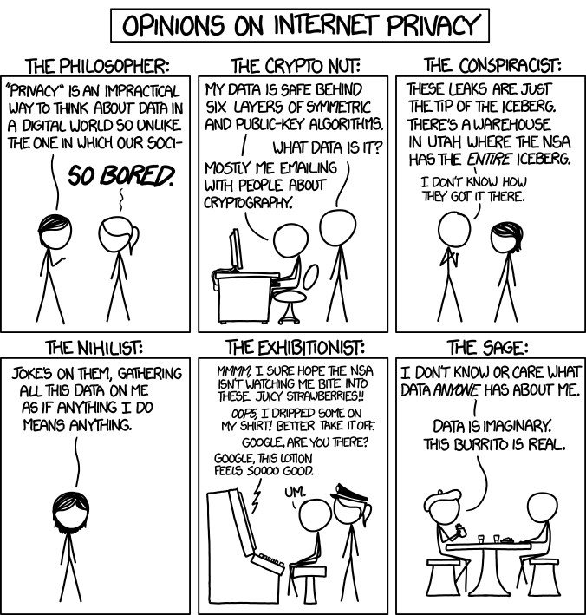
Overview
Review
Assignment
Students Present
http://xkcd.com/1269/
Notes:
1 – Accessed 2014-04-14
Everyone pick the category they identify most with.
Share reasons why.
Jimmy Kimmel Live – What is your password? (2:49)
https://www.youtube.com/watch?v=opRMrEfAIiI
Find out what your DNA says about you and your family.
https://www.23andme.com/
https://motherboard.vice.com/en_us/article/xwkaz3/23andme-sold-access-to-your-dna-library-to-big-pharma-but-you-can-opt-out?utm_source=vicefbus

Slide 5
My Reading Notes
pp. 229 means to end?
pp. 230 who videotapes anymore?
pp. 231 “businesswoman” nice change. Moral capitol – source published in 1984, “taking away” “1984”
pp. 234 Hilton consent to pic being in book?
pp. 237 Many daycares monitor, any studies yet?
pp. 238 “…privacy…in their own homes…” != nanny to expect privacy “…when… insides Sullivans’ home.
pp. 244 Human chip implant sources getting old, 2002, 2004, 2007, 2010
pp. 250 2012 source same year Target outed pregnant teen to parents
pp. 255 Why did Apple not enforce policy of asking permission in the API?
pp. 245 “…by 2015” did it happen?
pp. 246 Web Browsers put cookies on on your hard drive, not Web Servers.
pp. 250 why is bills – responsibility assumption flawed?
pp. 268 Why WPI not in list?
Notes:
Notes updated: 2018-04-03

Slide 6
Assignment
Prepare for class debate:
National ban on facial recognition surveillance for law enforcement?
  Once you’ve done the research and have decided “Yes” or “No” assign yourself to the appropriate group on Canvas:
    Canvas → People → Facial Recognition Debate: Use the groups to share your research
    https://canvas.wpi.edu/courses/23995/groups#tab-6898
  Come prepared with notes, facts, dates, high quality sources
  Optional One Page Paper on the topic, lowest paper grade will be dropped
Notes:
Morgan Lee write up 2021-09-13:
“Facial recognition technology has begun to see widespread adoption in modern law enforcement, with applications in physical & digital security, as well as identifying potential suspects. Critics of the technology argue that passive facial recognition technology violates privacy rights of individuals, while its proponents emphasize its positive uses in preventing and detecting crime. There are currently 12 state-level bills which propose limits or bans on the use of facial recognition technologies by government agencies, with several local bans (including ones in Boston, Brookline, and Cambridge) already in place. Should the United States implement a national ban on the use of facial recognition technology by law enforcement?”
Previous Debates:
Should law require you to use an official ID for Internet access?
Is a National ID System a good thing?

Slide 7
Overview
Review
Assignment
Students Present

Slide 8
Has targeted marketing gone too far?
David Gibson

Slide 9

Targeted marketing has gone to far
David Gibson
They’re predicting what you will do based off collected data
Use data to show you ads you are likely to buy [3]
“Target” predicted teen’s pregnancy, before parents knew. [4]
[6]
Notes:
Have you ever been talking to a friend about a product and minutes later it shows up in a google or facebook ad. This is targeted marketing.
These situations make you think that the companies are listening to your personal conversations and basing your ads off those conversations. However, they aren’t listening. What they are really doing is predicting what you will do next and feeding you ads based off the data they are permitted to collect ( by you!)
One-way non-online businesses do this is by creating a profile for you based off your purchasing habits, denoting your name to your credit card and phone number. They then base your purchases based off the expected purchases of other people and predict what you will be looking for next.
Target example – In 2012 Target served ads to a teen for baby products, father gets angry as his daughter was keeping it secret, she was pregnant.
These advertisers know more about you than one would think, and now that they know what creeps us out they have started hiding their knowledge.
When interview about the case of the teen served ads for baby products and the use of information to send ads that know too much about you, Andrew Pole, a statictian working for target said this, “Then we started mixing in all these ads for things we knew pregnant women would never buy, so the baby ads looked random. We’d put an ad for a lawn mower next to diapers. We’d put a coupon for wineglasses next to infant clothes. That way, it looked like all the products were chosen by chance.
“And we found out that as long as a pregnant woman thinks she hasn’t been spied on, she’ll use the coupons. She just assumes that everyone else on her block got the same mailer for diapers and cribs. As long as we don’t spook her, it works.”[4]
So, remember that the next time you receive a random coupon book in the mail or random coupons in your email, because most of those coupons have been tailored for you, to make you shop more.

Slide 10
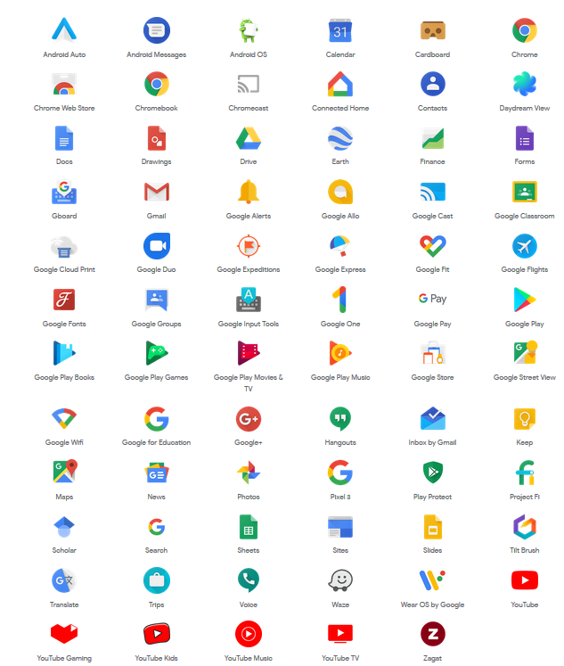
What data does google collect?
David Gibson
Location Data
  Date, time and Coordinates, Time spent
Photo Data
  Who, When, Where
All email attachments
And much more
[5]
[4]
Notes:
So how much data do these companies really collect on you? One of the best examples of this is google, a company who collects data on every platform that you use daily.
From across their many platforms google collects data, that you may not realize.
Some general data can include,
location data, including time, date, time spent at the location, who’s location data may be close by. (This helps to predict what people will talk about, thus serving ads)
Photo data, this data includes location, time, date, who was there, who's in the photo, what's in the background.
Email data, this includes any and all attachments, all emails and subjects, drafts and deleted emails
This data is all compiled to make an advanced profile of you, which allows for google to target ads at you.

Slide 11
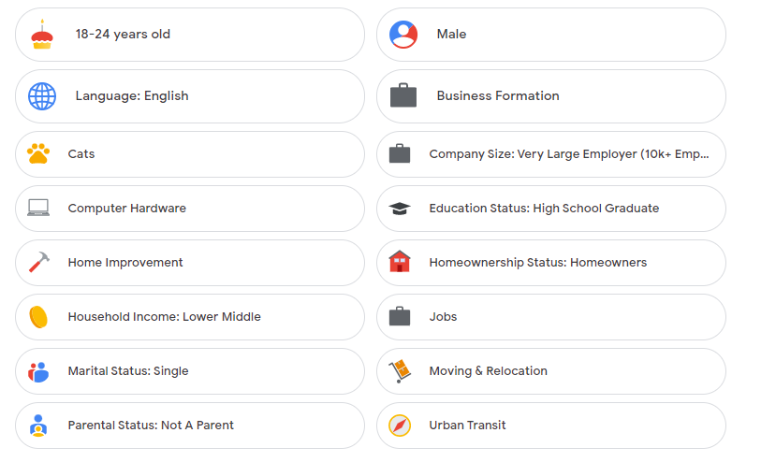
What do they know?
David Gibson
One of my emails showed 138 different factors google references for add targeting. [1]
Included many correct interests, age, gender, income, Education, Relationship Status.
Notes:
While researching I went through one of my email's ad security and privacy pages. I ended up finding 138 different categories that google lumped me into through various search information. This data included not only interests, but age, gender, marital status, employment status, and household income. Most of which were correct, all of which I did not expressly give google myself other than age and gender.
This means that google can not only serve you ads for products that you like, but they will also serve you products in this category that you have the ability to buy. Causing you to spend more money.

Slide 12
Should you be concerned?
David Gibson
Notes:
While I do enjoy being able to easily find ads and promotions for products that I am interested in, I find that all of these companies do know far too much about every individual. The vast amount of information they know is concerning to say the least, especially information you have not expressly given them access to. This aall does depend on whether you care about a muti billion-dollar company knowing everything about you, but I think if these companies showed you exactly how much they are able to predict about you would think twice about using their services.

Slide 13
Useful Links
David Gibson
https://takeout.google.com/settings/takeout?pli=1
-Download all information and files that google owns about you and for you.
https://adssettings.google.com/
Google>Nine dots>Account>Data & Security>Ad Setting> ad Personalization
-View and edit your own google ads page to see what they assume.
Notes:
Here Ive included two links to find out what google tells you they know about you. The second one allows you to also turn off add personalization to stop google from collecting information to send you adds.
If on zoom have people go to link on slide by posting in chat.

Slide 14
References
David Gibson
[1] Google. (n.d.). Account settings: Google. Retrieved September 12, 2022, from https://adssettings.google.com/u/1/authenticated?hl=en&ref=my-account
[2] Google's product portfolio. (2018, August 16). Retrieved September 12, 2022, from https://dotkay.github.io/2018/08/16/google-product-portfolio/
[3] Graham, J. (2019, June 28). Is Facebook listening to me? why those ads appear after you talk about things. USA Today. Retrieved September 12, 2022, from https://www.usatoday.com/story/tech/talkingtech/2019/06/27/does-facebook-listen-to-your-conversations/1478468001/
[4] Hill, K. (2022, August 11). How target figured out a teen girl was pregnant before her father did. Forbes. Retrieved September 12, 2022, from https://www.forbes.com/sites/kashmirhill/2012/02/16/how-target-figured-out-a-teen-girl-was-pregnant-before-her-father-did/?sh=70ef60886668
[5] Martin, N. (2019, March 11). How much does google really know about you? A lot. Forbes. Retrieved September 12, 2022, from https://www.forbes.com/sites/nicolemartin1/2019/03/11/how-much-does-google-really-know-about-you-a-lot/?sh=22ddb8ce7f5d
[6] R/meme - targeted ads acting wild. reddit. (n.d.). Retrieved September 12, 2022, from https://www.reddit.com/r/meme/comments/g7cpxa/targeted_ads_acting_wild/
[7] What is targeted marketing? definition, strategies & examples. Sender. (2022, July 25). Retrieved September 12, 2022, from https://www.sender.net/targeted-marketing/#:~:text=By%20Adomas%20Sulcas,Targeted%20marketing%2C%20by%20definition%2C%20is%20the%20strategy%20of%20tailoring%20and,traits%2C%20interests%2C%20and%20preferences.
Notes:
[3] https://www.forbes.com/sites/nicolemartin1/2019/03/11/how-much-does-google-really-know-about-you-a-lot/?sh=22ddb8ce7f5d
[2] https://www.forbes.com/sites/kashmirhill/2012/02/16/how-target-figured-out-a-teen-girl-was-pregnant-before-her-father-did/?sh=70ef60886668
[5] https://www.sender.net/targeted-marketing/#:~:text=By%20Adomas%20Sulcas,Targeted%20marketing%2C%20by%20definition%2C%20is%20the%20strategy%20of%20tailoring%20and,traits%2C%20interests%2C%20and%20preferences.
[1] https://www.usatoday.com/story/tech/talkingtech/2019/06/27/does-facebook-listen-to-your-conversations/1478468001/
[4] https://dotkay.github.io/2018/08/16/google-product-portfolio/
[6] https://adssettings.google.com/u/1/authenticated?hl=en&ref=my-account
[7] https://www.reddit.com/r/meme/comments/g7cpxa/targeted_ads_acting_wild/

Slide 15
Smart Homes: is your privacy worth it?
Arnav Mishra

Slide 16
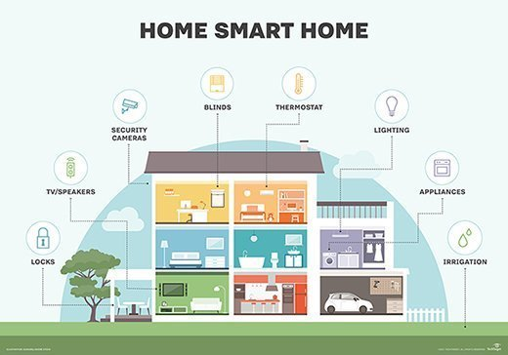
The Internet of Things
Arnav Mishra
Devices that can connect to the Internet and “interact with its environment through the collection and exchange of data” [1]
  Smart locks, cameras, TVs, speakers, lights, etc.
There are privacy and security problems associated with these devices
  provides more data for hackers to collect and learn about our lives
Because of the vulnerability and quantity of these devices, smart homes are not worth risking your privacy for.
Notes:
The internet does not just connect computers and phones anymore, it now connects a variety of “smart” devices, including lighting, appliances, cameras, etc. These devices are not only used in “smart” homes but also in hospitals and government agencies. Although the Internet of Things helps automate parts of our lives, they also have privacy and security problems. The Internet of Things provides more data for hackers to collect and learn about our lives [1]. Because of the vulnerability and quantity of these devices, smart homes are not worth risking your privacy for.

Slide 17
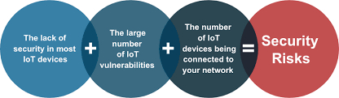
Security issues
Arnav Mishra
Vulnerability
Smart home devices lack computational capacity for built-in security [1]
Malware/ Cyberattacks
Smart TVs, smartwatches, and set-top boxes are of high risk
BotenaGo malware could exploit more than 30 different vulnerabilities in smart devices [6].
Information theft/ Unknown exposure
important personal information can be unknowingly stored in devices [1]
Notes:
Vulnerability: smart home devices lack the computational capacity for built-in security, many of these devices also have short development cycles and low price points, so there is a smaller budget for developing and testing secure firmware. This also means that there are less patches and updates, and many smart devices have technical limitations [6].
Malware: Hackers can install malware and change the function of a device, and once one device is attacked, other connected devices in a home network are more susceptible to attacks. A recent study found that devices with high risk of being attacked with malware are smart TVs, wearable smart watches, and set-top boxes. In 2021, the malware BotenaGo could exploit more than 30 different vulnerabilities in smart devices [6].
Information theft/ Unknown Exposure: Includes sensitive data such as location, bank account details, even health records. Many IoT devices can have insecure communications, making man in the middle attacks dangerous. [1]

Slide 18
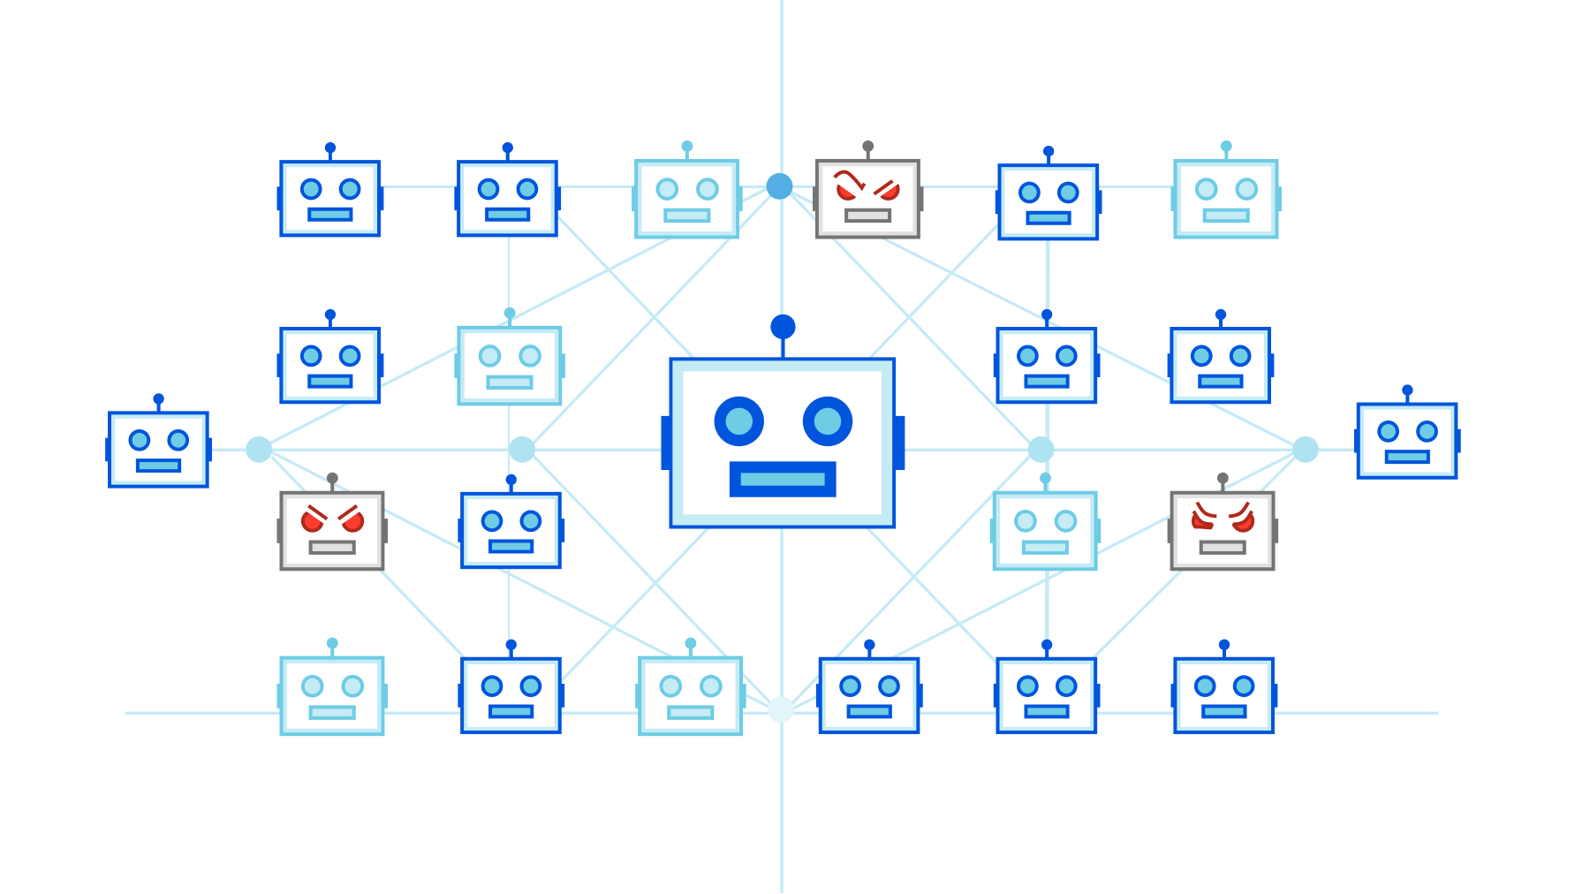
Mirai botnet attack
Arnav Mishra
Large cyber attack caused by a distributed denial of service (DDoS) attack
Mirai botnet was largely made up of IoT devices which bombarded servers with traffic until they collapsed
an estimated 100,000 malicious endpoints attacked the Internet [3]
Notes:
The Mirai botnet attack in 2016 was a large cyber-attack caused by a distributed denial of service (DDoS) attack. The Mirai botnet was largely made up of IoT devices which bombarded servers with traffic until they collapsed from being overwhelmed. Mirai was able to take down many major websites such as Netfilix, Twitter, and Reddit. Because the Internet of Things is so large and diverse, the botnet was able to attack on a much larger scale, and it was estimated that the attack involved 100,000 malicious endpoints [3].

Slide 19
IoT Cybersecurity act of 2020
Arnav Mishra
This bill, passed in 2020, is a step forward in increasing cybersecurity in the IoT
“This bill requires the National Institute of Standards and Technology (NIST) and the Office of Management and Budget (OMB) to take specified steps to increase cybersecurity for Internet of Things (IoT) devices.” [4]
Notes:
The IoT Cybersecurity Act of 2020 was a step forward in increasing cybersecurity for smart home devices. This act requires the increase of cybersecurity for IoT devices that are owned or controlled by the federal government – even though the act is not making devices safer for consumers directly, it does make sensitive government data more secure and hopefully leads to increased cybersecurity in a wider range of IoT devices that are also available to consumers. [4]

Slide 20
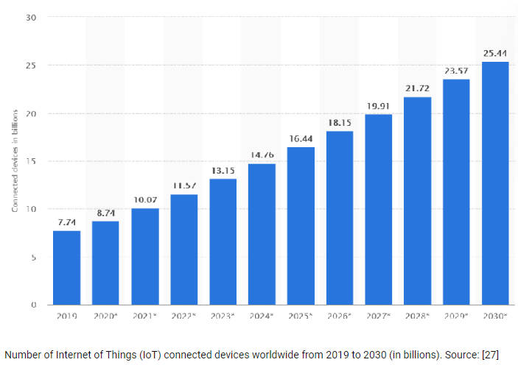
the Growth of the iot
Arnav Mishra
Graph of IoT connected devices worldwide from 2019-2030 [5]
Notes:
The Internet of Things is extremely large and is growing fast. The amount of connected devices by the end of 2022 and into 2023 is estimated to be over 13 billion. As more devices are connected, more data is collected, and more and more information can be made vulnerable to hackers.

Slide 21
Is it worth it?
As you connect more and more devices to the Internet, more and more data is gathered
Companies can monitor how and when you use devices, leading to decreased privacy
Devices can be hacked – information can be stolen and devices can be manipulated [2]
Avoiding smart home products is difficult, so minimize the risk
Update devices, use camera covers, and mute microphones when not in use
Protect sensitive information and make sure devices are only collecting necessary data
Secure your network communications: use encryption, firewalls, use strong passwords, rename routers and networks [6].
Notes:
As you connect more and more devices to the Internet, more and more data is gathered. Companies can monitor how and when you use devices, leading to decreased privacy. Devices can be hacked – even data stored in the cloud can be leaked - information can be stolen and devices can be manipulated [2].
Secure smart devices: make your device tamper-proof – use strong passwords, camera covers, and mute microphones when not in use
Update devices: make sure you have the latest patches and updates
Secure data: protect sensitive information and make sure devices are only collecting necessary data
Secure network communications: use encryption, firewalls, keep everything updated, use strong passwords, rename routers and networks [6].

Slide 22
References
Arnav Mishra
[1] Vit Sembera and Jakub Urbanec, IoT Security Issues, Threats, and Defenses (Trend Micro, 7/22/2021) https://www.trendmicro.com/vinfo/us/security/news/internet-of-things/iot-security-101-threats-issues-and-defenses (9/10/2022)
[2] Malcolm Higgins, Smart home privacy concerns: how can you protect yourself? (NordVPN, 4/4/2022) https://nordvpn.com/blog/smart-home-privacy-concerns/ (9/10/2022)
[3] Nicky Woolf, DDoS attack that disrupted internet was largest of its kind in history (The Guardian, 10/26/2022) https://www.theguardian.com/technology/2016/oct/26/ddos-attack-dyn-mirai-botnet (9/10/2022)
[4] US Congress, IoT Cybersecurity Imporvement Act of 2020 (Congress, 12/4/2020) https://www.congress.gov/bill/116th-congress/house-bill/1668 (9/10/2022)
[5] https://www.researchgate.net/figure/Number-of-Internet-of-Things-IoT-connected-devices-worldwide-from-2019-to-2030-in_fig1_351885272
[6] Anna Katenko and Elena Semeniak, IoT Security: Challenges and Best Practices (Apriorit, 2/17/2022) https://www.apriorit.com/dev-blog/513-iot-security (9/12/2022)

Slide 23
AI and our Privacy
Aidan Bryar

Slide 24
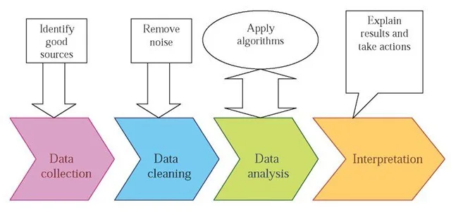
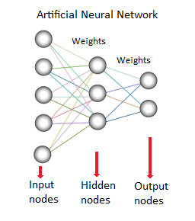
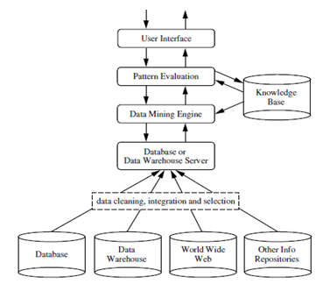
Who Collects our Data and How?
Aidan Bryar
Government Agencies
  NSA
  CIA
Datamining
  Google
  Apps
  Amazon
Notes:
Datamining is more widespread than most people realize and the amount and type of information they collect is surprising.
The Government collects our information, sometimes illegally, everyday in the name of security and safety.
Methods of DataMining:
Association
Classification
Clustering Analysis
Prediction
Sequential Patterns or Pattern Tracking
Decision Trees
Outlier Analysis or Anomaly Analysis
Neural Network
Data is being collected at 2x the rate every year from the last year

Slide 25
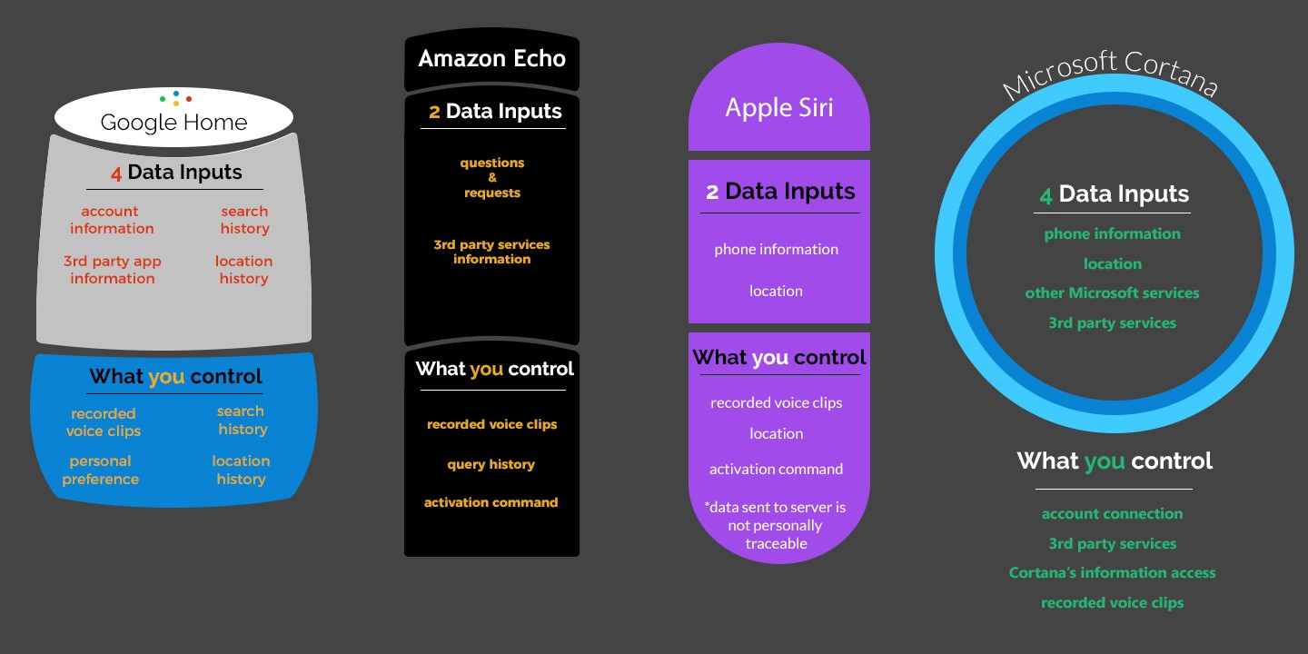
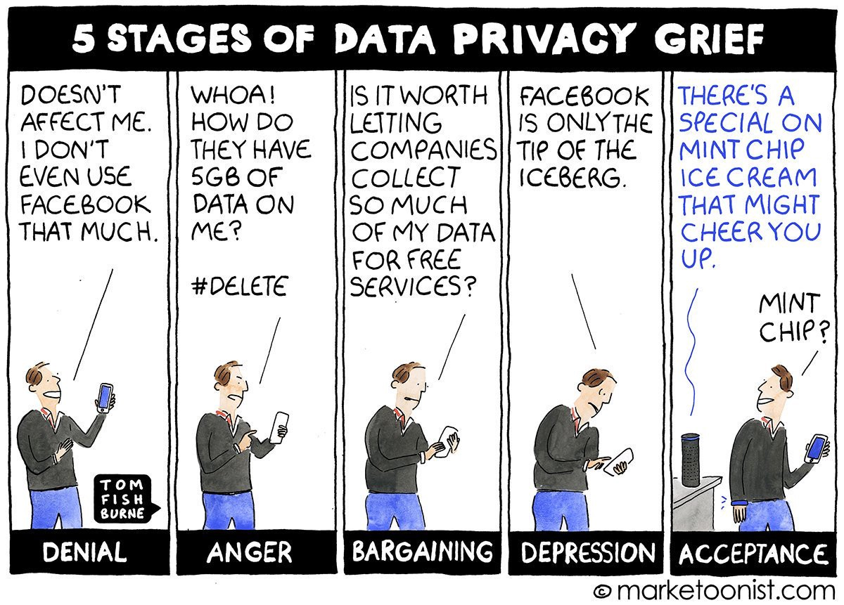
How does Ai Affect our Privacy?
Aidan Bryar
Information Database
  Google
  Criminals
  Persistent Surveillance
Data Security
  Encryption
  Hackers
  AI security
Information Collected vs Used
  How much is too much?
Notes:
While AI can do a lot of good for the world in terms of convenience it can also do a lot of harm to your privacy. Persistent Surveillance is growing as companies are collecting more data which is classified as the gathering of data at all times even when inactive from its true purpose. Criminal can use your data to try to impersonate you, to steal bank information, or even scam you. Hackers are most likely trying your accounts in the background with automated AI tools to try to crack your password.

Slide 26
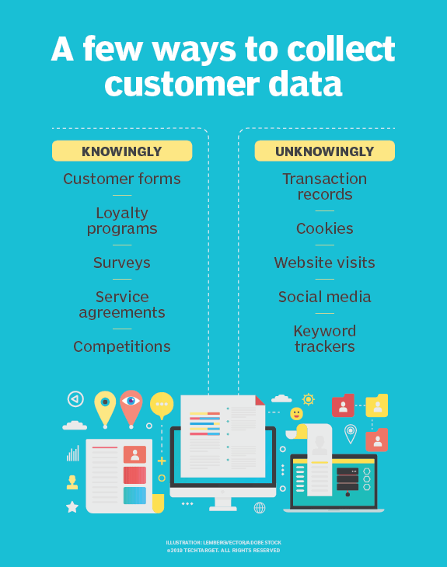
What Data is Being Collected?
Aidan Bryar
  Personal Information
    Name
    Number
    Address
    Card Numbers
  Personal Interests
    Shopping
    Videos
    Speech Patterns
    Exercise
Notes:
Different types of data are being collected in numerous amounts from individuals every day. Currently there is no limit to the information companies can collect outright. China implemented a Social Credit system based on what you post on the internet and other factors. Devices such as Alexa or Google home can collect speech data and patterns to help you with your daily routine. Devices like Apple Watch and Fitbit can use your exercise data to keep you healthy. Shopping and Advertising data can be collected to increase your engagement in services.

Slide 27
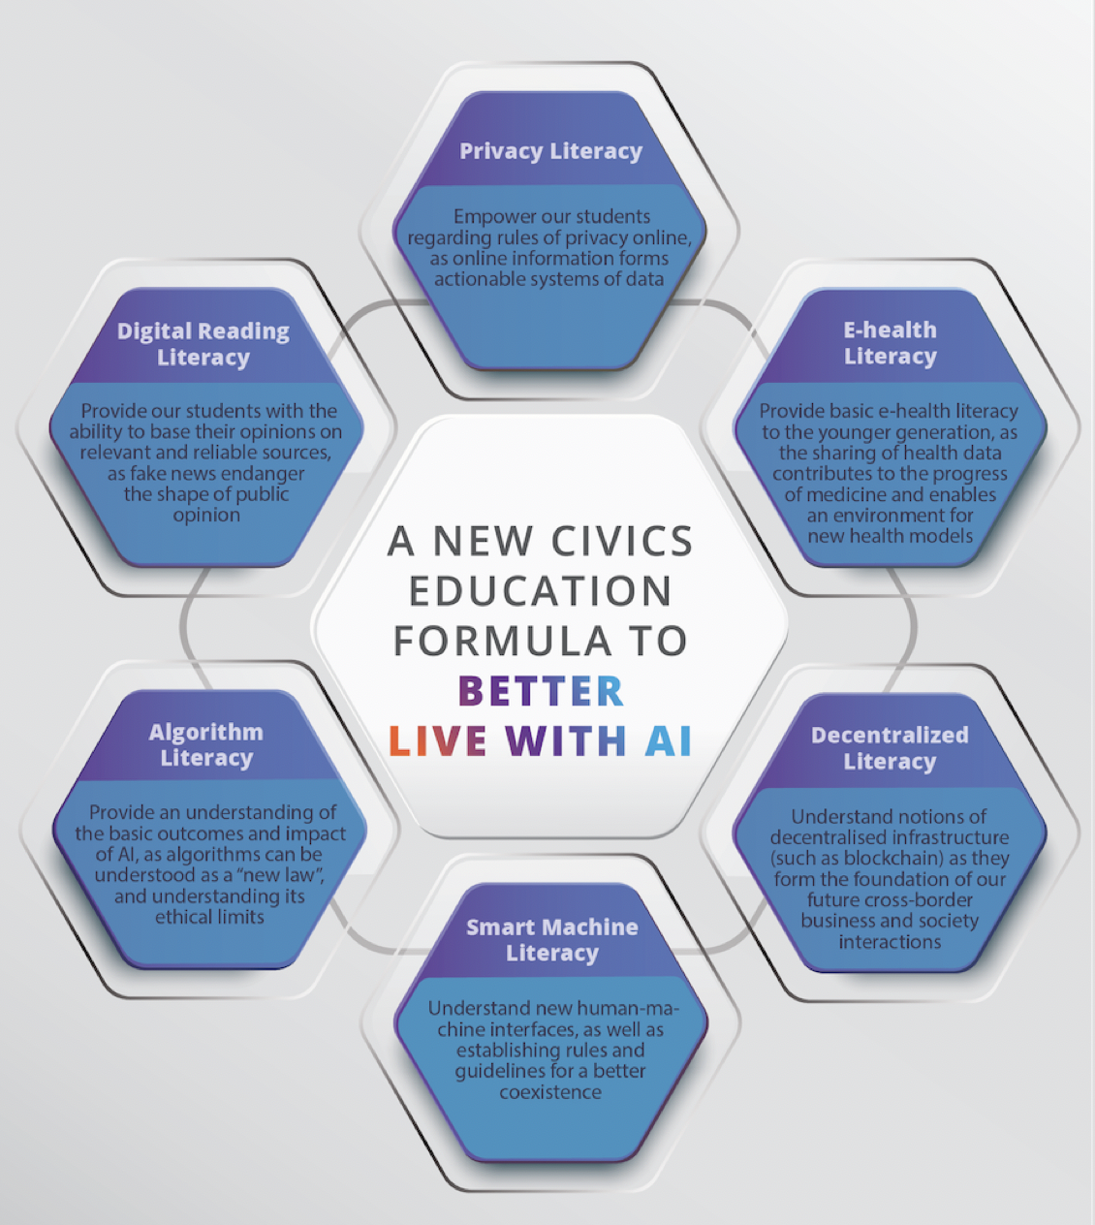
How to Protect Yourself
Aidan Bryar
VPN
Education on Data Security
Web Browsers
Operating Systems
Android
Passwords
Notes:
CCPA in California is working to uphold the privacy rights of people on the internet. There are a number of free and paid VPNs that can help protect you from location and IP tracking. Web browsers such as Firefox and Tor help protect you from data collection as they are way less intrusive than google and safari. Linux can also be a good option to protect yourself since it is open source and doesn’t allow backdoors for companies like Microsoft and Apple do. The Android platform is in general better for privacy than ios which might be surprising. Make sure to use 2-factor authentication when protecting your accounts online.

Slide 28

What does the Future Hold?
Aidan Bryar
Regulation
  HIPPA Act
  Data Limiting
  Restrictions on Data Collection
AI solutions
  Privacy Preserving Machine-Learning
Notes:
HIPPA act allows people to not disclose certain information to a potential employer for privacy reasons.
Companies need to limit their Data intake so the Data we collect does not become too intrusive. Data Hoarding is a big problem within companies especially due to data attacks.
Privacy Preserving Machine Learning is becoming a thing as Computer Scientists search for AI solutions to uphold privacy.
Devices like Amazon Alexa restrict certain data collection to protect the privacy of individuals.
Europe’s GDPR is taking Data Security seriously and posts regulations to companies under their net describing what data they can collect and use. The GDPR describes the right to be forgotten which is very important in the digital age as things are described as never forgotten.

Slide 29
Sources
Aidan Bryar
API, Nidhi B. on, et al. “Google Analytics Data Mining Simplified 101 - Learn.” Hevo, 4 July 2022, https://hevodata.com/learn/google-analytics-data-mining/.
“Data Mining Methods: Top 8 Types of Data Mining Method with Examples.” EDUCBA, 16 Oct. 2021, https://www.educba.com/data-mining-methods/.
Team, ThinkML. “Is Artificial Intelligence a Threat to Privacy?” ThinkML, ThinkML, 11 May 2022, https://thinkml.ai/is-artificial-intelligence-a-threat-to-privacy/#:~:text=When%20you%20are%20using%20technology,to%20customize%20your%20online%20experience.
Kojouharov, Stefan. “Chatbots, AI &amp; The Future of Privacy.” Medium, Chatbots Life, 26 July 2018, https://chatbotslife.com/chatbots-ai-the-future-of-privacy-174edfc2eb98.
AI, Live With. “We Need to Reinvent Civic Education for the AI Future.” Medium, Medium, 1 July 2018, https://medium.com/@livewithai/we-need-to-reinvent-civic-education-for-the-ai-future-c0ddfcf0851b.
Stedman, Craig, and Emily McLaughlin. “Data Collection: Methods, Challenges and Key Steps.” SearchCIO, TechTarget, 2 Feb. 2022, https://www.techtarget.com/searchcio/definition/data-collection.
“The Actual Hidden Costs of in-House AI Data Collection.” Shaip, 16 Aug. 2022, https://www.shaip.com/blog/the-actual-hidden-costs-of-in-house-ai-data-collection/.
“General Data Protection Regulation (GDPR) Compliance Guidelines.” GDPR.eu, https://gdpr.eu/.

Slide 30
Class 6
The End
Keith A. Pray
socialimps.keithpray.net
Notes:
This is the end. Any slides beyond this point are for answering questions that may arise but not needed in the main talk. Some slides may also be unfinished and are not needed but kept just in case.
If there’s time and we didn’t already look at:
Find out what your DNA says about you and your family.
https://www.23andme.com/
Jimmy Kimmel Live – What is your password? (2:49)
https://www.youtube.com/watch?v=opRMrEfAIiI

Slide 31
what works well Online With Zoom
Sign in with First and Last Name
Stay muted unless you are going to speak
To speak use the raise your hand feature
To answer yes/no questions use the “yes” ”no” buttons
Turn your camera on
Wait until the end of student presentations to ask questions
  Write them down so you don’t forget

