Slide 1
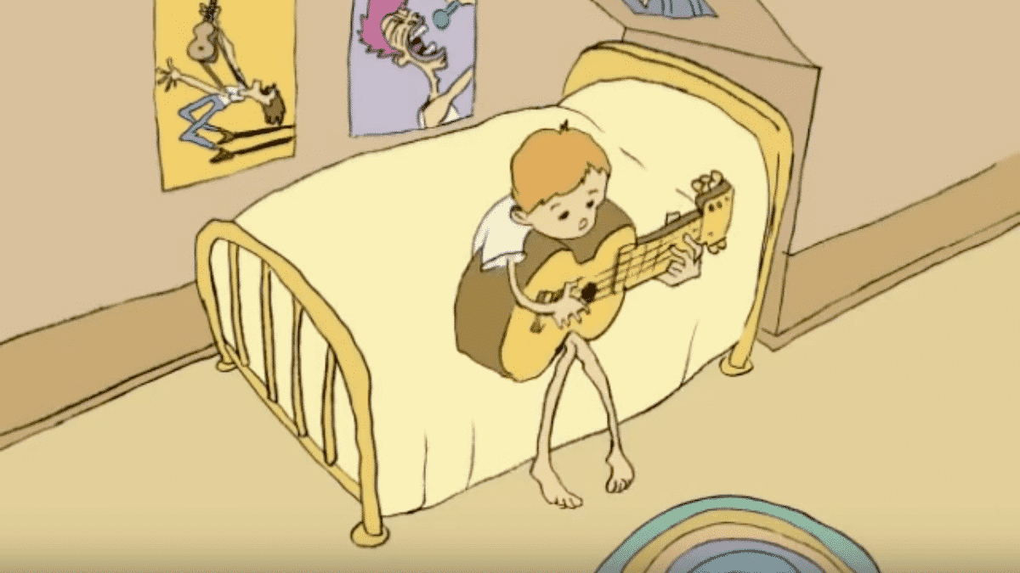
Class 5
Intellectual Property
Keith A. Pray
socialimps.keithpray.net
Notes:
Weird Al Yankovic “Don’t Download This Song” (3:53)
2006-08-21 released exclusively as digital download
https://www.youtube.com/watch?v=zGM8PT1eAvY
Some Analysis Points:
- Slippery Slope Fallacy
- CDs were most common way to obtain music
- Winner take all society
- Virtue ethics, guilt, shame

Slide 2
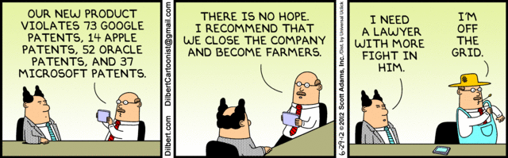
Overview
Review
Assignment
Students Present
Notes:
Comments, observations, questions on IP Chapter?

Slide 3
My Reading Notes
pp. 172 „not have bothered to invent it.“ or had the time. Any music entering public domain, not just classical. Why does orchestra budget matter? Public domain year 1997/1999 from source published in 1996?
pp. 174 SaaS, Google Search example? “…before he gave them the plot.”? “…cannot erase the memories...” Paycheck (2003)
pp. 176 When was instant photography invented?
pp. 177 $134 billion, copyright leading export 2010, now?
pp. 178 ”not profited” but violated right to distribute and reproduce…
pp. 179 Mickey Mouse – CGP Grey “Copyright: Forever Less One Day”
pp. 180 $150K for VP seems low.
pp. 182 Felicity is also an affected party.
pp. 185 4.4 #2 preferred assuming means published works more likely fair use. See pp. 190
pp. 190 Will Google do the same for music and movies as books?
pp. 191 What about lawsuits over a single hook sample? Revenue != profit. (also pp. 201)
pp. 195 Blocking 100% seems impossible.
pp. 199 Any legitimate BitTorrent use examples since 2005?
pp. 2021 How many subscribe now compared to 2015?
pp. 202 “licensing agreement … hardware”? Confidential source code very outdated.
pp. 203 4.7.3 references?
pp. 204 2021-04-05 Supreme Court find fair use in favor of Google [1]
pp. 207 What did the smartphone patent wars cost consumers?
pp. 208 Pouring can of tomato juice into ocean != hard work/labor
pp. 210 Developers often need the tool they make and share. Good reputation can lead to more financial remuneration. Producers are currently allowed to share, just not forced. 3rd claim used by opposing argument too.
pp. 212 Perhaps friends should not ask you to break the law?
pp. 213 With Dev/Sec/Ops adoption trending is long release cycles still true? Any successful businesses operate as a support service? Shift to service may be most compelling I list.
pp. 214 Is Perl still most popular? Source? Quality study from 2003, change?
pp. 215 who uses tape?
pp. 216 “human-readable, lawyer-readable…” How strong is Creative Commons chain of reasoning?
pp. 229 Interview has nothing to do with computing
Questions I liked: 20
Notes:
SaaS = Software As A Service
[1] 2021-04-05: SUPREME COURT OF THE UNITED STATES Syllabus GOOGLE LLC v. ORACLE AMERICA, INC.
https://www.supremecourt.gov/opinions/20pdf/18-956_d18f.pdf
Accessed 2021-09-09

Slide 4
Group Quiz
For each On the left answer a–d on Right
Trademark
Copyright
Patent
Trade Secret
What does it protect?
Qualifications required?
How long does protection last?
Specific example currently protected?
Notes:
Trademark
Used to denote a product or service.
Apply in specific areas of commerce. Only applies in specified area of business
Indefinite term as long as in use and protected against becoming a common noun or verb.
You do not have to register a trademark unless you want to bring litigation before a federal court (there are other benefits too, but what are they?)
Copyright
Expression, not ideas: Fuzzy. E.g. derivative works, characters, merchandising, plots.
Mickey Mouse, Tarzan.
US Default : Original Author, Exception: work for hire, Transferred: yes
Rights: Publication, Performance / exhibition, Adaptation to other media, Excerpting, Attribution, Derivative works
US Term: Lifetime of author plus 70 years., 95 years for companies.
Governed by US law and international treaties (e.g. WIPO).
Fair Use: News reporting, reviews, etc., Scholarly / educational use, Private, non-commercial use, Lending libraries and archives
Fair Use restrictions: Admission charge, Re-transmission
In general, you can: Read, view, play, etc., Copy for personal use., Time-shift, Space-shift
In general, you cannot: Copy for others., Transfer to someone else but keep a copy., Show / perform it publicly.
What about video rentals?
Rationale: Encourage creativity. Encourage dissemination. Balance between private and public good. It’s a social contract.
Patent
A mechanism, process, or composition of matter.
Must be: Novel. Useful. Non-obvious. Described clearly. Must do what it says.
Usual term 20 years.
Utility and plant patents: 20 years.
Design patents last 14 years. (ornamental design of functional item)
Provisional patent gives 1 year, before full patent
Trade Secret
You must take steps.
Enforceable by: Contracts, Laws against industrial espionage.

Slide 5
Group Quiz
For each On the left answer a–d on Right
Trademark
Copyright
Patent
Trade Secret
What does it protect?
Qualifications required?
How long does protection last?
Specific example currently protected?
Notes:
Trademark
Used to denote a product or service.
Apply in specific areas of commerce. Only applies in specified area of business
Indefinite term as long as in use and protected against becoming a common noun or verb.
You do not have to register a trademark unless you want to bring litigation before a federal court (there are other benefits too, but what are they?)

Slide 6
Group Quiz
For each On the left answer a–d on Right
Trademark
Copyright
Patent
Trade Secret
What does it protect?
  Mark denoting product or service
Qualifications required?
  Unique in specific area of commerce
How long does protection last?
  While in use and protected against common noun or verb usage. Need to register to sue.
Specific example currently protected?
Notes:
Trademark
Used to denote a product or service.
Apply in specific areas of commerce. Only applies in specified area of business
Indefinite term as long as in use and protected against becoming a common noun or verb.
You do not have to register a trademark unless you want to bring litigation before a federal court (there are other benefits too, but what are they?)

Slide 7
Group Quiz
For each On the left answer a–d on Right
Trademark
Copyright
Patent
Trade Secret
What does it protect?
Qualifications required?
How long does protection last?
Specific example currently protected?
Notes:
Copyright
Expression, not ideas: Fuzzy. E.g. derivative works, characters, merchandising, plots.
Mickey Mouse, Tarzan.
US Default : Original Author, Exception: work for hire, Transferred: yes
Rights: Publication, Performance / exhibition, Adaptation to other media, Excerpting, Attribution, Derivative works
US Term: Lifetime of author plus 70 years., 95 years for companies.
Governed by US law and international treaties (e.g. WIPO).
Fair Use: News reporting, reviews, etc., Scholarly / educational use, Private, non-commercial use, Lending libraries and archives
Fair Use restrictions: Admission charge, Re-transmission
In general, you can: Read, view, play, etc., Copy for personal use., Time-shift, Space-shift
In general, you cannot: Copy for others., Transfer to someone else but keep a copy., Show / perform it publicly.
What about video rentals?
Rationale: Encourage creativity. Encourage dissemination. Balance between private and public good. It’s a social contract.

Slide 8
Group Quiz
For each On the left answer a–d on Right
Trademark
Copyright
Patent
Trade Secret
What does it protect?
  Expression, not ideas. Derivative work, publication, performance
Qualifications required?
  Original
How long does protection last?
  Author lifetime + 70 years, 95 years for companies
Specific example currently protected?
Notes:
Copyright
Expression, not ideas: Fuzzy. E.g. derivative works, characters, merchandising, plots.
Mickey Mouse, Tarzan.
US Default : Original Author, Exception: work for hire, Transferred: yes
Rights: Publication, Performance / exhibition, Adaptation to other media, Excerpting, Attribution, Derivative works
US Term: Lifetime of author plus 70 years., 95 years for companies.
Governed by US law and international treaties (e.g. WIPO).
Fair Use: News reporting, reviews, etc., Scholarly / educational use, Private, non-commercial use, Lending libraries and archives
Fair Use restrictions: Admission charge, Re-transmission
In general, you can: Read, view, play, etc., Copy for personal use., Time-shift, Space-shift
In general, you cannot: Copy for others., Transfer to someone else but keep a copy., Show / perform it publicly.
What about video rentals?
Rationale: Encourage creativity. Encourage dissemination. Balance between private and public good. It’s a social contract.

Slide 9
Group Quiz
For each On the left answer a–d on Right
Trademark
Copyright
Patent
Trade Secret
What does it protect?
Qualifications required?
How long does protection last?
Specific example currently protected?
Notes:
Patent
A mechanism, process, or composition of matter.
Must be: Novel. Useful. Non-obvious. Described clearly. Must do what it says.
Usual term 20 years.
Utility and plant patents: 20 years.
Design patents last 14 years. (ornamental design of functional item)
Provisional patent gives 1 year, before full patent

Slide 10
Group Quiz
For each On the left answer a–d on Right
Trademark
Copyright
Patent
Trade Secret
What does it protect?
  Mechanism, process, composition of matter
Qualifications required?
  Novel, useful, non-obvious, described clearly, must function
How long does protection last?
  Utility and plant: 20 years
  Design: 14 years
  Provisional adds 1 year
Specific example currently protected?
Notes:
Patent
A mechanism, process, or composition of matter.
Must be: Novel. Useful. Non-obvious. Described clearly. Must do what it says.
Usual term 20 years.
Utility and plant patents: 20 years.
Design patents last 14 years. (ornamental design of functional item)
Provisional patent gives 1 year, before full patent

Slide 11
Group Quiz
For each On the left answer a–d on Right
Trademark
Copyright
Patent
Trade Secret
What does it protect?
Qualifications required?
How long does protection last?
Specific example currently protected?
Notes:
Trade Secret
Anything with business value
You must take steps to keep it secret: Non Disclosure Agreement, protected storage, compartmentalization, etc.
As long as the secret is kept
Enforceable by: Contracts, Laws against industrial espionage.

Slide 12
Group Quiz
For each On the left answer a–d on Right
Trademark
Copyright
Patent
Trade Secret
What does it protect?
  Anything
Qualifications required?
  Must take steps to keep secret, e.g. Non-Disclosure Agreements, contracts
How long does protection last?
  As long as kept secret
Specific example currently protected?
Notes:
Trade Secret
Anything with business value
You must take steps to keep it secret: Non Disclosure Agreement, protected storage, compartmentalization, etc.
As long as the secret is kept
Enforceable by: Contracts, Laws against industrial espionage.

Slide 13
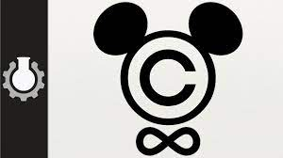

Overview
Review
Assignment
Students Present
Notes:
But first take a look at:
CGP Grey
Copyright: Forever Less One Day (6:27)
https://www.youtube.com/watch?v=tk862BbjWx4
Tom Scott
http://tomscott.com
Welcome To Life (2:44)
https://www.youtube.com/watch?v=IFe9wiDfb0E&feature=youtu.be

Slide 14
Assignment - Self Search 1/3
What Really
Is You?
1 Page
Paper
Filter
Inspiration
Search Methods
…
…
…
…
Filter
Profile
Could Be You

Slide 15
Assignment - Self Search 2/3
Discussion Board
Post search techniques
  Do not repeat entries.
Use techniques listed to produce a profile that could be you.
  Not responsible for techniques posted less than 24 hours before due
Filter first profile so that the information is for you.
Provide as paper appendix
  Summary is fine. No details needed unless you for making a point.
Consider:
  Exactly how did the data get there?
  How can this data be used?
  Is this a secondary use?
  Did you authorized use of the data? If not and you want to, request its use be discontinued and share the experience.
Be creative, anyone can type a name into Google
Do not pay for search services

Slide 16
Assignment - Self Search 3/3
1 Page Paper
Refer to search results to support your conclusion
Subscribe to the Discussion Board
Example questions conclusion could answer:
  What impression would the profile make on a potential employer?
  What would an elder family member (or equivalent) think?
  Are you comfortable with what you found or did not find?
  Do you believe protecting your privacy is important or needed?
5 High quality sources required
  Sites used in search techniques not included

Slide 17
Overview
Review
Assignment
Students Present

Slide 18
Trademarks and Social Media
Timory Goggin
Notes:
Should trademarking have additional restrictions based on the changing atmosphere surrounding words created by online platforms?

Slide 19
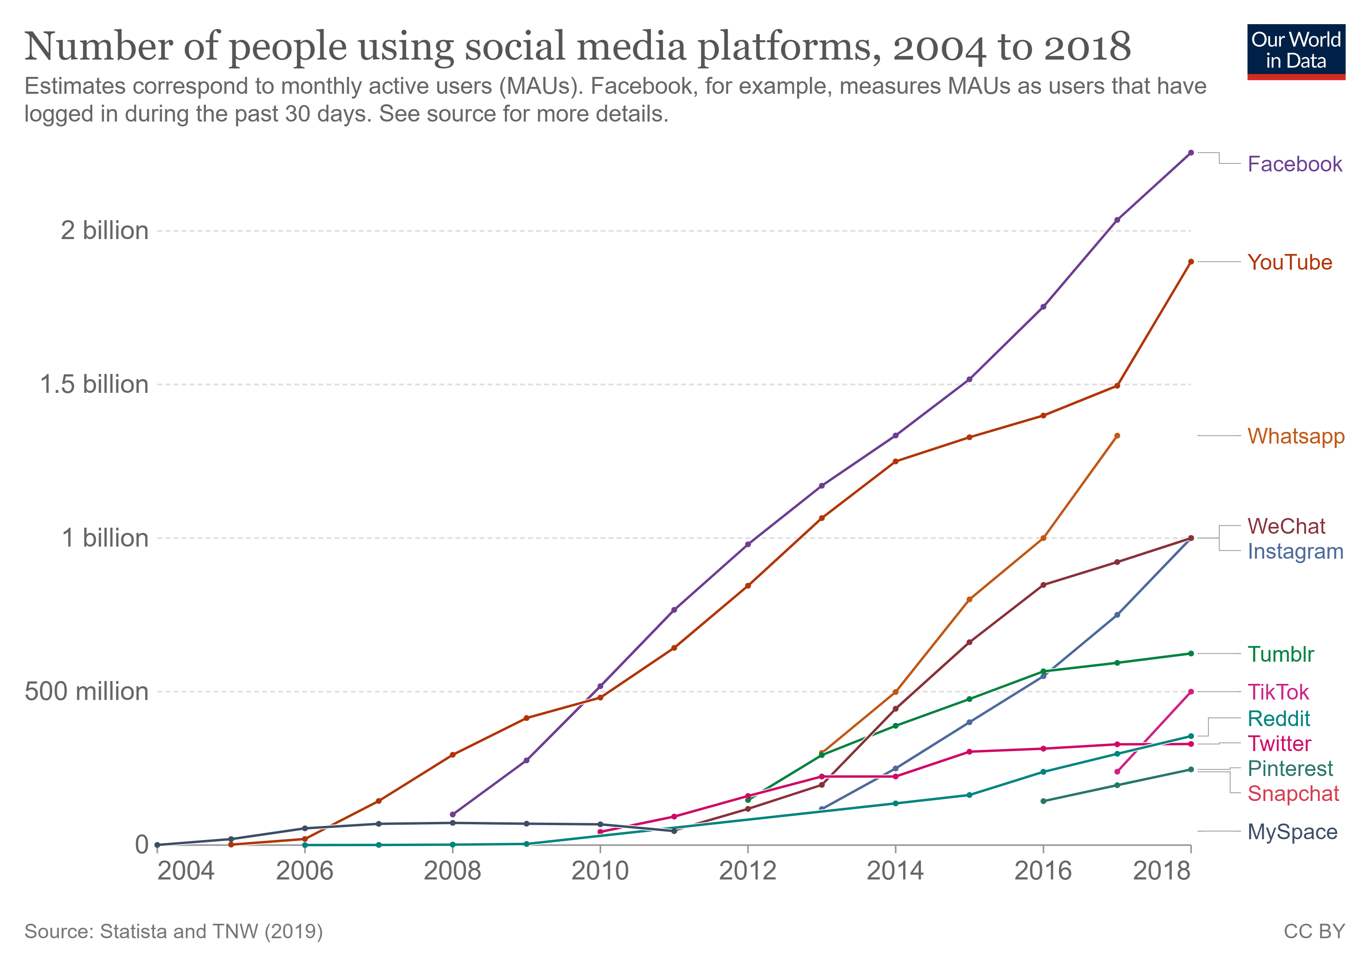
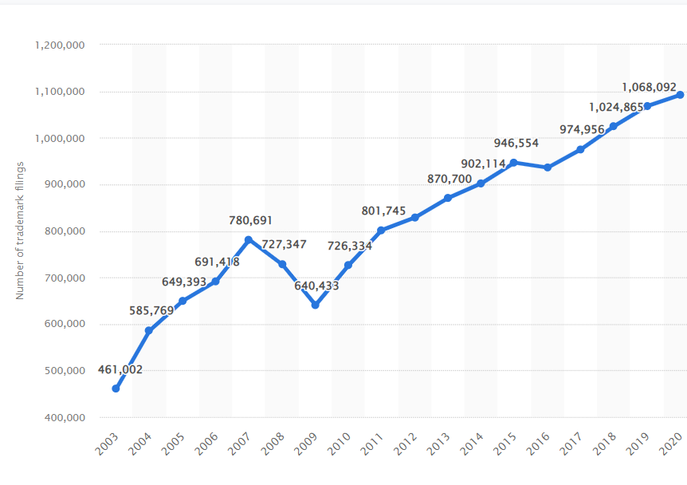
Social Media Effects on Trademarks
Timory Goggin
Social Media
  Means of communication [1]
  1,068,092 trademark requests
  Cost
Affects on Businesses
  Trademark Strength Analysis
  Challenges with names
  Ex: Cold Stone Creamery [2]
  Figure 1 (top) and 2 (bottom): Depict the sharp increase in social media use and trademark requests in the past two decades, suggesting a correlation [3,4].
Notes:
In the past two decades, Social Media has become a primary means of communication. Across multiple platforms, individuals can send text, images, and videos to a large audience with only a few clicks.
Social media has undeniably changed marketing and created a vast number of opportunities for companies to promote their products and services. This is especially true with domestic trade, which with the use of social media can have exposure on a global and international scale [1].
The use of social media provides a cheaper option for advertisement.
Over the past two decades the number of trademark applications has increased from 461, 002 to 1,068,092 per year[4]. (Read off figure 2)
This increase can be seen as a result of social media’s effect on trademarks.
For businesses, trademarking a name or brand can be crucial for their own marketing purposes as well as to avoid infringing on others.
Social Media is the next big marketing tool for large and small enterprises [1].
There is an existing debate on social media’s role in trademark strength analysis which would influence businesses claims to trademarks.
Finding a name that is not already trademarked in some way is a challenge.
One individual looking to open an ice cream shop wanted to chose the name ‘Cold Hearted’, but trademark screenings discovered that ‘Cold Stone Creamery’ was quite litigious when protecting its name, so it was decided that the word ‘cold’ was going to be problematic. Even if it was unlikely that there would be confusion between Cold Hearted and Cold Stone and that the individual would have had a good chance of success if questioned, she did not want to invest the time or money to fight it [2].

Slide 20
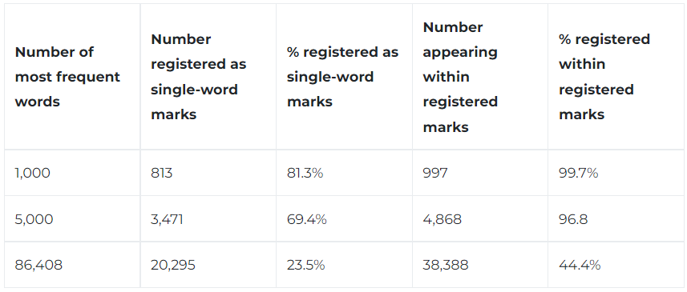
Evolution of Trademarks
Timory Goggin
Trademark Percentages
  9.1 million request in 2017 [2]
  Commonly used words
  81.3% of 1,000 most frequent words [5]
Trademark Range
  “The” – The Ohio State and Marc Jacobs [6]
  Phrases and Song Lyrics
  Names
Figure 3: The chart illustrating how increasingly common trademarks are [5].
Notes:
9.1 million trademark applications were filed worldwide in 2017 which was a 30% increase from the year before [2].
Table to the right shows that 81.3% of common words are registered marks which is proving that it is becoming increasingly difficult to find unique trademarks.
The idea that we are at a level of economic development where we are running out of words to, trademark but looking at the statistics it is not a reality that is far off [5].
Ohio State University officially registered a trademark for the word "THE.” There was a nearly three-year battle to gain legal branding access to a word. They reached an agreement with Marc Jacobs, the designer, that allowed both to register "THE" branded products for continuous use and license [6].
Song lyrics are covered under copyright because they are a work of art whereas trademark distinguishes goods and services. Recently artists have also been trademarking unique phrases from their songs. Taylor Swift was the first to do so [7].
People have been known to trademark their names or versions of it, but now celebrities are trademarking their children's as well. This can only occur if the individuals promise to be selling products associated with the name as trademarks are meant to represent goods or services [8].

Slide 21
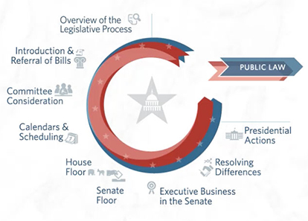
Gap Between The Law and the World
Timory Goggin
Rate of change in the legal world
  3 billion Facebook and 1.44 million Instagram users [3]
  Two decades of social media
  620 to 1,200 laws enacted [12]
The need to define new bounds
  Trademarks on social media
  Trademark infringement
  Trademark dilution
Figure 4: Depicts the extensive process to enact laws which can not match the pace of evolving social media [9].
Notes:
The development of technology, specifically social media, has increased at a rapid rate over the past 20 years.
Facebook at nearly 3 billion users and Instagram 1.44 million users when 20 years ago they didn’t exist [3].
In the early 2000s about 600 laws were enacted in two years, in the last Congress session ~1,200 laws were enacted [12]. Some laws can take month or years to enact because of the significant process of drafting and changing bills for them to pass.
Despite it being two decades since the surge of social media use, few laws have been updated or created to reflect the changing atmosphere surrounding trademarks in regard to social media.
The situation exemplifies the constant disparity between technology in the world and associated laws.
The potential damage that could result from the unauthorized use of a trademark on social media is incomparable to the potential of unauthorized trademark use offline [10].
Technology has created issues, that were previously unconsidered, with current trademark law [1].
Trademark infringement (the use of the trademark without the explicit authorization from the trademark owner) is a common issue of social media with the ability for individuals to create fake accounts and sell knock off products [10].
Trademark dilution (the ability of the trademark owner to stop others from using the trademark in order to keep it unique to the owner's purpose) is also common on social media for similar reasons to infringement [10]. A common example of this was with the word thermos.

Slide 22
Shifting The restrictions
Timory Goggin
Existing trademarks
  Reevaluation after a couple years
  Opposing contexts
  Raising maintenance and renewal fees
Trademark law
  Social Media’s contribution to strength analysis
  Infringement and dilution
Notes:
To “free” some of the words already trademarked, the US patent and trademark agency should consider reevaluating trademarks after a period of time to ensure that trademarks are being used as they are intended. This would help eliminate the trademarks that were registered but never actually used.
Similar to the agreement that Marc Jacobs and The Ohio State came to over the trademark “THE”, splitting the claim to trademarks based on the intended use could also loosen the hold individuals or businesses have on words or phrases.
Maintenance and renewal fees to increase the likelihood that registered trademarks will be released and more strictly enforced use requirements are other ways to deal with the issue [5].
Regarding the issues with trademark law, social media should be considered when conducting trademark strength analysis. When investigating commercial strength of a trademark, courts consider sales and advertising costs as circumstantial evidence, but neglect to assess the social media presence [11].
Trademark laws need to be updated to accurately reflect the climate regarding infringement and dilution on social media.

Slide 23
References
Timory Goggin
[1] Neema, S., & Sura, V. (2022, January 29). The tale of trademark infringement on social media: From protection to disparagement. The IP Press. Retrieved September 5, 2022, from https://www.theippress.com/2022/02/02/the-tale-of-trademark-infringement-on-social-media-fro-m-protection-to-disparagement/
[2] Lince, T. (2019, September 2). "dig deep" – branding expert reveals challenges of finding new brand names in a crowded trademark market. World Trademark Review. Retrieved September 5, 2022, from https://www.worldtrademarkreview.com/article/dig-deep-branding-expert-reveals-challenges-of-finding-new-brand-names-in-crowded-trademark-market
[3] Ortiz-Ospina, E. (2019, September 18). The rise of Social Media. Our World in Data. Retrieved September 5, 2022, from https://ourworldindata.org/rise-of-social-media
[4] Published by Erin Duffin. (2022, August 11). Number of trademark filings U.S. 2020. Statista. Retrieved September 5, 2022, from https://www.statista.com/statistics/256754/number-of-trademark-filings-in-the-united-states/
[5] Beebe, B., & Fromer, J. C. (2018). Are we running out of trademarks? An empirical study of trademark depletion and congestion. Harvard Law Review , 131(4).
[6] Simonson, A. (2022, June 23). Ohio State University wins trademark for the word 'the'. CNN. Retrieved September 5, 2022, from https://www.cnn.com/2022/06/23/us/ohio-state-university-trademarks-the/index.html
[7] Morales, X. (2022, January 7). This sick trademark - trademarks owned by Taylor Swift. Secure Your Trademark. Retrieved September 5, 2022, from https://secureyourtrademark.com/blog/taylor-swift/
[8] Tiffany, K. (2019, April 19). Why celebrities try to trademark their catchphrases and Baby Names. Vox. Retrieved September 5, 2022, from https://www.vox.com/the-goods/2019/4/19/18507920/celebrity-trademark-history-baby-names-taylor-swift
[9] The Legislative Process: Overview (video) - congress. Congress.gov. (n.d.). Retrieved September 5, 2022, from https://www.congress.gov/legislative-process
[10] Friedmann, D. (2015). Trademarks and social media: Towards algorithmic justice. Edward Elgar.
[11] Connors, E. (2018). Trademarks and Twitter: The Costs and Benefits of Social Media on Trademark Strength, and What This Means for Internet-Savvy Celebs. New England Law Review, 52(2), 189–213.
[12] Statistics and historical comparison. GovTrack.us. (n.d.). Retrieved September 8, 2022, from https://www.govtrack.us/congress/bills/statistics

Slide 24
AI-Generated Art: Caution Advised
Mich Toryu
Notes:
Today I'm going to be talking about the rather controversial topic that is AI-generated art. In particular, how it relates to fair use and how it is affecting today's artists. I believe that it's in our best interests to carefully consider where we should implement AI art and where we should leave things to human artists.

Slide 25
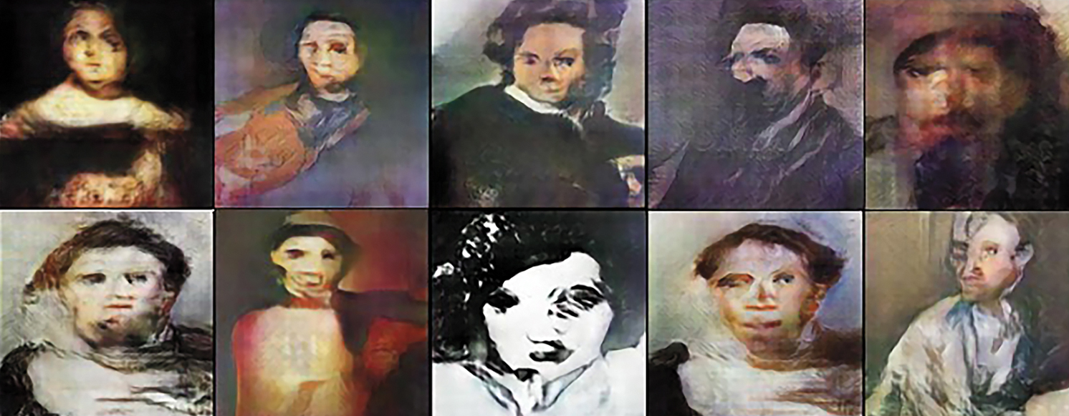
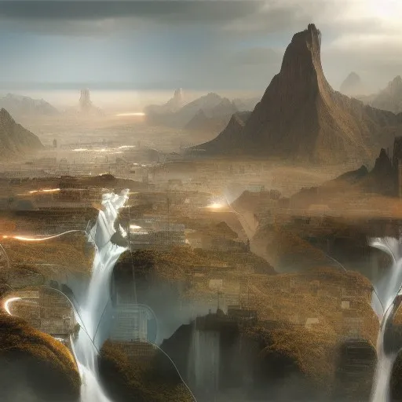
How is AI Art Generated?
Mich Toryu
AI "learns" art styles by being fed thousands of images
  Adversarial networks: one leg generates, another chooses [1]
Users sift through AI-generated images to find one that they can assign value to
Lots of AI art generates deformed versions what we would typically see in human art
Users can input prompts
  Databases with photos corresponding to words [10]
AI-generated portraits
Image created on nightcafe.studio using the prompt "Social Implications of Information Processing"
Notes:
Before we talk about the ramifications of AI art, it's important that we understand how this art is made. AI art generators work by being fed thousands of images from curated databases. A lot of models use what is called a "General Adversarial Network," that features two neural networks. One of which generates numerous random images, which then get fed into the other network, which appraises the images based on criteria developed by looking at the databases it is fed. From there, creators and users of AI art tools run the algorithm and generate images until they stumble upon something of meaning. The creators of the AI may then tweak the program's parameters to produce more favorable results. Due to the nature of AI not being able to perfectly emulate human form, a lot of AI art takes a much more novel form than most human art. As you can see in the image of AI generated portraits, something feels kind of "off" about them. Another aspect of AI art is the use of prompts. The images used to train these prompt-based generators will have words associated with them, which then factor into what data to choose from when given a prompt. I decided to generate "my own" image using one of the first sites to come up on google, and used the name of this class as the prompt.

Slide 26
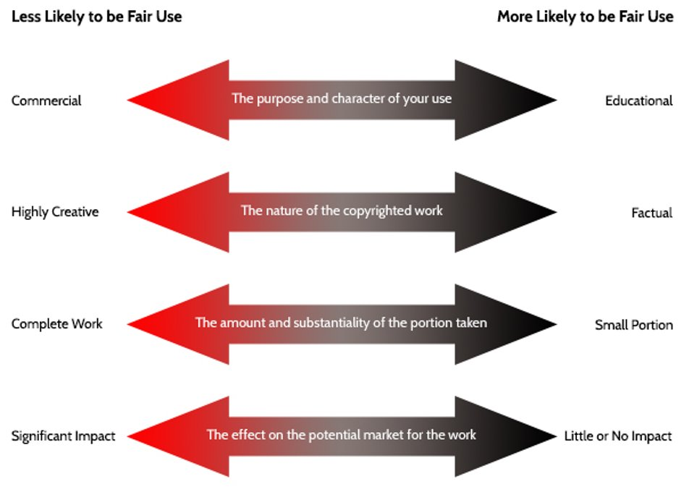
Does Ai Art fall under Fair Use?
Mich Toryu
Images used to train AI had to come from somewhere
  Some datasets are public domain [3]
Many art generation tools commercialize the images their users generate [2]
AI is trained on collections of art
Does AI art take the market of human art?
  Market impact is highest when the new work substitutes the used work [4]
Fair use is decided on a sliding scale based on four factors [4]
Notes:
One thing chapter four mentioned was the idea of fair use, which is judged by four scales. Some datasets used to train AI are comprised of public domain images. However, unless we think that every single image generator uses images from public domain databased, or images with expressed permission from their authors, then we need to analyze the use of image datasets in AI to consider whether it is fair use. For the commercial to educational scale, many AI image generators (including the one I used on the last slide) have some way of commercializing the images that users create, whether that be through prints of the images or even NFT's (I'll leave the topic of NFT's for someone else's presentation, though). In this way, AI art is indeed commercialized. The images in the training datasets are all art, and are used in their full portions and in vast quantities, thus corresponding to the middle two dimensions. As for the market impact dimension, it is considered very impactful when the new work serves as a substitution for the old work that it uses. But how much does AI art affect the market of the types of human art used to produce it? More on the next slide.

Slide 27
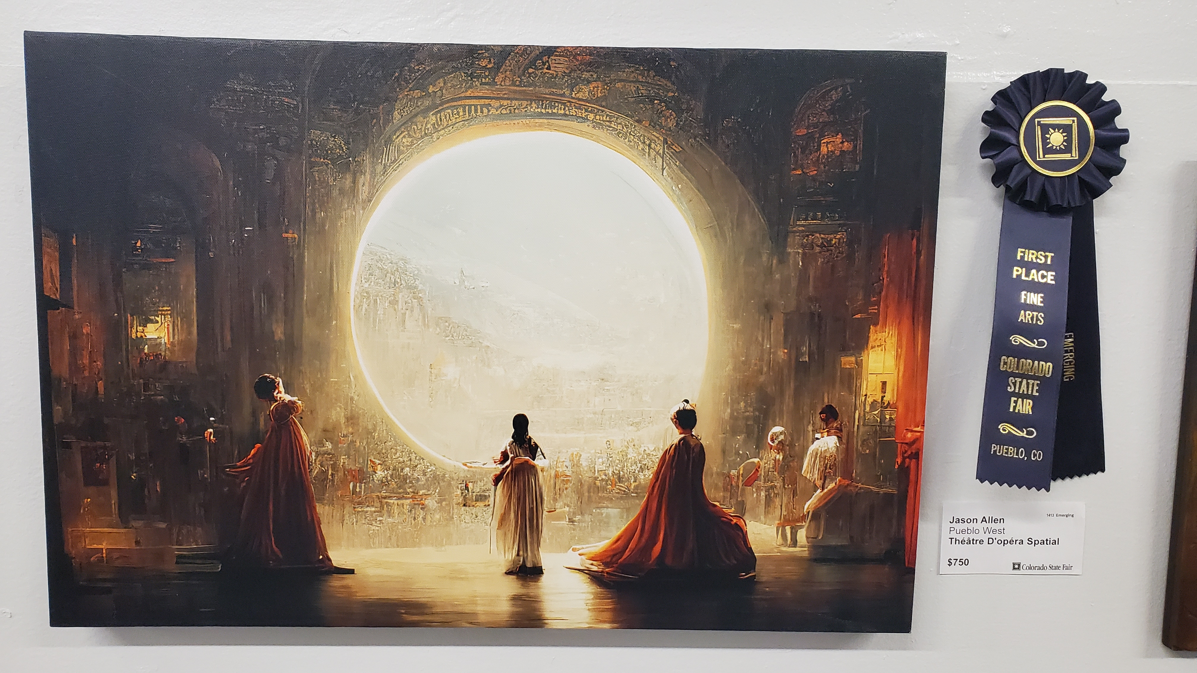
AI Art Affects the Market of Human Art
Mich Toryu
Recently, an AI-generated image won an award at the Colorado State Fair
  Creator spent weeks choosing between generated imagery [5]
AI art has been auctioned off at over $400k
Is AI art a distinguishable category of art?
  In a survey of participants recruited on Amazon, 75-85% of users were only able to identify 1 out of 5 AI landscapes [6]
Notes:
There have been cases where AI art competed directly with human art. One example (that Twitter especially was up in arms about) happened not to long ago, where an AI-generated piece of art won the digital art category of the Colorado State Fair. Rather than digitally illustrating their piece, the creator spent weeks generating images and choosing between. About a year ago, an AI-generated portrait, La Baronne de Belamy, was sold at auction for just over 430,000 dollars. Since the auction house also deals with human art, it could be argued that AI art is competing with human art for space at auction. At first, you may think that the novel nature of AI-generated art gives it an entirely new market compared to human art. However, 75-85% of participants in a survey conducted on around a couple hundred users from Amazon were only able to correctly identify 1 out of 5 AI-generated landscape as being AI-generated. The fact that any people at all were fooled by this means that AI art has potential to pose as human art and directly compete with it in sales.

Slide 28
Where does our example fit?
Mich Toryu
Notes:
Let's take another look at our example and rank it on the scale of fair use. In our case, it is being used in this presentation, which is a fairly educational endeavor. However, the tool it was made with draws on the complete creative works of many artists, putting it pretty low on both of those scales. In terms of market impact, however, it is not impacting the market of human-made art, as I chose it specifically because it was AI-generated.

Slide 29
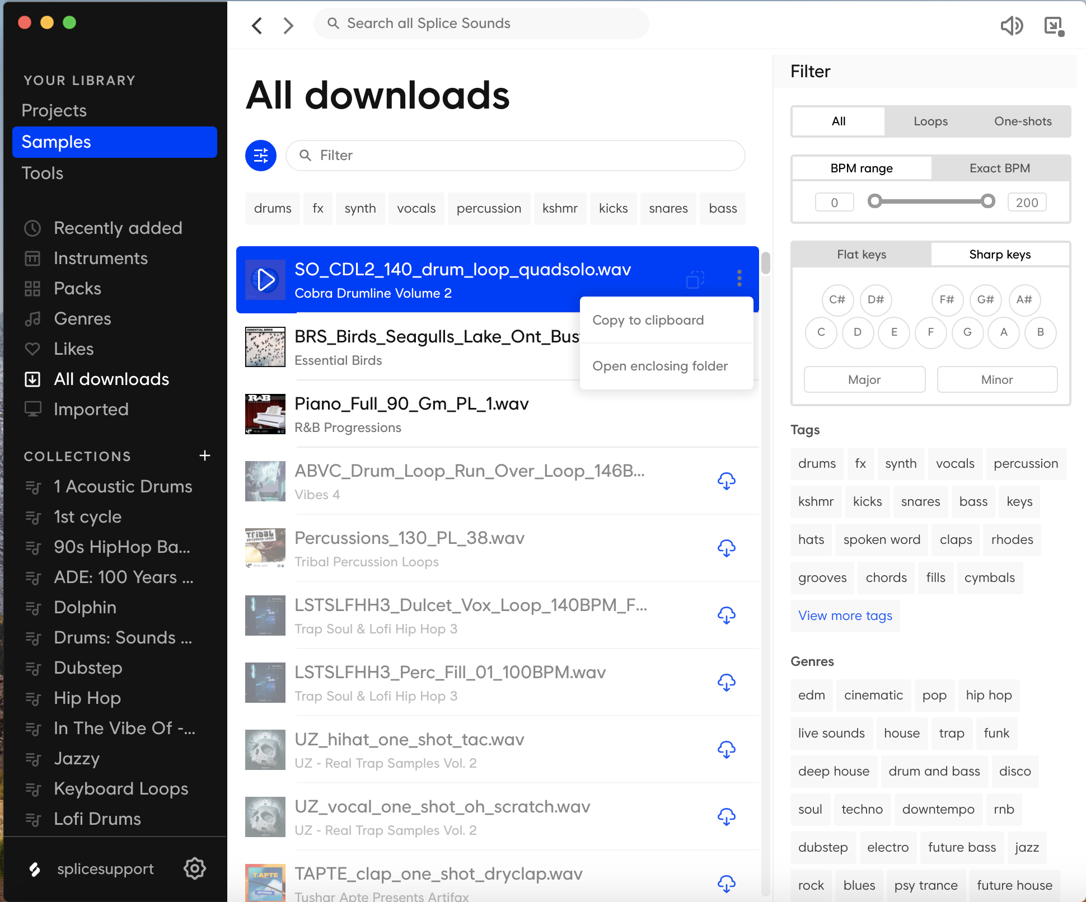
Ai Art's Accessibility
Mich Toryu
Art generators pride themselves on increasing the accessibility of art creation
Tools for accessibility exist in other mediums
  Music: sampling
Users are still involved [1]
  At what point does the process become un-artful?
Music-making tools such as Splice provide libraries of sounds that users can feature in their own works
Notes:
Moving on, one of the main arguments and mission statements of AI art is that it makes art more accessible to create, even for people who have no background in art. To that extent, there are tools that are made for different mediums, such as music, that have similar goals. For example, many modern songs contain samples from other songs or online libraries. Splice is an example of an online library that provides a myriad of musical samples across many genres and moods. Using these libraries can greatly increase what composers are capable of creating relative to their skill level, to the point where it is possible to make entire songs using just samples. In the case of both sample-based music creation and AI-generated art, the user still has a role. Making music with samples still requires users to place these samples in a rhythmically interesting and engaging way, and AI art still requires the user to create prompts and sift through what the algorithm has created. Some may argue that these processes are inherently less artful than their full counterparts due to the lack of skill or effort involved in the process.

Slide 30
Criteria: what is a step too far?
Mich Toryu
Do the artists featured in AI training datasets receive compensation or give consent?
  E.g., museum datasets [7]
Is the work sufficiently different than the source?
  Legal grey area [8]
  Novel enough to not be considered human-made?
What role did the prompts play in generating the art? [9]
The machine cannot legally own the artwork [9]
Intention: provide a new medium based on human-machine interaction
  Don't try to replace artists
Notes:
All this being said, I think it's important to establish some base criteria around AI art and fair use. As I said at the start of this presentation, I think it would be a good idea to exercise caution in our implementations of AI-generated art. Since there are artists whose works are used to train AI image generators, it's important to consider whether those artists chose to have their art be incorporated in the training datasets, and whether they are compensated for it. For example, some museums post extensive libraries of their works online. Since the artists that created those works either sold or donated them to the museums, it is up to the museum to decide how to use their works. In this case, the original artists, the museum, and the creators of the AI all benefit from this process. The only party to get negatively affected is the artists whose work is competed with by AI artwork. Another criteria that may be important is the idea of originality. If I were to train an AI off of the complete works of an artist (who is alive today) in order to produce a parody of that artist's work, then that artist would have reasonable legal ground to sue. That being said, there is a legal grey area regarding what may be considered original. Additionally, the creative process of creating and manipulating prompts to produce AI art should be considered at least to some degree, even if it takes less skill and effort. It's also worth noting that the machine or algorithm does not have the legal right to the art it creates, similar to how animals cannot be represented in court. Overall, I think the ethics of AI art should strongly tie to its intention. If it is made with the intent to produce an entirely new category of art based around the interactions between human and machine (like those DALL-E memes you may see floating around), then it is more moral. AI art is less permissible when aimed specifically at replacing the artist entirely.

Slide 31
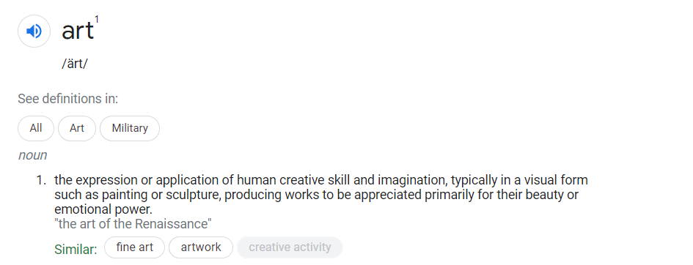
Is AI art even Art?
Mich Toryu
The Oxford Dictionary definition of art. Does AI art fall under this? Should it?
Notes:
As a final bit of food for thought, I thought it'd be interesting to discuss whether AI-generated art even constitutes art. This definition states that it is "the expression or application of human creative skill and imagination," which begs a few questions. Is the process of creating an algorithm analyze and sort through images inherently creative? How about the process of coming up with prompts for image generators? If not, should the definition of art be expanded to include these machine-dependent expressions? I leave you with these questions as I close my presentation. Thank you.

Slide 32
References
Mich Toryu
[1] Elgammal, Ahmed. “Ai Is Blurring the Definition of Artist.” American Scientist, 14 June 2019, https://www.americanscientist.org/article/ai-is-blurring-the-definition-of-artist. Accessed 9/7/22.
[2] Knight, Will. “When AI Makes Art, Humans Supply the Creative Spark.” Wired, Conde Nast, 13 July 2022, https://www.wired.com/story/when-ai-makes-art/. Accessed 9/7/22.
[3] Gross, Dariusz. “65 Art Datasets for AI Artwork Generation. Ready-to-Use.” Medium, 27 June 2022, https://medium.com/mlearning-ai/65-art-datasets-for-ai-artwork-generation-ready-to-use-beabc34afd9b. Accessed 9/7/22.
[4] “Fair Use.” Georgetown University Library, https://library.georgetown.edu/copyright/fair-use. Accessed 9/7/22.
[5] Foley, Joseph. “Ai-Generated Art Won a Fine Arts Competition – and Artists Are up in Arms.” Creative Bloq, 7 Sept. 2022, https://www.creativebloq.com/news/ai-art-wins-competition. Accessed 9/7/22.
[6] Boucher, Brian. “Most People Can't Tell the Difference between Art Made by Humans and by Ai, a Rather Concerning New Study Says.” Artnet News, 27 Apr. 2021, https://news.artnet.com/art-world/machine-art-versus-human-art-study-1946514. Accessed 9/7/22.
[7] “Art Data.” Artnome, https://www.artnome.com/art-data. Accessed 9/7/22.
[8] Ligon, Sarah. “AI Can Create Art, but Can It Own Copyright in It, or Infringe?” Lexis Nexis, 1 Mar. 2019, https://www.lexisnexis.com/community/insights/legal/practical-guidance-journal/b/pa/posts/ai-can-create-art-but-can-it-own-copyright-in-it-or-infringe. Accessed 9/7/22.
[9] Lawson-Tancred, Jo. “'A.I. Is Being Trained on the Collective Works of Humanity': How Artists Are Using Image Generators to Usher in the New 'Recombinant Art' Movement.” Artnet News, 20 July 2022, https://news.artnet.com/art-world/ai-image-generators-dall-e2-2143275. Accessed 9/7/22.
[10] Wu, Yonghui. “How AI Creates Photorealistic Images from Text.” Google, Google, 22 June 2022, https://blog.google/technology/research/how-ai-creates-photorealistic-images-from-text/. Accessed 9/7/22.

Slide 33
Class 5
The End
Keith A. Pray
socialimps.keithpray.net
Notes:
This is the end. Any slides beyond this point are for answering questions that may arise but not needed in the main talk. Some slides may also be unfinished and are not needed but kept just in case.

Slide 34
what works well Online With Zoom
Sign in with First and Last Name
Stay muted unless you are going to speak
To speak use the raise your hand feature
To answer yes/no questions use the “yes” ”no” buttons
Turn your camera on
Wait until the end of student presentations to ask questions
  Write them down so you don’t forget

