Slide 1
Class 4
Freedom Of Speech
Keith A. Pray
socialimps.keithpray.net
Notes:
If forgot to show the ethical analysis guide, do so now.

Slide 2
what works well REmotely With Zoom
Turn your camera on
Sign in with First and Last Name
Stay muted unless you are going to speak
To speak use the raise your hand feature
To answer yes/no questions use the “yes” ”no” buttons
Wait until the end of student presentations to ask questions
  Write them down so you don’t forget

Slide 3
Overview
Review
Assignment
Students Present
Notes:
Show syllabus updates if any

Slide 4
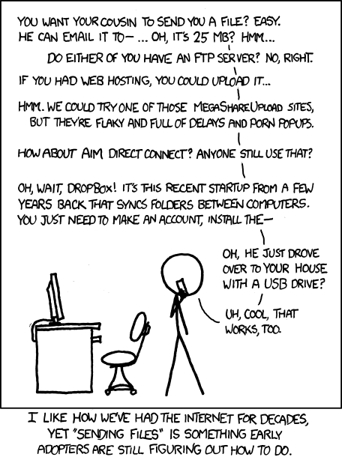
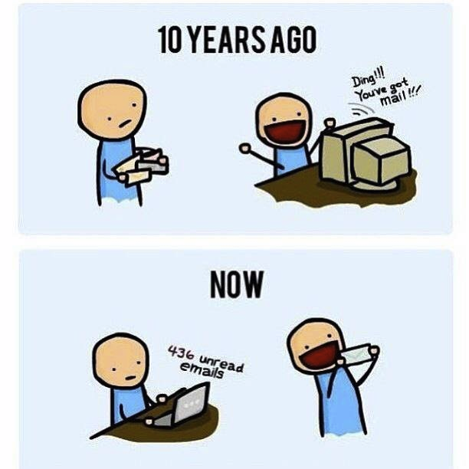
http://poofytoo.com/
25
http://xkcd.com/949/
Notes:
What is more exciting now for you, email or snail mail?

Slide 5
My Reading Notes
pp. 110 First e-games 1972 at Stanford [1]. Has Twitch viewership gone up since the start of the COVID pandemic?
pp. 111 What powers the cell phones and towers? “everyday tasks” not apparent from image.
pp. 113 Ann did not force people to complain.
pp. 114 Does Kantian analysis agree?
pp. 117 9% # transactions or $$? Wikipedia critics source from 2005, is quality still in question?
pp. 118 MOOC source from 2012, now?
pp. 122 Macedonian is nice addition to new edition
pp. 123 “may have” = weak conclusion. Who funded studies?
pp. 124 Easier consolidation of newspapers. Advertisers switching away from newspaper source from 2014.
pp. 126 Search engines link deeper than home page
pp. 127 Any US agencies employing this many people?
pp. 131 Adult bookstores lowering property values source?
pp. 135 “texted… images”
pp. 136 Stating people searching did not consent to material being blocked makes more sense.
pp. 138 sexting examples all from 2009?
pp. 140 College students still as likely? 2013 source
pp. 141 Do mobile plans still charge for text messages?
pp. 146 Hunter Moore convictions seem unrelated to “Anyone Up?” site.
pp. 153 See: http://en.wikipedia.org/wiki/Wikipedia:Citing_Wikipedia
pp. 154 Question 40 same as 46
Questions I liked: 17, 43
Interview nice update
Notes:
[1] Owen Good (19 October 2012). "Today is the 40th Anniversary of the World's First Known Video Gaming Tournament". Kotaku. Retrieved 1 August 2013

Slide 6
Group Quiz
Name two methods some governments use to control access to information.
A large company has a policy prohibiting employees from blogging about company products.
  Does it violate the First Amendment? Why?
  Name two possible reasons for the policy.
  Is it reasonable? Why?
What does “URL” stand for and what is it?
Notes:
Censorship (religious, governmental, private). Adult authentication. Firewalls. Government owned media outlets (TV and radio stations, newspapers), private photocopier ownership illegal
First Amendment prohibits Congress from making laws limiting free speech, not private companies.
Uniform Resource Locator

Slide 7

Overview
Review
Assignment
Students Present
Notes:
But before that:
CPG Grey - This Video Will Make You Angry [Thought Germs] (7:25) – 2015-03-10
https://www.youtube.com/watch?v=rE3j_RHkqJc
Find better examples:
Cedric Gervais - Hashtag (Original Mix) (3:58)
https://www.youtube.com/watch?v=6OmBKd7X7EE
Dave Audé vs Luciana - You Only Talk In #HASHTAG (3:36)
http://www.youtube.com/watch?v=53wIN87lJn0

Slide 8
Assignment
Reading
Individual Presentations
Extra Credit – One page paper
  Is WPI’s IT Acceptable Use Policy morally acceptable?
Work on your group project
  1.23 Happiness!
    1-3 scale with 1 = everyone getting their first pick
  See full group project description on course website
  Send Web Site URL before next class
Notes:
- Or review group project and individual presentation guidelines right now.
Possible One page paper:
Global intellectual property laws, friends or foes?

Slide 9
Overview
Review
Assignment
Students Present

Slide 10
Freedom of Speech and Hate On social media
Sasha Daraskevich

Slide 11
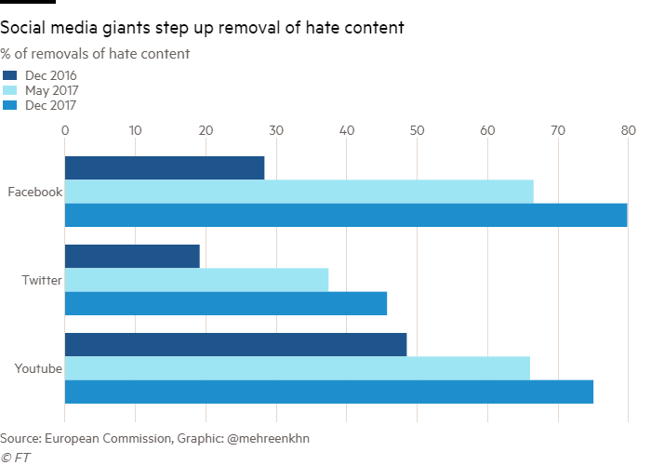
Restrictions on hate speech are imperative
Sasha Daraskevich
Freedom v. Hate = Complex relationship
“Moral and social responsibility” [3]
Broad definition of hate speech
  Racism, sexism, homophobia, religious slander, etc. [4]
Social media becoming more popular
  More need to regulate
  Different companies, different restrictions
    Ex: Twitter & Elon Musk
[6]
Notes:
There is a complex relationship between freedom of speech and hate speech
Freedom of speech critical to society, important to express thoughts and ideas, people want to be heard
Fine line between the two
Difference between speaking your opinion and being purposefully malicious
In some countries, creating more of a push against
Ex: Germany fines $60 million to companies fail to remove hate speech / Denmark + Canda creates laws against hate speech directed at minorities
“Moral and social responsibility” to place limitations on hate speech
Ethically wrong to purposefully cause harm to someone else
Can strongly negatively impact an individual -> “words kill”
Definition of hate speech: “Any kind of communication which is offensive, underestimating and humiliating an individual or group of people” (Source 4)
Commonly include racism, sexism, homophobia, religious slander, etc.
Especially as social media continues to grow
potential for more hate online that needs to be regulated
Private companies have their own policies -> ex: Twitter being bought by Elon Musk, who wanted to increase freedom of speech
Can give platform to spread more hate

Slide 12
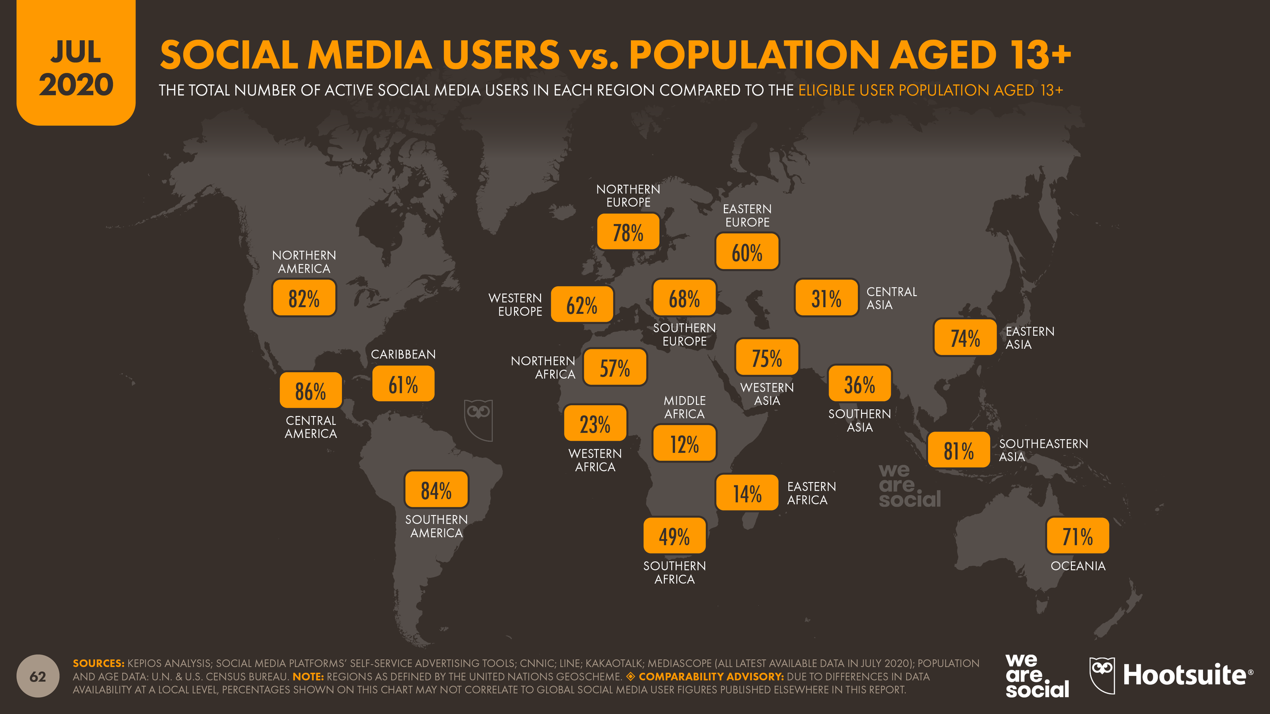
Universal definition not possible
Sasha Daraskevich
Widespread use of social media
Multicultural differences
Flexible definition needed
Instead - “sliding scale”
  Magnitude
  Frequency
  Platform
[7]
Notes:
Based on research, it is impossible to draw a universal concrete line
Widespread use of social media worldwide
Difficult to draw a “line” due to multicultural differences in what is deemed hate speech or what different cultures may be more or less sensitive too
Drawing a concrete line would make difficult to change later
“sliding scale taking into multiple factors including magnitude, frequency, intent of platform, and content of post and platform” (Source 3)
Restrictions should be based on area to align with differences

Slide 13
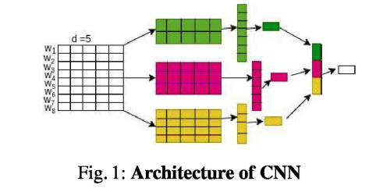
Software for detection is key
Sasha Daraskevich
Solely human detection inefficient
Multiple approaches
  Social network analysis [2]
  Convolutional neural network [5]
    Network learn directly from data [8]
    76% accuracy
  Multi Level Perception [4]
    83.4% accuracy
  Multinomial Naïve Bayes [4]
    Recall value 93.2%, accuracy 71.2%
  Lexicon detection [2]
[5]
Notes:
Having solely human detection would be inefficient -> not possible to monitor everything
Multiple approaches
Social network analysis
Network embedding -> machine learning -> uses queries to find
Uses complex algorithm through sentiment analysis, a data mining strategy, to detect feelings of content (positive/negative)
CNN
Breaks down into sequences to extract the exact information wanted
No need for manual feature extraction
76% accuracy in labelling words as racist v. non-racist
Multi Level Perceptron (MLP)
Indonesia -> Twitter
83.4% accuracy
Multinomial Naive Bayes algorithm
Study done in Indonesia
93.2% recall value
71.2% classification of hate speech
Lexicon detection
Lower precision
Hard to differentiate between hate speech & offensive language
Misclassify any sentence containing slang indicative of hate

Slide 14
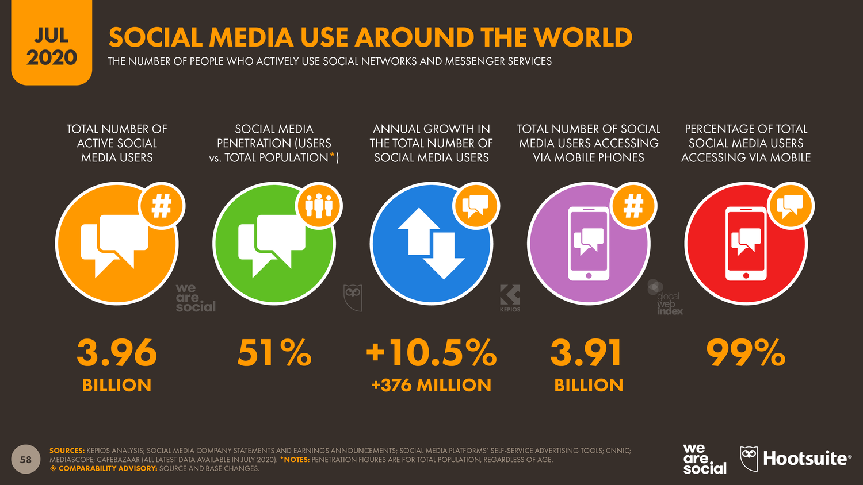
Looking forward
Sasha Daraskevich
Social media will continue to evolve
Platforms important for expression
  Restrictions necessary
Newer problem
  More research/development needed
  Current challenges
Different factors may require case-by-case approach
[7]
Notes:
Social media will continue to evolve, important to begin to look at how we can have optimal use
Push for more regulation of hate speech will help everyone
Platform important for expression of ideas and creativity
Restrictions are needed to ensure everyone has a safe experience
Creates a balance to protect freedom of speech
Since social media is still fairly young and tackling social media hate speech is a newer issue
Most research that I found was all from the past 5 years
More research and development of software and algorithms to detect speech is necessary
- Challenges
- Detecting different languages
- Errors in labelling type of hate
Abundance of factors might require case-by-case approach depending on the location, language, company who owns

Slide 15
Drawing the line
Sasha Daraskevich
Some basic universal rules
  Incitement
  “Fighting words” [3]
  Threats
  Degrading language
  Slurs
All platforms need to track and remove hate speech
Software isn’t perfect but needed
More guidelines implemented based on region/platforms
Notes:
As I’ve said, it would be nearly impossible to find guidelines that would create a perfect worldwide definition of hate speech
Yet, some basic universal rules can be established as a base layer
Incitement
“Fighting words” -> want a reaction
Threats
Degrading language
Slurs
All social media platforms need to track and remove hate speech
Should be company standard to ensure wellbeing of users
While software isn’t perfect at the moment, helpful tool to help platforms remove hate speech in a faster way
More guidelines could be implemented based on the region and platform as necessary

Slide 16
References
Sasha Daraskevich
[1] Four key changes expected as Elon Musk takes over Twitter, (TECHCiRCLE, 26 Apr, 2022), https://www.proquest.com/compscijour/docview/2654905741/C12944B4018546A5PQ/6 (9/1/2022)
[2] Udanor, Collin and Chinatu Anyanwu, Combating the challenges of social media hate speech in a polarized society: A Twitter ego lexalytics approach, (Data Technologies and Applications, 2019), https://www.proquest.com/compscijour/docview/2582738776/C12944B4018546A5PQ/12 (9/1/2022)
[3] Guiora, Amos and Elizabeth Park, Hate Speech on Social Media, (Philosophia, 2017), https://link.springer.com/article/10.1007/s11406-017-9858-4 (9/2/2022)
[4] Putri, T., A comparison of classification algorithms for hate speech detection, (IOP Publishing, 2020), 2-7
[5] Kapil, Prashant, Investigating Deep Learning Approaches for Hate Speech Detection in Social Media, (Indian Institute of Technology, 2020), 5-11
[6] Khan, Mehreen, Social media groups step up action on hate speech, (The Financial Times, 2018), https://www.ft.com/content/172d0684-fca0-11e7-9b32-d7d59aace167 (9/3/2022)
[7] Kemp, Simon, More Than Half of the People on Earth Use Social Media, (Kepios, 2020), https://datareportal.com/reports/more-than-half-the-world-now-uses-social-media (9/5/2022)
[8] Convolutional Neural Network, (The Mathworks, 2022), https://www.mathworks.com/discovery/convolutional-neural-network-matlab.html, (9/5/2022)

Slide 17
should government have Power over the internet?
Michael Sensat

Slide 18
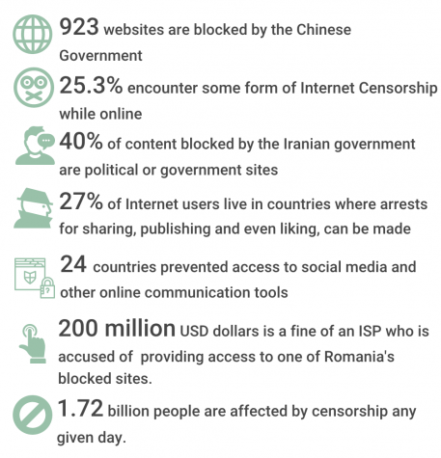
Governments have too much power over the internet
Michael Sensat
Governments can block content online by blocking domain names, keywords, and Ip addresses. [10]
Governments can spy on what websites you visit, emails you send, and chat rooms you visit. [5]
Governments around the world censor political opponents, and minorities. [2]
Notes:
Governments can censor things by using firewalls (like in china), or can go to ISPs to censor domains and sites.
In the United States, because of the 1st amendment, the government is not allowed to censor most sites, but censors sites containing illegal content.
In China, they hire people to spy on you, and also have people that block websites that don’t support them.

Slide 19
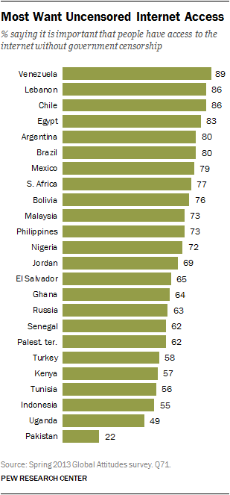
What do the people believe?
Michael Sensat
86% of people believe freedom of expression should be guaranteed on the internet [3]
74% of people believe increased government control of the Internet would limit their freedom of expression [3]
49% of people believe increased government control of the Internet would improve the content on the Internet [3]
Notes:
86% of people believe freedom of expression should be guaranteed on the internet
74% of people believe increased government control of the Internet would limit their freedom of expression.
49% of people believe increased government control of the Internet would improve the content on the Internet.
"Please tell the world, that we need Google, or Yahoo or something else that's useful to do the research. We don't care about politics, but please help us to reach Google.“
"I'm currently in China right now on a project, and coding without Google is not easy," he said, "especially since there isn't any English bookstore I can run over to while I'm here to pick up a tech manual."

Slide 20
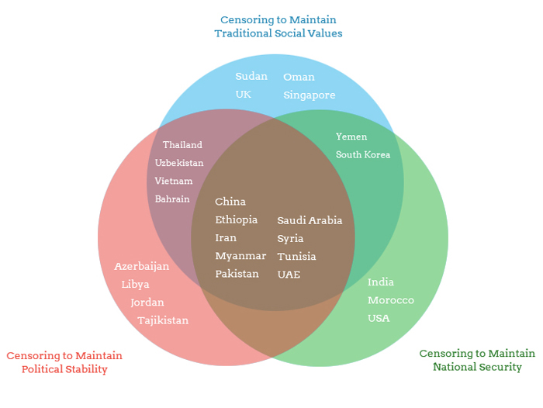
Examples of government ‘bad’ censorship
Michael Sensat
Chinese Government
Hires people to influence opinions on the internet [2]
Blocked citizens from using Google [5]
Shutdown internet cafés and blocked sites [5]
Notes:
Hired over 280,000 members to influence public opinion on the internet [2]
Blocked citizens from using Google [5]
Closed 150,000 internet café’s and had remaining café’s use software to block 500,000 banned sites [5]

Slide 21
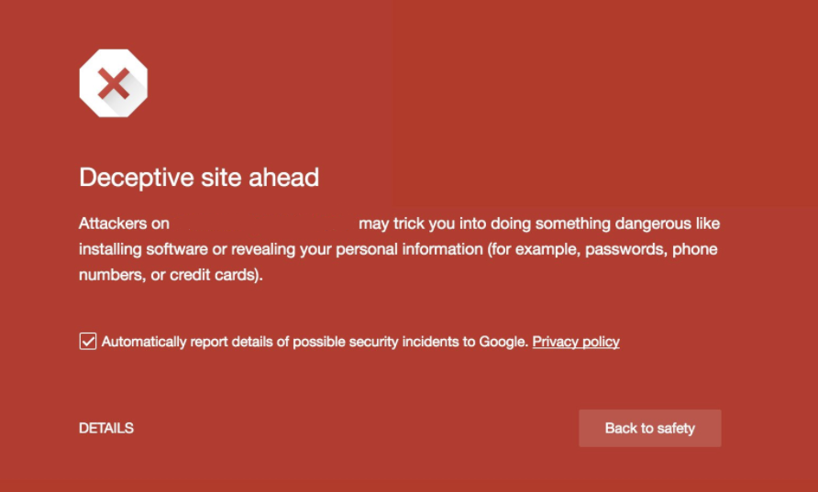
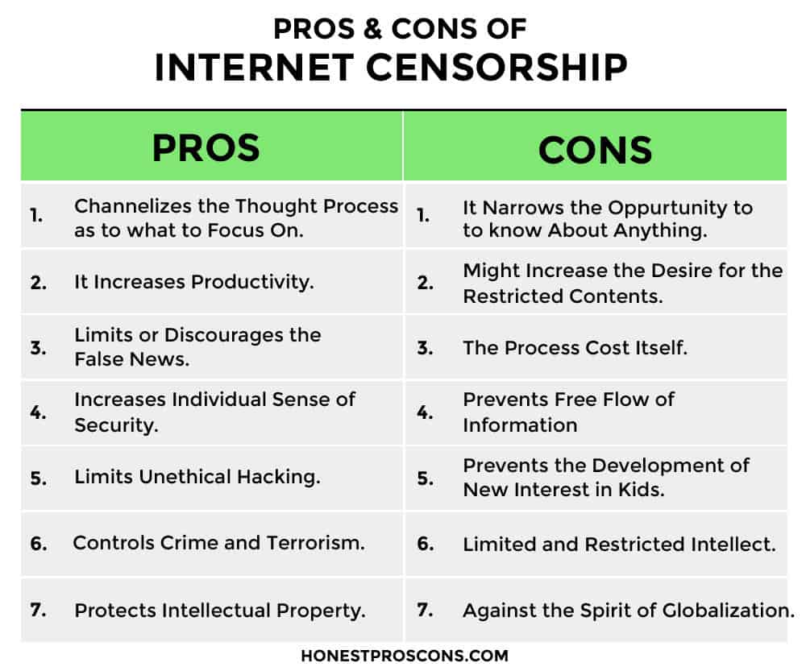
Government censorship isn’t always bad
Michael Sensat
Censorship of North Korean Propaganda
South Korea blocks 31 websites containing North Korean propaganda [4]
Censorship of criminal sites
Illegal drug use
Inciting/encouraging violence
Defamatory and slanderous content
Sites containing malware
Notes:
South korea censors by going to isp. 3000 extra domains hosted on the same servers as the blocked websites were also blocked for no reason.
Criminal site censorship includes hate speech, pornographic sites, gambling sites, and quite a few more.
Although these are good sites to block, some other countries will block sites that may include things we believe shouldn’t be blocked like lgbt and minority websites, and sites that oppose current governments

Slide 22
References
Michael Sensat
[1] Dave Graham, Wikipedia sued over Nazi symbols, The Australian, (12/7/07) https://web.archive.org/web/20081211175806/http://www.theaustralian.news.com.au/story/0,25197,22885402-12335,00.html
[2] David Bandurski, China’s Guerrilla War for the Web, Far Eastern Economic Review, July 2008 https://web.archive.org/web/20090225113222/http://feer.com/essays/2008/august/chinas-guerrilla-war-for-the-web
[3] Global Internet User Survey 2012, Internet Society, July 2012 https://web.archive.org/web/20130314063616/https://www.internetsociety.org/sites/default/files/GIUS2012-GlobalData-Table-20121120_0.pdf
[4] Collateral Blocking: Filtering by South Korean Government of Pro-North Korean Websites, OpenNet Initiative (1/31/05) https://opennet.net/bulletins/009/
[5] China blocking Google, BBC News (9/2/02) http://news.bbc.co.uk/2/hi/technology/2231101.stm
[6] Polina Dashevsky, Censorship extends to the internet, The Standard, (2/4/20) https://standard.asl.org/14083/opinions/censorship-extends-to-internet/
[7] John Pavlus, Infographics: Internet Censorship Is Rampant Around the World, FastCompany (2/4/11) https://www.fastcompany.com/1724119/infographics-internet-censorship-rampant-around-world
[8] Domantas G., How to Fix the “Deceptive Site Ahead” Error: 4 Steps to Remove It, (Hostinger, 8/23/22) https://www.hostinger.com/tutorials/fix-site-ahead-contains-harmful-programs-error
[9] Emerging and Developing Nations Want Freedom on the Internet, Pew Research Center (3/19/14) https://www.pewresearch.org/global/2014/03/19/emerging-and-developing-nations-want-freedom-on-the-internet/
[10] Content Blocking, (Electronic Frontier Foundation, 10/14/20) https://www.eff.org/issues/content-blocking

Slide 23
Social Media controls their users
Aaron Brady
Notes:
I asked the question: Are the users in control of the social media they use, or does social media control their users. The conclusion I came to is …

Slide 24
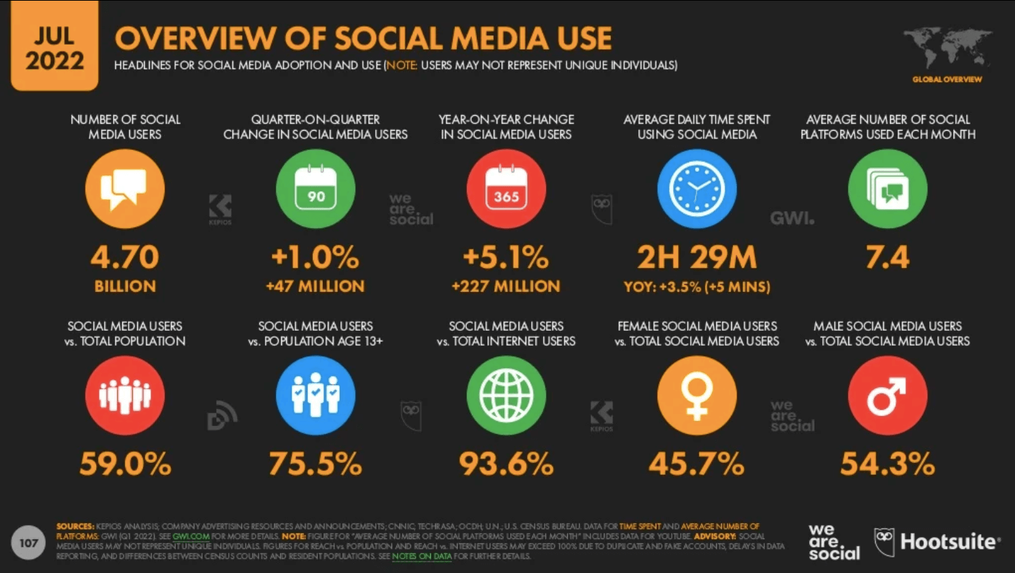
Social media is prominent
Brady, Aaron
Average age of introduction is approximately 12.6 years old [1]
15.6% of the day spent on social media
The overview of social media users [2]
Notes:
Average age of introduction is 12 years old. This age of 12.6 corresponds to kids in 7th grade. The range of people using these platforms is very vast. 13 year old’s are using the same platforms as adults.
This info graph provides meaningful statistics about social media use. We can see that there is a total of 4.70 billion social media users, that is nearly 60% of the world's population. In reality this percent is slightly lower because the count does not take into account users having multiple accounts. Despite that, we still see a 5.1% increase from last year to this year in social media accounts. That is more than the entire population of Brazil. All of these users are spending on average 2 hours and 29 minutes a day on social media. Suppose someone gets 8 hours of sleep a night. That would allow them to be awake for 16 hours. This means that this person would spend 15.625 % of the time awake on social media. But how has social media become this prominent.

Slide 25
The Addiction
Brady, Aaron
Trigger
Action
Reward
Investment
Steps social media uses to retain their users [3]
Notes:
Social media has implemented tactics make their users become addicted to their platform. They take 4 simple steps.

Slide 26
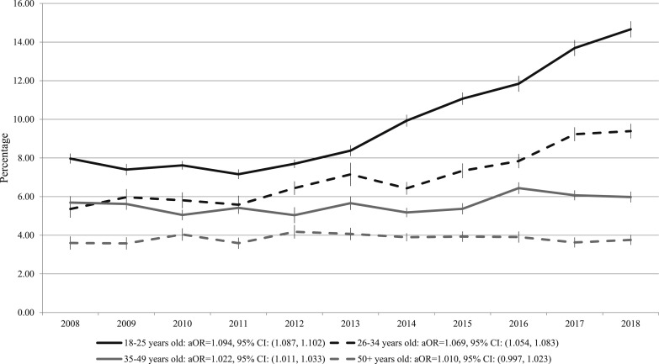
Taking advantage of user emotions
Brady, Aaron
Takes advantage of weaknesses
Only cure to our feelings is to check our phones [5]
Prevalence of past-month anxiety by age from 2008 to 2018 (NSDUH, US adults ages 18 years and older)[4]
Notes:
Trigger:
The most common way to activate a trigger is to play with our fear, anxiety, and loneliness. Take advantage of the humans when they are feeling the worst. They want us to feel this when we are not using the apps.
The only way for us to handle these feelings is to check our phones.
Companies are taking advantage of rising anxiety, One could even argue that they are responsible for rise

Slide 27
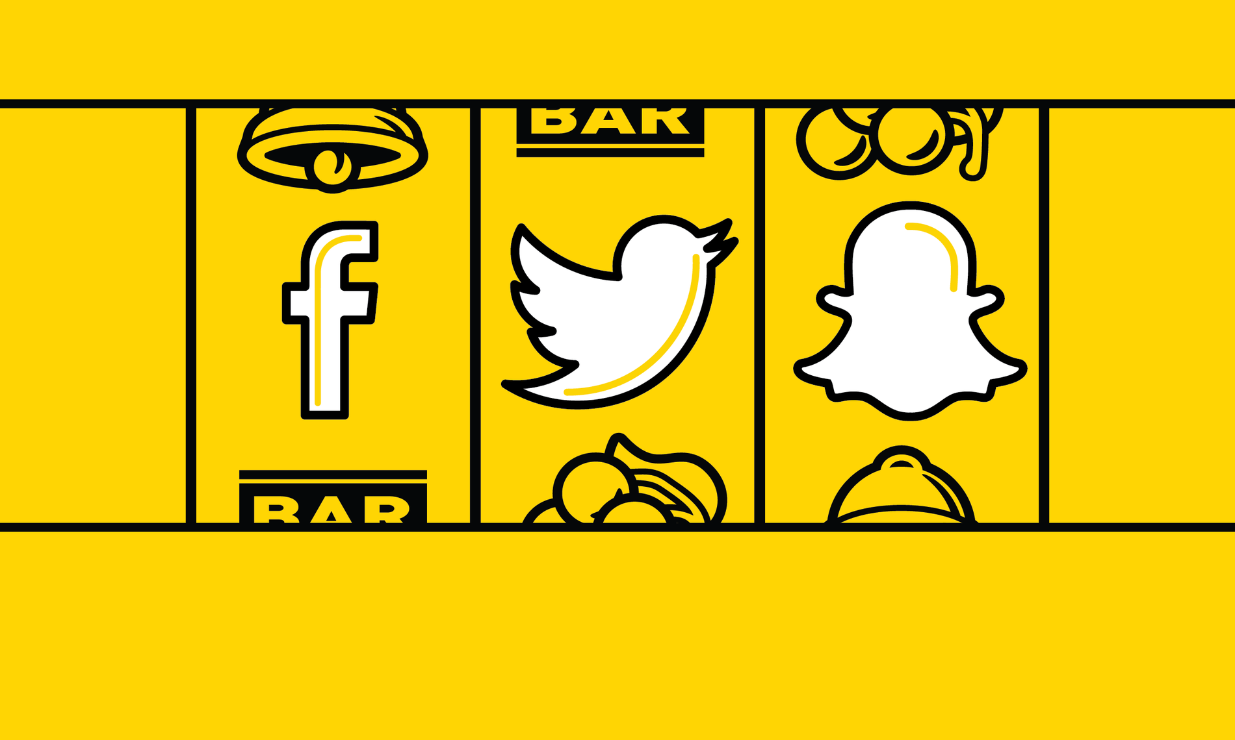
User interaction with the platform
Brady, Aaron
Gambling
  Virtually infinite scrolling [5]
    42% of users “lost track of time” [11]
  Interacting with others [6]
Social media slot machine [6]
Notes:
Action:
A behavior happens when a trigger coincides with both the motivation to take action and the ability to do so
The comparison that is quite similar to social media use is gambling.
Tristan Harris -> quit his job of software manager at google to speak out against the business models of tech companies
“When we swipe down our finger to scroll the Instagram feed, we’re playing a slot machine to see what photo comes next.” This unknowing of what is coming next keeps users engaged. Instead of having to pull a lever all you need to do is swipe your thumb. In a study by a graduate student at the university of Washington found that 42 percent of users of a twitter like app lost track of time. [11] The infinite scroll makes it so the user never runs out of feed.
The other action that takes place is interacting with people. Likes, posts, comments It is easy to essentially create a public group chat under every post. You can leave a like or create your own post or comment on your feed. Taking a picture and starting a streak. You take a gamble of how many likes is this going to get. How will people respond to my comment.
With each action comes a reward.

Slide 28
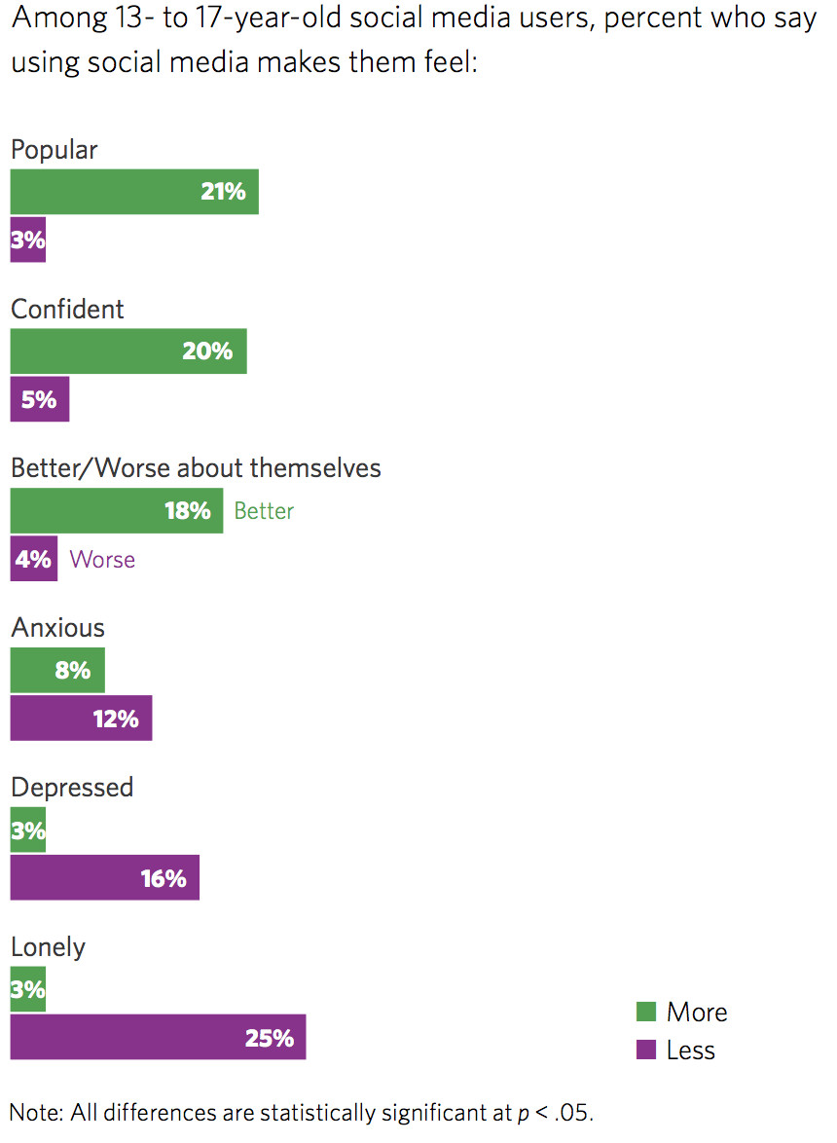
the interaction makes users feel good
Brady, Aaron
Attention, approval, and affection [8]
Helping or Hooking?
2018 survey results from teenagers [7]
Notes:
Reward:
Rewards can come in an almost endless variety of forms, from receiving attention, acceptance, and appreciation.
Can be thought of the result of the gamble.
Example is snapchat streaks. Prevalent in youth.
This is essentially why the like button is so effective. Let’s say you post an image or tweet that garners a lot of likes. These likes ultimately translate into three of the most powerful reinforcers — attention, approval, and affection from other people.[8]
Can be seen in the graph… explain the graph
There are algorithms in place to determine the best time to reward its users. They will hold back the reward to provide them in bursts for the users. Each user is an experiment and an algorithm is figuring out when the best time to reward the user is to get better behavior [5]
Tristan Harris brings up the idea of helping or hooking, is the software that these companies release helping society or is it hooking them to the platform. Most of the time the answer is hooking and this is part of the reason why Tristan Harris finally decided to speak out against the current model of tech companies.
The rewards that people receive hook them to their devices.

Slide 29
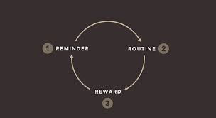
Make the user want more
Brady, Aaron
Cortisol is released [5,9]
Loop turns into habit [5]
Cycle to make a habit [10]
Notes:
Investment
"loading the next trigger”.
Think of cortisol as nature’s built-in alarm system. It’s your body’s main stress hormone. It works with certain parts of your brain to control your mood, motivation, and fear.
Ramsey Brown -> Study neuroscience and now is a software engineer for exercising apps:
“They’re engineered to become addictive… because we have figured out how these pieces of the brain that handle addiction are working people have figured out how to juice them further and bake that information into apps.” [5]
Everytime we put our phone down, cortisol is released by our brain. This in turn sets off the alarm system. Users become anxious about what is going on. People have the fear of missing out. This in turn reloads the cycle for they are triggered once again to check their phone and their social media accounts. People are waiting for their next reward or want to take an action to reward someone else. We can see the habit cycle and how closely related it is to this social media addiction cycle. Overtime this cycle becomes habitual and the users do not even realize how often they are checking their phone.
Now you may be wondering, why are social media companies trying to get their users addicted, well it is for money of course.

Slide 30
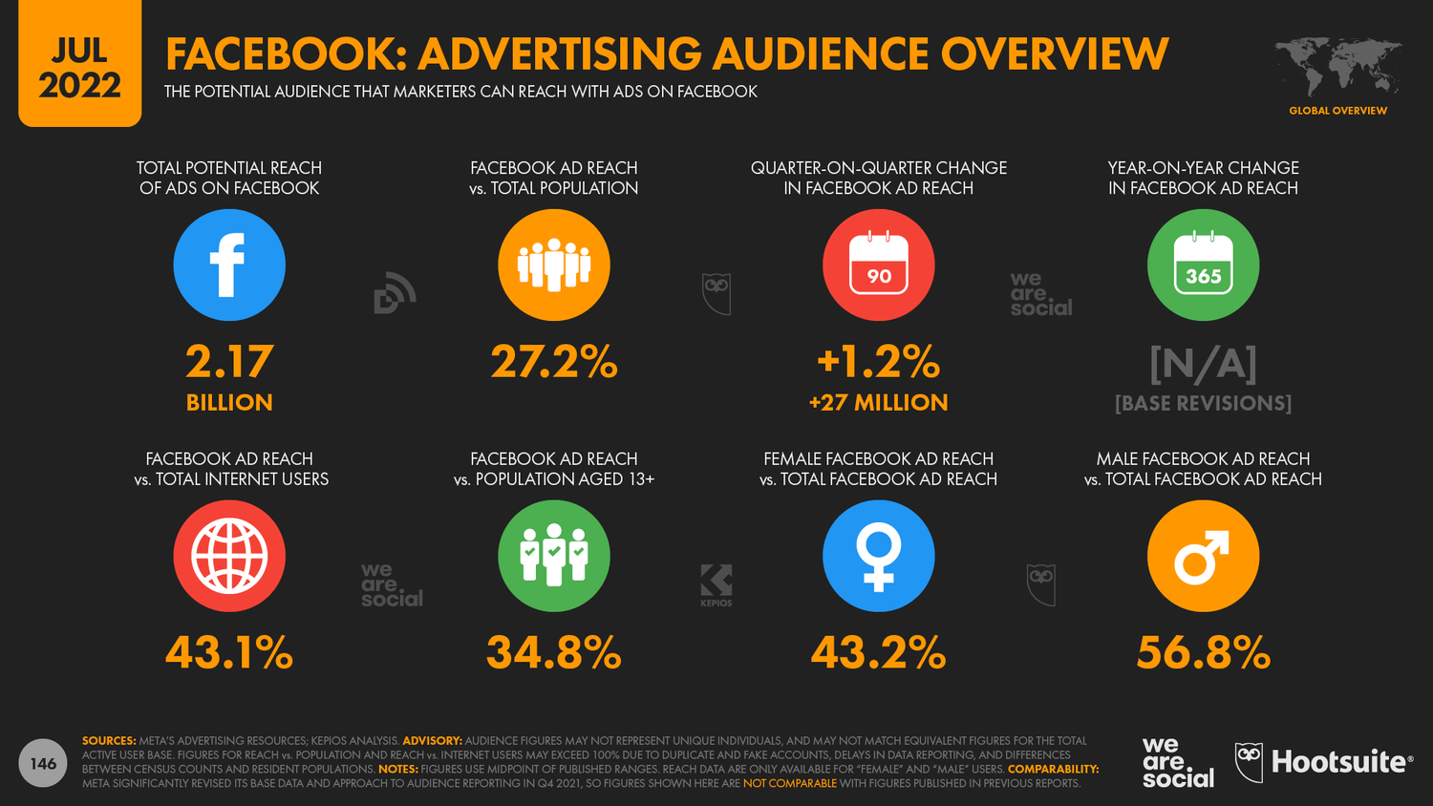
Companies Are motivated by money
Brady, Aaron
Users are not the customers [5]
Longer interaction, more ads viewed
Overview of Facebook ads [2]
Notes:
The social media companies do not care about you, they care about the fact that they can sell you. Users do not pay to use the platforms, rather the income for these companies come from people paying for ads. Companies would want to promote their product on a platform based on retention of customers. If their users are addicted then it is clear that advertisements would be largely viewed.
Tristan Harris
“Technology is neutral, and it is up to us how to use it. This is just not true, they want you to use in particular ways for a long period of time, because that is how they make their money.”
Social media wants users to use their platform as much as possible so they can leverage negotiations.

Slide 31
References
Brady, Aaron
[1] Howard, Jacqueline. “What’s the Average Age When Kids Get a Social Media Account?” CNN, 22 June 2018, https://www.cnn.com/2018/06/22/health/social-media-for-kids-parent-curve/index.html.
[2] “The Global State of Digital in July 2022.” DataReportal – Global Digital Insights, https://datareportal.com/reports/digital-2022-july-global-statshot. Accessed 3 Sept. 2022.
[3] Greenwald, Ted. "Under the Influence." Wired, vol. 23, no. 1, 01, 2015, pp. 76-n/a. ProQuest, http://ezproxy.wpi.edu/login?url=https://www.proquest.com/magazines/under-influence/docview/1648130961/se-2.
[4] Goodwin, Renee D., et al. “Trends in Anxiety among Adults in the United States, 2008–2018: Rapid Increases among Young Adults.” Journal of Psychiatric Research, vol. 130, Nov. 2020, pp. 441–46. PubMed Central, https://doi.org/10.1016/j.jpsychires.2020.08.014.
[5] 60 Minutes. Brain Hacking. 2018. YouTube, https://www.youtube.com/watch?v=awAMTQZmvPE.
[6] Seymour, Richard. “The Machine Always Wins: What Drives Our Addiction to Social Media.” The Guardian, 23 Aug. 2019. The Guardian, h6tps://www.theguardian.com/technology/2019/aug/23/social-media-addiction-gambling.
[7] Molla, Rani. “Teens Are Hooked on Social Media. But How Does It Make Them Feel about Themselves?” Vox, 10 Sept. 2018, https://www.vox.com/2018/9/10/17826810/social-media-use-teens-time-spent-facebook-instagram-snapchat.
[8] Collins, Grant. “Why the Infinite Scroll Is so Addictive.” Medium, 11 Dec. 2020, https://uxdesign.cc/why-the-infinite-scroll-is-so-addictive-9928367019c5.
[9] “What Is Cortisol?” WebMD, https://www.webmd.com/a-to-z-guides/what-is-cortisol. Accessed 3 Sept. 2022.
[10] New Year. New Habits. Language Learning Habits. | EN Inglés. https://en-ingles.com.ar/blog/2019/01/08/new-year-new-habits-language-learning-habits/. Accessed 5 Sept. 2022.
[11] It’s Just Mindless Scrolling, Right? A Brief Look at Social Media Effects on Mental Health – The Pipettepen. https://www.thepipettepen.com/its-just-mindless-scrolling-right-a-brief-look-at-social-media-effects-on-mental-health/. Accessed 5 Sept. 2022.

Slide 32
Class 4
The End
Keith A. Pray
socialimps.keithpray.net
Notes:
Use remaining time for group project questions and/or review group assignment slides.
This is the end. Any slides beyond this point are for answering questions that may arise but not needed in the main talk. Some slides may also be unfinished and are not needed but kept just in case.

