Slide 1
Class 7
Privacy and Government
Keith A. Pray
socialimps.keithpray.net
Notes:
After this class we will be half done with the course… very sad I know.
Somebody’s Watching Me (1984) – Rockwell (3:36)
https://www.youtube.com/watch?v=7YvAYIJSSZY
Be the envy of all your classmates if you know the band and/or year:
Rockwell (1984) Michael Jackson sings chorus and Jermaine Jackson on backing vocals.

Slide 2
what works well Online With Zoom
Sign in with First and Last Name
Stay muted unless you are going to speak
To speak use the raise your hand feature
To answer yes/no questions use the “yes” ”no” buttons
Turn your camera on
Wait until the end of student presentations to ask questions
  Write them down so you don’t forget

Slide 3
Papers
Quantify
  Not terms like: less, more, a lot, huge, great, big, tiny, drastic, etc.
Avoid absolutes
  Terms like: all, none, always, never
  Difficult to prove, easy to show false
Read directions, many time lines missing
Read paper aloud to proof
Avoid blogs, encyclopedias, and text book. These are generally not primary and high quality sources.
Be wary of counter point strawman fallacy
http://socialimps.keithpray.net/assignments/paper-guidelines/
Notes:
Save for next time:
Define terms
Quantify
Not terms like: less, more, a lot, huge, great, big, tiny, drastic, etc.
Avoid absolutes
Terms like: all, none, always, never
Difficult to prove, easy to show false
Read paper aloud to proof
Read directions, many time lines missing
Be sure to put quotes around entire quote
State a strong, clear conclusion
First statement preferred
Provide Counter Point and Rebuttal
Counter Point and Rebuttal should directly relate
Print 2 sided and save a tree
Hyperbole is the best thing ever!
but not in these papers
Be wary of counter point strawman fallacy
Text book is not a primary source
Use template, saves time
Cite as suggested [1]
Beware of fallacies

Slide 4
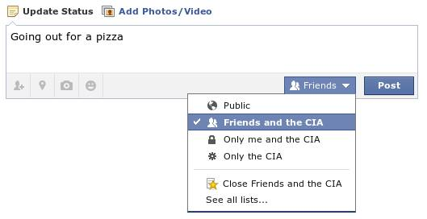
Overview
Review
Assignment
Students Present
Notes:
Review before debate in case anyone unsure of something in reading.
TODO: Image source?

Slide 5
My Reading Notes
pp. 276 Any examples from the last 25 years? Arrests, altering and deleting records are violations of privacy?
pp. 277 Why not try to verify and correct records?
pp. 278 Figure does not show # cameras increasing.
pp. 279 300 times = frames, locations, …? More police drones since 2013?
pp. 296 Shouldn’t credit card issuers take “reasonable steps” to verify identity all the time?
pp. 297 Any syndromic system successes in the last 15 years?
pp. 301 Confusing false positive and negative explanations. Not correct use of “Orwellian”
pp. 305 E-ZPass now mandatory on Mass Pike…
pp. 310 # 17 Interesting but not computing related
End of Chapter questions: 1, 18
pp. 319 “Since I have done nothing wrong, why should the government be investigating me?”
Notes:
Let’s debate!

Slide 6
Debate Ground Rules
Before Debate
  Add “(YES)” or “(NO)” to the end of your name in Zoom to show your side
  10 minutes to converse with your team
  Share argument points, counter points, and responses
  Share experiences, especially in different countries, cultures, situations
  Decide who will: Go first, Respond to which points from opposing side
During Debate
  1 turn per person until everyone on your team has spoken
  Try to keep remarks to 30 seconds
  Switch sides at any time if you change your mind
Notes:
“National ban on facial recognition surveillance for law enforcement” Debate
If in class:
Stand up when speaking
30 second limit (elect a timekeeper)
Previous:
Should law require you to use an official ID for Internet access
National ID or Not Debate

Slide 7
Group Quiz
List two problems with using biometrics for identification.
List two advantages of using biometrics for identification.
Describe two tools people can use to protect their privacy on the Web.
For each of the 4 categories of Daniel Solove’s privacy taxonomy give an example not listed in the book.
Notes:
Only if need to fill time.
Information Collection
Information Processing
Information Dissemination
Invasion

Slide 8
Overview
Review
Assignment
Students Present

Slide 9
Assignment – Group Project
Catch up on reading
Group Project
  Analyze Movie for all topics covered to date
  Add analysis of computing technology portrayed
  See group project slide deck for more
  Frequent interaction with your group members is key to success!
-----
Mid Term Survey on Canvas → Quizzes
Notes:
Movie group project:
List of computing technologies portrayed in movie on website
Categorize computing technologies as existing, future, emerging, impossible or plausible with rationale
Analyze movie for all topics covered to date

Slide 10
Overview
Review
Assignment
Students Present

Slide 11
Government’s Rights over private Data
Rosemary Shelton

Slide 12
What should the government be allowed to do
Rosemary Shelton
Allowed to demand data from private organizations
Allowed to buy data from private organizations
Allowed to sell data about their citizens
Allowed to buy and sell data without informing their citizens
Notes:
There is a lot of ambiguity when it comes to the governments access to private data and what the government should be allowed to do with it. In the past the government has tried to outright demand data be given to them. We also know that the government has bought access to private data and then gives access to private organizations without informing the public. But should the government be able to do this? The governments first priority should be to serve and protect their citizens. There are benefits of the government having data on it’s citizens but the fact that the government has not disclosed what data they have access to is concerning. It would make us believe that there is nefarious actions being done. So in my opinion, unless the government is willing to disclose what data they have and what they intend to do with it, they should not be doing anything with our data.

Slide 13
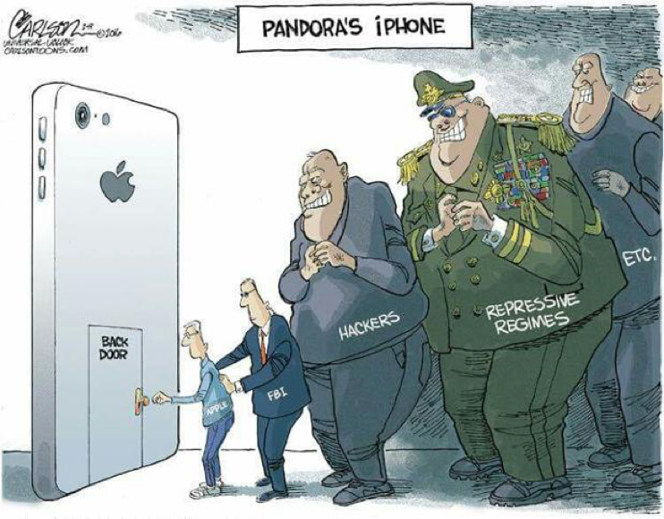
What Is the government allowed to do
Rosemary Shelton
There is an increase in government demands
The government is not allowed to randomly demand data and have their demands answered without a warrant
They are allowed to buy private data
Companies are generally allowed to do what they want with their collected data
Companies do not have to inform the users that they sold their data
Notes:
There has been an increase of government demands to see private information. Often times when the government demands data, the companies will voluntarily disclose information, but in one example, when the police tried to force a phone company to give them information on suspects, the phone company was allowed to deny that request. The police would need a warrant to get companies to disclose their data. Though, in other cases, the government is allowed to buy data from private companies and when the companies sell their data, they do not have to inform the users that they have sold their information.

Slide 14
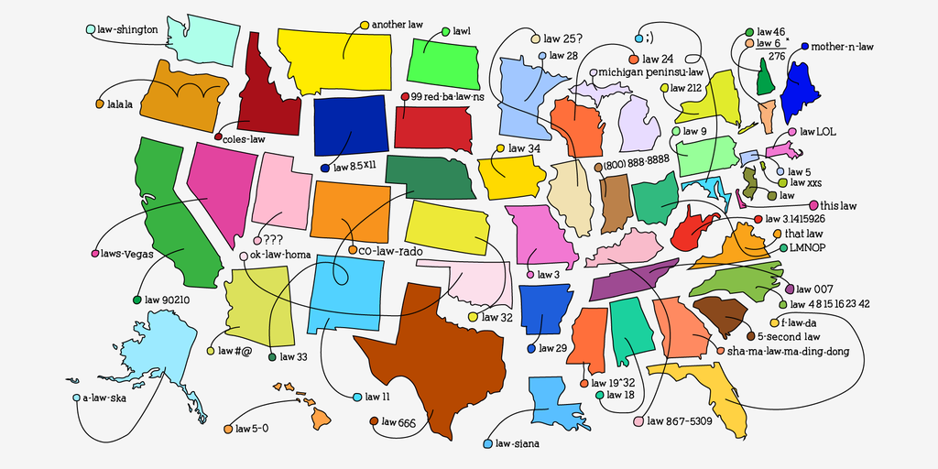
How data is collected
Rosemary Shelton
There is no single federal law to control how data is collected
Once collected the data can be sold to a third party
When the data is spread throughout different databases, there is a higher chance of a data leak
With vastly spread-out data, it becomes more difficult to find who is responsible for the leak
Notes:
There is no federal law for how all our data is collected, this makes it so when companies collect data, they can utilize third party companies under different jurisdiction to collect data in the different ways they want. These companies can now sell the data collected to anyone who is willing to buy it, including the government. When the data is spread throughout different databases in different companies and organizations, it becomes significantly more likely for the data to be leaked somewhere. And not only will it be more likely that the data will be leaked, it will also become significantly harder to find the source of the leak. An example of this was when the United States military got information from a Muslim prayer app, so that now they can get the location of all of the 98 million users.

Slide 15
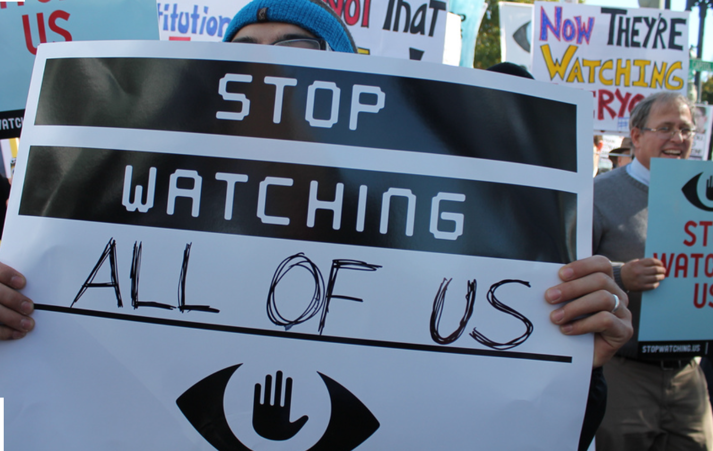
Downsides of government having easy access to our data
Rosemary Shelton
Political control
Lack of personal privacy
Everyone is constantly under investigation
Increased possibility of abuse
Expenses
Notes:
There are many concerns when it comes to government data. If you have watched any dystopian movie or read any dystopian book, the concept of over surveillance by the government is always there. One issue that has to be taken into consideration is the data being used for political control. Every person in the government has a political agenda, it is unlikely that no one would use the data for their own benefit. Another issue is our own personal knowledge that the government knows everything about us. Through technology, it seems they would be able to find who we talk to, where we are, what are interests are, what are political affiliations are. Many people would find that extremely concerning. There is also the concern that everyone would be constantly under investigation. For example, if the government had access to everyone’s search history and they are looking for everyone who looks up flights to a location, every single person who innocently looked up flights to that place would be under investigation. Not only that, but the government would have looked through every single persons search history. With all this information, and such little monitoring of it, its very likely that people will abuse it. Lastly, buying all this data would be expensive.

Slide 16

Pros of government surveillance
Rosemary Shelton
Safety
Catered services
It does not physically harm you
Make it less motivating to become a criminal
Notes:
Along with the many cons of government surveillance there are also plenty of benefits. For one, safety. Safety is the main excuse for government surveillance given to the public. We have already made accommodations for the government trying to increase our safety by letting go of our privacy. Every time we go on an airplane, we let the government search us and our personal items so that we can ensure our safety. So why wouldn’t we continue these accommodations when it comes to our information privacy. There is also the idea of catered services. The more the government can see about our opinions and needs, the more likely the government will do something to help these wants and needs. Also, the government knowing things about each of us will not physically harm us. Instead of having physical searches or other interfering actions, the government can now investigate you without you even knowing. Lastly, if everyone knows the government is constantly watching, people will be deterred from entering criminal activity.

Slide 17
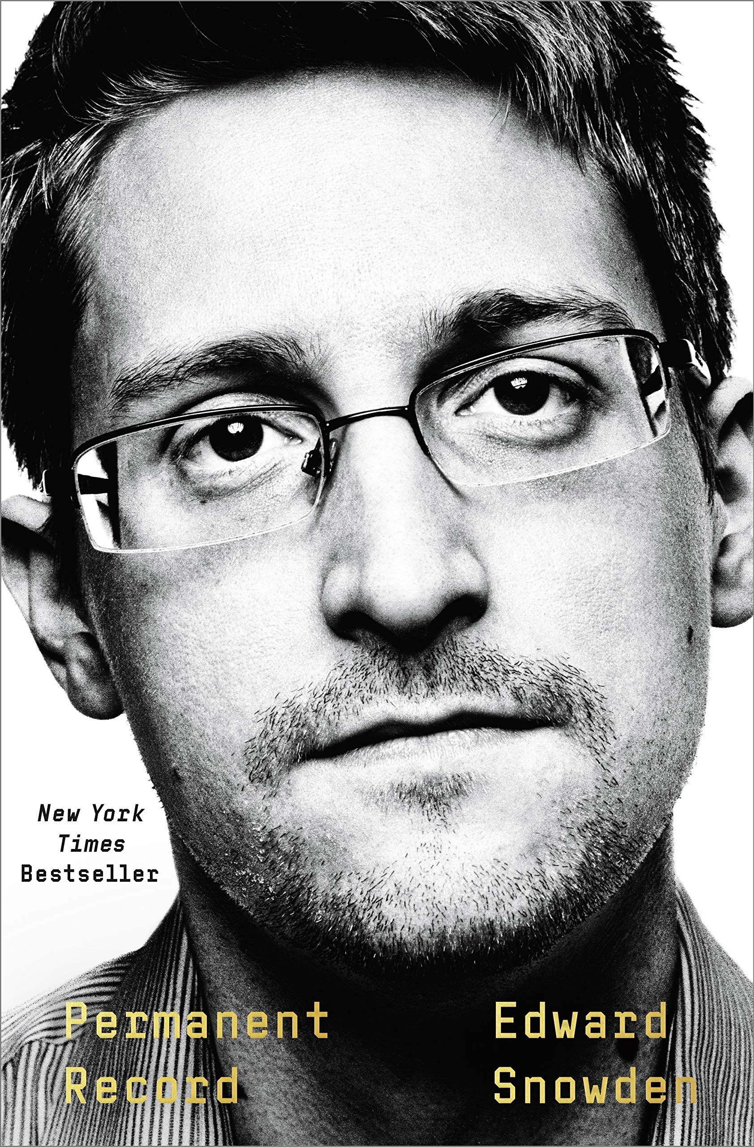
What Information does the government currently have
Rosemary Shelton
They currently have information from many large tech companies (Apple, Facebook, Microsoft, Google)
This would include your location, searches, interests, personal connections,
Notes:
In 2013 Edward Snowden released that the government had access to the servers of many prominent tech companies such as Apple, Facebook, Microsoft, Google, and Yahoo. Snowden worked for a consulting company called Booz Allen. Booz Allen is a consulting firm that works with multiple different branches of the government. Their employees are granted security clearance and they currently have employees working in the pentagon. So even the government has third party companies with access to citizens data even though there is a history of leaks.

Slide 18
References
Rosemary Shelton
[1] Citizen surveillance: What does the US Government know about you? Privacy.net. (2019, July 4). Retrieved April 4, 2022, from https://privacy.net/us-government-surveillance-spying-data-collection/
[2] Goitein, E. (2021, April 27). Perspective | the government can't seize your Digital Data. except by buying it. The Washington Post. Retrieved April 4, 2022, from https://www.washingtonpost.com/outlook/2021/04/26/constitution-digital-privacy-loopholes-purchases/
[3] How the U.S. military buys location data from ordinary apps. VICE. (n.d.). Retrieved April 4, 2022, from https://www.vice.com/en/article/jgqm5x/us-military-location-data-xmode-locate-x
[4] The New York Times. (2021, September 6). The State of Consumer Data Privacy Laws in the US (and why it matters). The New York Times. Retrieved April 4, 2022, from https://www.nytimes.com/wirecutter/blog/state-of-privacy-laws-in-us/
[5] Rubinstein, I. S., Nojeim, G. T., & Lee, R. D. (2014, May 1). Systematic government access to personal data: A comparative analysis†. OUP Academic. Retrieved April 4, 2022, from https://academic.oup.com/idpl/article/4/2/96/734798
[6] The New York Times. (2021, September 6). The State of Consumer Data Privacy Laws in the US (and why it matters). The New York Times. Retrieved April 4, 2022, from https://www.nytimes.com/wirecutter/blog/state-of-privacy-laws-in-us/
[7] Kwee, D. (2019, April 1). Why the government shouldn't have access to your digital data. Medium. Retrieved April 4, 2022, from https://medium.com/@20KweeDa/why-the-government-shouldnt-have-access-to-your-digital-data-28396b1daaf7

Slide 19
The GDPR and you
Casey Wohlers

Slide 20
Why You Should Care
Casey Wohlers
Data privacy is important
Protects EU consumers from unwanted advertising
It is likely to come to the US soon (it has in some places already)
Provides protection and reparations from data breachs
Is it good for you?
YES
Notes:
First/foremost: is this a good thing: yes.
Wonderful for consumers in almost every way (especially if you value privacy at all)
Less unwanted advertising, less selling your data to advertisers, less automated profiling
All that stuff that’s bad about using apps: EU has to deal with less of it.
Data security is also regulated, audited, etc. If anything slips through, EU consumers affected are notified
And given an opportunity to seek reparations
Good for you in every way.

Slide 21
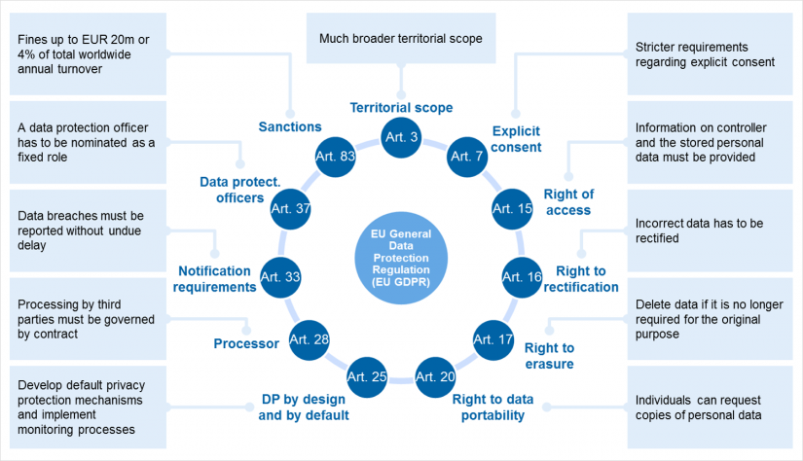
Main Tenets
Casey Wohlers
Opt-in
  Consent to data collection
  Ability to withdraw consent
Anonymization of data
Consumer knowledge and protection [1][2]
Another representation of the main tenets.
See [8]
Notes:
GDPR is composed of 99 articles in 11 chapters
Chapters 1-4 is what we really care about
1-4 Intro- covers definitions, and the scope of the legislation
5-11 Covers processing principles like opt-in consent, not allowed to collect more data than necessary, and avoid identifying info as you collect
12-23 Covers many consumer rights- return to this later
24-43 Covers general business concerns-return to this as well
Mostly admin stuff in the rest, though still important
Covers data transfers to other countries
Supervision authorities
Cooperation of supervisors
Reparations- consumer right to sue/complain for infringement
Specific situations – law enforcement, employment, churches, etc
10-11. administrative – old laws gone, etc
[2]
Generally, the main points are consumer knowledge of data collection/processing and protection from hacks/leaks/identifying info

Slide 22
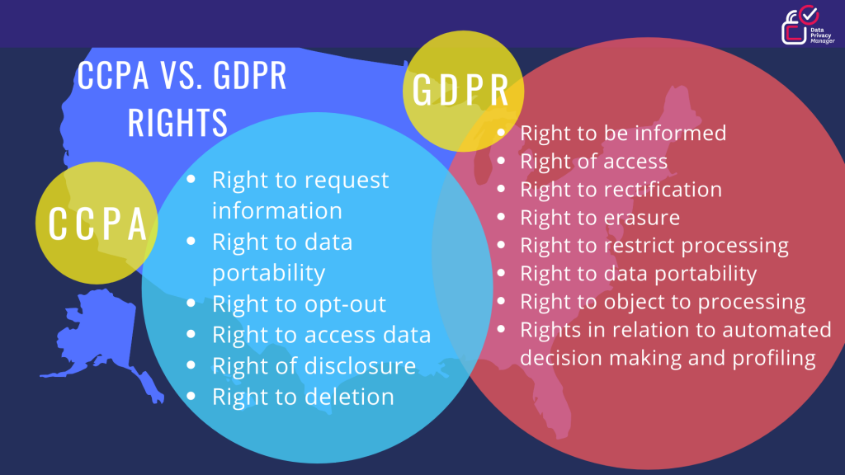
Chapter 3: Consumer Rights
Casey Wohlers
Request erasure
Request collected data
Separate marketing consent
Data protection
[1][2]
California derivative data protection act and its similarities to GDPR
See [9]
Notes:
Chapter 3 gives wide rights to the data subject/consumer including
“Plain language” representation of consumer requests in under one month
Notification of collection/noncollection and access to such information
Also provides the consumer several other rights to request of companies
Correction of info
Request deletion of info in some cases
Refuse to have data processed in some cases
Business must provide notification of correction/deletion
Transfer – request info and take it to another processor
Object to data processing
Not subjected to automated individual decision making like profiling

Slide 23
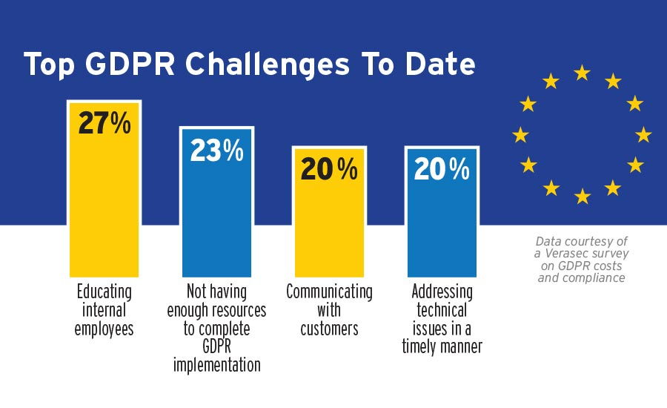
Chapter 4: Business Concerns
Casey Wohlers
Additional costs
  Compliance officer - $100,000/year [6]
  Fines (up to 4% of global turnover)
  $9 billion global preparedness costs
Auditing
Data Breaches
  Data security
  Timely public notification
  [2]
Companies report these as top problems faced.
See [10]
Notes:
Burden of implementation falls completely on businesses
Main concerns:
Companies must employ a compliance officer should they process data as specified
Frequent audits for compliance
Must provide an appropriate level of data security
Of course, many notifications and additional protocols to follow
Anonymization of data is the big one (technically stripping personal stuff out, pseudonymization/encryption)
Results of failure
Requirement to notify public of data breach in a timely manner – no more random spam emails out of nowhere
Fines – up to 4% of turnover globally or 20m euro, whichever is larger for severe violations, half that for lesser
Loss of profit from freemium – immeasurable
Many places deleted extraneous info, in some cases that they didn’t know they had [7]
Solution- don’t collect data

Slide 24
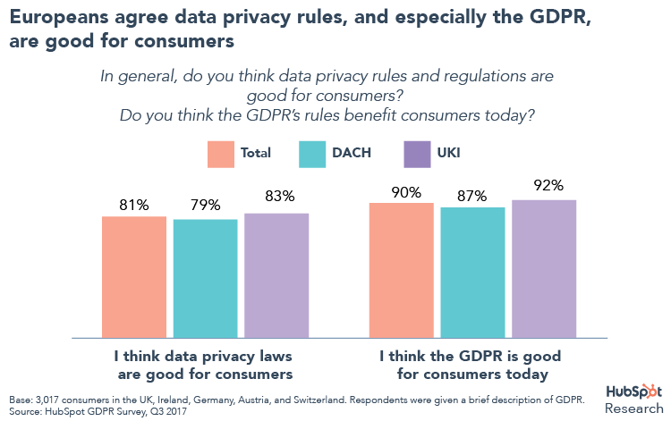
Global results
Casey Wohlers
California, Virginia, Colorado [4][5]
Partial end of data selling model [7]
Global partial adoption
Problems
  Spam to scam emails
  Costs to startups
Pre-rollout survey shows incredible support for GDPR and data privacy laws in general, pointing to a societal need.
See [11]
Notes:
GDPR has lead to several derivative bills in the US
California Consumer Privacy Act
Virginia Consumer data protection act
Colorado privacy act
These are not as comprehensive or widely followed as GDPR, though adoption is rising and many more states are following suit
Global partial adoption is also a result:
Cookie notifications are a result of GDPR
Privacy change notifications, also a result
There have been some enforcement problems given that digital data is hard to track. However, fines totaling over $1b have been imposed despite this
Amazon – 877m
WhatsApp – 255m
Google – several violations totaling over 200m
Etc [3]
Privacy statement change emails are annoying
Several large costs associated with compliance like compliance officers make compliance a problem for startups
100000 for compliance officer
Pay for regular audits (several thousand to tens of thousands at a time)
Should this come to the US in a national level: absolutely. Data privacy/protection is a huge problem, and the GDPR did an excellent job
Managing most of the concerns associated.

Slide 25
References
Casey Wohlers
[1] Intersoft Consulting. (2019, September 2). Official Legal Text. General Data Protection Regulation (GDPR). Retrieved April 4, 2022, from https://gdpr-info.eu/
[2] Eckerson, H. H. (2017, November 28). GDPR Reference Guide: All 99 Articles in 25 Minutes. GDPR Reference Guide. Retrieved April 4, 2022, from https://www.eckerson.com/articles/gdpr-reference-guide-all-99-articles-in-25-minutes
[3] Data Privacy Manager. (2022, February 1). 20 biggest GDPR fines so far [2019, 2020, 2021 &amp; 2022]. Data Privacy Manager. Retrieved April 4, 2022, from https://dataprivacymanager.net/5-biggest-gdpr-fines-so-far-2020/
[4] Data Privacy Manager. (2020, August 1). CCPA vs. GDPR - differences and similarities. Data Privacy Manager. Retrieved April 4, 2022, from https://dataprivacymanager.net/ccpa-vs-gdpr/
[5] Bloomberg. (2022, February 2). Data Privacy Laws by State: Comparison Charts. Bloomberg Law. Retrieved April 4, 2022, from https://pro.bloomberglaw.com/brief/data-privacy-laws-in-the-u-s/
[6] Salary.com. (2019, April 8). Compliance &amp; Privacy officer salary. Salary.com. Retrieved April 5, 2022, from https://www.salary.com/research/salary/posting/compliance-and-privacy-officer-salary
[7] Smith, O. (2018, May 2). The GDPR racket: Who's making money from this $9bn business shakedown. Forbes. Retrieved April 5, 2022, from https://www.forbes.com/sites/oliversmith/2018/05/02/the-gdpr-racket-whos-making-money-from-this-9bn-business-shakedown/?sh=2c1f98b434a2
Notes:
https://dataprivacymanager.net/5-biggest-gdpr-fines-so-far-2020/
https://pro.bloomberglaw.com/brief/data-privacy-laws-in-the-u-s/
https://www.eckerson.com/articles/gdpr-reference-guide-all-99-articles-in-25-minutes
https://gdpr-info.eu/
https://dataprivacymanager.net/ccpa-vs-gdpr/

Slide 26
Image References
Casey Wohlers
[8] Zeb. (2017). Figure 1: Major Requirements of Gdpr. Banking Hub. Retrieved April 4, 2022, from https://www.bankinghub.eu/banking/finance-risk/gdpr-deep-dive-implement-right-forgotten.
[9] Data Privacy Manager. (2020). Ccpa Vs. Gdpr Rights. Data Privacy Manager. Retrieved April 4, 2022, from https://dataprivacymanager.net/ccpa-vs-gdpr/.
[10] BNP Media. (2018). Top Gdpr Challenges To Date. Security Magazine. Retrieved April 4, 2022, from https://www.securitymagazine.com/articles/89644-gdpr-implementation-costs-enterprises-more-than-expected.
[11] Hubspot Inc. (2017). Europeans agree data privacy rules, and especially the Gdpr, are good for consumers. The GDPR is Coming – Are We Ready? Retrieved April 4, 2022, from https://www.hubspot.com/data-privacy/gdpr/research.

Slide 27
Law Enforcement and Genetic Privacy
Noah Plasse
Notes:
Name
Presentation : Law Enforcement and Genetic Privacy

Slide 28
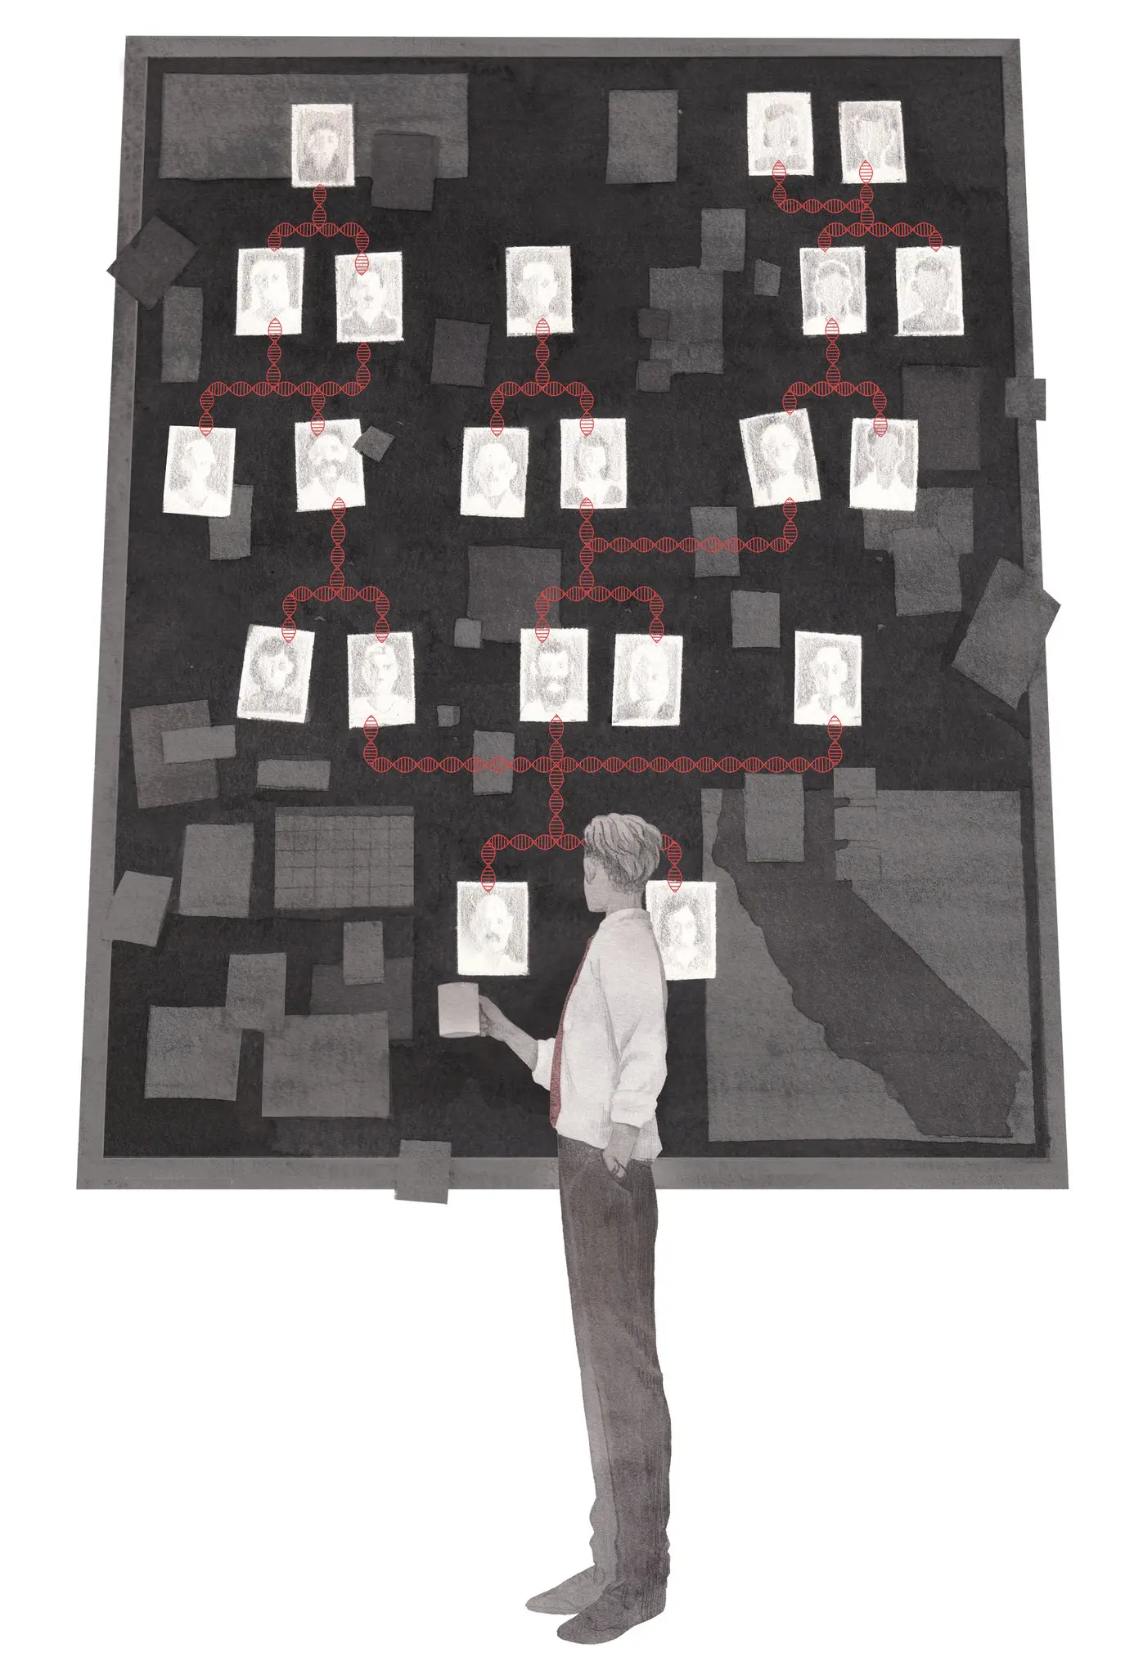
What is genetic genealogy?
Noah Plasse
Biological relationships
Uses DNA test results
Can determine the levels and types of biological relationships between or among individuals.
Notes:
What is genetic genealogy?
Finds biological relationships between or among individuals
Uses DNA test results to determine relationships.
Can determine the levels and types of biological relationships between or among individuals.

Slide 29
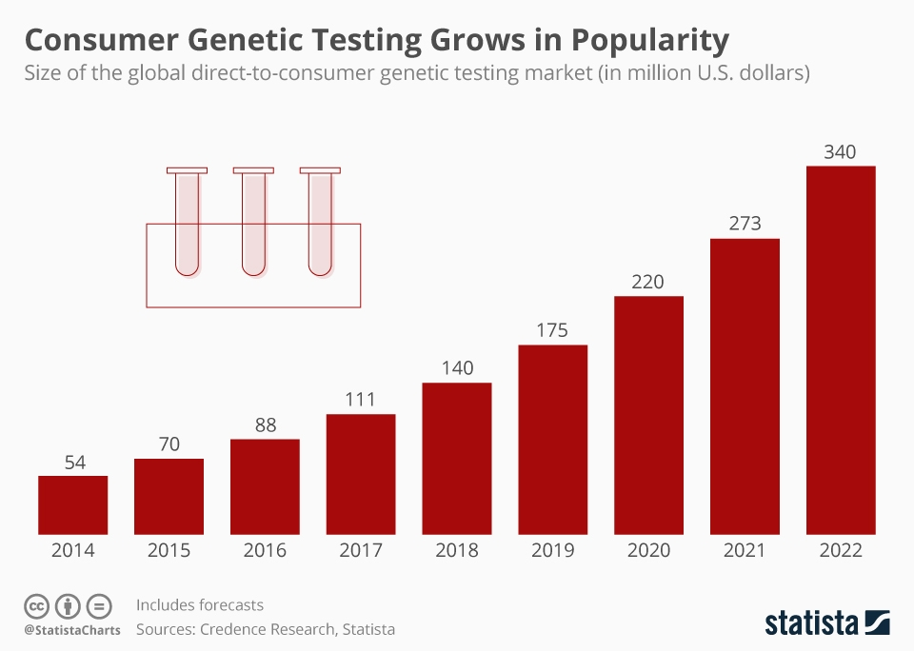
Consumer genetic genealogy testing
Noah Plasse
Has been growing in popularity
Testing services offered by several companies.
23andMe, Ancestry, FamilyTreeDNA, GEDMatch
Notes:
Rise of Genetic genealogy companies
Has been growing in popularity in recent years
Testing services offered by several companies such as 23AndMe, Ancestry.com, FamilyTreeDNA, GEDMatch

Slide 30
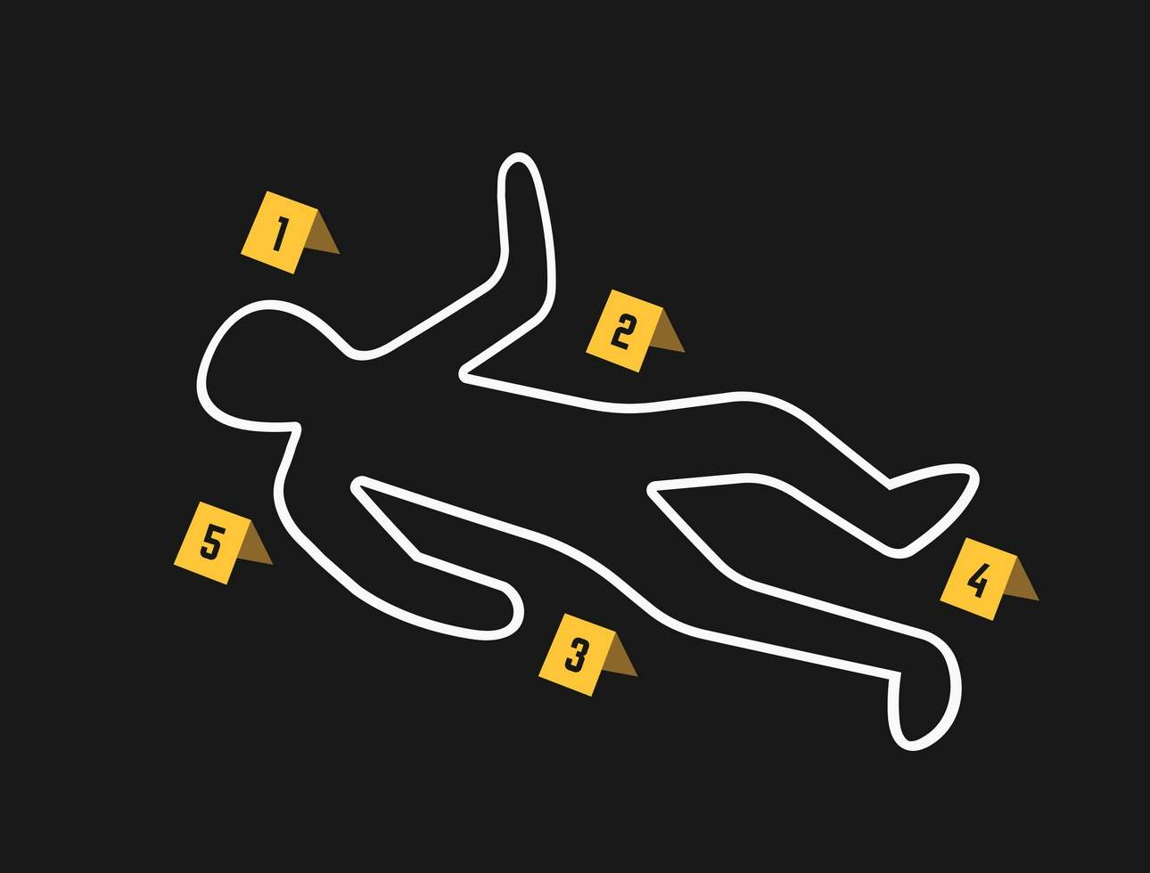
Effectiveness of genealogy databases in law enforcement
Noah Plasse
In the past few years, genealogy databases have been used to solve cases
Use family links to ID criminals
Cold cases, some as old as 66 years are being solved [3]
Notably the "Golden State Killer" was caught in 2018 using GEDMatch [4]
Notes:
Effectiveness of Genealogy in law enforcement
In the past few years, genealogy databases have been used to solve cases
Law enforcement uses family links to narrow down the potential list of suspects
A number of cold cases have been solved, some being several decades old
A double homicide case from 1956, 66 years, was solved with genealogy databases
Notably the "Golden State Killer" was caught in 2018 using GEDMatch, which is a consumer genealogy service

Slide 31
Should law enforcement be able to use
consumer genealogy databases to solve crimes?
Noah Plasse
Not without more government regulations
Downsides
Invasion of privacy
Lack of legislation
We don’t have enough info on what companies do with data
Upsides
Very old cold cases are being solved
Can help give families closure on otherwise impossible cases
Notes:
Should law enforcement be able to access genetic genealogy databases to identify criminals?
Not without more government regulation!!
Downsides
Privacy concerns over user data being used without proper consent
Lack of legislation in the USA
Especially in some states where there is next to no legislation
We don’t have enough info on what companies do with data
Upsides
Very old cold cases are being solved
Note the 66 year old case and Golden State Killer
Can help give families closure on otherwise impossible cases

Slide 32
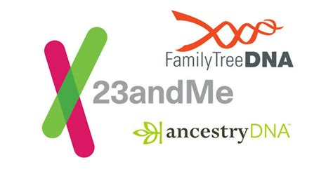
Company Policies & Law Enforcement
Noah Plasse
Most require warrant/subpoena and some will fight the release of data in court [5] [6] [7] [8]
FamilyTreeDNA & GEDMatch have been more compliant with law enforcement
Notes:
Company Policy
Most major genealogy companies require a warrant or subpoena access information
23andMe Ancestry FamilyTreeDNA GEDMatch
Some will fight the release of data in court (23andMe and Ancestry)
FamilyTreeDNA and GEDMatch have been more compliant with law enforcement
GEDmatch has been used to solve many cases

Slide 33
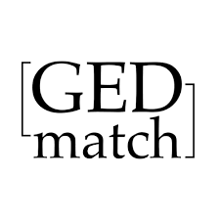
GEDMatch
Noah Plasse
Much more permissive with law enforcement access.
Allows for DNA processed elsewhere to be uploaded
Popular with law enforcement
Only recently allowed users to ‘opt-out’ of law enforcement use [7]
Notes:
GEDMatch
GEDMatch, compared to other genealogy companies, was much more permissive with law enforcement access.
GEDMatch unlike other sites allows for DNA processed elsewhere to be uploaded, no samples have to be uploaded.
Very popular with law enforcement as they can submit raw DNA data they have to find potential family members
USED in several cases
In 2018, the Golden State Killer was caught by law enforcement with the help of GEDMatch
““You don’t want to get caught, don’t be a criminal,” said Curtis Rogers, a co-founder of GEDMatch” https://www.pbs.org/newshour/science/genetic-genealogy-can-help-solve-cold-cases-it-can-also-accuse-the-wrong-person
After the identification and arrest of several criminals using the GEDMatch database, GEDMatch received a lot of backlash.
GEDMatch only recently changed its policy to make law enforcement access more restrictive, now requiring users to ‘opt-in’ to law enforcement use.
Law enforcement without checks and regulations is a legal concern!

Slide 34
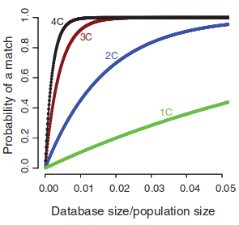
Only a fraction of the population is needed
Noah Plasse
GEDMatch is small, but its database alone is enough to be effective
Study done on the effectiveness of genealogy databases in IDing people
“a genetic database needs to cover only 2% of the target population to provide a third-cousin match to nearly any person” [9]
Notes:
It doesn’t take much data
Most companies will not allow for data release but GEDMatch has a history of doing so
GEDMatch is small,but its database alone is enough to be effective
Study done on the effectiveness of genealogy databases in IDing people
“a genetic database needs to cover only 2% of the target population to provide a third-cousin match to nearly any person”
Narrows down the potential suspects by a large margin
Even small firms can be a privacy concern

Slide 35
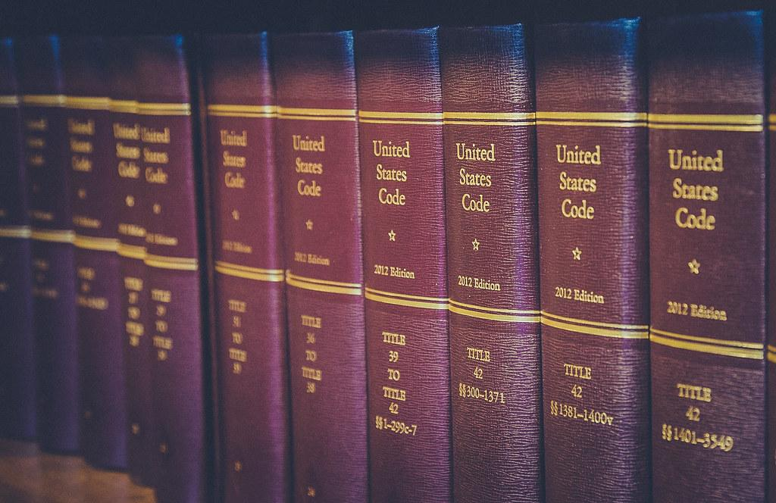
Current legislation on genetic privacy
Noah Plasse
Little legislation that bars companies from releasing data.
Varies state by state
Some states have introduced laws protecting genetic privacy [10]
A court in Florida recently subpoenaed GEDMatch to allow for the search of their entire database [11]
Notes:
Current Legislation
Little legislation that bars companies not to release data
It varies from state to state
Utah, along with several other states, have taken steps forward by passing bills to protect citizen’s genetic privacy
A Court in Florida subpoenaed GEDMatch recently to access their results regardless of their policies and had full access to the database

Slide 36

Privacy Concerns
Noah Plasse
Don’t know exactly what companies are doing with genetic data
Don’t have control over data that these companies hold.
“few, if any, applicable legal doctrines or enactments provide adequate protection or meaningful control to individuals over disclosures that may affect them.“ [12]
Notes:
Privacy Concerns
We don’t know exactly what these companies are doing with genetic data
We also don’t have much control over data that these companies hold.
From recent review of laws on genetic privacy published in the Journal of Law and the Biosciences
“few, if any, applicable legal doctrines or enactments provide adequate protection or meaningful control to individuals over disclosures that may affect them.“

Slide 37
We need more protections and regulations
Noah Plasse
More comprehensive legislation on genetic privacy
More ways to hold companies and law enforcement accountable
More awareness of privacy concerns
Notes:
Need more protections and regulations
More comprehensive legislation on genetic privacy
More ways to hold companies and law enforcement accountable
More awareness of privacy concerns
Even if it is useful to catch elusive criminals,
How can we hold law enforcement accountable when they use genealogy databases to identify criminals?

Slide 38
REFERENCES
Noah Plasse
[1] Steen, Tomoko. n.d. “Research Guides: Genetic Genealogy: DNA and Family History: Introduction.” Research guide. Accessed April 5, 2022. https://guides.loc.gov/genetic-genealogy/introduction.
[2] “Infographic: Consumer Genetic Testing Grows in Popularity.” n.d. Statista Infographics. Accessed April 5, 2022. https://www.statista.com/chart/19996/size-of-global-direct-to-consumer-gentic-testing-market/.
[3] Pruitt-Young, Sharon. 2021. “Detectives Just Used DNA To Solve A 1956 Double Homicide. They May Have Made History.” NPR, June 12, 2021, sec. National. https://www.npr.org/2021/06/12/1005690930/detectives-just-used-dna-to-solve-a-1956-double-homicide-they-may-have-made-hist.
[4] Fuller, Thomas. 2018. “How a Genealogy Site Led to the Front Door of the Golden State Killer Suspect.” The New York Times, April 26, 2018, sec. U.S. https://www.nytimes.com/2018/04/26/us/golden-state-killer.html.
[5] 23andMe. n.d. “DNA Genetic Testing & Analysis - 23andMe.” Accessed March 21, 2022. https://www.23andme.com/about/privacy/.
[6] “Privacy Statement - Ancestry.Com.” n.d. Accessed April 5, 2022. https://www.ancestry.com/c/legal/privacystatement.
[7] “GEDmatch.Com Terms of Service and Privacy Policy.” n.d. GEDmatch. Accessed April 5, 2022. https://www.gedmatch.com.
[8] “FamilyTreeDNA - Genetic Testing for Ancestry, Family History & Genealogy.” n.d. Accessed April 5, 2022. https://www.familytreedna.com/legal/law-enforcement-guide.
[9] Erlich, Yaniv, Tal Shor, Itsik Pe’er, and Shai Carmi. 2018. “Identity Inference of Genomic Data Using Long-Range Familial Searches.” Science 362 (6415): 690–94. https://doi.org/10.1126/science.aau4832.
[10] SB0227. https://le.utah.gov/~2021/bills/static/SB0227.html. Accessed 5 Apr. 2022.
[11] Hill, Kashmir, and Heather Murphy. 2019. “Your DNA Profile Is Private? A Florida Judge Just Said Otherwise.” The New York Times, November 5, 2019, sec. Business. https://www.nytimes.com/2019/11/05/business/dna-database-search-warrant.html.
[12] Clayton, Ellen Wright, Barbara J Evans, James W Hazel, and Mark A Rothstein. 2019. “The Law of Genetic Privacy: Applications, Implications, and Limitations.” Journal of Law and the Biosciences 6 (1): 1–36. https://doi.org/10.1093/jlb/lsz007.

Slide 39
Class 7
The End
Keith A. Pray
socialimps.keithpray.net
Notes:
This is the end. Any slides beyond this point are for answering questions that may arise but not needed in the main talk. Some slides may also be unfinished and are not needed but kept just in case.

