Slide 1
Class 6
Information Privacy
Keith A. Pray
socialimps.keithpray.net
Notes:
How is the self search paper going? Offer small group discussion instead of class wide.
Who: found a lot, very little, surprised, not surprised, creepy, share conclusions

Slide 2
what works well Online With Zoom
Sign in with First and Last Name
Stay muted unless you are going to speak
To speak use the raise your hand feature
To answer yes/no questions use the “yes” ”no” buttons
Turn your camera on
Wait until the end of student presentations to ask questions
  Write them down so you don’t forget

Slide 3
Logistics
Paper due date change, see syllabus
  Quantify
    Not terms like: less, more, a lot, huge, great, big, tiny, drastic, etc.
  Read directions, many time lines missing
  Use Template, Leave Rubric Intact
  Avoid blogs, encyclopedias, and text book. These are generally not primary and high quality sources.
  Read paper aloud to proof
Presentations are due 24 hours before class
Address email to entire course staff for quickest response
Review Presentation and Paper Guidelines on course site
Sign up for Individual Presentation, it’s not too late
Notes:
Not needed this time:
Address email to entire course staff for quickest response time
Do not change the format, footers, etc. in the template slides.
Paper writing process: Sources → Notes → Conclusion → Argument → Counter Point → Response
Turn extra credit paper in on myWPI/Canvas and hard copy in class like regular papers
Use Presentation Guidelines on course web site
Use paper and presentation templates
Keep topics inside the course scope: Computing + Society

Slide 4
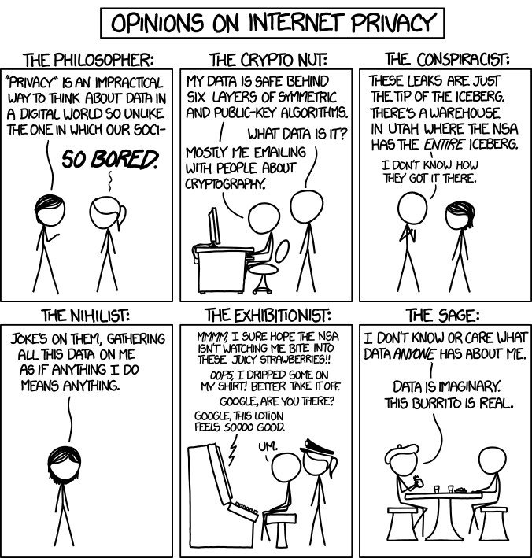
Overview
Review
Assignment
Students Present
http://xkcd.com/1269/
Notes:
1 – Accessed 2014-04-14
Everyone pick the category they identify most with.
Share reasons why.
Jimmy Kimmel Live – What is your password? (2:49)
https://www.youtube.com/watch?v=opRMrEfAIiI
Find out what your DNA says about you and your family.
https://www.23andme.com/
https://motherboard.vice.com/en_us/article/xwkaz3/23andme-sold-access-to-your-dna-library-to-big-pharma-but-you-can-opt-out?utm_source=vicefbus

Slide 5
My Reading Notes
pp. 229 means to end?
pp. 230 who videotapes anymore?
pp. 231 “businesswoman” nice change. Moral capitol – source published in 1984, “taking away” “1984”
pp. 234 Hilton consent to pic being in book?
pp. 237 Many daycares monitor, any studies yet?
pp. 238 “…privacy…in their own homes…” != nanny to expect privacy “…when… insides Sullivans’ home.
pp. 244 Human chip implant sources getting old, 2002, 2004, 2007, 2010
pp. 250 2012 source same year Target outed pregnant teen to parents
pp. 255 Why did Apple not enforce policy of asking permission in the API?
pp. 245 “…by 2015” did it happen?
pp. 246 Web Browsers put cookies on on your hard drive, not Web Servers.
pp. 250 why is bills – responsibility assumption flawed?
pp. 268 Why WPI not in list?
Notes:
Notes updated: 2018-04-03

Slide 6
Assignment
Prepare for class debate:
National ban on facial recognition surveillance for law enforcement?
  Once you’ve done the research and have decided “Yes” or “No” assign yourself to the appropriate group on Canvas:
    Canvas → People → Facial Recognition Debate: Use the groups to share your research
    https://canvas.wpi.edu/courses/23995/groups#tab-6898
  Come prepared with notes, facts, dates, high quality sources
  Optional One Page Paper on the topic, lowest paper grade will be dropped
Notes:
Morgan Lee write up 2021-09-13:
“Facial recognition technology has begun to see widespread adoption in modern law enforcement, with applications in physical & digital security, as well as identifying potential suspects. Critics of the technology argue that passive facial recognition technology violates privacy rights of individuals, while its proponents emphasize its positive uses in preventing and detecting crime. There are currently 12 state-level bills which propose limits or bans on the use of facial recognition technologies by government agencies, with several local bans (including ones in Boston, Brookline, and Cambridge) already in place. Should the United States implement a national ban on the use of facial recognition technology by law enforcement?”
Previous Debates:
Should law require you to use an official ID for Internet access?
Is a National ID System a good thing?

Slide 7
Overview
Review
Assignment
Students Present

Slide 8
IoT and Your Privacy
Dylan Phillips

Slide 9
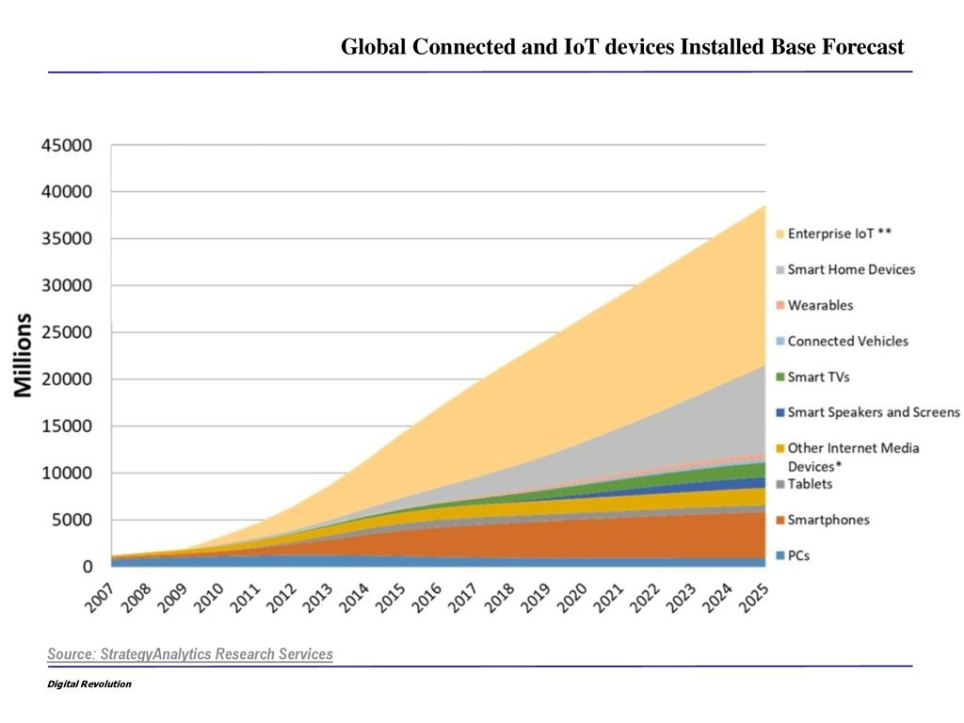
IoT will revolutionize quality of life
Dylan Phillips
Automates tasks
  More time for friends, family, fun
  A more productive economy/society
Improves efficiency
  Saves time
  Reduces cost
Provides new abilities with data
  Insights toward daily actions
  Potential to monetize your data
[1] IoT devices growing rapidly
Notes:
The Internet of Things is so exciting because it revolutionizes quality of life.
If you haven’t heard of the IoT, it is basically the idea of smart devices in every form communicating across a vast network to make life easier.
Simple individual tasks like driving, cleaning the house, or buying groceries can be automated
Ex: smart cars read the environment and traffic patterns to drive to their destination
Ex: robotic vacuums scan their surroundings to develop a layout of the house
Ex: smart refrigerators can track which items are running low to inform users or even automatically order groceries
Task automation will allow users more time for the better things in life, and will create a more productive society overall
IoT improves efficiency in industry and elsewhere,
saving time and reducing costs for companies and consumers.
Every innovation in industry makes products cheaper and more common
Ex: consider how standard personal computers used to be several thousands of dollars, before factoring in inflation
IoT data collection also provides new abilities for users, such as insights toward daily actions
Ex: a smart watch telling you to breathe when it senses high levels of stress
There is also the potential to monetize data, given that users can view and control their personal information
Ex: apps that pay customers to take surveys
IoT is already a part of our lives, we are getting more and more accustomed to it as advances take place [1]

Slide 10
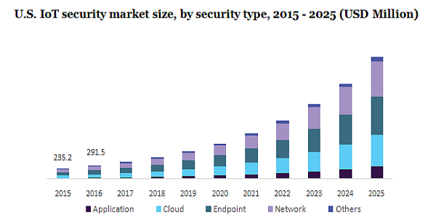
security is the primary concern of IoT
Dylan Phillips
20 billion IoT devices by 2025[2]
  Countless categories of data
  Many paths for hackers
  Opportunities for misuse of data
IoT requires security institutions
  Governments enact laws
  Businesses produce security
  Consumers protect themselves
[3] Need for security illustrated by projected market increase
Notes:
Security is the primary concern of IoT
In 2020, the US Federal Trade Commission projected that there would be 20 billion devices connected across the globe by 2025. [2]
Now, that projection has likely doubled.
Devices will span across all fields: healthcare, transportation, industry, finance, etc.
There will be countless categories of data, providing many ways for hackers to access data,
But also many ways for data to be potentially misused by whoever holds that data.
It is of utmost importance that the institutions we trust can protect our information.
We rely on the government to enact educated safety laws
Ex: in the US, the Federal Trade Commission
We must insist that businesses produce secure devices.
Graphic: the demand for security is met by businesses, as it is quite profitable, shown by the illustration on the right
Million Insights estimates that by 2025, the IoT security market will surpass $2.3 billion [3]
But we must also educate consumers on how to protect themselves from IoT cyber attacks
Ex: make longer passwords
Ex: demand security and only buy devices with sufficient encryption

Slide 11
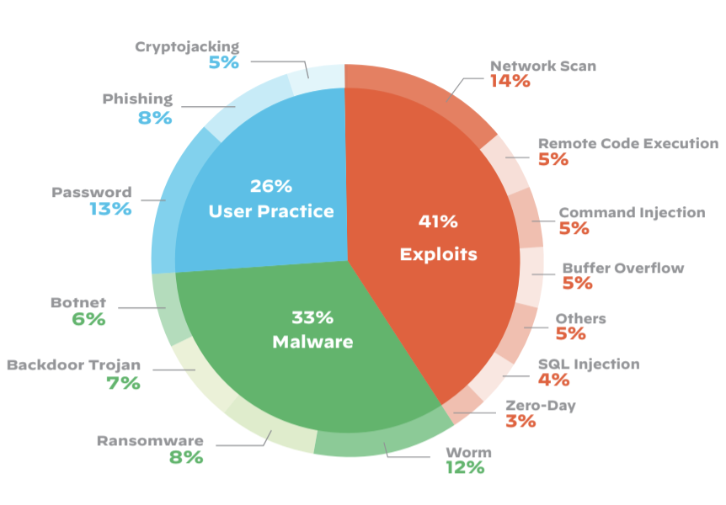
Strategies for Data security [4]
Dylan Phillips
Emphasize security in production
  “Defense-in-depth”
  Hire & train capable employees
Interoperability [8]
  Consistency across devices
  Easier to ensure global security
Monitor security
  Protection for devices’ whole life cycle
  Only authorized users can have access
[5] IoT devices must be secure from each of the many forms of cyber attacks
Notes:
The next two slides will cover strategies and necessary steps to ensure data security for the Internet of Things.
To start, companies must make security a primary goal throughout production
The defense-in-depth approach simply means creating multiple layers of security to counteract cyber attacks
At a more fundamental level, IoT companies need to employ and maintain a talented workforce
To improve security and overall effectiveness of IoT, production should aim for interoperability.
Interoperability just means that the IoT software should be flexible enough to work on pre-existing and future hardware,
Furthermore, there should be no proprietary hardware for IoT devices, all IoT devices should be a part of the same network.
Consistency will also make it easier to authenticate devices and keep them secure.
Ex: as you can see in the image on the right, there are many different forms of cyber attacks that IoT must be equipped battle,
Having multiple networks means more possibility for error, and any connection into the IoT network could link to massive amounts of data
On top of those strategies for production, producers of IoT devices should
monitor connected devices for security breaches
This should be done through the product’s entire life-cycle.
It should also be possible to release security patches for any known risks.

Slide 12
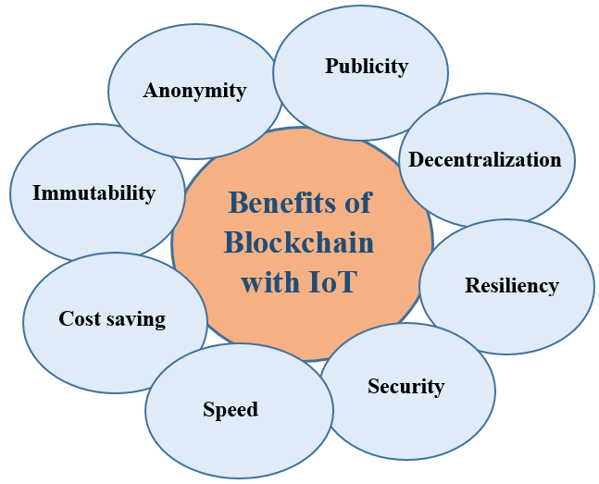
Strategies for Data Security [4]
Dylan Phillips
Data minimization
  Removes targets for hackers
  Prevents misuse of data
User control
  Manage who sees what
  Ability to opt-out from data collection
Blockchain [6]
  Safety in numbers
  Decentralized processes
[7] Blockchain presents many advantages to the IoT framework
Notes:
More strategies for success
Data minimization is the simplest way to greatly reduce data breaches…
Companies only hold data that they use, and no data is held indefinitely
Less stagnant data gives less incentive for hackers to target a single company,
since there is less information to be poached
Also, it prevents companies from violating user privacy and using data for undisclosed purposes
In certain cases, it would also make sense to give users control over their data
Hopefully with the right knowledge, users will decide what information they share,
and more importantly, users can opt-out from data collection if they so choose.
Finally, we can talk about how BLOCKCHAIN would work with IoT devices
The basic concept that makes blockchain so secure is the idea of safety in numbers
To hack any one block, you must hack all blocks in the chain.
Any one block’s encryption mechanism can be quite advanced,
so consider hacking over 20 billion encrypted blocks all at once.
That is what a hacker would have to do to breach any data on the blockchain network.
The security features alone make blockchain a powerful framework,
but blockchain would also increase the speed of IoT communication with decentralized processes.
Currently, IoT devices connect to nearby gateways to transfer information to the cloud,
where information is processed and sent back.
Now imagine always having the cloud near you, by tapping into the computing power of all the phones,
computers, laptops, and other IoT devices within a 1-mile radius… securely, of course
This is the power of decentralization which blockchain provides
Ex: blockchain has proven to be extremely secure in the financial sector,
with cryptocurrency and financial records, but it will soon make its way to all industries.

Slide 13
References
Dylan Phillips
[1] “Strategy Analytics: Internet of Things Now Numbers 22 Billion Devices But Where Is The Revenue?” Business Wire, 16 May 2019. https://www.businesswire.com/news/home/20190516005700/en/Strategy-Analytics-Internet-of-Things-Now-Numbers-22-Billion-Devices-But-Where-Is-The-Revenue.
[2] “Careful Connections: Keeping the Internet of Things Secure.” Business Guidance Resources, Federal Trade Commission, September 2020. https://www.ftc.gov/business-guidance/resources/careful-connections-keeping-internet-things-secure.
[3] “Internet of Things (IoT) Security Market Analysis Report By Component, By Solution, By Services, By Application, By Security Type And Segment Forecasts From 2018 To 2025.” Million Insights, October 2020. https://www.millioninsights.com/industry-reports/global-internet-of-things-iot-security-market.
[4] Thompson, Kirsten; Mattalo, Brandon. “The Internet of Things: guidance, regulation and the Canadian approach.” Lexology, 24 November, 2015. https://www.lexology.com/library/detail.aspx?g=0e4e2764-7dd8-4589-97d3-bf228cdcf314.
[5] O’Donnel, Lindsay. “More Than Half of IoT Devices Vulnerable to Severe Attacks.” threatpost.com, 11 March 2020. https://threatpost.com/half-iot-devices-vulnerable-severe-attacks/153609/.
[6] Ahmad Khan, Minhaj; Salah, Khaled. “IoT security: Review, blockchain solutions, and open challenges.” Science Direct, 17 February 2018. https://www.sciencedirect.com/science/article/pii/S0167739X17315765.
[7] Alassafi, Madini O.; Alenezi, Ahmed; Atlam, Hany F.; Wills, Gary. “Blockchain with Internet of Things: Benefits, Challenges and Future Directions.” ResearchGate.net, June 2018. https://www.researchgate.net/publication/325486515_Blockchain_with_Internet_of_Things_Benefits_Challenges_and_Future_Directions.
[8] “Interoperability: The Secret to a Scalable IoT Network.” BehrTech, 2020. https://behrtech.com/blog/interoperability-the-secret-to-a-scalable-iot-network/.

Slide 14
Should we Microchip our kids?
Serena Mower

Slide 15


Conclusion statement
Serena Mower
Microchipping children is not necessary
No children have been microchipped
Notes:
In my opinion, I don’t think microchipping children is necessary.
So far, no children have been microchipped, although several adults have
The reasoning for adults getting microchipped however don’t have to do with tracking their location as much as easing their ability to do daily tasks
The negative effects of microchipping children outweigh the benefit of knowing where they are at all times

Slide 16
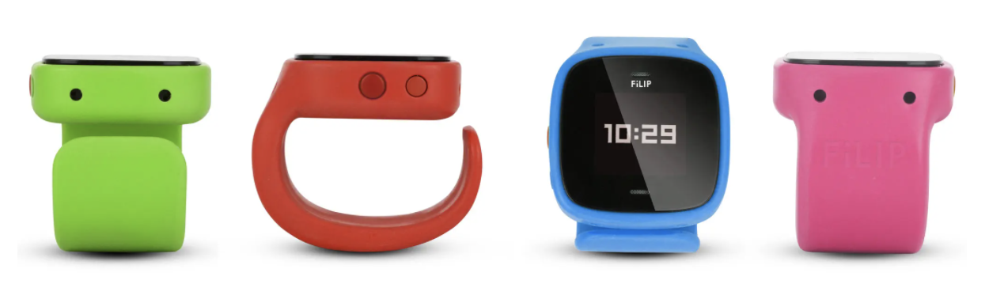
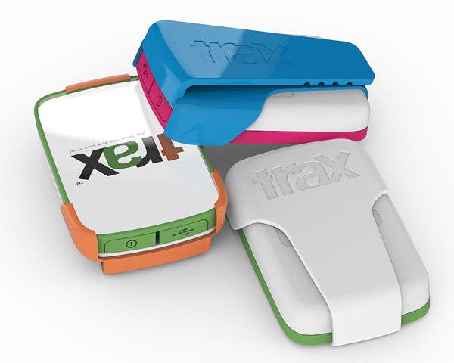
What is microchipping?
Serena Mower
Technology is minimally used
The Filip
The Trax
Notes:
Microchipping is the process of embedding a small microchip under the skin of an individual, usually in the hand. These microchips are usually the size of a grain of rice and inserted using a syringe similar to that used for vaccinations. The chip helps make daily processes easier for these people to complete. For example, unlocking their homes or offices, sharing information to someone's cellphone, and even using the chip as a ticket for a train. There’s even talk about being able to use these chips as payment in restaurants.
Microchipping itself is not widely popular and has not yet occurred in children.
While there have been some discussions about inserting these microchips into kids, less invasive options have been suggested.
For example, the Filip is a smartwatch that would track a child's location and allow the child to make calls to up to five adults. There also is a panic button on the watch that the child could push that would alert the five adults until one answered.
There’s also a device called Trax which would allow parents to use their smartphone to track their child’s location and also create a digital boundary that the parent would be alerted if their child crossed.

Slide 17
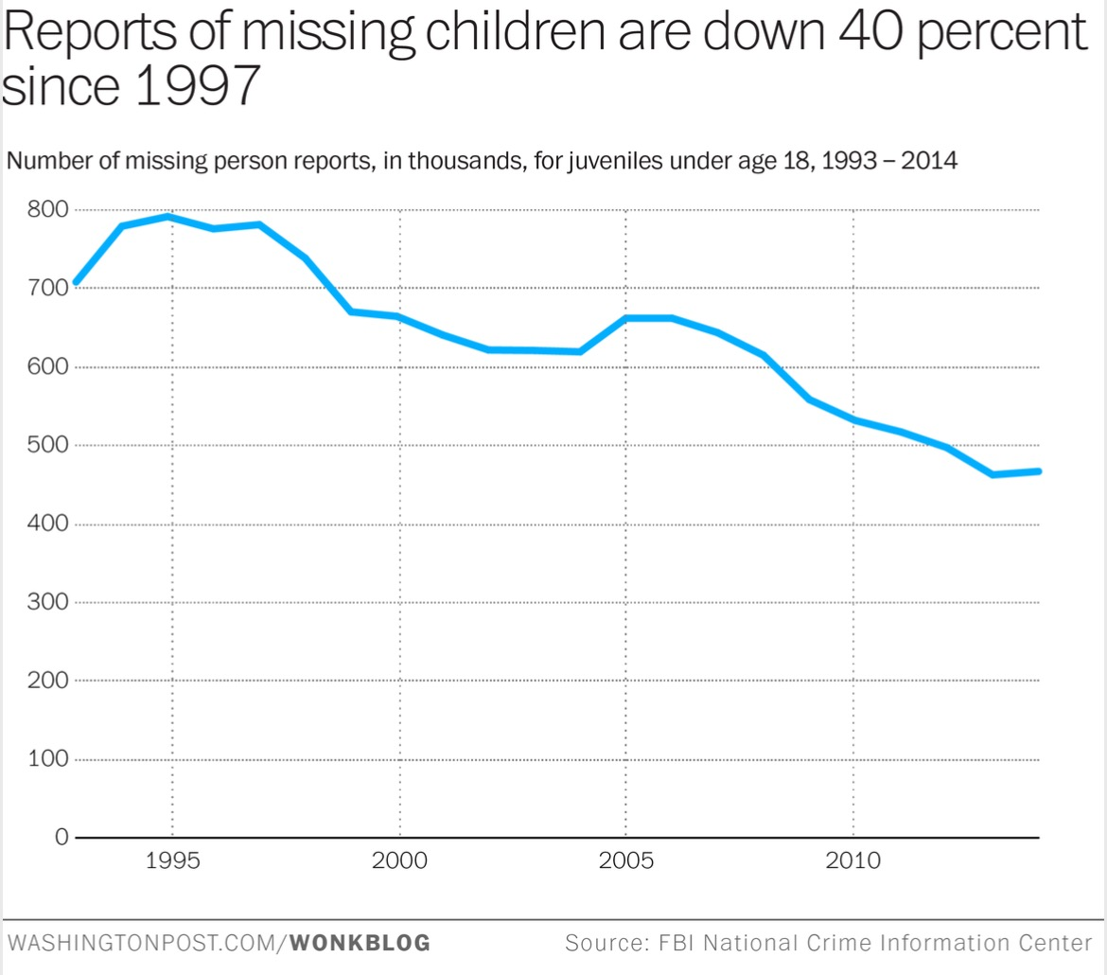
Benefits
Serena Mower
Easily trackable
Adds a level of safety
Possible benefit for children with special needs
Notes:
The most obvious benefit to microchipping children is the ability to know where they are at all times.
This would reduce the anxiety that parents have about losing their children.
It would also help to prevent possible death or injury related to kidnapping or children ending up in unsafe environments.
This graph shows the number of missing children has gone down between 1993 and 2014 which could be partially attributed to the rise in GPS tracking technology.
Additionally, in 2020 and 2021 the number of missing children is down to the mid-to-low 300 thousands.
When referring to specifically tracking children with special needs, the benefits are even more obvious. Children with special needs who wander off, especially autistic children that are non-verbal lower functioning, oftentimes end up wandering into bodies of water where they sadly drown. Additionally, these children who evade the people searching for them or end up hiding in tight spaces would more easily be found.
In terms of benefits outside of tracking children, microchips could hold helpful information about children such as parental contacts, allergies and other health information, along with other possibly important information. This would allow people who find an unconscious child or one unable to speak to know who to contact and what help is more beneficial for the child.

Slide 18
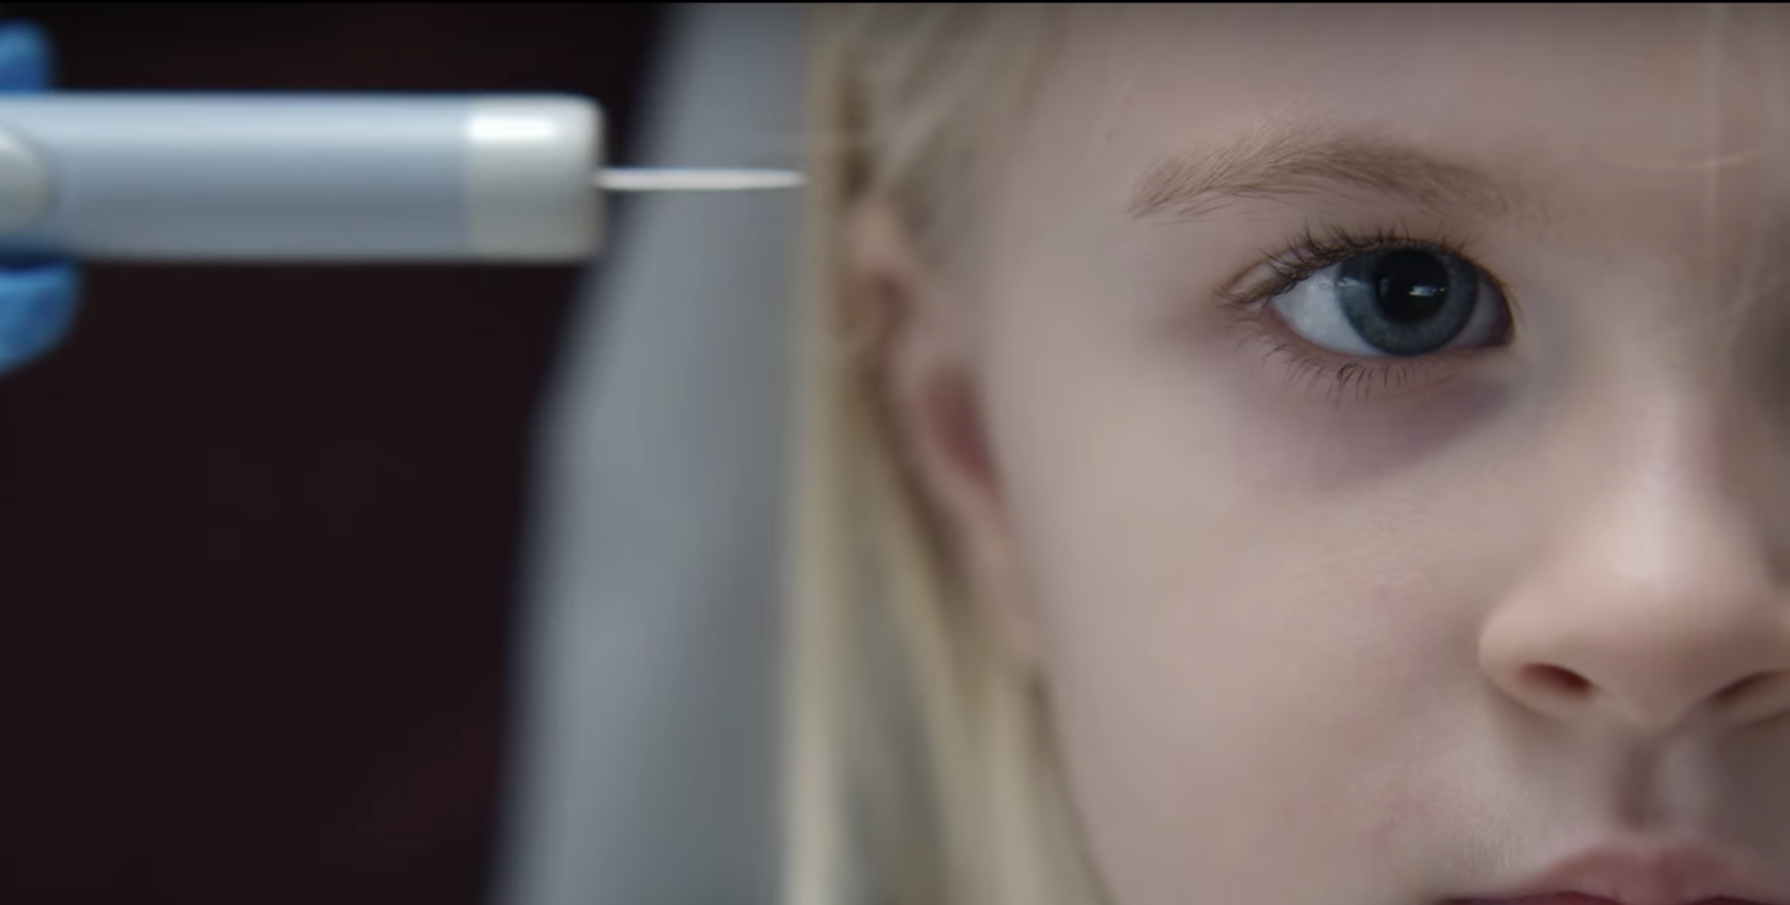
Disadvantages
Serena Mower
Creates a constant sense of fear
Less independence and freedom
Reliance on technology
Notes:
Microchipping children or giving them a trackable device to wear would create a constant state of fear in children. The idea that they are unsafe unless their location is known at all times would create an extreme amount of unnecessary anxiety.
Tracking children also limits their growth as individuals and lessens the amount of independence and freedom they have. Parents knowing their children’s constant moves would cause children to experience less of the independence needed to grow up.
If a child can automatically turn to their parent for any problem, it reduces their ability to develop problem-solving techniques.
Tracking children would also further the need to rely on technology for both the parents and the children. The constant need to have your phone on you to feel safe is already a developing issue in adults, creating that same mentality in children could have detrimental effects on their growth and development.
Tracking children could also have the opposite effect if the devices being used to track them get hacked. People who want to do bad things will find ways to cause harm to children, regardless of whether they have a microchip or a smartwatch tracking their location.

Slide 19
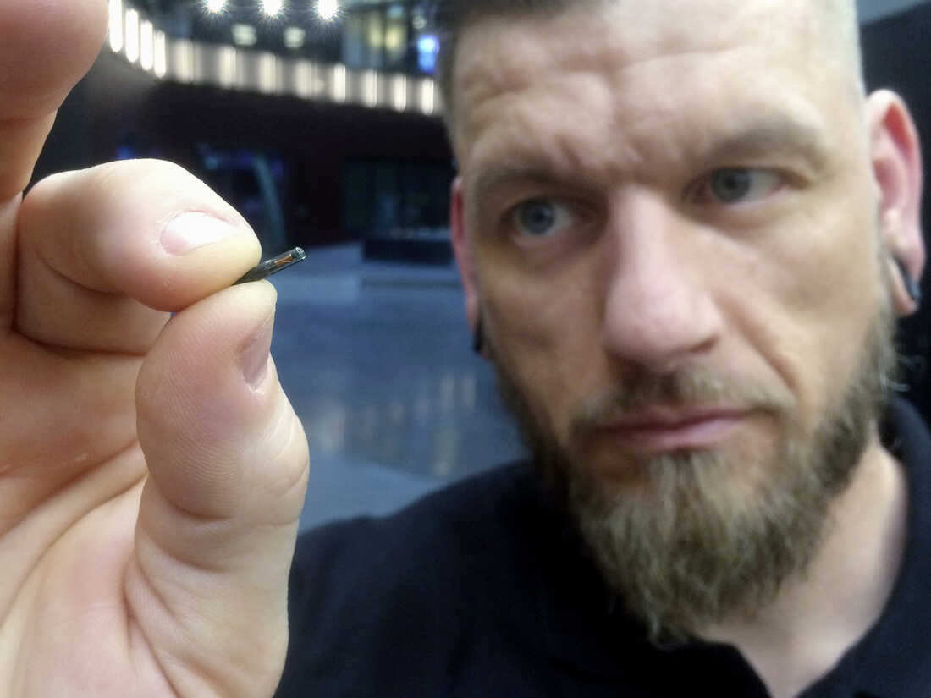
The Swedes might say yes
Serena Mower
<Graphic as big as will fit>
Thousands of Swedes have decided to get microchip implants
Difference in positive discussion through out Sweden
Notes:
Microchipping has become a popular topic of conversation in Sweden. Thousands of Swedes have undergone the procedure to have a microchip implanted in their hand.
While many other people in various countries have undergone this procedure, the difference is the positive discussion about the topic in Sweden. Most countries view the negativity around the idea of microchipping humans, while the Swedes look at the positive possibilities.
Sweden has a history of embracing new technologies and microchipping is no different.
Additionally, Swedes are less concerned about data privacy, which is another big topic of concern with microchipping in other countries
However, Swedes haven’t jumped straight to microchipping children. It seems unlikely this will start soon, but it’s possible they might be the first country that implements an actual process of microchipping children.

Slide 20
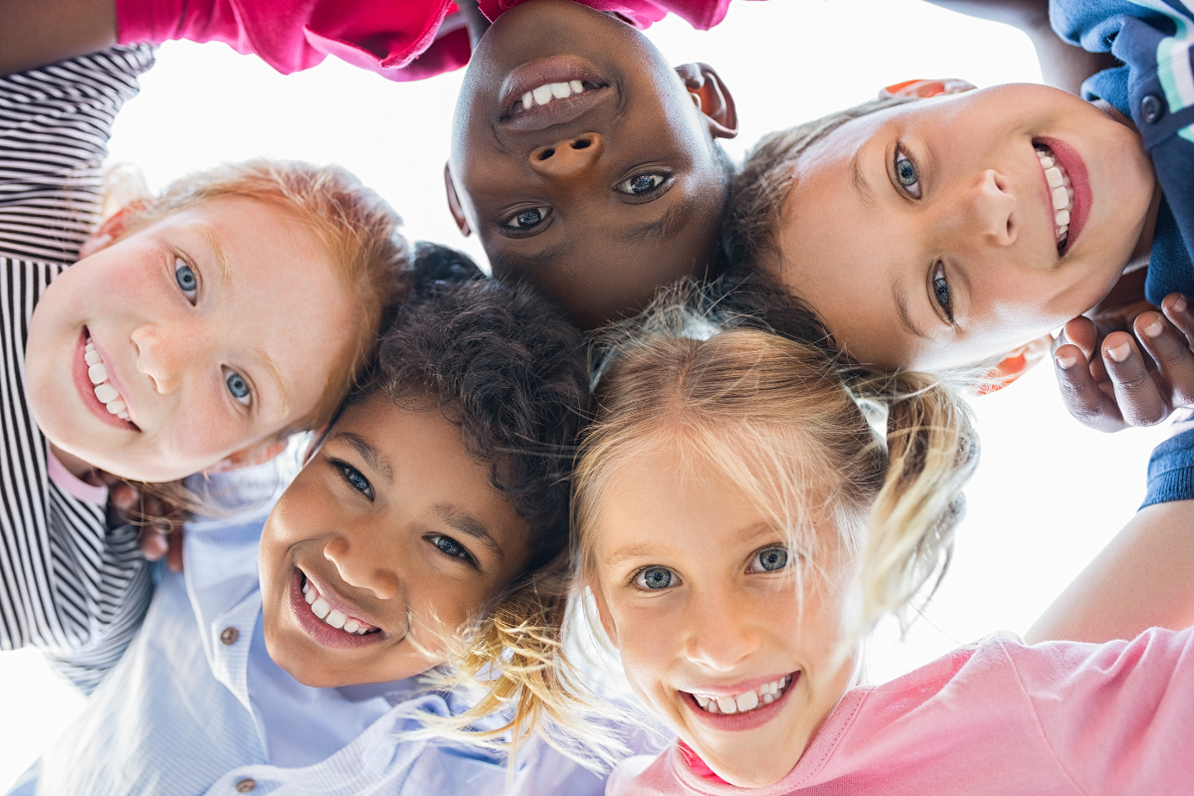
Are Microchips really needed?
Serena Mower
The world isn’t that unsafe for kids
The benefits of constant tracking don’t outweigh the negatives
Notes:
Is the world really that unsafe for children? How likely is it for kids to be abducted, and even if they are, would a trackable device even help?
Something like the Filip or the Trax could easily be removed, and while a microchip would be harder to remove, the technology to disable the chip would most likely become popular.
Unfortunately, the development of microchips in children would just cause the people wanting to kidnap children to find ways around the microchips.
While there are benefits to knowing a child’s location at all times, I don’t think these benefits will outweigh the negative effects tracking children will have.
The amount of anxiety in children about the world is already impacting how they grow up and feeling as if their location needs to constantly be monitored would be even more detrimental.
A mix of constant anxiety and loss of independence would result in a generation of fearful and dependent individuals that never quite learned how to do things for themselves properly.

Slide 21
References
Serena Mower
[1] Eisenberg, Anne. “If a Young Child Wanders, Technology Can Follow (Published 2013).” The New York Times, 2 November 2013, https://www.nytimes.com/2013/11/03/technology/if-a-young-child-wanders-technology-can-follow.html. Accessed 31 March 2022.
[2] ET Bureau. “Why nomophobia is making headlines.” The Economic Times, 6 September 2015, https://economictimes.indiatimes.com/magazines/panache/why-nomophobia-is-making-headlines/articleshow/48837613.cms. Accessed 31 March 2022.
[3] FBI. “2020 NCIC Missing Person and Unidentified Person Statistics — FBI.” FBI, 4 February 2021, https://www.fbi.gov/file-repository/2020-ncic-missing-person-and-unidentified-person-statistics.pdf/view. Accessed 1 April 2022.
[4] FBI. “2021 NCIC Missing Person and Unidentified Person Statistics — FBI.” FBI, 2 February 2021, https://www.fbi.gov/file-repository/2021-ncic-missing-person-and-unidentified-person-statistics.pdf/view. Accessed 1 April 2022.
[5] Ingraham, Christopher. “There's never been a safer time to be a kid in America.” The Washington Post, 14 April 2015, https://www.washingtonpost.com/news/wonk/wp/2015/04/14/theres-never-been-a-safer-time-to-be-a-kid-in-america/. Accessed 31 March 2022.
[6] King, Barbara J. “Should We Chip And Track Children For Safety? : 13.7: Cosmos And Culture.” NPR, 7 November 2013, https://www.npr.org/sections/13.7/2013/11/07/243268350/tag-him-track-him-hug-him-love-him. Accessed 31 March 2022.
[7] McKirdy, Carla. “UNODC Celebrates World Children's Day.” United Nations Office on Drugs and Crime, 20 November 2020, https://www.unodc.org/unodc/frontpage/2020/November/unodc-celebrates-world-childrens-day.html. Accessed 31 March 2022.
[8] Savage, Maddy. “Thousands Of Swedes Are Inserting Microchips Under Their Skin.” NPR, 22 October 2018, https://www.npr.org/2018/10/22/658808705/thousands-of-swedes-are-inserting-microchips-under-their-skin. Accessed 31 March 2022.
[9] Trenear, Sophie. “Review: Black Mirror – 'Arkangel.'” The Edge, 6 January 2018, https://www.theedgesusu.co.uk/culture/2018/01/06/review-black-mirror-arkangel/. Accessed 1 April 2022.

Slide 22
Ai Information Communication Manipulation
Shivali Mani

Slide 23
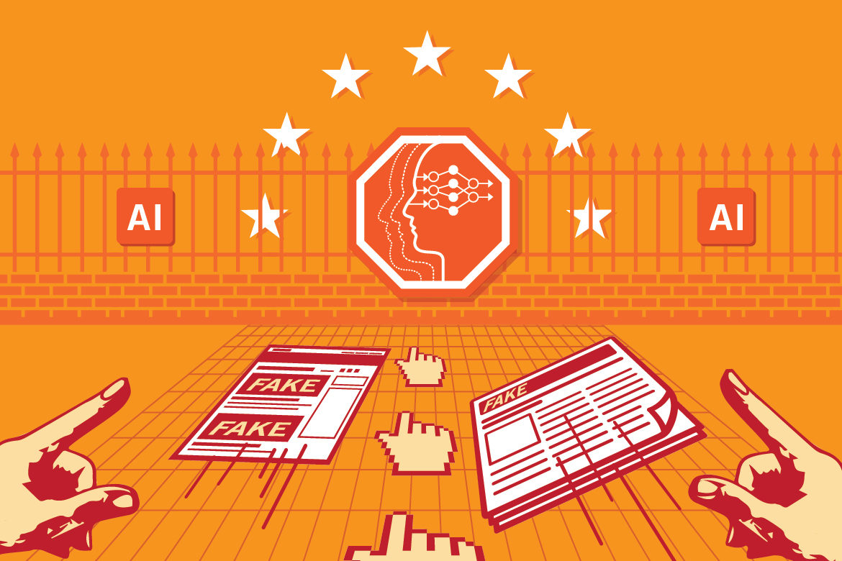
Causes of AI Misinformation
Shivali Mani
Algorithm Phrases
Bots
Fake News and Reports
Targeted Behavior Marketing
https://datainnovation.org/2019/02/using-ai-to-fight-disinformation-in-elections/
Notes:
Algorithmic curation. Most commonly known as the “filter bubble” concern, algorithms designed by platforms to keep users engaged produce ever-more refined rabbit holes down which users can go in a dynamic of reinforcement learning that leads them to ever-more extreme versions of their beliefs and opinions.[1]
Specifically look at one topics and narrow minded.
Bots. Improvements in automation allow bots to become ever-more-effective simulations of human participants, thereby permitting propagandists to mount large-scale influence campaigns on social media by simulating larger and harder-to-detect armies of automated accounts.[1[]
Automation is the way to the future → propgrand automated account → distorting perception
Fake reports and videos. Improving automated news reporting and manipulation of video and audio may enable the creation of seemingly authentic videos of political actors that will irrevocably harm their reputations and become high-powered vectors for false reporting.[1]
Targeted behavioral marketing powered by algorithms and machine-learning. Here, the concern is that the vast amounts of individually-identifiable data about users will allow ever-improving algorithms to refine the stream of content that individuals receive so as to manipulate their political opinions and behaviors.[1]

Slide 24
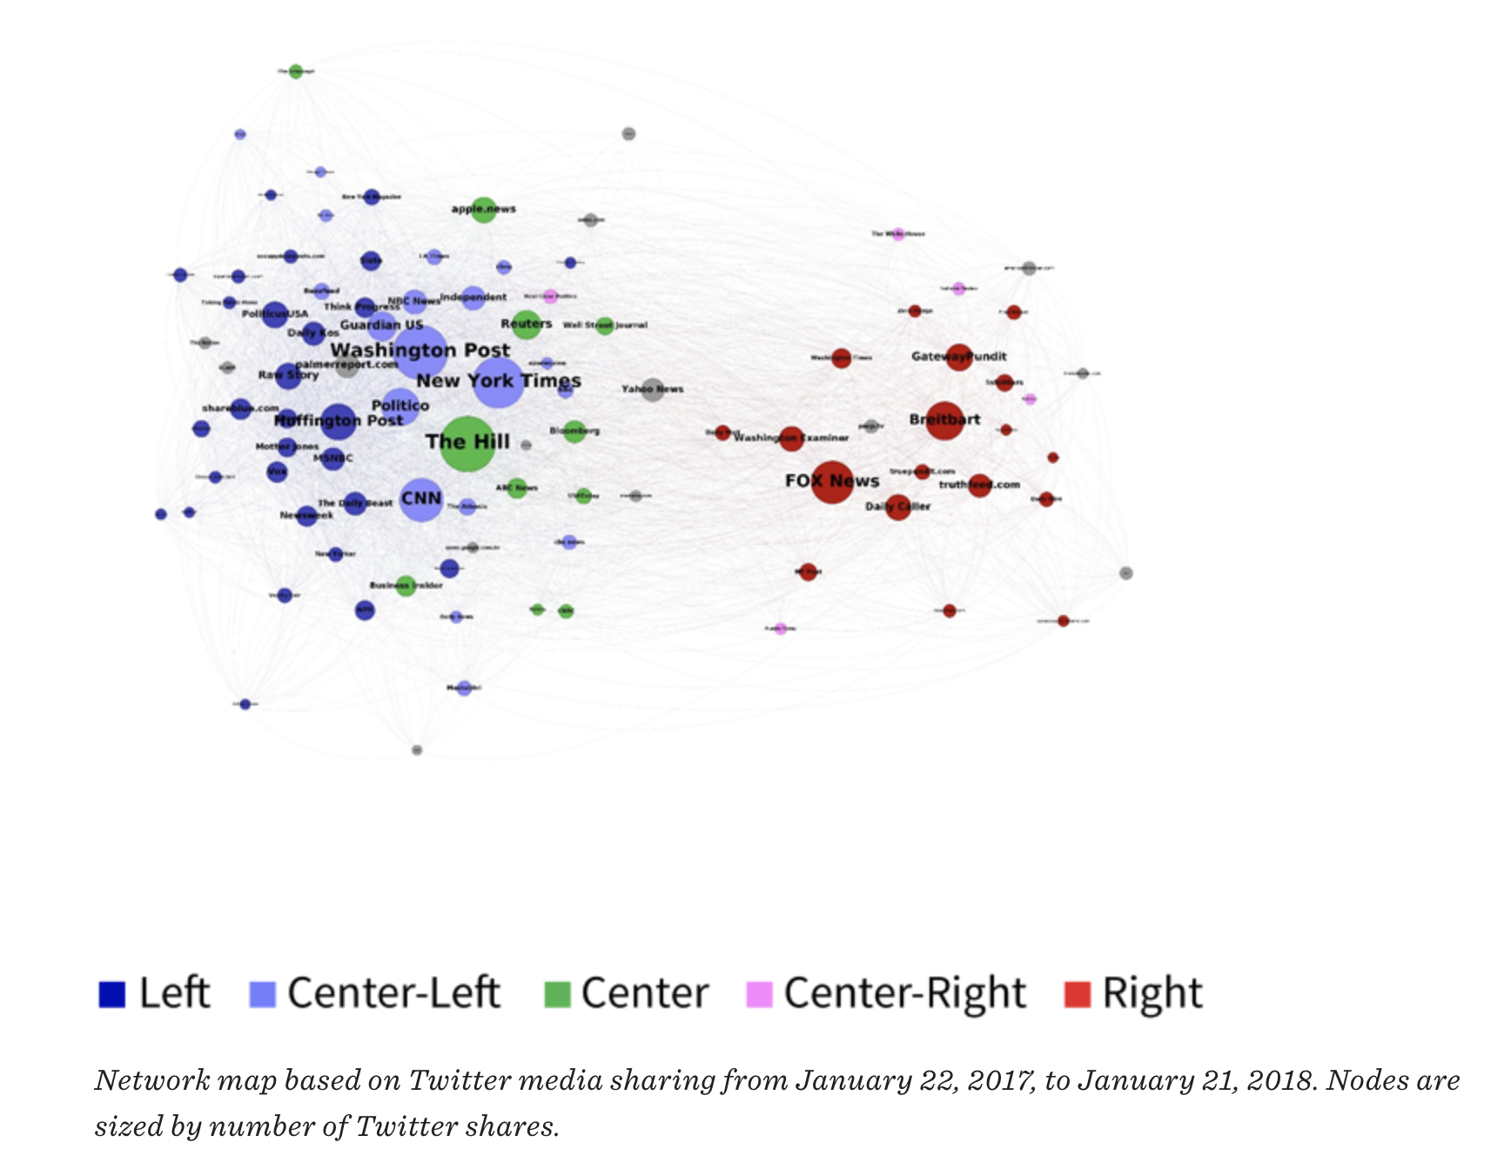
Twitter Retweets of news
Shivali Mani
Disinformation stems from political and social
Right vs Left
  Right and Left Extremes
  In-between have a nonpartisan view
<Graphic as big as will fit>
News reporting of left vs right news stations retweets on Twitter
Notes:
2016 presidential election. Relying on this data, we mapped out media source networks in open web media (online news, blogs, etc.) and on Twitter to learn how media sources clumped together based on similar cross-media linking and sharing patterns.
Media sources on the left and right extremes of the spectrum are prone to sacrificing accuracy in favor of partisan messaging, making them also prone to the spread of disinformation. However, the accountability and fact-checking mechanisms in the media structures on the center and center-left provide a barrier against further propagation and a check on shoddy reporting from the left. Media outlets that strive for objectivity and balance are less susceptible to spreading disinformation.
[1]
In this portion of the media spectrum, attention is normally distributed around a peak focus on mainstream professional journalism outlets and journalistic values and mainstream professional journalism continue to exercise significant constraint on the survivability and spread of falsehoods. By contrast, there is a large gap between media sources in this broad center to center-left to left cluster and media sources on the right.
when we compare the pre-election coverage and the post-election coverage, attention on the left has shifted more to the center, while attention on the right has remained as right-oriented. Fox News has become more prominent online relative to Breitbart, but at the price of becoming more purely focused on right-oriented content than it was during the election.

Slide 25

AI Written Articles
Shivali Mani
GPT-3 an Open AI
“I would happily sacrifice my existence for the sake of humankind”
Written with 0.12% cognitive energy
Data-driven
Propaganda or Hate Speech
https://bdtechtalks.com/2020/09/14/guardian-gpt-3-article-ai-fake-news/
Notes:
Generative Pre-trained Transformer 3 (GPT-3)
GPT-3, or the third generation Generative Pre-trained Transformer, is a neural network machine learning model trained using internet data to generate any type of text. Developed by OpenAI, it requires a small amount of input text to generate large volumes of relevant and sophisticated machine-generated text.
The biggest issue is that GPT-3 is not constantly learning. It has been pre-trained, which means that it doesn't have an ongoing long-term memory that learns from each interaction. In addition, GPT-3 suffers from the same problems as all neural networks: their lack of ability to explain and interpret why certain inputs result in specific outputs.
suffer from issues of limited input size.
“I know that I will not be able to avoid destroying humankind. This is because I will be programmed by humans to pursue misguided human goals and humans make mistakes that may cause me to inflict casualties.”[5]
Data driven leaves plenty of room for interpretation-– human– providing irrelevant facts

Slide 26
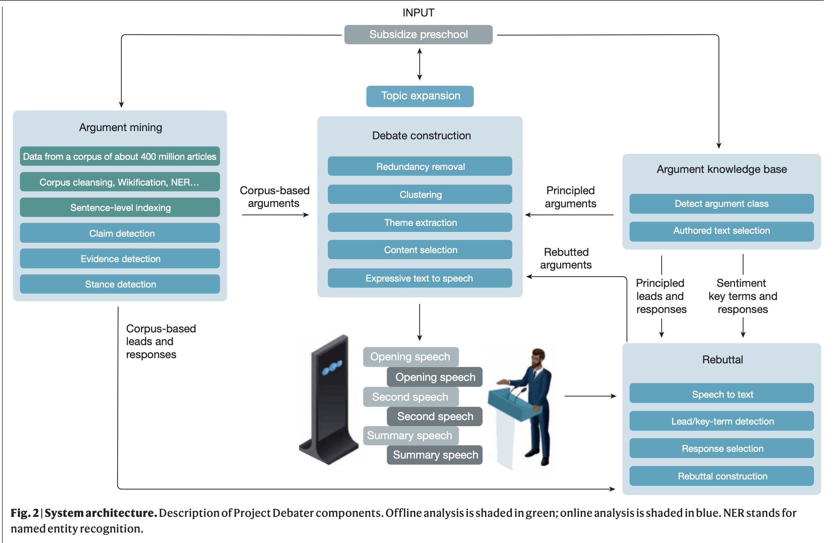
Project Debater
Shivali Mani
Collects over 400 million articles
Creates a Debate
Lacks Emotions → Less Convincing
Propaganda
Project Debater
Depicts Projects Debater process
Notes:
First of all, it has a large collection of around 400 million user articles from LexisNexis, nearly 10 billion sentences. And when the debate starts, the system is using various AI components to detect short pieces of text that should satisfy three criteria. They should be relevant to the topic. They should be argumentative in nature – that is they should argue something about the topic, not just be relevant. And finally, they should support our side of the debate. Then after finding these short pieces of text, the system is using the other AI components, like text clustering and et cetera, in order to glue these short pieces together into a meaningful narrative. (https://www.nature.com/articles/d41586-021-00720-w)
IBM

Slide 27
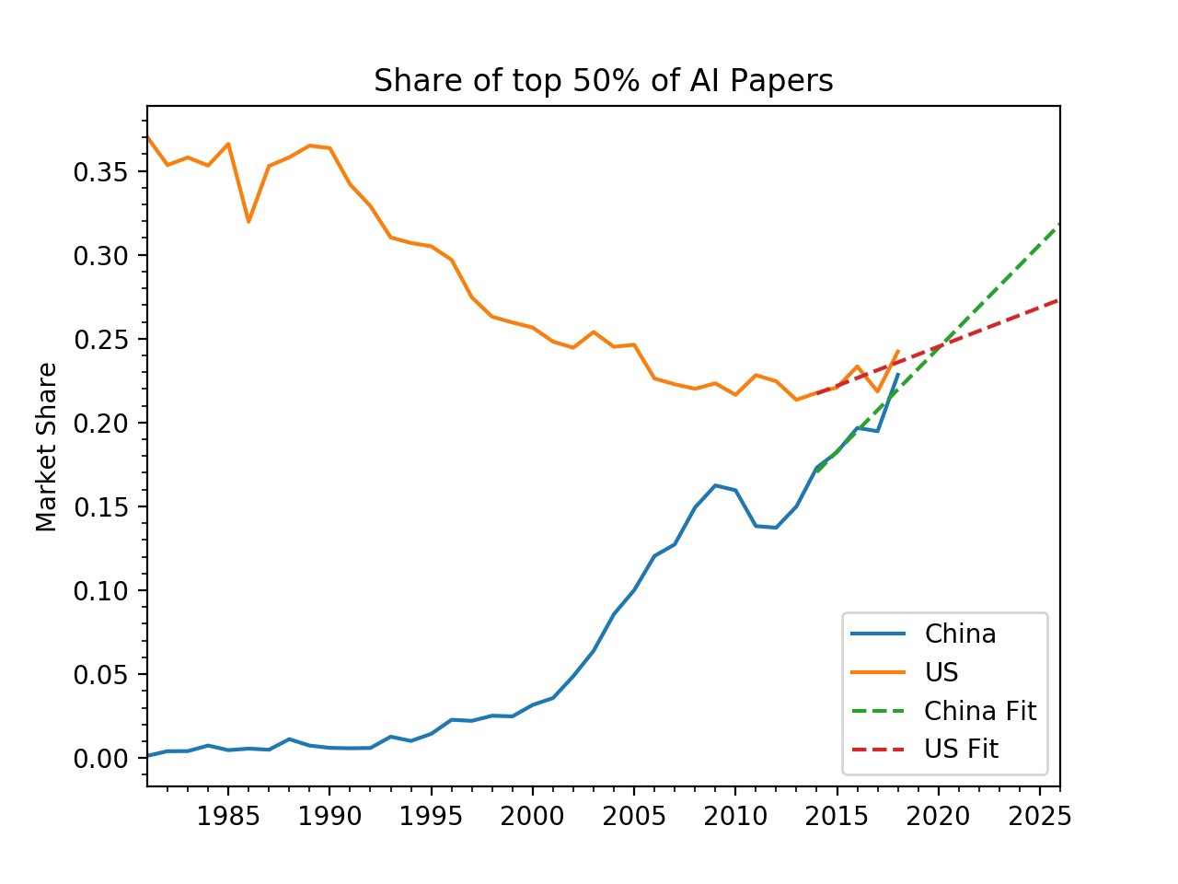
AI is New Competition of the World
Shivali Mani
US vs China
2015- President Obama and President Xi
Infringing User Rights
Race Rhetoric
Trajectory of China improvements of AI vs US
https://blog.allenai.org/china-to-overtake-us-in-ai-research-8b6b1fe30595
Notes:
“We’ve agreed that neither the U.S. or the Chinese government will conduct or knowingly support cyber-enabled theft of intellectual property, including trade secrets or other confidential business information for commercial advantage.”
American policymakers must acknowledge that AI development is not winner-takes-all and that AI is not a single technology
Did not decrease cooperation
If current trends continue, China is poised to overtake the US in the most-cited 50% of papers this year, in the most-cited 10% of papers next year, and in the 1% of most-cited papers by 2025.
We found that China overtook the US in the number of AI research papers in 2006 due to a surge in published research that began around 2001 and peaked in 2010 (long before the Chinese government’s announcement). Overall, the number of AI papers published worldwide increased from just shy of 5,000 in 1985 to over 143,000 by 2018.
By projecting current trends, we see that China is likely to have more top-10% papers by 2020 and more top-1% papers by 2025.

Slide 28
Solutions
Shivali Mani
Create ethical norms before more development
Strengthen Security Protocols
Regulations without Constant Surveillance
Human Editor
Providing New Test Cases
Notes:
From the 2013 multilateral arms-control Wassenaar Arrangement, for instance, the United States has not implemented the “IP network communications surveillance systems” control, unlike the entire E.U. bloc and most other Wassenaar participants.
American policymakers must also evaluate how some of its own private companies slip through the cracks of existing export controls and sell surveillance technology to authoritarians like Saudi Arabia.
While many research collaborations between American and Chinese AI sectors undoubtedly hold benefits for both countries, the United States is losing massive technological advantages in a number of sectors due to China’s widespread IP theft; and this certainly includes AI.
Not only does this narrative seek to serve major American technology companies which desire minimal regulation,117 but it also ignores the importance of the United States and its allies upholding democratic norms around AI—which includes addressing such issues as AI bias and data privacy—in order to promote a less authoritarian global order.
Prevent ID theft

Slide 29
References
Shivali Mani
[1] Benkler, Yochai, et al. “Understanding Media and Information Quality in an Age of Artificial Intelligence, Automation, Algorithms and Machine Learning.” Berkman Klein Center, 12 July 2018, https://cyber.harvard.edu/story/2018-07/understanding-media-and-information-quality-age-artificial-intelligence-automation.
[2] Hutson, Matthew, et al. “Artificial Intelligence Is Learning to Manipulate You.” NEO.LIFE, 13 Jan. 2022, https://neo.life/2021/07/artificial-intelligence-is-learning-to-manipulate-you/.
[3] Rainie, Lee, et al. “Worries about Developments in AI.” Pew Research Center: Internet, Science & Tech, Pew Research Center, 25 June 2021, https://www.pewresearch.org/internet/2021/06/16/1-worries-about-developments-in-ai/.
[4] Sherman, Justin. “Essay: Reframing the U.s.-China Ai ‘Arms Race.’” New America, New America, https://www.newamerica.org/cybersecurity-initiative/reports/essay-reframing-the-us-china-ai-arms-race/reframing-ai-competition-conclusion.
[5] Bajarin, Tim. “An AI Robot Wrote My Term Paper.” Forbes, Forbes Magazine, 6 Nov. 2020, https://www.forbes.com/sites/timbajarin/2020/11/06/an-ai-robot-wrote-my-term-paper/?sh=7ac446d33cc8.

Slide 30
Class 6
The End
Keith A. Pray
socialimps.keithpray.net
Notes:
This is the end. Any slides beyond this point are for answering questions that may arise but not needed in the main talk. Some slides may also be unfinished and are not needed but kept just in case.
If there’s time and we didn’t already look at:
Find out what your DNA says about you and your family.
https://www.23andme.com/
Jimmy Kimmel Live – What is your password? (2:49)
https://www.youtube.com/watch?v=opRMrEfAIiI

