Slide 1
Class 14
Last Day
Keith A. Pray
socialimps.keithpray.net

Slide 2
Notes:
Automation Paper results. This term’s additions in RED

Slide 3
Papers
Great improvement!
Very Clear Conclusions
Significant Counter Points
Notes:
Save for next time:
Clearly state conclusion
First statement preferred
Absolute statements are difficult to prove
Avoid: all, always, any, every, everyone, never, none… unless you can show it
Be sure to put quotes around entire quote
Hyperbole is the best thing ever!
but not in these papers
Print 2 sided and save a tree
Use template, saves time (and -1 point)
Include Counter Point and Response
Include Author, Title, Publish Date, Publisher for references
Read paper aloud to proof

Slide 4
Grades
To Date
52 Max Possible
- Discussion 1-10
- Papers 1-4

Slide 5
Overview
Reminder: Course and Group Evaluations
Group Present
Class 14:
  Students Present
  Students’ Choice

Slide 6
The global chip shortage
Jair Meza

Slide 7
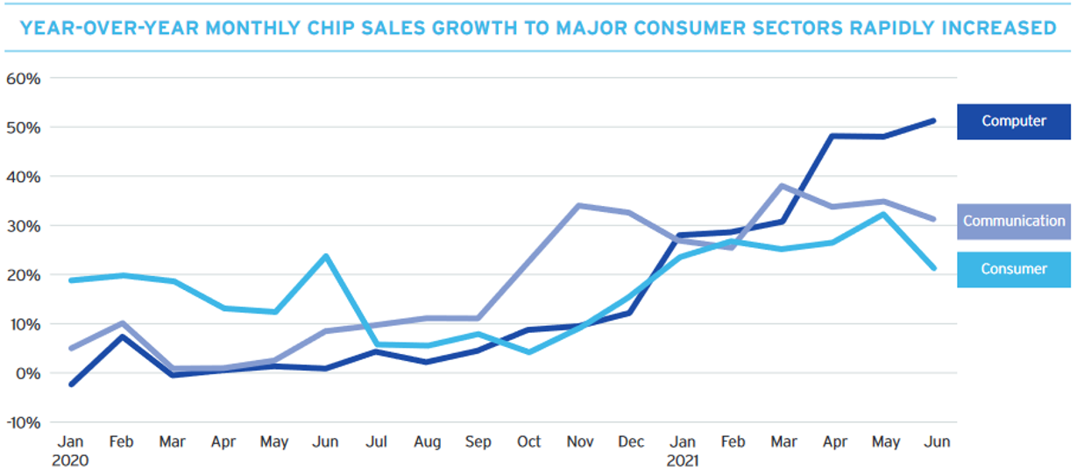
Conclusions
Jair Meza
The global chip shortage is fueled by
  The pandemic
  Regional concentrations
  High barrier to entry
It is affecting many industries
  Automotive
  Computing
  Everything?
Notes:
intro

Slide 8
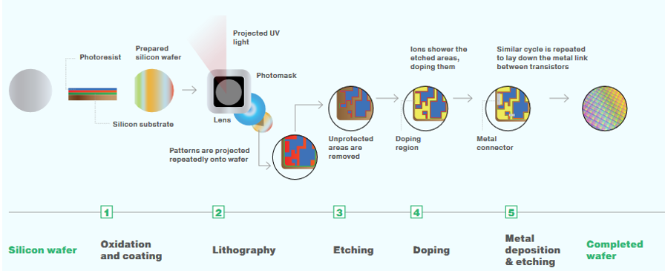
What are computer chips?
Jair Meza
Semiconductors
8 main stages
Extremely costly to produce [1]
No direct human contact [3]
Overview of the wafer fabrication process
Notes:
To understand the complexities of the semiconductor supply chain, we need to understand how they are manufactured, which I will explain briefly. On the Semiconductor Industry Association website, they lay out 8 main points of production. This includes, researching the technology, designing the chips, sourcing raw materials, purifying into ingots, creating the blank wafer, finishing the wafer, cutting the wafer, and finally packaging the chip so that it can be used for production. This process is extremely complex and requires very precise automation and extremely expensive factories. In fact, no human comes into contact with a wafer during its manufacturing process [1, 3]. [NEXT SLIDE]

Slide 9
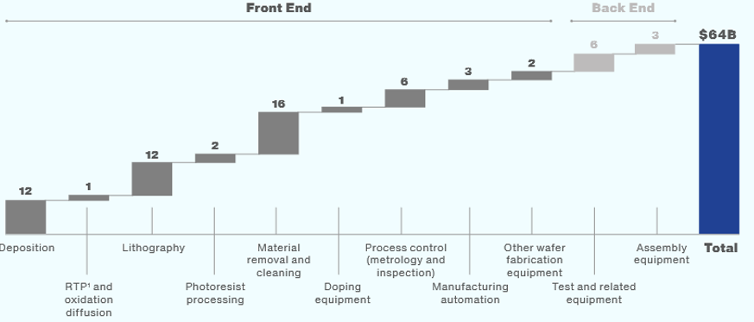
HIGH BARRIER TO ENTRY
Jair Meza
3 months active, 6 months total
Lithography machines cost $25-100
million [2, 3]
Lithography machines limit wafer production [3]
Breakdown of market size of semiconductor manufacturing equipment
Notes:
Producing these chips are extremely costly and time consuming. The active manufacturing time for a wafer can take up to 3 months and total up to 6 months before the chips are tested and sent off which means companies have to plan months ahead [3]. The machine responsible for the lithography phase (the most important step in production) can cost between 25 and 100 million dollars, and the number of these machines in a fab essentially limits how many wafers a fab can produce [2, 3]. This means the barrier for entry to produce these chips is extremely costly, which is why many companies outsource their chip production, and instead focus on the research and design phases, as they can just create a glass template for the lithography machines to use [3]. [NEXT SLIDE]

Slide 10
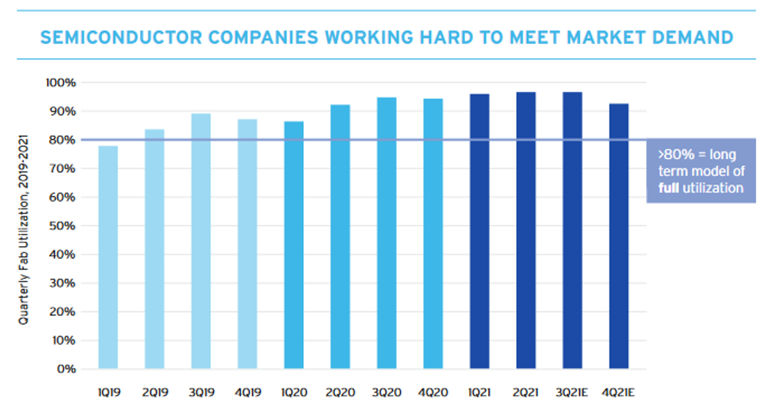
Chips are everything
Jair Meza
Almost everything connected to power has a chip [3]
12.5% increase in demand in 2021 [3]
Fabs increasing production above typical 80% capacity [1]
1.4 Billion dollars to improve 3 fabs [3]
New fab $7-$15 billion dollars
$3 trillion dollars over next 3 decades [3]
Notes:
Now we know how the chips are made, what are they used for? Well, do you own a fridge, toaster, microwave, phone, car, computer? These days, almost everything that is connected to electricity has a semiconductor chip in it. This allows these appliances to be connected to the internet and control peripherals which means there are so many industries and products relying on semiconductors to function [cn]. The fact that the world is becoming increasingly reliant on semiconductor chips, is creating a lot of pressure on the global supply chain. Semiconductors are seeing a 12.5% increase in demand in 2021 alone [3]. The pandemic is driving the increase, as many people are required to work from home, which in turn is increasing demand on products that rely on semiconductor chips such as laptops, webcams, gaming devices, and phones. To combat this, Fabs have been increasing their production above the typical 80% mark, although, it is extremely costly to just increase the size and production capabilities of an individual fab [2]. Global Foundries, a leading company producing wafers has put in a 1.4 billion dollar investment to expand 3 of their fabs, and constructing a new fab can take anywhere between 7 and 15 billion dollars, depending on the size, as stated by the Vice President of Global Foundries Fab 7. An estimated 3 trillion dollar investment into the global fab industry is required in order to match demand [3]. [NEXT SLIDE]

Slide 11
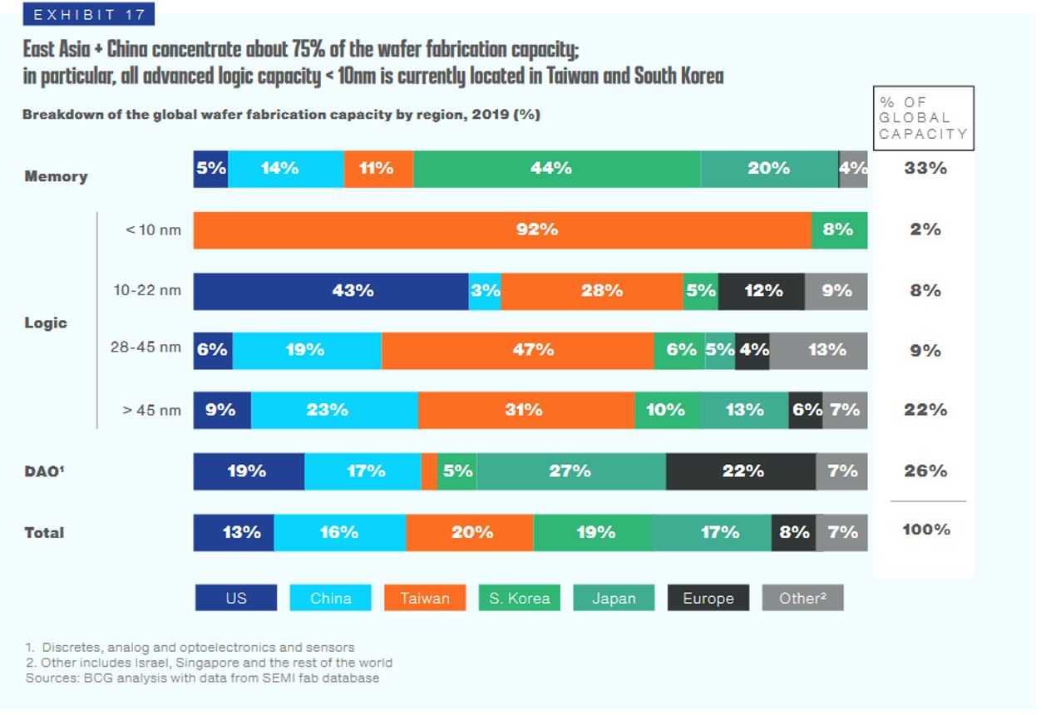
High Regional Concentration
Jair Meza
72% produced in Asia
Geopolitical tensions, natural disasters, pandemics
Renesas fire, accounts for 30% of the worlds auto chips [9]
Notes:
On top of the high costs to match demands, another major issue with fabs in general is their concentration in a specific region. Taiwan is almost solely responsible for producing the worlds <10 nm chips, where in 2019 they produced about 92% of the <10nm chips, while South Korea produced the remaining 8%. In total, 72% of semiconductor chips are produces in Asia [1]. Any disruption in the region such as natural disasters and geopolitical tensions, or pandemics, can affect up to 65% of the global market share for semiconductors, including fabrication, materials, and testing [1]. For example, there was large fire in the Renesas auto-chip fab, which delayed their production to for nearly 3 months. This fab was accountable for producing around 30% of the world’s microcontrollers for cars, which further set back auto production [9]

Slide 12
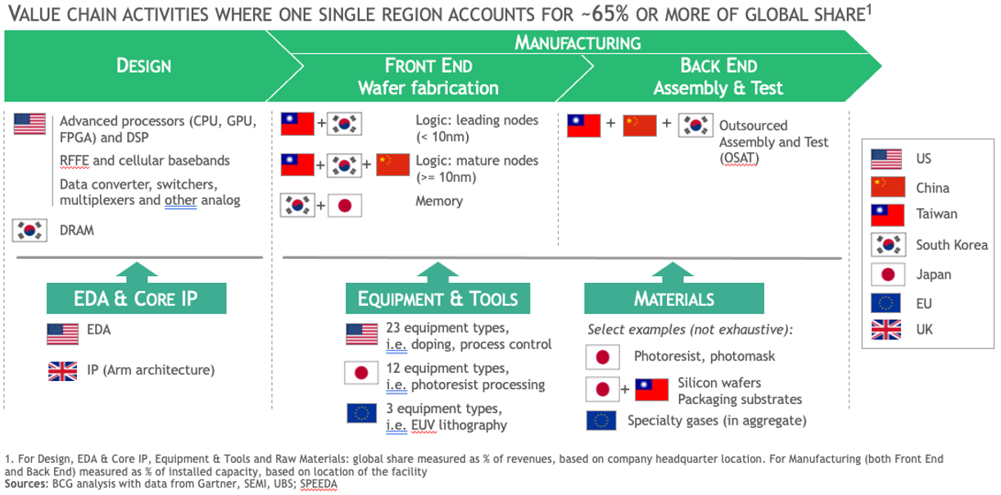
Industry
Jair Meza
Notes:
Explain difference in participation by region

Slide 13
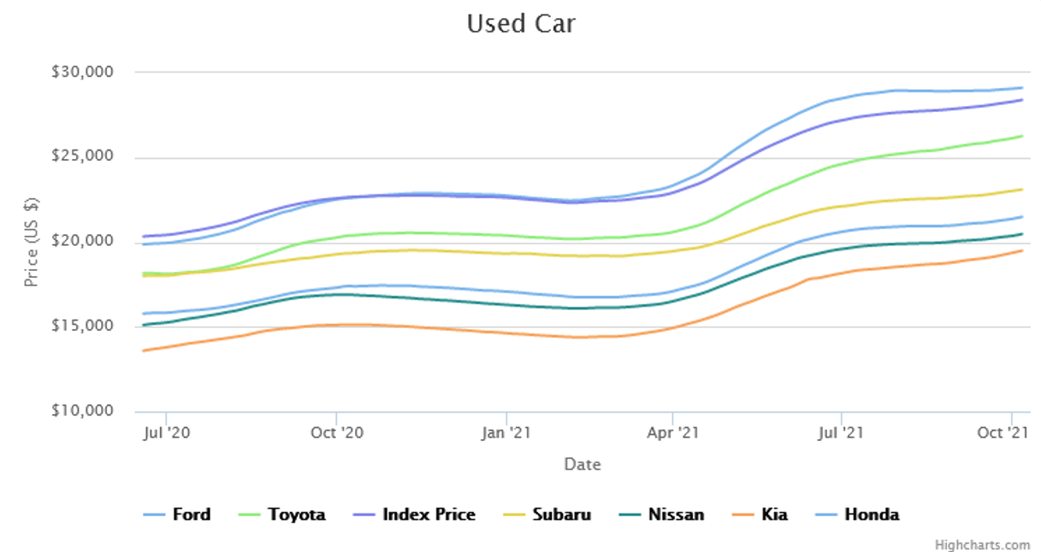
Industry
Jair Meza
Automobile industry
Reduction in labor, flow of materials [4]
Increasing demand in other industries, reduced production
12% global chip production capacity [1]
“Just In Time” [5]
Notes:
Now we understand the pressures that the industry is facing, let’s take a look at the affect that the shortage has had. The automobile industry has been hit the hardest by the shortage [4]. Covid-19 forced many industries to heavily reduce production. This mean that there was an overall reduced amount of labor as many factories had to abide by the stay-at-home mandates from their local government. This also affected the shipping industry which meant that the automobile companies couldn’t even receive their chips in the first place [4]. While this was happening, demand for chips were increasing in different industries, in order to make remote work and school possible. This meant that although the automobile industry only makes up 12% of the global chip production capacity, their capacity was being further reduced because of higher demand in those other industries [1, 4]. [NET SLIDE]

Slide 14

Sea of trucks
Jair Meza
Notes:
The Toyota production plan before the pandemic was aimed at extreme efficiency. The way it worked was by utilizing their “just in time” production scheme which meant that as soon as a product was ordered, parts for that product would arrive “just in time” for production, which reduced inventory size and costs and reduced wasted supply [4,5]. This meant that all the materials for the car would arrive as soon as they are needed, making the supply chain highly efficient. Of course, covid had to disrupt this extremely delicate production methodology, which meant that many cars were unable to be finished [4]. This included its semiconductor chips, which are necessary for controlling a cars’ many electrical systems. As cars are being produced without these semiconductor chips, companies have begun cutting production altogether, and even hoarding cars while they wait for parts to finish [4]. Ford has started to hoard fleets of trucks at the Kentucky Speed Way, which can even be seen from space, while they await their chips [4].
As you can see, the supply chain of semiconductor computer chips is extremely delicate which is why many industries are being heavily affected. Along with Covid 19 reducing the ability for factories in all industries to function, and increasing demand on electronics during the pandemic, these semiconductor fabs must figure out how to increase their production. Global Foundries Fab 7 increased their production from 600,000 wafers, to 120,000 additional wafers per year, because of the increase in demand [3]. [NEXT SLIDE]

Slide 15
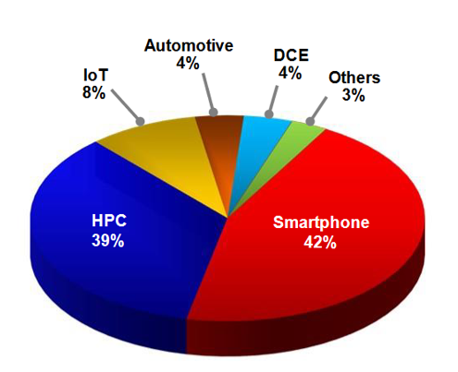
Where’s my GPU?
Jair Meza
TSMC Q2 Earnings
4% of revenue from consumer electronics [6]
1% revenue from crypto [7]
Notes:
This is why we can’t buy a fancy GPU or even the updated Nintendo Switch which actually just launched on October 8th yet is already sold out or heavily marked up. Even the gaming and mining industry has increased demand on graphics cards, which I’m sure all of you are aware of by now. Interestingly, TSMC, the largest fab in the world, gets only 4% of their revenue from consumer electronics, which include these graphics cards, and chips for gaming devices [6]. So why is it that I can’t buy a new RTX 3080. Well, that has to do with the graphics card industry itself, more than the global semiconductor industry.

Slide 16
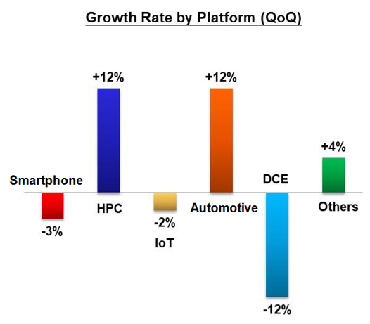
Reduction in crypto sales
Jair Meza
$266 million crypto related sales
$6.51 billion total revenue
$3.06 billion in gaming revenue [7, 8]
<Graphic as big as will fit>
Notes:
It is estimated that only 1% of the revenue for TSMC is driven by crypto, and NVIDIA reported in their Q2 earnings that crypto related sales accounted for only 4% of their total revenue, as it only accumulated $266 million out of $6.51 billion total revenue. Gaming revenue was recorded to $3.06 billion [7, 8]. [NEXT SLIDE]

Slide 17
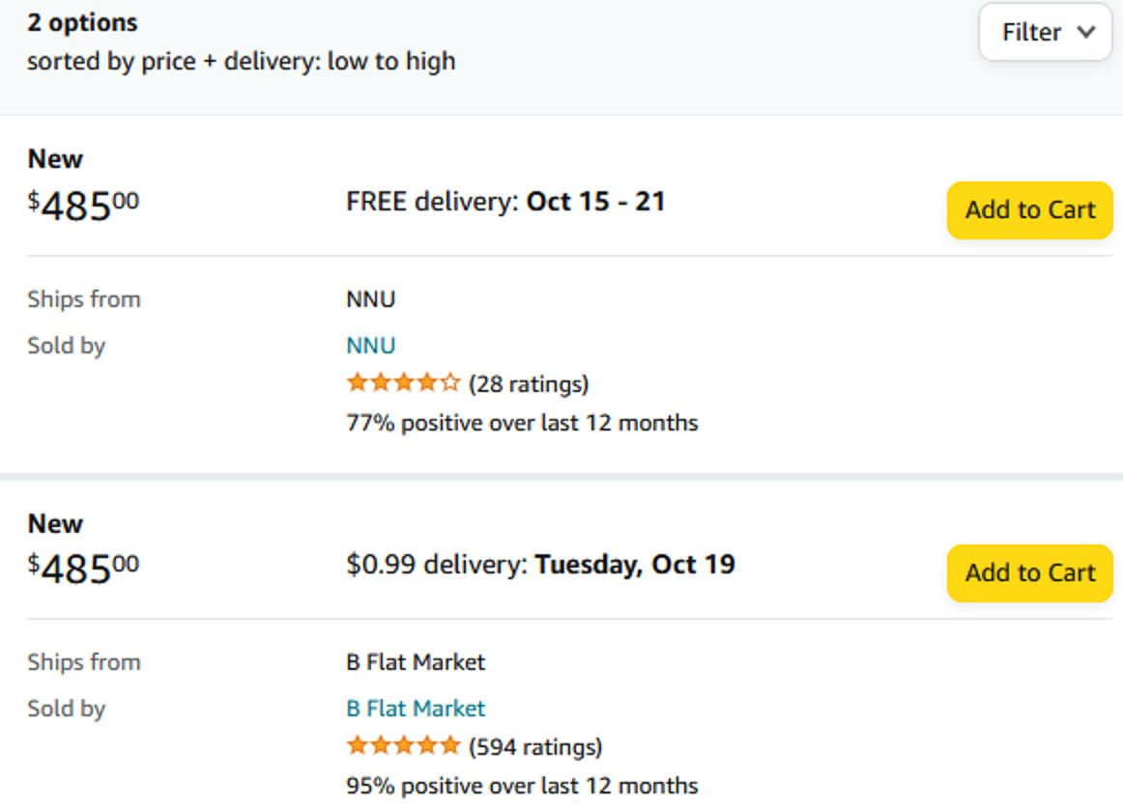
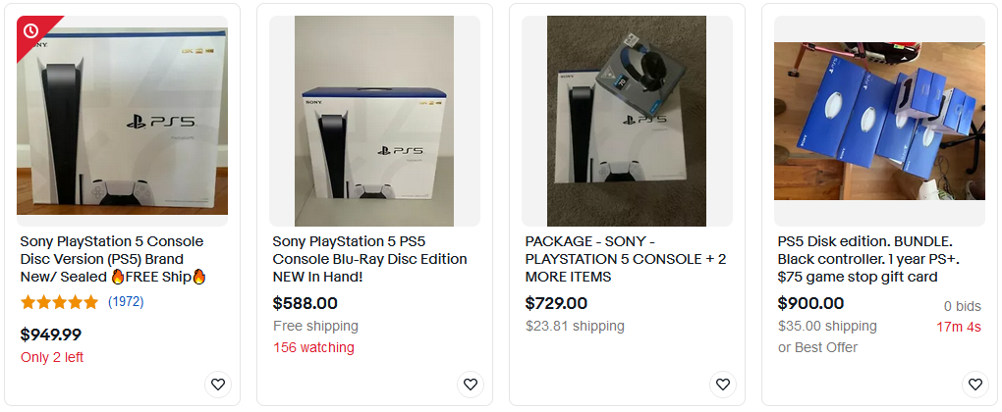
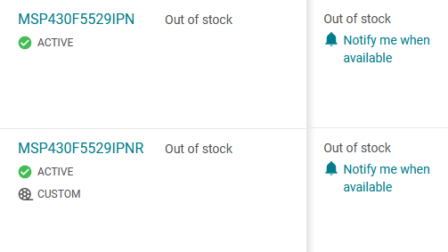
Summary
Jair Meza
The pandemic sucks
Strained the delicate manufacturing processes
Heavy increase in demand
Notes:
To summarize, the global chip shortage was the result of the pandemic, as it increased demand for computing technologies, and put strain on the manufacturing infrastructure due to stay-at-home related mandates. This slowed down production in nearly all industries, and while demand for semiconductor-reliant products increased. Semiconductor fabs also had to heavily increase their production despite extremely high costs, and hard caps on the quantity of wafers they can produce. This in turn lead to the crisis that we are experiencing today, and even though the sales of certain products, such as graphics cards, make up a small portion of a fab’s revenue, these industries are still heavily affected.

Slide 18
References
Jair Meza
[1] Varas, A.; Varadarajan, R.; Goodrich, J.; Yinug, F. Strengthening The Global Semiconductor Supply Chain in an Uncertain Era. https://www.semiconductors.org/wp-content/uploads/2021/05/BCG-x-SIA-Strengthening-the-Global-Semiconductor-Value-Chain-April-2021_1.pdf (accessed Oct 11, 2021).
[2] SIA. 2021 State of the U.S. Semiconductor Industry. https://www.semiconductors.org/wp-content/uploads/2020/06/2020-SIA-State-of-the-Industry-Report.pdf (accessed Oct 11, 2021).
[3] Why the Global Chip Shortage Is Hard to Overcome | WSJ; Wall Street Journal, 2021.
[4] Sykes, N. J. How we ran out of new cars. https://www.youtube.com/watch?v=2mqqY-MDyZo (accessed Oct 11, 2021).
…

Slide 19
References
Jair Meza
[5] Corporation., T. M. Toyota production system: Vision & Philosophy: Company. https://global.toyota/en/company/vision-and-philosophy/production-system/ (accessed Oct 11, 2021).
[6] Taiwan Semiconductor Manufactoring Company. TSMC 2021 Q2 quarterly results. https://investor.tsmc.com/english/quarterly-results/2021/q2 (accessed Oct 11, 2021).
[7] Newsroom, N. V. I. D. I. A. Nvidia announces financial results for second quarter fiscal 2022. https://nvidianews.nvidia.com/news/nvidia-announces-financial-results-for-second-quarter-fiscal-2022 (accessed Oct 11, 2021).
[8] Healy, W. How much is cryptocurrency mining influencing chip demand. https://www.fool.com/investing/2021/06/11/how-much-is-cryptocurrency-mining-influencing-chip/ (accessed Oct 11, 2021).

Slide 20
References
Jair Meza
[9] Staff, R. Global auto recovery to take more hits from Japan Chip Plant Fire, severe U.S. weather: IHS. https://www.reuters.com/article/us-autos-chips/global-auto-recovery-to-take-more-hits-from-japan-chip-plant-fire-severe-u-s-weather-ihs-idUSKBN2BN27E (accessed Oct 11, 2021).
Images from:
https://www.amazon.com/
https://www.ebay.com/
https://www.ti.com/product/MSP430F5529
https://www.wcpo.com/rebound/when-will-racing-return-to-kentucky-speedway-its-anyones-guess

Slide 21
Is this trustworthy?
Harmful Misinformation Is Wide-Spread on Social Media and it is Hard to Eliminate
Shen Fang
Notes:
Hi, everyone, today I am going to present you

Slide 22
Misinformation floods Internet
Shen Fang
Form:
  Fake News
  Clickbait
  Rumors
Content:
  Political Statement
  Medical Misinformation
Notes:
Misinformaton can happen in various forms, with many possible contents. For example, it could take the form of Fake News
Clickbait
Rumors
and two major contents are Political Statement
and Medical Misinformation

Slide 23
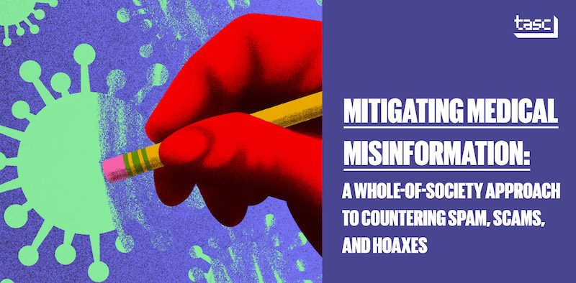
Medical Misinformation
Shen Fang
Mostly infectious disease and vaccine
Dreadful (Cancer) rumors
“Expert Patients”
Fear, anxiety and mistrust in institutions[6]
https://shorensteincenter.org/mitigating-medical-misinformation/
Notes:
First, lets take a look of what these information are like. Lets take an example of medical misinformation.
Medical misinformation often target on infectious diseases and vaccine for their social impact. While it also spreads dreadful cancer rumors as the patients an those concerning would be desperate and easily mislead.
The Expert Patients could be falsely trusted as medical professionals, but they have no credibility. The low trust in institutions also facilitated the trust in “expert patients” since they often offer contradicts against authority.

Slide 24
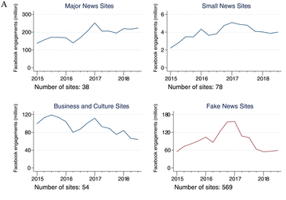
Wide-spreading False Information
Shen Fang
Fake News Sites identified by Facebook still gains 60-150 million of engagement every quarter.
Average engagement is around 0.18 million/site/ quarter, compares to 5 for major news sites and 0.05 of small news sites.
There are also sites that are not identified but contains fake news/ false information.[1]
https://journals.sagepub.com/doi/full/10.1177/2053168019848554
Notes:
So, after having a brief review of what these social media false information is like, lets take a look at how wide-spread there false information are. From the pictures on the right, we can see the trends of quarter Facebook engagements for various sites. The Fake news sites are those already identified and marked as fake information by Facebook. First, these Fake News Sites identified by Facebook still gains 60-150 million of engagement every quarter. And also, all the

Slide 25
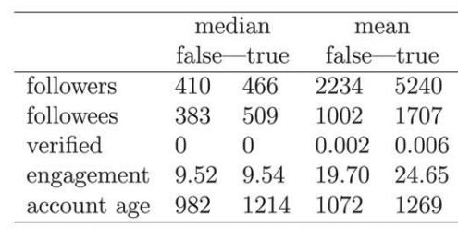
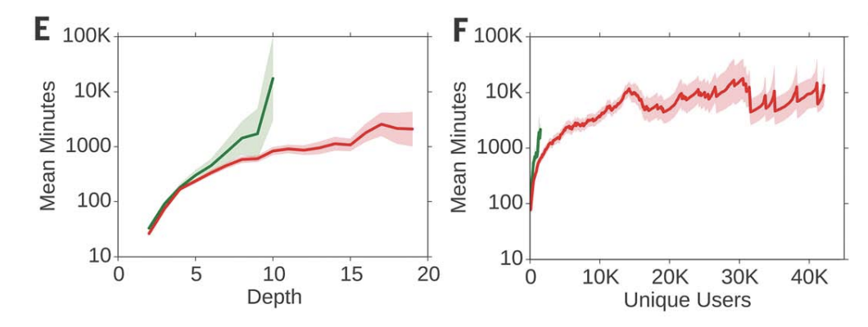
Fake information spreads faster
Fake news accounts are significantly less active[8]
It takes significantly less time to reach more unique users/depth of cascade(retweets)[8]
Notes:
From a research on fake/real twitter news story, it is revealed that fake news often spread faster than the real ones. False news spreading account have less followers, followees, percent of verification, engagement in social media, and account age in average. However, It takes significantly less time to reach more unique users/depth of cascade(retweets)

Slide 26
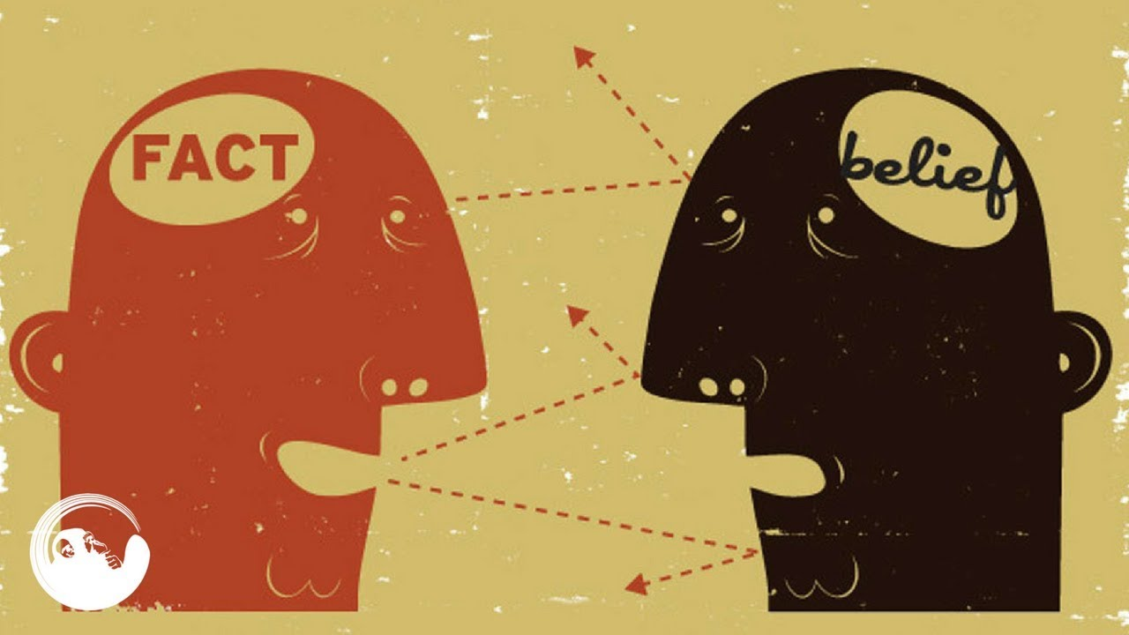
Bias’s role in misinformation
Shen Fang
BIAS IN THE BRAIN
  Information overload
  Focus on headline instead of author and content
BIAS IN SOCIETY
  Partisan communication networks
  “Us versus them” confrontations
BIAS IN THE MACHINE
  Algorithms filtering out favorable information
  Targets[3]
<Graphic as big as will fit>
https://www.youtube.com/watch?v=0xKklLplngs
Notes:
Bias plays an important role in misleading people with fake information . First, there is bias in the brain, with all kind of information bombarding us through social media, it is hard to identify them one by one, and people would tend to focus on headlines instead of critically judge the credibility of the author and contents. Then, it is the bias in society, the comfort zone phenomena also happens online: people would tend to stay in niches with people having similar political beliefs, and thus it creates a “Us versus them” feeling hen they are confronting information contradicting there innate beliefs. Next, the system also pushes our bias further by filtering out favorable information to individuals. Robots would target on those who are vulnerable cognitive and confirmation bias, (for example, a desperate patient or political activists) and feed them sources with low-credibility.

Slide 27
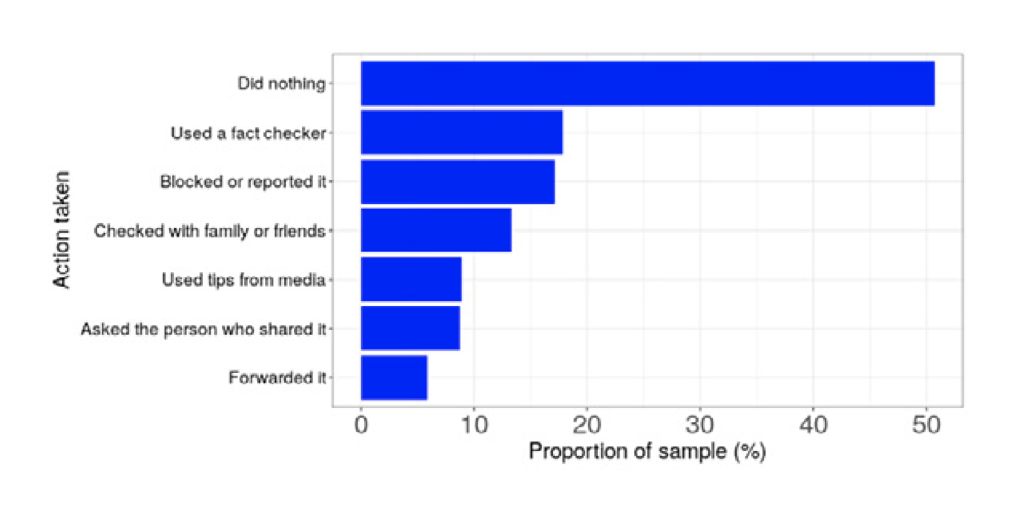
People/websites against misinformation
Shen Fang
52% people choose to do nothing about information they believe to be false and only 17% claimed to check the credibility.[4]
https://www.turing.ac.uk/sites/default/files/2021-02/misinformation_report_final1_0.pdf
Notes:
52% people choose to do nothing about information they believe to be false and only 17% claimed to check the credibility.

Slide 28
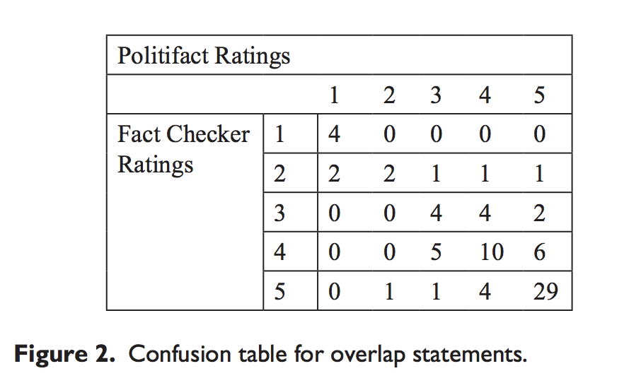
Fact Checking
Working, but limited when dealing with ambiguity, carefully crafted false info.[5]
Notes:
From comparing two major factchecking sites, polifact and fact checker, the two sites agree most on those that are apparently correct, but limited when dealing with ambiguity, carefully crafted false info.[5]

Slide 29
References
Shen Fang
[1] Hunt Allcott, Matthew Gentzkow, Chuan Yu, Trends in the diffusion of misinformation on social media, https://journals.sagepub.com/doi/full/10.1177/2053168019848554, accessed Sep. 7th, 2021
[2] Sara Brown, MIT Sloan research about social media, misinformation, and elections, https://mitsloan.mit.edu/ideas-made-to-matter/mit-sloan-research-about-social-media-misinformation-and-elections, accessed Sep. 7th, 2021
[3] Giovanni Luca Ciampaglia, Filippo Menczer, Biases Make People Vulnerable to Misinformation Spread by Social Media, https://www.scientificamerican.com/article/biases-make-people-vulnerable-to-misinformation-spread-by-social-media/, accessed Sep. 7th, 2021
[4] Bertie Vidgen, Harry Taylor, Myrto Pantazi, Zoe Anastasiou, Becky Inkster and Helen Margetts, Understanding vulnerability to online misinformation, https://www.turing.ac.uk/sites/default/files/2021-02/misinformation_report_final1_0.pdf
[5] Chloe Lim, Checking how fact-checkers check, https://journals.sagepub.com/doi/full/10.1177/2053168018786848, accessed Sep. 7th, 2021
[6] Yuxi Wanga, Martin McKeeb, Aleksandra Torbicaa, David Stucklerc, Systematic Literature Review on the Spread of Health-related Misinformation on Social Media, https://www.sciencedirect.com/science/article/pii/S0277953619305465
[7] Boston University, FAKE NEWS, SOCIAL MEDIA AND POLITICS, https://sites.bu.edu/cmcs/2018/11/26/fake-news-social-media-and-politics/, accessed Sep. 9th, 2021
[8] Vosoughi, Soroush; Roy, Deb; Aral, Sinan (2018). The spread of true and false news online. Science, 359(6380), 1146–1151. doi:10.1126/science.aap9559

Slide 30
Should we legislate face recognition better
Ander Carbajo

Slide 31
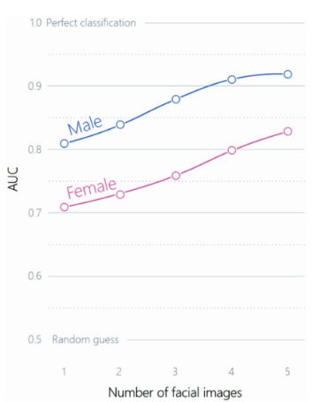
Track your persona
Ander Carbajo
With a facial recognition algotithim self identified political ideology can be identified 72% of the time in contrast to 55% by humans. [1]
An algorithim can sort people based on their sexual orientation with startilg accuracy. (81% for men.)
Notes:
<speaker notes>

Slide 32
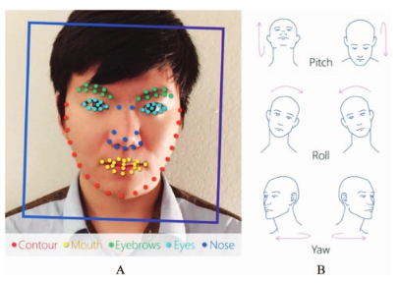
Face data
Ander Carbajo
Social networks have a large amount of information about your facial features. [4]
If you stream in websites like twitch you are giving anyone hundreds of hours of your facial and gesture information.
Companies can store your face data in order to make online payments more secure[5]
Notes:
<speaker notes>

Slide 33
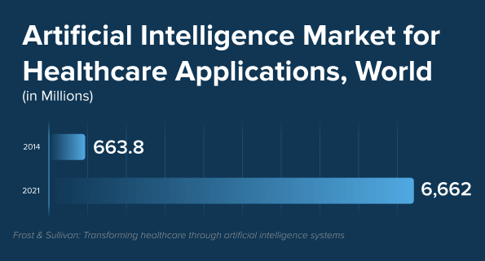
Use in medicine
Ander Carbajo
Face scan can check your health status[3]
Machine learning-based approaches allow doctors to uncover abnormalities in imaging data[2]
Combining facial recognition with evidence-based therapy (EBT), mental disorders can be treated as nearly as good as physical ones.[2]
Notes:
With face recognition health apps, your health status is just one face scan away. By simply looking at the camera, a person can measure the heart rate, blood pressure, stress level, and more. Thanks to face recognition, the technology is contact-free and non-invasive. using custom image recognition software in the diagnostic process helps make fewer errors. Machine learning-based approaches allow doctors to uncover abnormalities in imaging data and accelerate the treatment. Today, combining facial recognition with evidence-based therapy (EBT), mental disorders can be treated as nearly as good as physical ones. Accuracy of facial recognition is maintained via a built-in AI engine for optimal performance. Using facial recognition for mental health purposes, patients can get personalized, patient-centered, efficient, and timely care. One of the main advantages is that tracking of the patients is going to be more constant, for example a patient can take images of themselves twice a day in contrast to once every week for check ups. With a special mirror you wouldn't even have to take pictures as it will track you every time you pass through it. Image tracking of emotions is more reliable that humans as it looks for changes that wouldn’t be significant enough for the human eye to recognise. In a more current topic, the government has been using facial recognition in order to track covid patients in quarantine, as this procedure is non physical, doctors can ensure their own safety and stop the spread of the virus while ensuring that the patient recovers as well as possible.

Slide 34
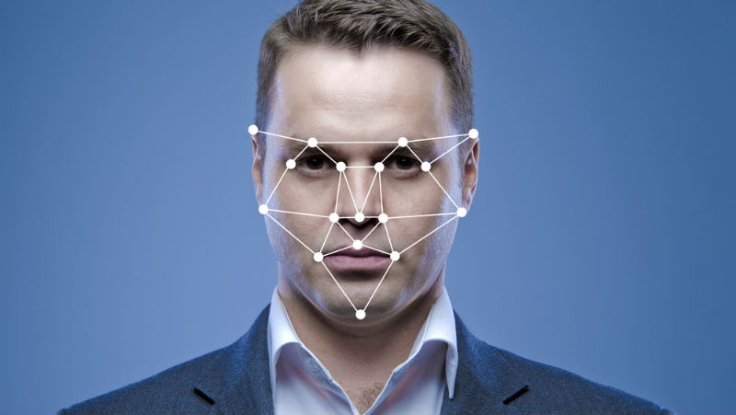
Banning facial recognition is illogical
Ander Carbajo
There are too many positive uses for facial recognition that could be really helpful in the future.
A better legislation must be done by experts in the field
Government and private facial recognition should be tracked separately
Notes:
<speaker notes>

Slide 35
References
Ander Carbajo
[1] Wang, M. K. Y., Kosinski, M., &amp; Wang, Y. (2018, February 1). Deep neural networks are more accurate than humans at detecting sexual orientation from facial images. Stanford Graduate School of Business. Retrieved October 12, 2021, from https://www.gsb.stanford.edu/faculty-research/publications/deep-neural-networks-are-more-accurate-humans-detecting-sexual.
[2] Zharovskikh, A. A. (2021, June 10). How face recognition and AI are used in Healthcare. InData Labs. Retrieved October 12, 2021, from https://indatalabs.com/blog/ai-face-recognition-in-healthcare.
[3] Smith, M., &amp; Miller, S. (2021, July 7). The ethical application of biometric facial recognition technology. AI &amp; SOCIETY. Retrieved October 12, 2021, from https://link.springer.com/article/10.1007/s00146-021-01199-9.
[4] What are the dangers of facial recognition tech? Futurity. (2021, August 12). Retrieved October 12, 2021, from https://www.futurity.org/facial-recognition-risks-2611852/.
[5] Facial recognition on phones - what is it and how does it work? Xfinity. (n.d.). Retrieved October 12, 2021, from https://www.xfinity.com/hub/mobile/facial-recognition-on-phone.

Slide 36
Parasocial Online Relationships, Helpful or harmful?
Sean Barbour

Slide 37
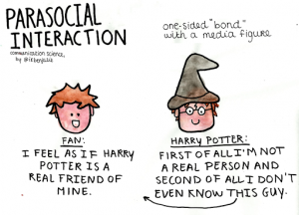
What are parasocial Relationships
Sean Barbour
One sided deep relationships
One person knows everything about the other
The other person knows nothing about the first [1]
Notes:
The term was coined in 1956 by the study “Mass Communication and Para-Social Interaction: Observations on Intimacy at a distance,” Horton and Wohl, which explored an emerging kind of relationship developing with the emergence of radio and tv into homes. In this kind of relationship, an individual becomes deeply emotionally attached and connected to the life of someone else who does not have any meaningful relationship or interaction with them in turn. While this phenomenon is sometimes used to describe fictional characters, it is more often applied to those who have developed an emotional connecting to celebrity figures from one sided communication made possible by modern technology.

Slide 38
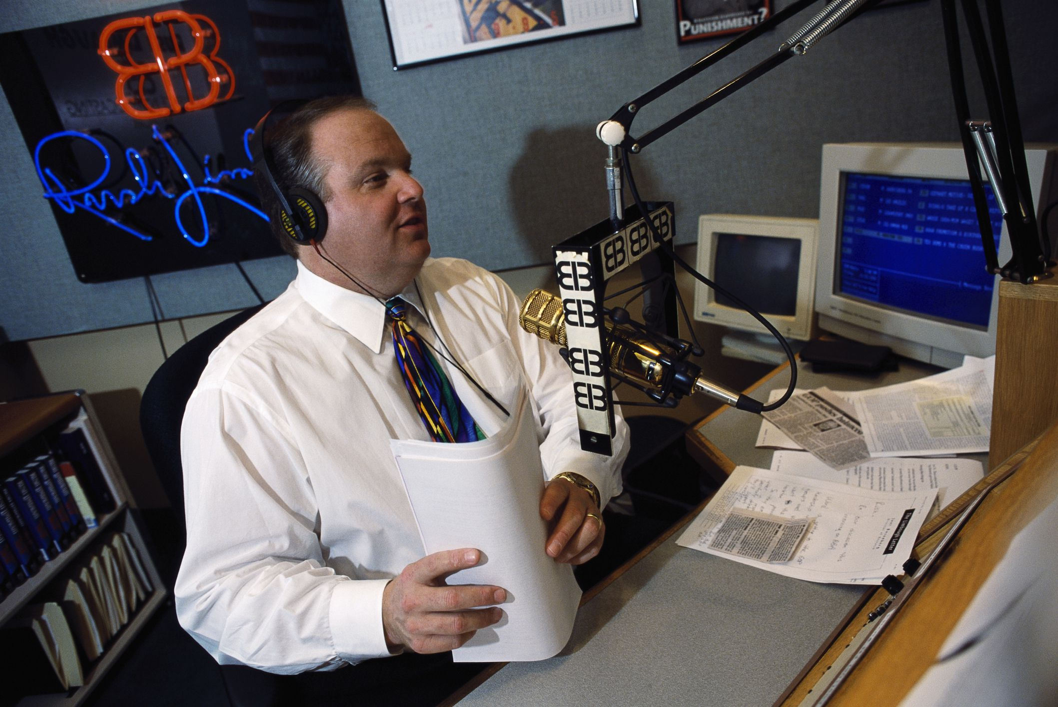
Evolution of the concept : pre-internet
Sean Barbour
Coined in the 1950s
Was seen as rare and ridiculous
Associated with obsession of high profile actors
An unknown term outside of psychology circles
Emerged a bit more in talk shows and radio [1]
Notes:
Originally considered a sign of derangement and mental illness, it was a term that was not very clearly defined and was only really recognized in certain psychological circles. It was compared often to the childhood idea of imaginary friends and unhealthy fanaticism, and was similarly derided in psychological and popular circles. As media communication became cheaper to produce and more widespread, this slowly began to change. Certain programs began to have more of a social focus, in which an entertainer gave honest impressions and opinions of day to day things, and thus developed further into this phenomenon. Going the furthest with this concept was the birth of the talk show, in which the audience was presented with an individual or group sharing opinions or discussing things they found relevant. Shows like Oprah Winfrey’s worked hard to make the viewer feel like they were in on a conversation, and many shows in this format would take feedback from a live audience or select callers to amplify the social nature of their show.

Slide 39
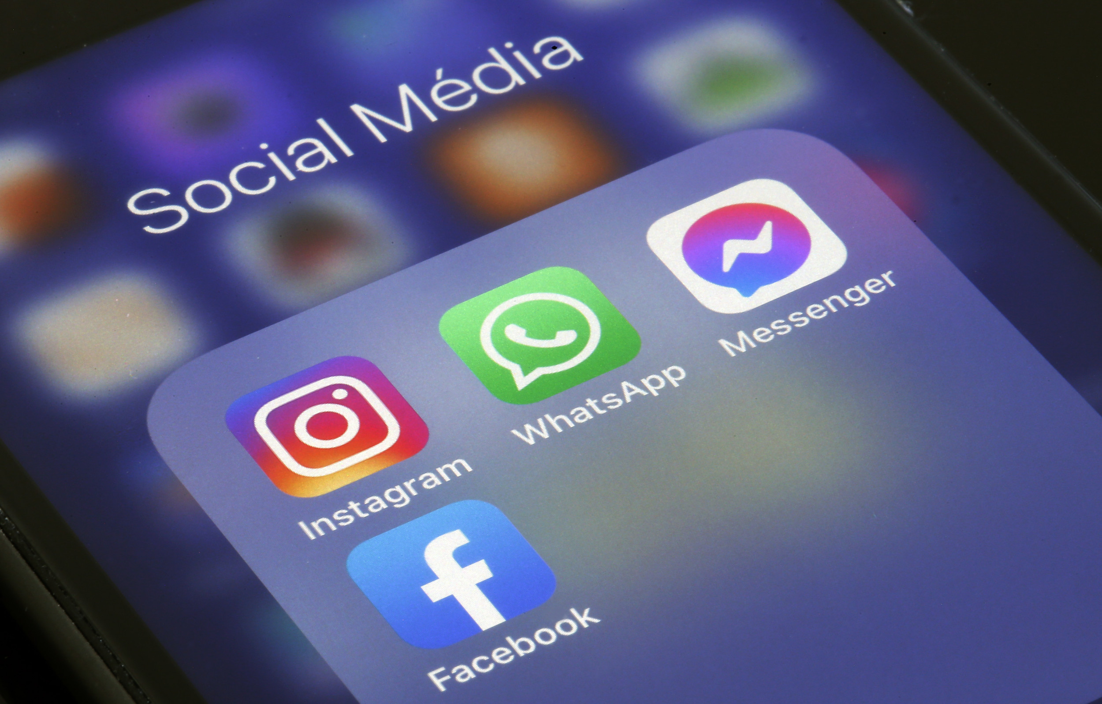
Evolution of the Concept: Post Internet
Sean Barbour
Increasingly Common
Increasingly socially acceptable
Still associated with celebrities
Now also connected to individuals who develop an online following
Vloggers, Streamers, and other content creators
The internet has made one sided interactions easy
Ease of use has created more personal expression [2]
Notes:
The explosion of more personable content hit a fever pitch with the internet. Social media created a means in which anyone could grow an audience through sharing personal experience. These platforms advertised themselves as being a place in which individual creators could be more sincere with their viewership, such as in YouTube’s original tagline, “broadcast yourself”. Because content was now easier to produce than ever before, there was less of a need to invest as much time and organization beforehand, allowing creators to post frequent, improvised and off the cuff videos and messaging rather than highly corporate prepared ones. This all contributed to an environment that was more down to earth than in the past, in which people could easily share their life experiences, interests, and activities to a public audience. Further adding to the social aspect was the interaction in comment sections and likes, which allowed audiences to communicate back to their favorites in a way that was previously far more limited.

Slide 40
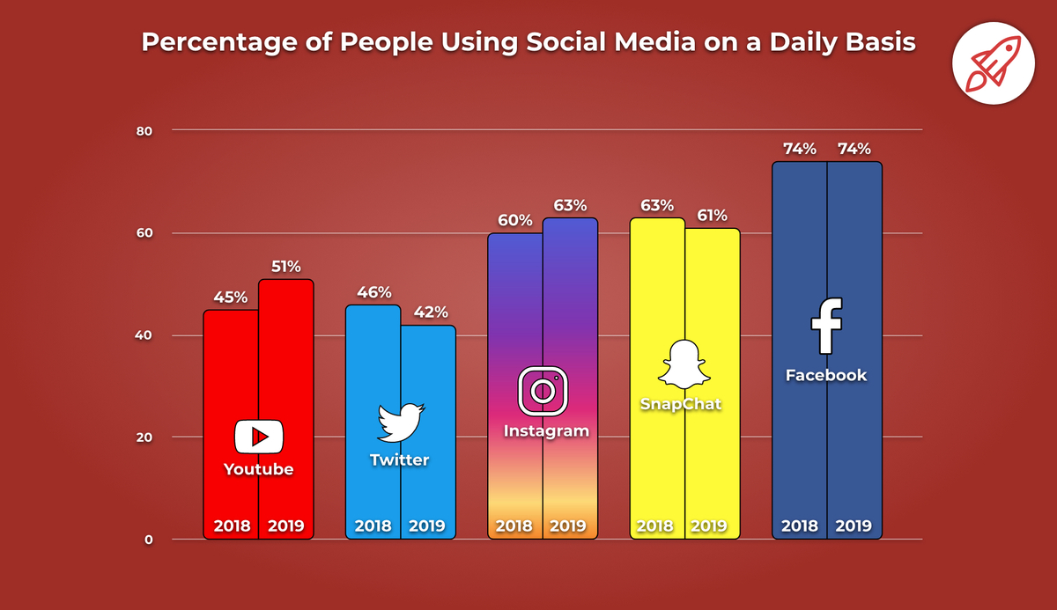
Evolution of the Concept: Modern Boom
Sean Barbour
Almost any activity is streamed online
Unboxing products
Live Eating, Gaming, and everything else
Coronavirus lockdowns created even more traffic
A common part of people’s lives
[2]
Notes:
Individuals have developed audiences larger than the population of most countries. Especially amongst young people, parasocial relationships have become a near given. The vast majority of people use social media platforms to communicate, and what started as an online novelty has revolutionized the way people relate to one another. Given the sheer volume of people engaged, there is an online celebrity for every possible hobby, activity, or topic of discussion, no matter how mundane. Playing video games, doing makeup, and even unpackaging products before an audience has earned the attention of millions of people, as those who post such content invite viewers to experience these things with them. Over the course of the pandemic, online engagement surged even further as real-world interaction became more limited.

Slide 41
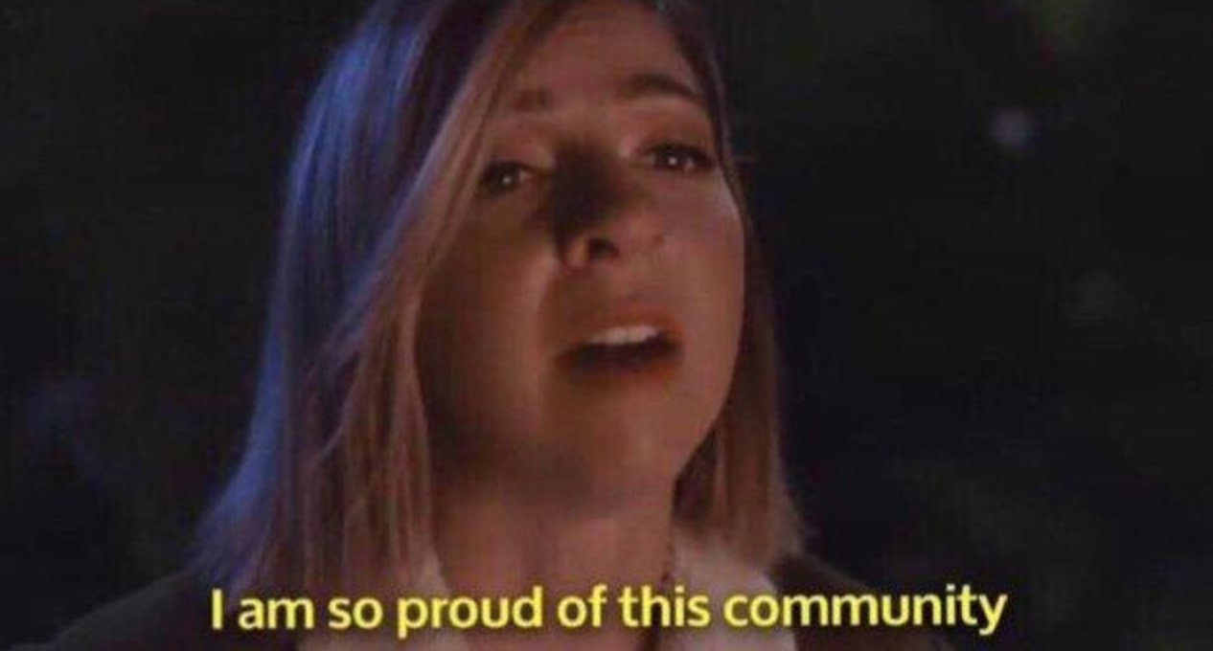
helpful effects
Sean Barbour
Online ‘Communities’ formed around common interests
Niche hobbies and views find a connected audience
Serve as role models for low confidence people [3]
Massive vehicles for advertising and messaging [2]
Notes:
Online relationships often build networks of community surrounding certain hobbies and interests. People with niche interests and experiences that aren’t shared by those around them often find validation by relating to online figures in a similar niche. As people within the audience can then interact with each other, people can form more connections on the basis of similarity. Attachments in parasocial relationships are valued in a way similar to real world ones. The strength of the bond felt through parasocial relationships also reaches similar heights to that felt from real ones, as people become deeply concerned with these celebrity figures. The reasons for which people choose to form this kind of relationship are also similar to their real-world standards, but come without the risk of rejection. Given that common activities of interest often serve as the basis for these relationships, it is no surprise research has shown that competence in their hobby is a key factor in online celebrity success. On the other hand, physical attractiveness is a smaller factor in forming parasocial relationships compare to real life ones. One university study has shown that students with less confidence see their targets as people they would like to become, while more confident people see them as like themselves. In this way, parasocial figures serve as a way to explore potential identity development from afar. In this way, people can explore ideas on how to grow as an individual by relating to the experience of others who have already done so in a safe and low-risk environment.

Slide 42
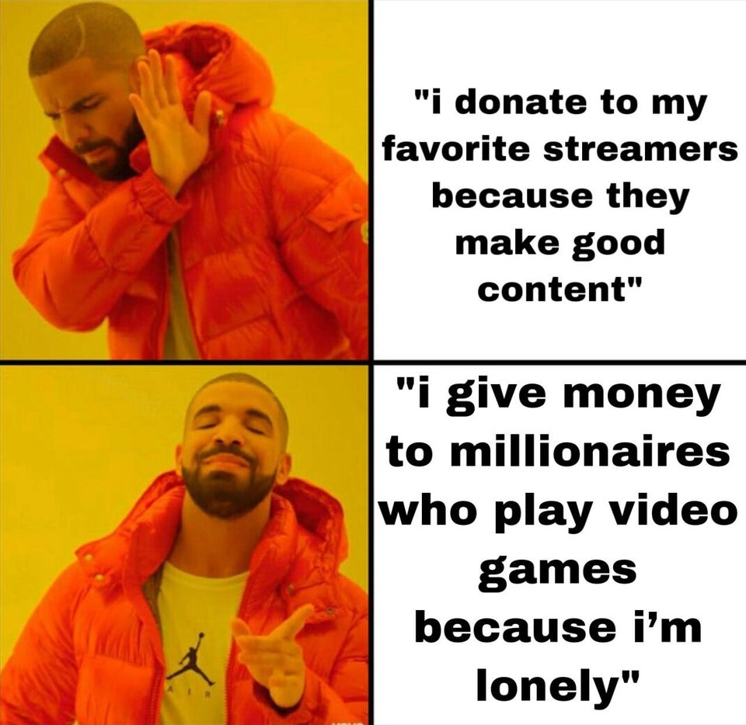
Pitfalls and harmful effects
Sean Barbour
Parasocial Relationships aren’t real [4]
They cannot replace real interaction
Lower recognition of real emotional expression [2]
Can lead to obsessive behavior and radicalization
Becomes a crutch for antisocial people [5]
Notes:
Parasocial relationships cannot replace real authentic interactions. The person on the other side has no connection to them in any way, and impressions of them are controlled by what they are willing to express publicly. Placing personal stake in someone you don’t know much about can become unhealthy. This deep attachment to an online persona holds the risk of emotional scarring if that persona is exposed to be artificial. When expectations implied by previous online conduct become uprooted from a revelation of true character, it can be just as damaging as real betrayal. For many, the content they create is a business, and the relationship built with an audience is not built on the notion of sincerity, but instead for profit. For lonely people, studies have shown they are vulnerable to using parasocial relationships as a substitute for real ones, in part enabling their loneliness. Participation in parasocial relationships can distract from isolation in the short term enough so that lonely people do not seek real world interaction, but in the long term it does nothing to alleviate associated negative emotion. Beyond even this, participation in parasocial relationships can damage our capacity to understand other people in real life. In studies of children, spending too much time engaged in parasocial behavior reduces social competence in the areas of emotional recognition and recognition of social cues compared to children who do not participate in them. Investment in parasocial relationships not only enables loneliness, but it hinders social development as well.

Slide 43

Conclusion
Sean Barbour
Parasocial Relationships are a regular part of life now
Moderation is critical
Discernment is key
They can be engaged with in a healthy and balanced way
They have their place
Should never replace real world connection
Notes:
Parasocial interaction is not going anywhere soon. It is a part of almost everyone’s daily life, and hold significant influence over how we act, grow, and relate to others. As such, it is important to engage with these sorts of relationships carefully and in moderation. With proper discernment, it is possible to attach oneself to like minded communities of people, following healthy role models that motivate people to become better, or with similar individuals that help maintain personal confidence and validation. In this way, relationships such as these can pose a real benefit to those who partake in them. At the same time, it is important to differentiate between the virtual and the real, keeping in mind that what one sees online is not the full story behind any particular person. Prioritizing real world interaction and maintaining social skills is the only way to avoid social isolation and its many negative symptoms on the long term. It is these choices that will decide whether or not parasocial online relationships are helpful or harmful in the lives of people who entertain them.

Slide 44
References
Sean Barbour
[1]Cinthia Vinny, Understanding Parasocial Relationships with Celebrities, (September 2018, ThoughtCo), Understanding Parasocial Relationships with Celebrities (thoughtco.com) (7 October 2021)
[2] Annette Choi, The Parasocial Phenomenon, (5 April 2017, PBS) The Parasocial Phenomenon | NOVA | PBS , (7 October 2021)
[3] Patricia Donavan, Study Finds if your Self Esteem is Low, a Faux Relationship Can Give You a Boost, (September 2008, University at Buffalo) Study Finds If Your Self Esteem Is Low, a Faux Relationship Can Give You a Boost - University at Buffalo (7 October 2021)
[4] Griffin Wynne, Why Parasocial Relationships are not Necessarily a Bad Thing (14 September 2021, Bustle) Why Parasocial Relationships Are Not Necessarily A Bad Thing (bustle.com) (7 October 2021)
[5]Parasocial Relationships: The Nature of Celebrity Fascinations (Find a Psychologist) Parasocial Relationships: The Nature of Celebrity Fascinations – Find a Psychologist (8 October 2021)

Slide 45
Image References
Sean Barbour
[1] http://comsoc275.amandarmartinez.com/image-works/parasocial-relationships-dangerous-or-beneficial/
[2]https://www.reddit.com/r/dankmemes/comments/q3dot9/got_anymore_of_those_parasocial_relationships/
[3] https://www.lifewire.com/greatest-radio-talk-show-hosts-2842729
[4] https://www.newsweek.com/social-media-cowards-palace-australian-pm-says-calling-end-anonymous-users-1636652
[5] https://www.broadbandsearch.net/blog/social-media-facts-statistics
[6] https://knowyourmeme.com/memes/i-am-so-proud-of-this-community
[7] https://www.powerofpositivity.com/work-life-balance-achieved/

Slide 46
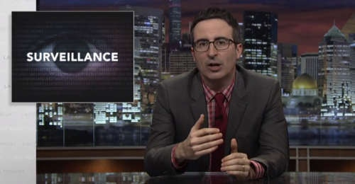
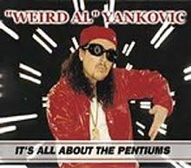
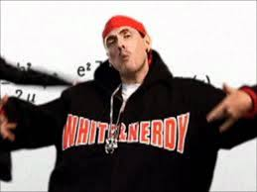
Student Choice – Interesting Videos
  Last Week tonight with John Oliver Snowden (33:14)
  It’s All About The Pentiums
  Weird Al (3:34)
  White and Nerdy Weird Al (2:50)
Notes:
All Last Accessed 2018-10-04
CGP Grey
Humans Need Not Apply (15:00) – 2014-08-13
http://www.youtube.com/watch?v=7Pq-S557XQU
Last access 2016-04-22
Why Electronic Voting is a BAD Idea – Computerphile (Tom Scott) (8:20)
https://www.youtube.com/watch?v=w3_0x6oaDmI
Last Week tonight with John Oliver – Patriot Act, Edward Snowden (33:14)
http://www.upworthy.com/john-oliver-flew-10-hours-to-russia-to-interview-edward-snowden-and-get-him-on-record?c=ufb1
Weird Al – It’s All About The Pentiums (3:34) and look at lyrics
https://www.youtube.com/watch?v=qpMvS1Q1sos
Tie into Ray Kurzweil Singularity
Epic Rap Battles of History: Steve Jobs vs. Bill Gates (If class ok with obscene lyrics) (2:47)
https://www.youtube.com/watch?v=njos57IJf-0
Also Work links on web site http://socialimps.keithpray.net/documents/
-----
Tom Scott
http://tomscott.com
Welcome To Life (2:44)
https://www.youtube.com/watch?v=IFe9wiDfb0E&feature=youtu.be
Passphrases (2:08 need to give context for video)
https://firstlook.org/theintercept/2015/03/26/passphrases-can-memorize-attackers-cant-guess/
If not shown during first class
What "Orwellian" really means - Noah Tavlin (5:31)
http://ed.ted.com/lessons/what-orwellian-really-means-noah-tavlin
Weird Al – White and Nerdy (2:50) and look at lyrics
https://www.youtube.com/watch?v=N9qYF9DZPdw

Slide 47


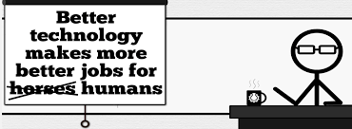


Student Choice – Interesting Videos (Full)
  Last Week tonight with John Oliver Snowden (33:14)
  It’s All About The Pentiums
  Weird Al (3:34)
  White and Nerdy Weird Al (2:50)
  The Game Of Trust - Nicky Case
  Why Electronic Voting is a BAD Idea
  Computerphile (Tom Scott) (8:20)
  Welcome To Life – Tom Scott (2:44)
  What "Orwellian" really means - Noah Tavlin (5:31)
  Humans Need Not Apply
  CGP Grey (15:00)
Notes:
All Last Accessed 2018-10-04
CGP Grey
Humans Need Not Apply (15:00) – 2014-08-13
http://www.youtube.com/watch?v=7Pq-S557XQU
Last access 2016-04-22
Why Electronic Voting is a BAD Idea – Computerphile (Tom Scott) (8:20)
https://www.youtube.com/watch?v=w3_0x6oaDmI
Last Week tonight with John Oliver – Patriot Act, Edward Snowden (33:14)
http://www.upworthy.com/john-oliver-flew-10-hours-to-russia-to-interview-edward-snowden-and-get-him-on-record?c=ufb1
Weird Al – It’s All About The Pentiums (3:34) and look at lyrics
https://www.youtube.com/watch?v=qpMvS1Q1sos
Tie into Ray Kurzweil Singularity
Epic Rap Battles of History: Steve Jobs vs. Bill Gates (If class ok with obscene lyrics) (2:47)
https://www.youtube.com/watch?v=njos57IJf-0
Also Work links on web site http://socialimps.keithpray.net/documents/
-----
Tom Scott
http://tomscott.com
Welcome To Life (2:44)
https://www.youtube.com/watch?v=IFe9wiDfb0E&feature=youtu.be
Passphrases (2:08 need to give context for video)
https://firstlook.org/theintercept/2015/03/26/passphrases-can-memorize-attackers-cant-guess/
If not shown during first class
What "Orwellian" really means - Noah Tavlin (5:31)
http://ed.ted.com/lessons/what-orwellian-really-means-noah-tavlin
Weird Al – White and Nerdy (2:50) and look at lyrics
https://www.youtube.com/watch?v=N9qYF9DZPdw

Slide 48
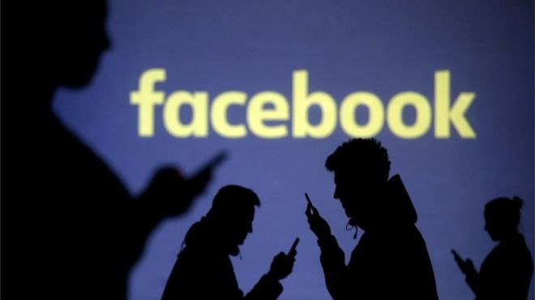
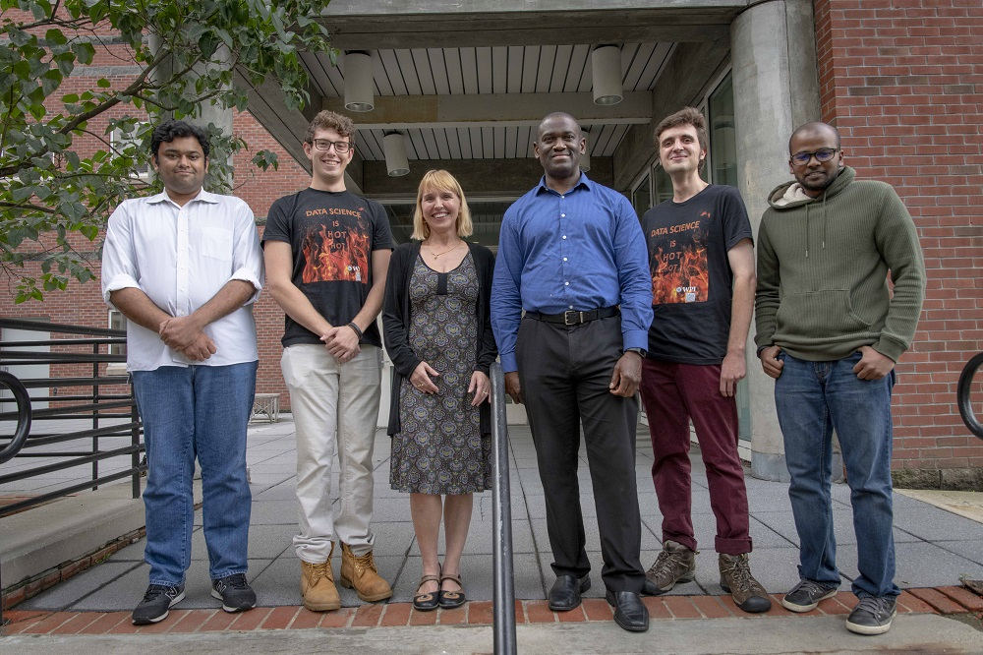

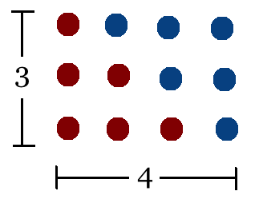
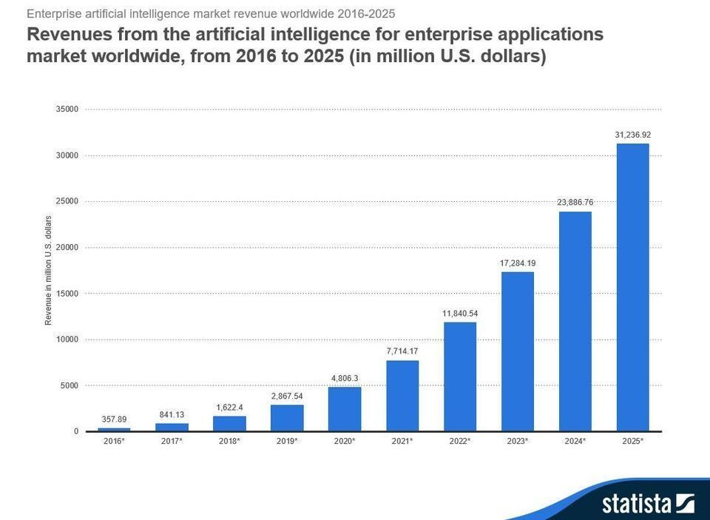
Student Choice – Interesting Articles 1/2
Facebook security breach: Up to 50m accounts attacked - Dave Lee, North America technology reporter, 2018-09-29
WPI Secures $2.8 Million to Develop a Smartphone App to Help Assess the Health of Soldiers, 2018-09-24
Quantified Toilets, 2014, Quantified Toilets LLC
What Did Ada Lovelace's Program Actually Do? - Sinclair Target, 2018-08-18 (First Programming Bug 1843?)
We know ethics should inform AI. But which ethics? - Mauro Guillen, World Economic Forum, 2018-07-26
Notes:
All Last Accessed 2018-10-04
TOOD: Add to first day slides.
Emacs – psychoanalyze-pinhead
doctor (implementation of ELIZA)
yow (quotes from Zippy the Pinhead zippythepinhead.com)

Slide 49
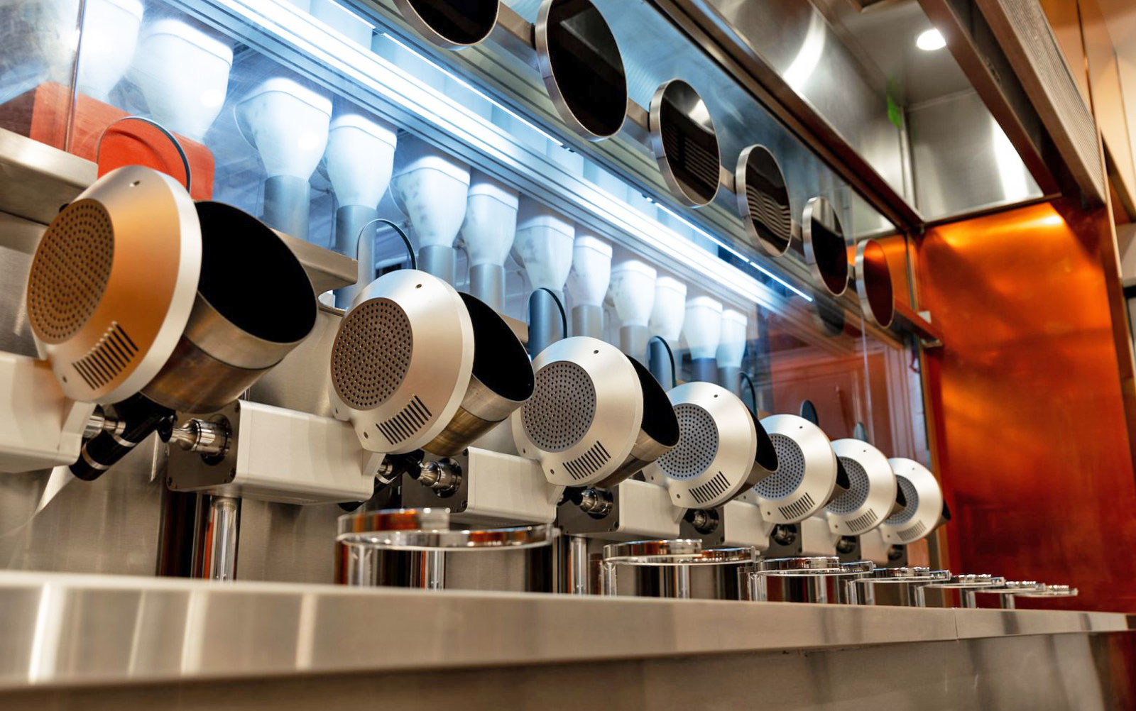

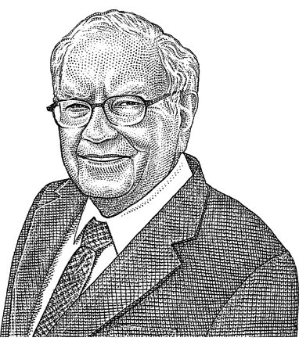
Student Choice – Interesting Articles 2/2
MIT-born Spyce raises $21M to open new robotic restaurants - Lucia Maffei, BostInno, 2018-09-07
The Coders Programming Themselves Out of a Job - Brian Merchant, The Atlantic, 2018-10-02
Berkshire Hathaway’s Stock Price Is Too Much for Computers - Alexander Osipovich, The Wall Street Journal, 2021-05-05 (approaching $429,496.7295 32 bit limit)
Notes:
All Last Accessed 2018-10-04
Spyce image: https://www.engadget.com/2018/05/04/boston-robotic-kitchen-spyce/ , 2018-05-04
Coders Programming Themselves Out of a Job image: Gabrielle Lurie, Reuters (date unknown)

Slide 50
Class 14
The End
Keith A. Pray
socialimps.keithpray.net

