Slide 1
Class 10
Professional Ethics
Keith A. Pray
socialimps.keithpray.net

Slide 2
what works well Online With Zoom
Sign in with First and Last Name
Stay muted unless you are going to speak
To speak use the raise your hand feature
To answer yes/no questions use the “yes” ”no” buttons
Turn your camera on
Wait until the end of student presentations to ask questions
  Write them down so you don’t forget

Slide 3
Overview
Review
Debate
Assignment
Students Present
Notes:
ADD QUIZ AS BACKUP IF CLASS DISCUSSION NOT LONG ENOUGH

Slide 4
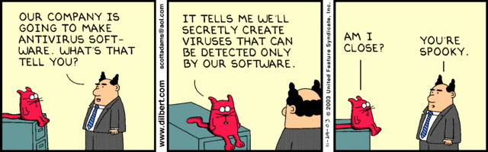
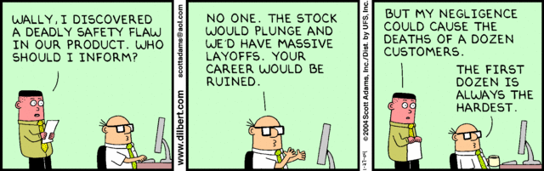
Notes:
Ask how many people in ACM or IEEE

Slide 5
Debate Ground Rules
Before Debate
  Add “(YES)” or “(NO)” to the end of your name in Zoom to show your side
  10 minutes to converse with your team
  Share argument points, counter points, and responses
  Share experiences, especially in different countries, cultures, situations
  Decide who will: Go first, Respond to which points from opposing side
During Debate
  1 turn per person until everyone on your team has spoken
  Try to keep remarks to 30 seconds
  Switch sides at any time if you change your mind
Notes:
Release Game or Not Debate
Chapter 9 In-class Exercises # 24.
Should the company produce the game?
Use the SWE Code Of Ethics as the basis for your argument.

Slide 6
Assignment
1 Page Paper
  What should computerized automation be applied to next?
Finish all reading
Group Project
  Add analysis to website addressing remaining topics
  Group Presentation Draft
    Submit as Power Point on Canvas
    Post Power Point file on group website
Notes:
1 Page Paper Ideas:
For Good - How will you use your computing related education to do good in the world?
Dark Net - Is the Dark Net good or bad?
Does computerized automation help the economy or society?
What should computerized automated be applied to next?
If productivity has increased so much, why are we working so hard? Should we?
What job skills will survive computerized automation?

Slide 7
Overview
Review
Debate
Assignment
Students Present
Notes:
Show WPI and/or corporate code of ethics.

Slide 8
Disadvantages of Growing up Digitally
Nicole Burgess
Notes:
My presentation is on the disadvantages of growing up digitally
So children today are at more of a disadvantage both physically and mentally due to their use of technology than those who did not grow up in the digital age.

Slide 9
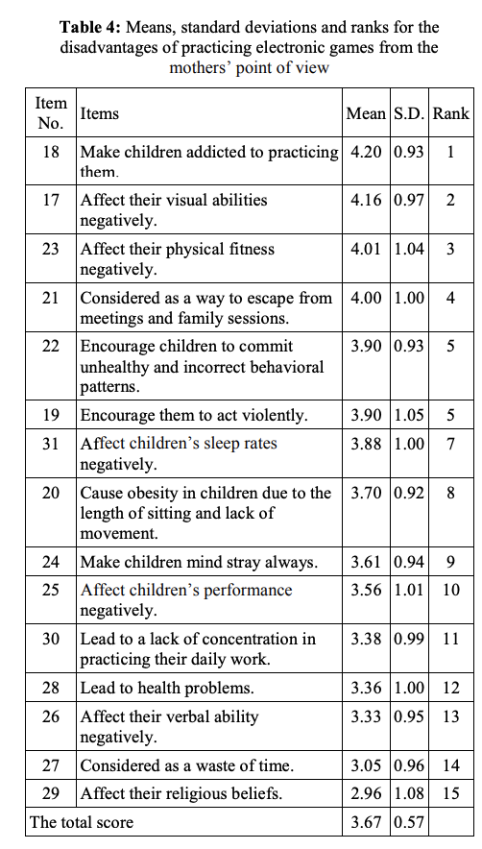
Negative effects of Video Game Use
Nicole Burgess
[1]
Notes:
This study that I found focused on both the mother’s point of view and on kindergarten teacher’s point of view but the results showed that the differences in opinions were negligible, so I decided to just focus on the mothers’ point of view
In this study mothers scores of the effects of video games were ranked
The ones that are higher on the list have a higher impact on children and the negative impacts of the games

Slide 10

Children have a Reliance on Technology
Nicole Burgess
Many parents use technology as a babysitter
The internet is not safe for young children
Children have become reliant on technology [2]
Multitasking [3]
Notes:
parents will give their children their phone or tablet and they will have free range and much of the time parents use this as a babysitter so they can do other things while not having to entertain the child but this gives them free range of the device and they can do anything with it
When parents give their children these devices, they begin to feel like its just an everyday thing and they start to use it without permission which could have bad consequences like contacting strangers online or going to sites which they should have access to
One girl in a study said that she preferred to play on a phone because it talks back to her and her dolls don’t
In a study of the children in families, one family had one of their children had become addicted to technology and they ended up having to send the child to a speech therapist because he was having so much trouble communicating with other members in the family
[3] children rely on technology for most of their play time now which is limiting motor skills development
(last bullet)Tests such as this show that children who heavily use technology and become accustomed to its constant reminders and multiple functionality will be better at multitasking, but will be far more sensitive to incoming information, and will not be as good at focusing entirely on tasks that may require it.

Slide 11
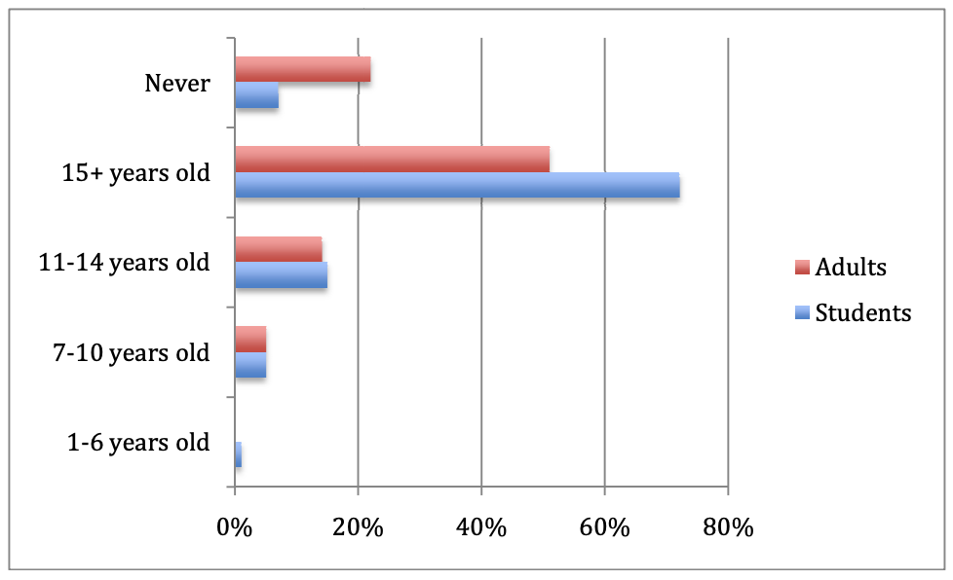
Children’s safety online is compromised
Nicole Burgess
Privacy is a concern as people freely share personal information online
You never know for sure who you are actually talking to online[3]
When is it appropriate for children to have a detailed Facebook where they update their age and location?
Notes:
People have become more open to sharing information about themselves online
Facebook profiles may be set to be private but much of the information about you can still be found
Even having only friends be able to see your information may not be enough to keep children safe as anyone can try to pose as someone and request to be friends
One parent found messages posted by her daughter and then saw that her friends were having conversations with strangers and sharing personal information like their email

Slide 12
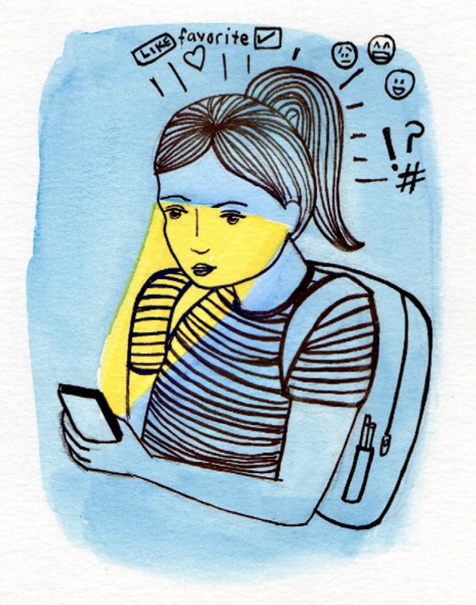
Health concerns
Nicole Burgess
Obesity rate in children has tripled over the past 20 years
Sensory development is being put at risk
Causing a disconnect from others including themselves[3]
Affects sleep [5]
Notes:
The obesity rate in children has tripled in the past 20 years, fifteen percent of children between six and nineteen years old can be considered overweight, with twice as many on the brink of becoming such
When children overuse technology their sensory development is being put at risk
Many childrens toys are designed to help develop a childs sensory skills and when children just sit on a phone or tablet they are not using the same senses as one would while physically playing outside or with toys
Use of technology is causing a disconnect from others socially
Personally I saw this working at a daycare when children would come in with devices and all the kids would swarm but none of them would really interact with each other, only watching the screen
The shining of light affects sleep and can reduce the amount of deep sleep you get
Sleep deprivation has a psychological effect on teens including irritability, poor social skills, and a negative impact on memory which in turn can diminish academic performance

Slide 13
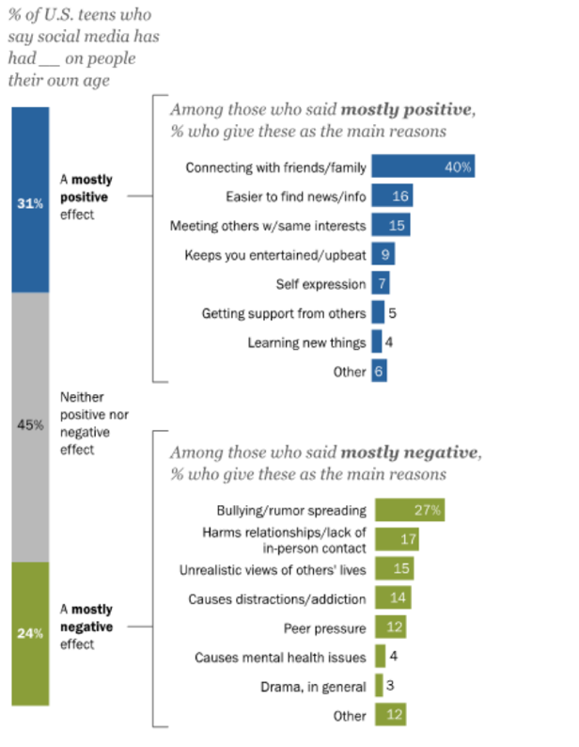
Teen Social media use
Nicole Burgess
Teens are losing skills to be able to interact with others
Inability to focus on things for long periods of time
Social media use can be linked to low-self esteem[5]
[4]
Notes:
Teens are able to hide behind a screen and have conversations with others but once they go out in public and try to do this face to face it becomes increasingly difficult the more time gets spent online and on social media
One study reported that students couldn’t focus on their homework for longer than 2 minutes without getting distracted because of a device and the constant notifications from social media
People who use social media can begin to have lower self esteem due to the constant comparison to others that happens on social media
Also Become hyper focused on appearances
Even adolescents and young adults who appear to be well-adjusted are at risk for having a decrease in their mood and life satisfaction due to large amounts of time spent on Facebook

Slide 14
References
Nicole Burgess
[1] Al-Hileh, Mohamed M. “The Advantages and Disadvantages of Electronic Games Played by Children Aged (3-6) Years, from Mothers and Kindergarten Teachers’ Point of View.” International Journal of Applied Engineering Research, vol. 13, 2018, pp. 1805–1812.
[2] Sonntag, Hans-Joachim. “Growing up in the Digital Age.” L-Università Ta' Malta, University of Malta, 1 Jan. 1970, https://www.um.edu.mt/library/oar/handle/123456789/65324.
[3] Hatch, Kristina E., "Determining the Effects of Technology on Children" (2011). Senior Honors Projects. Paper 260. http://digitalcommons.uri.edu/srhonorsprog/260http://digitalcommons.uri.edu/srhonorsprog/260.
[4] Anderson, Monica, and Jingjing Jiang. “Teens, Social Media &amp; Technology 2018.” Pew Research Center: Internet, Science &amp; Tech, Pew Research Center, 27 May 2021, https://www.pewresearch.org/internet/2018/05/31/teens-social-media-technology-2018/.
[5] T;, Solecki S;Fay-Hillier. “The Toll of Too Much Technology on Teens' Mental Health.” Journal of Pediatric Nursing, U.S. National Library of Medicine, 5 Aug. 2015, https://pubmed.ncbi.nlm.nih.gov/26364771/.

Slide 15
future of the military – virtual reality
Dov Ushman
Notes:
Hello everyone my name is Dov Ushman and today I’ll being talking about Virtual Reality and how it is already and will continue to support military personnel.
Next Slide Please

Slide 16

What is virtual reality?
Dov Ushman
Virtual reality = VR
Virtual reality requirements [1]
  Immersion
  Present in environment
  Interact with environment
Immersion levels [1]
  Non-immersive systems
  Semi immersive
  Fully immersive
    Uses head mounted displays (HMD)
https://www.forbes.com/sites/bernardmarr/2019/07/19/the-important-difference-between-virtual-reality-augmented-reality-and-mixed-reality/?sh=1964c06835d3
Notes:
Vr Background
vr short for virtual reality
no constant definition
immersion, perception to be present in environment and interaction with that environment
Immerson goes deeper
non immersive systems – simple, cheap, used desktops to reproduce images
semi immersive – 3-dimensional environment viewed on monitor, user wears special headset in certain location, allows to be viewed in 3 dimensions
immersive – completely simulated experience, effects multiple sensory out puts, uses head mounted display (HMD), human movement effects environment
VR Today – used in different fields, most common is gaming, also in military, architectural design , product design and much more
Next slide please
Before we begin to go into how VR is going to be used in the future, some background information is required. First of all, what is virtual reality or vr for short. Well since VR is constantly changing and has changed already, there is no constant definition of what VR is, but there are 3 main features which which are required for something to be considered virtual reality. These 3 features are, immersion, perception to be present in the environment and interaction with that environment.
When looking at these features, they go deeper and have different levels. Specifically, immersion. Immersion once again has 3 levels which are used to classify what type of virtual reality is being dealt with. The lowest level is the non immersive systems. These systems are the simplest and cheapest version of vr that uses desktops to reproduce images. The second level is known as semi immersive. Semi immersive vr uses an image of a 3 dimensional environment viewed on a monitor while having the user in a specific head position while wearing a special headset which basically allows for the object being monitored to be viewed in 3 dimensions. Lastly, there are immersive systems. These systems are what most people consider VR and will be the main topic of this presentation. These systems allow for complete simulated experiences while effecting multiple sensory outputs using a head mounted display also known as HMDs. This set up allows for human movement to be seen in the view of the environment being presented through the headset.
Now, what is VR Today. Today VR is used in many different fields. While most people might be familiar with VR being used in gaming with headsets such as the Oculus or HTC vive, it is also being used for military training, architectural design, product design and much more.
Next slide please

Slide 17
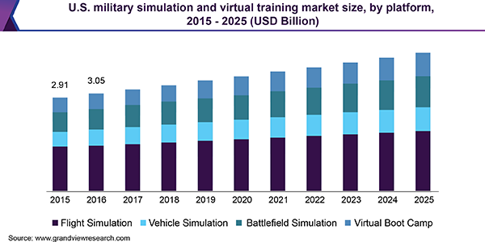
Advancements in the military
Dov Ushman
Simulation [2]
  Used since the 1960s
  Uses real world to make simulations more realistic
  Practice in extreme conditions
  Engineering new technologies
By 2022, as much as $11 billion is supposed to be funded [3]
https://www.grandviewresearch.com/industry-analysis/military-simulation-and-virtual-training-market
Notes:
VR Used in military since 1960s for simulation
Simulation is when wear a headset to put in situations – still common today
Flying simulations – now has cockpit in real world
Scenarios to gain experience
Simulations also used for submarines and tanks
Simulations prepare soldiers for conditions and to plan
On side is graph to see where simulation tech is being used by the military and the expected use by 2025
Simulation used by foreign countries – Ex. Australia
Predicted that simulations will grow, better prepare soldiers + cheaper
Research on engineering new tech – cost + safety advantages
Build prototypes – with less resources + cheaper
Research on making battle fields – train soldiers + strategize battle plans
By 2022 predicted 11 billion will go to VR, AR and MR training – vr primary focus
Next slide please
VR has been used in the military for many years both directly and indirectly. Directly, it has been used in the military since the 1960s for simulation. Simulations are when people put on VR headsets and use it to put themselves in a variety of situations. Simulations are still a very common use of VR in the military. For years it has been common for VR to simulate piloting planes and drive different types of cars. These simulations have grown over the years, for example modern flight simulations have a full cockpit in the real world and as you reach for a switch in the simulation, you are are actually going to flip a switch in real life as to make the experience even more real. Simulation over the years have also grown to where it has many scenarios built in for people to gain experience.
Outside of the sky, simulations are also being used for the same purposes except in submarines, armored trucks, tanks and other machines. Outside of machines, simulations are being used to prepare soldiers for conditions prior to them being at their location as well as for planning purposes. On the side you can see a graph on where simulation technology is being used by the military and how much is predicted by the year 2025.
All of these other simulation practices are not just being used by the American military but foreign ones as well such as the Australian army.
In the future it is predicted that simulations are only going to continue to grow as not only it helps better prepare soldiers, but it is also cheaper than prior training methods.
Outside of simulation, research is being done on how VR can used in helping the engineering process of new technologies. The main reason for this excitement, is for the cost and safety advantages of planning over VR. By using VR, people are able to build prototypes without putting in the resources to actually develop them in the real world as this is once again cheaper but also quicker. Further, research is also being done on how to create accurate battlefields in VR to help train soldiers as well as to strategize battle plans.
With all of these plans for virtual reality, it is predicted that that by 2022 as much as 11 billion dollars will go to virtual, augmented and mixed reality training systems with virtual reality being the primary focus of military invention.
Next slide please

Slide 18
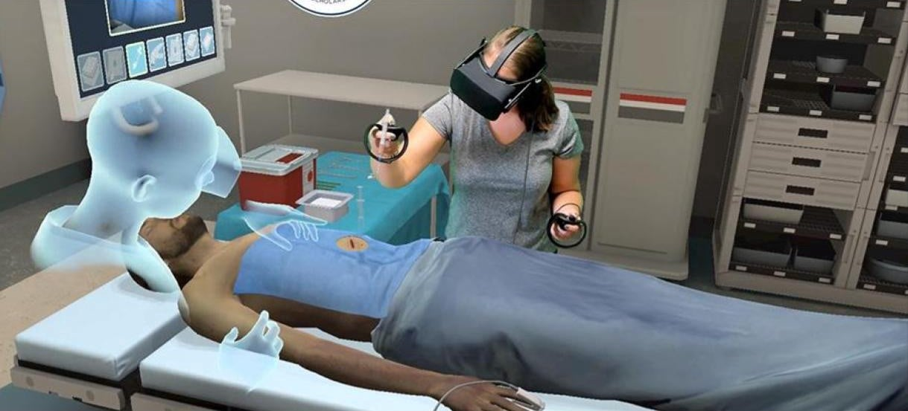
Vr enhanced medical training
Dov Ushman
Estimates 100,000 military healthcare needs to be trained annually [4]
50,000 excess deaths and 1 million avoidable injuries [4]
Simulated surgeries [5]
VR training shows 230% improvement over standard training [5]
20% faster and 38% more precise [5]
https://www.affinityvr.com/top-medical-simulation-companies-using-vr-ar-in-india/
Notes:
VR in the medic field
Training through vr
Department of defense estimates need to train 100,000 military healthcare personnel annually
50,000 excess deaths and 1 million avoidable injuries every year
Allows for practice surgeries – no risk
SimX allows for practice procedures – routine and casualty care [8]
Study at UCLA’s David Geffen School of Medicine shows surgical performance improved by 230%
Participants vr trained averaged 20% faster while being 38% more accurate in procedure checklist
Photo shows training software
Next slide please
The next topic is how VR is playing a part in the medical field. Just like the advancements on preparing the military, advantages in the medical field are also being shown. Just like in the military, training though vr is essential to preparing doctors. Currently, the department of defense estimates that they need to train 100 thousand military healthcare personnel every year. Not only do they need more healthcare professionals, but more training is required as there are about 50 thousand excesses deaths and 1 million avoidable injuries happening every year.
This need of doctors and more training has led to the use of VR to be used in the medical field to allow for doctors to practice surgeries and other operations without having any risk associated.
One company which is focusing on this is SimX which allows for practice procedures to be done. The procedures being taught go through a wide range of routine care to casualty care [8].
One study which has been completed was done at UCLA’s David Geffen School of Medicine. Their findings included that through training on the Osso vr platform improved surgical performances by 230% when when compared to traditional training methods. In addition vr trainined participants completed procedure on average of 20% faster while also completing 38% more steps in the procedure checklist.
On the side you can see a photo of what one type of traning software looks like.
Next slide please

Slide 19
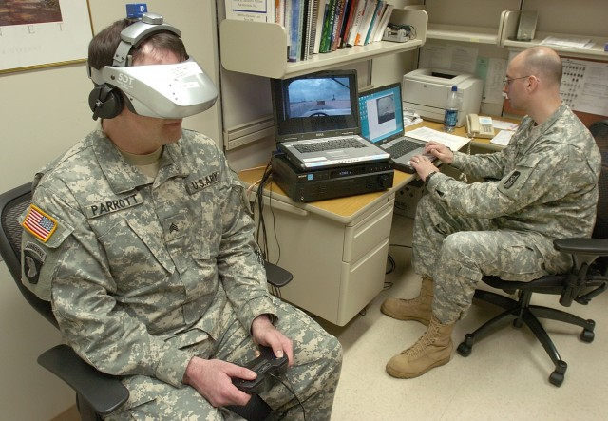
PTSD Treatment through VR
Dov Ushman
10-20% of veterans suffer from PTSD [6]
Virtual reality exposure (VRE) [7]
  90 minute appointments
  3-12 appointments
  45% of soldiers tested negative for PTSD
https://www.army.mil/article/2387/army_uses_virtual_tool_in_its_battle_with_ptsd
Notes:
Used to treat PTSD
Estimated 10-20% of veterans have PTSD
PTSD already being treated through virtual reality exposure
Studies have shown works on PTSD stemmed from different means – war, car accidents etc
Study from mental health clinic works on active duty soldier
starts in nice environment, describe the incident and it is being reflected in vr
sessions are 90 min, 3 – 12 appointments
post treatments 45% no longer test positive for PTSD
patients who had 7 sessions significantly less symptoms of PTSD
VRE to grow in the future
Next slide please
Lastly the topic of how VR plays a role in mental stability of military personnel is a large industry. Specifically, how vr can be used to treat soldiers suffering from PTSD.
In the military PTSD is extremely common where it is estimated that 10 – 20 percent of veterans are suffering from it.
Through the use of VR, PTSD is already being treated by virtual reality exposure also known as VRE. A number of studies have been done on if VRE is effective in treating PTSD which has stemmed from different means. Examples are through war, motor vehicle accidents, survivors of nine eleven and much more. One of the first studies which was done on the topic was on a military mental health clinic which works on treating active duty soldiers. During VRE treatments soldiers started off in a pleasant environment but as they articulated their trauma, the clinician would change the environment to reflect what actually occrued so they could attempt to watch what happened to help them come to terms with it. These sessions occurred for about 90 minutes and ranged from 3-12 appointments. Post treatment 45% of the soldiers being studied no longer tested positive for PTSD. On a related note, the patients who received an average of 7 sessions were reported to have significantly less symptoms of PTSD.
Because of these studies and their positive outcome, it is expected for VRE to continue to grow into the future.
Next Slide Please

Slide 20
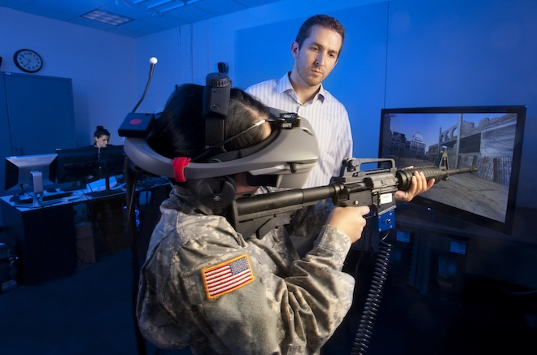
Where does that leave us?
Dov Ushman
Simulations will improve
Medical applications will grow
Medical procedures will improve
PTSD can be treated
Lives will be saved
https://www.wired.com/2012/01/army-virtual-reality/
Notes:
VR Has many applications and will continue to have more
military in form of simulations
medical through practice procedures, doctors become more qualified faster
treat veterns suffering from PTSD
That is all I have! I hope you enjoyed and are there any questions?
So where does that leave us? Well clearly VR has many applications regarding the military and as time moves on the use of VR and its applications is only going to grow. As VR continues to grow, the applications it has in the military in the form of simulation, planning purposes and others can save lives. As applications continue to grow in the medical field, doctors will continue to become better at saving the lives of military personnel, as well as the ability for doctors to become more qualified and qualified faster. Lastly, VR is already being used to treat veterans and soldiers who are suffering through PTSD and as VR improves, treatment for PTSD as well as other mental issues will be able to be improved through the use of VR.
That is all I have to talk about! I Hope you enjoyed my presentation and are there any questions?

Slide 21
References
Dov Ushman
[1] Pietro Cipressso, Irene Alice Chicchi Giglioli, Marioano, Alacañiz Raya, Giuseppe Riva, The Past, Present, and Future of Virtual and Augmented Reality Research: A Network and Cluster Analysis of the Literature, (November 6, 2018), https://www.ncbi.nlm.nih.gov/pmc/articles/PMC6232426/(September 24, 2021)
[2] Ajey Lele, Virtual reality and its military utility, (April 7 2011), https://www.researchgate.net/publication/251188523_Virtual_reality_and_its_military_utility, (September 24, 2021)
[3] Sintia Radu, The Future of War May Be Virtual, (March 20, 2018), https://www.usnews.com/news/best-countries/articles/2018-03-20/the-us-military-wants-to-lead-the-innovation-game-in-vr (September 24, 2021)
[4] < Ka-Chun Siu, Bradley J Best, Jong Wook Kim, Dmitry Oleynikov, Frank E Ritter, Adaption Vitual Reality Training to Optimize Military Medical Skills Acquisition and Retention, (May 1, 2016), https://academic.oup.com/milmed/article/181/suppl_5/214/4209471 (September 25, 2021) >
[5] Gideon Blumstein, Research: How Virtual Reality Can Help Train Surgeons, (Harvard Business School, October 16, 2019), https://hbr.org/2019/10/research-how-virtual-reality-can-help-train-surgeons (September 26, 2021)
[6] POST-TRAUMATIC STRESS, https://www.cohenveteransbioscience.org/post-traumatic-stress/ (September 26, 2021)
[7] Greg M. Reger, Kevin M. Holloway, Colette Candy, Barbara O. Rothbaum, Joann Difede, Albert A. Rizzo, Gregory A. Gahm, Effectiveness of virtual reality exposure therapy for active duty soldiers in a military mental health clinic, (February 3, 2011), https://onlinelibrary.wiley.com/doi/10.1002/jts.20574 (September 25, 2021)
[8] Matthew Greenwood, U.S. Military Expands VR Medical Training for Soldier Medics, (May 19, 2021), https://www.engineering.com/story/us-military-expands-vr-medical-training-for-soldier-medics (September 15, 2021)
Notes:
Matthew Greenwood, U.S. Military Expands VR Medical Training for Soldier Medics, (May 19, 2021), https://www.engineering.com/story/us-military-expands-vr-medical-training-for-soldier-medics (September 15, 2021)
U.S. Military Expands VR Medical Training for Soldier Medics
WRITTEN BY
Matthew Greenwood
PUBLISHED
May 19, 2021
Author, Title, (Publisher, Date), URL (Access Date)

Slide 22
Virtual Reality should be used in treating anxiety disorders and specific phobia
Andrew Hariyanto
Notes:
Greeting:
Good afternoon. My name is Andrew Hariyanto, and today I will be presenting about the prospects of virtual reality technology in the healthcare sector, primarily in the treatment of specific phobia.

Slide 23
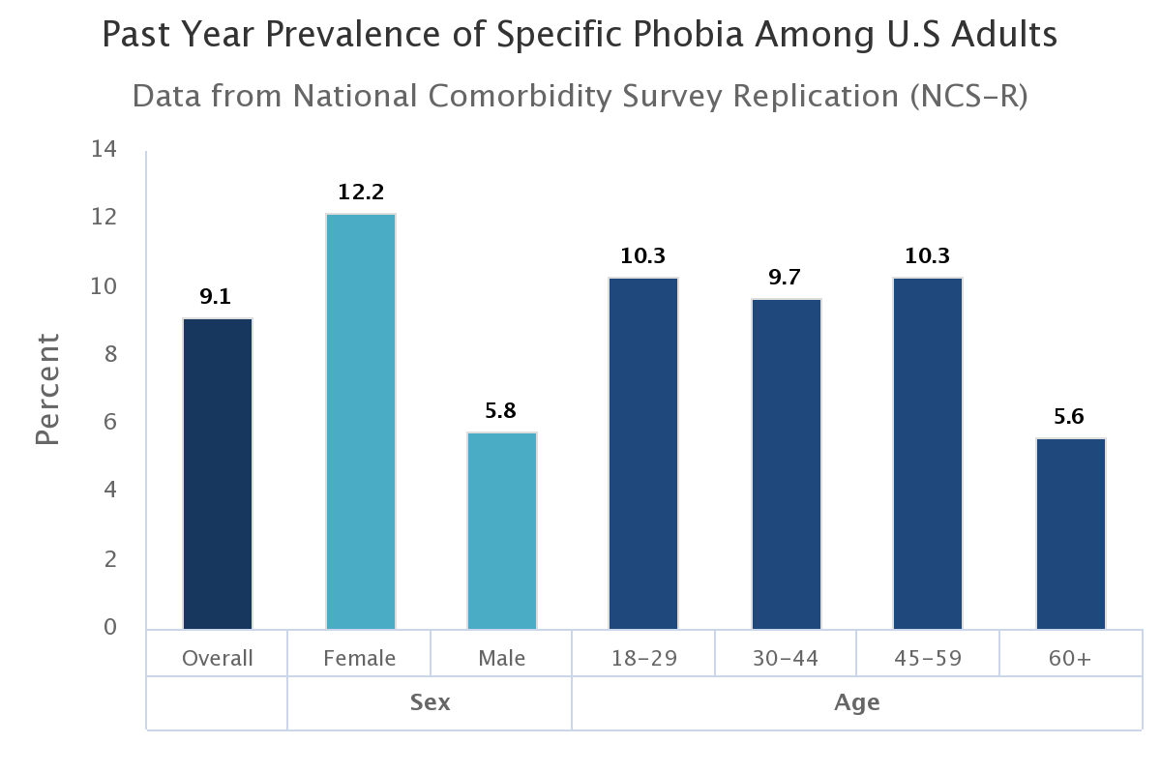
specific phobia
Andrew Hariyanto
Irrational fear of objects/scenarios [1]
9.1% of American adults struggle with specific phobia [1]
Examples
  Acrophobia: 28% of the world [5]
  Arachnophobia
  Claustrophobia
Traditional Exposure Treatments [2]
  Imaginal exposure
  In vivo exposure
Fig. 1 shows the distribution of US adults suffering from specific phobia in year 2017 [1]
Notes:
Specific Phobia
Specific phobia is the irrational and unreasonable fear of objects or scenarios that are normally not harmful
According to a survey by National Institute of Mental Health in 2017, 9.1% of US adults suffer from specific phobia
Some common examples of specific phobia include acrophobia (the fear of heights), arachnophobia (the fear of spiders), and claustrophobia (the fear of tight spaces)
For my arguments, I will focus my points on acrophobia.
28% of the world’s population have had acrophobia at least once in their lives (me included)
There are two popular exposure treatments that are used by therapists to help people overcome their specific phobia. Both treatments expose the patient to their phobias in an attempt to make them face and overcome their fears.
Imaginal exposure: therapist helps the patient recall or imagine their phobia
In vivo exposure: therapist places the patient in a real-life situation that involves the phobia

Slide 24
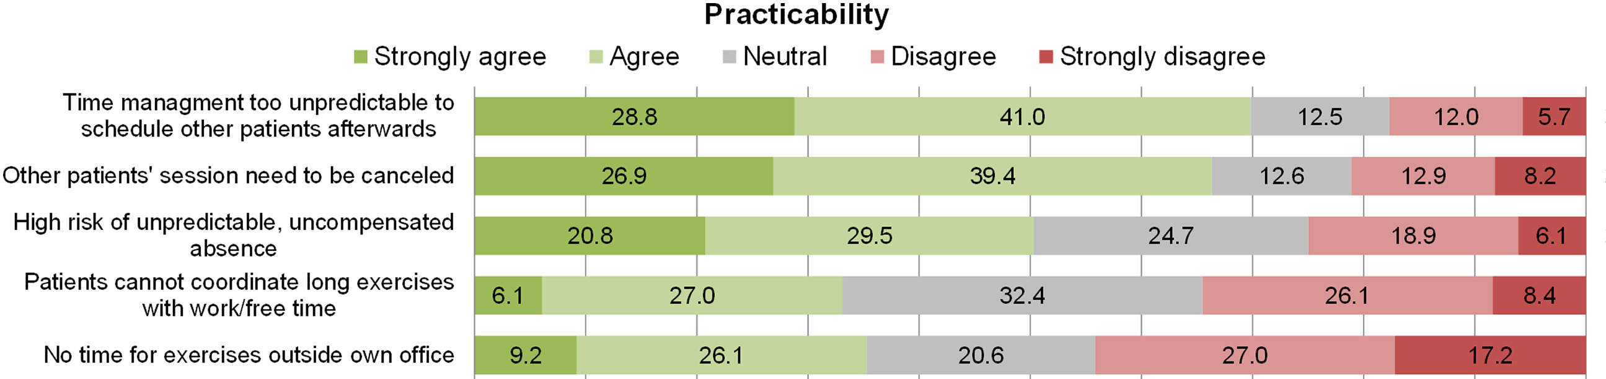
Obstacles in traditional treatments
Andrew Hariyanto
Hard to control [2]
Hard to organize [3]
  50%-70% agree that scheduling appointments are difficult
  30% agree that coordinating longer sessions conflict with other activities
Fig. 2 shows therapists’ perspectives on the practicability of in vivo treatments [3]
Notes:
Obstacles in those treatments
Hard to control
Imaginal: limited by the patient’s ability to imagine and describe the phobia.
In vivo: for acrophobia, cannot be done within the office and must be done in public outside, which has random variables that cannot be controlled like wind and safety of equipment. Other examples include phobias concerning animals, which are hard to control because therapists cannot control the behavior of animals
Hard to organize
A study asked 684 therapists their opinions about the practicability of in vivo exposure treatments.
50%-70% of the therapists agreed that there were issues with scheduling appointments. These scheduling issues included the sudden absences of patients that dropout and the inconsistent time window for each patient
30% of the therapists agree that it was difficult to schedule longer sessions for treatments because it conflicted with patients’ other work and activities

Slide 25
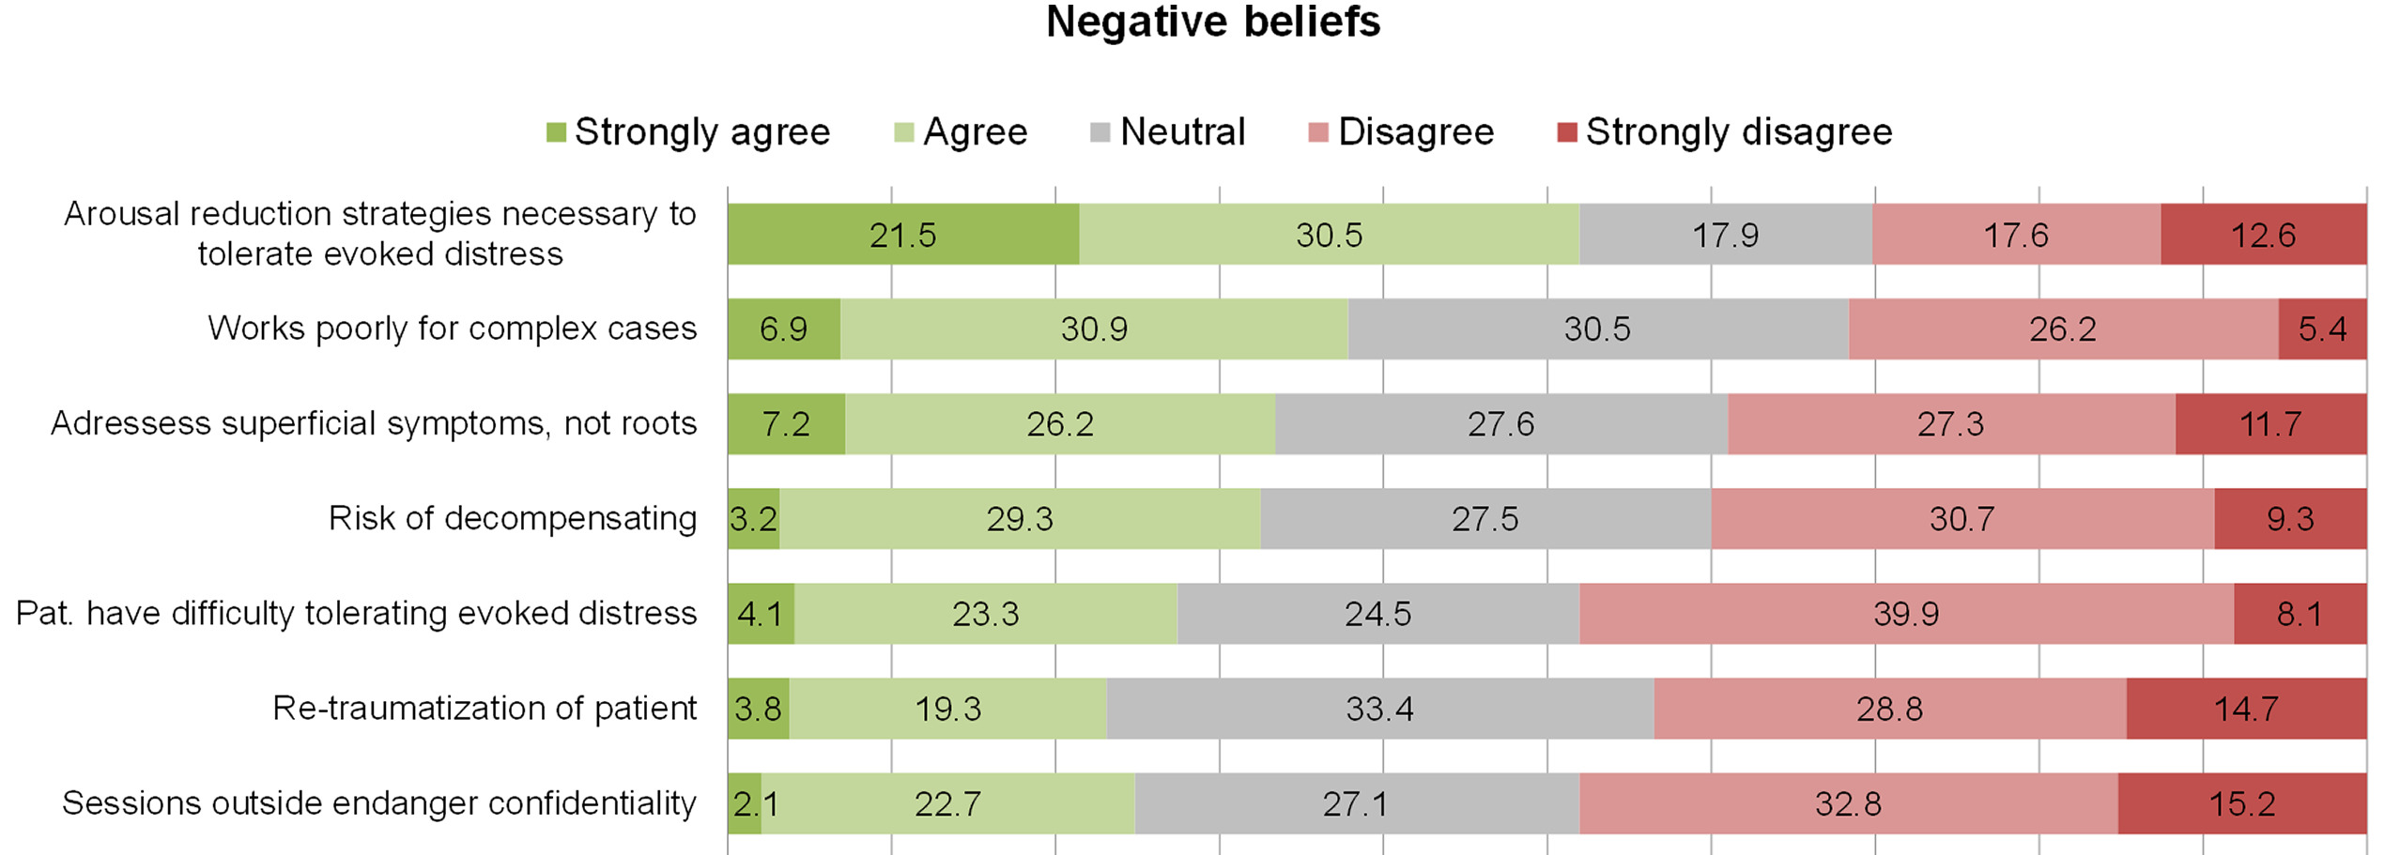
Obstacles in traditional treatments
Andrew Hariyanto
Negative beliefs about exposure [3]
  23%-52% agree that exposure can evoke patient distress
  24.8% agree that in vivo sessions could breach confidentiality
Fig. 3 shows therapists’ perspectives on negative perceptions about in vivo treatments [3]
Notes:
Negative beliefs about exposure
In that same study, 23%-52% of the therapists agree that these exposure treatments have a risk of evoking a patient’s distress and trauma, which meant that they had to adjust fear arousal.
24.8% of the therapists also agree that in vivo sessions could breach patient’s confidentiality especially since they are normally done in the public.
However, with virtual reality technology, therapists can now avoid those obstacles.

Slide 26
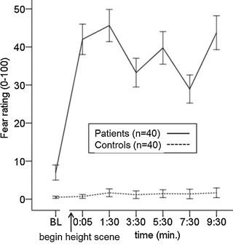
Virtual environments Can Induce Fear
Andrew Hariyanto
Only patients with acrophobia experienced significant fear [4]
Other studies report that VR treatment is just as effective as in vivo treatment [9]
90% success rate [8]
Fig. 4 shows the fear levels of patients suffering from acrophobia vs. volunteers with no mental disorders [4]
Notes:
The biggest concern with virtual reality in exposure treatments is: If the patients know that they are undergoing a simulation, can they even exhibit fear?
A study that discusses the effectiveness of virtual reality exposure treatment examined data gathered from 40 acrophobic patients and compared it to control volunteers who do not have any mental disorders. The results showed in figure 4 show that the mean fear ratings of acrophobic patients are significantly larger than the fear ratings of the control volunteers. The results confirm that fear is indeed exhibited even in a virtual environment, making exposure possible.
Another study reported that VR treatment is as effective as in vivo treatment. For a successful exposure treatment, there must be a decrease in fear ratings post treatment compared to before the treatment. VR treatment showed that the change in fear ratings are close to the change in in vivo treatment fear ratings.
Europa Health also claimed that virtual reality treatment had a 90% success rate in reducing specific phobia in general.

Slide 27
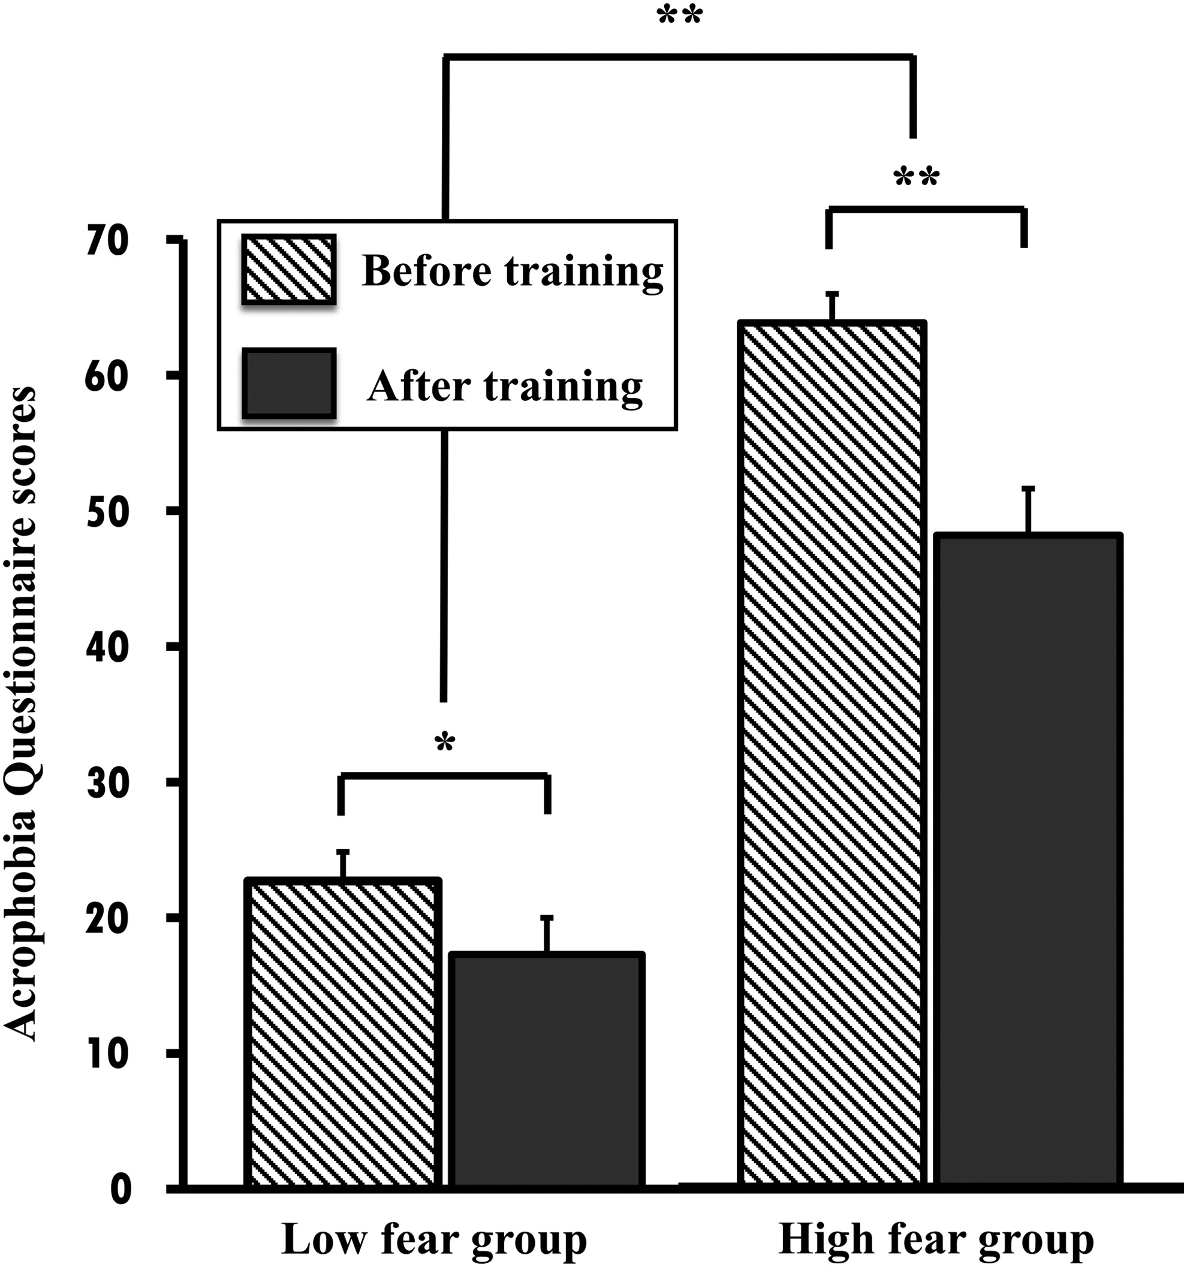
Opportunities for Self-Therapy
Andrew Hariyanto
Self-therapy VR programs were successful in lowering acrophobia [5]
VR headsets are becoming affordable [6]
  8 bpm difference between low-cost and specialized headsets
  Needs research
Fig. 5 shows the changes in acrophobic fear levels after self-training via virtual reality therapy over 2 weeks
Notes:
To address the obstacle of impracticality and scheduling conflicts, virtual reality therapy allows for self-therapy at the patients’ own homes.
A group of researchers developed their own self-therapy VR program for acrophobia and examined the changes in fear ratings low-fear and high-fear patients over two weeks. The results showed that in the low-fear group, there was a 5.42 decrease in fear ratings, and for the high-fear group, there is a 15.67 decrease in fear ratings, which indicate that self-therapy is possible in the treatment of acrophobia
High quality VR headsets are also becoming affordable. One study that compare the performance of the Oculus Rift CV1 (a commercial headset) and the nVisor (specialized headset).
Study measured patients’ heartbeat response to heights in the simulated environment, and it showed that the Oculus Rift was 8 bpm less than the nVisor.
While that value is promising, more research must be done to examine the effectiveness of commercial VR equipment as it is a new area of research.

Slide 28
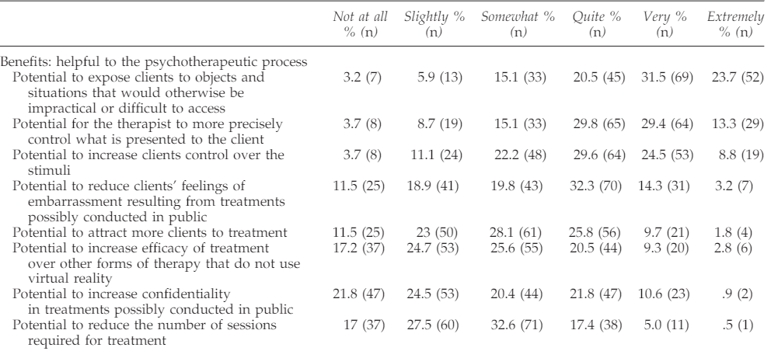
Therapists’ Perspectives on VR
Andrew Hariyanto
90% are positive that VR can generate scenarios that would otherwise be impractical in real life [7]
85%-88% agree that they can now control the environment precisely [7]
55%-70% agree that patient confidentiality can be controlled [7]
Fig. 6 shows therapists’ perspectives on the benefits of virtual reality exposure treatment [7]
Notes:
Therapists also have opinions about the use of VR in treatments
90% of the 271 therapists that were asked agreed that VR makes in vivo treatments more practical as the environment is designed as a simulation, eliminating the need to find places and props for real life treatment.
85-88% of therapists agree that VR gives the therapist control over the environment as random variables can be eliminated in the design and programming of the simulation
55-70% agree that patient confidentiality can be controlled because the sessions are held within the office and not in the public.

Slide 29
Conclusion
Andrew Hariyanto
Virtual reality can be used effectively and should be used in treating specific phobia
More research must be done for self-therapy using commercial virtual reality equipment
Notes:
These studies show that virtual reality can be used effectively and should be used in the treating of acrophobia, which can then be translated and applied to other specific phobia. However, further research must be done on the effectiveness of virtual reality tech that is commercially available to the public.
Any questions?

Slide 30
References
Andrew Hariyanto
[1] Specific Phobia. (National Institute of Mental Health, 2017). https://www.nimh.nih.gov/health/statistics/specific-phobia#part_2639 (accessed 9/21/2021).
[2] Boeldt, D., McMahon, E., McFaul, M., & Greenleaf W. Using Virtual Reality Exposure Therapy to Enhance Treatment of Anxiety Disorders: Identifying Areas of Clinical Adoption and Potential Obstacles. (Frontiers in Psychiatry, Vol. 10, 773, 2019). https://www.frontiersin.org/article/10.3389/fpsyt.2019.00773 (accessed 9/21/2021).
[3] Pittig, A., Kotter, R., & Hoyer, J. The Struggle of Behavioral Therapists With Exposure: Self-Reported Practicability, Negative Beliefs, and Therapist Distress About Exposure-Based Interventions. (Behavior Therapy, Vol. 50(2), 353-366). https://doi.org/10.1016/j.beth.2018.07.003 (accessed 9/21/2021).
[4] Diemer, J., Lohkamp, N., Mühlberger, A., & Zwanzger, P. Fear and physiological arousal during a virtual height challenge—effects in patients with acrophobia and healthy controls, (Journal of Anxiety Disorders, Vol. 37, 30-39, 2016). https://doi.org/10.1016/j.janxdis.2015.10.007 (accessed 9/23/2021).
[5] Yeon-Ju Hong, Hesun Erin Kim, Young Hoon Jung, Sunghyon Kyeong, & Jae-Jin Kim. Usefulness of the Mobile Virtual Reality Self-Training for Overcoming a Fear of Heights. (Cyberpsychology, behavior, and social networking, Vol. 20(12), 753-761, 2017). https://doi.org/10.1089/cyber.2017.0085 (accessed 9/23/2021).
[6] Bun, P., Gorski, F., Grajewski, D., Wichniarek, R., & Zawadzki, P. Low – Cost Devices Used in Virtual Reality Exposure Therapy. (Procedia Computer Science, Vol. 104, 445-451, 2017). https://doi.org/10.1016/j.procs.2017.01.158 (accessed 9/24/2021).
[7] Segal, R., Bhatia, M., & Drapeau, M. Therapists' Perception of Benefits and Costs of Using Virtual Reality Treatments. (Cyberpsychology behavior and social networking, Vol. 14, 29-34, 2011). https://10.1089/cyber.2009.0398 (accessed 9/24/2021).
[8] New virtual reality therapy proves successful in treating anxiety. (Health Europa, 2018). https://www.healtheuropa.eu/virtual-reality-therapy-anxiety/85906/ (accessed 9/25/2021).
[9] Emmelkamp, P.M.G., Bruynzeel, M., Drost, L., and van der Mast, C.A.P.G. Virtual Reality Treatment in Acrophobia: A Comparison with Exposure in Vivo. (Cyberpsychology, behavior, and social networking, Vol. 4(3), 335-339, 2004). https://doi.org/10.1089/109493101300210222 (accessed 9/25/2021).

Slide 31
Class 10
The End
Keith A. Pray
socialimps.keithpray.net
Notes:
This is the end. Any slides beyond this point are for answering questions that may arise but not needed in the main talk. Some slides may also be unfinished and are not needed but kept just in case.

