Slide 1
Class 9
Errors Failures Risks
Keith A. Pray
socialimps.keithpray.net
Notes:
What is the point of this assignment? (Did SW Teams from the reading pick good test strategies? Will you be able to support your choices if something goes wrong?)
What errors? – Have student record list on board
Who looked for directions on how to test currency?

Slide 2
what works well Online With Zoom
Sign in with First and Last Name
Stay muted unless you are going to speak
To speak use the raise your hand feature
To answer yes/no questions use the “yes” ”no” buttons
Turn your camera on
Wait until the end of student presentations to ask questions
  Write them down so you don’t forget

Slide 3
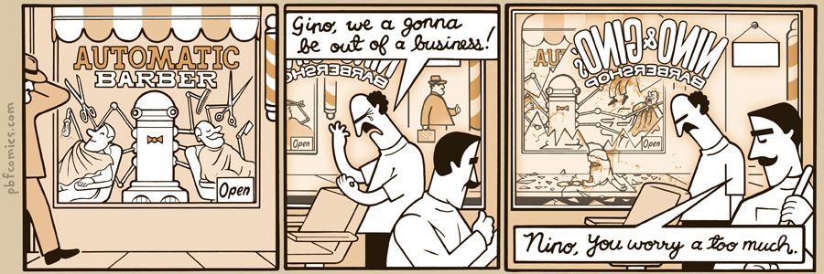
http://pbfcomics.com/197 (2014-09-26)
Notes:
10 – Errors, Failures, Risks

Slide 4
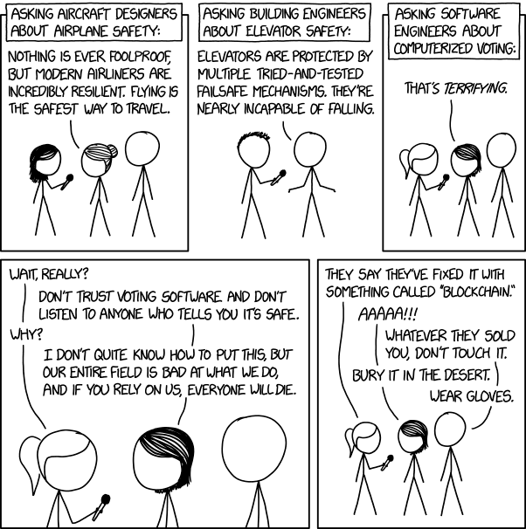
Overview
Review
Assignment
Students Present
https://xkcd.com/2030/ (2018-09-21)
Notes:
Good alternative if guest speaker not coming or late
Why Electronic Voting is a BAD Idea - Computerphile
https://www.youtube.com/watch?v=w3_0x6oaDmI
Might be better in Security
MSNBC on Denver's Automated Baggage System 2010-08-23 (2:27)
https://www.youtube.com/watch?v=xx8f4x6C_KY
Accessed 2019-04-09
No Discussion Board
Other videos:
9News - Looking back at the massive failure that was DIA's automated baggage system 2020-02-28 (2:32)
https://www.youtube.com/watch?v=xmas0-SthUQ
9News - Watch DIA's old luggage system toss baggage into the air 1995 (1:42)
https://www.youtube.com/watch?v=OtLHVGtFmKU
abcNews - Major Luggage Debacle at Denver Airport
https://abcnews.go.com/Travel/video/major-luggage-debacle-denver-airport-28054918
We can also discuss articles listed on Security Discussions under documents of course web site.
TODO: add quiz as backup if class discussion or guest speaker fail

Slide 5
Overview
Review
Assignment
Students Present
Notes:
We can also discuss articles listed on Security Discussions under documents of course web site.
ADD QUIZ AS BACKUP IF CLASS DISCUSSION OR GUEST SPEAKER FAIL

Slide 6
Assignment
Prepare for Debate
  You are a software engineer in the company
  from Chapter 9 In-class Exercises # 24.
  Should the company produce the game?
  Use the SWE Code Of Ethics as the basis for your argument.
  Use high quality sources for supporting data
Optional 1 paper on topic, lowest paper grade will be dropped
Add to Group Project Web Site

Slide 7
Reducing Human Bias in AI
Joshua Malcarne
Human bias in AI is detrimental to ourselves and our use of related technologies and must therefore be cut down as much as possible.
Notes:
Name is Joshua Malcarne
Today I'll be talking about reducing human bias in AI
It is my opinion that *read conclusion*
Today I'd like to talk a bit about how human bias in AI affects us, how we can reduce human bias in AI, and how we can ensure this reduction is carried out by the creators of such technologies

Slide 8
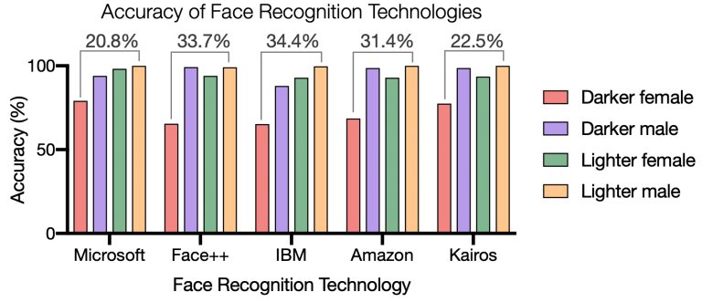
Clear bias: Facial recognition
Joshua Malcarne
Human bias in AI is most prominent in facial recognition technology
Accuracy decreases white to black, male to female [4]
Findings confirmed across 189 different algorithms [4]
Figure 1. 34.4% increase in error when identifying darker-skinned females than white males [4]
Notes:
As many of you from the last class may remember, facial recognition in law enforcement has been a very controversial topic in recent years
Human bias in AI is most prominent in facial recognition technology
Currently, it also has the most negative effects due to it's related applications
Accuracy of these systems decreases white to black, male to female
As evidence for this, the 2018 "Gender Shades" project spearheaded by researchers at MIT and Stanford showed a 34.4% increase in error when identifying darker-skinned females as opposed to white males
National Institute of Standards and Technology confirmed these findings across 189 different algorithms
It is absolutely unacceptable for error such as this to exist in a technology used to enforce law.
It's prejudiced, gendered, and ironically inhumane
If we want to use facial recognition technology not just for law enforcement, but for other applications as well, cutting down bias in FRT is surely the first step forward in order to ensure a more fair, equal, and unprejudiced system.

Slide 9
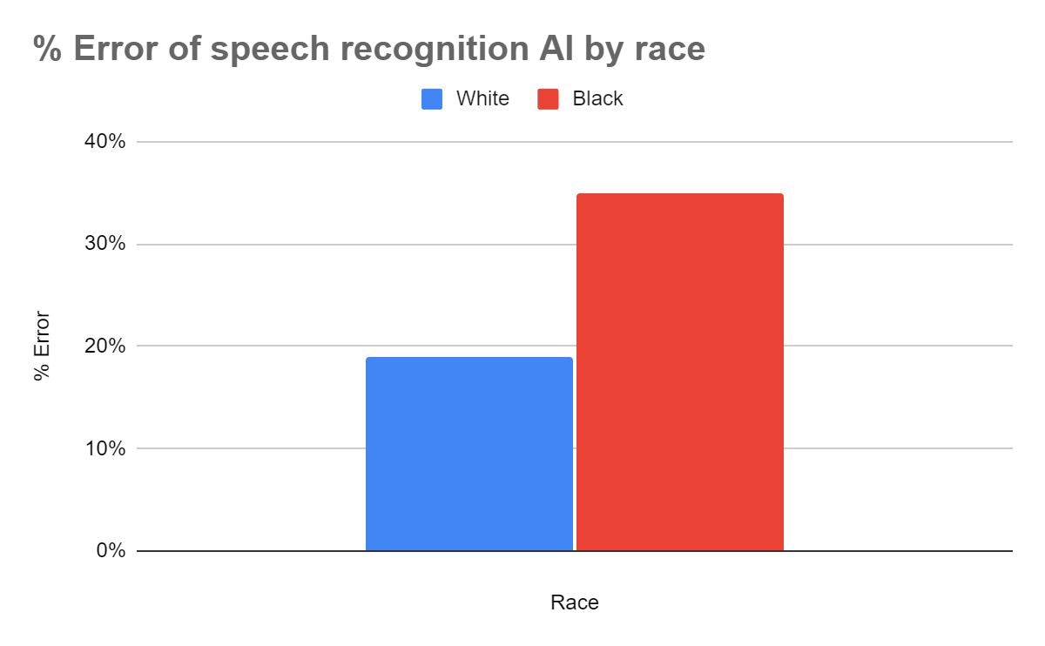
Clear bias: Speech recognition
Joshua Malcarne
Error rates for speech recognition almost doubled for black speakers [2]
Error rates highest for African American men [2]
Accents, vernacular, slang, and gender all associated with increased error rates [2]
~16%
Figure 2. Black speakers misinterpreted 35% of the time, white speakers 19% [2]
Notes:
Another application that contains human bias skewing the algorithm towards prejudice and gendering, while not at commonly discussed, is speech recognition
A study performed at Stanford University showed that error rates for speech recognition across 5 different algorithms almost doubled for black speakers
On average, the systems misunderstood 35% of words spoken by blacks but only 19% of those spoken by whites
Error rates were highest for African American men
This isn't just an issue of race: accents, vernacular, slang, and gender are all associated with increased error rates
Some of you may be wondering, "it's speech recognition, how is this problem even comparable to that posed by facial recognition, which is used in law enforcement"
Currently, it may not be, but the future is unsure. Perhaps eventually we'll see vocal profiling as a form of secondary identification, or something of the sort.
Even then, new technologies and AI have so many different applications that small biases snowball into big issues

Slide 10
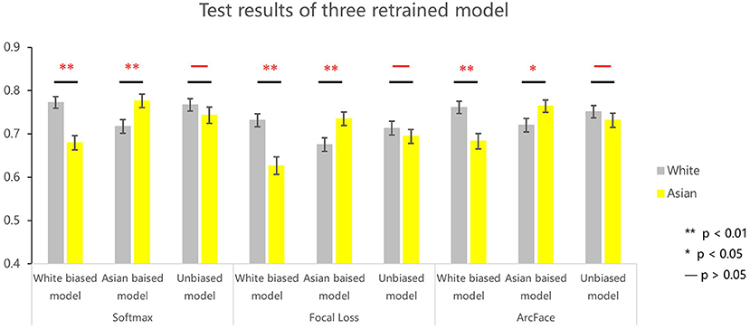
Reducing Bias: Better Data Sets
Joshua Malcarne
Figure 3. "Transfer Learning" used on facial recognition technology [5]
Results show that diversity in training sets has a huge impact on AI bias
Bias was not eliminated, but significantly reduced
Training from scratch with balanced data sets would yield even less bias
Notes:
Now that we've talked a bit about the WHY, I'd like to move onto the HOW.
How can we reduce bias in AI?
The foremost answer is very simple: by introducing better data sets
We can put together more diverse data sets with equal representation among intended subjects
Tsinghua University and Beijing Normal University research study used transfer learning (training pretrained AI on different smaller data sets) on facial recognition technology. White biased, unbiased, and asian biased models created.
Results show that diversity in training sets has a huge impact on reducing AI bias
Bias was not eliminated, but significantly reduced
Still, every little bit counts. Even if the bias isn't completely eliminated, culling it in such a way is a step forward. That says, there is a more effective method:
Training from scratch with balanced sets would result in even less bias
Overall, I believe this would be a huge step forwards towards toward reducing human bias in AI
Perhaps there should be a regulating body or evaluative committee for data sets. It may not be easy for people alone, but with CS algorithms they could sort through data sets are evaluate quality/diversity/etc

Slide 11
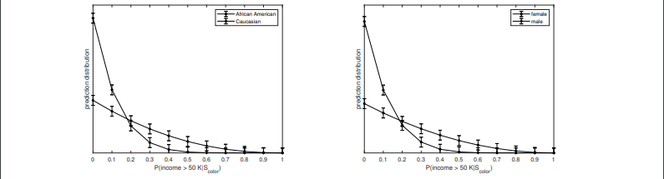
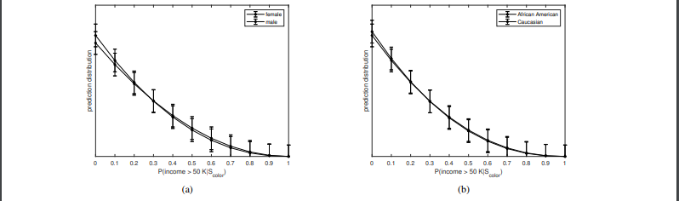
Reducing bias: gans
Joshua Malcarne
GANS: Generative Adversarial Networks
One algorithm generates, the other evaluates
Used to synthesize better datasets, removing human bias from the picture [1]
Figure 4. AI Predictions Graphed (Trained Without GAN Data) [1]
Figure 5. AI Predictions Graphed (Trained With GAN Data) [1]
Notes:
While a regulating body for data sets might be an effective (and necessary) addition to AI regulation, I believe an even more effective way to regulate data sets would be via the use of GANs
GANS: Generative Adversarial Networks
One algorithm generates, the other evaluates
This synthesizing and evaluation can be used to train an AI that synthesizes artificial data sets for training other AI
Study from 24th European Conference on Artificial Intelligence - GANs can be used to synthesize better datasets, removing human bias from the picture
These are 2 of the images from this study, which show the impact of this GAN data. The graphs display prediction distribution of each subgroup before and after training with the GAN data.
The predictions made without the GAN data are biased towards white over black and male over female.
The predictions made with the GAN data are, amazingly, almost equally distributed, to the point that a graph of the distributions follows nearly the same line.
I would like to once again emphasize the importance of better data sets towards reducing bias in AI. They have a significant effect on AI training, as has been shown in the figures on this and the previous slide
Perhaps with such training, AI for facial recognition and speech recognition could be made viable in the very near future
But now this begs the question:
How do we ensure that such methods of improving data sets and reducing bias in AI are actually used?

Slide 12
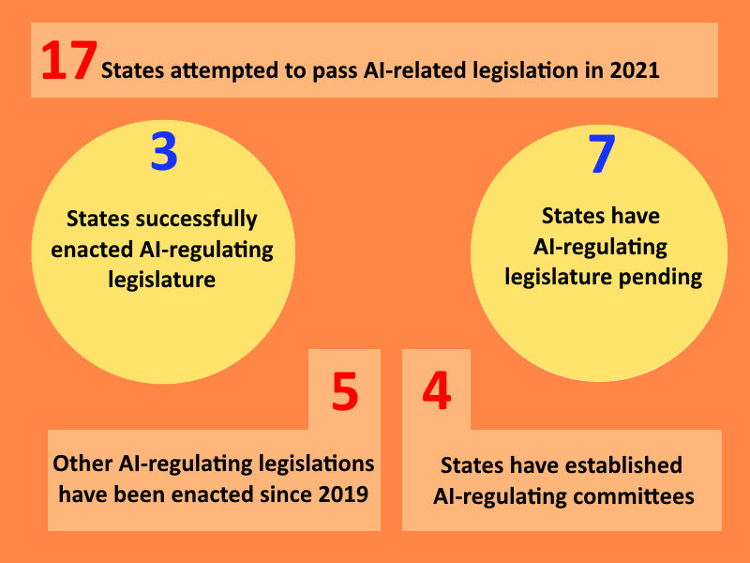
Lack of regulation
Joshua Malcarne
There is a concerning lack of regulation of AI at the state level [3]
There is even less regulation of AI at the federal level
Laws regulating the accreditation of AI technologies should be enacted in order to set standards of acceptability
Figure 6. Concerning Statistics [3]
Notes:
The most effective way is surely via the law
Currently:
There is a concerning lack of regulation of AI at the state level. Very little has been proposed, and even less has passed.
Read statistics on Figure 6. made from data from the National Conference on State Legislature (NOTE: I made the graphic using data I sorted through from source [3])
There is even less regulation of AI at the federal level
This lack of enforcement is undoubtedly a problem. Whether for financial reasons, or for more prejudiced reasons, it is entirely possible that a company may choose not to cut down the bias in their AI by using reasonable methods
We thus need to enforce the use of such methods through the law
In my opinion, laws regulating the accreditation of AI technologies should be enacted in order to set standards of acceptability
As mentioned earlier, we could use a similar system on data sets
It is my hope that as we approach the future, we see these changes in the legal system, which has seen a small push towards regulating AI since 2019.
As stated at the beginning, human bias in AI is detrimental to ourselves and our use of related technologies and must therefore be cut down as much as possible.
Going at least this far to reduce such bias is necessary.

Slide 13
References
Joshua Malcarne
[1] Abusitta, Adel, "Generative Adversarial Networks for Mitigating Biases in Machine Learning
Systems", (ECAI, 2020), http://ecai2020.eu/papers/348_paper.pdf (21 Sept. 2021)
[2] Andrews, Edmund, "Stanford researchers find that automated speech recognition is more likely to
misinterpret black speakers", (Stanford News, 23 Mar. 2020),
https://news.stanford.edu/2020/03/23/automated-speech-recognition-less-accurate-blacks/
(20 Sept. 2021)
[3] "Legislation Related to Artificial Intelligence", (NCSL, 2021),
https://www.ncsl.org/research/telecommunications-and-information-technology/2020-
legislation- related-to-artificial-intelligence.aspx (20 Sept. 2021)
[4] Najibi, Alex, "Racial Discrimination in Face Recognition Technology", (Harvard University, 24 Oct. 2020),
https://sitn.hms.harvard.edu/flash/2020/racial-discrimination-in-face-recognition-technology/
(20 Sept. 2021)
[5] Tian, Jinhua, et al., “Multidimensional Face Representation in a Deep Convolutional Neural Network
Reveals the Mechanism Underlying AI Racism”, (Frontiers, 10 Mar. 2021),
https://www.frontiersin.org/articles/10.3389/fncom.2021.620281/full (20 Sept. 2021)

Slide 14
Blame the Car?
Brianna Sahagian

Slide 15
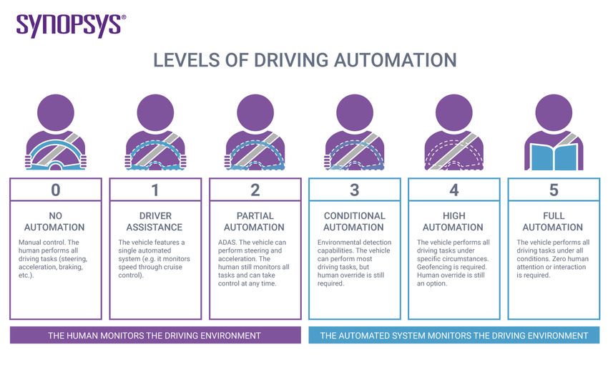
Levels of Autonomy
Brianna Sahagian
Levels 0-5
Level 0: sounds warnings/helps in emergencies only [5]
Level 5: no human control [5]
Highest level current vehicles: Level 4 [6]
Across levels 0-4 of autonomy
Require failsafe for human control [7]
Passengers assume ultimate control [6]
Levels of Autonomy system by SAE provides a framework for driverless car programming
Notes:
Levels of Autonomy System - Proposed by Society of Automotive Engineers details 6 separate levels of automation
Level 0 describes a car that has no autonomous capability to control movement or navigation but can only sound warnings or help in emergency situations.
Levels 1 through 4 describe cars with increasing amounts of autonomous features, while level 5 cars represent fully hands-off automated cars.
Current driverless cars = maximum of level 4, that is, there is still a need for human intervention in emergency situations
Common driverless systems like Tesla and Audi Autopilot are level 2
Emergency failsafe - Federal Automated Vehicles Policy and that in emergency situations, a human = ultimately responsible for the accident
Picture details the capabilities of each level of autonomy - may be used to classify current vehicles and can be used in law system to distinguish blame.

Slide 16
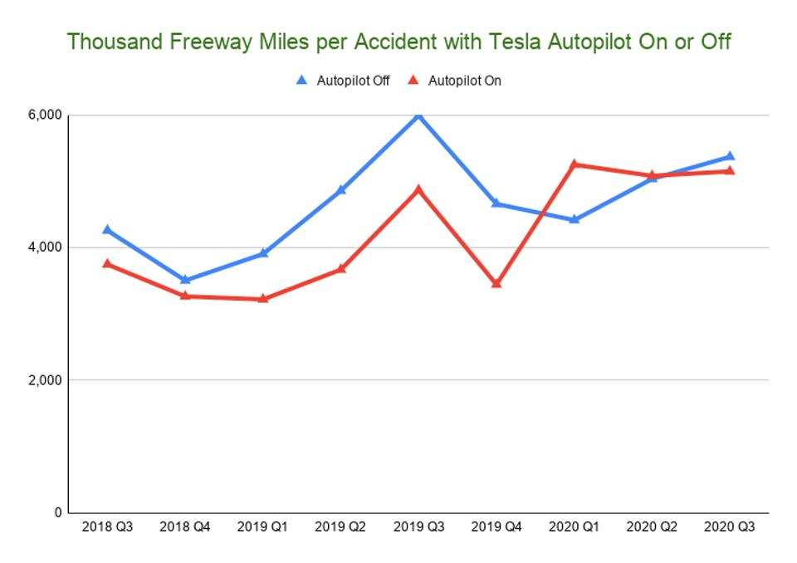
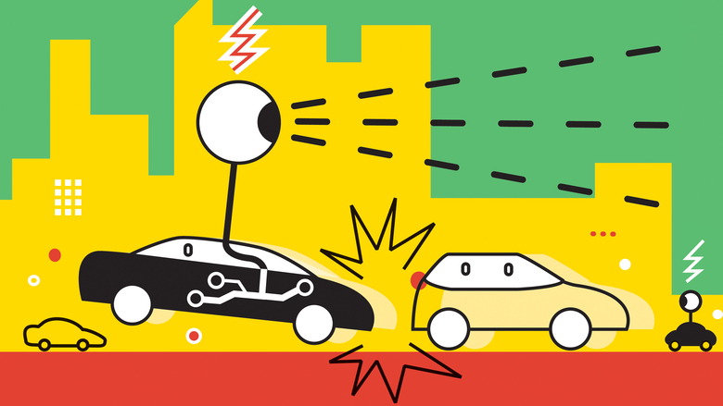
Possible Parties at Fault for a Crash
Brianna Sahagian
Remote hackers
Human passengers in driverless cars
Manufacturer/Company
Spike of level 2 car accidents in 2020 present a need for a precedent ruling for these types of accidents
Notes:
The possible parties at fault for a crash can range from hackers trying to disable or modify software of the car remotely, to the human passengers in the driverless cars, to the manufacturer or company of the car. In order to explain what would happen to cause each of these parties to be responsible, there are examples of different crash scenarios with the same basic premise in the following slides.
Picture represents the trends of level 2 autopilot crashes increasing, showing an increased importance for concrete precedent in litigation.

Slide 17
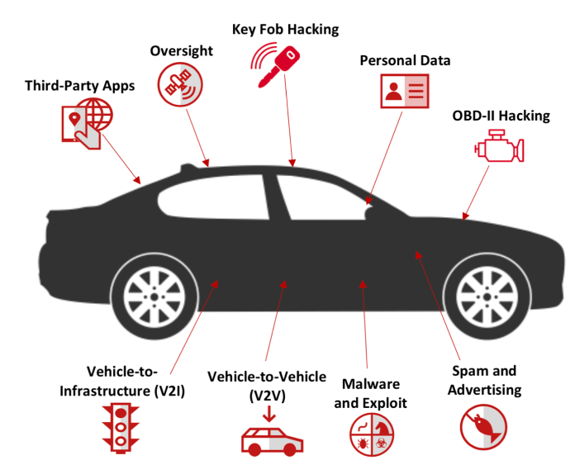
Blame the Hacker
Brianna Sahagian
Scenario: Person A buys a driverless car
Remote hack takes control of the car
2014 hack of Jeep Cherokee [5]
Hacked car crashes into and kills a pedestrian in the road
Direct blame falls on the remote hacker
Secondary blame falls on the manufacturer (liability lawsuit) [1]
Different methods by which cars are vulnerable to hacking - remote/planted device
Notes:
In the first scenario, person A decides to buy a self driving car and a hacker remotely takes control of the car while it is driving on the road.
2014 hack - Valasek and Miller hacked the Jeep Cherokee
The remote hacker crashes the driverless car into a pedestrian in the road, killing the pedestrian.
Direct blame falls on the hacker as they were the one who remotely guided the car to crash - hacks are difficult to trace with VPN systems/security
Blame can be assigned to the manufacturer because of a software vulnerability. The driver can file a lawsuit for product liability.
The picture displays the different types of hacking that can threaten a driverless car. The key fob of a car may be hacked by replicating the transmission from fob to car system. An external device may be placed in the car to serve as a backdoor to control of brakes, engines, door locks.

Slide 18
Blame the Passenger
Brianna Sahagian
Scenario: Person A buys a driverless car
Person A tinkers with the software
Allowed under the exemptions to Digital Millennium Copyright Act [4]
Car crashes into and kills a pedestrian in the road
Blame falls on Person A
Notes:
In the next scenario, person A decides to buy a self driving car and decides to modify the software of the car themselves.
Legal under the exemptions to the Digital Millennium Copyright Act passed in 2015. (Section 1201)
The modifications that they made to their own car malfunction caused the car to bes unable to detect a pedestrian in the road, running over and killing the pedestrian.
For this situation, the blame falls solely on person A - manufacturer is not responsible.

Slide 19
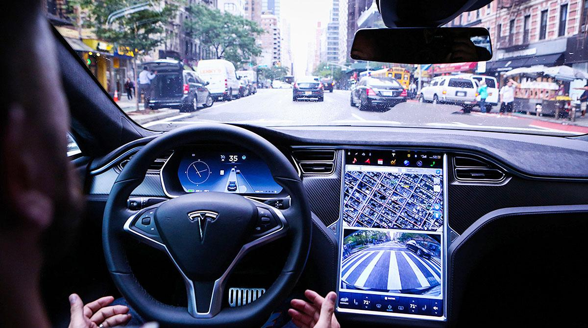
Blame the Passenger (As of 2021 Max Level 4)
Brianna Sahagian
Scenario: Person A buys a level 4 or under self driving car
Person A has their hands off the wheel during the crash
Car’s sensor fails to detect a pedestrian and crashes
Light saturation blinds the sensor
Blame falls on Person A
May 2016 Tesla case [3]
NHTSA blames the driver
Tesla Autopilot layout - Level 2 System
Notes:
In the next scenario, person A buys a self driving car of level 4 or under, that is, a car with the maximum autonomous capabilities that is currently offered.
Person A is not paying attention to the road light saturation blinds sensor and car crashes into and kills pedestrian.
May of 2016 when a Tesla in autopilot mode crashed into a tractor-trailer when the camera did not recognize the truck, killing the passenger. NHTSA blamed the driver.
Manufacturer takes advantage of the human requirement of level 4 autonomous vehicles.
Passenger was not upholding their part of the level 4 standard, that is, being available to take control of the vehicle if there is a malfunction.
The picture displays the layout of the Tesla Autopilot, a level 2 driverless car system. This system can detect a driver’s touch on the steering wheel. This system is useful to compare to the predicted system for a level 5 car in the next slide.

Slide 20
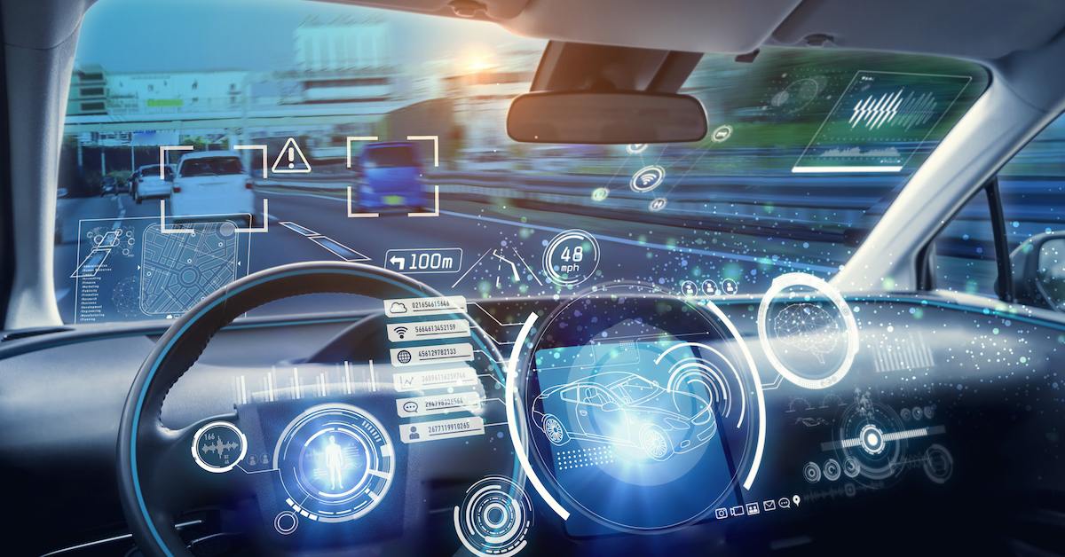
Blame the Manufacturer/Company
Brianna Sahagian
Scenario: Person A buys a level 5 self driving car
Car functions normally
The self driving car crashes into and kills a pedestrian in the road
Unforseen software error
Blame falls on the manufacturer
Level 5 car predicted layout - “hands-off” control
Notes:
In the last scenario, person A decides to buy a level 5 self driving car.
Level 5 cars are completely hands off so the passenger does not need to have their hands on the wheel.
Car has a software failure; crashes and kills pedestrian.
In this scenario, the blame falls on the manufacturer, passenger is not responsible for software failure.
The picture displays a predicted layout of a level 5 - completely hands-off system. This system may be compared to that of the Tesla Autopilot and shows control of proximity, speed, steering, messaging and wireless connection

Slide 21
Summary
Brianna Sahagian
Hacking accidents have a direct blame
Non-hacking accidents have indirect blame
Go-to defense for manufacturer = levels of autonomy
Tesla Model X crash 2018 [3]
Release of a level 5 vehicle would nullify this defense
There has been no precedent for driverless crash litigation
Nilsson v. General Motors [2]
Driver v. Manufacturer debate
Notes:
It is important to learn about the current system for driverless car accidents to understand both the controversial nature around the topic of blame and the future of vehicle autonomy.
The standards for fault in a driverless car crash = loopholes for manufacturers to exploit in court.
2016 Tesla crash and another 2018 Tesla Model X crash, Tesla asserted that the drivers were responsible because their hands were not detected on the wheel.
Level 4 vehicles - drivers responsible for ultimate control.
A level 5 car would change the system of litigation in an already blurry system - defense of level 4 is nullified
Cases like Nilsson v. General Motors represent manufacturers trying to avoid case development and a negative ruling.
There has not yet been a precedent for driverless crash litigation to follow in future accidents.
Driverless cars present a challenge for the legal system and will continue to raise the question of driver vs. manufacturer as car designs become less reliant on human intervention.

Slide 22
REFERENCES
Brianna Sahagian
[1] Botto Gilbert Lancaster, “Who is Liable When Your Car Gets Hacked?”, https://www.bgsllaw.com/mchenry-county-lawyers/your-car-gets-hacked (9/22/2021)
[2] ClassAction.com, “Self-driving Cars Lawsuit”, https://www.classaction.com/self-driving-cars/lawsuit/ (9/22/2021)
[3] Faegre Drinker, “5 Defenses for Autonomous Vehicles Litigation”, https://www.faegredrinker.com/en/insights/publications/2018/9/5-defenses-for-autonomous-vehicles-litigation (9/22/2021)
[4] Jain, Khyati, “You Can Hack Your Own Car - It’s Legal Now”, (The Hacker News, 2015), https://thehackernews.com/2015/10/hack-car.html (9/22/2021)
[5] Ornes, Stephen, “How to Hack a Self-driving Car”, (Physics World, 2020), https://physicsworld.com/a/how-to-hack-a-self-driving-car/ (9/22/2021)
[6] Synopsys, “The 6 Levels of Vehicle Autonomy Explained”, https://www.synopsys.com/automotive/autonomous-driving-levels.html (9/22/2021)
[7] US Department of Transportation, “Federal Automated Vehicles Policy - September 2016”, transportation.gov/AV/federal-automated-vehicles-policy-september-2016 (9/22/2021)

Slide 23
Self Driving Cars –Selling your safety
Omri Green

Slide 24
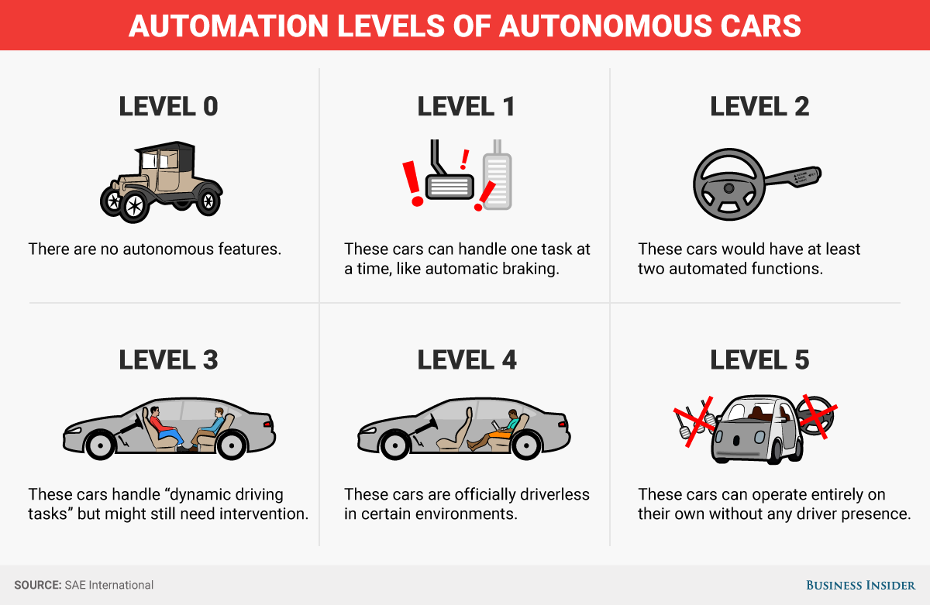
Automation levels of cars
Omri Green
Level 0 – No Automation
Level 1 – Driver Assistance
Level 2 – Partial Automation
Level 3 – Conditional Automation
Level 4 – High Automation
Level 5 – Full Automation
[1]
Notes:
Before we start discussing the pros and cons of automated cars, we must know what we mean by that. Level 0 automation means that there are no automated features in the car, an example of this would be the Model T. Most cars on the road today are Level 1, meaning that they have automation assisting the driver, examples include cruise control and just braking. There are some cars that are Level 2, an example of this would be a Tesla model S, while they can drive without your hands on the wheel, you must pay attention to the road, it is essentially a glorified cruise control. Level 3 cars can drive if you take your eyes off the road, but you must be prepared to take control of the car if something goes wrong. Level 4 cars are completely self-driving, but only in specific circumstances, the only example of these is Waymo’s self driving car, there is no driver required, but it will not drive in bad weather. Level 5 cars are what most people refer to when they say a “self-driving car” where the car is completely autonomous and doesn’t even have a steering wheel, an example would be the Numo, a small autonomous car that delivers groceries.

Slide 25
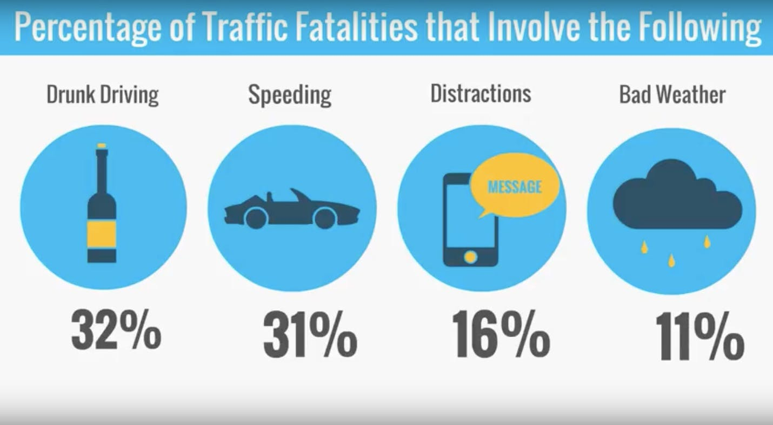
The case for self-driving cars
Omri Green
10,142 deaths from drunk driving per year [2]
3,142 deaths from distracted driving in 2019[2]
9,378 deaths due to speeding in 2018[2]
795 deaths due to drowsy drivers behind the wheel in 2017[2]
2,549 deaths due to not wearing seatbelts in 2017 [2]
[3]
Notes:
The main reason you would want a Level 4 or 5 car is that most Traffic Fatalities are caused by Human error and human flaws. A self-driving car never gets drunk, never gets distracted, never gets tired, and never speeds. In other words, it is a “perfect” driver. If all cars were self-driving there would be no drunk drivers, no distracted drivers, no reckless drivers, and no sleepy drivers. According to the NHTSA 32% of driving fatalities are caused by drunk driving, 31% by speeding, and 16% by distracted driving, most fatalities on the road are due to driver recklessness or impairment, things that would never happen to a self-driving car

Slide 26
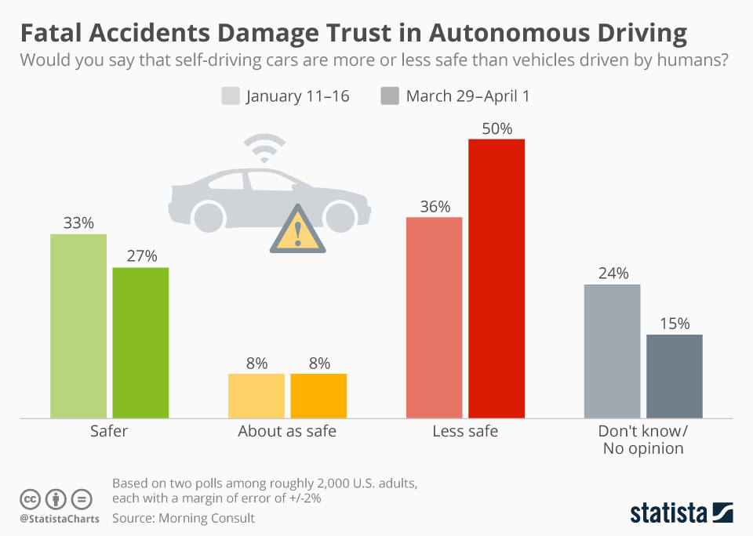
The case Against self-driving cars
Omri Green
Drivers using Tesla autopilot are more distracted from the road [4]
Tesla Autopilot has caused cars to crash into first responders 11 times since 2018 [4]
Self driving cars have a multitude of security flaws. [6]
The average person believes self-driving cars are less safe than normal ones [5]
[5]
Notes:
According to the Society of Automotive Engineers describe Tesla’s autopilot as Level 2 automation, meaning that you have to pay attention to the road. However, as the trend of Tesla drivers sleeping while utilizing Autopilot, people do not do this. In fact, according to studies from MIT, drivers utilizing autopilot pay less attention to the road if they do it at all. Glitches in the software has caused 11 crashes into First Responders due to drivers not paying any attention to the road. Due to these facts, it is not advisable for self-driving cars to be utilized if they have an Automation Level below 4, however, while this solves the problem of careless driving, it doesn’t malicious attacks.
As the recent ransomware attack on the Keystone Pipeline has shown, hacking can have real effects on the real world. Everything that is filled with computers can be hacked, and self-driving cars only exasperate that issue. There is currently nothing stopping someone from hacking into self driving car and murder, kidnap, or ransom people in their own vehicles. According to Forbes Magazine “You might be puzzled that if self-driving cars are potentially a leaking sieve of cybersecurity holes, why haven’t those despicable cyberhackers already been going after self-driving cars in droves. The straightforward answer is that it hasn’t been worth their time.”

Slide 27
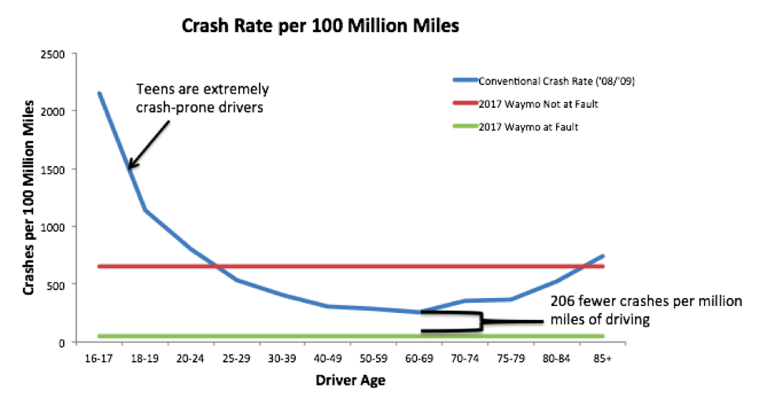
Rebuttal
Omri Green
Tesla autopilot is level 2, not level 4 or 5. [4]
Level 4 automated cars such as Waymo’s fleet are much safer than human drivers. [7]
There are currently efforts to reduce cybersecurity flaws in self-driving cars[8]
[7]
Notes:
While there are cases of reckless drivers in self driving cars, this only applies to low level automation levels, Tesla Autopilot only constitutes as a level 2 automated car, Autopilot for as much hype as Tesla brings to it is basically a glorified cruise control. While Tesla only makes level 2 automated vehicles. Waymo makes level 4 vehicles, and according to the Crash Rate per 100 million miles, not only do these vehicles crash less, but when they do crash it is almost never at fault. Simply put, they are safer.
While Cybersecurity is a definite concern, companies are trying to fix it, Uber alone has paid white hack hackers $10,000 per every bug they find. Of course, there is a fear of hackers making your self-driving car crash, and it is a valid one, but you must remember that a hacker could just as easily invert your automatic steering, or turn off your breaks, as they could hack a self-driving car.

Slide 28
References
Omri Green
[1] <https://www.howtogeek.com/401759/what-are-the-different-self-driving-car-levels-of-autonomy/>
[2] <https://www.bankrate.com/insurance/car/car-crash-statistics/>
[3] <https://www.aceable.com/safe-driving/car-accident-statistics/>
[4] <https://www.euronews.com/next/2021/09/15/tesla-autopilot-crash-investigation-expands-as-ford-bmw-and-10-other-carmakers-asked-for-d>
[5] <https://www.statista.com/chart/13450/perceived-safety-of-self-driving-cars/>
[6] <https://www.forbes.com/sites/lanceeliot/2021/08/25/serious-concerns-that-ai-self-driving-cars-cybersecurity-will-be-a-hacker-leak-like-an-open-sieve/>
[7] <https://rmi.org/safe-self-driving-cars/>
[8] <https://www.theverge.com/2016/3/22/11283782/uber-bug-bounty-hacker-code-security-facebook>

Slide 29
Class 9
The End
Keith A. Pray
socialimps.keithpray.net
Notes:
This is the end. Any slides beyond this point are for answering questions that may arise but not needed in the main talk. Some slides may also be unfinished and are not needed but kept just in case.

Slide 30
Reliability Of Statistics
Are other factors controlled?
Is enough time covered?
Is all data reported?
Use Intuition
  Are results reasonable?
Notes:
Power line dangers. Electromagnetic fields? PCBs in transformers?

Slide 31
Some Measures
Mean Time To Failure (MTTF)
Mean Time Between Failures (MTBF)
Mean Time To Repair (MTTR)
Notes:
Is it repairable?
What does it mean to repair? Running again? Data fixed? Caught up?
Restoring the GBC Web site.

Slide 32
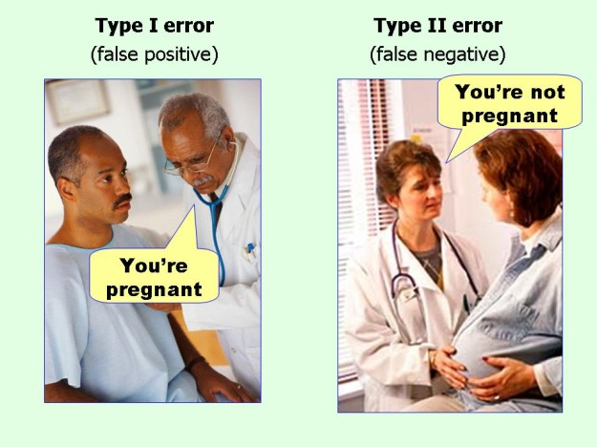
marginalrevolution.com/marginalrevolution/2014/05/type-i-and-type-ii-errors-simplified.html (2016-04-11)

