Slide 1
Class 5
Intellectual Property
Keith A. Pray
socialimps.keithpray.net
Notes:
Weird Al Yankovic “Don’t Download This Song” (3:53)
2006-08-21 released exclusively as digital download
https://www.youtube.com/watch?v=zGM8PT1eAvY
Some Analysis Points:
- Slippery Slope Fallacy
- CDs were most common way to obtain music
- Winner take all society
- Virtue ethics, guilt, shame

Slide 2
what works well Online With Zoom
Sign in with First and Last Name
Stay muted unless you are going to speak
To speak use the raise your hand feature
To answer yes/no questions use the “yes” ”no” buttons
Turn your camera on
Wait until the end of student presentations to ask questions
  Write them down so you don’t forget

Slide 3
Papers
Quantify
  Not terms like: less, more, a lot, huge, great, big, tiny, drastic, etc.
Avoid absolutes
  Terms like: all, none, always, never
  Difficult to prove, easy to show false
Read directions, many time lines missing
Use Template, Leave Rubric Intact
Counter Point and Rebuttal together should be 1-2 paragraphs, have backing data and sources
Avoid blogs, encyclopedias, and text book. These are generally not primary and high quality sources.
http://socialimps.keithpray.net/assignments/paper-guidelines/
Notes:
Save for next time:
Define terms
Quantify
Not terms like: less, more, a lot, huge, great, big, tiny, drastic, etc.
Avoid absolutes
Terms like: all, none, always, never
Difficult to prove, easy to show false
Read paper aloud to proof
Read directions, many time lines missing
Be sure to put quotes around entire quote
State a strong, clear conclusion
First statement preferred
Provide Counter Point and Rebuttal
Counter Point and Rebuttal should directly relate
Print 2 sided and save a tree
Hyperbole is the best thing ever!
but not in these papers
No strawman fallacy in counter point
Text book is not a primary source
Use template, saves time
Cite as suggested [1]
Beware of fallacies

Slide 4
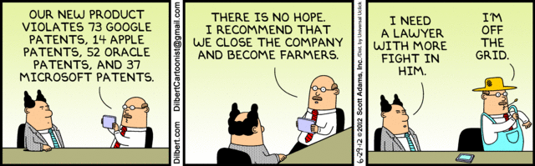
Overview
Review
Assignment
Students Present
Notes:
News: 2021-04-05: SUPREME COURT OF THE UNITED STATES Syllabus GOOGLE LLC v. ORACLE AMERICA, INC.
https://www.supremecourt.gov/opinions/20pdf/18-956_d18f.pdf
Accessed 2021-09-09
Comments, observations, questions on IP Chapter?

Slide 5
IP Protection Is Important To Our Economy
2019 Intangible Assets Financial Statement Impact Comparison Report [1]
Notes:
An example of using data to back a statement:
From the transition of tangible assets to intangible, ie. intellectual property assets we can see today’s global economy is highly dependent on IP and the laws governing its protection.
Note how the 5 largest companies also changed to those who’s main product or business model relies heavily on IP.
TODO: Look into Apple’s split between tangible and IP assets since they do have a very successful manufacturing and physical product base.
[1] AON report: 2019 Intangible Assets Financial Statement Impact Comparison Report
Sponsored by AonIndependently conducted by Ponemon Institute LLCPublication Date: April 2019
https://www.aon.com/getmedia/60fbb49a-c7a5-4027-ba98-0553b29dc89f/Ponemon-Report-V24.aspx
Last accessed 2021-09-10

Slide 6
My Reading Notes
pp. 172 „not have bothered to invent it.“ or had the time. Any music entering public domain, not just classical. Why does orchestra budget matter? Public domain year 1997/1999 from source published in 1996?
pp. 174 SaaS, Google Search example? “…before he gave them the plot.”? “…cannot erase the memories...” Paycheck (2003)
pp. 176 When was instant photography invented?
pp. 177 $134 billion, copyright leading export 2010, now?
pp. 178 ”not profited” but violated right to distribute and reproduce…
pp. 179 Mickey Mouse – CGP Grey “Copyright: Forever Less One Day”
pp. 180 $150K for VP seems low.
pp. 182 Felicity is also an affected party.
pp. 185 4.4 #2 preferred assuming means published works more likely fair use. See pp. 190
pp. 190 Will Google do the same for music and movies as books?
pp. 191 What about lawsuits over a single hook sample? Revenue != profit. (also pp. 201)
pp. 195 Blocking 100% seems impossible.
pp. 199 Any legitimate BitTorrent use examples since 2005?
pp. 2021 How many subscribe now compared to 2015?
pp. 202 “licensing agreement … hardware”? Confidential source code very outdated.
pp. 203 4.7.3 references?
pp. 204 2021-04-05 Supreme Court find fair use in favor of Google [1]
pp. 207 What did the smartphone patent wars cost consumers?
pp. 208 Pouring can of tomato juice into ocean != hard work/labor
pp. 210 Developers often need to the tool they make and share. Good reputation can lead to more financial remuneration. Producers are currently allowed to share, just not forced. 3rd claim used by opposing argument too.
pp. 212 Perhaps friends should not ask you to break the law?
pp. 213 With Dev/Sec/Ops adoption trending is long release cycles still true? Any successful businesses operate as a support service? Shift to service may be most compelling I list.
pp. 214 Is Perl still most popular? Source? Quality study from 2003, change?
pp. 215 who uses tape?
pp. 216 “human-readable, lawyer-readable…” How strong is Creative Commons chain of reasoning?
pp. 229 Interview has nothing to do with computing
Questions I liked: 20
Notes:
SaaS = Software As A Service
[1] 2021-04-05: SUPREME COURT OF THE UNITED STATES Syllabus GOOGLE LLC v. ORACLE AMERICA, INC.
https://www.supremecourt.gov/opinions/20pdf/18-956_d18f.pdf
Accessed 2021-09-09

Slide 7
Group Quiz
For each On the left answer a–d on Right
Trademark
Copyright
Patent
Trade Secret
What does it protect?
Qualifications required?
How long does protection last?
Specific example currently protected?
Notes:
Trademark
Used to denote a product or service.
Apply in specific areas of commerce. Only applies in specified area of business
Indefinite term as long as in use and protected against becoming a common noun or verb.
You do not have to register a trademark unless you want to bring litigation before a federal court (there are other benefits too, but what are they?)
Copyright
Expression, not ideas: Fuzzy. E.g. derivative works, characters, merchandising, plots.
Mickey Mouse, Tarzan.
US Default : Original Author, Exception: work for hire, Transferred: yes
Rights: Publication, Performance / exhibition, Adaptation to other media, Excerpting, Attribution, Derivative works
US Term: Lifetime of author plus 70 years., 95 years for companies.
Governed by US law and international treaties (e.g. WIPO).
Fair Use: News reporting, reviews, etc., Scholarly / educational use, Private, non-commercial use, Lending libraries and archives
Fair Use restrictions: Admission charge, Re-transmission
In general, you can: Read, view, play, etc., Copy for personal use., Time-shift, Space-shift
In general, you cannot: Copy for others., Transfer to someone else but keep a copy., Show / perform it publicly.
What about video rentals?
Rationale: Encourage creativity. Encourage dissemination. Balance between private and public good. It’s a social contract.
Patent
A mechanism, process, or composition of matter.
Must be: Novel. Useful. Non-obvious. Described clearly. Must do what it says.
Usual term 20 years.
Utility and plant patents: 20 years.
Design patents last 14 years. (ornamental design of functional item)
Provisional patent gives 1 year, before full patent
Trade Secret
You must take steps.
Enforceable by: Contracts, Laws against industrial espionage.

Slide 8
Group Quiz
For each On the left answer a–d on Right
Trademark
Copyright
Patent
Trade Secret
What does it protect?
Qualifications required?
How long does protection last?
Specific example currently protected?
Notes:
Trademark
Used to denote a product or service.
Apply in specific areas of commerce. Only applies in specified area of business
Indefinite term as long as in use and protected against becoming a common noun or verb.
You do not have to register a trademark unless you want to bring litigation before a federal court (there are other benefits too, but what are they?)

Slide 9
Group Quiz
For each On the left answer a–d on Right
Trademark
Copyright
Patent
Trade Secret
What does it protect?
  Mark denoting product or service
Qualifications required?
  Unique in specific area of commerce
How long does protection last?
  While in use and protected against common noun or verb usage. Need to register to sue.
Specific example currently protected?
Notes:
Trademark
Used to denote a product or service.
Apply in specific areas of commerce. Only applies in specified area of business
Indefinite term as long as in use and protected against becoming a common noun or verb.
You do not have to register a trademark unless you want to bring litigation before a federal court (there are other benefits too, but what are they?)

Slide 10
Group Quiz
For each On the left answer a–d on Right
Trademark
Copyright
Patent
Trade Secret
What does it protect?
Qualifications required?
How long does protection last?
Specific example currently protected?
Notes:
Copyright
Expression, not ideas: Fuzzy. E.g. derivative works, characters, merchandising, plots.
Mickey Mouse, Tarzan.
US Default : Original Author, Exception: work for hire, Transferred: yes
Rights: Publication, Performance / exhibition, Adaptation to other media, Excerpting, Attribution, Derivative works
US Term: Lifetime of author plus 70 years., 95 years for companies.
Governed by US law and international treaties (e.g. WIPO).
Fair Use: News reporting, reviews, etc., Scholarly / educational use, Private, non-commercial use, Lending libraries and archives
Fair Use restrictions: Admission charge, Re-transmission
In general, you can: Read, view, play, etc., Copy for personal use., Time-shift, Space-shift
In general, you cannot: Copy for others., Transfer to someone else but keep a copy., Show / perform it publicly.
What about video rentals?
Rationale: Encourage creativity. Encourage dissemination. Balance between private and public good. It’s a social contract.

Slide 11
Group Quiz
For each On the left answer a–d on Right
Trademark
Copyright
Patent
Trade Secret
What does it protect?
  Expression, not ideas. Derivative work, publication, performance
Qualifications required?
  Original
How long does protection last?
  Author lifetime + 70 years, 95 years for companies
Specific example currently protected?
Notes:
Copyright
Expression, not ideas: Fuzzy. E.g. derivative works, characters, merchandising, plots.
Mickey Mouse, Tarzan.
US Default : Original Author, Exception: work for hire, Transferred: yes
Rights: Publication, Performance / exhibition, Adaptation to other media, Excerpting, Attribution, Derivative works
US Term: Lifetime of author plus 70 years., 95 years for companies.
Governed by US law and international treaties (e.g. WIPO).
Fair Use: News reporting, reviews, etc., Scholarly / educational use, Private, non-commercial use, Lending libraries and archives
Fair Use restrictions: Admission charge, Re-transmission
In general, you can: Read, view, play, etc., Copy for personal use., Time-shift, Space-shift
In general, you cannot: Copy for others., Transfer to someone else but keep a copy., Show / perform it publicly.
What about video rentals?
Rationale: Encourage creativity. Encourage dissemination. Balance between private and public good. It’s a social contract.

Slide 12
Group Quiz
For each On the left answer a–d on Right
Trademark
Copyright
Patent
Trade Secret
What does it protect?
Qualifications required?
How long does protection last?
Specific example currently protected?
Notes:
Patent
A mechanism, process, or composition of matter.
Must be: Novel. Useful. Non-obvious. Described clearly. Must do what it says.
Usual term 20 years.
Utility and plant patents: 20 years.
Design patents last 14 years. (ornamental design of functional item)
Provisional patent gives 1 year, before full patent

Slide 13
Group Quiz
For each On the left answer a–d on Right
Trademark
Copyright
Patent
Trade Secret
What does it protect?
  Mechanism, process, composition of matter
Qualifications required?
  Novel, useful, non-obvious, described clearly, must function
How long does protection last?
  Utility and plant: 20 years
  Design: 14 years
  Provisional adds 1 year
Specific example currently protected?
Notes:
Patent
A mechanism, process, or composition of matter.
Must be: Novel. Useful. Non-obvious. Described clearly. Must do what it says.
Usual term 20 years.
Utility and plant patents: 20 years.
Design patents last 14 years. (ornamental design of functional item)
Provisional patent gives 1 year, before full patent

Slide 14
Group Quiz
For each On the left answer a–d on Right
Trademark
Copyright
Patent
Trade Secret
What does it protect?
Qualifications required?
How long does protection last?
Specific example currently protected?
Notes:
Trade Secret
Anything with business value
You must take steps to keep it secret: Non Disclosure Agreement, protected storage, compartmentalization, etc.
As long as the secret is kept
Enforceable by: Contracts, Laws against industrial espionage.

Slide 15
Group Quiz
For each On the left answer a–d on Right
Trademark
Copyright
Patent
Trade Secret
What does it protect?
  Anything
Qualifications required?
  Must take steps to keep secret, e.g. Non-Disclosure Agreements, contracts
How long does protection last?
  As long as kept secret
Specific example currently protected?
Notes:
Trade Secret
Anything with business value
You must take steps to keep it secret: Non Disclosure Agreement, protected storage, compartmentalization, etc.
As long as the secret is kept
Enforceable by: Contracts, Laws against industrial espionage.

Slide 16
Overview
Review
Assignment
Students Present
Notes:
But first take a look at:
CGP Grey
Copyright: Forever Less One Day (6:27)
https://www.youtube.com/watch?v=tk862BbjWx4
Tom Scott
http://tomscott.com
Welcome To Life (2:44)
https://www.youtube.com/watch?v=IFe9wiDfb0E&feature=youtu.be

Slide 17
Assignment - Self Search 1/3
What Really
Is You?
1 Page
Paper
Filter
Inspiration
Search Methods
…
…
…
…
Filter
Profile
Could Be You

Slide 18
Assignment - Self Search 2/3
Discussion Board
Post search techniques
  Do not repeat entries.
Use techniques listed to produce a profile that could be you.
  Not responsible for techniques posted less than 24 hours before due
Filter first profile so that the information is for you.
Provide as paper appendix
  Summary is fine. No details needed unless you for making a point.
Consider:
  Exactly how did the data get there?
  How can this data be used?
  Is this a secondary use?
  Did you authorized use of the data? If not and you want to, request its use be discontinued and share the experience.
Be creative, anyone can type a name into Google
Do not pay for search services

Slide 19
Assignment - Self Search 3/3
1 Page Paper
Refer to search results to support your conclusion
Subscribe to the Discussion Board
Example questions conclusion could answer:
  What impression would the profile make on a potential employer?
  What would your elder family members (or equivalent) think?
  Are you comfortable with what you found or did not find?
  Do you believe protecting your privacy is important or needed?
5 High quality sources required

Slide 20
Overview
Review
Assignment
Students Present

Slide 21
The illegal act of Music Piracy is harmful to producers and artists
Emily Lin

Slide 22
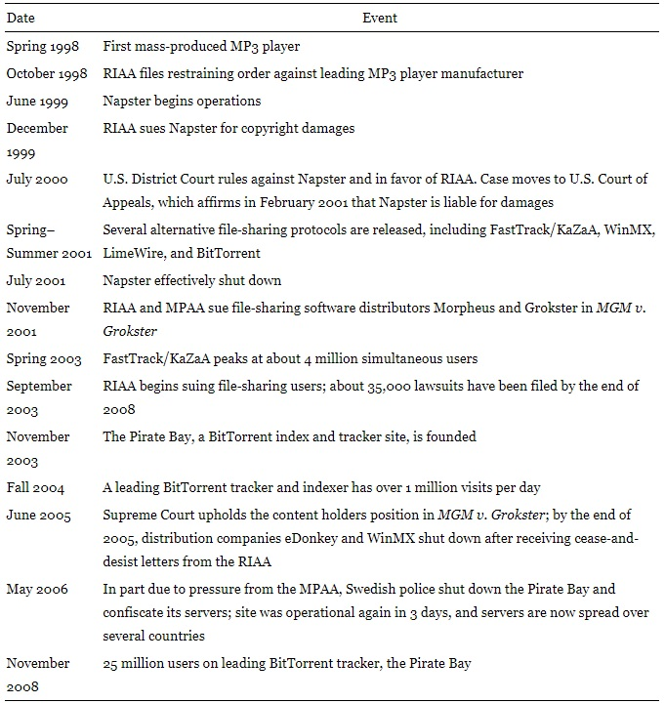
History
Emily Lin
Figure: key events of file-sharing [1].
Oberholzer and Strumpf on file-sharing.
IPRED on April 1st, 2009 [2].
HADOPI in 2009
<Graphic as big as will fit>
Notes:
The figure shows some of the most significant events regarding file-sharing.
Researchers Oberholzer and Strumpf explain file-sharing as a process that “relies on computers forming networks to allow the transfer of data. Each computer (or node) may agree to share some files, and file‐sharing software allows users to search for and download files from other computers in the network. Individual nodes are called clients if they request information, servers if they fulfill requests, and peers if they do both.”
On April 1st 2009, the international property rights law, the Intellectual Property Rights Enforcement Directive (IPRED), was implemented in Sweden. This enforcement directive made it easier for property right holders to identify file-sharers by requesting their identities from ISPs.
In 2009, France released the HADOPI law, or the Creation and Internet law, in order to prevent pirated material to be exchanged. It allows for online monitoring for piracy.
These are some more modern policies that reflect the severity of music piracy.

Slide 23
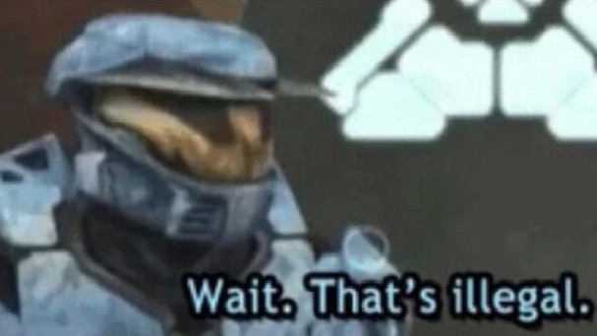
Laws and court cases that protect producers
Emily Lin
Section 143A: Unauthorized reproduction and transfer of sound recordings [3].
Digital Millennium Copyright Act (DMCA)
Capitol Records vs Thomas-Rasset 2007-2013 [4].
<Graphic as big as will fit>
Notes:
According to the 192nd General Court of the Commonwealth of Massachusetts, under Section 143A, if you use an artists’ work without their approval and gain profit off of it, you are violating the law.
As we read from the text, the DMCA prohibits people from copying a product that they did not make.
The most recent major court case regarding music piracy was Capital Records vs. Thomas-Rasset in 2007, and lasted 6 years. "Capitol Records and other major labels sued Thomas in 2006 for downloading and sharing 24 songs with KaZaa." "Plaintiffs sought injunctive relief, statutory damages, costs and attorney fees." The conclusion ruled in favor of Capitol Records, using the Grokster ruling from MGM Studios, Inc. vs. Grokster Ltd. 2005, which states: ‘[w]hen a widely shared service or product is used to commit infringement, it may be impossible to enforce rights in the protected work effectively against all direct infringers, the only practical alternative being to go against the distributor of the copying device for secondary liability on a theory of contributory or vicarious infringement”.

Slide 24
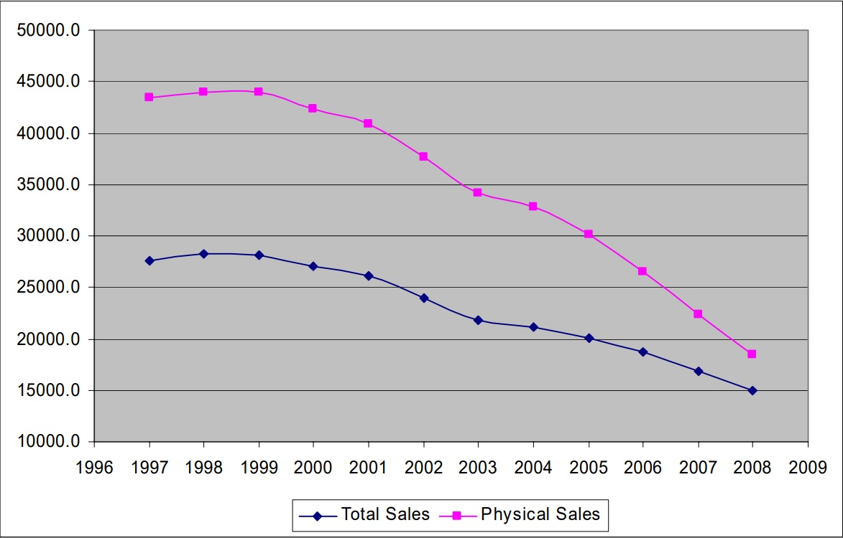
Effects of file-sharing on profits
Emily Lin
RIAA Statements [5]
Physical music sales dropped by 58% between 1999 and 2008.
Total (physical + digital music) sales dropped by 47.3% between 1999 and 2008.
More media exposure at a cost [5]
Static and dynamic analysis [5]
Gradual decline in total music sales from 1996 to 2009 [5]
Notes:
The Recording Industry Association of America (RIAA) stated:
“’Our goal with every anti-piracy effort is to protect the ability of the recording industry to invest in new bands and new music’”
Followed by:
“’this theft has hurt the music community, with thousands of layoffs, songwriters out of work and new artists having a harder time getting signed and breaking into the business.’”
According to Oberholzer and Strumpf, the graph indicates that the sales of physical music have dropped by 58% between 1999 and 2008. The total number of sales (physical and digital music) dropped by 47.3% between 1999 and 2008.
Prior to internet sales of music, we had 12-song compact discs. Costs included: physical pressing, packaging, and delivery. Royalties are also due to artists and labels.
Static analysis describes music that already exists. Dynamic analysis revolves around fluctuating demand. The static analysis tells us that eliminating intellectual property rights benefits society because everybody can share music without paying for it. However, the dynamic analysis tells us that in an ever-changing industry, the dynamic impact of a weakening copyright will potentially cause producers to stop investing in producing music.

Slide 25
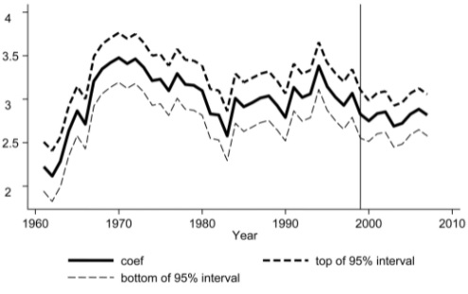
Effects of file-sharing on profits (cont.)
Emily Lin
Concerns regarding digital sales [5].
  iTunes released in 2001
  iTunes saw great success in 2003
  Sales downtrend post-2003
  97, 751 new albums in 2009, but
  2,050 sold over 5,000 units (Soundscan)
European examples of piracy being harmful [2].
Notes:
The graph you saw beforehand provided insight into the trend of physical sales, and it might pique your curiosity about digital sales. In 2001 iTunes was released and the application had great success in 2003, which is accounted for in digital sales. This graph demonstrates that, however, beyond that instance of album sales success, there is no other demonstration. A curious point is how the sales graph seems to be keeping up with decades prior to the Napster incident, but there was a massive increase in album production. Despite this, not all albums were successful. Soundscan, a widely used tracking system that assists in recording sales to music Billboards, showed 97,751 new albums were released in 2009, but only 2,050 sold over 5,000 units.
One study concluded that while under the HADOPI laws, control group nations like Belgium and Netherlands demonstrated that piracy damaged sales for larger celebrity musicians. The reason for choosing other nations, alongside the United States is because the laws involving ISP subscriber monitoring is typically more strict than the laid-back surveillance that the U.S. has. This provides a more accurate representation for data that is desperately needed. Most of the studies I came across proclaimed that not enough solid data is available to prove the damage done to sales overall.

Slide 26
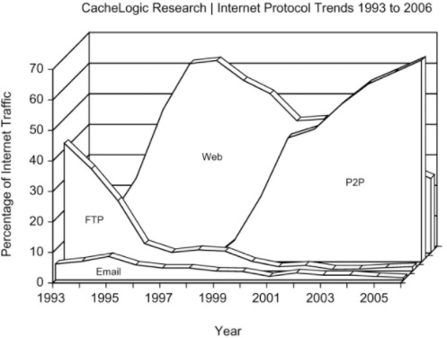
Evidence of file-sharing via packet Inspections
Emily Lin
Deep-packet inspection for further analysis [1].
  Sandvine and CacheLogic are 2 companies responsible for packet inspection.
  CacheLogic revealed Peer-to-Peer activity had a sharp incline starting from Napster’s release in 1999.
  There is an indication between the years 2003 and 2006 that correlate loss of sales and P2P connectivity.
Notes:
Peer-to-Peer connections (P2P) started a huge incline at the start of the Napster’s launch year. This graph, with extrapolated data from CacheLogic Research--a company that specializes in Deep-Packet Inspections, gives us insight into this irregularity. File-sharing is proven to be the most prevalent method of piracy. This lines up with the previous graph, showing a dip around the 2004 mark, with a small incline in the following year of 2005.

Slide 27
References
Emily Lin
[1] Felix Oberholzer‐Gee and Koleman Strumpf, File Sharing and Copyright, (The University of Chicago Press, 2010), https://www.journals.uchicago.edu/doi/full/10.1086/605852
[2] Adrian Adermon and Che-Yuan Liang, Piracy and music sales: The effects of an anti-piracy law, (ScienceDirect, September 2014), https://www.sciencedirect.com/science/article/abs/pii/S0167268114001395?casa_token=K5P2Zel55ZEAAAAA:aXs28Kma1ldYROoGL4cz88yTxtas-9S9m82S-zRkGvlyegGpJbALxkej_h_Va5oSGmpUt1dElw
[3] General Law - Part IV, Title I, Chapter 266, Section 143A, https://malegislature.gov/Laws/GeneralLaws/PartIV/TitleI/Chapter266/Section143A, Accessed 8 September 2021
[4] Péter Mezei, Copyright Liability and Music ‘Piracy’: Capitol Records v Thomas-Rasset, (SSRN, 22 March 2021), https://papers.ssrn.com/sol3/papers.cfm?abstract_id=3793417
[5] Joel Waldfogel, Music Piracy and Its Effects on Demand, Supply, and Welfare, (The University of Chicago Press, 2012), https://www.journals.uchicago.edu/doi/full/10.1086/663157
[6] Alejandro Zentner, Ten Years of File Sharing and Its Effect on International Physical and Digital Music Sales, (SSRN, 14 December 2010), https://dx.doi.org/10.2139/ssrn.1724444

Slide 28
AI Generated code, who owns it?
Justin Luce

Slide 29
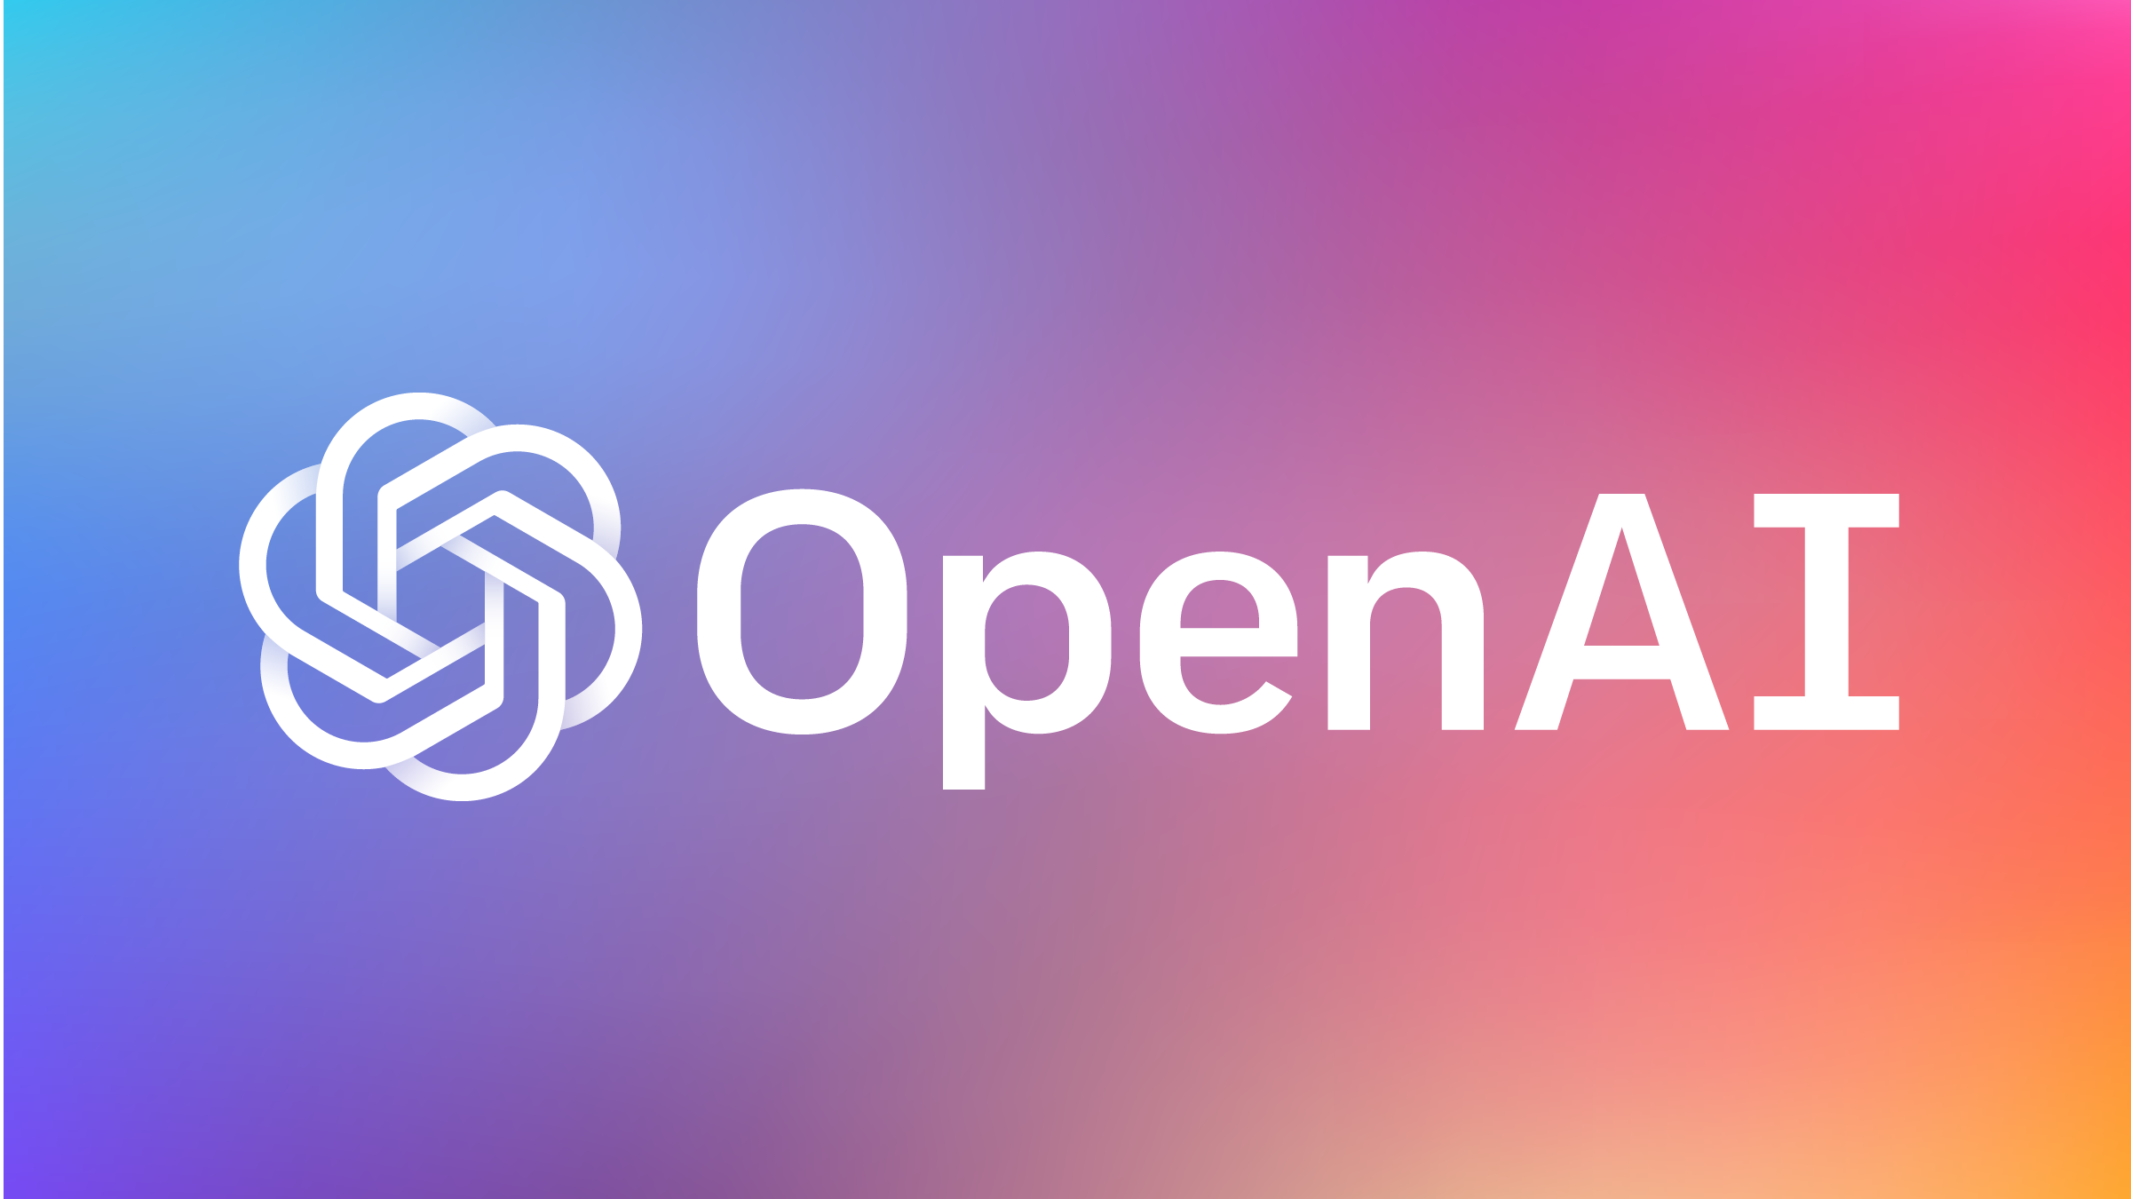
Growth Of AI Content Generation
Justin Luce
2015 – Open AI
2018 – GPT 1
2019 – GPT 2
2020 – GPT 3
2021 – Codex
Notes:
While there are many content generation models and companies working on AI powered content generation,
I’ll be focusing in on Open AI.
Founded in 2015
After 3 years, GPT every year
Released Codex in late 2021

Slide 30
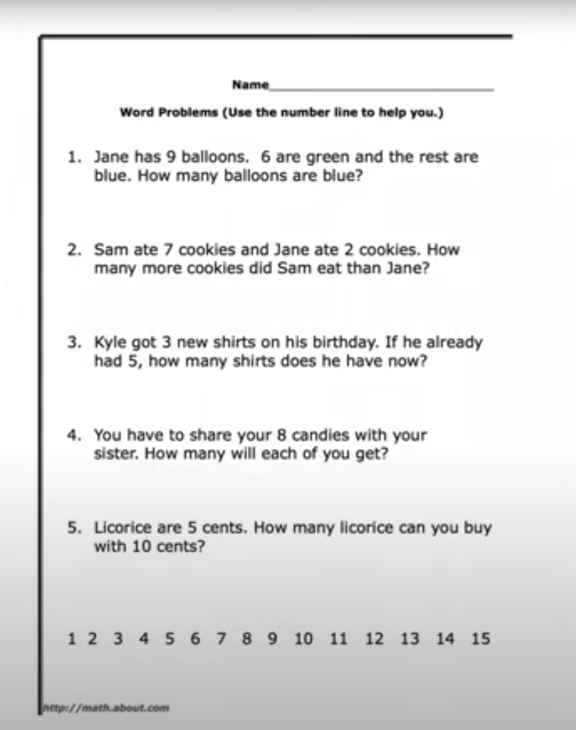
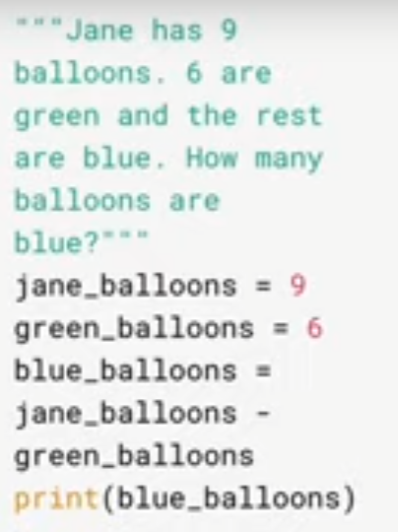
Open AI Codex
Justin Luce
Descendant of GPT-3
General-purpose programming model
Natural language
Used billions of lines of source code from publicly available repositories
Word problems
Notes:
Utilized training data/resources from GPT-3
Combination of GPT-3 natural language data and code from GitHub/publicly available repositories
They gave it a first-grade math test (seen to the right)
We often don’t appreciate the ability to comprehend text/speech…
From a programming/hard-coding, it’s a nearly impossible problem.

Slide 31
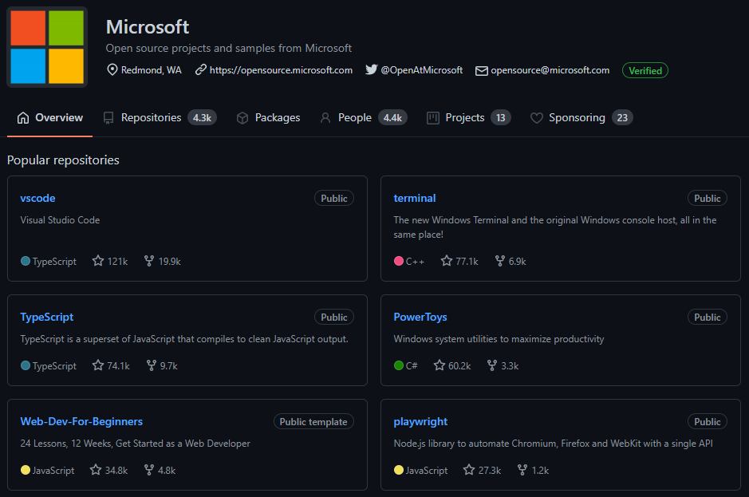
Training Data
Justin Luce
Used publicly available code on GitHub
Code on GitHub has different licenses
There aren’t clear standards for what can be used as training data
Notes:
Two elements pertaining to IP, the training data code, and the output.
The code used in the training data, although publicly available, has a multitude of difference licenses. Unclear how they handled that.
The license don’t provide any clarity in terms of use in training data.

Slide 32
CODEX Terms
Justin Luce
Codex Terms
“OpenAI will not assert any rights in, or claim to, the Code Output”
Who owns it?
Consistent output isn’t guaranteed.
“You and your end users may want to use Code Output freely, without worrying that OpenAI might claim it. Therefore, as between OpenAI and you (and your end users), OpenAI will not assert any rights in, or claim to, the Code Output other than license and use rights in these Preview Terms and the API Terms of Use (but excluding Section 2(b)), so long as you and your end users do not breach or violate any promises, covenants, obligations, representations or warranties with or made to OpenAI. “Code Output” means the source code generated by OpenAI Codex in response to your (or your end users’) prompts, and not any metadata, telemetry data, contextual data or the like.”
Notes:
Looking at the code output, OpenAI says they won’t claim any rights to it… (in the beta)
If OpenAI doesn’t claim rights to it, who does?
You may get different outputs for the same input; someone may just get lucky with some breakthrough output, despite having the same input as dozens of others.

Slide 33
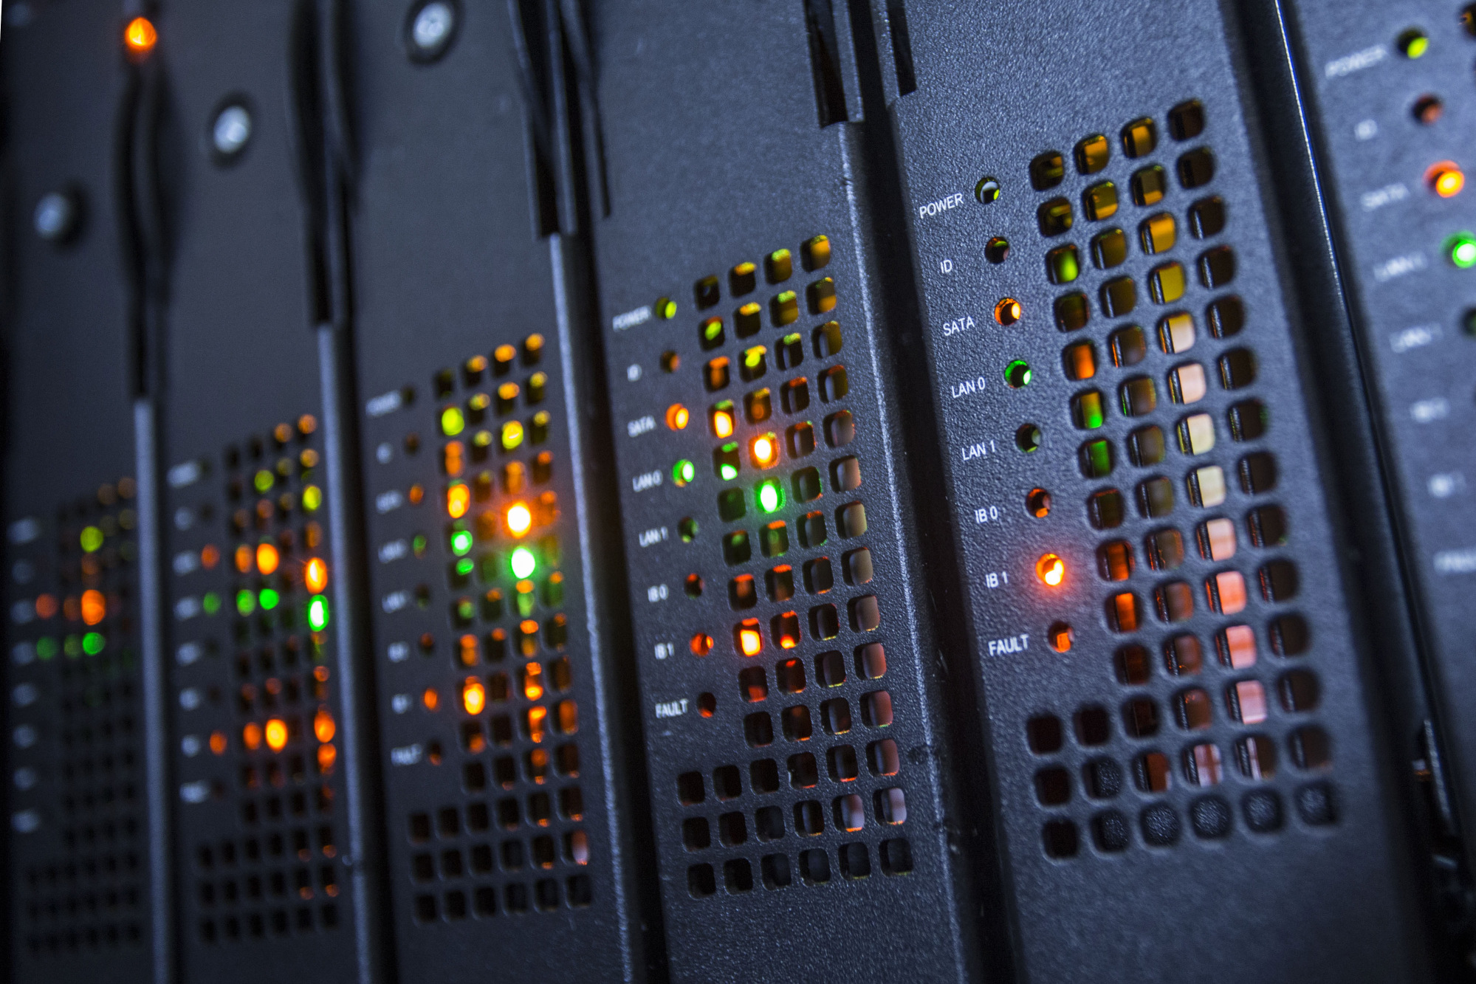
“Natural Person”
Justin Luce
Patent act
Who is an “inventor”?
“Whoever,” “himself or herself,” and “individual”
Notes:
Can the AI claim rights to it?
Patent Act describes an inventor with “whoever”, “himself or herself”, etc.
Recent Patent case, USPTO ruling that only a “natural person” can file for a patent.

Slide 34
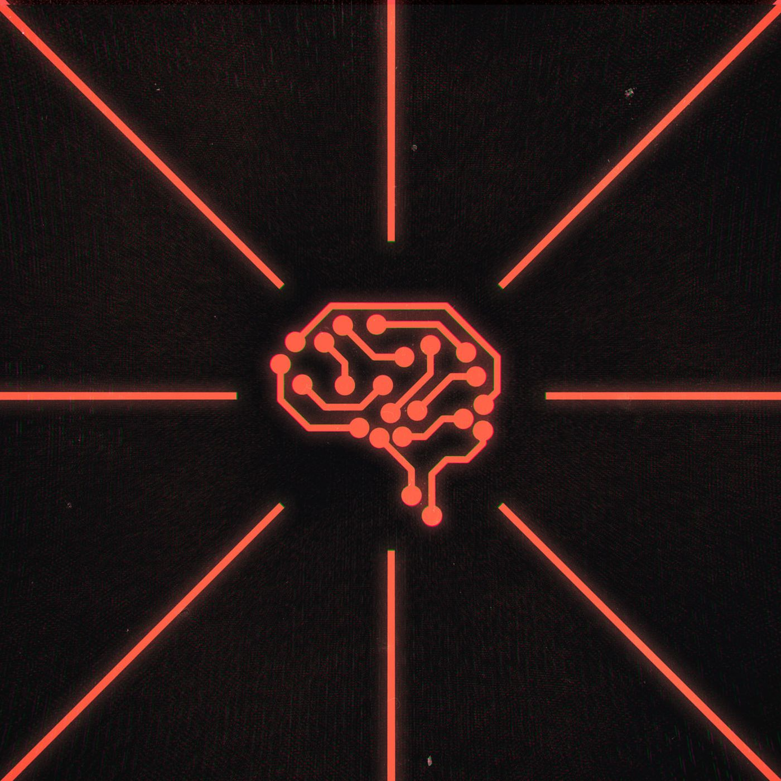
Quantity
Justin Luce
What percent of the code was AI-generated?
Entry-level programming
Entirely generated
Notes:
How much of the code was generated by the AI
Shouldn’t be able to copyright something solely written/developed by the AI
If it’s simply performing entry-level programming work on a much larger project, it really doesn’t matter.
Publicly available
What the AI has generated is basically the Tree (reading/Locke). Once someone modifies it enough, they can lay claim.

Slide 35
References
Justin Luce
[1] Wojciech Zaremba, Greg, Brockman, and OpenAI, OpenAI Codex, (OpenAI, Aug 10 2021), https://openai.com/blog/openai-codex/ (Sep 10, 2021)
[2] OpenAI, Timeline, (OpenAI, Aug 10 2021), https://openai.com/timeline/ (Sep 10, 2021)
[3] OpenAI, Additional Terms and Conditions for the OpenAI Codex Beta Preview, (OpenAI, 2021), https://beta.openai.com/policies/codex-terms (Sep 10, 2021)
[4] Susan Decker, Only Humans, Not AI Machines, Get a U.S. Patent, Judge Says, (Bloomberg, Sep 3 2021), https://www.bloomberg.com/news/articles/2021-09-03/only-humans-not-ai-machines-can-get-a-u-s-patent-judge-rules (Sep 10, 2021)
[5] USPTO, Trademark Manual of Examining Procedure, (USPTO, Jul 2021), https://tmep.uspto.gov/RDMS/TMEP/current#/current/TMEP-800d1e122.html (09/10/2021)

Slide 36
Class 5
The End
Keith A. Pray
socialimps.keithpray.net
Notes:
This is the end. Any slides beyond this point are for answering questions that may arise but not needed in the main talk. Some slides may also be unfinished and are not needed but kept just in case.

