Slide 1
Unintended Consequences of a career in Engineering
Brannen Hough
brannen.s.hough@baesystems.com

Slide 2
How to end up a mass murderer
without even trying

Slide 3
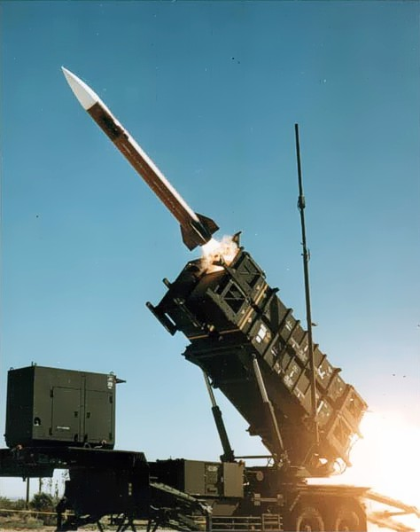
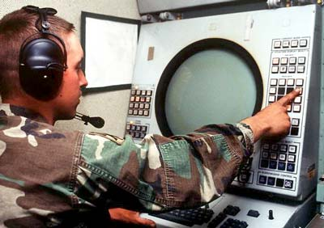
What am I here to talk about?
The PATRIOT System, and my part in it
  Anti-aircraft / ABM system
  PATRIOT stands for:
Phased
Array
Tracking
Radio
Intercept
Of
Target
Notes:
Generally I’m here to share with you a bit of what it like to work in the Defense sector – what kinds of cool things you can be working on, and some of what you can expect.
Specifically I’m here to talk about the PATRIOT system and my part in it.

Slide 4
What am I here to talk about?
The PATRIOT System, and my part in it
  Anti-aircraft / ABM system
  PATRIOT stands for:
Battlebots Edition
Phased
Array
Tracking
Radio
Intercept
Of
Target
Notes:
Generally I’m here to share with you a bit of what it like to work in the Defense sector – what kinds of cool things you can be working on, and some of what you can expect.
Specifically I’m here to talk about the PATRIOT system and my part in it.

Slide 5
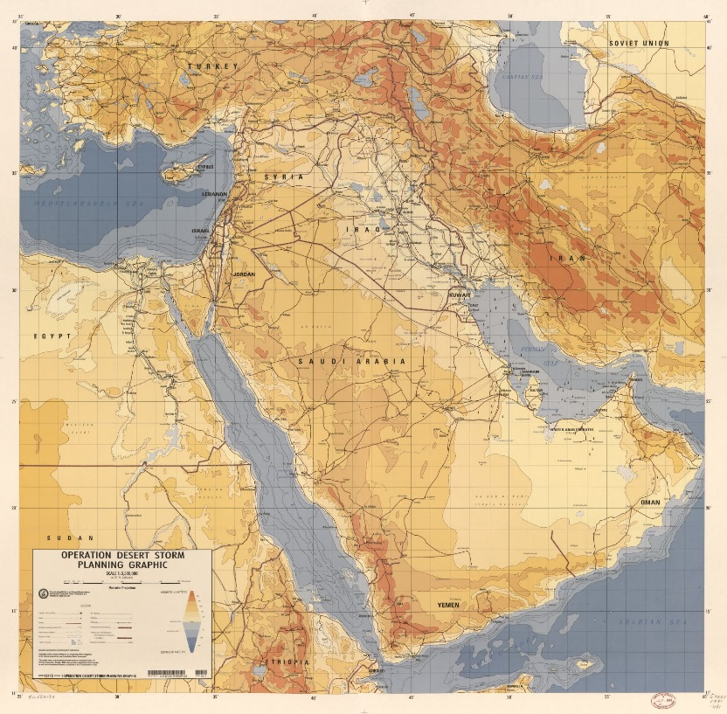
The Arena
Date: Aug 1990 – Feb 1991
Operation Desert Storm / First Gulf War
Goal: Liberation of Kuwait and destruction of Iraq’s war fighting capability
Notes:
Iraq overruns Kuwait, seizing their oil fields and cities A coalition of nations (led by the US) builds up troops in neighboring Saudi Arabia, looking to retake Kuwait
KAP: suggest labeling countries of interest

Slide 6
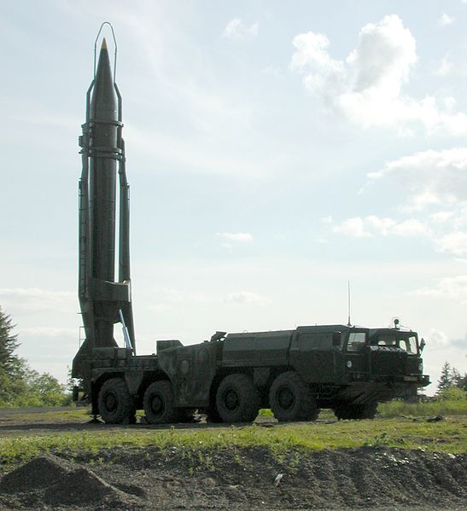
Contestant 1 – Scud
Scud means “to move or run swiftly”
Soviet built surface to surface missile
Scud is the designation NATO gave the missile

Slide 7
Contestant 1 – Scud
37’ Long
Scud means “to move or run swiftly”
Soviet built surface to surface missile
Scud is the designation NATO gave the missile
Designed from the German V-2
Came in various versions as it was refined over the years – Iraq had Scud-B, the most common one (about 7,000 produced)

Slide 8
Contestant 1 – Scud
37’ Long
13,000 Lb
Scud means “to move or run swiftly”
Soviet built surface to surface missile
Scud is the designation NATO gave the missile
Designed from the German V-2
Came in various versions as it was refined over the years – Iraq had Scud-B, the most common one (about 7,000 produced)
Can carry explosive, chemical, or 5-80 kilo-ton nuclear warhead

Slide 9
Contestant 1 – Scud
37’ Long
13,000 Lb
Scud means “to move or run swiftly”
Soviet built surface to surface missile
Scud is the designation NATO gave the missile
Designed from the German V-2
Came in various versions as it was refined over the years – Iraq had Scud-B, the most common one (about 7,000 produced)
Can carry explosive, chemical, or 5-80 kilo-ton nuclear warhead
Iraq was also building their own, improved, version
Mach 5+

Slide 10
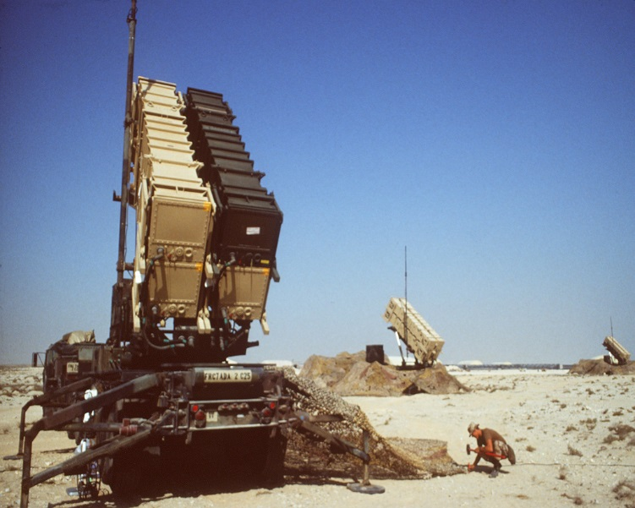
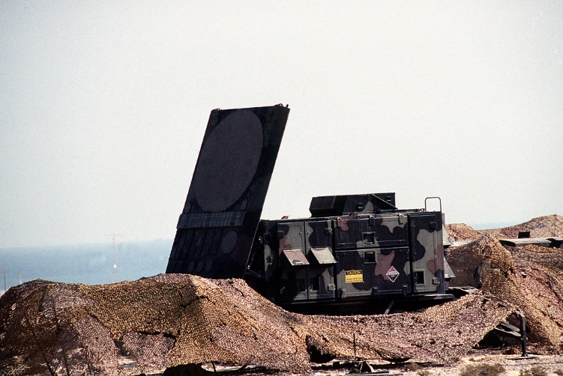
Contestant 2 - PATRIOT
Phased Array Tracking, Radio Intercept of Target
Movable (not mobile) anti-aircraft system developed back in the 60s by Raytheon, Hughes, and RCA
Developed to shoot down bombers during the Cold War days
Pitched as an anti-missile system by Raytheon before the war (1988)
Notes:
Hughes and RCA also had a hand in the PATRIOT. First fielded in 1969.
PATRIOT is an all-in-one solution – many AA systems have multiple radar sets to handle different jobs. PATRIOT has one radar set that does every job.

Slide 11
Contestant 2 - PATRIOT
Phased Array Tracking, Radio Intercept of Target
Movable (not mobile) anti-aircraft system developed back in the 60s by Raytheon, Hughes, and RCA
Developed to shoot down bombers during the Cold War days
Pitched as an anti-missile system by Raytheon before the war (1988)
PAC-2 (PATRIOT Advanced Capability) missile:
  Optimized for ABM Role (mostly software updates)
  Cost: $1-6 Million
  19 Feet Long
  Flies at Mach 2.8
  200lb Warhead

Slide 12
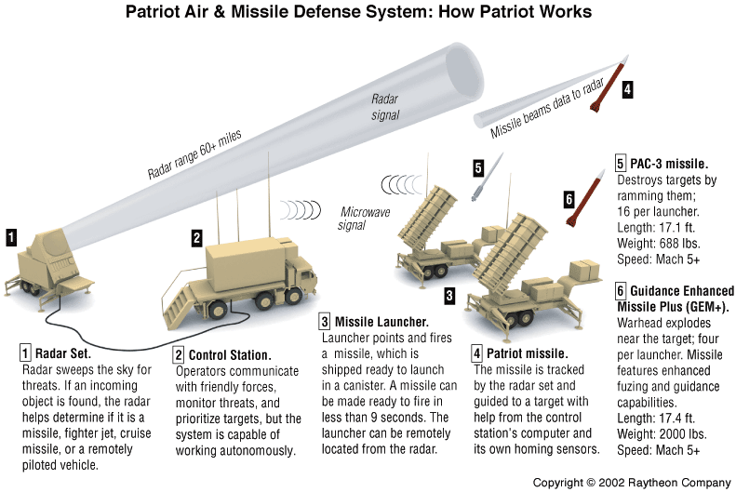
Here's what it looks like

Slide 13
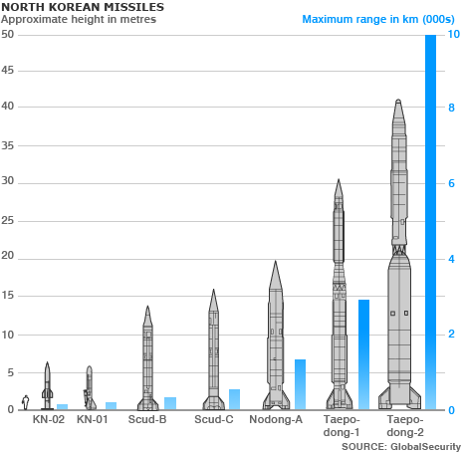
The Matchup
Graph on the right shows the relative sizes of the missiles
Scud on the right
Patriot on the left
And a person, to the left of the Patriot.
Scale is in Meters

Slide 14
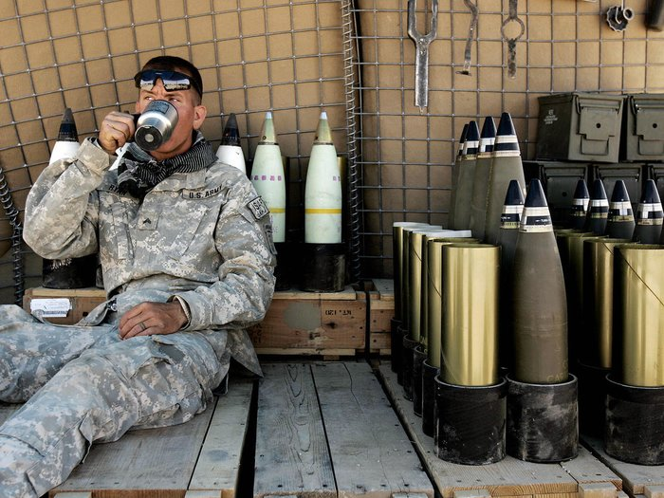
So, where do I come in?
PATRIOT Transmitter had flaws
PATRIOT flaws
Reliable in general
When it broke, took a long time to repair
Little diagnostic information
Laborious field service procedures

Slide 15
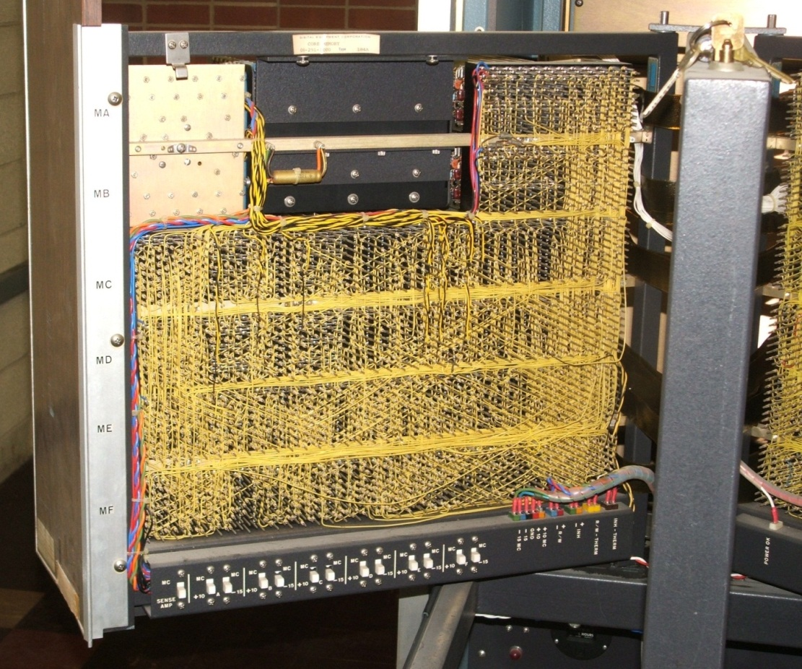
The old PATRIOT Transmitter
63 circuit cards
AND cards
OR cards
Inverter cards
Digital counter cards
All circuits wired on a backplane, using individual wires, like this example (not PATRIOT)

Slide 16
PATRIOT TMU Program
Meant to upgrade the PATRIOT transmitter units with new control logic
  Simpler, fewer parts to replace
  Faster to repair
  More self-test information available (450 bits vs. 24)
  Better health monitoring
Replaced 63 circuit cards with 13 cards (including a microprocessor)
Program length was 5+ years from contract start to first units leaving factory
True Waterfall development effort
I worked this for 4 ½ years
Notes:
Maybe add a Bar Chart to graphically show differences?

Slide 17
Round 1 – Knockout!
August 2, 1990
Iraq invades Kuwait with the 4th largest army in the world - taking everyone by surprise
Kuwait falls in days
UN and the Arab League (with the exception of Libya) condemn the invasion
US troops flown into Saudi Arabia at the request of the Saudis

Slide 18
Round 2 – the Coalition Strikes Back
The US formed a coalition of countries to oppose Iraq
34 countries joined
Japan and Germany, forbidden military intervention, lent financial support
Even the Soviet Union supported the effort
US
Saudi Arabia
Egypt
Syria
United Kingdom (England)
France
Greece
Turkey
…..

Slide 19
Round 2 – the Coalition Strikes Back
The US formed a coalition of countries to oppose Iraq
34 countries joined
Japan and Germany, forbidden military intervention, lent financial support
Even the Soviet Union supported the effort
Israel was specifically NOT part of the coalition
US
Saudi Arabia
Egypt
Syria
United Kingdom (England)
France
Greece
Turkey
…..

Slide 20
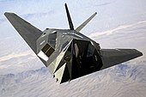
Round 3 – Trading Blows
Coalition forces launched massive airstrikes starting Jan 16, 1991
Over 100,000 sorties; over 88,000 tons of bombs
Iraq responded with scud missile attacks
Aimed at Saudi Arabian targets
And at Israel

Slide 21
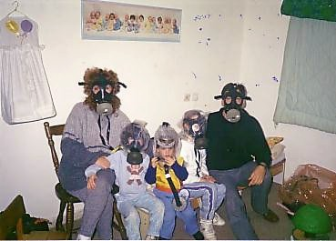
Under Scud Bombardment
In a bid to keep Israel from striking back at Iraq, PATRIOT batteries were rushed to protect Israeli citizens
PATRIOT batteries were permanently placed around sensitive areas, manned and running 24/7, in case of missile attack
Conventional high explosives
were carried by the Scuds,
but the fear was they would be
armed with chemical or biological weapons

Slide 22
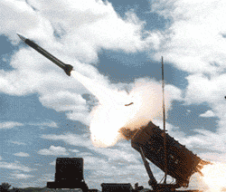
How effective was the Patriot vs the Scud?
In the initial trials, extremely (4 on 1)
In 'economy' mode (1 on 1), somewhat less effective (detailed evaluations still classified)
  The PATRIOT missiles were skewed towards the front of the Scud
  The idea was to disable/detonate the warhead
  Worked as planned, but that left several tons of falling rocket
When deployed to Israel, the 'economy' mode was less helpful as Israel is a densely populated area.

Slide 23
Fateful Day
The worst scud attack occurred on Feb 25, 1991
28 dead, 97 wounded
Direct hit by a scud on an Army barracks
Under protection from a PATRIOT battery

Slide 24
So what went wrong that day?
A software error in the Engagement Control System caused the PATRIOT guarding the area to lose track
Without a good target track, the PATRIOT missiles cannot engage
So it never fired at the Scud

Slide 25
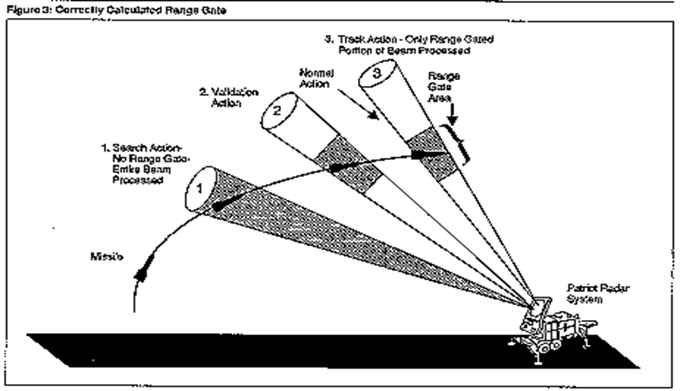
Normal operation
(this is all from the GAO report)

Slide 26
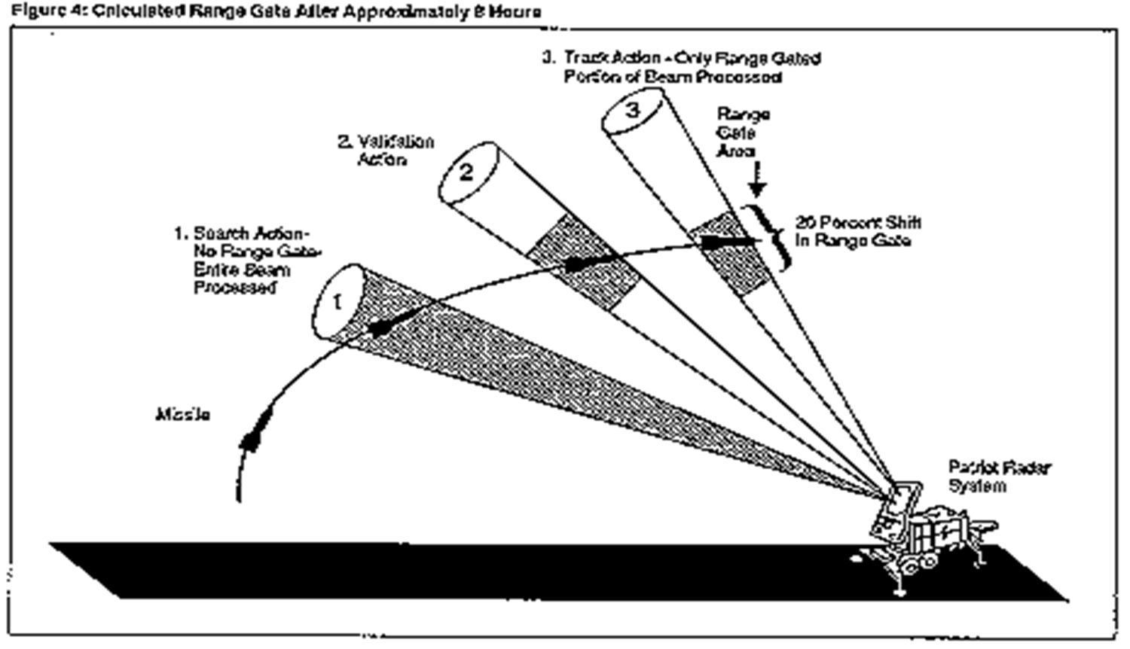
The range gate error

Slide 27
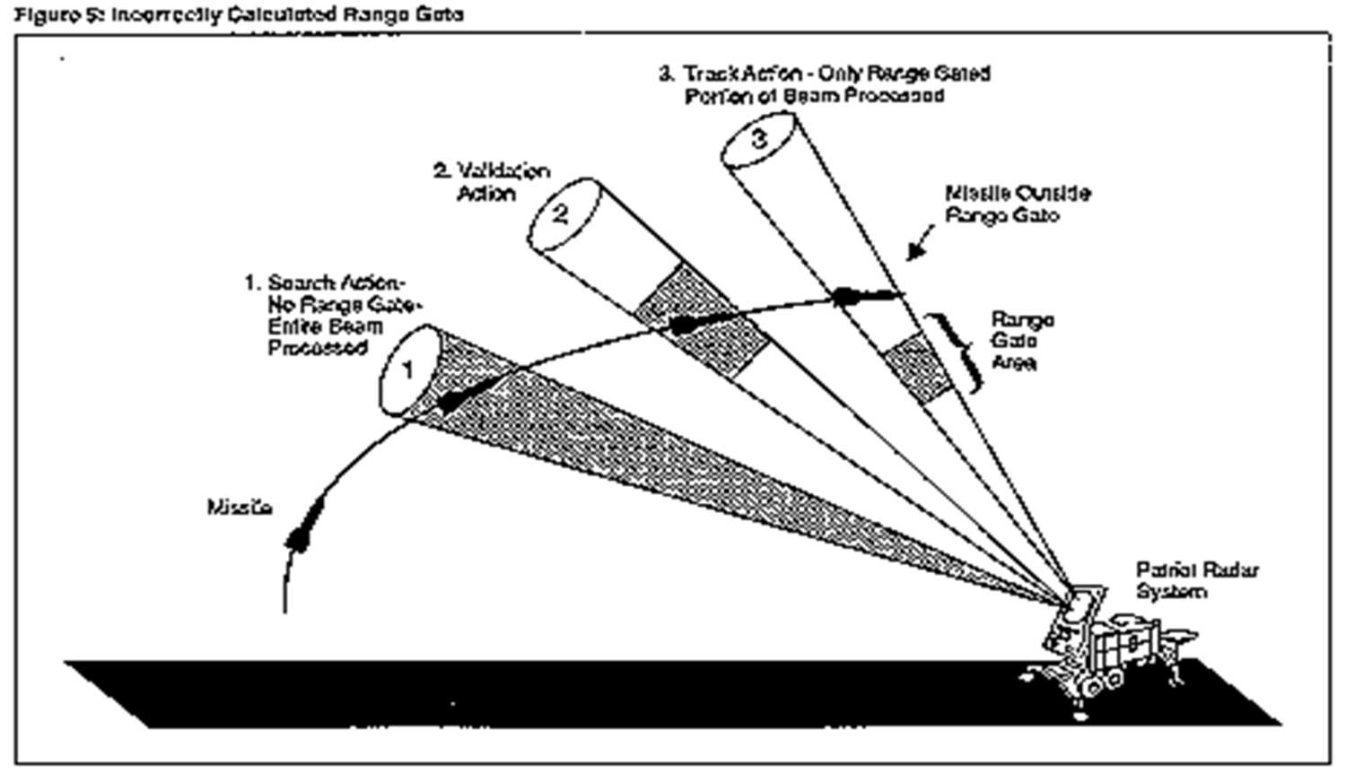
What happened that day

Slide 28
A Perfect Storm of Circumstances
The PATRIOT system's software had a flaw
Our Army never found the flaw due to how they used the system
  Used as a point defense system against the Soviet Union mostly
  Moved around constantly for security reasons
  Pretty reliable, but if down, it took a long time to repair
I had just finished the TMU project at Raytheon, and the upgraded units were in the field – both in Saudi Arabia and Israel.

Slide 29
The Storm Continues Building
The PATRIOT systems were being used in fixed positions, run 24 hours a day
With the TMU improvements I made, the system was both more reliable (it could spot trouble sooner) and much quicker to repair
The Israel Army found the flaw in PATRIOT when running for as little as 8 hours
They alerted our Army, which issued a vague warning that didn't prompt anyone to action

Slide 30
The Storm breaks
The Iraqi launched a Scud missile at Dhahran, in Saudi Arabia
The Scud functions perfectly
The PATRIOT battery guarding the city was running too long, and the flaw prevented the missile from being tracked.
The automatic systems never fired
There was no time for the operators to do anything
The Scud hit the barracks, killing and wounding 125 people

Slide 31
And yet it could have been prevented
Raytheon worked on a software fix to the flaw for 2 weeks after it was found – the two weeks prior to the attack
Patches were distributed for the software to all PATRIOT units in the theatre

Slide 32
And yet it could have been prevented
Raytheon worked on a software fix to the flaw for 2 weeks after it was found – the two weeks prior to the attack
Patches were distributed for the software to all PATRIOT units in the theatre
The patches arrived on Feb 26th
One day after the barracks was destroyed.

Slide 33
Nothing like that can happen to me, right?
No matter what we're working on, there is almost always some potential for disaster, especially with software and hardware for the military (also CIA, NSA, etc.), transportation, and medicine (and many others).
Sometimes it's not even doing your job wrong, but doing it right, that can lead to disaster.
How will YOU handle it?

