Slide 1
Class 10
Professional Ethics
Keith A. Pray
socialimps.keithpray.net

Slide 2
what works well Online With Zoom
Sign in with First and Last Name
Stay muted unless you are going to speak
To speak use the raise your hand feature
To answer yes/no questions use the “yes” ”no” buttons
Turn your camera on
Wait until the end of student presentations to ask questions
  Write them down so you don’t forget

Slide 3
Overview
Review
Debate
Assignment
Students Present
Notes:
ADD QUIZ AS BACKUP IF CLASS DISCUSSION NOT LONG ENOUGH

Slide 4
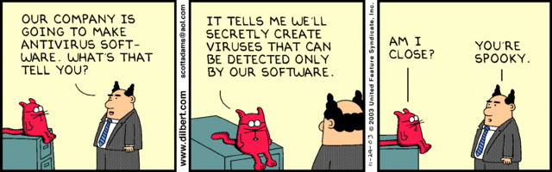
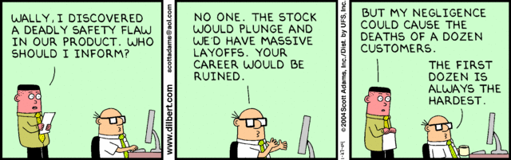
Notes:
Ask how many people in ACM or IEEE

Slide 5
Debate Ground Rules
Before Debate
  Add “(YES)” or “(NO)” to the end of your name in Zoom to show your side
  10 minutes to converse with your team
  Share argument points, counter points, and responses
  Share experiences in different countries, web sites, access points
  Decide who will: Go first, Respond to which points from opposing side
During Debate
  1 turn per person until everyone on your team has spoken
  Try to keep remarks to 30 seconds
  Switch sides at any time if you change your mind
Notes:
Release Game or Not Debate
Chapter 9 In-class Exercises # 24.
Should the company produce the game?
Use the SWE Code Of Ethics as the basis for your argument.

Slide 6
Assignment
1 Page Paper
  What should computerized automation be applied to next?
Finish all reading
Group Project
  Add analysis to website addressing remaining topics
  Group Presentation Draft
    Submit as Power Point on Canvas
    Post Power Point file on group website
Notes:
1 Page Paper Ideas:
For Good - How will you use your computing related education to do good in the world?
Dark Net - Is the Dark Net good or bad?
Does computerized automation help the economy or society?
What should computerized automated be applied to next?
If productivity has increased so much, why are we working so hard? Should we?
What job skills will survive computerized automation?

Slide 7
Overview
Review
Debate
Assignment
Students Present
Notes:
Show WPI and/or corporate code of ethics.

Slide 8
What am I agreeing to?
Renee Sawka
Notes:
In this presentation, we will explore the concerns of the current structure of terms and conditions of service and argue why we, as computing professionals, should advocate for more ethical and understandable agreements that users must accept to use software.

Slide 9
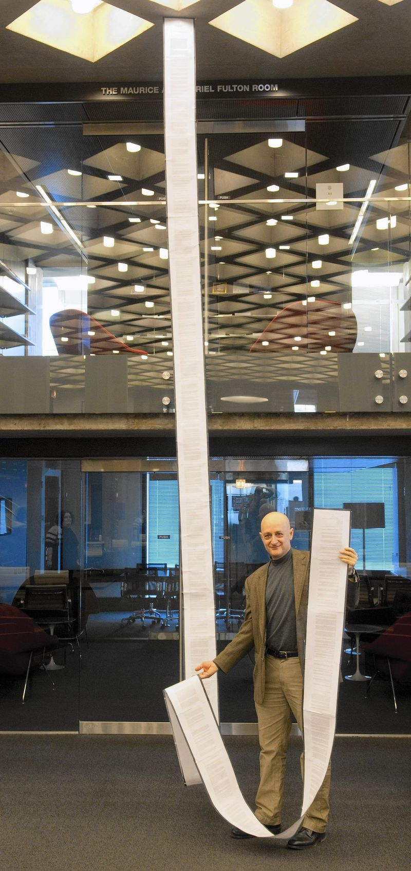
Terms of service are too Complex
Renee Sawka
Higher reading level than the average consumer
  Most U.S. documents require at/below 8th grade
  Terms of Service at level of academic journals (Ph.D.)
Average user sees 1462 policies/year
  ~244 hours of estimated reading time
Simple ‘accept’ button enables habit of acceptance
  91% of individuals blindly accept terms
  [1,2,8]
Figure 1: The iTunes TOS is daunting in length [3]
Notes:
Whether from updating operating systems on our mobile devices or signing up for streaming services, we are all familiar with software terms of service agreements that we agree to in order to have access to services that are often considered required for many activities.
These agreements are used to govern user behavior and customers’ rights to use the software, helping to limit companies’ liability and dictate legal consequences in situations where users breach the rules outlined. They also serve to protect companies’ intellectual property and commercial rights, in addition to specifying the privacy policy and stating what data is collected and used from customers.
Yet, the long-winded and complicated legal nature of these policies naturally discourages the overwhelming majority of customers from understanding the information contained, fostering a common culture where people accept the policies without reading them or evaluating the rights that they waive by accepting. While the legal responsibility of reading a contract falls on the customer in order to maintain informed consent, the ethical responsibility falls on the company to ensure that policies are understandable by end users and not so legalistic.
Additionally, many customers absolutely require the service that they seek out and therefore do not effectively have a choice of not accepting the terms of service, making it futile to spend the time dissecting the policy. Saving this time, however, facilitates clients in making the dangerous assumption that the companies have the best interests of their data in mind and that no clauses that could harm customers have been more subtly included, since companies know that most people do not read these agreements and can take advantage of that fact.

Slide 10
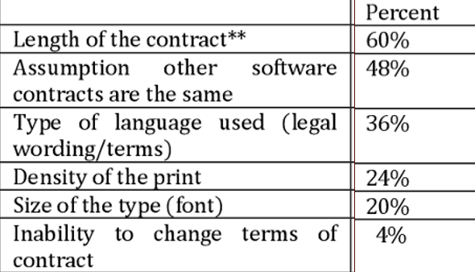
Service Providers Have No incentive To change
Renee Sawka
No legal obligation to do so
  More flexibility if following the bare minimum of the law
Companies want more use of their software
  Collect and sell user data for revenue
Terms are non-negotiable
  End users need the software
  Insignificant # of people who don’t agree
Figure 2: Reasons why people don’t read TOS show that they are unreasonably hard for readers to digest [4]
  [1,4]
Notes:
Yet, whether or not an individual reads a service agreement, by clicking “I Accept” or “I Agree,” they are legally bound by US contract law to abide by the terms and conditions of the contract. Because of this legal binding of clients and the expectation that consumers read before agreeing, service providers have no motivation internally or externally to make their policies more readable and they are in fact not required to do so.
Secondly, by inherently discouraging analysis of the agreements, companies drive up blind acceptance and consequent usage of their product, which enables them to make more revenue off of the data that they collect from users. This in effect makes the end user the product, as the software is at the forefront of a multi-billion dollar industry in data collection.
For these reasons, it is actually in the interest of the companies to make their policies as unintelligible to the average consumer as possible, utilizing the techniques in the left column of figure 2, which are factors known to deter even the most privacy concerned individuals from reading such agreements. Another large factor motivating service providers to keep their agreements very legal intensive is that they know customers need their service regardless, and so very few people would disagree with the terms anyways, a number that would not have even a remote significance on their customer base.
Another ethical concern about these agreements, with their ubiquity in the age of modern computing, is that unlike essentially any other contract, end users do not have any avenue to negotiate the terms and conditions that they must adhere to. This lack of negotiation framework in the current policy infrastructure coupled with the arguments against the lack of readability in the last slide demonstrates a need for societal advocacy for better contracts.

Slide 11
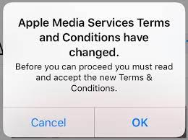
Agreements are all or nothing
Renee Sawka
Rights of users have evolved
  Initially, downloading = consenting
  Now need explicit user permission
  Evolving technology presents another issue
One size shouldn’t fit all
  User agrees to everything upfront
  Users should have some say in terms
  No choice to opt-in to different service levels
Figure 3: Customers either sacrifice some privacy to significantly benefit from the service or suffer from not having the service [6]
  [7, 11]
Notes:
While companies may not currently take users’ best interests into consideration, a monumental societal shift pushing for more transparent agreements will necessitate the introduction of reformed policies at large tech companies that pride themselves on customer satisfaction. This significant change will then lead to a domino effect, where smaller corporations and web applications follow this new standard.
In 2002, Netscape Communications lost a landmark case regarding the enforcement of a Terms of Service Agreement. In a ruling in favor of end users, the US Second Circuit Court of Appeals declared that end users are not bound by the terms of a software license agreement that they downloaded if they were not provided notice that they were entering into an agreement and were not clearly asked for their consent. However, while this ruling led to the prominent display of ‘I Agree’ and ‘I Accept’ buttons, users are not given a third option to negotiate the terms on a large-scale basis such as a petition, where a majority of individuals support a specific change.
As the agreements currently stand, there are many situations where neither agreeing nor disagreeing is a good option. If a user agrees, they may be waiving rights that they weren’t aware of, but if a user disagrees, say for example on a software update, they risk rendering their device incapable in the future. One instance of this is take an iPhone, if you hit cancel on agreeing to the terms of service, it doesn’t give you the option to speak with a company lawyer or offer you the opportunity to comment sections that you wish to renegotiate or clarify, instead it just bounces back to the previous page. Yet without updating like the company wants you to, functionality eventually starts to deteriorate, with some services or apps becoming unavailable and the performance of your device dramatically decreasing, leading you to update despite your initial inclination not to.
Arguably, people should not face consequences like these as a result of limited and poor policy design and integration, drawing attention to the need for computing professionals like us to create some semblance of a code of ethics that can be applied to ensure the protection of the general public from harmful or unreasonable terms of service agreements.

Slide 12
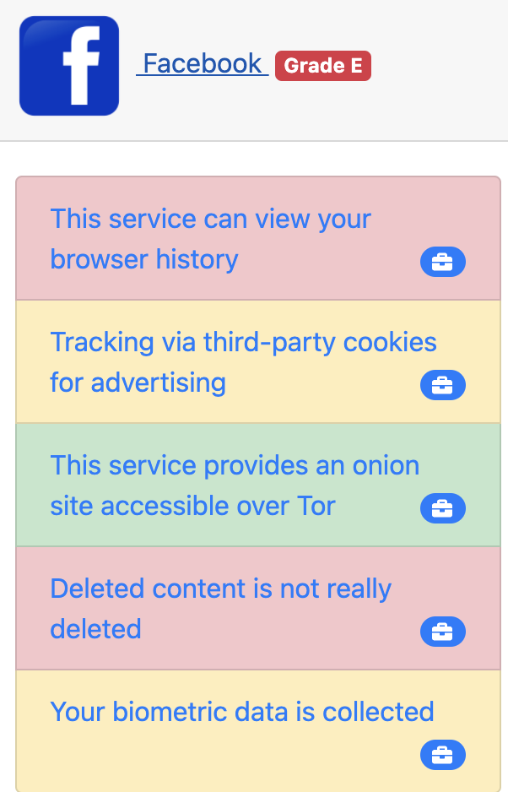
End users need advocates
Renee Sawka
Simpler, shorter, clearer
  Understandable language
  Transparent with respect to data sharing
  Google: 4,220 words in 2007; 3,400 words in 2020
Watchdog groups look out for consumers
Code of Conduct
  Subject digital agreements to ethics
  Governing body to set standards
Figure 4: Terms of Service; Didn’t Read site shows workability of a more officially regulated assessment system [9]
  [5, 10]
Notes:
While the Netscape communications lawsuit was able to enact effective and lasting change to the framework of terms and service agreements, current contracts are within their legal rights, and as such proponents for more understandable terms of service need to instead appeal to companies’ ethicality.
End users and computing professionals have a responsibility to society and to themselves to advocate for fair policies where they aren’t at risk of unintentionally clicking away their right to court by agreeing to something they don’t fully understand.
Early last year in 2020 Google famously overhauled their entire terms of service agreement, clearly outlining in simpler English what the company expects from users, what information it collects from users, and all the other typical components of these agreements. A notable difference is the increased readability and inclusion of definitions and reference links that users can use to augment their understanding of the base agreement.
While this is a step in the right direction and will hopefully prompt more companies to follow in Google’s footsteps, customers still lack motivation to read the agreements, thus steps could be taken to further improve customers’ comprehension, such as alleviating clients of the burden of this seemingly impossible and daunting task entirely. By outsourcing the responsibility to professional organizations or watchdog groups, similar to how taxes are managed by accounting specialists, users can focus their attention on brief bullet summaries of the agreements and the overall quality rating and then determine whether to accept or not based on this quick comprehensible assessment.
Another consideration could be to subject internet and software agreements to a code of ethics like the ACM Code of Ethics and Professional Conduct or one more tailored to this specific medium. Rules like being honest and trustworthy, taking action not to discriminate, respecting privacy, and fostering public awareness of computing would serve to increase the company’s policy’s integrity as well as foster an environment of trust among customers.

Slide 13
References
Renee Sawka
[1] Benoliel, Uri, and Schmuel Becher. “The Duty to Read the Unreadable.” Boston College Law Review, vol. 60, no. 8, Dec. 2019, lawdigitalcommons.bc.edu/bclr/vol60/iss8/2/#:~:text=The%20duty%20to%20read%20doctrine,not%20they%20actually%20read%20th. Accessed 26 April 2021.
[2] McDonald, Aleecia, and Lorrie Cranor. “The Cost of Reading Privacy Policies.” A Journal of Law and Policy for the Information Society, vol. 4, no. 3, 2008. Accessed 26 April 2021.
[3] Ben-Shahar, Omri. “Veto the Privacy Bill.” Chicago Tribune, 18 Aug. 2015, www.chicagotribune.com/opinion/commentary/ct-veto-illinois-rauner-privacy-bill-apps-internet-perspec-0819-jm-20150818-story.html. Accessed 26 April 2021.
[4] Maronick, Thomas. “Do Customers Read Terms of Service Agreements When Installing Software?” International Journal of Business and Social Research, vol. 416, no. 535, 2014, www.semanticscholar.org/paper/Do-Consumers-Read-Terms-of-Service-Agreements-When-Maronick/cc87b0728295b35e6a94f542c6aa63e5a02ffa3b. Accessed 26 April 2021.
[5] Berreby, David. “Click to Agree With What?” The Guardian, 3 Mar. 2017, www.theguardian.com/technology/2017/mar/03/terms-of-service-online-contracts-fine-print. Accessed 26 April 2021.

Slide 14
References
Renee Sawka
[6] Tooki. “‘Apple Media Services Terms and Conditions Have Changed’ Preventing App Downloads & Updates.” "Apple Media Services Terms and Conditions Have Changed", 24 Apr. 2019, discussions.apple.com/thread/250327991. Accessed 26 April 2021.
[7] Ben-Shahar, Omri. “Why Do We Blindly Sign Terms of Service Agreements.” All Things Considered, www.npr.org/2014/09/01/345044359/why-do-we-blindly-sign-terms-of-service-agreements. Accessed 26 April 2021.
[8] Deloitte, 2017, 2017 Global Mobile Consumer Survey, www2.deloitte.com/content/dam/Deloitte/us/Documents/technology-media-telecommunications/us-tmt-2017-global-mobile-consumer-survey-executive-summary.pdf. Accessed 26 April 2021.
[9] Roy, Hugo. “Frontpage -- ToS;DR.” Terms of Service; Didn't Read, tosdr.org/. Accessed 26 April 2021.
[10] “Google Terms of Service – Privacy & Terms.” Google, Google, policies.google.com/terms?
hl=en-US. Accessed 26 April 2021.
[11] Kelly, Heather. “Apple Is Slowing Your Phone Down.” CNN Business, 31 Jan. 2018, money.cnn.com/2017/12/22/technology/apple-iphone-slowdown/index.html. Accessed 26 April 2021.

Slide 15
Digital addiction: responsibility of the Producers
Anna Cherkinsky
Notes:
Hello, I’m Anna Cherkinsky, and today I will be discussing the ethical responsibility of tech industries and developers with regards to gadget, or digital addiction

Slide 16
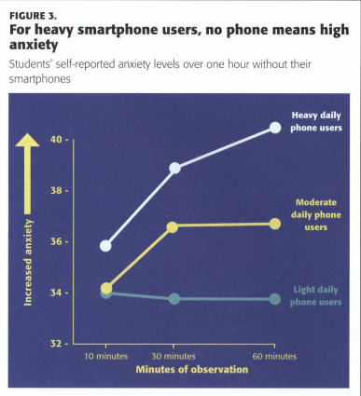
Digital Addiction is an ongoing problem
Anna Cherkinsky
Types of digital addiction are medically classified
  ICD-11 tracks gaming disorder [1]
  Internet, phone, binging addictions are researched ([2], [3], [4])
  Debated subject
It leads to mental health decline
  Anxiety, depression [3]
  Cognitive failures [3]
  Negatively affects performance and quality of life
Rating scale
Depicts increase of anxiety in individuals who heavily utilize their phones. [5].
Notes:
Digital addiction is an ongoing problem
First on the background of digital addiction
Certain types of digital addiction are medically classified
For example, International Statistical Classification of Diseases lists gaming disorder as a recognized addiction disorder
Diagnostic and Statistical Manual of Mental Disorders in the US also recognizes it, and provides a special listing for internet gaming disorder
Other nations (such as China) classify other forms of digital addictions, such as Internet and phone addictions.
Such disorders are still being researched in the US, along with binging addiction (for example, binging shows on Netflix)
Digital addiction is still a debated subject.
It leads to mental health decline
Mobile phone addiction correlates with anxiety and depression.
Looking in the chart on the right, with the y axis representing how the participants would rate their anxiety levels when they have no phone, the anxiety levels of students who use their phones heavily (throughout the whole day) are higher and have experienced a rapid increase with relation to moderate or light daily phone use participants.
There is a study which correlates cognitive failure to mobile phone addiction.
Cognitive failure meaning: the difficulty in performing daily cognitive tasks which one should be confident in performing.
Because people experience this, they will have difficulty in experiencing a fulfilling life (social life, procrastination)

Slide 17
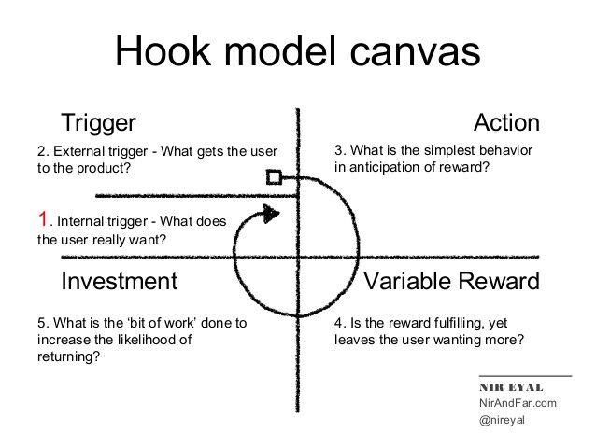
Industries are promoting Digital addiction
Anna Cherkinsky
Recommender Systems [6]
  Algorithm: user data
  Increase ad and content engagement
Notification Systems [7]
  Designed with emotional responses in mind
  Study: median response time was 3.5 minutes, with 69.2% screens off
The Infinite Scroll [8]
  Keeps people on the app/website
  Raskin: If the brain does not catch up to impulses, you will keep scrolling
Explains what tech developers consider when making their product to keep users “hooked” [9]
Notes:
Tech industries are promoting digital addiction (Whether intentionally or not)
Here are some examples of systems which contribute to addiction
Recommender Systems
Algorithms are implemented to keep track of user data and behavior in order to provide ads and content specific to user’s interest
The purpose is to keep users engaged and clicking.
We see this on social media
On websites like YouTube, the more videos people watch, the more ads they are likely to watch
Streaming services like Netflix use the recommender system to increase engagement with their own content
Notifications
Responses to emotional stimuli
Could be negative emotions: inducing stress and anxiety through developing a sense of urgency
Positive emotions: rewarding stimuli (text messages, creator content, “likes”)
In a study conducted: the medial response rate to notifications was 3.5 minutes, and 69.2% of the participants had their devices turned off
Notifications increase engagement with devices
Infinite scroll
Aza Raskin is an entrepreneur who invented the infinite scroll
the purpose was to increase funding and stock price through user engagement
Raskin: "If you don't give your brain time to catch up with your impulses you just keep scrolling."
In his book: “Hooked: How to Build Habit Forming Products”, Nir Eyal provides the hook model shown here
What developers need to consider to keep users “hooked”

Slide 18

Producer’s responsibility
Anna Cherkinsky
“We’re a business, we make money”
  Consumers are responsible for their own well-being [10]
  Is it ethical to place restrictions on a product people use?
People do not choose to be addicted
  Addiction associates with loss of free will and lack of control [11]
  Survey: 36% believe that tech labeling is necessary, and 50% it is a good idea [13]
  Study: 70% of children are exposed to gadgets before the age of 3 [12]
Social responsibility of producers
  Raskin has expressed remorse [8]
  Business: Do not contribute to negative externalities [14]
Wall-E satirizes the potential consequences of a technologically dependent world [15]
Notes:
Producer’s Responsibility
If you are a developer, you may argue that your priority is to make money
You (as a developer) may say that consumers should be responsible for their own well being
You (as a developer) may question the ethics: if a product is introduced and people enjoy it, does it make sense to restrict it?
The response would be that people do not choose to be addicted, especially if they are not aware of the addiction risk
Firstly, according to Addictive Behaviors Reports study, there is a consensus that addiction negatively impacts free will and control over daily life
This can be easier to achieve if someone does not recognize their addiction in the first place
In a report about labeling technological products with addiction warning signs, 36% of the users surveyed stated that labeling is necessary, and 50% state that it is a good idea.
The reasoning is that users tend to lose track of how much time they consume on gadgets, and they would prefer to be aware of the risks.
Secondly, according to a study conducted for International Conference on Management, Business and Technology, 70% of children encounter a tablet or a cell phone before the age of 3
In nations where digital technology is integrated into daily life, there is a generation raised on technology
If industries continue to use addiction strategies to increase engagement, the future is in danger
Producers should take responsibility for this
Raskin states that he regrets creating the infinite scroll
Make sure you don’t do things you will regret
One must also consider the externalities. Externalities are financial effects brought upon third parties by the industries, which do not affect the industries, themselves.
Digital addiction may bring negative externalities through lack of productivity coming from affected consumers, as well as potential therapy bills

Slide 19
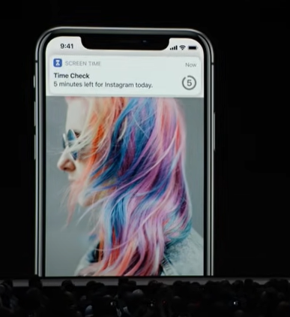
Solutions are A possibility
Anna Cherkinsky
Ethical market is on the rise
  Contribute positive externalities
  ESG investment increased 76% from 2012 to 2016 [16]
  Extend socially responsible investment to tech-development
Companies are trying to provide solutions
  Backlash [2]
  Apple and Android introduced features to help prevent addiction ([18], [17])
  Features to help with gaming addiction [2]
Apple introduces a feature to restrict app use in order to guide users away from excessive app use [18].
Notes:
However, solutions are possible, and are slowly being introduced
You can be a part of the industry and still practice ethics… or rather, you should!
You can analyze your economic contributions and ensure to contribute positive externalities
Attempt to resolve the negative ones
Environmental, Social and Corporate Governance investment has been gaining popularity
This investment type increased 76% from 2012 to 2016 alone
While ESG focuses on environmentalism, it is a prime example that ethics plays a role in economics
It should likewise be expanded to tech development
investors are concerned about the ethical impacts brought by production
Another reason to stay ethical
They will likely refrain from investment if your company receives backlash
Technology corporations are looking for solutions
In 2018, Stanford Students Against Addictive Devices held a protest against Apple corporation
The backlash was one of the reasons Apple introduced features to break phone-addiction habits.
Restrict daily app use
Do not disturb during sleep
Report of screentime
Android introduced similar features
Other industries are attempting similar solutions
Gaming platforms have “time to take a break” message
While solutions are minor, we are on the right path
It is important to solve the issue in a way which respects the autonomy of users

Slide 20
References
Anna Cherkinsky
[1] CD-11 (2019), “Gaming Disorder, Primarily Online,” https://icd.who.int/browse11/l-m/en#/http://id.who.int/icd/entity/338347362.
[2] Berthon P, Pitt L, Campbell C. Addictive De-Vices: A Public Policy Analysis of Sources and Solutions to Digital Addiction. Journal of Public Policy & Marketing. 2019;38(4):451-468. doi:10.1177/0743915619859852
[3] Hong, W., Liu, R.-D., Ding, Y., Sheng, X., & Zhen, R. (2020). Mobile phone addiction and cognitive failures in daily life: The mediating roles of sleep duration and quality and the moderating role of trait self-regulation. Addictive Behaviors, 107, 106383. https://doi.org/10.1016/j.addbeh.2020.106383
[4] Forte, G., Favieri, F., Tedeschi, D., & Casagrande, M. (2021). Binge-Watching: Development and Validation of the Binge-Watching Addiction Questionnaire. Behavioral Sciences, 11(2), 27. doi:10.3390/bs11020027
[5] Rosen, L. D. (2017). The distracted student mind — enhancing its focus and attention. Phi Delta Kappan, 99(2), 8–14. https://doi.org/10.1177/0031721717734183…
[6] Hunt, R., & McKelvey, F. (2019). Algorithmic Regulation in Media and Cultural Policy: A Framework to Evaluate Barriers to Accountability. Journal of Information Policy, 9, 307-335. doi:10.5325/jinfopoli.9.2019.0307
[7] E. Kanjo, D. J. Kuss and C. S. Ang, "NotiMind: Utilizing Responses to Smart Phone Notifications as Affective Sensors," in IEEE Access, vol. 5, pp. 22023-22035, 2017, doi: 10.1109/ACCESS.2017.2755661.
[8] Ayeni, P. (2019). Social Media Addiction: Symptoms And Way Forward. The American Journal of Interdisciplinary Innovations and Research, 1(04), XIX-XLII. Retrieved from https://usajournalshub.com/index.php/tajiir/article/view/12
[9] Eyal, Nir., Hooked: How to Build Habit-Forming Products. (Penguin, December 26, 2013), pp 5.

Slide 21
References
Anna Cherkinsky
[10] Bowles, Nellie. Addicted to Screens? That’s Really a You Problem. (New York Times, October 7, 2019), https://www.nytimes.com/2019/10/06/technology/phone-screen-addiction-tech-nir-eyal.html
[11] Vonasch, A. J., Clark, C. J., Lau, S., Vohs, K. D., & Baumeister, R. F. (2017). Ordinary people associate addiction with loss of free will. Addictive Behaviors Reports, 5, 56–66. https://doi.org/10.1016/j.abrep.2017.01.002
[12] S. A. Murtaza, “Digital heroin the impact of digital gadgets on developing minds an empirical study on growing children of Lahore,” in International Conference on Management, Business & Technology (ICMBT), 2017, pp. 303–309.
[13] Ali R., Jiang N., Phalp K., Muir S., McAlaney J. (2015) The Emerging Requirement for Digital Addiction Labels. In: Fricker S., Schneider K. (eds) Requirements Engineering: Foundation for Software Quality. REFSQ 2015. Lecture Notes in Computer Science, vol 9013. Springer, Cham. https://doi.org/10.1007/978-3-319-16101-3_13
[14] L. Zhongyan, "Analysis of Externality Based on Internet," 2010 International Conference on Multimedia Information Networking and Security, 2010, pp. 217-220, doi: 10.1109/MINES.2010.55.
[15] Stanton, Andrew,, et al. WALL-E. Burbank, Calif.: Walt Disney Home Entertainment, 2008.
[16] Blank, H., Sgambati, G., & Truelson, Z. (2016). Best Practices in ESG Investing. Journal of Investing, 25(2), 103-112. http://dx.doi.org.ezpxy-web-p-u01.wpi.edu/10.3905/joi.2016.25.2.103
[17] Haselton. Todd.,, “How Google is fighting smartphone addiction with its next Android update”, (CNBC, May 9, 2018), https://www.cnbc.com/2018/05/09/google-fighting-smartphone-addiction-with-android-p-digital-wellness.html
[18] Apple, , (June 5, 2018), WWDC 2018 Keynote-Apple [Video}. YouTube. https://www.youtube.com/watch?v=UThGcWBIMpU

Slide 22
Digital Colonialism
Liam Rathke
Notes:
Hello, I’m Liam, and today I’ll be talking about digital colonialism. The internet is home to many big tech companies, and these companies can have great influence over our online interactions. But how is the internet different if you live outside the US? Or Europe? Instead, suppose you’re from a country classified as “Less economically developed”, likely a long-term result of being occupied by a foreign power in the past. To what extent do colonialist ideas persist in big tech’s worldwide expansion?

Slide 23

What is colonialism?
Liam Rathke
Nation-states steal territory
  Seize natural resources
  Control trade routes and movement
  Establish monopoly
Victims held back by economy of scale [1]
  Dependent on imported goods
  Few opportunities in any given area
  Local government cronyism
<Graphic as big as will fit>
Notes:
To understand whether the big tech companies of today perpetuate colonialism, let’s first establish some background – what happens under colonialism?
First, a nation-state will forcibly take control over another region. The natural resources are exploited, shipped around the world, and then turned into products that can generate profit for the colonizer. Critically, these products are then resold to the countries being colonized at low prices, taking advantage of economies of scale, to ensure that the colony both becomes dependent on imported goods provided by the colonizer, and is unable to build any wealth on its own without the colonizer taking a sizeable cut as well [1].
Although it isn’t a requirement, colonizers often benefit from local cronies, who accept the terms of their fellow citizens being subjected to colonial rule and collaborate with the colonizer for great personal profit.
On the right, refugees in India ride a train built by the British, a key component of their imperialist strategy. The rail network allowed the British Empire to rapidly move raw materials around the country, and also played to a common justification for colonialism: the development of infrastructure. In other words, since the British built trains in India, and the Belgians built hospitals in the Congo, the argument follows, perhaps the colonized benefitted from the system? (Of course, they didn’t)
Image Source: https://www.theguardian.com/world/2017/mar/08/india-britain-empire-railways-myths-gifts

Slide 24
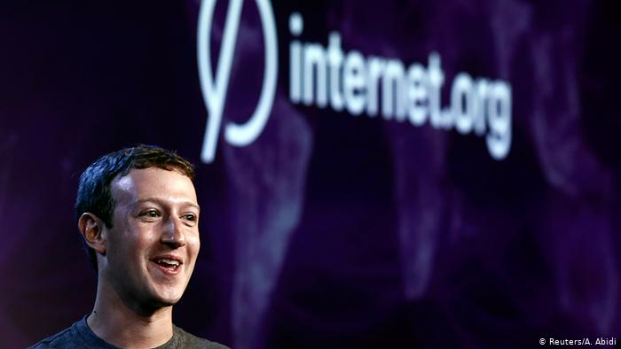
Internet.org
Liam Rathke
Facebook-backed program
  No-cost access to limited internet
  Available in select countries
Restricts individual rights
  “Facebook = Internet”
  Opposed by human rights groups [2]
Controversial
  Forced to rename
  Favorable to FB, “Charity Card”
  Net Neutrality concerns
<Graphic as big as will fit>
Notes:
Facebook’s Internet.org initiative is perhaps the quintessential example of digital colonialism. Seeking to expand into new markets, specifically ones where internet was not readily available, Facebook worked towards creating a program that would allow residents of countries like India, Colombia, and Ghana to access a very limited subset of the internet for free. Specifically, this subset consisted of Facebook, Wikipedia, and only a handful of other sites.
Unsurprisingly, this attempt drew significant criticism. With Facebook basically being the primary website accessible via Internet.org (Google, for example, did not offer their services), internet and human rights advocates suggested that Facebook was trying to equate itself with the entire internet. 67 human rights groups signed a letter opposing the program. Facebook responded by renaming the program to “Free Basics” and expanding the scope of the program to include research into new internet service technologies as well.
There are some clear parallels to the colonial model here. Facebook took advantage of its enormous wealth to bring users a version of the internet that was favorable to the company, and by blocking other websites, limited the way users could use this Facebook internet. And Facebook played the charity angle as well – they were offering service to those who did not have it, just as the British brought rail travel to unmobilized India. But just as the trains transported the crown jewels to the queen, Facebook’s network whisked precious user data to its data centers far away.
Speaking of India, Facebook’s Free Basics were banned in India shortly after the renaming over Net Neutrality concerns. Even before Ajit Pai’s FCC ruling, Facebook made it clear that they do not care about the internet as a whole; instead, they care about the internet only as a means to attract more users and draw in more revenue. And when the whole internet isn’t necessary to add members who will interact with ads, the whole internet no longer matters.
Image Source: https://www.dw.com/en/internetorg-free-access-or-digital-prison/a-18653851

Slide 25
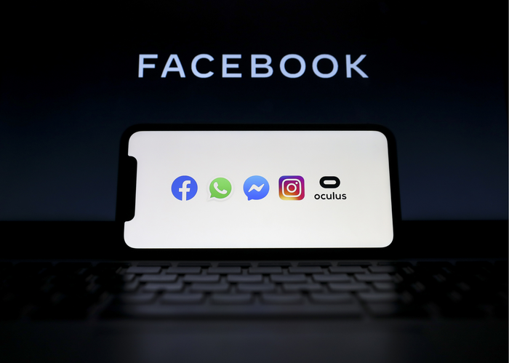
Facebook Messaging merger
Liam Rathke
WhatsApp: Largest IM app
  2 billion+ worldwide users
  Most members outside “The West” [3]
Facebook forcing data linking
  Valuable data now accessible
  Cannot be disabled [4]
Impact inequity
  Privacy while messaging: luxury?
<Graphic as big as will fit>
Notes:
Despite the Internet.org setback, Facebook’s efforts to collect more user data, and specifically user data from less economically developed countries persist. Just two months ago, Facebook was set to enact a change in its advertising and messaging model that would allow the company to gain user data from WhatsApp, a company it had acquired. WhatsApp isn’t a big deal in the US, but it is by far the most commonly used messaging app in the world. Over two billion people use the service, and most of these users are from less economically developed countries, where it’s a convenient alternative to paying for expensive SMS texting plans; there are over 450 million users in India and 140 million in Indonesia [3].
While Facebook merely moving data it already owned as a company around might not seem like a major issue, the decision will overwhelmingly impact the privacy of users outside the United States. Here, if you want to send quick messages to someone, you could find their phone number, and send a text. This text will be transferred to your mobile carrier, then to their mobile carrier, then to their device. If you have an issue with your cell provider, you can simply switch to a competitor, which will support the same SMS messaging protocol. By comparison, in countries where users primarily communicate over WhatsApp, it’s impossible to send a message to a WhatsApp account without using WhatsApp yourself, and thus exposing your personal information to Facebook as well [4].
Therefore, privacy while messaging can be seen as a luxury good – a luxury available to those able to avoid messaging via an intermediary, such as Facebook. Colonialism thrived on limiting opportunities for their colonized populations. Facebook’s prevalence limits messaging options to those from many formerly-colonized countries in a similar way.
Image Source: https://www.businessinsider.com/facebook-breakup-restoring-competition-regulation-experts-say-2021-1

Slide 26
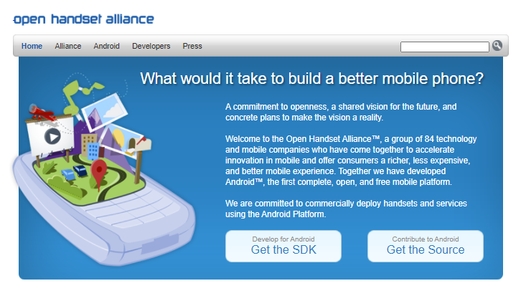
Google, android, and the world
Liam Rathke
Google profits from user data
  Services integrated with Android
  Major revenue source
Hardware manufacturer lock-in
  Open Handset Alliance
  Google approves hardware [5]
Global privacy variance
  Fewer options outside US
  Communications effective monopoly
<Graphic as big as will fit>
Notes:
Of course, Facebook isn’t the only big tech company to pursue policies that overwhelmingly impact users from less economically developed countries. Android is developed by Google, which profits from Google products (such as Google Search and YouTube), installed by default on standard Android phones. Each device running Google-approved Android collects data on the user, which Google can then integrate into its targeted ads.
Through the Open Handset Alliance [5], Google has the power to approve specific versions of the Android operating system software that is downloaded on mobile phones. Under the provisions of the OHA, if a mobile phone manufacturer attempts to release an Android-based phone without Google services pre-installed, Google is able to block these manufacturers from releasing other phones in the future that do contain the same Google services. Thus, Google maintains control over Android, and again, the privacy of its users.
While Android alternatives, such as iPhones, are available and competitive in America, they are often more difficult to obtain and significantly more expensive outside the US (speaking from personal experience). Thus, to use a smartphone, some degree of Google data transmission is required, effectively reinforcing the previously-described monopoly.
Image Source: https://www.openhandsetalliance.com/

Slide 27
References
Liam Rathke
[1] Michal Kwet, “Digital Colonialism is Threatening the Global South” (Aljazeera, March 13 2019), https://www.aljazeera.com/opinions/2019/3/13/digital-colonialism-is-threatening-the-global-south (Accessed April 26 2021)
[2] Jessi Hempel, “What Happened to Facebook’s Grand Plan to Wire the World?” (Wired, May 17 2018), http://wired.com/story/what-happened-to-facebooks-grand-plan-to-wire-the-world/ (Accessed April 26 2021)
[3] Resty Woro Yuniar and Vasudevan Sridharan, “WhatsApp-Obsessed Indonesia and India Struggle to forsake App Amid Privacy Policy Confusion” (South China Morning Post, January 21, 2021), https://www.scmp.com/week-asia/economics/article/3118694/whatsapp-obsessed-indonesia-and-india-struggle-say-goodbye (Accessed April 26 2021)
[4] K. Balakumar and James Peckham, “WhatsApp’s New Privacy Policy Requires You to Share Data with Facebook” (TechRadar, January 7 2021), https://www.techradar.com/news/whatsapps-new-privacy-policy-requires-you-to-share-data-with-facebook (Accessed April 26 2021)
[5] Ron Amadeo, “Google’s Iron Grip on Android: Controlling Open Source by Any Means Necessary” (ArsTechnica, July 21 2018), https://arstechnica.com/gadgets/2018/07/googles-iron-grip-on-android-controlling-open-source-by-any-means-necessary/ (Accessed April 26 2021)
Notes:
These are my references, any questions?

Slide 28
Class 10
The End
Keith A. Pray
socialimps.keithpray.net
Notes:
This is the end. Any slides beyond this point are for answering questions that may arise but not needed in the main talk. Some slides may also be unfinished and are not needed but kept just in case.

Slide 29
My Reading Notes
pp. 409 Can one perform services for one’s self?
pp. 412 1993-1999 Does this seem like a long time?
pp. 413 “errors of omission or commission”?
UPDATE
pp. 422 3. Would people agree – social contract?
pp. 438 So the baby can be left outside and no one is responsible?
Notes:
An error of commission is one where the person responds where they should not. This is compared to an error of omission, where the person fails to respond when they should.

