Slide 1
Class 8
Crime
Keith A. Pray
socialimps.keithpray.net
Notes:
Take 5 minutes to fill out survey on Canvas → Quizzes → SGA’s Midterm Course Feedback Questionnaire

Slide 2
what works well Online With Zoom
Sign in with First and Last Name
Stay muted unless you are going to speak
To speak use the raise your hand feature
To answer yes/no questions use the “yes” ”no” buttons
Turn your camera on
Wait until the end of student presentations to ask questions
  Write them down so you don’t forget

Slide 3
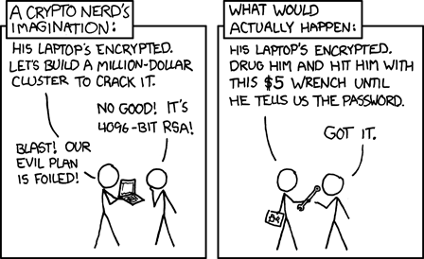
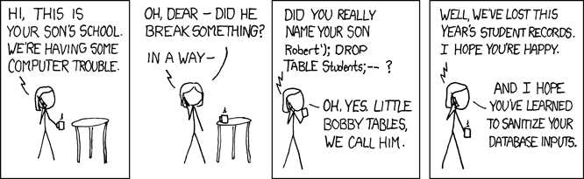
Overview
Review
Assignment
Students Present
https://xkcd.com/538/ (2010-11-14)
https://xkcd.com/327/ (2007-10-10)
Notes:
Are there any questions on the assigned reading?
Use the backup slides to explain any of the attack methods from the text.
XKCD Links last accessed 2020-09-25

Slide 4
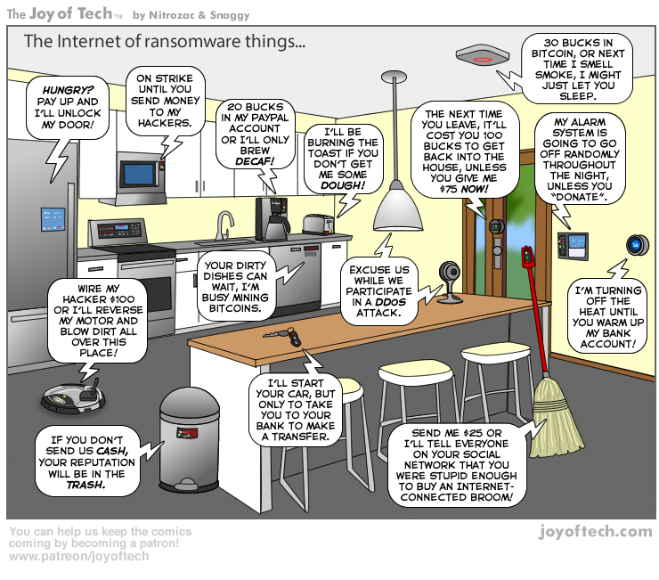
https://cointelegraph.com/storage/uploads/view/5e8f6e0d3a029807dfe181dc3d160cf0.png
Notes:
Find publish date
Note which really exist
Extra credit

Slide 5
My Reading Notes
pp. 323 Interesting to compare password guidance over the years.
pp. 325 plenty not sent with HTTP
pp. 328 Getting on TV much more difficult than releasing software
pp. 330 Virus could be new
pp. 332 Goals include infect 3 machine per LAN and as many computers as possible? Never make last minute changes before release. Were they related to the defects?
pp. 333 Testing w/out DEBUG often neglected
pp. 335 Do people use the Internet as an experimental laboratory these days? Shutdown right after booting, “benign” doesn’t seem like the right word.
pp. 337 “send reports back to a host computer”?
pp. 338 Firewalls often not running on same machine as malware, routers?
pp. 339 Have 2003 fears of cyber terrorist attacks been realized?
pp. 347 How is online voting a moral issue?
End of Chapter questions: 14. 25. 29.
Notes:
- If time ask class about online voting in light of COVID-19 challenges.

Slide 6
Group Quiz
A denial of service attack shuts down a bunch of retailer, stock brokerage, large corporate entertainment and information web sites. Possible guilty parties:
  Terrorist who aimed to cause billions of damage to U.S. economy.
  Protest organization opposing commercialization of the web and corporate manipulation of consumers.
  Script kiddie (a minor) just having fun with tools he found on the web.
  Show off hacker in search of bragging rights.
State what penalties are appropriate for each.
Explain your answer to 1. using a single Ethical Theory for all.
Name the laws/acts under which these parties could be prosecuted.
Notes:
Works well as small group exercise.
Note: short answer format expected.
Note: 2. only one argument needed, should include logic for all parties
Note: 3. same law(s) should be applicable to all parties

Slide 7
Assignment
Code Testing 1 Page Paper 1/2
Research testing, decide on test strategy, test the given code
There are major and minor defects to find
Once testing is done write paper with conclusion: Testing strategy was adequate
Things that might be useful in your argument:
  Rationale for testing strategy used (use data, high quality sources)
  Explanations of defects found (use data, high quality sources)
  How to fix them (use data, high quality sources)
  Consequences of leaving defects in production code (use data, high quality sources)
Weakness in testing strategy as counter point (use data, high quality source)
Working example: http://socialimps.keithpray.net/assignments/Test_Sales_Fun
Notes:
If guest presenter coming next class remind students to prepare questions for him.
Remember to work on groups projects.
Each group should have material on their sites for the topics we’ve covered so far.
OLD Prompt:
Design tests for the code on the following slide.
Contains at least one major defect and several minor ones.
Write a paper (1 page not counting any source code) including :
Did you choose a good test strategy? (This is your conclusion.)
The inputs and expected outputs
What defects you found
How you would fix the defects (you may include fixed source)
Why would that fix the problems?
What could happen if the defects are not found before the code is put into production?

Slide 8
Assignment
Code Testing 2/2
import java.text.NumberFormat;
public class SalesFun {
public static double calculateSalesTotal ( double amount, double discountRate, double taxRate ) {
double discount = amount * discountRate;
double total = amount - discount;
double tax = total * taxRate;
double taxedTotal = tax + total;
NumberFormat numberFormat = NumberFormat.getCurrencyInstance();
System.out.println ( "Subtotal : " + numberFormat.format ( amount ) );
System.out.println ( "Discount : " + numberFormat.format ( discount ) );
System.out.println ( "Total : " + numberFormat.format ( total ) );
System.out.println ( "Tax : " + numberFormat.format ( tax ) );
System.out.println ( "Tax+Total: " + numberFormat.format ( taxedTotal ) );
return taxedTotal;
}
}
} Lines of interest
Notes:
Bold lines are real focus.
Example input:
amount = 100.05;
discountRate = 0.10;
taxRate = 0.05;
OR
0.70, 0.0, 0.05
95.67, 0.20, 0.7

Slide 9
Overview
Review
Assignment
Students Present

Slide 10
The Root(kit) of all evil
Gracen Antedomenico

Slide 11
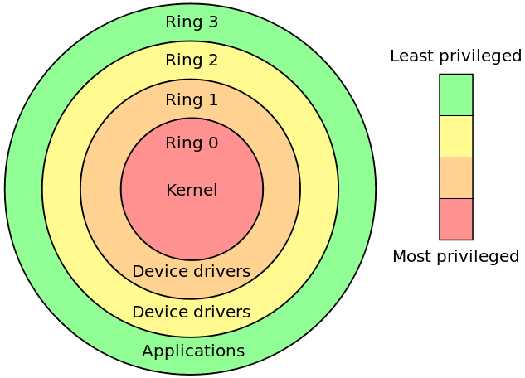
Types of rootkits
Gracen Antedomenico
Kernel
Hardware/Firmware
Hypervisor/Virtualized
Bootloader
Memory
User-mode/application
Image Source
Notes:
Rings
Outer rings are less privileged user-mode applications
The higher the privileges of the rootkit, the more dangerous, hard to detect
Kernel
OS-level
Add or delete code from os
Complex – if there are bugs, easily detected, noticeable negative impact on PC performance
Discoverable by antivirus or antirootkit
Hardware/Firmware
Targets the software that manages hardware
Can change hardware function, including that of hard drive
Imagine if your computer just stopped saving things to the hard drive
Hypervisor/virtualized
Rootkit boots before OS and creates a VM
Has more control over system than kernel rootkit
Bootloader
Infects master boot record or volume boot record
Rootkit files not visible in system view
Can modify boot records, which would damage your pc
Memory
Occupies RAM
Reduces performance by using up resources
User-mode/application
Easiest rootkit to detect
Hide in an application, won’t damage your system, will cause trouble

Slide 12
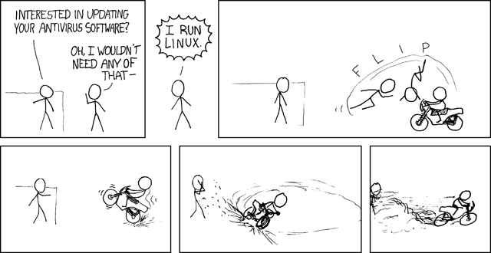
How do rootkits infiltrate our computers?
Gracen Antedomenico
Malware
  Rootkits may be included in other types of malware to make malware more difficult to remove
Infected Drives
  Bootkits can proliferate if we boot from an infected drive
Legitimate Software
  May contain a rootkit to prevent user from uninstalling the program
Image Source
Notes:
Malware
Malware, including spyware, adware, and trojan horses may also have a rootkit as one of their components
This gets on a computer the same way most malware does:
Infected emails
Infected downloads
“Helpful programs”
“Antivirus”
Infected drives
Could be a hard drive, flash drive, cd… anything you can boot from
When booting from this infected drive, the rootkit boots before the os
Be wary of drives that you don’t know where they came from
A flash drive you found on the floor could potentially install a bootkit
Legitimate software
Trusted software may also have a rootkit in it
This software would be from a company that you have heard of and you would be more likely to give the program all the permissions it needs
These rootkits may not have malicious intent, but you may not want that software to have that kind of unfettered access to your system
This has been the source of some controversies

Slide 13

Sony Controversy (2005) - Intent
Gracen Antedomenico
Sony distributes copy-protection scheme with music CDs that installed a rootkit on computers
  Distributed on 2 million CDs
  Intended to stop CD piracy
  CD includes media player
  Music can only be played on included music player
Image Source
Notes:
Sony distributes copy-protection scheme with music CDs that installed a rootkit on computers
Primary intent was to stop piracy
Users had to install music player that was included on the cd if they wanted to play the music
This brings up an ethical question
Sony didn’t want their music pirated
2 million users did not want their computers compromised
Is it more harmful for the music to be pirated or for the computers to be compromised?
Who can get hurt?
Sony loses some money?
2 million people may need to replace their computers, can’t listen to their CD anymore, have their privacy invaded
Sony was faced with an ethical decision and imo they made the wrong choice. They deceived their users, which would ultimately reflect poorly on them anyway

Slide 14
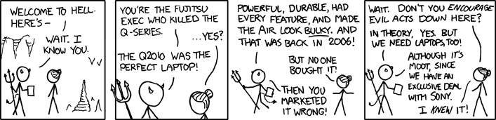
Sony Controversy (2005) - Results
Gracen Antedomenico
Rootkit ran without user knowledge or consent
Sends your information to Sony
Makes your system vulnerable to hackers
Removing the rootkit damages windows
Image Source
Notes:
Sony used a technique called cloaking
It does this by modifying windows (yikes)
Windows is unaware that the rootkit is there
The rootkit cannot be removed, it you do it breaks windows
The user never consents to have the rootkit installed
Likely doesn’t know that the CD has anything besides music
As a result of the controversy, Sony stopped selling the copy protected CDs
Replaced the customers’ CDs for free
It gets spicy
When sony “fixed” the infected computers, they only removed the cloaking and did not remove the rootkit
Sony then claims that the software is not sending users’ info to sony (it was)
Then, sony admits that the rootkit makes computers vulnerable to certain viruses
Irony time
Ironically, the software Sony created to remove the rootkit, the rootkit that was designed to protect copyright, violated copyright
The code included open-source software in a way that violated its license agreement
In the end, sony faced multiple class action lawsuits over this
For anyone who hasn’t gotten the joke in the comic yet
Sony made the unethical decision to violate user’s privacy/machines because they wanted to protect copyright
Thus, when hell needed laptops, the obvious choice was sony’s laptops

Slide 15
References
Gracen Antedomenico
[1] Bruce Schneier, Sony's DRM Rootkit: The Real Story, (Wired, 17 November 2005), https://www.schneier.com/blog/archives/2005/11/sonys_drm_rootk.html (19 April 2021)
[2] Dan Rafter, What is a rootkit? And how to stop them, (Norton, Unknown), https://us.norton.com/internetsecurity-malware-what-is-a-rootkit-and-how-to-stop-them.html (19 April 2021)
[3] Global Security Advisor, XCP.Sony.Rootkit, (CA Technologies, 5 November 2005), https://web.archive.org/web/20100818202245/http:/www.ca.com/us/securityadvisor/pest/pest.aspx?id=453096362 (19 April 2021)
[4] Malwarebytes Labs, Rootkits, (Malwarebytes, 9 June 2016), https://blog.malwarebytes.com/threats/rootkits/ (19 April 2021)
[5] Paul Cucu, Rootkit – the (Nearly) Undetectable Malware, (Heimdal Security, 7 February 2017), https://heimdalsecurity.com/blog/rootkit/ (19 April 2021)

Slide 16
Preparing for a data breach
Luke Savoie
© 2021 Keith A. Pray
Notes:
My name is Luke and I will be presenting about data breaches, giving background on the subject and statistics leading to a conclusion that there are major steps that need to be taken in order to dampen the effects of a data breach.

Slide 17
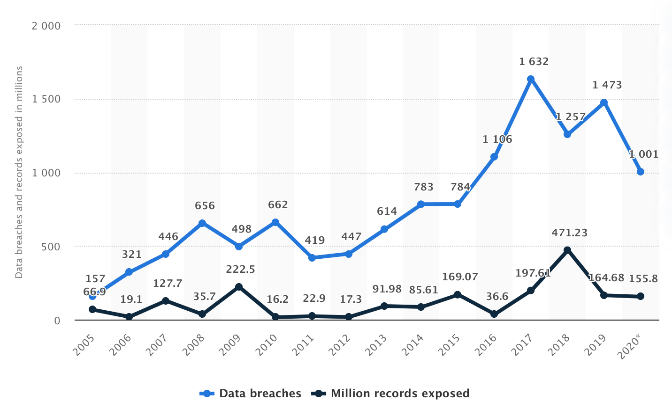
Data breaches are a daily occurrence
Luke Savoie
27.7 percent chance of a breach [1]
49 percent of US companies
25,575 records per breach
2,244 attacks per day
[4] [7]
https://www.statista.com/statistics/273550/data-breaches-recorded-in-the-united-states-by-number-of-breaches-and-records-exposed/
© 2021 Keith A. Pray
Notes:
Data breaches happen all the time. There are many ways people can gain access to an organizations data including malware, ransomware, phishing scams, and a denial of service attack. An IBM security survey shows that the average chance an organization has of encountering a data breach is 27.7 percent, which has risen 2.1 percent in the previous year. The probability of a data breach has risen 67 percent from 2014. An experiment from the University of Maryland reveals that their computers were attacked an average of 2,244 times per day. That’s once every 39 seconds! In the graph, you can see the increase in the amount of data breaches per year in the past 15 years in the United States alone. There has been a small decrease in the number of breaches in the past 2 years, however, that number is still over 1,000 and over 155 million records were exposed.

Slide 18
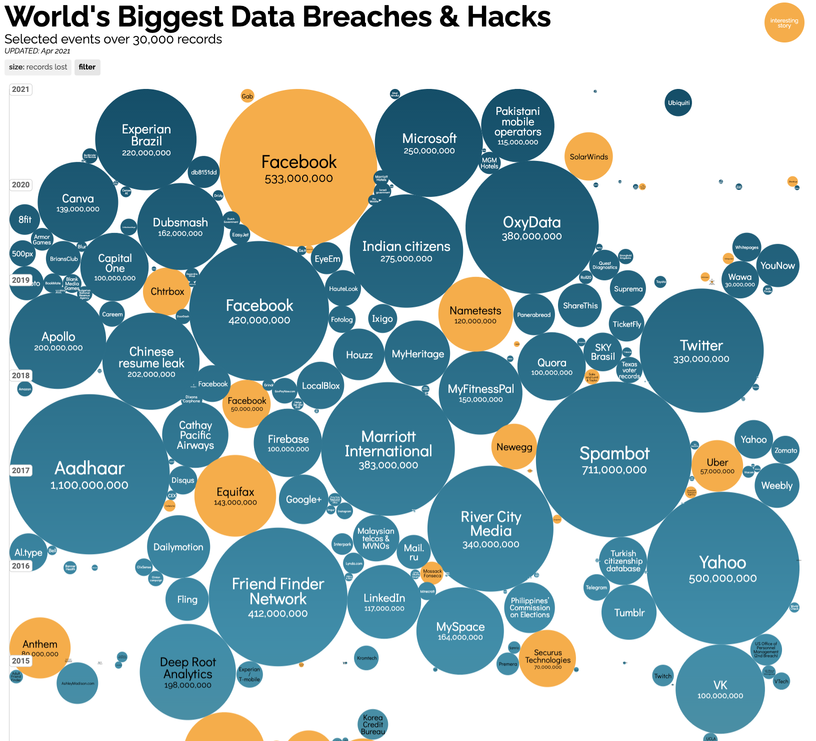
Recent Notable data breaches
Luke Savoie
Nintendo: April 2020 300,000 users
Zoom: April 2020 500,000 users
Marriott: March 2020 5.2 million guests
MGM Grand: February 2020 10.6 million users
Twitter: July 2020 130 users
[5]
https://www.informationisbeautiful.net/visualizations/worlds-biggest-data-breaches-hacks/
© 2021 Keith A. Pray
Notes:
There are some key examples of recent companies who experienced a major data breach that are important to point out. In 2020, 300,000 Nintendo users had their personal information exposed, 500,000 zoom accounts were stolen and sold on the dark web, 5.2 million guests of Marriott had personal information stolen, and hackers had access to 10.6 million guest accounts of MGM Grand. Most interestingly, 130 users on Twitter had their accounts hacked with the likes of Barack Obama, Joe Biden, Elon Musk, and Bill Gates in a bitcoin scam. The image shows a timeline of data breaches in the last 5 years. As you can see, Facebook is a frequent flier on this list, as well as there being some huge numbers like the Aadhaar data breach in 2017 where over 1 billion people were affected.

Slide 19
Devastating impact of breaches
Luke Savoie
3.86 million dollars per breach
Increased budget on data security
60 percent of breaches take a month or longer to discover
Take an average of 207 days to find
[3] [7]
https://www.comparitech.com/blog/vpn-privacy/data-breach-statistics-facts/
© 2021 Keith A. Pray
Notes:
Other than the compromised privacy of companies and their customers information, a data breach also has other effects on an organization. In terms of money, the average data breach can cost almost 4 million dollars. This varies depending on the amount of records that are exposed and the amount of people affected. As seen in the image, the more records exposed, the large the debt for the company. Half of organizations say they allocate 6-15 percent of budget on data security. One of the biggest problems is how long it takes to realize you have experienced a breach. 60 percent of breaches take over a month to discover while on average it takes 207 days to find a data breach. If there is a way to cut down on the time it takes, the damage could be reduced.

Slide 20
Preventing data breaches is essential
Luke Savoie
Compliance with the General Data Protection Regulation(GDPR)
  432 million dollars worth of fines
  Spreading the word
Employ incident response team
  Refine incident response plan
[2] [6]
https://irb.tcnj.edu/international/
© 2021 Keith A. Pray
Notes:
Going forward there are things that can happen in order to decrease the severity of these data breaches. The General Data Protection Regulation is a regulation in European laws that control the protection of data and privacy. It was created in 2016 and fully implemented in 2018. The major concepts of the GDPR are seen in the image. Since it’s implementation, there have been 432 million dollars worth of GDPR fines given out. The US expressed interest in this development early, and 78 percent of American businesses made steps to comply with the GDPR. 32 percent of US companies reported appointing a data protection officer and another 32 percent increased their budget for data privacy. There is no doubt in the positive impact of the GDPR, but still, the progress is slow because many companies both in the US and EU do not understand the regulations or how to implement them. Spreading the word about these things is important to extend the impact of the GDPR. Another thing that is an effective part of preparing for a data breach is creating an incident response team. Creating and updating an incident response plan can account for the worst case scenario data breach, and if your organization is monitoring the situation, you can stop the breach immediately or before it gets worse. It has been seen that having an incident response team can reduce the cost of damage done by a data breach by 2 million dollars.

Slide 21
References
Luke Savoie
[1] Probability of Data Breaches Increases, https://www.crownrms.com/us/insights/probability-of-data-breaches-increases/, April 16
[2] Five Ways to Prepare for a Data Breach in 2019, Gillware, https://www.gillware.com/data-recovery-lab/five-ways-prepare-data-breach-2019/, April 18
[3] 2020 Data Breaches Point to Cybersecurity Trends for 2021, Dan Lohrmann, https://www.govtech.com/blogs/lohrmann-on-cybersecurity/2020-data-breaches-point-to-cybersecurity-trends-for-2021.html, April 18
[4] 30+ Data Breach Statistics and Facts, Aimee O’Driscoll, https://www.comparitech.com/blog/vpn-privacy/data-breach-statistics-facts/, April 19
[5] The 52 Biggest Data Breaches, Abi Tyas Tunggal, https://www.upguard.com/blog/biggest-data-breaches, April 19
[6] 10 Eye-Opening GDPR Statistics, Branka Vuleta, https://legaljobs.io/blog/gdpr-statistics/#:~:text=Key%20GDPR%20Compliance%20Statistics,major%20GDPR%20fines%20so%20far., April 18
[7] 98 Must-Know Data Breach Statistics for 2021, Rob Sobers, https://www.varonis.com/blog/data-breach-statistics/, April 16
[8] International Human Subject Research Resources, TCNJ, https://irb.tcnj.edu/international/, April 18
© 2021 Keith A. Pray

Slide 22
The complications of self-Driving Cars
Conor McDonough

Slide 23
May prevent a fraction of accidents
Conor McDonough
Safety must be prioritized
  Driver error is the cause of 90% of crashes
  Could only prevent 1/3 of these crashes
Must account for uncertainty
  Test vehicle killed a pedestrian
  Failed to predict 49-year-old Elaine Herzberg would cross the street
%
Notes:
<speaker notes>Self-driving cars could only prevent a fraction of accidents. Driver error is the cause of 90% of accidents. The base functionality of self-driving cars will prevent 1/3 of these accidents. Insurance Institute for Highway Safety researchers analyzed 5,000 accidents from the National Motor Vehicle Crash Causation Survey. The IIHS divided the accidents into five categories of causes. Sensing and perceiving errors are where the driver is distracted or fails to identify hazards. Incapacitation is when the drive is under the influence. Planning and deciding is when the driver drives too fast or slow for the road which includes tailgating or driving aggressively. Execution and performance includes inadequate moves to avoid a collision and predicting is when the driver incorrectly guesses what a driver or person will do. Self-driving cars will be able to solve sensing and perceiving related issues, as well as incapacitation-caused crashes; however, software developers will need to prioritize safety over driver preference in order to avoid accidents in the other categories. For example, if an owner is in a rush, the car should maintain a safe speed despite the owner’s time constraints. This would prevent crashes in the planning and deciding category. In order to prevent crashes in the predicting category, these cars must take a conservative approach. For example, in March, 2018, a self-driving Uber vehicle killed pedestrian Elaine Herzberg. The car was able to identify Elaine but was not able to predict she would cross the street. In order to avoid these crashes, these cars must drive slowly, and potentially make unnecessary stops in order to ensure everyone’s safety. This is certainty a conflict between safety and driver preference. If safety is to be prioritized, these cars will drive much slower than a human-driven car. This will be frustrating to people who are in a rush. On the other hand, if rider preference is prioritized, it puts everyone else at risk.

Slide 24
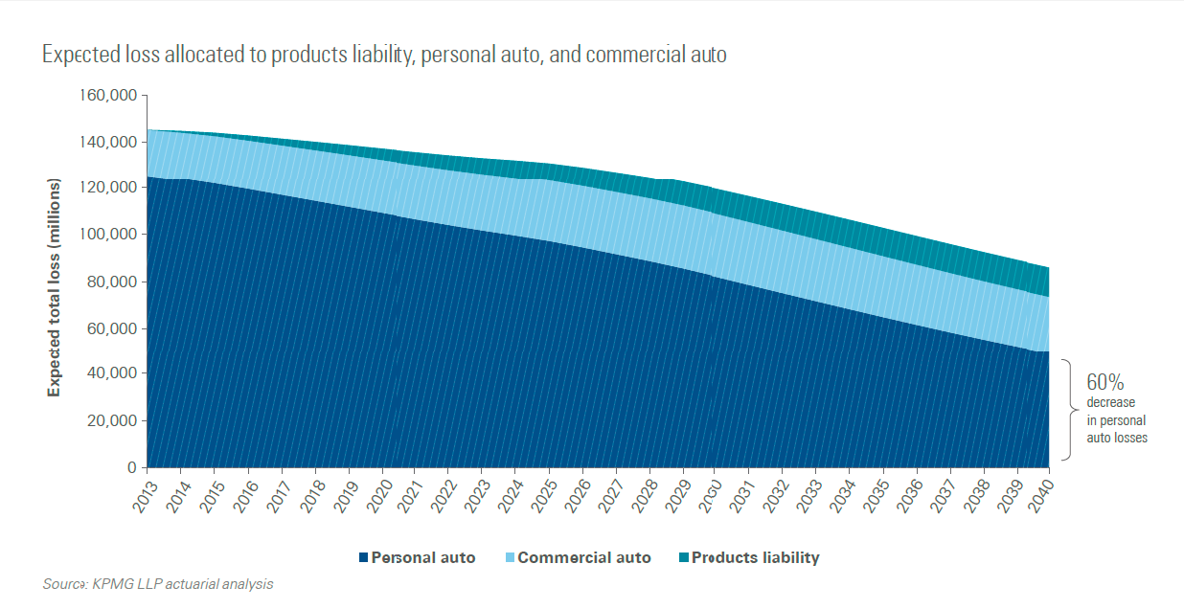
Will introduce Unclarity in liability
Conor McDonough
Difficult to determine who is liable
  Program error could be developer's fault
  Errors due to poor maintenance could be owner's fault
Manufacturer differs from software developer
  Manufacturers like Volkswagen
  Outsource programming to software company
  Who is at fault during crash?
Decrease in concern about being liable for crashes
https://www.hg.org/legal-articles/liability-and-safety-concerns-with-self-driving-cars-43458
Notes:
<speaker notes>Before self-driving cars, it was easy to determine who was liable for an accident. It was either driver A or B. With the introduction of self-driving cars comes an additional layer of complexity. When a passenger riding in a self-driving car gets into an accident and it is their cars fault, who is liable? If the cause of the crash was a software bug, then the developer could be found liable. If poor maintenance of the car caused the crash, then the owner could be deemed responsible. Another important distinction to make is the difference between manufacturers and the software developers. If the cause of the crash is a software bug, should the manufacturer or software developer be found liable? For example, if Volkswagen manufactures a self-driving car and outsources the development to a third-party company, who is at fault during a crash? Volkswagen could be held liable because they should have tested their vehicles. The third-party company could be held liable because they developed the software. The transition of liability will lead to a large decrease in revenue in the auto-insurance industry. As depicted in the image, it is predicted that personal auto, commercial auto, and products liability will decrease throughout the next two decades.

Slide 25
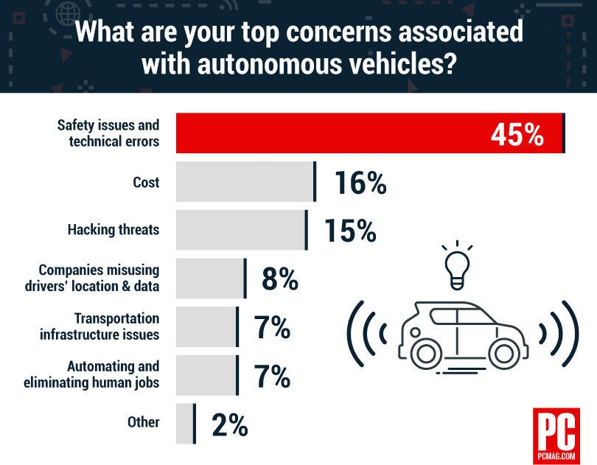
will be prone to hacking
Conor McDonough
Concern about self-driving cars vulnerability to hacking
A self-driving car hack is dangerous
  Disable sensors, and cameras
  Reroute to an area where passenger will be mugged
  Ransomware
Hacking is a privacy concern
  Hackers could connect to home devices if car is connected
  The vehicle’s OS system could be hacked
https://www.entrepreneur.com/article/336118
Notes:
<speaker notes>Another big concern with self-driving cars is that the are prone to being hacked. Being a car, these hacks will be dangerous and could result in many casualties. One approach hackers could take is disabling sensors and cameras. Sensors and cameras are the only way these cars can detect other vehicles and pedestrians. Disabling these could result in several collisions. Additionally, hackers could reroute the car’s destination without the passengers being aware. The hacker could take the passengers to a location where they could be robbed or mugged. A last strategy hackers could take is ransomware. Ransomware is where the hacker locks the owner inside or outside their car and does not give access back until the owner pays them. Apart from physical danger, hackers could collect private information. If the car is connected to any IoT (Internet of Things) devices at home, the hacker could gain access to an owner's home network. The car’s operating system could be breached, which could reveal past destinations, information about the driver, and other information from connected devices. As depicted in the right, hacking threats are one of the largest concerns of people regarding self-driving cars. The owner is giving up all control of their car to a software- something that is prone to being hacked.

Slide 26
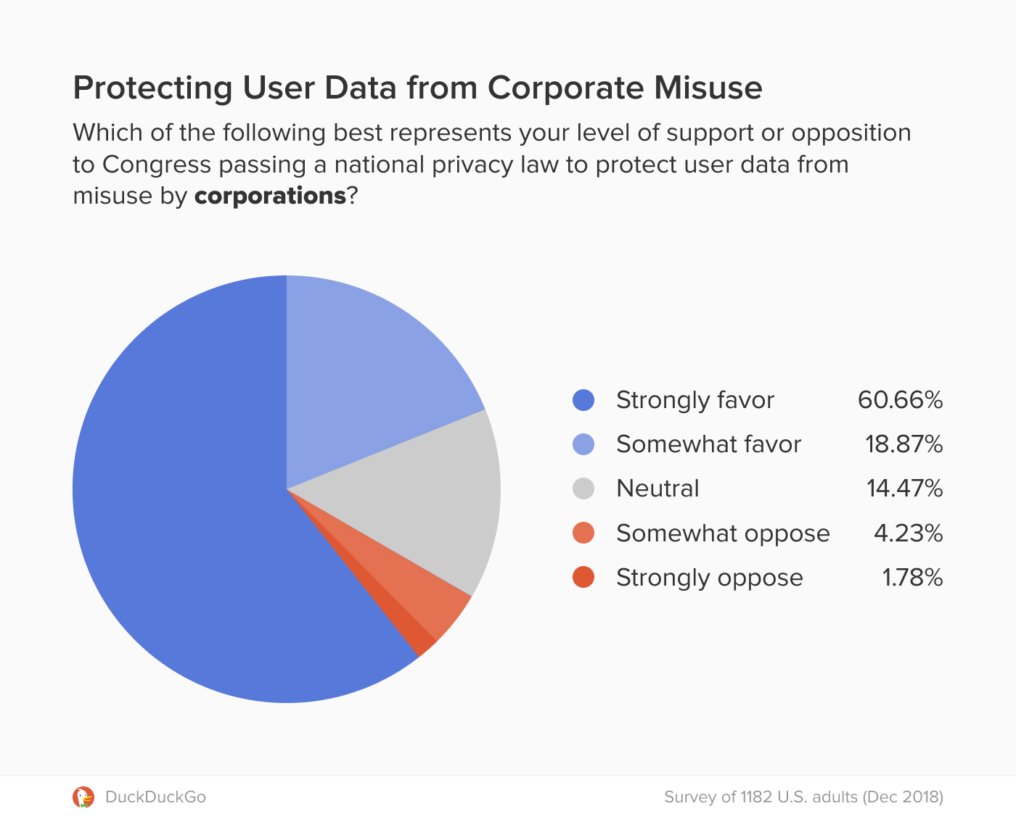
Data collection will invade privacy
Conor McDonough
People do not want their data used for marketing
Data collected is invasive
  Maintain owner information to authorize use
  Location, speed, route data
  Sensors collect data on other cars
Data can be used for unintended purposes
  Secondary marketing
  Determine home, workplace, etc.
  Susceptible to harm or stalking
https://spreadprivacy.com/privacy-legislation-survey/
Notes:
<speaker notes>Another large area or concern is the misuse of data collection from the autonomous vehicles. Naturally, these vehicles collect a large amount of data. These cars will most likely maintain information about the owners and passengers to authenticate using the vehicle. This may come in the form of face ID or a fingerprint. These cars would also log statistics like location, speed, and common routes taken. This data can be used in a nature that the car owner disapproves of. An example of this is secondary marketing. Companies can analyze common destinations to determine favorite stores, restaurants, etc. This type of data can reveal a lot about a person’s income, interests, and work. Destinations that an owner visits could be private. Examples of this would be a psychiatrist, criminal defense attorney, etc. Another concern is that sensors could constantly be collecting data from the cars around them, without them knowing. Passing cars could be logged at a location and speed. This is a privacy concern for people who do not even own self-driving cars. Additionally, if the companies are not careful with this data, it can end up in the wrong hands. As addressed in the last slide, this data makes owners of autonomous vehicles prone to harm and stalking. Despite all this, some people are in favor of corporations using their data for things like secondary marketing. As shown on the figure to the right, about 6% of people opposed Congress passing a privacy law to protect data from corporate misuse. Although there are some opposed, a large 80% are in favor.

Slide 27
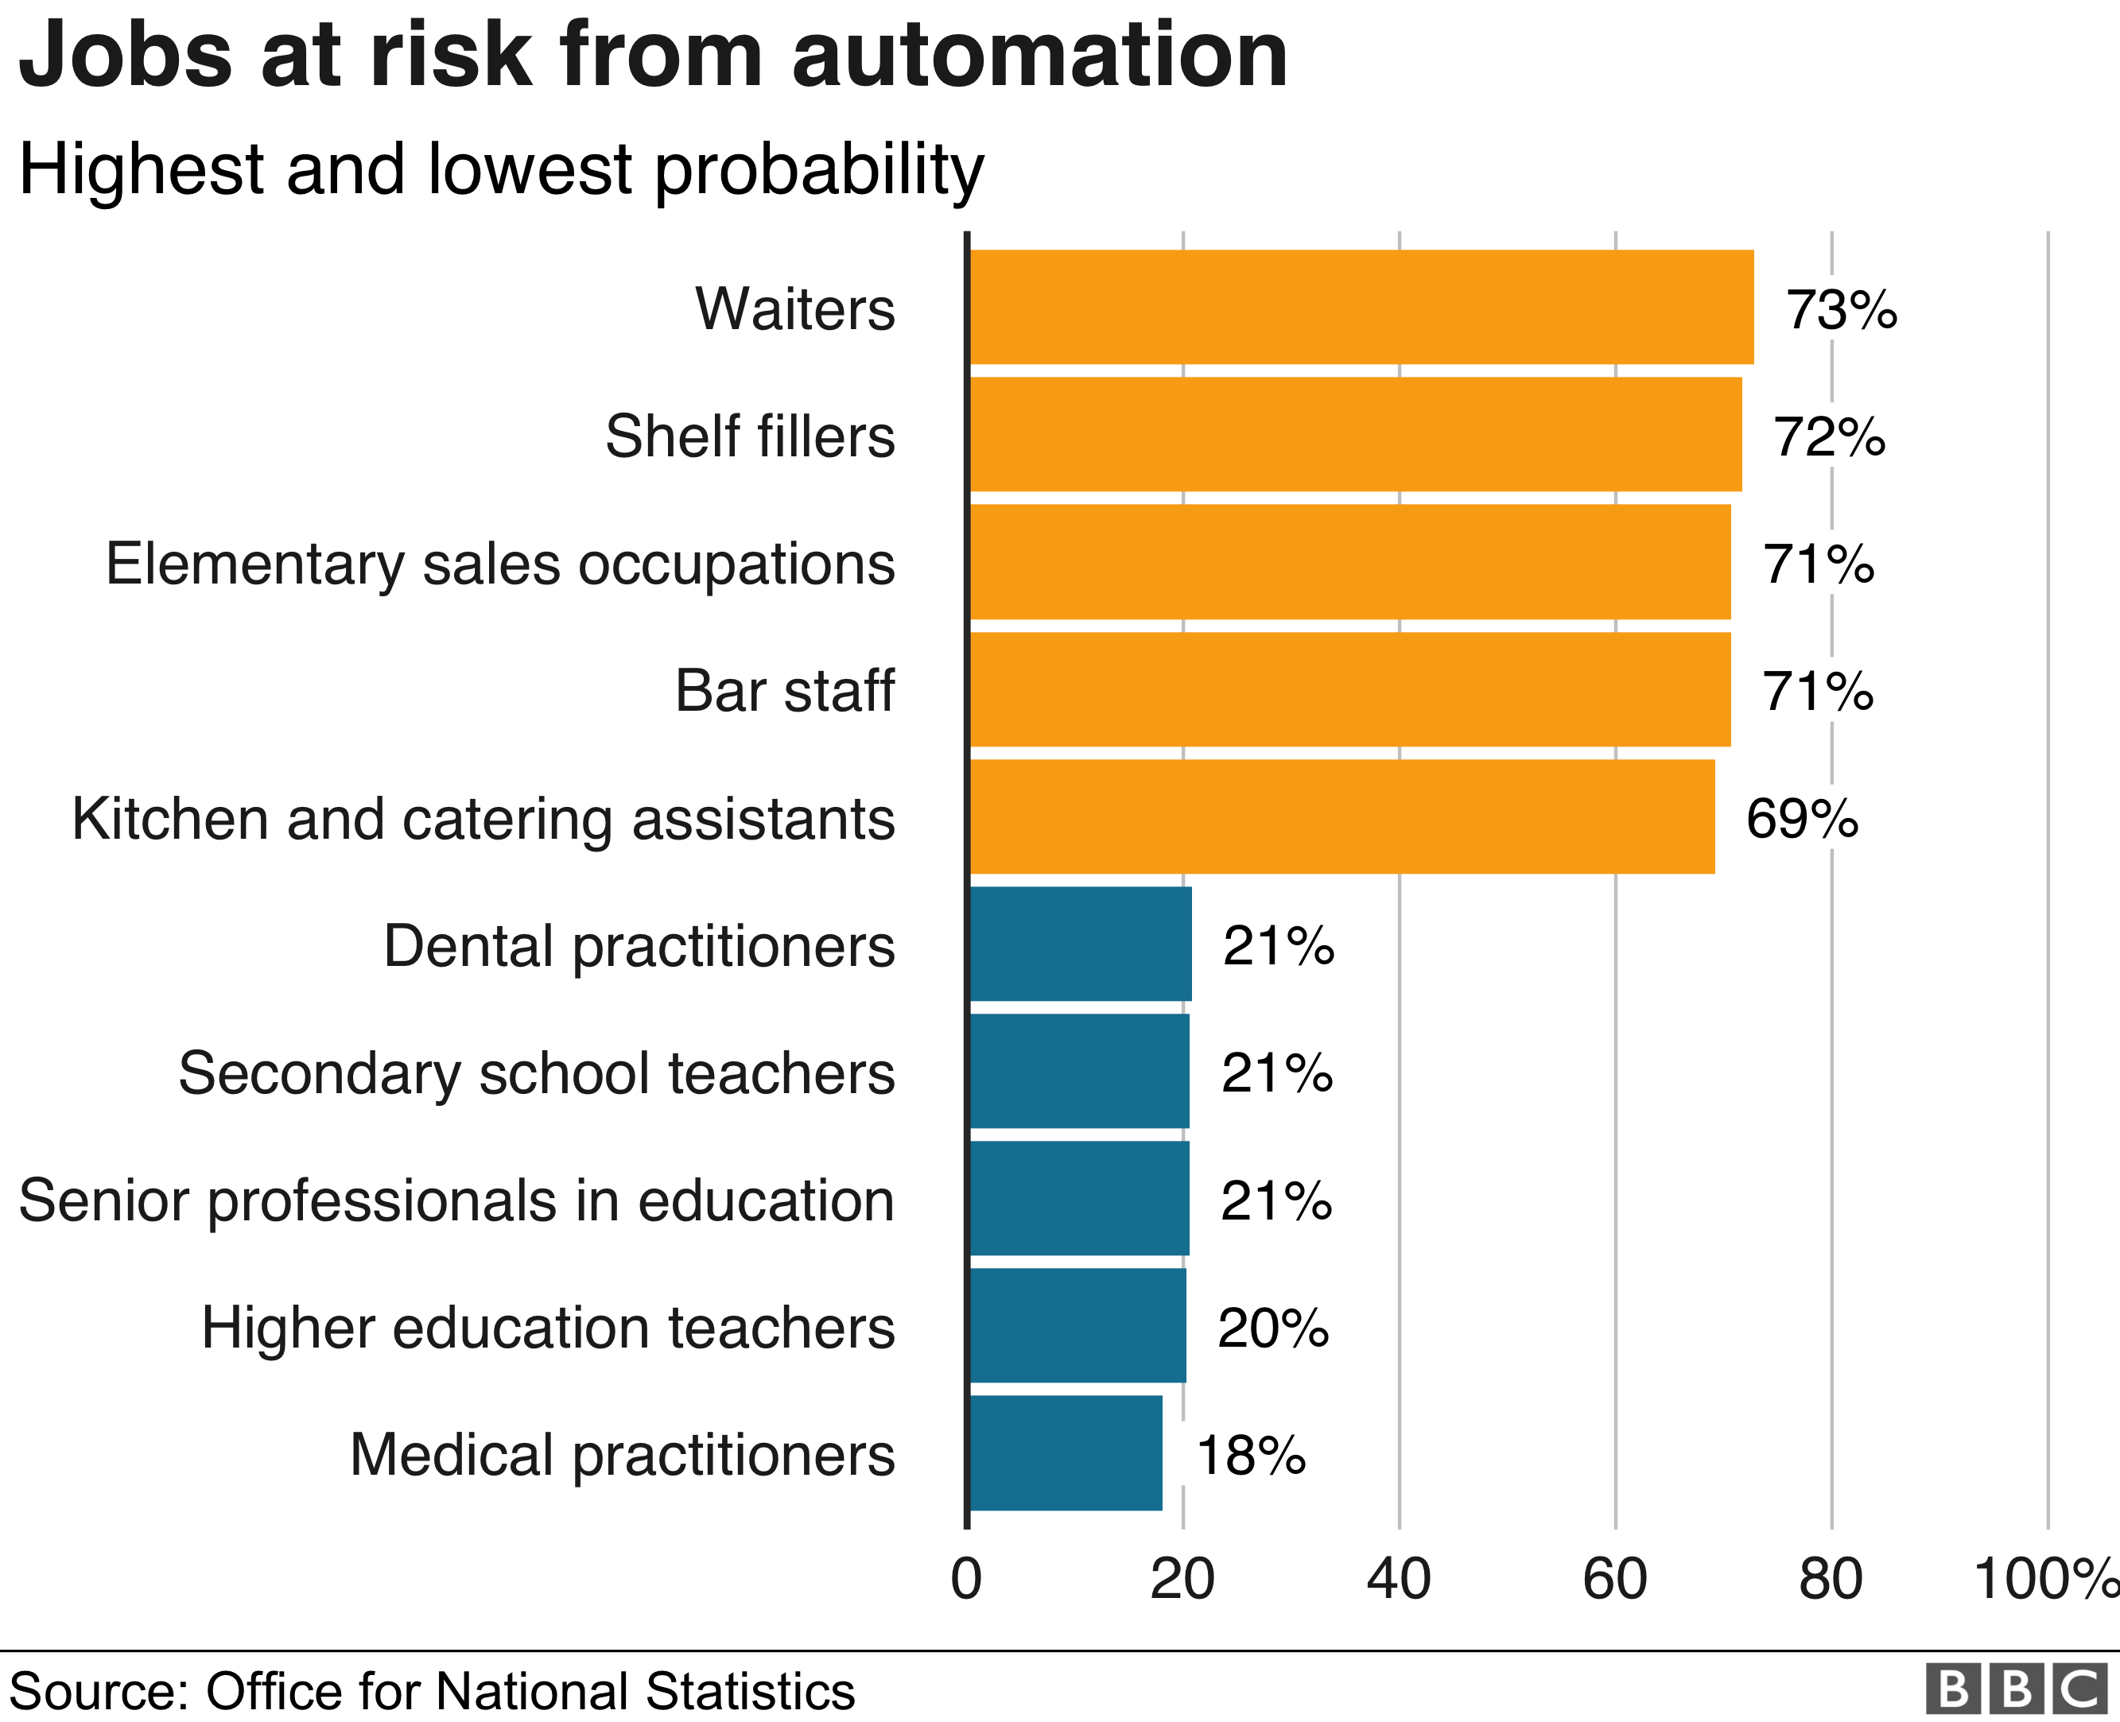
Jobs will be lost
Conor McDonough
Job automation will impact many industries
Professional drivers will lose jobs
  4 million Americans work as professional drivers
  A report estimates 1/2 to 3/4 of these jobs will be eliminated
Self driving cars will also hurt the crash economy
  Decrease in demand for auto assurance
  Decrease in demand for auto repair shops
https://www.bbc.com/news/business-47691078
Notes:
One certainty of the implementation of self-driving cars is that they will take jobs. About 4 million American workers work as professional drivers. This includes things like deliveries, taxi drivers, etc. but does not include drivers of Uber and Lyft. These jobs are all at risk because of self-driving cars. Depending on the specific job, it may or may not be able to be fully automated. Things like assisting passengers are difficult to program. A report from the White House estimates that between a half and 3 quarters of these jobs could be automated. Another area of concern is in the crash economy. With the proper integration, car accidents will go down, and the passengers would not be held liable. This will cause a decrease in auto insurance, auto repair and body shops, and health care. However, different types of jobs could be created from self-driving cars. This would include technical-based repair shops that could repair sensors and equipment of the car. As depicted in the graph, automation of jobs is not just in the auto industry and is widespread. As technology becomes further developed, an increasing amount of jobs will be automized including professional drivers. The introduction of self-driving cars will introduce many complications into society regarding liability, safety, privacy, and are not the ideal solution society believes them to be.

Slide 28
References
Conor McDonough
[1] Cyber Security of Autonomous Machines and Systems, (University of North Dakota), https://onlinedegrees.und.edu/blog/cyber-security-of-autonomous-machines-and-systems/ (April 10, 2021)
[2] Richard DiTomaso, Liability and Safety Concerns with Self-Driving Cars, (HG), https://www.hg.org/legal-articles/liability-and-safety-concerns-with-self-driving-cars-43458 (April 10, 2021)
[3] Self-driving vehicles could struggle to eliminate most crashes, (Insurance Institute for Highway Safety, June 4, 2020), https://www.iihs.org/news/detail/self-driving-vehicles-could-struggle-to-eliminate-most-crashes (April 10, 2021)
[4] David Navetaa, Boris Segalis, Kris Kleiner, Privacy and Security Issues in Autonomous Cars, (Cyber Defense Magazine, October 23, 2019), https://www.cyberdefensemagazine.com/privacy-and-security/ (April 10, 2021)
[5] Nidhi Kalra, What Autonomous Vehicles Could Mean for American Workers, (RAND Corporation, August 29, 2017), https://www.rand.org/blog/2017/08/what-autonomous-vehicles-could-mean-for-american-workers.html (April 10, 2021)

Slide 29
Class 8
The End
Keith A. Pray
socialimps.keithpray.net
Notes:
Any slides beyond this point are for answering questions that may arise but not needed in the main talk.
Some slides may also be unfinished and are not needed but kept just in case.

Slide 30
Buffer Overrun
Run time stack
Local Variables
Return Address
Parameters
Variable Attack
buffer
Target Variable
Stack Attack
buffer
Return Address
code
Return Address
Notes:
Retired slide. Most students have this in depth from new class now.
When a function call is made, local variables, return address, parameters stored on run time stack. Local variables occupy lower memory addresses.
Variable attack – change variable value. Program expects user to input character and allocates a buffer for them. Attacker supplies too many characters and ends up over writing a variable.
Run example of this if there’s interest – next slide
Stack Attack – goal is to change value of return address so execution control goes to code which the attacker has provided in the input buffer.
Prevention – add checks against array bounds being exceeded. modify operating system to not execute instructions stored on run time stack.

Slide 31
Run Example Code
Notes:
Retired demonstration. Most students have this in depth from new class now.
> imps
> assembly
> 123456789qwerty1

Slide 32
Buffer Overrun Code
#include <stdio.h>
#include <string.h>
int main ( void ) {
char buff [ 15 ]; int ace = 0;
printf ( "\n Enter best class ever : \n" );
gets ( buff );
if ( strcmp ( buff, "imps" ) ) {
printf ( "\n %s is wrong! You should FAIL! \n ace=%i\n", buff, ace ); }
else { printf ( "Correct! \n") ; ace = 1; }
if ( ace ) { printf ( "You get an A! \n" ); }
return 0; }
} The Naughty Line
Notes:
Retired slide. Most students have this in depth from new class now.

Slide 33
TCP Three-way Handshake
SYN
SYN-ACK
ACK
Notes:
Retired slide. Most students have this in depth from new class now.
SYNchronize
SYNchronize ACKnowledgement (socket reserved awaiting ACK)
ACKnowledgement
TCP socket connection established

Slide 34
SYN Flood Attack
SYN
SYN-ACK
Notes:
Retired slide. Most students have this in depth from new class now.
Attacker spoofs the IP address so the SYN-ACK is sent to a different machine that cannot respond to the SYN-ACK.
This leaves the connection half open on the server machine decreasing the resources (sockets, memory, threads/processes) available to respond to legitimate clients.
The attacker send many such spoofed SYN messages.

Slide 35
Ping Attack
Target
Attacker
ping
ping
Notes:
Retired slide. Most students have this in depth from new class now.
Attacker finds routers that support broadcasting messages to all computers on their local area networks.
The attacker sends a spoofed ping message, which the routers echo to the spoofed address.

Slide 36
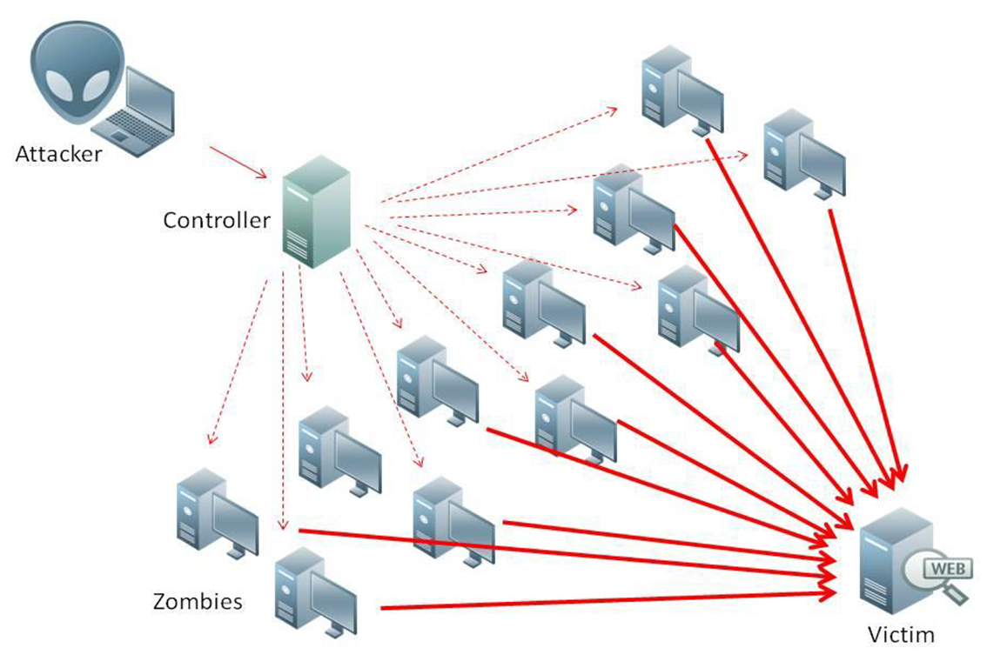
What is Denial of Service (DoS)
Attempts to make target unavailable by flooding with traffic
If victim has to filter attack, it’s too late
Internet Providers have no incentive to help
  Businesses get affected, but would not pay provider enough to make worthwhile
  This is why Cloudflare, e.g., exists
Many ways to perform this attack
Notes:
Contributed by Brett Ammeson.
https://www.cloudflare.com/ddos/reflection-attack-1.png
https://i.imgur.com/lxYv8cF.png

Slide 37
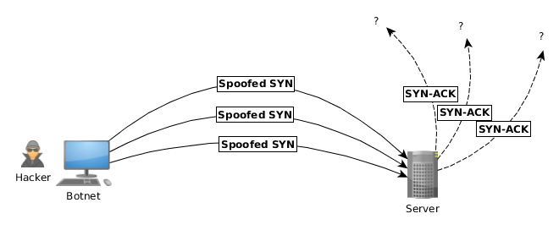
Distributed DoS Vectors
TCP SYN attack
  SYN packets are small, low difficulty for attacker
  Leaves half-open connections on server
  SYN cookies mitigate this
DNS amplification attack
  DNS requests are small
  Can request all records on server
  Crippled by proper configuration
Ingress/egress filtering will reduce effect
Notes:
Contributed by Brett Ammeson.
TCP SYN: https://www.cert.org/historical/advisories/CA-1996-21.cfm
DNS amplification: https://www.cert.org/historical/incident_notes/IN-2000-04.cfm
Ingress/egress: www.giac.org/paper/gsec/705/egress-filtering-keeping-internet-safe-systems/101588

Slide 38
Crime How
Technical and Non-Technical
  Break into computer.
  Prevent access to computer.
What things make computer related crime easy?
Notes:
Exploit security holes, Break encryption, Spoofing
Social Engineering: Guess passwords, Find out passwords and procedures
Poor passwords, Insecure protocols, Program limitations (buffer overruns), Eavesdropping (Email, Interactive), Insecure files

Slide 39
Crime Bane
Trojan Horse
Virus
Worm
Bot Network
Buffer Overrun
(Distributed) Denial Of Service Attack
How do they work?
How harmful are they?

Slide 40
Crime Why
Why?
Notes:
Money: stolen credit cards, change records, stolen property.
Political, military, economic.
Challenge, Revenge, Mean
Why do at all? Have motivation, think about it, think it will help, think it’s acceptable.
Feel forced. Don’t agree. Don’t care.

Slide 41
Crime Time
What is different now compared to:
  10 years ago?
  20 years ago?
  30 years ago?
  40 years ago?
Notes:
More computers. Unsophisticated owners. More complex software. Greater connectivity. Easy access to cracking tools. Incentives. File-sharing
In ’60s and ’70s, access was mostly localized.
Modems. Wardialing.
Some Arpanet and Usenet.

Slide 42
Crime Doers
Hacker or Cracker
  Pre-1980 - Golden Age ☺ ?
  Eighties
  Nineties
  Naughts
Criminal Hacking == Cracking?
Notes:
Script kiddies
Phreakers
Security analysts
Packet monkey

Slide 43
Crime Gain
Justifications for Computing Crimes?
What can be done after access is gained?
  What resources are available?
  How valuable are they?
Notes:
Machines are unused. No harm done. Education. Exposes security holes. Exposes abuses.
Use computer and/or resources. Take data. Destroy data. Alter data. Lock out others. Attack other computers.
Equipment, Processor Time, Disk space, Printer time / paper, Bandwidth

Slide 44
Crime Pay
Computer Fraud and Abuse Act (1986)
  Bans :
    unauthorized access or use of computers, copying, modifying, or destroying data, disclosing of passwords.
    disrupting government and utilities.
  Covers government, financial, medical, and interstate systems.
USA Patriot Act (2001)
  Raised penalties.
  Permits freer surveillance and monitoring to detect illegal activity.
Electronic Communications Privacy Act
  Illegal to intercept telephone, email, other data transmissions, access stored email messages without authorization
Assign Cybercrime Treaty (2006), Wire Fraud Act, National Stolen Property Act, Identity Theft and Assumption Deterrence Act
Notes:
Are either of these laws still in effect? Have they been changed?
For additional legislation ask for presenting volunteers to brief recent incidents/cases.
Also ask for volunteers to find out laws from their home country/state.

Slide 45
Crime Stop
Technical
  Protect Data
  Protect Machine
  Protect Access
Non-technical?
  Social?
  Legal?
Notes:
Encryption, Authentication, Biometrics, Anti-virus, File integrity checking (E.g. Tripwire), Virtual private networks, Point-to-point networking (Twisted-pair Ethernet vs. Coax vs. wireless)
Security through obscurity, physical access required, not on network, behind locked doors.
Remove desire, remove incentives
Legalize, increase penalties, increase chance of getting caught.

