Slide 1
Class 14
Last Day
Keith A. Pray
socialimps.keithpray.net
Notes:
This is the loneliest title slide you’ll ever see…

Slide 2
Automation
Papers
This Term
Includes Terms:
2018 A
2019 D
2019 A
2020 D
2020 A
2020 B

Slide 3
Papers
Great improvement!
Very Clear Conclusions
Great Quantifying Data
Significant Counter Points
Good Use Of Examples
Notes:
Save for next time:
Clearly state conclusion
First statement preferred
Absolute statements are difficult to prove
Avoid: all, always, any, every, everyone, never, none… unless you can show it
Be sure to put quotes around entire quote
Hyperbole is the best thing ever!
but not in these papers
Print 2 sided and save a tree
Use template, saves time (and -1 point)
Include Counter Point and Response
Include Author, Title, Publish Date, Publisher for references
Read paper aloud to proof

Slide 4
Grades
To Date
60 Max Possible

Slide 5
Overview
Course and Group Evaluations
Students Present
Students’ Choice

Slide 6
Computerized injustice
Russell DeSousa

Slide 7
Unintentional Bias
Russell DeSousa
Inadequately diverse data sets
  Lower representation of specific groups
  Race and gender diversity in data sets
  High rate of error in facial recognition of ’darker-skinned females’
Working to resolve these issues
  Intentional representing all groups equally
  Being aware of potential biases in work
Buolamwini et all.
Notes:
Data sets for facial recognition software, facial recognition comes up often, it's hard to avoid
Adience and IJB-A are existing data sets, PPB set was designed by the writers of the paper to try and be more diverse
Adience was less racially diverse, IJB-A was both less racially diverse and less gender diverse
Less represented groups in the data set were more prone to errors in the facial recognition
34.7% error rate in facial analysis toward darker-skinned females vs max of 0.8% for lighter-skinned males
Incorrect facial identification could lead to false arrests or potentially wrongful death, this will only become more and more of an issue as the technology becomes more widespread
A woman of color might have a 35% change to be falsely accused of a crime, on top of the increase chance to be pulled over
--------------
More equally representing groups can provide a better data set which might lead to less errors when dealing with underrepresented groups
It’s also impossible to do this perfectly, so you must recognize that your work will still have some bias, or if you are working with imperfect datasets you should be aware of the bias they might have

Slide 8
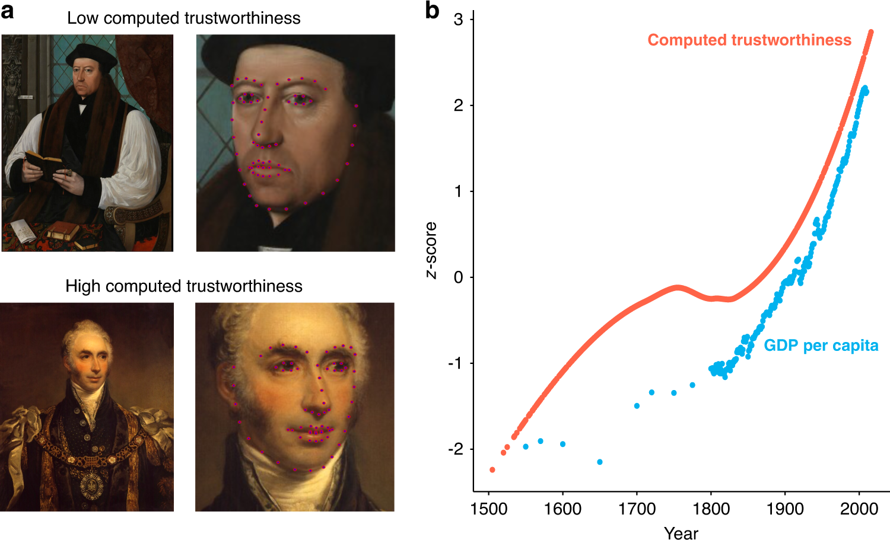
Unethical design
Russell DeSousa
“Tracking historical changes in trustworthiness using machine learning”
  Study based in work similar phrenology
  Potentially severely harmful uses
Preventing further projects like this
  Thoughtful analysis of what, why, and for who something is designed for
  Peer review
  Diversity of opinion
Safra L. Et al
Notes:
The experiment used machine learning to analyze facial features in artwork to try and compute a trustworthiness score that is linked to how trustworthy a person might view the face depicted
This paper was shared on Twitter and quickly received heavy backlash after it used information from the study on images of real people
Authors of the paper since removed this media from twitter, and I didn't get a chance to look at the paper before this change was made
Due to the nature of the experiment it is somewhat ‘phrenology-adjacent’, Phrenology uses features of the skull to try and determine things about someone
Phrenology has roots in racism and sexism, used as a scientific justification for these, people have tried to use physical features to discriminate against others for a long time
-Inherently has bias, based on who decides what features are and aren’t trustworthy
-Expression influenced the computation as well; Those with autism who might show a more ‘flat or blunt’ expression showed less “social openness”
-More feminine faces were seen as more trustworthy and more masculine faces were seen as less trustworthy
Ethics Declaration section of paper was just essentially blank
Providing these tools could lead to discrimination of people simply based off their facial features, or even go beyond that
------
It is important to think about and analyze why and for whom this might be used
Why should this technology exist? Who will be using this kind of software and what purpose will it have
Is it necessary to determine this information from someone’s face?
Who might be affected from this software and who will benefit from it
Having a more diverse set of eyes looking at your work will help to point out things that might not be obvious, the vast amount of people that saw the paper on twitter had a wide range of concerns to bring up
Someone might be able to point out very quickly that the study has the potential to be harmful if you simply ask people outside of the people you are working with
I personally didn’t see the inherent harm in this paper until others talked about it

Slide 9
More real examples
Russell DeSousa
COMPAS recidivism prediction AI
  Biased towards black prisoners
  COMPAS was correct about violent crime predictions 20% of the time
Unintentional usage of biased software
  Biases from the original software affect software written using it
  Any software that uses this new software now faces the same issue
ProPublica
Notes:
COMPAS is used to determine if someone who is arrested will likely commit another crime, recidivism
COMPAS was able to predict future crimes with an accuracy of 61% when looking at all crimes
Black defendants had more false flags, white defendants were often mislabeled as lower risk
Black defendants who did not recidivate within 2 years were labeled as high risk nearly twice as often as white counterparts (48% vs 28%)
Brisha Borden was arrested for attempting to steal a bike and a scooter with her friend on her way to pick up her god-sister from school, but immediately stopped once they were noticed and walked away
Vernon Prater had already served 5 years in prison, both had been charged for stealing things of equivalent value, and yet Vernon got a low risk score where Brisha got a high risk score
------------------
If you use a software library, for example, that has some sort of inherent bias from the programmer in it, that inherent bias will now affect what you write as well
Word embedding, trained on relations, is used as a sort of dictionary for computer software that needs to understand the meaning of words, for things such as machine learning and natural language processing
Word2Vec is one such software, and is trained on a collection of Google News texts containing 3 million English words
Word2Vec equated man with computer programmer and woman with homemaker (housewife)
Other relations in Word2Vec also reinforced gender stereotypes, typically based on occupation
Any software that uses this word embedding software will have the same stereotyping

Slide 10
cs3043
Russell DeSousa
Importance of ethics courses
  Impossible to solve issues you are not aware of
  Some issues are not ‘common sense’ or easily caught
Importance of this course
  All of us should be better prepared to prevent harm as designers
  Better prepared to cast light on issues beyond our own work
Notes:
This, and other ethics courses that we as students might take at wpi, are necessary so that we are better able to identify issues such as the ones represented.
Outside criticism can help to maintain the functionality of something while also removing the potentially harmful issues it might cause, as 2 of the papers showed. (Facial recognition and word2vec)
The more of us that are able to recognize problems such as these, the better. The experience that any individual student here has might be the key to bringing up criticism about a specific project.
For example, I as a gay man am more aware of issues that relate to discrimination of this sort, and will be more keen on bringing issues like this up. Other students who have a different upbringing might be more inclined to bring up issues that relate to their personal experience.
If we all have the knowledge to analyze and be critical of the work of others, as well as our own, we can apply that along with our own experiences to hopefully 'cover all bases' when looking at projects either at WPI or outside.

Slide 11
References
Russell DeSousa
[1] Hong, J. W., & Williams, D. (2019). Racism, responsibility and autonomy in HCI: Testing perceptions of an AI agent. Computers in Human Behavior, 100, 79-84.
[2] Buolamwini, J., & Gebru, T. (2018, January). Gender shades: Intersectional accuracy disparities in commercial gender classification. In Conference on fairness, accountability and transparency (pp. 77-91).
[3] Breland, A. (2017). How white engineers built racist code–and why it’s dangerous for black people. The Guardian, 4. Retrieved from https://www.theguardian.com/technology/2017/dec/04/racist-facial-recognition-white-coders-black-people-police (Dec 9 2020)
[4] Klare, B. F., Burge, M. J., Klontz, J. C., Bruegge, R. W. V., & Jain, A. K. (2012). Face recognition performance: Role of demographic information. IEEE Transactions on Information Forensics and Security, 7(6), 1789-1801.
[5] Safra, L., Chevallier, C., Grèzes, J., & Baumard, N. (2020). Tracking historical changes in trustworthiness using machine learning analyses of facial cues in paintings. Nature communications, 11(1), 1-7
[6] Angwin, Julia, Jeff Larson, Surya Mattu, and Lauren Kirchner. "Machine bias. Pro Publica. 23 May 2016." (2016). Retrieved from https://www.propublica.org/article/machine-bias-risk-assessments-in-criminal-sentencing (Dec 9 2020)
[7] Bolukbasi, T., Chang, K. W., Zou, J. Y., Saligrama, V., & Kalai, A. T. (2016). Man is to computer programmer as woman is to homemaker? debiasing word embeddings. Advances in neural information processing systems, 29, 4349-4357.
[8] Kasana, M. “AI researchers tried to gauge 'trust' by looking at faces. Surprise: it's racist.” (Sep 25, 2020). Retrieved from https://www.inputmag.com/culture/this-algorithmic-study-about-trustworthiness-has-some-glaring-flaws (Dec 11 2020)

Slide 12
Bias In Artificial Intelligence
Chris DeFranco

Slide 13
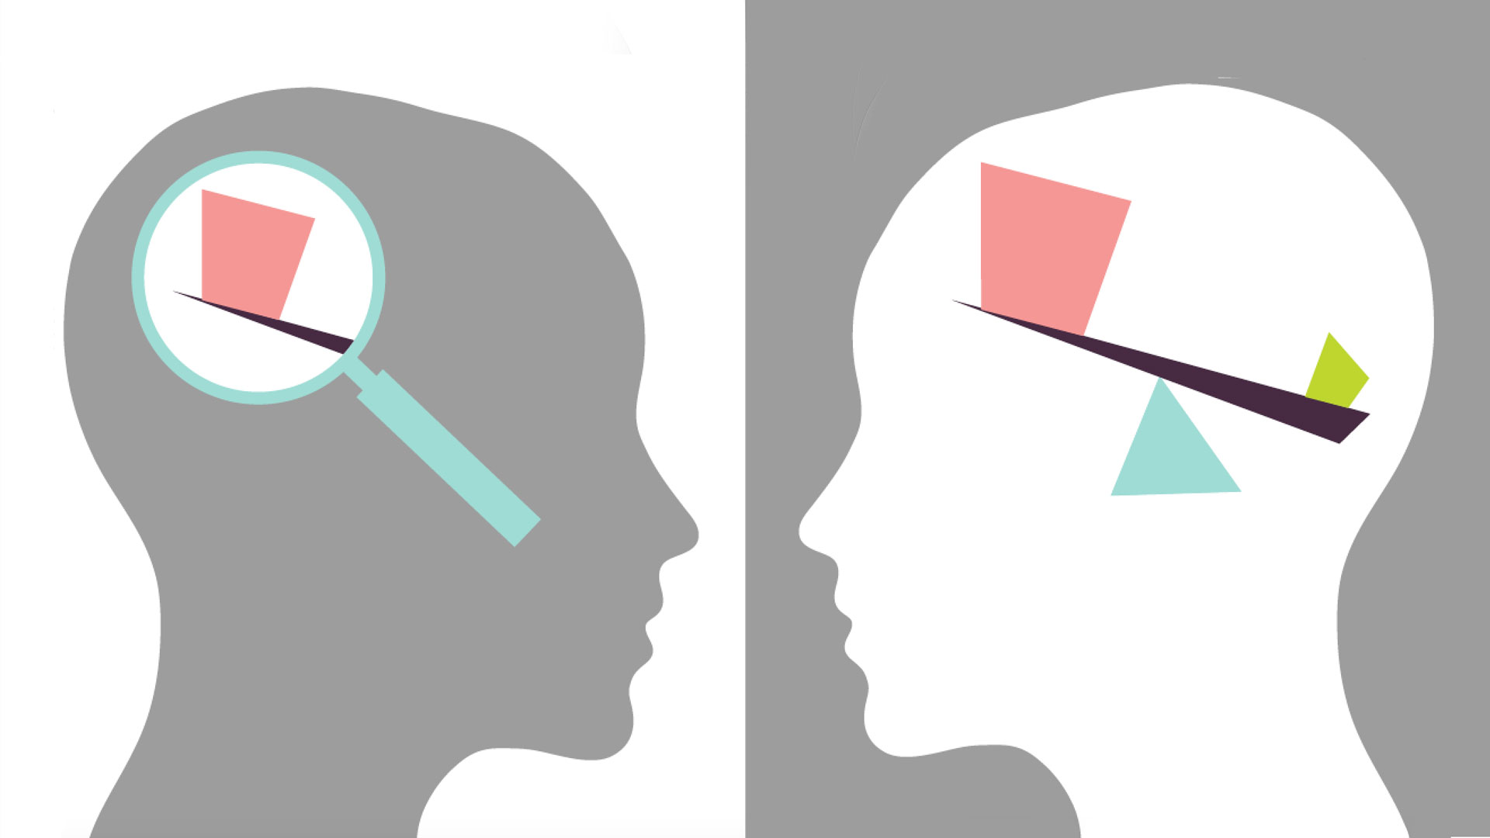
A Brief introduction to Bias
Chris DeFranco
Bias is a point of view or preference that you may not even know you have
Common examples of bias
The problem with bias
Image Source: https://www.vision.org/sites/default/files/img/2015fall_checking-the-bias_1920x1080.jpg
Notes:
A BRIEF INTRODUCTION TO BIAS
A bias is a point-of-view, or preference, that you may or may not know you even have
The problem is that biases affect decisions. A harmless example of bias could be a grocery shopper can be “biased” by not buying damaged fruit. However more harmful biases can affect more sensitive personal decisions which isn’t good. Worse, they may affect societal decisions such as hiring for a job, decisions on who gets government assistance, decisions on who gets medical care and what kind, decisions on investments and so many more. An example of this would be an employer who doesn’t hire minorities, either intentionally or for subconscious reasons.
Although understanding bias has always mattered, and companies have addressed it through employee training programs, it's now becoming a much more critical an issue with the introduction of automation.

Slide 14
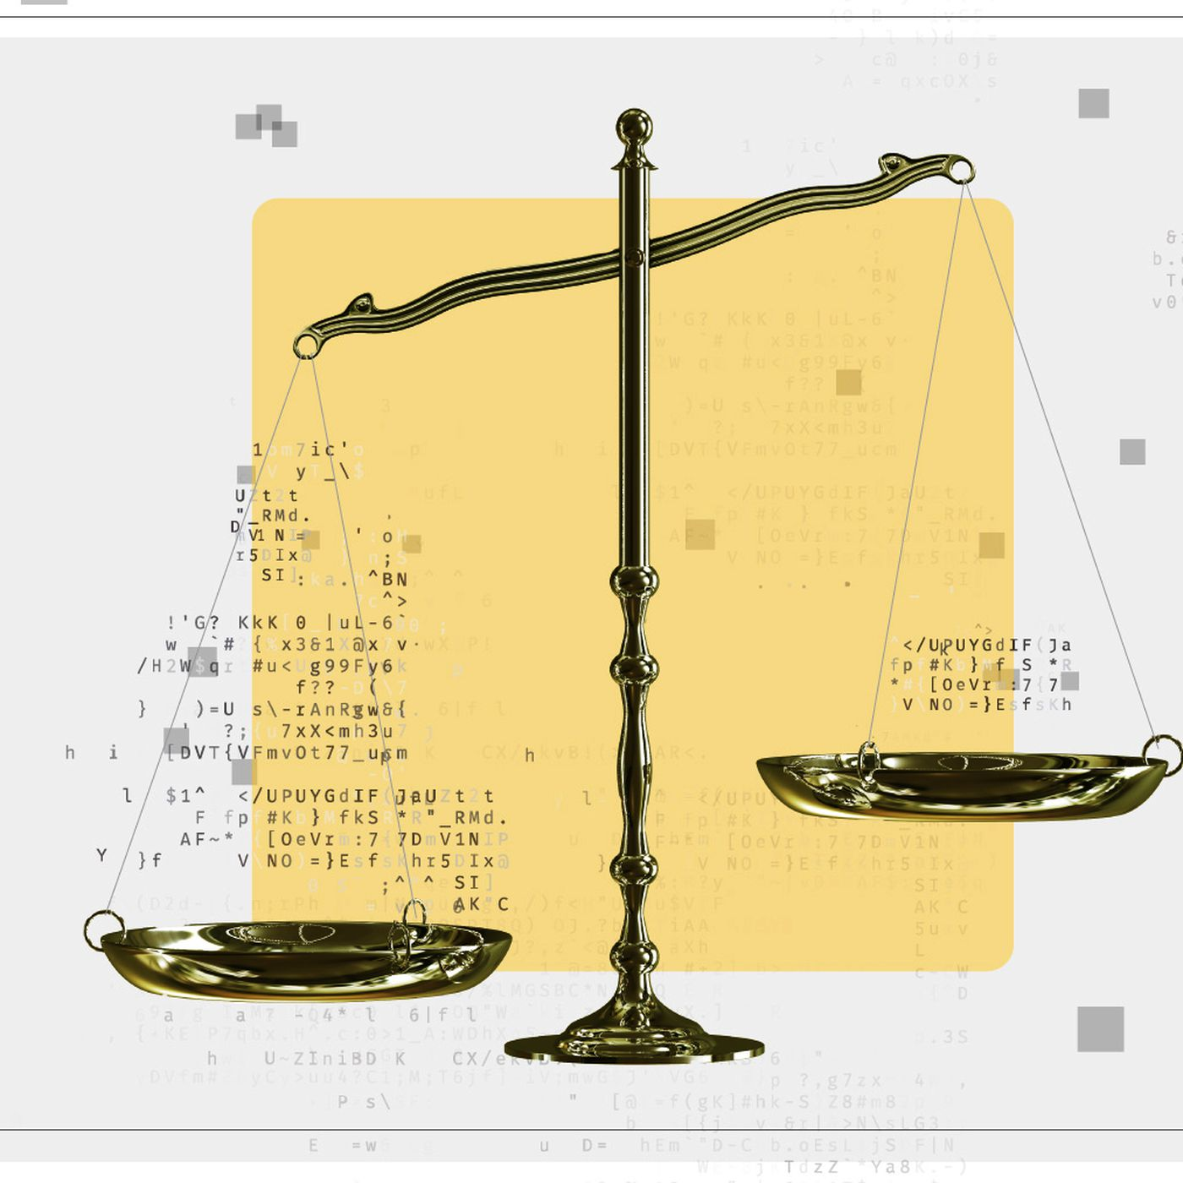
Bias in computing predating A.I.
Chris DeFranco
Algorithmic Bias
Examples
Image Source: https://cdn.vox-cdn.com/thumbor/NZX_xxh-zwP0jSUdV0uRG-Rkg8A
Notes:
BIAS IN COMPUTING PREDATING A.I.
An example of this would be algorithmic bias, something that has been going on well before A.I.
Algorithmic bias describes systematic and repeatable errors in a computer system that lead to unfair outcomes, such as privileging one group over another.

Slide 15
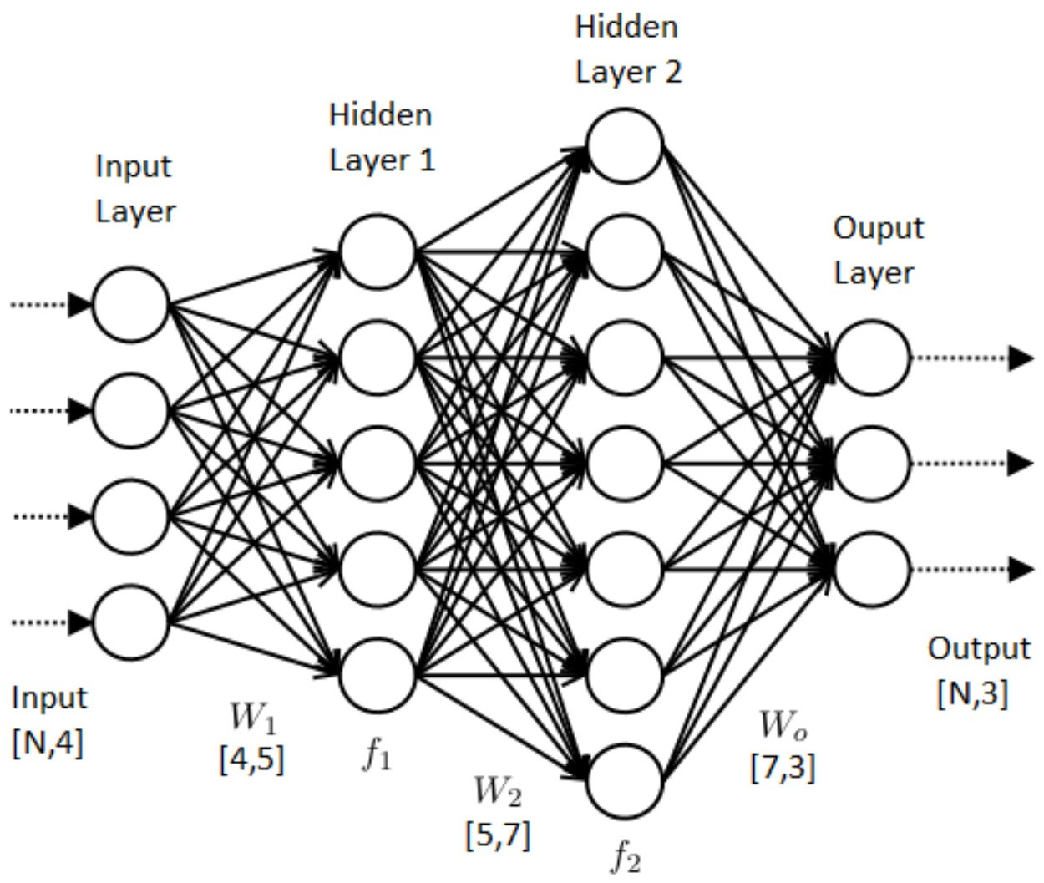
A.I. and how it works
Chris DeFranco
Old methods of computing
A.I. reverses this method
  The computer learns how to create desired outcomes given inputs
The black box
Image Source: https://miro.medium.com/max/2500/1*ZB6H4HuF58VcMOWbdpcRxQ.png
Notes:
A.I. AND HOW IT WORKS
Knowing how A.I. works is important for understanding how bias can enter into these systems.
In the history of computer science, computers were programmed by creating algorithms in code to take inputs and make decisions and solve problems. The code came first, the data and output came afterward.
In AI it's reversed. The computer is provided with the data and it learns how to create those outcomes given the inputs. However, what is in between, what used to be a human readable algorithm, is now very much a “black box.”
The problem is - with at least the current state of AI, it's quite difficult, if not impossible, to know how it got to its conclusion. You can't investigate that black box.
If you can't investigate the box, you don’t know how the AI made its decisions. Therefore, you have no ideas if it has any biases.

Slide 16
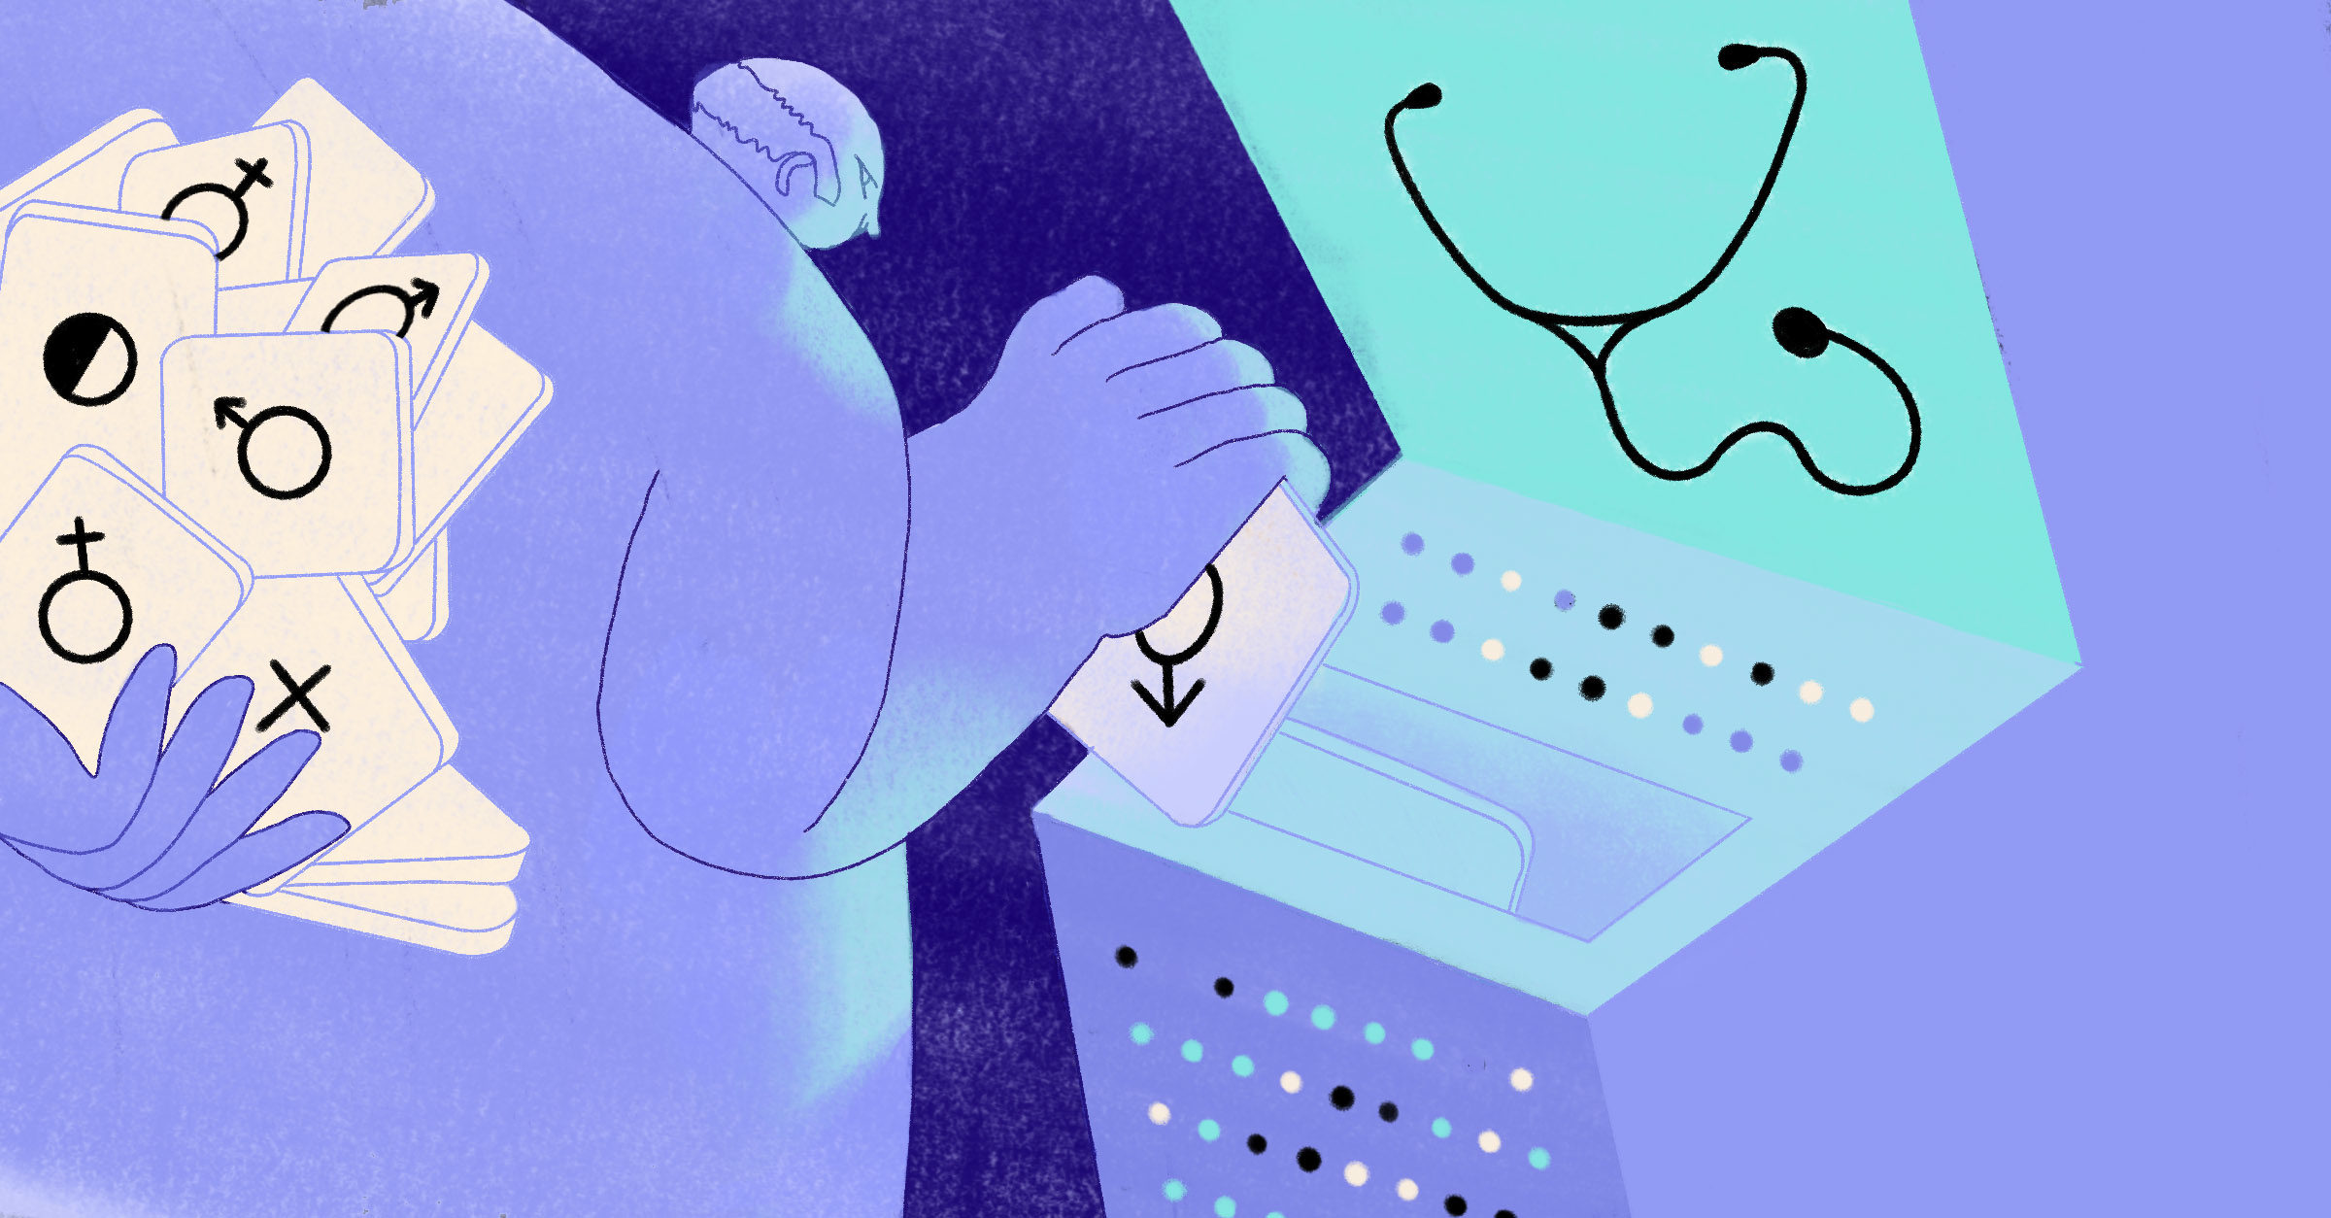
Bias in A.I.
Chris DeFranco
How old bias was easier to address
A.I. systems learn on their own and make it much more difficult to investigate bias
Image Source: https://unbabel.com/blog/wp-content/uploads
Notes:
BIAS IN A.I.
Before AI, back in 1988, the UK Commission for Racial Equality found a British medical school guilty of discrimination. A non-AI computer program that selected who would be interviewed was found to be biased against women and those with non-European names. The programmers had simply programmed the algorithm in a way that they felt best mimicked how Admissions has always selected candidates. [HBR].
Although not good, at least someone could look at the code and determine where the bias was coming from.
That was 30 years ago.
Today, AI systems learn on their own. If an AI cook in my home watches what I eat and what I throw away every meal, it will eventually stop giving me food I don’t like. And it would be very difficult to prove this without analyzing every action it takes.

Slide 17
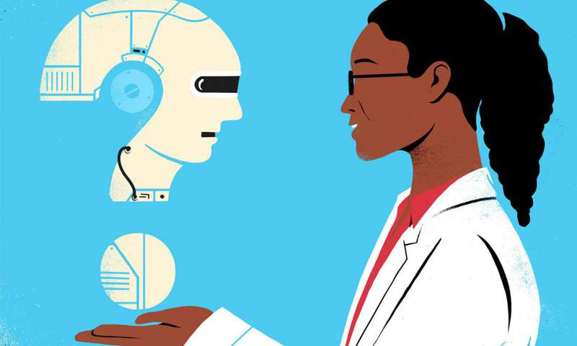
How does this happen?
Chris DeFranco
Intentional VS Unintentional
Examples
Image Source: https://techxplore.com/news/2019-07-bias-ai.html
Notes:
HOW DOES THIS HAPPEN?
Similar to Algorithmic bias, programmers of the AI system may intentionally or accidentally put bias into the system

Slide 18
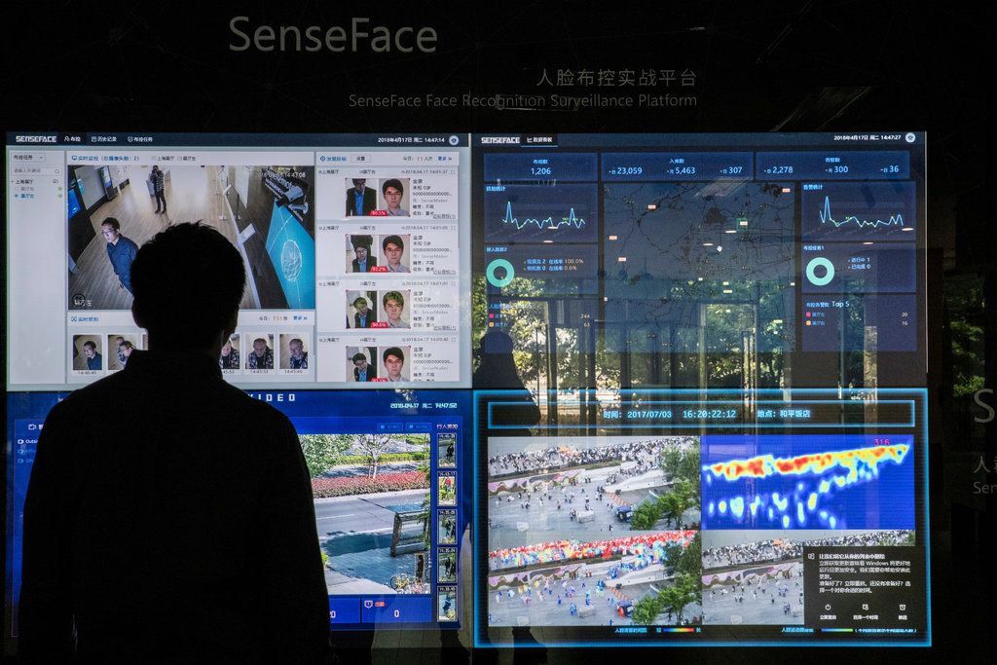
Why is this problematic?
Chris DeFranco
We could potentially automate the worst biases in people
Economic effects
Intentional bias
Image Source: https://static01.nyt.com/images
Notes:
WHY IS THIS PROBLEMATIC
We will potentially automate the worst biases in people.
For example, we will be automating discrimination.
This will lead to more frequent negative economic effects since people who should be able to participate in the economy are not admitted to colleges by AI admissions programs, hired as much by AI HR systems, are not recommended for promotion by AI HR Performance Evaluation systems, are not given the same raises and bonuses as recommended by AI Compensation systems and so on.
These same problems will inherit systems that make medical care recommendations, analyze genetic data for drug approvals, analyze racial data for legal precedence rulings and so much more.
Biased can be put into AI systems with the intent of causing harm
The Chinese government has used AI to track and racially profile the Muslim minority, about 1 million of whom are believed to be living in “internment camps”

Slide 19
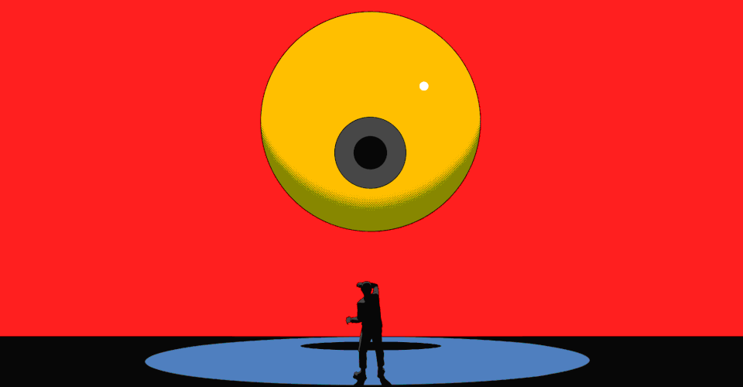
The problem is widespread
Chris DeFranco
A.I. Bias is very common
Examples:
  Amazon
  Self driving cars
As A.I. begins to power robots, this issue could get much worse
Image Source: https://.theatlantic.com%2Fmagazine%2Farchive%
Notes:
THE PROBLEM IS WIDESPREAD
Amazon.com stopped using an HR system hiring algorithm after it was found that it was selecting more applicants for interviews based on words like “executed” or “captured” being used on a resume - words that male applicants use much more frequently than female. [ProPublica]
Joy Buolamwini and Timnit Gebru from MIT found that facial recognition AI’s had higher error rates for minorities, particularly minority women, which was likely caused by data that was not properly sampled across ethnicities (basically, “unrepresentative training data.”) [MIT News]
Benjamin Wilson and his research team as Georgia Tech discovered that many self-driving car AI systems were worse at recognizing pedestrians with darker skin tones than paler ones, potentially leading to a higher rate of dark-skinned pedestrian deaths. Joy Buolamwini, who founded the Algorithmic Justice League and who is a graduate student researcher at MIT, has interacted with MIT robots at two different laboratories that failed to see her. She actually had to wear a white mask in order to be seen. [NY Times Article]
As AI is increasingly powering robots, the problem is about to potentially get much worse. In Dallas, in 2016, for the first time ever a police robot, built to defuse explosives was reconfigured to be used to kill an active shooter. The robot was directed by a police officer, but it’s only a matter of time before they can autonomously make such decisions. In this case, the shooter just happened to be African American and in these current times of social tension, imagine the implications if robots were making such decisions on their own and potentially had any sort of bias? This is clearly a much worse potential problem than not hiring someone. [NYTimes Robot Article]

Slide 20
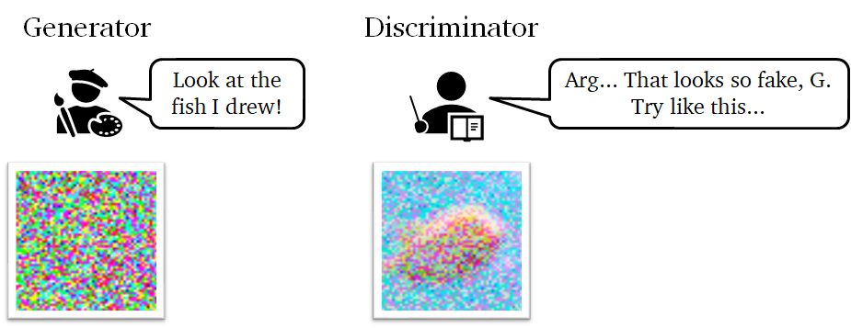
Addressing the problem
Chris DeFranco
Transparency is the first step for accountability
A.I. that looks for bias
Teaching A.I. fairness
Generative Adversarial Networks
Image Source: https://towardsdatascience.com/gan-papers-to-read-in-2020-2c708af5c0a4
Notes:
ADDRESSING THE PROBLEM
The good news is that AI is constantly improving. New tools are being created that help see how the black box is working (there is a very long way to go, however).
However, we can’t just hope bias in these systems will fade away. Transparency is the first step for accountability
It is very difficult to attack every instance of AI bias, instead we should code AI better going forward
AI systems will learn anything you want them to. So, people are focusing on having them also learn what bias looks like.
AI systems can be taught "fairness," or using statistical tools to ensure the proper distributions of decisions across possible outcomes. [Teaching Fairness Article]

Slide 21
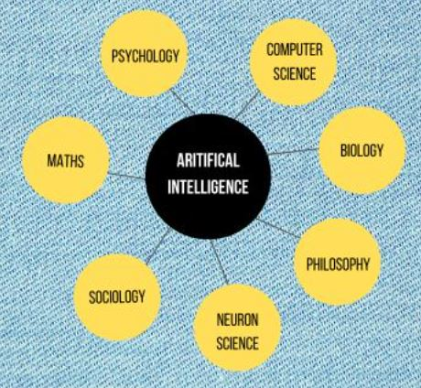
conclusion
Chris DeFranco
A.I. is becoming increasingly important to society
However, it is critical that we implement this technology cautiously
Image Source: https://python-tricks.com/introduction-to-artificial-intelligence/
Notes:
CONCLUSION
The importance of AI to society is at par, if not even more impactful, than discovery and application of electricity and antibiotics.
As with electricity and antibiotics, AI will change the world for the better and improve our quality of life in ways that we cannot yet even imagine.
It is critical that we solve the bias problem so that AI doesn't do harm to subgroups of people in the process of improving so many others’ lives.
Just as when electricity was implemented but with safeguards so that people were not electrocuted, and antibiotics were put through extensive clinical trials before being widely used, AI needs to be implemented with safeguards that prevent it from causing harm to anyone as well. Harm that is obviously, or harm that is hidden within the AI black box that no one even knows is there

Slide 22
References
Chris DeFranco
[1] Bias. (n.d.). Retrieved December 6, 2020, from https://www.psychologytoday.com/us/basics/bias
[2] By: IBM Cloud Education. (n.d.). What is Artificial Intelligence (AI)? Retrieved December 6, 2020, from https://www.ibm.com/cloud/learn/what-is-artificial-intelligence
[3] Julia Angwin, J. (2016, May 23). Machine Bias. Retrieved December 6, 2020, from https://www.propublica.org/article/machine-bias-risk-assessments-in-criminal-sentencing
[4] Larry Hardesty | MIT News Office. (n.d.). Study finds gender and skin-type bias in commercial artificial-intelligence systems. Retrieved December 6, 2020, from https://news.mit.edu/2018/study-finds-gender-skin-type-bias-artificial-intelligence-systems-0212
[5] What Do We Do About the Biases in AI? (2019, October 25). Retrieved December 6, 2020, from https://hbr.org/2019/10/what-do-we-do-about-the-biases-in-ai

Slide 23
References
Chris DeFranco
[6] Hacker, P. (2018, May 05). Teaching Fairness to Artificial Intelligence: Existing and Novel Strategies Against Algorithmic Discrimination Under EU Law. Retrieved December 6, 2020, from https://papers.ssrn.com/sol3/papers.cfm?abstract_id=3164973
[7] Berreby, D. (2020, November 22). Can We Make Our Robots Less Biased Than We Are? Retrieved December 6, 2020, from https://www.nytimes.com/2020/11/22/science/artificial-intelligence-robots-racism-police.html
[8] Dastin, J. (2018, October 10). Amazon scraps secret AI recruiting tool that showed bias against women. Retrieved December 6, 2020, from https://www.reuters.com/article/us-amazon-com-jobs-automation-insight/amazon-scraps-secret-ai-recruiting-tool-that-showed-bias-against-women-idUSKCN1MK08G
[9]https://nissenbaum.tech.cornell.edu/papers/Bias%20in%20Computer%20Systems.pdf
[10] Heilweil, R. (2020, February 18). Why algorithms can be racist and sexist. Retrieved December 7, 2020, from https://www.vox.com/recode/2020/2/18/21121286/algorithms-bias-discrimination-facial-recognition-transparency

Slide 24
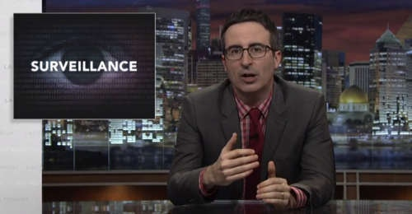

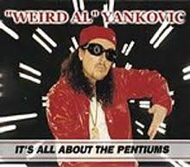

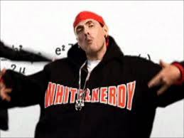
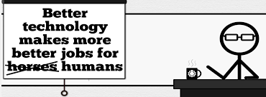
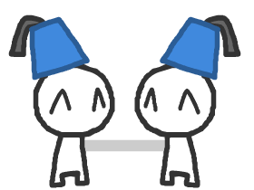

Student Choice – Interesting Videos
  Last Week tonight with John Oliver Snowden (33:14)
  It’s All About The Pentiums
  Weird Al (3:34)
  White and Nerdy Weird Al (2:50)
  The Game Of Trust - Nicky Case
  Why Electronic Voting is a BAD Idea
  Computerphile (Tom Scott) (8:20)
  Welcome To Life – Tom Scott (2:44)
  What "Orwellian" really means - Noah Tavlin (5:31)
  Humans Need Not Apply
  CGP Grey (15:00)
Notes:
All Last Accessed 2018-10-04
CGP Grey
Humans Need Not Apply (15:00) – 2014-08-13
http://www.youtube.com/watch?v=7Pq-S557XQU
Last access 2016-04-22
Why Electronic Voting is a BAD Idea – Computerphile (Tom Scott) (8:20)
https://www.youtube.com/watch?v=w3_0x6oaDmI
Last Week tonight with John Oliver – Patriot Act, Edward Snowden (33:14)
http://www.upworthy.com/john-oliver-flew-10-hours-to-russia-to-interview-edward-snowden-and-get-him-on-record?c=ufb1
Weird Al – It’s All About The Pentiums (3:34) and look at lyrics
https://www.youtube.com/watch?v=qpMvS1Q1sos
Tie into Ray Kurzweil Singularity
Epic Rap Battles of History: Steve Jobs vs. Bill Gates (If class ok with obscene lyrics) (2:47)
https://www.youtube.com/watch?v=njos57IJf-0
Also Work links on web site http://socialimps.keithpray.net/documents/
-----
Tom Scott
http://tomscott.com
Welcome To Life (2:44)
https://www.youtube.com/watch?v=IFe9wiDfb0E&feature=youtu.be
Passphrases (2:08 need to give context for video)
https://firstlook.org/theintercept/2015/03/26/passphrases-can-memorize-attackers-cant-guess/
If not shown during first class
What "Orwellian" really means - Noah Tavlin (5:31)
http://ed.ted.com/lessons/what-orwellian-really-means-noah-tavlin
Weird Al – White and Nerdy (2:50) and look at lyrics
https://www.youtube.com/watch?v=N9qYF9DZPdw

Slide 25
Student Choice – Interesting Videos (Full)
  Last Week tonight with John Oliver Snowden (33:14)
  It’s All About The Pentiums
  Weird Al (3:34)
  White and Nerdy Weird Al (2:50)
  The Game Of Trust - Nicky Case
  Why Electronic Voting is a BAD Idea
  Computerphile (Tom Scott) (8:20)
  Welcome To Life – Tom Scott (2:44)
  What "Orwellian" really means - Noah Tavlin (5:31)
  Humans Need Not Apply
  CGP Grey (15:00)
Notes:
All Last Accessed 2018-10-04
CGP Grey
Humans Need Not Apply (15:00) – 2014-08-13
http://www.youtube.com/watch?v=7Pq-S557XQU
Last access 2016-04-22
Why Electronic Voting is a BAD Idea – Computerphile (Tom Scott) (8:20)
https://www.youtube.com/watch?v=w3_0x6oaDmI
Last Week tonight with John Oliver – Patriot Act, Edward Snowden (33:14)
http://www.upworthy.com/john-oliver-flew-10-hours-to-russia-to-interview-edward-snowden-and-get-him-on-record?c=ufb1
Weird Al – It’s All About The Pentiums (3:34) and look at lyrics
https://www.youtube.com/watch?v=qpMvS1Q1sos
Tie into Ray Kurzweil Singularity
Epic Rap Battles of History: Steve Jobs vs. Bill Gates (If class ok with obscene lyrics) (2:47)
https://www.youtube.com/watch?v=njos57IJf-0
Also Work links on web site http://socialimps.keithpray.net/documents/
-----
Tom Scott
http://tomscott.com
Welcome To Life (2:44)
https://www.youtube.com/watch?v=IFe9wiDfb0E&feature=youtu.be
Passphrases (2:08 need to give context for video)
https://firstlook.org/theintercept/2015/03/26/passphrases-can-memorize-attackers-cant-guess/
If not shown during first class
What "Orwellian" really means - Noah Tavlin (5:31)
http://ed.ted.com/lessons/what-orwellian-really-means-noah-tavlin
Weird Al – White and Nerdy (2:50) and look at lyrics
https://www.youtube.com/watch?v=N9qYF9DZPdw

Slide 26
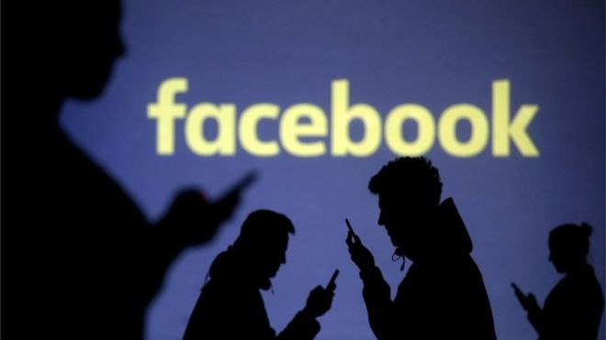
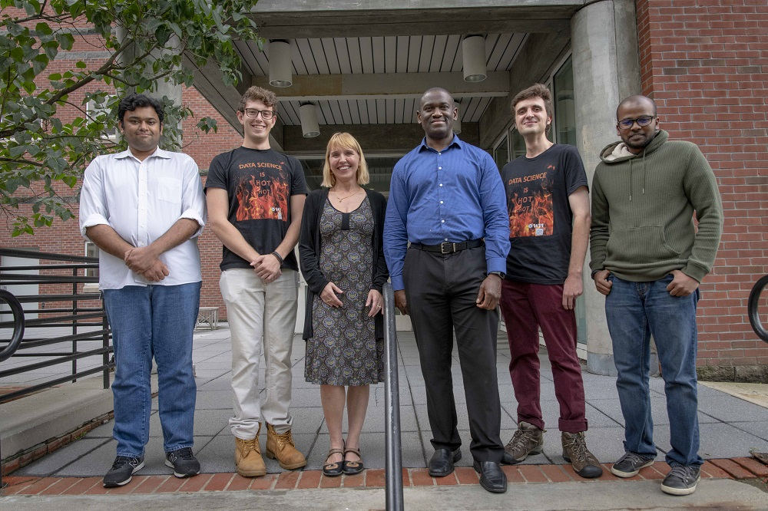

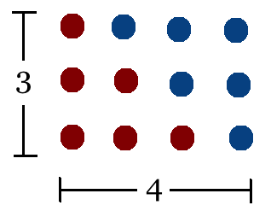
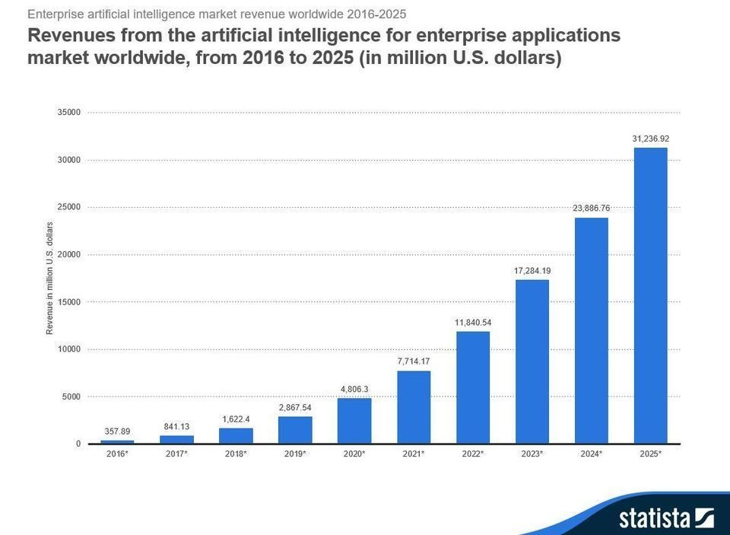
Student Choice – Interesting Articles 1/2
Facebook security breach: Up to 50m accounts attacked - Dave Lee, North America technology reporter, 2018-09-29
WPI Secures $2.8 Million to Develop a Smartphone App to Help Assess the Health of Soldiers, 2018-09-24
Quantified Toilets, 2014, Quantified Toilets LLC
What Did Ada Lovelace's Program Actually Do? - Sinclair Target, 2018-08-18 (First Programming Bug 1843?)
We know ethics should inform AI. But which ethics? - Mauro Guillen, World Economic Forum, 2018-07-26
Notes:
All Last Accessed 2018-10-04
TOOD: Add to first day slides.
Emacs – psychoanalyze-pinhead
doctor (implementation of ELIZA)
yow (quotes from Zippy the Pinhead zippythepinhead.com)

Slide 27
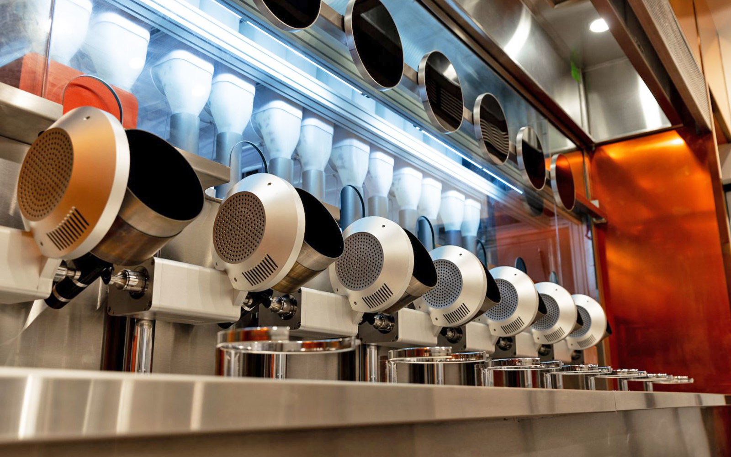

Student Choice – Interesting Articles 2/2
MIT-born Spyce raises $21M to open new robotic restaurants - Lucia Maffei, BostInno, 2018-09-07
The Coders Programming Themselves Out of a Job - Brian Merchant, The Atlantic, 2018-10-02
Notes:
All Last Accessed 2018-10-04
Spyce image: https://www.engadget.com/2018/05/04/boston-robotic-kitchen-spyce/ , 2018-05-04
Coders Programming Themselves Out of a Job image: Gabrielle Lurie, Reuters (date unknown)

Slide 28
Class 14
The End
Keith A. Pray
socialimps.keithpray.net

