Slide 1
Class 8
Crime
Keith A. Pray
socialimps.keithpray.net
Notes:
Here’s the title slide. Is anyone not excited?
Take 5 minutes to fill out survey on Canvas → Quizzes → SGA’s Midterm Course Feedback Questionnaire

Slide 2
what works well Online With Zoom
Sign in with First and Last Name
Stay muted unless you are going to speak
To speak use the raise your hand feature
To answer yes/no questions use the “yes” ”no” buttons
Turn your camera on
Wait until the end of student presentations to ask questions
  Write them down so you don’t forget

Slide 3
Papers
Quantify
  Terms like: less, more, a lot, huge, great, big, tiny, growing, etc.
Avoid Strawman Fallacy
Arguments should have at least 3 statements
http://socialimps.keithpray.net/assignments/paper-guidelines/
Notes:
0s not included.
Save for next time:
Make decisive conclusions
may, could, etc. = trivial
Absolute statements are difficult to prove
Avoid: all, always, any, every, everyone, never, none… unless you can show it
Be sure to put quotes around entire quote
Hyperbole is the best thing ever!
but not in these papers
Print 2 sided and save a tree
Use template, saves time (and -1 point)
Use and cite supporting data from high quality sources
Argument should directly support conclusion
Response should directly address counter point

Slide 4
Grades
To Date
31 Max Possible

Slide 5
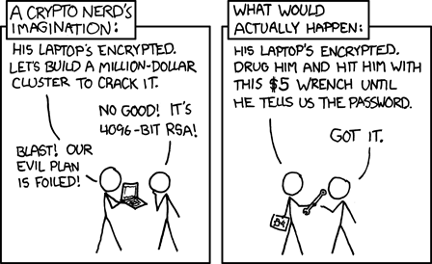
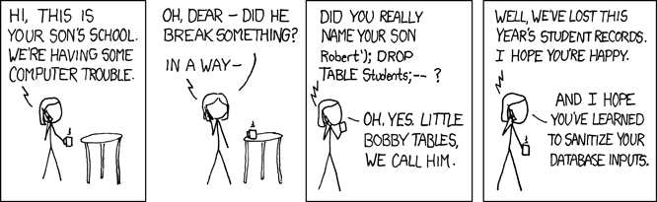
Overview
Review
Assignment
Students Present
https://xkcd.com/538/ (2010-11-14)
https://xkcd.com/327/ (2007-10-10)
Notes:
Are there any questions on the assigned reading?
Use the backup slides to explain any of the attack methods from the text.
XKCD Links last accessed 2020-09-25

Slide 6
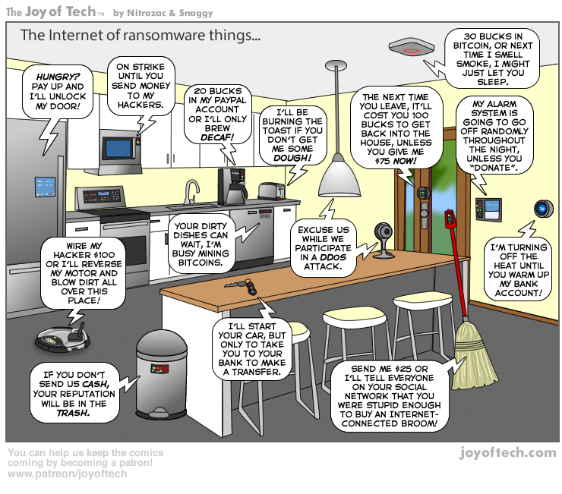
https://cointelegraph.com/storage/uploads/view/5e8f6e0d3a029807dfe181dc3d160cf0.png
Notes:
Find publish date
Note which really exist
Extra credit

Slide 7
My Reading Notes
pp. 323 Interesting to compare password guidance over the years.
pp. 325 plenty not sent with HTTP
pp. 328 Getting on TV much more difficult than releasing software
pp. 330 Virus could be new
pp. 332 Goals include infect 3 machine per LAN and as many computers as possible? Never make last minute changes before release. Were they related to the defects?
pp. 333 Testing w/out DEBUG often neglected
pp. 335 Do people use the Internet as an experimental laboratory these days? Shutdown right after booting, “benign” doesn’t seem like the right word.
pp. 337 “send reports back to a host computer”?
pp. 338 Firewalls often not running on same machine as malware, routers?
pp. 339 Have 2003 fears of cyber terrorist attacks been realized?
pp. 347 How is online voting a moral issue?
End of Chapter questions: 14. 25. 29.
Notes:
- If time ask class about online voting in light of COVID-19 challenges.

Slide 8
Group Quiz
A denial of service attack shuts down a bunch of retailer, stock brokerage, large corporate entertainment and information web sites. Possible guilty parties:
  Terrorist who aimed to cause billions of damage to U.S. economy.
  Protest organization opposing commercialization of the web and corporate manipulation of consumers.
  Script kiddie (a minor) just having fun with tools he found on the web.
  Show off hacker in search of bragging rights.
State what penalties are appropriate for each.
Explain your answer to 1. using a single Ethical Theory for all.
Name the laws/acts under which these parties could be prosecuted.
Notes:
Works well as small group exercise.
Note: short answer format expected.
Note: 2. only one argument needed, should include logic for all parties
Note: 3. same law(s) should be applicable to all parties

Slide 9
Assignment
Code Testing 1 Page Paper 1/2
Research testing, decide on test strategy, test the given code
There are major and minor defects to find
Once testing is done write paper with conclusion: Testing strategy was adequate
Things that might be useful in your argument:
  Rationale for testing strategy used (use data, high quality sources)
  Explanations of defects found (use data, high quality sources)
  How to fix them (use data, high quality sources)
  Consequences of leaving defects in production code (use data, high quality sources)
Weakness in testing strategy as counter point (use data, high quality source)
Working example: http://socialimps.keithpray.net/assignments/Test_Sales_Fun
Notes:
If guest presenter coming next class remind students to prepare questions for him.
Remember to work on groups projects.
Each group should have material on their sites for the topics we’ve covered so far.
OLD Prompt:
Design tests for the code on the following slide.
Contains at least one major defect and several minor ones.
Write a paper (1 page not counting any source code) including :
Did you choose a good test strategy? (This is your conclusion.)
The inputs and expected outputs
What defects you found
How you would fix the defects (you may include fixed source)
Why would that fix the problems?
What could happen if the defects are not found before the code is put into production?

Slide 10
Assignment
Code Testing 2/2
import java.text.NumberFormat;
public class SalesFun {
public static double calculateSalesTotal ( double amount, double discountRate, double taxRate ) {
double discount = amount * discountRate;
double total = amount - discount;
double tax = total * taxRate;
double taxedTotal = tax + total;
NumberFormat numberFormat = NumberFormat.getCurrencyInstance();
System.out.println ( "Subtotal : " + numberFormat.format ( amount ) );
System.out.println ( "Discount : " + numberFormat.format ( discount ) );
System.out.println ( "Total : " + numberFormat.format ( total ) );
System.out.println ( "Tax : " + numberFormat.format ( tax ) );
System.out.println ( "Tax+Total: " + numberFormat.format ( taxedTotal ) );
return taxedTotal;
}
}
} Lines of interest
Notes:
Bold lines are real focus.
Example input:
amount = 100.05;
discountRate = 0.10;
taxRate = 0.05;
OR
0.70, 0.0, 0.05
95.67, 0.20, 0.7

Slide 11
Overview
Review
Assignment
Students Present

Slide 12
Voting In the information Age
Ted Clifford

Slide 13
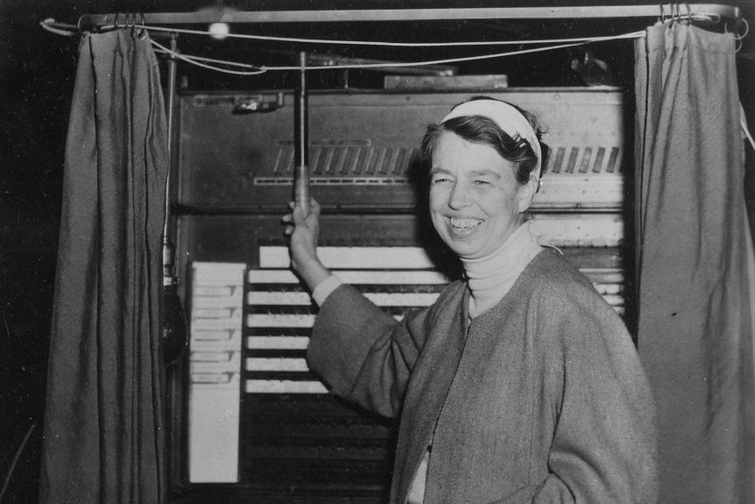
Voting has evolved with technology
Ted Clifford
Early 1800s: Voting “vice voce”
Mid 1800s: Party tickets
Civil War: First adoption of mail-in ballots
1890: Australian or Secret Ballot
Early 1900s: Mechanical voting
1960s: Punch card, computer tallied
2000s: Optically scanned ballot
[1]
Notes:
https://www.abc.net.au/news/2020-10-10/us-election-history-mail-in-ballots-other-voting-methods/12698466
Speaker notes:
- The infrastructure and methods we use to participate in democracy has evolved along with technology.
The ancient Greeks gathered and voted by voice, and this was the initial method used by the united states.
As voting expanded, technologies like the printing press allowed “tickets” that could be put in newspapers or handed out. Voters would turn in these tickets or write in their selection before handing them in.
During the civil war, many states pushed for the adoption of mail-in voting, a system that required infrastructure like the US Mail.
Australia developed a standardized ballot, which the united states adopted in the late 1800s
Experimentation with mechanical voting, as seen in this picture, represents the largest step towards a “black box” system of voting that I will cover more later in the presentation. Many ballots continued to be paper however.
Punch card computers brought a solution to increase efficiency in vote counting. Punch ballots were used from the 60’s until the 2000s
Now many ballots are filled out on paper and optically scanned and tallied on a computer.
Each advancement in voting infrastructure has led to increased voter participation, and increase in efficiency in counting votes.

Slide 14
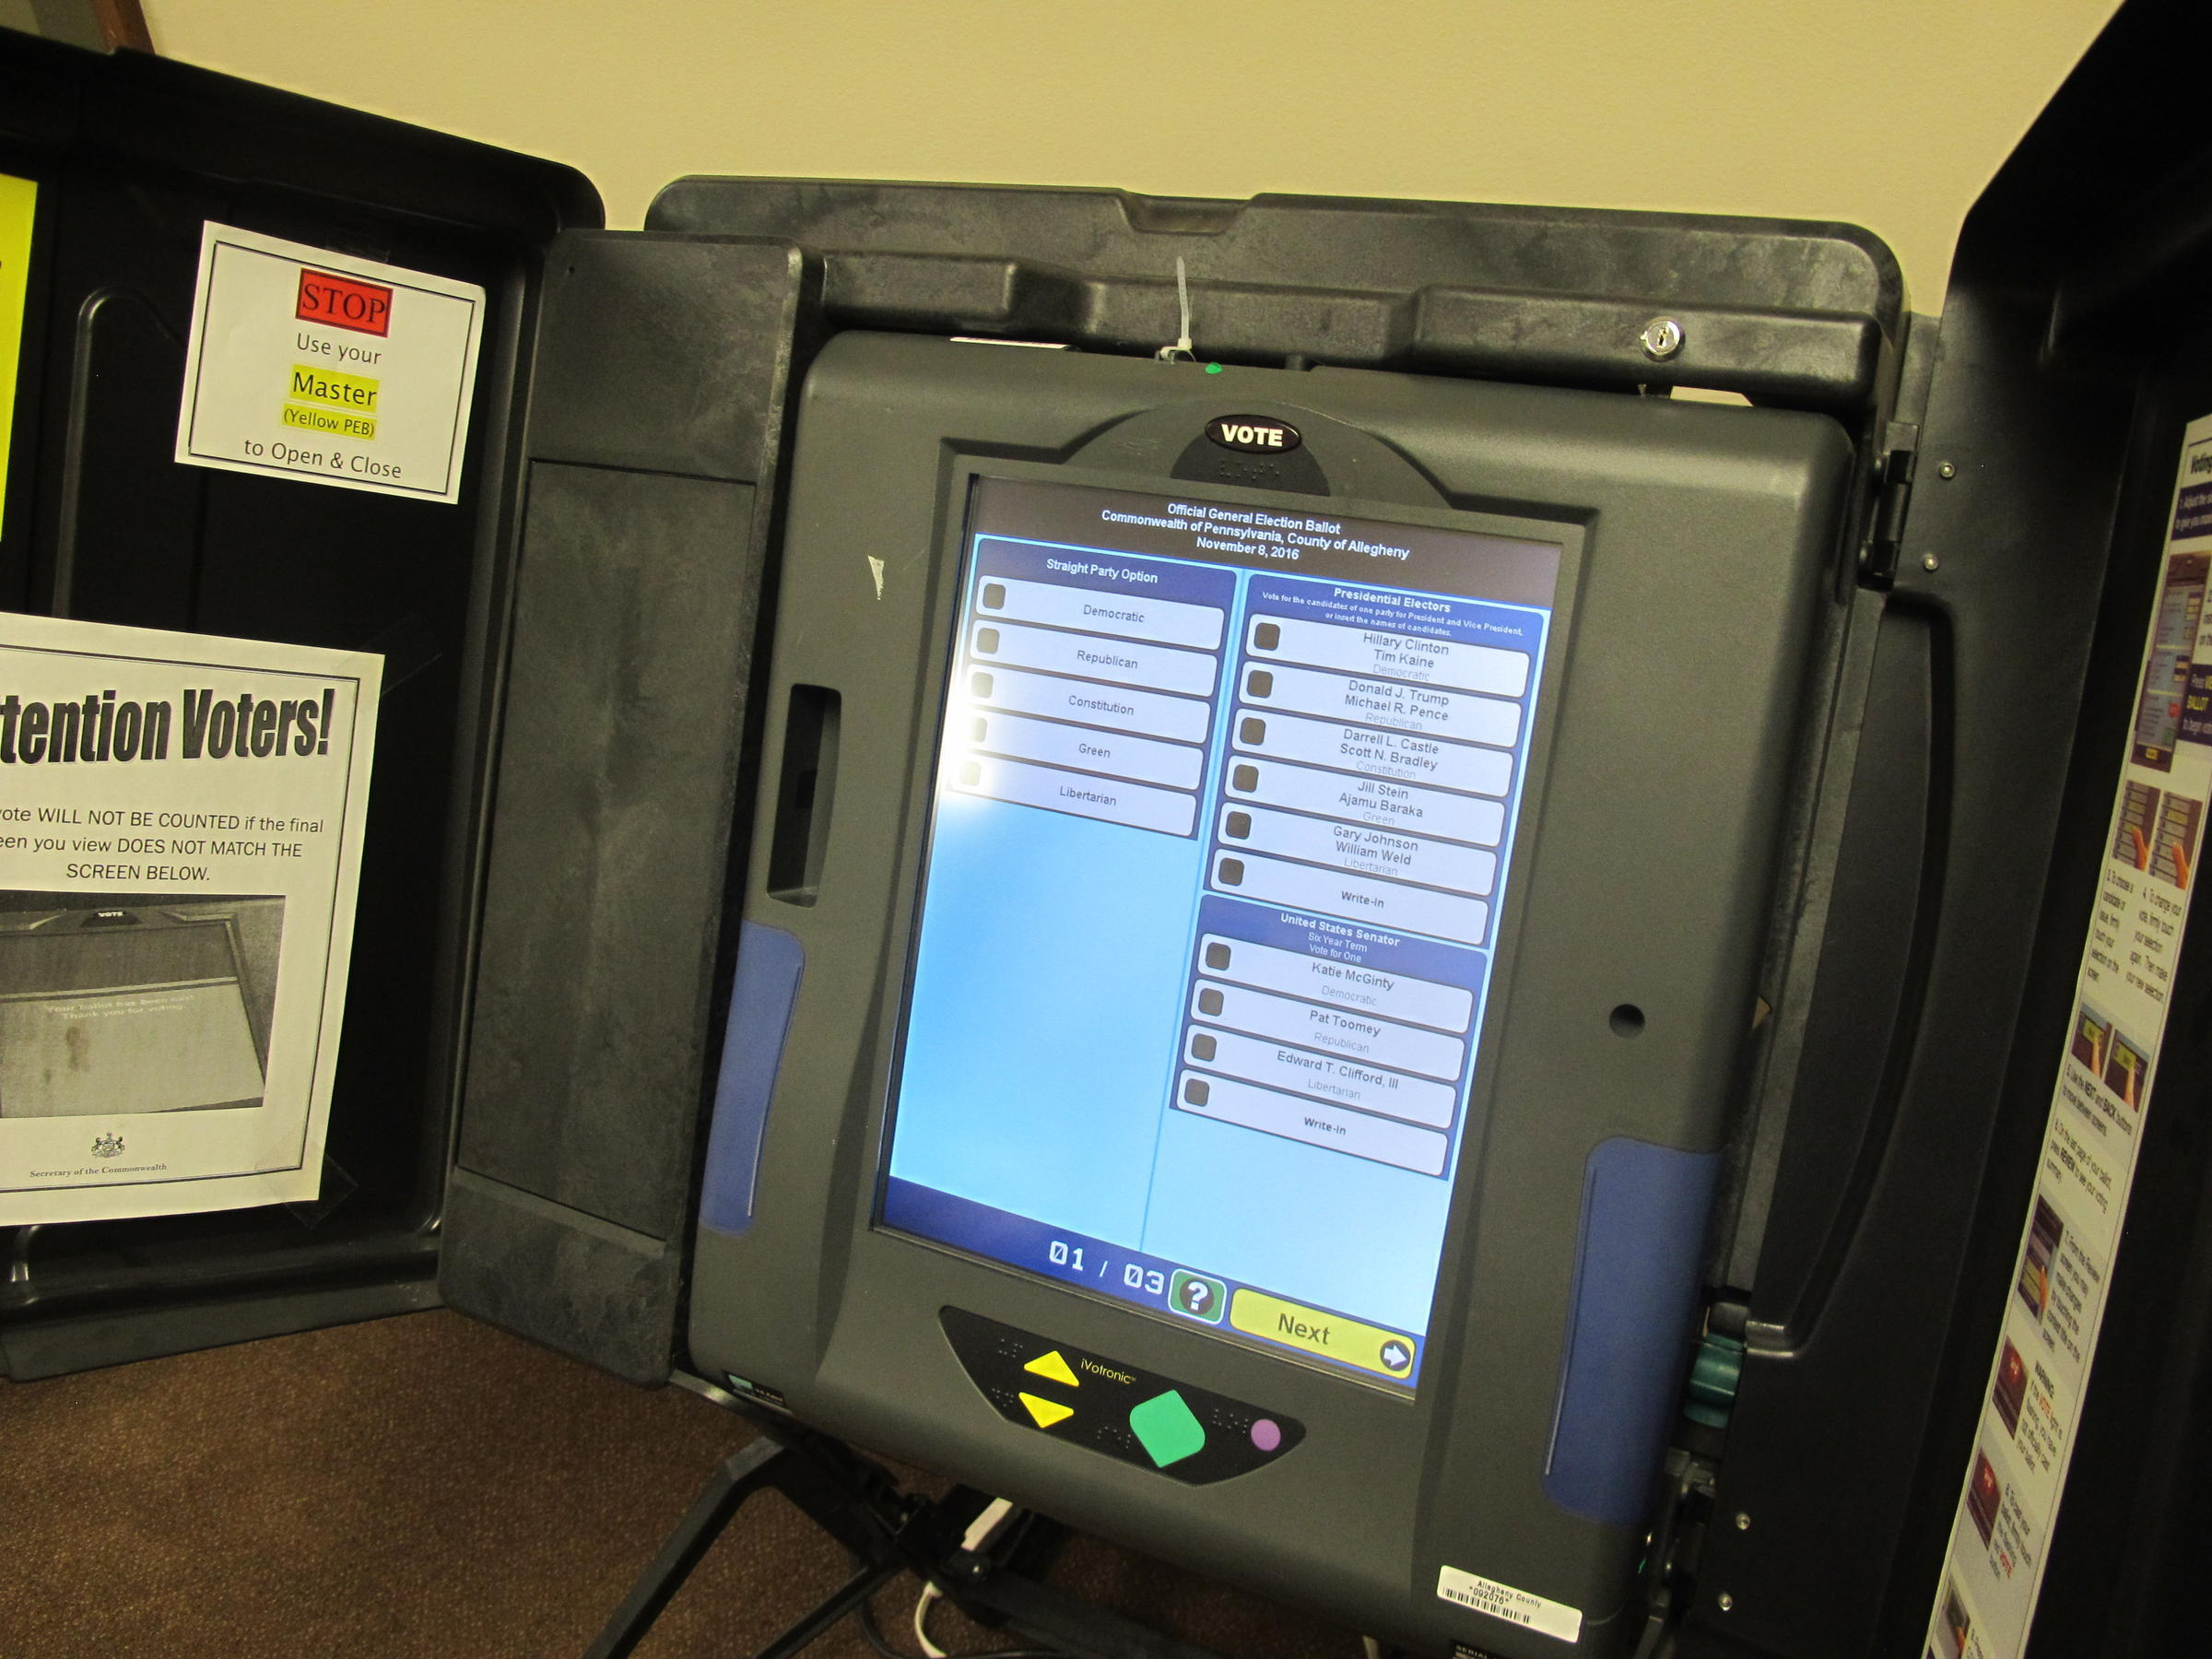
Electronic voting Machines
Ted Clifford
In addition to scanned ballots, electronic voting machines became prevalent in the 2000s.
Increased efficiency in the count.
Reduced user error (hanging chad).
Eliminates possibility of ballot tampering.
[2]
Notes:
https://cs.stanford.edu/people/eroberts/cs201/projects/2006-07/electronic-voting/index.html
The most recent advancement in voting technology has been a move to digital voting, though electronic voting machines.
These machines work by immediately tallying a vote, then sending the individual machine tally to a centralized vote count.
This takes individual vote counting out of the equation, improving the speed of the count and decreasing the cost.
These machines also solve some confusion voters have experienced with paper ballots, such as confusing layout or “hanging chad”(the punch hole flap)
Finally, in a perfect system, there is no chance for a ballot to be tampered with, since it goes straight from the selection to the counting server.
I mention perfect system because the current implementations are far from it.

Slide 15
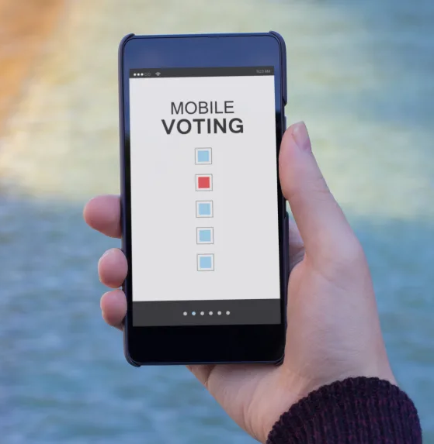
Voting over the internet
Ted Clifford
Voting becomes accessible to anyone with a connection.
  Cost is lower to vote
  Little inconvenience to voter
Increase in voter participation, particularly young voters.
[2]
Notes:
https://cs.stanford.edu/people/eroberts/cs201/projects/2006-07/electronic-voting/index.html
The logical next step following electronic voting is voting over the internet. This is similar to mail-in voting, where one does not have to be present at a voting booth to cast their vote.
This would make voting more accessible to people in remote areas.
The system would increase voter turnout in younger people, a demographic that does not have high turnout.
Estonia is the only country that has implemented this system in their state elections.

Slide 16
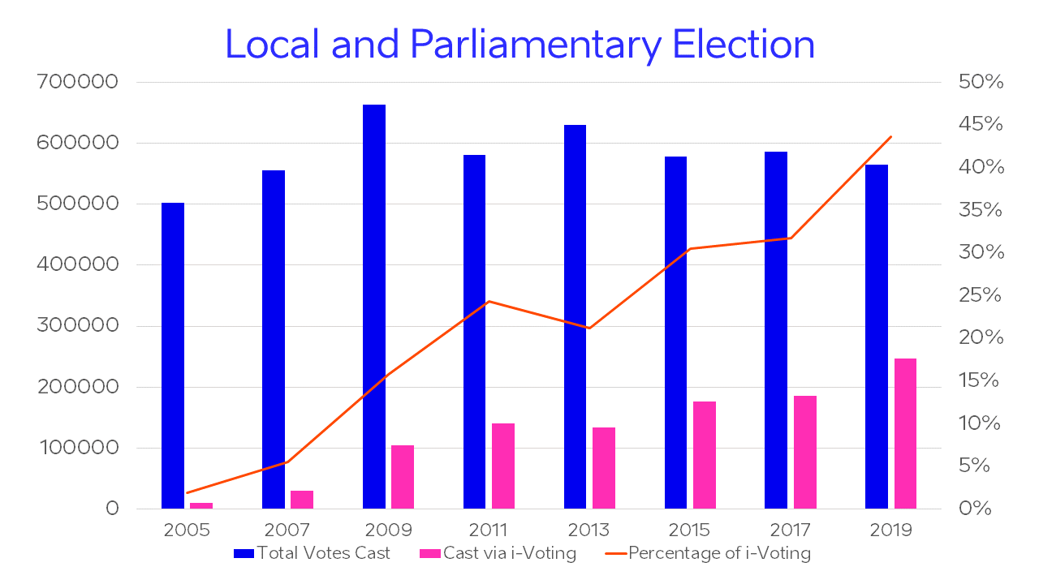
Case Study: Estonia
Ted Clifford
National elections are held partly online.
45% of votes cast online.
Outdated security architecture
Burden of trust lies on both voters’ systems and servers.
[3]
Notes:
https://estoniaevoting.org/findings/summary/
The portion of votes cast in the 2019 election cast online reached about 45%, and as you can see in this graphic, the portion of votes have increased since they introduced internet voting.
The system has been studied to understand the implications of a free election held online.
Many found that the digital infrastructure that Estonia uses is vulnerable to many attacks if they were to occur. The system has not been updated and relies on a security model that does not consider state actors or modern attacks.
For votes to be cast securely, the voter’s client must be trusted, and so must the centralized counting servers.

Slide 17

Academic Attacks on Estonian System
Ted Clifford
An independent study demonstrated attacks that would alter election results undetected.
A malware injected into a set-up system could pass system integrity checks and replace the vote count in the counting server.
A malware in the voting client SW or client system can steal voter credentials to cast an illegitimate vote.
[3]
Notes:
https://estoniaevoting.org/findings/summary/
This burden of trust opens up the system to malicious attacks that can impact the results of the election in a way that could be undetectable.
An independent study showed two academic attacks, one on the vote counting server and one on the voter’s device.
The first attack demonstrated that a malware can be loaded onto a set-up device used to configure the counting servers. The malware was able to pass integrity checks on these servers, and manipulate the final tally of votes.
The second attack was on the individual devices that voters use, such as their cell phone. This malware could be loaded into the client voting software or distributed to devices though a bot net. The malware was able to steal the voters’ credentials and cast illegitimate votes on their behalf. Since there was not paper trail or receipt, it would be impossible to prove this attack occurred.

Slide 18
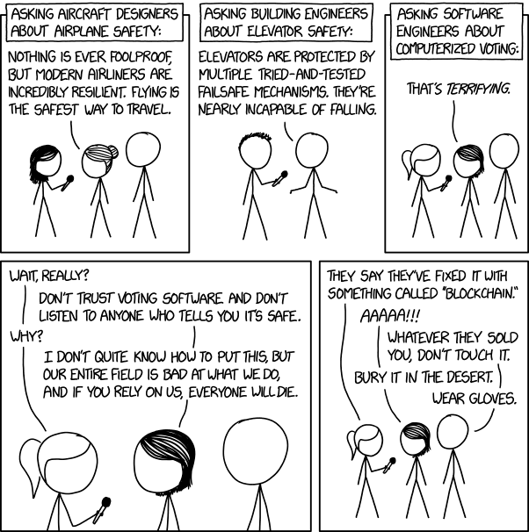
Vulnerabilities of Electronic Voting
Ted Clifford
Lack of paper trail
Multiple points of exposure
  Ballot configuration
  Internet connection
“Black Box” – Lack of transparency and trust
  The election results may not be trusted, even if no attack occurred.
Lack of education to support secure systems
Attacks are scalable
Attacks can be undetectable
[2][4][5]
Notes:
https://www.scientificamerican.com/article/the-vulnerabilities-of-our-voting-machines/
https://cs.stanford.edu/people/eroberts/cs201/projects/2006-07/electronic-voting/index_files/page0002.html
https://www.vice.com/en/article/3kxzk9/exclusive-critical-us-election-systems-have-been-left-exposed-online-despite-official-denials
As demonstrated in Estonia, there are many vulnerabilities in a digital system of voting.
Physical attacks on voting machines are easy to perpetrate, given the privacy a voter has with the machine.
These machines are often inexplicably connected to the internet as well, exposing them to malware attacks that can lead to a fault or malicious tally.
Bad actors in government tech services can easily modify how the machines tally votes during setup.
Many of these attacks are scalable as well, meaning they can be perpetrated across a country, drastically affecting the final vote count. Many nation states have resources to perpetrate such attacks: like Russia and China.
Finally, even if an election is held without foul play, distrust can easily be placed on the system, given it’s “black box” nature. Distrust in the system leads to distrust in the result. We are seeing a similar effect with mail-in voting, though the security concerns are greatly exaggerated with mail-in.
The vulnerabilities of digital voting concern security experts greatly. This XKCD shows how the software community tends to feel about voting machines. This attitude comes more from the lack of confidence in software in such an important environment like an election, and an inability to do a full scale test before an election.

Slide 19
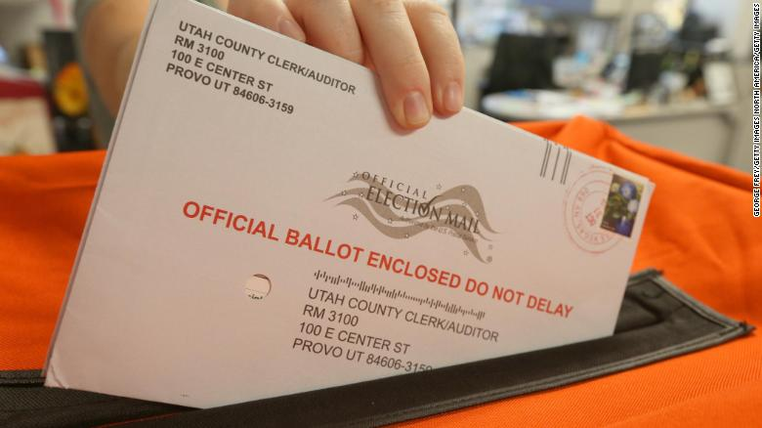
Solution: Paper and Mail-IN Ballots
Ted Clifford
All attacks against traditional paper ballots have already been done.
These attacks are not scalable.
Mail-in ballots provide similar accessibility as internet voting.
Decreased efficiency is the price to pay for a secure and trusted election.
Election security is an example where current technology does not improve results.
[2]
Notes:
<speaker notes>
I believe the solution is to move away from technology
In most areas, technology improves our lives and society, but in an election, the introduction of electronic voting machines or voting over the internet greatly threatens the security of that election.
Current methods of paper vote tallying and mail-in voting has been proven secure.
These systems have tested against all attacks, and no large scale attack is feasible with these traditional systems.
There are advantages in a digital system that we would miss out on, such as greater accessibility and faster results. This is the price to pay for a secure and fair election in the information age.

Slide 20
References
Ted Clifford
[1] Wiggins, Nick, and Annabelle Quince. “US Political Parties Once Printed Their Own Election Ballots. Then They Imported an Australian Innovation.” ABC News, ABC News, 10 Oct. 2020.
[2] Lin, Gloria, and Nicole Espinoza. Electronic Voting, Standford University, 2007, cs.stanford.edu/people/eroberts/cs201/projects/2006-07/electronic-voting/index.html.
[3] Halderman, J. Alex, et al. “Independent Report on E-Voting in Estonia.” Independent Report on Evoting in Estonia, 2014, estoniaevoting.org/findings/summary/.
[4] Schwartz, Jen. “The Vulnerabilities of Our Voting Machines.” Scientific American, Scientific American, 1 Nov. 2018, www.scientificamerican.com/article/the-vulnerabilities-of-our-voting-machines/.
[5] Zetter, Kim. Exclusive: Critical U.S. Election Systems Have Been Left Exposed Online Despite Official Denials, 8 Aug. 2019, www.vice.com/en/article/3kxzk9/exclusive-critical-us-election-systems-have-been-left-exposed-online-despite-official-denials.
Notes:
https://www.abc.net.au/news/2020-10-10/us-election-history-mail-in-ballots-other-voting-methods/12698466

Slide 21
Tor and Tails: Good, Bad, or Ugly?
Ezra Werlinich
Notes:
Hello, my name is Ezra Werlinich and today I’ll be presenting on the Tor Browser and Tails OS.

Slide 22
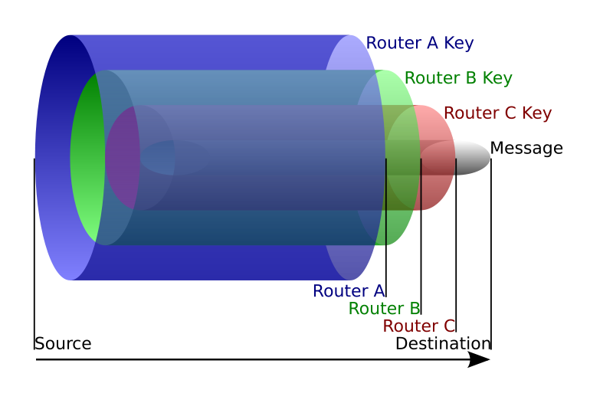
What are tor and tails?
Ezra Werlinich
Tor Browser
  Web browser created by The Tor Project [11]
  Access the network through a technique called “onion routing” [5]
Tails [8]
  Linux distribution
  All connections go through Tor
A visual example of onion routing
Image courtesy of Wikipedia Creative Commons
Notes:
Tor is a special type of web browser created by the non-profit Tor Project
When you try to connect to a site, your data is forced through 3 relays, each of which mask your IP separately
Each relay only holds a fraction of your data, so even if one is breached you don’t lose your anonymity
The nodes are randomly selected from the public list of over 6000 relays
Tails is a Debian-based linux distribution that is completely based around the use of tor
All connections, not just web browsers, are forced to connect through tor
All unencrypted connections are completely blocked
It also can be used as a live OS, which means you don’t need to install the operating system to use it
You can use it straight from a usb stick, so that when you’re done using it, it leaves no trace on your computer

Slide 23
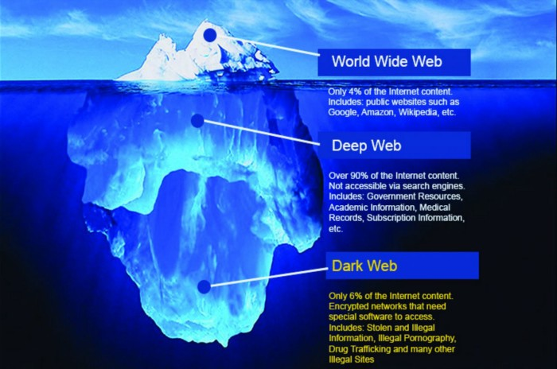
Uses of tor
Ezra Werlinich
Normal internet browsing, but anonymous
Gateway to dark web
  Parts of the web that are not accessible through normal means [9]
  Access “.onion” sites
    NY Times: http://www.nytimes3xbfgragh.onion/
    Buzzfeed News: https://bfnews3u2ox4m4ty.onion/
An iceberg as a representation of the internet
Image courtesy of Medium, citation 9
Notes:
When you use Tor, while you can still access normal World Wide Web links, you also can access “onion” sites
These are special links that let you access the darknet sites that are not listed in Internet DNS root
I’m sure you’ve all heard the terms dark web and deep web before
While they are often confused with each other, there is a distinction
The deep web is all of the data stored on the internet that isn’t accessible by search engines
This includes your emails, online banking, medical records, and much, much more
The dark web is all of the networks on the internet that can only be accessed with special software
.onion sites and the Tor Browser is a perfect example of this

Slide 24
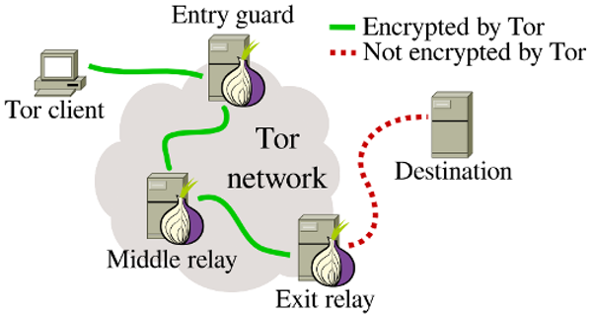
Risks of using tor
Ezra Werlinich
Exit node weaknesses [13]
  No encryption between exit node and destination
  Operator of the exit node can view any data passing through
Traffic analysis [8]
  Comparing response times of server connection to
Most vulnerabilities are caused by user error, not Tor
The dangers of the exit relay
Image courtesy of The Conversation, citation 6
Notes:
While Tor is incredibly secure in most situations, there are numerous ways an unwitting person can have their data stolen
One such way is through the inherent weakness of the exit node.
The final relay has to fully decrypt the data in order to deliver it to the destination
The owner of the server that is operating the exit node can view this data
An example of this is when a computer security consultant hosted 5 exit nodes, and was able to scalp the usernames and passwords for 100 different government officials across countries including Australia, Japan, Iran, and more
Another way that people’s anonymity is compromised is through a traffic timing analysis
This is when a third party observes the timings of the packets that are traveling through the nodes
Check for certain patterns on each side of the connection to match a connection to an end-user
Even though these are both real risks, and there are more vulnerabilities than just those two, most anonymity issues spawn from user error

Slide 25
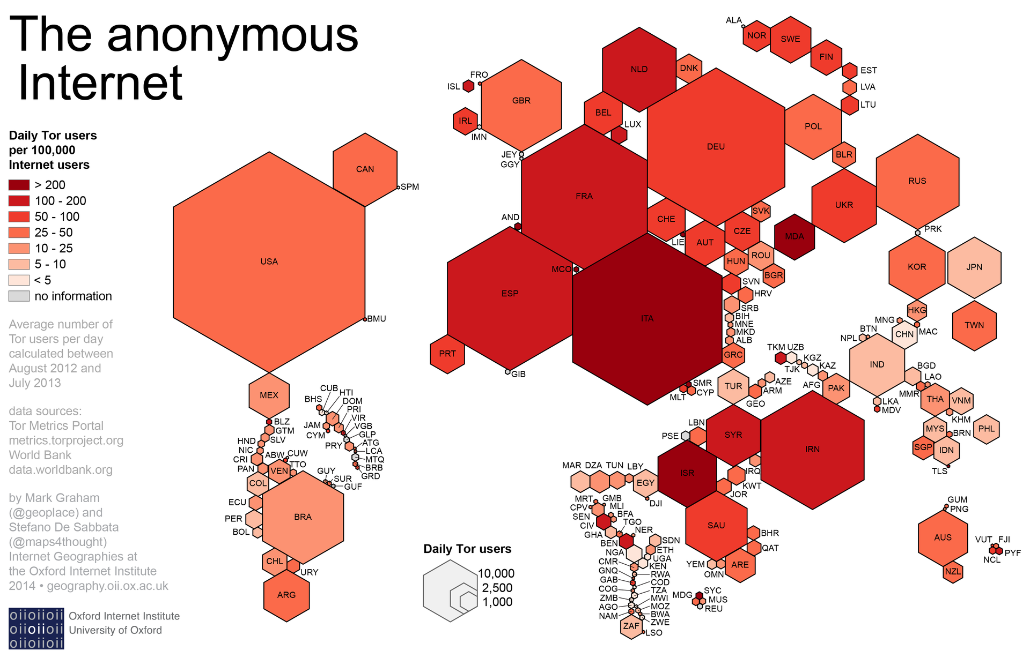
good side of tor
Ezra Werlinich
Government whistleblowers [2]
  Edward Snowden
Anonymous sources for journalists [2]
Countries with internet censorship [2]
Secure government communications
Victims of domestic violence [3]
Simple anonymous browsing
The distribution of countries that use Tor
Image courtesy of Wikipedia Creative Commons
Notes:
There are many positive and/or legal ways that Tor is used everyday.
This list is just a few of the situations in which the network is used in a beneficial way
Government whistleblowers, and to a greater extent, many anonymous news sources, use Tor as a means of getting their information out without risk of it being linked back to them
Edward Snowden is the most famous example of this. He leaked highly classified intelligence from the NSA, where he revealed that there were numerous government surveillance programs that were spying on citizens
Other positive uses of the network include people who live in countries that restrict internet use
For example, activists in countries like Iran or Syria will use Tor as a means of communicating without being caught by the government
All of these stem from the fact that Tor does one thing: protect your right to anonymity across the internet

Slide 26
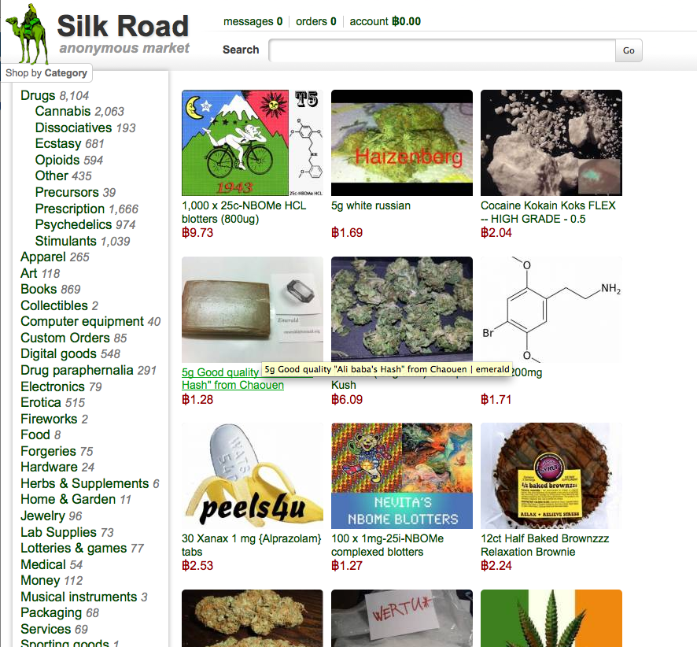
Not-so-Good side of tor
Ezra Werlinich
Black markets [4]
  Silk Road (pictured to the right)
    “Amazon.com of drugs”
  Drugs, weapons, child pornography, assassins, etc.
Terrorist networks [1]
Data storage and distribution of illegally obtained documents, files, etc.
Image courtesy of Business Insider, citation 4
Notes:
That being said, this anonymity also leaves the door open to many other options that are much more illicit.
The single biggest one of these is the black markets
On these markets, one can purchase all sorts of things including, but certainly not limited to, drugs, weapons, and illegal pornography
You can even hire things like hitmen on Tor
The most famous Tor black market was the Silk Road, which operated for years as the most well-known market before it was shut down by the FBI
To quote, “While in operation, Silk Road was used by thousands of drug dealers and other unlawful vendors to distribute hundreds of kilograms of illegal drugs and other unlawful goods and services to well over 100,000 buyers, and to launder hundreds of millions of dollars deriving from these unlawful transactions.”
Another frightening use of Tor is for terrorist faction communication
In April 2016, the Islamic State released a 15 page guide that gives instructions on how to setup Tails OS, connect to Tor securely, and communicate with other terrorist cells.

Slide 27
References
Ezra Werlinich
Authors: Robert Graham. (2017, November 16). How Terrorists Use Encryption. Retrieved November 14, 2020, from https://ctc.usma.edu/how-terrorists-use-encryption/
Collison, T. (2015, January 10). The Ethical Considerations of the Tor Browser. Retrieved November 14, 2020, from https://medium.com/applied-cryptography/the-ethical-considerations-of-the-tor-browser-8bbc415720b6
Daniari, S. (2017, April 12). Where Domestic Violence and Cybersecurity Intersect. Retrieved November 14, 2020, from https://rewirenewsgroup.com/article/2017/04/12/domestic-violence-cybersecurity-intersect/
Love, D. (2013, March 06). There's A Secret Internet For Drug Dealers, Assassins, And Pedophiles. Retrieved November 14, 2020, from https://www.businessinsider.com/tor-silk-road-deep-web-2013-3?op=1
Nicol, W. (2020, October 17). What Is Tor? A Beginner's Guide to the Deep Web. Retrieved November 14, 2020, from https://www.digitaltrends.com/computing/a-beginners-guide-to-tor-how-to-navigate-through-the-underground-internet/
Philipp Winter Postdoctoral Research Associate in Computer Science. (2019, August 27). Securing web browsing: Protecting the Tor network. Retrieved November 14, 2020, from https://theconversation.com/securing-web-browsing-protecting-the-tor-network-56840
Reilly, C. (2017, November 30). Inside the Dark Web: A guide to the badlands of the internet. Retrieved November 14, 2020, from https://www.cnet.com/news/darknet-dark-web-101-your-guide-to-the-badlands-of-the-internet-tor-bitcoin/

Slide 28
References
Ezra Werlinich
Soltani, R., Goeckel, D., Towsley, D., & Houmansadr, A. (2017). Towards provably invisible network flow fingerprints. 2017 51st Asilomar Conference on Signals, Systems, and Computers. doi:10.1109/acssc.2017.8335179
Staff, P. (2019, March 15). The Dark Web & What You Need To Know About It. Retrieved November 14, 2020, from https://medium.com/pyramidsecurity/the-dark-web-what-you-need-to-know-about-it-23bf07dc8650
Tails is a portable operating system that protects against surveillance and censorship. (n.d.). Retrieved November 14, 2020, from https://tails.boum.org/
The Tor Project: Privacy & Freedom Online. (n.d.). Retrieved November 14, 2020, from https://torproject.org/
What is Tor? A beginner's guide to the privacy tool. (2013, November 05). Retrieved November 14, 2020, from https://www.theguardian.com/technology/2013/nov/05/tor-beginners-guide-nsa-browser
Zetter, K. (2017, June 04). Rogue Nodes Turn Tor Anonymizer Into Eavesdropper's Paradise. Retrieved November 14, 2020, from https://www.wired.com/2007/09/rogue-nodes-turn-tor-anonymizer-into-eavesdroppers-paradise/?currentPage=all

Slide 29
Impact of Open Source
Mayank Govilla

Slide 30
Mayank Govilla
Open-Source development has had a major impact on the technology we use everyday, but is in danger of being taken over by Big Tech
Notes:
Read out conclusion
This topic is important to understand because it will certainly affect us as developers in the future. Whether we choose to work at software companies or go into research or other career paths, open-source projects will need our contribution to stay alive. By understanding its core values and how things are changing, we can make better decisions when the time comes.

Slide 31

Something gnu
Mayank Govilla
Started by Richard Stallman
Four “freedoms”
  To run the program
  To study and change the program
  To redistribute exact copies
  To distribute modified versions
Operating system to rival Unix
Created the GPL license
  “copyleft” instead of copyright
Image taken from GNU official website [2]
Notes:
During the 80s, the software industry did not really exist as the companies who created the hardware also put in their own software. At his lab, Richard Stallman wanted more freedom to tinker with the products and decided to make his own version of the software in a way that emphasized freedom.
Not necessarily free of cost, but rather freedom for the users to [read freedoms]
Based on these principles he set out, he developed GNU which would become the GNU/Linux operating system that is so popular today. While this was spearheaded by Stallman himself, he worked with many other developers which set a precedent for how open-source development could work
To make it official, he also wrote the GPL [General Public License] which would let go of the creator’s copyright over the intellectual property and enforce the 4 freedoms he believed in. He called this new type of license the copyleft as it was the opposite of copyright. In other words, it protects the rights of the users rather than the producers

Slide 32
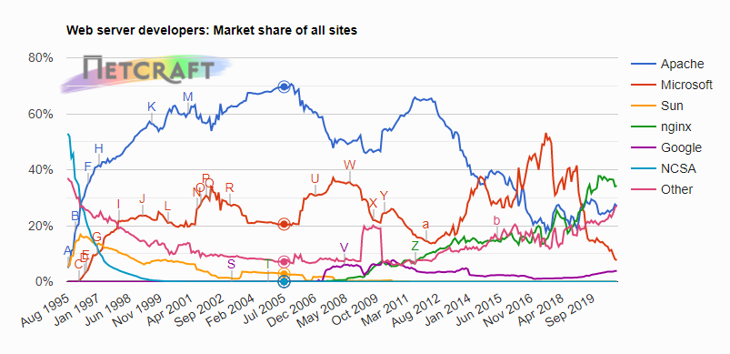
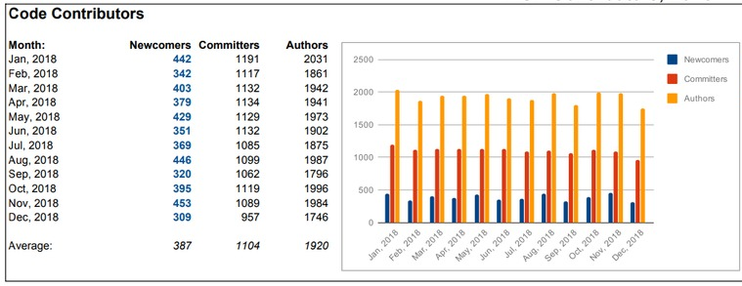
Apache software foundation
Mayank Govilla
Apache Web Server gained over 60% market share
Apache License allows commercial products
  The bridge between research and the corporate world
3,208 Apache Committers changed 78,493,228 lines of code in 328 projects
Web server market share from [7] Code contributions from [3]
Notes:
The ASF proves how valuable the open-source method can be.
Their Web Server project was industry changing and gained over 60 percent market share around 2005 as you can see from this chart. It is used to host websites, so many companies made their own versions of the code to grow their own business. This led to Apache’s license which promoted businesses to use the open-source software and create their own versions for their own products.
This introduced the bridge between these research-like open-source projects and the corporate world.
Apache is still huge, over 3000 people made contributions which equated to about 80 million lines of code changed in over 300 projects that span across all different industries. Their impact has been incredible, so it is worth analyzing their structure

Slide 33
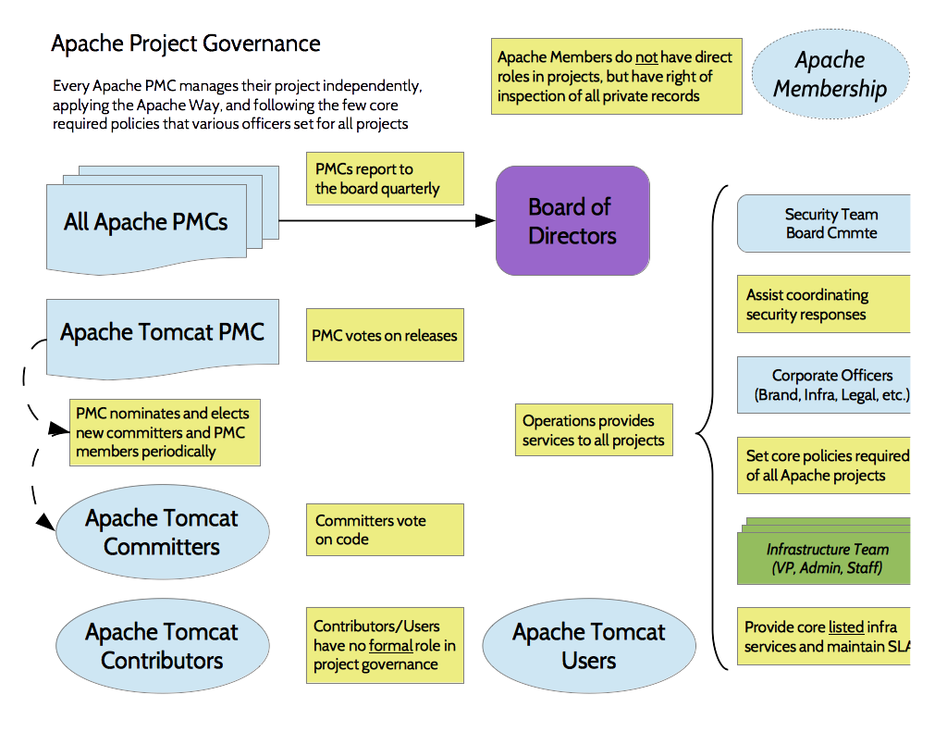
Apache structure
Mayank Govilla
Non-Profit organization
Run by volunteers, generally driven by their passion for a project
Organize asynchronously through mailing lists
Relies on funding from donations and other sponsors (companies)
Large companies pay employees to contribute to projects
Images from official Apache Website [3]
Notes:
Currently, Apache is a nonprofit organization run by volunteers who are generally driven by their passion for a specific project. Each of these projects are maintained asynchronously with mailing lists
The graphic on the right shows the project structure: Members elect a board of directors who oversee the whole operation, and they appoint a separate project managing committee for every one of those 300 some projects, who run mailing lists and keep track of progress. People can contribute to any project and their changes are reviewed and voted on by the committers, and major decisions are voted on.
When most of the contributors were volunteers, progress was slow because they did not have the time to constantly improve the project. But the impact of these projects in commercial projects incentivized large companies to provide funding and even pay their own employees to contribute to projects full time. This is the first bit of large companies creeping in on the open-source project.

Slide 34
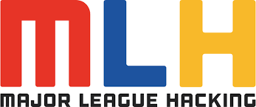
Hack culture vs business
Mayank Govilla
Community Based
Collaboration between developers
Merit based system
Anyone can contribute
Drives Innovation
Isolated within a company
Sign Non-Disclosure Agreement
Compete with other developers
Corporate espionage
Drives profit
Image from official MLH Website [4]
Notes:
Based on the structure and ideals of organizations like Apache, the “hack culture” was born. Hack culture contrasts business culture in that it is community based and values collaboration between all developers. The merit-based system allows for experts to lead the innovation, but it still allows for anyone to contribute which brings the diversity of ideas that drives innovation.
On the other hand, developers who worked on proprietary software were often isolated and signed non-disclosure agreements which promotes competition between developers. It also leads to corporate espionage so companies can stay in the market, but this method has been proven to be extremely efficient and profitable.
For the most part, these cultures were at odds with one another, the clash between passion vs profit.

Slide 35
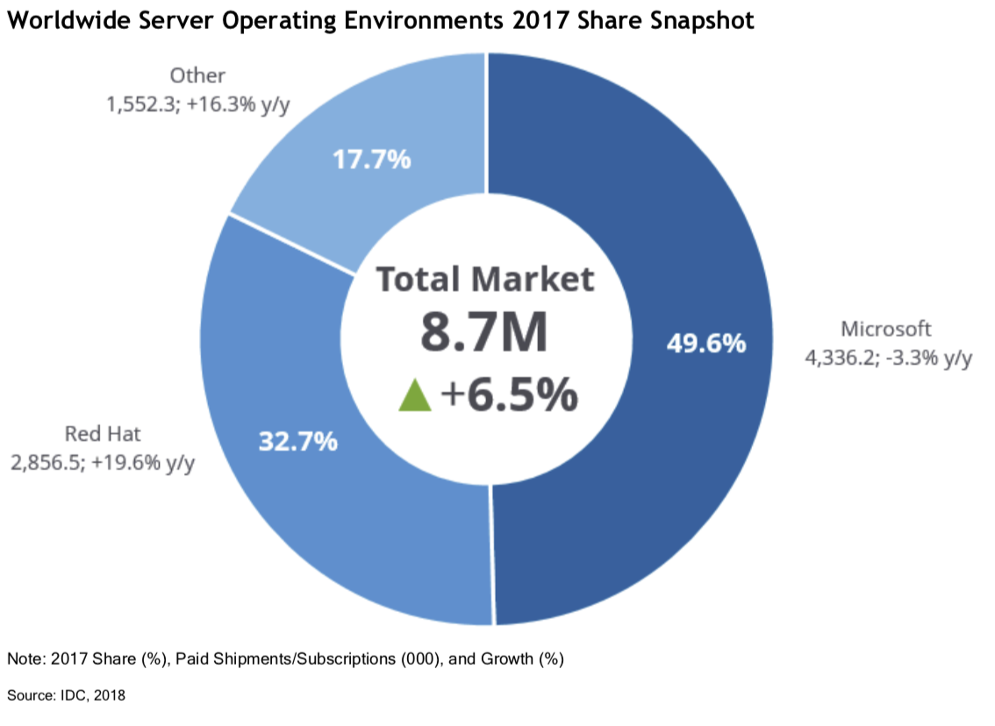
Red hat
Mayank Govilla
Successful companies to monetize an open-source model
They heavily contribute to Red Hat Linux (still open source)
Sell enterprise version including full tech support
Eventually grew into cloud business
Acquired by IBM for $34 billion
Images from Red Hat Blog [6]
Notes:
The first company to successfully get the best of both worlds was Red Hat with their Red Hat Linux Enterprise. They were able to maintain the open-source nature of code while selling it to other businesses and crucially providing support. Red Hat still heavily contributed to Red Hat Linux, a distribution of that original open-source operating system, but it was still open to the public community of developers who worked on it for fun. Red Hat Linux was also completely free for people to download, but of course this required some level of developed experience to run properly, which is how Red Hat was able to sell their Enterprise version as a package with full tech support.
They were incredibly successful and gained over 30% market share in the Server Operating Environments industry. They grew and expanded their business until they caught the eye of the tech giants. IBM bought the company in 2018 for $34 billion which leads us to the present situation

Slide 36

Big tech takeover
Mayank Govilla
Google, Amazon, and even Microsoft started funding OSS
Notable Projects:
  Android
  Angular
  Flutter
  Kubernetes
  Chromium
The only fully closed source browser is Internet Explorer
OPEN SOURCE
BIG TECH
Notes:
Big Tech Takeover
Huge companies that have made a lot of money have started their own Open-Source Software projects and importantly started paying employees to work on the projects that impact their company the most.
Some of these projects from Google specifically include [read list]
All of these are incredible projects that are well built and useful because of the amount of support from the tech companies who have transitioned from doing exclusively internal R&D to rather supporting a community that will do it for them. Just to show how widespread it is currently, the only fully closed source browser in Internet explorer. Chrome and Edge are based on Chromium which is open source. Firefox is open source. Safari is based on WebKit which is open source.

Slide 37
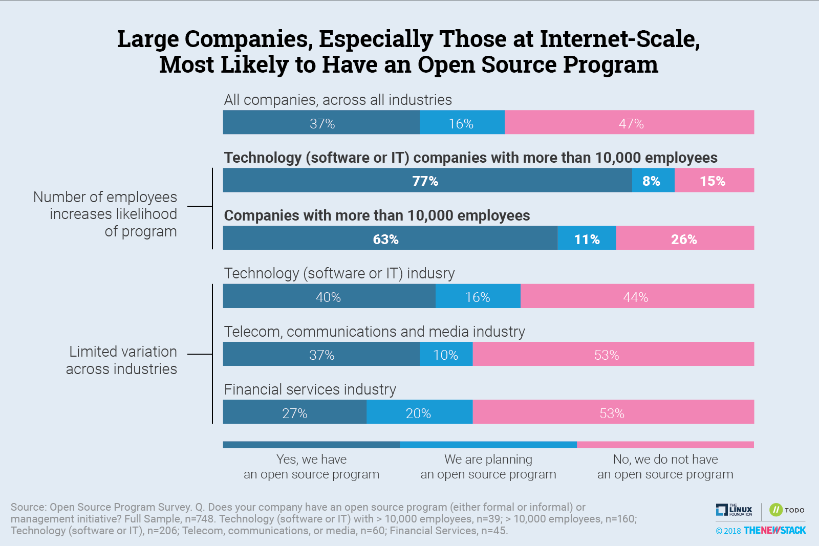
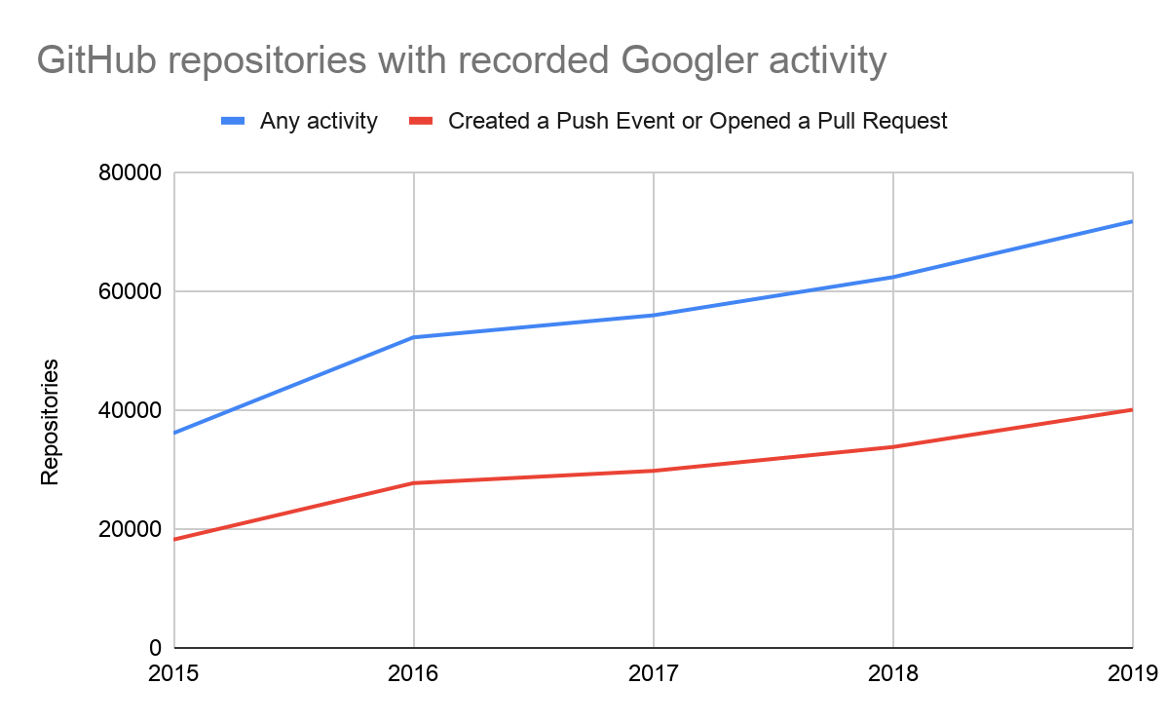
Big tech takeover
Mayank Govilla
Big companies have serious control over open-source projects
Googler Activity from [5] Survey results from [1]
Notes:
So what does this mean?
Well, I alluded to this earlier: the big tech companies can afford to pay hundreds of developers to work on open-source projects full time, which gives them serious influence on the direction of these projects. The original hack culture was only so strong because it was merit based and allowed for anyone to contribute their ideas, but if the pool of contributors is now mainly dominated by developers being paid by huge tech companies, only projects that are directly leading to profit will survive and the hacker culture will slowly dissipate. Take a look at these graphs: Google by itself has significant influence in over 40000 repositories on GitHub, and over 3/4s of large companies already have open-source projects.
The way things are going, the ideas of open source, those freedoms that Stallman envisioned in the beginning will be lost.
Of course this is a very pessimistic way to look at the way big tech companies support open-source projects, but it reinforces the responsibility that we have as the next generation of developers to carry on the legacy of hack culture and prevent it from being overshadowed by large companies.

Slide 38
References
Mayank Govilla
[1] Lawrence Hecht and Libby Clark, Open Source Programs Are a Best Practice Among Large Companies (August 2018), https://thenewstack.io/survey-open-source-programs-are-a-best-practice-among-large-companies/ (November 12, 2020)
[2] Richard Stallman, The GNU Manifesto (1985), https://www.gnu.org/gnu/manifesto.html (November 17, 2020)
[3] Sally, Apache in 2018 – By the Digits (January 2019), https://blogs.apache.org/foundation/entry/apache-in-2018-by-the (November 17, 2020)
[4] Major League Hacking, https://mlh.io/ (November 17, 2020)
[5] Sophia Vargas, Open source by the numbers at Google (August 2020), https://opensource.googleblog.com/2020/08/open-source-by-numbers-at-google.html (November 17, 2020)
[6] Red Hat, IBM Closes Landmark Acquisition of Red Hat for $34 Billion; Defines Open, Hybrid Cloud Future [press release] (July 9, 2019), https://www.redhat.com/en/about/press-releases/ibm-closes-landmark-acquisition-red-hat-34-billion-defines-open-hybrid-cloud-future (November 17, 2020)
[7] Netcraft, October 2020 Web Server Survey (October 21, 2020), https://news.netcraft.com/archives/category/web-server-survey/ (November 17, 2020)

Slide 39
Class 8
The End
Keith A. Pray
socialimps.keithpray.net
Notes:
This is the end. Any slides beyond this point are for answering questions that may arise but not needed in the main talk. Some slides may also be unfinished and are not needed but kept just in case.

Slide 40
Buffer Overrun
Run time stack
Local Variables
Return Address
Parameters
Variable Attack
buffer
Target Variable
Stack Attack
buffer
Return Address
code
Return Address
Notes:
Retired slide. Most students have this in depth from new class now.
When a function call is made, local variables, return address, parameters stored on run time stack. Local variables occupy lower memory addresses.
Variable attack – change variable value. Program expects user to input character and allocates a buffer for them. Attacker supplies too many characters and ends up over writing a variable.
Run example of this if there’s interest – next slide
Stack Attack – goal is to change value of return address so execution control goes to code which the attacker has provided in the input buffer.
Prevention – add checks against array bounds being exceeded. modify operating system to not execute instructions stored on run time stack.

Slide 41
Run Example Code
Notes:
Retired demonstration. Most students have this in depth from new class now.
> imps
> assembly
> 123456789qwerty1

Slide 42
Buffer Overrun Code
#include <stdio.h>
#include <string.h>
int main ( void ) {
char buff [ 15 ]; int ace = 0;
printf ( "\n Enter best class ever : \n" );
gets ( buff );
if ( strcmp ( buff, "imps" ) ) {
printf ( "\n %s is wrong! You should FAIL! \n ace=%i\n", buff, ace ); }
else { printf ( "Correct! \n") ; ace = 1; }
if ( ace ) { printf ( "You get an A! \n" ); }
return 0; }
} The Naughty Line
Notes:
Retired slide. Most students have this in depth from new class now.

Slide 43
TCP Three-way Handshake
SYN
SYN-ACK
ACK
Notes:
Retired slide. Most students have this in depth from new class now.
SYNchronize
SYNchronize ACKnowledgement (socket reserved awaiting ACK)
ACKnowledgement
TCP socket connection established

Slide 44
SYN Flood Attack
SYN
SYN-ACK
Notes:
Retired slide. Most students have this in depth from new class now.
Attacker spoofs the IP address so the SYN-ACK is sent to a different machine that cannot respond to the SYN-ACK.
This leaves the connection half open on the server machine decreasing the resources (sockets, memory, threads/processes) available to respond to legitimate clients.
The attacker send many such spoofed SYN messages.

Slide 45
Ping Attack
Target
Attacker
ping
ping
Notes:
Retired slide. Most students have this in depth from new class now.
Attacker finds routers that support broadcasting messages to all computers on their local area networks.
The attacker sends a spoofed ping message, which the routers echo to the spoofed address.

Slide 46
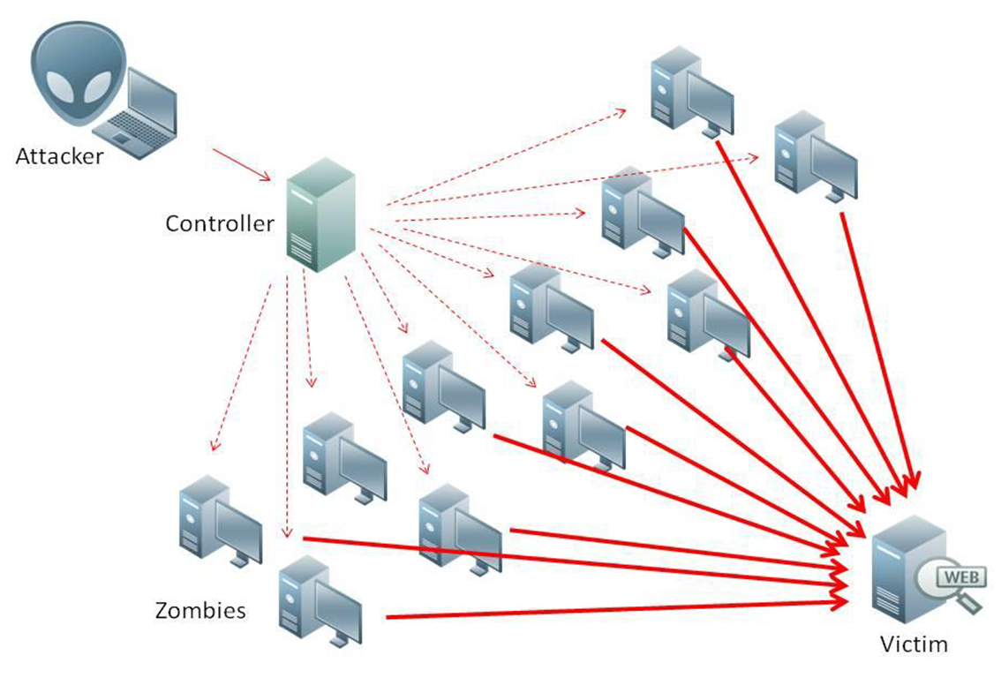
What is Denial of Service (DoS)
Attempts to make target unavailable by flooding with traffic
If victim has to filter attack, it’s too late
Internet Providers have no incentive to help
  Businesses get affected, but would not pay provider enough to make worthwhile
  This is why Cloudflare, e.g., exists
Many ways to perform this attack
Notes:
Contributed by Brett Ammeson.
https://www.cloudflare.com/ddos/reflection-attack-1.png
https://i.imgur.com/lxYv8cF.png

Slide 47
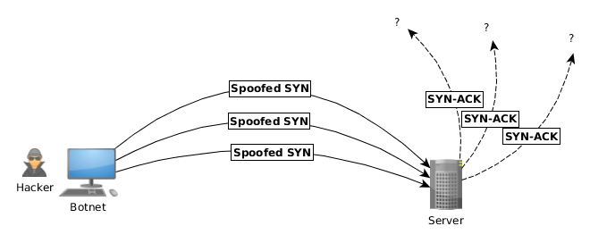
Distributed DoS Vectors
TCP SYN attack
  SYN packets are small, low difficulty for attacker
  Leaves half-open connections on server
  SYN cookies mitigate this
DNS amplification attack
  DNS requests are small
  Can request all records on server
  Crippled by proper configuration
Ingress/egress filtering will reduce effect
Notes:
Contributed by Brett Ammeson.
TCP SYN: https://www.cert.org/historical/advisories/CA-1996-21.cfm
DNS amplification: https://www.cert.org/historical/incident_notes/IN-2000-04.cfm
Ingress/egress: www.giac.org/paper/gsec/705/egress-filtering-keeping-internet-safe-systems/101588

Slide 48
Crime How
Technical and Non-Technical
  Break into computer.
  Prevent access to computer.
What things make computer related crime easy?
Notes:
Exploit security holes, Break encryption, Spoofing
Social Engineering: Guess passwords, Find out passwords and procedures
Poor passwords, Insecure protocols, Program limitations (buffer overruns), Eavesdropping (Email, Interactive), Insecure files

Slide 49
Crime Bane
Trojan Horse
Virus
Worm
Bot Network
Buffer Overrun
(Distributed) Denial Of Service Attack
How do they work?
How harmful are they?

Slide 50
Crime Why
Why?
Notes:
Money: stolen credit cards, change records, stolen property.
Political, military, economic.
Challenge, Revenge, Mean
Why do at all? Have motivation, think about it, think it will help, think it’s acceptable.
Feel forced. Don’t agree. Don’t care.

Slide 51
Crime Time
What is different now compared to:
  10 years ago?
  20 years ago?
  30 years ago?
  40 years ago?
Notes:
More computers. Unsophisticated owners. More complex software. Greater connectivity. Easy access to cracking tools. Incentives. File-sharing
In ’60s and ’70s, access was mostly localized.
Modems. Wardialing.
Some Arpanet and Usenet.

Slide 52
Crime Doers
Hacker or Cracker
  Pre-1980 - Golden Age ☺ ?
  Eighties
  Nineties
  Naughts
Criminal Hacking == Cracking?
Notes:
Script kiddies
Phreakers
Security analysts
Packet monkey

Slide 53
Crime Gain
Justifications for Computing Crimes?
What can be done after access is gained?
  What resources are available?
  How valuable are they?
Notes:
Machines are unused. No harm done. Education. Exposes security holes. Exposes abuses.
Use computer and/or resources. Take data. Destroy data. Alter data. Lock out others. Attack other computers.
Equipment, Processor Time, Disk space, Printer time / paper, Bandwidth

Slide 54
Crime Pay
Computer Fraud and Abuse Act (1986)
  Bans :
    unauthorized access or use of computers, copying, modifying, or destroying data, disclosing of passwords.
    disrupting government and utilities.
  Covers government, financial, medical, and interstate systems.
USA Patriot Act (2001)
  Raised penalties.
  Permits freer surveillance and monitoring to detect illegal activity.
Electronic Communications Privacy Act
  Illegal to intercept telephone, email, other data transmissions, access stored email messages without authorization
Assign Cybercrime Treaty (2006), Wire Fraud Act, National Stolen Property Act, Identity Theft and Assumption Deterrence Act
Notes:
Are either of these laws still in effect? Have they been changed?
For additional legislation ask for presenting volunteers to brief recent incidents/cases.
Also ask for volunteers to find out laws from their home country/state.

Slide 55
Crime Stop
Technical
  Protect Data
  Protect Machine
  Protect Access
Non-technical?
  Social?
  Legal?
Notes:
Encryption, Authentication, Biometrics, Anti-virus, File integrity checking (E.g. Tripwire), Virtual private networks, Point-to-point networking (Twisted-pair Ethernet vs. Coax vs. wireless)
Security through obscurity, physical access required, not on network, behind locked doors.
Remove desire, remove incentives
Legalize, increase penalties, increase chance of getting caught.

