Slide 1
Class 14
Last Day
Keith A. Pray
Instructor
socialimps.keithpray.net
Notes:
This is the loneliest title slide you’ll ever see…

Slide 2
Automation Papers
A Term 2018
3 - Construction
3 - Medical
2 - Everything
2 - Food Prep
2 - Retail
2 - Transportation
1 - Agriculture
1 - Crowdturfing Detection
1 - Cyber Security
1 - Firefighting
1 - Human Presence
1 - Problem Solving
1 - Small Scale Manufacturing
D Term 2019
5 - Food Prep
3 - Education
1 - Medical
1 - Manufacturing
1 - Manual Labor
1 - Transportation
1 - Waste Management
1 - Taxes
1 - Tree Logging
1 - Stock Market Trading
1 - Programming
1 - Language Translation
1 - Nothing
A Term 2019
4 - Dangerous Jobs
2 - Cooking
2 - Driving
2 - Retail
1 – Warehouse Work
1 – Air Traffic Control
1 – Online Moderation
1 – Customer Service
1 - IT
D Term 2020
6 - Medical
5 - Transportation
3 - Cooking
2 - Construction
2 - Video Games
1 - Agriculture
1 - Firefighting
1 - Driving
1 - Retail
1 -Hiring
1 - Laundry
1 - Art
1 - Calendars
1 – Legal Defense
A Term 2020
5 – Health Care
3 - Transportation
2 - Agriculture
2 - Manufacturing
1 - Business Documentation
1 - Climate Change
1 - Computer Design
1 - Democracy
1 - Education
1 - Legal System
1 - Logging
1 - Space Exploration

Slide 3
Papers
Great improvement!
Notes:
Save for next time:
Clearly state conclusion
First statement preferred
Absolute statements are difficult to prove
Avoid: all, always, any, every, everyone, never, none… unless you can show it
Be sure to put quotes around entire quote
Hyperbole is the best thing ever!
but not in these papers
Print 2 sided and save a tree
Use template, saves time (and -1 point)
Include Counter Point and Response
Include Author, Title, Publish Date, Publisher for references
Read paper aloud to proof

Slide 4
Grades
To Date
60 Max Possible

Slide 5
Overview
Course Evaluations
Students Present
Students’ Choice

Slide 6
Big data in Law
Nathan Rogers

Slide 7
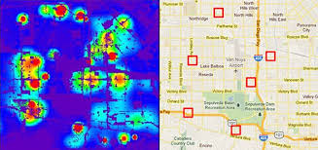
“predictive policing”
Nathan Rogers
Two types
  Place Based:
    Based on the history of crimes taking place provides a heat map (right)
  Person based:
    Takes in information about a person such as age, gender criminal history, history of substance abuse, contacts
    determines whether they can be at a high risk for being involved in crimes.
<Graphic as big as will fit>
https://www.smithsonianmag.com/innovation/artificial-intelligence-is-now-used-predict-crime-is-it-biased-180968337/
Notes:
Predictive Policing:
comes in two forms
Location based is a newwhich taken a narrow band or previous related crimes
then based on this information predect where the police soul look
The NYPD runs multiple algorithims to for property crimes, murder, grand theft auto
Based on findings: IN crime which is that 41% of crimes are were comitted by 4% of the arrested
what they found those 4% of peolple tend to be arrested together in groups.
This came to the birth of person based algorithins that look for people which look for
connections on in data about who they associate with criminal history, and look for individuals
This has run into problems where the outcomes of this algorithim are evidence in courts
people on these who are identified are put on the strategic subject list

Slide 8
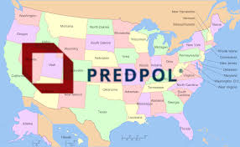

Nathan Rogers
https://tvguide1.cbsistatic.com/feed/1/587/11738587.jpg
https://www.predpol.com/
Notes:
When it comes to predictive policing many people’s first thoughts go to the Minority Report, and the predictive crime unit or precogs, The effectiveness of these algorithms either give us a likelihood for who id most at risk for

Slide 9

Use AI in the judicial system
Nathan Rogers
Parole:
  Used as a tool to help decide whether a person should receive parole[3]
The person based AI has been used as evidence in court
  When brought up as evidence in court it ends up with lengthier sentencings
Has been used to predict supreme court verdicts
https://www.nationsencyclopedia.com/Americas/United-States-JUDICIAL-SYSTEM.html
Notes:
In Pennsylvania they developed a system as a tool to assist whether or not to put some on parole and it
came back with 50% reduction in parolees returning to jail and had changed the popuation to whether or not
had changed a large portion of the
Is used to determine the likelihood if someone will show up for there pretrial meetings
Exploratory testing in whether or not it could in risk assessments for letting people out on bail
Having AI replace judges
There have also been models that have been used to predict Supreme court rulings
experimentation

Slide 10
Problems
Nathan Rogers
Setting a higher threshold for deeming a person of color high risk increased Accuracy
  This is not legally allowed to be done
Location based models can suffer from runaway feedback loops[2]
The use of the data from the models has been used quite liberally in court as evidence [1]
Datasets are biased
Notes:
algorithims need to be altered to provide better more accurate results
such that means with all other factors held constant a black man is more likley to be flagged
as a repeat offender than in actuality
Location based models suffer from runaway feedback loops which suffer which will cause polic to direct more
resources to the same aea over time
The person based models have been used as evidence in court
Police departments that use a predictive policing effectively are nown for notoriously bad relationships with there minorities
Data sets are based on racist police data sets based onb bias data
A stanford study that used a data from departments nation wide but found that minority drivers
were pulled over at 1.5x - 3x higher rateat local and statewide
w\data taken before 7pm and after 7pm dawn to dusk when alpha vlue of -.033 which they believed
was engugh to suggest a bias that was not statistically insignificant

Slide 11
References
Nathan Rogers
[1]will douglas Heaven, predictive polcing algoritihims,(MIT technology review, 6/17/2020) https://www.technologyreview.com/2020/07/17/1005396/predictive-policing-algorithms-racist-dismantled-machine-learning-bias-criminal-justice/ accessed 9/25
[2] Megan Stevenson, Assessing risk assessments inaction,(MLR,1/13/2019), https://www.minnesotalawreview.org/wp-content/uploads/2019/01/13Stevenson_MLR.pdf accessed 9/28
[3] Richard berk, Ann impact assessment of machine learning risk forecast on parole Board decisions and recidivism(UPENN,08/03/2016) https://crim.sas.upenn.edu/sites/default/files/WP2016-04_Berk_MachineLearningParole_08.03.2016%281%29.pdf accessed 9/27
[4]Danielle ensign, Runaway feedback loops in predictive policing,(PLR,12/2018), http://proceedings.mlr.press/v81/ensign18a/ensign18a.pdf accessed 9/27
[5] Emma Pierson, A large scale analysis of racial disparities in police stops across the United states, (nature human behavior,5/4/2020 )https://doi.org/10.1038/s41562-020-0858-1 accessed 9/28
[6] Mara Hvistendahlcan predictive policing prevent crimes before it happens,(AAAS, 9/28/2016)https://www.sciencemag.org/news/2016/09/can-predictive-policing-prevent-crime-it-happens accessed 9/30

Slide 12
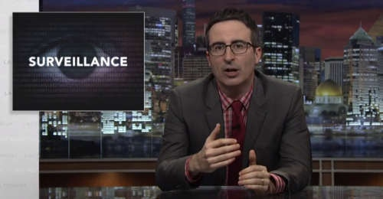

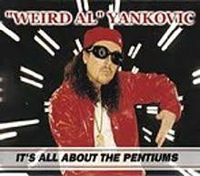


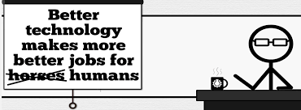


Student Choice – Interesting Videos
  Last Week tonight with John Oliver Snowden (33:14)
  It’s All About The Pentiums
  Weird Al (3:34)
  White and Nerdy Weird Al (2:50)
  The Game Of Trust - Nicky Case
  Why Electronic Voting is a BAD Idea
  Computerphile (Tom Scott) (8:20)
  Welcome To Life – Tom Scott (2:44)
  What "Orwellian" really means - Noah Tavlin (5:31)
  Humans Need Not Apply
  CGP Grey (15:00)
Notes:
All Last Accessed 2018-10-04
CGP Grey
Humans Need Not Apply (15:00) – 2014-08-13
http://www.youtube.com/watch?v=7Pq-S557XQU
Last access 2016-04-22
Why Electronic Voting is a BAD Idea – Computerphile (Tom Scott) (8:20)
https://www.youtube.com/watch?v=w3_0x6oaDmI
Last Week tonight with John Oliver – Patriot Act, Edward Snowden (33:14)
http://www.upworthy.com/john-oliver-flew-10-hours-to-russia-to-interview-edward-snowden-and-get-him-on-record?c=ufb1
Weird Al – It’s All About The Pentiums (3:34) and look at lyrics
https://www.youtube.com/watch?v=qpMvS1Q1sos
Tie into Ray Kurzweil Singularity
Epic Rap Battles of History: Steve Jobs vs. Bill Gates (If class ok with obscene lyrics) (2:47)
https://www.youtube.com/watch?v=njos57IJf-0
Also Work links on web site http://socialimps.keithpray.net/documents/
-----
Tom Scott
http://tomscott.com
Welcome To Life (2:44)
https://www.youtube.com/watch?v=IFe9wiDfb0E&feature=youtu.be
Passphrases (2:08 need to give context for video)
https://firstlook.org/theintercept/2015/03/26/passphrases-can-memorize-attackers-cant-guess/
If not shown during first class
What "Orwellian" really means - Noah Tavlin (5:31)
http://ed.ted.com/lessons/what-orwellian-really-means-noah-tavlin
Weird Al – White and Nerdy (2:50) and look at lyrics
https://www.youtube.com/watch?v=N9qYF9DZPdw

Slide 13
Student Choice – Interesting Videos (Full)
  Last Week tonight with John Oliver Snowden (33:14)
  It’s All About The Pentiums
  Weird Al (3:34)
  White and Nerdy Weird Al (2:50)
  The Game Of Trust - Nicky Case
  Why Electronic Voting is a BAD Idea
  Computerphile (Tom Scott) (8:20)
  Welcome To Life – Tom Scott (2:44)
  What "Orwellian" really means - Noah Tavlin (5:31)
  Humans Need Not Apply
  CGP Grey (15:00)
Notes:
All Last Accessed 2018-10-04
CGP Grey
Humans Need Not Apply (15:00) – 2014-08-13
http://www.youtube.com/watch?v=7Pq-S557XQU
Last access 2016-04-22
Why Electronic Voting is a BAD Idea – Computerphile (Tom Scott) (8:20)
https://www.youtube.com/watch?v=w3_0x6oaDmI
Last Week tonight with John Oliver – Patriot Act, Edward Snowden (33:14)
http://www.upworthy.com/john-oliver-flew-10-hours-to-russia-to-interview-edward-snowden-and-get-him-on-record?c=ufb1
Weird Al – It’s All About The Pentiums (3:34) and look at lyrics
https://www.youtube.com/watch?v=qpMvS1Q1sos
Tie into Ray Kurzweil Singularity
Epic Rap Battles of History: Steve Jobs vs. Bill Gates (If class ok with obscene lyrics) (2:47)
https://www.youtube.com/watch?v=njos57IJf-0
Also Work links on web site http://socialimps.keithpray.net/documents/
-----
Tom Scott
http://tomscott.com
Welcome To Life (2:44)
https://www.youtube.com/watch?v=IFe9wiDfb0E&feature=youtu.be
Passphrases (2:08 need to give context for video)
https://firstlook.org/theintercept/2015/03/26/passphrases-can-memorize-attackers-cant-guess/
If not shown during first class
What "Orwellian" really means - Noah Tavlin (5:31)
http://ed.ted.com/lessons/what-orwellian-really-means-noah-tavlin
Weird Al – White and Nerdy (2:50) and look at lyrics
https://www.youtube.com/watch?v=N9qYF9DZPdw

Slide 14
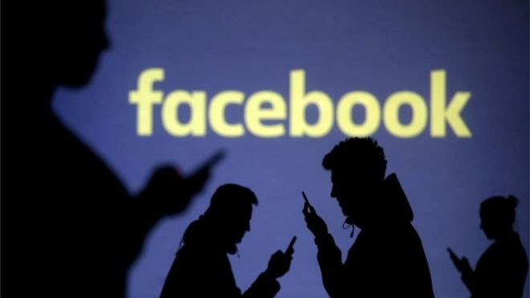
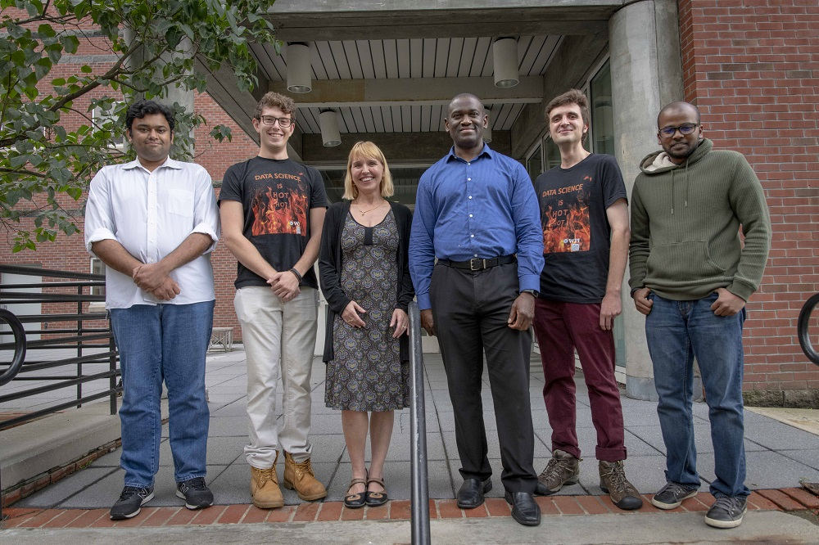

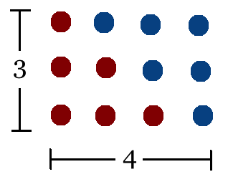
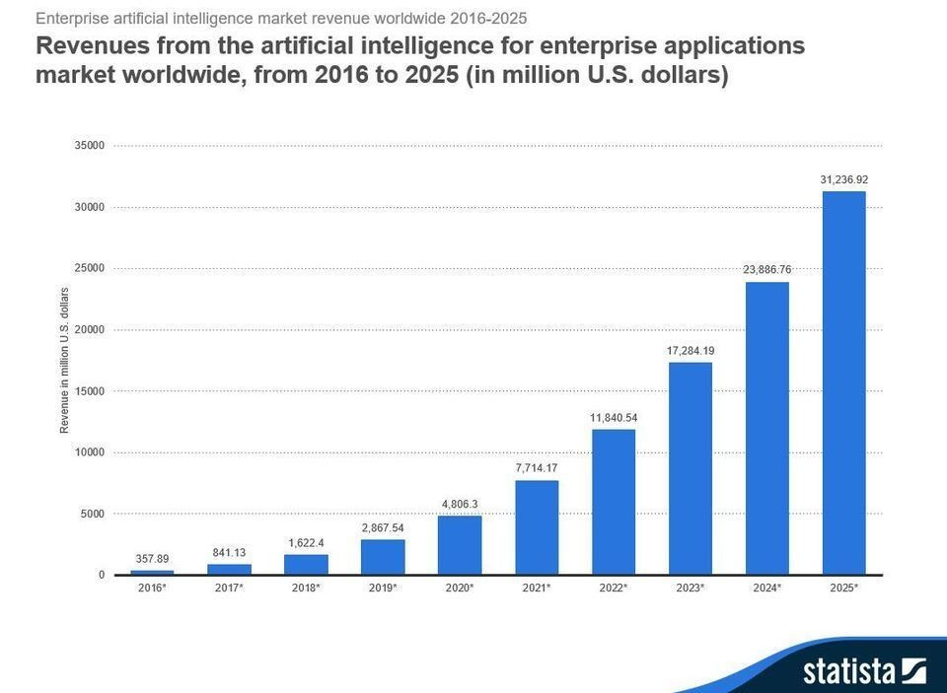
Student Choice – Interesting Articles 1/2
Facebook security breach: Up to 50m accounts attacked - Dave Lee, North America technology reporter, 2018-09-29
WPI Secures $2.8 Million to Develop a Smartphone App to Help Assess the Health of Soldiers, 2018-09-24
Quantified Toilets, 2014, Quantified Toilets LLC
What Did Ada Lovelace's Program Actually Do? - Sinclair Target, 2018-08-18 (First Programming Bug 1843?)
We know ethics should inform AI. But which ethics? - Mauro Guillen, World Economic Forum, 2018-07-26
Notes:
All Last Accessed 2018-10-04
TOOD: Add to first day slides.
Emacs – psychoanalyze-pinhead
doctor (implementation of ELIZA)
yow (quotes from Zippy the Pinhead zippythepinhead.com)

Slide 15
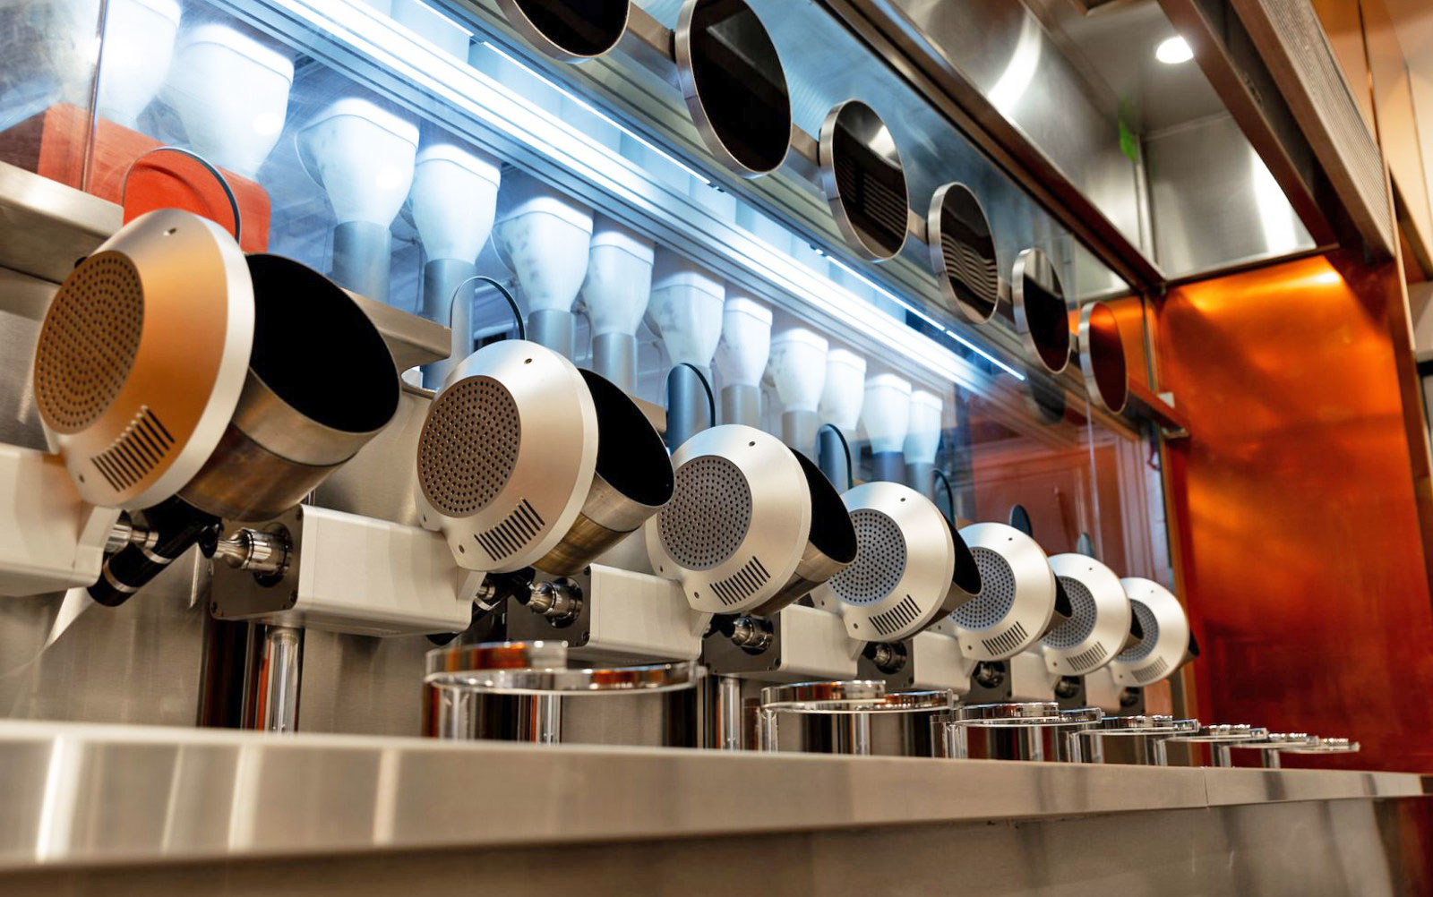

Student Choice – Interesting Articles 2/2
MIT-born Spyce raises $21M to open new robotic restaurants - Lucia Maffei, BostInno, 2018-09-07
The Coders Programming Themselves Out of a Job - Brian Merchant, The Atlantic, 2018-10-02
Notes:
All Last Accessed 2018-10-04
Spyce image: https://www.engadget.com/2018/05/04/boston-robotic-kitchen-spyce/ , 2018-05-04
Coders Programming Themselves Out of a Job image: Gabrielle Lurie, Reuters (date unknown)

Slide 16
Class 14
The End
Keith A. Pray
Instructor
socialimps.keithpray.net
Notes:
This is the end. Any slides beyond this point are for answering questions that may arise but not needed in the main talk. Some slides may also be unfinished and are not needed but kept just in case.

Slide 17
Evaluations
Use only BLUE or BLACK ballpoint pen
Use an X to mark (Do NOT fill in box)
Course Evaluation
  Write MY NAME and COURSE TITLE in box at top of form
  Keith A. Pray
  CS 3043 Social Implications Of Information Processing
  Return to Academic Advising Office in Daniels Hall
  Include “Evaluation Sheet” cover letter
Notes:
No TA/SA this time
TA/SA Evaluation
Name:
Return to CS Department: Fuller 233

