Slide 1
Class 9
Errors Failures Risks
Keith A. Pray
Instructor
socialimps.keithpray.net
Notes:
Here’s the title slide. Excited already, aren’t you?
What is the point of this assignment? (Did SW Teams from the reading pick good test strategies? Will you be able to support your choices if something goes wrong?)
What errors? – Have student record list on board
Who looked for existing test strategies?
Who looked for directions on how to test currency?

Slide 2
what works well Online With Zoom
Sign in with First and Last Name
Stay muted unless you are going to speak
To speak use the raise your hand feature
To answer yes/no questions use the “yes” ”no” buttons
Chat is fine for questions
Turn your camera on
Wait until the end of student presentations to ask questions
  Write them down so you don’t forget
Others?

Slide 3
Survey Results (1/3) -19 Responses
Notes:
Common items for next time:
I am in FL 140 about an hour before and after each class
Estimated breakdown of course time per week:
4 hours class time
4 hours reading (2 chapters ~90 pages @ 2 minutes per page)
8 hours practicing mastery of material (papers, group project, class activity prep)
If you are spending much more than this let me know and we can figure out a more efficient way to spend your time

Slide 4
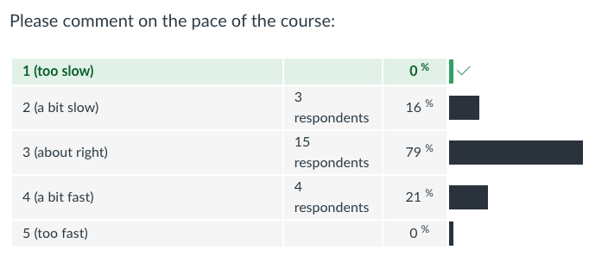
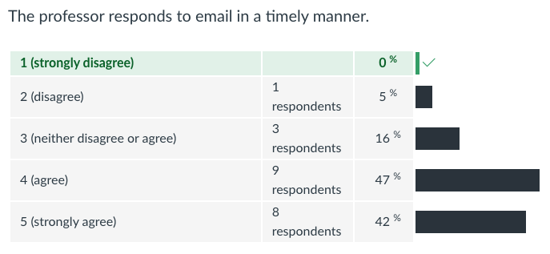
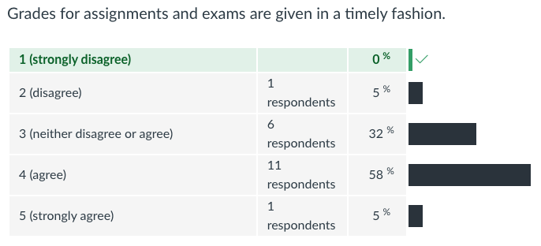
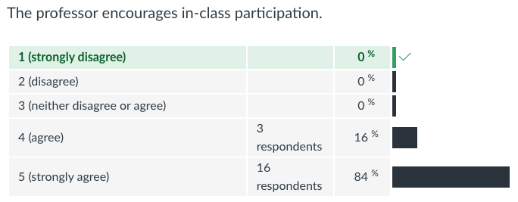
Survey Results (2/3) -19 Responses

Slide 5
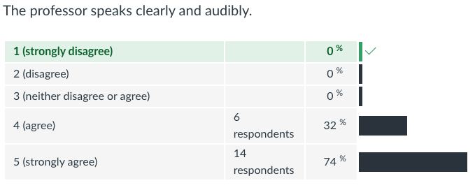
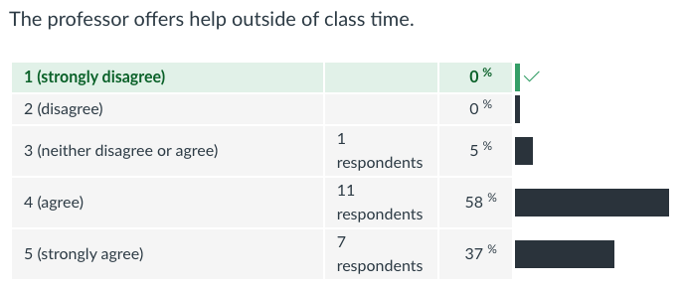
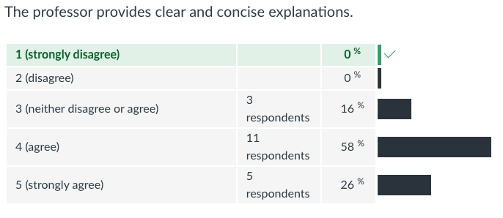
Survey Results (3/3) -19 Responses

Slide 6
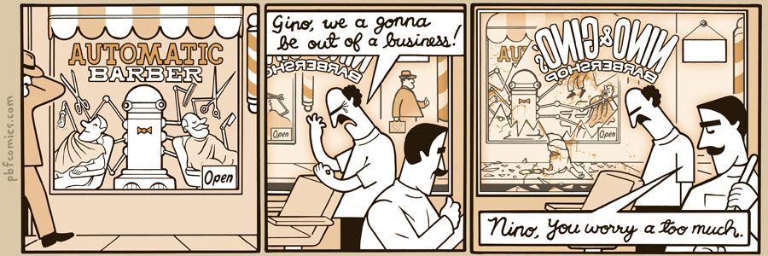
http://pbfcomics.com/197 (2014-09-26)
Notes:
10 – Errors, Failures, Risks

Slide 7
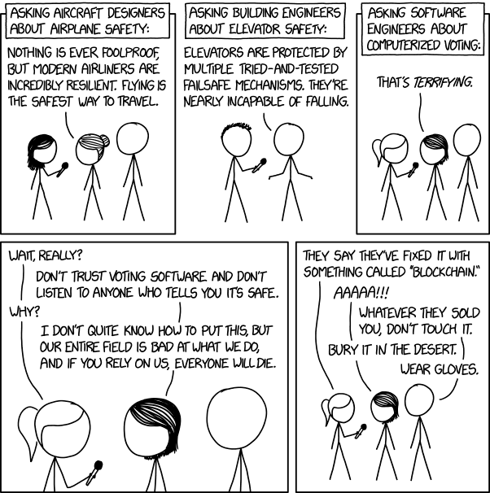
Overview
Review
Assignment
Students Present
https://xkcd.com/2030/ (2018-09-21)
Notes:
Good alternative if guest speaker not coming or late
Why Electronic Voting is a BAD Idea - Computerphile
https://www.youtube.com/watch?v=w3_0x6oaDmI
We can also discuss articles listed on Security Discussions under documents of course web site.
TODO: add quiz as backup if class discussion or guest speaker fail

Slide 8
My Reading Notes
pp. 366 Any false arrests since 1989?
pp. 368 Argument assumes DB cannot exist without existing inaccuracies.
pp. 373 This is not to keep the PATRIOT system from responding to false alarms.
pp. 375 Always encapsulate units! Not clear if SW involved.
pp. 376 Any SW diffs between Mars Missions?
pp. 378 Why did the Tokyo Stock Exchange refuse?
pp. 380 Republicans and Florida?
pp. 381. Do the second thoughts on DRE machines make the interview at end Chapter’s end less relevant?
pp. 389 No simulation examples since 2002?
pp. 390 Did The Limits to Growth predictions motivate people to change?
pp. 392 What happened to Verification?
pp. 394 “satisfies the specification” = verification. “needs of the user” = validation.
pp. 395 SW quality since 2009?
pp. 396 Gender bias nice addition!
pp. 406 21, source from 2004, is it implemented yet? 23 like game release question in next chapter.
Questions I liked: 10, 12, 16, 17, 18, 20, 21
Notes:
MSNBC on Denver's Automated Baggage System 2010-08-23 (2:27)
https://www.youtube.com/watch?v=xx8f4x6C_KY
Accessed 2019-04-09

Slide 9
Overview
Review
Assignment
Students Present
Notes:
We can also discuss articles listed on Security Discussions under documents of course web site.
ADD QUIZ AS BACKUP IF CLASS DISCUSSION OR GUEST SPEAKER FAIL

Slide 10
Assignment
Prepare for Debate
  From Chapter 9 In-class Exercises # 24.
  Should the company produce the game?
  Use the SWE Code Of Ethics as the basis for your argument.
  Use other sources for supporting data
Optional 1 paper on topic, lowest paper grade will be dropped

Slide 11
Queries of death
Jonathan Metcalf
Notes:
Hi, my name is Jonathan Metcalf and I'll be talking about Queries of Death today.

Slide 12
Background information
Jonathan Metcalf
Attackers send malformed messages to a computer that crash it or run malicious code
  Also called a "teardrop" or "Ping of Death" (PoD) attack
Used to be very effective on website servers [1]
  Attacker's identity could be spoofed
  No knowledge of machine necessary except for IP address
Zero Day Security Vulnerabilities Explained [1]
Notes:
First, some background information you need to know: What is a Query of Death attack? Broadly, a query of death is a type of attack on a computer system in which malformed or malicious pings, queries, or messages are sent to the computer that can crash it or run malicious code.
This used to be a very effective mode of attack on desktops because the attacker’s identity could be easily spoofed, or disguised, by sending false data to make the system think it was a different computer.
Additionally, no knowledge of the machine being attacked is necessary for the attacker to successfully attack it besides the IP address, which can be found easily in many ways, including through fake websites, video games, or even texts or emails you send.

Slide 13
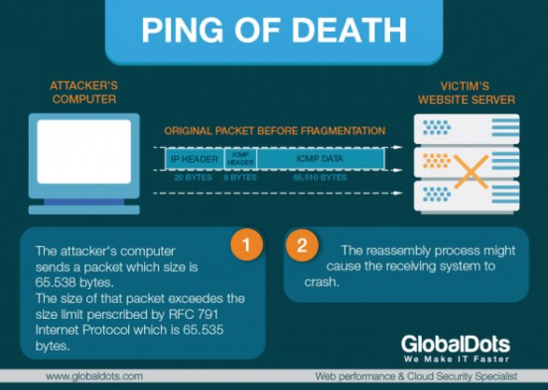
Not an issue for desktops Anymore
Jonathan Metcalf
Buffer overflow caused by larger packets received than expected
  Computer reassembles fragmented packets
Companies such as Imperva or Cloudflare screen packets sent and filters abnormal packets [2]
  As of 2019, 83% of companies use a tool that protects against these attacks [3]
<Graphic as big as will fit>
Image Credit [1]
Notes:
The size of a correctly-formed packet is 65,538 bytes, and if a larger packet is sent, it can cause a buffer overflow (like Professor Pray showed us) and could cause various problems in the system, including it crashing.
Since sending a packet larger than that size violates the Internet Protocol, causing it to be dropped and not sent, attackers cleverly found a way around that.
They would send multiple fragmented packets with flags telling the computer to reassemble them, and when the computer attempted to reassemble them, it would end up with an oversize packet and crash.
However, companies such as Imperva or Cloudflare screens packets that are sent to your computer and filters out all abnormal packets, even if they are fragmented.
This eliminates the thread of Ping of Death attacks for any system that uses them.
As of 2019, 83% of companies have a DDoS protection tool that protects their servers against Ping of Death attacks. It's not really an issue for desktops anymore. As Cloudflare eloquently puts it, "The original Ping of Death attack has mostly gone the way of the dinosaurs"

Slide 14
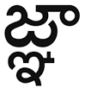
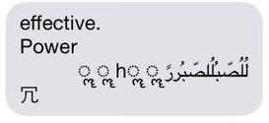
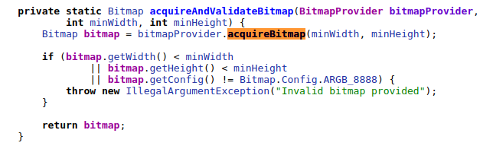
Still an issue on mobile phones
Jonathan Metcalf
Character encoding standard called Unicode
  Every character has a unique numeric value
Certain sequences of Unicode characters would break Apple's text renderer [4]
  It would enter an invalid, potentially dangerous state
Android phones are vulnerable to malformed GIFs that cause Null Pointer Exceptions [5]
Example sequences
Faulty code
Image Credits [5]
Notes:
It is, however, still an issue on mobile phones. Messaging apps on phones are sent packets of text encoded by Unicode, which is one popular encoding standard. In Unicode, every character has a unique numeric value. This allows for non-English symbols like Chinese or Japanese characters or emojis.
Apple's notification box draws the characters given by the Unicode sequence using a program called Core Text. Core Text could not handle displaying certain sequences of unicode characters and would enter an invalid state, potentially allowing malicious code to be run or simply freezing or crashing your phone.
Android phones are more vulnerable to malformed GIFs that cause Null Pointer Exceptions or NPEs. NPEs occur when a program tries to use data that isn't there. In this case, it's due to the GIF not being processed correctly, but then no error is thrown up saying that. The code on the right is one issue in Android's operating system that has since been fixed. The method acquireBitmap() can fail with malformed GIFs and return a null pointer, which as you can guess, when it's called, it causes a null pointer exception and crashes the app.

Slide 15
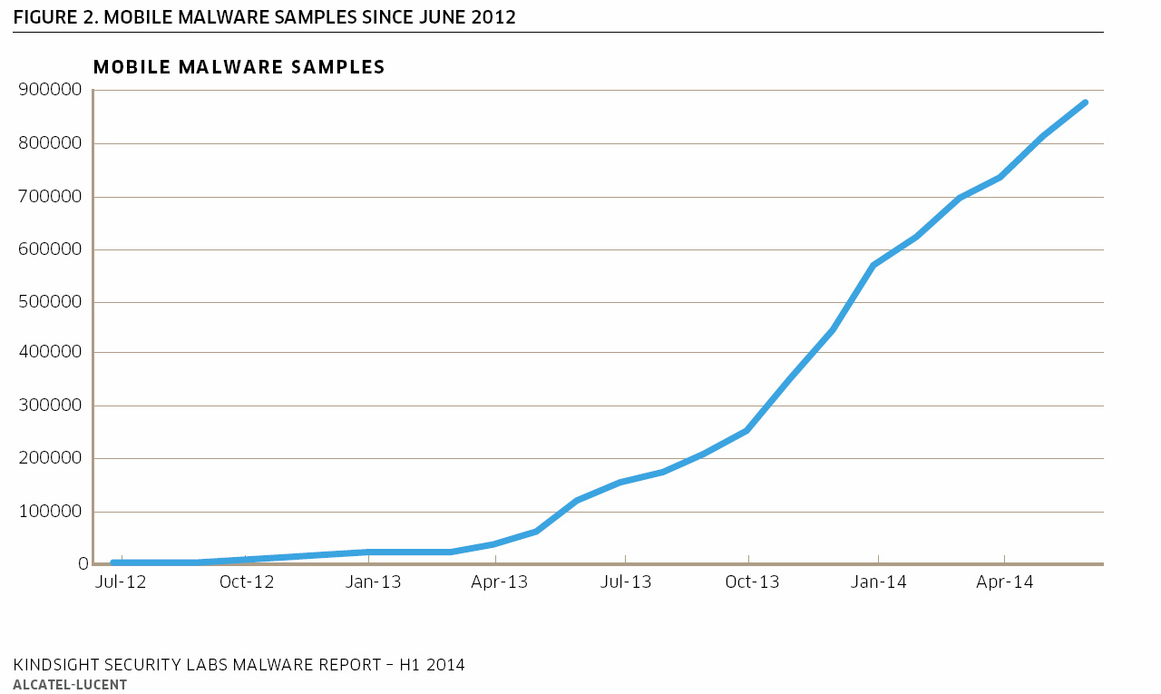
It's only getting worse for phones
Jonathan Metcalf
Malware attacks for phones are getting more common
  In 2016, the amount of malicious apps tripled to 8,526,221 from the previous year [6]
Android malware can give attackers access to your email if you open an SMS [7]
  This affects millions of Android phones, and requires software patches to fix
New "interaction-less" iOS malware shown at conference [8]
  Code being run just from receiving iMessage
Image Credit [9]
Notes:
In fact, it's only getting worse for phones. General malware attacks for phones are getting more common. In 2016, the amount of malicious apps tripled to eight and a half million from the previous year.
New bugs that enable "interaction-less" attacks are constantly popping up more and more, such as a new Android malware discovered that can give attackers access to your email if you simply open an SMS. This is possible because of how your phone "provisions" features over the air, which is basically how carriers can change phone settings remotely; hackers have taken advantage of this to gain access to the device's email settings. To fix it, a software patch is required. So far, out of the main Android manufacturers, only Samsung and LG have released patches. Huawei is working on a fix, and Sony is refusing to acknowledge the issue at all, stating that they'd followed security procedures accordingly. Because of this, roughly 320 million Android phones are affected.
It's not just Android either! For iOS, researchers presented multiple "interaction-less" bugs in iMessage that would allow hackers to gain control of the user's device. Examples of this were shown that could do many things on the device, ranging from text messages that would make iMessage return specific user data back to malicious code being placed on a user's device. I even found a 2 minute video of it happening, so if anyone is curious, I can provide the link.
Link: https://www.youtube.com/watch?v=kH4rZwjCpXY

Slide 16
What you can do
Jonathan Metcalf
DO:
Force restarting your phone and turning off notifications is effective for character crashes [4]
Consider blocking texts from unknown numbers
Keep all of your devices up to date
  Software patches are constantly being released to fix exploits
DON'T:
Open text messages from phone numbers you don't know
Click on links in text messages, even if they are your friends
Jailbreak/root your phone
  Gives attackers an easy vector into your phone
How That Crazy Text Message Keeps Crashing Your iPhone [4]
Notes:
So, knowing that malware on phones is getting worse, what can you, the average user, do?
Force restarting your phone and turning off notifications was found to be effective for the current character crashes. Blocking texts from all unknown numbers is possible on Android, and blocking texts from specific unknown number is possible on iOS. The most important thing you can do, however, is keep all of your devices up to date. Software patches are constantly being released to fix new exploits. For example, Apple has released a patch to fix six bugs presented that would allow iOS users to get hacked by receiving a text message, and as I mentioned, many Android companies are also releasing patches to fix Android exploits.
Also, be smart about messages you receive; don't open text messages from phone numbers you don't know, and especially don't click on links in text messages, even if they are your friends. Lastly, even if it's tempting to jailbreak or root your phone, which allows you to get unauthorized apps and removes restrictions, it also is a security risk, as it gives attackers an easy vector into your phone.

Slide 17
References
Jonathan Metcalf
[1] Čandrlić, G, Zero Day Security Vulnerabilities Explained, (GlobalDots, 10/27/16), https://www.globaldots.com/blog/zero-security, (9/27/20)
[2] N.A., Ping of Death DDoS attack, (Cloudflare, n.d), https://www.cloudflare.com/learning/ddos/ping-of-death-ddos-attack/, (9/27/20)
[3] N.A., US Signal State of Web and DDoS Attacks Survey. (US Signal, June 2019), https://ussignal.com/uploads/general/Documents/fGeneral/misc/USS-State-of-Web-and-DDoS-Attacks-Survey.pdf, (9/27/20)
[4] Limer, E, How That Crazy Text Message Keeps Crashing Your iPhone, (Popular Mechanics, 11/14/17), https://www.popularmechanics.com/technology/a15756/how-effective-power-crashes-your-iphone/, (9/27/20)
[5] N.A., DoS Vulnerability Crashes Android Messages App, (Trend Micro, 9/7/17), https://www.trendmicro.com/en_us/research/17/i/cve-2017-0780-denial-service-vulnerability-android-messages-app.html, (9/27/20)
[6] Ahvanooey, M., Li, Q., Rabbani, M., & Rajput, A, A Survey on Smartphones Security: Software Vulnerabilities, Malware, and Attacks, (arXiv, 1/26/20), https://arxiv.org/abs/2001.09406, (9/27/20)
[7] N.A., Protect yourself from this new text message spyware scam, (Komando, 10/12/19), https://www.komando.com/security-privacy/watch-out-texting-scam-can-hijack-your-emails/594255/, (9/27/20)
[8] Newman, L, Hackers Can Break Into an iPhone Just by Sending a Text. (Wired, 8/8/19), https://www.wired.com/story/imessage-interactionless-hacks-google-project-zero/, (9/28/20)
[9] Unsworth, A, Mobile malware report reveals that more apps are spying on us, (MobilePaymentsWorld, 9/8/24), https://www.mobilepaymentsworld.com/mobile-malware-report-reveals-apps-spying-us/, (9/28/20)

Slide 18
AI In The Kill Chain
Jason Dominguez
Notes:
State name, title of presentation

Slide 19
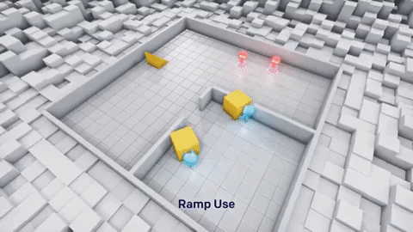
What is an AI
Jason Dominguez
Artificial intelligence(AI)
Can learn, from experience
Implemented in thousands of applications
Military use
  AlphaDogfight Trials
  IRON Dome
OpenAI via YouTube
(1,2,3)
Notes:
AI= artificial intelligence
Separate from regular computer program, learn from itself until it compeltes its given task. Known to think out side the box
Used in thousands of applications, reduces work labor needed, facebook, google, etc.
AI in the military should it be done, multiple uses
AlphaDogfight Trials, great example of how superior AI can be to human 5 Heron system, 0 human (2)
IRON Dome used since 2011 intercepted roughly 1500 rockets 85-90% accuracy(3) used in isreial

Slide 20
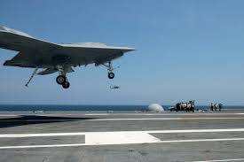
Ai ethics
Jason Dominguez
Different situations
Different ethical concerns
  Objections based on the limits of technology to function within legal constraints and ethical norms
  Ethical objections that are independent of technological capability
USNI news
(4,5)
Notes:
Army ranger, Scharre , his team spotted a little girl – maybe 5 or 6 years old – with a herd of goats circling their position. They soon realized the animals were a ruse and the child was, in fact, reporting their location to Taliban officials by radio. Rules of war would have labeled her an enemy combatant that would have allowed Scharre’s team to shoot.
(4)
Removing human agency from decisions to kill, injure and destroy–decisions to use force –leading to a responsibility gap where humans cannot uphold their moral responsibility32
Undermining the human dignity of those combatants who are targeted,and of civilians who are put at risk of death and injury's a consequence of attacks on legitimate military targets
furtherincreasinghuman distancing–physically and psychologically –from the battlefield, enhancingexisting asymmetries and making the use of violence easier or less controlled.34

Slide 21
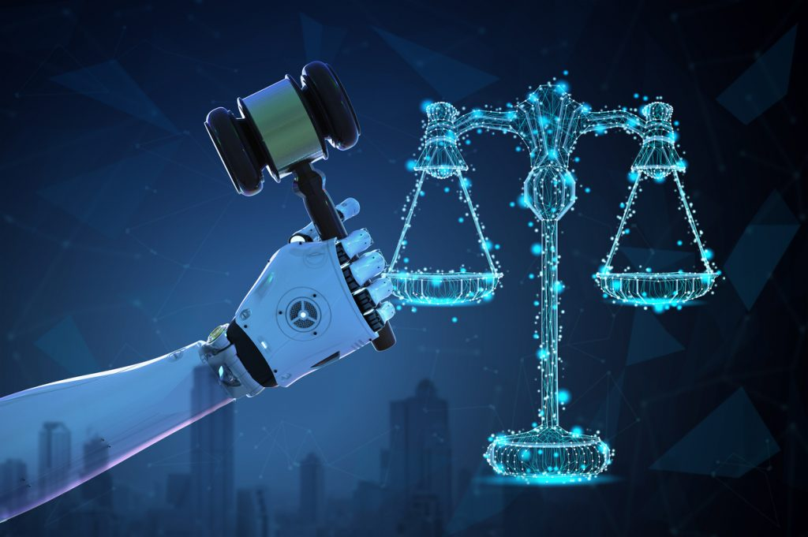
Ai ethics
Jason Dominguez
Not upholding moral reasonability
Undermining human dignity
Further increasing human distancing
  Drone pilots still experience PTSD
istock
(5,6)
Notes:
Removing human agency from decisions to kill, injure and destroy–decisions to use force –leading to a responsibility gap where humans cannot uphold their moral responsibility32
Undermining the human dignity of those combatants who are targeted, and of civilians who are put at risk of death and injury's a consequence of attacks on legitimate military targets
Further increasing human distancing–physically and psychologically –from the battlefield, enhancing existing asymmetries and making the use of violence easier or less controlled.34
(file:///C:/Users/jason/AppData/Local/Temp/icrc_ethics_and_autonomous_weapon_systems_report_3_april_2018.pdf)
Drone are different as it has been proven the operator even though was not right still get ptsd. Showing there is some human interaction, however it is not nearly as much as being on ground with only 4.3 percent having moderate to severe ptsd vs. 10 to 18% coming from deployments. Showing some distance(https://www.livescience.com/47475-drone-operators-develop-ptsd.html)

Slide 22

result
Jason Dominguez
Majority of states agree a law has to be made
Understand the point of having humans in process
UN flags
(7)
Notes:
The majority of states support the development of new international law that contains prohibitions and regulations of autonomous weapon systems.(6) Of these, 28 governments support a complete ban on the development, possession, and use of AI weapons. But some still want to use but with restriction. UN conference 2019

Slide 23
References
Jason Dominguez
[1] Roth, M. (2019, November 22). AI Drones and UAVs in the Military - Current Applications. Retrieved September 28, 2020, from https://emerj.com/ai-sector-overviews/ai-drones-and-uavs-in-the-military-current-applications/
[2] Host, P. (2020, August 24). Heron Systems' AI defeats human pilot in US DARPA AlphaDogfight Trials. Retrieved September 28, 2020, from https://www.janes.com/defence-news/news-detail/heron-systems-ai-defeats-human-pilot-in-us-darpa-alphadogfight-trials
[3] Callahan, A. M. (2020, January 24). Global Affairs STRATEGIC STUDIES - Universidad de Navarra. Retrieved September 28, 2020, from https://www.unav.edu/web/global-affairs/detalle/-/blogs/an-assessment-on-israel-s-iron-dome-defense-system
[4] Witte, M. D. (2019, May 02). Ethics of autonomous weapons. Retrieved September 28, 2020, from https://news.stanford.edu/2019/05/01/ethics-autonomous-weapons/
[5] Geneva (2018, April 03). Ethics and autonomous weapon systems: An ethical basis for human control? (pp. 8-9, Rep.). ICRC.
[6]Blaszczak, A. (2014, August 20). Drone Pilots Suffer PTSD Just Like Those in Combat. Retrieved September 28, 2020, from https://www.livescience.com/47475-drone-operators-develop-ptsd.html
[7]Recaps of the UN CCW meetings March 25-29, 2019. (2019, March 29). Retrieved September 28, 2020, from https://autonomousweapons.org/recaps-of-the-un-ccw-meetings-march-25-29-2019/

Slide 24
Racial bias in Facial Recognition Software
By Amy Orozco
© 2020 Keith A. Pray

Slide 25
Evidence racial bias Exists
Amy Orozco
The severity of misidentification varies between algorithm
    Amazon
    Microsoft
    IBM’s
    Megavii’s
The group of people being misidentified change between countries
    In asian countries white people get misidentified at a higher rate
[1][2][5][7]
Notes:
Back up statement that racial bias exists.
The rate at which misidentification happens depends on the algorithm but exist in all of them; including the major companies providing facial recognition software.
Happens across the world, not an isolated issue.

Slide 26
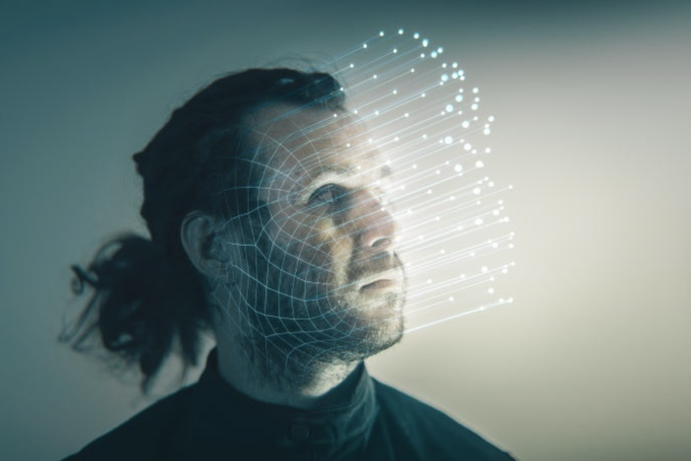
Why
Amy Orozco
Datasets
  Faces used to train the algorithm are predominantly white men
Companies struggle to find high-resolution photos.
Police bias
Image: Getty Images
[4][6][8]
© 2020 Keith A. Pray
Notes:
Algorithms are not being trained on a diverse enough array of photographs.
Reflects the people creating the algorithms
High quality pictures of POC are needed and integrate into training set.
POC are overrepresented in police datasets, leading to an even high risk over being wrongly misidentified.

Slide 27
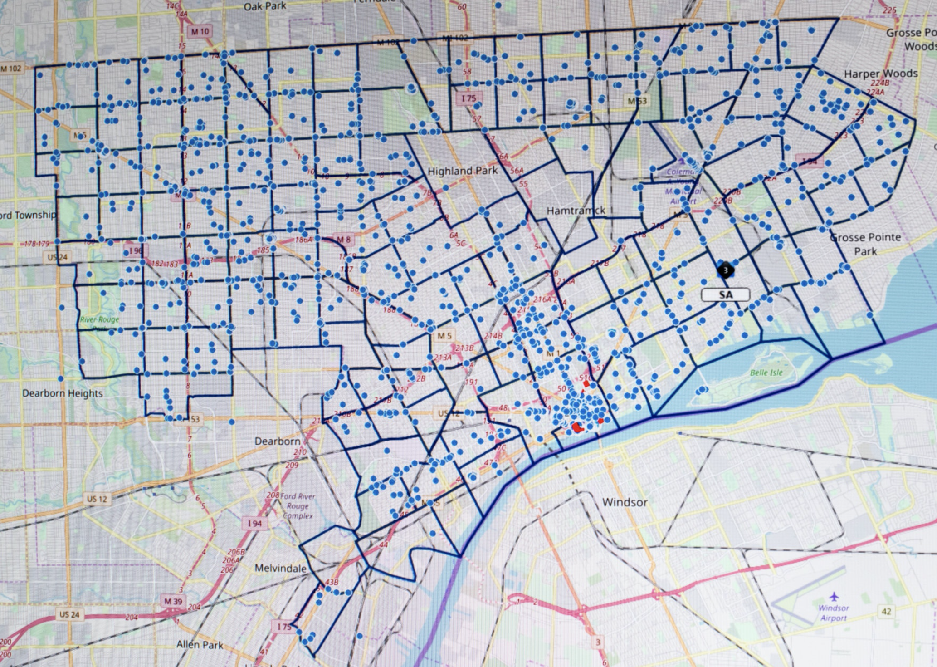
Effects
Amy Orozco
Worsens pre-existing racism in policing system
Another way of over-policing in Black and Brown communities.
Wrongful imprisonment
Infringes on human rights
Image: Brittany Greeson
[6][2][7]
Notes:
Even if racial recognition is no longer bias the police system itself has to be reform and be less bias agianst POC
Unproportionally effects POC.
Reflects the racial issue occurring in the country.
No laws regulating the use of facial recognition software

Slide 28
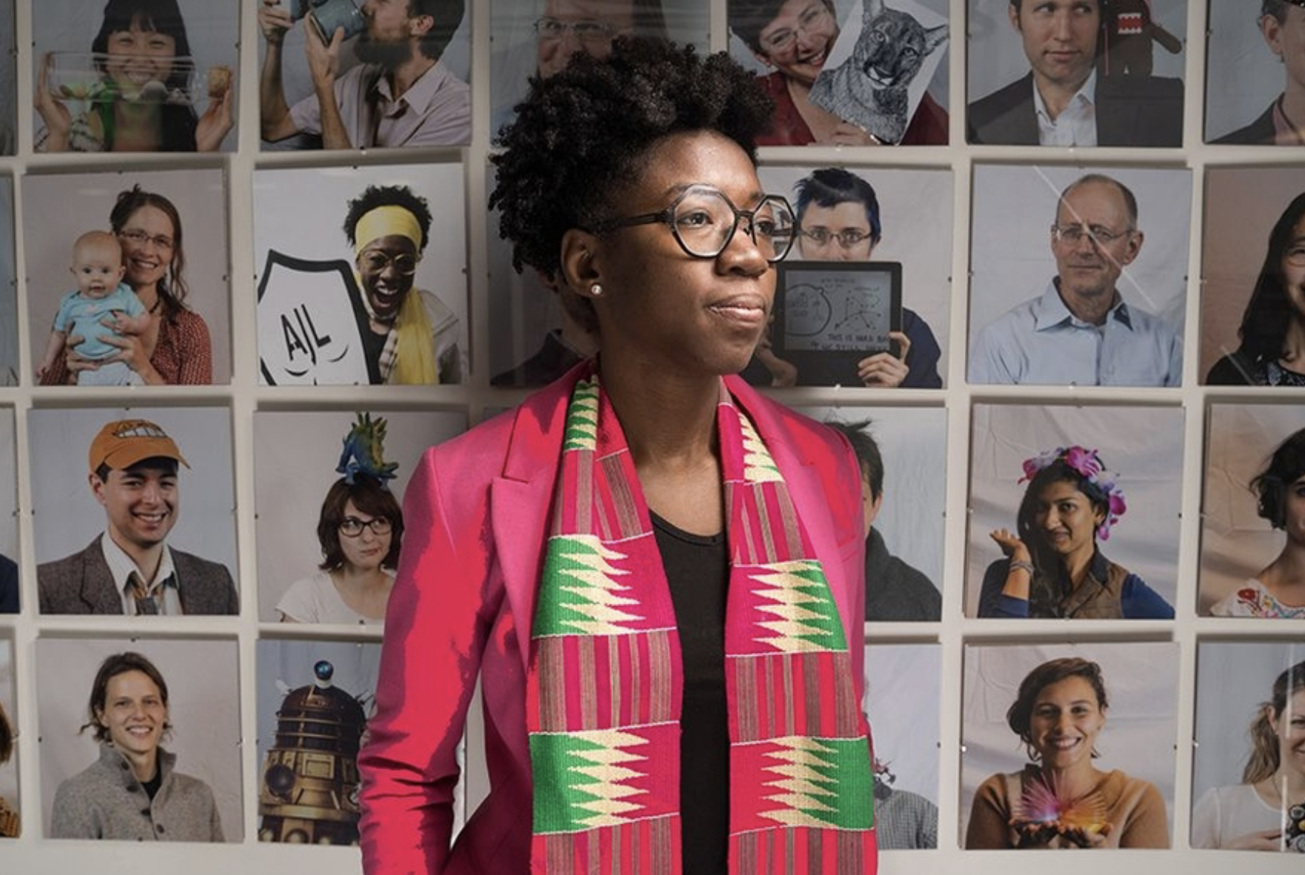
Whats being done about it
Amy Orozco
Actively push for improvement
Better datasets
Police reform
Major tech companies in the field are edging away from their artificial intelligence creations
  Amazon
  IBM
Image: Bryce Vickmark
[3][9][10]
Notes:
People are fight against it, like Joy Boulamwini
In todays America there's a push for police reform as a whole, including facial recognition.
Movements like BLM have pushed tech companies to stop selling to the police.
Theres need to be less of a bias towards POC in the policing system as a whole.

Slide 29
References
Amy Orozco
[1] Sophia Bushwick, How NIST Tested Facial Recognition Algorithms for Racial Bias, (scientificamerican.com, December 27, 2019), https://www.scientificamerican.com/article/how-nist-tested-facial-recognition-algorithms-for-racial-bias/(September 26, 2020)
[2] Nathan Singer, Amazon Is Pushing Facial Technology That a Study Says Could Be Biased, (nytimes.com, Jan. 24, 2019), https://www.nytimes.com/2019/01/24/technology/amazon-facial-technology-study.html(September 26, 2020)
[3] Geoffrey Fowler, Black Lives Matter could change facial recognition forever — if Big Tech doesn’t stand in the way, (washintonpost.com, June 12, 2020), https://www.washingtonpost.com/technology/2020/06/12/facial-recognition-ban/(September 26, 2020)
[4]Drew Harwell, Federal study confirms racial bias of many facial-recognition systems, casts doubt on their expanding use, (Dec. 19, 2019), https://www.washingtonpost.com/technology/2019/12/19/federal-study-confirms-racial-bias-many-facial-recognition-systems-casts-doubt-their-expanding-use/(September 26, 2020)
[5] Natasha Singer and Cade Metz, Many Facial-Recognition Systems Are Biased, Says U.S. Study, (nytimes.com, Dec. 19, 2019), https://www.nytimes.com/2019/12/19/technology/facial-recognition-bias.html(September 27, 2020)
[6] Amy Harmon, As Cameras Track Detroit’s Residents, a Debate Ensues Over Racial Bias, (nytimes.com, July 8, 2019), https://www.nytimes.com/2019/07/08/us/detroit-facial-recognition-cameras.html(September 27, 2020)
[7] Steve Lohr, Facial Recognition Is Accurate, if You’re a White Guy, (nytimes.com, Feb. 6, 2018), https://www.nytimes.com/2018/02/09/technology/facial-recognition-race-artificial-intelligence.html(September 27, 2020)
[8] Isabella Garcia. Can Facial Recognition Overcome Its Racial Bias?, (SolutionsJornalism, April 16, 2020), https://www.yesmagazine.org/social-justice/2020/04/16/privacy-facial-recognition/(September 27, 2020)
[9] Larry Hardesty, Study finds gender and skin-type bias in commercial artificial-intelligence systems, (news.mit.edu, February 11, 2018), https://news.mit.edu/2018/study-finds-gender-skin-type-bias-artificial-intelligence-systems-0212(September 27, 2020)
[10] Irina Ivanova, Why face-recognition technology has a bias problem, (cbsnews.com, June 12, 2020), https://www.cbsnews.com/news/facial-recognition-systems-racism-protests-police-bias/(September 27, 2020)
© 2020 Keith A. Pray

Slide 30
Class 9
The End
Keith A. Pray
Instructor
socialimps.keithpray.net
Notes:
This is the end. Any slides beyond this point are for answering questions that may arise but not needed in the main talk. Some slides may also be unfinished and are not needed but kept just in case.

Slide 31
Reliability Of Statistics
Are other factors controlled?
Is enough time covered?
Is all data reported?
Use Intuition
  Are results reasonable?
Notes:
Power line dangers. Electromagnetic fields? PCBs in transformers?

Slide 32
Cost-Benefit Analysis
How much does it cost?
What do I get for this cost?
Notes:
Like a social contract.

Slide 33
Risk-Benefit Analysis
What could go wrong?
How likely is it?
How costly are the consequences?

Slide 34
Limitations to
Risk-Benefit Analysis
Hard to quantify probabilities
Hard to quantify costs
Who bears the costs?
Are the potential benefits worth it?
Notes:
What is the value of a human life?
What is the value of a species?
E.g. future generations, poor people.
Omelas

Slide 35
Some Measures
Mean Time To Failure (MTTF)
Mean Time Between Failures (MTBF)
Mean Time To Repair (MTTR)
Notes:
Is it repairable?
What does it mean to repair? Running again? Data fixed? Caught up?
Restoring the GBC Web site.

Slide 36
Relying Too Much
Limits of modeling reality
Limits of precision
Limits of algorithms
Limits of interpretation
Notes:
Battle of the X-Planes
Trusting the statistics. Are differences significant?
Colin Chapman’s Lotus 7 chassis.

Slide 37
Producing Good Software
Good specifications
Good usability
Good design
Robustness
Good implementation
Testing
Notes:
Specs: Know what you are going to do. Often difficult. What does the customer want? What does the customer need?
Usability: Logical and intuitive, Consistent, Helpful, Complete, Accessible, Disability. Complete—not have to write things down.
Design: Logical, Modular, Consistent, Well-specified, Flexible, Extensible, Adaptable, New features, new platforms.
Robustness: Tolerant of data errors, Tolerant of human errors, Tolerant of network errors, Enough detail / not too much. Stack trace vs. “?” “A script error has occurred. Do you want to debug?”
Implementation: Adequate hardware (E.g. memory, storage, speed), Adequate software (Languages, OS, libraries), Internal and external documentation
Testing: Should be at all phases of the development cycle. Plan ahead for it. Consistent, repeatable, documented. Regression testing.

Slide 38
Plan For The Long Term
Version control
Future development
New platforms
Patches
Security
Training
Customer support

Slide 39
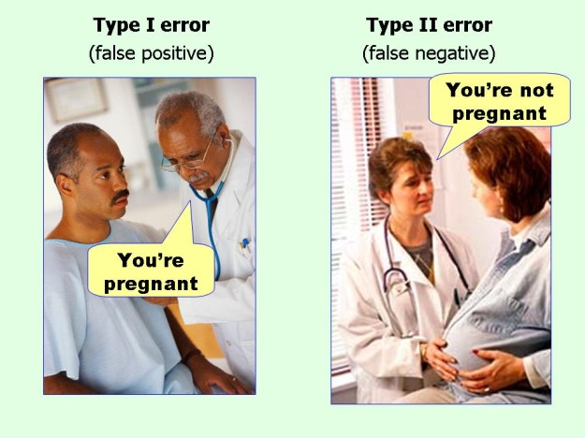
marginalrevolution.com/marginalrevolution/2014/05/type-i-and-type-ii-errors-simplified.html (2016-04-11)

