Slide 1
Class 6
Information Privacy
Keith A. Pray
Instructor
socialimps.keithpray.net
Notes:
Here’s the title slide. Excited already, aren’t you?
How did the self search paper go? Offer small group discussion instead of class wide.
Who: found a lot, very little, surprised, not surprised, creepy, share conclusions

Slide 2
what works well Online With Zoom
Sign in with First and Last Name
Stay muted unless you are going to speak
To speak use the raise your hand feature
To answer yes/no questions use the “yes” ”no” buttons
Chat is fine for questions
Turn your camera on
Wait until the end of student presentations to ask questions
  Write them down so you don’t forget
Others?

Slide 3
Logistics
Any course logistic questions?
Notes:
Not needed this time:
Address email to entire course staff for quickest response time
Send presentations via email as attachment.
Do not change the format, footers, etc. in the template slides.
Paper writing process: Sources → Notes → Conclusion → Argument → Counter Point → Response
Turn extra credit paper in on myWPI/Canvas and hard copy in class like regular papers
Presentations are due 24 hours before class
Use Presentation Guidelines on course web site

Slide 4
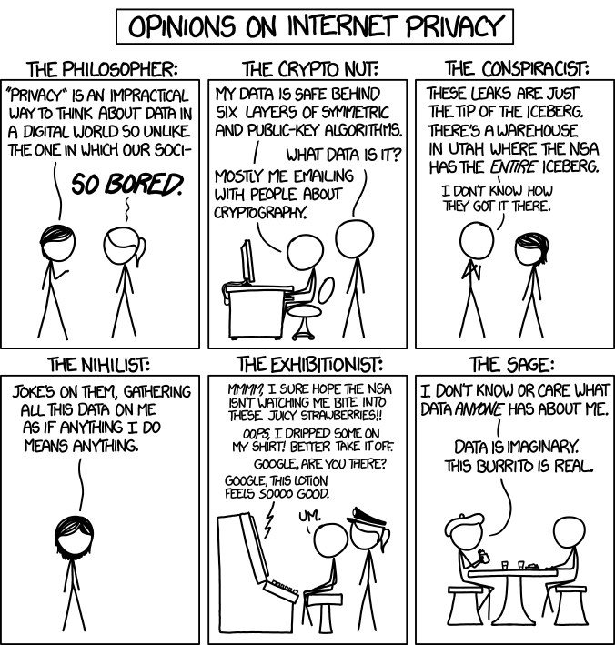
Overview
Review
Assignment
Students Present
http://xkcd.com/1269/
Notes:
1 – Accessed 2014-04-14
Everyone pick the category they identify most with.
Share reasons why.

Slide 5
My Reading Notes
pp. 229 means to end?
pp. 230 who videotapes anymore?
pp. 231 “businesswoman” nice change. Moral capitol – source published in 1984, “taking away” “1984”
pp. 234 Hilton consent to pic being in book?
pp. 237 Many daycares monitor, any studies yet?
pp. 238 “…privacy…in their own homes…” != nanny to expect privacy “…when… insides Sullivans’ home.
pp. 244 Human chip implant sources getting old, 2002, 2004, 2007, 2010
pp. 250 2012 source same year Target outed pregnant teen to parents
pp. 255 Why did Apple not enforce policy of asking permission in the API?
pp. 245 “…by 2015” did it happen?
pp. 246 Web Browsers put cookies on on your hard drive, not Web Servers.
pp. 250 why is bills – responsibility assumption flawed?
pp. 268 Why WPI not in list?
Notes:
Jimmy Kimmel Live – What is your password? (2:49)
https://www.youtube.com/watch?v=opRMrEfAIiI
Find out what your DNA says about you and your family.
https://www.23andme.com/
https://motherboard.vice.com/en_us/article/xwkaz3/23andme-sold-access-to-your-dna-library-to-big-pharma-but-you-can-opt-out?utm_source=vicefbus
Notes updated: 2018-04-03

Slide 6
Assignment
Prepare for class debate:
Should law require you to identify yourself for Internet access?
In other words you would not be anonymous online.
  Once you’ve done the research and have decided “Yes” or “No” assign yourself to the appropriate group on Canvas:
    Canvas → People → Internet ID: https://canvas.wpi.edu/courses/20853/groups#tab-5809
    Feel free to use the groups to share your research
  Come prepared with notes, facts, dates, high quality sources
  Optional One Page Paper on the topic, lowest paper grade will be dropped
Notes:
Previous Debates:
Is a National ID System a good thing?

Slide 7
Overview
Review
Assignment
Students Present

Slide 8
Social media echo chambers
"Does targeted content exacerbate echo chambers?"
Alvin Lee
Notes:
My topic today is "Social Media Echo Chambers", and the question I was looking to explore and answer was whether or not targeted content exacerbates the echo chamber phenomenon.

Slide 9

Defining echo chambers
Alvin Lee
Echo chamber (n.): “a situation in which people only hear opinions of one type, or opinions that are similar to their own” [1]
often blamed for polarization of opinions
Famous examples: election discourse on Twitter, online Brexit debate, region-based political alignment
Image credit [2]
Notes:
Let's first define echo chambers. Cambridge Dictionary defines the figurative echo chamber as “a situation in which people only hear opinions of one type, or opinions that are similar to their own." The graphic to the right demonstrates the concept, as the man's opinions are echoed right back to him based on his environment, and he is then given confirmation that his opinion is correct.
In the context of social media, it refers to users being fed content that they starkly agree or disagree with, leading to distorted world views or polarized opinions.
Echo chambers are widely blamed for the polarization of opinions. It's important to note that echo chambers are not limited to online social media based environments, but are also heavily based on the local region. Famous examples include election discourse on Twitter, online Brexit debates, and region-based political alignment.

Slide 10
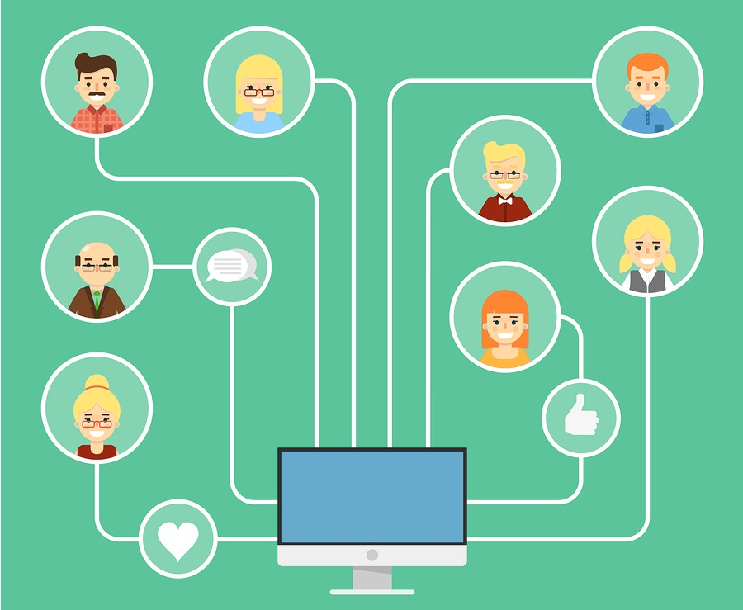
Role of social media
Alvin Lee
Two Major Components: community and profiling
COMMUNITY
User's interacted groups
  Often local
Examples: Facebook friends, Instagram follows, subreddits
Often included in profiling
Image credit [3]
Notes:
Today, social media heavily criticized for its purported role in echo chambers and polarization.
There are two major components of social media's role in creating echo chambers – community and profiling. My presentation will be focusing on profiling since targeted content is based on user profile, but it's important to cover community first. Community is simple; the groups which the user interacts with, like facebook friends or followers, causes the user's feed to be full of content from that community. Since the user is likely to only be friends or connected with people with similar interests or views, they're essentially in a bubble of similar opinions. The user's community is very often included in profiling.

Slide 11
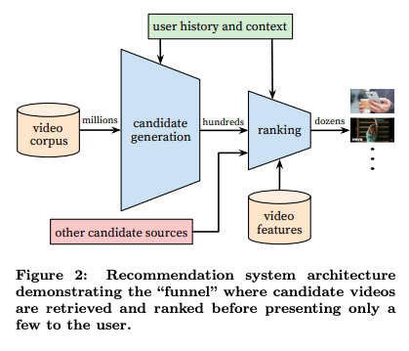
Profiling (Data Collection & Use)
Alvin Lee
Social media platforms collect data to push content
Common examples of collected data
Biological information
Content user interacted with
Website visited
User's contacts or connections
All of these can be found in privacy policies, or terms of service.
Image credit [4]
Notes:
Profiling of users has everything to do with their information. Social media platforms generally operate by collecting information on their users, and use it to increase user retention rates by pushing the content deemed "best" for the user, so that the user sticks around for the most advertisements. Examples of data commonly collected by these platforms include but are not limited to biological information, content the user interacted with, websites visited, and user contacts or connections. If you're curious about a particular platform, you can find any of that information on either their privacy policies, or their terms of service.
Companies do not have to tell their users specifically how this information is used, as it's proprietary information that's integral to the success of the company. YouTube in 2016 released a research paper detailing the basics of their recommendation system, seen on the right. It's important to note that "user history and context" is only a little green box at the top, yet is extremely important in the selection of recommended content.
Based on who YouTube determines you to be similar to, video candidates are funneled to you; in other words, what you view on platforms like YouTube is specially targeted media that was determined to be "relevant" to you. In fact, the exact same search query that two distinctly different people input can lead to entirely different search results. This concept of content funneling is ubiquitous across social media companies, and it has severe potential ramifications.

Slide 12
ramifications
Ramifications include:
Push of inflammatory content [5] (Facebook controversy)
Distorted world views [6] (Twitter controvery)
Concerns of corporate interest pursuit
Notes:
Such purported ramifications include increased push of inflammatory content, as seen on an HBO interview with Mr. Zuckerberg. Distorted world views; an example of this is the shock people had when blindsided by Donald Trump's win over Hilary Clinton. Finally, there are some concerned that these platforms may use content targetting for their own interests. However, this is protected against by law.

Slide 13
Ramifications II: What Does Research Say?
Social media DOESN'T exacerbate echo chambers:
1.) Pew Research Center found that in 2016's election, social media led to diversity in opinions [7]
3.) Researchers for Oxford's Journal of Communication concluded there's "no support for the idea that online audiences are more fragmented than offline audiences." [8]
Social media DOES exacerbate echo chambers:
2.) Duke University researchers found that after social media exposure, subjects were more confident of pre-existing beliefs. [9]
4.) In a study of over 1 million users, "consumption patterns elicit the emergence of two distinct communities" with respect to Brexit debates. [10]
Notes:
Since we the consumers do not know exactly the degree at which content is targeted to us, we can only rely on observations and research to determine how this targeted content affects us.
Research AGAINST the social media echo chamber problem includes evidence that social media creates diversity in opinion. HOWEVER, Duke University found that after social media exposure, subjects were more confident of pre-existing beliefs. The most critical argument against the echo chamber problem is the argument that offline echo chambers are far more significant that online counterparts.

Slide 14
Conclusive evidence
CONCLUSION: Targeted content is a significant factor in echo chambers
PLOS One, a peer reviewed journal, had evidence disproving that online echo chambers were insignificant compared to offline ones.
  "the collapsing of distances brought by internet technologies may foreground the role of geography within one’s social network." [11]
  This study resolves the most critical counterargument against existence of social media echo chambers
Notes:
One final piece of evidence pushed me to conclude that targeted content heavily exacerbates echo chambers. PLOS One's study of Twitter communications found evidence rejecting the idea that offline echo chambers dilute the significance of online ones, thereby resolving the most critical counterargument against the existence of social media echo chambers.

Slide 15
Plos One's study
Barebone Methodology Basics:
Found user locations
Determined partisanship (on Brexit) and categorized users into neutral, Leave, and Remain
Classified interactions as either in-bubble (Leave-Leave or Remain-Remain), out-bubble (neutral-other), and cross-bubble (Leave-Remain)
Notes:
Plos One's study started with determining users' locations based on their privacy settings, and matched it with their political views. They then determined what side of the Brexit issue the users stand on. Users were categorized into neutral, leave, or remain groups. Finally, interactions were classified as either in-bubble (so leave-leave or remain-remain interaction), out-bubble (or neutral-other interaction), and cross-bubble (or Leave-Remain interactions).

Slide 16
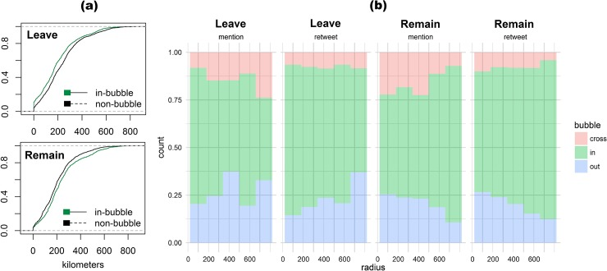
Notes:
As you seen in the histograms on the right, in-bubble and cross-bubble interactions did not have much correlation with distance between users. In other words, no matter the geographical distance, users are still overwhelmingly seen to communicate within their own bubbles, and are averse to interacting with content outside their bubble. Furthermore, the Cumulative Distribution Functions on the left show that partisan group members "are significantly more likely to interact with users also tweeting highly partisan hashtags." [11]

Slide 17
References (page 1)
<Your Name>
[1] Cambridge International Dictionary of English. “Meaning of echo chamber in English” (Cambridge University Press) https://dictionary.cambridge.org/us/dictionary/english/echo-chamber (Accessed September 14, 2020)
[2] C. Nguyen. “The problem of living inside echo chambers” (The Conversation, September 11, 2019) https://theconversation.com/the-problem-of-living-inside-echo-chambers-110486 (Accessed September 15, 2020)
[3] Tess Parajon, "How to Build an Engaged Social Media Community" (Online Marketing Institute, 2017). https://www.onlinemarketinginstitute.org/blog/2017/08/how-to-build-an-engaged-social-media-community/ (Accessed September 15, 2020)
[4] Paul Covington, "Deep Neural Networks for YouTube Recommendations" (Paul Covington, 2016)
[5] Ina Fried, "What Mark Zuckerberg wishes he'd done differently" (Axios, September 9, 2020), https://www.axios.com/zuckerberg-facebook-regulation-free-speech-0a847b53-2c27-41c1-8615-cb14e199858a.html (Accessed September 15, 2020)
[6] Mostafa El-Bermawy, "Your Filter Bubble is Destroying Democracy" (Wired, November 18, 2016) https://www.wired.com/2016/11/filter-bubble-destroying-democracy/ (Accessed September 15, 2020)

Slide 18
References (page 2)
<Your Name>
[7] Maeve Duggan, Aaron Smith "The Political Environment on Social Media" (Pew Research Center, October 25, 2016) https://www.pewresearch.org/internet/2016/10/25/the-political-environment-on-social-media/ (Accessed September 16, 2020)
[8] Richard Fletcher, Rasmus Kleis Nielsen, "Are News Audiences Increasingly Fragmented? A Cross-National Comparative Analysis of Cross-Platform News Audience Fragmentation and Duplication" (Oxford Journal of Communication, July 25, 2017), https://doi.org/10.1111/jcom.12315 (Accessed September 16, 2020)
[9] Christopher Bail, Lisa Argyle, Taylor Brown, John Bumpus, Haohan Chen, M.B. Hunzaker, Jaemin Lee, Marcus Mann, Friedolin Merhout, Alexander Volfovsky, "Exposure to Opposing Views can Increase Political Polarization: Evidence from a Large-Scale Field Experiment on Social Media" (Duke University, March 21, 2018) 10.31235/osf.io/4ygux (Accessed September 16, 2020)
[10] Michela del Vicario, Fabiana Zollo, Guido Caldarelli, Antonio Scala, Walter Quattrociocchi. "Mapping social dynamics on Facebook: The Brexit debate" (Social Networks, July 2017) https://doi.org/10.1016/j.socnet.2017.02.002 (Accessed September 16, 2020)
[11] Marco Bastos, "The geographic embedding of online echo chambers: Evidence from the Brexit campaign", (PLoS One, 2018) 10.1371/journal.pone.0206841 (Accessed September 16, 2020)

Slide 19
How I Learned To Stop Worrying And Love The Ads
Jacob McManus

Slide 20

Junk Mail vs. the Environment
Jacob McManus
Junk mail creates 51.5 million MT of greenhouse gases yearly
2 acres of trees per minute are felled to produce junk mail
Yearly, 62 trillion spam emails are sent, utilizing 33 billion KWh
<Graphic as big as will fit>
[1] https://marketbusinessnews.com/financial-glossary/junk-mail/
Notes:
Start off talking about unsolicited, untargeted advertisement
Gases produced in processing, production, and transportation
45% of junk mail is thrown away unopened
About 1 acre of tree per minute processed, printed on, shipped, and then shipped directly to a landfill unread
Differentiate between junk mail and spam
Reiterate that, although electronic, spam still has a cost
Cost for email providers
Sifting through spam mail wastes time, and worker productivity (double edged sword)

Slide 21
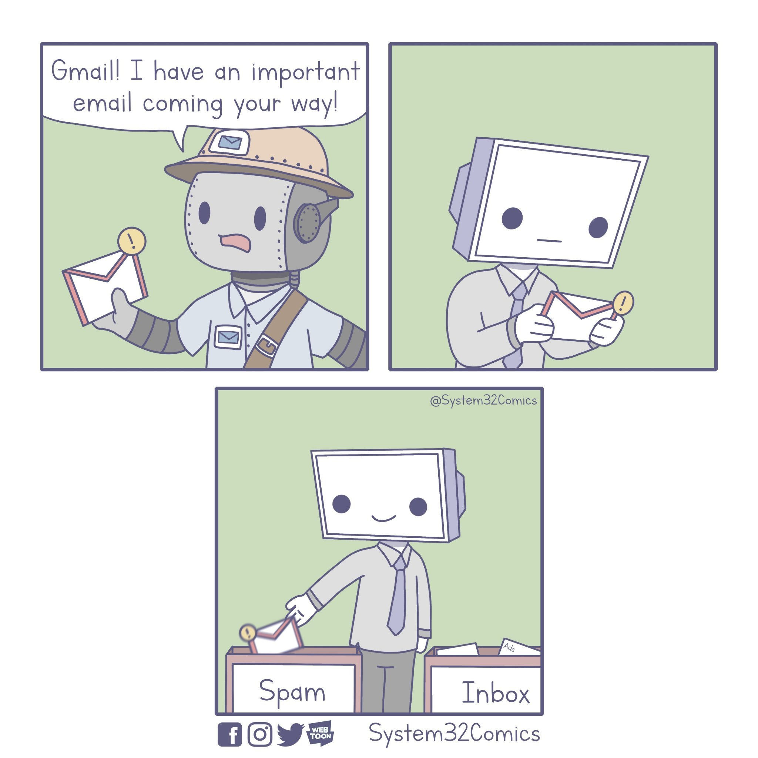
Untargeted Advertising is Ineffective
Jacob McManus
Merely 2.9% of junk mail recipients respond
1 reply for every 12.5 million spam emails sent
<Graphic as big as will fit>
Notes:
It’s doubly unfortunate then, that it is also so ineffective
Under 3% of junk mail garners a response
Even worse for spam, 0.000008% (8 millionths of a percent), significantly less effort to reply to an email
Unlike physical junk mail, many email services provide spam filters, which have their own costs and drawbacks
Cost for email provider
Cost for you (time to set up)
False Positives
False Negatives

Slide 22

targeted Advertising is More Effective
Jacob McManus
Target attributes $20 billion rise in revenue to targeted ads
70% of consumers polled preferred targeted ads
Location-based ads have a click-through rate of 1.21% compared to 0.61% for non-location based
[6] https://www.ereach.net/benefits-of-targeting-advertisements/
Notes:
In our modern era, targeted advertising is becoming more and more common, and with good reason
More effective for both the company and the customer
More effective for the company financially
Each advertisement they run is more likely to sell
Less work has to be done to find the lowest common denominator
Better liked by the consumer
Connects the consumer with something they would be likely to enjoy
Study done with restaurant location based ads

Slide 23
References
Jacob McManus
[1] What is junk mail?, (Market Business News, 2020), https://marketbusinessnews.com/financial-glossary/junk-mail/ (2020)
[2] Mike Berners-Lee, What's the carbon footprint of ... email?, (The Guardian, 2010), https://www.theguardian.com/environment/green-living-blog/2010/oct/21/carbon-footprint-email (2020)
[3] How to Stop Junk Mail in 6 Easy Steps, (Ecocycle, 2016, https://www.ecocycle.org/junkmail (2020)
[4] Adam Hartley, Spam gets 1 response per 12,500,000 emails, (Techradar, 2008), https://www.techradar.com/news/internet/computing/spam-gets-1-response-per-12-500-000-emails-483381 (2020)
[5] Will Penman, In Your Face, (Carnegie Mellon 2013), http://www.willpenman.com/teaching/in-your-face.html (2020)
[6] Michael George Keating, Benefits of Targeted Advertisements: A Spotify Fail, (eReach, 2013), https://www.ereach.net/benefits-of-targeting-advertisements/ (2020)
[7] Lauren Johnson, Location doubles the effectiveness of mobile campaigns for quick-service restaurants: study, (Mobile Marketer, 2017), https://www.mobilemarketer.com/ex/mobilemarketer/cms/news/research/15452.html (2020)

Slide 24
Is technology a replacement for policy for medical data?
Julia Tatone

Slide 25
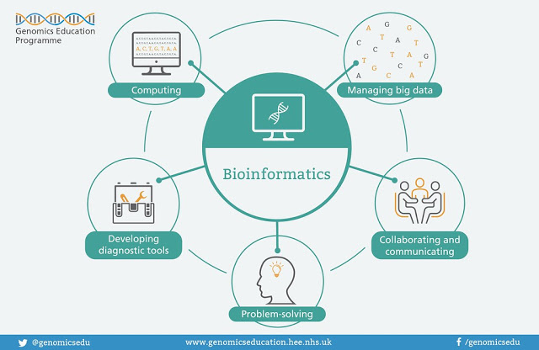
What is bioinformatics?
Julia Tatone
“Research, development, or application of computational tools and approaches for expanding the use of biological, medical, behavioral or health data, including those to acquire, store, organize, archive, analyze, or visualize such data.” [2]
Image Source: https://www.genomicseducation.hee.nhs.uk/image-library/
Notes:
There is a need to address these privacy, security, and ethical issues that arise throughout the medical field because of the rapid increase in data and technology over the past several decades
This issue increased as all the medical data switched to electronic records
Vast amount of data being produced by the human genome project
Bioinformatics is the backbone of computation for the medical field, so ethical questions need to be addressed.
Clinical data contains sensitive information about a patient and their history
Patients want the ability to control who sees their data

Slide 26
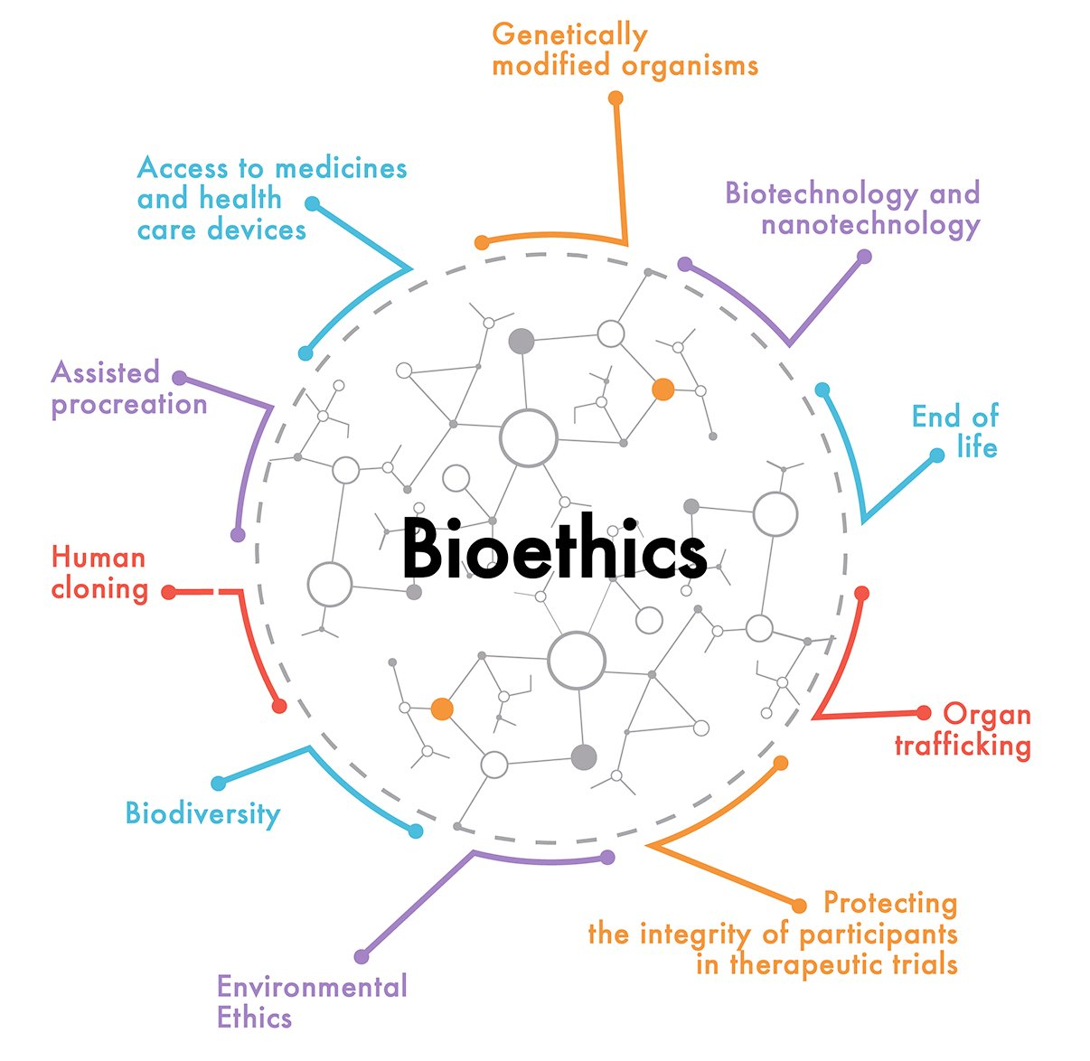
What are the issues?
Julia Tatone
Who has the right to access and use our personal genetic data?
Who controls the data?
Will the data lead to discrimination?
Image Source: https://www.collegehippo.com/blog/fellowships-and-scholarships-for-bioethics-and-medical-ethics-graduate-program/
Notes:
Can anybody own pieces of our genome through patents, copyrights, and so on?
Bioethics
Genetic engineering and manipulation of human cells
Intellectual property
Ownership of the human genome!
Access
Who should have access to the data and for what use?
Privacy
How will privacy be protected and who controls the information?

Slide 27
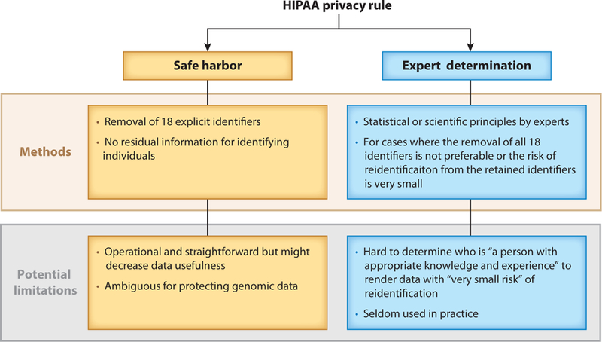
policy
Julia Tatone
Health Insurance Portability and Accountability Act of 1996 (HIPPA) [1]
How much faith can we put into humans regarding accountability and error?
Image source: [1]
Notes:
Expert determination
Requires an expert to certify that there is no significant risk of the patient being identified from the data
Statistical methods
No clear definition of “significant risk”
Safe harbor
Specifies a particular set of identifiers to be removed from the data
Procedurally simple, can be automated
Designed to protect the confidentiality and security of patient data
What about patients with rare or easily identifiable diseases?

Slide 28
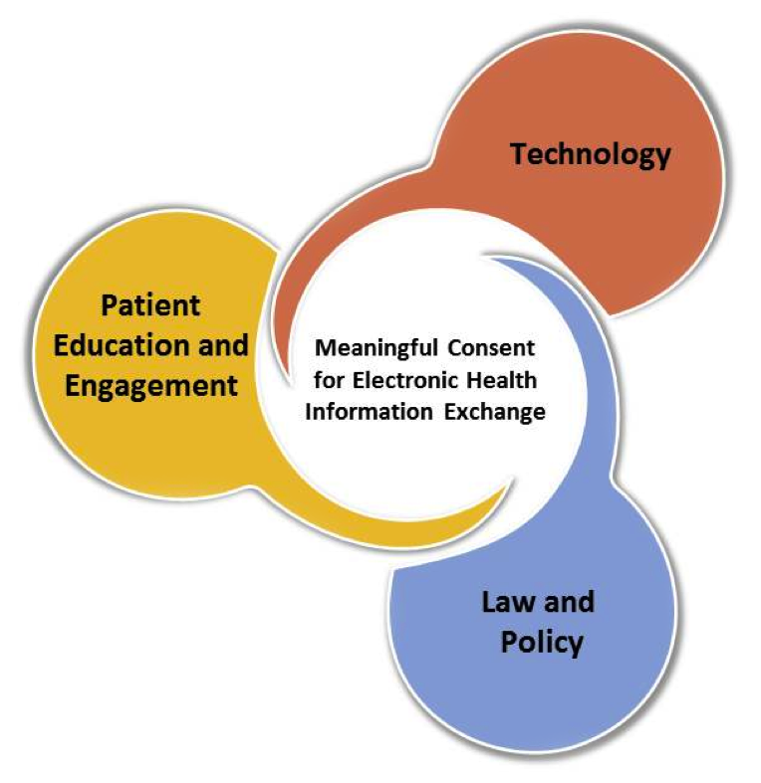
technology
Julia Tatone
Deidentification methods [1]
  Removing sensitive information from health care data to comply with policy
  Machine learning methods
Data anonymization [1]
  Goal is to make sure that no one is uniquely identifiable
Encryption [1]
  Ensure data confidentiality in storage, exchange, and manipulation.
Image Source: https://www.healthit.gov/topic/patient-consent-electronic-health-information-exchange
Notes:
Data anonymization does not take into account information external to the database that can be linked to the data being disclosed… like data from outside sources (government or private corp)
machine learning-based approaches to deidentification of clinic narratives are pushing the limits of accuracy and can be more efficient than rule-based methods devised by humans

Slide 29

Technology solutions are not a replacement for policy
Julia Tatone
The best way to ensure privacy is to constantly reevaluate the policies and technology in place
Privacy concerns will only continue to grow
We should be combining policy and technology to maximize privacy and security
Image Source: https://www.colleaga.org/article/privacy-issues-technology-healthcare-organizations
Notes:
There must be policies in place so that people don’t abuse their power of information. Just because the information is available, it doesn’t always mean it should be used.
There was a study done and most patients were not willing to pay for increased data privacy and they understood the importance of data sharing to improve health care
The government, the hospitals, and private companies all have access to your health care information. There is a need for medical data for research and for the advancement of the health care industry, but it must be used ethically and wisely.

Slide 30
References
Julia Tatone
[1] Arellano, A. M., Dai, W., Wang, S., Jiang, X., & Ohno-Machado, L. (2018). Privacy Policy and Technology in Biomedical Data Science. Annual review of biomedical data science, 1, 115–129. https://doi.org/10.1146/annurev-biodatasci-080917-013416
[2] Kesh, S., & Raghupathi, W. (2004). Critical issues in bioinformatics and computing. Perspectives in health information management, 1, 9.

Slide 31
Class 6
The End
Keith A. Pray
Instructor
socialimps.keithpray.net
Notes:
This is the end. Any slides beyond this point are for answering questions that may arise but not needed in the main talk. Some slides may also be unfinished and are not needed but kept just in case.
If there’s time and we didn’t already look at:
Find out what your DNA says about you and your family.
https://www.23andme.com/
Jimmy Kimmel Live – What is your password? (2:49)
https://www.youtube.com/watch?v=opRMrEfAIiI

