Slide 1
Class 5
Intellectual Property
Keith A. Pray
Instructor
socialimps.keithpray.net
Notes:
Here’s the title slide. Excited already, aren’t you?
Weird Al Yankovic “Don’t Download This Song” (3:53)
https://www.youtube.com/watch?v=zGM8PT1eAvY

Slide 2
what works well Online With Zoom
Sign in with First and Last Name
Stay muted unless you are going to speak
To speak use the raise your hand feature
To answer yes/no questions use the “yes” ”no” buttons
Chat is fine for questions
Turn your camera on
Wait until the end of student presentations to ask questions
  Write them down so you don’t forget
Others?

Slide 3
Papers
http://socialimps.keithpray.net/assignments/paper-guidelines/
Quantify
  Not terms like: less, more, a lot, huge, great, big, tiny, etc.
Avoid absolutes
  Terms like: all, none, always, never
  Difficult to prove, easy to show false
Define terms
Read paper aloud to proof
Read directions, many time lines missing
Notes:
Save for next time:
Be sure to put quotes around entire quote
State a strong, clear conclusion
First statement preferred
Provide Counter Point and Response
Print 2 sided and save a tree
Hyperbole is the best thing ever!
but not in these papers
No strawman fallacy in counter point
Text book is not a primary source
Use template, saves time (and -1 point)
Cite as suggested [1]

Slide 4
Overview
Review
Assignment
Students Present

Slide 5
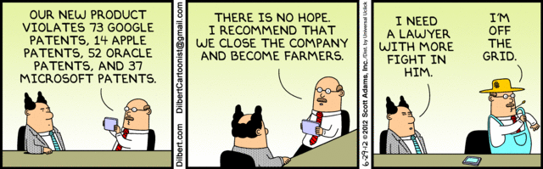
Notes:
Comments, observations, questions on IP Chapter?

Slide 6
My Reading Notes
pp. 165 “...ownership of ideas...” not quite right
pp. 168 public domain year 1997/1999 from source published in 1996?
pp. 170 SaaS, Google Search example? “…before he gave them the plot.”? “…cannot erase the memories...” Paycheck (2003)
pp. 180 4.4 #2 preferred?
pp. 186/196 revenue != profit
pp. 190 blocking 100% seems impossible
pp. 194 Any legitimate BitTorrent use examples since 2005?
pp. 197 “licensing agreement … hardware”? Confidential source code very outdated.
pp. 198 4.7.3 references?
pp. 205 Perhaps friends should not ask you to break the law?
Any successful businesses operate as a support service?
pp. 207 Is Perl still most popular? Quality study from 2003, change?
pp. 209 who uses tape?
pp. 210 “human-readable, lawyer-readable…”
pp. 223 Interview has nothing to do with computing

Slide 7
Group Quiz
For each On the left answer a–d on Right
Trademark
Copyright
Patent
Trade Secret
What does it protect?
What qualifications have to be met?
How long does protection last?
Give a specific example currently protected?
Notes:
Trademark
Used to denote a product or service.
Apply in specific areas of commerce. Only applies in specified area of business
Indefinite term as long as in use and protected against becoming a common noun or verb.
You do not have to register a trademark unless you want to bring litigation before a federal court (there are other benefits too, but what are they?)
Copyright
Expression, not ideas: Fuzzy. E.g. derivative works, characters, merchandising, plots.
Mickey Mouse, Tarzan.
US Default : Original Author, Exception: work for hire, Transferred: yes
Rights: Publication, Performance / exhibition, Adaptation to other media, Excerpting, Attribution, Derivative works
US Term: Lifetime of author plus 70 years., 95 years for companies.
Governed by US law and international treaties (e.g. WIPO).
Fair Use: News reporting, reviews, etc., Scholarly / educational use, Private, non-commercial use, Lending libraries and archives
Fair Use restrictions: Admission charge, Re-transmission
In general, you can: Read, view, play, etc., Copy for personal use., Time-shift, Space-shift
In general, you cannot: Copy for others., Transfer to someone else but keep a copy., Show / perform it publicly.
What about video rentals?
Rationale: Encourage creativity. Encourage dissemination. Balance between private and public good. It’s a social contract.
Patent
A mechanism, process, or composition of matter.
Must be: Novel. Useful. Non-obvious. Described clearly. Must do what it says.
Usual term 20 years.
Utility and plant patents: 20 years.
Design patents last 14 years. (ornamental design of functional item)
Provisional patent gives 1 year, before full patent
Trade Secret
You must take steps.
Enforceable by: Contracts, Laws against industrial espionage.

Slide 8
Group Quiz
For each On the left answer a–d on Right
Trademark
Copyright
Patent
Trade Secret
What does it protect?
Qualifications required?
How long does protection last?
Specific example currently protected?
Notes:
Trademark
Used to denote a product or service.
Apply in specific areas of commerce. Only applies in specified area of business
Indefinite term as long as in use and protected against becoming a common noun or verb.
You do not have to register a trademark unless you want to bring litigation before a federal court (there are other benefits too, but what are they?)

Slide 9
Group Quiz
For each On the left answer a–d on Right
Trademark
Copyright
Patent
Trade Secret
What does it protect?
  Mark denoting product of service
Qualifications required?
  Unique in specific area of commerce
How long does protection last?
  While in use and protected against common noun or verb usage. Need to register to sue.
Specific example currently protected?
Notes:
Trademark
Used to denote a product or service.
Apply in specific areas of commerce. Only applies in specified area of business
Indefinite term as long as in use and protected against becoming a common noun or verb.
You do not have to register a trademark unless you want to bring litigation before a federal court (there are other benefits too, but what are they?)

Slide 10
Group Quiz
For each On the left answer a–d on Right
Trademark
Copyright
Patent
Trade Secret
What does it protect?
Qualifications required?
How long does protection last?
Specific example currently protected?
Notes:
Copyright
Expression, not ideas: Fuzzy. E.g. derivative works, characters, merchandising, plots.
Mickey Mouse, Tarzan.
US Default : Original Author, Exception: work for hire, Transferred: yes
Rights: Publication, Performance / exhibition, Adaptation to other media, Excerpting, Attribution, Derivative works
US Term: Lifetime of author plus 70 years., 95 years for companies.
Governed by US law and international treaties (e.g. WIPO).
Fair Use: News reporting, reviews, etc., Scholarly / educational use, Private, non-commercial use, Lending libraries and archives
Fair Use restrictions: Admission charge, Re-transmission
In general, you can: Read, view, play, etc., Copy for personal use., Time-shift, Space-shift
In general, you cannot: Copy for others., Transfer to someone else but keep a copy., Show / perform it publicly.
What about video rentals?
Rationale: Encourage creativity. Encourage dissemination. Balance between private and public good. It’s a social contract.

Slide 11
Group Quiz
For each On the left answer a–d on Right
Trademark
Copyright
Patent
Trade Secret
What does it protect?
  Expression, not ideas. Derivative work, publication, performance
Qualifications required?
  Original
How long does protection last?
  Author lifetime + 70 years, 95 years for companies
Specific example currently protected?
Notes:
Copyright
Expression, not ideas: Fuzzy. E.g. derivative works, characters, merchandising, plots.
Mickey Mouse, Tarzan.
US Default : Original Author, Exception: work for hire, Transferred: yes
Rights: Publication, Performance / exhibition, Adaptation to other media, Excerpting, Attribution, Derivative works
US Term: Lifetime of author plus 70 years., 95 years for companies.
Governed by US law and international treaties (e.g. WIPO).
Fair Use: News reporting, reviews, etc., Scholarly / educational use, Private, non-commercial use, Lending libraries and archives
Fair Use restrictions: Admission charge, Re-transmission
In general, you can: Read, view, play, etc., Copy for personal use., Time-shift, Space-shift
In general, you cannot: Copy for others., Transfer to someone else but keep a copy., Show / perform it publicly.
What about video rentals?
Rationale: Encourage creativity. Encourage dissemination. Balance between private and public good. It’s a social contract.

Slide 12
Group Quiz
For each On the left answer a–d on Right
Trademark
Copyright
Patent
Trade Secret
What does it protect?
Qualifications required?
How long does protection last?
Specific example currently protected?
Notes:
Patent
A mechanism, process, or composition of matter.
Must be: Novel. Useful. Non-obvious. Described clearly. Must do what it says.
Usual term 20 years.
Utility and plant patents: 20 years.
Design patents last 14 years. (ornamental design of functional item)
Provisional patent gives 1 year, before full patent

Slide 13
Group Quiz
For each On the left answer a–d on Right
Trademark
Copyright
Patent
Trade Secret
What does it protect?
  Mechanism, process, composition of matter
Qualifications required?
  Novel, useful, non-obvious, described clearly, must function
How long does protection last?
  Utility and plant: 20 years
  Design: 14 years
  Provisional adds 1 year
Specific example currently protected?
Notes:
Patent
A mechanism, process, or composition of matter.
Must be: Novel. Useful. Non-obvious. Described clearly. Must do what it says.
Usual term 20 years.
Utility and plant patents: 20 years.
Design patents last 14 years. (ornamental design of functional item)
Provisional patent gives 1 year, before full patent

Slide 14
Group Quiz
For each On the left answer a–d on Right
Trademark
Copyright
Patent
Trade Secret
What does it protect?
Qualifications required?
How long does protection last?
Specific example currently protected?
Notes:
Trade Secret
Anything with business value
You must take steps to keep it secret: Non Disclosure Agreement, protected storage, compartmentalization, etc.
As long as the secret is kept
Enforceable by: Contracts, Laws against industrial espionage.

Slide 15
Group Quiz
For each On the left answer a–d on Right
Trademark
Copyright
Patent
Trade Secret
What does it protect?
  Anything
Qualifications required?
  Must take steps to keep secret, e.g. Non-Disclosure Agreements, contracts
How long does protection last?
  As long as kept secret
Specific example currently protected?
Notes:
Trade Secret
Anything with business value
You must take steps to keep it secret: Non Disclosure Agreement, protected storage, compartmentalization, etc.
As long as the secret is kept
Enforceable by: Contracts, Laws against industrial espionage.

Slide 16
Overview
Review
Assignment
Students Present
Notes:
But first take a look at:
CGP Grey
Copyright: Forever Less One Day (6:27)
https://www.youtube.com/watch?v=tk862BbjWx4
Tom Scott
http://tomscott.com
Welcome To Life (2:44)
https://www.youtube.com/watch?v=IFe9wiDfb0E&feature=youtu.be

Slide 17
Assignment - Self Search 1/3
Profile 2
Is You
1 Page
Paper
Filter
Inspiration
Search Methods
…
…
…
…
Filter
Profile 1
Could Be You

Slide 18
Assignment - Self Search 2/3
Discussion Board
Post search techniques
  Do not repeat entries.
Use techniques listed to produce a profile that could be you.
  Not responsible for techniques posted less than 24 hours before due
Filter first profile so that the information is for you.
Provide as paper appendix
  Summary is fine. No details needed unless you for making a point.
Consider:
  Exactly how did the data get there?
  How can this data be used?
  Is this a secondary use?
  Did you authorized use of the data? If not and you want to, request its use be discontinued and share the experience.
Be creative, anyone can type a name into Google
Do not pay for search services

Slide 19
Assignment - Self Search 3/3
1 Page Paper
Refer to search results to support your conclusion
Subscribe to the Discussion Board
Example questions conclusion could answer:
  What impression would the profile make on a potential employer?
  What would your elder family members (or equivalent) think?
  Are you comfortable with what you found or did not find?
  Do you believe protecting your privacy is important or needed?
5 High quality sources still required

Slide 20
Overview
Review
Assignment
Students Present

Slide 21
Copyright On The Internet Seas
Xianhan Jia

Slide 22
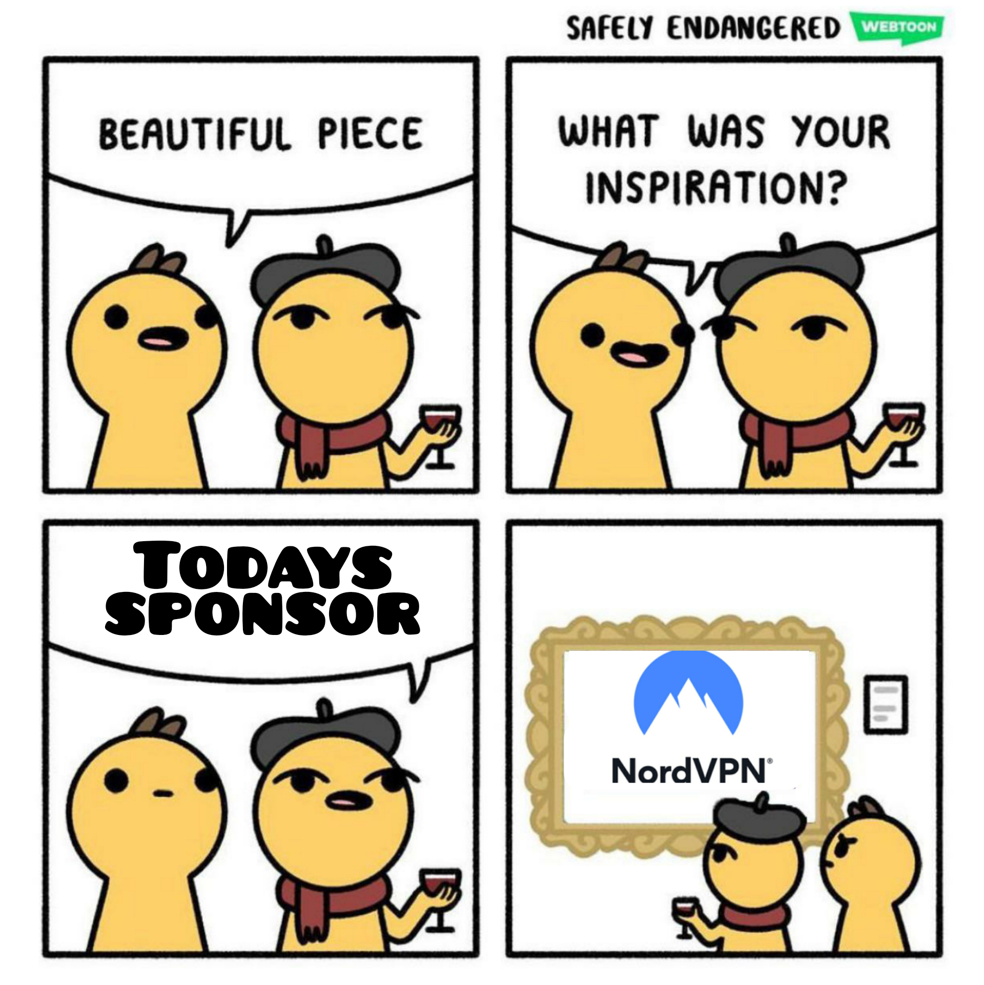
Hard to be reinforced
Xianhan Jia
Uncontrolled use of encryption[5]
  Virtual Private Network (VPN)
  Zip files with a password
  Internet segregation
[6] https://www.safelyendangered.com/
Notes:
purpose of the use
nature of the work being copied
amount of material being copied
effect the copying will have on the market for journal sales

Slide 23
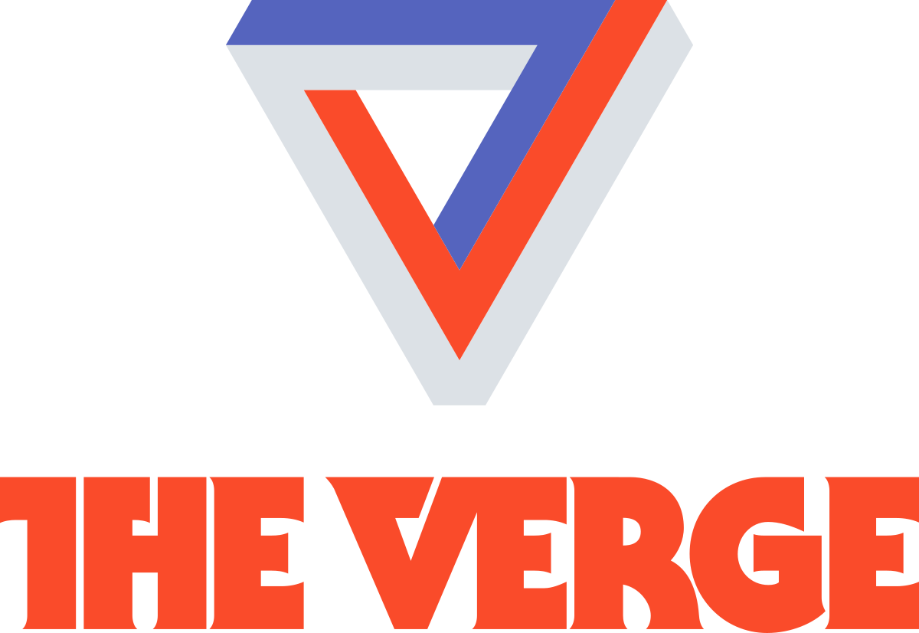
Copyright abuse
Xianhan Jia
YouTube Copyright system
  “The Verge” [3, 4]
  Virtual YouTubers [2]
https://www.theverge.com/
Notes:
purpose of the use
nature of the work being copied
amount of material being copied
effect the copying will have on the market for journal sales

Slide 24
References
Xianhan Jia
[1] Richardson, M. (2002). Downloading Music Off the Internet: Copyright and Privacy in Conflict? Richardson, Megan. Retrieved from https://wpi.primo.exlibrisgroup.com/discovery/fulldisplay?docid=cdi_gale_infotracacademiconefile_A137187940
[2] u/dnkscrub195 (2020, March 19). R/VirtualYoutubers - My VTuber translation channel got terminated (TC195). Retrieved from https://www.reddit.com/r/VirtualYoutubers/comments/fle0gu/my_vtuber_translation_channel_got_terminated_tc195/
[3] Etienne, S. (2018, September 13). How to build a custom PC for gaming, editing or coding. Retrieved from https://www.theverge.com/2018/9/13/17828092/gaming-pc-build-custom-how-to-asus-intel-geforce-cost
[4] Gamers Nexus (2019, February 14). The Verge Abusing Copyright Claim System to Hide PC Build Video (YouTube) Retrieved from https://www.youtube.com/watch?v=vbH17HMBusc
[5] Sitdikova, L., Shilovskaya, A., Volkova, M., Lenkovskaya, R., &amp; Stepanova, N. (2015, November). Legal Regulation and Copyright Protection in Internet in Russia and Abroad. Retrieved from https://www.mcser.org/journal/index.php/mjss/article/view/7927
[6] u/fred_proc20 (2019, November 07). R/memes - Either NordVPN or Dashlane. Retrieved September 14, 2020, from https://www.reddit.com/r/memes/comments/dsuf4x/either_nordvpn_or_dashlane/
Notes:
https://www.mcser.org/journal/index.php/mjss/article/view/7927

Slide 25
Fighting Misinformation
Tim Kwan

Slide 26
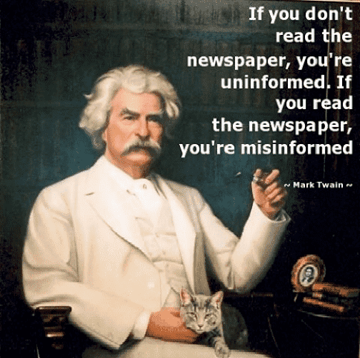
Misinformed vs uninformed vs Disinformed
Tim Kwan
Misinformed: Having incorrect information whether intentional or not
Uninformed: Not knowing information at all
Disinformed: Knowingly having incorrect information, intending to mislead
All of these go hand in hand
https://www.amnestyindia.org/being-uninformed-is-better-than-being-misinformed-we-are-being-misled-and-fooled-by/ (2020)
[1]
Notes:
Information can start form the disinformed or the uninformed and both lead to misinformation
For example, someone uninformed about the scientific method is likely to not believe in a study, so they explain something with an observation, which could be wrong. The uninformed person will misinform another

Slide 27
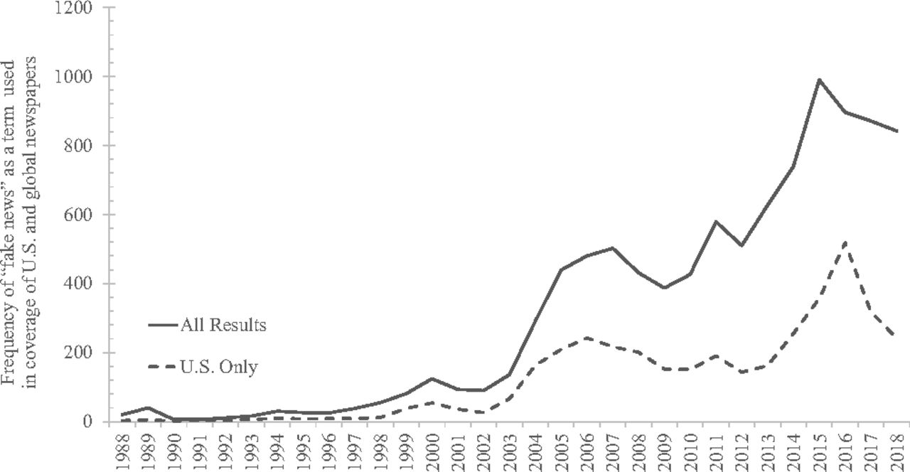
Causes of misinformation
Tim Kwan
Lack of media literacy
A majority of students do not consider biases when receiving a piece of information
62% of Americans use social media as a news source
23% of American adults disinform others
Emotion plays a part in the spreading of misinformation
The use of the term “Fake News” increased usage
[1]
Notes:
By lack of media literacy, I mean the in-ability to analyze and evaluate every piece of information we receive.
This can be due to the nature of social media, as our attention span is extremely short when we mindlessly scroll through the feed. We don’t have the attention span to evaluate every post.
It was an assessment of students on twitter, I did not find a specific number
According to the Pew Research Center 23 percent of American adults admitted to disinforming others through social media, for more attention
Like the thought germ video!
Over the last 20 years, the term fake news has increase in popularity to create media skepticism

Slide 28
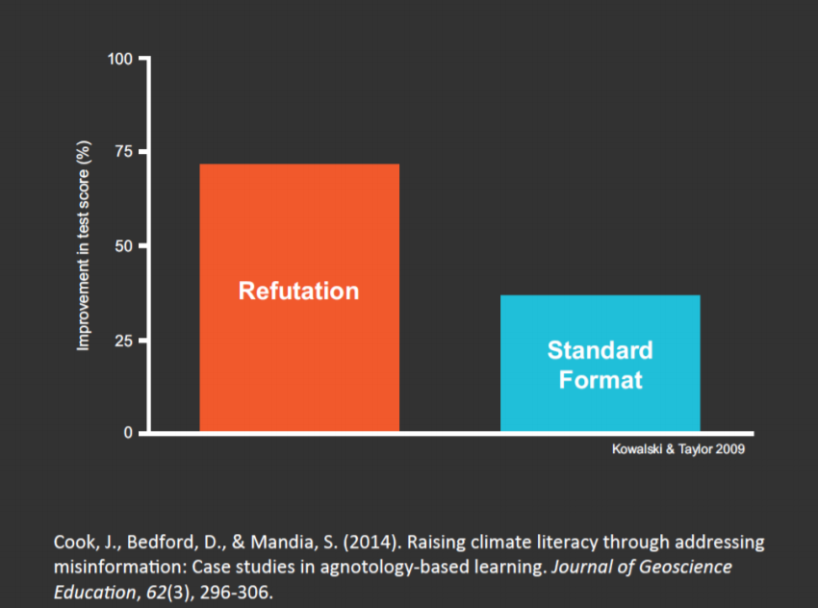
Some solutions
Tim Kwan
Agnotology-based learning
Be aware that information is not always correct
Facebook changed the feed so people will see “less public content”
[1-2]
Notes:
Its hard to measure the result of a misinformation case study, so the case study I found used climate change as a basis. The method the case study used is to present multiple pieces of information, intentionally leaving incorrect info in. By refuting the incorrect information, there was in increase in learning and it was good practice to protect against misinformation
What did we learn from this study? Just being aware that information can be incorrect is a good start. But giving every piece of information the time to evaluate is the best option, but its not realistic.
Seeing ”less public content” means that we narrow our scope of information, this could be bad if that information is incorrect.
There is only so much media can “gate keep,” we need to be able to recognize biases as individuals
Also as the internet continues to expand, it’ll get harder and harder to gate keep information

Slide 29
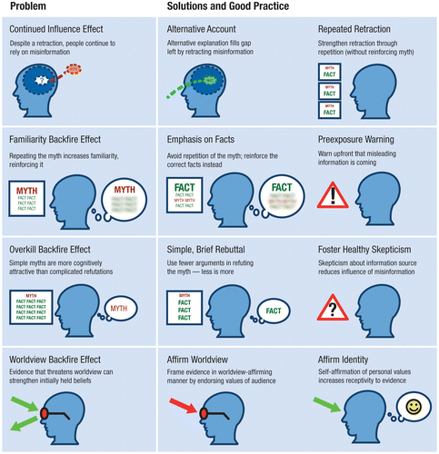
I’ve been misinformed! Now what?
Tim Kwan
[3]
Notes:
- Sometimes its hard to correct the information that is already in your head, especially if it’s a worldview. This chart helps to find a solution to the problem.

Slide 30
References
<Your Name>
[1] Scheufele, Dietram A., and Nicole M. Krause. “Science Audiences, Misinformation, and Fake News.” PNAS, National Academy of Sciences, 16 Apr. 2019, www.pnas.org/content/116/16/7662.
[2] Cook, John, et al. “Raising Climate Literacy Through Addressing Misinformation: Case Studies in Agnotology-Based Learning.” Taylor & Francis, 9 July 2018, www.tandfonline.com/doi/full/10.5408/13-071.1.
[3] Stephan Lewandowsky, Ullrich K. H. Ecker. “Misinformation and Its Correction: Continued Influence and Successful Debiasing - Stephan Lewandowsky, Ullrich K. H. Ecker, Colleen M. Seifert, Norbert Schwarz, John Cook, 2012.” SAGE Journals, Dec. 2016, journals.sagepub.com/doi/figure/10.1177/1529100612451018.

Slide 31
Class 5
The End
Keith A. Pray
Instructor
socialimps.keithpray.net
Notes:
This is the end. Any slides beyond this point are for answering questions that may arise but not needed in the main talk. Some slides may also be unfinished and are not needed but kept just in case.

