Slide 1
Class 4
Freedom Of Speech
Keith A. Pray
Instructor
socialimps.keithpray.net
Notes:
Here’s the title slide. Excited again, aren’t you? You should be.

Slide 2
what works well Online With Zoom
Sign in with First and Last Name
Stay muted unless you are going to speak
To speak use the raise your hand feature
To answer yes/no questions use the “yes” ”no” buttons
Chat is fine for questions
Turn your camera on
Wait until the end of student presentations to ask questions
  Write them down so you don’t forget
Others?

Slide 3
Overview
Review
Assignment
Students Present
Notes:
Show syllabus updates if any

Slide 4
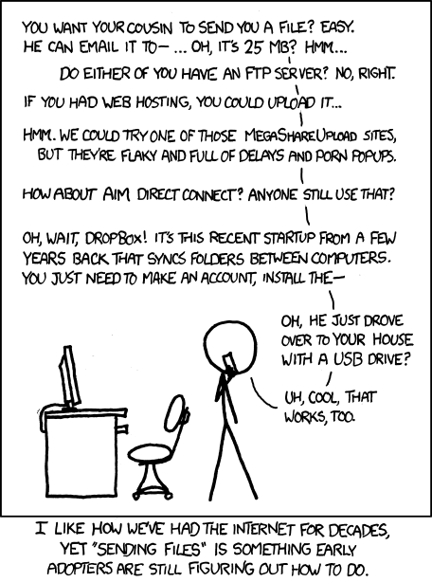
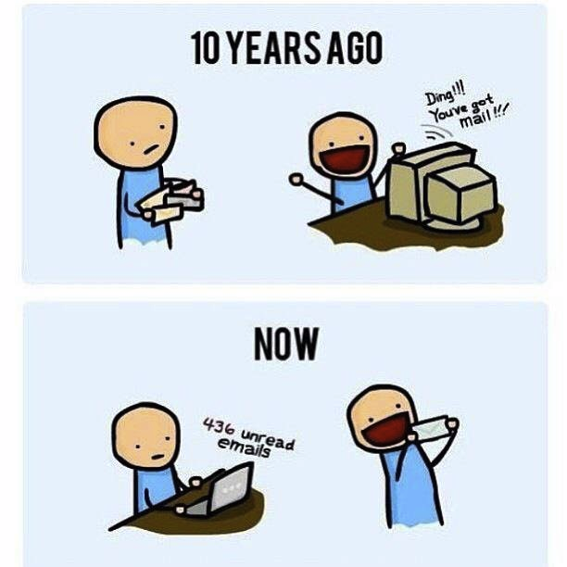
http://poofytoo.com/
25
http://xkcd.com/949/

Slide 5
My Reading Notes
pp. 110 What powers the cell phones and towers? “everyday tasks” not apparent from image.
pp. 114 Ann did not force people to complain.
pp. 117 7% # transactions or $$? Wikipedia critics source [19] from 2005, how has quality turned out? Nice to see darknet added.
pp. 118 [27] PC bangs youth source from 2003, all grown up now.
pp. 130 Is 20% realistic? What will search engines and facial recognition be capable of? Rule Utilitarian ignores the private setting.
pp. 131 Do any filters use image processing?
pp. 133 Stating people searching did not consent to material being blocked makes more sense.
pp. 134 Web access for no cost?
pp. 145 More accurate to say addicted to single app - good
pp. 149 20 same as 39
pp. 150 36 same as 42
End of Chapter questions I liked: 2, 25 http://en.wikipedia.org/wiki/Wikipedia:Citing_Wikipedia

Slide 6
Group Quiz
Name two methods some governments use to control access to information.
A large company has a policy prohibiting employees from blogging about company products.
  Name two possible reasons for the policy.
  Does it violate the First Amendment? Why?
  Is it reasonable? Why?
What does “URL” stand for and what is it?
Notes:
Censorship (religious, governmental, private). Adult authentication. Firewalls. Government owned media outlets.
First Amendment prohibits Congress from making laws limiting free speech, not private companies.
Uniform Resource Locator

Slide 7
Overview
Review
Assignment
Students Present
Notes:
But before that:
CPG Grey - This Video Will Make You Angry [Thought Germs] (7:25)
https://www.youtube.com/watch?v=rE3j_RHkqJc
If not shown yet:
What "Orwellian" really means - Noah Tavlin (5:31)
http://ed.ted.com/lessons/what-orwellian-really-means-noah-tavlin
Cedric Gervais - Hashtag (Original Mix) (3:58)
https://www.youtube.com/watch?v=6OmBKd7X7EE
Dave Audé vs Luciana - You Only Talk In #HASHTAG (3:36)
http://www.youtube.com/watch?v=53wIN87lJn0

Slide 8
Assignment
Reading
Individual Presentations
Extra Credit – One page paper
  Is WPI’s IT Acceptable Use Policy morally acceptable?
Work on your group project
  Average Group Happiness 1.21
  See full group project description on course website
  Send Web Site URL before next class
Notes:
- Groups will be announce by midnight tomorrow
- Or review group project and individual presentation guidelines right now.
- Respond with top 3 choices by noon tomorrow
Possible One page paper:
Global intellectual property laws, friends or foes?
Group Happiness 1 = everyone got first pick, 2 = everyone got second pick, etc.
Average Group Happiness 1.21

Slide 9
Overview
Review
Assignment
Students Present

Slide 10
How Video Games Raise Awareness To Social Issues
Rachael Sallie
Notes:
Hello, my name is Rachael Sallie, and I’m here to tell you about how video games can raise awareness to social issues.

Slide 11
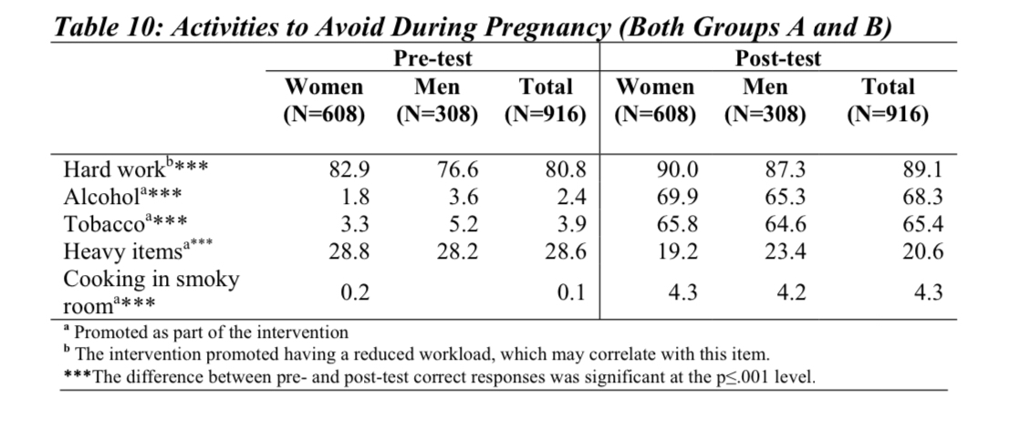
advise people affected
Rachael Sallie
Half the Sky Movement [1]
  Reducing maternal and child mortality rate
  Teach safe pregnancy and delivery habits
Dasgupta, P., K. Tureski, R. Lenzi, K. Bindu, G. Nanda. 2012. Half the Sky Movement Multimedia Communication Initiative: An Evaluation of the 9-Minutes Mobile Game and Video. Washington, DC: C-Change/FHI 360.
Notes:
Video games are able to act as a tool to advise those directly facing social issues. The Half the Sky Movement uses mobile games to educate men and women in India on the topic of safe pregnancy habits in an effort to reduce the mortality rates of both mothers and children. The games had measurably shifted the knowledge of players, increasing the percent of players aware of activities to avoid, seen in this chart, and increasing awareness of good habits to have during pregnancy. This study shows that video games can act as a good tool for educating those directly impacted by social issues.

Slide 12
Educate the Uninformed
Rachael Sallie
Floodsim: Flooding Policy and Citizen Engagement [2]
  Game to raise awareness on flooding policy in the UK
  25,000 players in 4 weeks
  Study found that game raised awareness at the basic level
  Players perceived game as accurate source of information
Notes:
Video games can also inform their players on issues they were entirely unaware of. Floodsim attempts to teach players about UK Flood policy by allowing them to take on the role of a flood policy strategist. The study found the game to be very successful at generating interest, gaining 25,000 players in 4 weeks. Surveys and interviews performed found that the game was able to increase awareness of flooding policy and the problems surrounding it at a basic level, and the players perceived the game to be an accurate source of information on strategies for flood prevention.

Slide 13
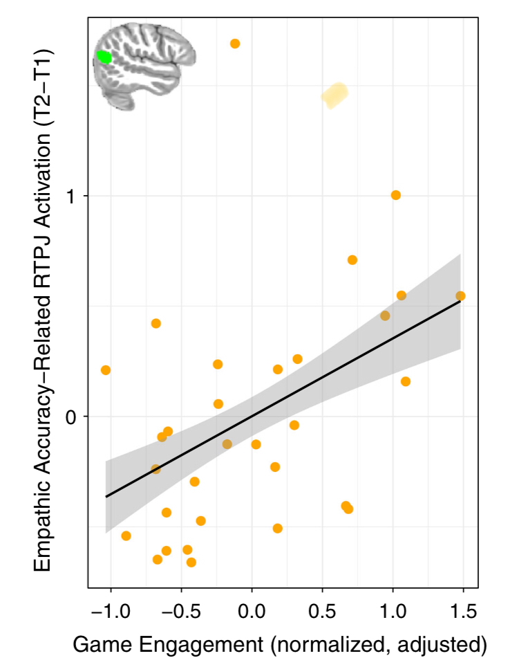
Develop Empathy in Players
Rachael Sallie
Crystals of Kaydor: Empathy Training Game[3]
  Increased empathy-related brain activation
Study on Effects of Prosocial Games[4]
  Increased empathy
  Decreased schadenfreude
Kral, Tammi & Stodola, Diane & Birn, Rasmus & Mumford, Jeanette & Solis, Enrique & Flook, Lisa & Patsenko, Elena & Anderson, Craig & Steinkuehler, Constance & Davidson, Richard. (2018). Neural correlates of video game empathy training in adolescents: a randomized trial. npj Science of Learning. 3. 10.1038/s41539-018-0029-6.
Notes:
In addition to teaching players about social issues, video games can also help them become more empathetic, which logically leads to players feeling more empathetic towards those facing social issues. A study on the neurological effects of empathy training video games found that subjects who engaged more with their game, Crystals of Kaydor, had a greater increase in brain activation connected to empathic accuracy, when comparing activity before and after playing the game. Another study found that playing a prosocial game, as opposed to a neutral game, felt more empathy towards those in need, and less schadenfreude, which is a feeling of pleasure from another’s misfortune.

Slide 14
Raising Money to make a change
Rachael Sallie
Game Sales: Itch.io Bundle for Racial Justice and Equality [5]
  $8.14 million raised
  Split between NAACP Legal Defense and Education Fund and Community Bail Fund
  1391 developers included games and 814,529 people donated.
In Game Events: Overwatch’s Mercy skin to Support Breast Cancer Research [6]
  $12.7 million raised
  Breast Cancer Research Foundation
Game Livestreams: Awesome Games Done Quick 2020 [7]
  $3.1 million to Prevent Cancer Foundation
  $25 million across all charity events
Notes:
Video games can also bring awareness to social issues through charity events, which directly support the cause in addition to raising awareness. Three major ways of doing this include game sales, where proceeds from purchasing the game itself go to a cause, in game events, where current players can purchase an item within the game to support a cause, and game livestreams, where players will encourage their viewers to donate. I’ve included examples of each. In response to the Black Lives Matter movement, the itch.io bundle for Racial Justice and Equality has raised over $8 million for the NAACP Legal Defense and Education Fund and the Community Bail Fund, with hundreds of thousands of people donating. For Blizzard’s game Overwatch, they created a purchasing in-game character skin that raised over $12 million for the breast cancer research foundation. Games Done Quick is an organization that hosts video game speed running events for charity. Their 2020 event raised over $3 million for the Prevent Cancer Foundation and $25 million for various charities overall since they started hosting events in 2010.

Slide 15
References
Rachael Sallie
[1] Dasgupta, P., K. Tureski, R. Lenzi, K. Bindu, G. Nanda. 2012. Half the Sky Movement Multimedia Communication Initiative: An Evaluation of the 9-Minutes Mobile Game and Video. Washington, DC: C-Change/FHI 360.
[2] Rebolledo-Mendez, Genaro & Avramides, Katerina & de Freitas, Sara & Star, Kam. (2009). Societal impact of a serious game on raising public awareness: The case of FloodSim. Proceedings of the 2009 ACM SIGGRAPH Symposium on Video Games, Sandbox '09. 15-22. 10.1145/1581073.1581076.
[3] Kral, Tammi & Stodola, Diane & Birn, Rasmus & Mumford, Jeanette & Solis, Enrique & Flook, Lisa & Patsenko, Elena & Anderson, Craig & Steinkuehler, Constance & Davidson, Richard. (2018). Neural correlates of video game empathy training in adolescents: a randomized trial. npj Science of Learning. 3. 10.1038/s41539-018-0029-6.
[4] Greitemeyer, T., Osswald, S., & Brauer, M. (2010). Playing prosocial video games increases empathy and decreases schadenfreude. Emotion, 10(6), 796–802. https://doi.org/10.1037/a0020194
[5] itch.io, Bundle for Racial Justice and Equality (itch.io, 2020), https://itch.io/b/520/bundle-for-racial-justice-and-equality , Accessed 9/9/2029
[6] Blizzard Entertainment, Thank You! Pink Mercy Raises More Than 12.7 Million (USD) For The Breast Cancer Research Foundation (Blizzard, 2018), https://playoverwatch.com/en-us/news/21931801/ Accessed 9/10/2020
[7] Eric Abent, AGDQ 2020 wraps up a record-setting speedrunning marathon (SlashGear, 2020), https://www.slashgear.com/agdq-2020-wraps-up-a-record-setting-speedrunning-marathon-13606665/ Accessed 9/10/2020
Notes:
Thank you for listening, I’ll now take any questions.

Slide 16
FACEBOOK CONTENT MODERATION
Oli Thode

Slide 17
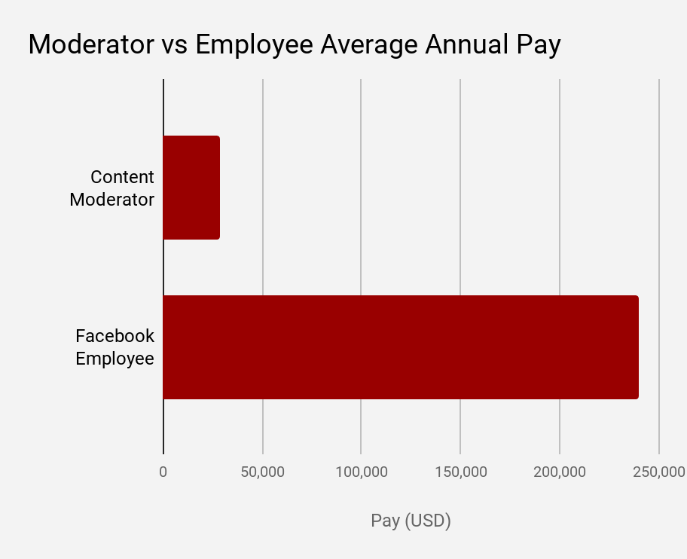
CONTRACT LABOR HELPS FACEBOOK
Oli Thode
Facebook began outsourcing in 2010 [1]
  In 2008, Facebook had 12 in-house workers, now they have 15,000 [1]
  Facebook saves billions of dollars by pushing content moderation to contractors
Moderation facilities were located around the world
  Allowed coverage across more time zones
  Improved cultural nuance
Based on data presented in [2]
Notes:
Employees at a facility in Phoenix were paid $15/hr [2], 1/10th of what the average FB employee makes [3]
For all of the reasons shown, this move seems to make sense for Facebook

Slide 18
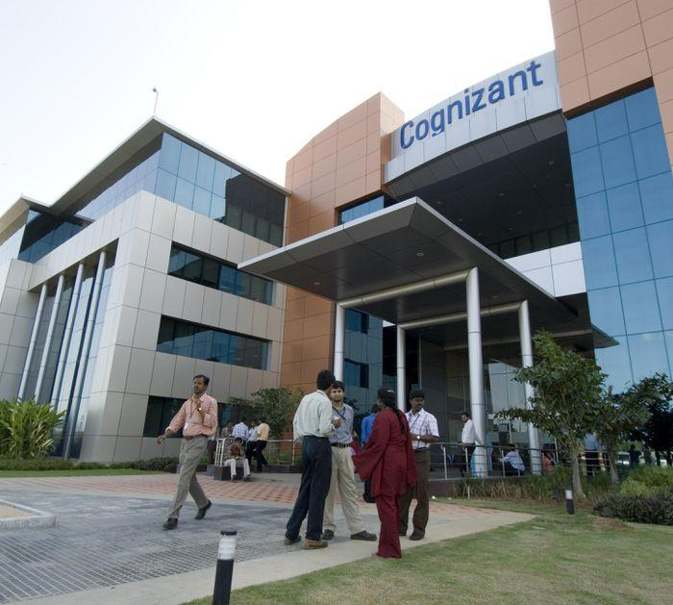
WORKPLACE CONDITIONS ARE TERRIBLE
Oli Thode
Workers felt immense pressure from their supervisors to increase accuracy
  Facebook pushed hard for 95-98% accuracy
Breaks were infrequent and short
  Moderators were required to log when they were on their breaks using a browser extension [1]
Moderators rarely lasted more than 2 years before they quit or were fired [2]
Picture from Madhu Kapparth/Getty Images
Notes:
Contractors often obscured the nature of the work in job descriptions (e.g. social media analyst, process executives)
Rules were unclear and updated daily
Moderators received two 15 minute breaks, a 30 minute lunch, and 9 minutes of wellness (time for mental breakdowns)
Pictured shows one of the Cognizant facilities in India

Slide 19
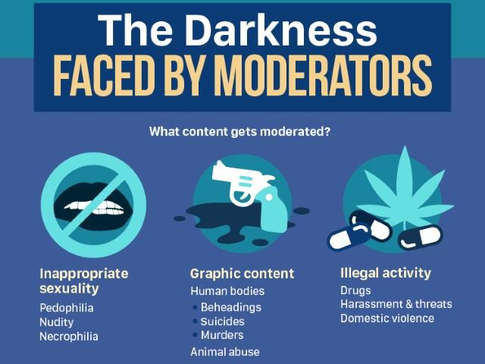
MODERATORS PLAY AN IMPORTANT ROLE
Oli Thode
Without these moderators Facebook would be flooded with hate speech and graphic content
  They see this stuff so that we don’t have to
Act Utilitarian Analysis: The trauma of the moderators is less than the protection of the users
  The moderators also receive pay and benefits from this transaction
Infographic from Adweek.com
Notes:
Act Utilitarianism supports this, but this framework has known issues

Slide 20
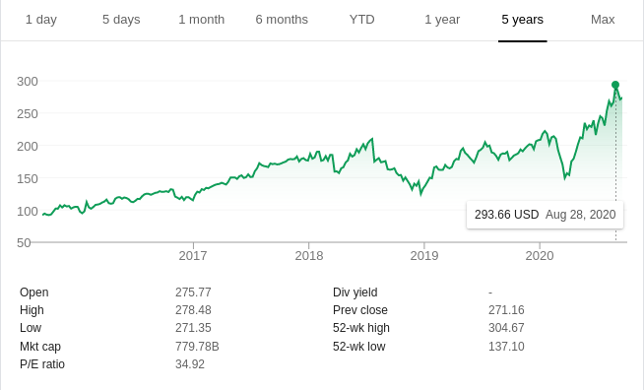
FACEBOOK IS USING THESE MODERATORS
Oli Thode
Facebook’s stock continues to grow
Facebook’s user base has increased by almost 600% in the past decade [3]
Kant’s second formulation of the Categorical Imperative:
  Treat others as ends, not as means [4]
Rawls’ second principle of justice:
  “Fair and equal opportunity” to assume the associated positions [4]
  They benefit the least advantaged people in society [4]
Screenshot of Google Market Summary
Notes:
If moderators were better informed, the story would be different
It can be argued that the opportunity is equal and fair, but the people taking these jobs don’t have much choice
The end users all benefit equally, but there isn’t any clear correlation there. The moderators take the brunt of the disadvantage here, and FB the company is certainly benefitting.

Slide 21
REFERENCES
<Your Name>
[1] “Post No Evil Redux.” Radiolab. WNYC Studios, New York, 19 June 2020.
[2] Casey Newton, “The secret lives of Facebook moderators in America,” (The Verge, 25 Feb. 2019) https://www.theverge.com/2019/2/25/18229714/cognizant-facebook-content-moderator-interviews-trauma-working-conditions-arizona (Accessed 10 Sept. 2020)
[3] “Number of monthly active Facebook users worldwide as of 2nd quarter 2020.” (Statistica, 2020) https://www.statista.com/statistics/264810/number-of-monthly-active-facebook-users-worldwide/#:~:text=With%20over%202.7%20billion%20monthly,network%20ever%20to%20do%20so
[4] Quinn, Michael J. Ethics for the Information Age. pg. 20. Pearson Education Inc., 2017. Print.

Slide 22
monetization alters social media
Paul Peterson

Slide 23
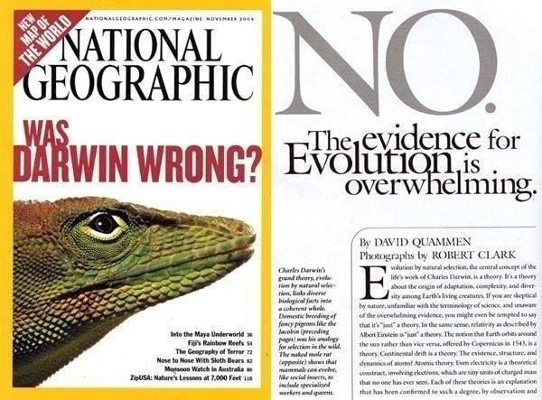
Monetization favors CLickbait
Paul Peterson
Flashy titles skew views
  Sensationalism grabs attention
  Clicks and traffic determine profit
  The first to report is the first to be seen
  Investigating isn't cheap
59% of people don't read the articles they share[4]
  Surface title what users look at
  Arcticles can disagree with the implication of the title (see image)
Image credit National Geographic
Notes:
Clickbait impedes news not only by skewing stories, it allows those who don't care to stir up storms for the monetization
less than half of the articles are ever read, doing nothing for the group that made the article
Theis setup affects everyone

Slide 24
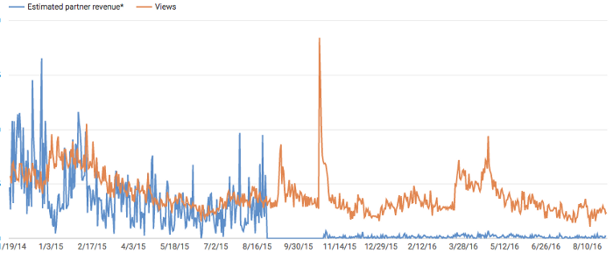
Monetization limits creativity
Paul Peterson
Algorithms calculate what to next show the user
  Creators must follow the algorithm to profit
  Algorithms can only observe data and trends
The more limits there are, the less people can deviate
  Algorithms control post order and organization
  Getting noticed fast means more traffic
  Speed matters more than quality
  The interest of the internet is not easy to keep
[1]YouTube De-Monetization Explained
Notes:
Graphic shows a video that got demonetized. Not long after that, it bacame more relevant.
Algortihms don’t see people, they move content and post for the "best engagement"

Slide 25
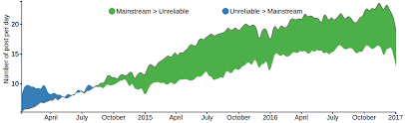
People learn from Social media
Paul Peterson
Public view is shaped by social media
  People are quick to share news they find important
  People don't want to be proven wrong
  People prefer to trust what they agree with
Correcting misinformation is much more difficult than causing it[9]
  Gaguing spread is difficult
  One person's influence is limited
  Nothing travels faster than bad news
  Did you actually read the username?
Image credit [10]
Notes:
We learn form the internet, we exist on the internet. Monetization warps what gets show for max profit, not truth or relevancy
Unreliable sources don’t care about wild exprtapolation. January 2020, Kobe Bryants family seeing twitter posts and news articles about a crash which they allegedly died in

Slide 26
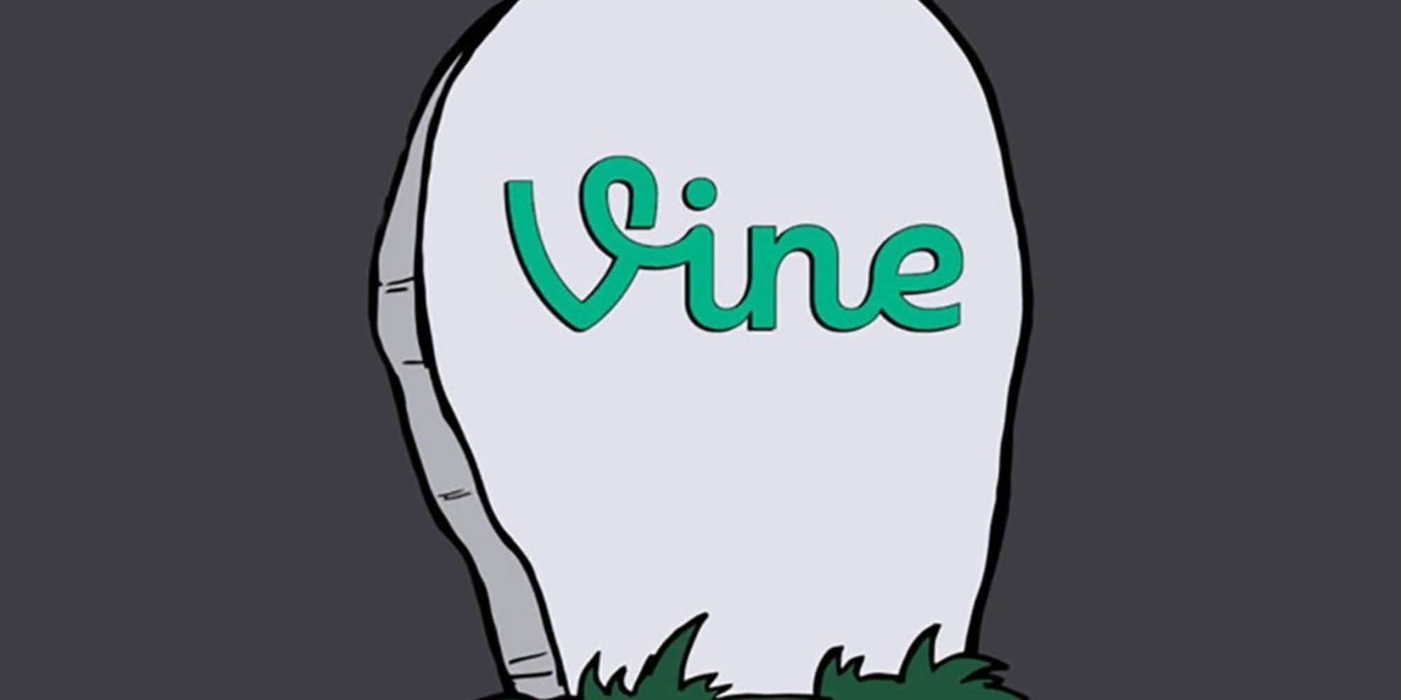
No ads, no creators, only data
Paul Peterson
Social media needs people to survive
  No site/app surivives without users
  Content creators draw in users
  Without a way to reward content creators, creators will leave for other means[5]
Algorithms arrange content for monetization, not user preference
  Algorithms can easily be biased[7] or manipulated[8]
  Algorithms only take small samples
  Algorithms can't check for truth or personal preferrence
  Not everything can be monetized (e.g. tumblr)
Image credit [6]
Notes:
Content is made by people. If there is ad revenue, some should go to the people who drove people to see those adds. Without dedicated creators, there is no media
If it's all for communication, you are the product, the company couldn't give a damn about this annoying you
Verizon bought tumblr for 1.1 bil, sold for 3 mil [11]

Slide 27
References
Paul Peterson
[1] Internet Creators Guild, "YouTube De-Monetization Explained" (Medium, September 2, 2016) https://medium.com/internet-creators-guild/youtube-de-monetization-explained-44464f902a22
[2] Goran Bogunović, "Clickbait Titles in SEO. Risks and Limits", (Four Dots, August 29th, 2016) https://fourdots.com/blog/clickbait-titles-seo-2634
[3] Nathan J. Robinson "The Truth Is Paywalled But The Lies Are Free" https://www.currentaffairs.org/2020/08/the-truth-is-paywalled-but-the-lies-are-free/
[4] Maksym Gabielkov, "Arthi Ramachandran, Augustin Chaintreau, Arnaud Legout. Social Clicks: What and Who Gets Read on Twitter?." (Performance 2016)
[5] Alex Kantrowitz "Vine Stars Want To Be Paid, And Twitter Is Considering It" https://www.buzzfeednews.com/article/alexkantrowitz/twitter-in-discussions-with-top-vine-creators-about-payment#.dajlN5Pe5
[6] Nicholas Becker "What happened to Vine?' https://techiegamers.com/what-happened-to-vine/ (Techie Gamer, 2020)
[7] Turner Lee, N. (2018), "Detecting racial bias in algorithms and machine learning", Journal of Information, Communication and Ethics in Society, Vol. 16 No. 3, pp. 252-260. https://doi.org/10.1108/JICES-06-2018-0056
[8] Gillian Bolsover & Philip Howard (2019) Chinese computational propaganda: automation, algorithms and the manipulation of information about Chinese politics on Twitter and Weibo, Information, Communication & Society
[9] Blankenship, M. (2020). How Misinformation Spreads Through Twitter. https://digitalscholarship.unlv.edu/brookings_capstone_studentpapers/6
[10] Md Main Uddin Rony, Naeemul Hassan Mohammad Yousuf "Diving Deep into Clickbaits: Who Use Them to What Extents in Which Topics with What Effects?" (2017) https://arxiv.org/pdf/1703.09400.pdf
[11] Aja Romano, "WordPress could give Tumblr the thing it needs most: stability" (Vox 2019) https://www.vox.com/2019/8/13/20802751/wordpress-tumblr-sale-porn-ban-future

Slide 28
Class 4
The End
Keith A. Pray
Instructor
socialimps.keithpray.net
Notes:
Use remaining time to form groups, approve group topics, etc.
This is the end. Any slides beyond this point are for answering questions that may arise but not needed in the main talk. Some slides may also be unfinished and are not needed but kept just in case.

