Slide 1
Class 1
Introduction
Keith A. Pray
Instructor
socialimps.keithpray.net
Notes:
Here’s the title slide to the first class. Excited already, aren’t you?
If applicable: Zoom guidance.
Practice critical thinking: Is there anything wrong with this slide?
Transition: Who knows what Emacs or vi is?

Slide 2
what works well Online With Zoom
Sign in with First and Last Name
Stay muted unless you are going to speak
To speak use the raise your hand feature
To answer yes/no questions use the “yes” ”no” buttons
Chat is fine for questions
Turn your camera on
Wait until the end of student presentations to ask questions
  Write them down so you don’t forget
Others?

Slide 3
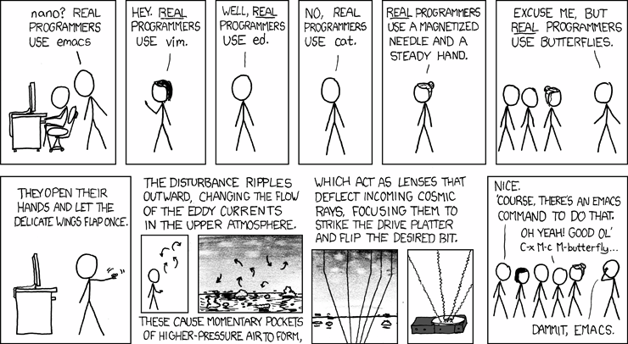
2008-02-01 http://xkcd.com/378/
Notes:
How many people in the world get this joke?
nano’s defining traits? – pico like editor from pine email system
emacs? - extensibility
vim? – Amiga programmers, modal
ed? – first parts of UNIX from 1969, very basic
cat? –oncatenates files (displays by concatenating to screen file)
What about Solid State Drives?

Slide 4
How many people might get that joke
Sources: www.census.gov nces.ed.gov | # People Degrees since 1971 | % People
2017 World population: | 7,377,435,000
2017 US population | 324,674,608 | 4.4% World population
US bachelor degrees | 25,568,606 | 7.9% US population
US Computer and Info Science degrees | 675,412 | 2.6% US degrees 0.2% US population
If representative of world’s population | 7,377,435,000 x 0.2% = 14,754,870 | 0.2% US == 0.2% World
Notes:
https://www.census.gov
2017 World population: 7,377,435,000
2017 US population: 324,674,608 (4.4% World population)
https://nces.ed.gov
Since 1971 US bachelor degrees: 25,568,606 (7.9% US population)
Since 1971 US Computer and Info Science degrees: 675,412 (2.6% US degrees, 0.2% US population)
If representative of whole world’s population:
0.2% US == 0.2% World: 7,377,435,000 x 0.2% = 14,754,870
2014-2015 US bachelor degrees: 1,894,934
2014-2015 US Computer and Info Science degrees: 59,581
OLD INFO
According to wolframalpha.com (2012-08-23):
2.34% (of 6.79 billion people) attend secondary school
50 million secondary school grads in United States (of 309 million people) 16.18%
3.3 million computer specialists in United States (of 309 million people) 1.06% (or 6.6% of college grads)

Slide 5
/(BB|[^B]{2})/
2018 LinkedIn People Claiming:
Software Development: 5,594,241
Regular Expressions : 33,007 (0.59%)
2017 SW Dev: 896,137 regex: 34528
Notes:
/
bb # two b's
| # or
[^ # not
b]{2} # two b's
/
2018:
People on LinkedIn claiming to have the skill “Software Development”: 5,594,241
People on LinkedIn claiming to have the skill “Regular Expressions”: 33,007 (0.59%)
2017:
People on LinkedIn claiming to have the skill “Software Development”: 896,137
People on LinkedIn claiming to have the skill “Regular Expressions”: 34,528 (3.9%)

Slide 6
Overview
Introduction
  Course Staff
  Logistics
  Outcomes
Assignment

Slide 7
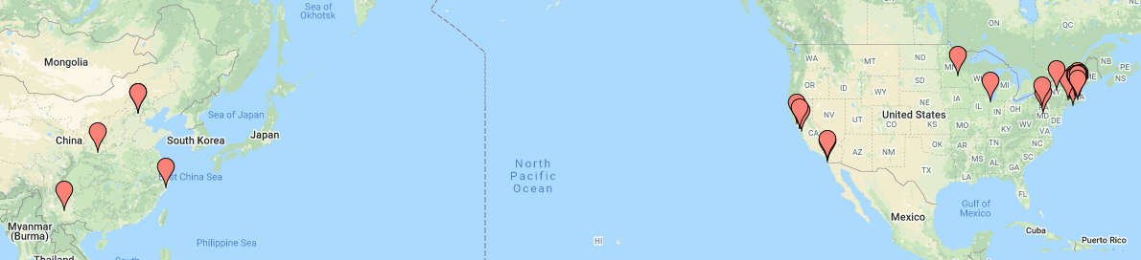
Where we are from

Slide 8
Course Staff
Instructor
Assistants
Keith A. Pray
kap@wpi.edu
FL 140
Office Hours
  First hour after class
  By Appointment
SA
  Matthew Spofford
  mespofford@wpi.edu
Who are you?
  Youngest? Oldest?
  Majors? Years?
  Why take this course?
Notes:
Here’s our contact info.
Introduce yourself.
Get to know class:
Youngest? Oldest? Country of origin?
Majors? Years?
Reasons for taking class

Slide 9
Outcomes – You will
Demonstrate understanding of links between computing technology, society, and computing professional responsibilities
Discover and use primary sources relevant to course topics in support of arguments
Present personal verbal and written opinions based on well reasoned arguments
Be familiar with social, moral, and ethical issues faced by computer professionals
Be able to recognize computing related ethical issues
Understand professional codes and ideals and apply them in decision making
Analyze popular portrayal of computing and its effects
Practice critical thinking, written, and oral presentations skills
Be responsible for your own learning
Practice dealing with ambiguity
Notes:
Paraphrased from Outcomes on web site
Stress students are responsible for their own learning
Stress dealing with ambiguity as useful skill

Slide 10
Logistics
Course Web Site
Interactive Assignments
http://socialimps.keithpray.net
Syllabus
Grading Policy
Due Dates
Etc.
Canvas
  Discussion Boards
  Paper Turn In
  Announcements made on Canvas
  Canvas → Account → Notifications
https://wiki.wpi.edu/cs3043
Notes:
Let’s go to the course website for this stuff.
Always check course web site for grading rubrics.
Individual presentations are due 24 hours before class so that they can be incorporated into class slides.
Since most things due class to class are small in the number of points we will not be giving credit late work. You can still turn it in and we’ll tell you how well you would have done.

Slide 11
Group Quiz!
What is the oldest computing device you can think of?
What computing technology do you wish society had not adopted?
What good will you do with your degree?
Notes:
The counters in an abacus is where the term “counter” meaning place in a shop where transactions take place.
What is the oldest computing device you can think of?
manual calculating aids –
clay or wax tablet (5500 BC or older)
slate tablet (1300s BC)
paper tablet
abacus (2700 BC)
mathematical tables (190 BC) (logarithms is an important one 1500s)
Antikythera Mechanism analog computer (0 BC)
What computing technology do you wish society had not adopted?
What good will you do with your degree?
What is the biggest impact computing has had on your life?
What is the difference between liberties (negative rights) and claim rights (positive rights)?
What is computing?

Slide 12

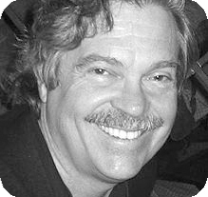
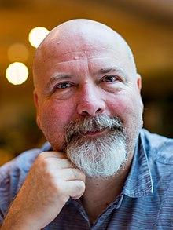
What is Technology?
Merriam-Webster: The use of science in industry, engineering, etc., to invent useful things or to solve problems [1]
Alan Kay: Technology is anything invented after you were born
  Pioneer in object oriented programming
Hillis Danny: Technology is anything that doesn't work yet
  Of Thinking Machines Corporation
Notes:
Segue: What technologies have been invented during your lifetime?
[1] http://www.merriam-webster.com/dictionary/technology (Accessed 2016-08-26)
Allan Kay: Pioneer in object oriented programming
Photo from https://amturing.acm.org/award_winners/kay_3972189.cfm
Hillis Danny: Of Thinking Machines Corporation
Phot0 from https://en.wikipedia.org/wiki/Danny_Hillis

Slide 13
Manufacturer | Compaq Computer Corporation, United States
Type | Portable computer
Release date | January 1983
Introductory price | US $3,590
Operating system | MS-DOS
Storage capacity | Two 5.25" floppy drives or, 1 floppy drive + 10 MB HD
Memory | 128 kilobytes (expandable to 640)
Display | Built-in 9" green screen monitor + CGA-compatible video card
Weight | 28 lbs (12.5 kg)
Processor | Intel 8088
Speed | 4.77 MHz
Notes:
Color Graphics Adapter (CGA)
Show old portable computer.
Info in slide from http://en.wikipedia.org/wiki/Compaq_portable
Links on web site.
http://socialimps.keithpray.net/documents/index.jsp?content=Show_and_Tell.html

Slide 14
Utopias and Dystopias
Types:
  Economic
  Political
  Technological
What makes it a utopia or dystopia?
Why do we create them?
Examples, real or fictional?
Notes:
What "Orwellian" really means - Noah Tavlin (5:31)
http://ed.ted.com/lessons/what-orwellian-really-means-noah-tavlin

Slide 15
Overview
Introduction
  Course Staff
  Logistics
  Outcomes
Assignment

Slide 16
Assignment 1/2
Read chapter summaries in beginning of text
Movie Discussion Board on Canvas
  List 2 movies you believe relevant to computing AND society
  State why in a paragraph
  Please create a new thread for each movie
  Do not repeat any existing entries, they will not earn credit
  Comment on a minimum of 2 movies you did not add
    No “me too” comments, add your own rationale
  Cite reference materials – must use at least 1 per movie
Notes:
Encourage students to send email right away if they have any problems with Canvas.

Slide 17
Assignment 2/2
Sign up for individual presentation
Current schedule at:
  http://socialimps.keithpray.net
Send course staff email
Specify your topic
  By that I mean be specific
  It may take time to refine your topic
  I’ll be happy to discuss your ideas
10 Minutes, reserve 2 for Q/A
6 points material quality
2 points presenting in class
2 points showing depth during Q/A

Slide 18
Extra Credit?
ECE Graduate Seminar Lecture by Professor Ziming Zhang, ECE Department, WPI
https://www.wpi.edu/news/calendar/events/ece-graduate-seminar-lecture-professor-ziming-zhang-ece-department-wpi
BME Distinguished Lecture Series: "The Virtual Cell Project" by Leslie Loew, PhD, Professor and Director, UCONN Medical School - Via Zoom
https://www.wpi.edu/news/calendar/events/bme-distinguished-lecture-series-virtual-cell-project-leslie-loew-phd-professor

Slide 19
Class 1
The End
Keith A. Pray
Instructor
socialimps.keithpray.net
Notes:
This is the end. Any slides beyond this point are for answering questions that may arise but not needed in the main talk. Some slides may also be unfinished and are not needed but kept just in case.

