Slide 1
Class 11
Work
Keith A. Pray
Instructor
socialimps.keithpray.net
Notes:
Here’s the title slide. Excited already, aren’t you?
Ask about Automation paper:
What did people choose to automate
Share 1 main reason

Slide 2
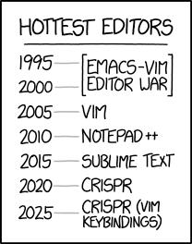
Overview
Review
Assignment
Students Present
https://www.xkcd.com/1823/
Notes:
Full circle.
CRISPR: Clustered Regularly Interspaced Short Palindromic Repeats
Allows permanent modification of genes within organisms.
Published 2017-04-12 according to https://www.explainxkcd.com/wiki/index.php/List_of_all_comics_(1501-2000)
Kickstarter Charter
https://www.kickstarter.com/charter?ref=about_subnav

Slide 3
Overview
Review
Assignment
Students Present
C lustered
R egularly
I nterspaced
S hort
P alindromic
R epeats
Permanent gene modification
https://www.xkcd.com/1823/
Notes:
Full circle.
CRISPR: Clustered Regularly Interspaced Short Palindromic Repeats
Allows permanent modification of genes within organisms.
Published 2017-04-12 according to https://www.explainxkcd.com/wiki/index.php/List_of_all_comics_(1501-2000)
Kickstarter Charter
https://www.kickstarter.com/charter?ref=about_subnav

Slide 4
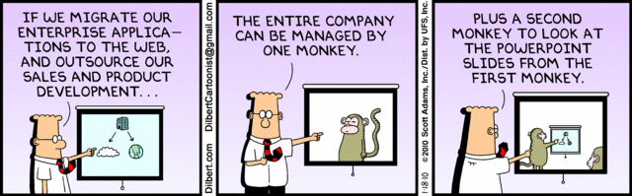
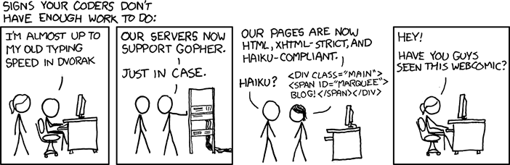
http://xkcd.com/554/
Notes:
Poll class:
Expected salary range upon graduation? Min, Max? Put on board.
Assume 40 hour work week.
How many people would work:
32 hours for 0.8 * Max? Put on board.
24 hours for 0.6 * Max? Put on board.
…continue until Min is reached.

Slide 5
Group Quiz
List 2 ways IT can lead to organizational change.
List 4 ways a Video Game Producer may protect its IP and what specific IP each protects.
List a computing technology that can be used to protect an individual’s privacy.
List a computing technology that can be used to intrude upon an individual’s privacy.
Notes:
Could split into groups of 4-5 for this.
Fill time with Work Discussion on Course Web Site

Slide 6
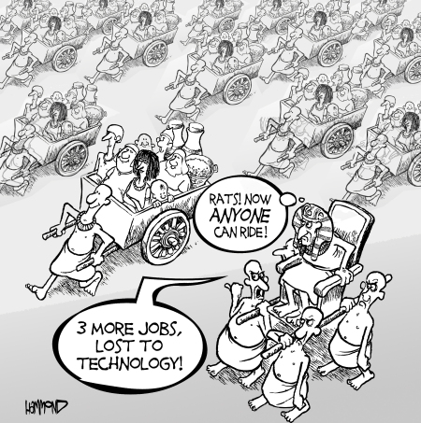
Overview
Review
Assignment
Students Present
©2009, MobileRobots Inc.
Notes:
Review Group Assignment Details.
Or first watch video: depends on student presentations, no thunder stealing.
CGP Grey
Humans Need Not Apply (15:00) – 2014-08-13
http://www.youtube.com/watch?v=7Pq-S557XQU
Last access 2016-04-22
These 3D printed homes can be constructed for $4,000 (3:00 – 2018-04-02)
http://www.businessinsider.com/3d-printed-homes-constructed-icon-new-story-tech-charity-4000-dollars-2018-3
https://www.youtube.com/watch?v=SvM7jFZGAec (1:28)
Last access 2018-04-22
Look at:
BBC Intelligent Machines
http://www.bbc.com/news/technology-33978561
BBC Likelihood of robot taking your job
http://www.bbc.com/news/technology-34066941

Slide 7
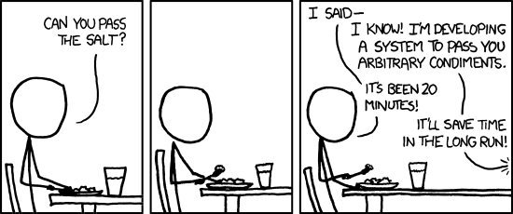
Overview
Review
Assignment
Students Present
https://xkcd.com/974/

Slide 8
Net Neutrality
Sean Morrissey

Slide 9
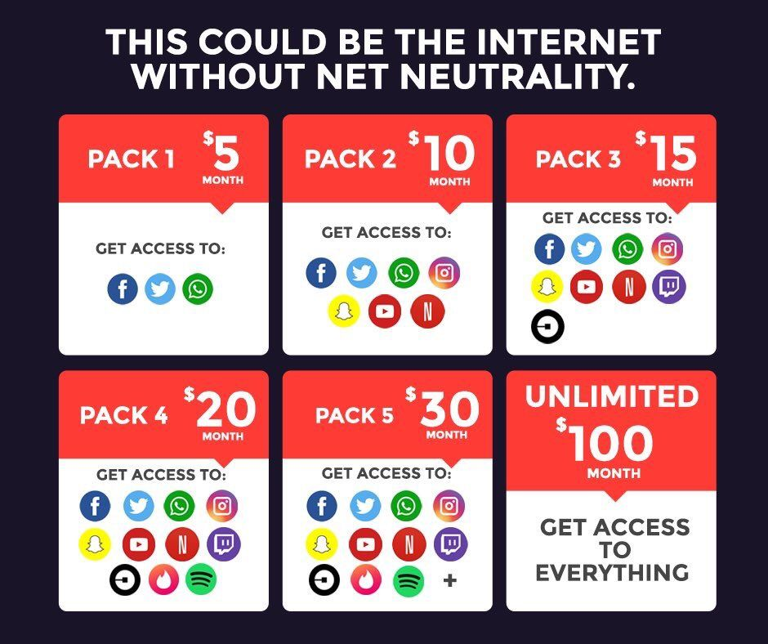
How did the debate begin?
Sean Morrissey
ISPs ban VPNs
ISP backlash from FCC
Net Neutrality is passed int 2015, but repealed in 2017
<Graphic as big as will fit>
[1][2][3][4][10]
Notes:
Began in the early 2000s with ISPs banning VPNs
2005, The FCC Fines Madison River for blocking internet phone calls (first effort to enforce Net Neutrality)
- changed classification of Internet Transmissions from Telecommunication to Information services
-this meant that ISPs are no longer forced to follow non-discrimination restrictions
2008, FCC demands for Comcast to stop throttling BitTorrent Connections on their network.
- Comcast denies it, sues the FCC and argues they can slow connections if they want to
- Comcast claimed that blocking ensured adequate QOS for their network, but it was more a bout money
- Peer to Peer Protocols like BitTorrent don’t create extra congestion for the whole internet
- They hurt the ISP’s business end benefits, the ISPs have to transmit twice the traffic when working with peer to peer connections. They have to invest more to satisfy the rising need of uploading data with no gain. But as it turns out from a study done by Beijing University on the topic, that peer to peer connections don’t actually generate extra traffic.
- They had allowed Verizon some degree of pricing freedom for its investment of improving broadband capacity. They said they needed better and more secure quality of service for time critical applications like TV which would suffer from degradation
2009, Apple blocks iPhones from making Skype calls because AT&T asked them to
2015, FCC passes Net Neutrality Order
2017, FCC Net Neutrality Order is repealed under Ajit Pai
Oct 1, 2019 -> Federal Appeals Court decides to keep the repeal in place.

Slide 10
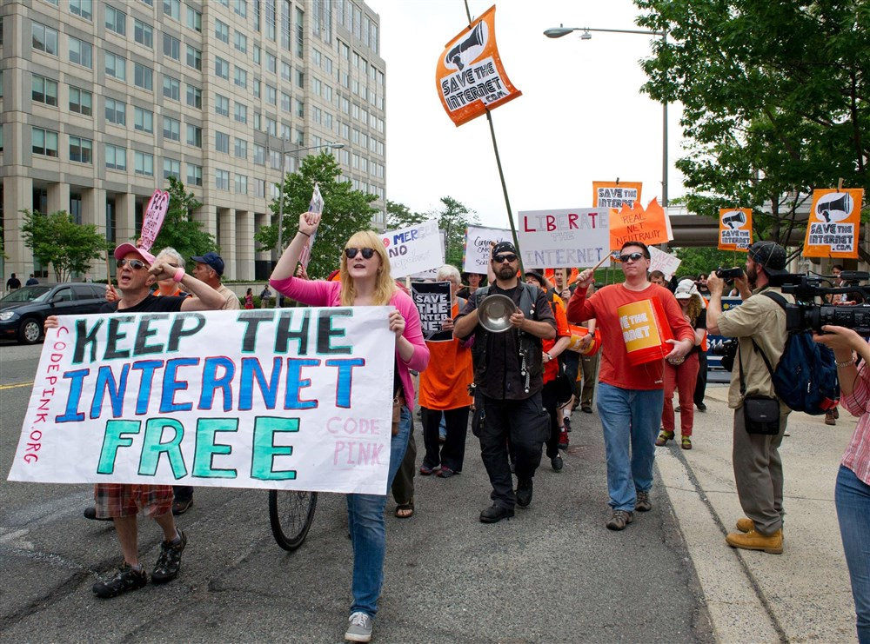
What It Means to Be For Net Neutrality
Sean Morrissey
Keep ISPs from controlling content
Avoid increasing charges on frequent users
Claim that ISPs want to
  Control and remove competition
  Large barrier of entry
[1][4][8][13]
Notes:
Advocates of Net Neutrality claim that the ISPs want to establish a tiered service model to control content and eliminate the competition. They believe this system will make it difficult for new services and applications to innovate as well as enter the market because of a barrier for entry. Advocates believe that it should preserved in the same that many of our current freedoms are. By repealing it, many believe they are having their freedom of expression revoked because ISPs would be able to control what users are able to see and block content that they do not agree with. Net Neutrality, "squashes the potential for internet fast lanes, where ISPs can charge content creators for enough bandwidth to deliver their service properly.”
Examples of Supporters:
Google, Amazon, Yahoo, Ebay, Microsoft, Steve Wozniak, Barack Obama, etc.

Slide 11
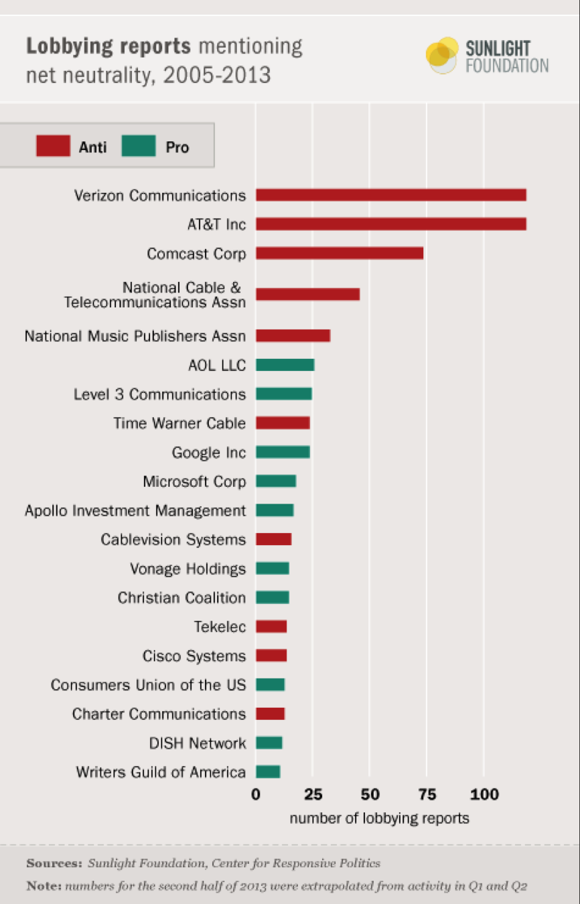
What it means to be against Net Neutrality
Sean Morrissey
First Amendment rights
Less income for innovation
No free internet access
Unregulated illicit content
[4][8][9][11]
Notes:
Opponents of Net Neutrality argue that existing rules enforced by the FCC make it so additional laws are not need and can hurt the ISPs’ first Amendment rights. They see it as “a solution in search of a problem” (as said by Ajit Pai). Also argue that bundles or data discrimination promotes a guarantee of QOS and is desirable. Some argue that by charging for access to certain sites, they will be able to offer access to other sites for free. The example used for this is that if they charge a bandwidth heavy service like Netflix, the ISPs will be able to provide Facebook or Wikipedia for free even without an internet contract. In addition, without filtering, it makes it easy for legal and age sensitive content to be available to everyone and anyone. It allows children to view things that they should not essentially.

Slide 12
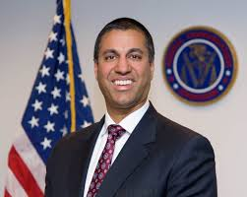
What has been Done So Far
Sean Morrissey
Legal Foundations Established
Repealed in 2019 Federally
State Legislation Enforced
  https://www.ncsl.org/research/telecommunications-and-information-technology/net-neutrality-legislation-in-states.aspx
Public Opinion
FCC Internet Freedom Order
[2][3][5][6][7]
Notes:
Despite the Net Neutrality order being established, there is not true Net Neutrality. It was repealed federally in 2019 under Ajit Pai and the Trump Administration, but not at the state level. This left states the ability to decide what they wanted to do. As of 2019, there are 34 states and the district of Columbia who have some sort of open internet legislation. I included a link to a page with everything these states have enforced. In Massachusetts, consumers are protected from blocking, throttling, or paid prioritization of services as well as have established a “Special State Committee” of which focuses on Net Neutrality as well as Consumer protection. The FCC set in place a Restoring Internet Freedom order of which ensures Consumer Protection, Transparency from ISPs and the FCC, and Removing regulations to promote broadband investment. The adjustment to transparency is supposed to make ISPs “clearly disclose their network practice upfront with the consumer,” giving the consumer the ability to choose if it suits their needs. The FCC is on the lookout for deceptive practices amongst ISPs. According to a survey done by Comparitech of 1,003 Americans on March 13th of 2019, 87 percent of Democrats and 77 percent of Republicans surveyed were in support of net neutrality. 67 percent of respondents were concerned with the censorship of internet content and 63.5 percent said they feared customers will have different services and speeds.

Slide 13
Conclusion
Sean Morrissey
It is an ongoing debate, it isn’t time to stop worrying about the rights we have as consumers.
Net Neutrality protects the consumer
We fail to appreciate the ease of access to goods and services we use online today.

Slide 14
References
Sean Morrissey
[1] Yiannis Yiakoumis, Neutral Net Neutrality,(ACM, 8/22/16), https://dl-acm-org.ezpxy-web-p-u01.wpi.edu/doi/abs/10.1145/2934872.2934896 (Accessed 4/26/2020)
[2] Klint Finley, A Brief History of Net Neutrality, (WIRED, 9/5/2018), https://www.wired.com/amp-stories/net-neutrality-timeline/ (Accessed 4/26/2020)
[3] Timothy Karr, Net Neutrality Violations: A Brief History, (FreePress, 1/24/2018), https://www.freepress.net/our-response/expert-analysis/explainers/net-neutrality-violations-brief-history (Accessed 4/26/2020)
[4] Fei-Yang Ling, Research on the Net Neutrality: The Case of Comcast Blocking, (IEEE, 9/20/2010), https://ieeexplore-ieee-org.ezpxy-web-p-u01.wpi.edu/document/5579492 (Accessed 4/26/2020)
[5] Emily Birnbaum, 4 in 5 Americans Say They Support Net Neutrality: Poll, (The Hill, 3/20/2019), https://thehill.com/policy/technology/435009-4-in-5-americans-say-they-support-net-neutrality-poll (Accessed 4/26/2020)

Slide 15
References
Sean Morrissey
[6] Tom Wheeler, California Will Have an Open Internet, (The New York Times, 10/2/2019), https://www.nytimes.com/2019/10/02/opinion/net-neutrality-fcc-wheeler.html (Accessed 4/26/2020)
[7] FCC, Restoring Internet Freedom, (FCC, 6/11/2018), https://www.fcc.gov/restoring-internet-freedom (Accessed 4/26/2020)
[8] IT Pro Team, The Pros and Cons of Net Neutrality, (ITPro, 11/4/2018),
https://www.itpro.co.uk/strategy/28115/the-pros-and-cons-of-net-neutrality (Accessed 4/26/2020)
[9] Jeffery Reed, The Downside of Net Neutrality, (Scientific American, 12/13/2017), https://blogs.scientificamerican.com/observations/the-downside-of-net-neutrality/ (Accessed 4/26/2020)
[10] Aja Romano, The Fight to Save Net Neutrality, Explained, (Vox, 7/13/2018), https://www.vox.com/2017/12/14/16774148/net-neutrality-repeal-explained (Accessed 4/26/2020)
[11] Lee Drutman, Who’s Putting the Most Money Against Net Neutrality, (Daily Dot, 3/1/2020), https://www.dailydot.com/debug/lobbyists-net-neutrality-fcc/ (Accessed 4/26/2020)
[12] FCC, Ajit Pai FCC Chairman, (FCC, 1/2017), https://www.fcc.gov/about/leadership/ajit-pai (Accessed 4/26/2020)
[13] Ben Popken, Google and Facebook Join Net Neutrality Day to Protest FCC’s Proposed Rollback, (NBC News, 7/12/2017), https://www.nbcnews.com/business/consumer/google-facebook-join-net-neutrality-day-protest-fcc-s-proposed-n781716 (Accessed 4/26/2020)

Slide 16
Telemedicine Satisfaction
Justin Moy
Notes:
Hello Everyone. I'm Justin Moy, and today I will be presenting about Telemedicine Satisfaction. Specifically, I will be discussing reasons for and solutions to doctor dissatisfaction with telemedicine.

Slide 17
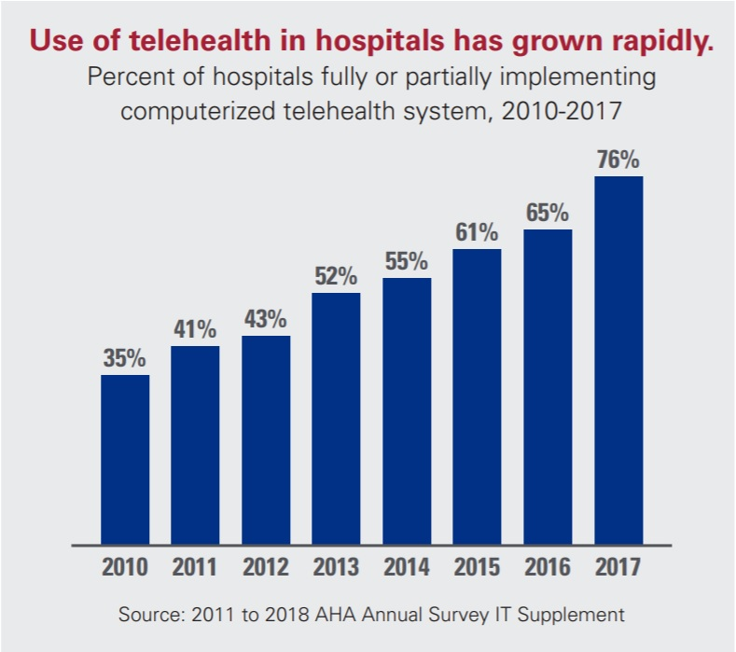
A Brief Overview of Telemedicine
Justin Moy
Healing at a distance
12% of Americans have used telemedicine systems
Examples
  Patient check up with a physician over video conference
  Patient communicating symptoms over email
<Graphic as big as will fit>
[1][2][3][4]
Notes:
I wanted to first start out by giving an overview of telemedicine. According to the World Health Organization, telemedicine is defined as “The delivery of health care services, where distance is a critical factor, by all health care professionals using information and communication technologies for the exchange of valid information for diagnosis, treatment and prevention of disease and injuries, research and evaluation, and for the continuing education of health care providers, all in the interests of advancing the health of individuals and their communities” [1]. That definition is pretty broad, but to sum it up, telemedicine is sharing patient data over a web portal. Telemedicine is phoning a physician during surgery. Telemedicine is video conferencing during a psychiatric consultation. Telemedicine is healing at a distance. Telemedicine is growing and here to stay. As of 2017, 76% of hospitals had adopted telemedicine systems [2]. Additionally the market size of telehealth is about $41.4 billion globally [3]. Despite these figures only about 12% of Americans have communicated with providers over telemedicine. On top of that 29% would distrust a telemedicine doctor versus only 6% distrusting an in person doctor [4]. This is a large difference, and it makes you wonder how much this lack of trust plays into a telemedicine interaction.

Slide 18
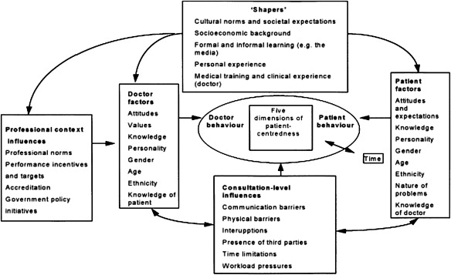
The doctor patient relationship
Justin Moy
Built upon trust
  Implied
  Earned
Instrumental and Affective
Affective primarily nonverbal
[5][6][7]
Notes:
The foundation of trust lies in the doctor patient relationship. I'm sure some of you can attest to how much the difference is between having a good doctor versus a bad doctor. The doctor-patient relationship has evolved over time, but has been categorized into activity-passivity, guidance-cooperation, and mutual participation [5]. Telemedicine consultations, and most interactions with doctors today fall under mutual participation. In this model, the patient is treated as an individual with agency rather than a collection of problems. In this model, trust must be built through communication rather than being implied institutionally. Communication takes place with a patient on two fronts: the instrumental and the affective. Instrumental communication consists of information about procedures, tests, and other technical aspects. On the other hand, affective communication is used to signal emotion. 7% of affective communication is verbal, 22% is tone of voice, and 55% is visual cues [6]. Affective communication makes the patient more open to the doctor, which in terms of the mutual participation model is a good thing. By opening a channel of rapport, the physician can better empathize with the fears, concerns and state of the patient. The patient in this case is an expert in their own condition which can provide insights to the doctor. Of visual cues, eye contact is particularly important[7]. Initiating eye contact signals to patients that they can disclose information and also engenders trust. As explained, the mutual participation relationship model relies heavily upon trust. This trust is based particularly in nonverbal communication. In telemedicine, most of these nonverbal cues can be distorted or missed. How does this affect doctor satisfaction with telemedicine?

Slide 19
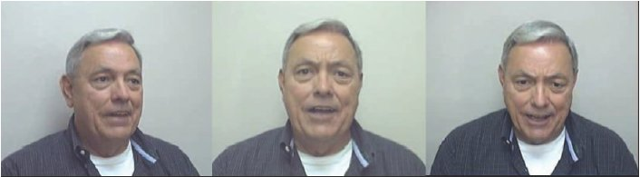
Lack of Trust Lack of communication
Justin Moy
Off centered camera generates distrust
Less time spent building trust
17% less patient communication over tele-consultation
[8][9][10]
Notes:
In the mutual participation relationship model, doctor satisfaction is bolstered by the understanding and inclusion of the patient. The current practice of telemedicine hampers understanding of the patient and thus decreases doctor satisfaction. Videoconferencing particularly exacerbates the issue of trust between the doctor and patient. Interestingly, a study in 2006 found that poor camera angles actively create distrust compared to looking directly at the camera. Off center videos scored lower on a trust scale compared to both voicemail and email [8]. Rather than fixating on audio, in the case where nonverbal cues are present, nonverbal cues took precedence. In a telemedicine setting it is impossible to control the camera angles of every interaction. It is of no surprise that doctors were dissatisfied due to the lack of understanding with patients. In a comparison of face to face versus telemedicine consultations, only 45% of doctors felt that they understood what was on the patients' minds. Also, the tele-consultations were shorter by about seven minutes[9]. In the study. doctors felt that they were able to get less information from the patients, but they also gave less praise and empathy utterances. This is in line with another study that found that patients participated 17% less in tele-consultations [10]. This information points to a lack of trust and connection between the doctor and the patient. If the doctor wants to be more satisfied with the tele-consultation, then a communication approach must be used that elicits more information.

Slide 20
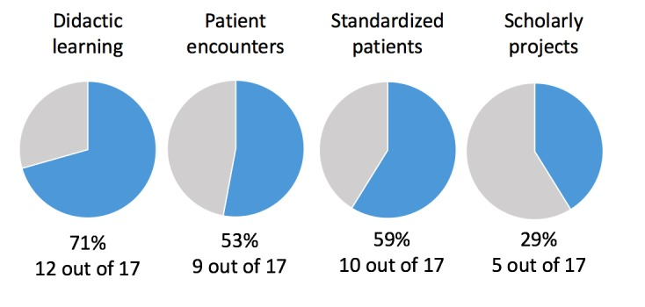
Possible solution
Justin Moy
Patient centered communication
Telemedicine in medical school curricula
<Citation>
Notes:
A possible solution to eliciting more information from the patient is a natural extension of the mutual participation relationship model. Patient centered communication, while obvious sounding is a solution that could possibly increase satisfaction among doctors using telemedicine systems. On the one hand, physician centered communication behaviors include "gathering information via closed-ended questions, testing hypotheses to make a diagnosis, giving medical directions, and controlling the visit" [11]. Patient centered communication is the opposite. By asking open-ended questions, doctors provide a forum in which a patient can address their concerns and feelings without worrying about derailing a physician's thought process. In addition statements of "concern, agreement, and approval" build trust. A patient centered approach could also alleviate eye contact issues by allowing the physician to focus on the camera rather than looking down at documents [7]. In order to facilitate these communication changes, telemedicine should be more rigorously included in medical education. Currently, though, only about half of medical schools in the United States include patient encounters in their telemedicine curriculum [12]. Doctors need to be taught these skills in order to apply them to real world situations.

Slide 21
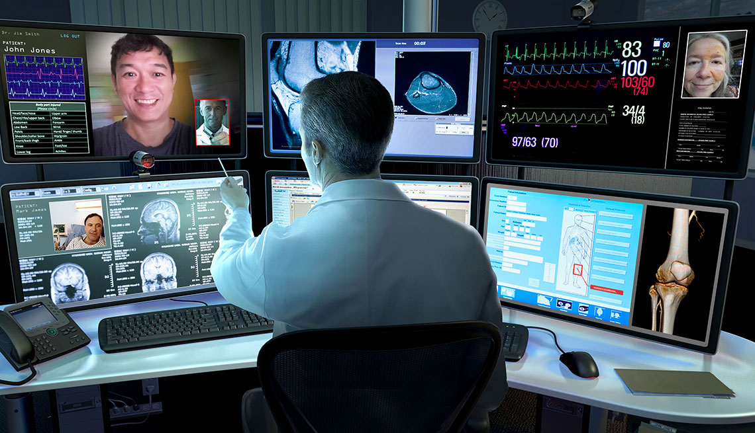
conclusion
Justin Moy
Patient Centered Communication → Doctor Satisfaction
  Decrease distrust
  Increase Communication
[13]
Notes:
In conclusion, patient centered communication could be the solution to doctor dissatisfaction with telemedicine and overcome inherent issues of distrust and patient communication. Any questions?

Slide 22
References
Justin Moy
[1] World Health Organization, Telemedicine, (World Health Organization, 2010), https://www.who.int/goe/publications/goe_telemedicine_2010.pdf (4/23/2020)
[2] American Hospital Association, Fact Sheet: Telehealth, (American Hospital Association, 2/2019), https://www.aha.org/factsheet/telehealth (4/23/2020)
[3] Grand View Research, Telemedicine Market Size, Share & Trends Analysis Report By Component, By Delivery Model, By Technology, By Application (Teleradiology, Telepsychiatry), By Type, By End Use, By Region, And Segment Forecasts, 2020 - 2027, (Grand View Research, 4/2020), https://www.grandviewresearch.com/industry-analysis/telemedicine-industry (4/25/2020)
[4] Andrew Greiner, How Americans feel about Telemedicine, (YouGov, 11/26/2019), https://today.yougov.com/topics/health/articles-reports/2019/11/26/cheddar-exclusive-how-americans-feel-about-telemed (4/23/2020)
[5] R.Kabaa, The Evolution of the Doctor-Patient Relationship, (International Journal of Surgery, 2007), https://www.sciencedirect.com/science/article/pii/S1743919106000094 (4/26/2020)
[6] L. M. L. Ong, Doctor-Patient Communication: A Review of the Literature, (Elsevier Science Ltd., 1995), https://in.bgu.ac.il/en/fohs/communityhealth/Family/Documents/DOCTOR-PATIENT%20COMMUNICATION%20A%20REVIEW%20OF.pdf (4/26/2020)

Slide 23
References
Justin Moy
[7] Jonathan Silverman, Doctors’ Non-Verbal Behaviour in Consultations, (British Journal of General Practice, 2/2010), https://bjgp.org/content/bjgp/60/571/76.full.pdf (4/26/2020)
[8] Ernst Bekkering, Trust in Videoconferencing, (Communications of the ACM, 7/2006), https://cacm.acm.org/magazines/2006/7/5876-trust-in-videoconferencing/fulltext (4/26/2020)
[9] Xiao Liu, Doctor-Patient Communication: A Comparison between Telemedicine Consultation and Face-to-Face Consultation, (Internal Medicine, 10/6/2006), https://www.jstage.jst.go.jp/article/internalmedicine/46/5/46_5_227/_pdf/-char/ja (4/25/2020)
[10] Richard L. Street, Specialist–Primary Care Provider–Patient Communication in Telemedical Consultations. (Telemedicine Journal, 2000), https://www.liebertpub.com/doi/pdf/10.1089/107830200311842 (4/26/2020)
[11] Zia Agha, Patient Satisfaction with Physician–Patient Communication During Telemedicine, (Telemedicine and e-Health, November 2009), https://www.liebertpub.com/doi/pdf/10.1089/tmj.2009.0030 (4/25/2020)
[12] Shayan Waseh, Telemedicine Training in Undergraduate Medical Education: Mixed-Methods Review, (JMIR Medical Education, 4/8/2019), https://www.ncbi.nlm.nih.gov/pmc/articles/PMC6475822/ (4/26/2020)
[13] Brobel Design, Telemedicine: Inside the Hospital without Beds, (AARP, 2018), https://www.aarp.org/health/conditions-treatments/info-2018/telemedicine-teleheath-online-doctors-appointment.html (4/27/2020)

Slide 24
Coordinated entry: data on homeless Americans
Imogen Cleaver-Stigum
Notes:
I am going to talk about some uses of computing that are intended to help homeless people in America get social services but that also have some negative social implications such as privacy violations. I am going to focus on studies from Los Angeles.

Slide 25
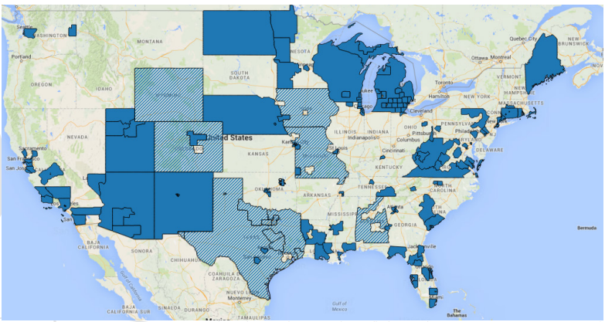
Coordinated entry
Imogen Cleaver-Stigum
VI-SPDAT = Vulnerability Index – Service Prioritization Decision Assistance Tool (survey)
Method:
Determine vulnerability level
Determine priority for services
Match with service providers
The VI-SPDAT is used all over the US [5].
[1, 2, 3, 5]
Notes:
Homelessness is a big problem across America so to try to deal with it, cities and organizations want to use their resources like shelters in the most efficient way possible. The popular method is called coordinated entry - using computerized algorithms to match homeless people to resources. To do this, there is a survey called the Vulnerability Index – Service Prioritization Decision Assistance Tool that is used to rank people based on their [5]. This is used in over 500 cities all over the US, as shown in the map. Generally, the social services in cities then use two different sets of data driven models: one to predict the priority level of the person for housing, and another to match the higher-priority people with services [1]. These algorithms are most often kept secret [1, 2], but one notable aspect is that they typically do not use machine-learning algorithms because those do not necessarily explain how the information was used to make the predictions and recommendations [3].
This use of computing produces social good by helping vulnerable homeless people get services they need most and by saving money for the system [2, 3]. One predictive algorithm for prioritizing homeless people’s needs in Los Angeles was estimated to reduce costs by $22 million overall in one year by recommending to give services only to those in greatest need [3]. This benefits the system by allocating resources more efficiently; however it also cuts assistance to some people, making decisions that determine people’s well being and survival.

Slide 26
Predictive algorithm problems
Imogen Cleaver-Stigum
Can have bias (race, sex, ethnicity, etc.)
Balancing money with human well being – ethical concerns
Keeping algorithms secret
[1, 2, 3, 4, 5]
Notes:
Since the data analysis is being used to determine whether the homeless people will get access to services, it is extremely important for its predictions to be accurate, otherwise people could die from not getting the services they need [1, 4]. There are a lot of factors that are difficult to take into account because of the subtleties of the social situation, [1]. Also, these algorithms need to balance the finances of the system with the well-being of the people, which is an ethically tricky consideration because some of the most vulnerable people are the ones who cost the social services systems the most money [3]. For example, the average homeless person in Los Angeles costs about $17,000 a year, but some of the most vulnerable people cost much more than that [3].
The fact that these algorithms are secret can be a concern because in the past, such algorithms have proven to have biases [4]. For example, algorithms that were intended to determine which children were most at risk were found to have racial bias because of the way they were defining the risk factors [4]. So the cultural context of the data must be considered for the computations to be effective.

Slide 27

Imogen Cleaver-Stigum
Violations of privacy
Very personal data given up in surveys
Goes to 168 organizations including government, police, etc.
Hard to revoke consent
[1, 2, 3, 4, 5]
Notes:
In Los Angeles,17% of the people who fill out the survey get matched with services – which is almost 10,000 people [2]. Overall this is a very good thing, and this tool helps the city place large number of homeless people in housing at a relatively low cost – about $1,140 per person [2].
However, the other 83% who are not matched with services have just given up very personal information about themselves. The survey asks questions about very personal issues like mental health, sexual assault, drug use, and sexual activity [5]. The data is provided to 168 different organizations that include not only relevant homeless shelters, hospitals, and addiction rehabilitation centers, but also governmental and religious organizations [2]. This data is also available to the police, which is concerning because some activities associated with homelessness, including even sleeping in public places and not having a place to put belongings, are illegal [2].
Once the people have given up this information about themselves, there are complex legal processes to revoke consent to the data, which makes it extremely difficult or impossible to have the data completely removed [2]. So as a direct result of the system being automated and the data being kept digitally, this system effectively becomes a surveillance system over the homeless people, which causes privacy issues [2].

Slide 28
Imogen Cleaver-Stigum
Summary
Social good for homeless people finding shelters
Financial savings
Responsibility to create a good algorithm
Privacy violations
[1, 2, 3, 4, 5]
Notes:
In conclusion, the social implications of these systems include helping the homeless people be matched with shelters, financial savings for the cities, the responsibility of those designing the algorithms to avoid bias and take all the factors into account, and some privacy violations for the homeless people who give up information in order to be considered by these systems.

Slide 29
References
Imogen Cleaver-Stigum
[1] Julia Stoyanovich, Bill Howe, Follow the Data! Algorithmic Transparency Starts with Data Transparency. (The Ethical Machine, 2018.) https://ai.shorensteincenter.org/ideas/2018/11/26/follow-the-data-algorithmic-transparency-starts-with-data-transparency (29 Apr 2020)
[2] Virginia Eubanks, High-Tech Homelessness. (American Scientist, 2020.) https://www.americanscientist.org/article/high-tech-homelessness (29 Apr 2020)
[3] Halil Toros, Daniel Flaming, “Prioritizing Homeless Assistance Using Predictive Algorithms: An Evidence-Based Approach.” (Economic Roundtable, 2018.) https://www.huduser.gov/portal/periodicals/cityscpe/vol20num1/ch6.pdf (29 Apr 2020)
[4] Eubanks, Virginia, Automating Inequality: How High-Tech Tools Profile, Police, and Punish the Poor. (St. Martin’s Press, New York, NY, 2017.) Chapter 3.
[5] OrgCode Consulting, Vulnerability Index - Service Prioritization Decision Assistance Tool (VI-SPDAT). (OrgCode, 2015.) http://pehgc.org/wp-content/uploads/2016/09/VI-SPDAT-v2.01-Single-US-Fillable.pdf (29 Apr 2020)

Slide 30
Dress Code and Workplace Dynamics
Eren Zeyn Eroglu

Slide 31
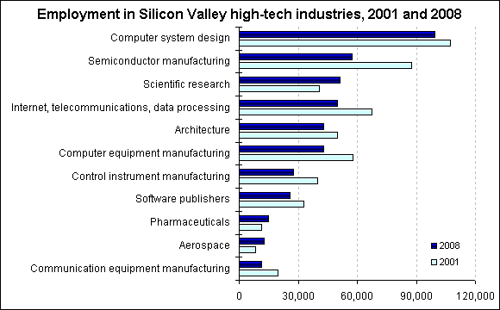
Companies I chose to look at
Eren Zeyn Eroglu
I focused on Silicon Valley
Companies such as Amazon and Microsoft hire a lot of WPI graduates [16]
Approximately, 6 million people in software development.
<Graphic as big as will fit>
[17]
Notes:
If we look at the figure we can see that the computer
US department of labor statistics

Slide 32
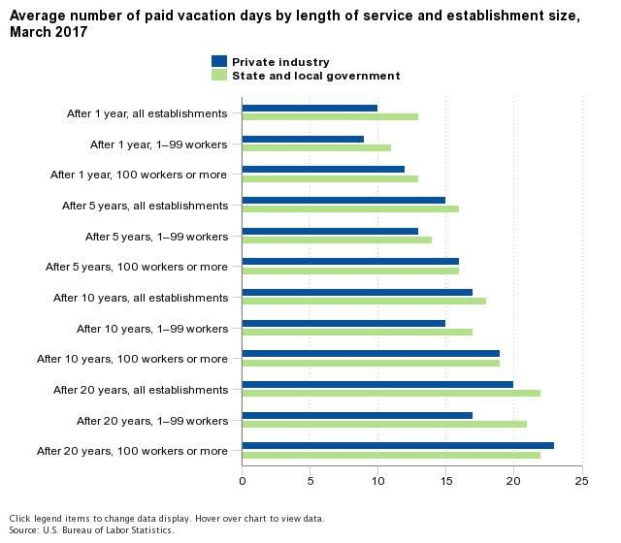
Average Workplace environment lacks Benefits
Eren Zeyn Eroglu
Only 32% of American Companies provide food [13]
Approximately, 60% of American office workers work in cubicles [14]
93% of cubicle workers prefer alternatives [14]
Detailed hierarchy and job titles
<Graphic as big as will fit>
[12]
Notes:
Cubicle offices and strict workplace environment constantly demanding work while you are at your desk
Everyone has a boss and a title denoting their importance.
Employees are often given limited days off.
According to the US Bureau of Labor Statistics the starting number of paid vacation days for Americans is 10 days after 1 year with the company

Slide 33
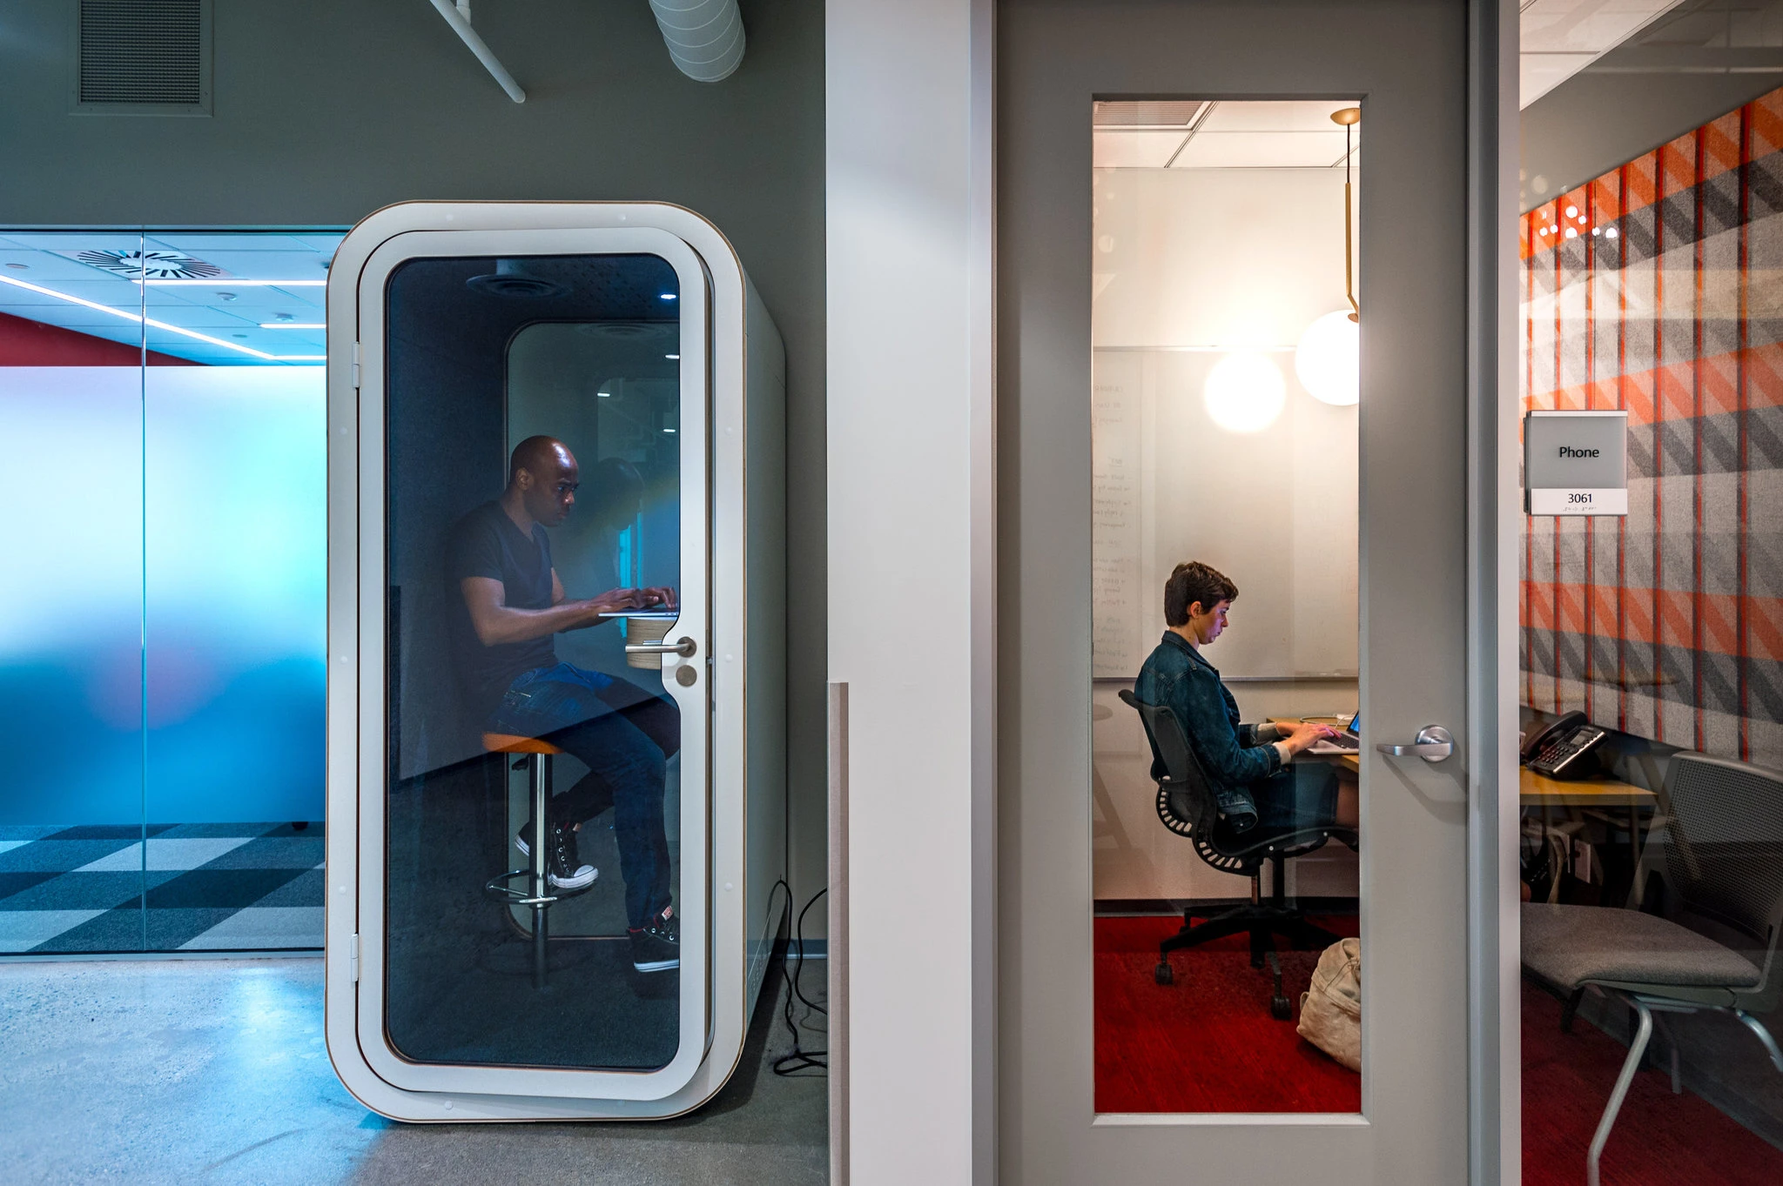
Tech Giants Workplaces Are progressive
Eren Zeyn Eroglu
Catered Meals [1][6]
Casual Dress Code [1]
Unconventional job titles[1]
Google employees start off with 50% more vacation days than the average [8]
[18]
Notes:
Several new tech companies cater their meals from nearby restaurants
Many companies are using unconventional job titles such as “Wizard” and “Ninja” [1]
Many silicon valley companies have generous benefits and flexible more flexible workplace environments[1]
I want to work for a company that promotes workplaces with more benefits, is more relaxed, and provides alternatives to regular office life

Slide 34
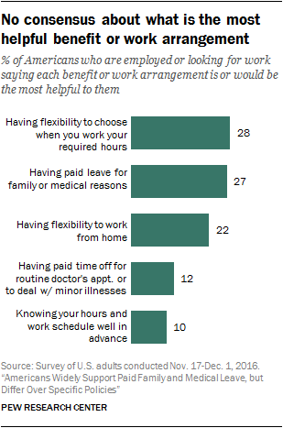
Happier, more productive employees
Eren Zeyn Eroglu
Google found a 37% increase in employee satisfaction [3]
Google also found a 12% increase in productivity [3]
Disengaged Workers experience 18% productivity on average [5]
Wider range of job candidates [15]
92% of employees indicate benefits being important to job happiness [13]
<Graphic as big as will fit>
[7]
Notes:
Google has reported that after these changes they found a 37% increase in employee happiness
Due to this increased employee satisfaction they noticed an increase in productivity by 12%.
By increasing employee happiness, the company also increases the number of individuals that want to work there. Thereby increasing the selection of potential job candidates.
This trend of increased productivity isn’t exclusive to Google either, a Harvard business review found that disengaged workers experience 18% lower productivity.
The society of for human resource management found that 92% of American employees

Slide 35
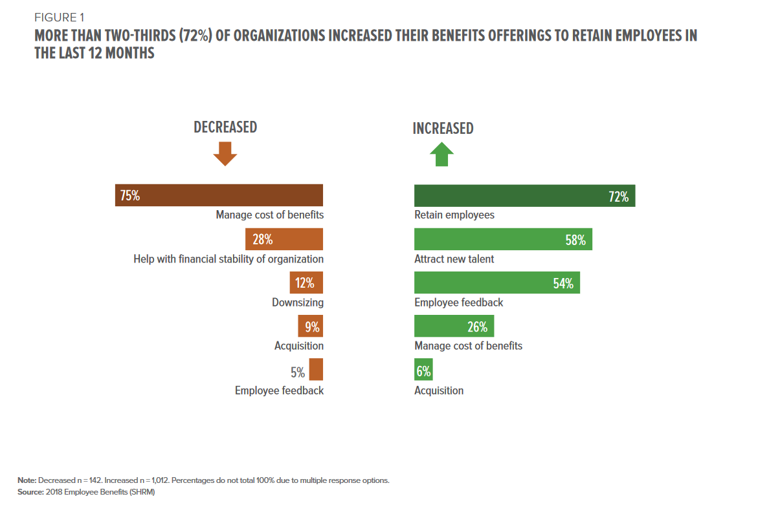
Social Implications
Eren Zeyn Eroglu
Wide scope of companies are adopting these policies [1] [15]
Most employees expect flexible hours and other benefits [2]
75% Goldman Sachs’s work force was born after 1981 [15]
<Graphic as big as will fit>
[13]
Notes:
Since the happier employee’s yields better results employers are conforming thus resulting in this silicon valley work culture to reform companies outside of the tech bubble making all workplaces more hospitable for employees.
Many are looking at these thriving companies and expecting similar working conditions
Undergraduates are beginning to expect companies to have similar work cultures to tech companies and thus are pushing this change [15]
Because young people are coming to expect more casual dress codes from work, even big traditional companies like Goldman Sachs
In a survey of 11,000 workers and 6,500 business leaders by Harvard Business School and Boston Consulting Group, the majority of employees expected flexible hours and other previously stated benefits and that that was driving the company's new developments

Slide 36
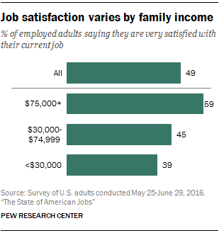
Additional Benefits
Eren Zeyn Eroglu
93% of Americans think paid leave will positively impact women [13]
Better the average quality of life
<Graphic as big as will fit>
[7][10]
Notes:
According to Pew Research Center, there is often a large disparity between the benefits men and women ask for when applying to jobs due to a multitude of reasons. Several women choose lower paying jobs due to the flexible hours. Therefore, a world in which flexible hours and benefits are understood to be a standard will help to promote female employees and allow them to receive the same benefits that men currently do. [7]
Additionally, another pew researcher found that only 49% of Americans were happy with their current jobs. While it does vary by income, this still leaves much room for improvement
I would love to work for a company that is on the front end of promoting a culture that will help people be more satisfied with their jobs.

Slide 37
References
Eren Zeyn Eroglu
[1] Arielle Pardes, “Silicon Valley Ruined Work Culture”, (Wired, Feb. 24, 2020) https://www.wired.com./story/how-silicon-valley-ruined-work-culture/ (4/30/2020)
[2] Joseph B. Fuller, Judith K. Wallenstein, Manjari Raman, Alice de Chalendar, “Future Positive”, (Harvard Business Review, May 2019), https://www.hbs.edu/managing-the-future-of-work/research/Documents/Future%20Positive%20Report.pdf (4/30/2020)
[3] Pavel Krapivin, “How Google’s Strategy For Happy Employees Boosts Its Bottom Line”, (Forbes, Sept 17, 2018), https://www.forbes.com/sites/pavelkrapivin/2018/09/17/how-googles-strategy-for-happy-employees-boosts-its-bottom-line/#5226bd8f22fc (4/30/2020)
[5] Emma Seppälä, Kim Cameron, “Proof That Positive Work Cultures Are More Productive”, (Harvard Business Review, Dec. 1, 2015), https://hbr.org/2015/12/proof-that-positive-work-cultures-are-more-productive (4/30/2020)
[6] Katie Canales, “Cayenne pepper ginger shots, homemade lemon tart…”,(Business Insider, Jul 31, 2018), https://www.businessinsider.com/free-food-silicon-valley-tech-employees-apple-google-facebook-2018-7#facebook-has-an-on-site-philz-coffee-1 (4/30/2020)

Slide 38
References
Eren Zeyn Eroglu
[7] Juliana Menasce Horowitz, Kim Parker, Nikki Graf, Gretchen Livinston, Views of paid leave relative to other workplace benefits”, (Pew Research Center, Mar. 23, 2017) https://www.pewsocialtrends.org/2017/03/23/views-of-paid-leave-relative-to-other-workplace-benefits/ (4/30/2020)
[8] Marguerite Ward, “25 Companies with the best vacation policies, according to employees”, (CNBC, Nov. 1 2016), https://www.cnbc.com/2016/10/31/25-companies-with-the-best-vacation-policies-according-to-employees.html (4/30/2020)
[10] Pew Research Center, “The State of American Jobs” Page 4, (Pew Research Center, Oct. 6, 2016), https://www.pewsocialtrends.org/2016/10/06/3-how-americans-view-their-jobs/ (4/30/2020)
[12] U.S Bureau of Labor Statistics, “Private Industry Workers received average of..”,(U.S Bureau of Labor Statistics, Jun. 28, 2018), https://www.bls.gov/opub/ted/2018/private-industry-workers-received-average-of-15-paid-vacation-days-after-5-years-of-service-in-2017.htm (4/30/2020)
[13]Kate Kennedy, Vanessa Hill, Sundra Hominik, “2018 Employee Benefits”, (Society for Human Resource Management, June 2018) https://www.shrm.org/hr-today/trends-and-forecasting/research-and-surveys/Documents/2018%20Employee%20Benefits%20Report.pdf (4/30/2020)
[14] Rebecca J. Rosen, “Our Cubicles, Ourselves: How the Modern Office Shapes American Life”, (The Atlantic, Apr. 14, 2014), https://www.theatlantic.com/business/archive/2014/04/our-cubicles-ourselves-how-the-modern-office-shapes-american-life/360613/ (4/30/2020)

Slide 39
References
Eren Zeyn Eroglu
[15] Elizabeth Dilts, “Suits and ties now optional, Goldman Sachs hedges dress code”, (Reuters, Mar. 5, 2019), https://www.reuters.com/article/us-world-work-goldman-sachs/suits-and-ties-now-optional-goldman-sachs-hedges-dress-code-idUSKCN1QM283 (4/30/2020)
[16] Worcester Polytechnic Institute, “Career Outlook, Computer Science”, (WPI, 2019), https://www.wpi.edu/student-experience/career-development/majors/career-outlook/computer-science (4/30/2020)
[17] U.S Bureau of Labor Statistics, “High-tech employment in Silicon Valley, 2001 and 2008”, (U.S Bureau of Labor Statistics, Sept. 8, 2009) https://www.bls.gov/opub/ted/2009/ted_20090908.htm (4/30/2020)

Slide 40
Class 11
The End
Keith A. Pray
Instructor
socialimps.keithpray.net
Notes:
If there’s time and we didn’t get to it:
Kickstarter Charter
https://www.kickstarter.com/charter?ref=about_subnav
CGP Grey
Humans Need Not Apply (15:00) – 2014-08-13
http://www.youtube.com/watch?v=7Pq-S557XQU
Last access 2016-04-22
These 3D printed homes can be constructed for $4,000 (3:00 – 2018-04-02)
http://www.businessinsider.com/3d-printed-homes-constructed-icon-new-story-tech-charity-4000-dollars-2018-3
https://www.youtube.com/watch?v=SvM7jFZGAec (1:28)
Last access 2018-04-22
Look at:
BBC Intelligent Machines
http://www.bbc.com/news/technology-33978561
BBC Likelihood of robot taking your job
http://www.bbc.com/news/technology-34066941
This is the end. Any slides beyond this point are for answering questions that may arise but not needed in the main talk. Some slides may also be unfinished and are not needed but kept just in case.

