Slide 1
Class 8
Crime
Keith A. Pray
Instructor
socialimps.keithpray.net
Notes:
Here’s the title slide. Is anyone not excited?

Slide 2
Let’s keep track of what works well Online and Remote
Sign in with First and Last Name
Stay muted unless you are going to speak
To speak use the raise your hand feature
To answer yes/no questions use the “yes” ”no” buttons
Chat is fine for questions
Turn your camera on if possible
Wait until the end of student presentations to ask questions
  Write them down so you don’t forget
Others?

Slide 3
Papers
Quantify
  Do not use terms like: less, more, a lot, huge, great, big, tiny, growing, etc.
Cite your sources in your paper
Read paper aloud to proof
http://socialimps.keithpray.net/assignments/paper-guidelines/
Notes:
0s not included.
Save for next time:
Make decisive conclusions
may, could, etc. = trivial
Absolute statements are difficult to prove
Avoid: all, always, any, every, everyone, never, none… unless you can show it
Be sure to put quotes around entire quote
Hyperbole is the best thing ever!
but not in these papers
Print 2 sided and save a tree
Use template, saves time (and -1 point)

Slide 4
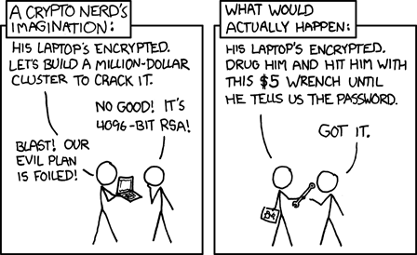
Overview
Review
Assignment
Students Present
http://xkcd.com/538/ (2010-11-14)
Notes:
Are there any questions on the assigned reading?
Use the slides ahead to explain any of the attack methods from the text.
If there are no questions you can skip those slides.

Slide 5
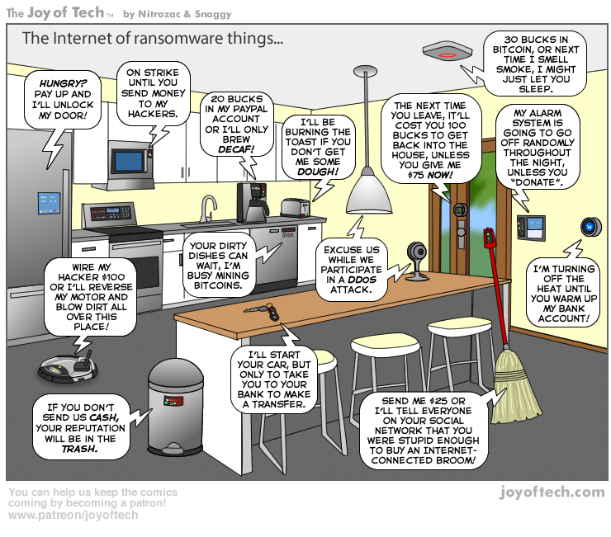
https://cointelegraph.com/storage/uploads/view/5e8f6e0d3a029807dfe181dc3d160cf0.png
Notes:
Find publish date
Note which really exist
Extra credit

Slide 6
My Reading Notes
pp. 323 Might be interesting to compare password guidance over the years.
pp. 325 plenty not sent with HTTP
pp. 328 Getting on TV much more difficult than releasing software
pp. 330 Virus could be new
pp. 332 Goals include infect 3 machine per LAN and as many computers as possible? Never make last minute changes before release. Were they related to the defects?
pp. 333 Testing w/out DEBUG often neglected
pp. 335 Do people use the Internet as an experimental laboratory these days? Shutdown right after booting, “benign” doesn’t seem like the right word.
pp. 337 “send reports back to a host computer”?
pp. 338 Firewalls often not running on same machine as malware, routers?
pp. 339 Have 2003 fears of cyber terrorist attacks been realized?
pp. 347 How is online voting a moral issue?
End of Chapter questions: 14. 25. 29.
Notes:
- If time ask class about online voting in light of COVID-19 challenges.

Slide 7
Group Quiz
A denial of service attack shuts down a bunch of retailer, stock brokerage, large corporate entertainment and information web sites. Possible guilty parties:
  Terrorist who aimed to cause billions of damage to U.S. economy.
  Protest organization opposing commercialization of the web and corporate manipulation of consumers.
  Script kiddie (a minor) just having fun with tools he found on the web.
  Show off hacker in search of bragging rights.
State what penalties are appropriate for each.
Explain your answer to 1. using a single Ethical Theory for all.
Name the laws/acts under which these parties could be prosecuted.
Notes:
Works well as small group exercise.
Note: short answer format expected.
Note: 2. only one argument needed, should include logic for all parties
Note: 3. same law(s) should be applicable to all parties

Slide 8
Assignment
Code Testing 1 Page Paper 1/2
Test the given code
Find as many defects possible
There are major and minor defects to find
Once testing is done write paper with conclusion: testing strategy was adequate
Things that might be useful in your argument:
  Rationale for testing strategy used (use data and sources)
  Explanations of defects found (use data and sources)
  How to fix them (use data and sources)
  Consequences of leaving defects in production code (use data and sources)
Use a weakness in testing strategy as counter point (use data and sources)
Working example: http://socialimps.keithpray.net/assignments/Test_Sales_Fun
Notes:
If guest presenter coming next class remind students to prepare questions for him.
Remember to work on groups projects.
Each group should have material on their sites for the topics we’ve covered so far.
OLD Prompt:
Design tests for the code on the following slide.
Contains at least one major defect and several minor ones.
Write a paper (1 page not counting any source code) including :
Did you choose a good test strategy? (This is your conclusion.)
The inputs and expected outputs
What defects you found
How you would fix the defects (you may include fixed source)
Why would that fix the problems?
What could happen if the defects are not found before the code is put into production?

Slide 9
Assignment
Code Testing 2/2
import java.text.NumberFormat;
public class SalesFun {
public static double calculateSalesTotal ( double amount, double discountRate, double taxRate ) {
double discount = amount * discountRate;
double total = amount - discount;
double tax = total * taxRate;
double taxedTotal = tax + total;
NumberFormat numberFormat = NumberFormat.getCurrencyInstance();
System.out.println ( "Subtotal : " + numberFormat.format ( amount ) );
System.out.println ( "Discount : " + numberFormat.format ( discount ) );
System.out.println ( "Total : " + numberFormat.format ( total ) );
System.out.println ( "Tax : " + numberFormat.format ( tax ) );
System.out.println ( "Tax+Total: " + numberFormat.format ( taxedTotal ) );
return taxedTotal;
}
}
} Lines of interest
Notes:
Bold lines are real focus.
Example input:
amount = 100.05;
discountRate = 0.10;
taxRate = 0.05;
OR
0.70, 0.0, 0.05
95.67, 0.20, 0.7

Slide 10
Overview
Survey
Review
Assignment
Students Present

Slide 11
Warrant canaries
Daniel Stusalitus
Notes:
My presentation is on Warrant Canaries, what they are, and issues related to that.
Throughout this presentation I would like you to ask yourself: is it ok for the government to be collecting my data, and if not what should change?

Slide 12

What is a warrant canary?
Daniel Stusalitus
A warrant canary is a statement that a company has not received a legal process that they are not allowed to state they received.
Ex: Companies cannot state they have received a National Security Letter(NSL), can state they have never received an NSL
Ex: Cloudflare has never modified customer content at the request of law enforcement or another third party.
[3][5][6]
Notes:
A warrant canary is a statement that essentially says a company has not received a legal process they cannot talk about. The most common example is a National Security Letter, or NSL. I will explain what an NSL is later, but anyone who receives an NSL is prohibited from talking about it or gagged, known as a gag order. Warrant canaries use negative terms to get around the gag order, essentially a loophole. Many warrant canaries exist to address NSLs, but they can be used for other issues. For example, Cloudflare is a company with numerous warrant canaries that address many issues. One such canary states they have never modified customer content due to outside pressure and is found in their Transparency report for the first half of 2019.

Slide 13
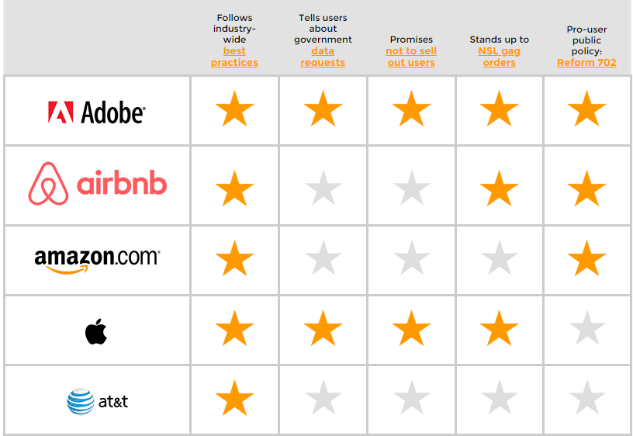
Who has your back?
Daniel Stusalitus
[4]
Notes:
In addition to warrant canaries, companies have some other options to help keep their users aware of what is being done with their data. A report by the Electric Frontier Foundation, or EFF, looked at 26 companies to see what they did for customers. All 26 companies met the criteria for following the industry-wide best practices. The industry-wide best practices are a wide range of policies and behaviors for companies that have become increasingly common as people become more aware of their privacy online. One crucial part of this is publishing a Transparency Report each year, which is where any warrant canaries a company has will be listed. If a transparency Report is published and lacks a warrant canary from the previous report this means the company has had to do something they claimed to have never done before in the canary, such as give up customer data to an NSL.

Slide 14
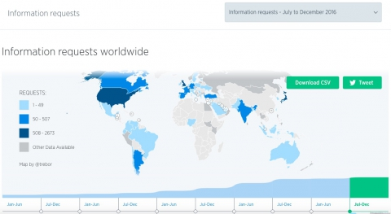
National security letters
Daniel Stusalitus
Gives FBI power to compel disclosure of customer records
Usage expanded by Patriot Act
In the past the FBI has underreported the number of NSLs issued
The FBI has likely underreported violations related to NSLs
[1][4]
Notes:
A National Security Letter is a legal process which gives the FBI the power to force companies to give up customer data. They are typically issued as part of counter terrorism efforts or other matters of national security. The Patriot Act we discussed last class has expanded the FBI’s authority to use NSLs. Nobody tells the public when an NSL is issued, or what the result is, however the FBI does report their usage of NSLs to Congress. A report by the Department of Justice in 2007 found that the FBI underreported the number of NSLs issued, likely underreported a significant number of violations in their use, and additionally sent out over 700 NSLs when they did not have the authority to do so.
While NSLs have existed since 1986, it was not until the Patriot Reauthorization act in 2005 that it became possible to challenge the letters and gag orders in court. Since then, judges have ruled against the gag orders on several occasions. Warrant canaries are in most cases the only way for a company to warn customers that it has received an NSL, and once the canary is gone it cannot be replaced.

Slide 15
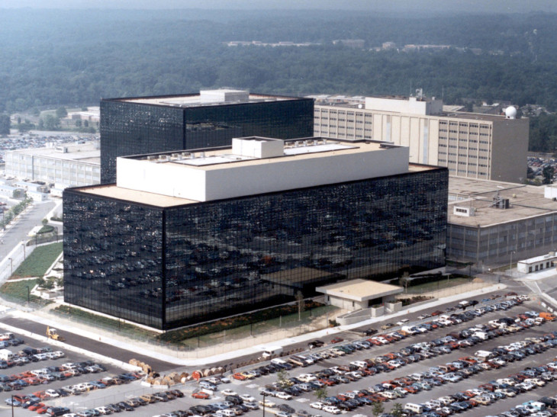
Data collection
Daniel Stusalitus
AT&T is involved in giving massive amounts of information to the NSA
Data from companies other than AT&T is handed over
[2]
Notes:
Through NSLs and other means the government is collecting massive amounts of information. Warrant canaries can only make people aware of what is happening to their data and are still limited in that regard. AT&T has 8 centers across the United States where it hands off data to the government. It is unclear just how much data, or what type of data, passes through these centers. It is unclear if the focus of these centers is domestic US traffic or international traffic. There is too much that people do not know about what is happening to their data and worse warrant canaries cannot help us. Warrant canaries are a useful tool for informing people about their own privacy online, but they are still very weak and very limited.

Slide 16
Conclusion
Daniel Stusalitus
Warrant canaries are one of the few ways for people to know if their data might have been collected.
If the government can have privacy, why can’t we?
The government is collecting massive amounts of data from people, potentially without their consent and without notifying them.
Notes:
Warrant Canaries let people know that something happened, but not what happened, or how many times, or if it affects them personally. The government is essentially able to collect people’s information without telling them. Why is this allowed? Use of warrant canaries is becoming much more common as people become more aware of issues surrounding their own online privacy, but often people need to go out of their way to find the information they need. Widespread use of warrant canaries is a good first step, but people should be taking a more active role online to learn about their privacy rights and to encourage companies to stand up for their customers.

Slide 17
References
Daniel Stusalitus
[1] Center, E. P. I. (n.d.). EPIC - National Security Letters. Retrieved April 20, 2020, from https://epic.org/privacy/nsl/
[2] Hatmaker, T. (2018, June 25). AT&T collaborates on NSA spying through a web of secretive buildings in the US. Retrieved April 20, 2020, from https://techcrunch.com/2018/06/25/nsa-att-intercept-surveillance/
[3] Opsahl, K. (2015, January 30). Warrant Canary Frequently Asked Questions. Retrieved April 20, 2020, from https://www.eff.org/deeplinks/2014/04/warrant-canary-faq
[4] Reitman, rainey. (2019, June 10). Who Has Your Back? Government Data Requests 2017. Retrieved April 20, 2020, from https://www.eff.org/who-has-your-back-2017#executive-summary
[5] Starzak, A. (2019, December 21). First Half 2019 Transparency Report and an Update on a Warrant Canary. Retrieved April 20, 2020, from https://blog.cloudflare.com/first-half-2019-transparency-report-and-an-update-on-a-warrant-canary/
[6] Whittaker, Z. (2019, February 26). Cloudflare expands its government warrant canaries. Retrieved April 20, 2020, from https://techcrunch.com/2019/02/26/cloudflare-warrant-canary/

Slide 18
AI Crime Fighters
Xuhao Zhang

Slide 19
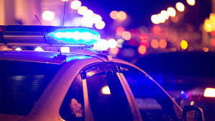
AI assists police to fight against crime
Xuhao Zhang
Facial Recognition and Identifying suspects
Machine learning algorithms and crime scene investigation
Processing Police Databases
Drawbacks
Future of AI in police work
Notes:
<speaker notes>

Slide 20
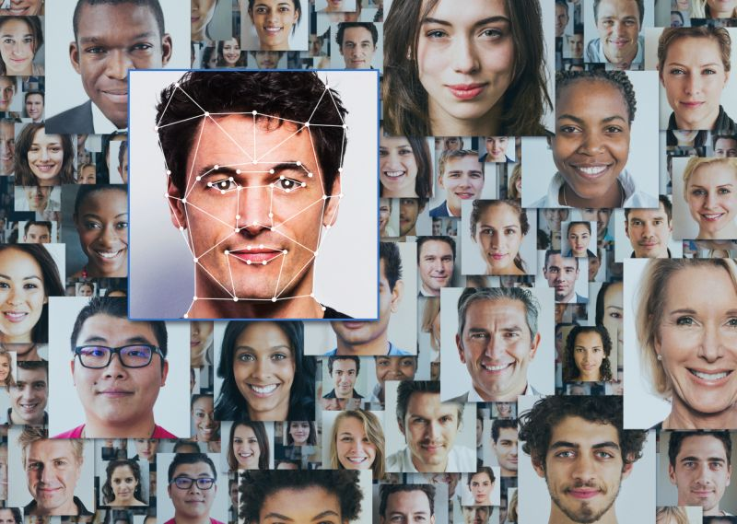
Facial Recognition
Xuhao Zhang
Identifying suspects
Spot the suspects on webpages
Help police monitor citizens, and catch petty crimes such as jaywalking
Identify and find missing person
[1] [3]
Notes:
First of all, facial recognition has received a wide range of application to assist in the identification of criminals in public space or on the internet. Traditionally, trying to identify one person from an entire crowd can be very difficult, and hard to prove in court since it is easy for a person to make a mistake when describing. But now, many cities like London have experimented with the use of AI in railway station for better law enforcement. Chinese officers succeeded in arresting a person from a crowd inside a stadium with AI technology. Also by feeding pictures of suspects, some software will spot the suspects on thousands of webpages allowing the police to track illegal activities. The same technology can be used to help identify and find missing persons.

Slide 21
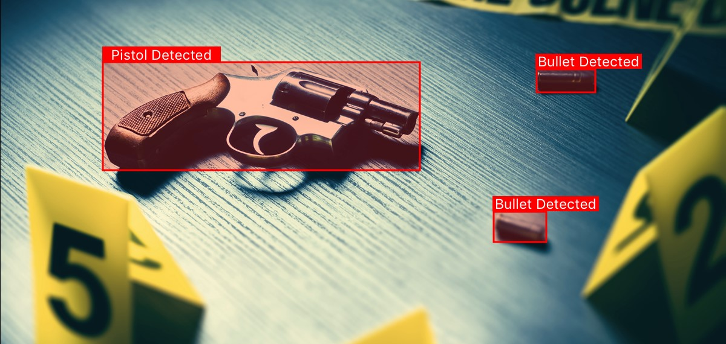
Machine learning algorithms
Xuhao Zhang
Crime Scene Investigation
Feeding images from crime scenes into computer, calculate possible pattern used by criminals in different situations
Foot prints
  Requires heavy annotation
Detect useful particles
  Requires Medical professionals
[1] [4]
Notes:
Next, machine learning algorithms is helping crime scene investigation. Researchers in Spain have been training neural networks to detect clues left at the crime scene. By feeding thousands of images from crime scenes into computer, the machine learning algorithms will know what they need to detect, and find out possible patterns used by criminals in different situations, possibly could connect crimes to suspects. The clues can be anything like foot prints, but it requires annotation matching specific type of shoes with footprints. Similarly with detecting particles in crime scene which also require what is the next topic, enhancing the police database.

Slide 22
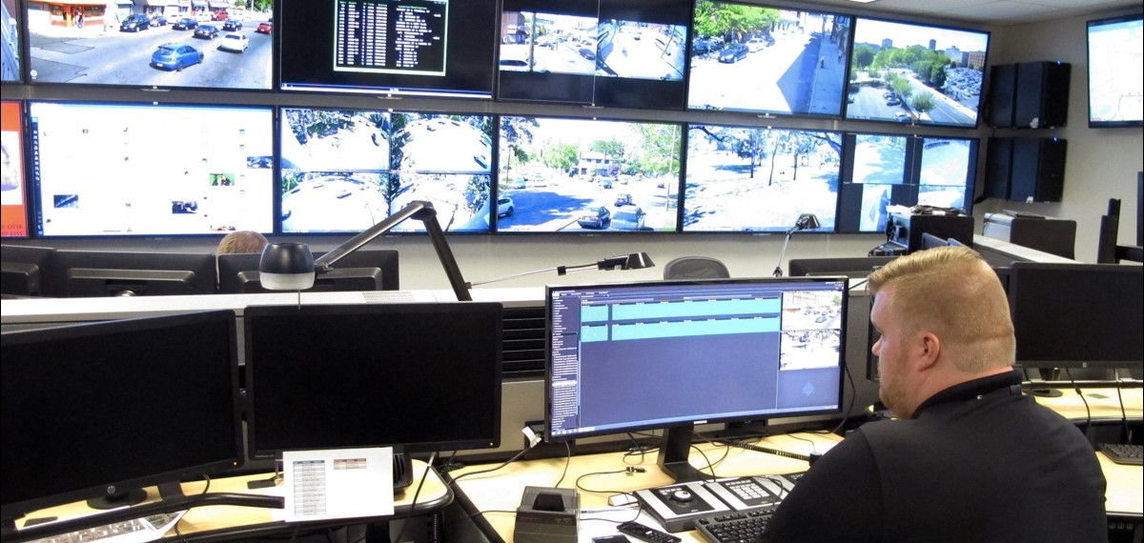
Processing Police Databases
Xuhao Zhang
AI can make better use at the existing police database
Shorten the time for police officer to browse through the data and make connections
AI can either provide an exact answer or data that is relevant
[1]
Notes:
As we all know, both police and law enforcement agencies have databases with all kinds of information on past suspects and crimes. However, without AI technology, the database are not used to its full potential. It would easy for police officers to take too much time to manually browse data and try to make connections, sometimes the connection could be hidden too far to detect with naked eyes. But with machine learning, even if the machine is not able to provide an exact answer, it could still give data that is relevant

Slide 23
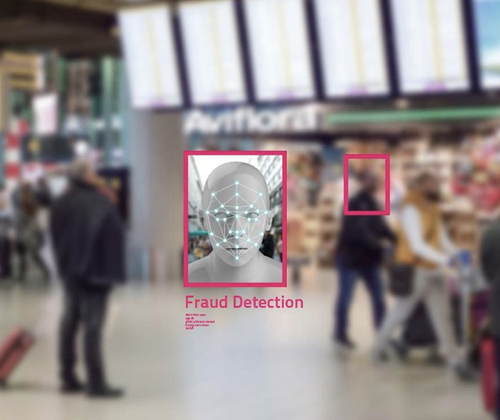
Drawbacks and Concerns
Xuhao Zhang
Using the conclusion from software could be challenged by lawyers
  Software owner will have to disclose all the inner algorithms or process
Bias
  Raising the risk of bias against those with disadvantaged backgrounds
  People who have contact with public services will generate more data to train AI
[1] [5]
Notes:
But there is still some drawbacks and concerns. For example, if the AI software has put together lofs of different pieces of data and came to a conclusion that a certain person did the crime. In court, the lawyer of the accused will be able to challenge this and ask the software development company how the machine conclude information. This means the software owner will have to disclose all the information about the inner working of their product to the attorney, which can be a problem since many software are confidential. Another concern is that artificial intelligence could be bias. For people from disadvantaged backgrounds, they were more likely to have contact with public services, therefore, generating more data that could be used to train the AI.

Slide 24
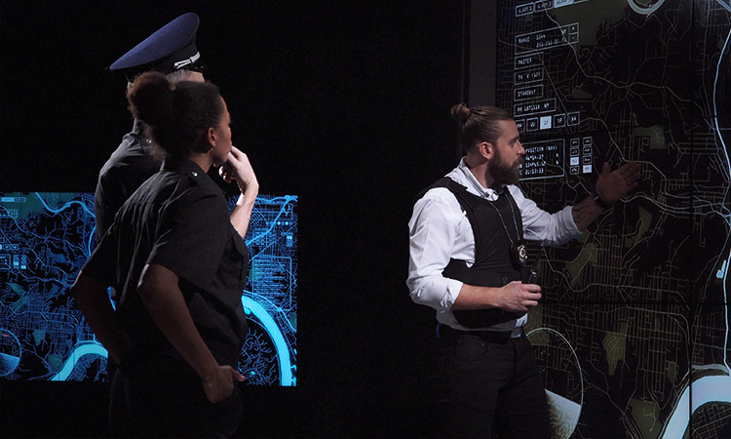
Future of the ai in police work
Xuhao Zhang
Predictive Policing
  Predicting crime location
  Analyze crime rates and develop a map of crime hot spots
Robots
  Replacement police officers
  Street robots: transmit data back to headquarters
  Dangerous locations
[2] [4]
Notes:
For the future of the AI in police work, I am only going to introduce the idea of predictive policing and robotics policing. AI predative policing is refer to the ability to predict where and where and when crimes will occur, individuals who will commit them, types of crime, and possible victims. Ideally, the system could help preventing crimes. For robots, police departments now are turning to robots to handle tasks that is under dangerous situation. For some countries, they are testing out robots as replacement police officers. For example, Dubai is experimenting with street robots that can transmit data back to headquarters to be reviewed by humans. They’re also equipped with touchscreens for reporting crimes.

Slide 25
References
Xuhao Zhang
[1] Mindy News Blog, Using AI to Fight Crime/ How police Use AI (mindy-support, 24 Oct. 2019), https://mindy-support.com/using-ai-to-fight-crime-how-police-use-ai/ (accessed 20 Apr. 2020)
[2] Appen., AI in Police Work, (Appen, 12 Nov. 2019), https://appen.com/blog/ai-in-police-work/ (accessed 19 Apr. 2020)
[3] Kathleen Walch and Congnitive World, The Growth Of AI Adoption in Law Enforcement (Forbes, 26 Jul. 2019), https://www.forbes.com/sites/cognitiveworld/2019/07/26/the-growth-of-ai-adoption-in-law-enforcement/#6df8b511435d, (accessed 20 Apr. 2020)
[4] Bernard Marr, How Robots, IoT And Artificial Intelligence Are Transforming The Police, (Bernard Marr & Co., n.d.), https://bernardmarr.com/default.asp?contentID=1170 (accessed 20 Apr. 2020)
[5] Patricia Nilsson, Police fear bias in use of artificial intelligence to fight crime, (Financial Times, 15 Sep. 2019), https://www.ft.com/content/5753689c-d63e-11e9-a0bd-ab8ec6435630, (accessed 20 Apr. 2020)
[6] Chris Baraniuk, The new weapon in the fight against crime, (BBC Machine Minds, 3 Mar. 2019), https://www.bbc.com/future/article/20190228-how-ai-is-helping-to-fight-crime, (accessed 20 Apr. 2020)

Slide 26
EARN IT Act of 2020
Elie Hess

Slide 27
Earn it act
Elie Hess
Eliminating Abusive and Rampant Neglect of Interactive Technologies Act of 2020
Bipartisan bill proposed March 5, 2020 to the U.S. Senate
Companies must earn liability protection for violations of child sexual abuse laws
Establishes a bipartisan commission to prevent online sexual exploitation of children
Commission will establish “best practices” with which applicable companies must comply
[1] [2]
Notes:
“Online platforms’ near complete immunity from legal responsibility is a privilege – they have to earn it” – Sen. Richard Blumenthal, co-sponsor [2]

Slide 28
Problems with earn it
Elie Hess
What constitutes “best practices” is unknown - such a term is too broad.
Potential Constitutional issues:
  “Best practices” cannot selectively apply Section 230 to coerce entities to give up their 1st Amendment right to make editorial choices
  “Best practices” also cannot coerce companies into scanning users’ data and giving it to the government under the 4th Amendment
Ethical issues:
  Government-dictated moderation infringes upon the principle of free speech
  Downfall of end-to-end encryption
[3]
Notes:
Section 230 of the Communications Decency Act provides corporations immunity from consequences for things users upload on their site. [3]
Companies can become subject to 4th Amendment if intending to assist law enforcement [3]

Slide 29
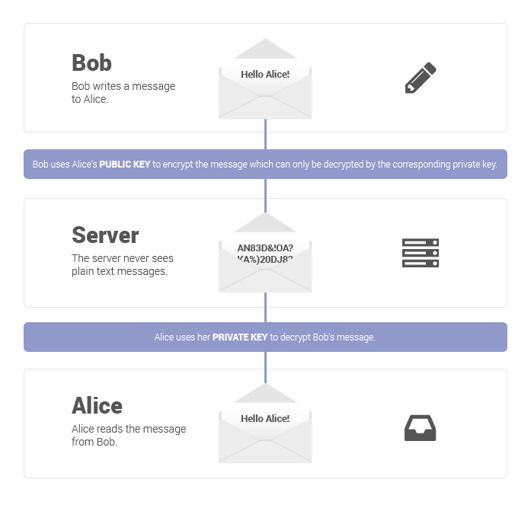
End-To-end encryption
Elie Hess
When sending a message, encrypt it with the recipient’s public key. The message can only be decrypted using the recipient’s private key.
Messages are never decrypted except by the recipient
Benefits:
  Harder for hackers to access
  Only the recipient can read messages
  Good for democracy
[4]
Notes:
Nobody else can read encrypted messages, not even the company facilitating the communication
Harder to hack: hacking the server doesn’t grant access to messages
Good for democracy: since government can’t read messages, people are free to express unpopular opinions

Slide 30
Earn it act and end-to-end encryption
Elie Hess
While the bill doesn’t explicitly mention encryption, its authors make their intent clear
  “Facebook is talking about end-to-end encryption which means they go blind … We’re not going to go blind and let this abuse go forward in the name of any other freedom.” – Sen. Lindsey Graham
Reducing encryption also makes it easier for hackers to gain access to private and/or sensitive content
  “The EARN It Act threatens the safety of activists, domestic violence victims, and millions of others who rely on strong encryption every day” – Kate Ruane, senior legislative counsel for the ACLU
Scanning messages for content related to sexual exploitation of minors allows for scanning of messages for any content
[5] [6]
Notes:
If hackers publish stolen data, a vast assortment of people will be in danger, including political activists, or closeted LGBT+ individuals, etc.

Slide 31

Conclusion
Elie Hess
The EARN IT Act of 2020 might be well-intentioned, but has more flaws than benefits:
  Too vague
  Removing end-to-end encryption would have far-reaching consequences
[7]
Notes:
“Best practices” have yet to be defined. We don’t know exactly what restrictions will be imposed
With no E2EE, people will not be able to share private information or conversations online

Slide 32
References
Elie Hess
[1] EARN IT Act of 2020 https://www.congress.gov/bill/116th-congress/senate-bill/3398/text (19 April 2020)
[2] Graham, Blumenthal, Hawley, Feinstein Introduce EARN IT Act to Encourage Tech Industry to Take Online Child Sexual Exploitation Seriously https://www.judiciary.senate.gov/press/rep/releases/graham-blumenthal-hawley-feinstein-introduce-earn-it-act-to-encourage-tech-industry-to-take-online-child-sexual-exploitation-seriously (19 April 2020)
[3] The EARN IT Act Violates the Constitution https://www.eff.org/deeplinks/2020/03/earn-it-act-violates-constitution (19 April 2020)
[4] What is end-to-end encryption and how does it work? https://protonmail.com/blog/what-is-end-to-end-encryption/ (19 April 2020)
[5] Newton, Casey. A sneaky attempt to end encryption is worming its way through Congress https://www.theverge.com/interface/2020/3/12/21174815/earn-it-act-encryption-killer-lindsay-graham-match-group (19 April 2020)
[6] Newman, Lily Hay. The EARN IT Act Is a Sneak Attack on Encryption https://www.wired.com/story/earn-it-act-sneak-attack-on-encryption/ (19 April 2020)
[7] Phillips, Kathryn. Two bad ballot measures deserve a NO on November ballot https://www.sierraclub.org/san-francisco-bay/blog/2018/08/two-bad-ballot-measures-deserve-no-november-ballot (19 April 2020)

Slide 33
Class 8
The End
Keith A. Pray
Instructor
socialimps.keithpray.net
Notes:
This is the end. Any slides beyond this point are for answering questions that may arise but not needed in the main talk. Some slides may also be unfinished and are not needed but kept just in case.

Slide 34
Buffer Overrun
Run time stack
Local Variables
Return Address
Parameters
Variable Attack
buffer
Target Variable
Stack Attack
buffer
Return Address
code
Return Address
Notes:
Retired slide. Most students have this in depth from new class now.
When a function call is made, local variables, return address, parameters stored on run time stack. Local variables occupy lower memory addresses.
Variable attack – change variable value. Program expects user to input character and allocates a buffer for them. Attacker supplies too many characters and ends up over writing a variable.
Stack Attack – goal is to change value of return address so execution control goes to code which the attacker has provided in the input buffer.
Prevention – add checks against array bounds being exceeded, or modify operating system to not execute instructions stored on run time stack.

Slide 35
Run Example Code
Notes:
Retired demonstration. Most students have this in depth from new class now.
> imps
> assembly
> 123456789qwerty1

Slide 36
Buffer Overrun Code
#include <stdio.h>
#include <string.h>
int main ( void ) {
char buff [ 15 ]; int ace = 0;
printf ( "\n Enter best class ever : \n" );
gets ( buff );
if ( strcmp ( buff, "imps" ) ) {
printf ( "\n %s is wrong! You should FAIL! \n ace=%i\n", buff, ace ); }
else { printf ( "Correct! \n") ; ace = 1; }
if ( ace ) { printf ( "You get an A! \n" ); }
return 0; }
} The Naughty Line
Notes:
Retired slide. Most students have this in depth from new class now.

Slide 37
TCP Three-way Handshake
SYN
SYN-ACK
ACK
Notes:
Retired slide. Most students have this in depth from new class now.
SYNchronize
SYNchronize ACKnowledgement (socket reserved awaiting ACK)
ACKnowledgement
TCP socket connection established

Slide 38
SYN Flood Attack
SYN
SYN-ACK
Notes:
Retired slide. Most students have this in depth from new class now.
Attacker spoofs the IP address so the SYN-ACK is sent to a different machine that cannot respond to the SYN-ACK.
This leaves the connection half open on the server machine decreasing the resources (sockets, memory, threads/processes) available to respond to legitimate clients.
The attacker send many such spoofed SYN messages.

Slide 39
Ping Attack
Target
Attacker
ping
ping
Notes:
Retired slide. Most students have this in depth from new class now.
Attacker finds routers that support broadcasting messages to all computers on their local area networks.
The attacker sends a spoofed ping message, which the routers echo to the spoofed address.

Slide 40
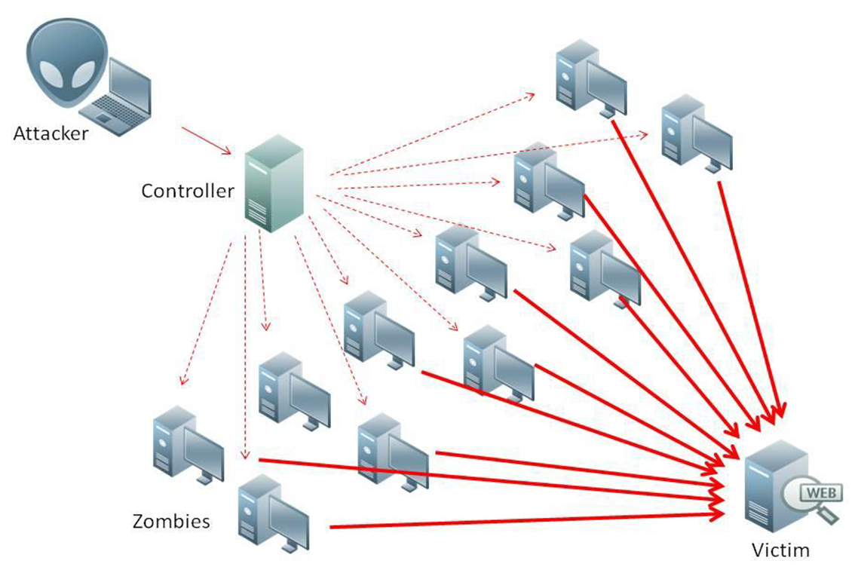
What is Denial of Service (DoS)
Attempts to make target unavailable by flooding with traffic
If victim has to filter attack, it’s too late
Internet Providers have no incentive to help
  Businesses get affected, but would not pay provider enough to make worthwhile
  This is why Cloudflare, e.g., exists
Many ways to perform this attack
Notes:
Contributed by Brett Ammeson.
https://www.cloudflare.com/ddos/reflection-attack-1.png
https://i.imgur.com/lxYv8cF.png

Slide 41
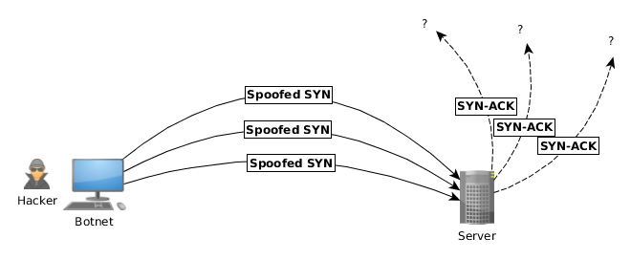
Distributed DoS Vectors
TCP SYN attack
  SYN packets are small, low difficulty for attacker
  Leaves half-open connections on server
  SYN cookies mitigate this
DNS amplification attack
  DNS requests are small
  Can request all records on server
  Crippled by proper configuration
Ingress/egress filtering will reduce effect
Notes:
Contributed by Brett Ammeson.
TCP SYN: https://www.cert.org/historical/advisories/CA-1996-21.cfm
DNS amplification: https://www.cert.org/historical/incident_notes/IN-2000-04.cfm
Ingress/egress: www.giac.org/paper/gsec/705/egress-filtering-keeping-internet-safe-systems/101588

Slide 42
Crime How
Technical and Non-Technical
  Break into computer.
  Prevent access to computer.
What things make computer related crime easy?
Notes:
Exploit security holes, Break encryption, Spoofing
Social Engineering: Guess passwords, Find out passwords and procedures
Poor passwords, Insecure protocols, Program limitations (buffer overruns), Eavesdropping (Email, Interactive), Insecure files

Slide 43
Crime Bane
Trojan Horse
Virus
Worm
Bot Network
Buffer Overrun
(Distributed) Denial Of Service Attack
How do they work?
How harmful are they?

Slide 44
Crime Why
Why?
Notes:
Money: stolen credit cards, change records, stolen property.
Political, military, economic.
Challenge, Revenge, Mean
Why do at all? Have motivation, think about it, think it will help, think it’s acceptable.
Feel forced. Don’t agree. Don’t care.

Slide 45
Crime Time
What is different now compared to:
  10 years ago?
  20 years ago?
  30 years ago?
  40 years ago?
Notes:
More computers. Unsophisticated owners. More complex software. Greater connectivity. Easy access to cracking tools. Incentives. File-sharing
In ’60s and ’70s, access was mostly localized.
Modems. Wardialing.
Some Arpanet and Usenet.

Slide 46
Crime Doers
Hacker or Cracker
  Pre-1980 - Golden Age ☺ ?
  Eighties
  Nineties
  Naughts
Criminal Hacking == Cracking?
Notes:
Script kiddies
Phreakers
Security analysts
Packet monkey

Slide 47
Crime Gain
Justifications for Computing Crimes?
What can be done after access is gained?
  What resources are available?
  How valuable are they?
Notes:
Machines are unused. No harm done. Education. Exposes security holes. Exposes abuses.
Use computer and/or resources. Take data. Destroy data. Alter data. Lock out others. Attack other computers.
Equipment, Processor Time, Disk space, Printer time / paper, Bandwidth

Slide 48
Crime Pay
Computer Fraud and Abuse Act (1986)
  Bans :
    unauthorized access or use of computers, copying, modifying, or destroying data, disclosing of passwords.
    disrupting government and utilities.
  Covers government, financial, medical, and interstate systems.
USA Patriot Act (2001)
  Raised penalties.
  Permits freer surveillance and monitoring to detect illegal activity.
Electronic Communications Privacy Act
  Illegal to intercept telephone, email, other data transmissions, access stored email messages without authorization
Assign Cybercrime Treaty (2006), Wire Fraud Act, National Stolen Property Act, Identity Theft and Assumption Deterrence Act
Notes:
Are either of these laws still in effect? Have they been changed?
For additional legislation ask for presenting volunteers to brief recent incidents/cases.
Also ask for volunteers to find out laws from their home country/state.

Slide 49
Crime Stop
Technical
  Protect Data
  Protect Machine
  Protect Access
Non-technical?
  Social?
  Legal?
Notes:
Encryption, Authentication, Biometrics, Anti-virus, File integrity checking (E.g. Tripwire), Virtual private networks, Point-to-point networking (Twisted-pair Ethernet vs. Coax vs. wireless)
Security through obscurity, physical access required, not on network, behind locked doors.
Remove desire, remove incentives
Legalize, increase penalties, increase chance of getting caught.

