Slide 1
Class 7
Privacy and Government
Keith A. Pray
Instructor
socialimps.keithpray.net
Notes:
After this class we will be half done with the course… very sad I know.
Play Somebody’s Watching Me (1984) – Rockwell (3:36)
https://www.youtube.com/watch?v=7YvAYIJSSZY
Be the envy of all your classmates if you know the band and/or year:
Rockwell (1984) Michael Jackson sings chorus and Jermaine Jackson on backing vocals.

Slide 2
Let’s keep track of what works well Online and Remote
Sign in with First and Last Name
Stay muted unless you are going to speak
To speak use the raise your hand feature
To answer yes/no questions use the “yes” ”no” buttons
Chat is fine for questions
Turn your camera on if possible
Wait until the end of student presentations to ask questions
  Write them down so you don’t forget
Others?

Slide 3
Overview
Review
Assignment
Students Present
Notes:
Review before debate in case anyone unsure of something in reading

Slide 4
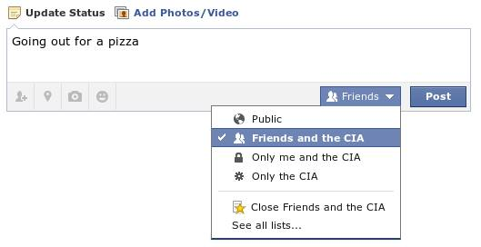
Notes:
Source?
Let’s see who said the government should make a law requiring ID for Internet access. Let’s debate!
Previous:
Let’s see who said National ID yes and no. Let’s debate!

Slide 5
My Reading Notes
pp. 276 Any examples from the last 25 years? Arrests, altering and deleting records are violations of privacy?
pp. 277 Why not try to verify and correct records?
pp. 278 Figure does not show # cameras increasing.
pp. 279 300 times = frames, locations, …? More police drones since 2013?
pp. 296 Shouldn’t credit card issuers take “reasonable steps” to verify identity all the time?
pp. 297 Any syndromic system successes in the last 15 years?
pp. 301 Confusing false positive and negative explanations. Not correct use of “Orwellian”
pp. 305 E-ZPass now mandatory on Mass Pike…
pp. 310 # 17 Interesting but not computing related
End of Chapter questions: 1, 18
pp. 319 “Since I have done nothing wrong, why should the government be investigating me?”

Slide 6
Debate Ground Rules
Before Debate
  15 minutes to converse with your team
  Share argument points, counter points, and responses so everyone can represent
  Decide who will respond to what points from the opposing side
During Debate
  1 minute opening statements (what you hope your answer will accomplish)
  Stand up when speaking
  1 turn per person until everyone on your team has spoken
  30 second limit (elect a timekeeper)
  Switch sides at any time if you change your mind
Notes:
Government should make law requiring ID for Internet Access Debate
Previous:
National ID or Not Debate

Slide 7
Group Quiz
List two problems with using biometrics for identification.
List two advantages of using biometrics for identification.
Describe two tools people can use to protect their privacy on the Web.
For each of the 4 categories of Daniel Solove’s privacy taxonomy give an example not listed in the book.
Notes:
Only if need to fill time, Orwellian video better use of time if we’ve not seen it yet.

Slide 8
Overview
Review
Assignment
Students Present

Slide 9
Assignment – Group Project
Catch up on reading
Analyze for all topics covered to date
Add list of computing technology portrayed
See group project slide deck for more
-----
Mid Term Survey on Canvas → Quizzes
Notes:
Movie group project:
List of computing technologies portrayed in movie on website
Categorize computing technologies as existing, future, emerging, impossible or plausible with rationale
Analyze movie for all topics covered to date
Technology group project:
Analyze computing technology for all topics covered to date
Add list of fiction (movies, books, TV, short stories, etc.) portraying your computing technology

Slide 10
Overview
Review
Assignment
Students Present
Notes:
What "Orwellian" really means - Noah Tavlin (5:31)
http://ed.ted.com/lessons/what-orwellian-really-means-noah-tavlin

Slide 11
Public safety vs. privacy
Keming Wang
Notes:
There are currently 770 million surveillance cameras installed worldwide and 70 million in United States, which means 4.6 people in US share 1 camera. And acts like the PATRIOT and FISA enabled US government unwarranted check of private data for security screening. While the definition of public safety is welfare and protection for the general public and privacy is the control over personal information access, the question I would like to address is whether the collection and disclosure of private data for surveillance is acceptable and under what conditions.

Slide 12
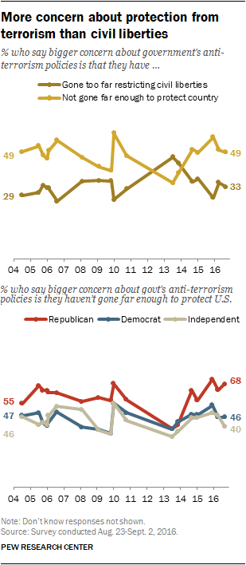
An Urge for protection
Keming Wang
Majority of Americans believe Snowden should be prosecuted when the leak surfaced.
More concern that anti-terrorism programs don’t go far enough than civil liberty
Most accepting of personal data collection to assess terrorist threats but worrying for other data use.
[3]
Notes:
I was surprised enough to find out that most of the Americans were supportive about prosecuting Edward Snowden for imposing a threat towards national security when the leak of PRISM surfaced. And according to a study in 2016, throughout the years from 2004 -2016, compared to those who were concerned that intelligence surveillance programs may pose restrictions on civil liberty, more people in United states thought that the intensity of anti-terrorism programs were still not enough. On the other hand, while most of American thought the investigation of personal data for the purpose of assessing terrorist threats to be acceptable, they were worried that their personal data could be used by the government for other purposes.

Slide 13
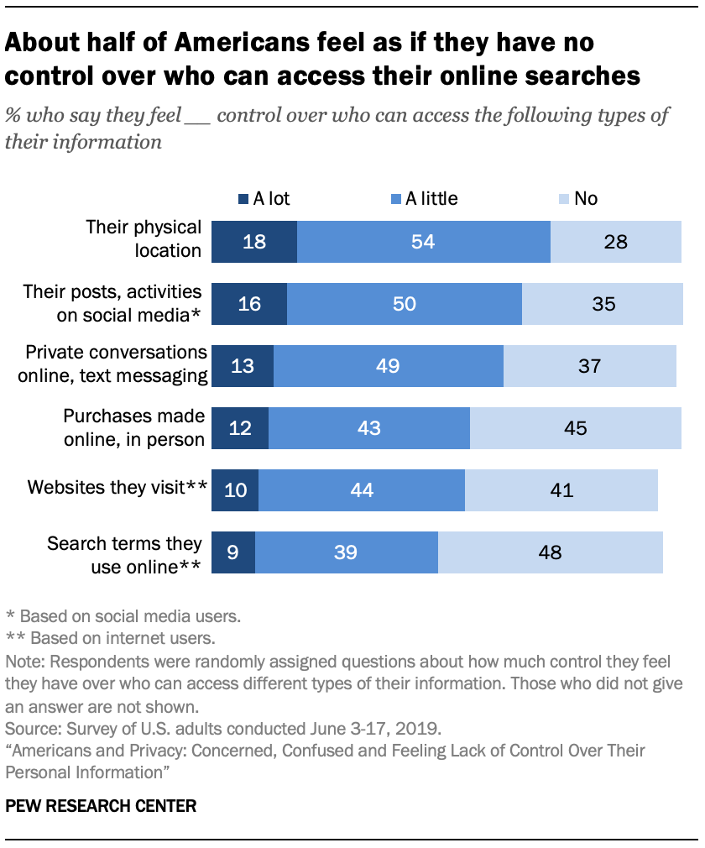
People feel lack of control over their personal information
Keming Wang
Data collection poses more risks than benefits.
It is not possible to go through daily life without being tracked
Greater Awareness of government monitoring ties to less confidence in privacy and security of personal data
Disapproval of data collection for anti-terrorism outweighs approval
<Graphic as big as will fit>
[1], [2]
Notes:
Although people seem to be demanding more protection from the government, it starts to get more contradictory under closer examination. As shown by a study done in 2019, more than half of people in US reported that they feel a lack of control over their personal information and thought it is impossible for them to go through everyday life without leaving traces of their private information that could be tracked by either the government or businesses. And the private information which they believe to be losing control of ranges from their physical location, search terms used online, to their private text messages. It is also shown that the greater people’s awareness of government monitoring, in other words, the more people heard of the intelligence surveillance programs, the less confidence they feel about the security of their personal data with more suspicion that the data would be used improperly rather than for the sole purpose of security after being obtained by the government. In the end of the study, the percentage of people disapproving data collection for anti-terrorism and security outweighed that of people approving.

Slide 14
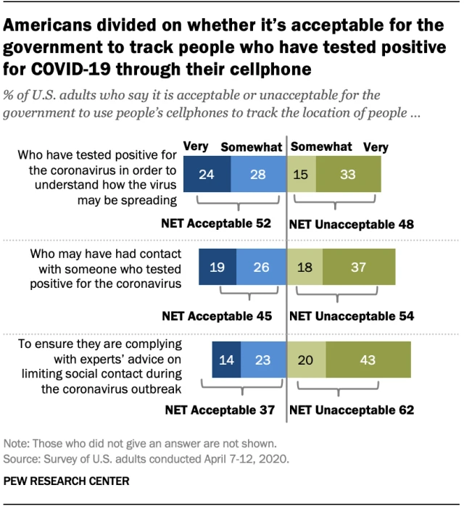
Effectiveness of public surveillance
Keming Wang
Saving lives by disrupting terrorist attacks
Destructing syndicates and reducing crime
controlling epidemic outbreak
[7], [10], [11]
Notes:
Despite the widespread uneasiness it has imposed upon people, the intelligence surveillance programs do have their merits. According to the interview of an NSA officer, 54 terrorist attacks were thwarted from year 2006 to 2016 and thousands of lives were saved as a result of information collected by surveillance programs operating under the PATRIOT and the FISA act. Also, accurate intelligence about criminal and terrorist activities combined with advanced surveillance equipment like military drones facilitate precise target-eliminating operations like targeted attack on Qaeda which effectively destruct syndicates with minimal impact on the public. In addition, recent camera surveillance systems with embedded sensors can detect unattended packages and radiation sources and raise alerts during passive surveillance. They are also capable of search for suspect with given features during active surveillance which help police locate and eliminate crimes faster. Further, syndromic surveillance systems collecting data from the health system can forecast and forestall the outbreak of epidemics (why doesn’t it work this time?). And as shown in the slide, most people consider the government’s cellphone location tracking of people tested positive of COVID-19 acceptable for public health measures.

Slide 15
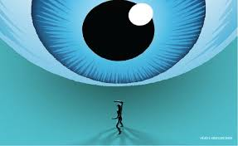
Infringement upon privacy and Rights
Keming Wang
Innocent people might be wronged for flaws in the surveillance system.
Leak of sensitive personal data due to corruption and criminal abuse
People with experimental opinions are less willing to express freely
[6], [8], [9]
Notes:
However, public surveillance can also infringe upon people’s privacy and rights due to imperfections in technology and human nature. Brandon Mayfield, if you remember, was falsely convicted for the Spain railway bombing as a result of fingerprint misidentification. And innocent people can be wronged by flaws in surveillance systems. Also, sensitive data obtained by the government for investigation might be leaked for profit due to corruption. What’s worse, if the system is compromised by abusive hackers, countless people will be subjected to information leak and blackmailing. Further, with the awareness of government monitoring, people with experimental or anti-mainstream opinions might become less willing to express freely in order to avoid potential attention from the agencies.

Slide 16
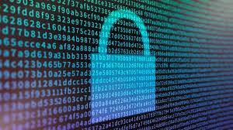
Anti-eAVES DROPPING EFFORTS
Keming Wang
Message encryption
Law enforcement has realized that encryption is potentially a threat to their ability to do wiretapping and accessing data using the tools they’ve become accustomed to. ---Matthew Green, associate professor of computer science at Johns Hopkins University
It is extremely hard that information is encrypted and private and still accessible to law enforcement when needed
[4], [5]
Notes:
As we can see today, many new technologies rise in response to the ever-increasing surveillance power. Chatting software like telegram, LINE with end-to-end message encryption keeps the text secret by preventing intercepted messages to be decrypted. In 2019, Facebook’s attempt to implement end-to-end encryption for Messenger was held off by law enforcement agencies in Australia, UK and US. “ Law enforcement has realized that encryption is potentially a threat to their ability to do wiretapping and accessing data using the tools they’ve become accustomed to” said Matthew Green from Johns Hopkins University. While encrypted chat, the Onion router and bit coins provides full anonymity and privacy, they could also become out-law zones for criminal activities to develop unchecked. “It is extremely hard that information is encrypted and private and still accessible to law enforcement when needed.” said Green.

Slide 17
Surveillance is acceptable
<Your Name>
As long as it serves solely for the protection of the public. While infringement upon privacy and personal right cannot be totally prevented, it is important that the government’s monitoring power remains checked.
Notes:
As we’ve discussed about the power and flaws of public surveillance systems, I would like to end my presentation with the conclusion that surveillance is acceptable as long as it serves solely for the protection of the public. While infringement upon privacy and personal right cannot be totally prevented, it is important that the government’s power remains checked. And new laws and regulations preventing potential abuse of the systems are necessary to facilitate a more effective and impartial public safety.

Slide 18
References
Keming Wang
1. Lee Raine, Mary Madden, Americans’ Privacy Strategies Post-Snowden (Pew Research Center, 2015), Retrieved from https://www.pewresearch.org/internet/2015/03/16/americans-privacy-strategies-post-snowden/ (Accessed 4/16/2020)
2. Brooke Auxier, et.al, Americans and Privacy: Concerned, Confused and Feeling Lack of Control Over Their Personal Information (Pew Research Center, 2019), Retrieved from https://www.pewresearch.org/internet/2019/11/15/americans-and-privacy-concerned-confused-and-feeling-lack-of-control-over-their-personal-information/ (Accessed 4/16/2020)
3. N.d., The state of privacy in post-Snowden America (Pew Research Center, 2016), Retrieved from https://www.pewresearch.org/fact-tank/2016/09/21/the-state-of-privacy-in-america/ (Accessed 4/16/2020)
4. N.d., Does encryption help with privacy, or does it violate public safety? (Marketplace Tech, 2019), Retrieved from https://www.marketplace.org/shows/marketplace-tech/does-encryption-help-with-privacy-or-does-it-violate-public-safety/ (Accessed 4/16/2020)
5. Talia Klein Perez, Does National Security Outweigh the Right to Privacy? (The Perspective, 2017), Retrieved from https://www.theperspective.com/debates/living/national-security-outweigh-right-privacy/ (Accessed 4/16/2020)
6. Jon Evans, Personal Privacy Vs. Public Security (Extra Crunch, 2018), Retrieved from https://techcrunch.com/2018/05/06/personal-privacy-vs-public-security-fight/ (Accessed 4/16/2020)
7. Michlle Cayford, Wolter Pieters, The effectiveness of surveillance technology: What intelligence officials are saying (The Information Society, 2018), Retrieved from https://www.tandfonline.com/doi/full/10.1080/01972243.2017.1414721?scroll=top&needAccess=true (Accessed 4/16/2020)
8. N.d., What’s wrong with public video surveillance? (ACLU, N.d.), Retrieved from https://www.aclu.org/other/whats-wrong-public-video-surveillance (Accessed 4/16/2020)
9. Patrick Toomey, The NSA Continues to Violate Americans’ Internet Privacy Rights (ACLU, 2018), Retrieved from https://www.aclu.org/blog/national-security/privacy-and-surveillance/nsa-continues-violate-americans-internet-privacy (Accessed 4/16/2020)
10. Monica Anderson, Brooke Auxier, Most Americans don’t think cellphone tracking will help limit COVID-19, are divided on whether it’s acceptable (Pew Research Center, 2020), Retrieved from https://www.pewresearch.org/fact-tank/2020/04/16/most-americans-dont-think-cellphone-tracking-will-help-limit-covid-19-are-divided-on-whether-its-acceptable/ (Accessed 4/16/2020)
11. Paul Bernal, Data gathering, surveillance and human rights: recasting the debate (Journal of Cyber Policy, 2016), Retrieved from https://www.tandfonline.com/doi/pdf/10.1080/23738871.2016.1228990?needAccess=true (Accessed 4/16/2020)

Slide 19
Implications of Drone Deliveries
PJ Mara
Notes:
Presentation should last 8 minutes
Hello everyone! I’ve been interested in drones for a while know, and how they can impact the world around us. In this presentation, for simplicities sake, I’m going to refer to the term “Drone” to mean unmanned flying vehicle with a camera on it. I will specify manned different types of drones as I need to, such as m

Slide 20
Question(s) to answer
PJ Mara
How will advancements in drone delivery technologies transform our lives?
Is society ready for drones?
Notes:
I started out with this first question, How will advancements in drone delivery technologies transform our lives?
After researching the topic, I found many convincing arguments about if widespread drones were a good idea, needed, but also some convincing arguments that we should be staying away from drones. So I switched my focus into contrasting the needs for these technologies vs the costs, moral or monetary. And I asked is society ready for drones? The purpose of answering this question is to examine how far down the line the technologies are from being implemented mainstream, and what will need to change for the technology to be adopted?
Spoiler alert- Society is not ready for widespread drones yet, but there are some applications being developed that make a very compelling case for it.

Slide 21

Presentation Overview
PJ Mara
Current work in drone industry
Current roadblocks in industry
Privacy Concerns / Public Opinion
<Graphic as big as will fit>
https://icons8.com/icons/set/clipboard--v2
Notes:
Current work to give a background to some possible cases for drones use
Then I’ll go into something blocking or slowing much of the progress
Finally I’ll finish with some opinions of my own and Public opinion on the matter

Slide 22
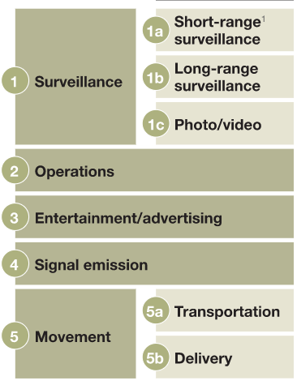
Current Work in Drone INdustry
PJ Mara
Surveillance
  Military, Search and Rescue
  Disaster Assessment
  Agriculture monitoring
  Taking cool photo/video!
[1]
Notes:
The government has been using drones in the military for quite some time as a surveillance tool. This is a widely known fact. Some more novel uses that are springing up are disaster assessment for insurance companies. It is a fast and automated way to see exactly what damage has been done. Another creative surveillance use is being used by farmers. A company called American Robotics sells a complete package for farmers looking to automate collecting information about their crops. Drones are also just a fun consumer product (for now) that take some unique pictures and videos.

Slide 23
Current Work in Drone Industry
PJ Mara
Window washing
Lights shows
Signal passing in high load areas
[1]
Notes:
I’m going to skip over this one for the most part, as its societal impacts seem to be fairly minimal as of now. Drones can complete dangerous operations such as window washing, entertain humans in a light show, or help spread a network load in remote areas or high load times.

Slide 24
Current Work in Drone Industry
PJ Mara
Movement
  Transporting humans (far future!)
  Delivering to remote areas
    1 Billion people without access to all season roads [3]
  Faster standard deliveries [1]
[1], [3], [8]
Notes:
The other important section- movement. Transportation is its own interesting subject, but it is so far off that it is hard to speculate the future for this area. One of the first positive examples in the public eye was given during a ted talk by Andreas Raptopoulos in 2013 that spoke about on medicine delivery in Lesotho there is an extreme lack of transportation infrastructure, making it difficult for medical supplies to be delivered. They fixed the problem with drones. The talk cited that 1 billion people around the world did not have access to all season roads, which would knock our normal delivery methods. Cases like these are ones that are marketable for the industry and are a positive for most public opinion. Starting to creep into the controversy, Amazon and UPS have tested drone delivery systems that could either replace traditional trucks or likely work with them. A swiss company named Matternet also flew some test medical samples just weeks ago in north Carolina. They cut down a 30 minute drive to a 3 minute flight. There are many roadblocks for both of these systems creeping into the mainstream.

Slide 25
There Are Industry ROadblocks
PJ Mara
Layers of Regulation in the way of any rapid progress
Example: Palm Beach Island, FL
  Federal Aviation Regulations
  State of Florida’s Freedom from Unwarranted Surveillance Act
  Palm Beach County’s ordinance prohibiting model airplane flights in county parks
  Palm Beach Island’s drone ordinance
Some local laws enacted from consumer drone market
FAA Regulations
State Regulations
Local Regulations
[2]
Notes:
For better or worse, there is a lot of governmental regulation on drones and their use. One of the main challenges slowing down research and experiments in drone technology is the layers of governmental regulation. For example, the FAA has regulations, rules, and waivers that companies need to complete to test certain drone technologies. However, this is not the only factor that these companies have to take into account. State government also has its own layer of rules surrounding drones, and even local governments have their own rules for it as well.
The article I read about this was by a drone Lawyer (a job which I didn’t even know existed…) and he spoke about a place he used to live in Florida where he would be under four different pieces of legislation when it came to drone flight. [read 4]. The point here is there are many expensive roadblocks to overcome just to test drone technologies other than just developing the technology. All of these layers of regulation have waivers and forms to get around them but it takes time to fill out.

Slide 26
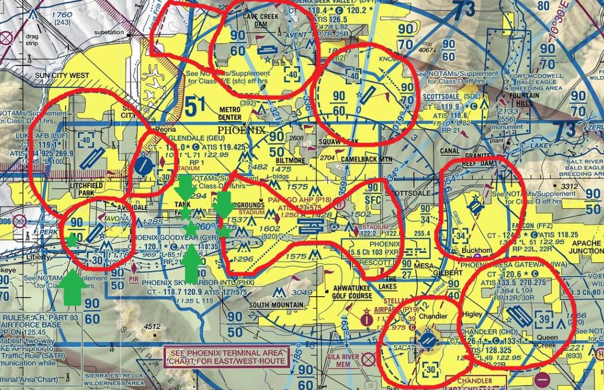
There Are Industry ROadblocks
PJ Mara
Urban Locations (high population) near airports where flying is not allowed at all
[2]
Notes:
A second major roadblock are no fly zones due to airports. Many urban areas where population is highest and most dense could be hampered by these no fly zones, which are very unlikely to change in the near future.

Slide 27
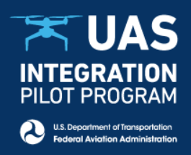
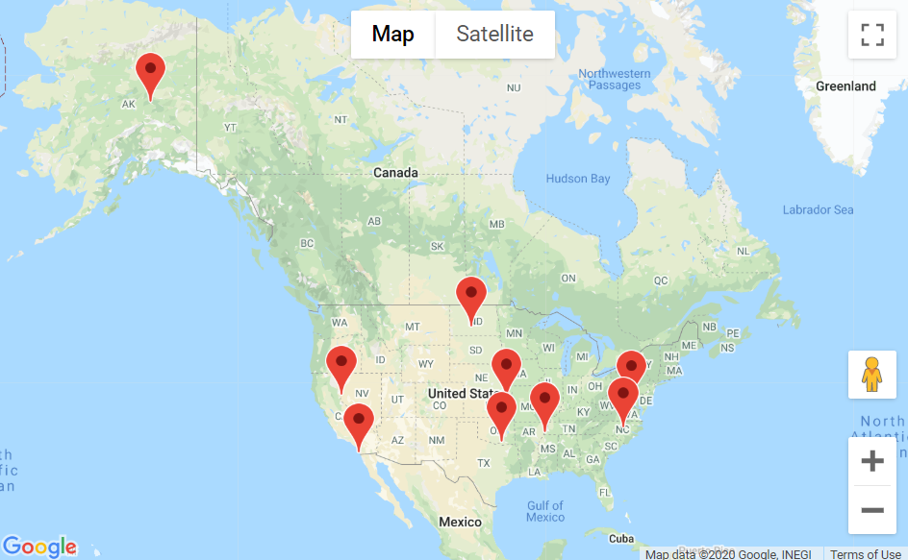
Aside: Programs to solve regulatory challenges
PJ Mara
There are some programs setup by FAA to explore deregulating
[5]
Notes:
As an aside, this legislative problem is recognized by the FAA and they have programs such as the UAS (Unmanned Ariel System) integration pilot program. Its kind of a funny name to call it a pilot program while many areas of the program is flight without a pilot but I guess that’s just my opinion. The four goals of the program are (Ripped straight from the website):
Identifying ways to balance local and national interests related to drone integration
Improving communications with local, state and tribal jurisdictions
Addressing security and privacy risks
Accelerating the approval of operations that currently require special authorizations.

Slide 28
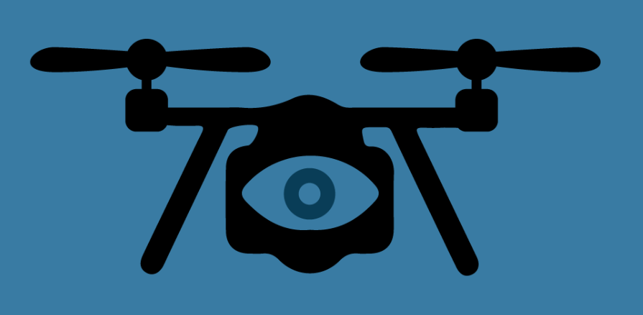
Privacy Concerns- It’s concerning!
PJ Mara
Government has developed surveillance from major jumps in tech before
  Telephone, email, online chat, see reading
  Ordering of footage from drones as evidence in court?
EFF: “Privacy law has not kept up with the rapid pace of drone technology”
[6]
Notes:
Little can be deciphered about the future of privacy concerns. According to the EFF, [EFF QUOTE]. The EFF also commented on various California police departments flying drones over protests, which is worrying. This is where I’m going to move from fact to opinion and speculation based on facts. You all read about government issuing requests for evidence from companies, to me it seems a natural extension to order drone footage if it exists. To me, that seems awfully spooky, because if these drones went mainstream they could be flying anywhere and be seeing anything. I feel at the very least if these delivery drones were to be implemented that I would worry about my privacy if the drone footage is ever stored anywhere. The government seems to be able to get its hands on evidence it needs as each new technology develops, through official legal means, or questionable methods like the Edward Snowden case. Since none of these things have actually happened yet, it is hard to tell exactly what will happen in this realm.

Slide 29
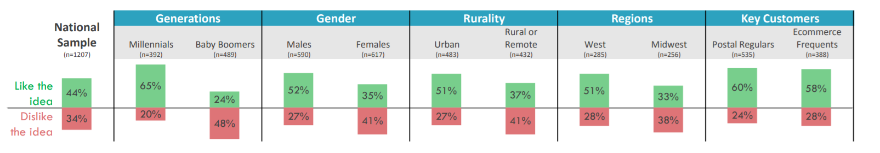
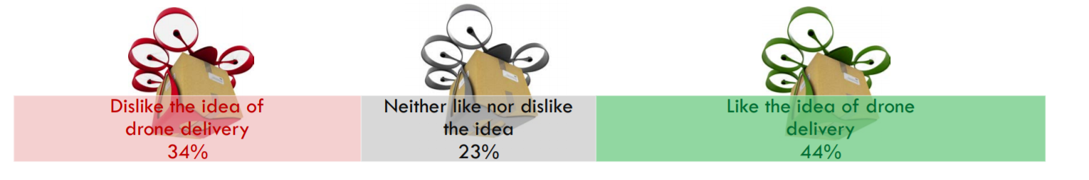
Overall public opinion
PJ Mara
Mixed opinions, with some divisions (data from 2016)
<Remove “<“ “>” from template
[4]
Notes:
Ok- back to facts. There was a fairly extensive survey done by the USPS in 2016 about drone delivery. They found if people like, disliked, or felt neutral about drone delivery. This response was also broken down by a couple of demographics. I think the most interesting one was the age divide, where only 24% of baby boomers approved of the idea. Not to be left out though, the Males vs. Females divide is also significant, with 52% of males approving compared to 35% females.
Given everything you know about this topic right now, I just want to see where you all land on the subject.

Slide 30
Implications of Drone Deliveries- Conclusions
PJ Mara
Notes:
To summarize: There are many possible cases for widespread drone use and many promising applications. For better or worse, legislation and public opinion is what will slow their use and deployment at this point. But these problems are trying to be circumvented with programs like the UAS integration pilot program. It’s hard to imagine delivery drones being widespread in the next 5 years to me, especially how autonomous cars have yet to really take over the market. There are great applications like delivering medicine in Lesotho, by Americans are not yet ready for their next amazon purchase to be shipped with a drone. I wonder if this will change due to the current pandemic and the desire for less people to be handling each package or piece of mail, but it remains to early to be seen.
Thanks for listening, on the next slide is references, any questions?

Slide 31
References
<Your Name>
[1] Pamela Cohn, Alastair Green, Meredith Langstaff, and Melanie Roller, Commercial drones are here: The future of unmanned aerial system (McKinsey, Dec 2017) https://www.mckinsey.com/industries/capital-projects-and-infrastructure/our-insights/commercial-drones-are-here-the-future-of-unmanned-aerial-systems (Accessed 4/15/20)
[2] Jonathan Rupprecht, Drone Delivery – 3 Big Legal Problems (2019) https://jrupprechtlaw.com/amazon-drone-delivery-3-major-legal-problems-amazon-prime-air/ (Accessed 4/15/20)
[3] Andreas Raptopoulos, No Roads? There’s a drone for that (TED, 2013) https://www.ted.com/talks/andreas_raptopoulos_no_roads_there_s_a_drone_for_that (Accessed 4/16/20)
[4] Office of the Inspector General USPS, Public Perception of Drone Delivery in the United States, (October 11, 2016) https://www.uspsoig.gov/sites/default/files/document-library-files/2016/RARC_WP-17-001.pdf (Accessed 4/16/20)
[5] UAS Integration Pilot Program (December 10, 2019) https://www.faa.gov/uas/programs_partnerships/integration_pilot_program/…(Accessed 4/16/20)
[6] Surveillance Drones (EFF, N.D.) https://www.eff.org/issues/surveillance-drones (Accessed 4/17/20)
[7] Dave Maas, Alameda and Contra Costa County Sheriffs Flew Drones Over Protests (EFF, December 2018) https://www.eff.org/deeplinks/2018/12/alameda-and-contra-costa-county-sheriffs-flew-drones-over-protests (Accessed 4/17/20)
[8] Eric Adams, UPS Drones Are Now Moving Blood Samples Over North Carolina, (Wired.Com, 2019) https://www.wired.com/story/ups-matternet-drone-delivery-north-carolina/ (Accessed 4/16/20)

Slide 32
California consumer privacy act
Pradnya Mahurkar
Notes:
Good evening everyone. My name is Pradnya Mahurkar and today I am going to talk about the California Consumer Privacy Act (CCPA). But first, I know most of us live in MA, so how does this affect us? Well, you have the right to exercise these rights for any company based in California. Secondly, you can exercise these right even if you simply visited California. And lastly, if you are a California resident, that’s awesome because you get immense power over the data stored on you by a huge range of businesses!

Slide 33
What is California consumer privacy act (ccpa)?
Pradnya Mahurkar
According to the CCPA fact sheet, California consumers have:
The right to know what personal information is being collected, stored, and used by businesses.
The right to delete personal information held by businesses and their service providers.
The right to non-discrimination when they exercise their rights under the CCPA.
The right to opt-out of the sale of personal information.
[1][2][3]
Notes:
Introduce the class to the California Consumer Protection Act by reading the text in the slide.
So how does a consumer get access to all this information? The consumer must place a request to get access to all the information stored about him/her (for free!). You could get this information in the form of a soft copy or a hard copy. As a consumer you can also get a list of third-party companies who got your data since 2019.
In case companies refuse comply with CCPA, you can also sue companies if they violate the privacy guidelines.
Important to include the the right to non-discriminate in the CCPA because there are chances that a company can penalize the consumer who exercised this right. It is important to ensure that this does not happen and the consumer feels safe while exercising this right.
You can opt out by using the “Do not sell my info” link on the link on company websites or mobile app. The last point brings me to the next slide.

Slide 34
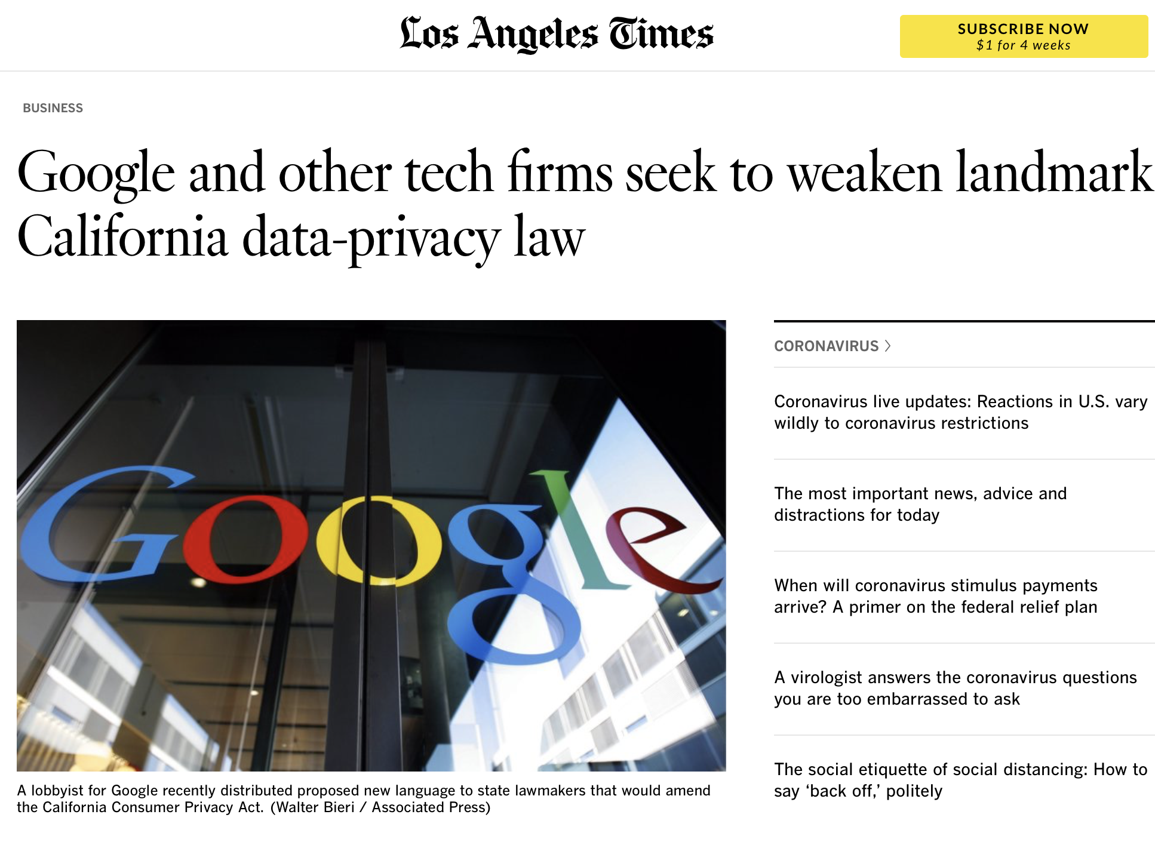
Some companies don’t like ccpa
Pradnya Mahurkar
Threatens their business model.
A major source of income is targeted advertisement.
[2]
© 2020 Keith A. Pray
34
Notes:
This part of the CCPA has been threatening a lot of business model. As seen to the right of the slide, Google and other tech firms are trying to weaken the CCPA. They want to provide the users targeted advertisements even if they don’t give consent to use their data. Because they earn billions of dollars through targeted advertisements.
During my research, I was surprised to know that the company must disclose the incentive they receive in exchange for the consumer’s information.
However, as consumers this is in your favor ☺ You get a huge amount of control over your data! You do not have to insecure about your personal information being stored and used anymore

Slide 35
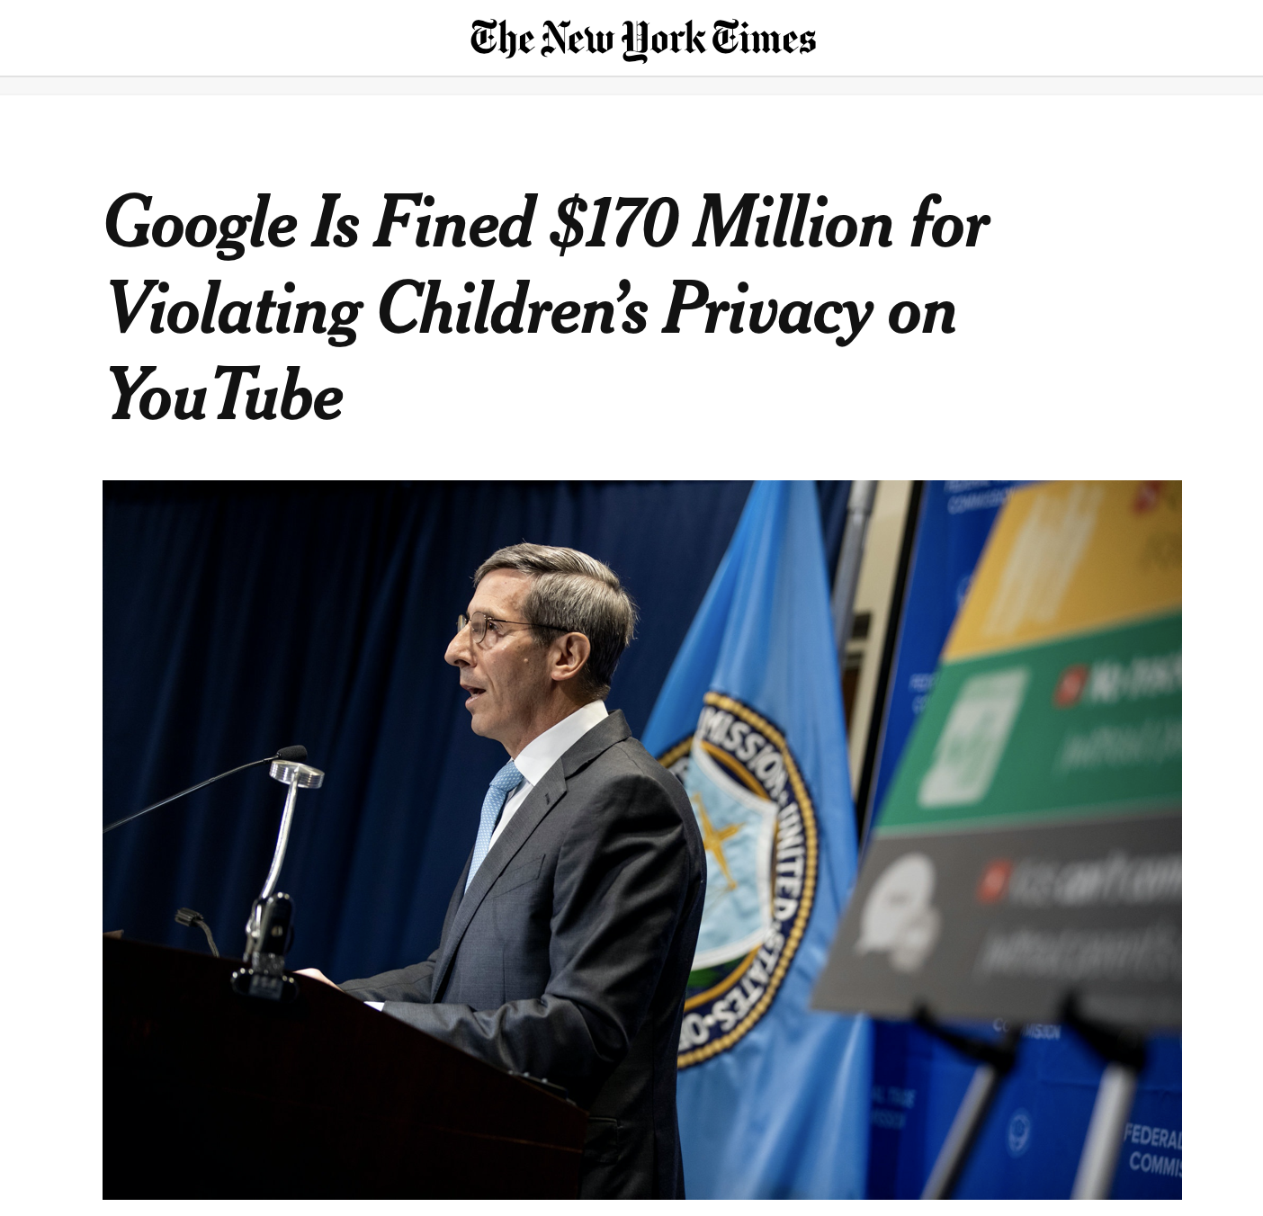
Some additional information
Pradnya Mahurkar
The law came into effect on January 1, 2020.
Applicable to only certain businesses.
Companies should have their records ready by the start of 2019
If companies are not CCPA compliant, they can be charged up to $7500 per record.
[5]
© 2020 Keith A. Pray
35
Notes:
The law was passed in June 2018, however businesses had to wait until 2019 to know what the law would look like. The law came into effect on January 1, 2020. It’s the fist law that allows transparency of consumer data.
Applicable to businesses whose gross revenue is more than $25 million, deals with information of more than 50,000 consumers, or derives more than half of their revenue from consumer data.
I would like to hear your thoughts about the fine charged for the noncompliance of CCPA since it is debatable. My thoughts are that the fine should be decided based on the revenue of a company. While a $7500 fine may be too much for a company whose revenue is $25 million, although, it might be low for companies like Facebook.

Slide 36
Conclusion
Pradnya Mahurkar
The CCPA is one-of-its-kind. It is the first law to give the consumers so much control over their personal information collected by businesses.
Other states are also trying to pass similar bills.
There is going to be an interesting change in the operation of businesses.
Such laws are important in today’s digital lifestyle.
[4]
© 2020 Keith A. Pray
36
Notes:
In my opinion, CCPA is an amazing law. It gives the consumer so much power. I observed that some people expressed their insecurity with social media and web browsing in last class’s discussion. Well now, you have the choice to opt-out of sharing your personal information. You can take a step ahead and even make sure that the company deletes your personal information.
Currently, this is for California state only. However, other states are also trying to pass similar bills. I read articles about New York, Texas, Washington, and Nevada trying to pass similar bills.
Here’s my parting shot. I am in favor of of the CCPA because:
With a digital lifestyle, we interact with websites daily who try collect information about us.
It is scary to know that your personal information is being “sold to other businesses.” A consumer consent is always appreciated before doing so.
We will be able to delete important information like our personal mobile phones, social security number, etc. from public records.

Slide 37
References
Pradnya Mahurkar
[1] California Legislative Information, California Consumer Privacy Act of 2018, (California Legislate, 2018), http://leginfo.legislature.ca.gov/faces/codes_displayText.xhtml?lawCode=CIV&division=3.&title=1.81.5.&part=4.&chapter=&article= (April 15, 2020)
[2] KARTIKAY MEHROTRA, LAURA MAHONEY AND DANIEL STOLLER, Google and other tech firms seek to weaken landmark California data-privacy law, (Los Angeles Times, September 4, 2019), https://www.latimes.com/business/story/2019-09-04/google-and-other-tech-companies-attempt-to-water-down-privacy-law (April 15, 2020)
[3] Maria Korolav, California Consumer Privacy Act (CCPA): What you need to know to be compliant, (CSO, October 4, 2019), https://www.csoonline.com/article/3292578/california-consumer-privacy-act-what-you-need-to-know-to-be-compliant.html (April 15, 2020)
[4] Jeewon Kim Serrato and Susan Ros, Nevada, New York and other states follow California’s CCPA, (Data Protection Report, June 6, 2019), https://www.dataprotectionreport.com/2019/06/nevada-new-york-and-other-states-follow-californias-ccpa/ (April 15, 2020)
[5] Natasha Singer and Kate Conger, Google Is Fined $170 Million for Violating Children’s Privacy on YouTube, (The New York Times, September 14, 2019), https://www.nytimes.com/2019/09/04/technology/google-youtube-fine-ftc.html (April 15, 2020)
Notes:
References

Slide 38
the patriot Act and Me
By: Justin Amevor
Notes:
Intro to tell class this presentation aims to inform you about how the patriot act can apply to you, why you should care about its impact on your civil liberties, and what you can do about it. First Describing the “letter of the law (by going over the two controversial sections), then seeing how they have been abused in specific cases and finally a comprehension section on understand truths and myths of the law
My argument is that the PATRIOT ACT violates everyday Americans civil liberties and it is essential to educate yourself on how it can impact you

Slide 39
What is the USA patriot act?
Justin Amevor
Uniting and Strengthening America by Providing Appropriate Tools Required to Intercept and Obstruct Terrorism Act of 2001
  Providing federal law enforcement and intelligence officials with greater authority to monitor communications
  Giving the Secretary of the Treasury greater powers to regulate banks, preventing them from being used to launder foreign money
  Making it more difficult for terrorists to enter the United States
  Defining new crimes and penalties for terrorist activity
Notes:
BRIEF explanation of the act and what it does
Law enforcement must show one of the four bullets applies when using the Patriot Act

Slide 40
Section 213
Justin Amevor
Allows for delayed notice of sneak-and-peak and sneak-and-steal warrants.
  An individual's physical safety will be endangered
  Someone will flee prosecution
  Evidence will be tampered with,
  Potential witnesses will be intimidated or,
  An investigation would be jeopardized or a trial unduly delayed.
Notes:
Pointing out the first key section that affects everyday Americans, one of the 5 bullet points need to apply for law enforcement to use the act
Law enforcement made 47 sneak-and-peek searches nationwide from September 2001 to April 2003. The 2010 report reveals 3,970 total requests were processed. Within three years that number jumped to 11,129. That's an increase of over 7,000 requests.
Of more than 11,000 sneak and peak search warrants requested in 2013, only 51 were for terror investigations.
They are using it against everyday people not terrorists

Slide 41
Section 215
Justin Amevor
Allows the government to conduct record searches held by third parties
  Allowed for mass surveillance of billions of Americans
  Was amended in 2015 after federal appeals court ruled interpretation of section 215 was “unprecedented and unwarranted”
Notes:
Brief explanation because it was covered in the book, Pointing out second key section that allowed for mass of surveillance Americans, became national headline during the Edward Snowden scandal, revised to give access to law enforcement with court order

Slide 42
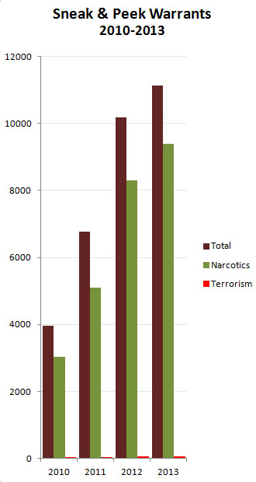
Sneak and Peak Warrants
Justin Amevor
Notes:
Graph showing warrants issued under provisions of patriot act, showing that patriot act moved away from terrorists
An argument for drug related uses of patriot act say law enforcement will have best judgment on how to use law applicable situations
The PATRIOT act was designed for terrorism, going outside of the scope violates your civil liberties and is deceptive by the government

Slide 43

Case Study #1 Steve Kurtz
Justin Amevor
Professor at University of Buffalo who worked with biological equipment
Reported his wife's death when police became suspicious of his petri dishes
Was held for 22 hours without charge under suspicion of bioterrorism
He was charged under the Biological Weapons Statue which was expanded under the Patriot Act
Notes:
Co founder of Critical Art Ensemble (CAE)
Under the patriot ACT the maximum possible sentence for these charges has increased from five to twenty years in prison
The section that appeared to be applicable to the CAE case prohibits possession of a biological agent for any purposes except “prophylactic, protective bona fide research toward educational or other peaceful purposes.”
Under the USA PATRIOT Act the maximum possible sentence for these charges has increased from five to twenty years in prison.
On April 21, 2008, the indictment for mail and wire fraud was ruled "insufficient on its face"

Slide 44

CASE STUDY #2 Adam McGaughey
Justin Amevor
Webmaster for a fan site of Canadian TV show “Stargate SG-1”
Was accused of streaming episodes of the show on his website while collecting ad revenue
Using the Patriot Act his financial records from his ISP.
Was charged with copyright infringement and computer fraud
Notes:
Three year FBI Investigation
Was issued cease and deist letters, instead of complying moved the IP overseas
His equipment was returned 8 months later than initially reported from the 60 day notice

Slide 45

Fact or Myth?
Notes:
For this section I would like people to use there yes no button to stay weather they agree or disagree with a statement

Slide 46
Statement 1
Justin Amevor
“the Patriot Act authorized federal law enforcement power to arrest and indefinitely detain material witnesses.”
Notes:
FALSE
abuses material witness statue (states you can be arrested if you have information pertaining to a crime) of fear they will flee with notice
After September 11 attacks it was used to detain people of terrorist investigations.
Patriot act did not amend article-

Slide 47
Statement 2
Justin Amevor
The Patriot Act's "new powers have allowed authorities to charge more than 400 people in terrorism investigations since the attacks of Sept. 11, 2001, and convict more than half."
Notes:
FALSE
Very little information is available about that number which is inflated
A list obtained by the Justice Department defines only 361 cases defined as terrorism investigations from September 11, 2001 to September 2004
Only 39 of these individuals were convicted of crimes related to terrorism. The median sentence for these crimes was 11 months.

Slide 48
Statement 3
Justin Amevor
The codification of delayed notice warrants in the Patriot Act "brought national uniformity to a court-approved law enforcement tool that had been in existence for decades."
Notes:
Section 213 is more focused on lowering standard for issuing warrants
Before patriot act 7 day rule was issued on delayed notices.
Patriot makes that time indefinite

Slide 49
Congressional Events
Justin Amevor
May 26 2011 - President Obama signs PATRIOT Sunsets Extension Act of 2011
June 1 2015 – sections of the originally act “sunset”
June 2 2015 – USA Freedom Act was passed
March 2020 – Senate passes 77-day extension passed until Senate resumes

Slide 50
Final Thoughts
Justin Amevor
Is government surveillance a necessary evil?
Is it okay to use the PATRIOT Act for non related terrorism purposes?
U.S Capitol Switchboard #(202)-224-3121
Notes:
Government surveillance is helpful to law enforcement in keeping us safe. Even if there has not been a lot of arrest made the act itself helps deter terrorism
The PATRIOT Act should be used specifically for terrorist related investigations, stretching the law off the will of few is exactly what poses the treat to our civil librities
The patriot act controversial provisions attack Americans everyday civil liberates. If you feel strongly about this contact your senator, session resumed last Wednesday

Slide 51
References
Justin Amevor
[1]https://cyber.harvard.edu/privacy/Introduction%20to%20Module%20V.htm Accessed 4/15/20
[2]https://www.regent.edu/acad/schlaw/student_life/studentorgs/lawreview/docs/issues/v19n1/05Shumatevol19.1.pdf Accessed 4/15/20
[3] https://www.aclu.org/other/surveillance-under-usapatriot-act Accessed 4/15/20
[4] Jim VandeHei, Bush Campaigns to Extent Patriot Act, WASH. POST, June 10, 2005, A-06. Accessed 4/15/20
[5] Reauthorization of the USA PATRIOT Act: Hearing Before the Committee on the Judiciary United States House of Representatives, 109th Congress, (2005) (written statement of James B. Comey, Deputy Attorney General, U.S. Department of Justice) at 11[hereinafter Comey Written Statement]. Accessed 4/15/20
[6] https://www.nytimes.com/2020/03/27/us/politics/house-fisa-bill.html
[7]Quinn Michael, Ethics for the Information Age Accessed, Pearson, Accessed 4/15/20
[8] https://www.eff.org/deeplinks/2014/10/peekaboo-i-see-you-government-uses-authority-meant-terrorism-other-uses
[9] Robert Hirsch, The Strange Case of Steve Kurtz, http://lightresearch.net/interviews/kurtz/kurtz.pdf

Slide 52
Class 7
The End
Keith A. Pray
Instructor
socialimps.keithpray.net
Notes:
This is the end. Any slides beyond this point are for answering questions that may arise but not needed in the main talk. Some slides may also be unfinished and are not needed but kept just in case.

