Slide 1
Class 6
Information Privacy
Keith A. Pray
Instructor
socialimps.keithpray.net
Notes:
Here’s the title slide. Excited already, aren’t you?
How did the self search paper go? Offer small group discussion instead of class wide.
Who: found a lot, very little, surprised, not surprised, creepy, share conclusions

Slide 2
Let’s keep track of what works well Online and Remote
Sign in with First and Last Name
Stay muted unless you are going to speak
To speak use the raise your hand feature
To answer yes/no questions use the “yes” ”no” buttons
Chat is fine for questions
Turn your camera on if possible
Wait until the end of student presentations to ask questions
  Write them down so you don’t forget
Others?

Slide 3
Logistics
Address email to entire course staff for quickest response time
Any course logistic questions?
Notes:
Not needed this time:
Address email to entire course staff for quickest response time
Send presentations via email as attachment.
Do not change the format, footers, etc. in the template slides.
Paper writing process: Sources → Notes → Conclusion → Argument → Counter Point → Response
Turn extra credit paper in on myWPI/Canvas and hard copy in class like regular papers
Presentations are due 24 hours before class
Use Presentation Guidelines on course web site

Slide 4
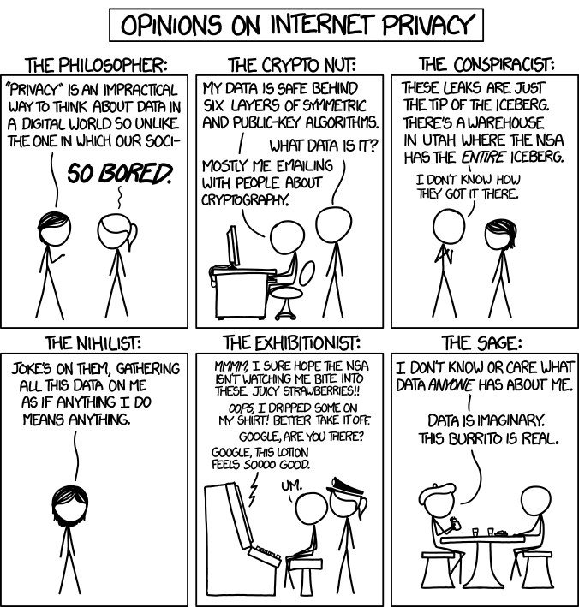
Overview
Review
Assignment
Students Present
http://xkcd.com/1269/
Notes:
1 – Accessed 2014-04-14

Slide 5
My Reading Notes
pp. 229 means to end?
pp. 230 who videotapes anymore?
pp. 231 “businesswoman” nice change. Moral capitol – source published in 1984, “taking away” “1984”
pp. 234 Hilton consent to pic being in book?
pp. 237 Many daycares monitor, any studies yet?
pp. 238 “…privacy…in their own homes…” != nanny to expect privacy “…when… insides Sullivans’ home.
pp. 244 Human chip implant sources getting old, 2002, 2004, 2007, 2010
pp. 250 2012 source same year Target outed pregnant teen to parents
pp. 255 Why did Apple not enforce policy of asking permission in the API?
pp. 245 “…by 2015” did it happen?
pp. 246 Web Browsers put cookies on on your hard drive, not Web Servers.
pp. 250 why is bills – responsibility assumption flawed?
pp. 268 Why WPI not in list?
Notes:
Find out what your DNA says about you and your family.
https://www.23andme.com/
https://motherboard.vice.com/en_us/article/xwkaz3/23andme-sold-access-to-your-dna-library-to-big-pharma-but-you-can-opt-out?utm_source=vicefbus
Jimmy Kimmel Live – What is your password? (2:49)
https://www.youtube.com/watch?v=opRMrEfAIiI
Notes updated: 2018-04-03

Slide 6
Assignment
Prepare for class debate:
Should law require you to identify yourself for Internet access?
In other words you would not be anonymous online.
  Once you’ve done the research and have decided “Yes” or “No” assign yourself to the appropriate group on Canvas:
    https://canvas.wpi.edu/courses/18085/groups#tab-5027
    Feel free to use the groups to share your research
  Come prepared with notes, facts, dates, high quality sources
  Optional One Page Paper on the topic, lowest paper grade will be dropped
Notes:
Previous Papers:
Prepare for class debate: Is a National ID System a good thing?
Come prepared with notes, facts, dates, high quality sources
You can build upon your self search work
Optional One Page Paper on the topic, lowest paper grade will be dropped

Slide 7
Overview
Review
Assignment
Students Present

Slide 8
Virtual Collective Consciousness
Antoinette Mavrotheris
Notes:
Question: How does social media put user's privacy at risk beyond data mining?
Conclusion: Peoples experiences online, specifically social media, influence their behavior and most people fall into this unspoken norm, or collective consciousness, of how to conduct themselves.

Slide 9
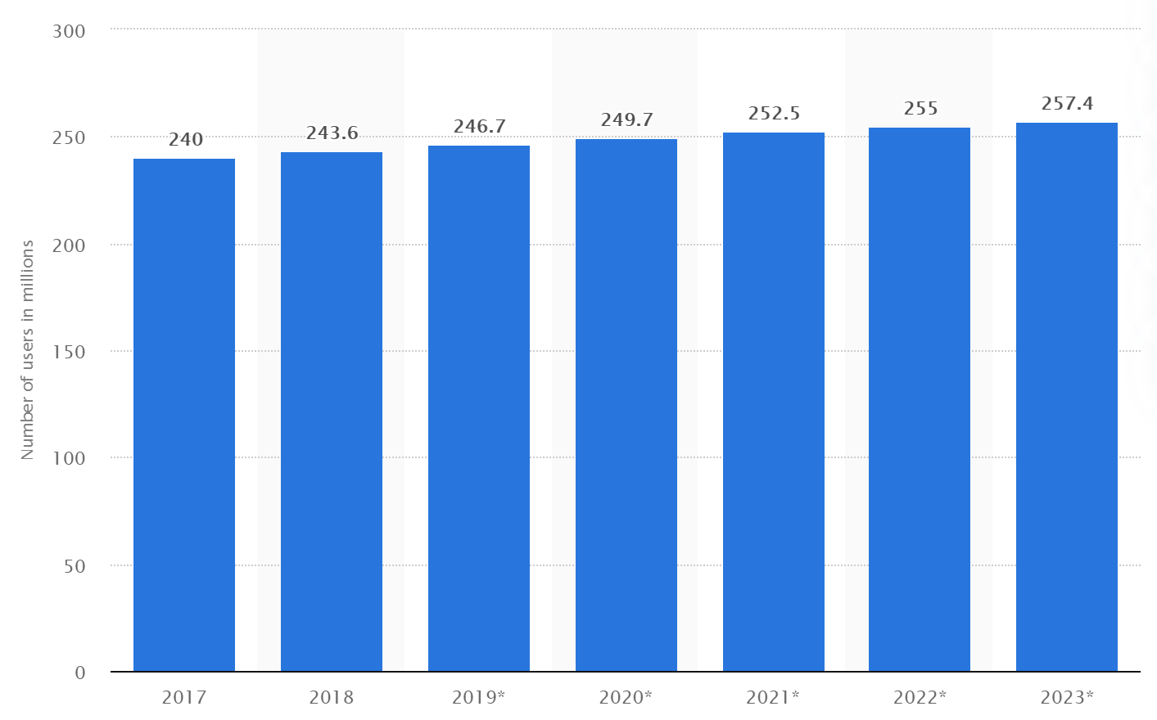
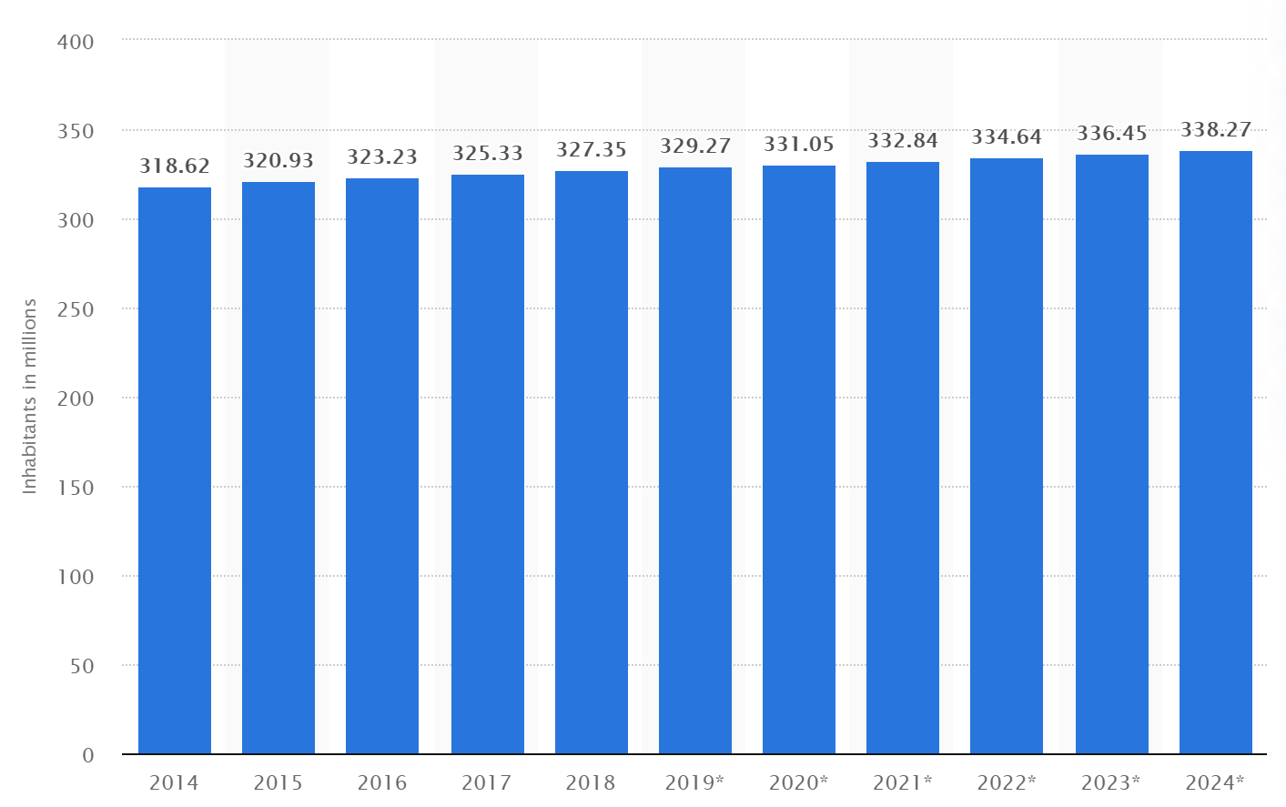
How Many People Actually use Social media?
Antoinette Mavrotheris
Social Network Users in the U.S. Projections
U.S. Population Projections
[1] [2]
Notes:
In the current year, 75 % of the U.S. population is on some social media platform.

Slide 10
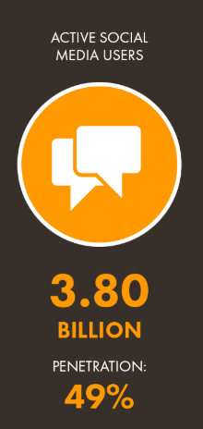
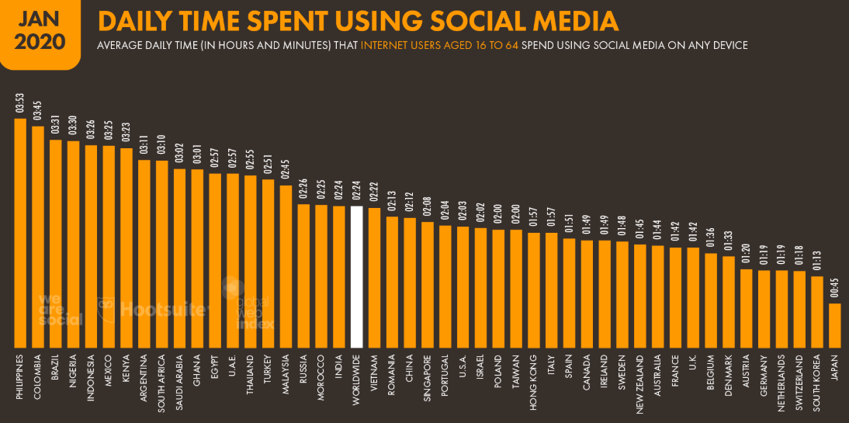
How Many People Actually use Social media?
Antoinette Mavrotheris
[3]
Notes:
In the world, 3.8 billion people are on social media, this is just under half of the entire world population. On average, these users spend 2 hours and 24 minutes on social media everyday. This is 10% of the day. If you factor in 8 hours of sleep into the day and 6 hours of work or school, that number then becomes 24%. So, roughly on average 24% of peoples free time is spent on social media. Now that you have an idea of just how large the reach of social media is I will move into my first argument.

Slide 11
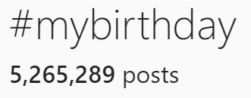
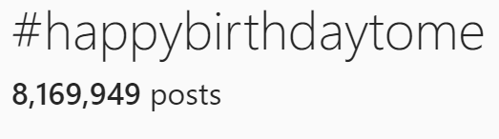
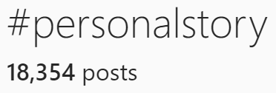
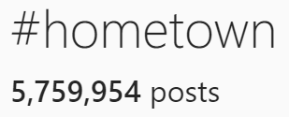
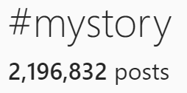
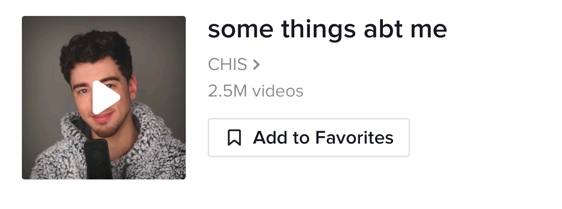
People Expose Information Through Following trends
Antoinette Mavrotheris
Why do we Follow Trends?
Dopamine
Oxytocin
Social Currency
Connectedness
[4] [5] [6]
Notes:
Argument 1: The behavior of following trends often leads to the exposure of personal information. When examining the number of various posts under certain hashtags on Instagram or sounds on TikTok this point is supported. People use the hashtag #mybirthday and #happybirthdaytome to post their birthday pictures as it is a common thing to do seeing as over 8 million people have done it. However, many of these posts are made on the persons actual birthday, which is exposing their birthdate to all who view the post. Even if this only gives away the month and day, many people put their age in their bio and from this the birth year could also be figured out. Similarly, over 2 million people have used the #mystory hashtag and share a shortened version of their life stories, many of them revealing very personal experiences, even more so under the #personalstory hashtag. There is also the #hometown hashtag under which many people write the name of their hometown, some even including a geotag of the exact location of the town. Further, there is a sound on TikTok which over 2 million people have dueted in which they list their name, age, favorite color, height, and more personal information about themselves. Although these may seem like harmless trends, people are exposing their personal information which puts their privacy at risk. So why do people follow these trends? Psychology studies have shown that it is for the release of dopamine and oxytocin. It is also for social currency, which is when stock in your social media content goes up, and a sense of connectedness through having a community of other people doing the same thing as you.

Slide 12
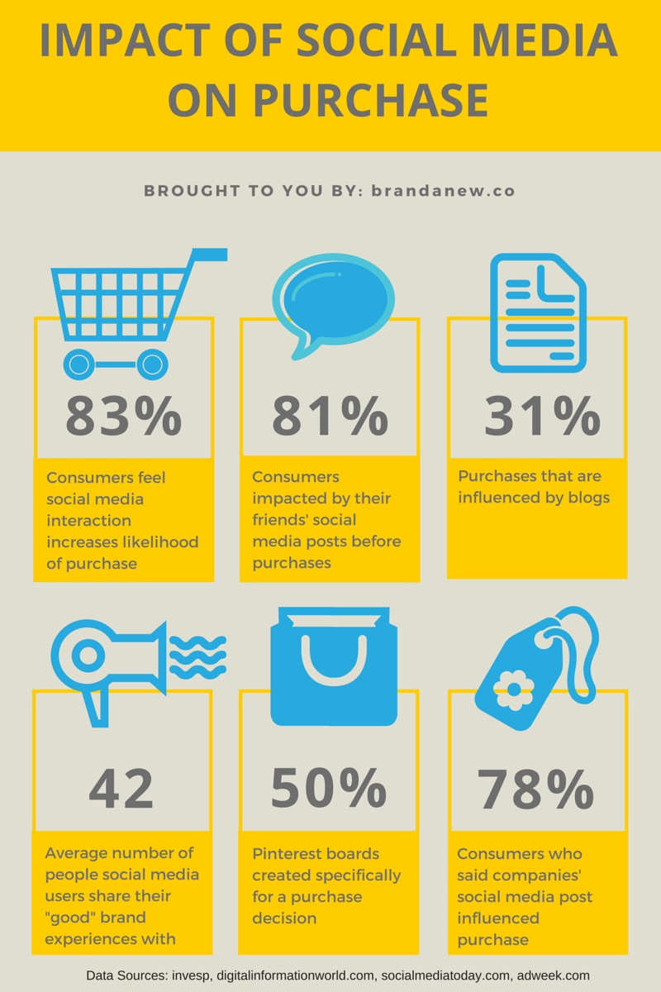
Social Media influences Shopping Behaviors
Antoinette Mavrotheris
[7]
Notes:
Argument 2: Social media also influences peoples shopping behaviors. This is due to the rapid spread of information from influencers, reviews and referrals. A study shows that 83% of American consumers have stated that social media interaction increases their likelihood of a purchase. 81% of consumers look at their friends posts before buying something, and 78% were influenced by company posts. Many people are looking to the opinions of others before buying something for themselves. Instead of following their own thought process to decide if they should buy a product, their thought process is being interrupted by the opinions of friends, strangers, and influencers on the internet. This can lead to them making decisions and purchasing products they may not have without that external influence.

Slide 13
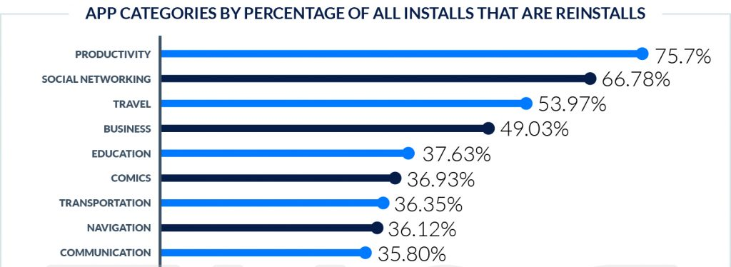
People Develop a Dependency to online Interactions
Antoinette Mavrotheris
“When I found myself doing something cool, I automatically reached for my phone to take a picture, [yet] I did not have Instagram anymore.”
Psychological State
Self Esteem
vs. self control
[8] [9]
Notes:
Argument 3: There is also a trend in which many people develop a dependency to online interactions. Research shows that around 67% of social network app downloads are actually reinstalls if the app. This shows that many people have deleted social media apps and then later, redownloaded them. One possible explanation for this is that the person has developed a dependency to social media, it has become a part of their natural habits, their instincts. One quote from someone who deleted Instagram stated that every time they were doing something cool they would reach for their phone to take a picture for Instagram, even though they did not have the app anymore. Psychological studies have theorized that the dependency on social media ties into a persons psychological state. They stated that many people who have low self-esteem, anxiety, depression or narcissism, feel a need for admiration or validation, which can often be found on social media. Another study shows that as people post more, they tend to exaggerate the positives in their lives to gain admiration. This then leads to an increase in self-esteem, but it decreases their self-control. They develop a dependency on these superficial means. This also ties back into the release of dopamine and oxytocin as well which also cause addictions in the brain.

Slide 14
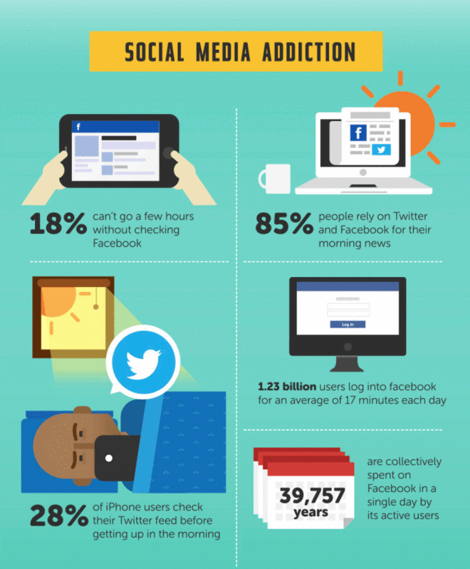
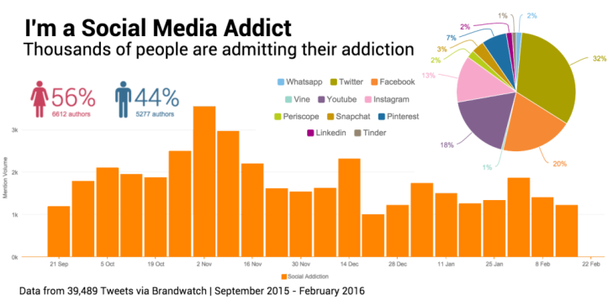
But it’s just an App, people can choose to not post or share information
Antoinette Mavrotheris
[10] [11]
Notes:
Counter Argument: On the contrary, some people could ask “but it’s just an app, can’t people just choose not to post or share information? Can’t they just delete it and walk away?” While this may be true for some, for others they have developed a very real addiction to social media. A study done over twitter asked user if they feel they have a social media addicion. In November of 2015, over 3,000 people of about 39,000 admitted to having an addiction to social media. Similarly, statistics show that 18% of users can’t go more than a few hours without checking facebook. Further, 28% of iPhone users check Twitter every morning before getting out of bed. Finally, this also again ties into how social media triggers the release of dopamine and oxytocin in the brain which are two very real chemicals which cause very real addictions to things, even virtual.

Slide 15
References
Antoinette Mavrotheris
[1] https://www.statista.com/statistics/278409/number-of-social-network-users-in-the-united-states/
[2] https://www.statista.com/statistics/263762/total-population-of-the-united-states/
[3] https://wearesocial.com/blog/2020/01/digital-2020-3-8-billion-people-use-social-media
[4] https://buffer.com/resources/psychology-of-social-media
[5] https://www.instagram.com/
[6] https://www.tiktok.com/en/
[7] http://www.brandanew.co/how-does-social-media-impact-consumer-purchases/
[8] https://blog.usejournal.com/the-psychology-of-social-media-why-we-feel-the-need-to-share-18c7d2d1236
[9] https://www.tune.com/blog/install-or-reinstall-42-of-mobile-app-installs-are-actually-reinstalls-and-in-some-categories-its-75/
[10] https://algonquincollegesocialmedia.wordpress.com/2018/06/17/are-you-addicted-to-social-media/
[11] https://histoplayblog.wordpress.com/2016/12/07/social-media-addiction/
All References were accessed on April 11, 2020

Slide 16
Smart homes: eyes everywhere how is data affecting policymakers, consumers and companies?
Sri Kalimani

Slide 17
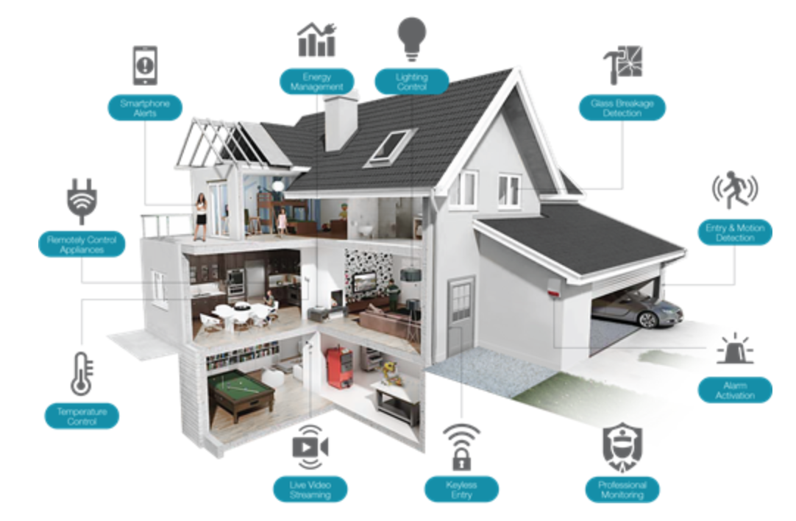
Smart home utopia
Sri Kalimani
[1]
Notes:
Projected vision of a smart home involves autonomous homes including
Energy management
Security
Personalization
Either through central hub or a distributed system
With sensors in every part of the home, there are more than a million data points generated every minute which has brought the opportunity for data analysis and usage with a few different external agencies.

Slide 18
Public perception
Sri Kalimani
Prioritize convenience and connectedness
Trust IoT manufacturers
Limited user understanding
  Unaware of revealing info through ML interference
External Entity | Comfort with Data Access
Manufacturer | 10/11
Advertiser | 6/11
Internet Service Providers (ISP) | 0/11
Government | 0/11
Table 1: Public Perception [7]
[7]
Notes:
In a research conducted with 11 households it was found that people welcomed IoT devices as they trust manufacturers to take care of their privacy. When it comes to data from individual sensors like a digital thermostat, people vastly underestimate the potential of data extraction from these.
And like most of us they were skeptical of government access to the data. The big question is how will this data be used?

Slide 19
Policymakers and corporations
Sri Kalimani
Adoption of smart home tech a priority
User info at government hands unclear
Not everyone publishes Transparency Report
Small companies unhappy
Policy Examples:
  Consumer focused policy: UK & US
  Social credit score: China
[2] [3] [4] [5] [6]
Notes:
- Policy makers intend to make adoption of smart technology widespread
- It is unclear how this data will be used and what the outcomes will be as companies do not disclose information asked by governmental agencies
- Transparency reports describe how user data collected is used. These are currently not mandated. Only recently have the big 3 companies (Amazon, Google, Facebook) disclosed if and when government demands customer data.
As a result of massive consumer flow at the hands of large corporations, small companies have limited data and are unable to operate at a data driven scale
Example policies

Slide 20
Call to action: Open data & transparency
Sri Kalimani
“Data of the public belongs to the public” ~Smart City Coordinator, Eilat, Israel
Open data = More research, Less monopoly
Higher consumer awareness of products
Consumer focused Transparency Reports
[6]
Notes:
I had the pleasure of doing my IQP in the area of smart cities and its data collection!
Small companies are vastly disadvantaged as they are unable to operate in a data driven manner. Large corporations control data and are mostly unwilling to share. But with policy and regulation to decentralize data possession it is possible to have open data.

Slide 21
References
Sri Kalimani
[1] Inspections, L. U. H. (2018). Wireless vs. connected smart home tech for homeowners. Retrieved from https://www.leveluphomeinspections.com/post/wireless-vs-connected-smart-home-tech-for-homeowners (Access Date 4/13/2020)
[2] Crisp, C. (2019-05-15). How can policymakers increase the adoption of smart home technologies? Retrieved from https://chicagopolicyreview.org/2019/05/15/how-can-policymakers-increase-the-adoption-of-smart-home-technologies/ (Access Date 4/13/2020)
[3] Smart device makers won’t say if they give governments user data. (). Retrieved from https://social.techcrunch.com/2019/12/11/smart-home-tech-user-data-government/ (Access Date 4/13/2020)
[4] Montalbano, E. (2019). New IoT security regulations on tap in U.S., U.K. Retrieved from https://securityledger.com/2019/05/new-iot-security-regulations-on-tap-in-u-s-u-k/ (Access Date 4/13/2020)
[5] Tofel, K. C. (2019, -08-28T15:04:44+00:00). What happens when your smart home data is used against you? Retrieved from https://staceyoniot.com/what-happens-when-your-smart-home-data-is-used-against-you/ (Access Date 4/13/2020)
[6] Sullivan Boyd, Nicholas Eusman, Sriranjani Kalimani, Julia Vanderstreet, Design of a Database Platform for Eilat (WPI, 3/6/2020) (Access Date 4/13/2020)
[7] Serena Zheng, Noah Apthorpe, Marshini Chetty, Nick Feamster, User Perceptions of Smart Home IoT Privacy, (ACM, November 2018), https://arxiv.org/pdf/1802.08182.pdf (Access Date 4/13/2020)

Slide 22
Privacy from government surveillance
Sebastian Pineda
Notes:
Hello, I am Sebastian pineda and today I am going to be presenting about the extent of government surveillance possible that we may not even know of

Slide 23
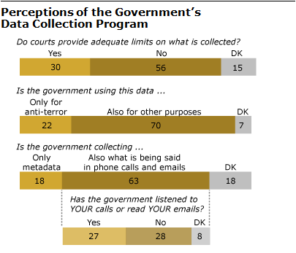
The average perception underestimates
Sebastian Pineda
Almost a 50/50 split
Many believe data is used for other purposes besides anti-terror
<Graphic as big as will fit>
[7]
Notes:
Here we have data from the pew research center from 2018 outlining how Americans feel about the government collecting data on them. As we can see, a little more than half believe that federal courts are not limiting the government enough, and a much higher amount of people think that the government is indeed using collected data for other uses besides anti terror. The complacency of the possibility of surveillance is clear and shows that many Americans do not truly know what can be seen and what can not be seen. This can stem from many causes, one of which being what we have discussed earlier: that many people do not actually know how much technology surrounds them.

Slide 24
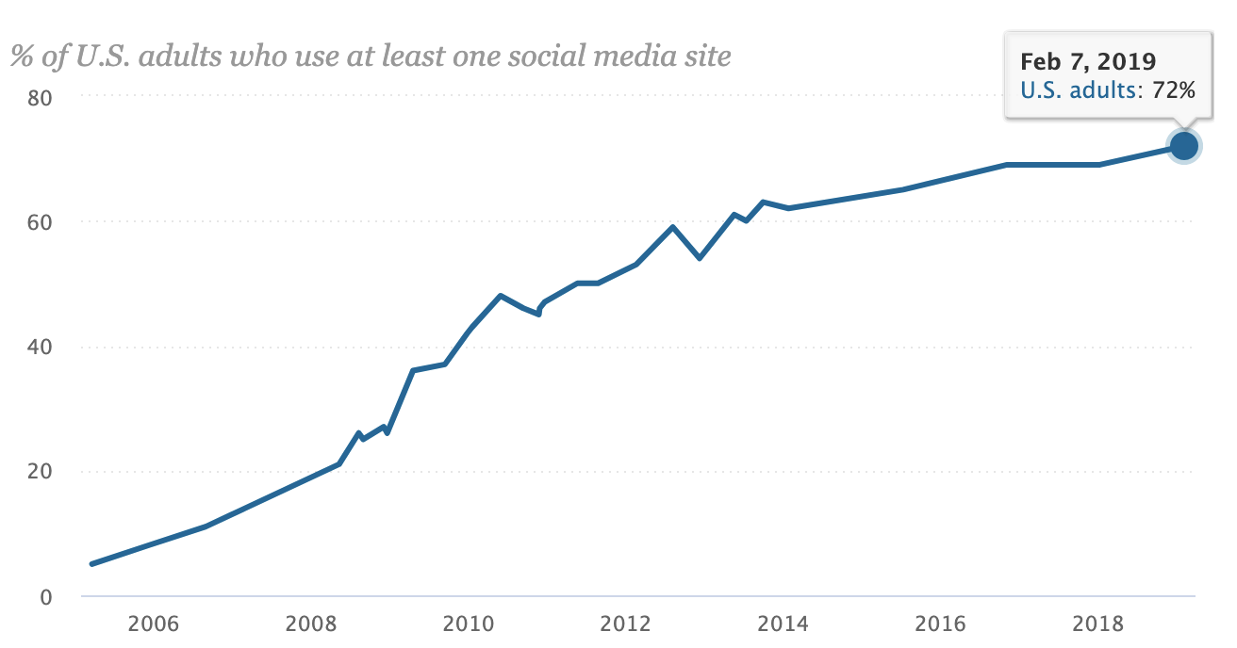
Lets compare
Sebastian Pineda
The proportion of people who use just social media is much higher
This only includes adults
[7]
Notes:
We are going to compare these figures to this data right here. As we can see here from another data collection from pew research center, a large majority of adults in America use at least one social media outlet. Keep in mind that this is only social media, and this data only accounts for adults. This does not include the large number of high school and middle school kids who use social media on a day to day basis. Everyone uses a large amount of technology in their day to day lives. Everything from the phones in our pockets to the navigation systems in our cars uses technology even if we can not see it. This exactly is the problem. We are too accepting of what is being collected.

Slide 25
It is not just wiretapping from 2013
Sebastian Pineda
The government adapts to the times
It isn’t just phones
You most likely agreed to it
[3][4][5]
Notes:
A misconception about the subject of data collection by the government is that it is old news. Yes, the huge news of Edward Snowden exposing the NSA was in 2013, and that still affects us to this day. However, The government has many powers of data collection besides telephone data, including internet data and social media data. The wiretapping of 2013 is just one of the examples of what they can do. The EPPA (employee polygraph protection act) even excludes all level of governments, meaning that government employees can be subjected to polygraph tests if it is deemed reasonable. As we know, “reasonable” can be bent to the use of whoever needs it, whether it be your own local government or the white house in Washington. The government can also access what is called meta data (which is very descriptive information about the data In question) from your internet information and your call history. And as most of you know, those terms and conditions that we always accept without reading usually always outlines the type of data the service is collecting. This was a big point in the Snowden scandal in 2013. Verizon had apparently been ordered by the government to hand over this so called “metadata” to see who people have been calling and who they have been called by.

Slide 26
“Legal” uses
Sebastian Pineda
Even data collection methods that are legal can be abused
Confidential info can sometimes be released
Notes:
Historically, the US census has evolved and grown through the use of technology to fit the needs of the government. After the Pearl Harbor attack in 1941, The US Census Bureau gave information to the Justice department aiding the Japanese internment camp process. Even lesser known:
During world war one, the bureau also gave information to the military to aid them in the search for men who were trying to evade the draft (another can of worms entirely)

Slide 27
FISA, Prism, and the Patriot Act
Sebastian Pineda
The Patriot Act increased the power the government has for surveillance
The lesser known PRISM allows the government to ask companies for communication data
FISA allows the government to monitor foreign coms
[1][2][4]
Notes:
The Patriot Act is well known for its establishment after 9/11. It increased the gov’s power of surveillance in the name of national security. It was criticized for the possibility of the invasion of innocent citizens’ privacy. This is verified further when looking at the NSA program PRISM. PRISM allows the government to legally collect information from data giants such as google. When many of us are using services from companies such as apple, amazon, google, etc, the power the government holds is staggering. FISA is the Foreign Intelligence Surveillance Act. FISA allows the government to monitor communications that either start or end oversees. That means international phone calls, emails, and any other form of communication you can think of. This grants the government a lot of leeway to surveil people who otherwise thought they had complete privacy

Slide 28
Don’t simply accept
Sebastian Pineda
Although completely dropping what we use on a day to day basis, we can make progress by informing
Notes:
In conclusion, what I want to say is that By simply educating more people of the extent of technology in their lives and how that can be used to watch them, we can keep the balance of power between the people and the government. Simply ceasing what we use in our lives would be nearly impossible. We will continue to use google, amazon, and youtube on a regular basis. However, We have systems in place where we can petition and vote for new legislation, but if only a small percentage of people understand how accessible our data is to the government, there isn’t much that can be done.

Slide 29
References
Sebastian Pineda
[1] “NSA Surveillance.” American Civil Liberties Union, www.aclu.org/issues/national-security/privacy-and-surveillance/nsa-surveillance.
[2] “Edward Snowden: Leaks That Exposed US Spy Programme.” BBC News, BBC, 17 Jan. 2014, www.bbc.com/news/world-us-canada-23123964.
[3] Weinstein, Adam. “The Government’s Phone, Text, and Email Spying, Explained.” ABC News, ABC News Network, 2013, abcnews.go.com/ABC_Univision/governments-phone-text-email-spying-explained/story?id=19347440.
[4] Gellman, Barton, and Ashkan Soltani. “NSA Infiltrates Links to Yahoo, Google Data Centers Worldwide, Snowden Documents Say.” The Washington Post, WP Company, 30 Oct. 2013, www.washingtonpost.com/world/national-security/nsa-infiltrates-links-to-yahoo-google-data-centers-worldwide-snowden-documents-say/2013/10/30/e51d661e-4166-11e3-8b74-d89d714ca4dd_story.html.
[5] Broache, Anne. “FBI Wants Widespread Monitoring of 'Illegal' Internet Activity.” CNET, CNET, 24 Apr. 2008, www.cnet.com/news/fbi-wants-widespread-monitoring-of-illegal-internet-activity/.
[6] Lau, Tim. “The Government Is Expanding Its Social Media Surveillance Capabilities.” Brennan Center for Justice, 2019, www.brennancenter.org/our-work/analysis-opinion/government-expanding-its-social-media-surveillance-capabilities.
[7] Geiger, A.W. “How Americans Have Viewed Surveillance and Privacy since Snowden Leaks.” Pew Research Center, Pew Research Center, 4 June 2018, www.pewresearch.org/fact-tank/2018/06/04/how-americans-have-viewed-government-surveillance-and-privacy-since-snowden-leaks/.
…

Slide 30
Class 6
The End
Keith A. Pray
Instructor
socialimps.keithpray.net
Notes:
This is the end. Any slides beyond this point are for answering questions that may arise but not needed in the main talk. Some slides may also be unfinished and are not needed but kept just in case.
If there’s time and we didn’t already look at:
Find out what your DNA says about you and your family.
https://www.23andme.com/
Jimmy Kimmel Live – What is your password? (2:49)
https://www.youtube.com/watch?v=opRMrEfAIiI

