Slide 1
Class 3
Ethics
Keith A. Pray
Instructor
socialimps.keithpray.net
Notes:
Here’s the title slide. Excited again, aren’t you? You should be.
How did the first paper go?
What were your topics?
What conclusions did you draw?

Slide 2
Let’s keep track of what works well Online and Remote
Sign in with First and Last Name
Stay muted unless you are going to speak
To speak use the raise your hand feature
To answer yes/no questions use the “yes” ”no” buttons
Chat is fine for questions
Turn your camera on if possible
Others?

Slide 3
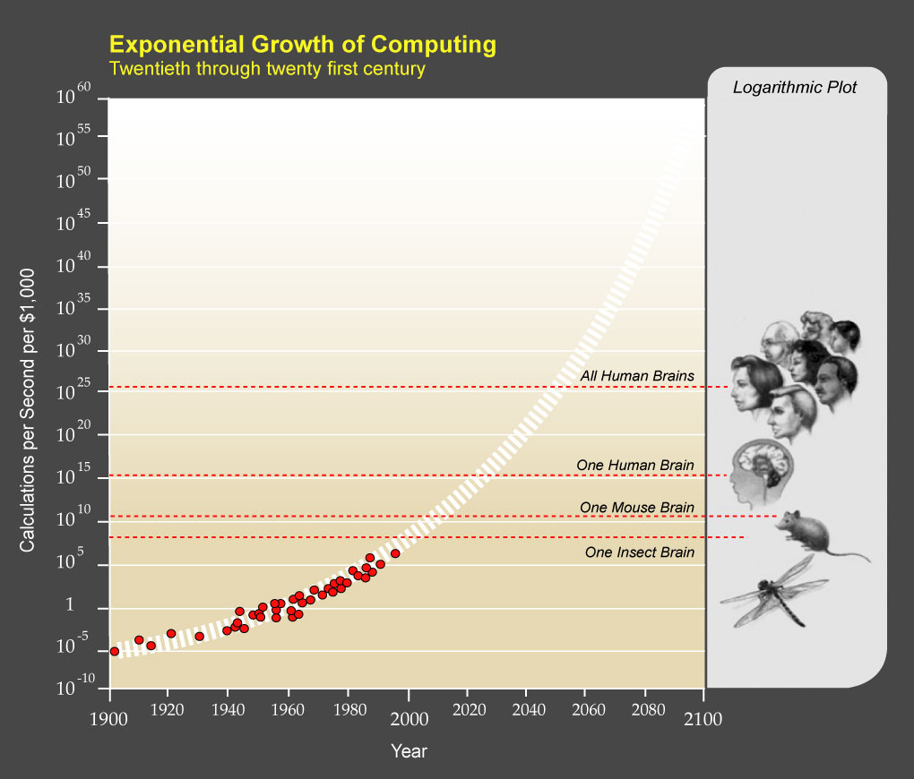
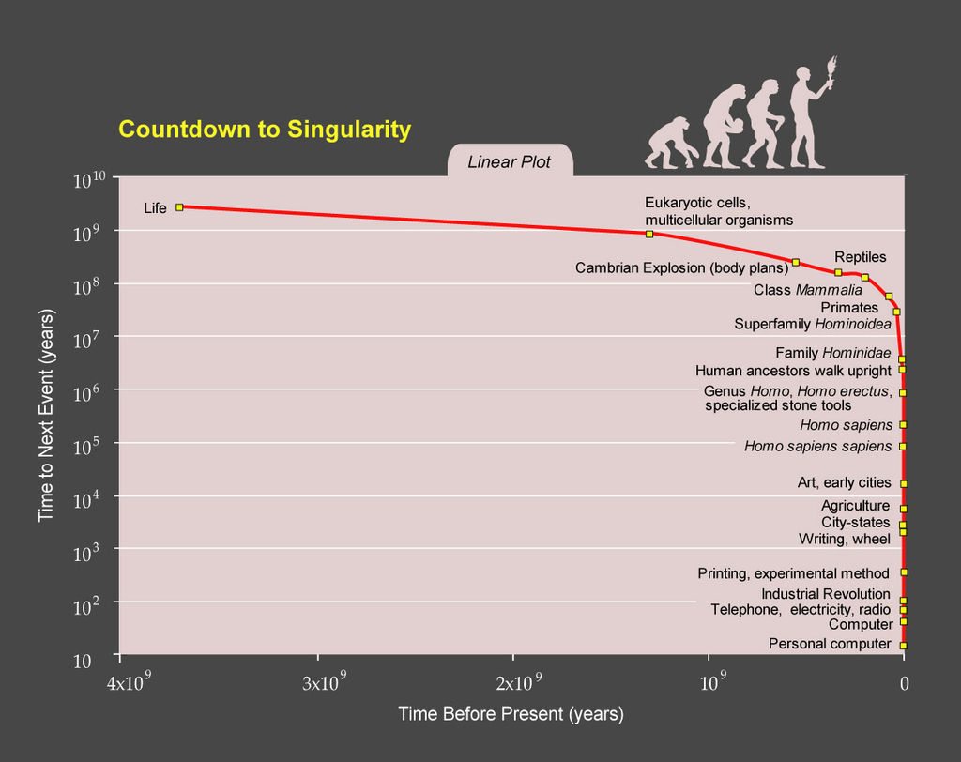
Ray Kurzweil
Notes:
TODO: https://epicrapbattlesofhistory.fandom.com/wiki/Steve_Jobs_vs_Bill_Gates/Rap_Meanings
This puts it a different way:
Show Epic Rap Battles of History: Steve Jobs vs. Bill Gates (If class ok with obscene lyrics) (2:47)
https://www.youtube.com/watch?v=njos57IJf-0
[1] "PPTExponentialGrowthof Computing" by Coutesy of Ray Kurzweil and Kurzweil Technologies, Inc. - en:PPTExponentialGrowthof_Computing.jpg. Licensed under CC BY 1.0 via Wikimedia Commons - http://commons.wikimedia.org/wiki/File:PPTExponentialGrowthof_Computing.jpg#/media/File:PPTExponentialGrowthof_Computing.jpg
[2] "PPTCountdowntoSingularityLinear" by Coutesy of Ray Kurzweil and Kurzweil Technologies, Inc. - en:PPTCountdowntoSingularityLinear.jpg. Licensed under CC BY 1.0 via Wikimedia Commons - http://commons.wikimedia.org/wiki/File:PPTCountdowntoSingularityLinear.jpg#/media/File:PPTCountdowntoSingularityLinear.jpg

Slide 4
Logistics Reminder
Sign up for individual presentations
  Great ideas so far!
  5 slots still open, 1 disappears next Friday
  10% of your grade
Email all the course staff, you’ll get a quicker response
Read Assignment Slides
Notes:
Email Etiquette – thoughts? Good this class.
Extra credit for identifying extra credit opportunities requires you complete the extra credit assignment
Email all the course staff, you’ll get a quicker response

Slide 5
Overview
Group Project
Review
Ethics
Assignment

Slide 6
Group Project Overview
Movie
Explore computing technology portrayed, analyze course topics
Project Web Site
  Analyze subject from the prospective of each topic covered in class
  Critical Thinking, Ethics, and Professional Ethics are analysis tools, not topics
Presentation
  Give arguments for most salient conclusions drawn

Slide 7
Overview
Group Project
Review
Ethics
Assignment

Slide 8
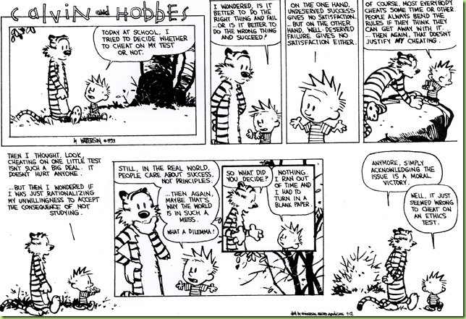

Slide 9
My Reading Notes
pp. 57 Does mention of Hitler invalidate the argument? - Mike Godwin
pp. 58 “Instincts were learned…”?
pp. 66 There’s no expectation the doctor’s practice would suffer?
pp. 80 Insurance companies do it, should they?
pp. 94-95 Do most states (#?) have anti-texting while driving laws now?
pp. 99 Good to see using theories to see how many produce same outcome
pp. 106 “… everyone… become… programmer” – Why is this an ethical issue?
End of Chapter questions I liked: 9, 10, 14, 15

Slide 10
Overview
Group Project
Review
Ethics
Assignment

Slide 11
Clarifying Points
Ethical Actions
Based on belief that people are
  Rational
  Free to choose
Can be
  Mandatory
  Prohibited
  Acceptable
Rights
Negative
  Liberties
  Often Absolute
Positive
  Claim-rights
  Often Limited
Notes:
Actions can be ethically mandatory, prohibited or acceptable.
Positive: someone else has to do something.

Slide 12
Ethics Vocabulary
Deontological Theories
  A.K.A. nonconsequentialist
  Theory/study of moral obligation
Consequentialist Theories
Social Contract Theory
Virtue Ethics
  A.K.A. Character Based Theory
Greek deon = duty
Emphasizes duty and absolute rules to be followed whether they lead to good or bad consequences.
Kant often primary example.
Rules should apply to everyone.
Good rules intrinsically follow logic. Follow reason not emotion to make decisions.
Treat people as an ends, not solely as a means. Respect for persons.
Notes:
Which formulation of the categorical imperative do you prefer?
Kant’s Axe (1:33)
Published on Nov 18, 2014 – BBC Radio 4
Accessed 2016-09-02
www.youtube.com/watch?v=x_uUEaeqFog

Slide 13
Ethics Vocabulary
Deontological Theories
  A.K.A. nonconsequentialist
  Theory/study of moral obligation
Consequentialist Theories
Social Contract Theory
Virtue Ethics
  A.K.A. Character Based Theory
Main example is Utilitarianism.
Increase aggregate utility or happiness. How to measure?
Watch out for theories going to far; violating rights of a few for the “good” of the many.
Notes:
Helpful?:
https://www.happify.com/hd/science-of-happiness-infographic/

Slide 14
Ethics Vocabulary
Deontological Theories
  A.K.A. nonconsequentialist
  Theory/study of moral obligation
Consequentialist Theories
Social Contract Theory
Virtue Ethics
  A.K.A. Character Based Theory
Uses rights as basis
Explains people’s selfishness in absence of common agreement
Analysis of moral issues regarding people and government.
Characterization of actions can change outcome of analysis, does not solve conflicting rights.
Are laws based on ethics?
Are all laws ethical?
Notes:
From Wikipedia (get primary source):
“Consent of the governed" is a political theory stating that a government's legitimacy and moral right to use state power is, or ought to be, derived from the people or society over which that power is exercised.
This theory of "consent" is historically contrasted to the divine right of kings and has often been invoked against the legitimacy of colonialism.
Following John Locke's notion of a nation of "free and equal" citizens, the Founders of the United States believed that consent of the governed was the only legitimate basis upon which one "free and equal" citizen could exercise legal authority over another -- otherwise neither equal could overcome the other.

Slide 15
Ethics Vocabulary
Deontological Theories
  A.K.A. nonconsequentialist
  Theory/study of moral obligation
Consequentialist Theories
Social Contract Theory
Virtue Ethics
  A.K.A. Character Based Theory
Stresses character development and moral education, not formalized rules.
What kind of person should I be?
Depends on homogeneous community standards for morality.
Plato and Aristotle, more recently by Alasdair MacIntyre.
Notes:
Aristotle on 'Flourishing’ (2:00)
https://www.youtube.com/watch?v=j_7deR0idvs
BBC Radio 4
Published 2015-03-30

Slide 16
Group Quiz
Scenario 4 in Section 2.1.2
Split into teams of 4
Pick one of:
  Kantian
  Act Utilitarian
  Rule Utilitarian
  Social Contract Theory
  Virtue Ethics
Does your team recommend release next week ?
Provide justification (argument)

Slide 17
Overview
Group Project
Review
Ethics
Assignment

Slide 18
Assignment
Complete all assigned reading
Work on your individual presentations
Start Group Project work (if possible)
  Send email with your top 3 movie choices after I send out the list to choose from

Slide 19
Class 3
The End
Keith A. Pray
Instructor
socialimps.keithpray.net
Notes:
If there is time:
The Game Of Trust - NICKY CASE
https://ncase.me/trust/
This is the end. Any slides beyond this point are for answering questions that may arise but not needed in the main talk. Some slides may also be unfinished and are not needed but kept just in case.

