Slide 1
Class 11
Work
Keith A. Pray
Instructor
socialimps.keithpray.net
Notes:
Here’s the title slide. Excited already, aren’t you?

Slide 2
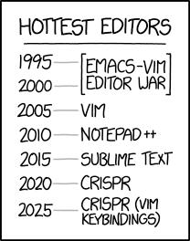
Overview
Review
Assignment
Students Present
https://www.xkcd.com/1823/
Notes:
Full circle.
CRISPR: Clustered Regularly Interspaced Short Palindromic Repeats
Allows permanent modification of genes within organisms.
Kickstarter Charter
https://www.kickstarter.com/charter?ref=about_subnav

Slide 3
Overview
Review
Assignment
Students Present
C lustered
R egularly
I nterspaced
S hort
P alindromic
R epeats
Permanent gene modification
https://www.xkcd.com/1823/
Notes:
Full circle.
CRISPR: Clustered Regularly Interspaced Short Palindromic Repeats
Allows permanent modification of genes within organisms.
Kickstarter Charter
https://www.kickstarter.com/charter?ref=about_subnav

Slide 4
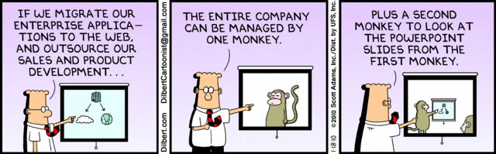
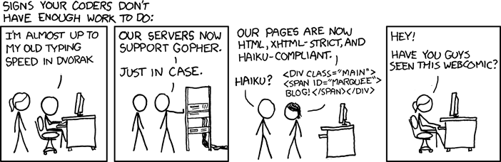
http://xkcd.com/554/
Notes:
Poll class:
Expected salary range upon graduation? Min, Max? Put on board.
Assume 40 hour work week.
How many people would work:
32 hours for 0.8 * Max? Put on board.
24 hours for 0.6 * Max? Put on board.
…continue until Min is reached.

Slide 5
Group Quiz
List 2 ways IT can lead to organizational change.
List 4 ways a Video Game Producer may protect its IP and what specific IP each protects.
List a computing technology that can be used to protect an individual’s privacy.
List a computing technology that can be used to intrude upon an individual’s privacy.
Notes:
Could split into groups of 4-5 for this.
Fill time with Work Discussion on Course Web Site

Slide 6
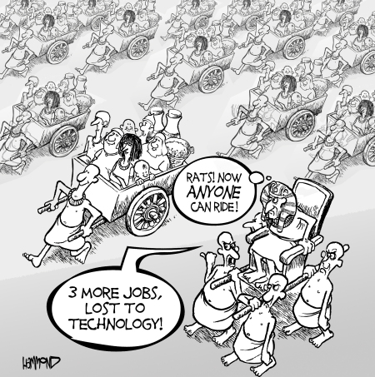
Overview
Review
Assignment
Students Present
©2009, MobileRobots Inc.
Notes:
Review Group Assignment Details.
Or first watch video: depends on student presentations, no thunder stealing.
CGP Grey
Humans Need Not Apply (15:00) – 2014-08-13
http://www.youtube.com/watch?v=7Pq-S557XQU
Last access 2016-04-22
These 3D printed homes can be constructed for $4,000 (3:00 – 2018-04-02)
http://www.businessinsider.com/3d-printed-homes-constructed-icon-new-story-tech-charity-4000-dollars-2018-3
https://www.youtube.com/watch?v=SvM7jFZGAec (1:28)
Last access 2018-04-22
Look at:
BBC Intelligent Machines
http://www.bbc.com/news/technology-33978561
BBC Likelihood of robot taking your job
http://www.bbc.com/news/technology-34066941

Slide 7
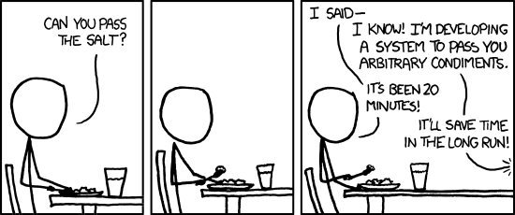
Overview
Review
Assignment
Students Present
https://xkcd.com/974/

Slide 8
Cryptocurrency
Adam Desveaux

Slide 9
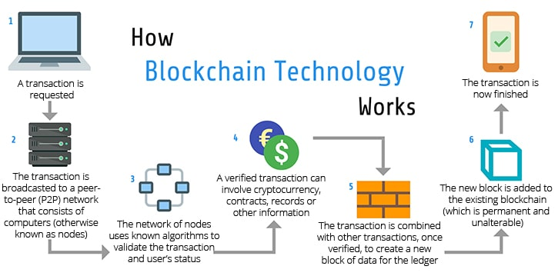
Blockchain Architecture
Adam Desveaux
A typical blockchain has thousands of sequential blocks [1]
  Permanent
  Many transactions make up a block
Cryptographic hashes used to verify transactions [1]
  P2P network
  Each hash based on previous blocks
The blockchain is public [1]
  Anyone can view all transactions
<Citation>
https://www.peerbits.com/blog/blockchain-cryptocurrency-is-shaping-up-for-the-future.html
Notes:
-Most Cryptocurrencies use the blockchain architecture to process and verify transactions
-Comprised of thousands of blocks, which each contain many transactions
-Once created, blocks are permanent and unchangeable
-Cryptographic hashes are used to verify each block, take into account all previous blocks
-The blockchain is public, meaning anyone can view the entire blockchain and all transactions that have ever taken place
-Walk through diagram

Slide 10
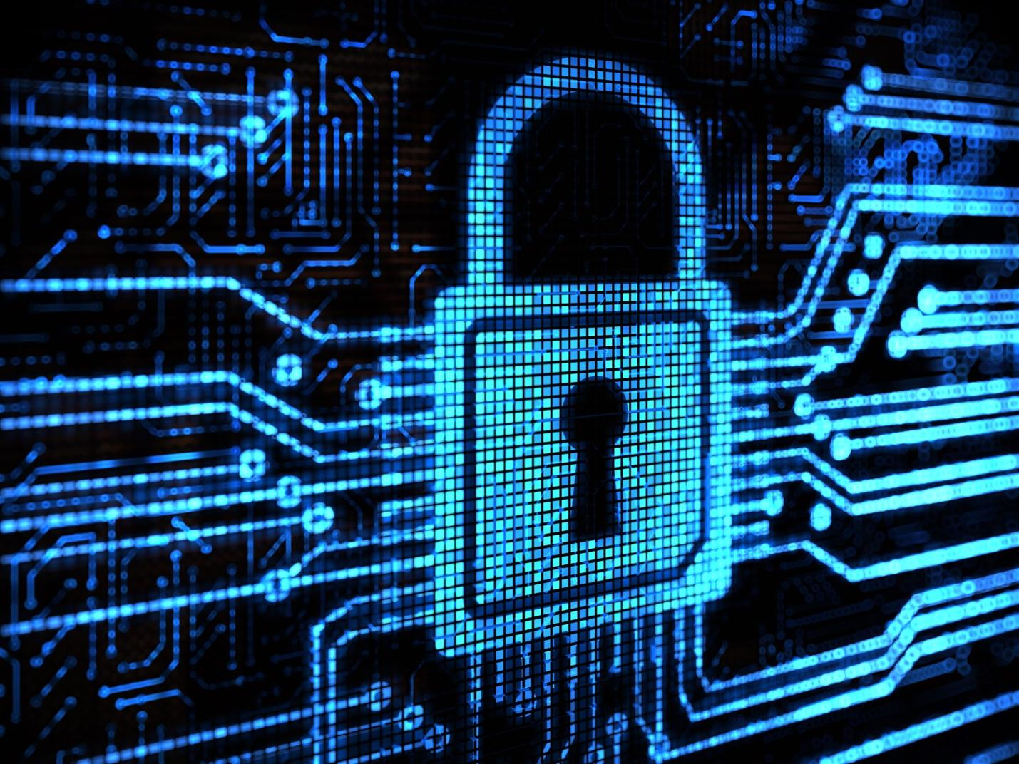
Security and privacy
Adam Desveaux
Changes to the blockchain are realistically impossible [2]
  Each block hash based on all previous blocks
  51% attack
Decentralized ledger [1]
  Blockchain status from most users is accepted
  No governing agency/group
Privacy and anonymity for users
  Varies between cryptocurrencies [3]
  Bitcoin – users have a Bitcoin address [3]
https://bitcoinist.com/wp-content/uploads/2019/04/image1-5.jpg
Notes:
-Cryptocurrency transactions are extremely secure due to the blockchain protocol
-Changes are impossible because cryptographic hashes are based on all previous blocks
-Altering a block would cause all of the subsequent block hashes to change
-The blockchain is altered very quickly, and the version of the blockchain accepted by the majority of users is accepted
-This means that in order to actually alter the blockchain, you would have to have more nodes/computing power than all other users combined (51% attack)
-This is obviously not realistically possible with the amount of nodes in the P2P network
-The decentralized ledger means that there is no governing agency, such as a bank, involved with cryptocurrencies. This means no laws, regulations, etc.
-User privacy and anonymity is generally preserved, although the level of privacy varies between cryptocurrencies
-Bitcoin users have a specific address, so it is easy to find all payments made by a specific user, but you can’t easily identify who that person is

Slide 11
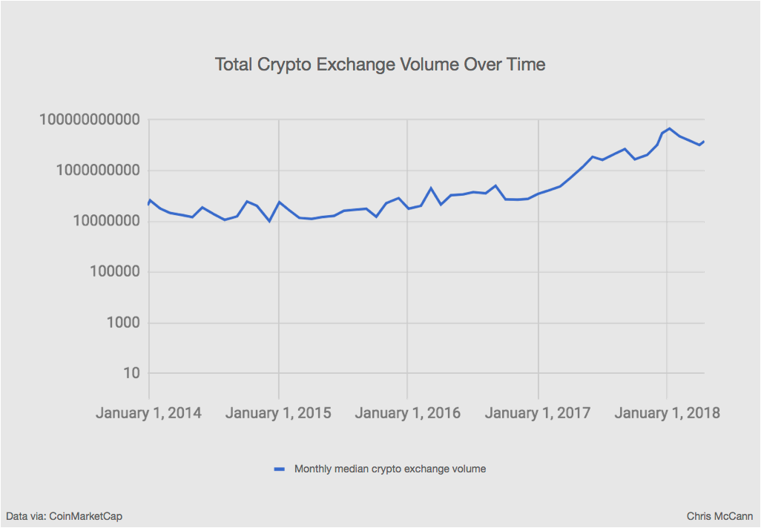
Crypto vs traditional currency
Adam Desveaux
Easily accessible [4]
  Only internet connection required
  No transaction fees or barriers to entry
Global [5]
  Available anywhere in the world
  No exchange rates
Growth [5]
  Market increasing
  More retailers accepting crypto payments
https://medium.com/@mccannatron/12-graphs-that-show-just-how-early-the-cryptocurrency-market-is-653a4b8b2720
Notes:
Some of the benefits off cryptocurrency over traditional payment methods
-Cryptocurrency is easily accessible, all that’s required is an internet connection
-There are no transaction fees or other barriers of entry, like signing up for a credit card/credit score/etc.
-Cryptocurrency is global, available anywhere in the world, worth the same everywhere
-There are no exchange rates or other issues preventing people from using cryptocurrency as payment anywhere
-Additionally, the crypto market overall is growing, as shown in the chart to the right
-More and more retailers are accepting crypto payments, especially bitcoin, making it even easier to use

Slide 12
References
Adam Desveaux
[1] Nofer, Michael, et al. “Blockchain.” Business & Information Systems Engineering, vol. 59, no. 3, 2017, pp. 183–187., doi:10.1007/s12599-017-0467-3. https://link.springer.com/article/10.1007/s12599-017-0467-3
[2] Kshetri, Nir. “Cryptocurrencies: Transparency Versus Privacy [Cybertrust].” Computer, vol. 51, no. 11, 2018, pp. 99–111., doi:10.1109/mc.2018.2876182.
[3] Henry, Ryan, et al. “Blockchain Access Privacy: Challenges and Directions.” IEEE Security & Privacy, vol. 16, no. 4, 2018, pp. 38–45., doi:10.1109/msp.2018.3111245.
[4] Lipovsky, William. “The Benefits Of Using Cryptocurrency.” Nasdaq, Due.com, 27 Feb. 2017, https://www.nasdaq.com/articles/benefits-using-cryptocurrency-2017-02-27. Accessed 9/26/19
[5] Milutinović, Monia. "CRYPTOCURRENCY." Ekonomika 64.1 (2018): 105-22. ProQuest. Web. 26 Sep. 2019. https://search.proquest.com/docview/2030180321?OpenUrlRefId=info:xri/sid:primo&accountid=29120

Slide 13
Medical + AI
Yujia Qiu

Slide 14
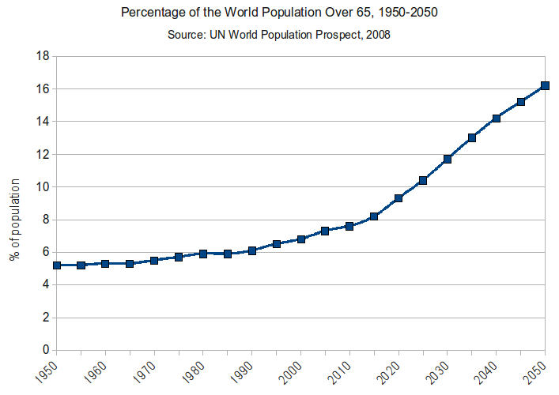
Population Aging
Yujia Qiu
In 2016， “8.5 percent of people worldwide (617 million) are aged 65 and over”[1]
World Health Organization(WHO) is working on three areas with a direct impact on ageing:
  “prevention of chronic disease;
  access to age-friendly primary health care;
  creation of age-friendly environments”. [2]
https://upload.wikimedia.org/wikipedia/commons/e/e3/Percentage_of_the_World_Population_Over_65_-_1950-2050.png
Notes:
What is the aging of the population and the current trend.

Slide 15
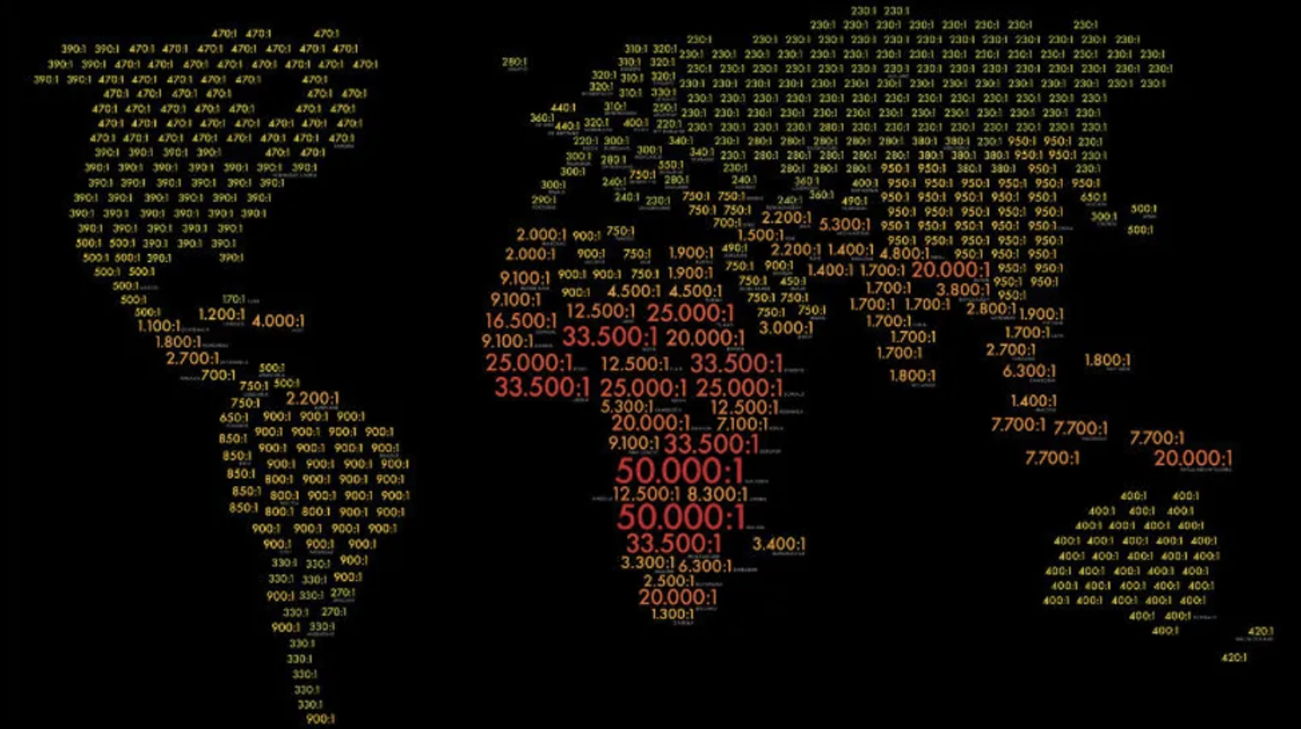
The ratio between Doctor and patient
Yujia Qiu
https://bigthink-img.rbl.ms/simage/https%3A%2F%2Fassets.rbl.ms%2F18578278%2F980x.jpg/2000%2C2000/TRVM0vX0GGx%2BFjI3/img.jpg
Notes:
The ratio of doctors to patients in modern times indicates that there is a great demand for doctors globally.

Slide 16
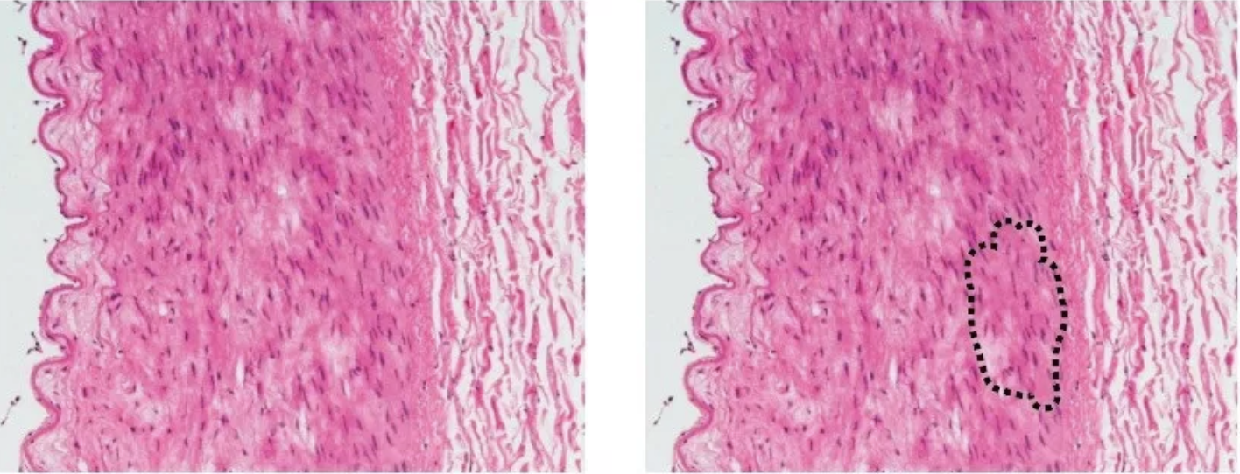
Medical + AI
Yujia Qiu
“In the fall of 2018, researchers at Seoul National University Hospital and College of Medicine developed an AI algorithm called DLAD (Deep Learning based Automatic Detection) to analyze chest radiographs and detect abnormal cell growth, such as potential cancers. “[3]
https://upload.wikimedia.org/wikipedia/commons/e/e3/Percentage_of_the_World_Population_Over_65_-_1950-2050.png
Notes:
The scene of artificial intelligence medical application now.

Slide 17
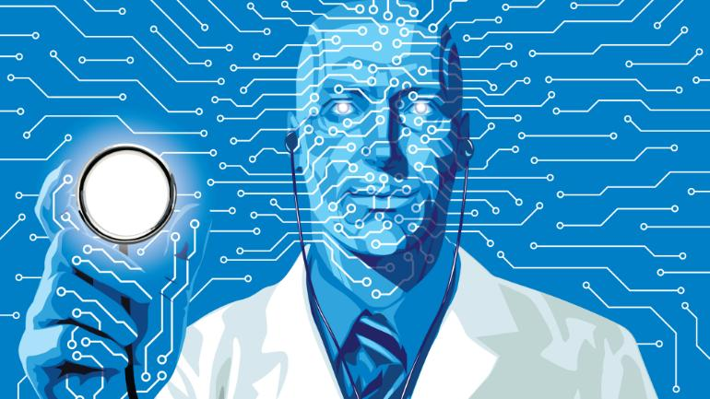
Medical + AI
Yujia Qiu
“Microsoft Develops AI to Help Cancer Doctors Find the Right Treatments”[4]
“Some of Watson's other features are based in problem solving across many different careers. A demonstration showed how quickly Watson is able to diagnose illnesses, and provided a real life case that took doctors and nurses six days to diagnose.”[5]
https://akm-img-a-in.tosshub.com/indiatoday/images/story/201811/ai_healthcare.jpeg?nPb5_BqhtEaH_TR9IOEl5ON8RIaWghJ2
Notes:
The scene of artificial intelligence medical application now.

Slide 18
Yujia Qiu
Thank You
Notes:
<speaker notes>

Slide 19
References
Yujia Qiu
Cire, B. (2016, March 28). World's older population grows dramatically. Retrieved from https://www.nih.gov/news-events/news-releases/worlds-older-population-grows-dramatically
Population ageing. (2010, November 30). Retrieved from https://www.who.int/features/qa/72/en/
Greenfield, D. (2019, June 19). Artificial Intelligence in Medicine: Applications, implications, and limitations. Retrieved from http://sitn.hms.harvard.edu/flash/2019/artificial-intelligence-in-medicine-applications-implications-and-limitations/
Bass, D. (2016, September 20). Microsoft Develops AI to Help Cancer Doctors Find the Right Treatments. Retrieved from https://www.bloomberg.com/news/articles/2016-09-20/microsoft-develops-ai-to-help-cancer-doctors-find-the-right-treatments
Lorenzetti, L. (2019, June 27). Here's How IBM Watson Health Is Transforming the Health Care Industry. Retrieved from https://fortune.com/longform/ibm-watson-health-business-strategy/

Slide 20
Did My Job So Well I Lost It
Wyatt Bahm

Slide 21
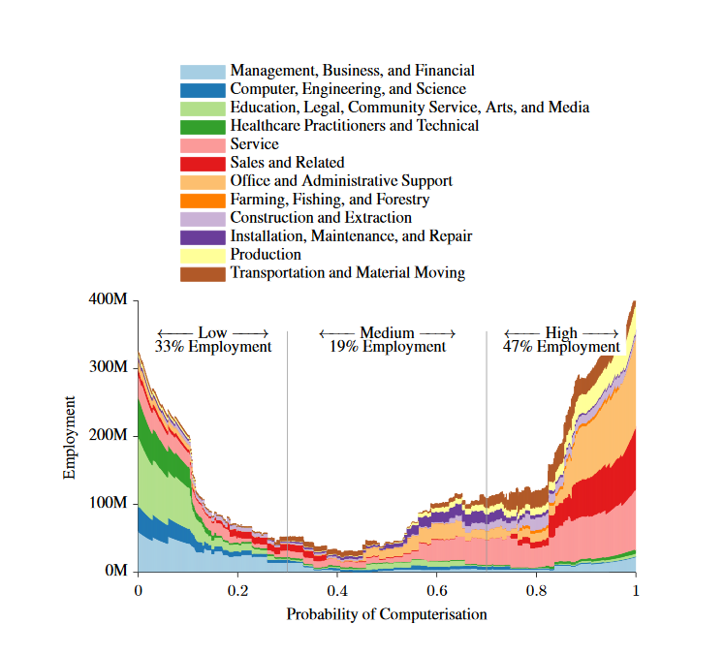
The automated future
Wyatt Bahm
About 47% of US employment is at risk of computerization [2]
  Estimates for the EU range from mid 40s to over 60% [1]
Other jobs will evolve as workers are freed up from modern jobs
  No way of knowing how many or what jobs will be created [2,3]
[2]
Notes:
Automation is coming and a huge portion of the jobs people have today will not exist in the future.
Talk about statistics.
Chart breaks down expected computerization by industry. This is over no set time period but rather based on bottlenecks to automation and more to be taken as broad analysis
Similar to industrial revolution or computer/internet boom where new jobs developed. No way to know yet what those jobs will be

Slide 22
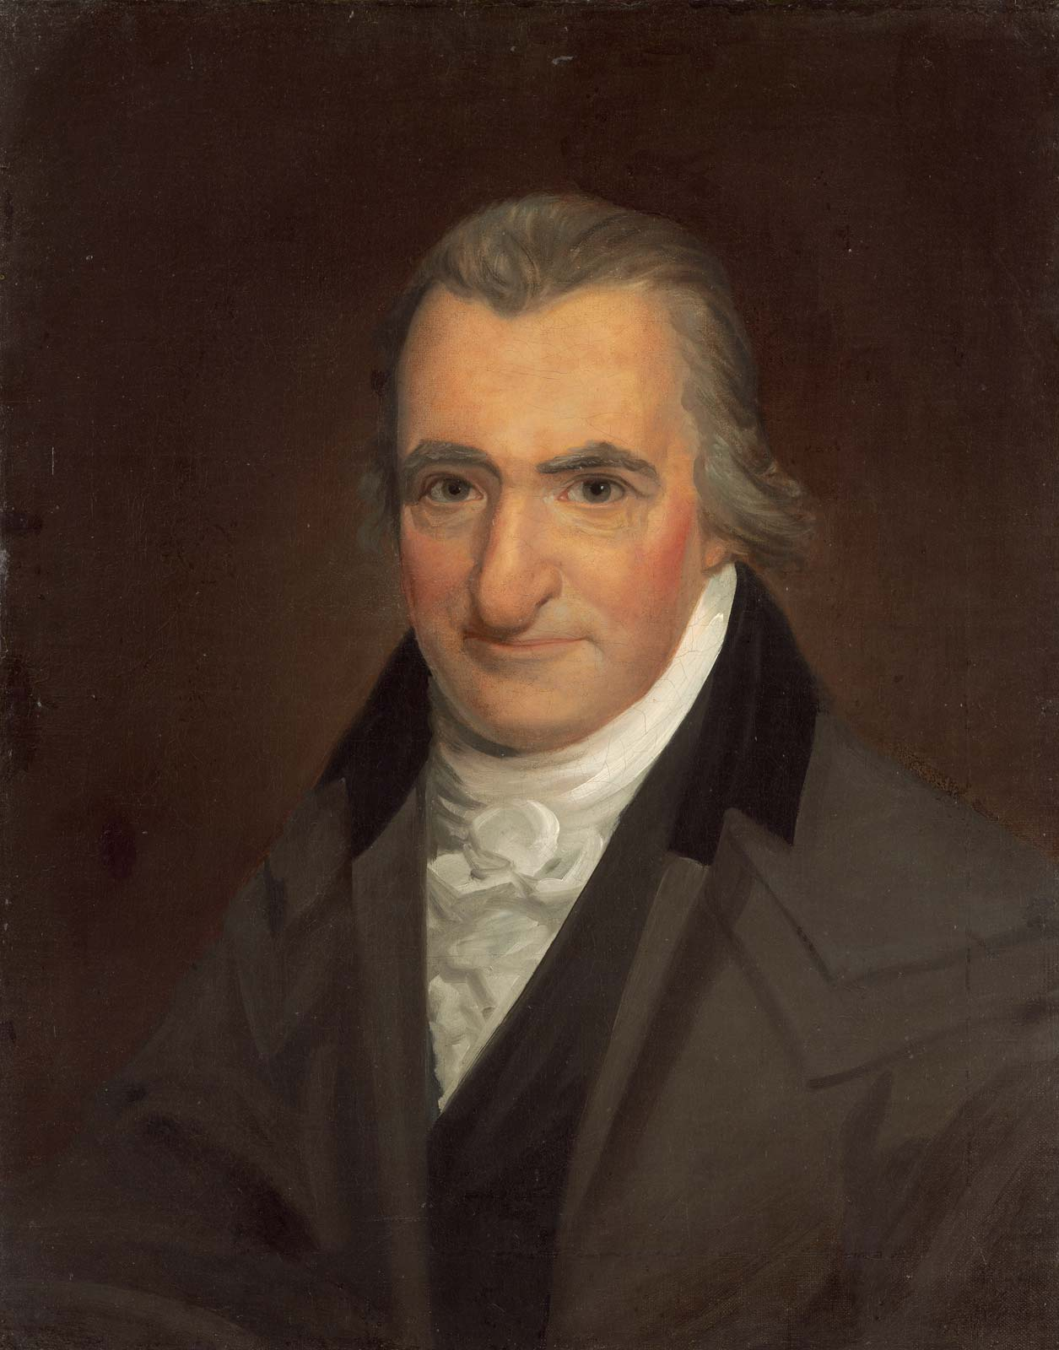
Universal basic income
Wyatt Bahm
Thomas More’s Utopia, Thomas Paine and the earth as common property [8,11]
A program where everyone receives money without any stipulations or requirements [4]
The money may come from the government or private entities [4]
https://www.britannica.com/biography/Thomas-Paine
Notes:
Thomas More Utopia discusses how UBI would be a better solution to the issues of theft than death sentences for thieves
Thomas Paine is best known for his writings about individual rights and his writings that inspired the Declaration of Independence, but he also wrote about the idea of social security for the poor and those unable to work. Argued that the earth in its base form was the common property of all people and society should pay a rent of sorts to all people to help support those who could not support themselves
UBI is the idea that every person within a particular area or country receives a set payment from either the govt or a private entity.

Slide 23
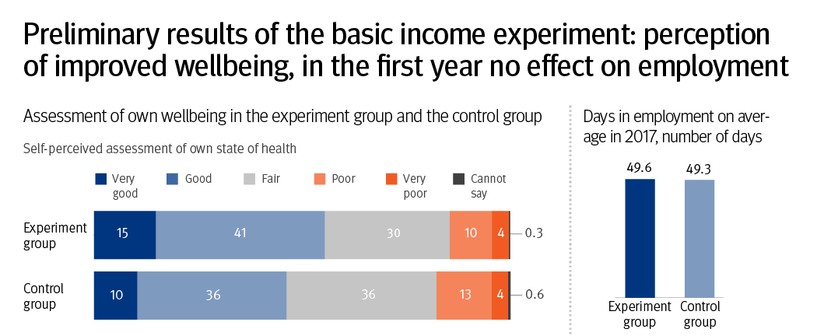
Universal basic income
Wyatt Bahm
Tests have been run in Finland, Scotland, Ontario, and The Netherlands [5]
Based on the idea that with increased automation will come increased resources and lower cost of living [6]
[12]
Notes:
Sam altman wrote that he believes in an automated society resources should become more abundant and we will therefore be able to provide for everyone.
Various experiments have been run in different places around the world. Smaller scale experiments in places other than Finland. Finland ran the experiment through Kela, their social security administration. The issue with it was that in addition to receiving the basic income, the experimental group continued to receive some conditional benefits. [13]
Perceived health and happiness went up but employment didn’t change.

Slide 24
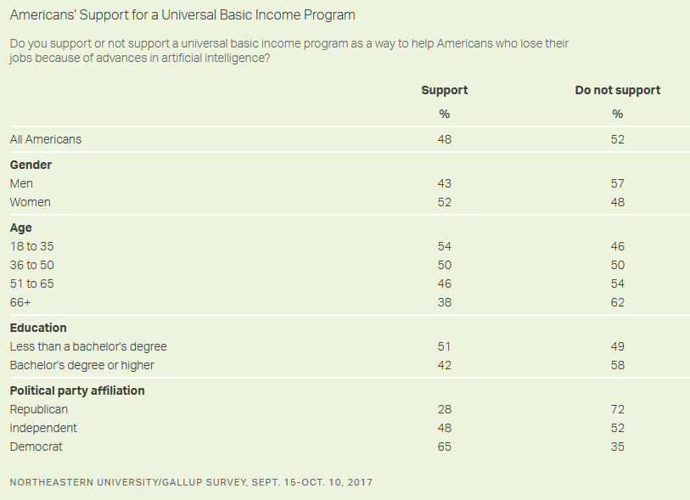
Specific Proposals and reception
Wyatt Bahm
MLK and attacking poverty itself rather than causes [9]
48% support for UBI programs in 2017 [7]
Elon Musk, Mark Zuckerburg, Sam Altman
Andrew Yang and the Freedom Dividend [10]
[7]
Notes:
MLK wrote about how he believes that the best way to deal with poverty for both blacks and whites was basic income. “Poor black and white are still perishing on a lonely island of poverty in the midst of a vast ocean of material prosperity.” About attacking the actual problem rather than perceived roots.
Support for UBI is rising among americans.
Big tech CEOs endorsing it.
Andrew Yang is running on a UBI system called the Freedom Dividend. Idea is that by pulling from other welfare options and imposing a VAT it could be paid for. $1000 per month per adult. VAT is essentially a percentage tax added on to all commercial activity. Would optionally replace traditional welfare. Causes issues for example for a single mother with 3 kids. Would probably result in a drop in total benefits so he is proposing that they be allowed to chose.

Slide 25
References
Wyatt Bahm
[1] Bowles, Jeremy. Chart of the Week: 54% of EU jobs at risk of computerization, July 24 2014 https://bruegel.org/2014/07/chart-of-the-week-54-of-eu-jobs-at-risk-of-computerisation/
[2] Frey, Carl; Osborne, Michael. THE FUTURE OF EMPLOYMENT: HOWSUSCEPTIBLE ARE JOBS TOCOMPUTERISATION?, Sept 17 2013 https://www.oxfordmartin.ox.ac.uk/downloads/academic/The_Future_of_Employment.pdf
[3] Bowles, Jeremy The computerization of European Jobs, July 24 2014 https://bruegel.org/2014/07/the-computerisation-of-european-jobs/
[4] Shahskevich, Alex Stanford Lab explores experiments in Universal Basic Income, December 10 2018 https://news.stanford.edu/2018/12/10/lab-explores-universal-basic-income/
[5] Dent, Anna From Utopia to Implementation: How Basic Income has progressed from radical idea to legitmate policy solution, Sept 2017 https://basicincome.org/wp-content/uploads/2018/09/From-Utopia-to-Implementation.pdf
[6] Altman, Sam Moving forward on basic income, May 31 2016https://blog.ycombinator.com/moving-forward-on-basic-income/
[7] Reinhart, RJ. Public Split on Basic Income for Workers Replaced by Robots, Feb 26 2018https://news.gallup.com/poll/228194/public-split-basic-income-workers-replaced-robots.aspx
[8] Paine on Basic Income and Human Rights http://thomaspaine.org/paine-on-basic-income-and-human-rights.html
[9] Weissmann, Jordan. Martin Luther King's Economic Dream: A Guaranteed Income for All Americans, Aug 28 2013 https://www.theatlantic.com/business/archive/2013/08/martin-luther-kings-economic-dream-a-guaranteed-income-for-all-americans/279147/
[10] Yang, Andrew. What is Universal Basic Income https://www.yang2020.com/what-is-freedom-dividend-faq/
[11] BIEN, History of Basic Incomehttps://basicincome.org/basic-income/history/
[12] KELA, Preliminary results of the basic income experiment: self-perceived wellbeing improved, during the first year no effects on employment, Feb 8 2019 https://www.kela.fi/web/en/news-archive/-/asset_publisher/lN08GY2nIrZo/content/preliminary-results-of-the-basic-income-experiment-self-perceived-wellbeing-improved-during-the-first-year-no-effects-on-employment
[13] Santens, Scott What is There to Learn From Finland’s Basic Income Experiment? Did It Succeed or Fail? Feb 14 2019 https://medium.com/basic-income/what-is-there-to-learn-from-finlands-basic-income-experiment-did-it-succeed-or-fail-54b8e5051f60

Slide 26
Class 11
The End
Keith A. Pray
Instructor
socialimps.keithpray.net
Notes:
If there’s time and we didn’t get to it:
Kickstarter Charter
https://www.kickstarter.com/charter?ref=about_subnav
CGP Grey
Humans Need Not Apply (15:00) – 2014-08-13
http://www.youtube.com/watch?v=7Pq-S557XQU
Last access 2016-04-22
These 3D printed homes can be constructed for $4,000 (3:00 – 2018-04-02)
http://www.businessinsider.com/3d-printed-homes-constructed-icon-new-story-tech-charity-4000-dollars-2018-3
https://www.youtube.com/watch?v=SvM7jFZGAec (1:28)
Last access 2018-04-22
Look at:
BBC Intelligent Machines
http://www.bbc.com/news/technology-33978561
BBC Likelihood of robot taking your job
http://www.bbc.com/news/technology-34066941
This is the end. Any slides beyond this point are for answering questions that may arise but not needed in the main talk. Some slides may also be unfinished and are not needed but kept just in case.

