Slide 1
Class 7
Privacy and Government
Keith A. Pray
Instructor
socialimps.keithpray.net
Notes:
After this class we will be half done with the course… very sad I know.
Play Somebody’s Watching Me (1984) – Rockwell (3:36)
https://www.youtube.com/watch?v=7YvAYIJSSZY
Be the envy of all your classmates if you know the band and/or year:
Rockwell (1984) Michael Jackson sings chorus and Jermaine Jackson on backing vocals.

Slide 2
Overview
Review
Assignment
Students Present
Notes:
Review before debate in case anyone unsure of something in reading

Slide 3
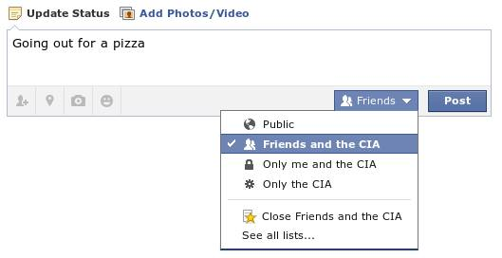
Notes:
Source?
Let’s see who said the government should make a law requiring ID for Internet access. Let’s debate!
Previous:
Let’s see who said National ID yes and no. Let’s debate!

Slide 4
My Reading Notes
pp. 274 Arrests, altering and deleting records are violations of privacy?
pp. 275 Why not try to verify and correct records?
pp. 276 Figure does not show # cameras increasing.
pp. 277 300 times = frames, locations, …?
pp. 289 “…don’t want anyone to know…” like seeking medical advice, etc.?
UPDATE
pp. 291 Just because it’s been happening for years doesn’t make it right.
pp. 297 Wouldn’t it be easy to make and show a fake SSN card?
pp. 298 Confusing false positive and negative explanations.
End of Chapter questions: 1, 31, 51

Slide 5
Debate Ground Rules
Before Debate
  15 minutes to converse with your team
  Share argument points, counter points, and responses so everyone can represent
  Decide who will respond to what points from the opposing side
During Debate
  1 minute opening statements (what you hope your answer will accomplish)
  Stand up when speaking
  1 turn per person until everyone on your team has spoken
  30 second limit (elect a timekeeper)
  Switch sides at any time if you change your mind
Notes:
Government should make law requiring ID for Internet Access Debate
Previous:
National ID or Not Debate

Slide 6
Group Quiz
List two problems with using biometrics for identification.
List two advantages of using biometrics for identification.
Describe two tools people can use to protect their privacy on the Web.
For each of the 4 categories of Daniel Solove’s privacy taxonomy give an example not listed in the book.
Notes:
Only if need to fill time, Orwellian video better use of time if we’ve not seen it yet.

Slide 7
Overview
Review
Assignment
Students Present

Slide 8
Assignment – Group Project
Catch up on reading
Analyze computing technology for all topics covered to date
Add list of fiction (movies, books, TV, short stories, etc.) portraying your computing technology
See group project slide deck for more
-----
Mid Term Survey on Canvas → Quizzes
Notes:
Movie group project:
List of computing technologies portrayed in movie on website
Categorize computing technologies as existing, future, emerging, impossible or plausible with rationale
Analyze movie for all topics covered to date
Technology group project:
Analyze computing technology for all topics covered to date
Add list of fiction (movies, books, TV, short stories, etc.) portraying your computing technology

Slide 9
Overview
Review
Assignment
Students Present
Notes:
What "Orwellian" really means - Noah Tavlin (5:31)
http://ed.ted.com/lessons/what-orwellian-really-means-noah-tavlin

Slide 10
Domestic and foreign threats: what the government does to protect us
Dakota Payette
Notes:
Hi! My name is Dakota and today I’ll be giving my presentation on domestic and foreign threats to the US and what actions the government takes to protect us and how those actions affects our privacy

Slide 11
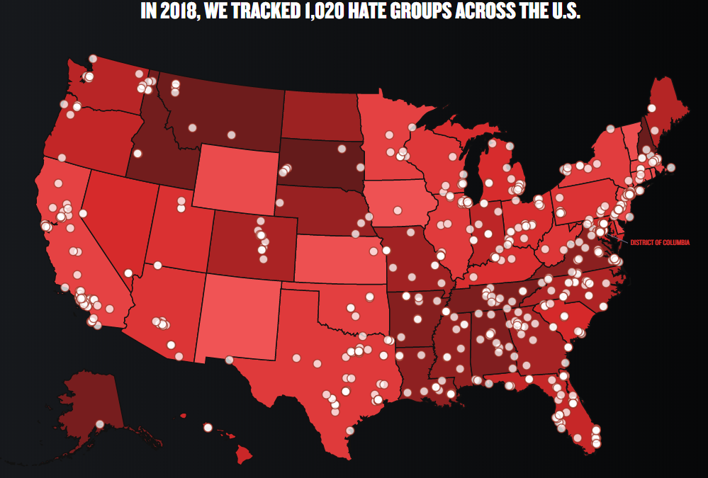
Previous/ongoing domestic threats
Dakota Payette
Radical hate groups [1]
Charlottesville car attack
Unabomber, OKC, and Boston Marathon bombings
[1] https://www.splcenter.org/hate-map
Notes:
Domestic threats have become a huge issue for our country. Hate groups, both political and religious extremist groups, have inflated in numbers. In 2018, over 1000 hate groups were registered across the US with 14 in Massachusetts. California leads all states with 83 followed by Florida with 75 and Texas with 73. According to the map, New Mexico is the only state without a statewide registered hate group. A very specific hate group, white nationalists, have been on the rise under the current presidential administration, giving way to even more
The Charlottesville car attack in 2017 stemmed from a clash between extremist groups on the left and the right, resulting in the injuries of 28 and the death of one person
Domestic attacks aren’t limited to just hate groups, as shown by the multiple bombings that have taken place over the years. Most notable ones include the Unabomber, the Oklahoma City bomber, and the Boston Marathon Bomber. All of these acts, including foreign threats, have affected how American’s live their lives.

Slide 12
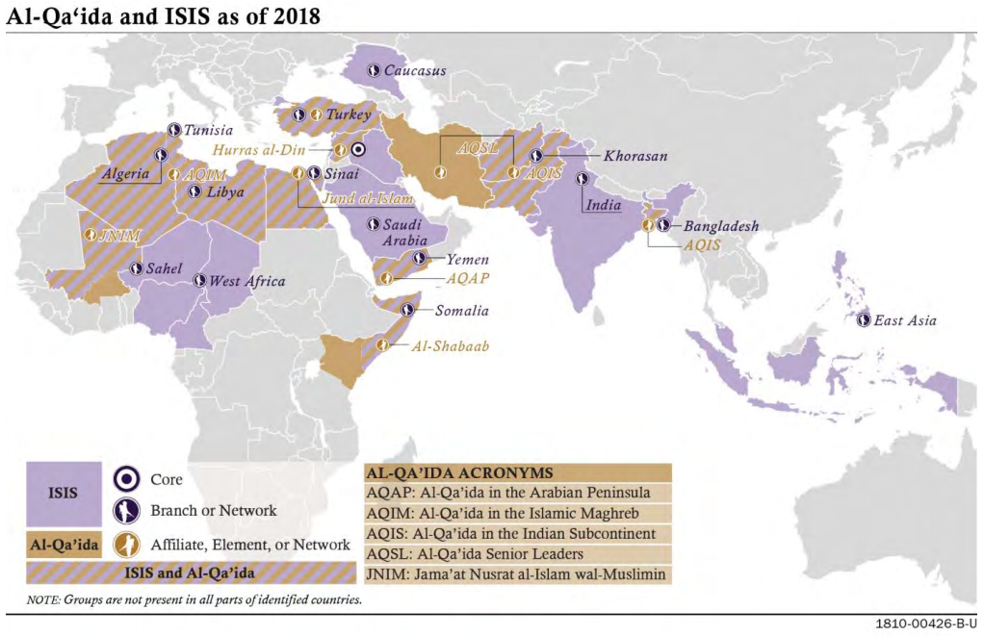
Previous/ongoing foreign threats
Dakota Payette
National Security Threat List [2]
Religious Extremist Groups [3]
  Taliban, Al Qaeda, and ISIS
Cyber Attacks
$716 Billion National Security Budget [4]
[2] https://www.wrc.noaa.gov/wrso/security_guide/nstl.htm
[3] https://www.dni.gov/files/ODNI/documents/2019-ATA-SFR---SSCI.pdf
[4] https://comptroller.defense.gov/Portals/45/Documents/defbudget/fy2019/fy2019_Press_Release.pdf
Notes:
The FBI compiles and releases a list of major threats to the US known as the Nation Security Threat List. 8 major threats are listed there, and they included (1) terrorism, (2) espionage, (3) proliferation, (4) economic espionage, (5) targeting the national information infrastructure, (6) targeting the US government, (7) perception management, and (8) foreign intelligence activities.
Religious extremist groups such as the Taliban, Al Qaeda, and ISIS, have participated in plethora of attacks against the US and its allies. The image shown on the slide highlights the areas of Africa and Asia where these groups operate and target. The US has military bases all throughout the area which help control the activity of these groups but also could be easy targets for an attack.
Cyber attacks have been on the rise in the past few years with Russia and China leading the charge. The most notable offense of these attacks was during the 2016 presidential election when Russia bots infiltrated most of our social media feeds with political ads. Government files have also been the target of these cyber attacks, prompting intelligences agencies to ask for a whopping budget of $716 billion dollars for national security purposes.

Slide 13
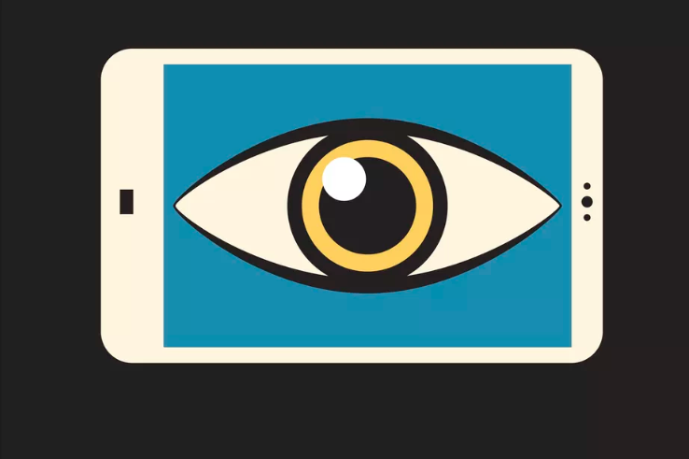
Government actions
Dakota Payette
USA Patriot Act [5]
Creation of National Security Agency in 1952
FBI Watchlists
Wiretaps / Bugs [7]
[6]
[5] https://www.crf-usa.org/america-responds-to-terrorism/the-patriot-act.html
[6] https://www.vox.com/2015/6/2/8701499/patriot-act-explain
[7] https://www.cnn.com/2014/01/23/us/watergate-fast-facts/index.html
Notes:
Following the 9/11 attacks, the US Congress passed the United and Strengthening America by Providing Appropriate Tools Required to Intercept and Obstruct Terrorism (AKA USA Patriot Act) and it was soon signed into law by then president George W Bush. The act combats both domestic and foreign terrorism and possible terrorist actions by stating that it defines terrorism as any “acts dangerous to human like that appear to be intended to (1) intimidate or coerce a civilian population, (2) to influence the policy of a government by intimidation or coercion, or (3) to affect the conduct of a government by mass destruction, assassination, or kidnapping.
In order to keep track of suspected individuals who may commit crimes or terrorist actions, the FBI created watchlists that flag these suspects. A special list they keep is the no fly list which prevents suspects from flying. Preventing them from flying limits how far they can travel and allows for the FBI to know their movements
Placing wiretaps and bugging rooms for intelligence is something that has been done for a while, and the most notable case of planting bugs was the Watergate scandal. When word got out the current president Richard Nixon had been secretly recording all of his conversations in the oval office since 1971. Wiretaps also allow for agencies like the NSA to secretly listen in on to conversations that they think might affect the countries national security.

Slide 14
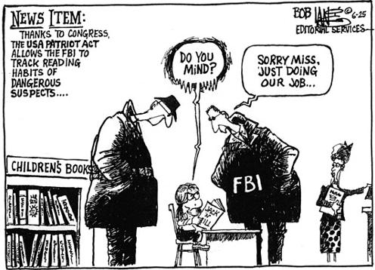
How are we affected?
Dakota Payette
Violates Our Right To Privacy
Violates Fourth Amendment
Wrongfully Accused [8]
[9]
[8] https://www.nbcnews.com/news/us-news/federal-judge-rules-fbi-terrorism-watchlist-violates-constitutional-rights-n1050271
[9] https://www.flickr.com/photos/library_mistress/32233862
Notes:
The actions that the government has taken to protect us from both domestic and foreign threat may threaten our own personal security and privacy. With the Patriot Act, it allows government agencies to keep watch over what we’re doing. As shown in the picture on the slide, however, these agencies tend to overstep their boundaries and infringe on our personal security and privacy.
As stated in the book, there has been fierce position of the Patriot Act because many feel it violates the fourth amendment. The fourth amendment states that unreasonable searches and seizures are unconstitutional, and the Patriot Act allows government agencies to bypass that. The Bill of Rights was written to protect the American people from a tyrannical government, yet the Patriot Act establishes the groundwork for the government to get around it.
A downfall from the creation of the FBI’s terrorist watchlist is that it generalized groups of people. In a very recent example, a federal judge ruled the that FBI terrorism watchlist violates constitutional rights. The Terrorist Screening Database is just one of the many watchlists that the FBI uses which identifies more than one million people who are identified as “known or suspected terrorists”. About 2 dozen Muslim Americans were wrongfully placed on the watchlist because of their Muslim background, not because of any of their actions. The federal judge ruled that the Muslim Americans who were placed on the list had no “evidence or contention” to satisfy the levels of being categorized as a known terrorist who warranted placement on the list

Slide 15
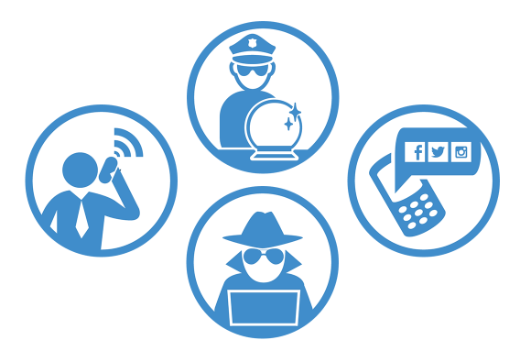
What can we do to protect ourselves?
Dakota Payette
American Civil Liberties Union Suggestion [10]
  Protection Your Passwords
  Keeping Your Communications Secure With Encryption
  Private Web Browsing
[10]
[10] https://www.aclu.org/blog/privacy-technology/internet-privacy/how-protect-yourself-government-surveillance-and-criminal
Notes:
The American Civil Liberties Union is an activist organization that fights for American citizen’s rights. In an article they posted in 2016, they provide three key ways to protect yourself from government surveillance and criminal hackers. These ways include, but aren’t limited to (1) protecting your passwords, (2) keeping your communication secure with encryption, and (3) private web browsing. While this list isn’t comprehensive, they’re everyday actions that you can do to improve your chances of protection against government surveillance.

Slide 16
References
Dakota Payette
[1] Southern Poverty Law Center, https://www.splcenter.org/hate-map (September 11th, 2019)
[2] National Security Threat List, https://www.wrc.noaa.gov/wrso/security_guide/nstl.htm (September 11th, 2019)
[3] Daniel R. Coats, Worldwide Threat Assessment of the US Intelligence Committee, https://www.dni.gov/files/ODNI/documents/2019-ATA-SFR---SSCI.pdf (September 11th, 2019)
[4] DoD Releases Fiscal Year 2019 Budget Proposal https://comptroller.defense.gov/Portals/45/Documents/defbudget/fy2019/fy2019_Press_Release.pdf (September 11th, 2019)
[5] Constitutional Rights Foundation, https://www.crf-usa.org/america-responds-to-terrorism/the-patriot-act.html (September 11th, 2019)

Slide 17
References
Dakota Payette
[6] Dara Lind, Everyone’s Heard of the Patriot Act, Here’s what it actually does, https://www.vox.com/2015/6/2/8701499/patriot-act-explain (September 11th, 2019)
[7] CNN Library, Watergate Fast Facts, https://www.cnn.com/2014/01/23/us/watergate-fast-facts/index.html (September 11th, 2019)
[8] Safia Samee Ali, Federal Judge Rules FBI Terrorism Watchlist Violates Constitutional Rights https://www.nbcnews.com/news/us-news/federal-judge-rules-fbi-terrorism-watchlist-violates-constitutional-rights-n1050271 (September 11th, 2019)
[9] https://www.flickr.com/photos/library_mistress/32233862 (September 11th, 2019)
[10] ACLU, How to Protect Yourself From Government Surveillance and Criminal Hackers, https://www.aclu.org/blog/privacy-technology/internet-privacy/how-protect-yourself-government-surveillance-and-criminal (September 12th 2019)

Slide 18
The Servers have ears…
End-to-end encrypted
Messaging Apps
Thomas White

Slide 19
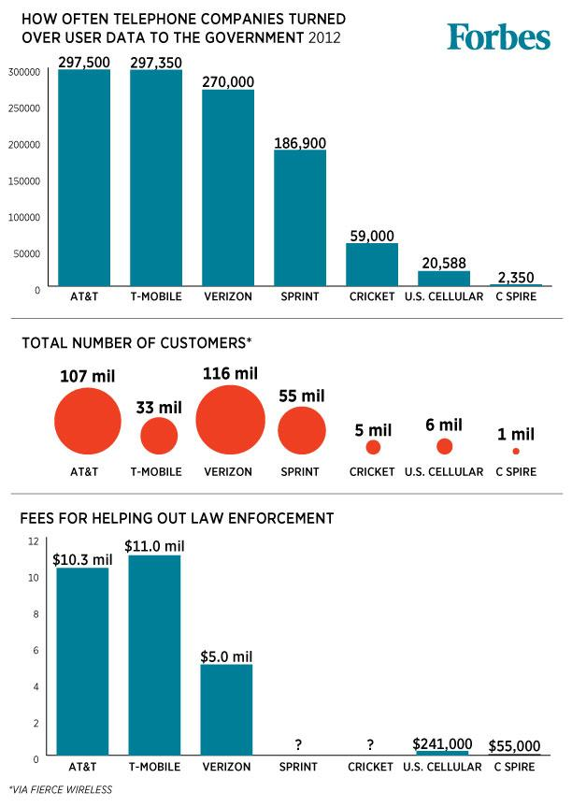
Can you send me a text?
Thomas White
2013 - Snowden revelations show US data collection from Cell Service Providers [1]
2014 - Protestors and residents of Kiev were sent a mass text by MTS (telecom) that they were a registered protestor [2]
2018 – DOJ Requests Facebook break encryption on calls to allow for wiretapping [3]
David Lada, of Forbes (https://b-i.forbesimg.com/kashmirhill/files/2013/12/telco-gov-user-requests.jpg)
Notes:
Linear talking points:
Conventional communication is not safe
Governments have been increasingly interested in having their citizens’ communications available to them
Closing argument: If you need to communicate something confidential in today’s world, you should be using end to end encryption

Slide 20
E2e TL;Dr PYMWM
Thomas White
Conversation starts with a key exchange
Utilize these keys to encrypt messages locally before transit
Send message to a central server, which routes the request
Message arrives at intended location, decrypted by the key
Notes:
End to end Too long; Didn’t read Protect your messages with math
Walk through how e2e works
General talking points:
Things like this have existed as a concept in technology since public key cryptography was discovered
You can use the same technology to create secure emails, digitally sign documents, etc

Slide 21
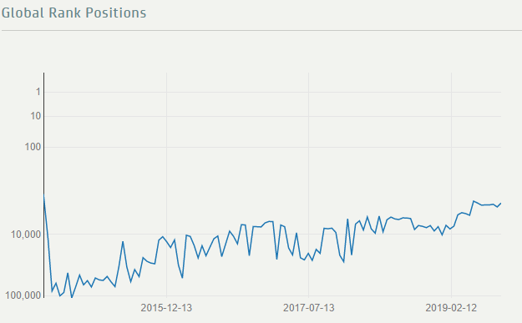

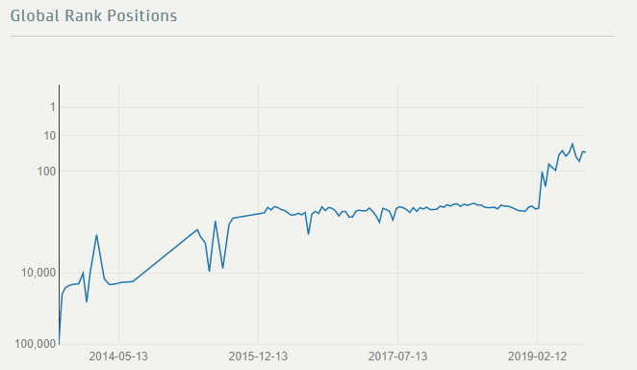

Increased usage of e2em apps
Thomas White
In 2016, after Trump’s election, Signal experienced a 400% increase in daily downloads[4]
Russia and Iran have banned the use of Telegram[5]
  About 50% of Iran’s citizens used Telegram[6]
  About 50% of Iran’s internet traffic was associated with Telegram[6]
Included in: WhatsApp, iMessage, Facebook Messenger, Signal, Telegram
Charts provided by apptrace.com
Notes:
Linear talking points:
Citizens that fear their leaders or of governments that practice heavy censorship use e2e more
Iranians used telegram message boards to subvert news censorship
Russian dissidents used private boards to discuss topics that the state frowns upon
You may be using apps that offer E2E already, but here are some major players in the market

Slide 22
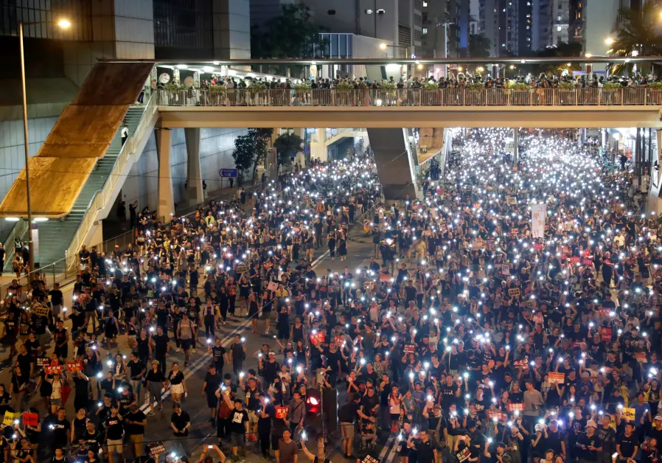
Hong-kong protest
Thomas White
“We owe the existence of the protests to it—mainly Telegram, live media and a whole lot of other social media,”
“We know that our biggest ‘enemy’ is IT security.”[7]
Telegram usership in Hong Kong jumped 110,000 in July 2019 [8]
TYRONE SIU/ REUTERS
Notes:
Linear Talking Points
Today Hong Kong is still protesting
Many of the protest communication has been done in Telegram groups
Telegram even rushed to fix a major security flaw in the app that had been used to identify protesters
Protesters have gone as far as to use Telegram on non-Chinese phones with non-Chinese SIM cards to avoid their data potentially getting uploaded before encryption
Hong Kong is a prime example of how E2E messaging apps create a place for free speech in a surveillance state

Slide 23
References
Thomas White
[1] https://www.forbes.com/sites/kashmirhill/2013/12/10/this-is-how-often-your-phone-company-hands-data-over-to-law-enforcement/#12d0a293767b Accessed 9/10/2019
[2] https://www.theguardian.com/world/2014/jan/21/ukraine-unrest-text-messages-protesters-mass-riot Accessed 9/8/2019
[3] https://www.reuters.com/article/us-facebook-encryption-exclusive/u-s-government-seeks-facebook-help-to-wiretap-messenger-sources-idUSKBN1L226D Accessed 9/10/2019
[4] https://www.nytimes.com/2016/12/07/technology/personaltech/worried-about-the-privacy-of-your-messages-download-signal.html?module=inline Accessed 9/11/2019
[5] https://www.nytimes.com/2018/05/02/world/europe/telegram-iran-russia.html Accessed 9/11/2019
[6] http://nymag.com/intelligencer/2018/06/the-implications-of-iran-and-russias-attack-on-telegram.html Accessed 9/12/2019
[7] https://finance.yahoo.com/news/telegram-messaging-app-driving-hong-184701749.html Accessed 9/12/2019
[8] https://www.bloomberg.com/news/articles/2019-08-15/hong-kong-protests-drive-surge-in-popular-telegram-chat-app Accessed 9/12/2019

Slide 24
How government should face its people
Garrett Smith
Notes:
INTRODUCTION [33s]
I’ll be addressing the question of how government should use facial recognition technology and what protections it should require. This technology was first tested by the FBI in 2001 [A] and is currently under serious legal scrutiny. Just yesterday, California banned use of facial recognition on police body cameras due to privacy concerns [B]. I’ll be analyzing the implementation of this technology in various countries to show that while it is effective in reducing crime, certain protections are necessary in order to prevent misuse.
The issue is concerning how facial recognition technology is used in world governments. The argument is how it should be implemented – analyzing its abuses and benefits, relating how the US system can be improved.

Slide 25
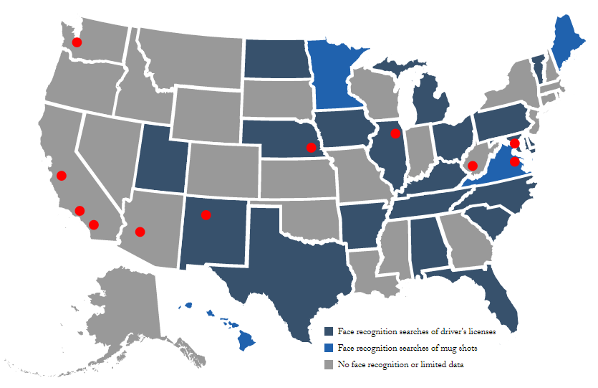
Facial recognition in the u.s.
Garrett Smith
1 of 2 US adults have photos scanned by government [1][2]
  117 million in gov. database
  < 90-95% accurate
  1 / 51 free speech protections
Millions donated for real-time surveillance [2]
WA, MA, TX International flight implementation in 2021 [1][2]
Gray – No Data/ No Use
Light Blue – Mugshots
Dark Blue – Driver License
https://www.perpetuallineup.org/
Notes:
FACIAL RECOGNITION IN THE US [80+181 + 63 + 66] 390 [2m35]
GRAPHIC This graphic is from the Georgetown Law Center on Privacy and Technology. The states in dark blue permit scanning the faces on drivers licenses for law enforcement purposes as well as mugshots, the states in light blue permit only mugshots. If the state is grey then they either didn’t comply with the public records request, its still pending, or they do not have law enforcement records of using this technology, which is confirmed true for only 2 states.
1 1 of 2 U.S. Citizens have had their faces scanned by the United States government, over 117 million people are in some sort of searchable government database. The first concern I have with this is that it isn’t common knowledge that the FBI uses drivers license photos. This is also done without informed consent, the people who signed up never agreed to these terms. It’s also a concern because the 4th amendment protects American citizens from unreasonable searches. It’s debatable whether this is a violation of that, because these searches aren’t technically targeting the millions of records it goes through for a match, but the criminal or the missing person that the search is after. However, the accuracy of these systems are at best 90-95%, the organizations that provide this software sometimes have no requirements for accuracy. Additionally, the FBI and many states do not require sufficient evidence to start a search, only one out of fifty one analyzed organizations had free speech protections, if the wrong person is selected they will be suspected only for having similar biometrics.
2 Certain states and districts have invested millions to develop real-time facial recognition, which they plan to use in public places and on police equipment. The intent is to make catching criminals easier for police but the primary concern is that having a system that surveils assumed innocent people in real-time is a violation of privacy, and many of these facial recognition systems are controlled by policing organizations without any audits for abuse.
3 All international flights by 2021 in certain airports are supposed to confirm passengers’ identities through facial recognition. The closest example of this is the Boston Airport, JetBlue actually uses this system there already. Washington, Texas, Nevada and other states have this 2021 deadline as well.
ARGUMENTS:
It is evident that law has difficulty in catching up with modern technology.
Intention of use is to reduce crime. Restrictions should be placed to prevent irresponsible use, free speech protections, citizens should become aware that their license will be used as facial data by gov when acquiring it– when FBI started facial recognition, began without consent or cause.
GRAPHIC – dark blue facial recognition of drivers license, light blue are solely mugshots, gray are mostly from limited data, only 2 are confirmed not to use it from the organization.
1.0 – Over 117 million Americans in some facial rec. database
2 – Millions have been invested into facial recognition from public cameras or other
3- Entire airports will use facial recognition for international flights in 2021 : Washington, Mass, Texas, Nevada, Cali, … JetBlue in Mass. already uses facial recognition to identify passengers.
Source 1:
1 In 2 american adults has photos searched by us gov for facial recognition
CP: Police used facial recognition to identify Capital Gazette shooter
CP: More quickly screen travelers & immigrants
Entire airports will use facial recognition for international flights in 2021 : Washington, Mass, Texas, Nevada, Cali, …
Some states already have airlines that use facial Mass: JetBlue
Facial Recognition used to arrest protesters in cities such as Baltimore
Software not entirely accurate, could lead to investigations of innocent people
Source 2:
Doesn’t only search criminals, but law-abiding citizens
9/15 States that complied with record requests use state drivers licenses for searches
9/15 States … including FBI don’t require reasonable suspicion for searches
FBI Uses driver licenses from 16 states
Often does not require reasonable suspicion to perform a search
6/15 states don’t have audits for misuse, and FBI. No information on 4 of others
Millions in research money given to real-time facial recognition from surveillance feed
Law enforcement records include 117 million adults
Only 1/52 agencies have laws to explicitly prevent tracking individuals for engaging in political, religious, other free speech
Less accurate for African Americans, most likely to effect them.
Source 3:
FBI Alone 4000 monthly searches
21 States allow FBI to scan driver photos

Slide 26
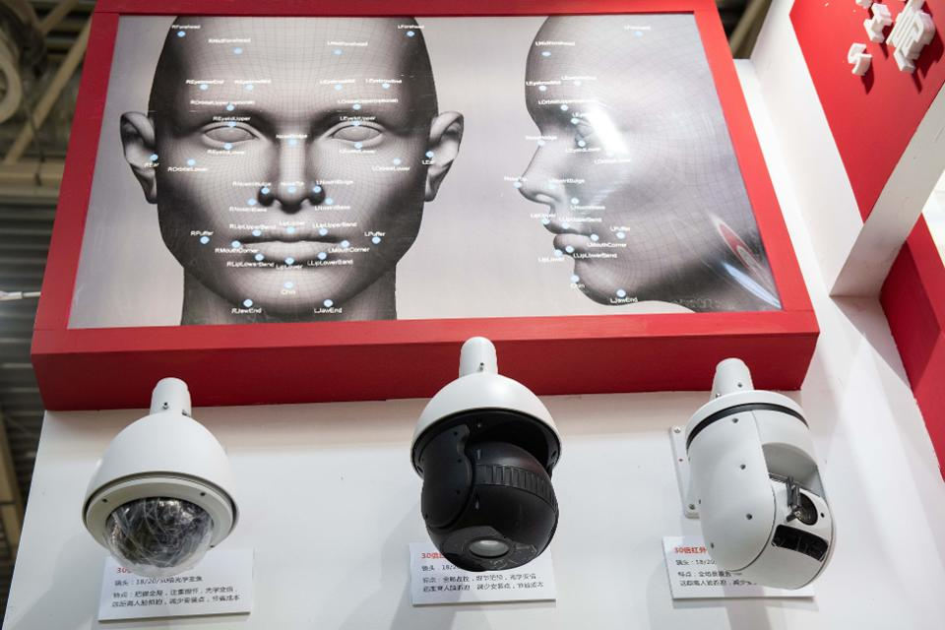
Facial recognition in china
Garrett Smith
Tracking Uighur Muslims [6]
  Detects minority status
Automatic Jaywalking Fines [7]
  Display information on billboard
Future Plans
  Search 1.3 billion people in 3 seconds [4]
  570 million cameras by 2021 [7]
https://www.forbes.com/sites/zakdoffman/2019/08/26/hong-kong-exposes-both-sides-of-chinas-relentless-facial-recognition-machine
Notes:
FACIAL RECOGNITION IN CHINA [27+27+58+48+77] 241 [1m25s]
The best example of misuse of this technology by government is in China, I’ll mention Hong Kong later but I’m just considering just the mainland at the moment.
GRAPHIC – These cameras are just examples of those that are being used all over China for facial recognition. China has over 170 million cameras in their surveillance network.
China is using this network to not just search for people, but to detect distinguishing characteristics of ethnic groups. They use this technology to target Uighur (weager) Muslims, which is a Chinese minority group. Uighur Muslims have a population of 11 million in china, 1 million of which are being held in detention camps.
China also uses this technology to fine jaywalkers, a street in Shenzhen has cameras that are used to automatically text them a fine and display their name and face on a nearby screen to ‘shame’ them. Its these trivial situations where facial recognition should not be used.
China has serious plans for expanding its use of facial recognition technology. The first is to develop as system to analyze its 1.3 billion people in three seconds with a 90% accuracy rate. It’s uncertain whether they can achieve this, but it is definitely possible. The second major plan they have, is to add 400 million cameras to their current 170 million by 2021. So China is probably the best example of a big brother situation
Graphic – Example of Chinese cameras used for facial recognition
1- China uses its facial recognition to detect Uighur muslims based solely on their appearance then track them. Hold as many as a million / 11 million in detention camps.
2- Jaywalkers are automatically detected in China and fined. China has 170 million cameras used for surveillance purposes
3.1 – China developing technology to analyze its 1.3 billion population in 3 seconds with 90% accuracy.
3.2 – China has 170 million surveillance cameras as part of their system, intend to have 400 million more by 2021.
Source 4:
Hong Kong protesters claim that installed ‘smart’ lampposts equipped with cameras are sending facial information to mainland China, destroyed at least one and demand lawmakers to move others.
Source 5:
Hong Kong riot police used cameras on poles behind line of officers, protesters used lasers to obfuscate. Man posted algorithm online for detecting officers from faces. Plainclothes officers tried to force man to unlock phone with facial recognition – he disabled it and they hacked his home computers.
Source 6:
China uses its facial recognition to detect Uighur muslims based solely on their appearance then track them. Hold as many as a million / 11 million in detention camps.
Source 7:
Jaywalkers are automatically detected in China and fined. China has 170 million cameras used for surveillance purposes, expect 400 million more by 2021
Singapore – leading project to outfit 110,000 lampposts with facial recognition software

Slide 27
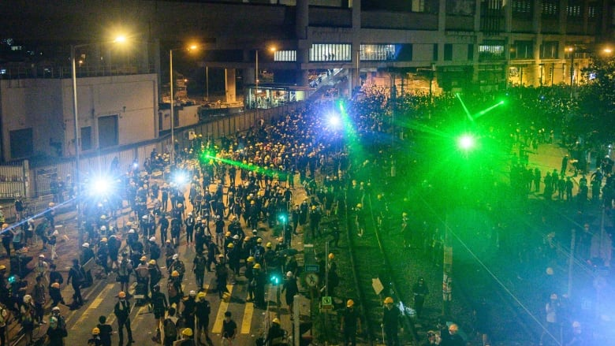
Hong kong, other countries
Garrett Smith
Hong Kong
  Flagging protesters [5]
  Lampposts [4][7]
U.A.E. [7]
  Used on Police Cars
  Public Transportation Safety
ID at Japan Olympics 2020 [7]
  Opt-in
Singapore 110,000 Lampposts With Facial Recognition [7]
https://www.cbc.ca/news/world/hong-kong-protest-lasers-facial-recognition-technology-1.5240651
Notes:
HONG KONG, OTHER COUNTRIES [43+132+45+54+25] 299 [1m15]
GRAPHIC – I’m sure you’re aware of the protests in Hong Kong, this image is of protesters using lasers to interfere with police cameras. The riot police are holding them up on poles and trying to flag protesters for arrest.
This brings up another incident where Hong Kong protesters brought down a lamppost containing various sensors and cameras, allegedly being used to detect protesters. One demand they have is for the Hong Kong government to remove all of these lampposts. In the United States, protesters in Baltimore were found using facial recognition technology and arrested. We should learn from Hong Kong and protect protesters from this technology regardless of the legality of the protest. , A Hong Kong computer programmer posted online a prototype system to use facial recognition on police, the police showed up in plain clothes and tried to force him to unlock his iPhone with its own facial recognition so that they could access his information.
In the United Arab Emirates Public buses are being equipped with these to determine if the driver is mentally fit to drive. police cars are being outfitted with this equipment to automatically detect criminals and wanted vehicles to flag them for arrest. The UAE has public safety in mind, but this indiscriminate use is a privacy violation – as shown by the passage of laws in California.
In Japan, there will be hundreds of booths at the 2020 Olympics to confirm the identities of people who are in their system, this surveillance has drawn privacy concerns but they still permit the traditional ID card verification. With transparency and an opt-in policy this is a responsible use of the technology, unlike what’s currently seen in the US. Japanese Retailers have also experimented with facial recognition and saw a 40% drop in thefts.
In Singapore, they’re running an independent project called Lampposts as a Platform, which involves installing 110,000 lampposts equipped with security cameras to prevent crime.
GRAPHIC – Protesters shining lasers at fac.rec. cameras for obfuscation.
1- Recent protests against a bill introduced to extradite citizens to mainland China.
1.1 - Hong Kong riot police used cameras on poles behind line of officers, protesters used lasers to obfuscate. Man posted algorithm online for detecting officers from faces. Plainclothes officers tried to force man to unlock phone with facial recognition – he disabled it and they hacked his home computers.
1.2 - Hong Kong protesters claim that installed ‘smart’ lampposts equipped with cameras are sending facial information to mainland China, destroyed at least one and demand lawmakers to move others. Given validity because Singapore – leading project to outfit 110,000 lampposts with facial recognition software.
2.1- UAE testing police cars outfitted with cameras to detect wanted criminals & vehicles
2.2 cameras to analyze state of bus drivers to see if condition to operate vehicles.
3-

Slide 28
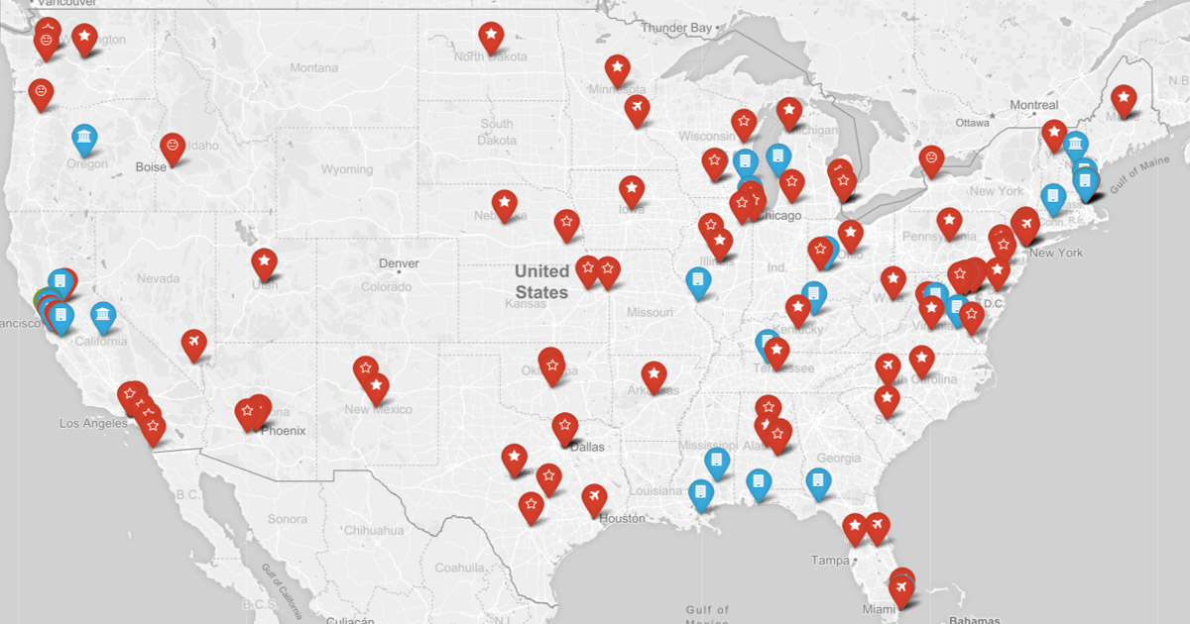
US Issues and solutions
Garrett Smith
  General & Racial Accuracy
    Less accurate for minority groups [2]
  Baltimore Protester Arrests [1]
  Informed Consent, Licenses [3]
    Not informed of use in government database
    21 states give FBI DMV info
  Oversight & Probable Cause
    6/17 limited oversight, 9/17 no reasonable suspicion [2]
Red – Facial Recognition in use
Blue - Has laws regarding facial recognition
https://www.banfacialrecognition.com/map/
Notes:
ISSUES AND SOLUTIONS [1m20]
GRAPHIC - The spots in red are where an organization or police community are using facial recognition. The blue points are the states where laws have been passed regarding its use.
I’ll start off by discussing the problems with the current system.
This technology should have a standard accuracy for implementation and should be met in all subsets of ethnic groups. It is less accurate for blacks than whites, and it is more likely to affect them, which results in unwarranted suspicion of innocents
The technology should not be permitted for targeting any members of a free speech demonstration regardless of the legality of it. Baltimore police used this to arrest protesters at an unregistered protest. The same strategy is being used in Hong Kong.
When people apply for drivers licenses they should be aware if they are going to be used for criminal searches. The FBI uses the DMV licenses of 21 different states for their information.
Organizations that use facial recognition technology should be required to have probable cause, 9 out of 17 states with public information don’t require probable cause for search and another set of 6 don’t require any sort of oversight on irresponsible use.
GRAPHIC- Red – Airport/State/Local police is confirmed to use recognition, Blue – Law has been passed regarding it.
1 – 9/17 that have publicly available data require no reasonable suspicion for searches, inc. FBI. 6/17 did not require audits for misuse inc. FBI.
2 – 21 states allow FBI to scan their driver photos, most allow FBI to use mugshots (less of a problem, because the former are assumedly law-abiding) FBI alone makes 4000 monthly searches,
3 – Only 1/52 analyzed jurisdictions have legal protections against searches that infringe on religious, political, other protected speech (no audits, requirements for search). BLM illegal protesters arrested using facial recognition.
4 – Facial recognition technology is less accurate on black people, more likely to affect their community due to 4x crime rate. Additionally, facial recognition requires untrained officers to distinguish results which could lead to mistakes, recognition systems at best 90-95% accurate regardless.

Slide 29
References
Garrett Smith
[1] Ghaffary, Shirin, and Rani Molla. “Here's Where the US Government Is Using Facial Recognition Technology to Surveil Americans.” www.vox.com/recode/2019/7/18/20698307/facial-recognition-technology-us-government-fight-for-the-future (10 September 2019)
[2] Garvie, Clare. “The Perpetual Line-Up.” www.perpetuallineup.org/ (10 September 2019)
[3] Harwell, Drew. “FBI, ICE Find State Driver's License Photos Are a Gold Mine for Facial-Recognition Searches.” www.washingtonpost.com/technology/2019/07/07/fbi-ice-find-state-drivers-license-photos-are-gold-mine-facial-recognition-searches/ (10 September 2019)
[4] Thalen, Mikael. “Hong Kong Protesters Knock down Alleged 'Facial Recognition Tower'.” www.dailydot.com/debug/hong-kong-protesters-facial-recognition-tower/ (10 September 2019)

Slide 30
References
Garrett Smith
[5] Mozur, Paul “In Hong Kong Protests, Faces Become Weapons.” www.nytimes.com/2019/07/26/technology/hong-kong-protests-facial-recognition-surveillance.html (10 September 2019)
[6] Mozur, Paul. “One Month, 500,000 Face Scans: How China Is Using A.I. to Profile a Minority.” The New York Times, The New York Times, 14 Apr. 2019, www.nytimes.com/2019/04/14/technology/china-surveillance-artificial-intelligence-racial-profiling.html (10 September 2019)
[7] Prakash, Abishur. “Facial Recognition Cameras and AI: 5 Countries With the Fastest Adoption.” Robotics Business Review, Robotics Business Review, 21 Dec. 2018, www.roboticsbusinessreview.com/ai/facial-recognition-cameras-5-countries/ (10 September 2019)

Slide 31
Class 7
The End
Keith A. Pray
Instructor
socialimps.keithpray.net
Notes:
This is the end. Any slides beyond this point are for answering questions that may arise but not needed in the main talk. Some slides may also be unfinished and are not needed but kept just in case.

