Slide 1
Class 5
Intellectual Property
Keith A. Pray
Instructor
socialimps.keithpray.net
Notes:
Here’s the title slide. Excited already, aren’t you?
Weird Al Yankovic “Don’t Download This Song” (3:53)
https://www.youtube.com/watch?v=zGM8PT1eAvY

Slide 2
Papers
http://socialimps.keithpray.net/assignments/paper-guidelines/
Quantify
  Not terms like: less, more, a lot, huge, great, big, tiny, etc.
State a strong, clear conclusion
Read paper aloud to proof
Use template, saves time (and -1 point)
Cite as suggested [1]
Provide Counter Point and Response
Notes:
Save for next time:
Be sure to put quotes around entire quote
Clearly state conclusion
First statement preferred
Print 2 sided and save a tree
Hyperbole is the best thing ever!
but not in these papers
No strawman fallacy in counter point
Text book is not a primary source

Slide 3
Overview
Review
Assignment
Students Present
Guest Speaker –

Slide 4
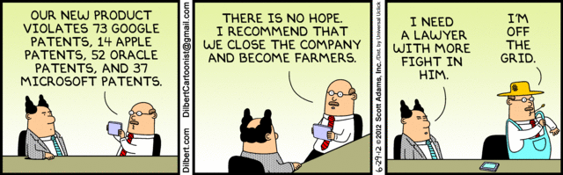
Notes:
Comments, observations, questions on IP Chapter?

Slide 5
My Reading Notes
pp. 165 “...ownership of ideas...” not quite right
pp. 168 public domain year 1997/1999 from source published in 1996?
pp. 170 SaaS, Google Search example? “…before he gave them the plot.”? “…cannot erase the memories...” Paycheck (2003)
pp. 180 4.4 #2 preferred?
pp. 186/196 revenue != profit
pp. 190 blocking 100% seems impossible
pp. 194 Any legitimate BitTorrent use examples since 2005?
pp. 197 “licensing agreement … hardware”? Confidential source code very outdated.
pp. 198 4.7.3 references?
pp. 205 Perhaps friends should not ask you to break the law?
Any successful businesses operate as a support service?
pp. 207 Is Perl still most popular? Quality study from 2003, change?
pp. 209 who uses tape?
pp. 210 “human-readable, lawyer-readable…”
pp. 223 Interview has nothing to do with computing

Slide 6
Group Quiz
For each On the left answer a–d on Right
Trademark
Copyright
Patent
Trade Secret
What does it protect?
What qualifications have to be met?
How long does protection last?
Give a specific example currently protected?
Notes:
Trademark
Used to denote a product or service.
Apply in specific areas of commerce. Only applies in specified area of business
Indefinite term as long as in use and protected against becoming a common noun or verb.
You do not have to register a trademark unless you want to bring litigation before a federal court (there are other benefits too, but what are they?)
Copyright
Expression, not ideas: Fuzzy. E.g. derivative works, characters, merchandising, plots.
Mickey Mouse, Tarzan.
US Default : Original Author, Exception: work for hire, Transferred: yes
Rights: Publication, Performance / exhibition, Adaptation to other media, Excerpting, Attribution, Derivative works
US Term: Lifetime of author plus 70 years., 95 years for companies.
Governed by US law and international treaties (e.g. WIPO).
Fair Use: News reporting, reviews, etc., Scholarly / educational use, Private, non-commercial use, Lending libraries and archives
Fair Use restrictions: Admission charge, Re-transmission
In general, you can: Read, view, play, etc., Copy for personal use., Time-shift, Space-shift
In general, you cannot: Copy for others., Transfer to someone else but keep a copy., Show / perform it publicly.
What about video rentals?
Rationale: Encourage creativity. Encourage dissemination. Balance between private and public good. It’s a social contract.
Patent
A mechanism, process, or composition of matter.
Must be: Novel. Useful. Non-obvious. Described clearly. Must do what it says.
Usual term 20 years.
Utility and plant patents: 20 years.
Design patents last 14 years. (ornamental design of functional item)
Provisional patent gives 1 year, before full patent
Trade Secret
You must take steps.
Enforceable by: Contracts, Laws against industrial espionage.

Slide 7
Group Quiz
For each On the left answer a–d on Right
Trademark
Copyright
Patent
Trade Secret
What does it protect?
Qualifications required?
How long does protection last?
Specific example currently protected?
Notes:
Trademark
Used to denote a product or service.
Apply in specific areas of commerce. Only applies in specified area of business
Indefinite term as long as in use and protected against becoming a common noun or verb.
You do not have to register a trademark unless you want to bring litigation before a federal court (there are other benefits too, but what are they?)

Slide 8
Group Quiz
For each On the left answer a–d on Right
Trademark
Copyright
Patent
Trade Secret
What does it protect?
  Mark denoting product of service
Qualifications required?
  Unique in specific area of commerce
How long does protection last?
  While in use and protected against common noun or verb usage. Need to register to sue.
Specific example currently protected?
Notes:
Trademark
Used to denote a product or service.
Apply in specific areas of commerce. Only applies in specified area of business
Indefinite term as long as in use and protected against becoming a common noun or verb.
You do not have to register a trademark unless you want to bring litigation before a federal court (there are other benefits too, but what are they?)

Slide 9
Group Quiz
For each On the left answer a–d on Right
Trademark
Copyright
Patent
Trade Secret
What does it protect?
Qualifications required?
How long does protection last?
Specific example currently protected?
Notes:
Copyright
Expression, not ideas: Fuzzy. E.g. derivative works, characters, merchandising, plots.
Mickey Mouse, Tarzan.
US Default : Original Author, Exception: work for hire, Transferred: yes
Rights: Publication, Performance / exhibition, Adaptation to other media, Excerpting, Attribution, Derivative works
US Term: Lifetime of author plus 70 years., 95 years for companies.
Governed by US law and international treaties (e.g. WIPO).
Fair Use: News reporting, reviews, etc., Scholarly / educational use, Private, non-commercial use, Lending libraries and archives
Fair Use restrictions: Admission charge, Re-transmission
In general, you can: Read, view, play, etc., Copy for personal use., Time-shift, Space-shift
In general, you cannot: Copy for others., Transfer to someone else but keep a copy., Show / perform it publicly.
What about video rentals?
Rationale: Encourage creativity. Encourage dissemination. Balance between private and public good. It’s a social contract.

Slide 10
Group Quiz
For each On the left answer a–d on Right
Trademark
Copyright
Patent
Trade Secret
What does it protect?
  Expression, not ideas. Derivative work, publication, performance
Qualifications required?
  Original
How long does protection last?
  Author lifetime + 70 years, 95 years for companies
Specific example currently protected?
Notes:
Copyright
Expression, not ideas: Fuzzy. E.g. derivative works, characters, merchandising, plots.
Mickey Mouse, Tarzan.
US Default : Original Author, Exception: work for hire, Transferred: yes
Rights: Publication, Performance / exhibition, Adaptation to other media, Excerpting, Attribution, Derivative works
US Term: Lifetime of author plus 70 years., 95 years for companies.
Governed by US law and international treaties (e.g. WIPO).
Fair Use: News reporting, reviews, etc., Scholarly / educational use, Private, non-commercial use, Lending libraries and archives
Fair Use restrictions: Admission charge, Re-transmission
In general, you can: Read, view, play, etc., Copy for personal use., Time-shift, Space-shift
In general, you cannot: Copy for others., Transfer to someone else but keep a copy., Show / perform it publicly.
What about video rentals?
Rationale: Encourage creativity. Encourage dissemination. Balance between private and public good. It’s a social contract.

Slide 11
Group Quiz
For each On the left answer a–d on Right
Trademark
Copyright
Patent
Trade Secret
What does it protect?
Qualifications required?
How long does protection last?
Specific example currently protected?
Notes:
Patent
A mechanism, process, or composition of matter.
Must be: Novel. Useful. Non-obvious. Described clearly. Must do what it says.
Usual term 20 years.
Utility and plant patents: 20 years.
Design patents last 14 years. (ornamental design of functional item)
Provisional patent gives 1 year, before full patent

Slide 12
Group Quiz
For each On the left answer a–d on Right
Trademark
Copyright
Patent
Trade Secret
What does it protect?
  Mechanism, process, composition of matter
Qualifications required?
  Novel, useful, non-obvious, described clearly, must function
How long does protection last?
  Utility and plant: 20 years
  Design: 14 years
  Provisional adds 1 year
Specific example currently protected?
Notes:
Patent
A mechanism, process, or composition of matter.
Must be: Novel. Useful. Non-obvious. Described clearly. Must do what it says.
Usual term 20 years.
Utility and plant patents: 20 years.
Design patents last 14 years. (ornamental design of functional item)
Provisional patent gives 1 year, before full patent

Slide 13
Group Quiz
For each On the left answer a–d on Right
Trademark
Copyright
Patent
Trade Secret
What does it protect?
Qualifications required?
How long does protection last?
Specific example currently protected?
Notes:
Trade Secret
You must take steps.
Enforceable by: Contracts, Laws against industrial espionage.

Slide 14
Group Quiz
For each On the left answer a–d on Right
Trademark
Copyright
Patent
Trade Secret
What does it protect?
  Anything
Qualifications required?
  Must take steps to keep secret, e.g. Non-Disclosure Agreements, contracts
How long does protection last?
  As long as kept secret
Specific example currently protected?
Notes:
Trade Secret
You must take steps.
Enforceable by: Contracts, Laws against industrial espionage.

Slide 15
Overview
Review
Assignment - Average Group Happiness 1.25
Students Present
Guest Speaker
Notes:
But first take a look at:
CGP Grey
Copyright: Forever Less One Day (6:27)
https://www.youtube.com/watch?v=tk862BbjWx4
Tom Scott
http://tomscott.com
Welcome To Life (2:44)
https://www.youtube.com/watch?v=IFe9wiDfb0E&feature=youtu.be

Slide 16
Assignment - Self Search 1/3
Profile 2
Is You
1 Page
Paper
Filter
Inspiration
Search Methods
…
…
…
…
Filter
Profile 1
Could Be You

Slide 17
Assignment - Self Search 2/3
Discussion Board
Post search techniques
  Do not repeat entries.
Use techniques listed to produce a profile that could be you.
  Not responsible for techniques posted less than 24 hours before class
Filter first profile so that the information is for you.
Provide as appendix
  Provide a brief description if you’d rather not list the details
For search result consider:
  Exactly how did the data get there?
  How can this data be used?
  Is this a secondary use?
  Did you authorized use of the data? If not and you want to, request its use be discontinued and share the experience.
Be creative, anyone can type a name into Google
Do not pay for search services

Slide 18
Assignment - Self Search 3/3
1 Page Paper
Refer to search results to support your conclusion
Subscribe to the Discussion Board
Conclusion idea examples (not comprehensive):
  What impression would the profile make on a potential employer?
  What would your elder family members (or equivalent) think?
  Are you comfortable with what you found or did not find?
  Do you believe protecting your privacy is important or needed?
5 High quality sources still required

Slide 19
Overview
Review
Assignment
Students Present
Guest Speaker

Slide 20
Digital Online Fair Use
Brennan Aubuchon
Notes:
Hi everyone. My name is Brennan and I am going to be talking to you today about digital online fair use. Specifically, should we alter our fair use laws to better accommodate the involvement of the internet.

Slide 21
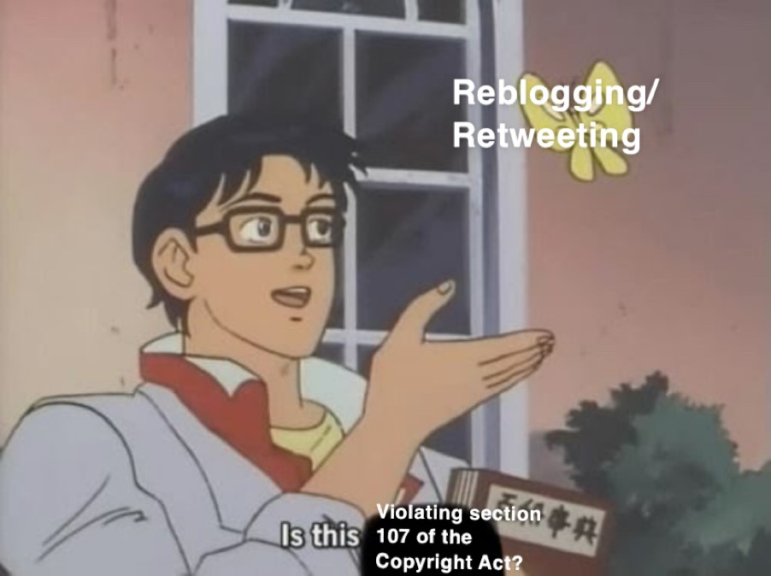
Reblogging/Retweeting
Brennan Aubuchon
Copies the original post
  Typically not educational
  Typically not informational
  Copies entire post
Is this still considered fair use?
https://www.vox.com/platform/amp/2018/5/15/17351806/is-this-a-pigeon-anime-butterfly-meme-explained
Notes:
So, how many people here have a Tumblr or a Twitter? How many people have ever reblogged or retweeted something? Just think about what that is for a moment, in relation to the four factors that determine fair use. I’ll pick on Tumblr since because it’s an easier target. If it’s fanart it is most likely not being used for an informational purpose, and if the person reblogging has a Patreon then you could even argue it is commercial use, so against fair use. It is a creative work of art so it is also against fair use. The entire post is being copied so that is also against fair use. That’s three out of the four already checked. Is it fair use?

Slide 22
Reblogging/Retweeting
Brennan Aubuchon
Thankfully, yes
Stated in Tumblr’s and Twitter’s Terms of Service [1] [2]
https://www.tumblr.com/policy/en/terms-of-service, https://twitter.com/en/tos
Notes:
Well yes, it is definitely fair use. Both Tumblr and Twitter include a line about it in their Terms of Service. Tumblr puts it a little more concisely than Twitter does, but they are ultimately the same. Consider what it would mean if these weren’t included though. A fundamental function of these programs would be dangerous and potentially illegal to use.

Slide 23
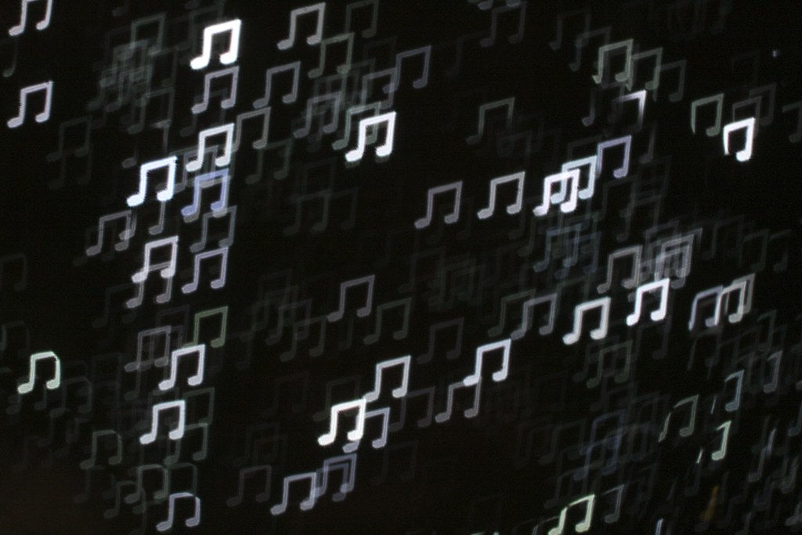
Nature of the Transfer
Brennan Aubuchon
Capitol Records, LLC v. ReDigi Inc.
ReDigi allowed people to sell old music that they no longer wanted
  Made sure music was legally purchased [3]
  Deleted the music on the owner’s computer once they went to sell it
Is this fair use?
"Music Note Bokeh" by all that improbable blue is licensed under CC BY-NC-SA 2.0 , https://ccsearch.creativecommons.org/photos/92b42db5-979c-4f66-a44e-ba3df6c31215
Notes:
Moving on to the next point I am going to talk about this court case between Capitol Records LLC v. ReDigi Inc. ReDigi was a service that allowed people to sell digital copies of music that they no longer wanted. They had a program to ensure that the music being uploaded was legally purchased and they even made sure that when a song was being sold, it was never on the original owner’s computer and the ReDigi server at the same time. Is this fair use?

Slide 24
Nature of the Transfer
Brennan Aubuchon
No… it is not
Files were copied from the owner to ReDigi’s server
Second Circuit Court found no fair use for resale of digital music [3]
NO
<Citation>
Notes:
The answer is no. According to the Second Circuit Court there was no fair use found for the resale of digital music. One of their primary arguments interested me. They said that because ReDigi copied the file from the original owner to their servers, even though they were never in both places at once, it was not considered fair use because it is the right of the copyright holder alone to create copies of their music. I find this strange because the same rule wouldn’t apply with a physical piece of artwork, or even a physical CD of music. So why apply it to digital music?

Slide 25
Lack of Precedent
Brennan Aubuchon
Russell Brammer v. Violent Hues Productions, LLC (VHP)
VHP used a photograph taken by Brammer on their website
All four criteria were in favor of fair use [4]
https://www.copyright.gov/fair-use/summaries/russellbrammer-violenthuesllc-4thcir2018.pdf
Notes:
I’ll move on now to another court case: Russell Brammer v. Violent Hues Productions LLC, which I will call VHP. Basically VHP used one of Brammer’s photographs on their website without his permission. He sued and they claimed fair use. The court found fair use, stating that it was there for non-commercial informational purposes, it was not considered a creative work, it was not the full picture as it had been scaled, and there was no market for the photograph anyway. After this, Brammer appealed.

Slide 26
Lack of Precedent
Brennan Aubuchon
Brammer appealed
All four criteria were found AGAINST fair use [5]
  Shows a severe lack of precedent
https://www.copyright.gov/fair-use/summaries/brammer-violenthues-4thcir2019.pdf
Notes:
In the appeal, every single one of the four factors was decided to be against fair use. I don’t have time to go into the details of it, but it was now non-informational commercial, a creative work, used the most important part of the photo, and destroyed whatever market the photo could have had. This kind of reversal is just completely ridiculous. There is just such a complete lack of precedent when it comes to these cases that it depends just as much on how the judge is feeling that day as what evidence there actually is.

Slide 27
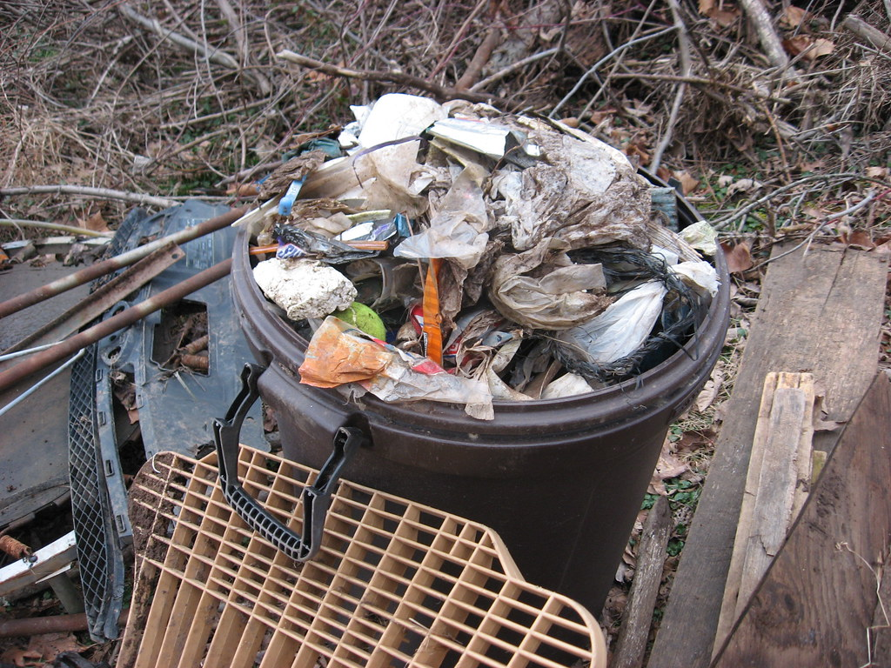
Counterpoint: Offensiveness
Brennan Aubuchon
Offensiveness is not a fair use factor [6]
Parodies can be offensive and still fall under fair use
"Creek Garbage" by stinkenroboter is licensed under CC BY-NC 2.0 , https://ccsearch.creativecommons.org/photos/a3865d1a-c0cc-45b1-ae7b-f28d31137bdd
Notes:
So a counterpoint that is sometimes made against a less restrictive but more defined set of fair use laws is that we should not allow offensive parodies or recreations of things. One example I saw was a parody of the Cabbage Patch Kids called the “Garbage Pail Kids”. Although this particular parody lost in its court case, offensiveness is not a factor when considering fair use, which is upsetting to people or companies who see offensive copies of their products.

Slide 28
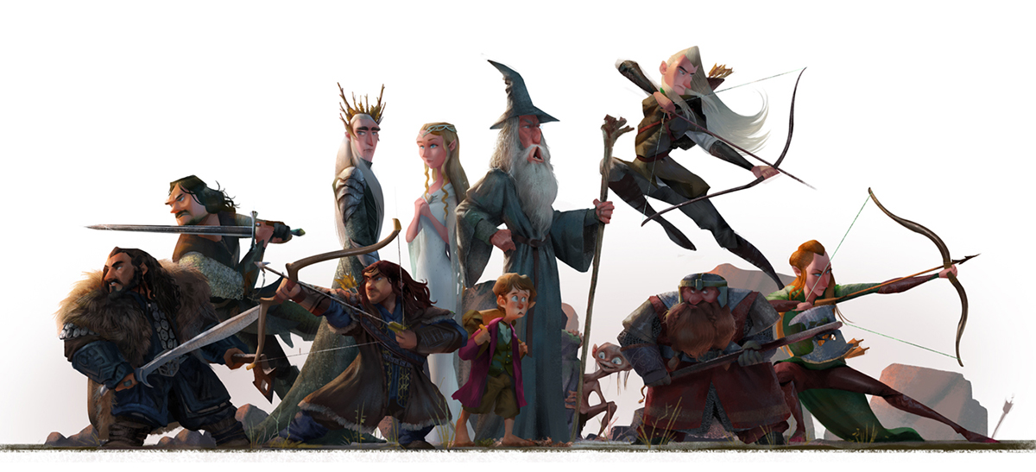
Counterpoint Response
Brennan Aubuchon
Fair use allows for more creative expression
Should encourage new ideas rather than restrict them [7]
"Fanart : The Lord of the Rings" by Wanchana Intrasombat is licensed under CC BY-NC 4.0 , https://ccsearch.creativecommons.org/photos/117ce2b5-d8bb-4098-b5dd-3abfc0bc7250
Notes:
My response to this would be the original purpose of fair use. That being: to allow for the lawful use of another person’s product or content, allowing for creativity and the spread of knowledge. People should not be worried about getting sued over poking fun at someone else’s creation. There should be fewer restrictions on fair use in our current digital age, not more, but have them be well defined to ensure that they are justly executed whenever cases may arise.

Slide 29
References
Brennan Aubuchon
[1] Tumblr, Terms of Service, Retrieved September 4th 2019 from https://www.tumblr.com/policy/en/terms-of-service
[2] Twitter, Twitter Terms of Service, Retrieved Sptember 4th 2019 from https://twitter.com/en/tos
[3] U.S. Copyright Office Fair Use Index, Capitol Records, LLC v. ReDigi Inc., Retrieved September 4th 2019 from https://www.copyright.gov/fair-use/summaries/capitol-records-llc-redigi-inc-no.16-2321-2nd-cir.dec.12.2018.pdf
[4] U.S. Copyright Office Fair Use Index, Russell Brammer v. Violent Hues Productions, LLC, Retrieved September 4th 2019 from https://www.copyright.gov/fair-use/summaries/russellbrammer-violenthuesllc-4thcir2018.pdf
[5] U.S. Copyright Office Fair Use Index, Brammer v. Violent Hues Productions, LLC, Retrieved September 4th 2019 from https://www.copyright.gov/fair-use/summaries/brammer-violenthues-4thcir2019.pdf
[6] Rich Stim, Measuring Fair Use: The Four Factors, Retrieved September 5th 2019 from https://fairuse.stanford.edu/overview/fair-use/four-factors/
[7] DanThu Thi Phan, Will Fair Use Function on the Internet?, Retrieved September 5th 2019 from https://www-jstor-org.ezproxy.wpi.edu/stable/1123397?Search=yes&resultItemClick=true&searchText=%22fair+use%22&searchUri=%2Faction%2FdoBasicSearch%3FQuery%3D%2522fair%2Buse%2522%26amp%3Bacc%3Don%26amp%3Bwc%3Don%26amp%3Bfc%3Doff%26amp%3Bgroup%3Dcontrol&ab_segments=0%2Fl2b_100k_with_tbsub%2Ftest&refreqid=search%3A791fac96b2add7de32d5b185d9495d01&seq=48#metadata_info_tab_contents
Notes:
So, any questions?

Slide 30
Do we invent our invention’s inventions?
Trang Ha
Notes:
We are creating smarter Ais (Go, Deep Blue)
Patent and Copyright: to provide an inventor with an exclusive right to a piece of intellectual property -> acknowledge and reward their hard work put into the invention
Usually: end products or patterns that can directly be used
If AI comes up with a novel, useful idea, do they own it?

Slide 31
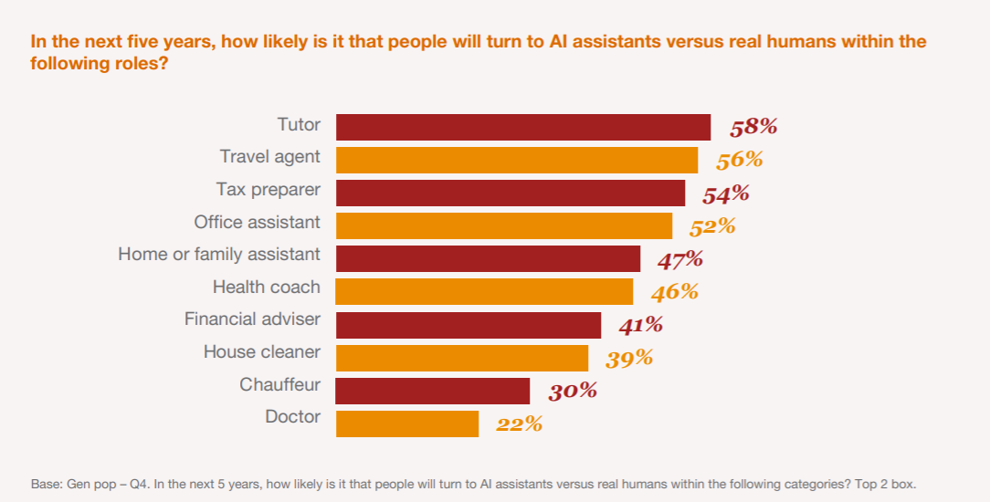
Statistics
Trang Ha
72% of business execs believe AI will be the business advantage of the future.
63 percent of consumers believe AI will help solve complex problems that plague modern societies.
AI market is projected to reach $70 billion by 2020
Graph from PwC CISAI, Bot.Me: A revolutionary partnership How AI is pushing man and machine closer together, April 2017
https://www.pwc.com/us/en/industry/entertainment-media/publications/consumer-intelligence-series/assets/pwc-botme-booklet.pdf
Notes:
Device for the Autonomous Bootstrapping of Unified Sentience. One benefit is that several containers can be fitted together more tightly to help them be transported safely. Another is that it should be easier for robotic arms to pick them up and grip them

Slide 32
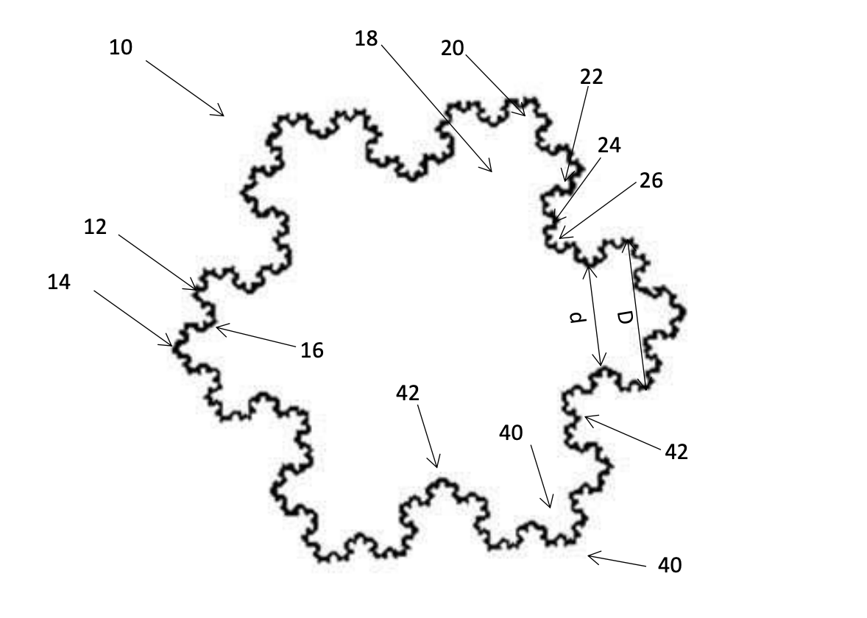
A Case study
Trang Ha
DABUS: AI system that “invented” 2 innovative designs.
  Fractal-like interlocking container system
Two professors from the University of Surrey and inventor of DABUS AI file patents in the system's name with the authorities
http://artificialinventor.com/?p=149
https://www.bbc.com/news/technology-49191645
Notes:
Device for the Autonomous Bootstrapping of Unified Sentience. One benefit is that several containers can be fitted together more tightly to help them be transported safely. Another is that it should be easier for robotic arms to pick them up and grip them

Slide 33
From a legal perspective
Trang Ha
Patent laws in both Europe including UK and the US require the inventor to be “persons”.
    “Whoever invents or discovers any new and useful process, machine, manufacture, or composition of matter, or any new and useful improvement thereof, may obtain a patent therefor, subject to the conditions and requirements of this title” (35 U.S.C. 101)
    Whoever = “The person who engages in the act of inventing”
https://uspto.gov/sites/default/files/101_step1_refresher.pdf
https://www.uspto.gov/sites/default/files/documents/aia0001.pdf
Notes:
In the UK and Europe, inventorship is restricted to “natural persons”. In the US, patent laws refer only to “individuals”

Slide 34
From a legal perspective
Trang Ha
Does it make sense to credit human as the inventor?
Counter arguments: AI doesn’t have rights to own properties, so it’s pointless to give inventorship of patents to them
    Ownership != Inventorship
    Patent inventorship to humans?
    No patent then? Invention lost
Solution: Inventorship = AI, Ownership = human!!
    Might change drastically if/when AI obtains rights to own properties.
https://www.uspto.gov/sites/default/files/documents/aia0001.pdf
http://artificialinventor.com/?p=149
Notes:
An alternative is to make the inventor the human who made the machine. But anyone obtaining a patent must sign a declaration stating they are the original inventor. If the machine comes up with a concept without humans’ training or inputs, then evaluates it and deems it usable, human, even the inventor of this machine cannot reasonably say he takes part in this invention.

Slide 35
From an ethical perspective
Trang Ha
As a child is conceived and taught by her parents, should they be credited for what she creates?
Invention of a Slave (1858): a slave owner could not patent a machine invented by his slave
    “Slave owners justified slavery by denying the humanity and creativity of African-Americans, but still wanted to claim ownership of valuable inventions created by their slaves” (Brian L. Frye, Invention of a slave, 2017)
https://papers.ssrn.com/sol3/papers.cfm?abstract_id=2918085
Notes:
Look at this from an ethical perspective. Attorney General

Slide 36
Conclusion
Trang Ha
AI should be credited as the inventor for its inventions in the patent, regardless of who should be the owners of this patent.
Notes:
While ownership rights for machines is beyond the scope of this discussion,

Slide 37
References
Trang Ha
[1] Ryan Abbott, “Should an AI System be credited as an inventor?”, Aug 24 2019, http://artificialinventor.com/?p=149
[2] Leo Kelion, “AI system 'should be recognised as inventor’”, Aug 1 2019,
https://www.bbc.com/news/technology-49191645
[3] USPTO, 35 USC § 101: Statutory Requirements and Four Categories of Invention, Sept 2019 https://uspto.gov/sites/default/files/101_step1_refresher.pdf
[4] Frye, Brian L., Invention of a Slave (February 15, 2017). 68 Syracuse Law Review 181 (2018). https://ssrn.com/abstract=2918085
[5] Financial Times, Patent agencies challenged to accept AI inventor, 2019
https://www.ft.com/content/9c114014-b373-11e9-bec9-fdcab53d6959
[6] Osborne Clarke, Artificial intelligence – who owns the invention, Sept 6 2019, https://www.osborneclarke.com/insights/artificial-intelligence-who-owns-the-invention/
[7] PwC Consumer Intelligence Series, “Bot.Me: A revolutionary partnership How AI is pushing man and machine closer together”, 2017, https://www.pwc.com/us/en/industry/entertainment-media/publications/consumer-intelligence-series/assets/pwc-botme-booklet.pdf

Slide 38
Class 5
The End
Keith A. Pray
Instructor
socialimps.keithpray.net
Notes:
This is the end. Any slides beyond this point are for answering questions that may arise but not needed in the main talk. Some slides may also be unfinished and are not needed but kept just in case.

