Slide 1
Class 11
Work
Keith A. Pray
Instructor
socialimps.keithpray.net
Notes:
Here’s the title slide. Excited already, aren’t you?

Slide 2
Grades
To Date
46 Max Possible

Slide 3
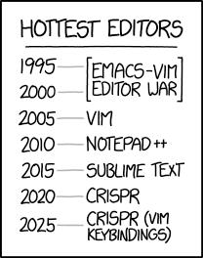
Overview
Review
Assignment
Students Present
https://www.xkcd.com/1823/
Notes:
Full circle.
CRISPR: Clustered Regularly Interspaced Short Palindromic Repeats
Allows permanent modification of genes within organisms.
Kickstarter Charter
https://www.kickstarter.com/charter?ref=about_subnav

Slide 4
Overview
Review
Assignment
Students Present
C lustered
R egularly
I nterspaced
S hort
P alindromic
R epeats
Permanent gene modification
https://www.xkcd.com/1823/
Notes:
Full circle.
CRISPR: Clustered Regularly Interspaced Short Palindromic Repeats
Allows permanent modification of genes within organisms.
Kickstarter Charter
https://www.kickstarter.com/charter?ref=about_subnav

Slide 5
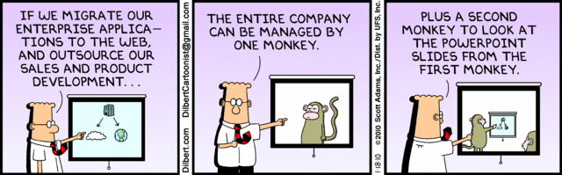
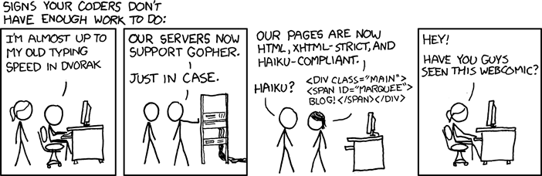
http://xkcd.com/554/
Notes:
Poll class:
Expected salary range upon graduation? Min, Max? Put on board.
Assume 40 hour work week.
How many people would work:
32 hours for 0.8 * Max? Put on board.
24 hours for 0.6 * Max? Put on board.
…continue until Min is reached.

Slide 6
Group Quiz
List 2 ways IT can lead to organizational change.
List 4 ways a Video Game Producer may protect its IP and what specific IP each protects.
List a computing technology that can be used to protect an individual’s privacy.
List a computing technology that can be used to intrude upon an individual’s privacy.
Notes:
Could split into groups of 4-5 for this.
Fill time with Work Discussion on Course Web Site

Slide 7
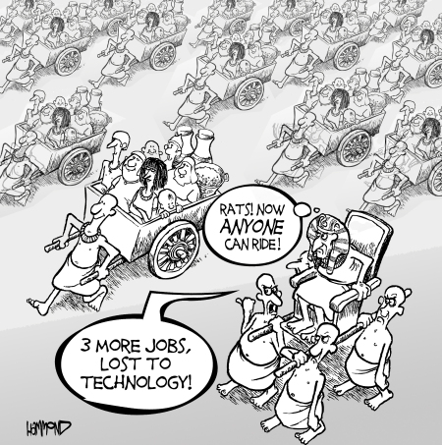
Overview
Review
Assignment
Students Present
©2009, MobileRobots Inc.
Notes:
Review Group Assignment Details.
Or first watch video: depends on student presentations, no thunder stealing.
CGP Grey
Humans Need Not Apply (15:00) – 2014-08-13
http://www.youtube.com/watch?v=7Pq-S557XQU
Last access 2016-04-22
These 3D printed homes can be constructed for $4,000 (3:00 – 2018-04-02)
http://www.businessinsider.com/3d-printed-homes-constructed-icon-new-story-tech-charity-4000-dollars-2018-3
https://www.youtube.com/watch?v=SvM7jFZGAec (1:28)
Last access 2018-04-22
Look at:
BBC Intelligent Machines
http://www.bbc.com/news/technology-33978561
BBC Likelihood of robot taking your job
http://www.bbc.com/news/technology-34066941

Slide 8
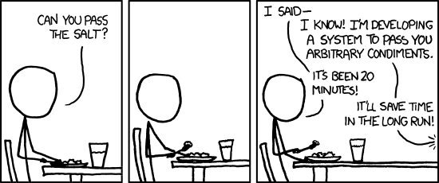
Overview
Review
Assignment
Students Present
https://xkcd.com/974/

Slide 9
Robot ed
By Noelle Morgan

Slide 10
Conclusion
Noelle Morgan
Robotics has tremendous potential to be useful in the education of young children and those with special educational needs
Notes:
<speaker notes>

Slide 11
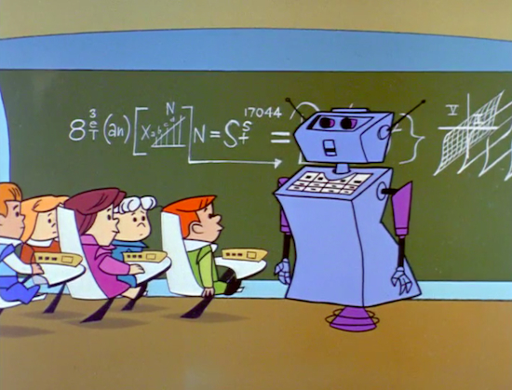
The potential
Noelle Morgan
One to One tutoring
Personalization
They’re believable
<Graphic as big as will fit>
[1][2][3][5][6]
Notes:
Studies have shown that 1 to 1 tutoring has positive benefits in learning
Personal social and academic support reinforces later achievements
Robots are good for learning and behavioral change in people, as has occurred with weight loss, learning words, and motor skills
Studies have shown that young children see robots as almost human; basically not inanimate objects but something conscious. They even have the potential to form relationships with children!

Slide 12
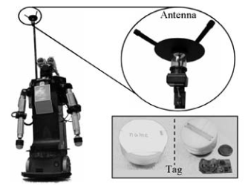
Personal tutoring
Noelle Morgan
One to One tutoring
Partner Robots
<Graphic as big as will fit>
[4]
Notes:
Studies have shown that 1 to 1 tutoring has positive benefits in learning
Partner Robots- There was a study done in Japan about robots as social partners and peer tutors, where young Japanese students made friends with robots and showed improvement in their English speaking skills. This particular challenge because the researchers saw a lack of motivation for Japanese students to learn English. This same concept of motivation by friendship could be applied to a variety of subject, such as animal biology, mathematics, other languages, etc.

Slide 13
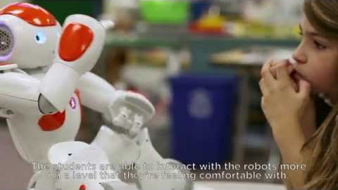
Primary Education
Noelle Morgan
Teacher Robot Collaboration
NAO robots are being used in classrooms around the world, teaching kids about coding and physical health
[7][8]
Notes:
A research group designed a system that would allow sociable robots to act as teacher’s assistants that would conduct multiple choice quizzes in class about what the students had learned. The lesson was on frog anatomy and the students were shown to have learned a lot and retain interest in the lesson
NAO Robots are a brand of robots being used in classrooms around the world to teach kids about coding, physical health, and more! (play video)
https://www.youtube.com/watch?v=mkt52Utz2Gk

Slide 14
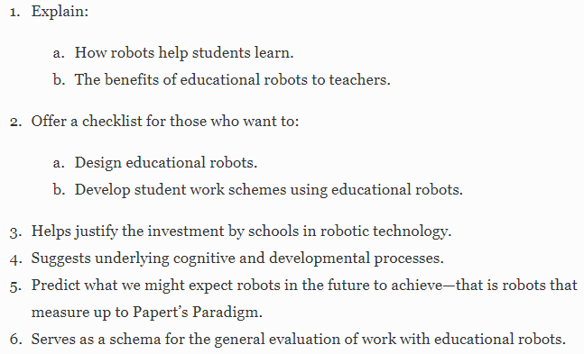
How will it work?
Noelle Morgan
Guidelines on how to make robots for special education
[9]
Notes:
The picture is a list of key facets regarding educational robotics
The Center for Augmentative and Special Technology, has come up with a list of guidelines on how to design special needs robots:
Multiple representations of content
Multiple options for expression and control
Multiple options for engagement and motivation
These are a few of the examples I could find, but there is tons of potential here. Most of the studies being done had students learn from quizzes when robotics has the potential to be at-home tutors, teacher’s assistants, language learning, personal readers, and so much more.

Slide 15
References
Catlin, D., & Blamires, M. (2018). Designing robots for special needs education. Technology, Knowledge and Learning, , . doi:10.1007/s10758-018-9378-8
Noelle Morgan
[1]BLOOM, B. S. (1984). The 2 sigma problem: The search for methods of group instruction as effective as one-to-one tutoring. Educational Researcher, 13(6), 4-16. doi:10.3102/0013189X013006004
[2]Fridin, M., & Belokopytov, M. (2014). Embodied robot versus virtual agent: Involvement of preschool children in motor task performance. International Journal of Human-Computer Interaction, 30(6), 459-469. doi:10.1080/10447318.2014.888500
[3]Hughes, J. N., & Kwok, O. (2006). Classroom engagement mediates the effect of teacher–student support on elementary students' peer acceptance: A prospective analysis. Journal of School Psychology, 43(6), 465-480. doi:10.1016/j.jsp.2005.10.001
[4]Kanda, T., Hirano, T., Eaton, D., & Ishiguro, H. (2004). Interactive robots as social partners and peer tutors for children: A field trial. Human-Computer Interaction, 19(1), 61-84. doi:10.1207/s15327051hci1901&2_4
[5]Kennedy, J., Baxter, P., & Belpaeme, T. (2014). Children comply with a robot's indirect requests. Paper presented at the 198–199. doi:10.1145/2559636.2559820 Retrieved from http://doi.acm.org/10.1145/2559636.2559820
[6]Klem, A. M., & Connell, J. P. (2004). Relationships matter: Linking teacher support to student engagement and achievement. Journal of School Health, 74(7), 262-273. doi:10.1111/j.1746-1561.2004.tb08283.x
[7]Morita, T., Akashiba, S., Nishimoto, C., Takahashi, N., Kukihara, R., Kuwayama, M., & Yamaguchi, T. (2018). A practical Teacher–Robot collaboration lesson application based on PRINTEPS. The Review of Socionetwork Strategies, 12(1), 97-126. doi:10.1007/s12626-018-0021-x
[8]NAO robot in school - for STEM, autism and engaging students. RobotLAB Inc. (Director). (2014).[Video/DVD] Retrieved from https://www.youtube.com/watch?v=mkt52Utz2Gk
[9]Catlin, D. & Blamires, M. Tech Know Learn (2018). https://doi.org/10.1007/s10758-018-9378-8

Slide 16
Richer rich, poorer poor
Jerry Assan

Slide 17
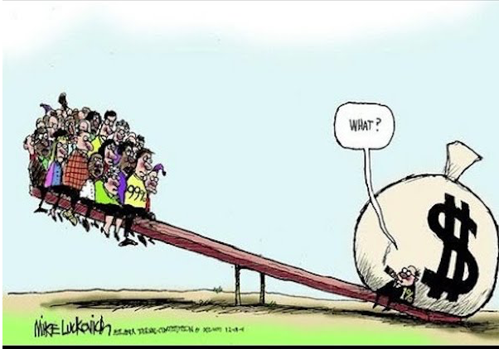
Wealth distribution in the past
Jerry Assan
Agricultural age:
  Who ever owns the most land are the richest
Industrial age:
  Who ever owns the most factory are the richest
Globalization:
  Who ever owns the most land and property are the richest
Next stage:
  Who ever owns the most data are the richest
Source: https://mronline.org/2018/06/30/the-u-s-is-a-world-leader-in-income-and-wealth-inequality/#lightbox/0/
[4]
Notes:
Firstly, I want to talk about some background on the wealth distribution. This is not a perfect communist world, so uneven wealth distribution has existed from ancient times. In the past, land was the most important asset in the world. Looking at the history, governments, churches, tribes ,etc. competes to control lands. This gradually leads to the winners accumulating land, and when too much land concentrated into a few people, society splits into the rich and the poor. Of course, this is an over generalization, but my point is, as computing power and technology rises, data is becoming the new land, and will be a key factor in the future wealth distribution.

Slide 18
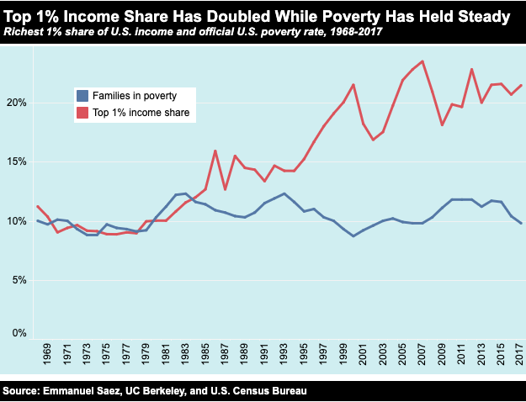
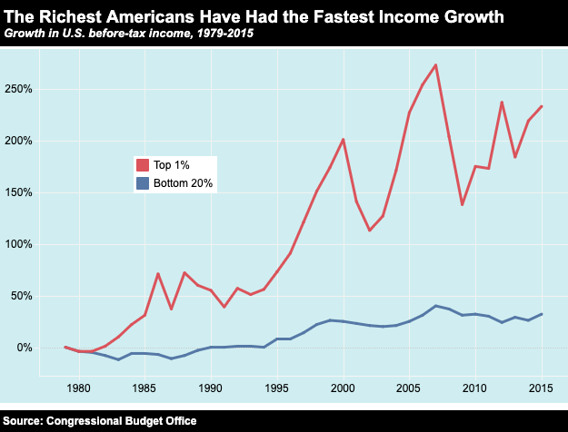
Support
Jerry Assan
[7]
Notes:
Here are some stats that shows the current wealth distributions in the united states.
The first figure is a statistic that shows how the richer American earners are getting even richer while the the poor’s income remained steady for almost five decades
The second figure is a statistic that shows the increasing rate of the income growth of top 1% people while that of the bottom 20% almost remained steady.
Billionaire wealth has risen by an annual average of 13 percent since 2010 – six times faster than the wages of ordinary workers, which have risen by a yearly average of just 2 percent. The number of billionaires rose at an unprecedented rate of one every two days between March 2016 and March 2017.
These trends are the key indication of forming a larger income inequality, the reason why this trend occurs and how it is related to competing for data will be explained in the next few slides.

Slide 19
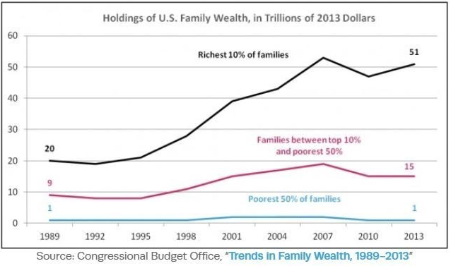
Support
Jerry Assan
[7]
Notes:
Here are some stats that shows the current wealth distributions in the united states.
The first figure is a statistic that shows how the richer American earners are getting even richer while the the poor’s income remained steady for almost five decades
The second figure is a statistic that shows the increasing rate of the income growth of top 1% people while that of the bottom 20% almost remained steady.
This figure shows that the middle class is not doing that good either.
Billionaire wealth has risen by an annual average of 13 percent since 2010 – six times faster than the wages of ordinary workers, which have risen by a yearly average of just 2 percent. The number of billionaires rose at an unprecedented rate of one every two days between March 2016 and March 2017.
This figure shows the inflation rate in us over the last 5 decades, where the average is close to 5 percent. Positive inflation rate results in less buying power, this indicates that even though the bottom 20%’s income has been steady over these few years, adding inflation into account, it is still declining.
These trends are the key indication of forming a larger income inequality, the reason why this trend occurs and how it is related to competing for data will be explained in the next few slides.

Slide 20
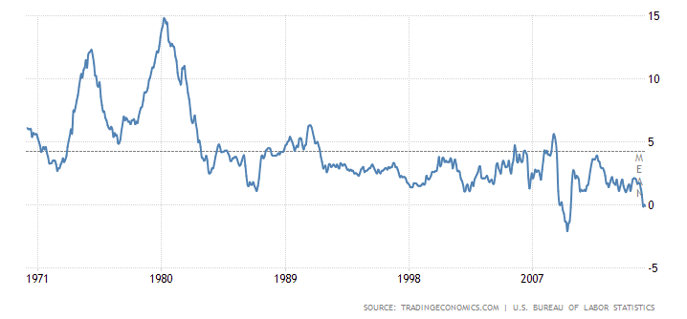
Support
Jerry Assan
[7]
Notes:
Here are some stats that shows the current wealth distributions in the united states.
The first figure is a statistic that shows how the richer American earners are getting even richer while the the poor’s income remained steady for almost five decades
The second figure is a statistic that shows the increasing rate of the income growth of top 1% people while that of the bottom 20% almost remained steady.
Billionaire wealth has risen by an annual average of 13 percent since 2010 – six times faster than the wages of ordinary workers, which have risen by a yearly average of just 2 percent. The number of billionaires rose at an unprecedented rate of one every two days between March 2016 and March 2017.
This figure shows the inflation rate in us over the last 5 decades, where the average is close to 5 percent. Positive inflation rate results in less buying power, this indicates that even though the bottom 20%’s income has been steady over these few years, adding inflation into account, it is still declining.
These trends are the key indication of forming a larger income inequality, the reason why this trend occurs and how it is related to competing for data will be explained in the next few slides.

Slide 21
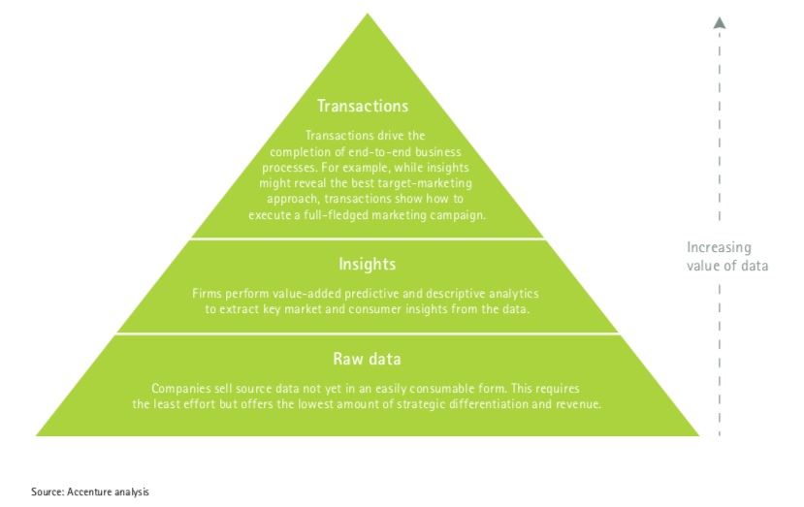
Who is owning Data?
Jerry Assan
What is data?
Who is owning the data?
  Private Corporations
    Tech companies
    Consulting and Banking
    Media
  The government
  Institutions
    Health-care
[6],[1]
Notes:
So let's talk about gaining control of the data. To do that, we have to clarify the what the data actually means. This graph illustrates a data value pyramid developed by Accenture. Where the value of data increases from raw data to transaction data. Raw data means source data for example a person’s height or he’s web activities whilst a transaction data means information has derived from that raw data and an example for that would be: a user’s preference on clothing so the company can start a whole marketing campaign for that user and/or similar target groups. There are laws developed to protect the right of owning land, property and company stocks. However, so far, there isn’t a strong protection or regulation on the ownership of personal data. The world assumes that the raw data belongs to individuals but the insights and transactions belongs to whoever created them.
For example, google search engine. (people’s visit time, search keyword, password are their own data, but activities, trend that derived by google belongs to google)
Essentially, we have no control over private corporations and government owning data from us, and that’s a problem.

Slide 22
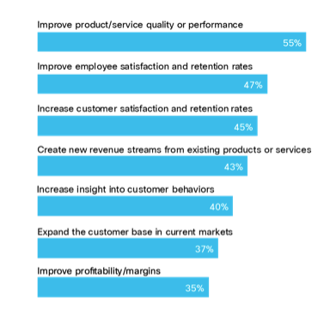
data is the new form of wealth
Jerry Assan
  How can data be used?
    Automation
    Advertising
    Marketing
    Artificial intelligence
    Machine learning
    These all lead to profit
Source: https://www.activistpost.com/wp-content/uploads/2012/04/customer-data-money-tree1.jpg
[2],[4]
Notes:
Having control of large amount of data means profit. Simply go back to the land example: If you have a house and the land that the house sits on, you can probably rent the place out or open a home restaurant, but usually, doing so will not necessarily generate large amount of profit. However, if you have land as big as Salisbury park, there are so much more things you can do with. For instances: build a farm, build a factory or even slice the land up and collect rent. Accumulating resources greatly impacts the gain of profit. This would also apply to data, and that’s why people are trying to take control of large amount of data at the first place.
Forbes insights and Cisco conducted a study on 207 large enterprises who adopted Advanced Data driven strategies, And is shown in the graph here:
These companies believe data has these values(the graph)
60% of those companies reported that company's direct annual revenue growth from adopting data driven strategies are greater than 7%

Slide 23
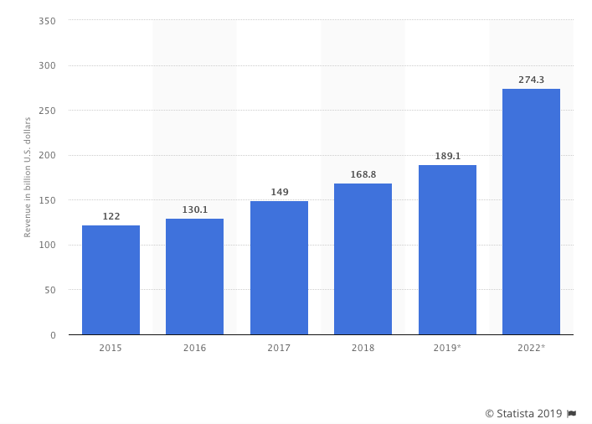
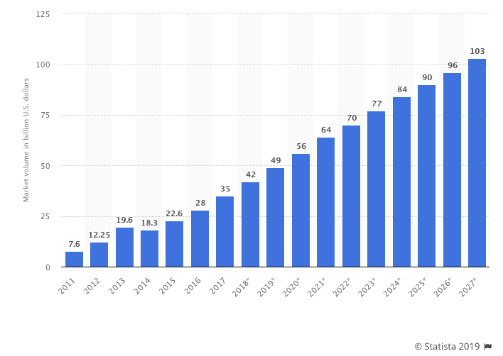
Support
Jerry Assan
<Graphic as big as will fit>
[7]
Notes:
Next, lets look at the market evaluation on big data.
The first figure shows the revenue generated from the big data and business analytics market worldwide, from 2015 to 2022. In 2019, big data and business analytics was expected to generate 189.1 billion U.S. dollars worldwide.
The second figure shows the global big data market is forecasted to grow to 103 billion U.S. dollars by 2027, more than double its expected market size in 2018.
The overall trend shows that there is huge potential and profit in the market, so data is the new form of wealth.

Slide 24
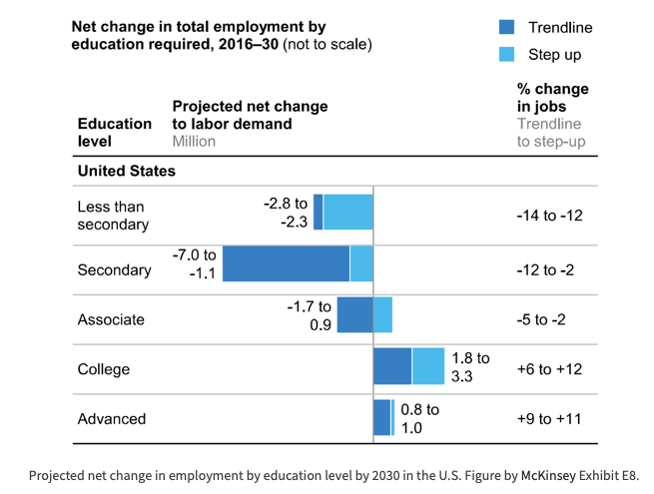
Further Creating inequality
Jerry Assan
Access to the market
Job opportunities in the data era
Education level
<Graphic as big as will fit>
https://blackgirlnerds.com/women-year-bridging-gap/
[3]
Notes:
This eventually goes back to the distribution of wealth. As mentioned, many market opportunities open up for profit. Who are the one’s that are most likely to seize those opportunities? Some affluent CEOs who know how the business work inside out, or some high school drop out who is part timing at a local gas station? According to this prediction provided by Mckinsey, in the era of data, artificial intelligence and automation, middle-income jobs requiring only secondary or associate level education will shapely decrease. Demand for these middle-income jobs and employment opportunities for those with low educational attainment will decline as demand for high-wage, high-educational attainment workers improve. This plus data being the new form of wealth will concentrates wealth and exacerbate the gap between the rich and the poor, especially the U.S., where the benefits flow to a smaller number of people who can afford good education and have the ability utilize the power of data. As a results, rich becomes richer. According to world bank the main reason why the poor has stagnated income growth is the absence of different kinds of assets (physical, natural, financial etc.) Now they have one more assets they don’t own, and that is data.

Slide 25
Conclusion
Jerry Assan
With Computing technology, owning data is the new form of wealth
Such ownership creates more inequality
Notes:
So my conclusion is: Computing technology has made data the new form of wealth, and taking control of this asset increases the inequality.
A counter point: Artificial intelligence, machine learning and automation not only increases productivity, but also creates job opportunity. For examples, the replacement of human pilots by drones has eliminated some jobs but created new sets of jobs like: maintenance, remote control, data analysis and cyber security. However, these jobs usually requires certain skill set to operate. As a result, only the ones who are already better off(having higher education, or opportunity to learn those skills) can benefit from the emerging new jobs. Subsequently, this will further increase the gap between the rich and the poor.

Slide 26
References
Jerry Assan
[1] M. Madden, M. Gilman, K. Levy, and A. Marwick, “Privacy, poverty, and Big Data: A matrix of vulnerabilities for poor Americans,” vol. 95, p. 53, 2017.
[2] A. M. Al-Khouri, “Data ownership: who owns ‘my data,’” vol. 2, no. 1, pp. 1–8, 2012.
[3] R. A. Isaak, The globalization gap : how the rich get richer and the poor get left further behind. Upper Saddle River, N.J: Prentice Hall/Financial Times, 2005.
[4] T. Wu, The attention merchants: The epic scramble to get inside our heads. Vintage, 2017.
[5] Y. N. Harari, 21 Lessons for the 21st Century<br>. 2018.
[6] A. M. Al-Khouri, “Data ownership: who owns ‘my data,’” vol. 2, no. 1, pp. 1–8, 2012.
[7] C. Collins and W. E. Creative, “Income inequality&nbsp;,” 2018. [Online]. Available: https://inequality.org/facts/income-inequality.

Slide 27
The way AI transformed Financial industry
Ivan Eroshenko
Notes:
Hey everyone! Today I’m going to talk about Artificial Intelligence in Financial Industry. I will try my best to make sure that all of you will come out of this classroom with a better understanding of how AI transformed financial industry and how it is currently used

Slide 28
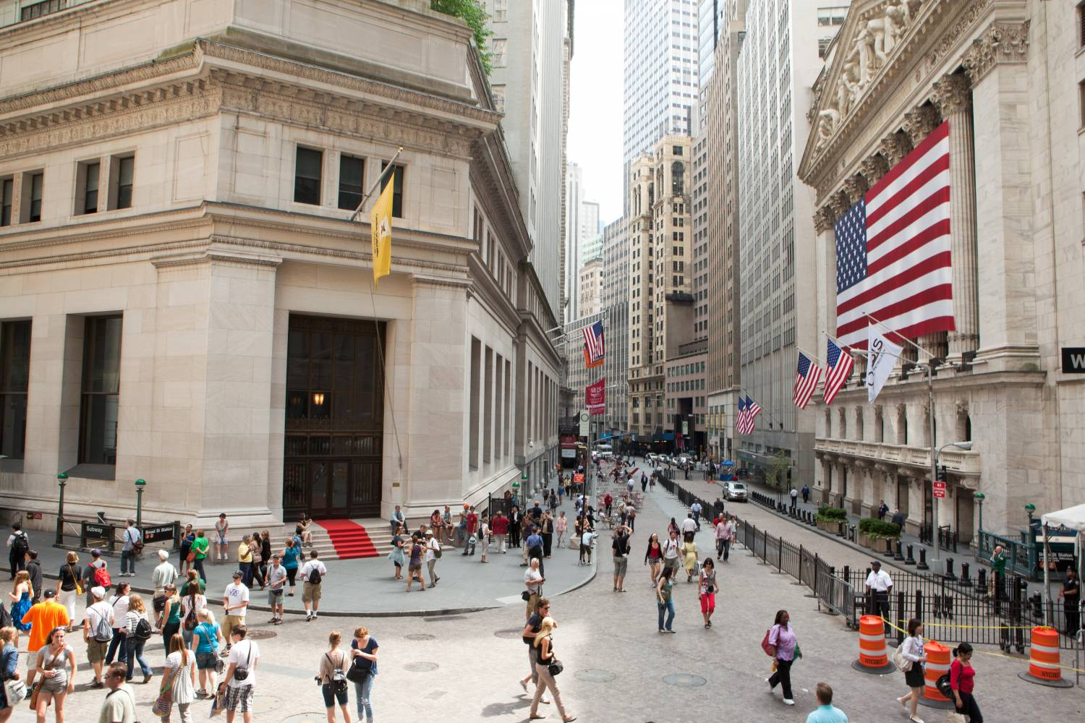
How AI is currently used in Finance
Ivan Eroshenko
Fraud detection
Trading
Risk assessment
Financial Advisory Services
Managing Finance
[5]
Notes:
I would like to start off by explaining how AI and machine learning are currently used in today’s world.
There are 5 major areas that have been influenced by AI
1) Fraud detection - based on the data of previous frauds, the algorithms is capable of detecting suspicious activity much better than a human}
2) Trading - which is the biggest area and most obvious, I guess. Algorithmic trading is a type of trading that uses powerful computers to run complex mathematical formulas for trading. Roughly 90 percent of volume in the public equities markets(stocks of different companies) is traded algorithmically, Roughly 50 percent of volume in the futures markets is traded Algorithmically, It is growing at 10.3% CAGR (source: Technavio’s 2016 report: Global Algorithmic Trading Market 2016-2020.) AI trading also capable of scan press releases and financial reports for keywords that could signal that a stock will rise or fall, that is pretty interesting.
3) Risk assessment – how many of you have credit cards? – it is one of the examples of this area. AI provides personalized interest rates specifically for you based on the data a bank ha: such as how many credit cards you have, how often do you pay for your credit card, do you pay on time and etc.
4) Financial Advisory Services - they basically use both a human and AI to bring up the most suitable wealth management or investment strategies based on how much risk you want and so on
5) Managing Finance - it is kind of an emerging field and it is basically about AI to builds algorithms to help the consumers make smart decisions about their money when they are spending it. The idea behind the wallet is very simple it just accumulates all the data from your web footprint and creates your spending graph. Start up that does that is http://wallet.ai
As we can see there are so many different areas, that are just mind-blowing to think about! However, as we all know AI technology is at its peak popularity right now, but what was before AI was implemented in financial market and how did it change over time?
To answer this question, I prepared some kind of a timeline of AI transforming financial industry

Slide 29
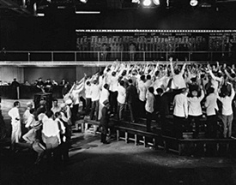
Timeline of AI in finance industry
Ivan Eroshenko
1) 19th century – the very beginning of the stock market idea
[4]
Notes:
1) 19th century – Stock markets were born. The way they worked was that Small businesses were set up in major cities across the country where people could go to make “plays” in the market. These were affectionately known as “bucket shops.” The players would all contribute money into the common “bucket.” The pool of money was then used as security for purchasing stocks or commodities with leverage. This enabled the small trader to speculate on otherwise “out of reach” stocks. I put it here to give you guys a glimpse of what it looked like back in the days.

Slide 30
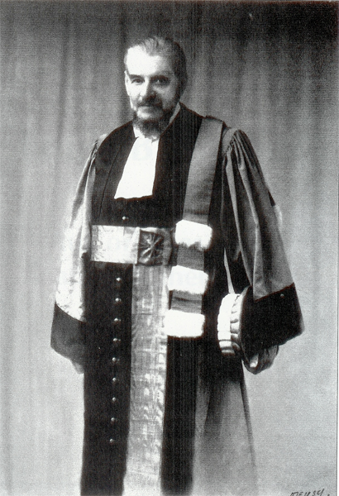
1900 - origins of AI in finance
Ivan Eroshenko
A lot of the mathematics that is now used in current AI solutions originated in the early 1900’s
The origins of using advanced mathematics in the financial field started with the release of Louis Bachelier’s thesis Théorie de la Spéculation (Theory of Speculation)
[3]
Notes:
1900 - A lot of the mathematics that is now used in current AI solutions originated in the early 1900’s. The origins of using advanced mathematics in the financial field started with the release of Louis Bachelier’s thesis Théorie de la Spéculation (Theory of Speculation) in 1900. His thesis is recognized as being one of the first papers to explore the use of mathematics as a method to evaluate stocks. With Bachelier’s work, the rise of statistical modelling marked the beginning of primitive AI in the financial world.

Slide 31
1960 – increasing popularity
Ivan Eroshenko
1) During 1960’s the application of Bayesian statistics became more popular and was backed by numerous researches in the field
[3]
Notes:
in 1960’s the application of Bayesian statistics grew even more popular due to the fact that numerous other scientists in the field backed his work and even publish books. One of the best received ones was by Robert Schlaifer called “Probability and Statistics for Business Decision”. However, no solutions have yet been created on the market using the existing researches. Partially due to the fact that computers were not advanced enough.

Slide 32
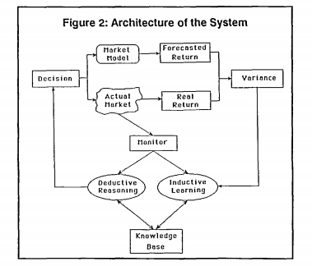
1980 – The rise of expert systems
Ivan Eroshenko
Creation of first expert system programs that predicted the market situation and provided tailored financial plans
[3]
Notes:
1980 - the rise of expert systems (expert system is a computer system that emulates the decision-making ability of a human expert) – basically AI.
During the 1980’s, there were multiple techniques used in building AI for finance, from Artificial Neural Networks[7] to Fuzzy Systems[8]. However, a lot of the interest was in knowledge based systems or Expert Systems. Expert systems were created and popularized in the 1960’s and 1970’s through their use in DENDRAL, a system that could help determine the molecular structure of unknown compounds, as well MYCIN, a system which could diagnose meningitis. However, it wasn’t until the 1980’s that the majority of commercialization attempts were done in the financial field. For example, Dupont had built 100 expert systems which helped them save them close to $10 million a year [3] - the company that still exists actually and focuses on solving challenging global problems using science.
1986 - One of the first programs to be hypothesized for market prediction was the Protrader expert system. It was able to predict the 87 point drop in Dow Jones Industrial Average using their system. The major functions of the system were to monitor premiums in the market, determine the optimum investment strategy, execute transactions when appropriate and modify the knowledge base through a learning mechanism.
One of the biggest drivers of Expert System Development was in its use of providing tailored financial plans. One of the first systems to do so was called PlanPower created by Applied Expert Systems (APEX ) which was conceptualized in 1982 and commercially shipped in 1986 provided tailored financial plans for individuals with incomes over $75 thousand.
Another system, developed by Chase Lincoln First Bank and Arthur D. Little Inc. was able to do investment planning, debt planning, retirement planning, education planning, life-insurance planning, budget recommendations, income tax planning and savings achievement for other major financial goals. If a client was interested in receiving a report it would cost them $300

Slide 33
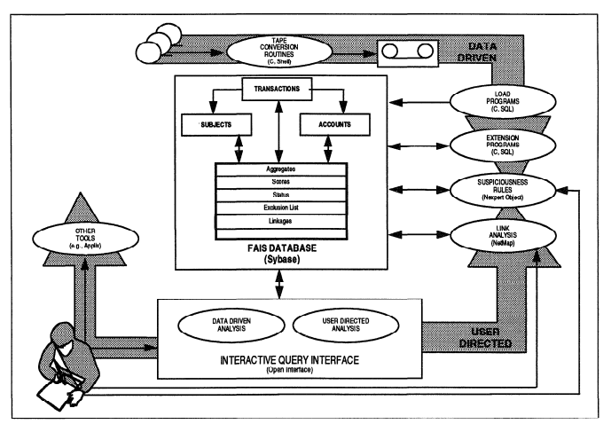
1990 - AI in financial fraud detection
Ivan Eroshenko
Over the period of 2 years, FAIS was able to identify 400 potential cases of money laundering equaling $1 billion.
[3]
Notes:
1990 - Fraud detection. The possibility of using AI in financial fraud detection was something which garnered a lot of interest in the 1990’s. Due to the nature of this crime, it was hypothesized that an intelligent system would be able to sift through a lot of data and identify discrepancies. One such system which was sponsored by the U.S Department of Treasury was the FinCEN Artificial Intelligence system (FAIS). This system, which was put into service in 1993 could be used to determine incidents of money laundering. It’s main advantage was that it could process a very large amount of data.
FAIS was able to do handwriting analysis and identify discrepancies which made it possible to review over 200,000 transactions per week. Over the period of 2 years, FAIS was able to identify 400 potential cases of money laundering equaling $1 billion.

Slide 34
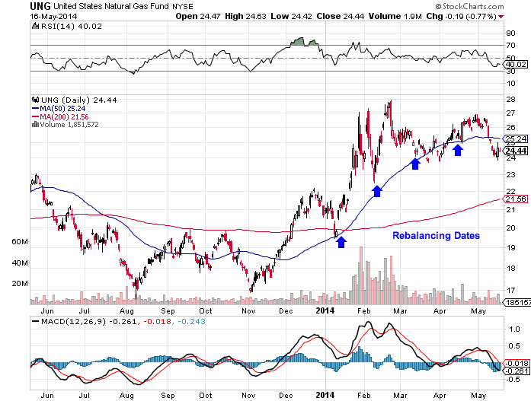
2001 – algorithmic trading
Ivan Eroshenko
In 2001, algorithmic trading received a boost when IBM researchers published Agent-Human Interactions in the Continuous Double Auction.
[2]
Notes:
2001
The research paper found that simple agent bidding strategies were able to outperform non-expert human subjects by a clear margin, setting the stage for the high-frequency trading algorithms that are widely used today in the financial markets.

Slide 35
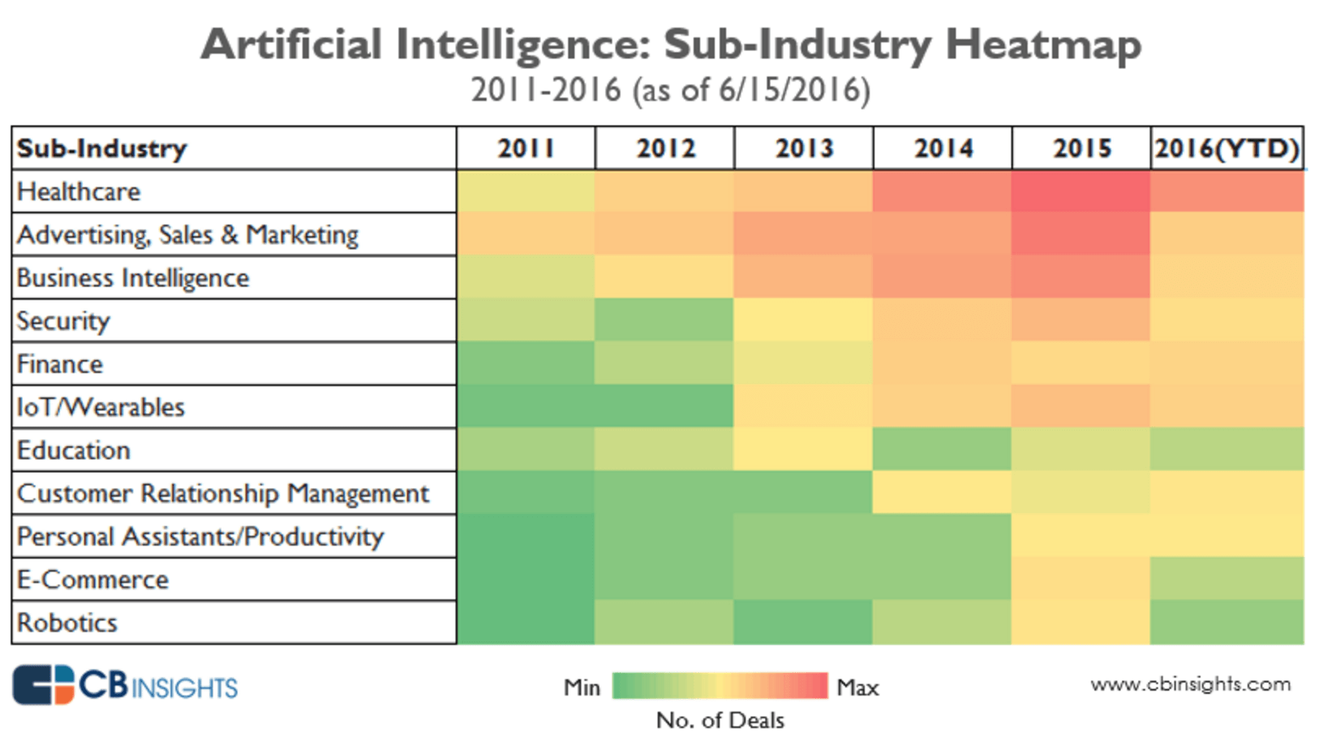
2001 – 2019 – financial companies invest
Ivan Eroshenko
2001 – 2019 – the AI technologies have been getting mode advanced.
Chat-bots found use in Financial Industry
[7]
Notes:
2001 - 2019 - chatbots and the AI technologies got more and more sophisticated and currently AI performs tremendous amount of transactions. During this time period, there were also big investments into AI by Financial institutions and, undoubtedly, the investments keep on coming
Currently, all short term operations such as day to day trading is done using AI and to bring back the statistic from the previous slide - Roughly 90 percent of volume in the public equities markets is traded algorithmically, Roughly 50 percent of volume in the futures markets is traded Algorithmically, Algorithmic trading is growing at 10.3% CAGR (source: Technavio’s 2016 report: Global Algorithmic Trading Market 2016-2020.)

Slide 36
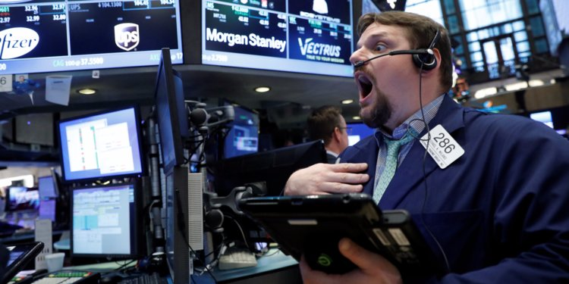
IS AI taking away jobs?
Ivan Eroshenko
What happened with old fashioned traders?
How did algorithmic trading affect them?
https://www.youtube.com/watch?v=2u007Msq1qo
[1]
Notes:
How many trades can an Algorithm do per second? 15 – 20 thousand per second
How many can a human do? – 1 per second
This raises a question, which can relate to our today’s topic : “Is AI taking away jobs of traders or finance people?”. To find the answer, let’s whach this short video.

Slide 37

The finance jobs changed
Ivan Eroshenko
Situation can actually be represented as a symbiosm between AI and a human
Traditional traders switched to managing long-term portfolios
Notes:
Most of the traditional traders either left professional institutions and trade on their own or switched to managing long-term portfolios (1 – 3 months)
As you can see: although AI changed the industry a lot and probably closed the way for day-to-day traders because a human just cannot compete with AI in short-term deals, the situation between employees of Financial Institutions and AI can be represented as a symbiosm, where AI is Venom and employee is Eddie Brock. AI would simply get out of control without the supervisor.

Slide 38
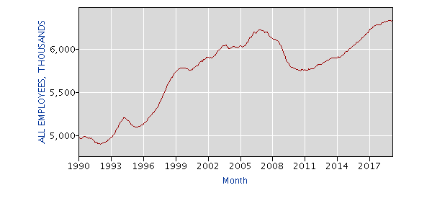
Conclusion
Ivan Eroshenko
Despite tremendous changes that AI has brought into Financial industry, it did not take away jobs of people, but transformed/changed them
Finance and insurance
[6]
Notes:
Here is a graphical representation of number of jobs in Finance and insurance over time. I could not find the representation of traders, but I think it is a more general graph. And as you can see it keeps on growing, despite the fact that AI is automating lots of processes.
We can see also a big drop during 2008 n the graph.

Slide 39
References
Ivan Eroshenko
[1] John Detrixhe, Why robot traders haven’t replaced all the humans at the New York Stock Exchange—yet, https://qz.com/1078602/why-the-new-york-stock-exchange-nyse-still-has-human-brokers-on-the-trading-floor/ (accessed April 15, 2019)
[2] Justin Kuepper, What Is Algorithmic Trading?, https://traderhq.com/introduction-algorithmic-trading/ (accessed April 15, 2019)
[3] Sydney Swaine-Simon, The History of AI in Finance, https://medium.com/district3/the-history-of-ai-in-finance-7a03fcb4a498 (accessed April 15, 2019)
[4] Joffrey Scully, History of Trading, https://www.tradingacademy.com/financial-education-center/history-of-trading.aspx (accessed April 15, 2019)
[5] Reagen Aldenderfer, 5 WAYS AI IS TRANSFORMING THE FINANCE INDUSTRY, https://www.marutitech.com/ways-ai-transforming-finance/ (accessed April 15, 2019)
[6] Bureau of Labor Statistics, Databases, Tables & Calculators by Subject, https://data.bls.gov/pdq/SurveyOutputServlet (accessed April 16, 2019)
[7] Daniel Faggella, Artificial Intelligence Industry – An Overview by Segment, https://emerj.com/ai-sector-overviews/artificial-intelligence-industry-an-overview-by-segment/ (accessed April 16, 2019)

Slide 40
Class 11
The End
Keith A. Pray
Instructor
socialimps.keithpray.net
Notes:
If there’s time and we didn’t get to it:
Kickstarter Charter
https://www.kickstarter.com/charter?ref=about_subnav
CGP Grey
Humans Need Not Apply (15:00) – 2014-08-13
http://www.youtube.com/watch?v=7Pq-S557XQU
Last access 2016-04-22
These 3D printed homes can be constructed for $4,000 (3:00 – 2018-04-02)
http://www.businessinsider.com/3d-printed-homes-constructed-icon-new-story-tech-charity-4000-dollars-2018-3
https://www.youtube.com/watch?v=SvM7jFZGAec (1:28)
Last access 2018-04-22
Look at:
BBC Intelligent Machines
http://www.bbc.com/news/technology-33978561
BBC Likelihood of robot taking your job
http://www.bbc.com/news/technology-34066941
This is the end. Any slides beyond this point are for answering questions that may arise but not needed in the main talk. Some slides may also be unfinished and are not needed but kept just in case.

