Slide 1
Class 10
Professional Ethics
Keith A. Pray
Instructor
socialimps.keithpray.net
Notes:
Here’s the title slide. Excited already, aren’t you? You may not be depending on how you enjoyed the last class.

Slide 2
Papers
Clearly state conclusion
Use supporting data
Make sure argument is for conclusion
Quantify
  Do not use terms like: less, more, a lot, huge, great, big, tiny, etc.
http://socialimps.keithpray.net/assignments/paper-guidelines/
Notes:
Save for next time:
Clearly state conclusion
First statement preferred
Absolute statements are difficult to prove
Avoid: all, always, any, every, everyone, never, none… unless you can show it
Be sure to put quotes around entire quote
Hyperbole is the best thing ever!
but not in these papers
Print 2 sided and save a tree
Use template, saves time (and -1 point)
Include Counter Point and Response
Include Author, Title, Publish Date, Publisher for references
Read paper aloud to proof

Slide 3
Grades
To Date
42 Max Possible

Slide 4
Overview
Review
Debate
Assignment
Students Present
Notes:
We can also discuss articles listed on Security Discussions under documents of course web site.
ADD QUIZ AS BACKUP IF CLASS DISCUSSION NOT LONG ENOUGH

Slide 5
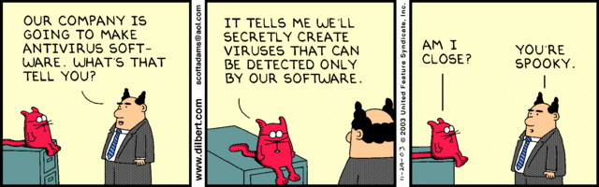
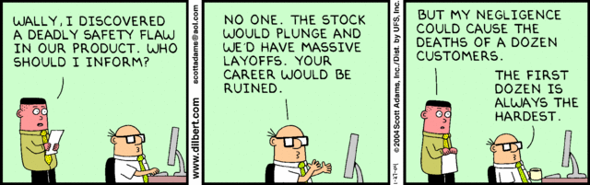
Notes:
Ask how many people in ACM or IEEE

Slide 6
Debate Ground Rules
Before Debate
  10 minutes to converse with your team
  Share argument points, counter points, and responses so everyone can represent
  Decide who will respond to what points from the opposing side
During Debate
  Stand up when speaking
  1 turn per person until everyone on your team has spoken
  30 second limit
  Switch sides at any time if you change your mind
Notes:
Release Game or Not Debate
Chapter 9 In-class Exercises # 24.
Should the company produce the game?
Use the SWE Code Of Ethics as the basis for your argument.

Slide 7
My Reading Notes
pp. 409 Can one perform services for one’s self?
pp. 412 1993-1999 Does this seem like a long time?
pp. 413 “errors of omission or commission”?
UPDATE
pp. 422 3. Would people agree – social contract?
pp. 438 So the baby can be left outside and no one is responsible?
Notes:
An error of commission is one where the person responds where they should not. This is compared to an error of omission, where the person fails to respond when they should.

Slide 8
Assignment
1 Page Paper
  What should computerized automation be applied to next?
Finish all reading
Group Project
  Add analysis to website addressing all topics covered to date
  Group Presentation Draft
    Email presentation as Power Point attachment to course staff
    Post on group website
Notes:
1 Page Paper Ideas:
For Good - How will you use your computing related education to do good in the world?
Dark Net - Is the Dark Net good or bad?
Does computerized automation help the economy or society?
What should computerized automated be applied to next?
If productivity has increased so much, why are we working so hard? Should we?
What job skills will survive computerized automation?

Slide 9
Overview
Review
Debate
Assignment
Students Present
Notes:
Show WPI and/or corporate code of ethics.

Slide 10
Recent Whistleblowers
Liam Setterlund

Slide 11

Conclusion Statement
Liam Setterlund
Implement laws preventing the prosecution of whistleblowers working under the government
[1]
Notes:
Whistleblower protection is only applicable in the public/private sector
There have been several large scale whistleblowing cases where no one was put in physical danger, yet the US charged the leakers with 30+ years in prison
There is a lack of protection for employees working in national security and intelligence.

Slide 12


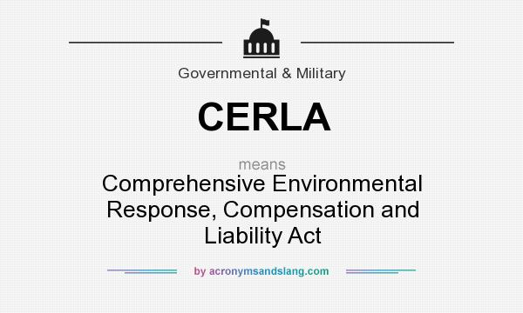
What Is Whistleblowing?
Liam Setterlund
The act of reporting illegal activities that occur in an organization.
There are a number of whistleblower protection programs
[2][3]
Notes:
The belief is that whistleblowing is ethical staying silent causes more harm than good
OSHA acts protect employers from discriminating against their employees for exercising there rights.
Clean water act – regulates pollutants in drinking water
CERLA – protects against endangered public health and environment
Any violation of these acts can be reported with whistleblower protection

Slide 13

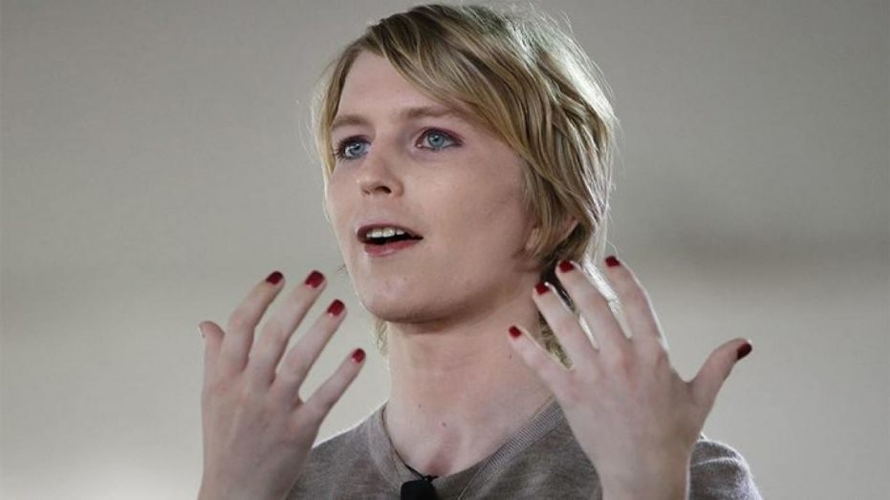
Famous Recent Whistleblowers
Liam Setterlund
Edward Snowden (2013)
  https://www.youtube.com/watch?v=jj3h8a2a0eE
Chelsea Manning (2010)
[4]
Notes:
Edward Snowden who worked for the CIA and leaked the NSA surveillance program in 2013 – current lives in Moscow Russia. (right of asylum)
Chelsea Manning was a former US Army soldier who leaked classified information to WikiLeaks in 2010 (videos of unarmed civilians being shot and killed) – recently jailed in March for refusing to answer grand jury’s questions
Both were charged as traitors under the Espionage Act by federal law – although Snowden fled to Moscow

Slide 14

Why weren’t they Protected?
Liam Setterlund
Both were charged with Espionage Act of 1917 and theft of gov. property
Makes sharing info on national defense punishable by death/imprisonment
Espionage acts provide no whistleblower protection
[2][4]
Notes:
Most whistle blowers are protected under the Whistleblower Protection Act
Snowden and Manning acts were both considered treasonous by the US government
Manning was actually charged with “aiding the enemy” (to which she was found not guilty”)
The government’s actions were really a form of retaliation against their own employees.

Slide 15
Why Did they do it?
Liam Setterlund
They believed it was their ethical right to do so
No one else influenced their decisions
Illegal does not mean unethical
“Ultimately, if people lose their willingness to recognize that there are times in our history when legality becomes distinct from morality, we aren't just ceding control of our rights to government, but our agency in determining our futures.” – Snowden
“I want people to see the truth... regardless of who they are...
because without information, you cannot make informed decisions as a
public.” - Manning
Notes:
“Ultimately, if people lose their willingness to recognize that there are times in our history when legality becomes distinct from morality, we aren't just ceding control of our rights to government, but our agency in determining our futures.” – Snowden
“I want people to see the truth... regardless of who they are... because without information, you cannot make informed decisions as a public.” - Manning

Slide 16


Who are The Stakeholders?
Liam Setterlund
The government
Society
You as an individual
[5][6]
Notes:
Although it appears at first glance that the government takes the largest hit for these types of leaks, it makes society more skeptical of their own nation
There were no leaks of anything that would bring physical harm to the American people
Now anyone looking at these whistleblowers might be hesitant in expressing their 1st amendment rights knowing there can be serious consequences for leaking illegal government activity.

Slide 17


What Can We Do?
Liam Setterlund
Being afraid to speak out due to consequences is not a good thing
If whistleblowing exposes illegal activities/violations, we should be encouraging that
We need whistleblower protection even when working under the gov.
Notes:
Maybe put a law in place where the government can’t prosecute the whistleblower if they can justify the act.
Be allowed to fire the employee but not charge them.
We need to promote ethical practices and the government should not make people scared to expose illegal actions just because they are a higher power.
This is a form of silencing the people to which society starts to lose control of their own future.

Slide 18
References
Liam Setterlund
[1] J. Nadler and M. Schulman, “Whistle Blowing in the Public Sector.” [Online]. Available: https://www.scu.edu/government- ethics/resources/what-is-government-ethics/whistle-blowing-in-the-public-sector/. [Accessed: 11-Apr-2019]
[2] U. S. D. of Labor, “The Whistleblower Protection Programs,” 2019. [Online]. Available: https://www.whistleblowers.gov/
[3] W. Kenton, “Whistleblower,” 20-Apr-2018. [Online]. Available: https://www.investopedia.com/terms/w/whistleblower.asp.[Accessed: 11-Apr-2019]
[4] D. Cameron, “Assange Charges Finally Reveal Why Chelsea Manning Is Sitting in Jail,” Apr. 2019 [Online]. Available: https://gizmodo.com/assange-charges-finally-reveal-why-chelsea-manning-is-s-1833972958
[5] A. Geiger, “How Americans have viewed government surveillance and privacy since Snowden leaks,” 04-Jun-2018. [Online]. Available: https://www.pewresearch.org/fact-tank/2018/06/04/how-americans-have-viewed-government-surveillance-and- privacy-since-snowden-leaks/.[Accessed: 11-Apr-2019]
[6] P. Moore, “Americans tend to oppose clemency for Manning,” 23-Jan-2018. [Online]. Available: https://today.yougov.com/topics/politics/articles-reports/2017/01/23/chelsea-manning.[Accessed: 11-Apr- 2019]
[7] “Chelsea Manning Quotes,” 13-Jul-2011. [Online]. Available: https://www.azquotes.com/quote/1247831. [Accessed: 11-Apr-2019]
[8] “Edward Snowden quotes ,” 2019. [Online]. Available: https://www.goodreads.com/author/quotes/7140597.Edward_Snowden. [Accessed: 11-Apr-2019]

Slide 19
Should Software Engineers be licensed as Professional engineers
Jacob Tutlis

Slide 20

What is a professional engineer
Jacob Tutlis
Licenses regulated by the NCEES.
Licensing required by those who work on and approve safety-critical systems.
Opens opportunities has independent consultant, government engineer, or educator.
[1] [2] [9]
Notes:
NCEES = National Council of Examiners for Engineering and Surveying
Why are professional engineering licenses required?
Required by those who work on and approve safety-critical systems
Licensed engineers are required in most engineering fields.
Why would some one want to become a professional engineer?
A professional engineer has the ability to sign and seal plans and drawings
It sets you apart from others that don’t have a license
Fundamentals of Engineering Exam (FE).
Four years of engineering experience.
Principles and Practice of Engineering (PE) Exam in discipline.

Slide 21
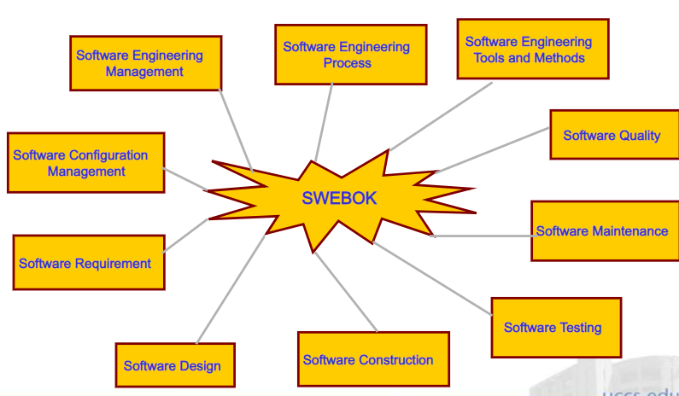
PE Exam for software engineers
Jacob Tutlis
PE Software exam first offered in 2013.
Exam based from SWEBOK.
Ensures a minimum standard of knowledge in safety-critical positions.
Holds licensed software engineers accountable.
[6] [7] [8]
Notes:
SWEBOK = Software engineering body of knowledge, published by IEEE
SWEBOK defined the body of knowledge that software engineers should know.
Used for the basis of licensing exams.
Obtaining a license will show ones competency as a software engineer.
Confirms that have all of the skills required and have a commitment to a moral code.
Right now there is only one exam offered for software engineers, for other fields like civil engineering there are multiple types of exams.
Clarify that software engineers != regular programmer

Slide 22
Implications of licensing
Jacob Tutlis
Licensed software engineers will be subject to malpractice lawsuits.
Who determines what is malpractice?
Liability of other’s malicious actions.
[1] [3]
Notes:
Would licensed software engineers need malpractice insurance.
Those determining what is malpractice would not be handled by those in the software fields. It would be lawyers and judges who have to determine what the professional standards are for a software engineer.
Right now software engineers can only be sued if they misrepresent there code when selling it. As in if they claim is does one thing but really does something else or if they claim it has been tested up to some standard when it really hasn’t.
Liable for all the security flaws in software

Slide 23
Is it practical?
Jacob Tutlis
Most people are exempt from needing a license.
Licensing is done at the state level.
Software is rapidly changing.
Extremely diverse field.
PE Exam canceled due to lack of participation.
No agreed upon set of testing techniques.
Number of software engineers in America | 3.6 Million
Number of people who passed the software engineering exam | 81
[2] [4] [5] [10]
Notes:
Most states provide an exemption from requiring a license when working in the industry and those who work for the government.
The FE exam is more orientated for physical engineering. Software engineers shouldn’t be forced to learn chemistry and physics.
Licensing is done at the state level so software engineers would be required to be licensed in most states. Also most states will have different standards.
The software field is rapidly changing and it would be hard to ensure that an exam could match the current challenges.
There would have to be many different exams that would match requirements in many different software engineering topics.
Canceled because only 81 people have received the licenses in the 5 years it has been administered.
One of the major failures of the software engineering field in licensing is the lack of agreed upon testing techniques.

Slide 24
Conclusion
Jacob Tutlis
The current approach of licensing is not practical.
There should be government regulation for safety-critical software, but not in the form of licenses for software engineers.
[5]
Notes:
The current system does not have a future as the P.E. exam for software engineers has been canceled as of March 2019.
Licensing is not effective and government regulated alternatives should be used to ensure public safety. Each alternative also presents their own set of problems.
Standards and codes (similar to building codes)
3rd party inspection of code
Ethical standards
Requiring certifications like the Software Professional Certification Program by the IEEE
International Standards of code exist and are effective

Slide 25
References
Jacob Tutlis
[1] NSPE, What is a PE?, https://www.nspe.org/resources/licensure/what-pe (Accessed 4/9/19)
[2] John Knight, Nancy Leveson, Should We License Software Engineers? http://www.cs.virginia.edu/~jck/publications/cacm.2002.pdf (Accessed 4/9/19)
[3] Jim Turley, Can You Get Sued for Bad Code?, https://www.eejournal.com/article/20161116-liability/ (Accessed 4/10/19)
[4] Patrick Thibodeau, India to overtake U.S. on number of developers by 2017, https://www.computerworld.com/article/2483690/india-to-overtake-u-s--on-number-of-developers-by-2017.html (Accessed 4/10/19)
[5] NCEES, NCEES discontinuing PE Software Engineering exam, https://ncees.org/ncees-discontinuing-pe-software-engineering-exam/ (Accessed 4/9/19)
[6] SWEBOK, https://www.computer.org/education/bodies-of-knowledge/software-engineering (Accessed 4/10/19)
[7] NCEES Ends Software Engineering PE Exam, https://www.nspe.org/resources/pe-magazine/may-2018/ncees-ends-software-engineering-pe-exam (Accessed 4/10/19)
[8] Aaron Collins, Professional Licensure for Computer Engineers and Software Engineers, https://insight.ieeeusa.org/articles/professional-licensure-for-computer-engineers-and-software-engineers/ (Accessed 4/10/19)
[9] Kristin Manganello, Is a Professional Engineer License Worth It?, https://news.thomasnet.com/featured/is-a-professional-engineer-license-worth-it-/ (Accessed 4/12/19)
[10] Knight, J. C., & Leveson, N. G, Should software engineers be licensed?.
Notes:
Knight, J. C., & Leveson, N. G. (2002). Should software engineers be licensed?. Communications of the ACM, 45(11), 87-90.
Chicago

Slide 26
Vr in the classroom
Morgan Langstaff

Slide 27

Virtual Reality
Morgan Langstaff
A computer generation of the real or imagined environment or world
HDM and Desktop VR
<1>
Notes:
HDM=head mounted display (oculus and vive)
Desktop pertains more towards virtually created worlds navigated with mouse and keyboard

Slide 28
Pros vs. cons of vr
Morgan Langstaff
Pros:
  Provides rich learning environment
  More interaction and involvement
    Learn by doing
Cons
  Expensive
  Can cause discomfort with long time use
<Graphic as big as will fit>
<1>
Notes:
<speaker notes>
People learn better through visuals and by doing the actions
Can only read 100 characters per second
Cons:
AR is less expensive and still a viable learning environment
It is not completely different than VR
Still allows students to be hands on and partake in simulations

Slide 29
Styles of learning
Morgan Langstaff
Sensory/Intuitive
  Can help make an abstract concept tangible
    ie being able to walk on a mathematical surface
Visual/Verbal
  Highly visual and verbal
    Be used to create the sound of molecular bonds breaking
Inductive/Deductive
  All about learning from experience
Active/Reflective
  Student is an active participant of the simulation
Sequential/Global
  Can help provide the big picture
<Graphic as big as will fit>
<6>
Notes:
Sequential/Global
Can see how the world changes
Can use VR to see different places and how life is impacted

Slide 30
Google Earth
Morgan Langstaff
Available on HTC Vive and Oculus Rift
Allows one to navigate the globe in VR
https://www.youtube.com/watch?v=QMpXQ_XjPWY
<5>
Notes:
Show the first 30 seconds to a minute of the video just to show how it works

Slide 31
Gates of Horus
Morgan Langstaff
Grades 6-8, 85 students
University of Pittsburgh
Engage fully and learn from the experience
Navigate through an Egyptian temple and learn about the history
Similar to a virtual tour
2 groups
  Theatre group
  Desktop group
Control group
  Took test for basic knowledge before playing
<2>
Notes:
Theatre-used immersive dome
Desktop-used a standard desktop computer
hypothesis:
Immersive VR will lead to more retention and more learning
-Immersive VR will have better spatial knowledge of temple
Students were asked to draw a map of the temple from memory and placed magnets to represent features
Then they produced a video, giving the tour of the temple navigating with a gyromouse

Slide 32
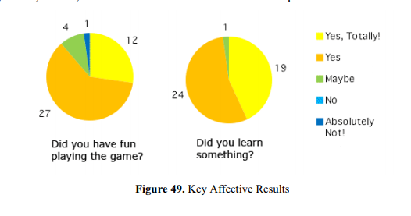
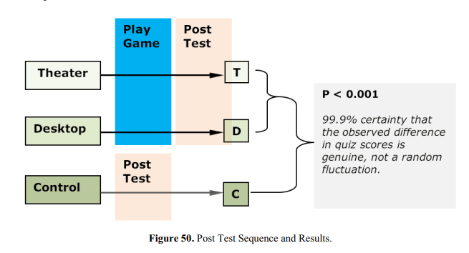
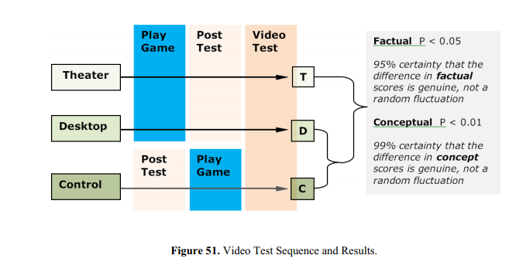
Results
Morgan Langstaff
<2>
Notes:
Take Post Test
Self report about how they felt about the experience
Almost all students played without asking for a break (45min – 1 hour)
Theatre Group and Desktop Group did better than Control group on Post Test
No significant difference between Theatre and Desktop
Immersion
Theatre group performed significantly better

Slide 33
Conclusion
Morgan Langstaff
Virtual Reality is the new frontier of learning and provides so many more ways to learn information by interacting and submerging oneself in it.
It might not be the most viable option now since it is costly but teachers should start learning now how to use it since it could become an important component in their teaching styles

Slide 34
References
Morgan Langstaff
[1] Guiseppe Riva https://books.google.com/books?hl=en&lr=&id=c9UnQ0OKL_wC&oi=fnd&pg=PA207&dq=vr+in+classrooms&ots=MJdRCPobpv&sig=2hiBdEc0WfhB74InDXPI2v0pdt4#v=onepage&q&f=false (4/10/19)
[2]Jeffrey Jacobson, https://pdfs.semanticscholar.org/5822/67df8b8b1feb25d6fe6f285064bfd6c1fe4b.pdf (4/12/19)
[3] Helsel, Sandra. “Virtual Reality and Education.” Educational Technology, vol. 32, no. 5, 1992, pp. 38–42. JSTOR, www.jstor.org/stable/44425644. (4/10/19)
[4] Christine Youngblut, https://apps.dtic.mil/dtic/tr/fulltext/u2/a339438.pdf (4/11/19)
[5] Lorna Buttimer, https://medium.com/axonista-hq/the-possibilities-of-google-earth-in-virtual-reality-cc70fdaaa1c8 (4/11/19)
[6]Scott Fogler, https://www.researchgate.net/profile/H_Scott_Fogler/publication/247920944_The_Investigation_and_Application_of_Virtual_Reality_as_an_Educational_Tool/links/55f721fb08ae07629dbfcfee/The-Investigation-and-Application-of-Virtual-Reality-as-an-Educational-Tool.pdf (4/11/19)

Slide 35
Class 10
The End
Keith A. Pray
Instructor
socialimps.keithpray.net
Notes:
This is the end. Any slides beyond this point are for answering questions that may arise but not needed in the main talk. Some slides may also be unfinished and are not needed but kept just in case.

